Slide 1

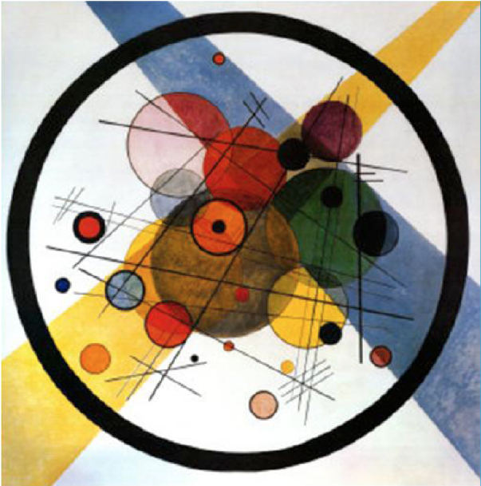
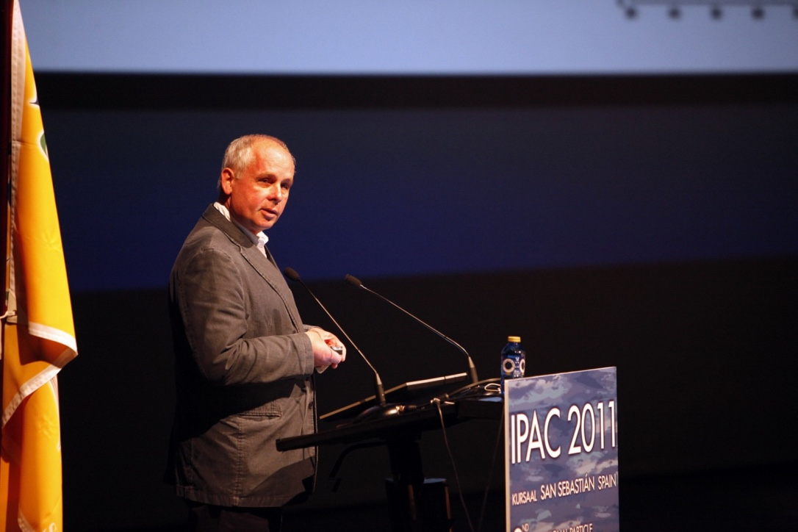
Introduction to the LHeC / FCC-eh machines
In memory of Max Klein

Slide 2
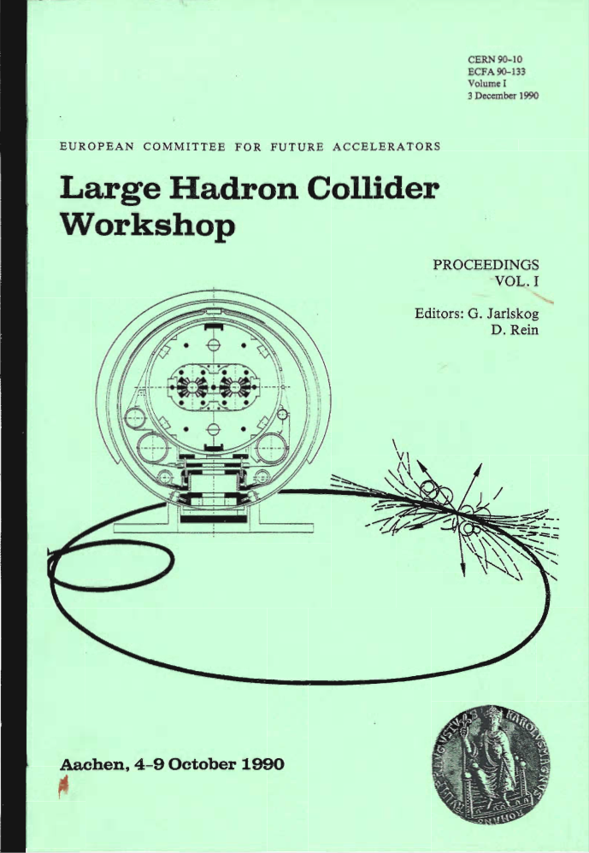
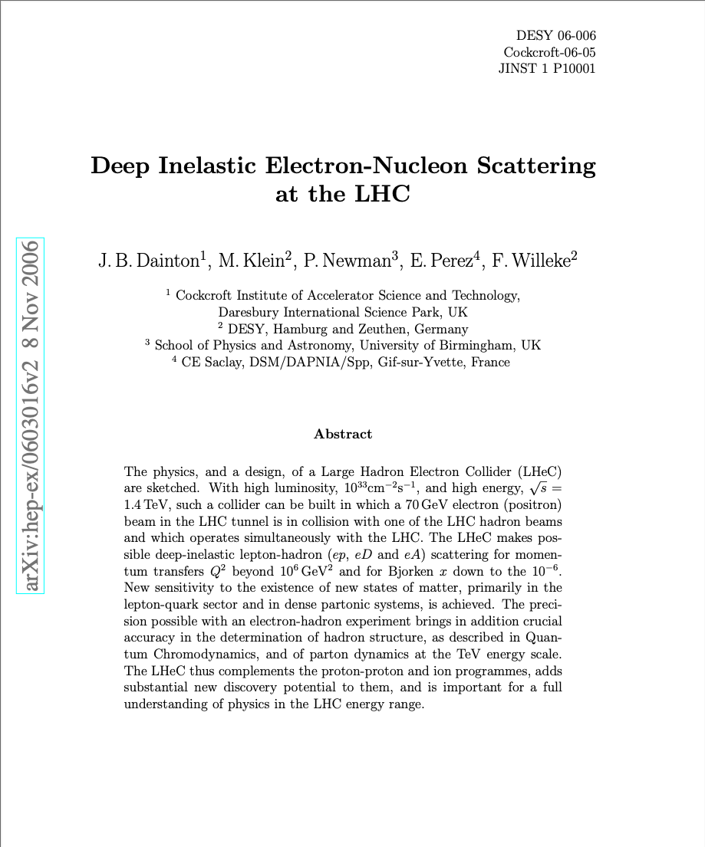
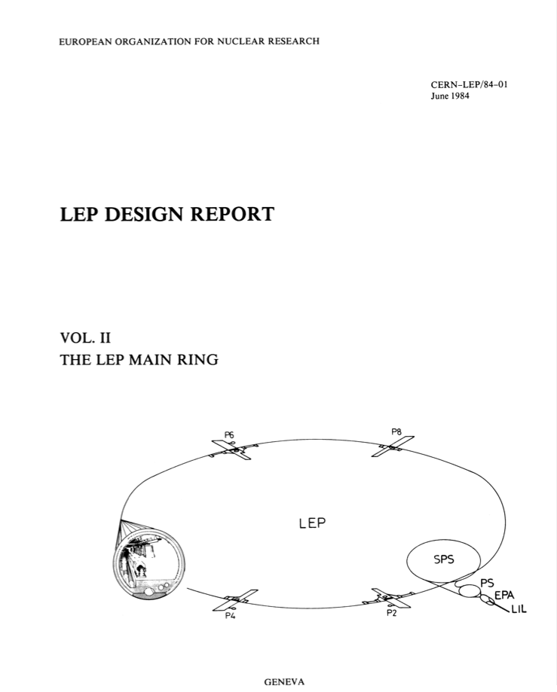
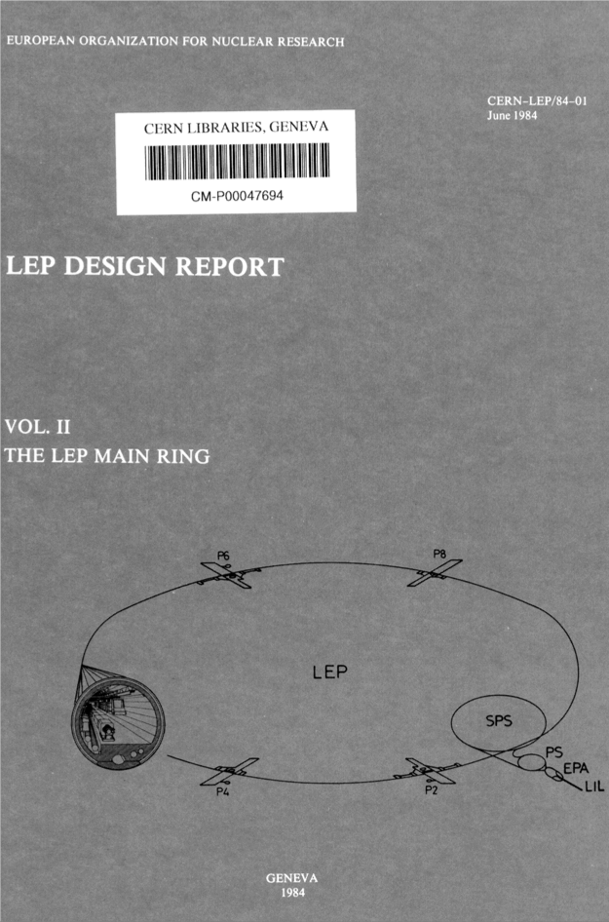
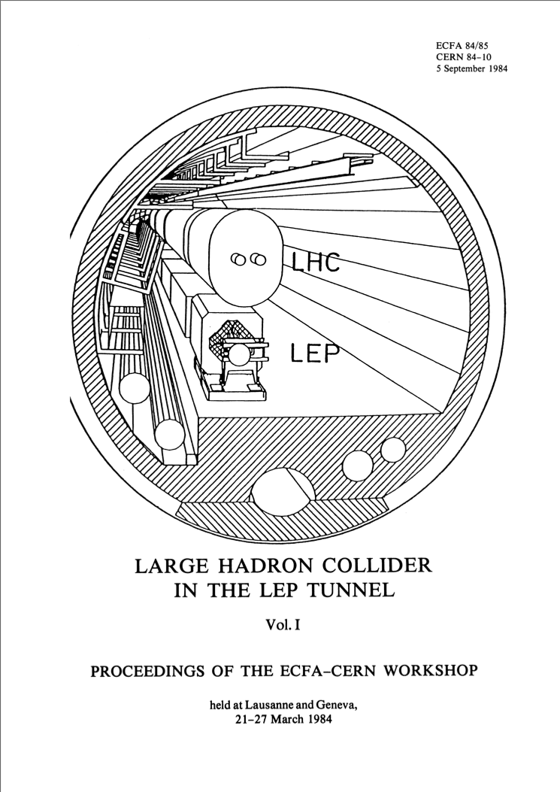
LHeC: e-p Option was already Considered from the Start of LEP
LEP
Design
Report
1984
Lausanne
ECFA-CERN
Workshop
1984
Launch of a revision of the feasibility in 2007 with the boundary Condition that
the proposed collider must fit into the existing power infrastructure of CERN ➔ 100MW power limit
➔ L = 10³²cm⁻²s⁻¹
➔ L = 10³³cm⁻²s⁻¹
Notes:
With the mandate to help preparing an update on the ep option for the LHC

Slide 3
LHeC / FCC-eh Accelerator Studies and Considerations
Motivation -Unique Physics case ! e-p @ TeV scale!
-Full exploitation of the LHC / FCC Infrastructures
-Accelerator Concept and Operation innovation and development
LHeC CDR Choices and Studies:
-Ring-Ring and Linac-Ring options ➔ ERL baseline
-Optics and layout: arc and IR
-Magnets
-SRF Frequency choice
-Site options
-Simulations
Feasibility!!!
Notes:
Better Cover

Slide 4
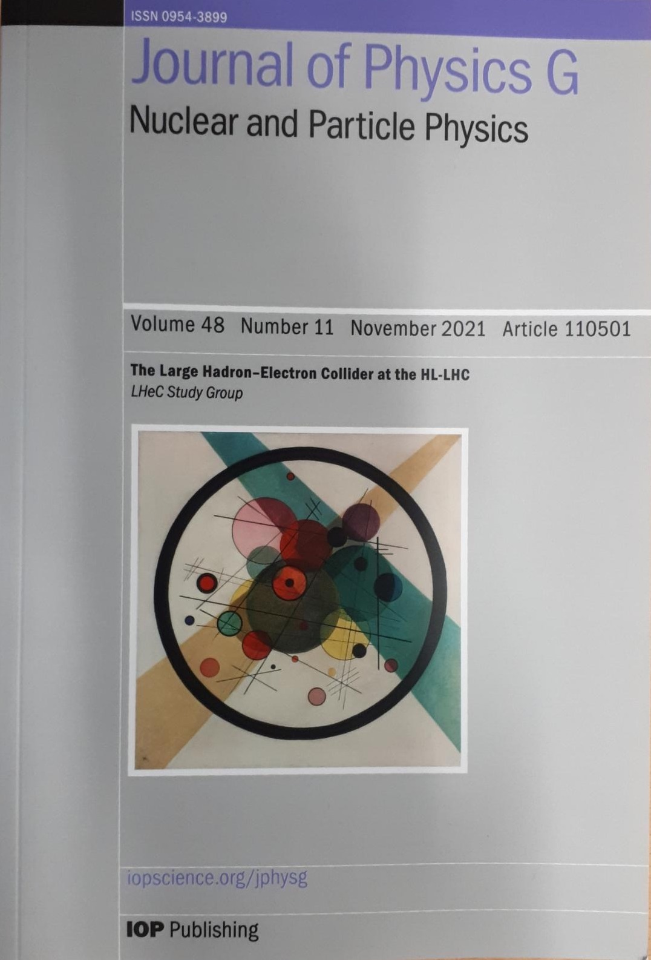
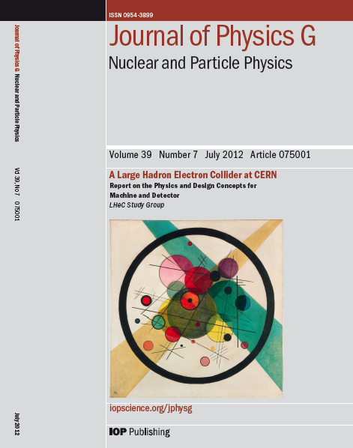
Documenting the LHeC Concept: CDRs
CDR Study assumptions:
-Assume parallel operation to HL-LHC / FCC-hh
-TeV Scale collision energy
➔ 50-150 GeV Beam Energy
-Limit power consumption to 100 MW
➔ (beam & SR power < 70 MW)
➔ 60 GeV beam energy
-Peak Luminosity > 10³³ cm⁻²s⁻¹
Higgs @ 125GeV
➔ 150MW
➔ 50GeV
➔ 1000 * HERA
➔ L > 10³⁴ cm⁻²s⁻¹
& Cost Study

Slide 5
LHeC: Motivation
Physics:
➔ Unique opportunity for realizing an ep and e-ion collider in the TeV
center of mass region
Infrastructure
➔ Full exploitation of the existing LHC and future FCC infrastructures
➔ New installation with a potential user community beyond HEP and LHeC
Technology and Accelerator Physics
➔ Unique opportunity for realizing a revolutionary new accelerator concept
Allowing a sustainable accelerator operation!
With a manifold of potential applications beyond HEP!

Slide 6
LHeC/ FCC-eh: Motivation
Physics:
LHeC: -Most powerful microscope
-Electro-Weak High precision measurements
-Higgs production with e-p collisions
-Structure functions for precision physics with HL-LHC
-Exploring the unknown @ the TeV scale
-Unique possibility of an EIC @ the TeV scale
Plus ERL Test Facility applications:
- electron and photon physics with high precision
(electromagnetic, weak, nuclear, BSM subjects)
-SRF, SC magnets, Beam Instrumentation etc.
-Hard X-rays source for industrial applications

Slide 7
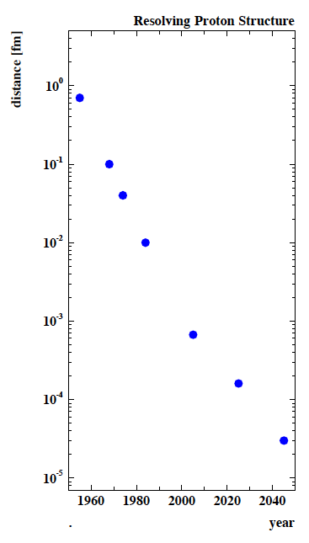
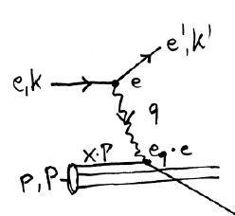
Motivation: EIC facilities as a microscope:
Finest microscope with resolution
varying like √1/Q²
Finite p Radius
Parton momentum fixed by electron kinematics:
Stanford
Quarks
SLAC
FNAL
e⁺e⁻
Quark
Gluon
Dynamics
→
CERN
HERA
eh →
LHeC
X
Higgs
BSM
→
FCC-he
hh
Max Klein
Notes:
The 'resolution vs time plot' for DIS is obtained as follows:
d*p=hbar [Heisenberg] ➔ in natural dimensions there follows
d [fm] = 0.2 / sqrt(Q_2^max/GeV^2)
The maximum Q2 is given as s=4EeEp in an ep collider.
I use Q2max = 0.9 *s because one never reaches s
For example: LHeC: sqrt(s) = sqrt(4 * 60 * 7000) = 1300 GeV --> Q2 max = 1250 GeV2
d = 1.6 * 10^-4 fm which is the LHeC point drawn

Slide 8
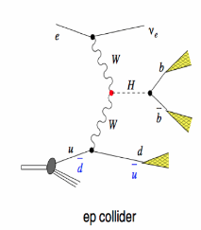
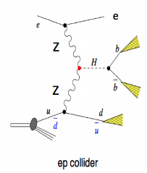
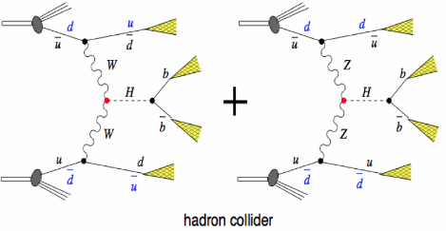
Motivation: LHeC as a Higgs Factory
-Cross section of 200fb @ LHeC
➔ comparable to linear collider!
-Clean bb final state (S/B ≈ 1)
-e-h cross calibration ➔ precision
-Pile-up in ep @ 10³⁴cm⁻²s⁻¹ is 0.1
-Pile-up in pp @ 5 10³⁴cm⁻²s⁻¹ is 140
or
Notes:
The 'resolution vs time plot' for DIS is obtained as follows:
d*p=hbar [Heisenberg] ➔ in natural dimensions there follows
d [fm] = 0.2 / sqrt(Q_2^max/GeV^2)
The maximum Q2 is given as s=4EeEp in an ep collider.
I use Q2max = 0.9 *s because one never reaches s
For example: LHeC: sqrt(s) = sqrt(4 * 60 * 7000) = 1300 GeV --> Q2 max = 1250 GeV2
d = 1.6 * 10^-4 fm which is the LHeC point drawn

Slide 9
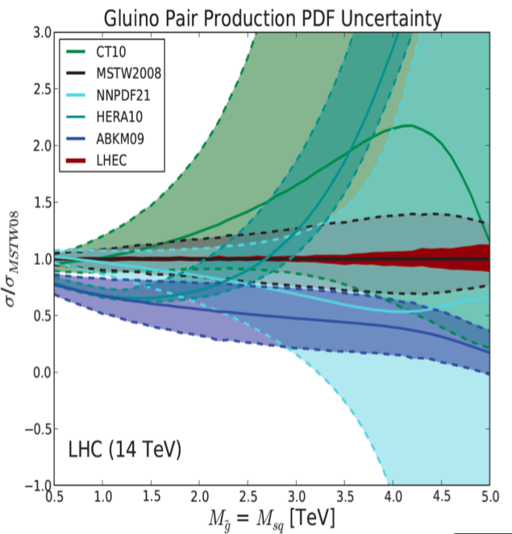
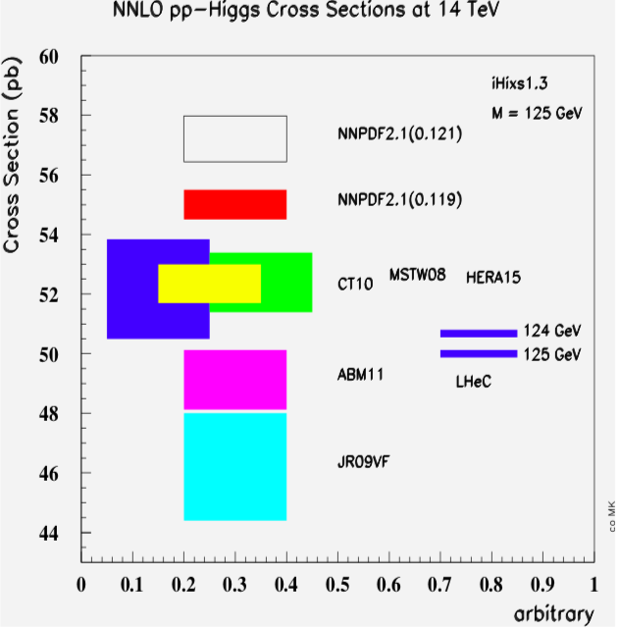
Motivation: LHeC for PDF measurements:
Max Klein
PDF Uncertainty from HERA data:
Example Gluon Pair production uncertainty
Implication on LHC experimental reach:
Allows predicting the Higgs
Cross section in pp to 0.2% precision
Notes:
The 'resolution vs time plot' for DIS is obtained as follows:
d*p=hbar [Heisenberg] ➔ in natural dimensions there follows
d [fm] = 0.2 / sqrt(Q_2^max/GeV^2)
The maximum Q2 is given as s=4EeEp in an ep collider.
I use Q2max = 0.9 *s because one never reaches s
For example: LHeC: sqrt(s) = sqrt(4 * 60 * 7000) = 1300 GeV --> Q2 max = 1250 GeV2
d = 1.6 * 10^-4 fm which is the LHeC point drawn

Slide 10
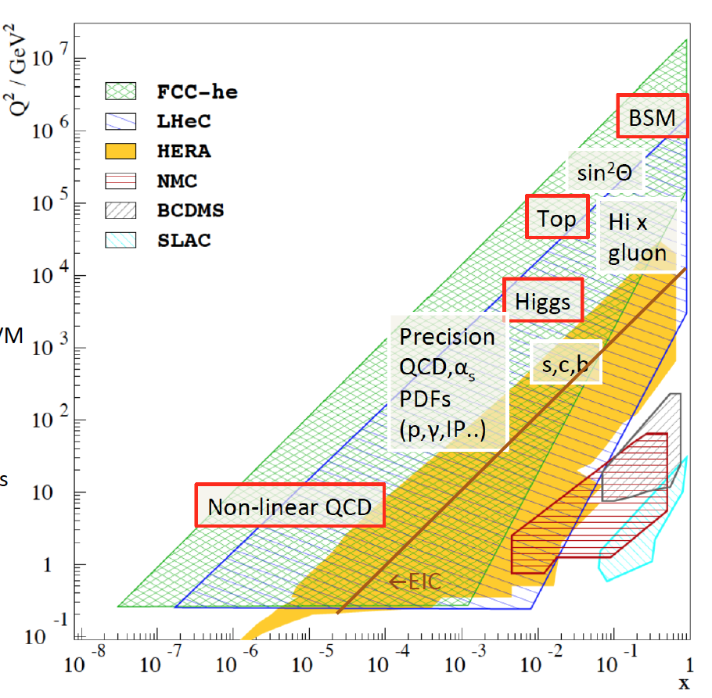
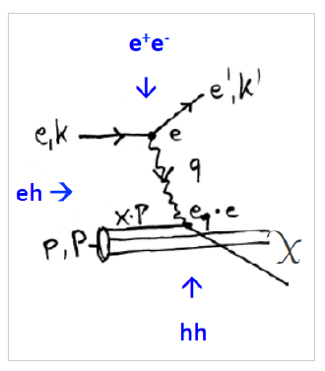
Physics with Energy Frontier DIS
Deep Inelastic Scattering

Slide 11
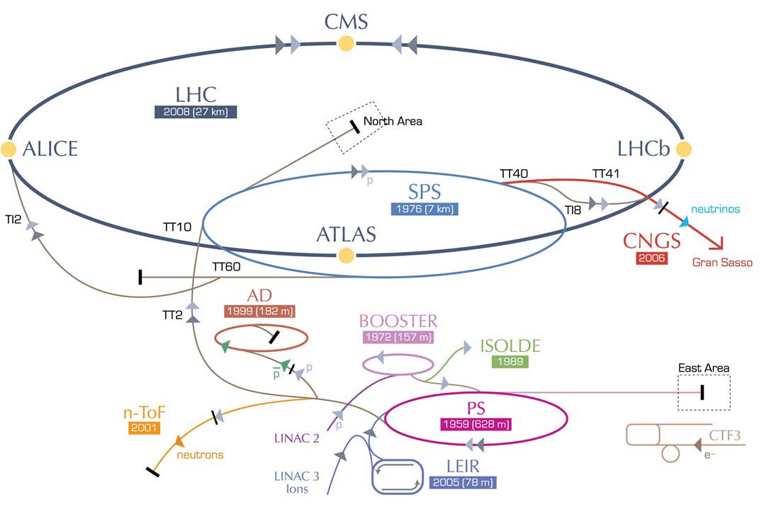
LHeC options: RR and LR
RR LHeC:
new ring in
LHC tunnel,
with bypasses
around
existing
experiments
RR LHeC
e-/e+ injector
10 GeV,
10 min. filling time
LR LHeC:
recirculating
linac with
energy
recovery,
or straight
linac

Slide 12
LHeC Proposal endorsed by ECFA (30.11.2007)
As an add-on to the LHC, the LHeC delivers in excess of 1 TeV to the electron-quark cms system. It accesses high parton densities ‘beyond’ what is expected to be the unitarity limit. Its physics is thus fundamental and deserves to be further worked out, also with respect to the findings at the LHC and the final results of the Tevatron and of HERA.
First considerations of a ring-ring and a linac-ring accelerator layout lead to an unprecedented combination of energy and luminosity in lepton-hadron physics, exploiting the latest developments in accelerator and detector technology.
It is thus proposed to hold two workshops (2008 and 2009), under the auspices of ECFA and CERN, with the goal of having a Conceptual Design Report on the accelerator, the experiment and the physics. A Technical Design report will then follow if appropriate.
Unanimously supported by rECFA and ECFA plenary in November 2007

Slide 13
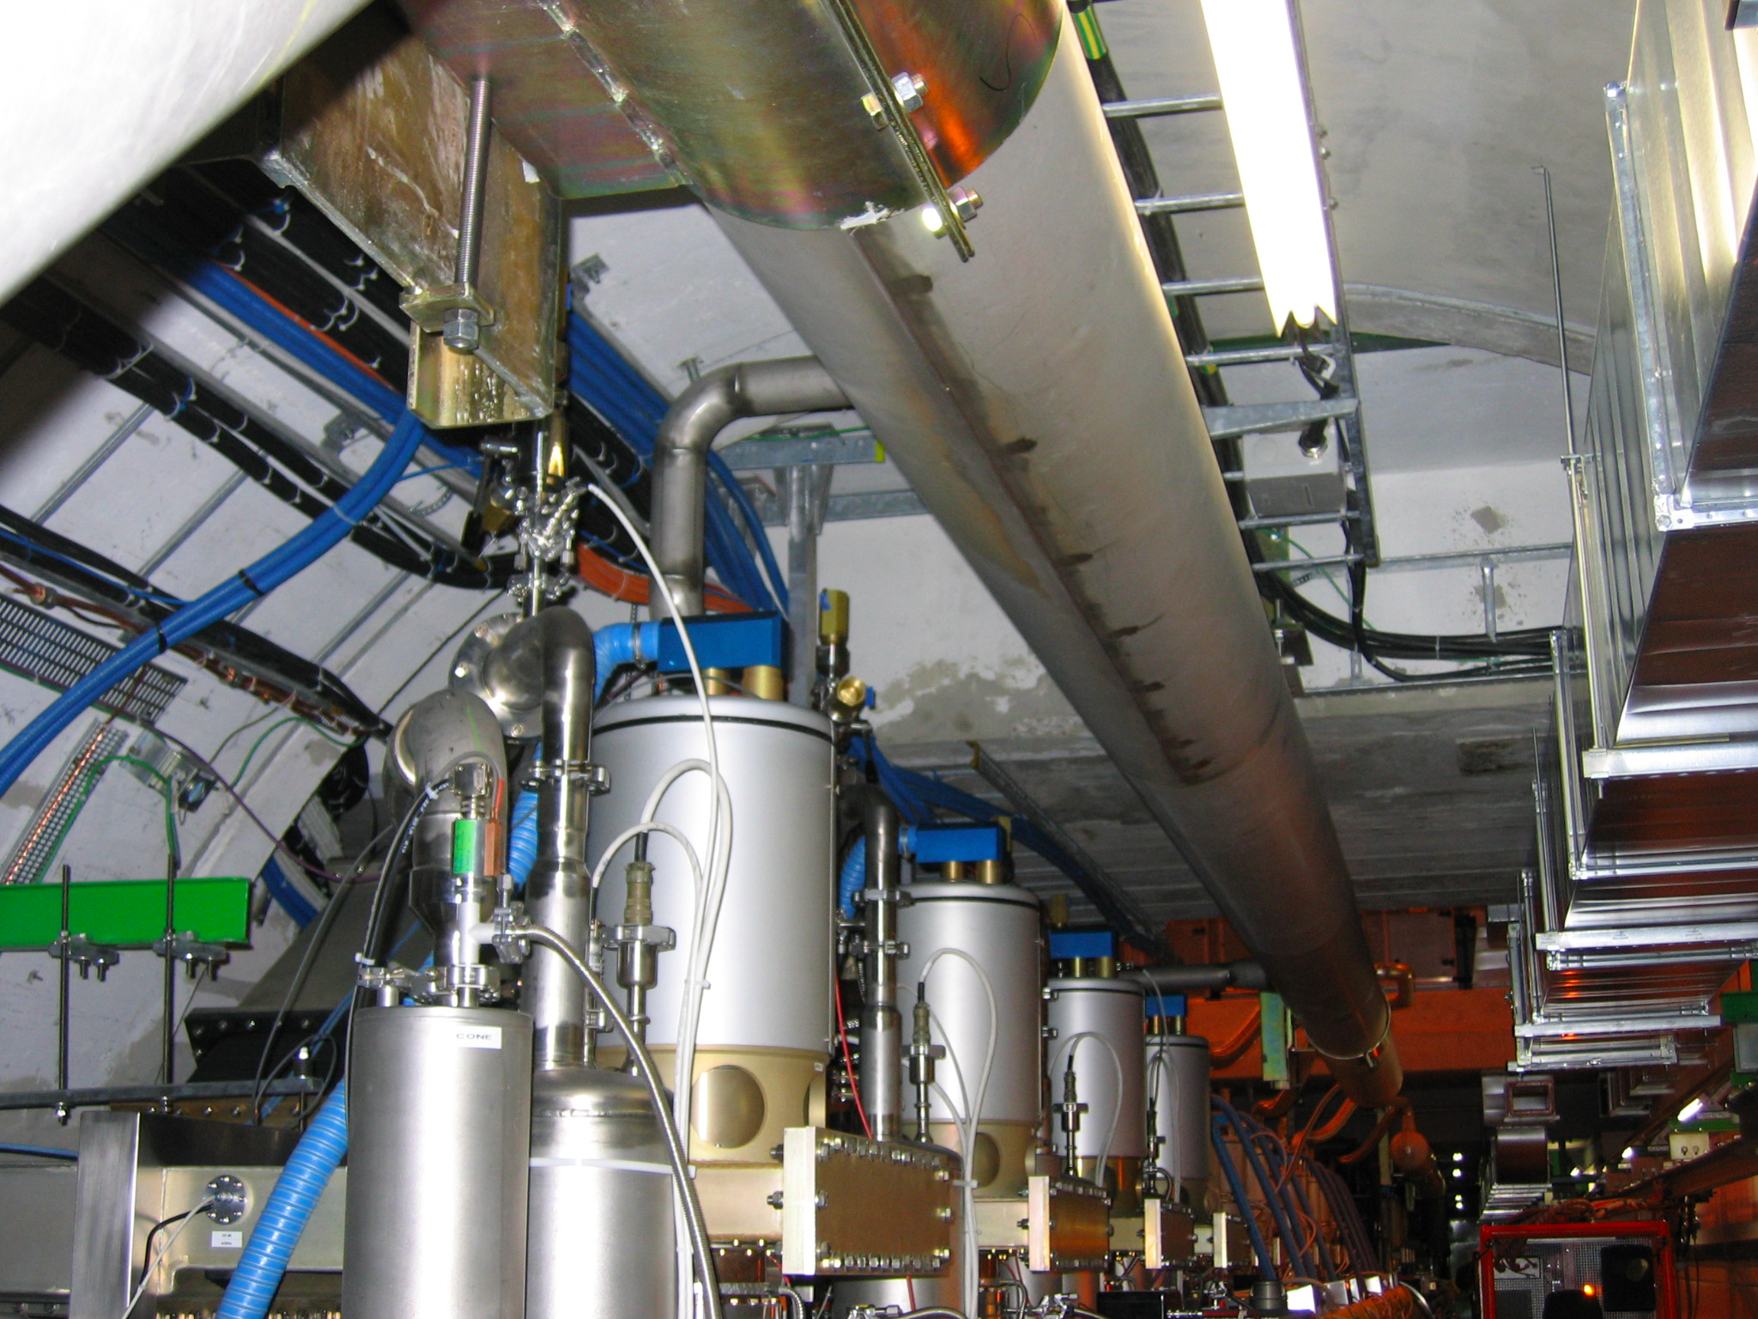
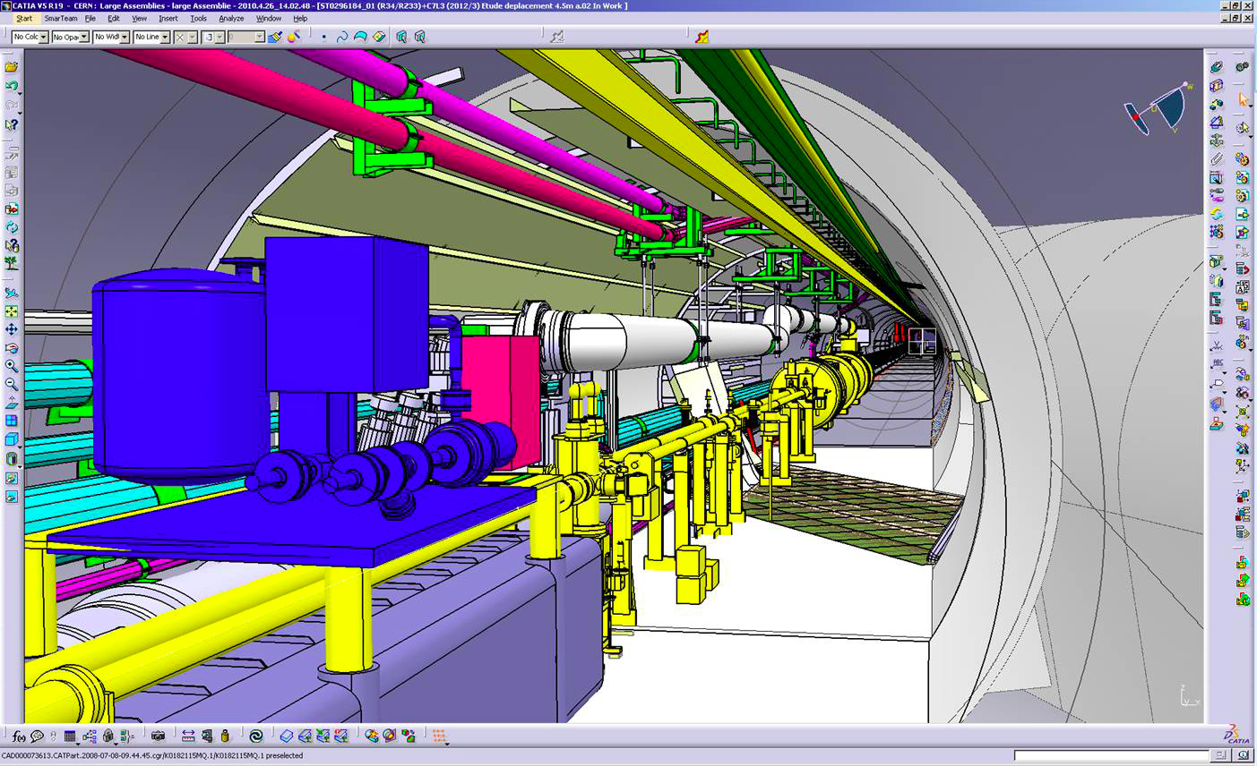
1st Workshop @ Divonne in 2008: Ring-Ring Option
Challenge: Integration in the LHC tunnel
RF Installation in IR4
The constraints and limitations implied by a Ring-Ring implementations were judged as to too restrictive
➔ Linac-Ring Option chosen as the baseline configuration
Many Obstacles and interferences with existing LHC machine!
Cryo link in IR3

Slide 14
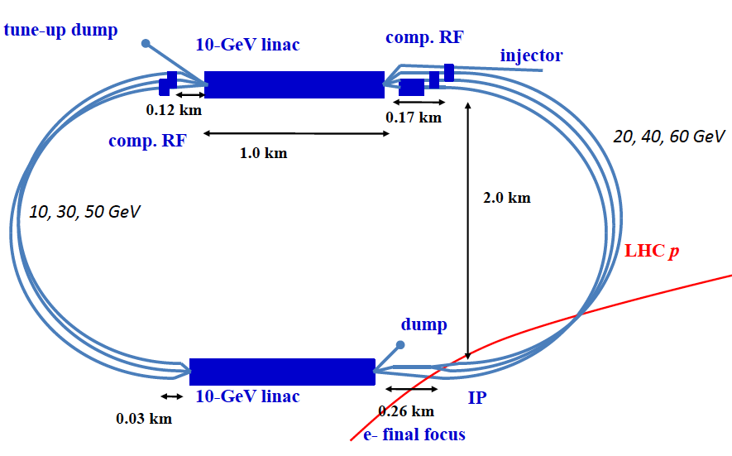
LHeC Linac-Ring Option: Power & Cost considerations
2 Super Conducting Linacs with Energy Recovery & high current (> 6mA)
Two 1 km long SC
linacs in CW operation (Q₀ > 10¹⁰)
requires Cryogenic system
comparable to LHC system!
ca. 9km underground tunnel
infrastructure [SPS size]
Installation fully decoupled from LHC operation!
Efficient Concept
re-circulation implies cost effective use of the SRF investment
ERL implies efficient operation and higher performance reach

Slide 15
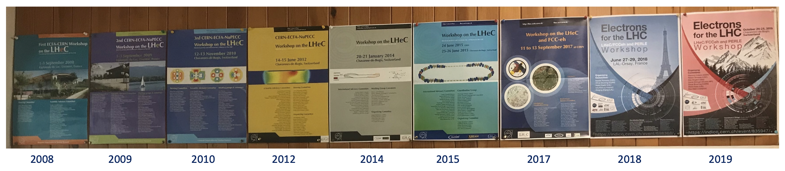
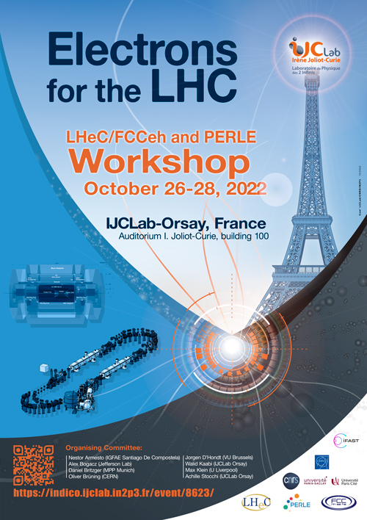
Out of 2 initially requested workshops grew over 10!
Plus many discussions at
IPAC and ICHEP conferences
and FCC, ERL and EIC Workshops!
Notes:
Add Krakow poster page

Slide 16





















LHeC - Participating Institutes: A very rich collaboration
TOBB ETU
KEK

Slide 17
CERN Mandate of 2012: 5 main points
The mandate for the technology development includes studies and prototyping of the following key technical components:
Superconducting RF system for CW operation in an Energy Recovery Linac (high Q₀ for efficient energy recovery)
Superconducting magnet development of the insertion regions of the LHeC with three beams. The studies require the design and construction of short magnet models
Studies related to the experimental beam pipes with large beam acceptance in a high synchrotron radiation environment
The design and specification of an ERL test facility for the LHeC.
The finalization of the ERL design for the LHeC including a finalization of the optics design, beam dynamics studies and identificationof potential performance limitations
The above technological developments require close collaboration between the relevant technical groups at CERN and external collaborators.
Given the rather tight personnel resource conditions at CERN the above studies should exploit where possible synergies with existing CERN studies.
S.Bertolucci at Chavannes workshop 6/12 based on
CERN directorate’s decision to include LHeC in the MTP

Slide 18
Superconducting RF Studies
Choice of the SC RF frequency:
-HL-LHC bunch spacing requires bunch spacing with multiples of
25ns (40.079 MHz)
Decided to redesign from scratch:
Chose a frequency of 802MHz as optimum from power considerations and beam stability considerations
➔ Later: Synergy with FCC-ee SRF developments!
Frequency choice: h * n* 40.079 MHz
Symmetry in ERL: n=3 ➔ h * 120.237 MHz
h=6: 721 MHz or h=11: 1.323GHz
SPL & ESS: 704.42 MHz; ILC & XFEL: 1.3 GHz
Frequencies are slightly different (20MHz) from existing technologies!
➔ Can not directly profit from ILC / TESLA and ESS developments

Slide 19
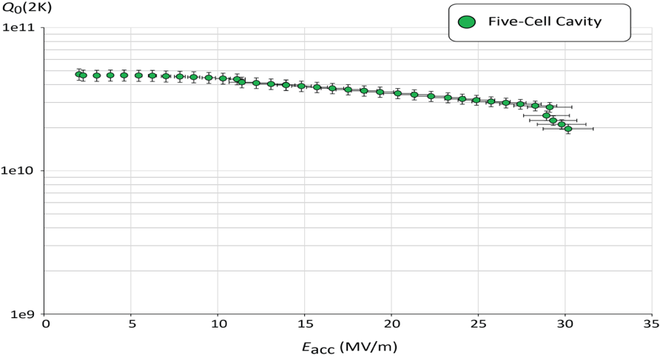
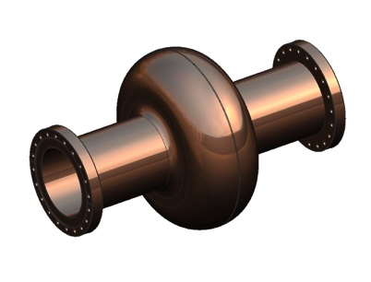
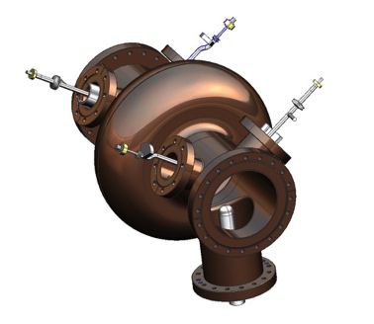
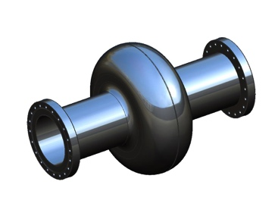
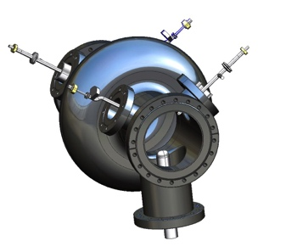
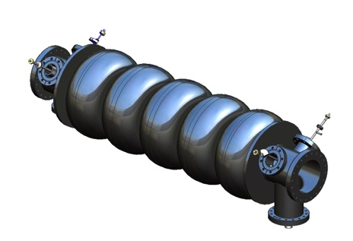
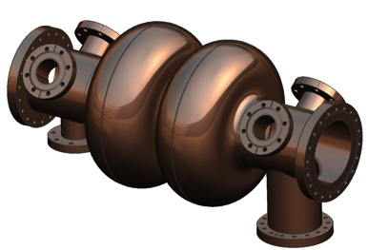
Superconducting RF Studies: 802 MHz 5-Cell Cavity
JLAB / CERN
collaboration
1st Cavity Prototype for PERLE/LHeC and FCC-ee/eh
F. Marhauser Feb 2018
Q₀ (2k) = 3 e10 @ ~27 MV/m
Very encouraging SRF results that still offer headroom for improved performance!!!
LHeC can be done with state-of-the-art SRF!
✔
?
Quench @ E_{acc} ~ 30 MV/m
✔
?
LHeC minimum requirements
✔
?
✔ = done, ? = option

Slide 20
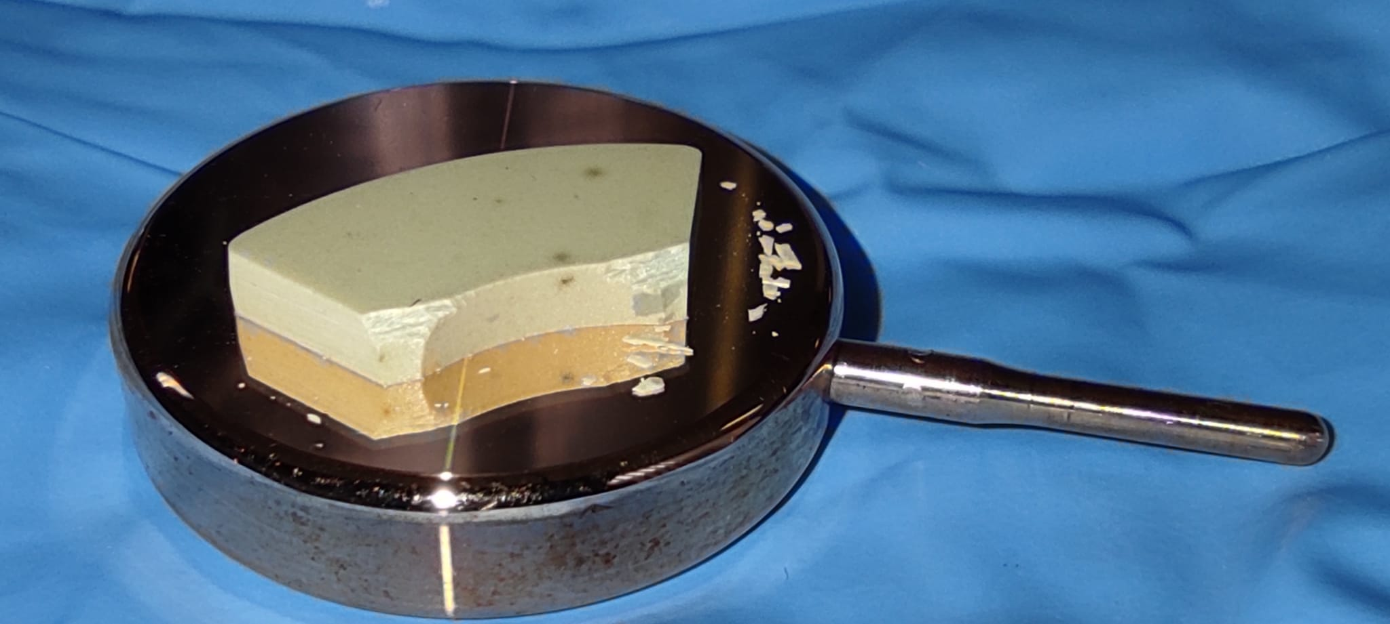
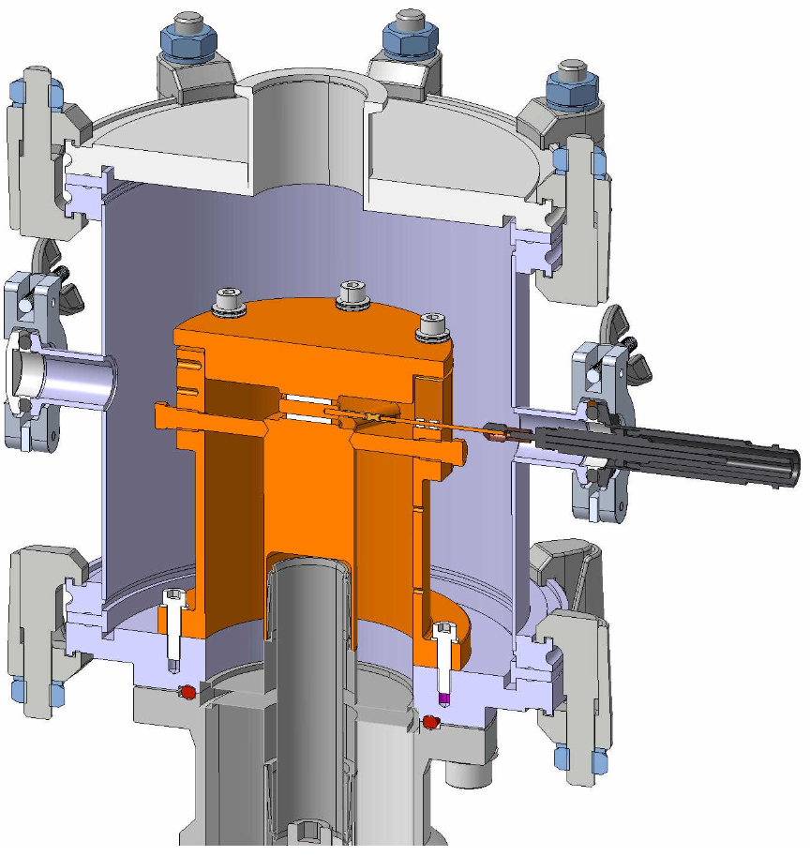
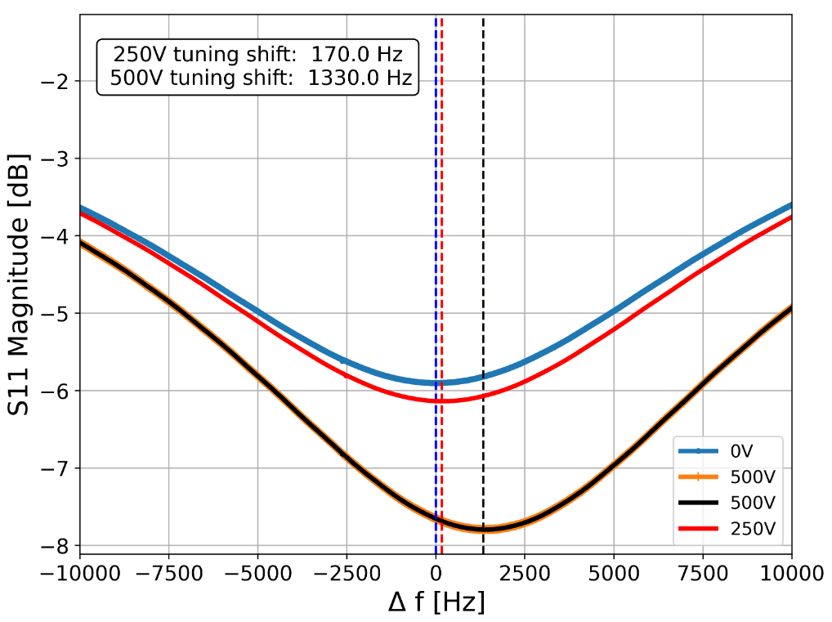
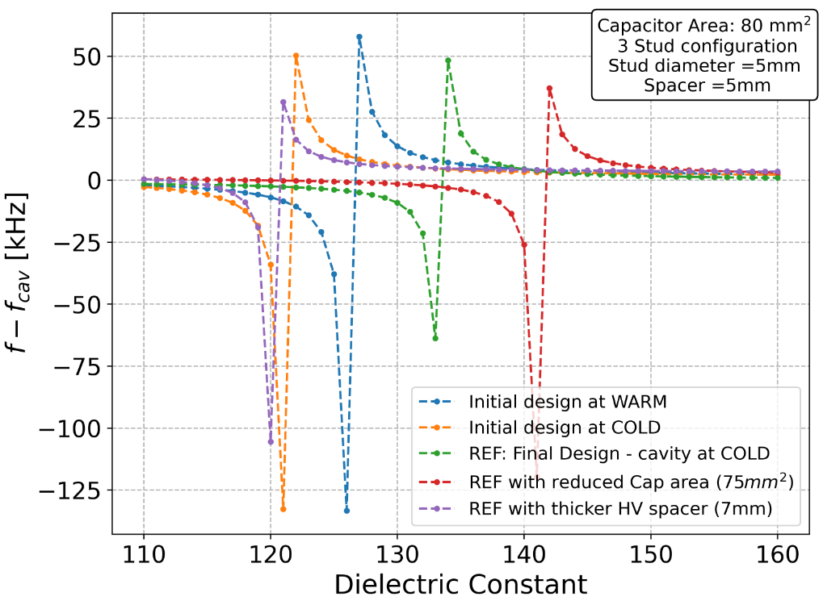
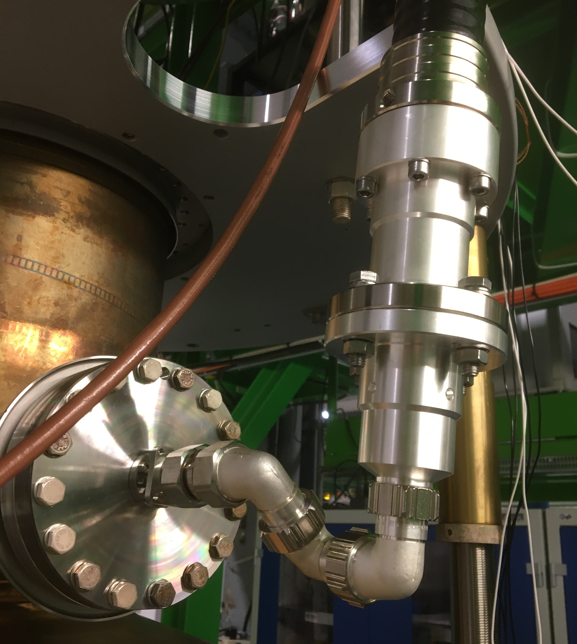
Transient Detuning Project: TDD0
Nik Shipman @ ERL’2022
RF designs of FRT focused on coupled mode scheme
  FRT resonance jumped across cavity resonance
  Greater phase shift and larger tuning range with smaller antenna
  Discontinuous tuning range – not suitable microphonics suppression
Brazeless (compression fit) thin wafers of ferro-electric in vacuum
  Aim: reduced losses + higher biasing electric fields
  + greater change in permittivity at reduced voltage
First prototype TDD0 (Transient Detuning Demonstrator) built and tested on cold LHC cavity
Result: 1.3kHz tuning shift observed with 500V
  Test cut short due to cavity vacuum leak
  TDD0 designed for 10-16kV, voltage limited due to vacuum leak on TDD0
Lessons learned:
  FerrElectric stack sensitive to air gap/compression force
  Care must be taken to apply compression evenly
  Implementation of rigid line in cryostat susceptible to mechanical stress and losses
    Place FRT inside cryostat for next test.
Top: uneven compression force cracked ceramic.
Left: Large diam. rigid line caused vacuum leak.
Right: Breakdown through ceramic near cracks?

Slide 21
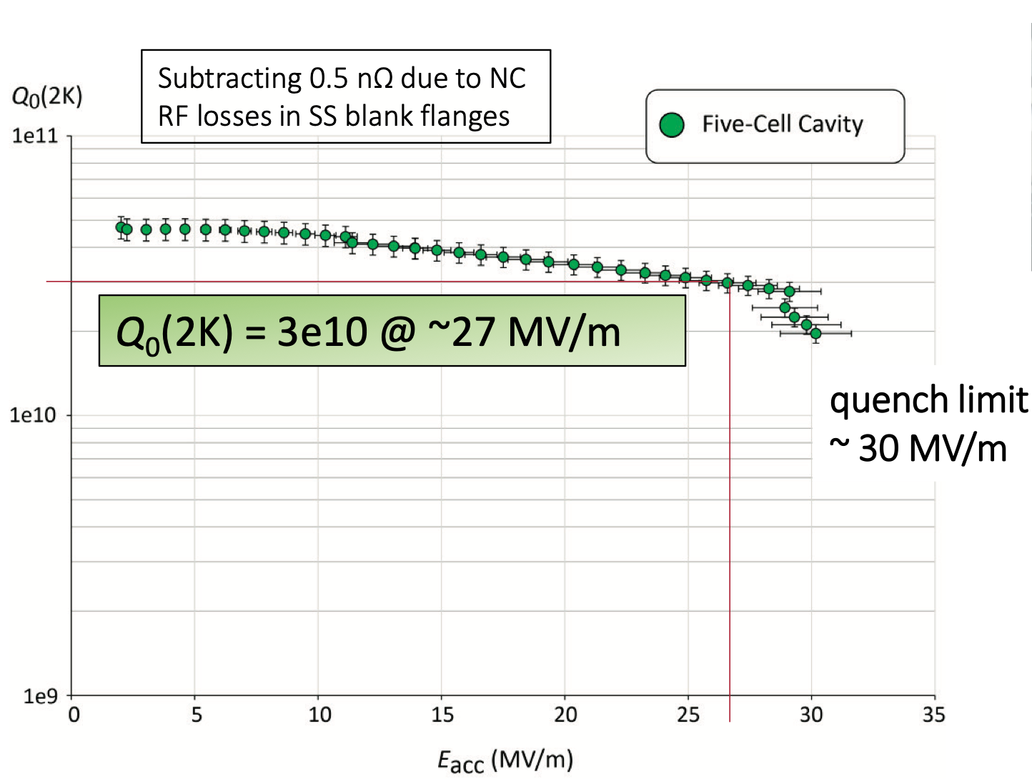
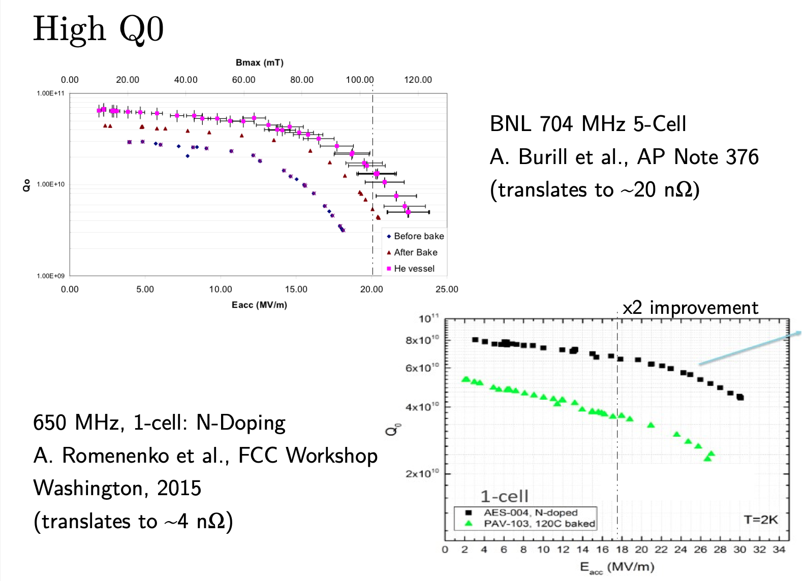
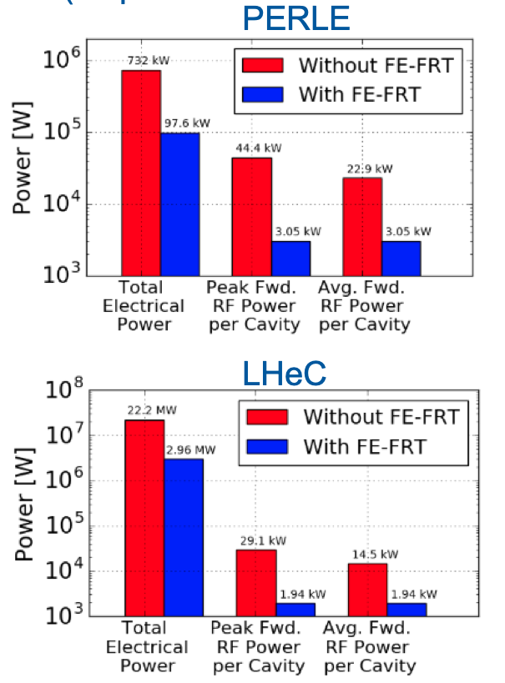
Technical Challenges of the LHeC design: SRF R&D
Nitrogen doping and Q₀ versus gradient
SRF Cavity design: High Q₀ at high gradient
Microphonics: FerroElectrical Fast Reactive Tuner
Nicholas Shipman @
PERLE Meeting Orsay 2020
Frank Marhauser @FCC Week Amsterdam 2018
and @ PERLE Meeting Orsay 2020

Slide 22
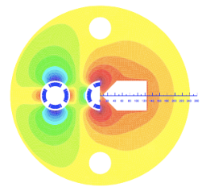
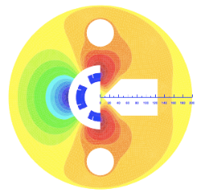
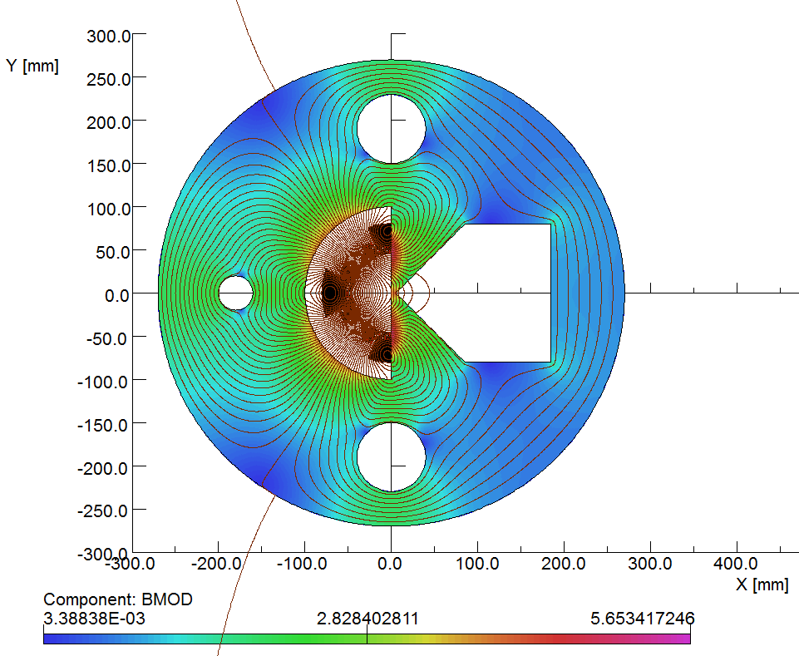
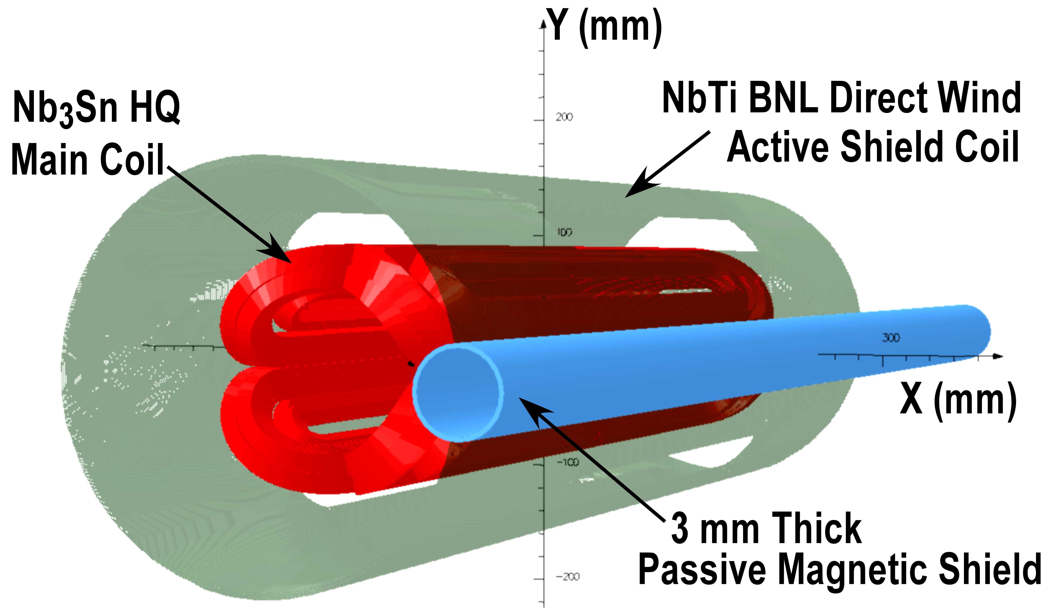
Asymmetric IR Design: Challenge Triplet Magnets & SR
S. Russenschuck in CDR 2012
CDR parameter: R = 23mm; 250T/m SA [6-7T] &
R = 46mm; 145 T/m HQ [6-7T]
IR magnet design is clearly challenging and
requires novel SC magnet design features!
B. Parker @ LHeC 2017
Workshop and IPAC2016:
R = 30mm; 151T/m [4.5T]
With an active coil for field
Compensation ➔ ‘sweetspot’

Slide 23
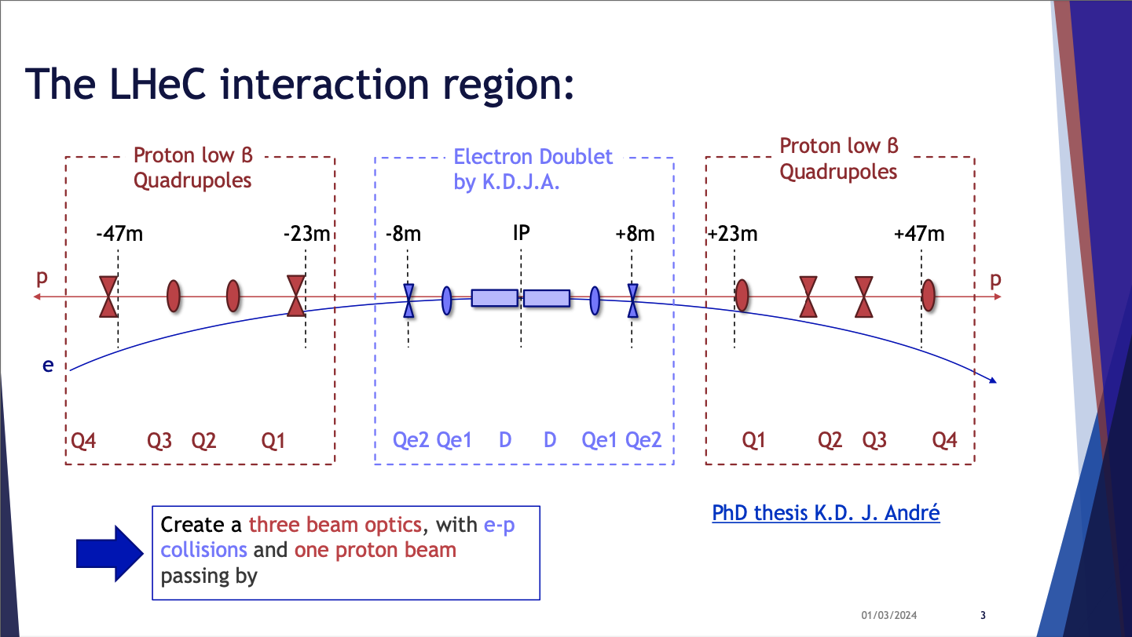
Tiziana Von Witzleben @ Synergy Workshop
ep/eA, CERN 1.3.2024
Notes:
Magnet, 2024 workshop at CERN

Slide 24
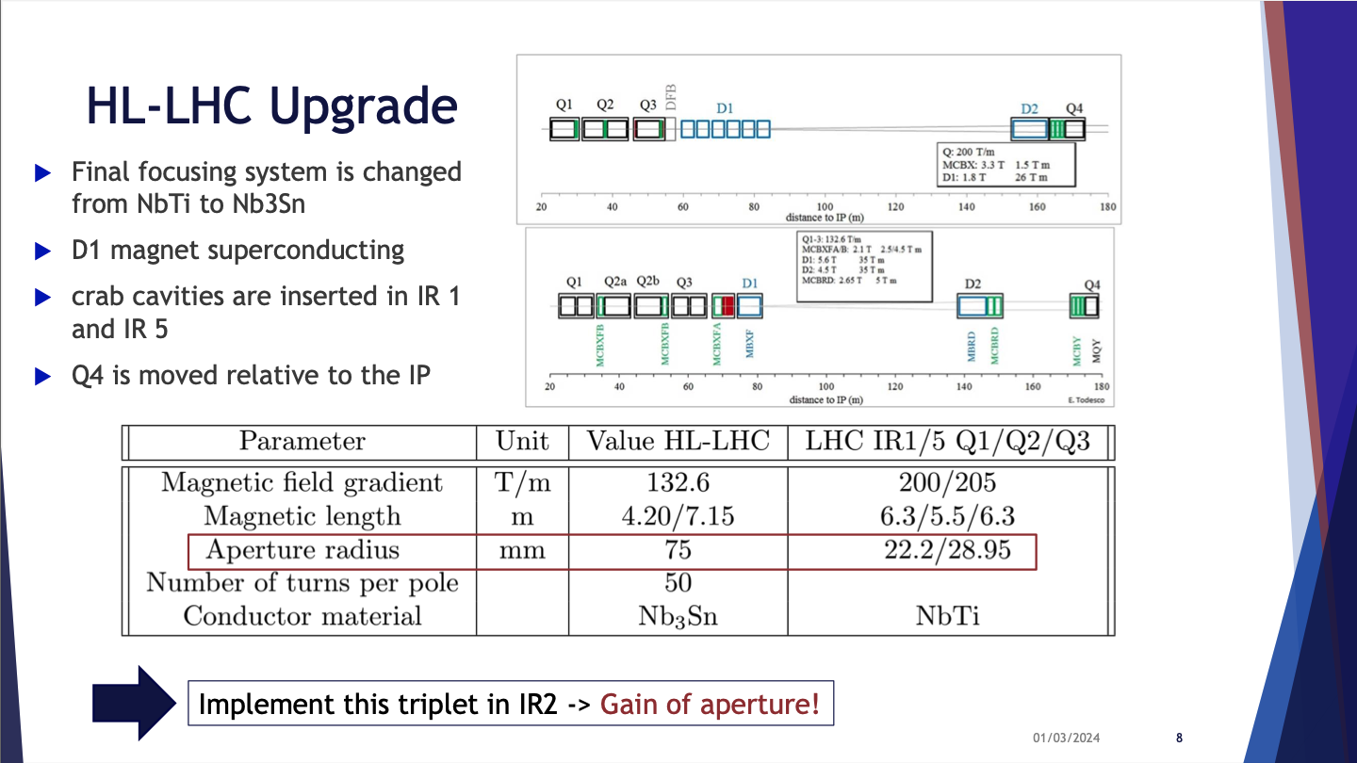
Tiziana Von Witzleben @ Synergy Workshop
ep/eA, CERN 1.3.2024

Slide 25
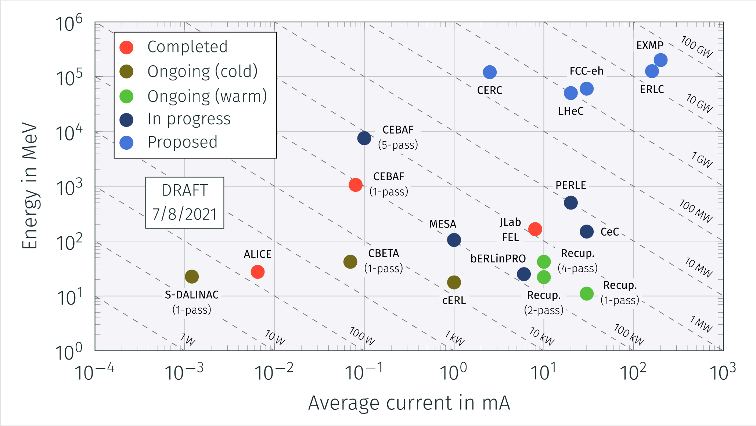
Advancing the ERL Concept
Need to demonstrate scalability!

Slide 26
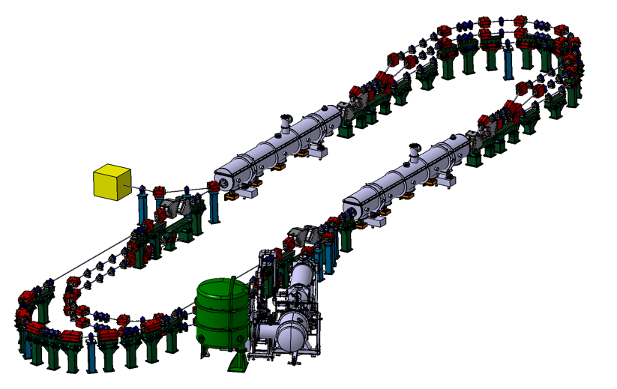
ERL Demonstrator / Test Facility
PERLE: A testbed to explore and validate a broad range of accelerator phenomena & technical choices on the pathway to the LHeC and other new frontier machines realisation.
Main challenges: Multi-turn, high bunch charge, high power energy recovery, …
2 Linacs (Four 5-Cell 801.58 MHz SC cavities)
3 turns (164 MeV/turn)
Max. beam energy 500 MeV
I = 20mA
Target Parameter | Unit | Value
Injection energy | MeV | 7
Electron beam energy | MeV | 500
Normalised Emittance γε_{x,y} | mm mrad | 6
Average beam current | mA | 20
Bunch charge | pC | 500
Bunch length | mm | 3
Bunch spacing | ns | 25
RF frequency | MHz | 801.58
Duty factor |  | CW
Walid Kaabi @ Electrons for the LHC workshop in Orsay in 2022

Slide 27
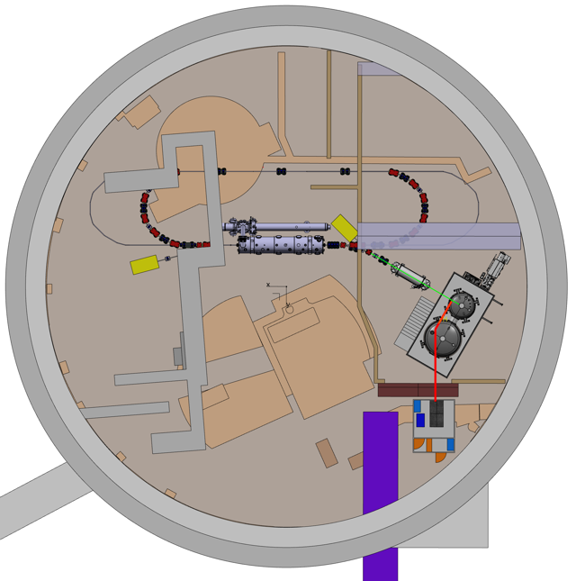
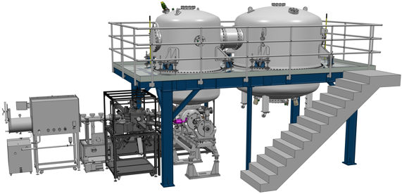
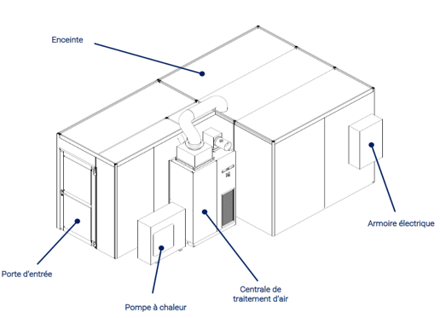

Site choice and first equipment implementation
After site studies of the the two possible locations to host PERLE (Super ACO hall and Igloo):
The IGLOO was the preferred solution. Several scenario of implementation were thus discussed.
Implantation in igloo being finalized
Laser clean room: to be delivered in June 2024

Slide 28

New staging strategy –first 1-tour of a simplified PERLE by beginning 2028
Financed through
iSAS Program
+ ESS + in-Kind IN2P3
21m
Delivered@IJCLab
Infrastructures and radioprotection
Financed by CPER funds
Cryogenic Plants.
In-kind from HZB + extra funding

Slide 29
Macro Vision on the PLANNING (detailed plans available)
Designs/ Studies
Site is now choosen : IGLOO !
(infrastructure sinstallation started)
Today
Procuirement / Construction / Installation
Commissioning
DC-Gun/Laser/FC
Delivered@Orsay
Injector
LINAC
Cryomodule
First Loop
2nd 3rd Loop
If obtained within 2years. PERLE@250MeV could be completed in 2030
2024
2025
2026
2027
2028

Slide 30
LHeC / FCC-eh ERL Configurations:
SRF as the main cost driver for the 60 GeV Configuration:
Reducing the electron beam energy can almost half the ERL cost
Design and build the arcs for higher beam energy to allow for later upgrades
Provide free space in the linac sections for later upgrades
30GeV to 50GeV Variation:
Reducing the initial SRF cost by 50%
Provide upgrade potential for up to 60GeV ➔ total cost reduction ca. 40%
Overall size reduction from 1/3rd to 1/5th of the LHC circumference [SR power]
The LHeC ERL SRF could be re-used for the first installation phase of FCC-ee
and / or [part of it] as an FCC-ee injector and as ERL for the FCC-eh option

Slide 31

Site, Size and Beam Energy Considerations:

Slide 32

Future Circular Collider Study
International FCC collaboration (CERN as host lab) to study:
pp-collider (FCC-hh) → main emphasis, defining infrastructure requirements
80-100 km tunnel infrastructure in Geneva area, site specific
e⁺e⁻ collider (FCC-ee), as potential first step [light Higgs!]
p-e (FCC-he) option, integration one IP, ERL a la LHeC
HE-LHC with FCC-hh technology
20 T ⇒ 100 TeV pp in 100 km
[16 T ⇒ 80 TeV pp in 100 km]

Slide 33








FCC-eh Studies
Initially Point L
Junction Caverns
16.8 m x 15 m x 100 m
25 m x 15 m x 50 m
16.8 m x 15 m x 90 m
Small Experimental Caverns
30 m x 35 m x 66m
Tunnels:
9.091 km of 5.5m dia. machine tunnel.
2 x 1.04 km of 5.5m dia RF tunnel.
Shafts:
2 x Service shafts:
9 m dia. x 175 m depth
Service Caverns
25 m x 15 m x 50 m

Slide 34

FCC-eh ERL Configuration:
Consistent Performance Projections for ep:
EDMS 17979910 FCC-ACC-RPT-0012 V1.0, 6 April, 2017,
“A Baseline for the FCC-he”
Oliver Brüning, John Jowett, Max Klein, Dario Pellegrini, Daniel Schulte, Frank Zimmermann

Slide 35
Summary LHeC / FCC-eh
Unique machine for exploring the TeV Center of Mass region of HEP with ep
Maximum Infrastructure exploitation of the LHC and FCC!
Moderate cost – [compared to ILC, CLIC or FCC]
Unique oportunity – no other machine can provide ep @ TeV CME
Technology driver with many spin off benefits – ERL & SRF
➔ Sustainable accelerator operation!
Unique physics program
Modular design with several operation phases!
➔ LHeC, FCC-ee injector, FCC-eh

Slide 36

Start now ‘29

Slide 38






ERL Evolution:
First Idea:
M. Tigner 1965
JLab First MW beam power operation
FEL Demo [1999] & Upgrade [2000]
Multi-turn SRF
C-Beta 2019-2020
Multi-turn SRF, multi-MW
PERLE@Orsay 2025
PERLE is now part of the ERL Roadmap for Accelerator R&D!
ALICE
JEARI ERL
1960
1970
1980
1990
2000
2010
2020
2030
2040
First Demonstration
SLAC SCA / FEL 1987
Multi-turn Operation
BINP FEL 2004 [NC]
Multi-MW Operation
bERLin-Pro 2020
HEP / NP ERL application
LHeC; FCC-hh; ep and eI;

Slide 39

Introduction: Electron-Weak Precision Physics
Precision Measurements: Running of weak interactions
Fills in the regions that have not yet been measured
➔ requires high Luminosity

