Slide 1
Update from LAF Section
LAF - Lepton Accelerator Facilities
A. Latina

Slide 2
RF-Track update
Python packaging improved: self-contained binary wheels available on www.pypi.org for Linux and MacOS.
RFT Training on-going:
Jupyter Notebooks available in Octave and Python
April 2024, ESRF – focus on X-band linac design
June 2024, IFIC-Valencia – focus on light ion SCDTL linac simulation
November 2024, LNF-INFN – focus on high-intensity electron linacs for medical applications
More is being planned: here at CERN; at ASU in August?
X-Suite interface: Completed
RF-Track, seen as an X-suite element – allows, e.g., to include Linac4 in X-Suite.
In progress / planned development:
Multi-bunch beam model: helps implement bunch-to-bunch collective effects more efficiently; helps to simulate the bunching of continuous beams (Linac4’s RFQ)
More collective effects are being developed for muons / medical simulations, such as IBS and coherent synchrotron radiation (CSR).
Muons will require more developments, such as bidirectional tracking.; recirculating topologies? --- Integration with PLACET2?
On-going studies: FCCee pre-injector linacs; Positron sources: beam loading from e+ and e-; misalignment studies; muons: e.g., space-charge in materials, cooling studies; Linac4, source, etc. – effort to get field maps/description for all structures; Compton scattering; Medical applications

Slide 3
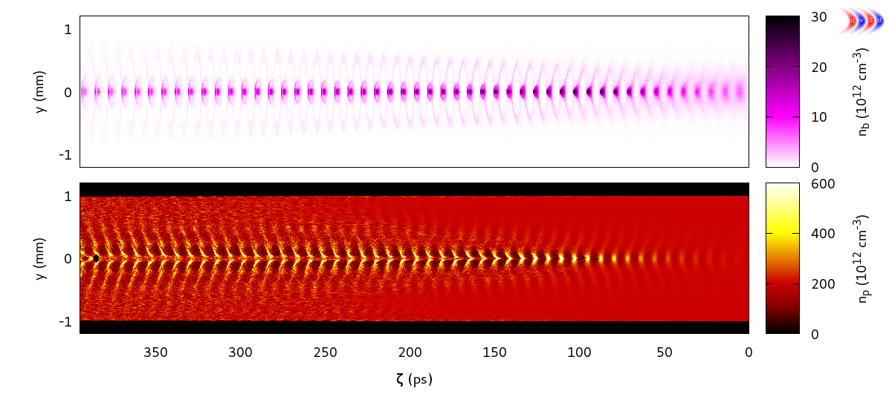
AWAKE
John Famers: AWAKE simulations are challenging due to disparate scales of proton and electron beams - we need to resolve both.
So far, simulation efforts have used "toy models" to separate these scales.
Now that Run 2c is approved, we push towards fully self-consistent simulations. This will potentially require new techniques, such as mesh refinement, already implemented in some codes.
Explore if RF-Track can help.

