Slide 1
LHC Optics Developments
R. De Maria

Slide 2
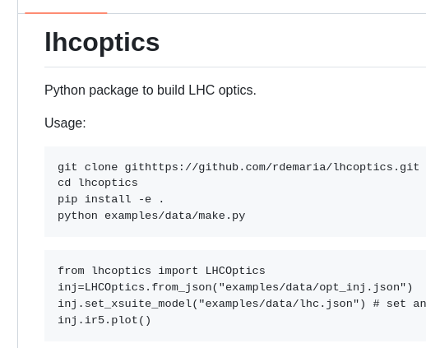
LHC Optics Package for optics design and interface with control room.
LHCXsuiteModel
Xsuite
LHCOptics:
strengths
knobs
parameters
LHCMadxModel
MAD-X
Layout data
LHCCircuits
LSA
LHCAperture
Work in progress:, complete squeeze matching, aperture calculation, circuit simulations, optics scenario generations. On the side, trying to refactor optics website.

