Slide 1
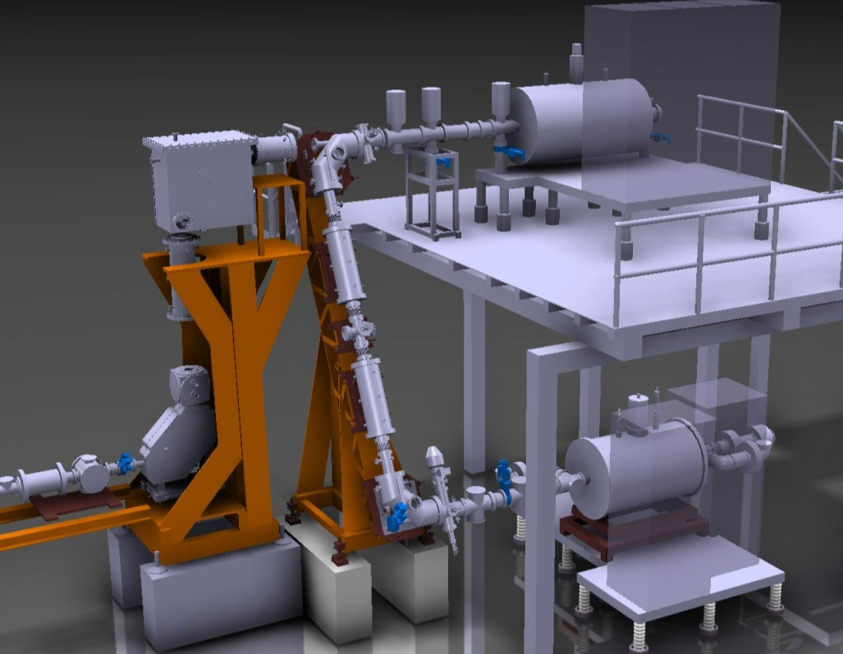
Charge breeding system
REXEBIS
1+ -> q+
Repetition rate 2-50 Hz
Achromatic mass separator
1+
30 keV
pulsed
~10 us
charge state mix
5 keV/u
pulsed ~20-800 us
beam from GPS or HRS
1+, CW, 30 keV
beam to linac
selected q+
REXTRAP
accumulation
cooling
bunching
Beam transfer section electrostatic

Slide 2
How are we doing?
With the non-adiabatic gun, installed 2020, world leading (until last week)
Stable potassium beam
Uranium beam
A/Q=4.32
A/Q=4.03
K¹⁷⁺
A/Q=4.95
A/Q=4.58
+ 55% in a single charge state
+ A/Q=2.29 => ~11.2 MeV/u
T_{breed}=245 ms instead of nominal 8 ms
Only applicable for special cases
+ Single charge state efficiency 16-18%
+ Beams with A/Q<4.5 attainable
Only valid for few ions (1E7 ions/bunch)

Slide 3
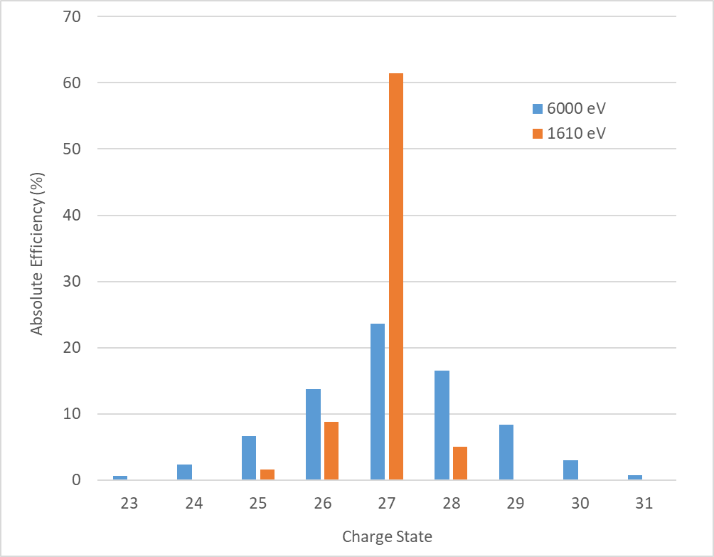
Courtesy of R. Vondrasek
Latest results from ANL
61.4%
¹³³Cs
A/Q=4.93
Preliminary result
Closed atomic shell breeding
+ Very high efficiency
- Special cases
A/Q has to be clean
A/Q has to be < 4.5 for REX-ISOLDE
- Low electron beam energy → run into perveance limit
→ low electron beam current → longer breeding time
8.8%
5.0%
1.5%
CARIBU EBIS operated with exceptionally low electron beam energy
Parameters for 1610 eV electron beam energy
  V_{gun}: -890 V, V_{trap}: 1141 V
  Electron beam current: 172 mA
  T_{breed}: 89 ms
  Cs+ injected: 4.3 pA
Aim to try on Zn beams at REX-ISOLDE this year

Slide 4
What can we improve?
Increase efficiency
* closed shell breeding can improve efficiency in certain cases
requires adjustable electron current energy
will complicate the setup
* total REXEBIS efficiency already ~75% => not much to gain
* REXTRAP efficiency <50%
Shorten breeding time
* increased repetition rate
* attain higher charge states within reasonable time
Beam purity
* increase number of available isotopes
Address complexity
* setting up and reproducibility
* machine maintenance

Slide 5
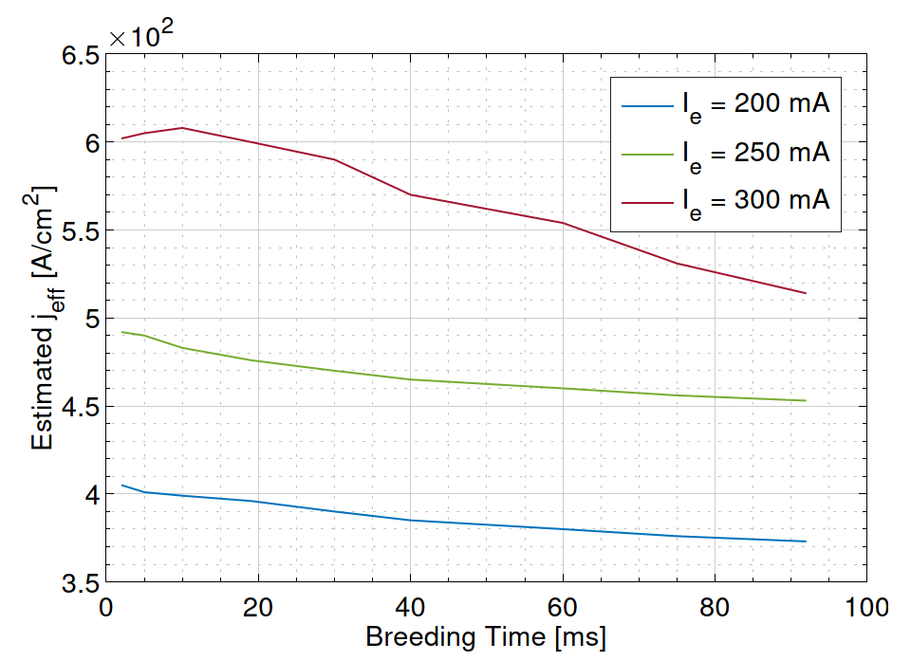
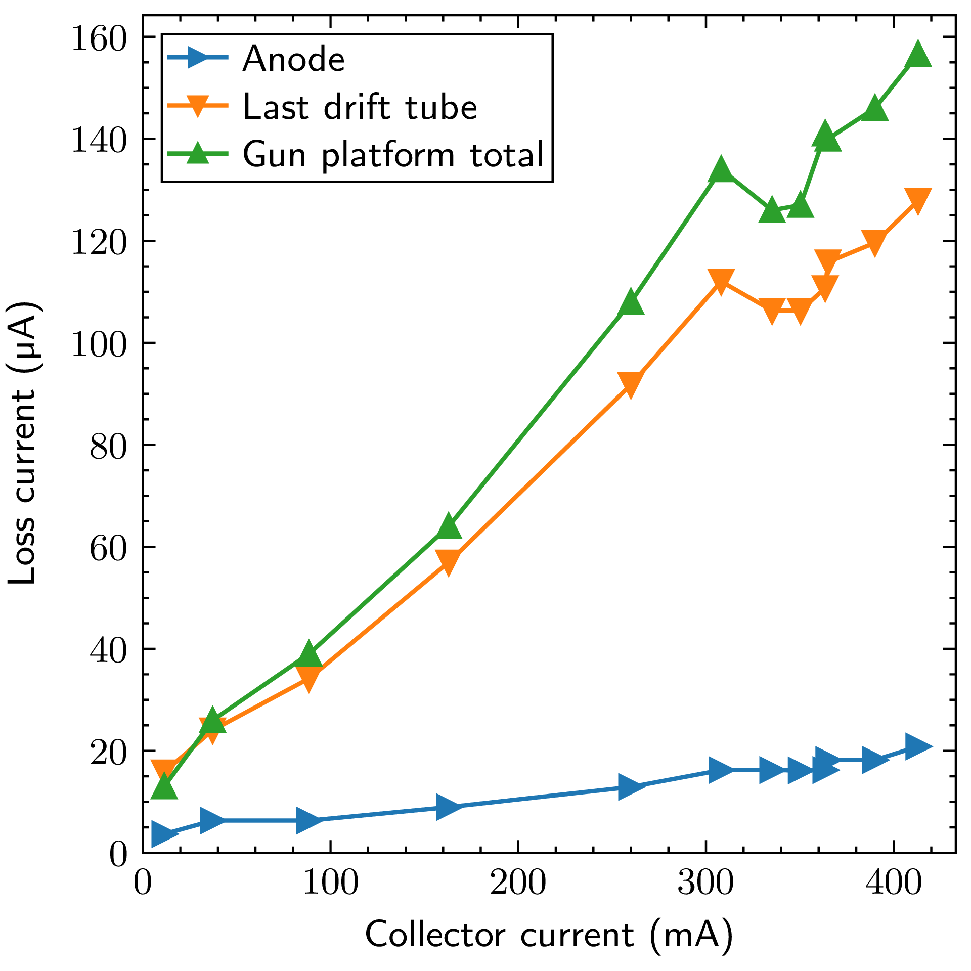
Why higher electron current?
Gas injection
Electron loss currents
Loss currents becoming limiting
Courtesy of N. Bidault
* Higher current => higher effective j_{e} => faster charge breeding
* Non-adiabatic electron gun designed for 500-700 mA
* Higher electron beam losses when I_{e} > 300 mA. Believed to be caused by back-scattered or elastically reflected electrons from the collector region.
Notes:
Heavier, highly charged ions confined to beam axis
=> Heavy ions experiencing the peak current density

Slide 6
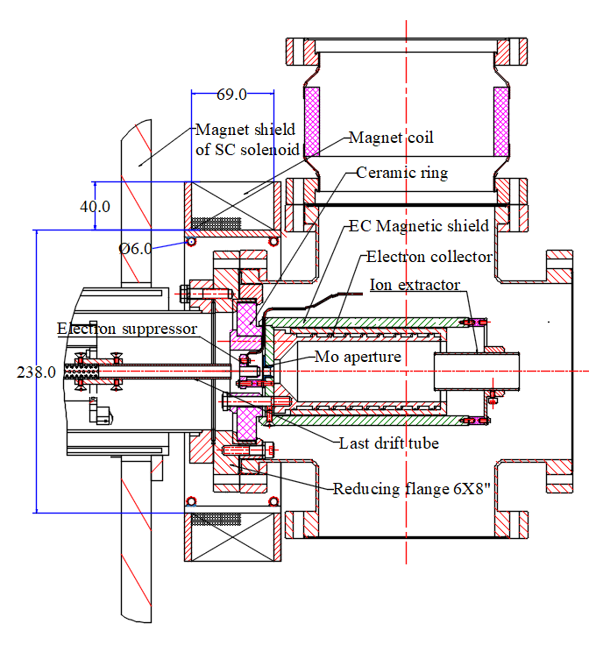
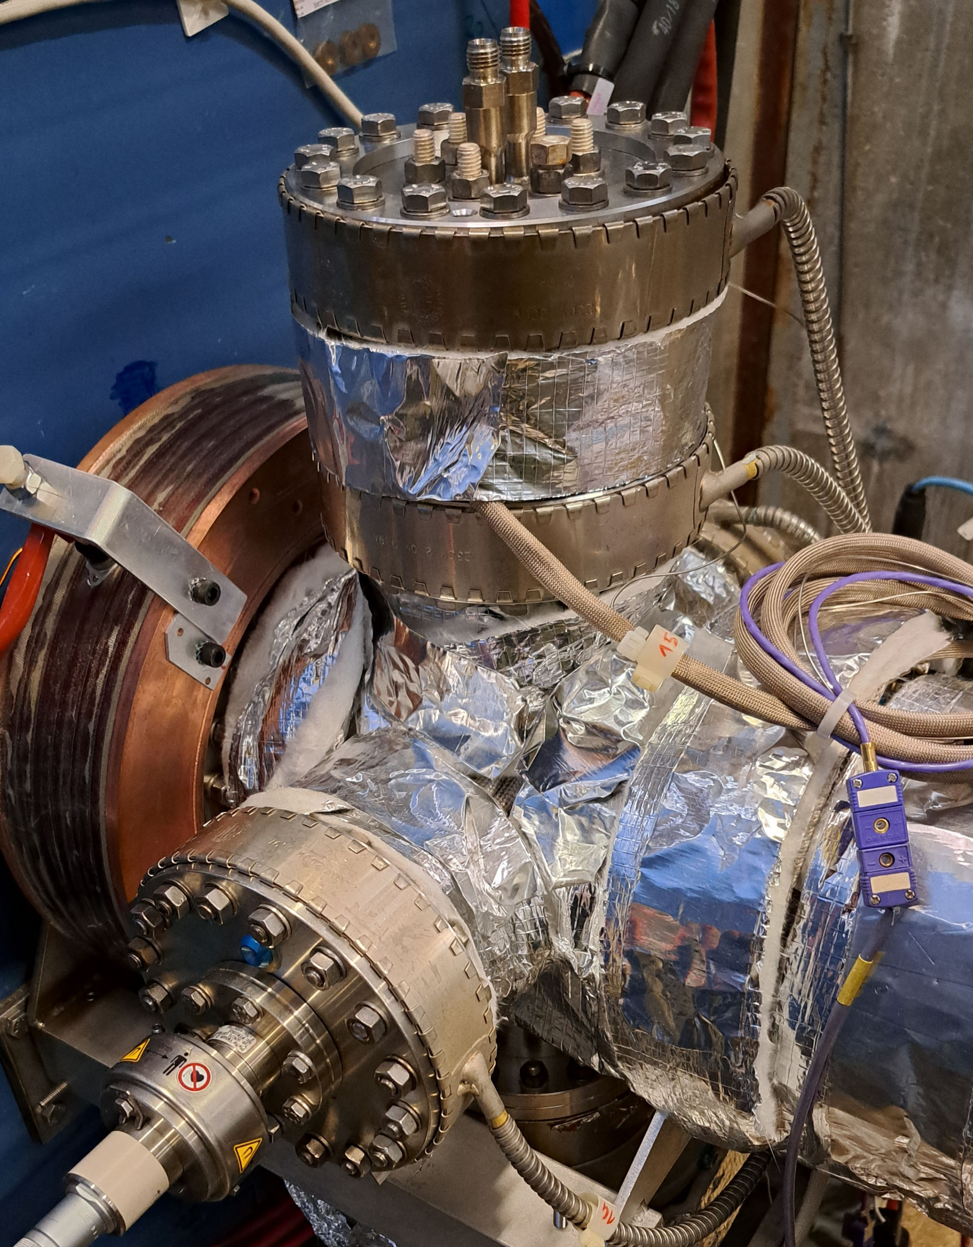
New electron collector design
Reduce ID of the entrance diaphragm
Aim to reduce elastically reflected electrons from the collector region
Magnet coil at the entrance into EC to control the electron beam diameter.
New magnetic shield
Installed at TwinEBIS
Testing foreseen summer/autumn 2024
Courtesy of A. Pikin

Slide 7
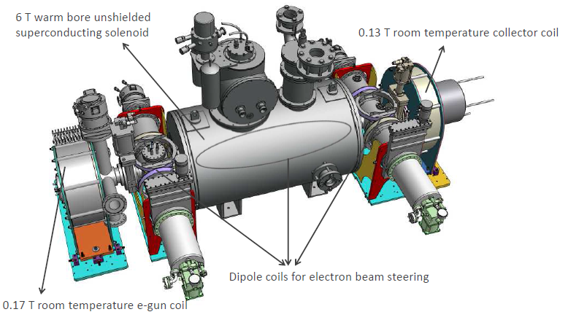
5 T EBIS upgrade – RT version
Use proven concept like CARIBU at ANL, US
(originally based on RHIC concept, BNL)
Though, with different gun as a copy of CARIBU has only a similar current density as REXEBIS
  Controllable current density
  Maximum possible electron current density providing a stable electron-ion system in the ion trap
  Current at least 1.0 A, ability to go to 2.0 A for boosting efficiency of trapping and confining ions in the trap
  Backup solution: present non-adiabatic electron gun, operated at 500 mA instead of present 200-300 mA
No details ironed out
Notes:
Brillouin electron gun at TwinEBIS (MEDeGUN) not performing as predicted

Slide 8
5 T EBIS upgrade – RT version
Benefits | Risks and Drawbacks
+ Address aging solenoid issue + Eliminate need for a technician performing coolant filling + Faster breeding -> higher repetition rate + Consistent better breeding efficiency + Option with very fast extraction | - Delayed magnet delivery; magnet teething problems - Maintenance of cryo-cooler - Stray magnetic fields from a stronger EBIS magnet – what is the effect on beam transport and is shielding technically possible? - Available space at the REXEBIS platform very limited - Degraded vacuum due to higher electron beam current, power deposition and 10 kV on drift tubes - Electron beam problems Electron reflection from collector region Instabilities - Longer activation time for dispenser cathode in case of vacuum venting - Design is heavily relying on VISC Alexander Pikin
Hardware cost (kCHF) | Manpower (FTE) | Timeline
~1.5 MCHF (solenoid >30% of the total cost) | 14 | Estimated project time >5 years
Motivates/requires complete off-line test before installation
FW estimate

Slide 9
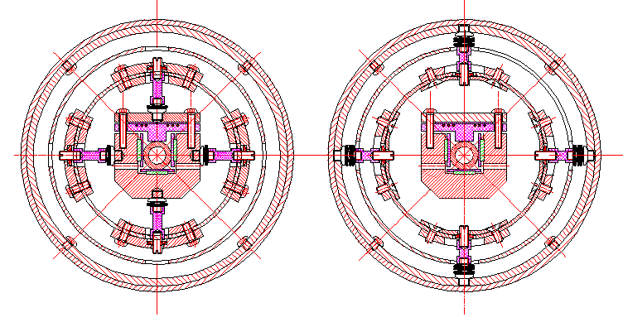
5 T EBIS upgrade – cryogenic version
Focus on vacuum
=> less residual gas contamination
=> better breeding performance
=> make use of A. Pikin’s exceptional experience
vacuum tube
drift tube
77 K
floating shield
10 K
RT
Cold drift tube structure
“Easy” and fast getting ultra high vacuum in EBIS
Courtesy A. Pikin
Transverse cross-sections of the cold drift structure

Slide 10
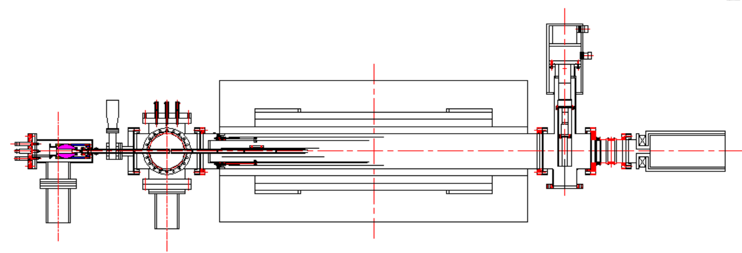
5 T EBIS upgrade – cryogenic version
cryo-cooler
2 A adjustable gun
collector
Courtesy A. Pikin
cryogenic structure
* 5 T unshielded solenoid with cryocooler (identical to RT concept)
* 2 A controllable current density gun (identical to RT concept)
* Warm bore, large ID=205 mm for vacuum and HV leads
* Includes independent cold drift tube structure
* Cryocoolers (Sumimoto) => no weekly coolant refillings
* Automatically contains built-in vacuum separation
Physical envelope – fit onto the platform?
New untested concept!
How can one manage without gun coil?
Also the collector coil much smaller than at CARIBU
HV break + bellow +water cooling of collector at ground
Steerer coils at the gun cross for compensation of magnetic / stray field
4 K doesn’t improve our vacuum situation, go for ~10 K at 2nd stage
HV break + bellow +water cooling of collector at ground
Higher stabilizing magnetic flux (than Brillouin)
More laminar electron beam with the same current density, easier beam dissipation in electron collector (than Brillouin)
Proposed cold structure of drift tubes can utilize a Sumimoto cryocooler with parameters:
T2= 12-15K, P1=4-5W
T1=70-80K, P1=14W
Compressor: Air-cooled, P=2.6 kW

Slide 11
Summary
Low-intensive, incremental improvements on-going
Design of a cryogenic “paradigm-shift” device being pursued
An upgrade requires major resources in terms of money and manpower and a critical mass
Off-line testing is necessary, so a 5-year’s time-line is minimum

Slide 12
Backup slides

Slide 13
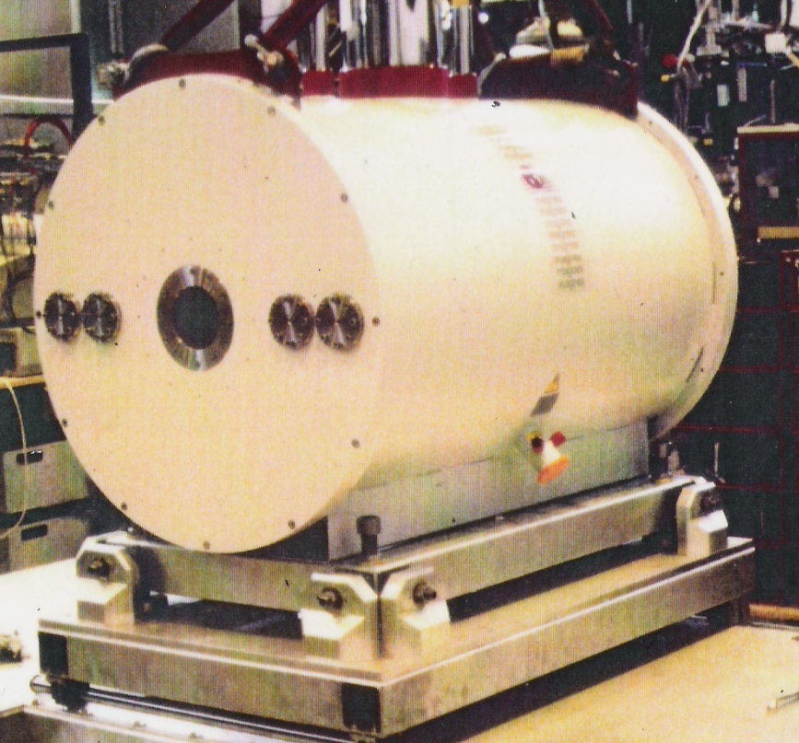
REXTRAP concerns
1. REXTRAP solenoid – consolidation request pending
  * 26 years old, no spare
  * limited knowledge about de- and re-energization
2. REXTRAP efficiency
  * < 50%, losses at the injection side
  * poor efficiency for light elements (A<10)
3. REXTRAP operation
  * difficult to set up, numerous elements and parameters
4. REXTRAP reliability
  * increasing problems with internal discharges / beam disturbance
  * until now mitigated by lowering critical voltages
  * not identified the exact reasons despite several dedicated MDs and internal inspections
Complete renovation during LS3?
Exchange for an RFQ cooler-buncher

Slide 14
First phase of a 5 T system
Deliverables
* Electron beam and ion beam simulations
* Engineering simulations (vacuum, heat, magnetic fields)
* Production of the electron gun
* Tests of electron gun at TwinEBIS
* Detailed design of complete system (stage before production drawings)
* Design specification of external parts
=> prepared for launching production and procurement of external parts
Cost (kCHF) | Manpower (FTE) | Involved groups | Time span | Benefits Risks and Drawbacks (compared to Full 5 T EBIS upgrade) | Risks and Drawbacks
<200 | ~4.5 | BE-ABP, TE-VSC, EN-MME, TE-MSC, TE-CRG, SY-BI, SY-STI | 2 years (After finished first phase, expect 4.5 years until operational system) | + Assure fully successful and optimal design concept before committing + Reduced initial peak workload | - Later final implementation - Postpones addressing old REX and TwinEBIS solenoids

Slide 15
5 T EBIS upgrade – RT version
1. Preparatory studies | 2. Hardware procurement and preparation | 3. Installation an tests
Principal investigator / project management Electron and ion beam simulation electron gun design (laminarity, compression) electron collector design (e- reflection, energy deposition ion injection acceptance / phase space matching / trapping ion extraction simulation error studies beam optics for 1+ ion injection branch at test bench Theoretical studies instabilities ion breeding performance Concept studies and engineering simulations evaluate and decide on design concepts vacuum simulations heat dissipation gun and collector stray magnetic field for turbo pumps | Magnet specification and follow-up of production process acceptance testing incl. field measurement Mechanical design and production of manufacturing drawings Integration Design and production of HV gas feed breaks Installation cooling water and compressed air Ordering, medication and installation of larger motor-generator Installation of vacuum system, incl. controls Installation of PSU, incl. low-level controls Gas injection Ordering and installation HV platform + racks HV cage modification Timing, Controls, Function generation Beam diagnostics (incl. test bench) | Assembly Controls applications Preparation of test bench ion extraction line separator magnet external 1+ ion source beam diagnostics (emittance meter and TOF) Commissioning tests at test bench gun collector electron beam transmission tests as function of current and B-fields characterisation of gas injected ions ion injection tests and characterisation of the breeding performance Final installation and commissioning
Tasks
Hardware cost (kCHF) | Manpower (FTE) | Involved groups | Timeline
~1.5 MCHF (solenoid >30% of the total cost) | 14 | BE-ABP, TE-VSC, EN-MME, TE-MSC, EN-ACE, TE-CRG, SY-EPC, EP-DT, BE-CSS, BE-CEM, SY-BI, BE-OP, SY-STI, BE-GM | Estimated project time >5 years
NB! Once operational, a spare solenoid would be needed
Tentative group assignment and estimations by FW

Slide 16
Goals
Present Limits / Problems
Machine modifications
A. Higher ion charge
=> reach higher beam energy
=> of use in storage ring?
Increased e-beam losses >200 mA
due to back-scattered electrons in the collector?
(in order of complexity ↓)
REXTRAP requires 20 ms cooling time
in principle not a problem as long as REX linac in place
Increase injection aperture at REXTRAP
C+, 2 weeks, YETS2023
B. Shorter breeding time
=> reach shorter t_{1/2}
=> higher repetition rate
(less instantaneous extracted peak current)
Optimal efficiency at around electron beam 200 mA
not finding the right settings
or aperture focusing limitation
BJUT cathode
B+ D- I-, 2 months, YETS2023?
C. Higher efficiency
=> shorter data taking time
=> reach more exotic isotopes /reactions
2 T limits the magnetic beam compression
limits the charge breeding time
Ion pumps at REXEBIS
D+ I+, LS3
D. Less residual contaminants
=> increase number of available isotopes
Poor ion result with Brillouin compression
would have provided very fast breeding
Upgraded electron collector
B+ C? D? I?, 1 year, LS3
E. Higher beam intensities
=> not sure there’s a need?
Limited range of electron beam energy
practically limited to ~8 keV
varying the energy affects the injection/extraction conditions
alas, can’t reach very higher charge states
Adjustable 2 A gun
A? B+ C+ D? H-, 2 years, LS3
F. Slower ion extraction
=> lower instantaneous beam rate
G. Faster ion extraction
=> of interest for ISS?
REXTRAP efficiency very poor for light ions
believed that the injection and trapping is poor
RFQ cooler-buncher
C+ E+ H+ I?, >3 years
H. Easier maintenance
=> allow long-lived high intensity beams
Multi-Reflection TOF
D+ H- I-, >3 years, requires RFQ-CB
Limited RF pulse length in REX linac
pulses >1.5 ms from EBIS not transported
I. Reliability
=> allow long-lived high intensity beams
New EBIS
A+ B+ C+ D- H- I?, >5 years
Complex machines +radioactive
difficult to maintain

