Slide 1
Safety at CERN

Slide 2





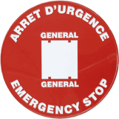


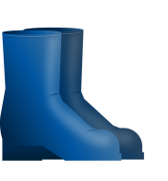

CERN working environment
A safe work place!
SAFETY
SAFETY
!
SAFETY
SAFETY
!
Notes:
Now that you are introduced to the CERN working and living environment you should know that we have made CERN a safe working place. We keep it that way through efficient preventative and protective means already in use. They are being maintained and continuously improved.
However, as there is no such thing as zero risk you may face residual hazards which you should be informed about and prepared for. Therefore, we expect you to actively perpetuate CERN’s safe working environment. How can you contribute to this?
First: consider Safety in every aspect of your work and in discussions with your supervisor and colleagues. Second: follow dedicated and tailored safety training courses, and third: wear the Safety equipment and the personal hazard monitoring devices wherever required.

Slide 3
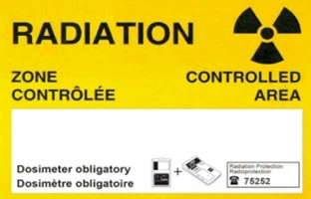
CERN working environment
What will you gain from safety training?
!
!
Notes:
Since we are working with highly complex technologies and processes, it is important to be informed and properly trained. Thanks to the safety training courses you will learn how to recognise and protect yourself from hazards and how to behave.
In the different working environments you may encounter both common and specific hazards. Those lead to risks that should be identified, evaluated and high-lighted if necessary. Depending on your activity, you will learn how to deal with radiological, electrical, cryogenic, magnetic and many other risks. Also, common risks like slipping, tripping or falling as well as handling and commuting risks will be covered. We want you to be aware and to proactively contribute to their avoidance.
Moreover we want you to be prepared to handle unforeseen circumstances in your future work place and working environment.
You will learn everything you need for your own safety and contribute to other’s safety. We want you to get home safely every day.

Slide 4


In case of emergency
Keep calm, keep thinking and act!
EDH
FIRE/FEU
74444
ACCIDENT
+41 22 76 74444
Notes:
When you go on a journey to another country, you would probably prepare yourself. You would find out, where to go and whom to call in case of emergency.
You would write a short list with facts and numbers on it. Here at CERN, in case of emergency, you have to follow a simple rule: Keep calm, keep thinking. Ask for help and call the CERN Fire and rescue service by dialling 74444. Provide them with facts and also watch out for other people who need help.
After the worst is over, report any accidents or near misses to your supervisor and fill out the electronic incident reporting form: This is an important action to continuously improve Safety. By learning from the gained experience we can avoid having the same accident twice.

Slide 5
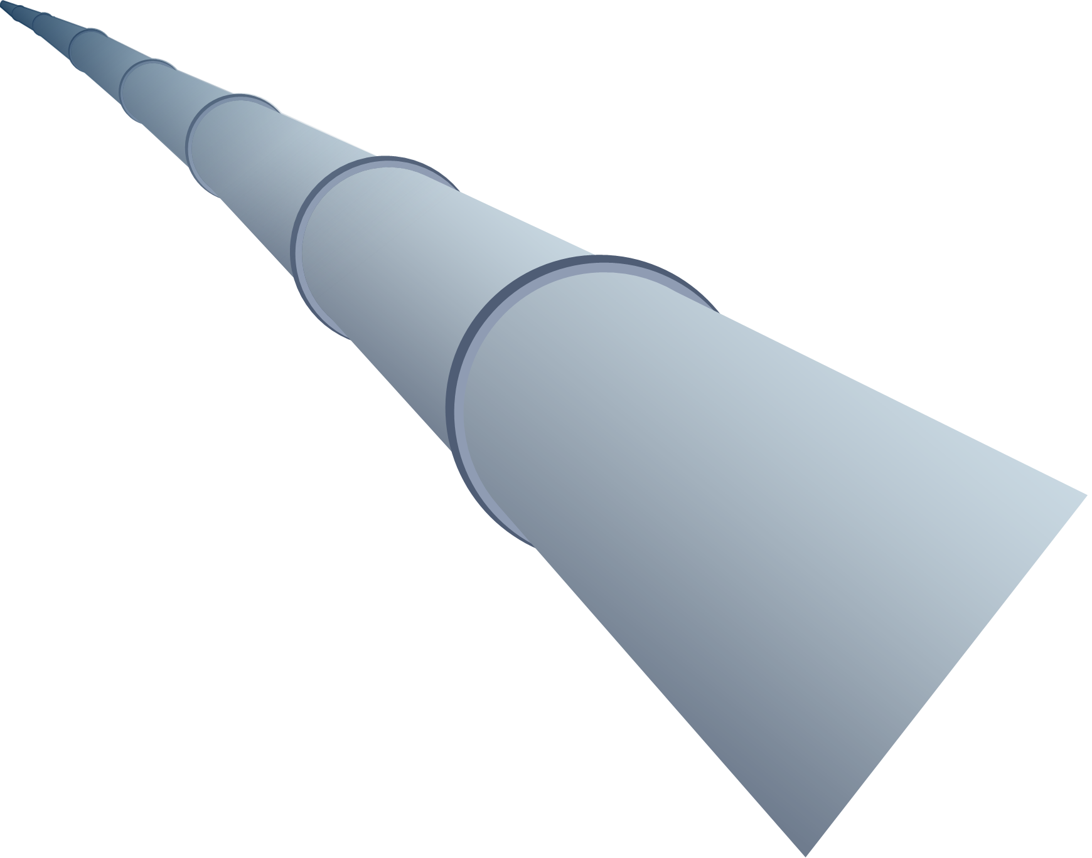
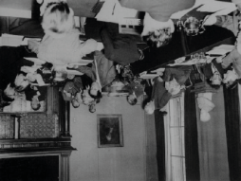
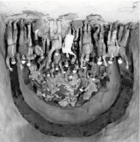
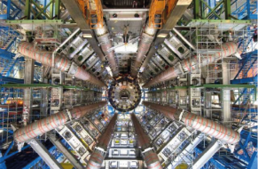
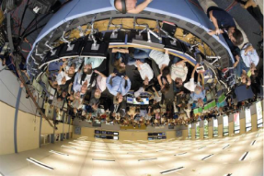
Be exemplary
Respect Safety signs and Safety instructions!
?
1952
1974
2006
2008
!
Notes:
Even if you already know many things, you should continue to pay attention to safety signs and safety instructions which may change. Although you learned a lot about CERN, you might not understand the reason behind each panel and instruction right away. Bear in mind that rules, instructions and procedures to be respected have evolved with the culture and the heritage.
Even if you think there is no reason for something, there certainly is one! The violation of Safety rules, instructions and procedures has consequences: don`t get careless and do pay attention to avoid accidents.

Slide 6
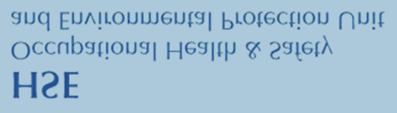

Helpful attachments
Your guidebook in the foreign country
SAFETY EXPERTS
AND SERVICES
CONTACTS
Supervisor
Colleagues
Safety Officers
Fire and rescue service
Medical service
HSE
SAFETY EXPERTS
AND SERVICES
www.espace.cern.ch/hse-unit
Notes:
When you arrive in a foreign country, you may feel lonely. But you will find out there are lots of people to help you.
It`s the same at CERN. Always remember that you're not on your own. CERN will support you with all available means. In the list of contacts that can assist you with various questions you will first find your supervisor and your colleagues. Then the different Safety Officers acting in your Department or Collaboration.
Moreover, visit the website of the HSE unit - also called the Safety unit. There you will find a list of its Safety experts and Safety services. It also contains the CERN Safety Rules and the catalogue of mandatory and optional Safety training courses. The CERN Fire and rescue service as well as the CERN Medical service are also your partners with respect to health and safety matters.
Now it`s time to unpack your suitcase and join the CERN community.

