Slide 1
Safety at CERN
Summer Student Induction 2024
HSE-OHS
June 2024

Slide 2

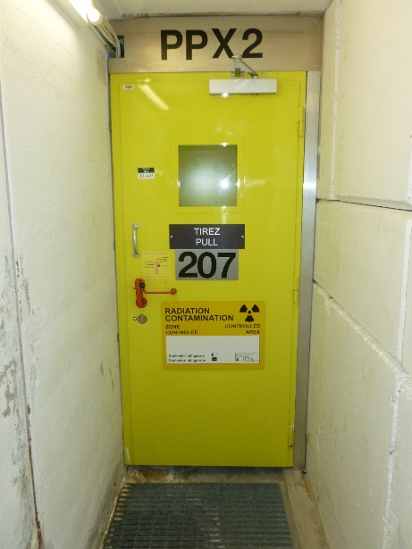
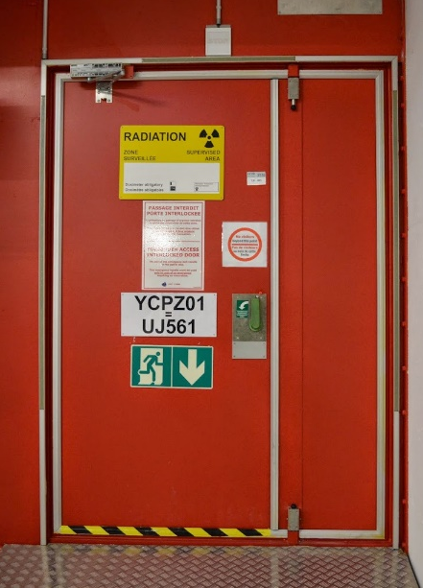

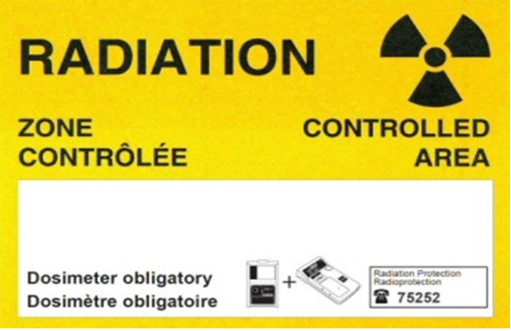
Key messages from the video?
Respect Safety signs and Safety Rules
“Your Safety is our business”
Unjustified access by non-authorized personnel will be subject to investigations, and disciplinary action per CERN Staff Rules and Regulations
Notes:
Respect Safety signs and Safety Rules
Be aware / be prepared to handle unforeseen circumstances
Discuss with Supervisor & colleagues
Think Safe, Work Safe … Be Safe

Slide 3

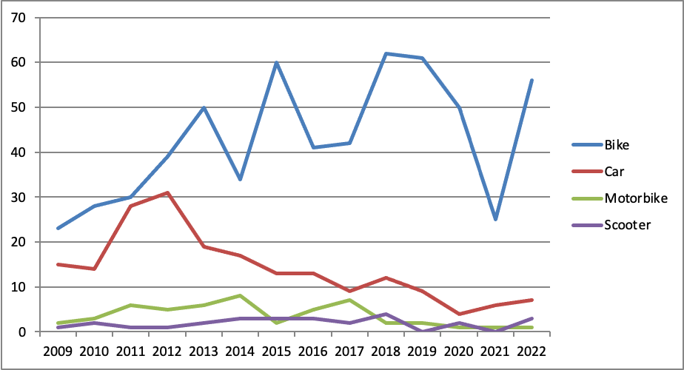

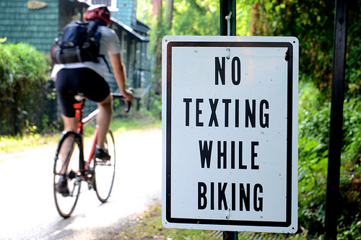
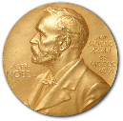
Key messages from the video?
Respect Safety signs and Safety Rules
Be aware / be prepared to handle unforeseen circumstances
Cycling at CERN
‘Bike Riding’ e-learning required
https://lms.cern.ch/
Required equip. on bikes
Important Safety tips
Let’s protect the brain of the future Nobel Prize winner in Physics
Helmet !!
Source: thewashcycle.com
Notes:
What are the main causes of accidents at CERN (trips and falls first, then cycling accidents…)
Respect Safety signs and Safety Rules
Be aware / be prepared to handle unforeseen circumstances
Discuss with Supervisor & colleagues
Think Safe, Work Safe … Be Safe

Slide 4

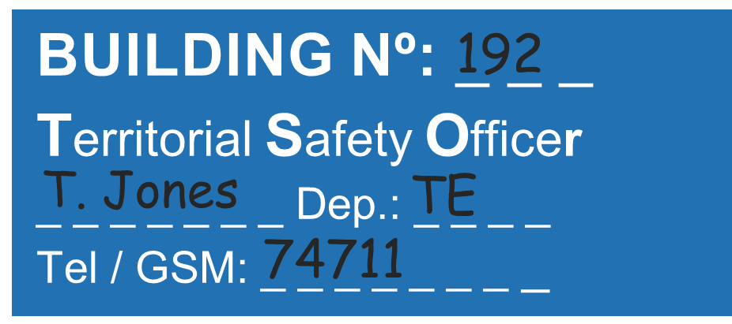






Key messages from the video?
Respect Safety signs and Safety Rules
Be aware / be prepared to handle unforeseen circumstances
Discuss with Supervisor & colleagues
“Safety is a shared responsibility of all of us, not someone else’s job”
F. Gianotti,
CERN Director General
Supervisor
TSO
First Aider
What courses to take…
What access I need…
What PPE I need…
What specific risks are in my Bldg. ?
SOS / Safety Officers Support
Locate the nearest First Aider
Notes:
Respect Safety signs and Safety Rules
Be aware / be prepared to handle unforeseen circumstances
Discuss with Supervisor & colleagues
Think Safe, Work Safe … Be Safe

Slide 5




Key message from the video?
Respect Safety signs and Safety Rules
Be aware / be prepared to handle unforeseen circumstances
Discuss with Supervisor & colleagues
Think Safe,
Work Safe
… Be Safe
s
a
f
e
FIRE/FEU
74444
ACCIDENT
+41 22 76 74444
In case of emergency:
Only for CERN phones (landline / GSM)
Any phone !
Notes:
Respect Safety signs and Safety Rules
Be aware / be prepared to handle unforeseen circumstances
Discuss with Supervisor & colleagues
Think Safe, Work Safe … Be Safe
Messages: use the 50+ FFs, don’t take your health into your own hands – we’re here for you!
Prompt to out mobiles and record the number

Slide 6
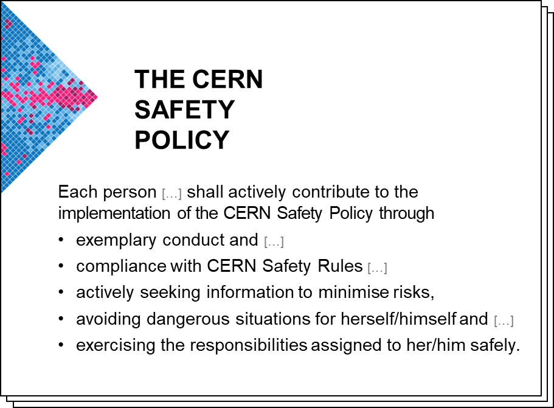
CERN Safety Policy
https://hse.cern/content/safety-policy
https://cern.ch/safety-rules

Slide 7
HSE Unit
Occupational Health & Safety and Environmental Protection Unit

Slide 8
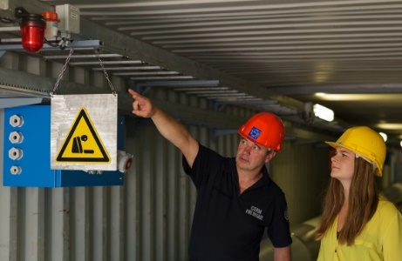
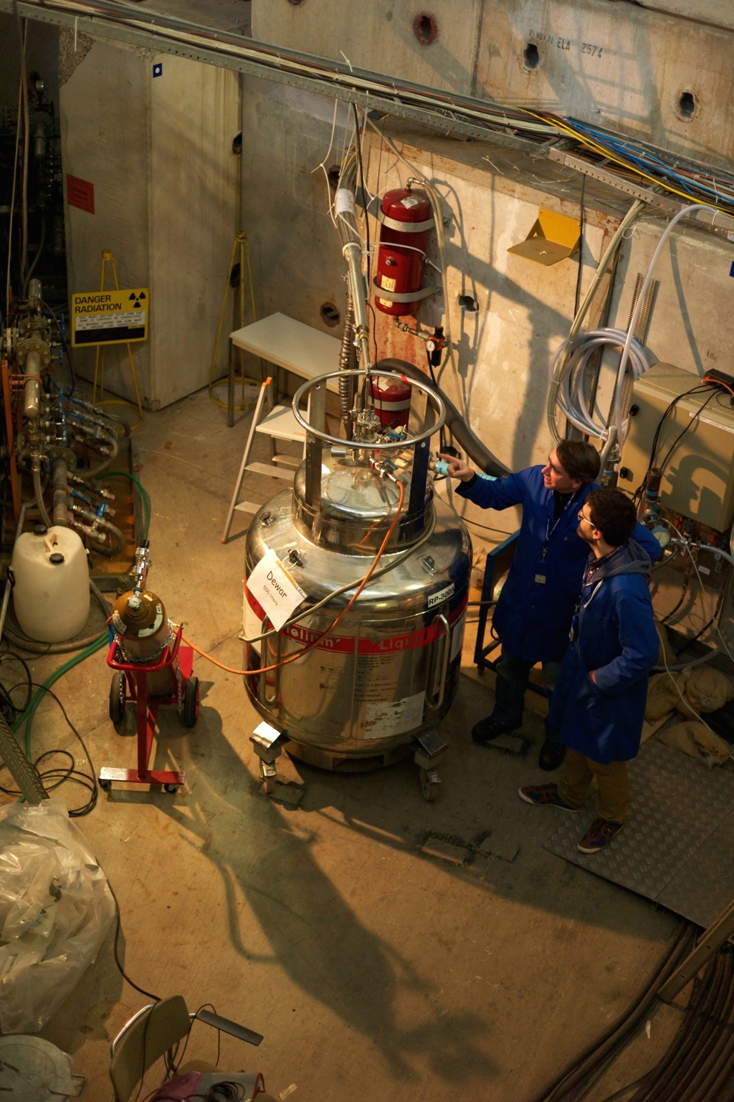
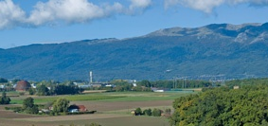

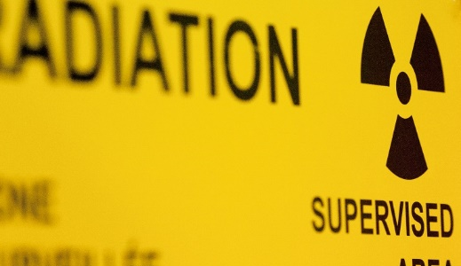

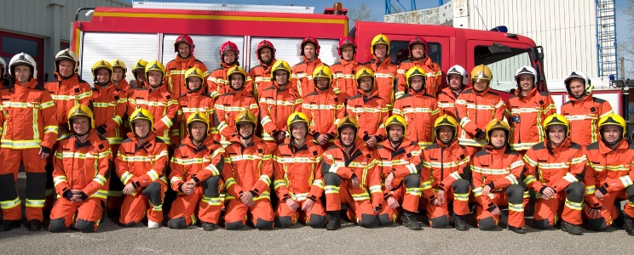

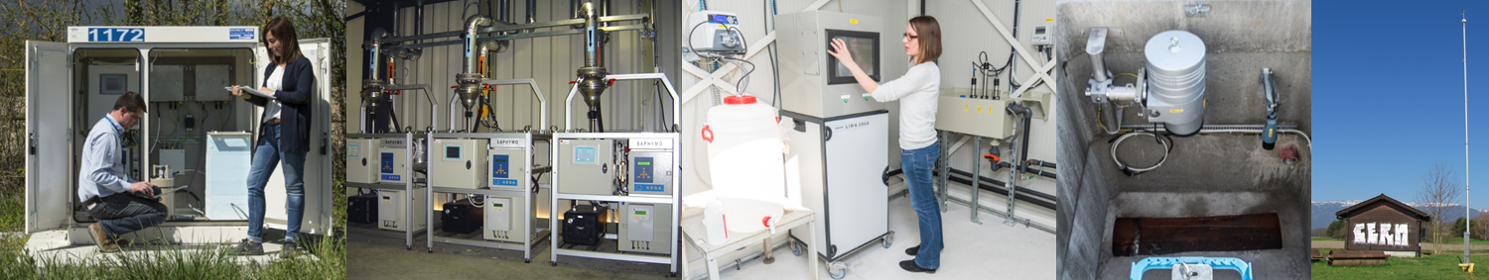
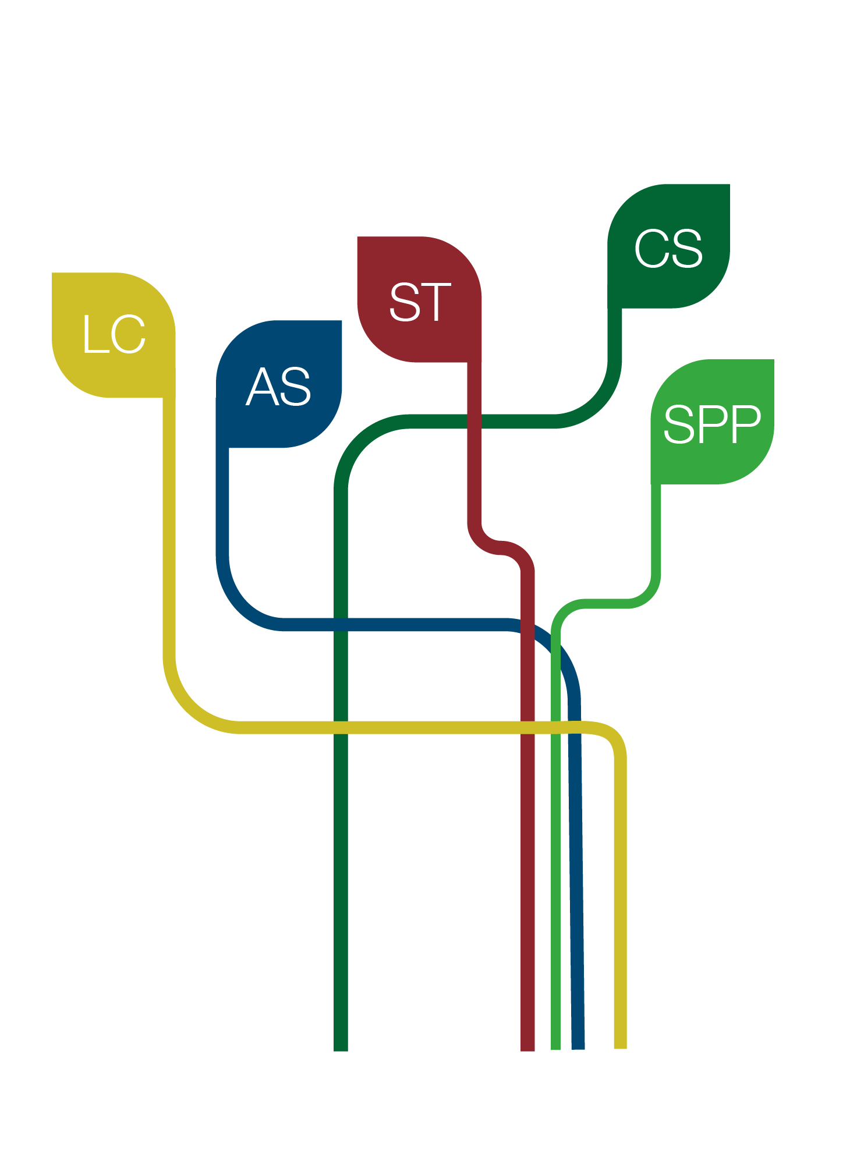

Safety Engineering
Safety Advice
Safety Inspections
Medical Service
Transversal services
Services transversaux
Legal Support & Communication
Administrative services
Safety Training
Computing support
Special projects and services
Occupational
Health & Safety
Santé au travail & Sécurité
Research & Design Studies
Operational Radiation Protection
Personal Dosimetry
Radioactive Waste
Radiation Monitoring
Radiation
Protection
Radioprotection
Ambulance
Prevention
Intervention
Drill
74444
+41 22 767 4444
Fire & Rescue
Service
Service Secours & Feu
Air, Water, Soil
Waste, Energy
Management
Monitoring & Reporting
Awareness
Environmental
Protection
Protection
environnementale
Notes:
4 groups
a. Occupational Health & Safety
cover all aspects re Occupational Health & Safety and Environmental Protection.
Medical service – mention the next talk
b. Radiation Protection Group
* ensures that all personnel on the CERN sites and the public are protected from potentially harmful effects of ionizing radiation linked to CERN activities.
c. Fire & Rescue Service
* CERN has its own Fire Brigade.
* 58 professionnals firefighters do
* ensure the safety of all CERN personnel, contractors, visitors and users due to fire and other threats.
* provide emergency ambulance care due to accident or illness.
* act in case of environment incidence
* hold Safety training courses
* in case of emergency (like a fire, work accident, any medical emergencies, pollution) call the Fire Brigade at 7 44 44
hold the line if a machine is answering!
remain calm and wait for instructions from the Fire Brigade.
FB is open 24/24 and able to receive any call in French and English.
d. Environment Protection
F. Gianotti 29.02.2016 : “ … I believe CERN should become a role model for an environmentally-aware scientific research laboratory …”
Energy – You don’t use it? Switch it off!
Waste – Sort it for easier recycling!
Water – Stop wasting it. Sewer systems are not waste bins
Hazardous substances – Pay attention, follow regulations when using and disposing of the substances.
Natural environment – Some green areas are protected (bee, orchids, …) Respect them!
Prevention of environmental accidents – In case of pollution dial 0041 22 76 (74444)!
The HSE Unit – support, monitor and grant Safety clearance
HSE Reports directly to the Director General
HSE Unit
The HSE Unit supports the Organization in the implementation of
* the CERN Safety Policy,
* the CERN Safety Rules,
* the CERN Safety Objectives and
* best practices at all levels.
It is in particular responsible
* for Radiation Protection and
* the establishment of the CERN Safety Rules.
It grants Safety clearance for
* Installations, including special equipment,
* activities,
* projects and
* CERN Experiments with major Safety implications

Slide 9
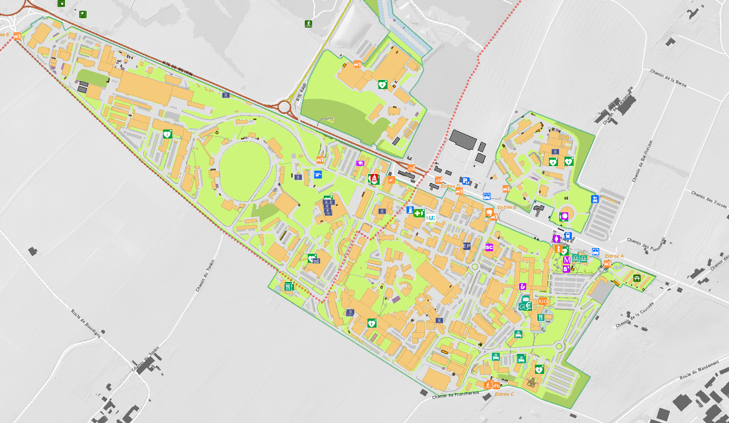
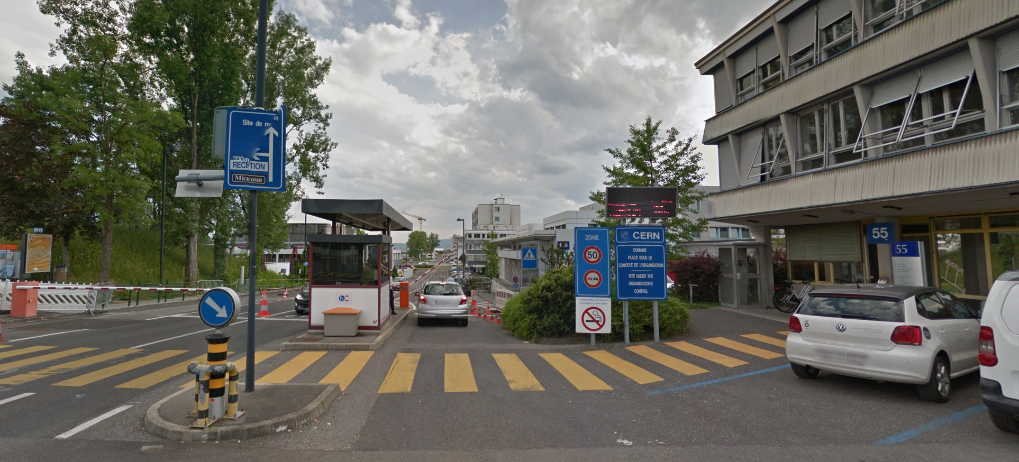

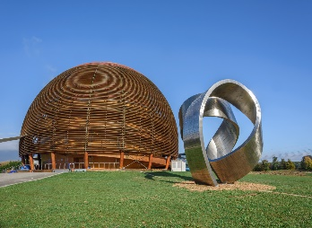
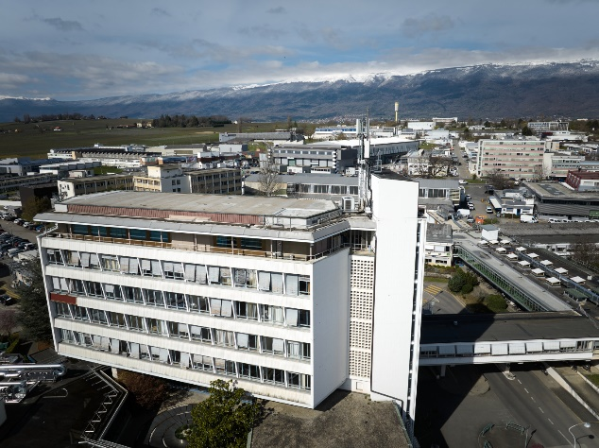
CERN Map
St Genis
Meyrin site
Geneva

Slide 10
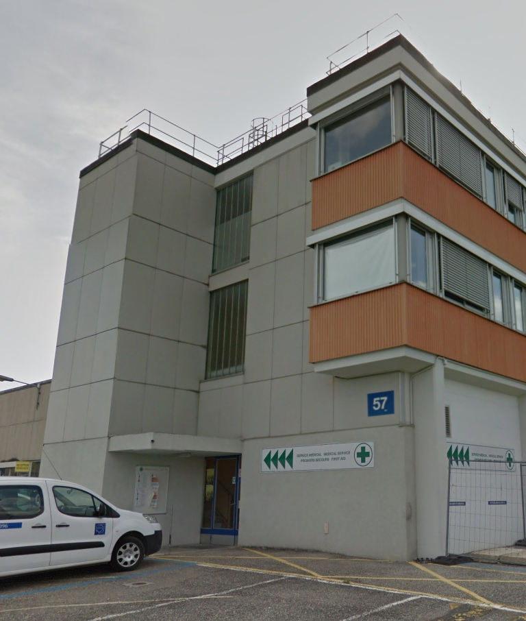

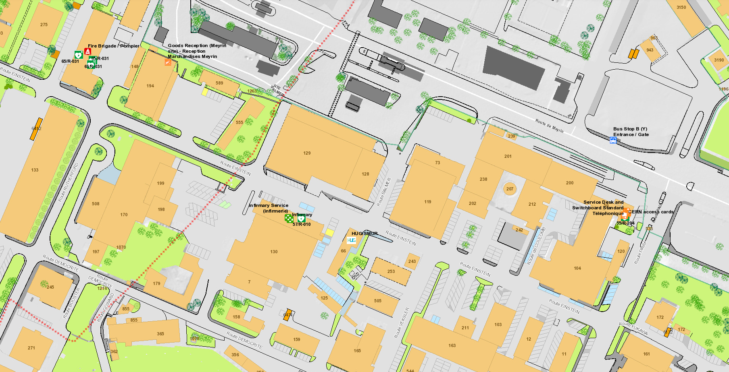

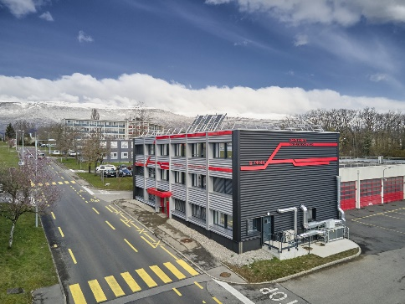

CERN Map
Bldg. 57 – Medical Service
Meyrin site
Entrance B
Route EINSTEIN
FIRE/FEU
74444
ACCIDENT
+41 22 76 74444
Bldg. 65 – CERN Fire and Rescue service
Notes:
From start Einstein to B57 -> 200 m
From B57 to b65 -> 200 m
CERN Map app android iOS

Slide 11
Primary Safety contacts
First Aider
Locate the nearest First Aider
TSO
What specific risks are in my Bldg. ?
SOS / Safety Officers Support
Notes:
Respect Safety signs and Safety Rules
Be aware / be prepared to handle unforeseen circumstances
Discuss with Supervisor & colleagues
Think Safe, Work Safe … Be Safe

Slide 12
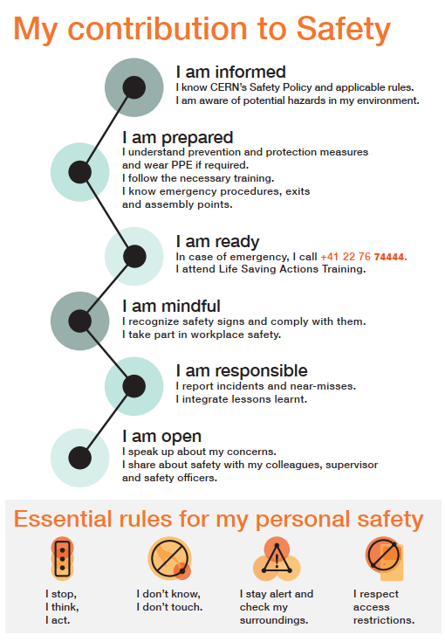
Safety starts with us!
Informed
Prepared
Mindful
Ready
Responsible
Open
Notes:
Respect Safety signs and Safety Rules
Be aware / be prepared to handle unforeseen circumstances
Discuss with Supervisor & colleagues
Think Safe, Work Safe … Be Safe

Slide 13
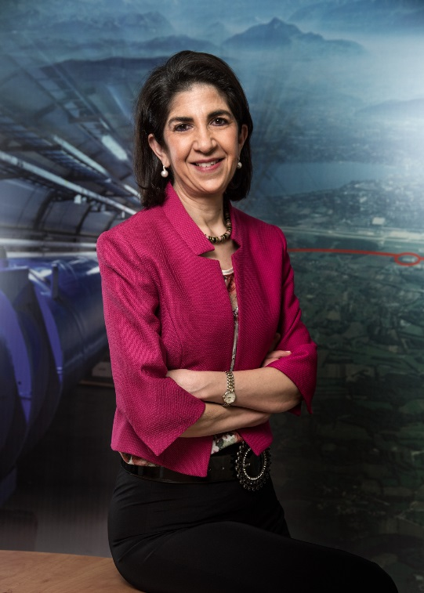
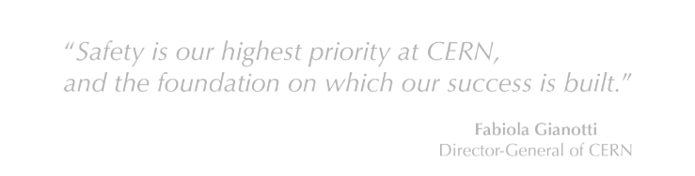
Thank you for your attention
Stay Safe and Enjoy!!
Fabiola Gianotti
CERN Director General

