Slide 1
A safe summer at CERN: looking after your health
Medical service
Summer 2024
EDMS reference

Slide 2
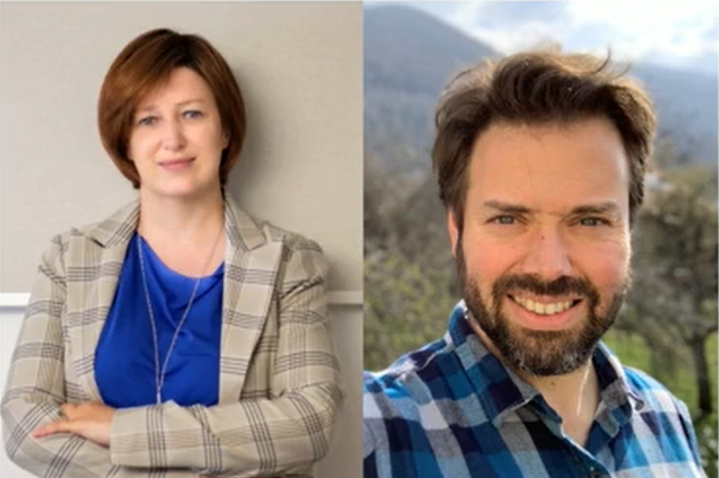
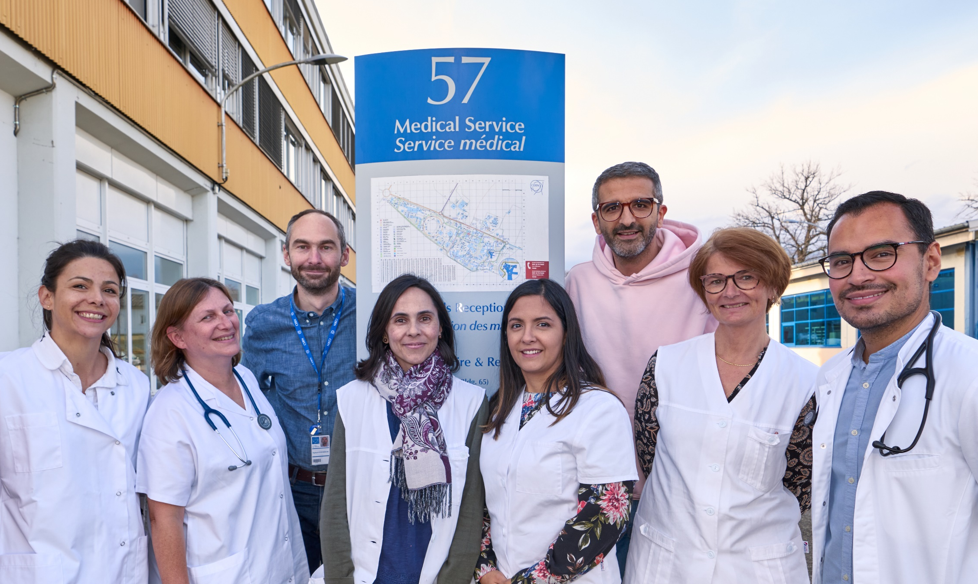
If you need primary care, advice or support
We are here for you!
  Building 57
  Monday – Friday
  8.00 - 12.30 | 13.30 - 17.00
Ground floor
  Infirmary
1st floor
  Psychologists
  Occupational Health Medicine
website

Slide 3
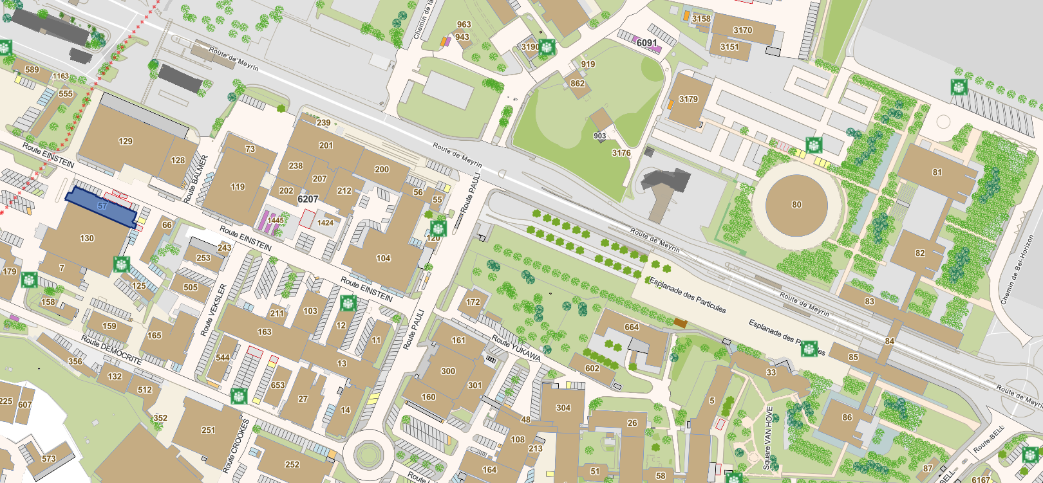
B Entrance / Building 55
The Globe
Science Gateway

Slide 4
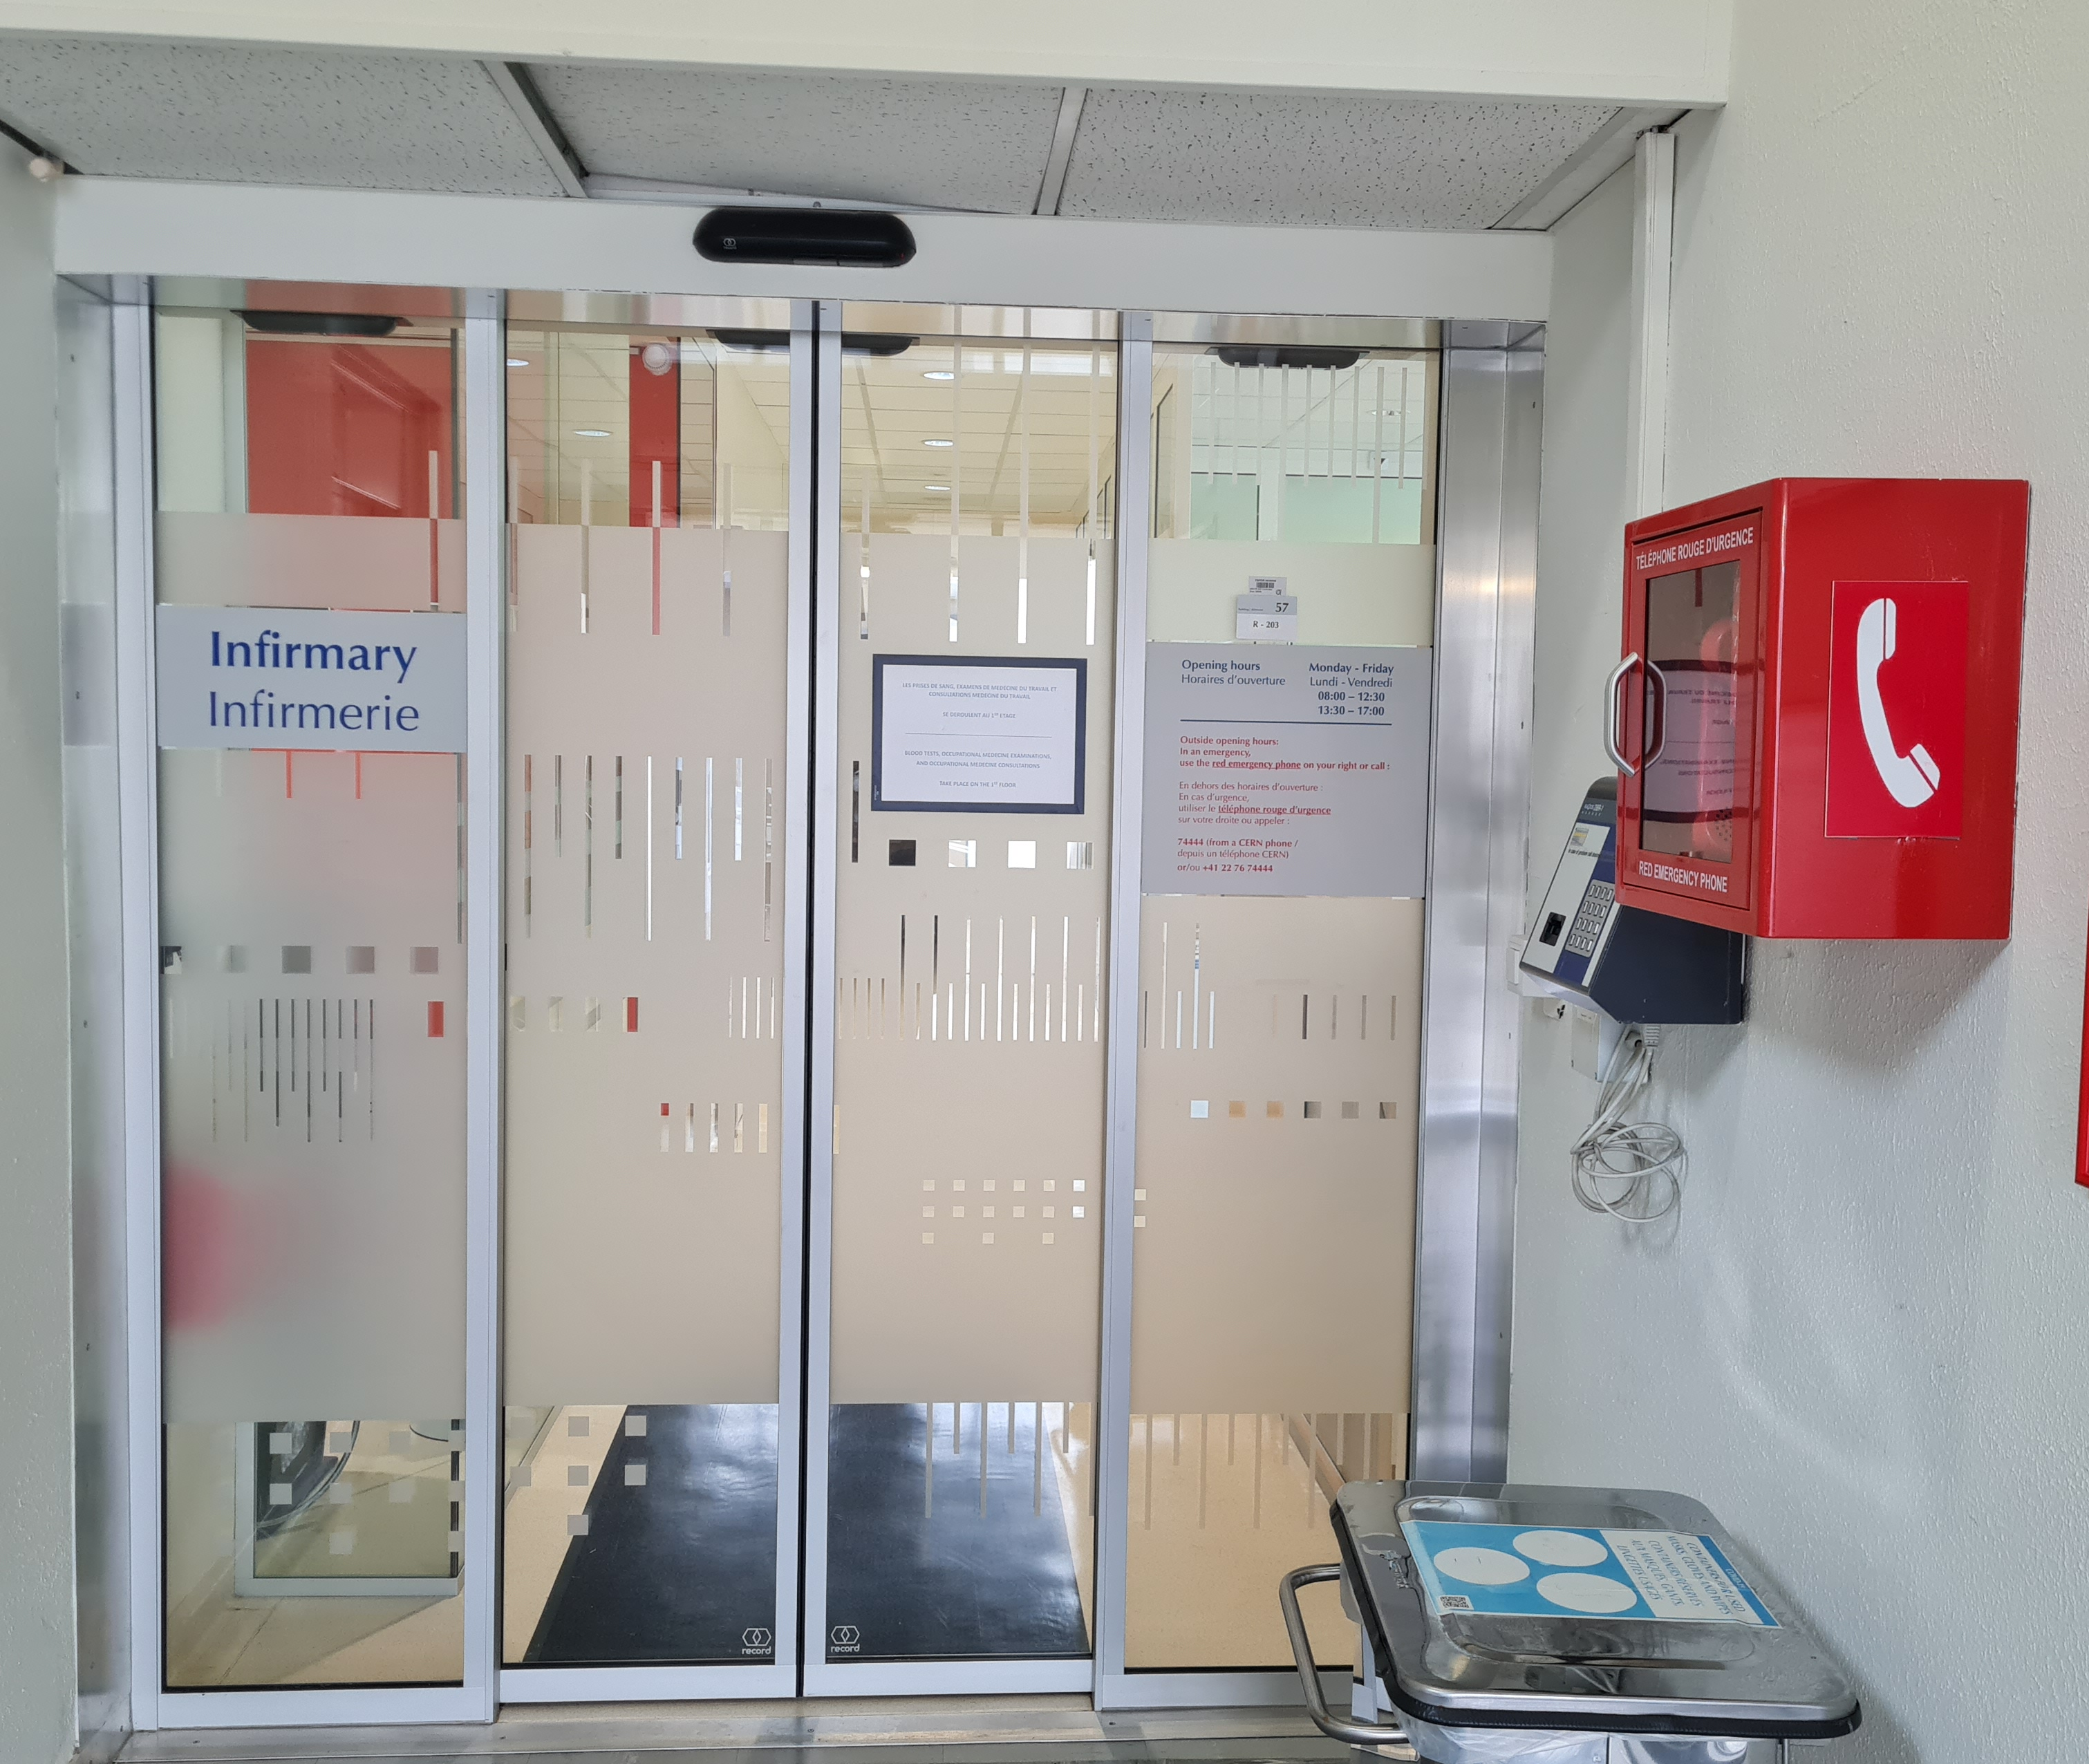
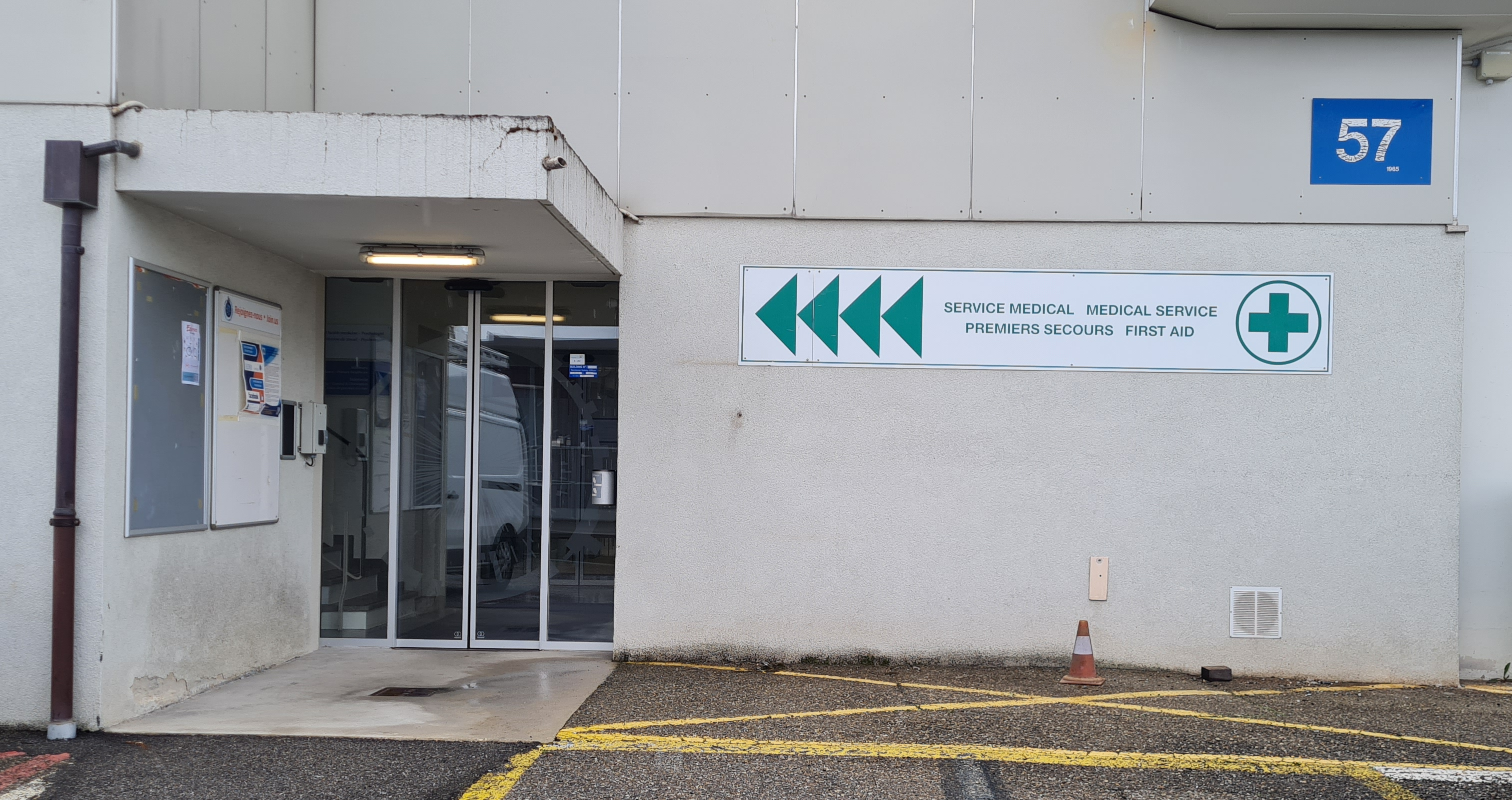

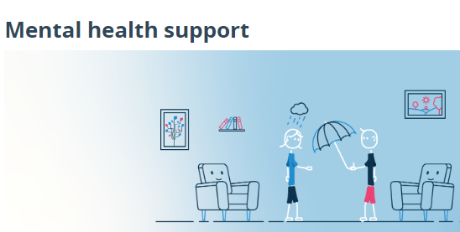
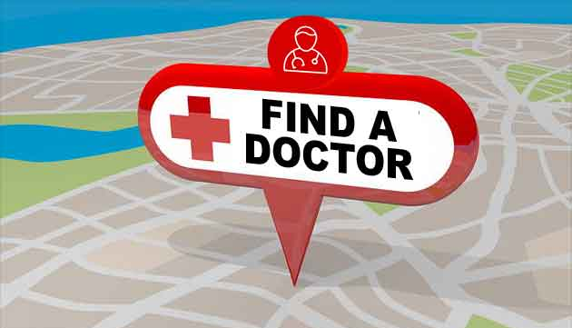

Health Support
In case of emergency at CERN
+41 22 76 74444
Outside CERN call 112 or
In FR call 15
In CH call 144
Find a doctor

Slide 5
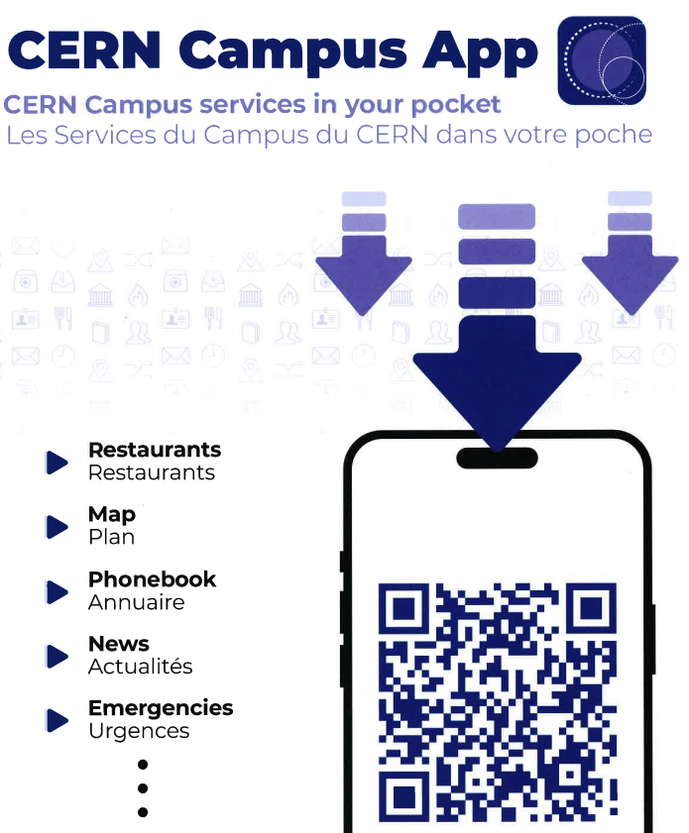



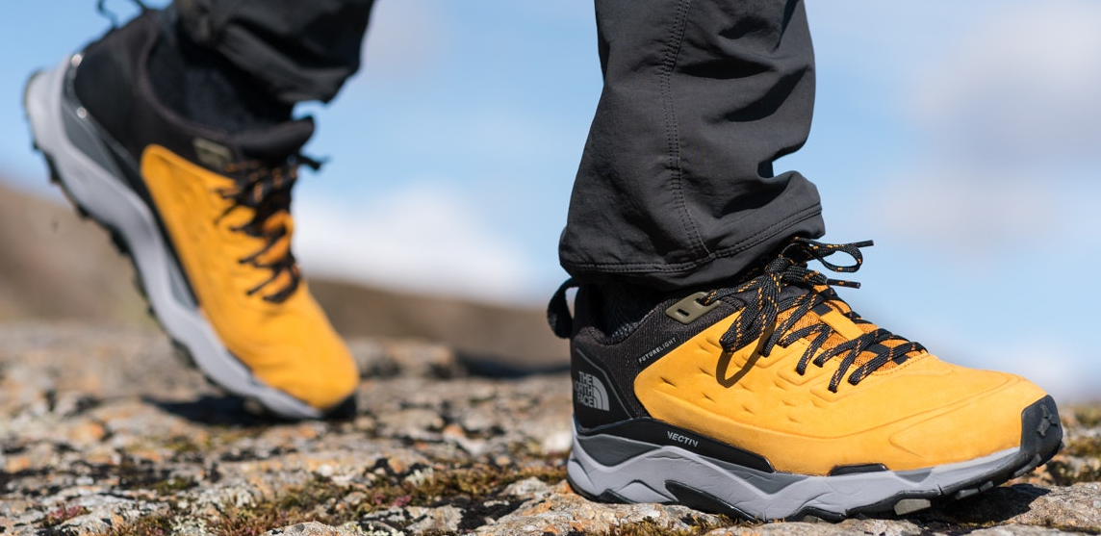


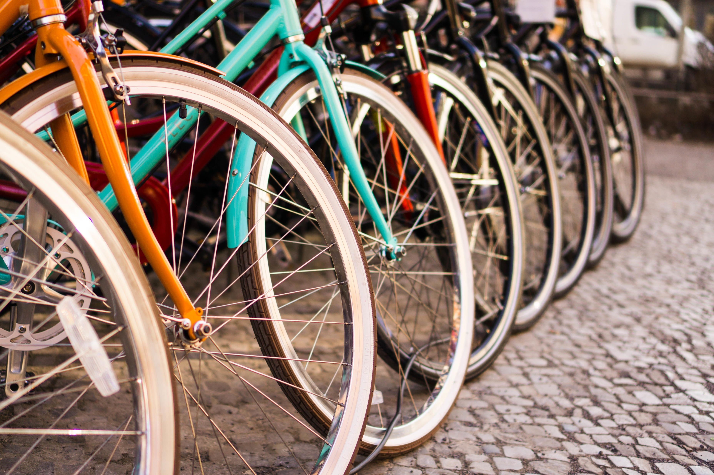
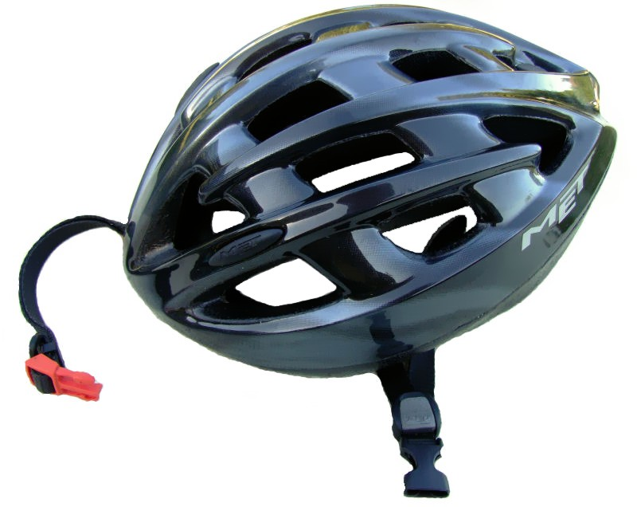
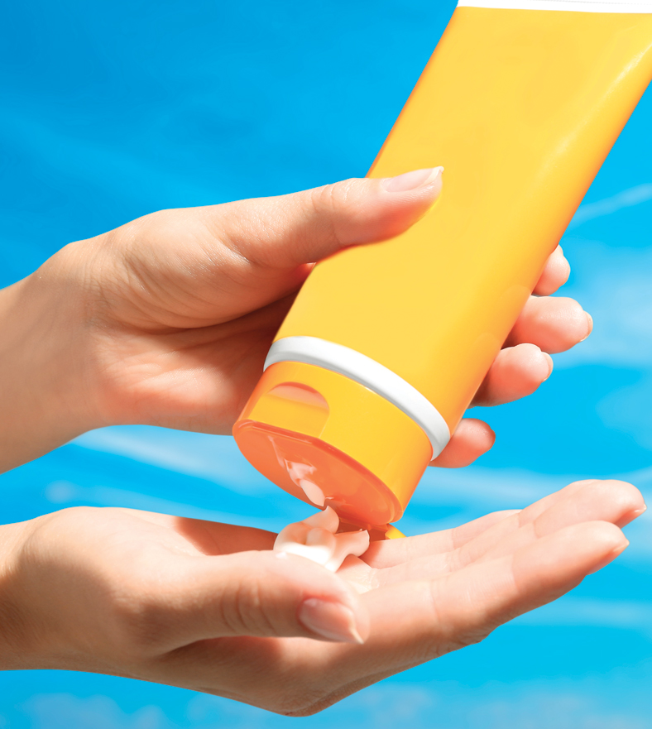
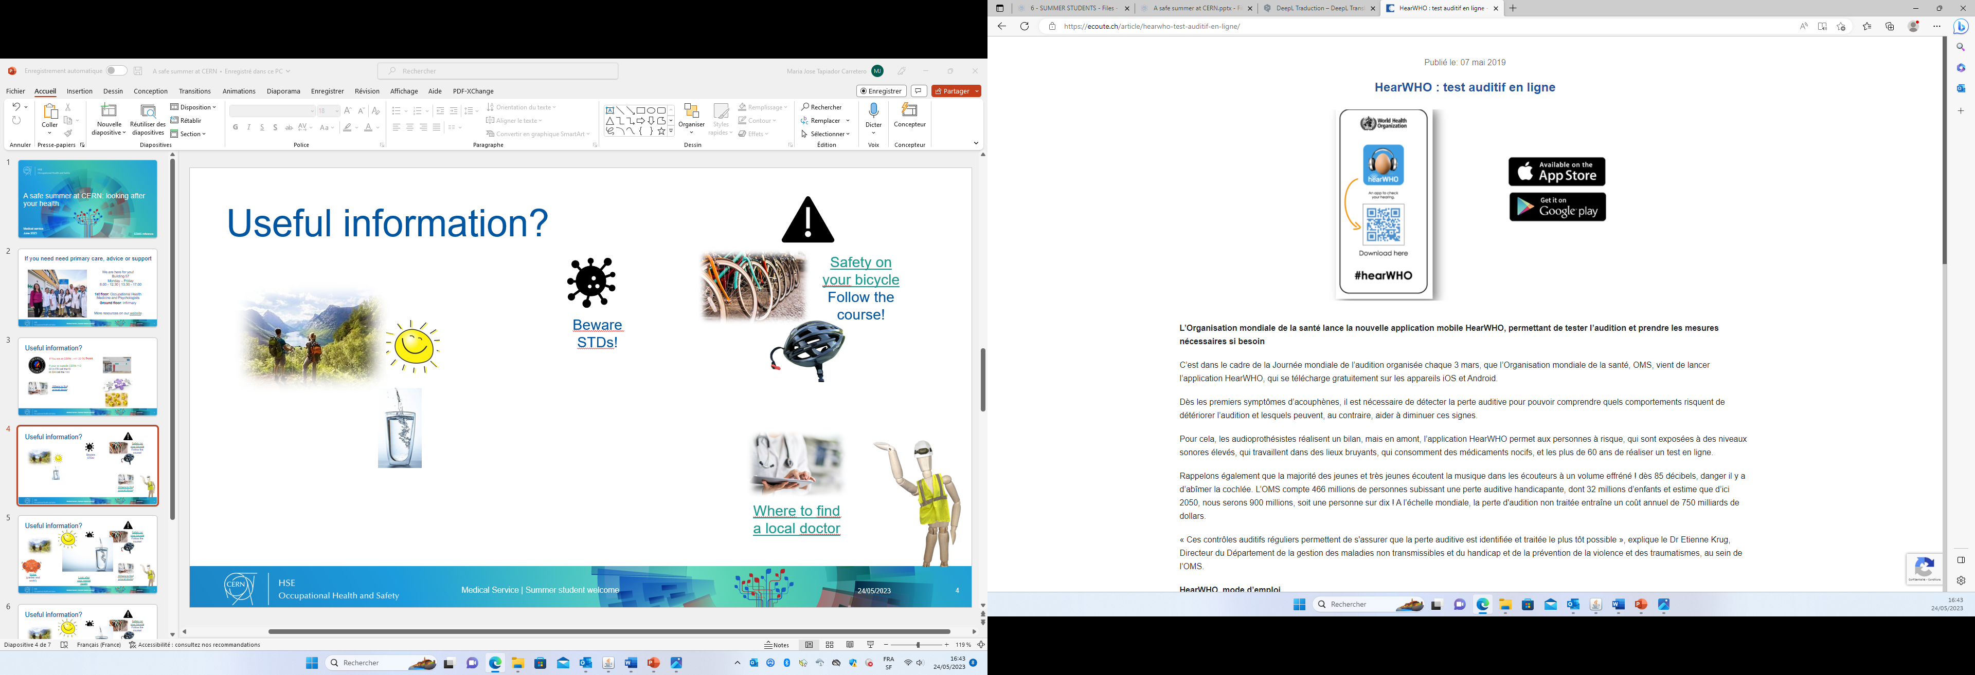


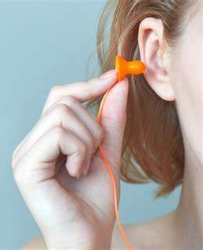
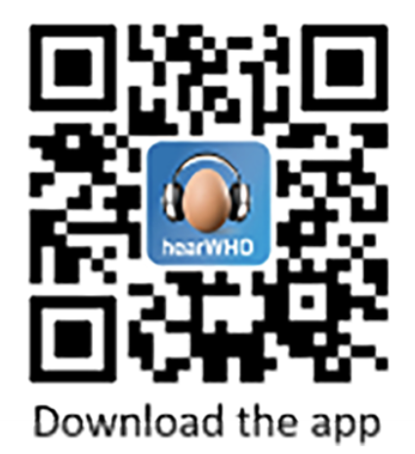

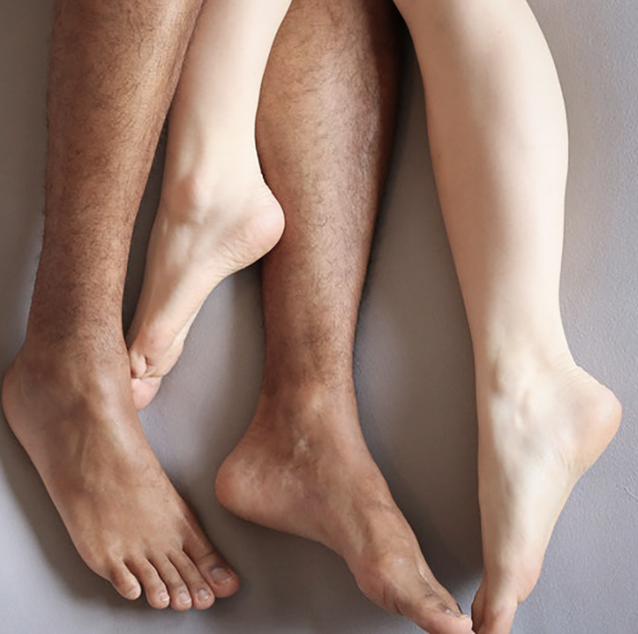
Useful information?

Slide 6
Comming soon…
A meeting with the psychologists :
  Tuesday June 18th at 9 am – building 13/2-005
  Mental health discussion (June 18, 2024) · Indico (cern.ch)
Tuesday July 16th at 2 pm – building 2/R-030
Mental health discussion (July 16, 2024) · Indico (cern.ch)

Slide 7
Have a great, safe time at CERN!

