Slide 1
Data-driven Schematics for Experimental Areas
Anastasiia Moshenska
11 June 2024

Slide 2
Agenda
  Motivation
  Requirements
  Demo
  What’s next?

Slide 3

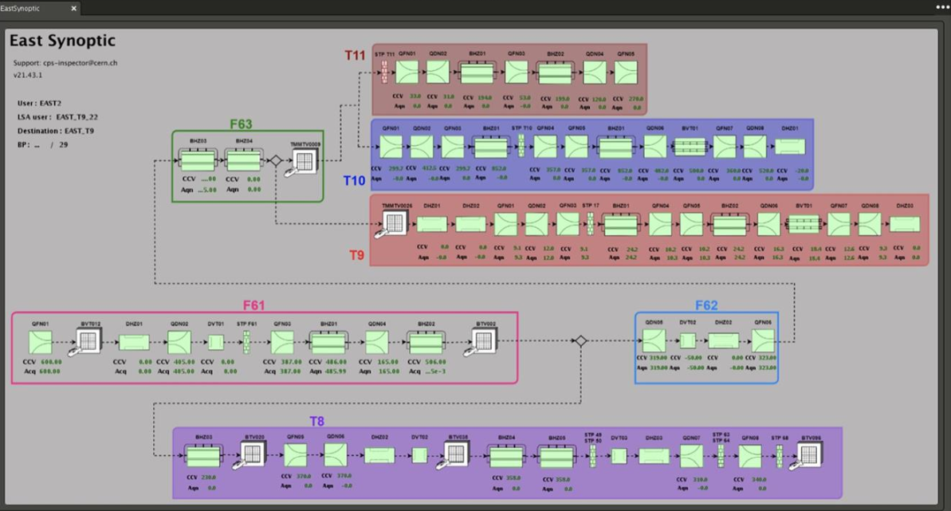

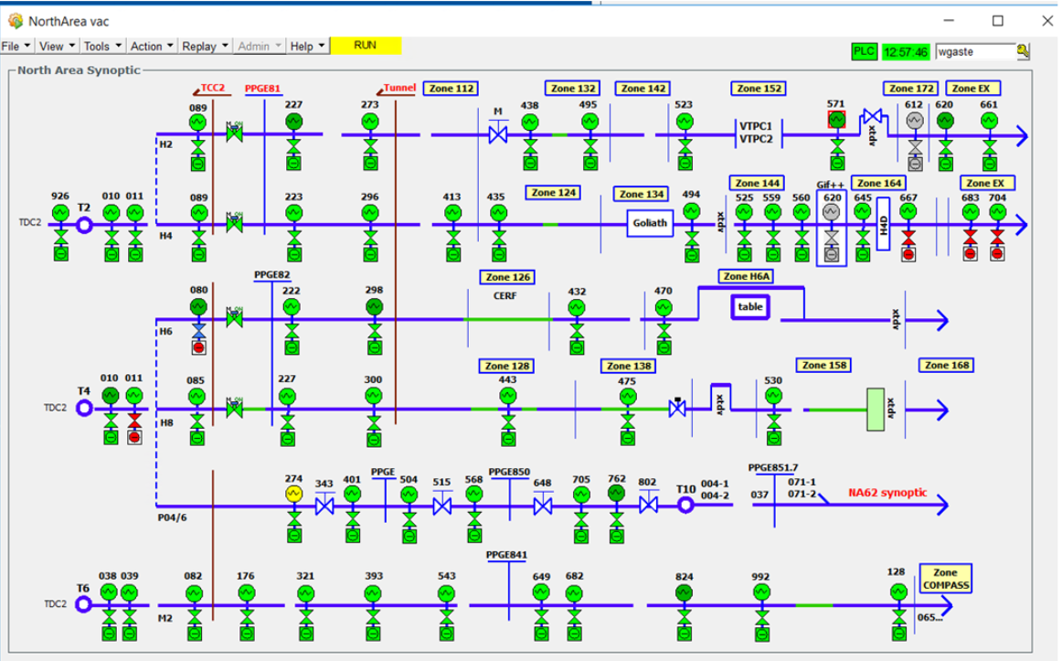

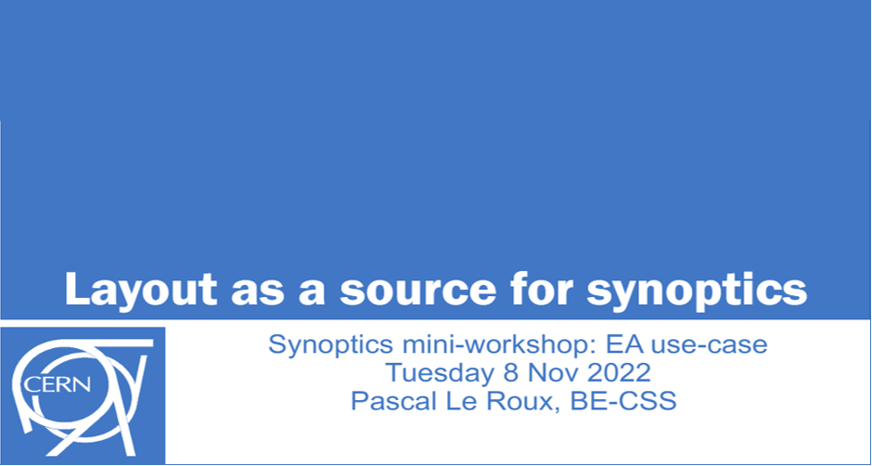
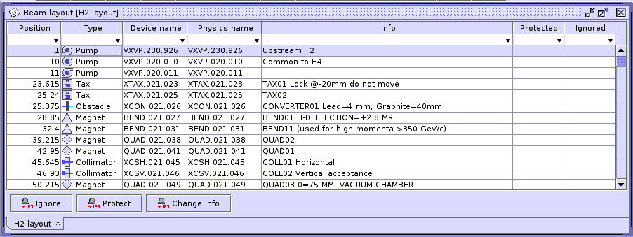
Motivation
This project is part of the NA-CONS WP 6
With growing complexity of CERN systems, manual visualisation is not sustainable
Different solutions, with varying degree of maturity and functionality, are present
Updated manually
Not standardized
No available history
Difficult to maintain

Slide 4
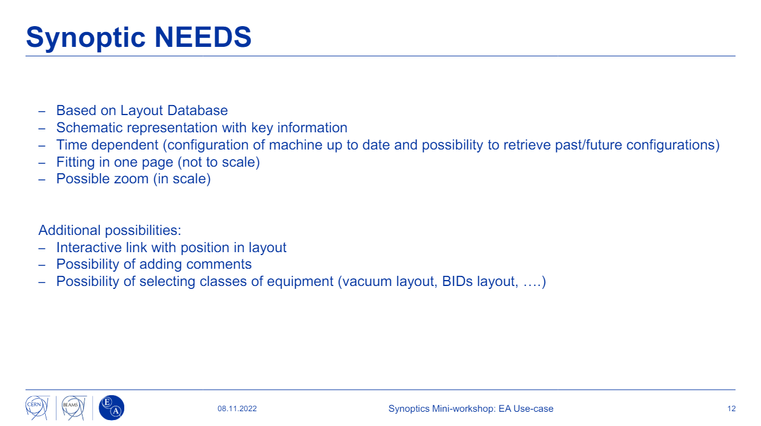

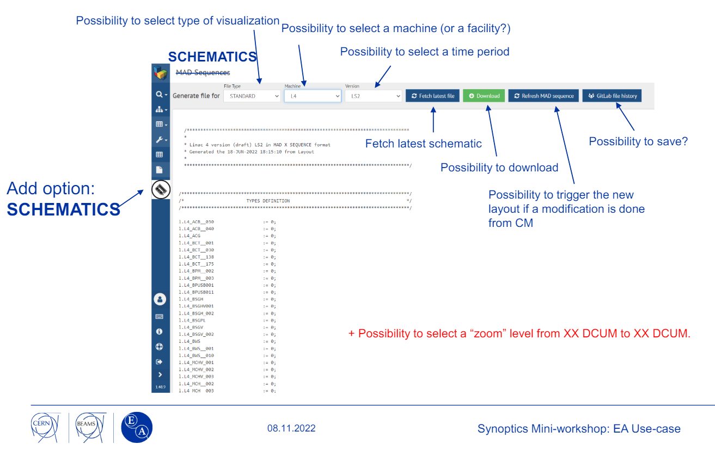
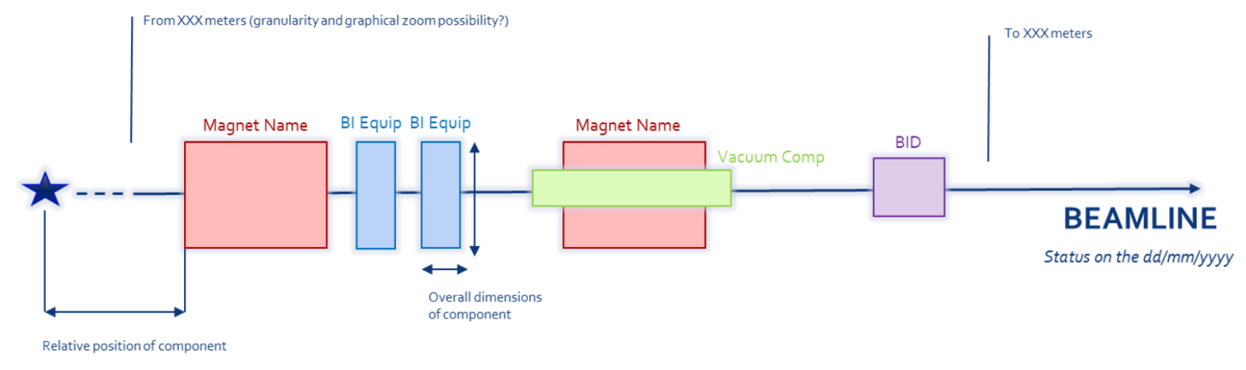

Requirements

Slide 5
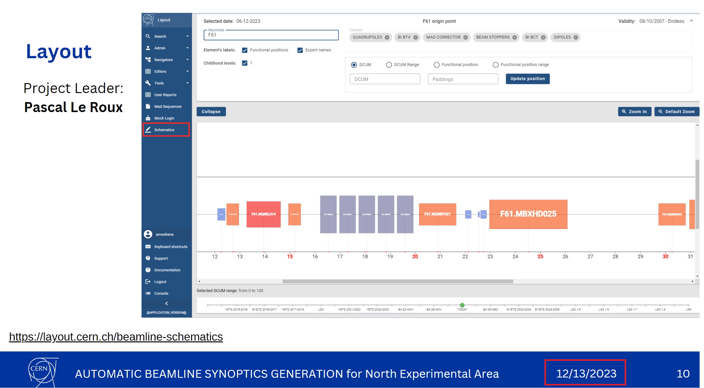
MVP
Delivered in December 2023

Slide 6
Schematics Demo
(Current version)
https://layout.cern.ch/beamline-schematics

Slide 7
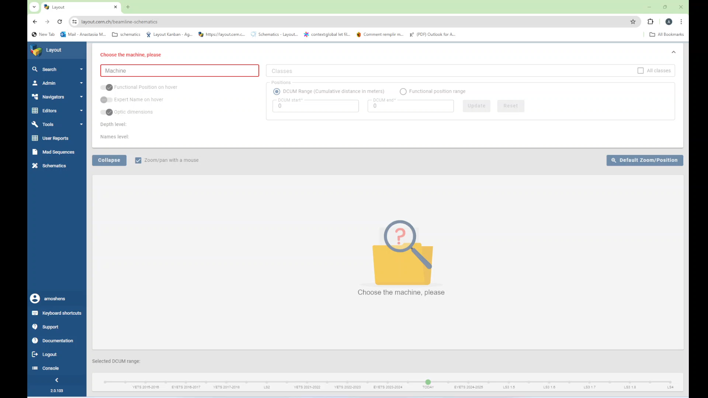

Slide 8
Schematics Demo
(Upcoming version)
https://layout-provisioning.cern.ch:14635/
https://layout-provisioning.cern.ch:14635/login.html

Slide 9
Outlook
Short-term
Two distinct time versions of same beam line area for comparison
Pop-up window when clicking an element to display more element information
Wrapping a beam line in multiple stacked sections instead of one single straight line ("print friendly version")
Mid-term and more, in function of resources:
In addition to side view, support for top view of beam lines
Dedicated icons per element type instead of boxes in the out-of-scale view
Support for electrical circuit layer in the out-of-scale view
Support for a location layer representing the locations

Slide 10
Summary
The MVP work planned in WP 6.3 (“Configuration and Quality Management”) is done. See EDMS for MVP details.
We plan to use remaining time (until end of July) to add a few features outside the MVP.
  Beyond this date the schematics goes into feature freeze (only critical bug-fixing and maintenance should be expected).
The schematics are not EA specific and can be used for all the machines.
There is potential to advance this work as synoptics-based controls.

