Slide 1

ECR/Documents for Information and Approval
Giulia Romagnoli and Natalya Kahn for BE-EA, 2024-06-11
EA Documents - Agile Board - CERN Central Jira

Slide 2
LIST OF DOCUMENTS for Info
FOR INFORMATION EATM
Summary | Reporter | EA Projects | EDMS number | EDMS Status
Engineering Specification of XWCM in M2 Beamline | Krystian Sidorowski | North Area, NACONS | 3093420 – SPSX-B-ES-0004 | Under Approval
BA80 Consolidation | Ixone Angulo Vaquero | North Area, NACONS | 3094273 – SPSX-J-SPC-0002 | Engineering check
NEPTUNE Converter Family for North Area and SPS Consolidation | Jerome Savary | North Area, NACONS | 3018519 – SPSX-R-ES-0004 | Released
Electron Intensity in the H8 Beamline | Maarten Van Dijk | North Area, NACONS | 3020139 – SPSX-O-RPT-0002 | Under Approval
Installation d'un Contrôle d'Accès Provisoire à la Porte YDPZ01.853=BX83 | Fernando Pedrosa | North Area, NACONS | 2967321 – SPSX-S-PRD-0001 | Released
Mandate of the Planning Officer of the NA-CONS Project | Deepti Kandhol | North Area, NACONS | 2458833 – SPSX-PM-MG-0003 | Released
BCR Template | Yacine Kadi | North Area, NACONS | 3084731 | Released
Automatic Fire Detection and Evacuation Systems of North Area Surface Buildings | Anna Suwalska | North Area, NACONS | 1896659 – SPSX-SF-WD-0004 | Under Approval
Fire Detection, Protection, and Voice Alarm Systems for SPS North Area Underground Facilities | Rachid Haddad | North Area, NACONS | 2476161 – SPSX-SF-WD-0001 | Released
Integration of the North Experimental Area | Michael Lazzaroni | North Area, NACONS | 2488117 – SPSX-LJ-WD-0001 | Under Approval
Consolidation of the Beam Intercepting Devices Cabling and Controls of the North Experimental Area | Jerome Lendaro | North Area, NACONS | 2488117 – SPSX-C-WD-0001 | Under Approval

Slide 3
LIST OF DOCUMENTS for Info
FOR INFORMATION EATM
Summary | Reporter | EA Projects | EDMS number | EDMS Status
Vacuum System of the P4/P42 Primary Beam Line for the High Intensity Facility in ECN3 | Matthew Fraser | HI-ECN3 | 3006552 | Under Approval
Advanced SND Experiment in TI18 | Lukasz Krzempek | ADVSND | 3076501 | Engineering check
Risk Assessment for the Individual System Tests of the Elena Kicker | Christophe Lolliot | ELENA | 3006567 – LNA-MKKFH-SR-0001 | Released
Risk Assessment for the Individual System Tests of ELENA Transfer Lines' Fast Deflectors (ZDFA) | Nicolas Voumard | ELENA | 3006581 – LNA-ZDFA-SR-0001 | Released
Functional Specification for the AD E-Cooler HV Powering | Christophe Machado | AD | 2938278 – AD-LNT-ES-0004 | Released

Slide 4
LIST OF DOC for FUTURE APPROVAL
ECR INFO/FUTURE APPROVAL EATM
Summary | Reporter | EA Projects | EDMS number | EDMS Status
Smoke Detector in EHN1 Galleries | Michael Jeckel | North Area – NACONS | 3072500 – SPSX-SF-EC-0008 | Engineering check
BA80 Fire Detection Equipment | Florian Andre Deperraz | North Area – NACONS | 2997829 - SPSX-SF-EC-0005 | Under Approval
Shielding Improvement for the High Intensity Hadron Operation of M2 | Dipanwita Banerjee | North Area | 2868386 - SPSX-J-EC-0002 | Engineering check
User Requirement for the XABS Absorbers in M2 Line in North Area | Dipanwita Banerjee | North Area – NACONS | 3012379 – SPSX-T-ES-0007 | In Work
User Requirements for XTAX Absorbers in North Area Beamlines | Miguel Lino Diogo Dos Santos | NACONS, Equipment | 2747997 - SPSX-T-ES-0003 | In Work
Replacement of Big Vertical Collimator XCBV on M2 Beamline in TT84 | Giulia Romagnoli | North Area – NACONS | 2976670 - SPSX-TC-EC-0002 | Under Approval
Installation of XCET Detectors in Neutrino Platform NP02 and NP04 | Giulia Romagnoli | North Area | 2811758 - SPSX-X-EC-0001 | Under Approval
TBIU Spare Disassembly for Construction of New TBIU | Jean-Louis Grenard | North Area – NACONS | 3089574 - SPSX-B-EC-0006 | Engineering check
EHN1 Workshop Refurbishment | Iliasse Derrag | North Area – NACONS | 3089621 - SPSX-J-EC-0005 | In Work
CESAR NA-CONS Renovation - virtual Device Server Consolidation Plan | Maciej Peryt | North Area – NACONS | 3095571 - SPSX-C-EC-0002 | Engineering check
BA81 Building Extension | Rachid Haddad | North Area – NACONS | 3093423 - SPSX-SF-EC-0009 | In Work

Slide 5
LIST OF MISSING ECRS for YETS 23/24
MISSING ECRS
Summary | Reporter | EA Projects | EDMS number
NP Platform Installation on H4 | Filippo Resnati | North Area | Coming soon…

Slide 6
LIST OF DOCs for APPROVAL
ECR APPROVAL EATM
Summary | Reporter | EA Projects | EDMS number | EDMS Status
Space Reservation Request Fire-resistant Partitions | Adem Kaymak | North Area – NACONS | 2907780 – SPSX-SF-EC-0003 | Under Approval
NA-CONS Fire Safety and Access WP 5.1.3 Fire-Resistant Partition | Adem Kaymak | North Area – NACONS | 3010259 - SPSX-SF-EC-0006 | Under Approval
Power Converters for the Quadrupole Magnets DI.QDE6030, DI.QFO6040, DI.QDE6050 and DI.QFO6060 for AD injection | Jean-Marc Cravero | AD | 3076867 - AD-R-EC-0006 | Under Approval

Slide 7
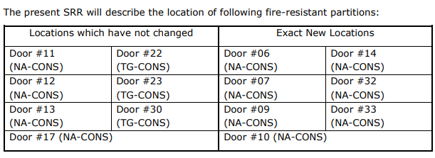
ECR for Approval
SPSX-SF-EC-0003
Version 0.3
Space Reservation Request Fire-Resistant Partitions
This SRR aims to reserve the required space for the installation of 11 of 36 fire-resistant partitions for NA-CONS and 3 of 22 fire-resistant partitions for the TG-CONS project, which are located in the NA facilities (head of the shafts, TT tunnels, TDC2/TCC2, BA80/BA81/BA82, EHN1/EHN2, TT81/TT82/TT83/TT84/TT85, TDC85/TCC8, ECN3) and galleries.
By Adem Kaymak
An assessment by HSE found that fire-resistant partitions do not exist in several locations, so the NA site is not compliant with current safety rules and regulations.
The main goal of compartmentalizing the NA is to:
Limit the propagation of fire and smoke
Make personnel evacuation easier and safer.
Prevent potentially radioactive smoke from spreading and not propagate to other parts of the facility.
By design, the doors on fire-resistant partitions will be controlled and triggered automatically upon detection of smoke by the detection systems.

Slide 8
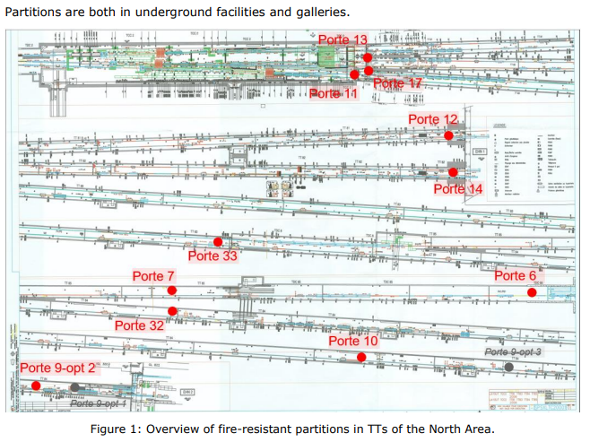
ECR for Approval
SPSX-SF-EC-0003
Version 0.3
Space Reservation Request Fire-Resistant Partitions
By Adem Kaymak

Slide 9
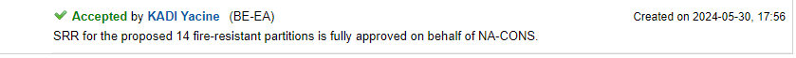
ECR for Approval
SPSX-SF-EC-0003
Version 0.3
Space Reservation Request Fire-Resistant Partitions
By Adem Kaymak
Seeking approval from EATM

Slide 10
ECR for Approval
SPSX-SF-EC-0006
Version 0.2
NA-CONS Fire Safety and Access WP 5.1.3 Fire-Resistant Partitions
By Adem Kaymak
This ECR concerns the installation of fire-resistant partitions, doors, frame sets and ancillaries for the creation of fire compartments in the NA facilities.
An assessment by HSE found that fire-resistant partitions do not exist in several locations, so the NA site is not compliant with current safety rules and regulations.
The main goal of compartmentalizing the NA is to:
Limit the propagation of fire and smoke
Make personnel evacuation easier and safer.
Prevent potentially radioactive smoke from spreading and not propagate to other parts of the facility.
By design, the doors on fire-resistant partitions will be controlled and triggered automatically upon detection of smoke by the detection systems.
Following the CPRs for NA-CONS and TG-CONS, this ECR proposes the installation of
For NA-CONS:
  Fire-resistant partition #48b
  Fire-resistant partition #50
  Fire-resistant partition #50b
For TG-CONS:
  Fire-resistant partition #22
  Fire-resistant partition #23
  Fire-resistant partition #30

Slide 11
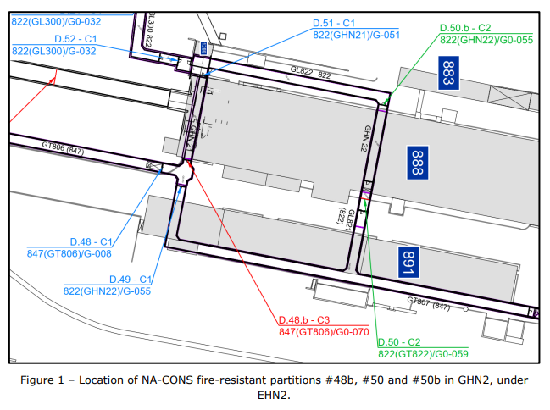
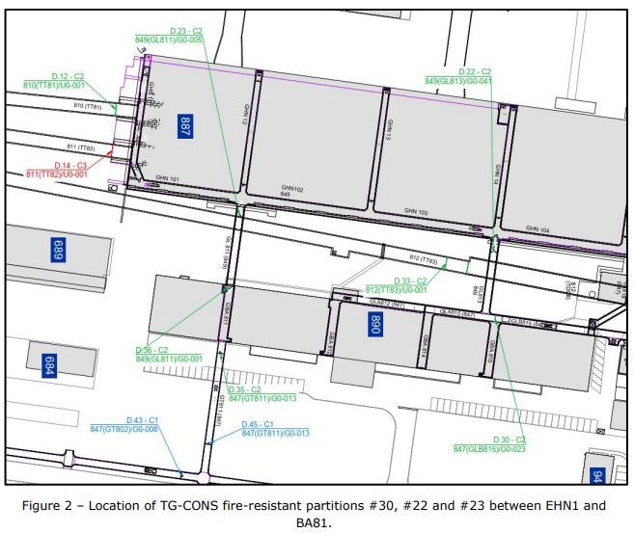
ECR for Approval
SPSX-SF-EC-0006
Version 0.2
NA-CONS Fire Safety and Access WP 5.1.3 Fire-Resistant Partitions
By Adem Kaymak

Slide 12
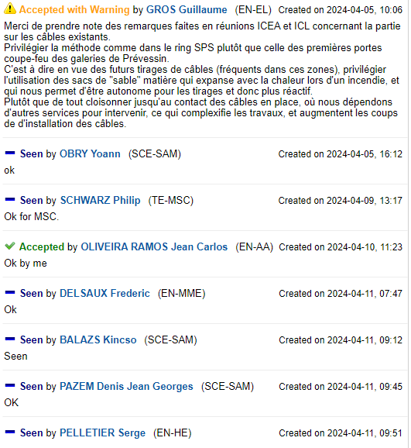
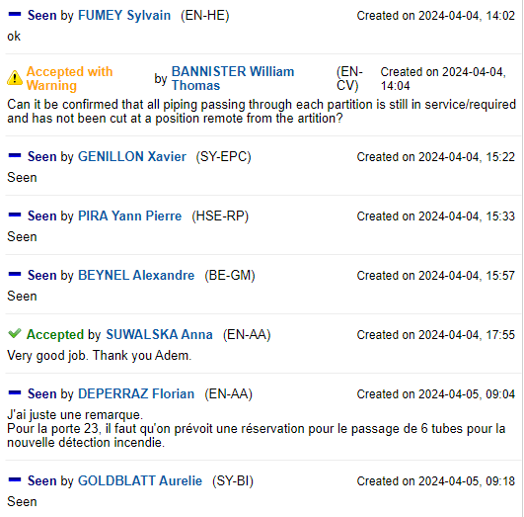
ECR for Approval
SPSX-SF-EC-0006
Version 0.2
NA-CONS Fire Safety and Access WP 5.1.3 Fire-Resistant Partitions
By Adem Kaymak

Slide 13
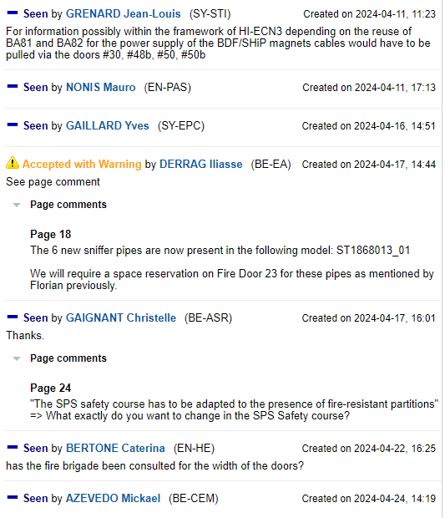

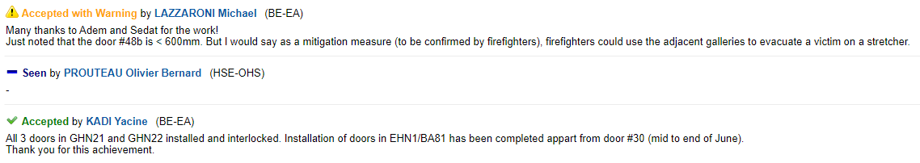
ECR for Approval
SPSX-SF-EC-0006
Version 0.2
NA-CONS Fire Safety and Access WP 5.1.3 Fire-Resistant Partitions
By Adem Kaymak
Seeking approval from EATM

Slide 14
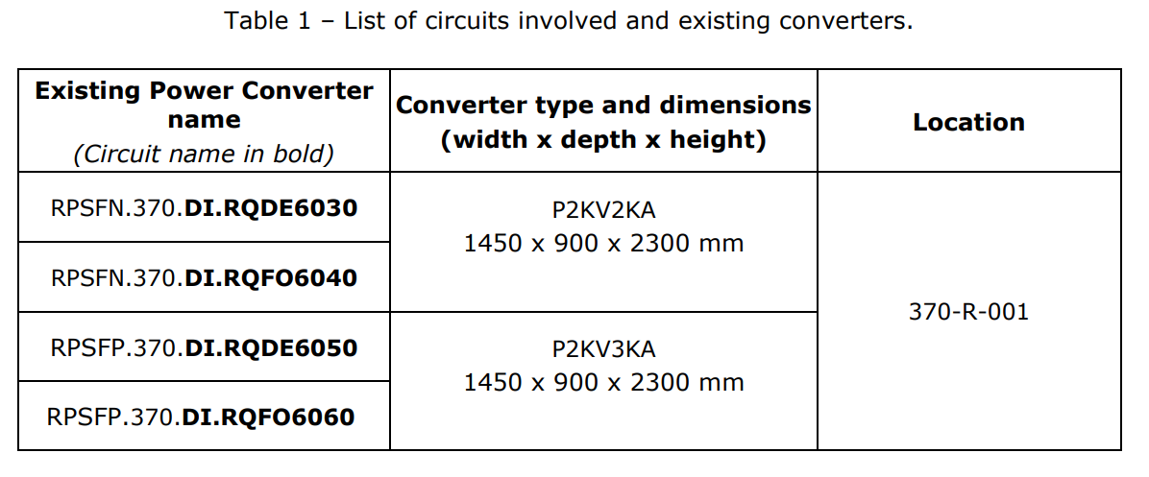
ECR for Approval
AD-R-EC-0006
Version 0.2
Power Converters for the Quadrupole Magnets DI.QDE6030, DI.QFO6040, DI.QDE6050 and DI.QFO6060 for AD injection
By Jean-Marc Cravero
This ECR concerns the replacement of the power converters for DI.QDE6030, DI.QFO6040, DI.QDE6050 and DI.QFO6060 magnets.
In the injection line of the AD machine, four quadrupole magnets are still supplied by capacitor discharge power converters type P2KV2KA and P2KV3KA installed in the 1980s and partially renovated in the 2000s.
In order to pursue the consolidation program and for the purpose of standardisation, these converters will be replaced by MegaDiscaP converter type.
Additionally, this modification allows the change of the MIL-1553 based electronics, which is not supported anymore in EPC group, to FGC3 based electronics.

Slide 15
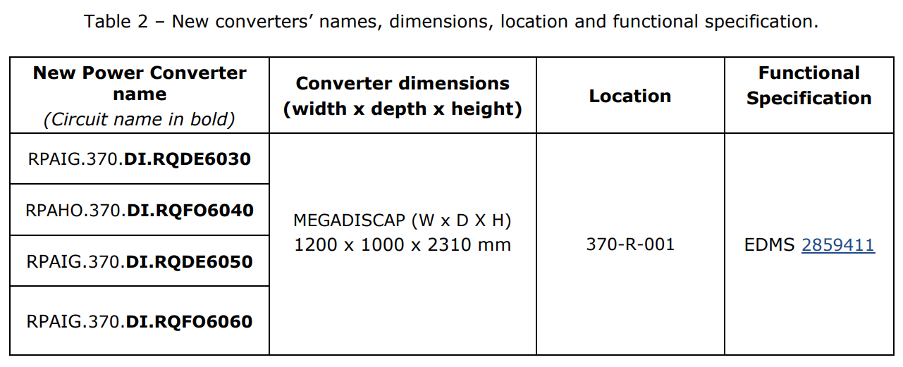
ECR for Approval
AD-R-EC-0006
Version 0.2
Power Converters for the Quadrupole Magnets DI.QDE6030, DI.QFO6040, DI.QDE6050 and DI.QFO6060 for AD injection
By Jean-Marc Cravero

Slide 16
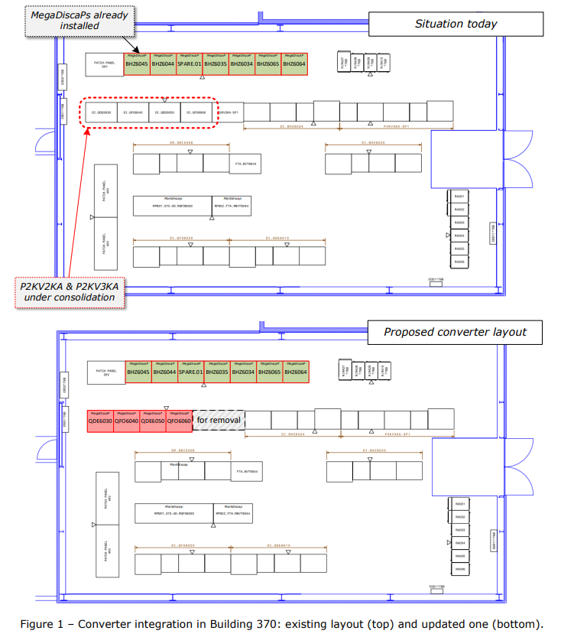
ECR for Approval
AD-R-EC-0006
Version 0.2
Power Converters for the Quadrupole Magnets DI.QDE6030, DI.QFO6040, DI.QDE6050 and DI.QFO6060 for AD injection
By Jean-Marc Cravero

Slide 17
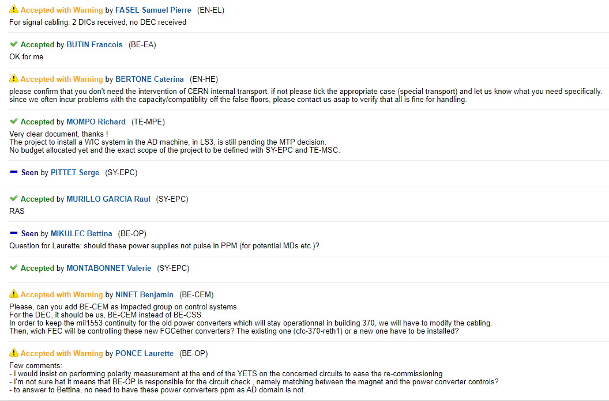
ECR for Approval
AD-R-EC-0006
Version 0.2
Power Converters for the Quadrupole Magnets DI.QDE6030, DI.QFO6040, DI.QDE6050 and DI.QFO6060 for AD injection
By Jean-Marc Cravero

Slide 18
Thank you!

