Slide 1

The physics of strong electromagnetic fields in heavy ion collisions
B
Z
Z
Z
Z
ω =∇×v
Koichi Hattori
Zhejiang University
10th Asian Triangle Heavy Ion Conference (ATHIC 2025), Jan. 13

Slide 2
Hard probes in magnetic fields
Photons/dileptons from vacuum to medium effects
Heavy quarks
“Linearly Polarized Photon Collisions,” STAR collaboration,
PRL 127, 052302 (2021)
“Directed Flow of 𝐷⁰ and ‾𝐷⁰ ,” STAR collaboration,
PRL 123, 162301 (2019)
Soft probes in magnetic fields
Magnetohydrodynamics (MHD)
Spin magnetohydrodynamics
Magneto-vortical matter
“Global Lambda polarization,” STAR Collaboration
Nature 548, 62-65 (2017); PRC108,014910(2023)
“Charge-Dependent Directed Flow,” ALICE, PRL 125 (2020) STAR collaboration, PRX 14, 011028 (2024)

Slide 3
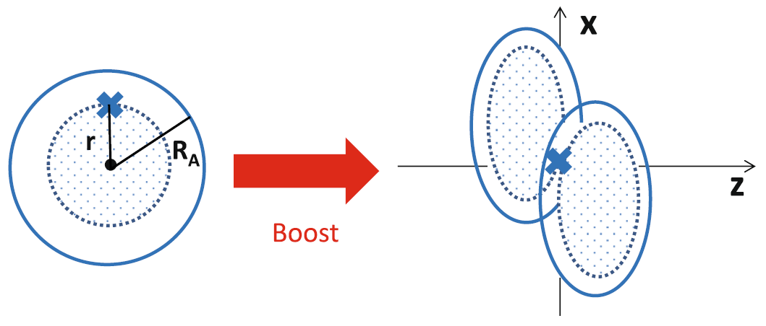
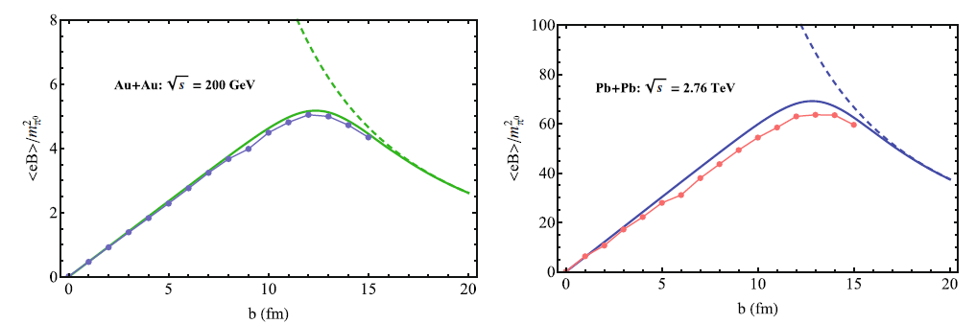
Strong magnetic fields induced by relativistic heavy-ion collisions
B
Z
Z
Z
Z
Static Coulomb field
Boost → Lienard-Wiechert potential
Free streaming
HIJING
Central coll.
Peripheral coll.
Deng & Huang; KH & Huang [1609.00747]

Slide 4
Hard probes in magnetic fields
Photons/dileptons from vacuum to medium effects
Heavy quarks

Slide 5
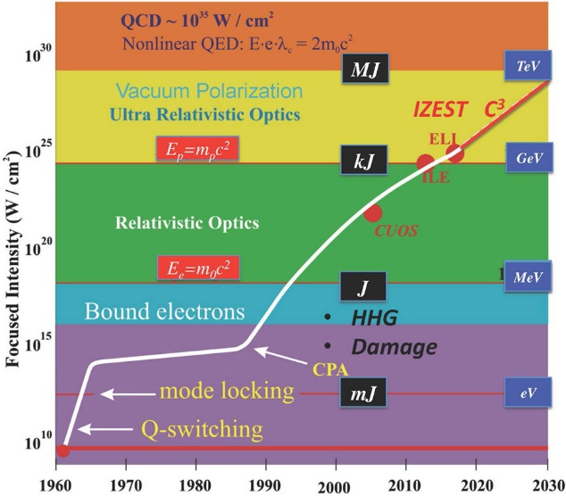
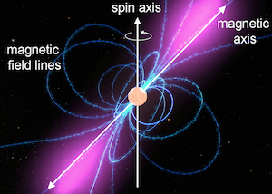
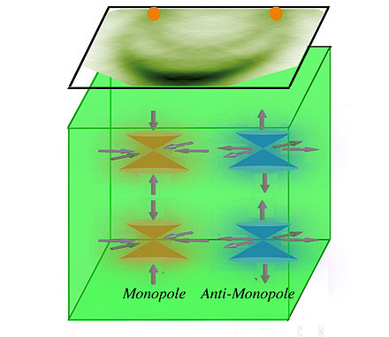
Strong fields and EM probes in nature and laboratory
Magnetospheres of neutron stars/magnetars
High-intensity laser field
(Ultra)peripheral collisions
Cond. Matt. materials
B
Z
Z
RHIC, LHC
Z
Z

Slide 6
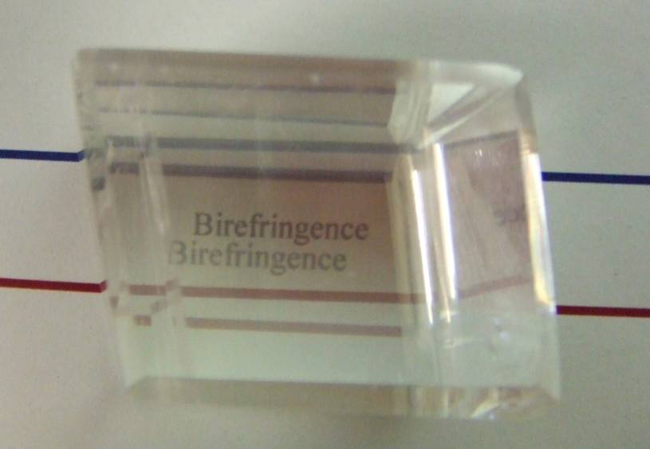
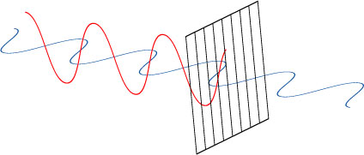
Effects of B on photon propagation
B
Lorentz symmetry broken
Without B field
In B field
Polarization rotation
Not experimentally confirmed yet
Real-photon decay
(Dichroism)
In medium: Refractive index
In vacuum: No change in refractive index
(Gauge and Lorentz symmetries)
Birefringence
Polarizer
Cf. Magneto-optic effects
Cotton-Mouton effect, Faraday effect, etc in optics

Slide 7



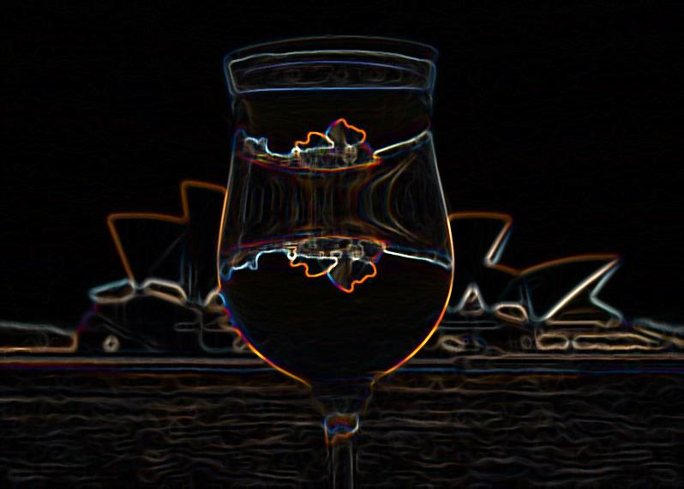

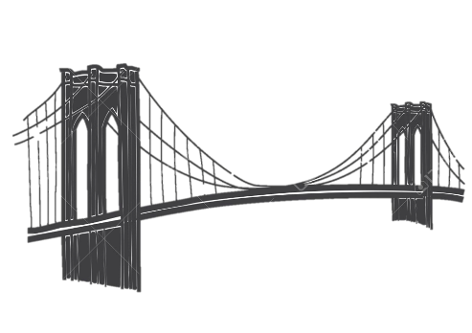
Complex refractive indices
Refraction (real part of the index of refraction)
Decay cross-section
Optical theorem for the imaginary part
Strong B provides a preferred orientation.
→ “Vacuum birefringence”: Polarization dependent refractive indices
=
＋
=
＋
＋
＋ ・・・
B-field opens 1-to-2 kinematics
Lorentz & gauge symmetries → n ≠ 1 in general
Both sides of a coin
Photon refraction
Dispersion integral
Di-fermion production
Imaginary part = On-shell processes
Simpler to understand (than the real part)

Slide 8
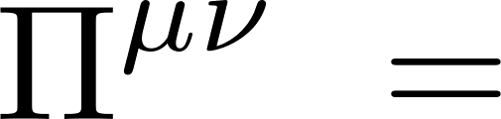
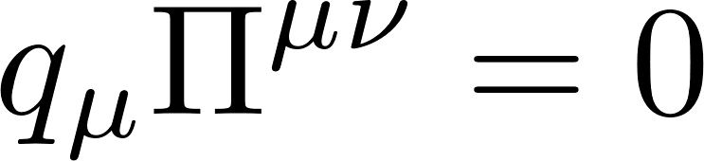

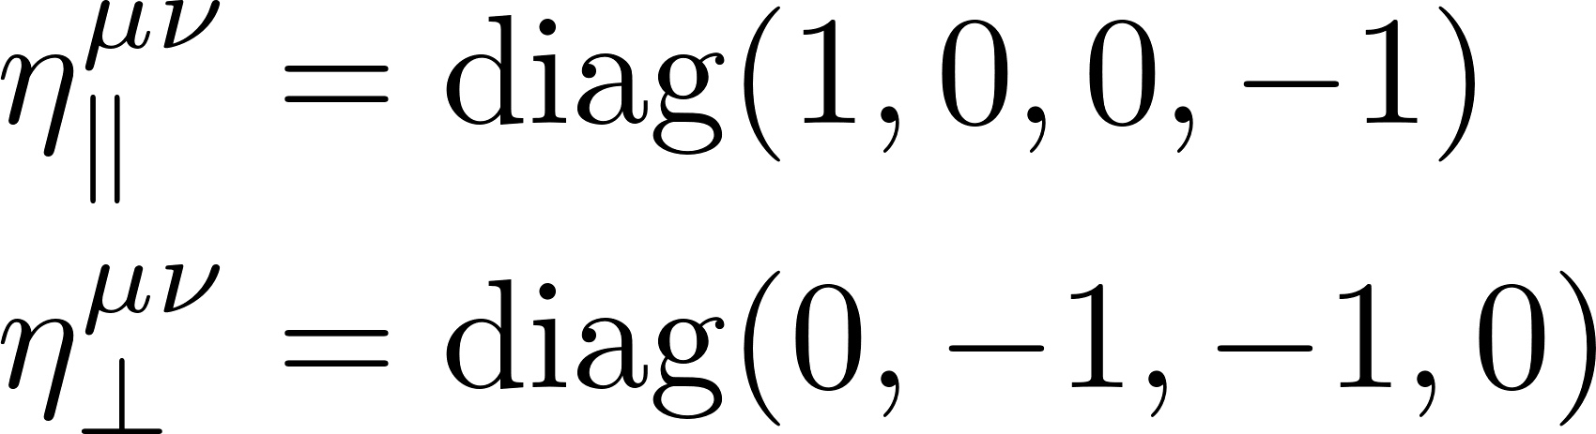
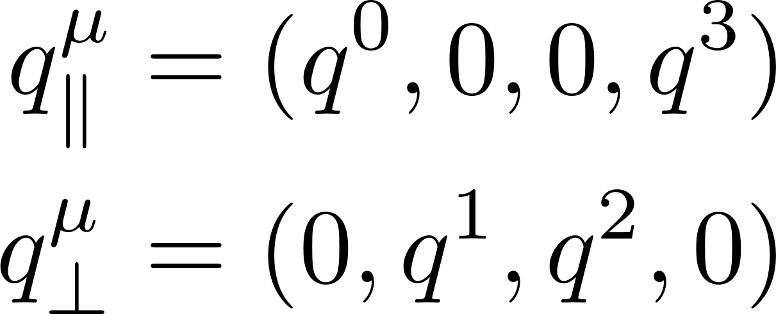
Refractive index from the Maxwell equation
Ward identity:
Constraint by the gauge symmetry
Preferred orientation in B
B-induced anisotropic structures
Medium effects may induce more structures.

Slide 9
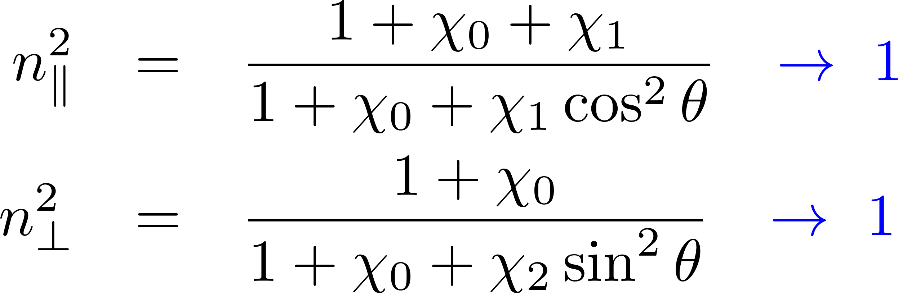
Birefringence
Cf. KH, Itakura, 1209.2663
Definition of refractive index
Two distinct solutions for the Maxwell equation:
Direct consequence of the gauge symmetry and the breaking of one spatial rotational symmetry.
Vanishing B limit:
Theoretical issues boil down to computation of χ.

Slide 10
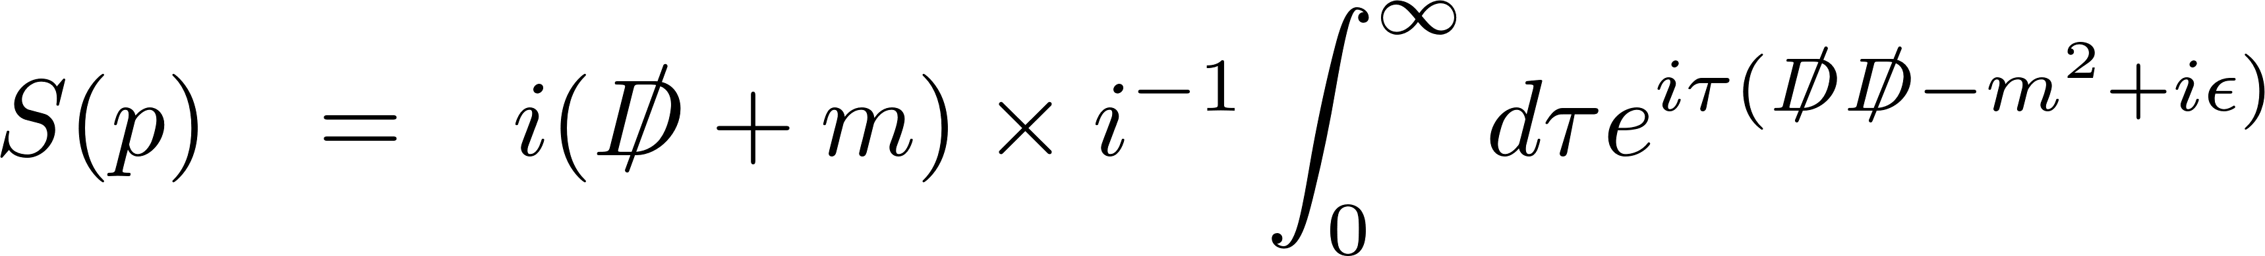


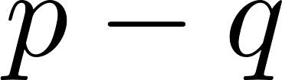
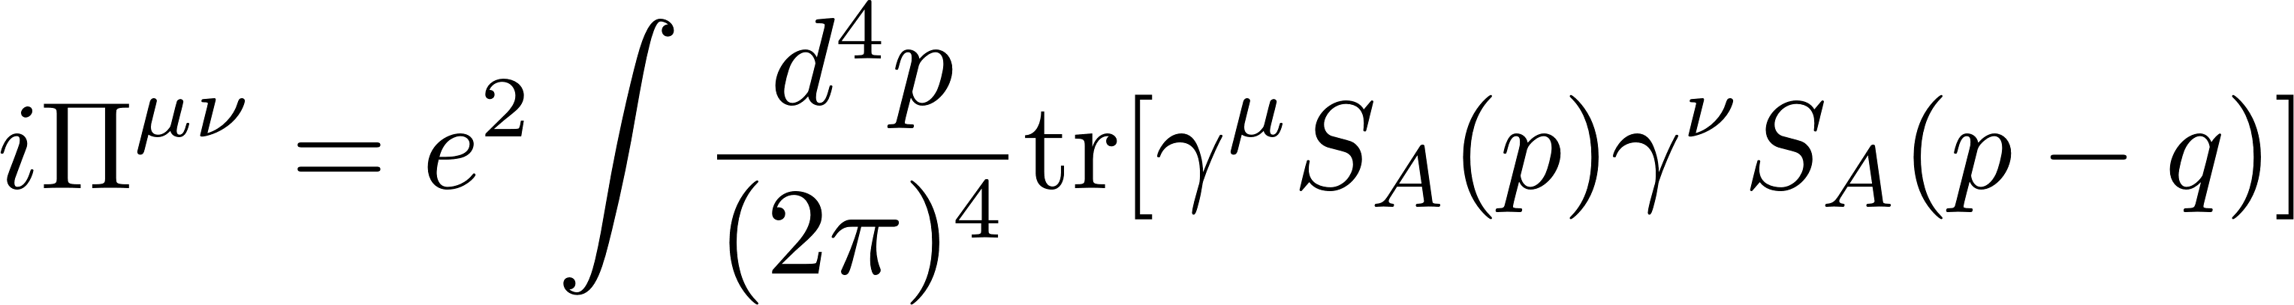
Computation of the polarization tensor
Resummed propagator
eB
eB
eB
eB
eB
eB
eB
eB
eB
eB
eB
eB
eB
=
＋
＋
＋ ・・・
＋ ・・・
Fock (1937), Schwinger (1951)
Furry’s theorem: The odd-order diagrams cancel in C-even systems.
＋
＝ ０
Resummed polarization tensor
Charge flows
=
＋
＋ ・・・
＋ ・・・
Options: vacuum or medium; strong or weak field, etc.

Slide 11
Rich products from the polarization tensor
Vacuum: KH, Itakura (2012), Ishikawa, Kimura, Shigaki, Tsuji (2012)
KH, Taya, Yoshida (2021)
Medium: KH, Itakura (2022), Fukushima, Hidaka, Uji (2024)
Refractive index/Photon decay rate
Photon emission rate
Debye screening/plasma frequency
Electric conductivity
In-medium axial Ward identity in strong B
Wang, Shovkovy (2020-2024)
Fukushima, KH, Yee, Yin (2016), Bandyopadhyay, Ismam, Mustafa (2017), KH, Itakura (2022)
KH, Li, Satow, Yee (2016), Fukushima, Hidaka (2018), Ghosh, et al. (2020), Das, et al. (2020), Satapathy, Ghosh, Ghosh (2021), Peng, et al (2023), Ghosh, Shovkovy (2024)
KH, Itakura (2022)
Studied in other communities as well.

Slide 12
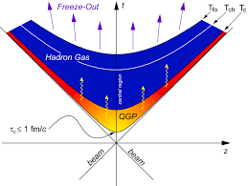
Theory + Phenomenology + Experiment
Kimura, Benoit, Ishikawa, Nonaka, Shigaki (2024)
Talk by C. Nonaka (Same session)
Polarization measurement is challenging in other communities too.
(Cosmology, astrophy, laser physics)

Slide 13
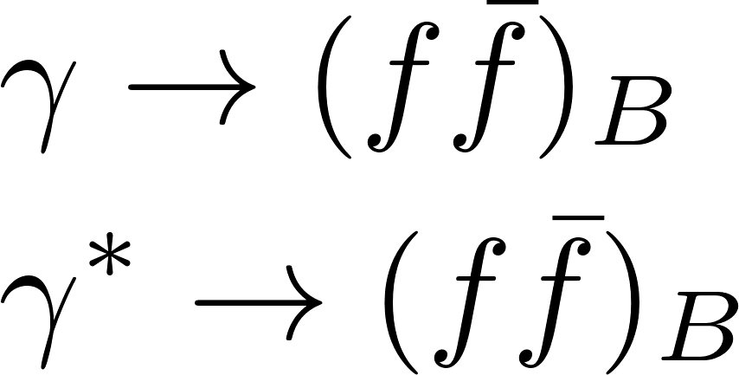
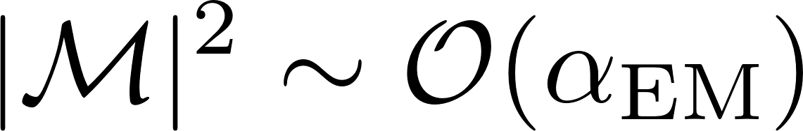
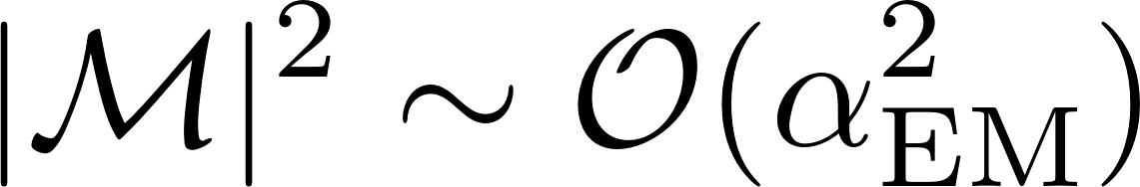
Pair production in a magnetic field
LO w/ strong B-fields
LO w/o B-fields
No kinematical window for
a single on-shell photon when B = 0.
→ Starts only from 2 photons
Nonperturbatively dressed fermions
Both on-shell and off-shell photons can decay in B.
Breit-Wheeler process
in UPC

Slide 14
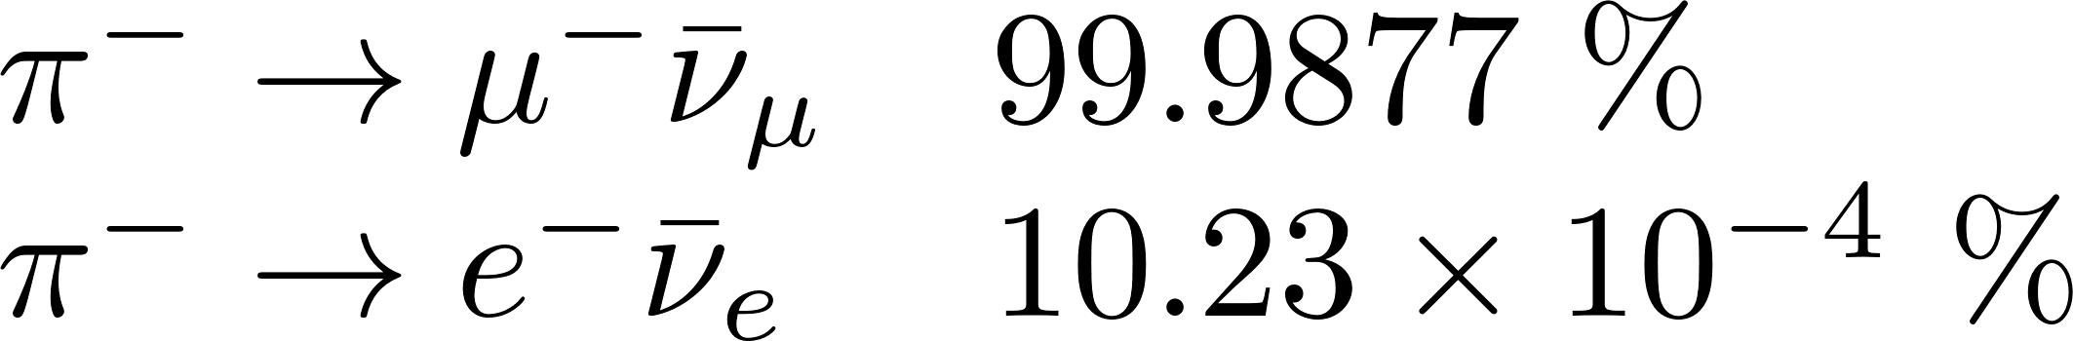
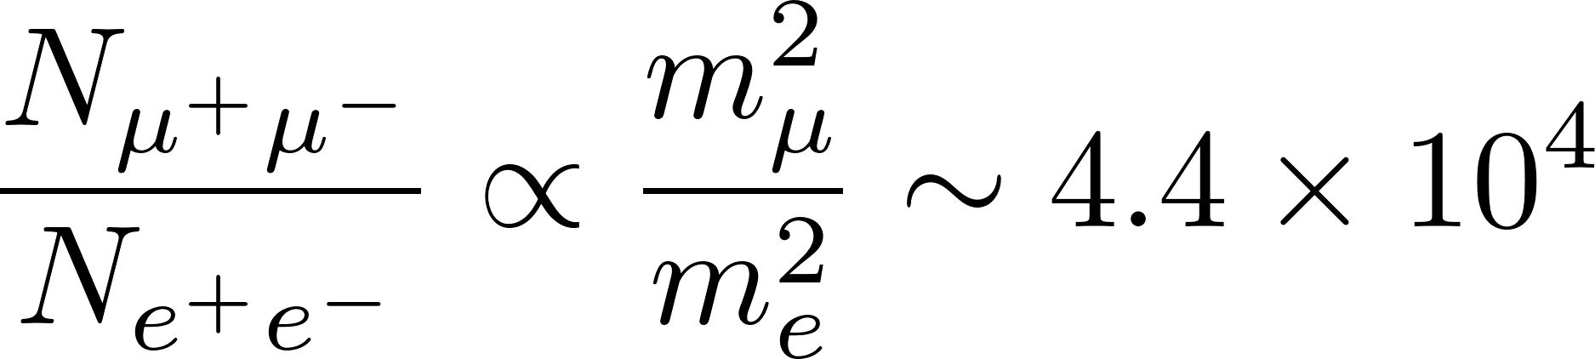

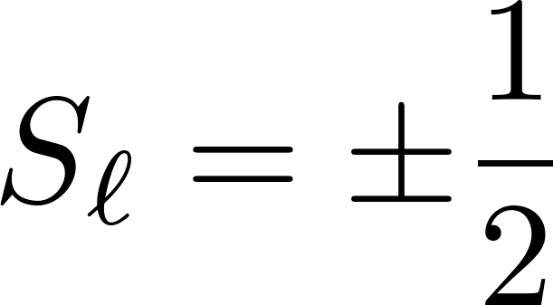
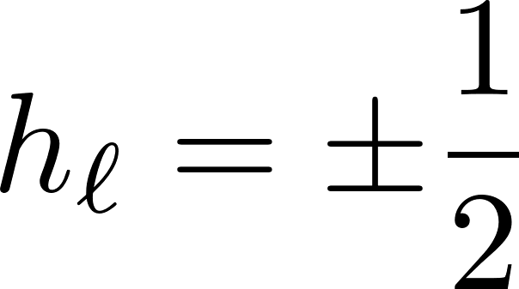
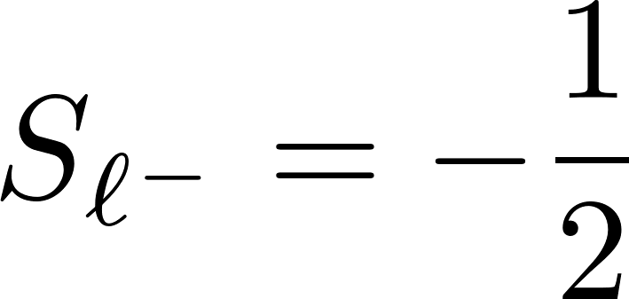
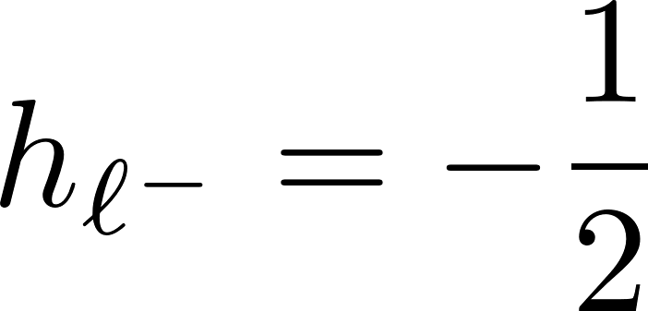
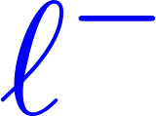
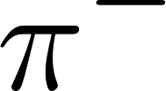
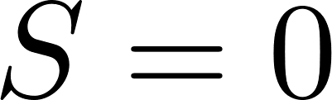
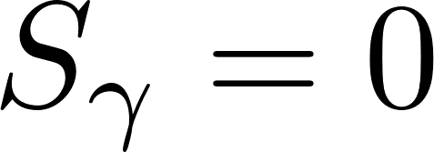
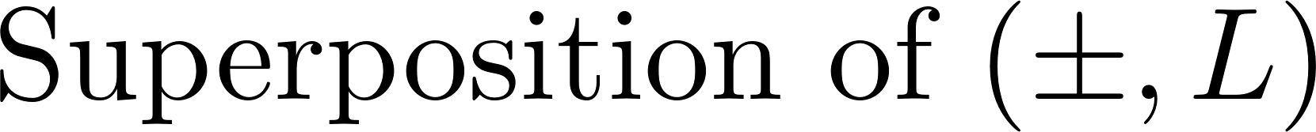

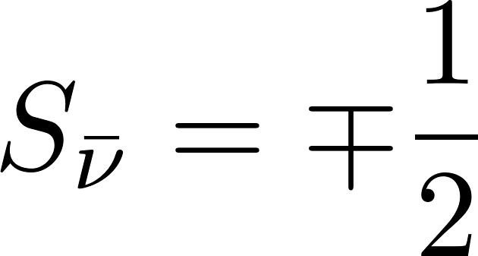
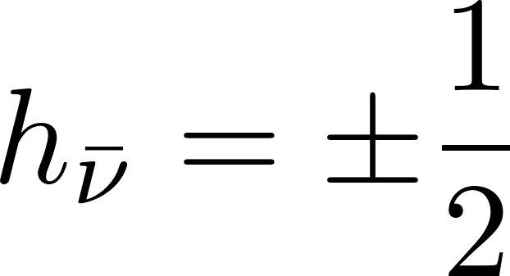
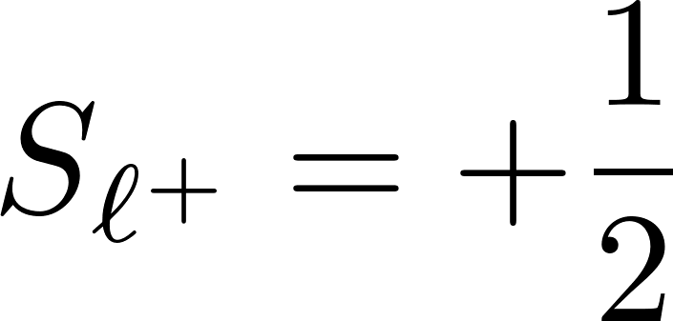
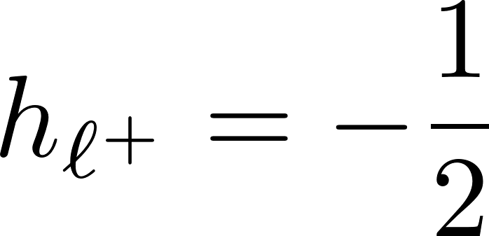
Muon-pair excess over electron pairs
KH, Taya, Yoshida [2010.13492]
“Helicity suppression” in pion decay
The LLL (= soft photon decay)
PDG
Opposite momentum
Opposite spin
along B-field
Opposite spin
Same helicity
Same helicity
Needs chirality mixing by a finite mass.
Needs chirality mixing by a finite mass.
R neutrino (L antineutrino) does not exist at the QCD scale.
However, this is not an essential reason for the helicity suppression.

Slide 15
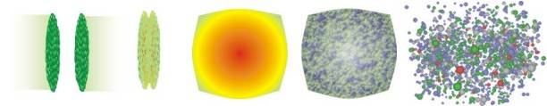
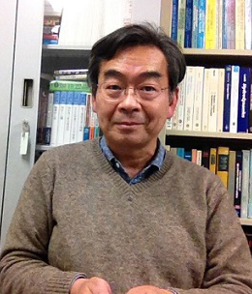

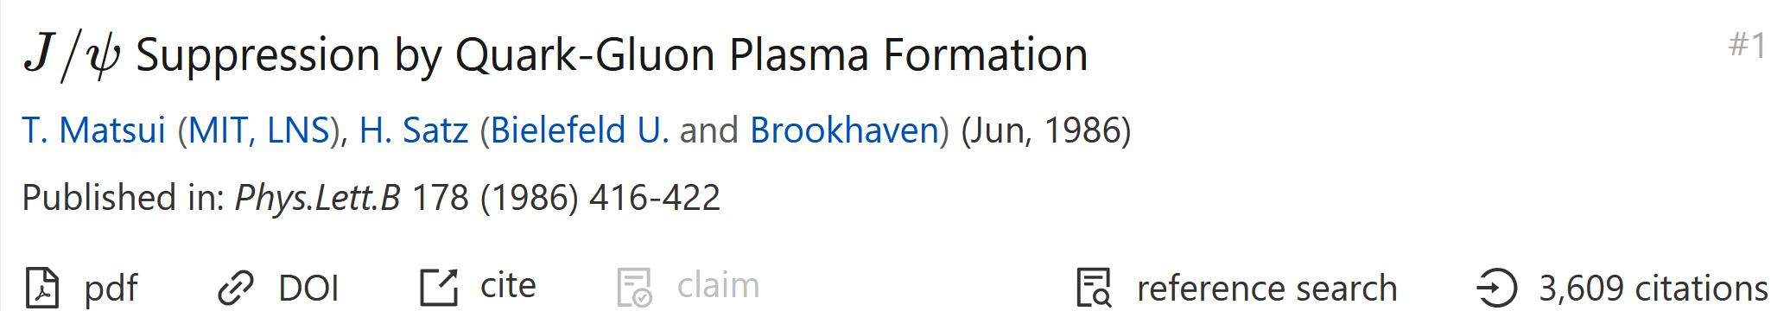
Heavy quarks
g
g
HQ production
Dissociation
Diffusion
Recombination
Open HQs
Thermometer of QGP

Slide 16
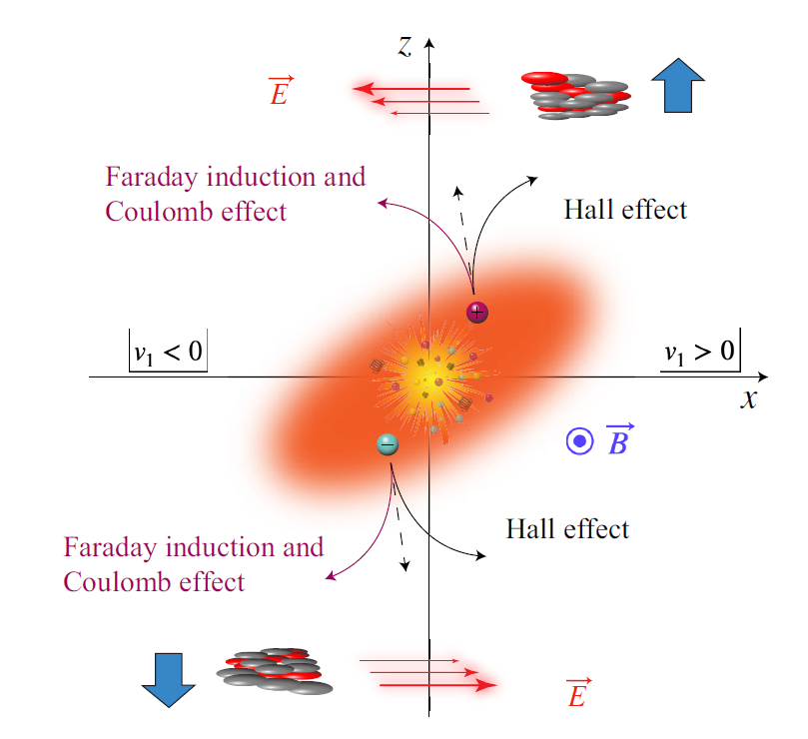
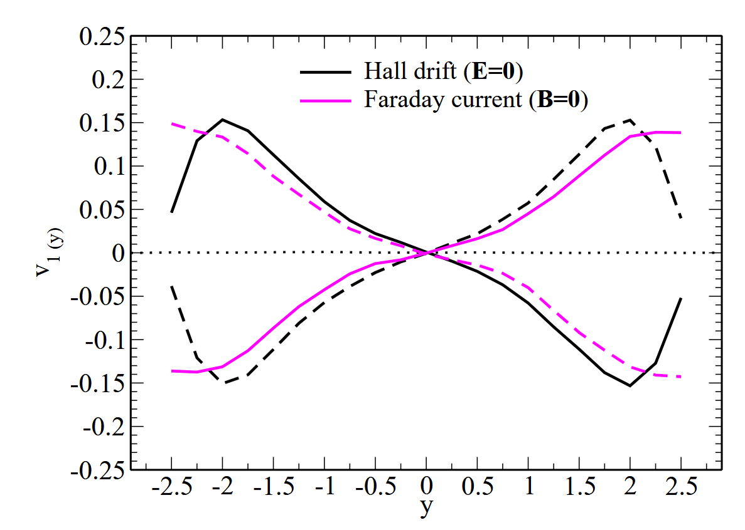
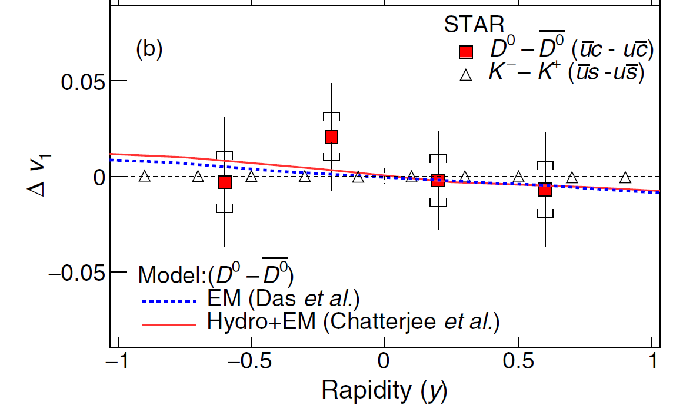
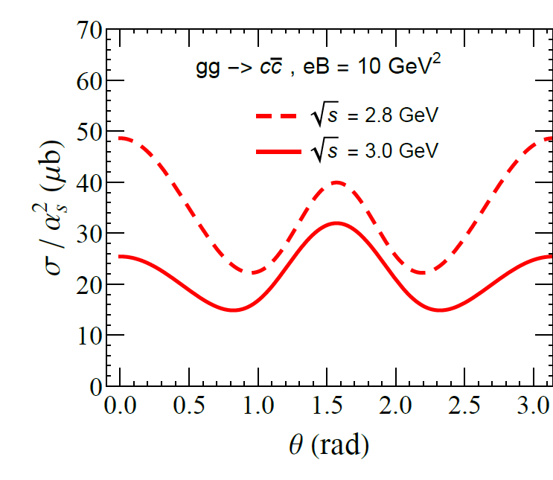
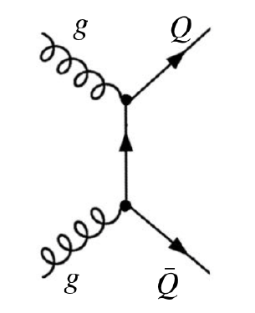
Early-time dynamics
Directed flow (v1)
Das, Plumari, Chatterjee, Alam, Scardina, Greco, 1608.02231
Sun, Plumari, Das, 2304.12792
STAR, PRL 123 (2019)
Gluon fusion in B
“Gluonic Breit-Wheeler”
From STAR, PRX (2024)
(for light hadrons)
Chen, Zhao, Zhuang, 2401.17559

Slide 17
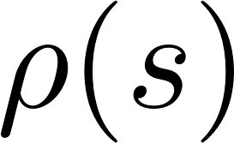
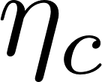
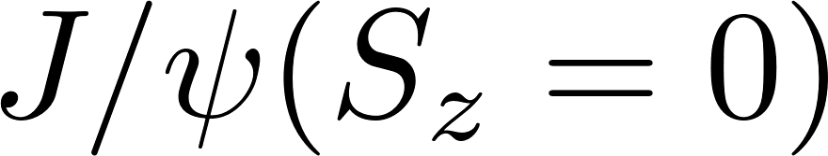

Spectral modification and dissociation
In anisotropic systems, spin size S is not a good quantum number.
→ Spin singlet and triplet (S_{z} = 0) are mixed, and the energy levels repel with each other.
Marasinghe, Tuchin, 1103.1329
Machado, Navarra, de Oliveira, Noronha, Strickland, 1305.3308
Alford, Strickland, 1309.3003
Cho, KH, Lee, Morita, Ozaki, 1406.4586; 1411.7675
Guo, Shi, Xu, Xu, Zhuang, 1502.04407
Gubler, KH, Lee, Ozaki, Suzuki, 1512.08864
Suzuki and Lee, 1610.09853
Iwasaki, Oka, Suzuki, Yoshida, 1802.04971
Singh, Thakur, Mishra, 1711.03071
Jahan, Dhale, Reddy, Kesarwani, Mishra, 1803.04322
Mishra, Misra, 2004.01007
Sebastian, Thakur, Mishra, Haque, 2308.04410
Lattice measurement by Pisa group
1403.6094, 1607.08160, 1807.01673, 2111.11237

Slide 18



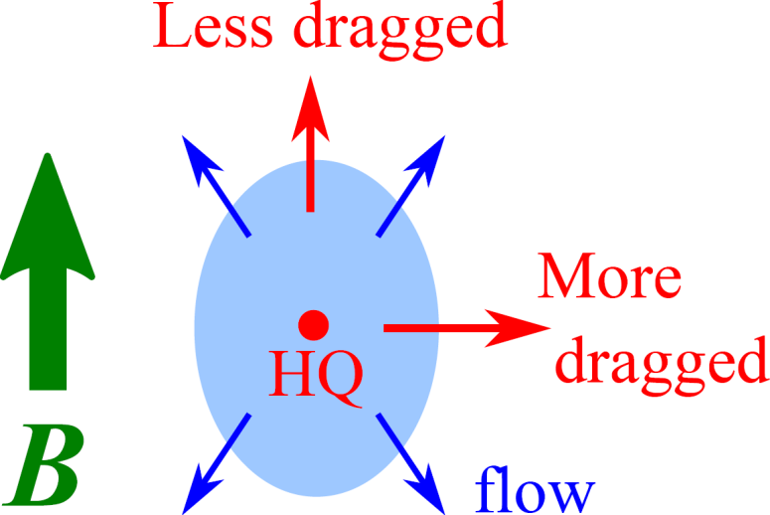
Brownian motion in QGP
Momentum diffusion constant
Momentum transfer rate in LO Coulomb scatterings
2
2
2
2
+
+
Fukushima, KH, Yee, Yin, 1512.03689
Cf. KH and Huang, 1609.00747
HQ
HQ
HQ
Thermal quarks
HQ
Thermal gluons
Thermal quarks
Thermal gluons
c.f.) LO and NLO without B (Moore & Teaney, Caron-Huot & Moore)
Anisotropy in a magnetic field
Effects on heavy-quark spin alignment
Liu, Bai, Zhen, Huang, Chen, 2404.02032

Slide 19
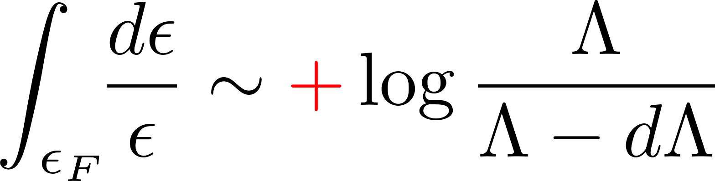
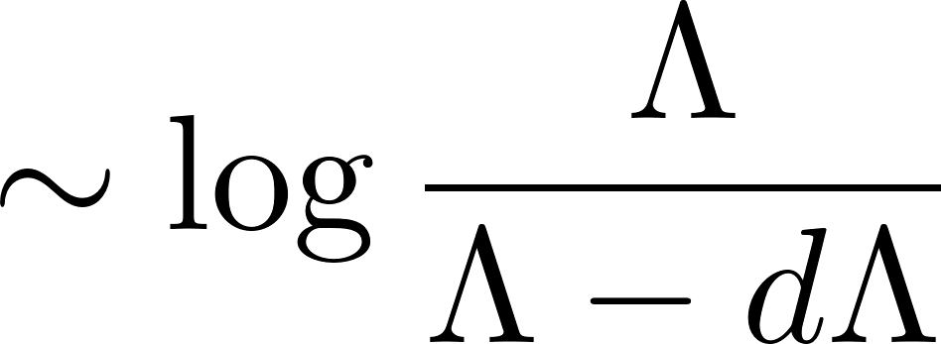

Large log corrections from quantum effects
Beyond the LO may be interesting.
Particle contribution
Light quark
Heavy quark
This log is the origin of the Kondo effect.
→ Strong correlation between a HQ impurity and light quarks.
Imp
KH, Itakura, Ozaki, Yasui, 1504.07619
Ozaki, Itakura, Kuramoto, 1509.06966
KH, Huang, Pisarski, 1903.10953
KH, Suenaga, Suzuki, Yasui, 2211.16150
etc.
Imp
Hole contribution

Slide 20
Phase diagram extracted from the results
KH, Suenaga, Suzuki, Yasui, 2211.16150
New quantum critical point: Switch over
between the true vacua at zero T

Slide 21





How hydro evolves in magnetic and vortical fields
Magnetohydrodynamics (MHD)
Spin magnetohydrodynamics
Magneto-vortical matter
Talk by C. Nonaka and A. Dash
Talk by H. Z. Huang and S. Sharma
STAR (2007 – 2017, 2018, 2023)
“Global Lambda polarization,” STAR Collaboration
Nature 548, 62-65 (2017); PRC108,014910(2023)
“Charge-Dependent Directed Flow,”
ALICE, PRL 125 (2020), STAR, PRX 14 (2024)

Slide 22

Hydrodynamics behavior of the quark-gluon plasma
Relativistic heavy-ion collisions at RHIC and LHC
✘ Free-streaming limit?
(Asymptotic-free limit)
✘ Random momentum distribution
✔ Strongly correlated matter
Collective flow at RHIC and LHC
✔Correlated momentum angle distribution
QGP
Frequent interactions induce strong correlations (even if the coupling constant is perturbatively small.)

Slide 23



Collective “hydrodynamic” motion in various systems
Condensed matter systems
Back flow
Ordinary metals
Hydrodynamic limit
One-way flow
Left: Long mean-free path (Scattering with defects)
Right: Short mfp (Frequent scattering among electrons) → Strongly interacting electrons
Science, Zaanen
Graphene
Nature Phys., Levitov & Falkovich
Astrophysics
Nagataki group, RIKEN

Slide 24



Hydrodynamics as universal low-energy EFT
Relevant dof. in low energy regime = Gapless modes
= Conserved charges surviving in a long spacetime scale.
A set of conservation laws
= Equations of motion
Hydrodynamics = Universal low-energy EFT based on symmetries
Low energy
E.g., Translational symmetry
Low momentum

Slide 25








Dynamics of conserved charges
Hydrodynamic variables
Conservation laws
{Total energy density, fluid flow velocity}
Electromagnetism
A static charge distribution does not screen the B-field.
(No “magnetic Coulomb field” without a magnetic monopole).
Conservation of magnetic flux.
Electromagnetism
E-field is screened by a static charge distribution, i.e., the Debye screening effect.
+
-
E(u, B) and j(u, B) are induced at off-equilibrium

Slide 26

Derivation of constitutive equations
See a review, KH, Huang, Hongo (2022)
Statistical description of underlying theory
Weak coupling
Strong coupling
Kinetic theory
Operator method (QFT)
Zubarev, Becattini, Hayata-Hidaka-Noumi-Hongo,
Hongo-KH (for MHD), Hongo-Huang-Stephanov-Yee (for spin)
Grad, Israel-Stewart,
Frankfurt group
Dynamics of averaged charges
(Course graining)
Thermodynamics
Constraints on constitutive eqs. from the 2nd law aka the “entropy-current analysis”
Hydrodynamics

Slide 27











Anisotropies in constitutive equations
Anisotropic pressure
Splitting + a cross bulk viscosity
Anisotropic viscosities
Splitting of shear viscosity
2 shear viscosities
3 bulk viscosities
B
B
See a review, KH, Huang, Hongo (2022)

Slide 28








Spin as a quasi-hydro variable
- Total AM conservation from rotational symmetry :
- Spin-orbit coupling for relativistic constituents
Orbital AM
Spin
→ Spin “non-conservation” equation
No symmetry protecting spin conservation.
Shear
Torque
Bulk

Slide 29




Rotational viscosities (Anti-symmetric part)
Fang, KH, Hu, 2409.07096
Thermal vorticity
Spin potential
- Extended first law
Energy density Spin density Magnetic flux
Spin potential
“No-slip condition” with
the rotational fluid motion
Spin hydrodynamics
KH, Hongo, Huang, Matsuo, Taya, 1901.06615
Fukushima, Pu, 2010.01608
Li, Stephanov, Yee, 2011.12318
She, Huang, Hou, Liao, 2105.04060
Hongo, Huang, Kaminski, Stephanov, Yee, 2107.14231
Biswas, Daher, Das, Florkowski, Ryblewski, 2304.01009
Isotropic limit
KH, Hongo, Huang, Matsuo, Taya, 1901.06615

Slide 30


Leading-order constitutive eq.
Available symmetric tensor

Slide 31

Anisotropic viscosities
2 shear viscosities
3 bulk viscosities
Splitting of shear viscosity
Splitting + a cross bulk viscosity
B
B

Slide 32



Explicit, but weak, symmetry breaking
→ Small energy gap
Quasi-hydrodynamic modes
Cf. Hydro+ (Stephanov-Yin) for a long-lived mode due to the critical slowing down.
(kinetic relaxation time) ≲ 1/gap << (spacetime scale of our interest)
Momentum transfer rate
(randomization of momentum)
Transfer rate of quasi-conserved charge

Slide 33




Solving spin MHD within linear-mode analysis
Weak disturbances on top of the equilibrium state.
For numerical methods beyond linear regime,
see talk by C. Nonaka and A. Dash
Linear regime
Nonlinear regime
Energy density (1)
Flow velocity (3)
Magnetic field (2)
Spin (3)
9 × 9 matrix !!
Exactly diagonalized with an analytic algorithm.
Fang, KH, Hu, 2402.18601; 2409.07096

Slide 34




An issue in preceding works
B
B
- Ideal MHD (well-known)
Alfven waves and Magneto-sonic waves
Magnetic tension and pressure
- First-order MHD (Not known due to strong anisotropy)
Solutions had been known only at θ = 0 or π/2.
Moreover, there was disagreement
between those known solutions at θ = π/2.
B
Grozdanov et al. (2017)
Armas and Camilloni (2022)
Hernandez and Kovtun (2017)

Slide 35




“Critical angle”
Fang, KH, Hu, 2402.18601
Solutions at θ = 0 and π/2 are not smoothly connected.
Trig. functions serve as another small parameter.
Small k expansion breaks down due to the anisotropy.
→ Small k and cos θ limit do not commute.
Phase velocities
Damping rates
Small cos θ limit first
Small k limit first
Purely diffusive near the transverse direction.
Split of the diffusion rates

Slide 36





Split of damping spin modes
Spins are not conserved → Gapped modes at k = 0.
All solutions are always damping.

Slide 37






Anomalous quantum transport
Dirac equation in the chiral representation
→ Chirality-spin-momentum locked in the massless limit
Talk by H. Z. Huang and S. Sharma
{Chirality, Spin, Momentum}
B
Spin polarization in B or ω
Chirality-momentum locking
Finite currents when one of chirality is favored.
ω

Slide 38


Magneto-vortical matter
- Anomalous transport w/o chirality imbalance
B
KH and Yin, 1607.01513
- Chiral kinetic theory
Yang, et al., 2003.04517, Mameda, 2305.02134,
Yang, et al., arXiv:2409.00456
- Effective theory as the Chern-Simons current
Yamamoto and Yang, 2103.13208
→ Effective chemical potential
But some technical issue is recognized in QFT approach. Ebihara, Fukushima, Mameda, 1608.00336

Slide 39



Sign inversion by the orbital contribution
in the strong-field regime
Fukushima, KH, Mameda 2409.18652
Spin - Orbital
Each cyclotron orbit has a kinetic angular momentum
that is additive to spin.
Cf. KH, Itakura, Ozaki, 2305.03865
Orbitronics!?

Slide 40
Summary
Physics opportunities both in hard and soft observables.
EM probes and anomalous transport have been pursued in
other communities as well (laser, cond. matt., cosmology/astro)
Collaborations among theory, pheno., and exp. are developing.
Theoretical challenge: Transition from strong to weak fields.

