Slide 1



Exploring RF Breakdown and Conditioning in High-Gradient Accelerating Cavities
03.06.2025
Pablo Martinez-Reviriego
On behalf of CERN SY-RF-MKS, SY-RF-LIS and IFIC accelerator group
pablo.martinez.reviriego@cern.ch

Slide 2

Outline
High power conditioning and Breakdown studies:
BTW cavity for medical applications:
Publication: https://doi.org/10.1016/j.net.2024.08.033
RFQ2 for Linac4 (ongoing):
Poster: https://indico.cern.ch/event/1424597/contributions/6532647/

Slide 3
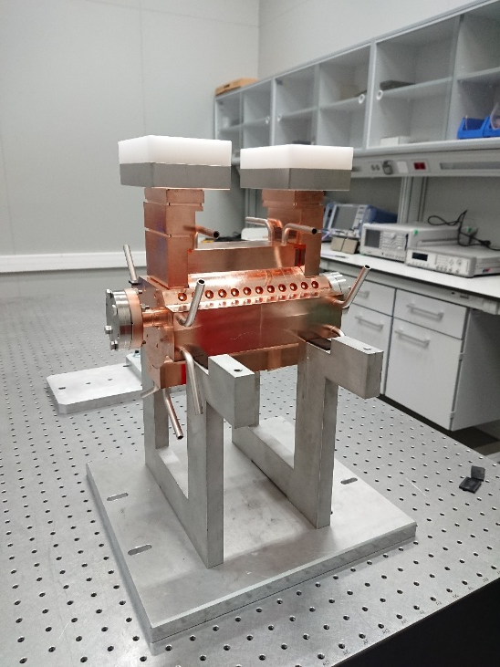
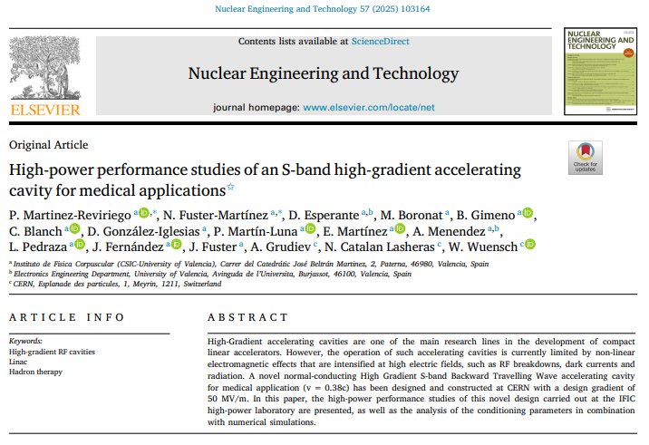
Outline
High power conditioning and Breakdown studies:
BTW cavity for medical applications:
Publication: https://doi.org/10.1016/j.net.2024.08.033
RFQ2 for Linac4 (ongoing):
Poster: https://indico.cern.ch/event/1424597/contributions/6532647/

Slide 4
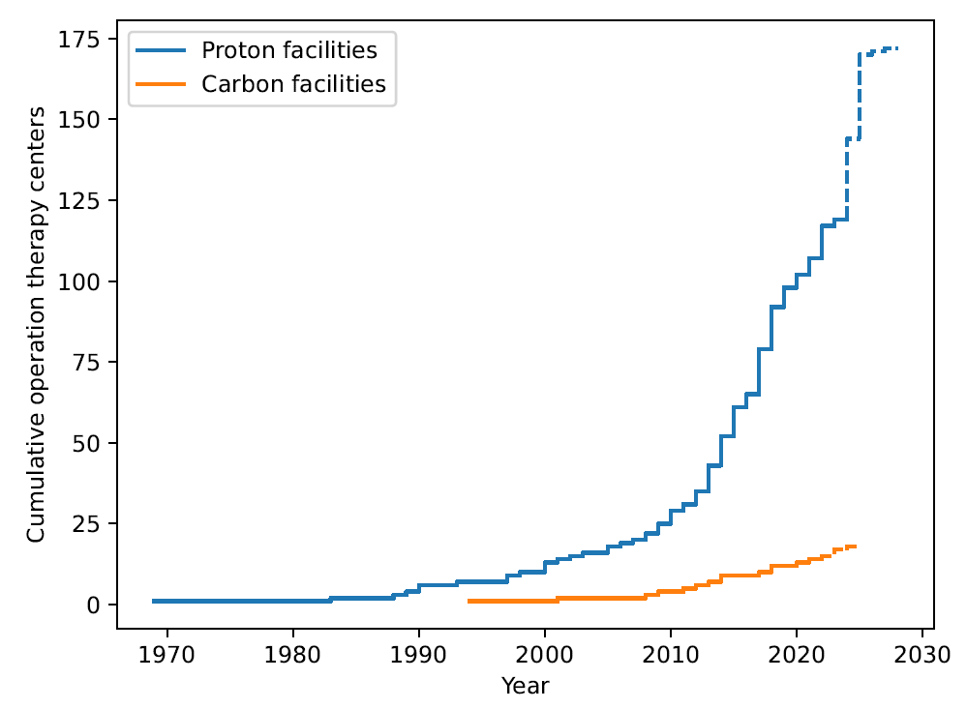
Hadron therapy
Accelerator | Beam always present during treatment? | Energy variation by electronic means? | Time needed for varying the energy
Cyclotron | Yes | No | 80-100 ms (*)
Synchrotron | No | Yes | 1-2 s
Linac | Yes | Yes | 1-2 ms
Hadron Therapy centres are growing fast, but all of them are based on circular machines
Advantages of linacs:
Fast dose delivery.
High beam quality.
High repetition rate.
Almost 100% of transmission: low radiation levels.
Technological challenges:
Large machines.
Complexity.

Slide 5
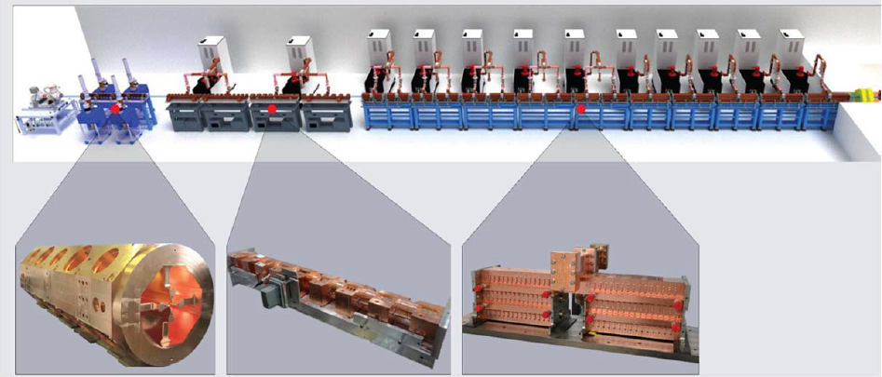
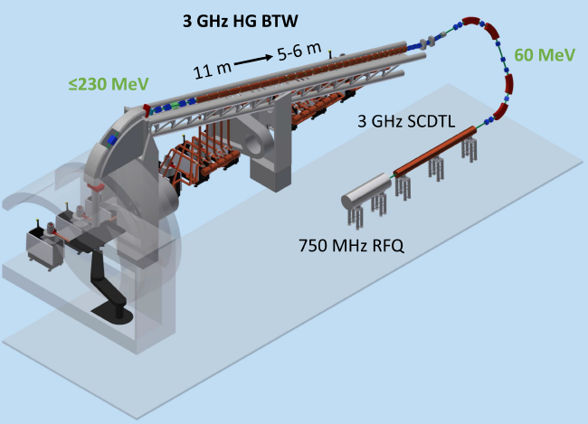
Linear accelerators for hadron therapy
LIGHT project by A.D.A.M
TULIP project
230 MeV proton beam at 200 Hz. Coupled Cavity Linac:
18-20 MV/m.
Total length ∼28 m.
230 MeV proton beam at 200 Hz.
BTW cavities: 40 MV/m.
Length reduced by a factor 2.

Slide 6
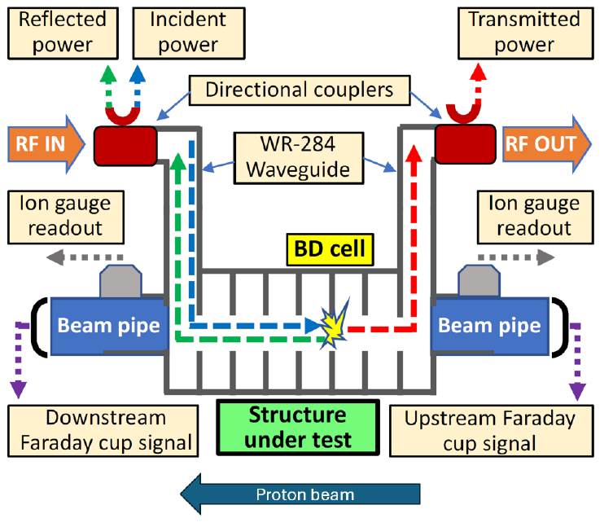
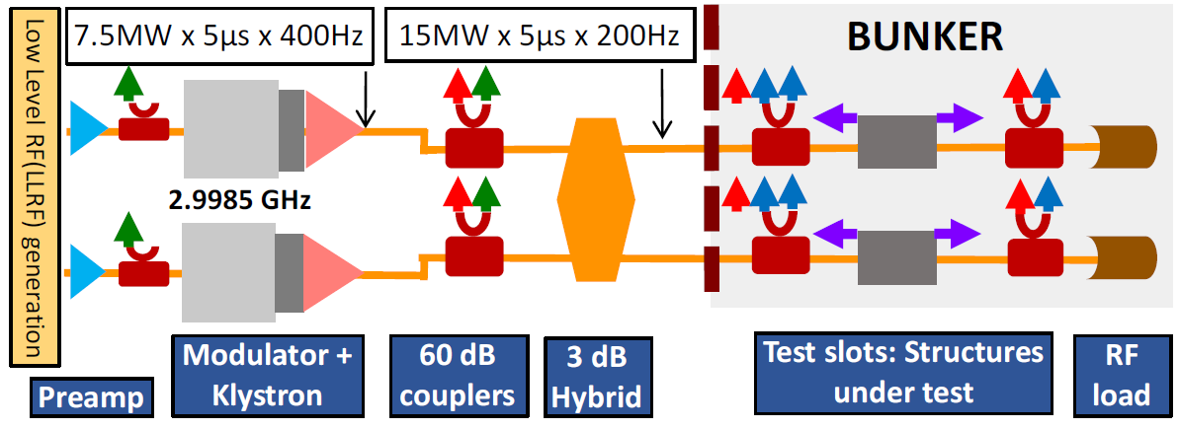
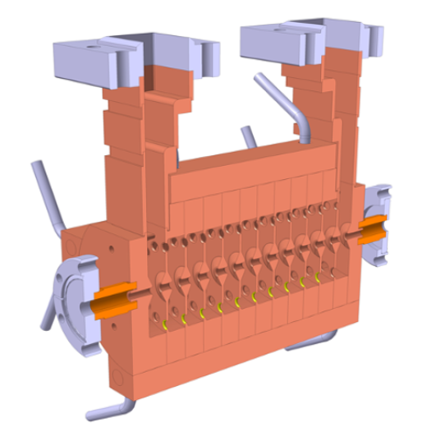
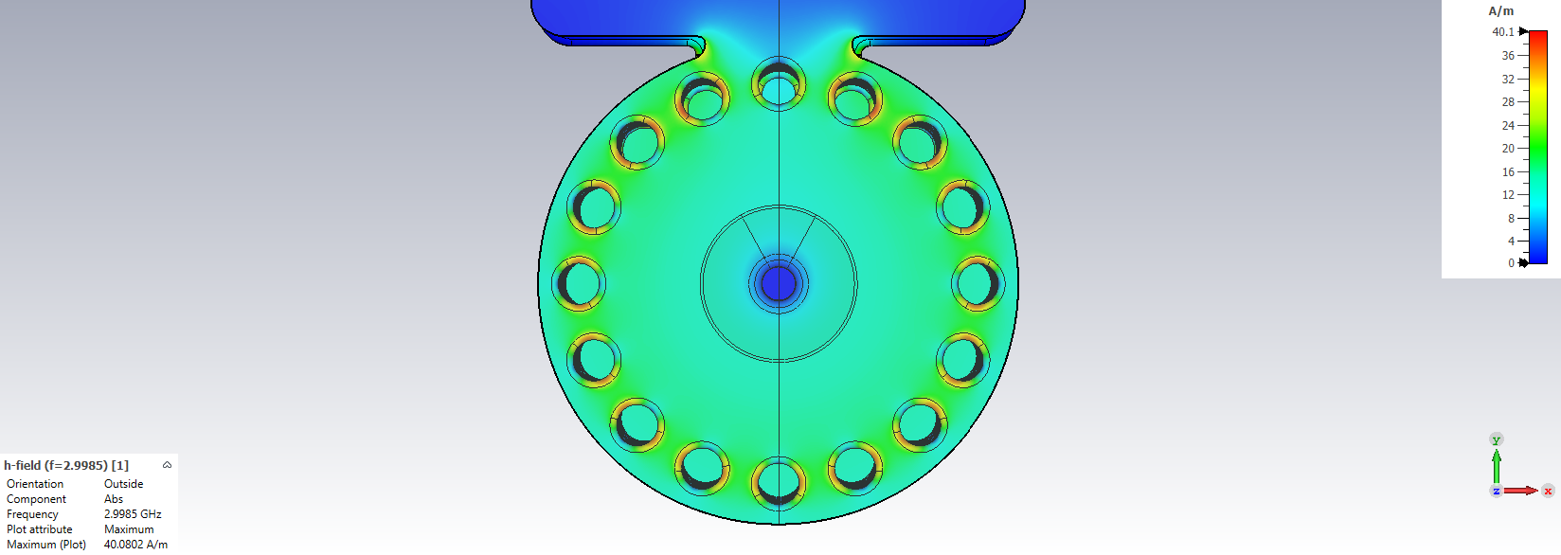
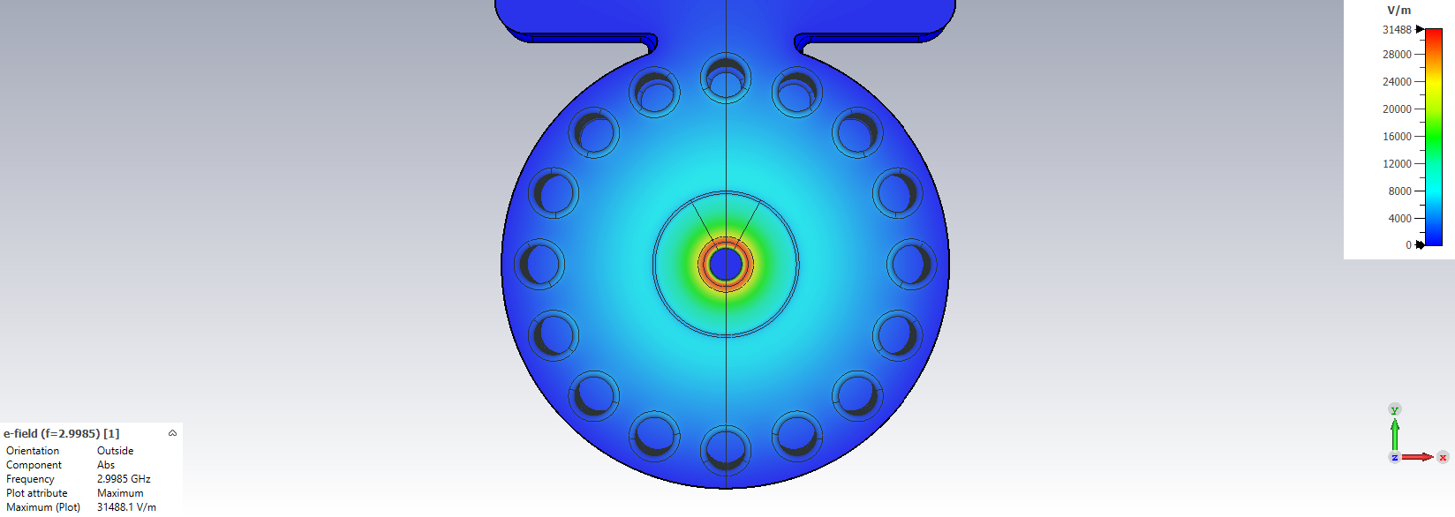
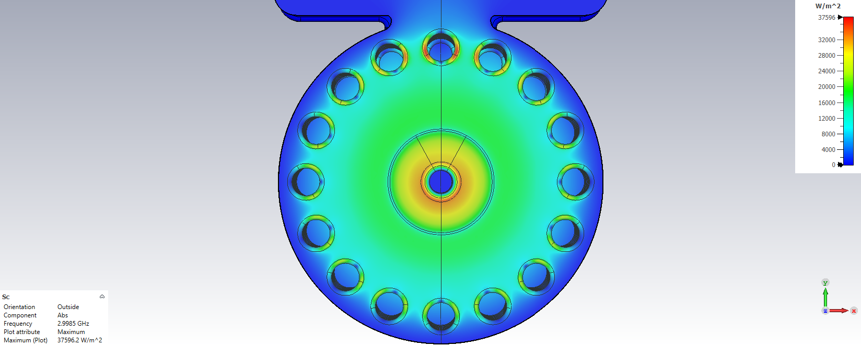

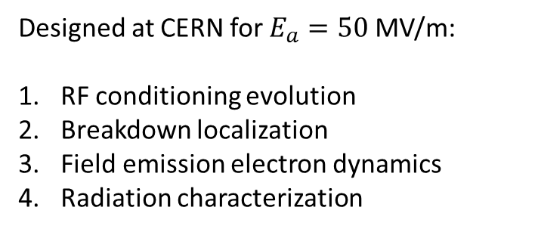


IFIC High-Power S-band facility and BTW structure
Designed at CERN for $E_{a}=50$MV/m:
RF conditioning evolution
Breakdown localization
Field emission electron dynamics
Radiation characterization
$E$-field
$H$-field
$$S_{c}$$
FC-Down

Slide 7
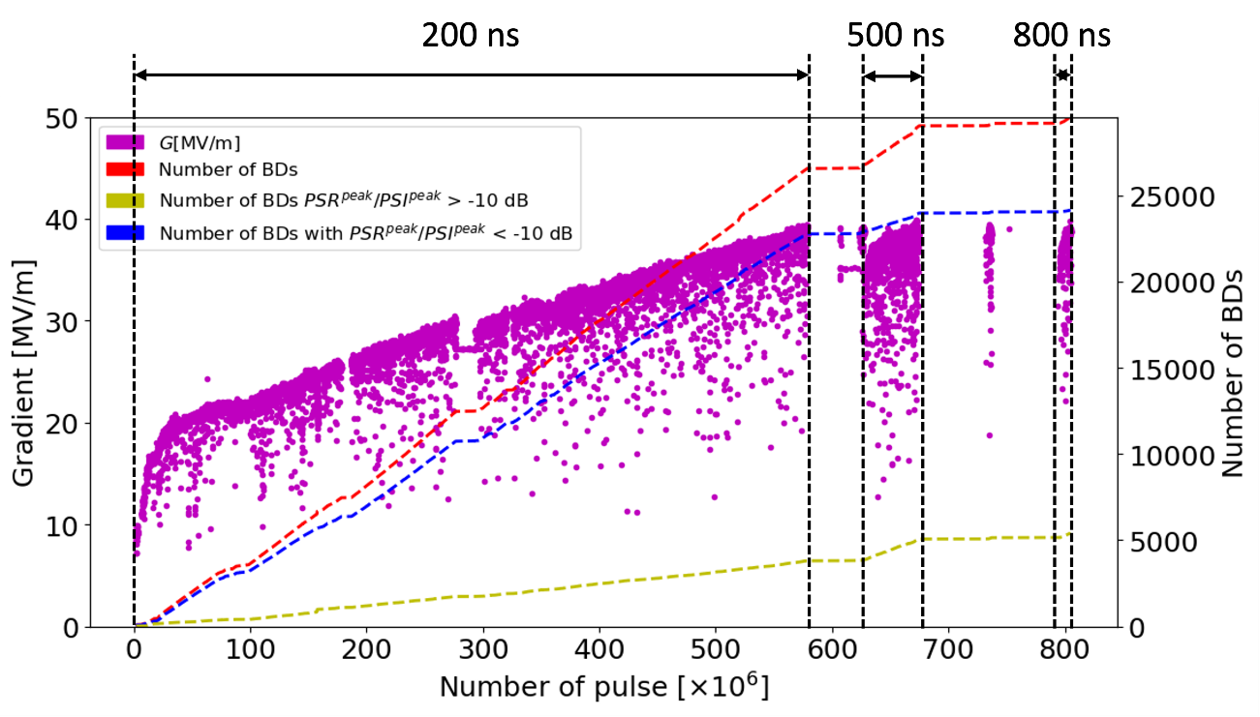
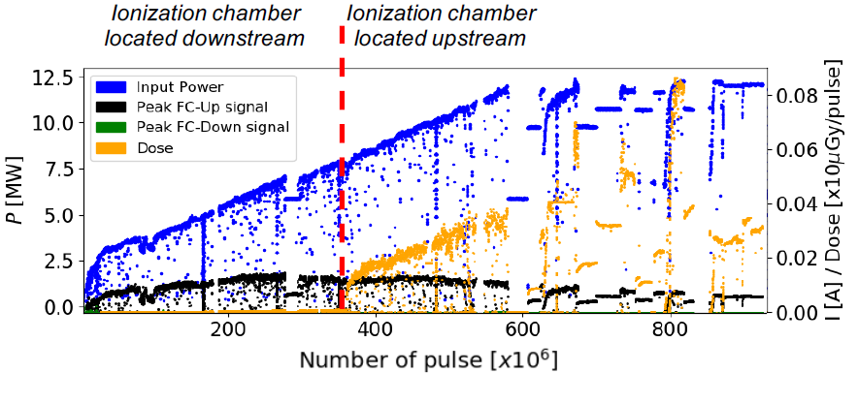
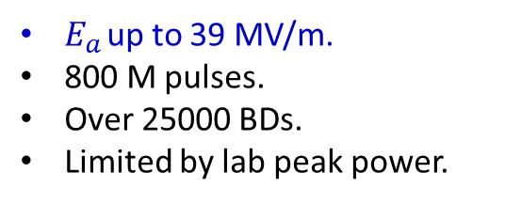
RF conditioning
$E_{a}$ up to 39 MV/m.
800 M pulses.
Over 25000 BDs.
Limited by lab peak power.
FC down signal ∼ 0.
FC up signal saturates.
Dose reduced with conditioning.
Pablo Martinez

Slide 8
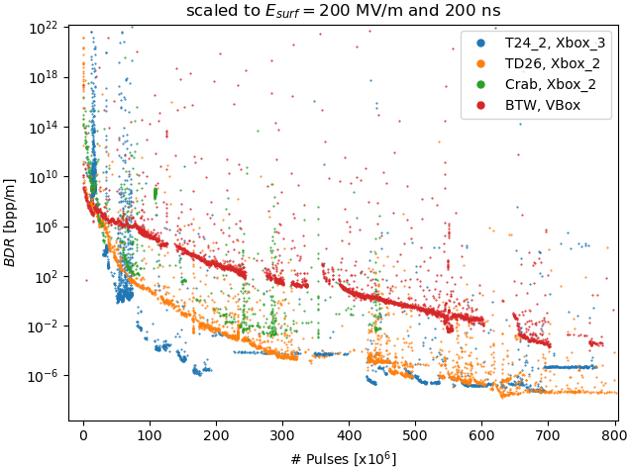
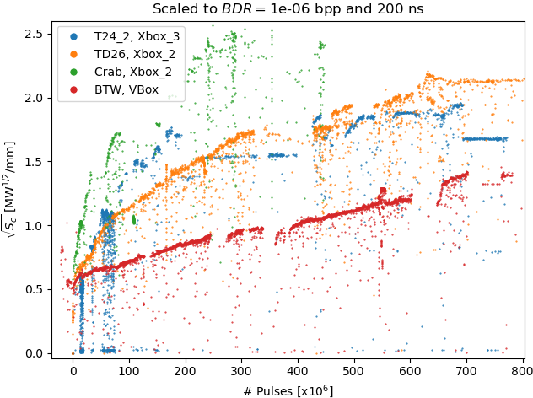
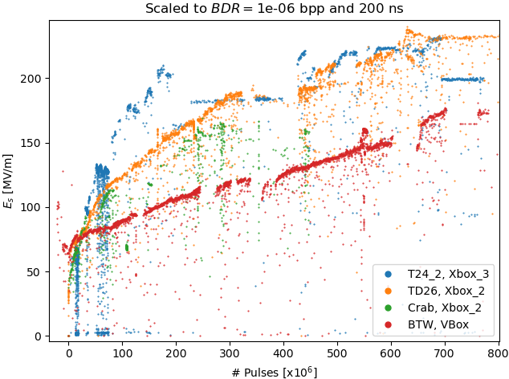

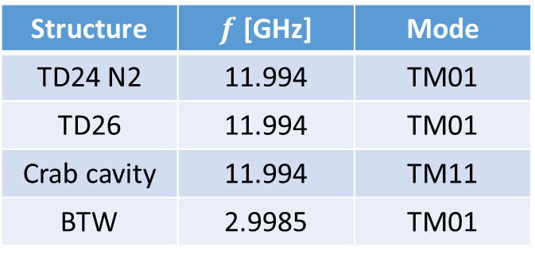
Comparison with other tests
Structure | $f$ [GHz] | Mode
TD24 N2 | 11.994 | TM01
TD26 | 11.994 | TM01
Crab cavity | 11.994 | TM11
BTW | 2.9985 | TM01
Normalization factor: $BDR∝E_{a}^{30}τ_{p}^{5}$

Slide 9
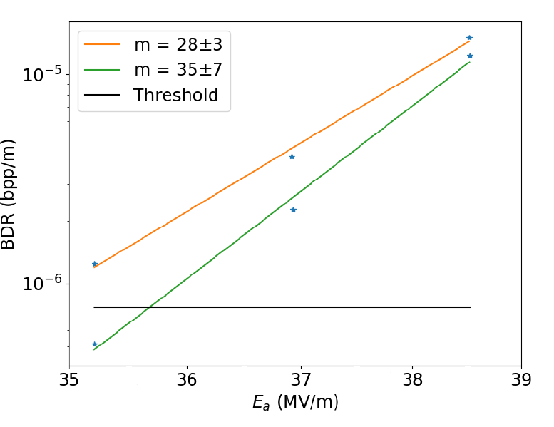
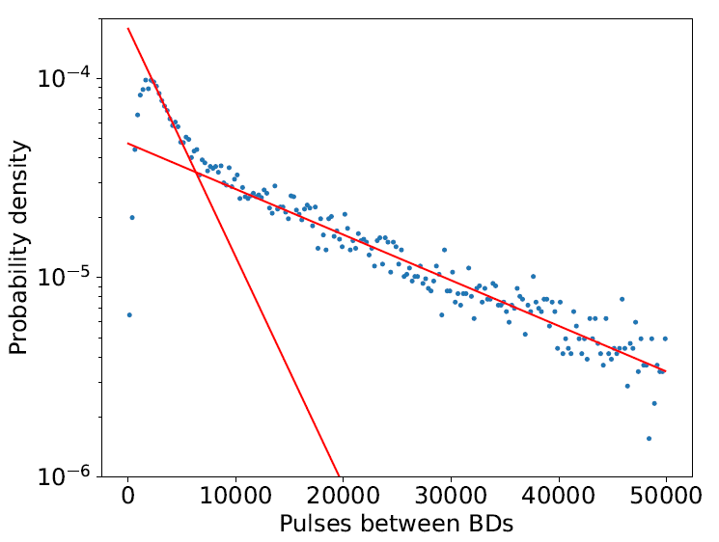

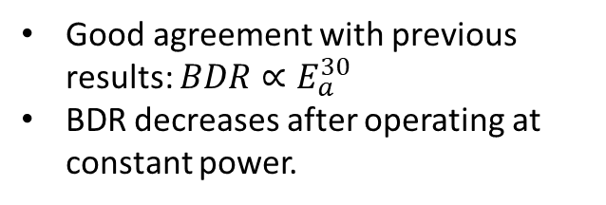
BD studies
Good agreement with previous results: $BDR∝E_{a}^{30}$
BDR decreases after operating at constant power.
Double exponential: tendency of BDs to produce clusters.
$$PDF=Ae^{−an}+Be^{−bn}$$

Slide 10
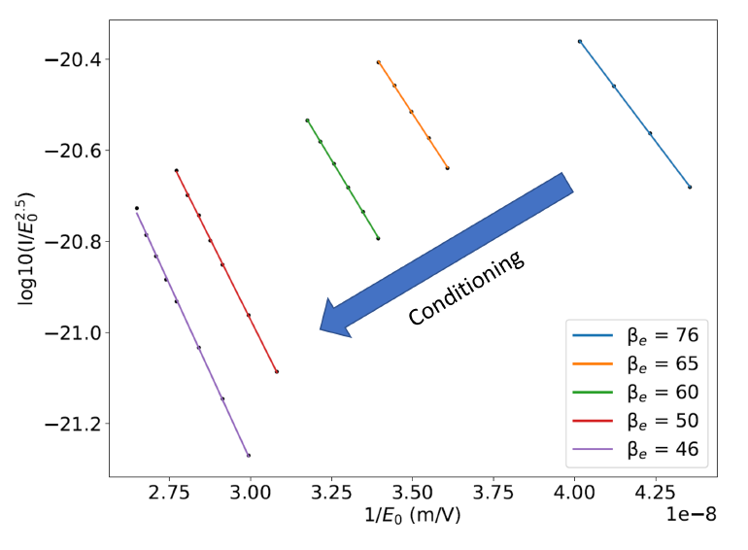
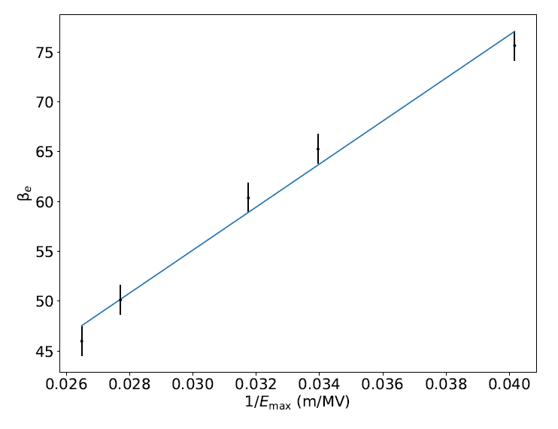


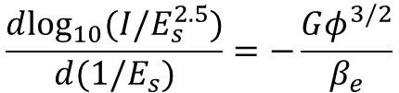
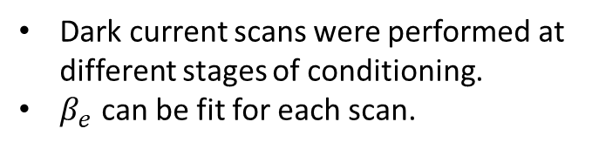
Enhancement factor evolution
Dark current scans were performed at different stages of conditioning.
$β_{e}$ can be fit for each scan.
$β_{e}$ evolution during conditioning.
$$\frac{d{\text{log}}_{10}(I/E_{s}^{2.5})}{d(1/E_{s})}=−\frac{Gφ^{3/2}}{β_{e}}$$
$$β_{e}E_{max}=\text{constant}$$

Slide 11
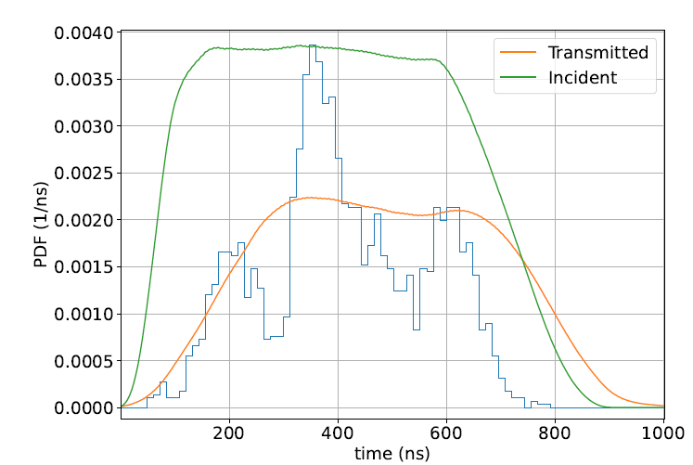
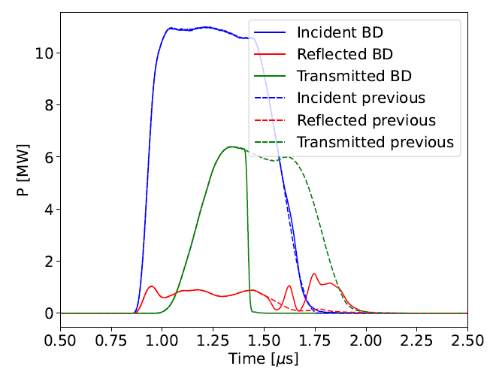
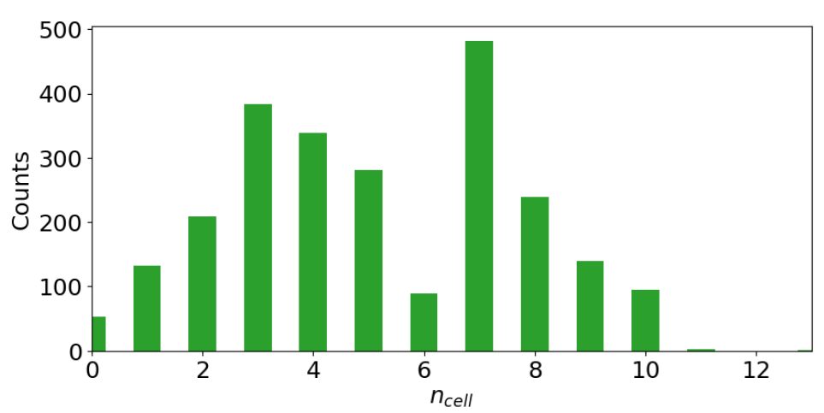

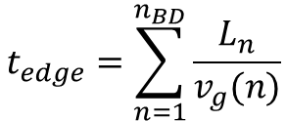
BD localization: Edge method
No hot cells detected
Search of reflection rise and transmission drop.
$$t_{edge}=\frac{Δt_{ref}−Δt_{tra}}{2}$$
$$t_{edge}=\sum_{n=1}^{n_{BD}}{\frac{L_{n}}{v_{g}(n)}}$$

Slide 12
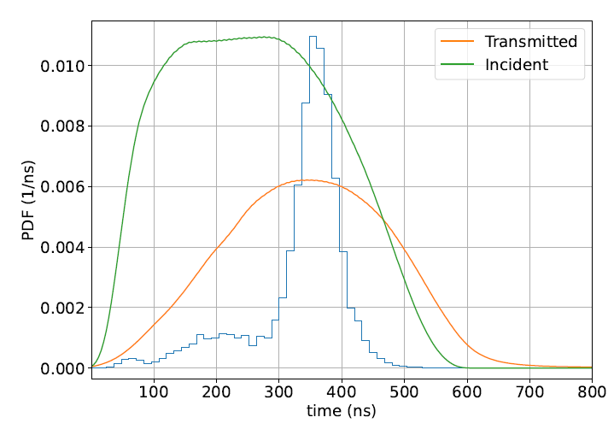
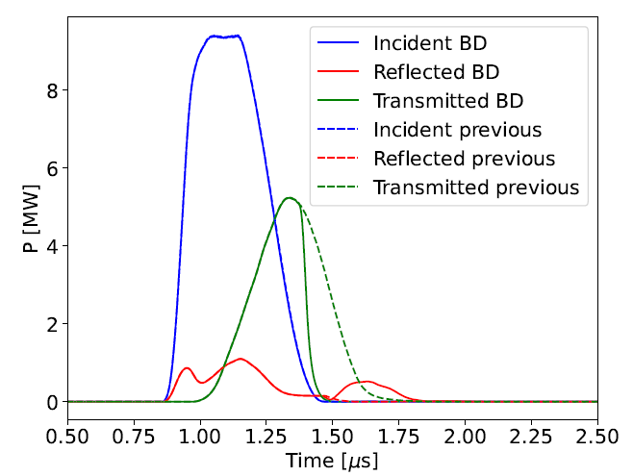
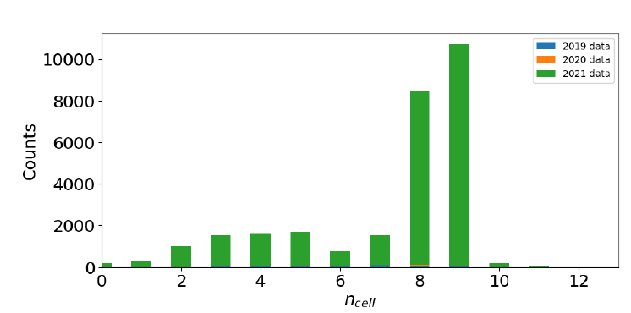
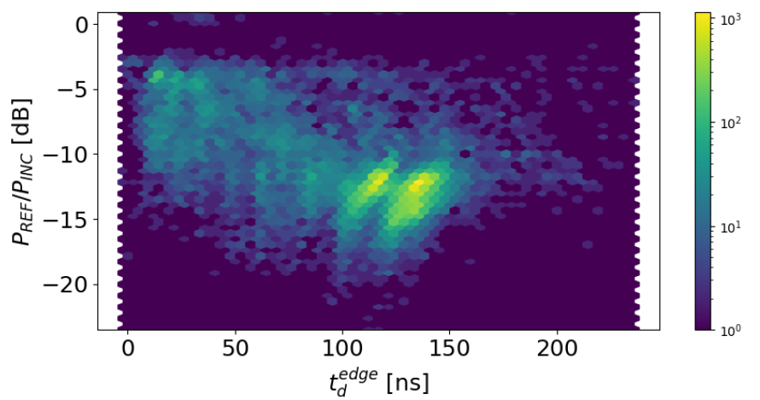
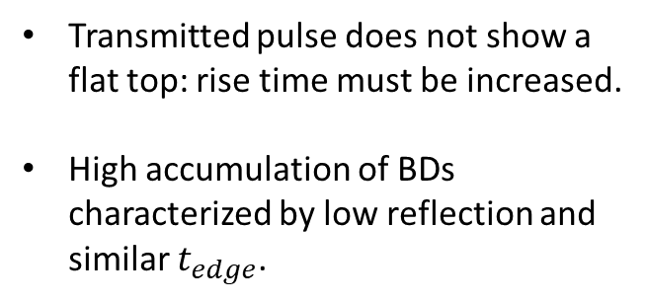
BD localization: Short pulses
Transmitted pulse does not show a flat top: rise time must be increased.
High accumulation of BDs characterized by low reflection and similar $t_{edge}$.

Slide 13
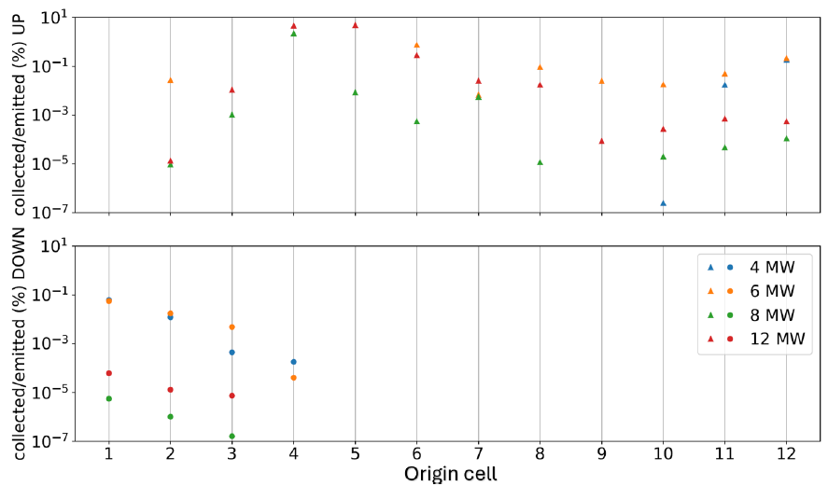
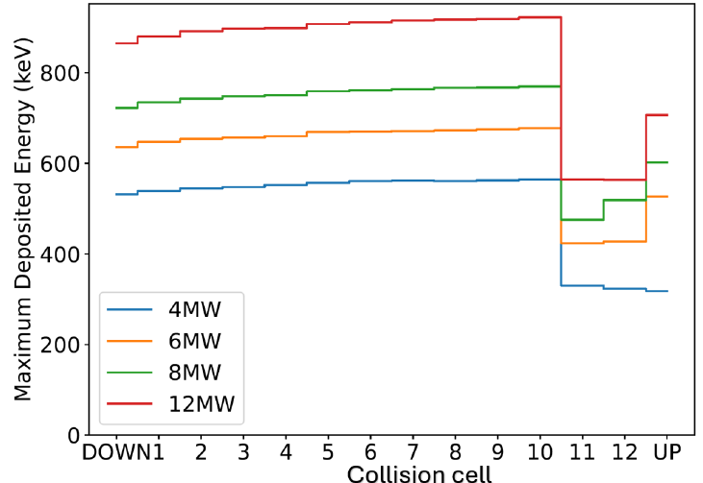
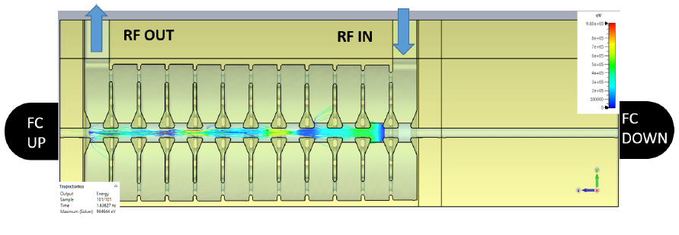


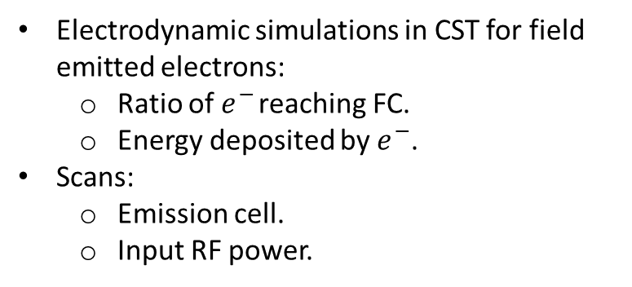

Dark current dynamic simulations
Electrodynamic simulations in CST for field emitted electrons:
  Ratio of $e^{−}$ reaching FC.
  Energy deposited by $e^{−}$.
Scans:
  Emission cell.
  Input RF power.
$e^{−}$ travelling
Down
$e^{−}$ travelling
Up
$$β=0.38$$

Slide 14
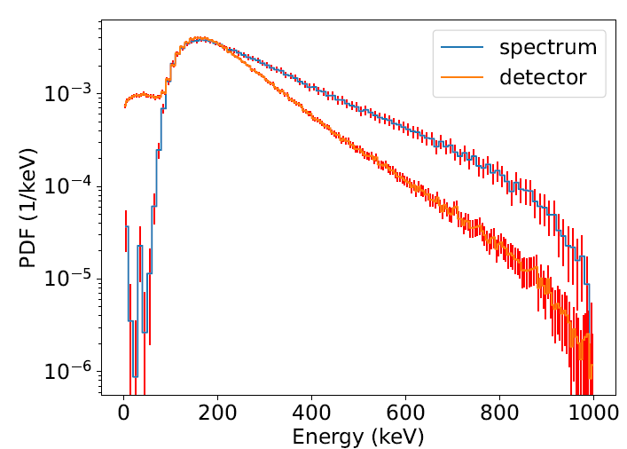
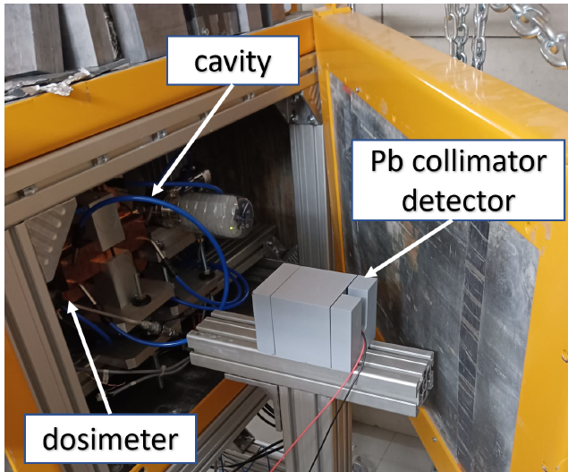
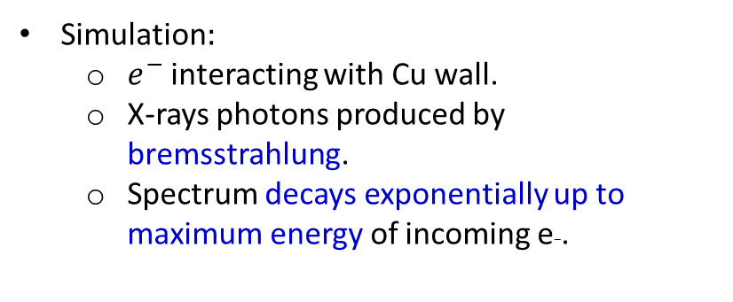
Radiation simulations and measurements
Simulation:
  $e^{−}$ interacting with Cu wall.
  X-rays photons produced by bremsstrahlung.
  Spectrum decays exponentially up to maximum energy of incoming e−.
Measurement challenge:
  High fluence of photons during RF pulse: huge pile-up.
Solution:
  Small CeBr3 scintillating crystal detector.
  Pb collimator system: Holes of 4 and 2 mm.
  Measurements directly from PMT.

Slide 15
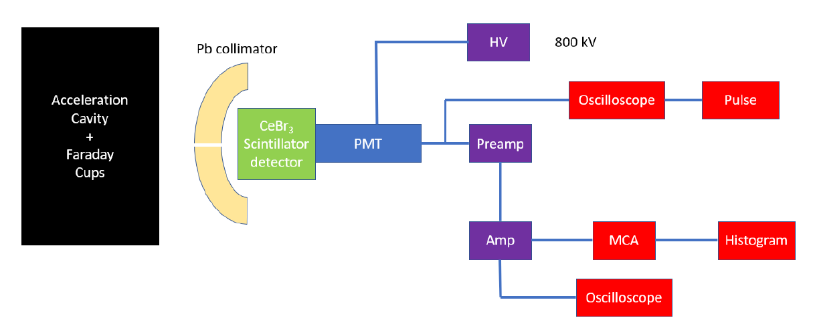
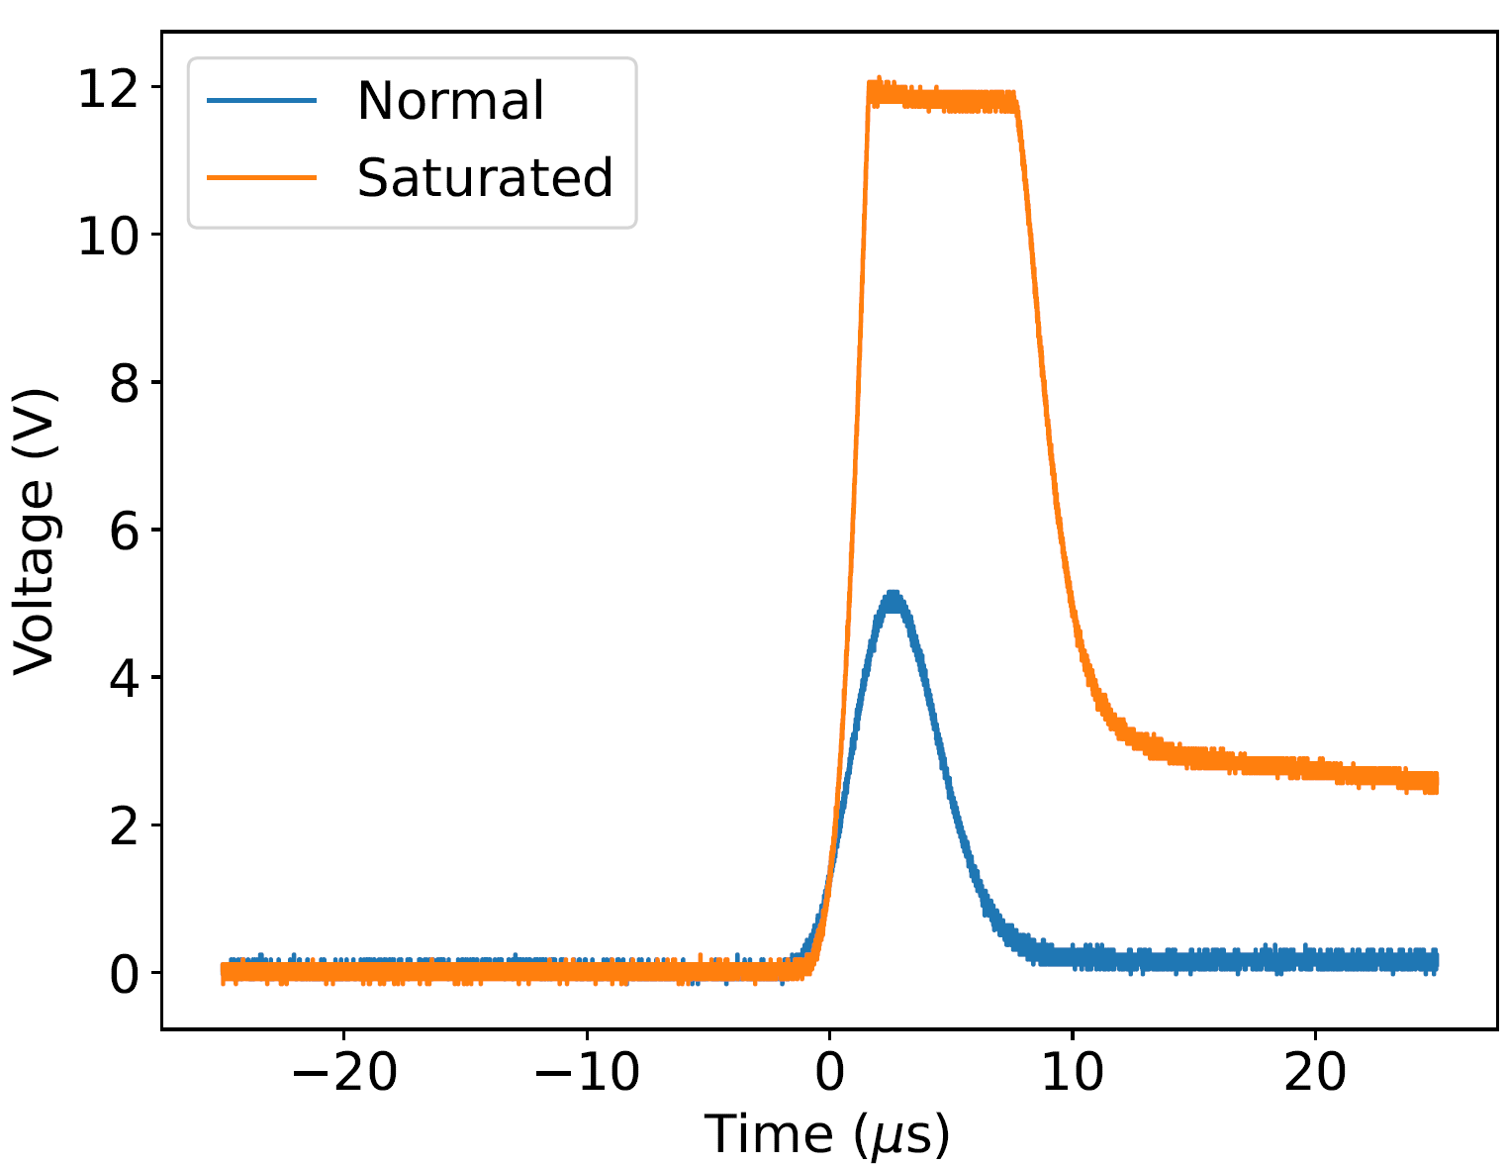
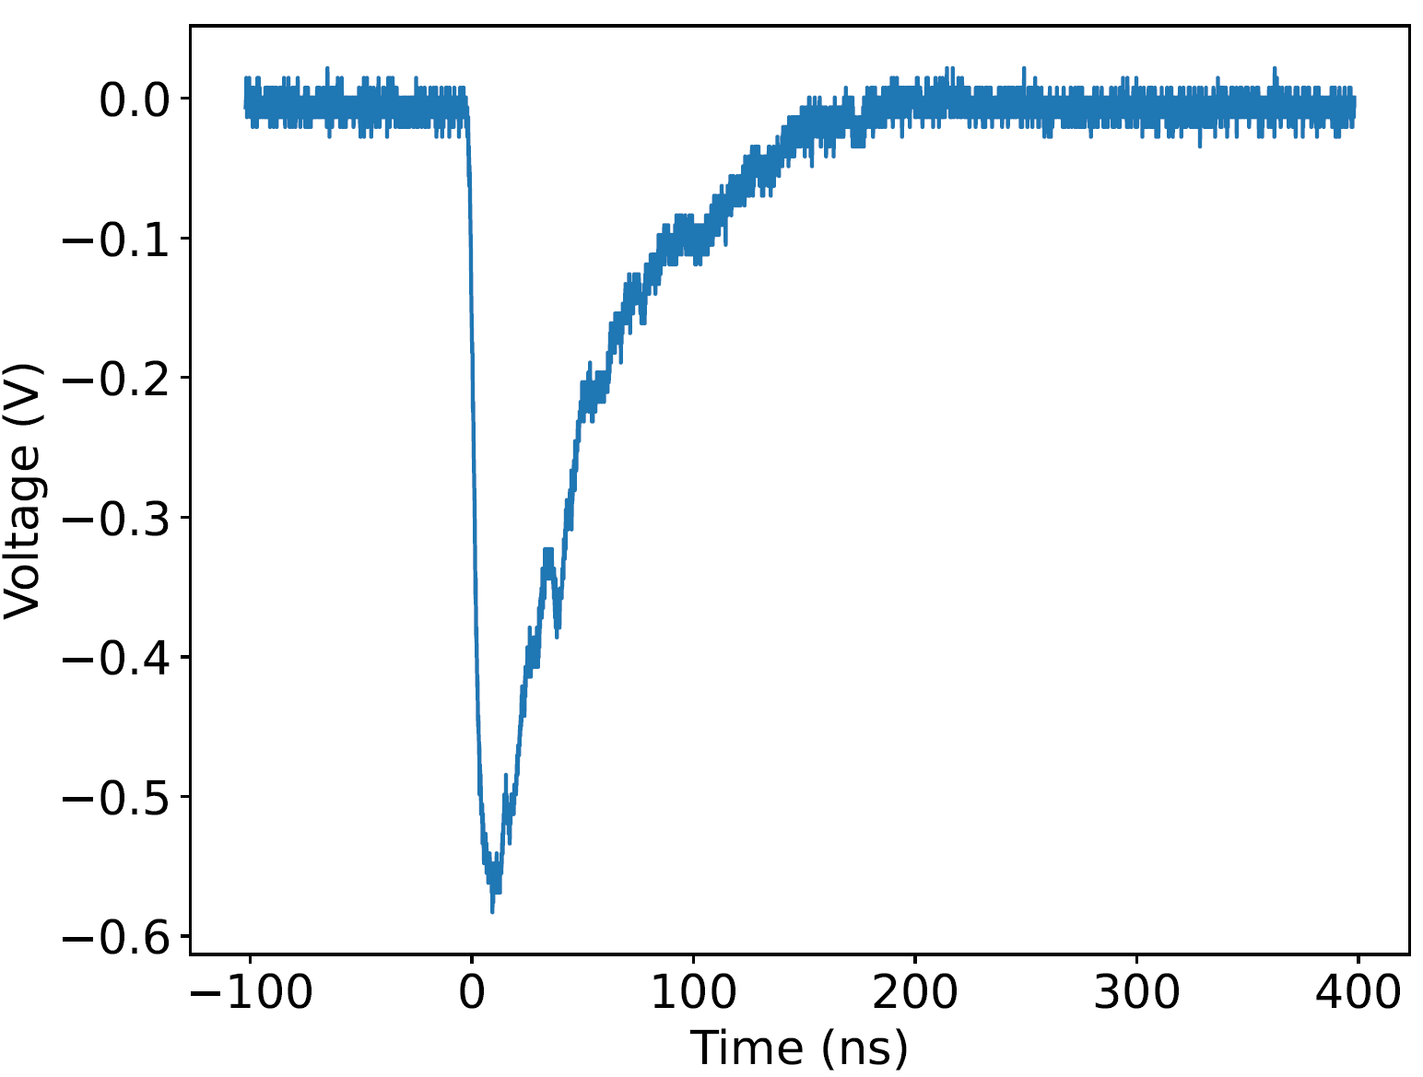
Spectrum measurement set-up
Pulse Amp
Pulse PMT

Slide 16
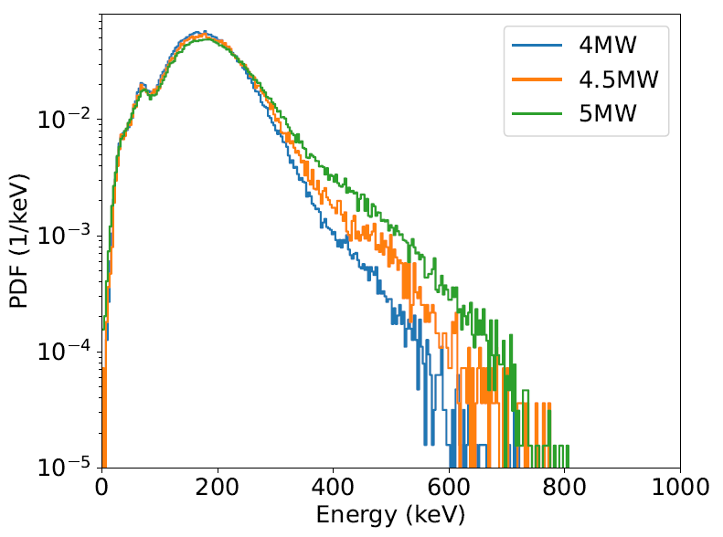
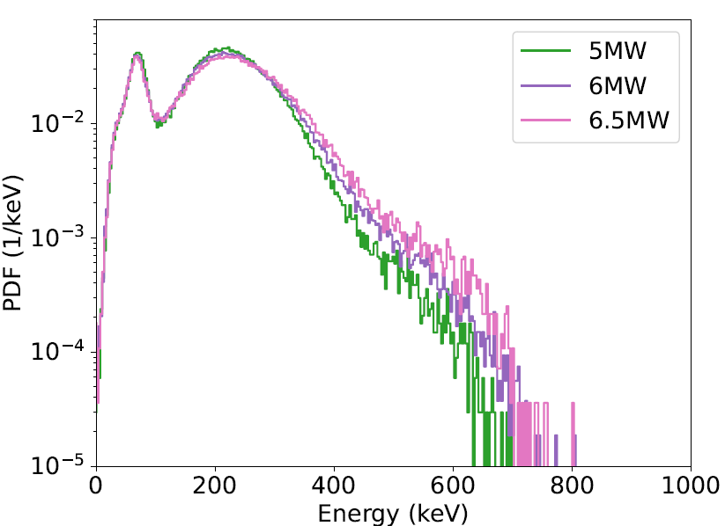
Spectrum measurements
4 mm hole
2 mm hole
Maximum energy of photons in agreement with dark current $e^{−}$ simulations.
Measurement campaign stopped due to a klystron mulfunctioning.

Slide 17
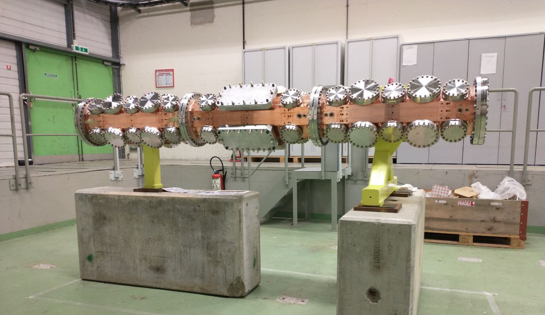
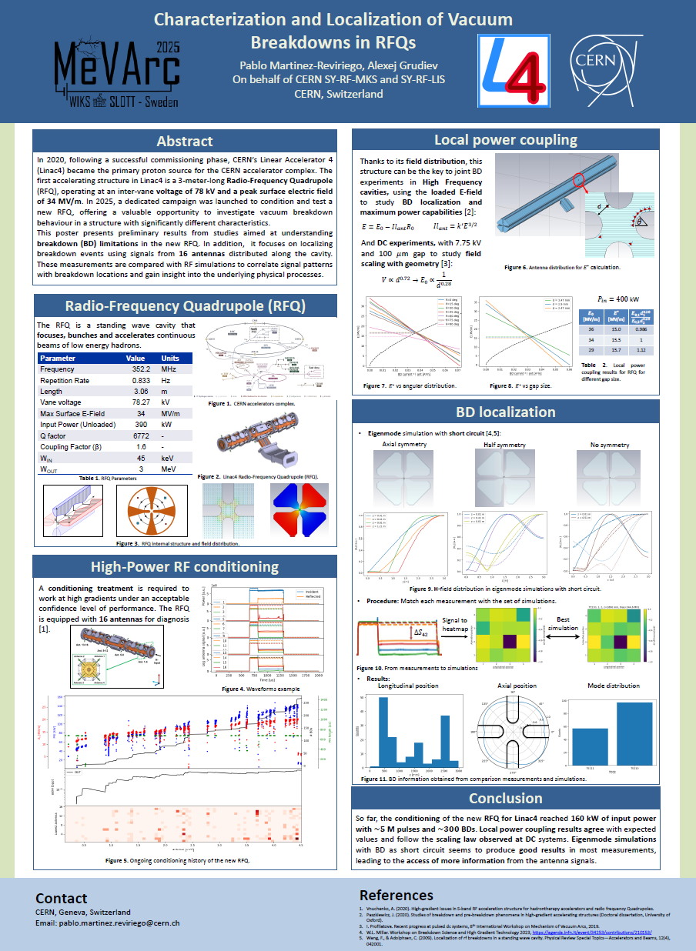
Outline
High power conditioning and Breakdown studies:
BTW cavity for medical applications:
Publication: https://doi.org/10.1016/j.net.2024.08.033
RFQ2 for Linac4 (ongoing):
Poster: https://indico.cern.ch/event/1424597/contributions/6532647/

Slide 18
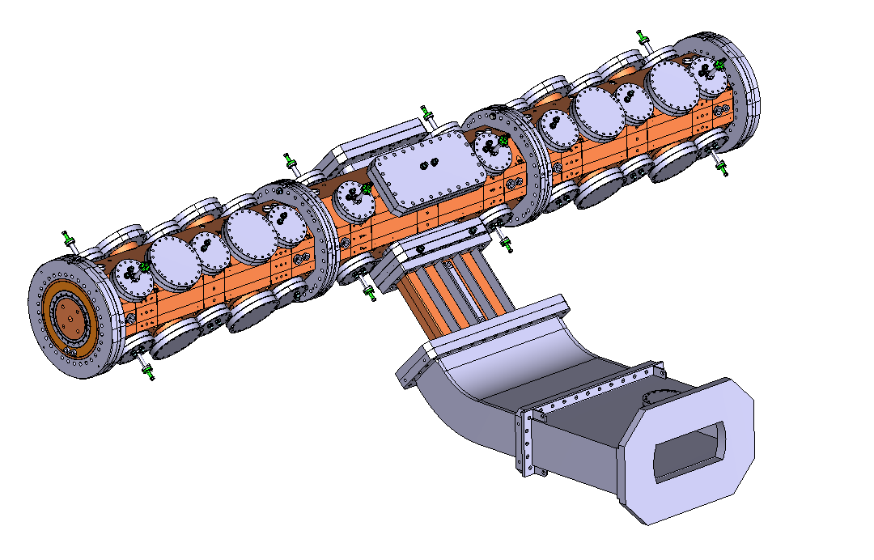



Radio Frequency Quadrupole (RFQ)
$\sim 3$ m structure that focuses, bunches and accelerates continuous beam of low energy hadrons (few MeV)

Slide 19

The Linac4 RFQ
Surface damage observed in Linac4 RFQ
Critical element in CERN proton chain: No spare
Hypothesis:
$H^{−}$ irradiation $→$ Degradation $→$ More BDs
Serafim, C., Calatroni, S., Djurabekova, F., Peacock, R., Bjelland, V., Perez-Fontenla, A. T., ... & Sargsyan, E. (2025). Effects of H− low beam irradiation and high field pulsing tests in different metals. Physical Review Accelerators and Beams, 28(1), 013101.
Solution:
New RFQ fabrication and conditioning
Great opportunity for BD studies!
Limitation: New RFQ must survive the conditioning

Slide 20





A very different structure
Parameter | CLIC T24 | Crab cavity | BTW (hypothetical) | RFQ
Type | Travelling wave | Travelling wave | Travelling wave | Standing wave
Mode | TM01 | TM11 | TM01 | TE210
$f$[GHz] | 11.994 | 11.994 | 2.9985 | 0.352
Length [m] | 0.2 | 0.24 | 0.190 | 3.06
Repetition Rate [Hz] | 20 - 200 | 50 | 20 - 200 | 0.833
Pulse length [$μ$s] | 0.2 | 0.2 | 2.5 | 1000
$P_{in}$ [MW] | 42.4 | 40 | 33 | 0.4
Max. E-field [MV/m] | 220 | 154 | 281 | 34
Max. H-field [kA/m] | 410 | 505 | 319 | 5.17
Max. $S_{c}$ [MW/${\text{mm}}^{2}$] | 3.4 | 5.48 | 5.13 | 0.01
$E^{∗}$ [MV/m] | 123 | 105 | 115 | ?
Paszkiewicz, J. (2020). Studies of breakdown and pre-breakdown phenomena in high-gradient accelerating structures (Doctoral dissertation, University of Oxford).

Slide 21






Field distribution
Large Electrode System (LES)
E-field
$$V_{0}∝d^{0.72}$$
RFQ cross section:
TE210 mode
$$E_{0}∝\frac{1}{d^{0.28}}$$
I. Profilatova, Recent progress at pulsed dc systems, 8th International Workshop on Mechanism of Vacuum Arcs, 2019.
H-field
Parameter | RFQ | LES
$f$[MHz] | 352 | 0
Repetition Rate [Hz] | 0.833 | 1 - 6000
Pulse length [$μ$s] | 1000 | 1 - 1000
Gap [mm] | 2.3 | 0.1
Voltage [kV] | 78 | 7.75
Max. E-field [MV/m] | 34 | 77.5
Large separation between electric and magnetic field
RFQ might be a key to connect High Frequency and DC

Slide 22





Local power coupling simulation
Angular dependence
$$θ$$
Paszkiewicz, J. Local power coupling as a predictor of high-gradient breakdown performance. High Gradient Workshop 2021.
Notes:
Antenna length: 1 mm
$k_{l}=5.4×{10}^{−9} {\text{Am}}^{3/2}{\text{V}}^{−3/2}$

Slide 23





Local power coupling simulation
Gap dependence At $P_{in}=400$ kW
$$d$$
d [mm] | $E_{0}$[MV/m] | $E^{∗}$ [MV/m] | $$\frac{{E_{0,1}d}_{1}^{0.28}}{{E_{0,2}d}_{2}^{0.28}}$$
2.47 | 36 | 15.0 | 0.986
2.9 | 34 | 15.5 | 1
3.47 | 29 | 15.7 | 1.12
$d↓ → C↑ → f↓$
$d↓ → E_{0}↑$
$d↓ → R_{0}↓$

Slide 24


RFQ measurements
Reflected power increases: Different coupling
Antennas show different behavior: BD localization
Vnuchenko, A. (2020). High-gradient issues in S-band RF acceleration structure for hadrontherapy accelerators and radio frequency Quadrupoles

Slide 25

RFQ conditioning (ongoing work)
Experimental set-up:
Incident power
Reflected power
16 antenna signals
Lack of:
Transmitted power
Dark current
How can we localize BDs?

Slide 26





BD simulation
Axial symmetry
Half symmetry
No symmetry
Up right
Down right
Up
Up left
Down
Down left
Wang, F., & Adolphsen, C. (2009). Localization of rf breakdowns in a standing wave cavity. Physical Review Special Topics—Accelerators and Beams, 12(4), 042001

Slide 27






From measurement to simulation
Most similar simulation
Normalization:
$$ΔS_{42}$$
$$ΔS_{ij}=\frac{ΔS_{ij}−ΔS_{min}}{ΔS_{max}−ΔS_{min}}$$
W.L. Millar. Workshop on Breakdown Science and High Gradient Technology 2023, https://agenda.infn.it/event/34253/contributions/210153/

Slide 28



What information can be obtained?
Measurement and simulation agreement
BD longitudinal position
Most similar mode distribution

Slide 29




Axial position
12 and 1 type BD can be rotated by integers of $π/4$
0
12
Sum of all BDs
1
V1
V2
V4
Power Coupler
V3

Slide 30
Conclusions
BTW structure:
  A maximum gradient of 39 MV/m was achieved with 800 ns pulses without saturation.
  No hot cells detected.
  Dark current simulations show good agreement with experimental observations.
  Spectroscopy measurements showed good results. Klystron malfunction stopped measurements campaign.
  Dose decreases with conditioning. HG linacs produce high radioactive dose, requiring shielding.
Radio-Frequency Quadrupole:
  Local power coupling simulations agree with BD location and field gap dependence in DC.
  First conditioning curve for an RFQ structure (ongoing).
  Testing of method to compare antenna signals and BD localization simulation.
THANK YOU!

Slide 31
Back up

Slide 32


Hadron therapy
Accelerator | Beam always present during treatment? | Energy variation by electronic means? | Time needed for varying the energy
Cyclotron | Yes | No | 80-100 ms (*)
Synchrotron | No | Yes | 1-2 s
Linac | Yes | Yes | 1-2 ms
Relative Biological Effectiveness (RBE)
Linear Energy Transfer (LET)
Marx, V. (2014, April 4). Sharp shooters. 508. Nature, p. 137

Slide 33






Some pulses

Slide 34

The S-band BTW structure

Slide 35



Tapering
Design direction
The tapering makes the structure asymmetrical in the longitudinal direction
Opposite direction

Slide 36





BD localization: Phase method
$Δφ$ is highly affected by $ΔT$
Accumulation of BDs in agreement with short pulses
Search for BD phase.
$$φ_{BD}=φ_{REF}\left(t+t_{d}\right)−φ_{INC}\left(t\right)$$
Cell localization.
$$φ_{BD}=2Δφn_{BD}+φ_{0}$$

Slide 37


Hole size impact
Small hole: Photons must pass through small Pb region. Attenuation is higher for photons of lower energy.
Big hole: Photons can reach directly to the detector.

Slide 38




Local power coupling
Peak power demand during breakdown onset!
$$Il_{ant}=k^{′}E^{3/2}$$
voltage
current
$$E=E_{0}−Il_{ant}R_{0}$$
power
time
Field emission,
no plasma, tiny currents
Fully formed plasma
Voltage collapse
$$k^{′}R_{0}E^{∗3/2}+E^{∗}−E_{0}=0$$
Onset of breakdown and plasma formation

Slide 39





BD simulation
Before BD:
Mostly TE210 is excited
Close to critical coupling
TE110
TE112
TE210
Input power
After BD:
Different eigenmode $f, Q_{0}, Q_{ext}$
New field distribution

Slide 40







Measurement normalization
$$ΔS_{42}$$
Normalization 1:
Normalization 2:
$$ΔS_{ij}=\frac{ΔS_{ij}−ΔS_{min}}{ΔS_{max}−ΔS_{min}}$$
Normalization 3:
Linear
$$ΔS_{ij}=ΔS_{ij}−ΔS_{min}$$

Slide 41




Simulation normalization
Linear (Normalization 3)
To dB (Normalization 2)
Normalization 1:
$$ΔS_{ij}=\frac{ΔS_{ij}−ΔS_{min}}{ΔS_{max}−ΔS_{min}}$$

Slide 42





Error minimization
Measurement
$$\text{error}=\sqrt{\sum_{i=1}^{16}{{\left(ΔS_{i}^{sim}−ΔS_{i}^{meas}\right)}^{2}}}$$
1
2
3
4

Slide 43




Local power coupling
Angular dependence
Longitudinal dependence
Quadrant dependence
Antenna length: 1 mm
$k_{l}=5.4×{10}^{−9} {\text{Am}}^{3/2}{\text{V}}^{−3/2}$
$$θ$$

Slide 44

BD distribution RFQ1

Slide 45


RFQ measurements
BD recovery and soon activation with the same antenna pattern
Reflected power increases: Different coupling
Antennas show different behavior: BD localization
Consecutive BDs (1 s separation) with the same antenna pattern
Vnuchenko, A. (2020). High-gradient issues in S-band RF acceleration structure for hadrontherapy accelerators and radio frequency Quadrupoles

