Slide 1

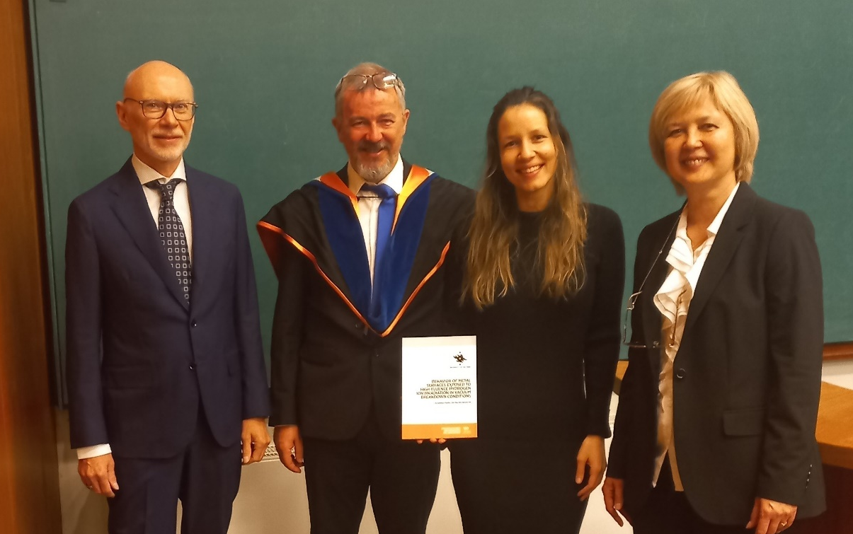
Effect of Cu surface blistering on vacuum breakdown
Alvaro Lopez Cazalilla, Flyura Djurabekova
Helsinki Institute of Physics, University of Helsinki,
Finland
Catarina Da Palma Serafim, Sergio Calatroni
CERN
Switzerland
Faculty of Science Department of Physics Alvaro Lopez Cazalilla
1.6.2025
1

Slide 2
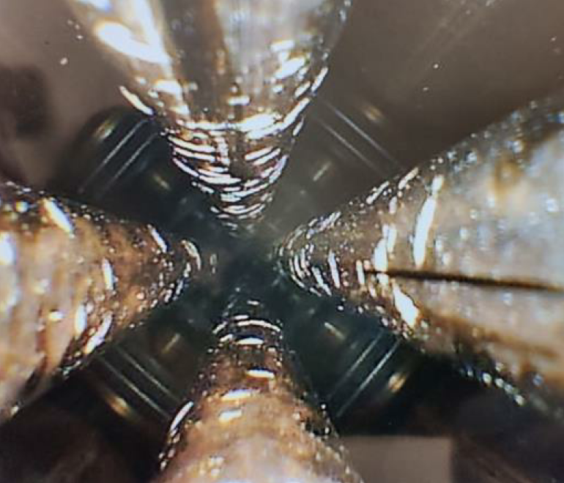
RFQ in a heart of LINAC
Radio-Frequency-Quadrupole (RFQ) - belongs to the Linear accelerator which is the first stage of acceleration towards the LHC, at CERN.
  Study alternative materials with a better performance to a future manufacturing of a new RFQ.
    Need to understand the origin of enhanced breakdown and find a mitigation
    Can blistering influence the lower performance?
    Find materials more resistant to breakdown phenomenon
Surface damages from vacuum breakdowns and H implantation found inside RFQ’s vanes
Inspection of RFQ interior vanes during the long shut-down, 2019

Slide 3
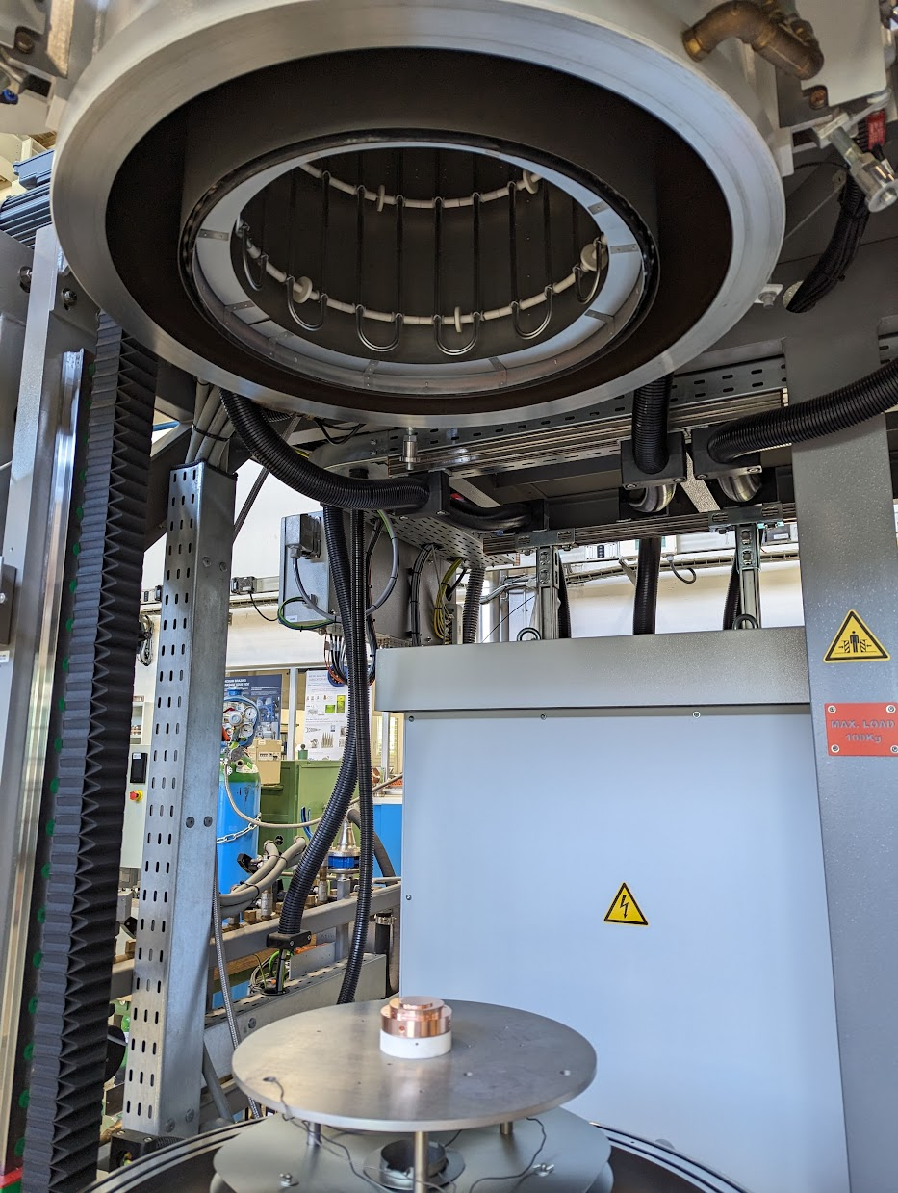
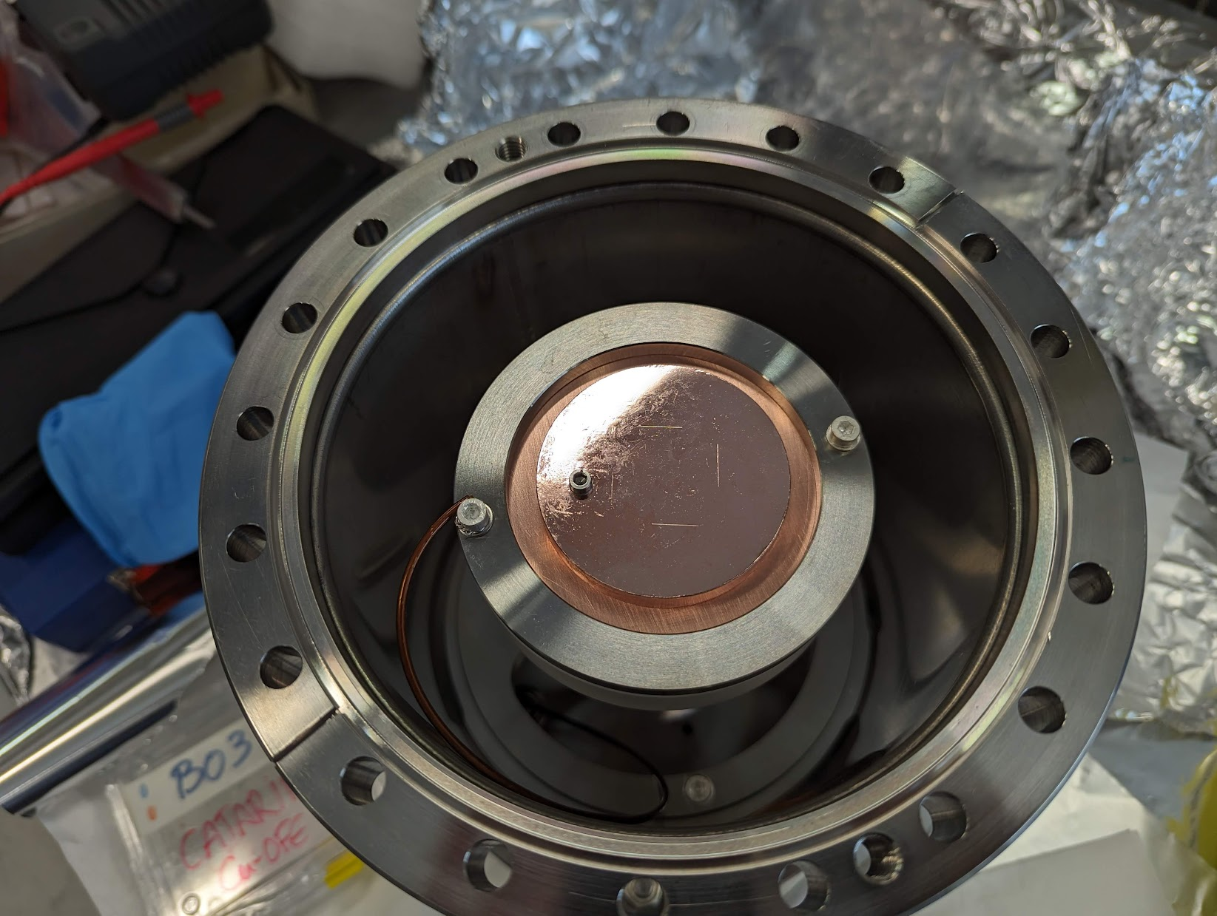
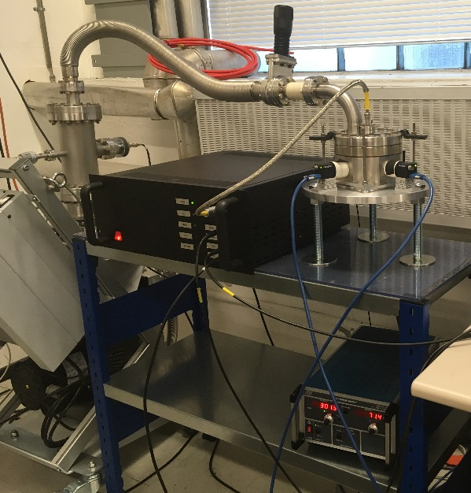
Materials for the study
Materials were selected based on their:
  Usability for meter-long high gradient RF structures
  Potential resistance to blistering (trying to limit hydrogen blister formation)
  Resistance to breakdown phenomena
Selected Materials | Source of manufacturing | Quantity
Cu-OFE | Purchase from external company | 2 pairs of anode-cathode electrodes
TiAl6V4 | Machined at CERN Workshop | 2 pairs
Nb | Machined at CERN Workshop | 2 pairs
CuCr1Zr | Machined at CERN Workshop | 2 pairs
CuBe2 | Purchase from external company | 2 pairs
Ta | Machined at CERN Workshop | 2 pairs
SS316LN | Machined at CERN Workshop
1 - Irradiation with H- beam
Testing
2 - High Voltage Pulsing testing
Before testing, electrodes have been through a preparation phase:
  Manufacturing/Machining
  Metrology and SEM finishing surface analyses
  Surface cleaning
  Thermal treatments

Slide 4
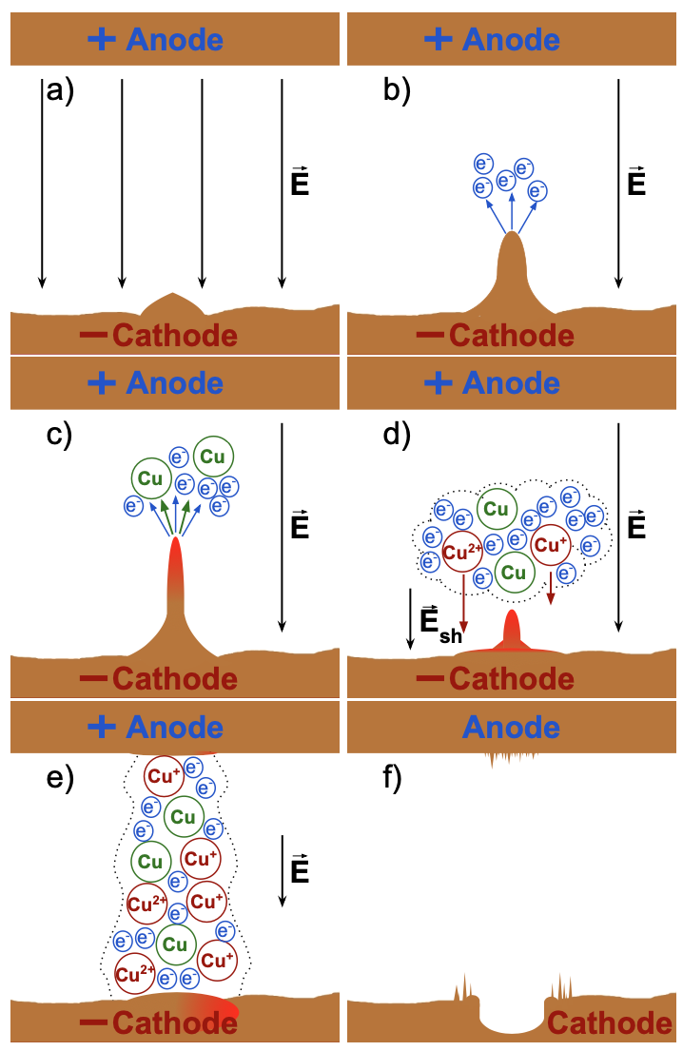
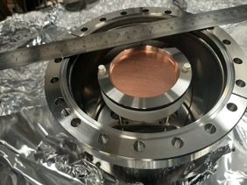
Study hypothesis
Testing
- Irradiation with H- beam
- High Voltage Pulsing testing
Vacuum Breakdown
When applying a high voltage potential, if the electric field on the surface is high enough, the emissions of neutrals, and their sequential ionization will form a conductive plasma within our gap and allow the flow of current.

Slide 5
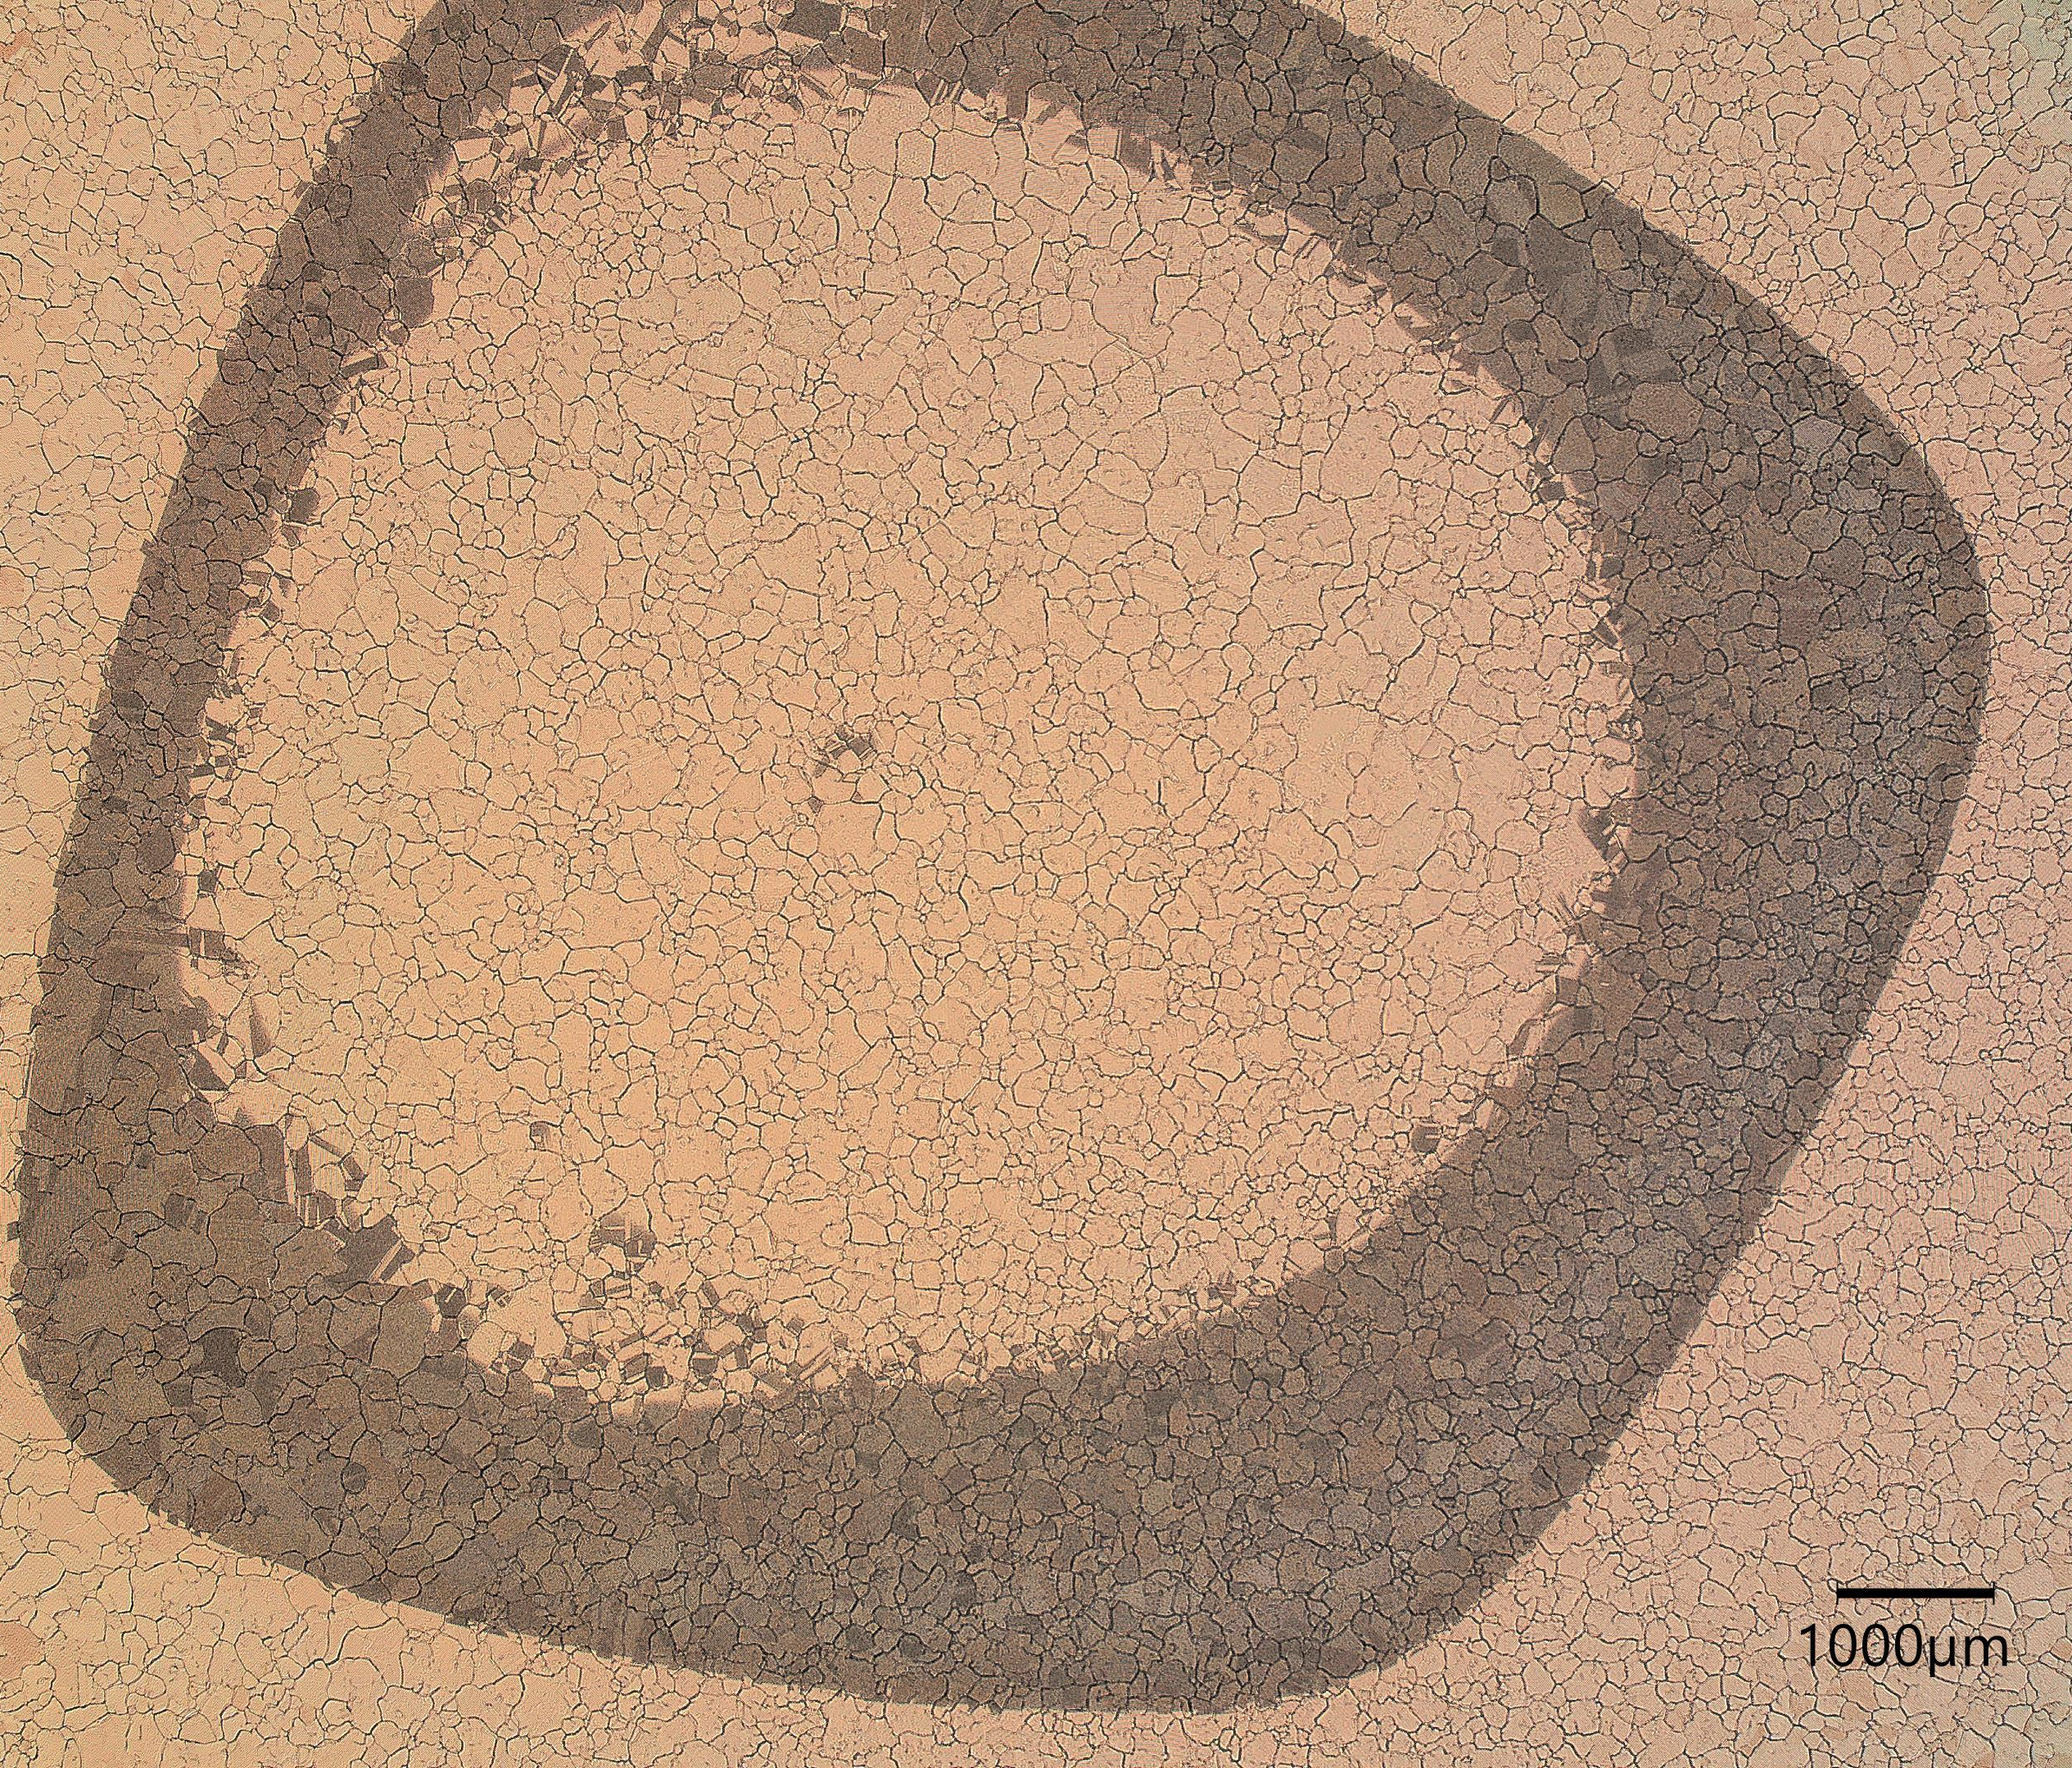
Irradiated Cu cathode
1)
2)
1)
2)
1)
2)
SEM observations in different areas surrounding the irradiation zone

Slide 6
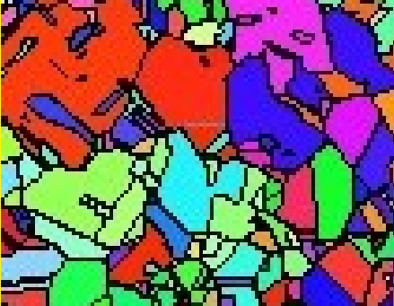
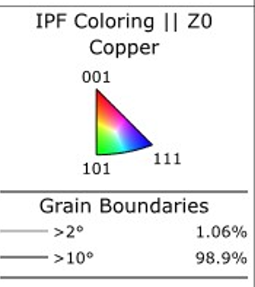
Analysis of grain orientation
Red grain = orientation 001
Blue grain = orientation 111
Lopez Cazalilla, A., Serafim, et.al. Effect of surface orientation on blistering of copper under high fluence keV hydrogen ion irradiation. Acta Materialia, 266(119699), Published 20th January 2024, DOI: 10.1016/j.actamat.2024.119699
SEM front camera

Slide 7
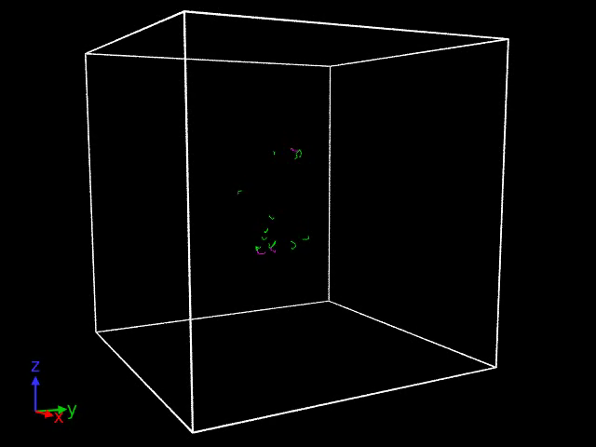
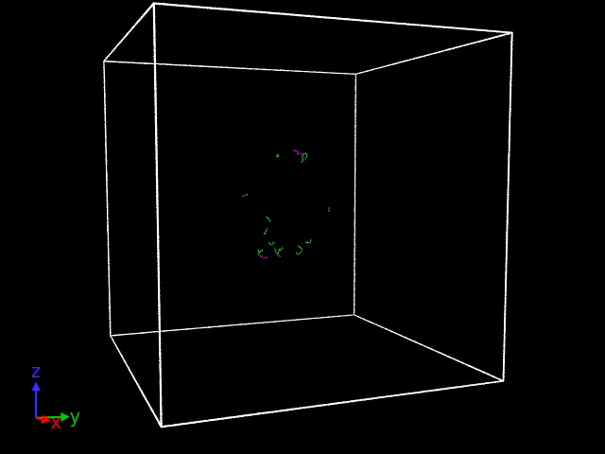
Bubble growth in Cu
To model this effect, some computational approaches have been implemented before.
The growth of tiny He bubble was followed in Cu, showing the dissociation of small prismatic loops [Jin et al., Sci. Rep. 11 (2021) 12839]
We simulated a range of H concentrations (n_{H}/Vac = [0.5,5]) and followed the dislocation network around the bubble
n_{H/Vac} = 4
n_{H/Vac} = 5
(n_{H/Vac}: number of H per vacancy in the void)

Slide 8
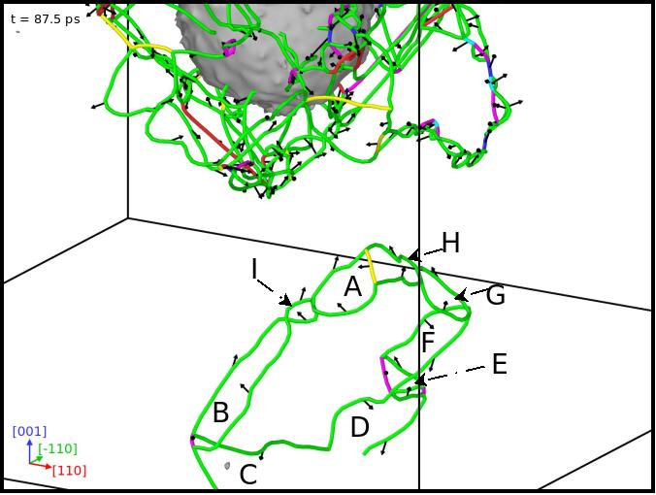
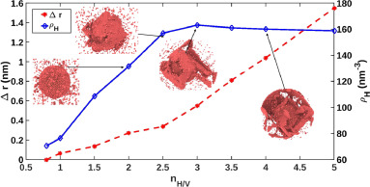
Bubble growth in Cu
We showed that even much larger bubbles grow via prismatic loop punching (PLP). In this case the network of shear loops is forming on adjacent {111} planes with the Burgers vector either aligned or opposite to the gliding direction of the prismatic loop
[A. Lopez, F. Djurabekova et al. Acta Materialia 225 (2022) 117554]
PLP
Elastic
Plastic
1.6.2025
8

Slide 9
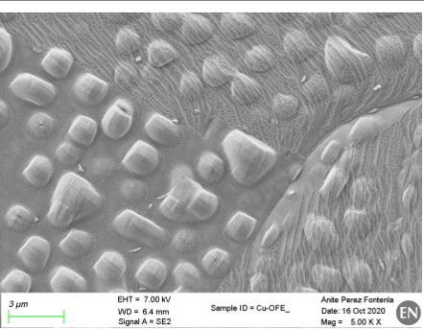
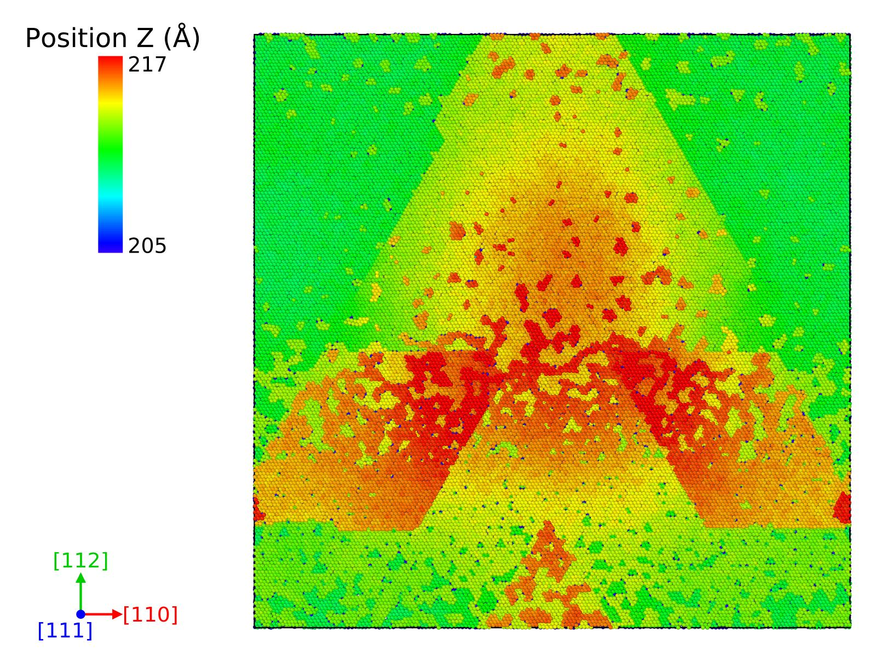
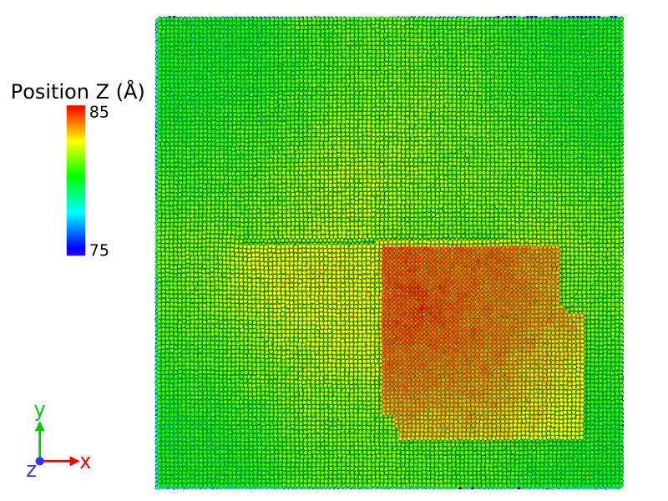
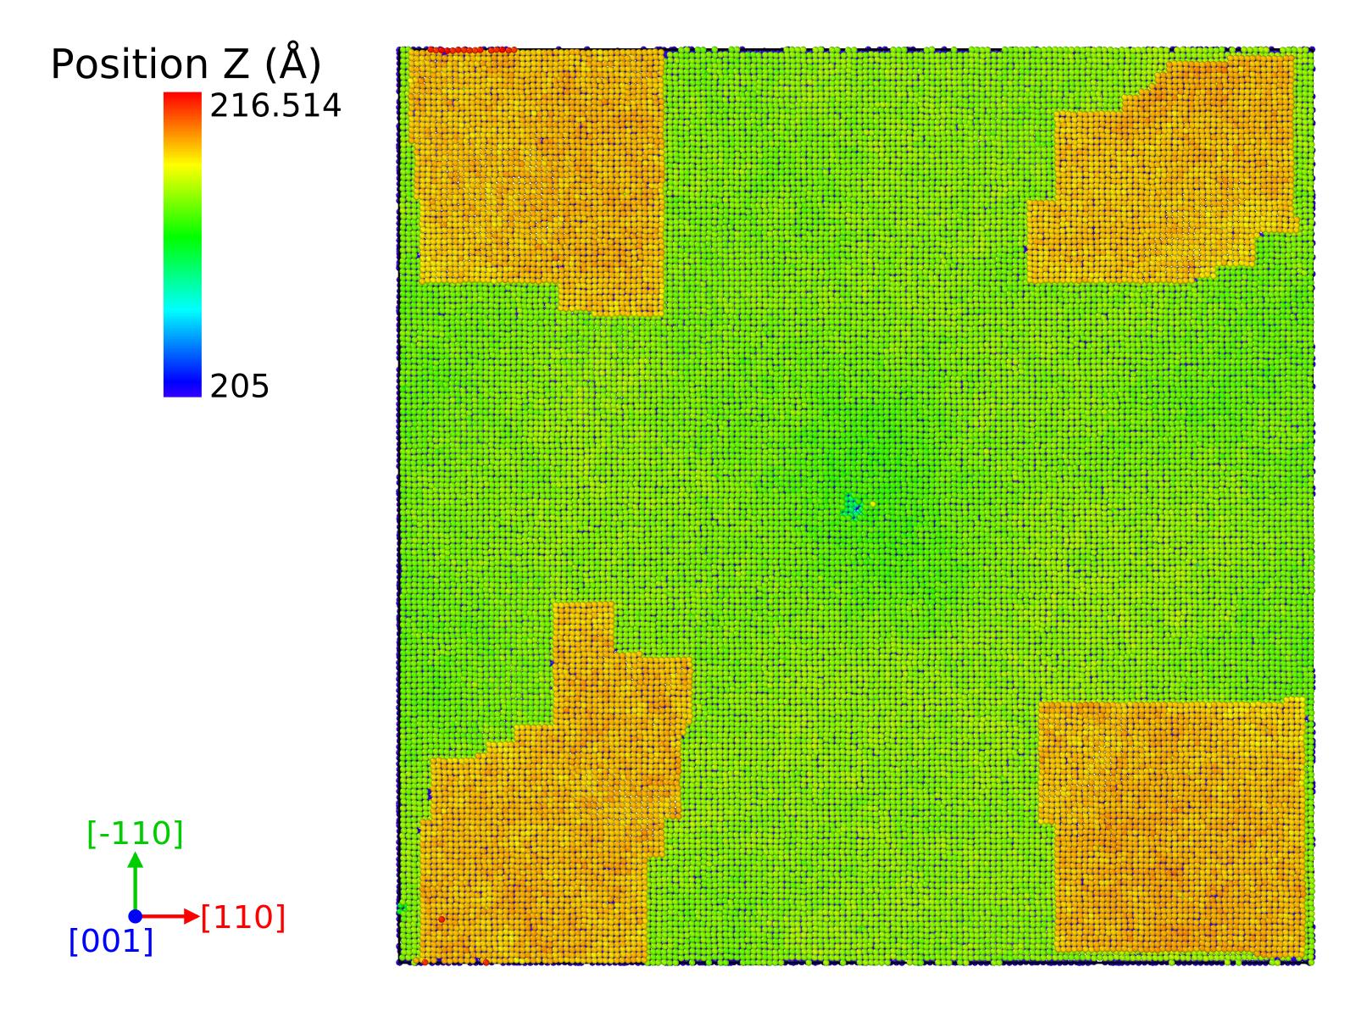
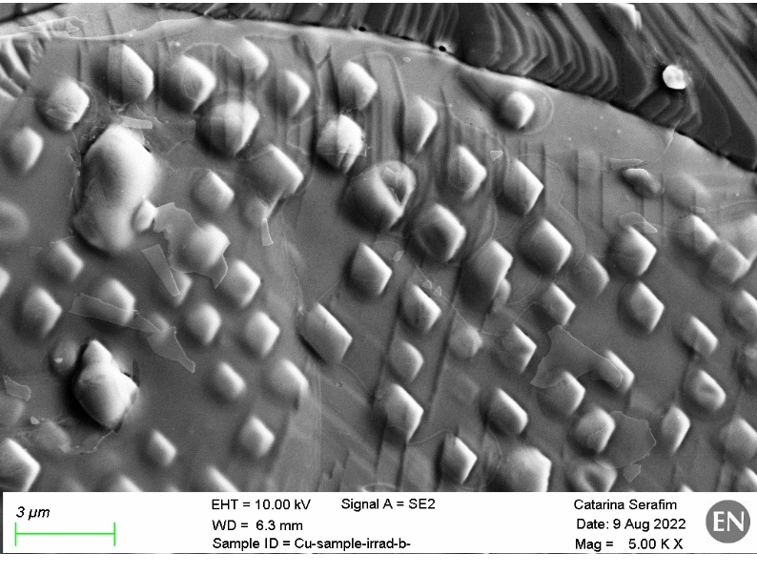
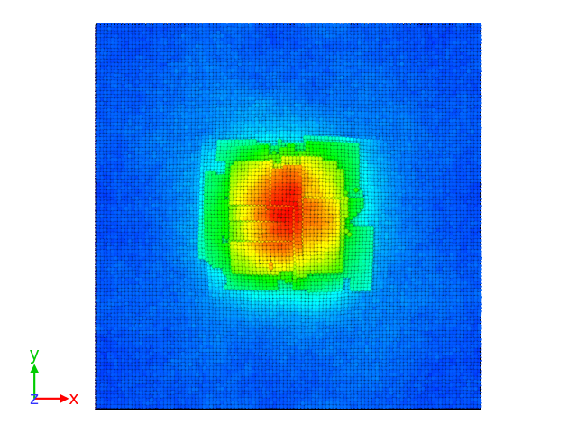
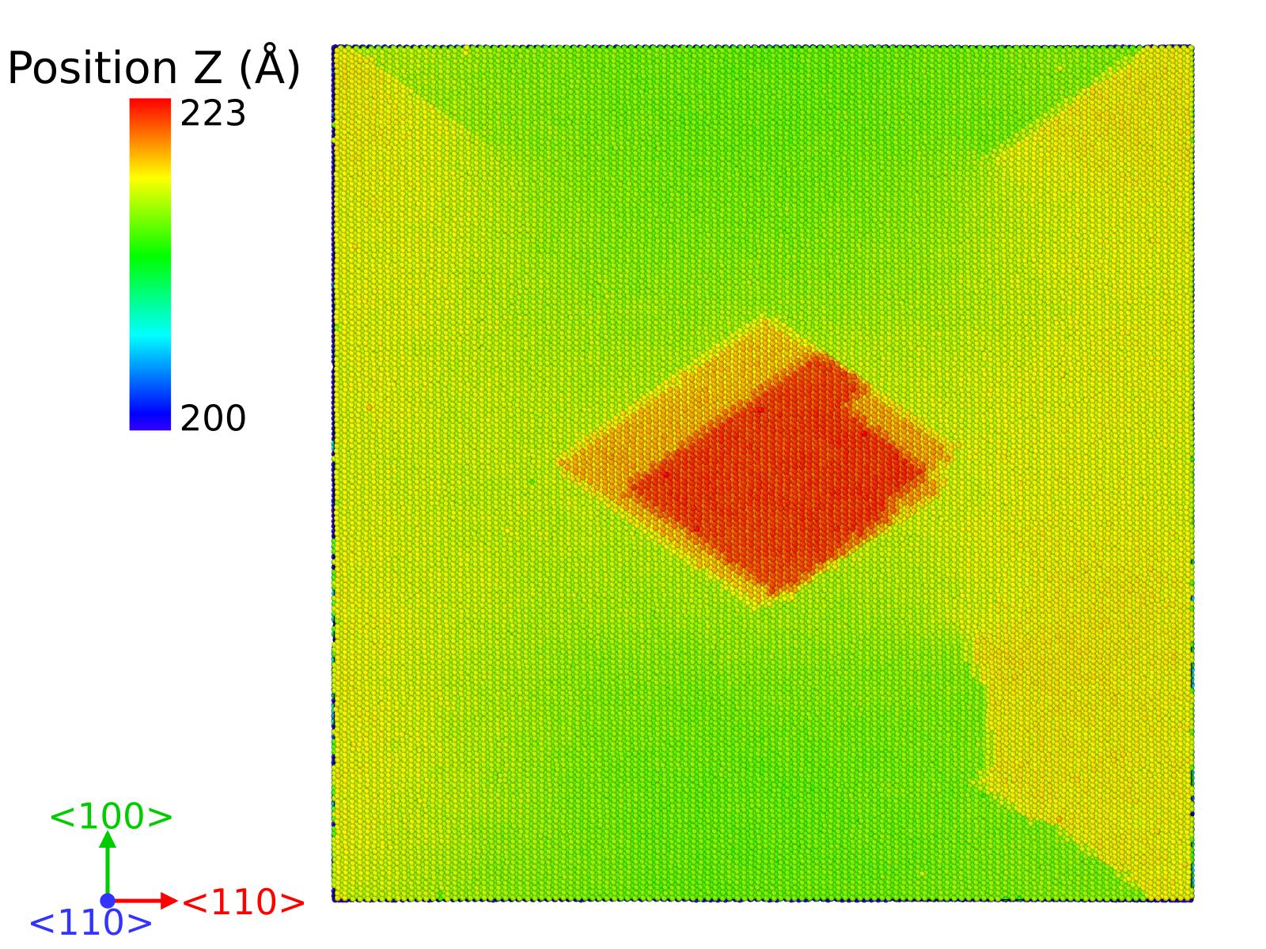
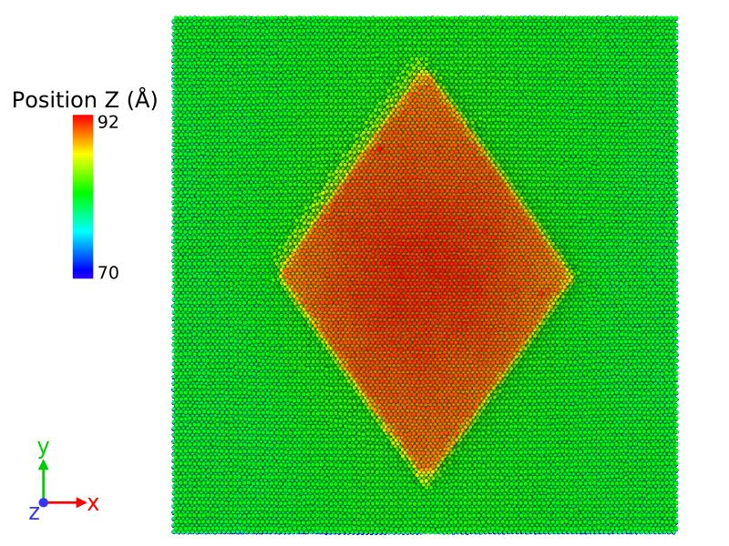
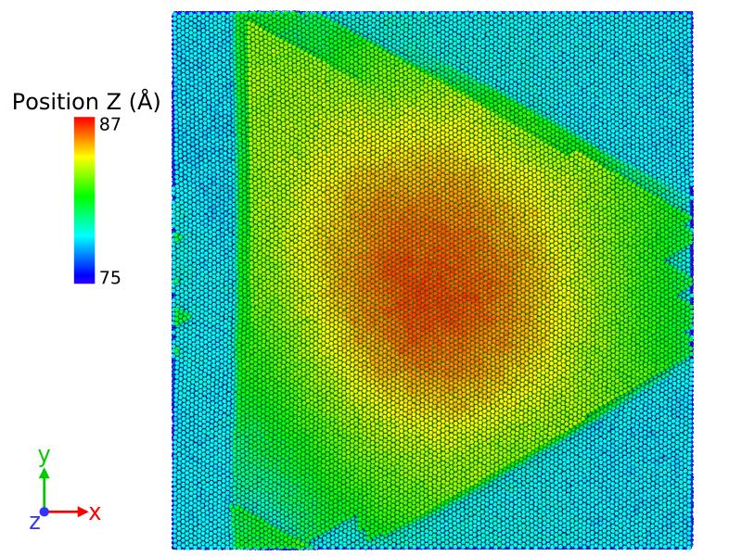
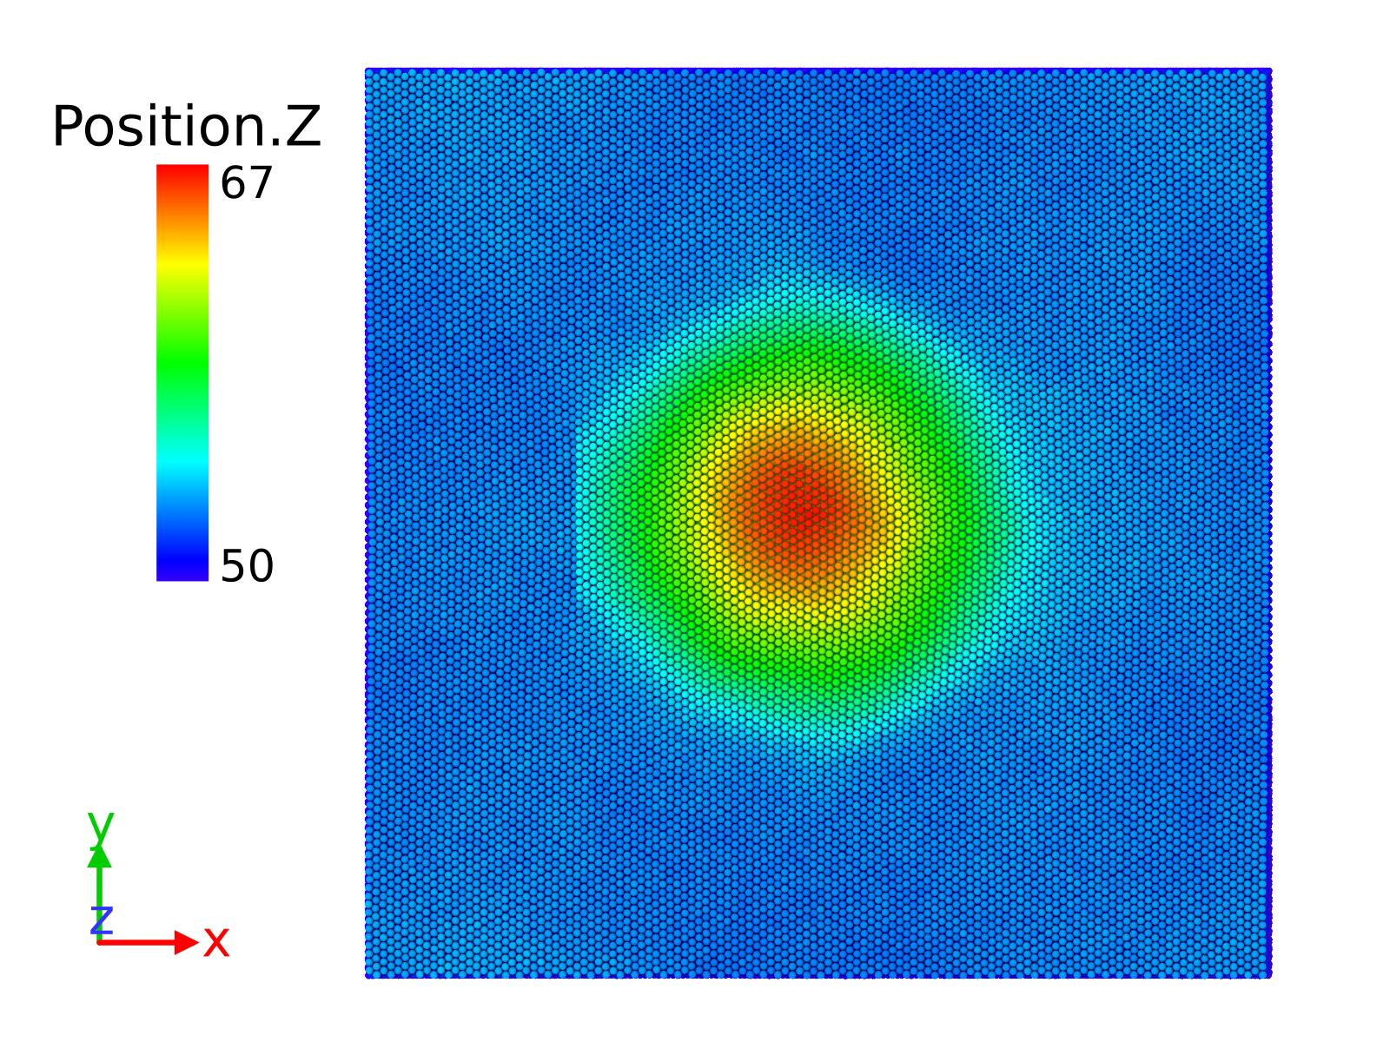
Dependence of blister shape on grain orientation
[A. Lopez-Cazalilla, C. Serafim, F. Djurabekova, Acta Materialia, 266, 119699 (2024)]
(111)
(100)
(100)
(110)
(100)
(110)
(111)
(n_{H/Vac=} 2)
(111)
(111)
(110)
1.6.2025
9

Slide 10
Looking under the surface
a)
Formation of blisters
Same appearance in both grains
c)
a)
b)
D=31.26 nm
A=768 nm2
c)
111
100
b)
The process of formation of blistering seems to occurs in the two different grains, at the depth between 260-280 nm.
Slower development on the blue grain 111.
Middle fase of development with small agglomerations of the small voids.

Slide 11
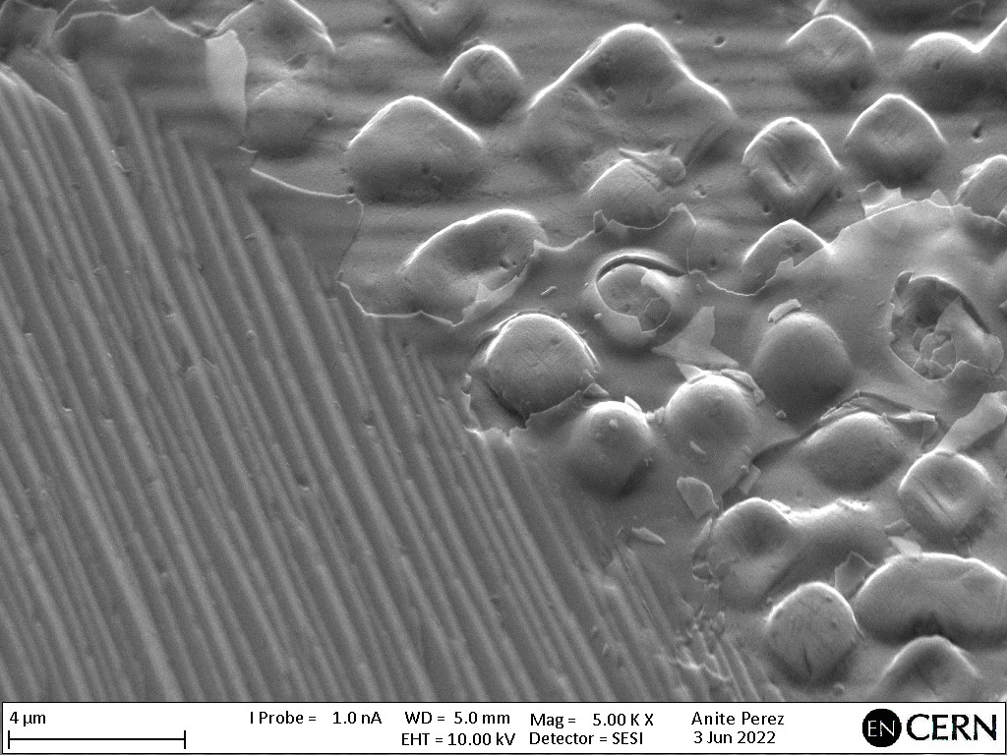
Uneven appearance of blisters on different grains
(100)
The MD results do not provide information on why (110)/(111) are not the first surface yielding, being the glide direction/plane. We see (110) is the first yielding, contradicting the experiments.
Since the initiation sites are formed at different depths depending
on the grain orientation, we
need to know how the pe-
netration depths are for
45 keV H in Cu.
  For this, we use
  MDRANGE*, while typically
  Monte Carlo methods are
  commonly applied.
(111)
(111)
(100)
1.6.2025
11
(*) K. Nordlund ,Computational Materials Science 3 (1995) 448-456

Slide 12
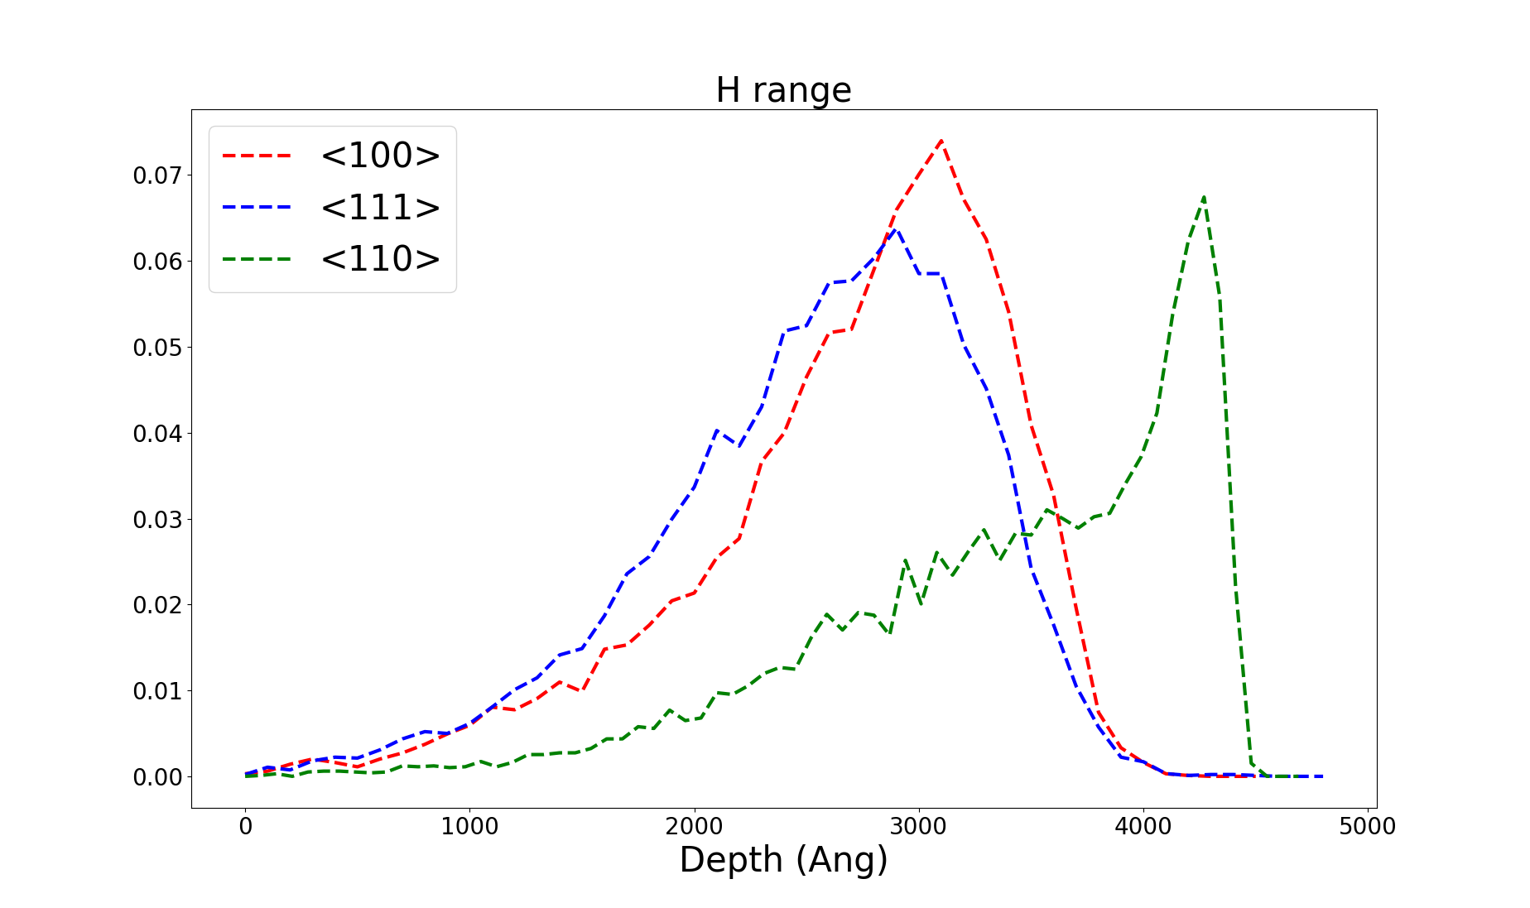
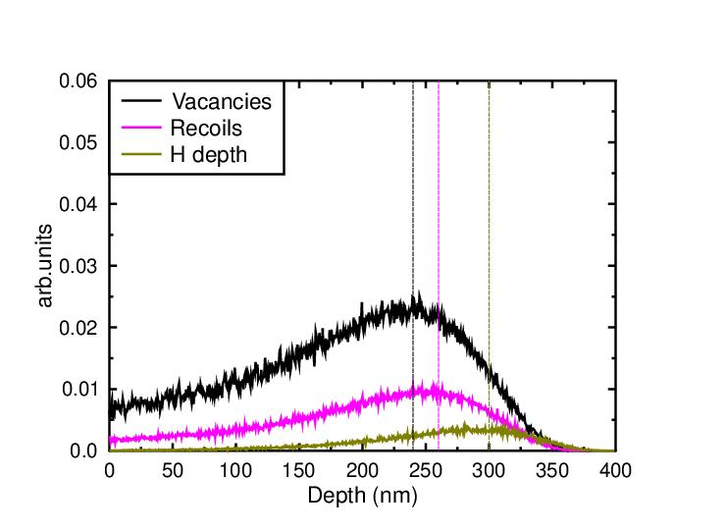
MDRANGE + BCA
(111)
(100)
MDRANGE
Recoils formation ~ vacancy formation
The studied grains under low fluence show that bubbles are formed at different distances, which is consistent with MDRANGE results, observing a deeper formation in (110) grains.
After a complete dataset of blisters/protrusions is obtained with MD, we understand the mechanisms of surface modification. However, we observe that under low fluences, only (100) grains experience blistering and not (111), with a similar H profile
CASWIN BCA code
1.6.2025
12

Slide 13
Comparison with experiments
We filter those recoils with kinetic energy lower than 40 eV (approximately the energy needed to create a vacancy), and we observe that for <100> the peaks are close, however the distances between them in <111> and <110> (specially the latter)
A. Lopez-Cazalilla, C. Serafim, F. Djurabekova, Acta Materialia, 266, 119699 (2024)
Open markers
Filled markers

Slide 14
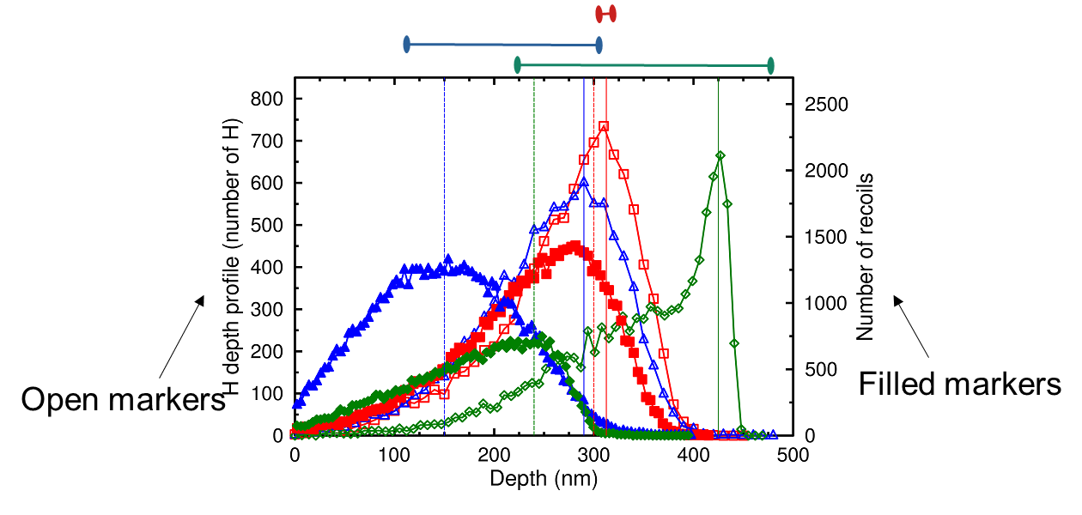
Difference in range profiles of H ions and vacancies explains the different blister growth rate!
[A. Lopez-Cazalilla, C. Serafim, F. Djurabekova, Acta Materialia, 266, 119699 (2024)]
The formation of vacancies occurs closer to the surface in <111> and <110>grains, but the hydrogen atoms need more time (fluence) to fill these gaps and develop larger blisters visible in the surface, while in <100> is immediate
<100>
<111>
<110>
Vac
H

Slide 15
LES tests for all materials
TiAl6V4, CuBe2 and SS316 were the best materials in reaching a stable field. Followed by Cu-OFE and CuCr1Zr.
We see very big differences in the electric fields reached between irradiated pairs and non irradiated pairs.
The blistering effect from irradiation doesn't seem to provoke a decrease of performance on the electrodes.
 | Non-irradiated |  | Irradiated
 | Max Field (MV/m) | Stable Field (MV/m) | Max Field (MV/m) | Stable Field (MV/m)
SS316LN | 120 | 120 | 62.5 | 60
CuBe2 | 110 | 100 | 40 | 16.7
TiAl6V4 | 110 | 100 | 95 | 90
CuCr1Zr | 87.5 | 82.5 | 29 | 25
Cu-OFE | 80 | 80 | 25 | 20
Nb (BCP) | 94 | 80 | 42 | 21.7
Ta | 60 | 60 | 38.1 | 24

Slide 16
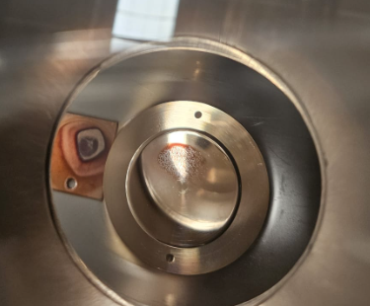
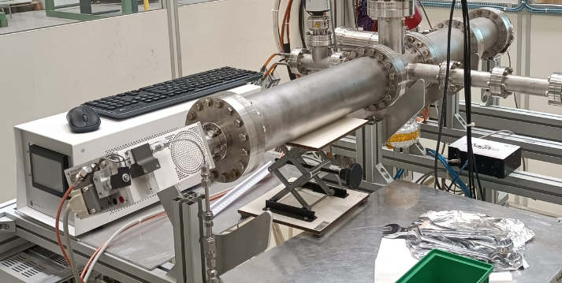
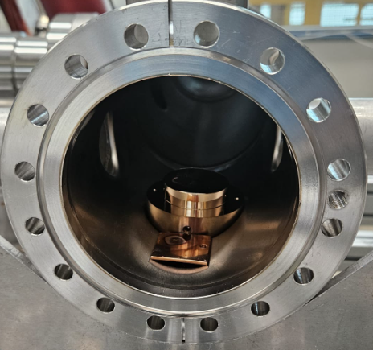
Effect of carbon contamination
Plasma cleaning treatment
+
Repeat LES testing
Carbon layer
viewport

Slide 17
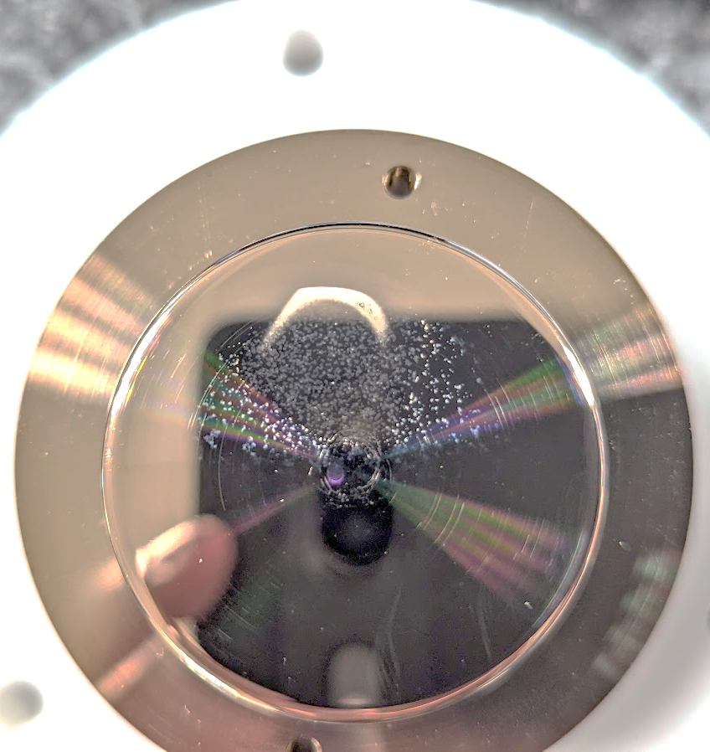
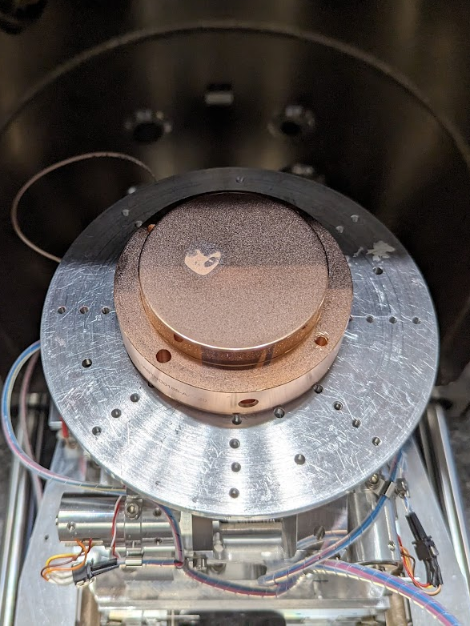
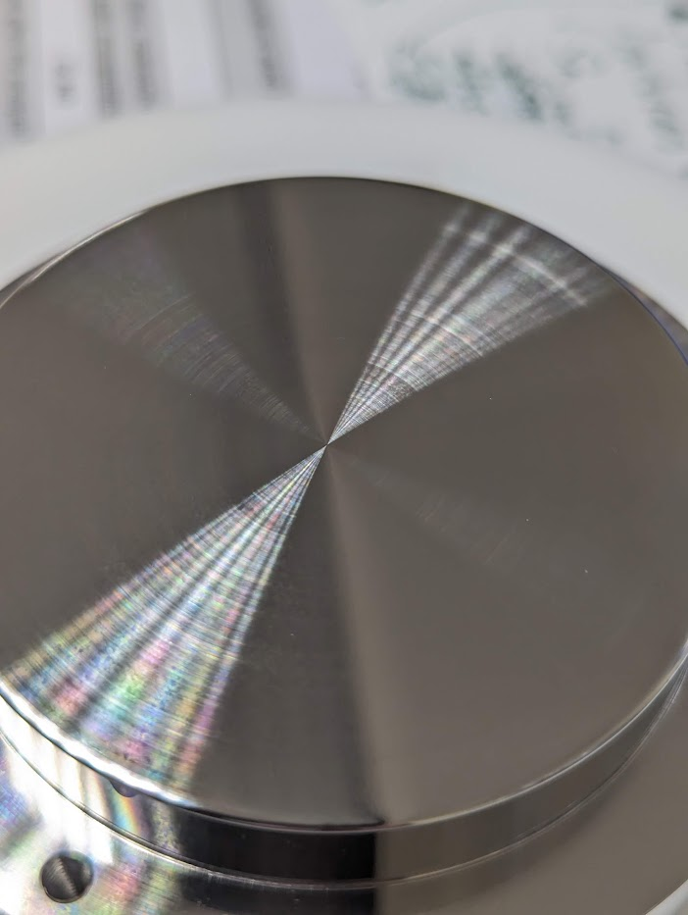

Plasma treatment of the electrodes
CuBe2
Cu-OFE
SS316
Chemical analysis was performed in different areas before and after plasma cleaning.
  Before plasma treatment we had 9-12% of C
  After plasma cleaning we have 1-3% of C
Hence, plasma treatment was a success for carbon removal from the surface.
New electrodes (Cu-OFE and Stainless Steel)
  manufactured -> irradiated -> plasma cleaned -> subjected to new high voltage pulsing tests.

Slide 18
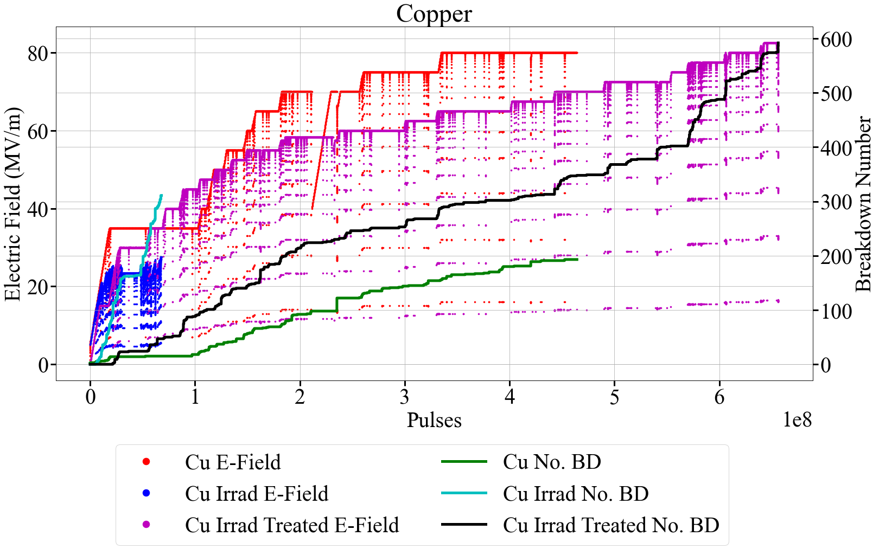
Conditioning results with and without plasma treatment
Cu-OFE electrodes
after irradiation
  Electric field
  achieved: 25 MV/m
Cu-OFE electrodes after irradiation + plasma cleaned
  Electric field achieved: 82.5 MV/m

Slide 19
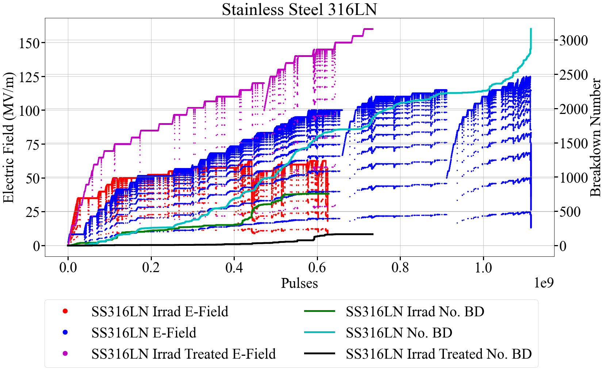
Conditioning results with and without plasma treatment
SS316LN electrodes
after irradiation
  Electric field
  achieved: 60 MV/m
SS316LN electrodes after irradiation + plasma cleaned
  Electric field achieved: 160 MV/m

Slide 20
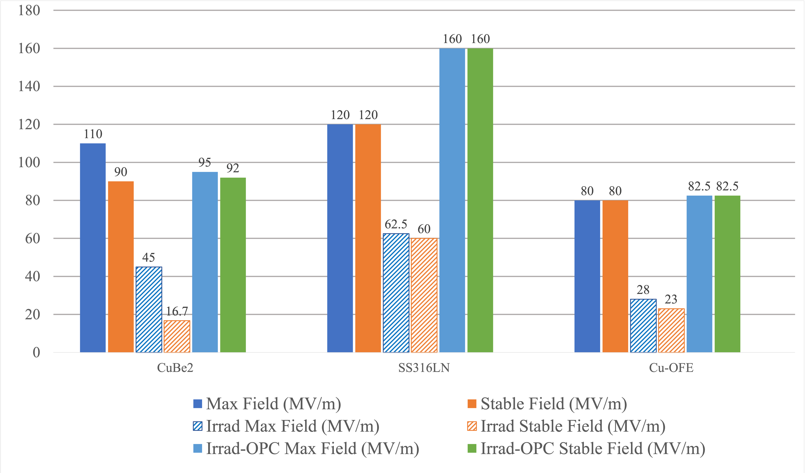
Conditioning results – after irradiation and oxygen plasma treatment
Electric Field (MV/m)

Slide 21
Conclusions
We identify the effect of surface orientation on the shape of appearing protrusions using MD, in agreement with experiments.
The difference between the vacancies range and the penetration depth of H in (110) and (111) grains explains the later development of blisters, complementing the previous models.
The blisters do not induce breakdowns
However, carbon contamination during irradiation plays a certain role in increased breakdown rate
Faculty of Science Department of Physics Alvaro Lopez Cazalilla
1.6.2025
21

Slide 22
Thank you for you attention!
Faculty of Science Department of Physics
Alvaro Lopez Cazalilla
1.6.2025
22

