Slide 1

12th International Workshop on the Mechanisms of Vacuum Arcs (MeVArc 2025)
Three-dimension hybrid simulation on plasma jet formation in Zirconium-Deuterium multi-component vacuum arc discharge
Wei Yang, Qiang Sun, Mengmeng Song, Qianhong Zhou
yangwei861212@126.com
Institute of Applied Physics and Computational Mathematics
2025.06

Slide 2
Table of contents
I
Introduction: vacuum arcs of composite electrode
II
Insights from PIC-DSMC simulations
III
Insights from multi-component fluid simulation
IV
Recent results of three-dimension hybrid simulation
V
Conclusions

Slide 3
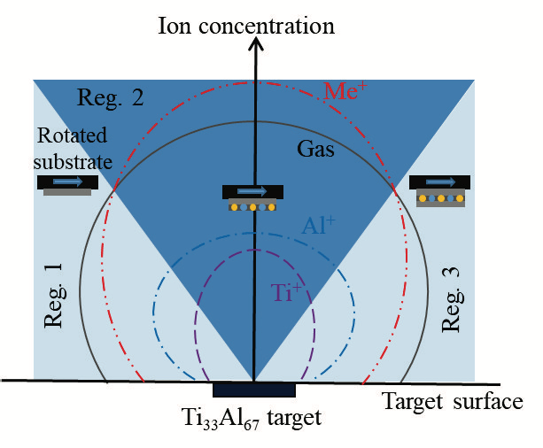
Vacuum arcs of multi-component composite cathode
Vacuum arcs (VA) of multi-component composite cathode have been widely used in ion source, thin film deposition and other industrial fields, due to its ability to generate ion beams of different elements.
A. G. Nikolaev, IEEE TPS 47, 3590 (2019)
Liu H, et al. Appl Surf Sci, 501, 144025 (2020).

Slide 4
Velocity distribution of two-component vacuum arcs
The directed velocity of light ions is slightly higher than that of heavy ions.
The directed velocity of ions of same element but with different charge states is usually very close to each other.
Frolova et al., 28th ISDEIV (2018).
A. G. Nikolaev, J Appl Phys 116, 213303 (2014)

Slide 5
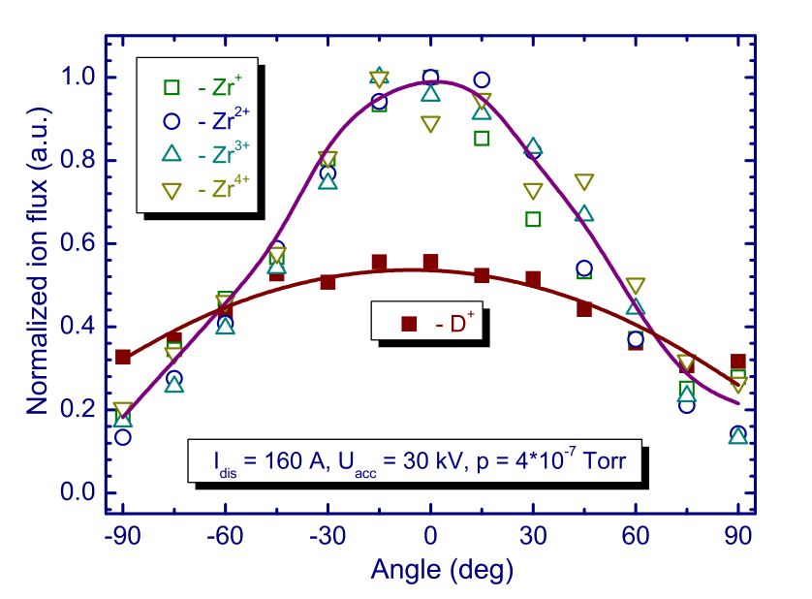
Angular distribution of two-component vacuum arcs
The angular distribution of light ions is rather unifrom, while that of heavy ions is more concentrated in the central axis.
Comparing the angular distribution of pure metal cathode and composite cathode, similar trend is observed for heavy ions but different for light ions.
Angular distributions of ions (ZrD)
comparisons: pure metal cathode and composite cathode
A. G. Nikolaev, IEEE TPS 47, 3590 (2019).
A. G. Nikolaev, J Appl Phys 116, 213303 (2014)

Slide 6
Table of contents
I
Introduction: vacuum arcs of composite electrode
II
Insights from PIC-DSMC simulations
III
Insights from multi-component fluid simulation
IV
Recent results of three-dimension hybrid simulation
V
Conclusions

Slide 7
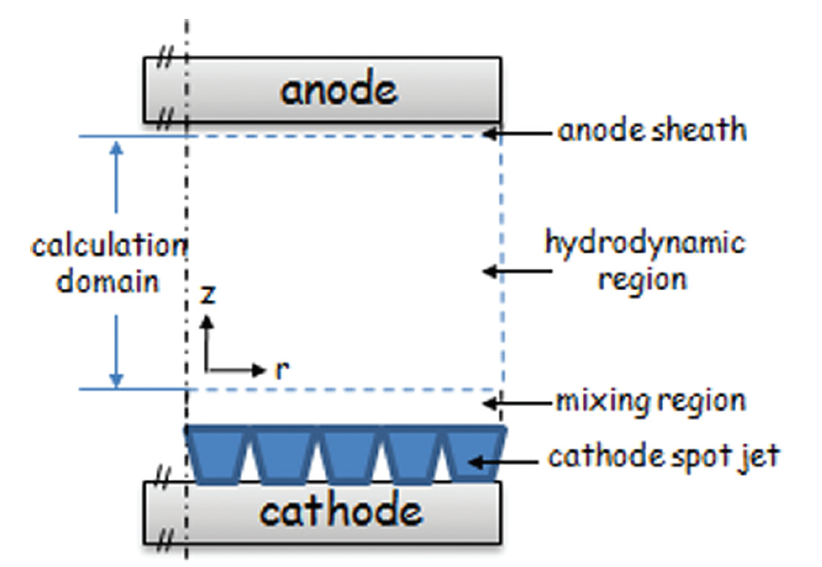
The structure of VA plasma and their parameters
  The vaccum arc plasma is composed of sheath, cathode spot, plasma jet, arc column etc., in which physical parameters can vary orders-of-magnitude! Therefore, different numerical approaches are needed.
different zone of vacuum arc plasma
parameters of arc column and cathode spot
 | arc column | cathode spot
electric field | ~MV/m | >GV/m
current density | 10⁷-10⁸A/m² | 10⁸-10¹²A/m²
plasma density | 10²¹-10²²m⁻³ | 10²⁰-10²⁷m⁻³
pressure | ~10³Pa | 1Pa-10⁷Pa
Langlois et al., J. Appl. Phys. 109, 113306 (2011)
Qiang Sun, Wei Yang, et al. 2020 Phys Plasmas 27: 053501

Slide 8
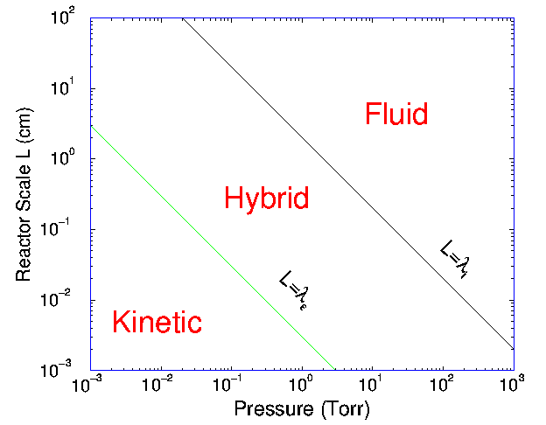
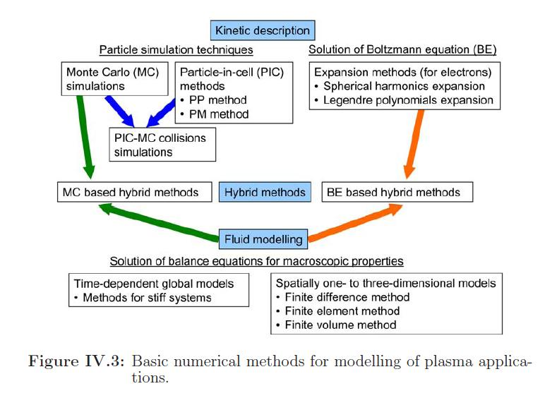
The numerical approaches: kinetic, fluid and hybrid
  The numerical approaches are usually chosen according to reactor scale and mean free path (gas pressure), and categorized by the description of (full/partial) kinetic behavior of particle species.

Slide 9





fully kinetic PIC-DSMC method is computationally heavy
In standard DSMC simulations, the spatial step should resolve mean free path, time step should resolve collision frequency, and around 100 particles per cell (to avoid stochastic noise).
$$∆x<λ_{MFP}$$
$$∆t<{0.1/ν}_{collision}$$
PPC (particles per cell) ~100
In explicit ES-PIC simulations, the spatial step should resolve Debye length (to avoid numerical heating), and time step should resolve plasma oscillation frequency.
$$∆x<{3.4λ}_{D}$$
$$∆t<{0.2/ω}_{pe}$$
Although implict scheme can enlarge the temporal step, the Courant–Friedrichs–Lewy (CFL) condition should always be ensured (particles do not travel across spatial cell per step).
$$∆t<{∆x/v}_{te}$$

Slide 10
Fully kinetic 2D modeling on short-gap vacuum breakdown
  Previously, a 2D r-z geometry electrostatic (ES) PIC-DSMC fully kinetic model is used to simulate micro-meters scale short-gap vacuum breakdown.
The computing cycle of PIC-DSMC simulation at each time step
Cu⁺ density distribution at different times during the short-gap vacuum breakdown
Wei Yang, Qianhong Zhou ... J. Appl. Phys. 126, 243303 (2019);Wei Yang, ... J. Appl. Phys. 128, 060905 (2020)

Slide 11
1D3V spherical PIC-DSMC method: time-saving technique
Time-saving technique：effective cross-section method for Coulomb collision
Time-saving technique： 1D spherical momentum-conserving implicit PIC scheme
comparison with traditional TA and Nanbu method: accuracy and improved efficiency
Implicit scheme with larger spatial and time steps compared with explicit scheme: 1dr1dt
Song et al., High Power Laser and Particle Beams, 2021, 33: 034004; Computer Physics Communications. under review

Slide 12
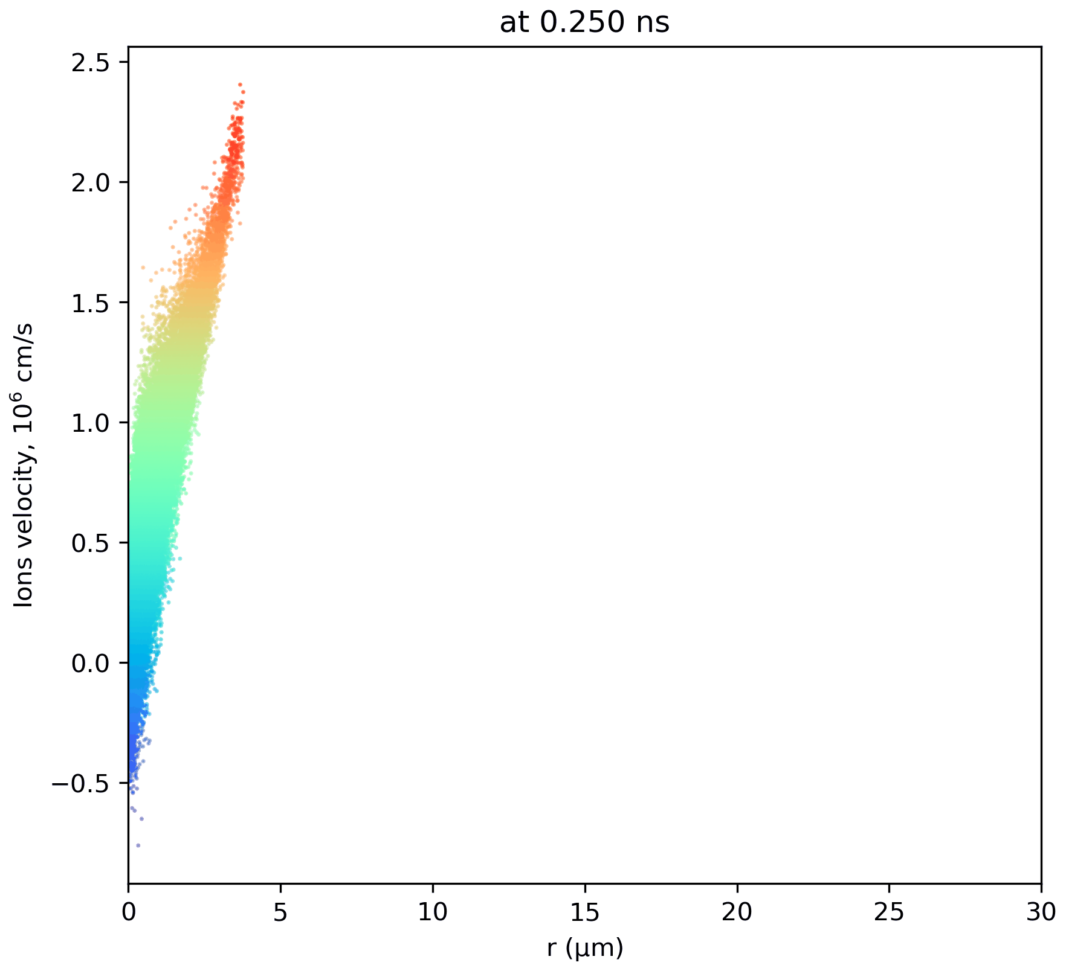
1D spherical PIC-DSMC simulation on plasma expansion
1D spherical PIC-DSMC method was used to study ion acceleration in vacuum spark and arcs, VA plasmas of composite cathode in longer gaps (~100 microns)
plasma expansion in quasi-spherical geometry
Phase-space plot showing ion acceleration
Song et al., Phys Plasmas. 32, 023506, 2025; J Phys D: Appl Phys, 57, 315207, 2024
Plasma Source Sci Technol, 33, 105009, 2024; Plasma Source Sci Technol, 32, 095002, 2023

Slide 13
Insights from 1D3V PIC simulation
The directed velocity of light and heavy ions is quite close. However, light ions show higher thermal velocity. These effects make the expansion of D ions more isotropically in broad area (thermal energy->kinetic energy), but is not affordable in PIC simulation (mm-scale).
The directed velocity of ions (solid line) as well as potential distribution (red dash)
Ion velocity distribution
M Song, Q Sun, W Yang et al., Plasma Source Sci Technol 33, 075004, 2024

Slide 14
Table of contents
I
Introduction: vacuum arcs of composite electrode
II
Insights from PIC-DSMC simulations
III
Insights from multi-component fluid simulation
IV
Recent results of three-dimension hybrid simulation
V
Conclusions

Slide 15
Simulation domain, assumptions and BCs of fluid model
The system is assumed to be 2D axisymmetric and in steady state.
Each species (for example Ti, Ti⁺, Ti²⁺, Ti³⁺) has the same velocity and temperature.
The plasma is assumed to be quasi-neutral.
The electron inertia and viscosity can be neglected.
the Lorentz forces can be ignored compared to the pressure gradients.
The electrons and ions are regarded as ideal gases.
Q. Sun, W. Yang, Q. Zhou*, J. Phys. D: Appl. Phys. 53, 375201 (2020).

Slide 16
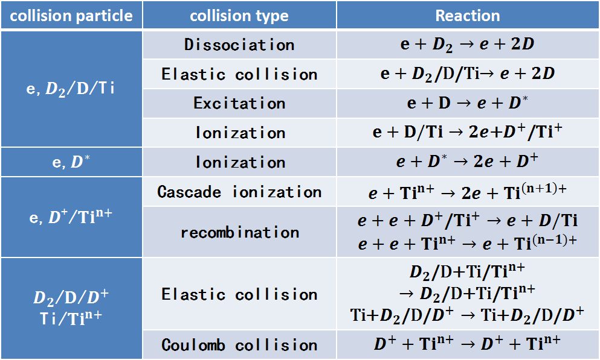
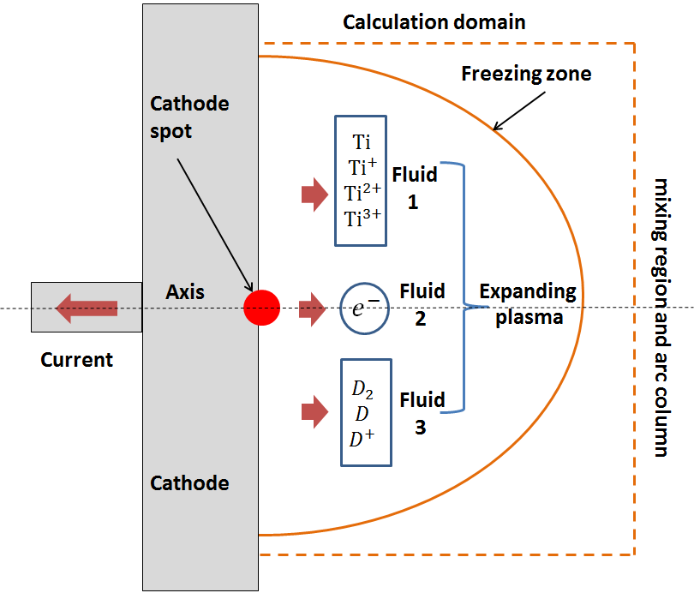
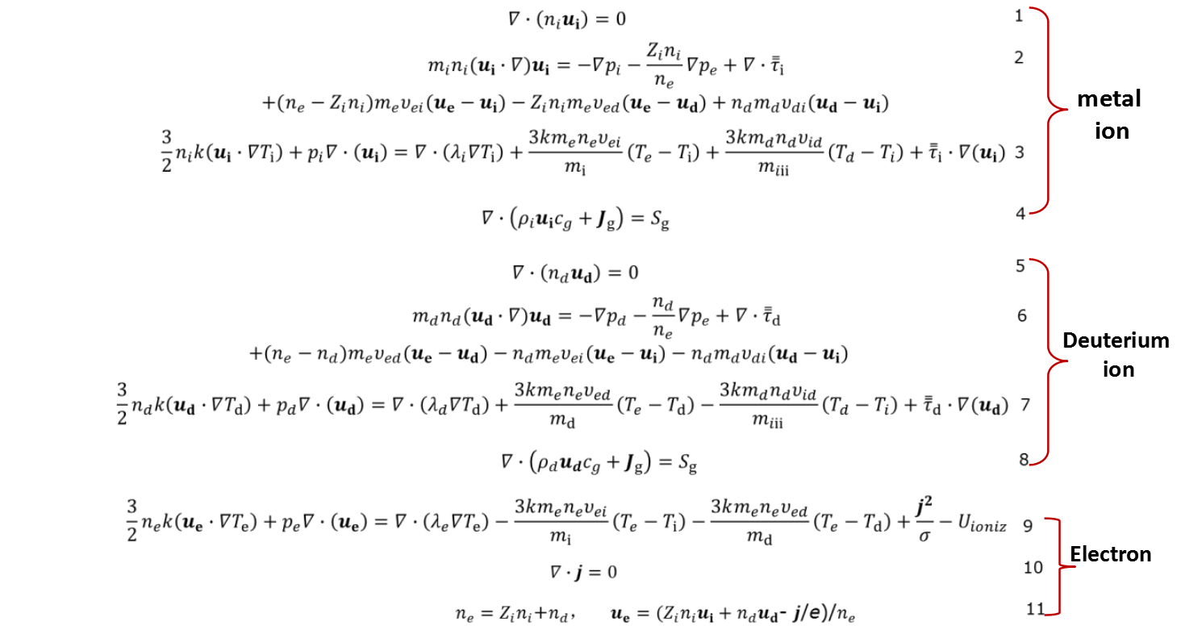
Fluid model of multi-component plasma jet
To study the physical process of a cathode spot jet in VA with metal deuteride cathode (TiD), a two-dimensional hydrodynamic model based on three-fluid theory is established.
28 reaction channels with 8 plasma species are considered, including ionization and recombination processes.
schematic of fluid model
28 reaction channels
governing equations in steady state
Q. Sun, W. Yang, Q. Zhou*, J. Phys. D: Appl. Phys. 53, 375201 (2020).

Slide 17
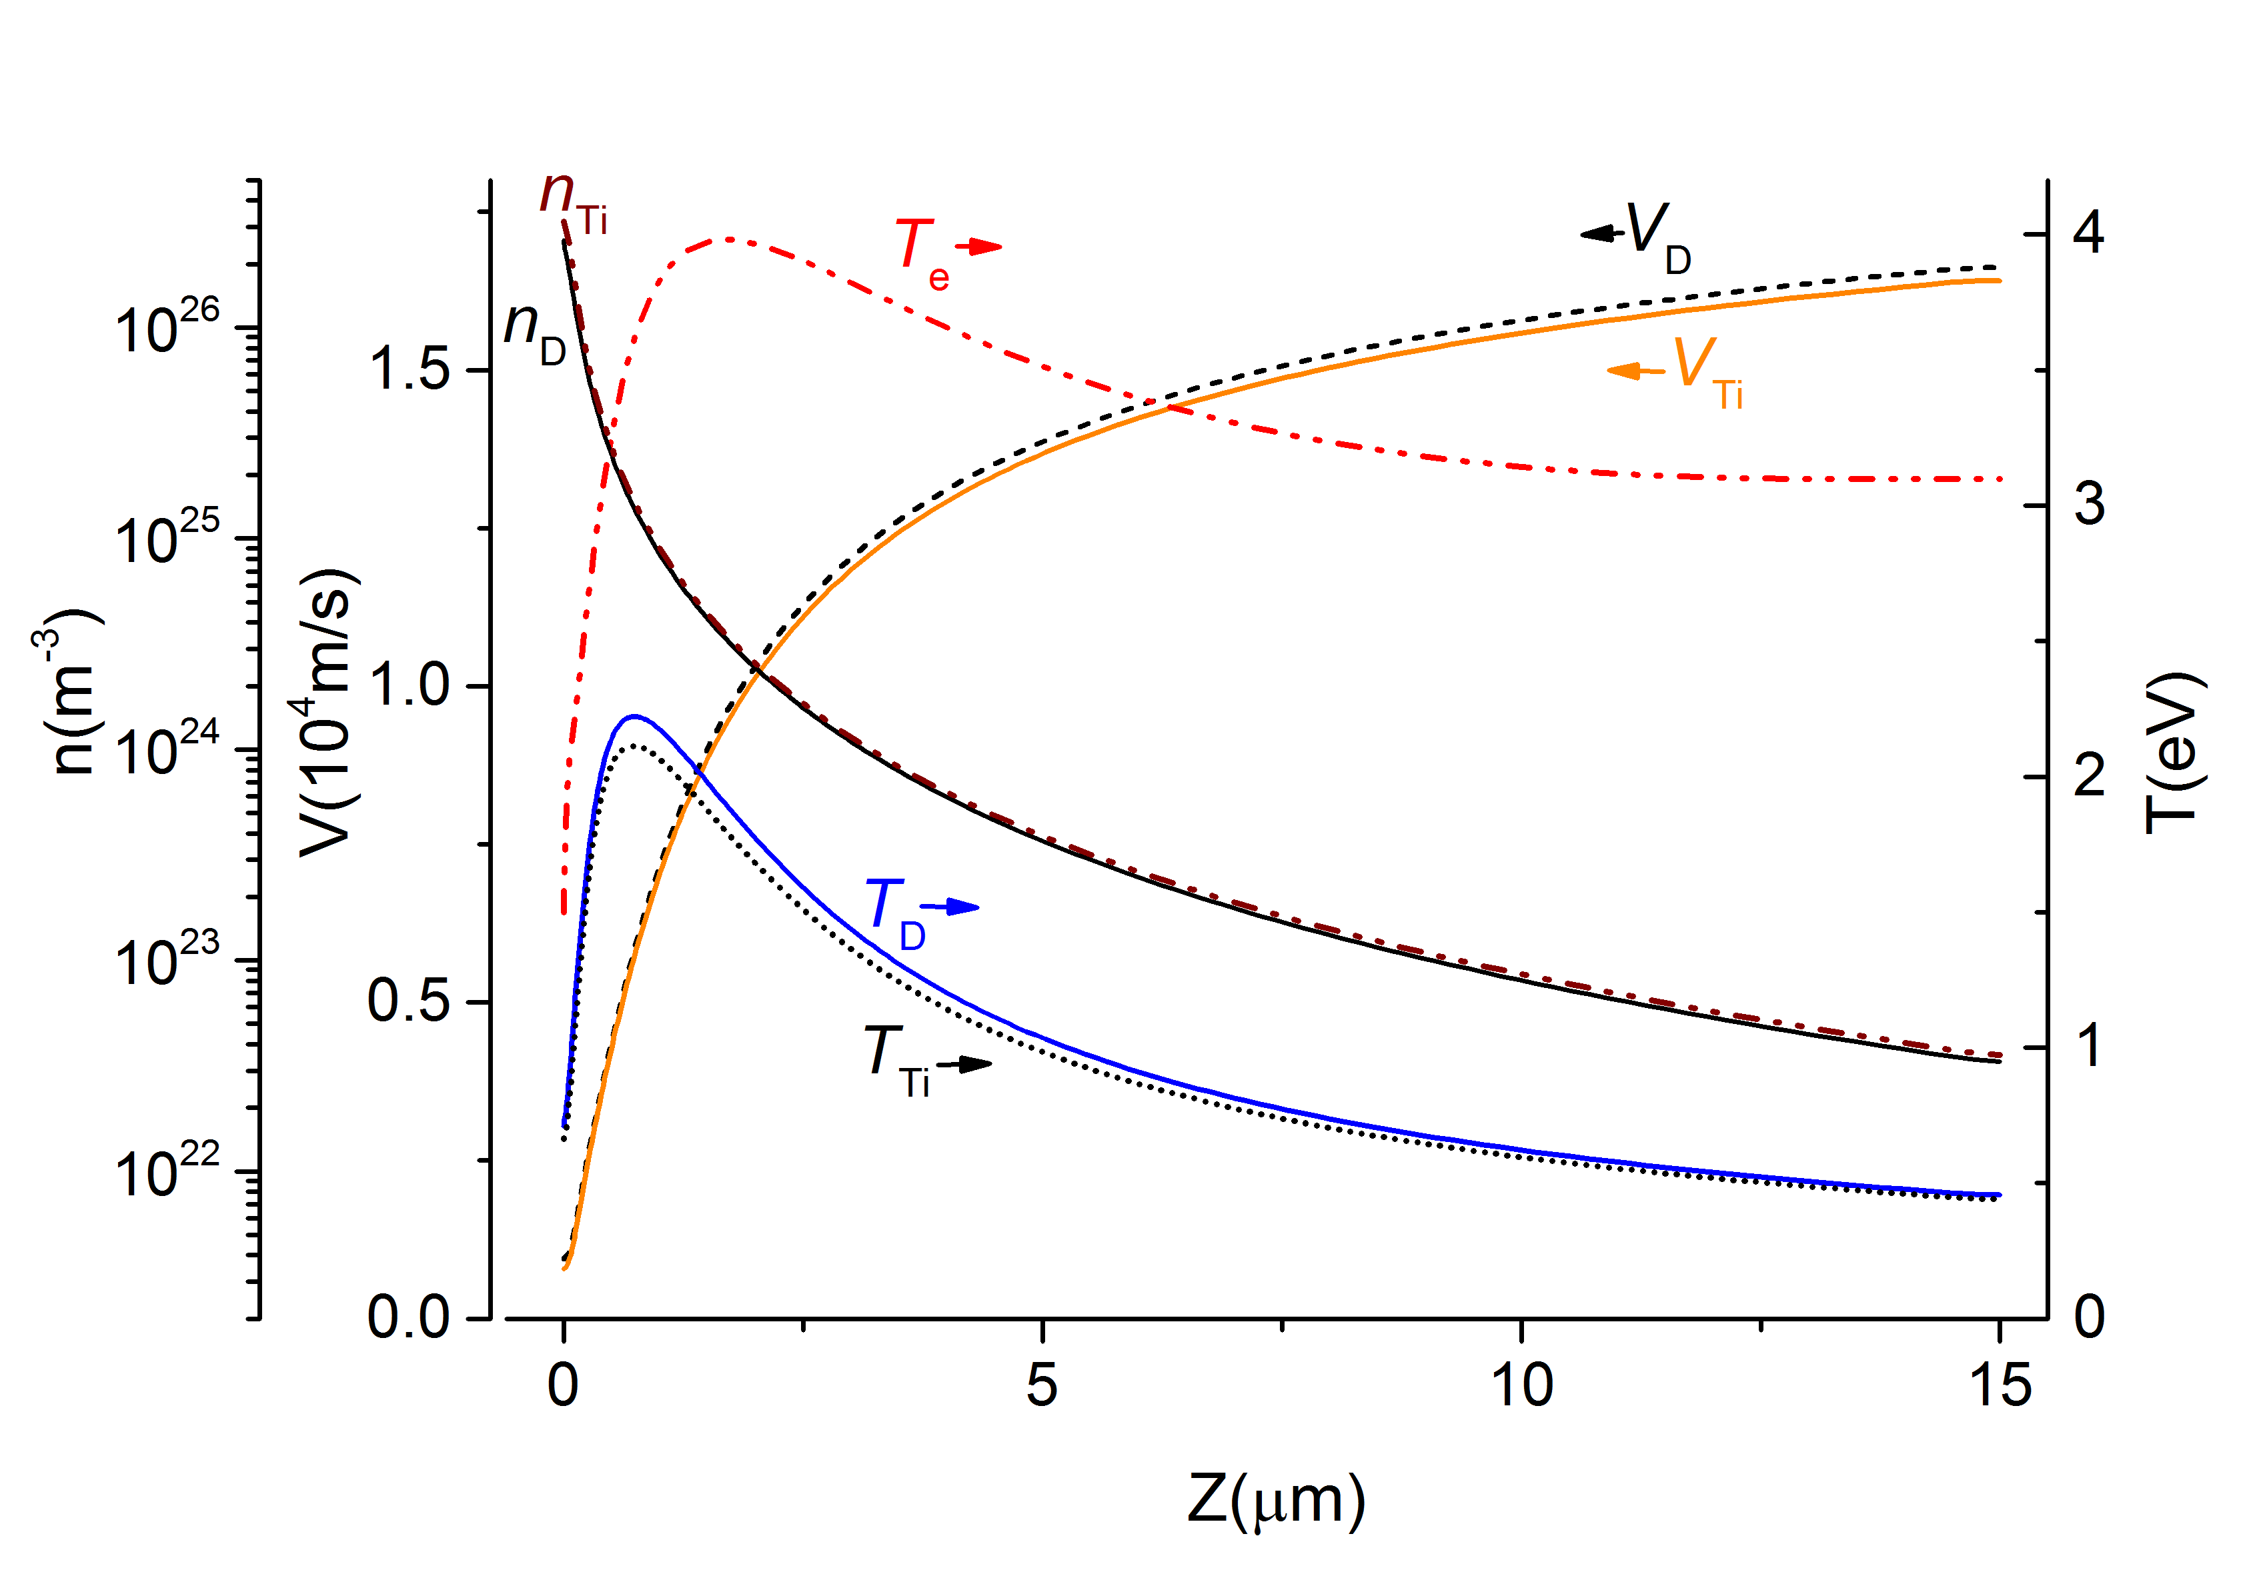
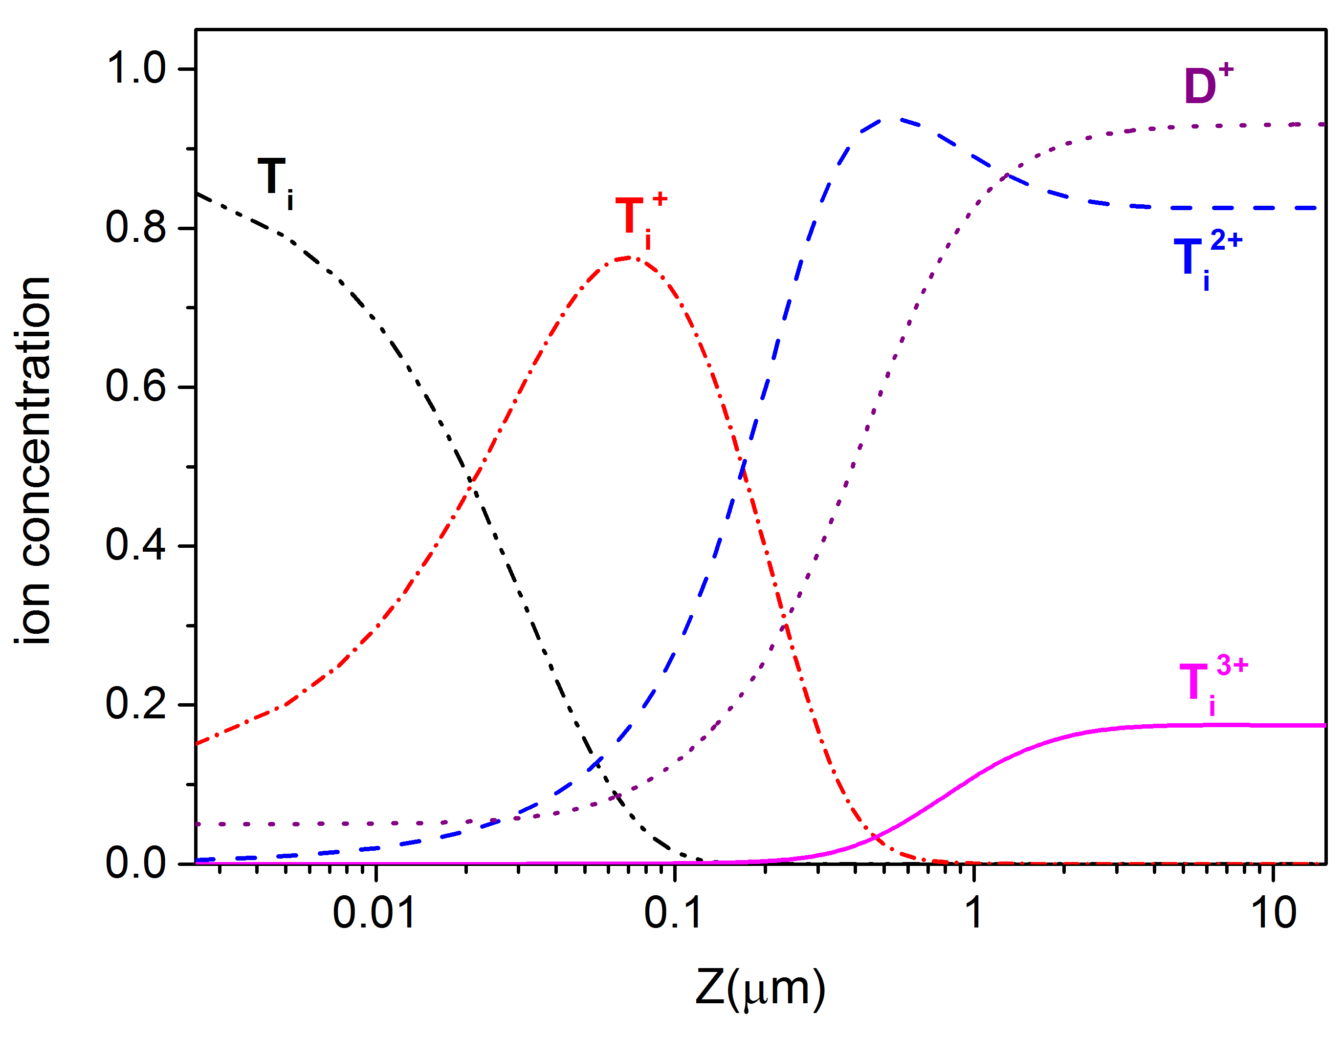
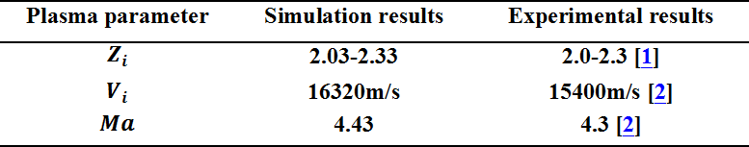
calculated plasma parameters and comparison with experiment
The charge states and directed velocity of metal ions agreed well with previous experiment.
However, the directed velocity of light and heavy ions is quite close in simulation.
calculated plasma parameters along the z axis
Plasma parameter | Simulation results | Experimental results
$$Z_{i}$$ | 2.03-2.33 | 2.0-2.3 [1]
$$V_{i}$$ | 16320m/s | 15400m/s [2]
$$Ma$$ | 4.43 | 4.3 [2]
comparison with experimental results in literature
[1] Oks E M, Anders A, Brown I, Dickinson M and MacGill R 1996 IEEE TPS 24 1174
[2] Anders A and Yushkov G Y 2002 JAP 91 4824

Slide 18
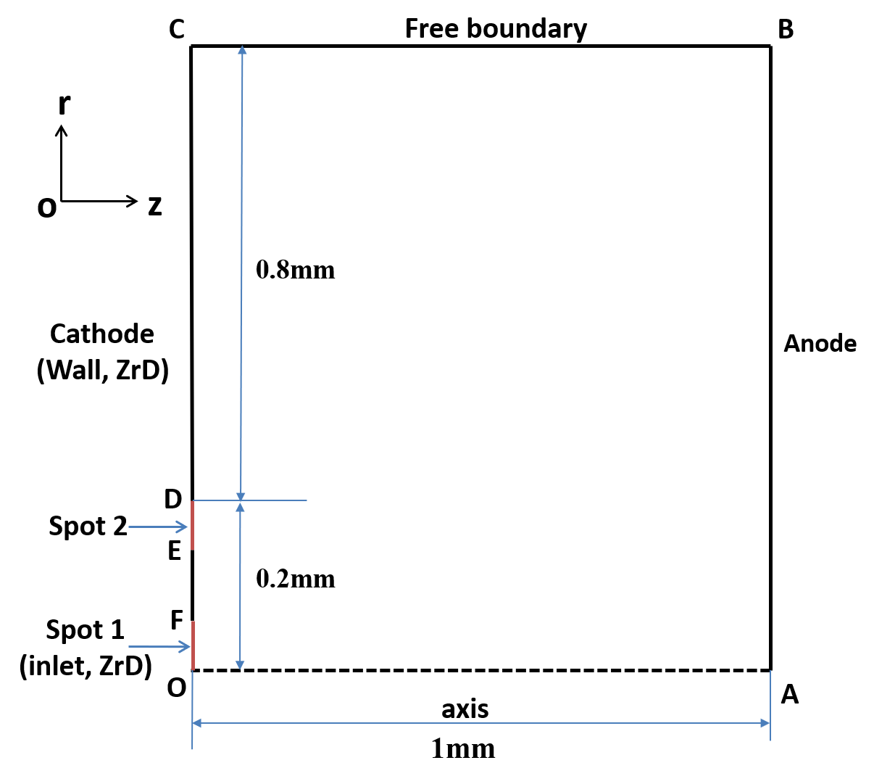
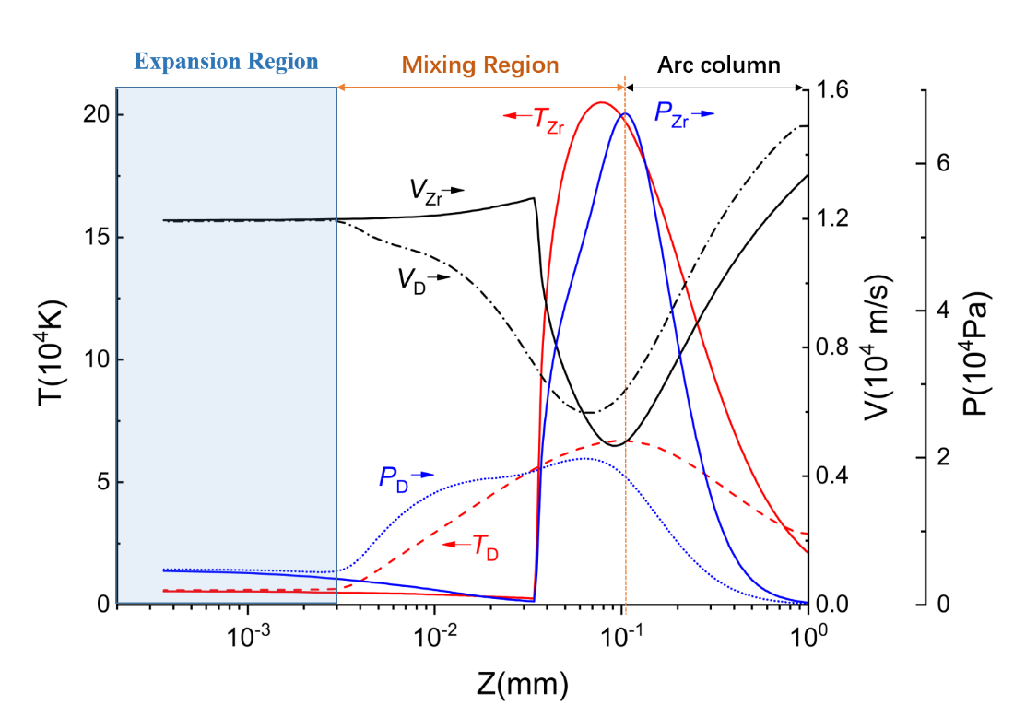
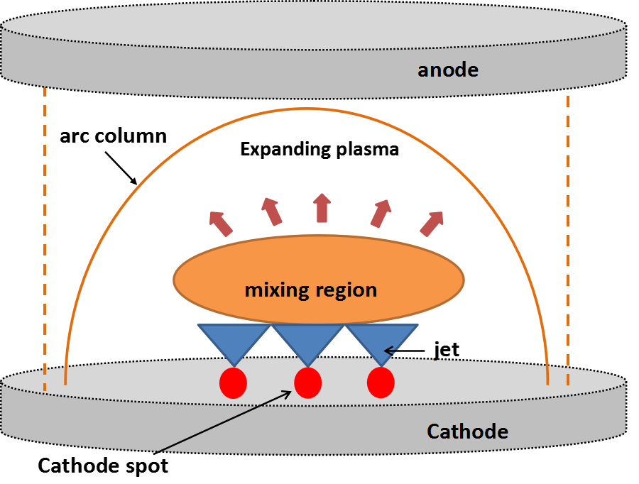
plasma jet mixing of multi-component VA plasma
While directed velocity of light and heavy ions is close in plasma expansion of single cathode spot (CS), the plasma jet mixing of multiply CS is simulated in mm-scale.
Due to 2D r-z geometry, two CS is set in the inlet: the spot 1 has a circular shape but the spot 2 has a ring shape, representing a number of separate CS.
阴极斑1和2：轻重离子速度一致（Zr、D设为12000m/s），速度方向为75度角射流。由于二维轴对称结构，阴极斑1呈圆形，而2呈环状，代表阴极斑1周围的许多个单独的阴极斑点。
schematic of jet mixing
simulation domain with two CS
velocity separation in arc column
Q. Sun, Q. Zhou* …, Plasma Sources Sci. and Technol. 31, 015014 (2022)

Slide 19
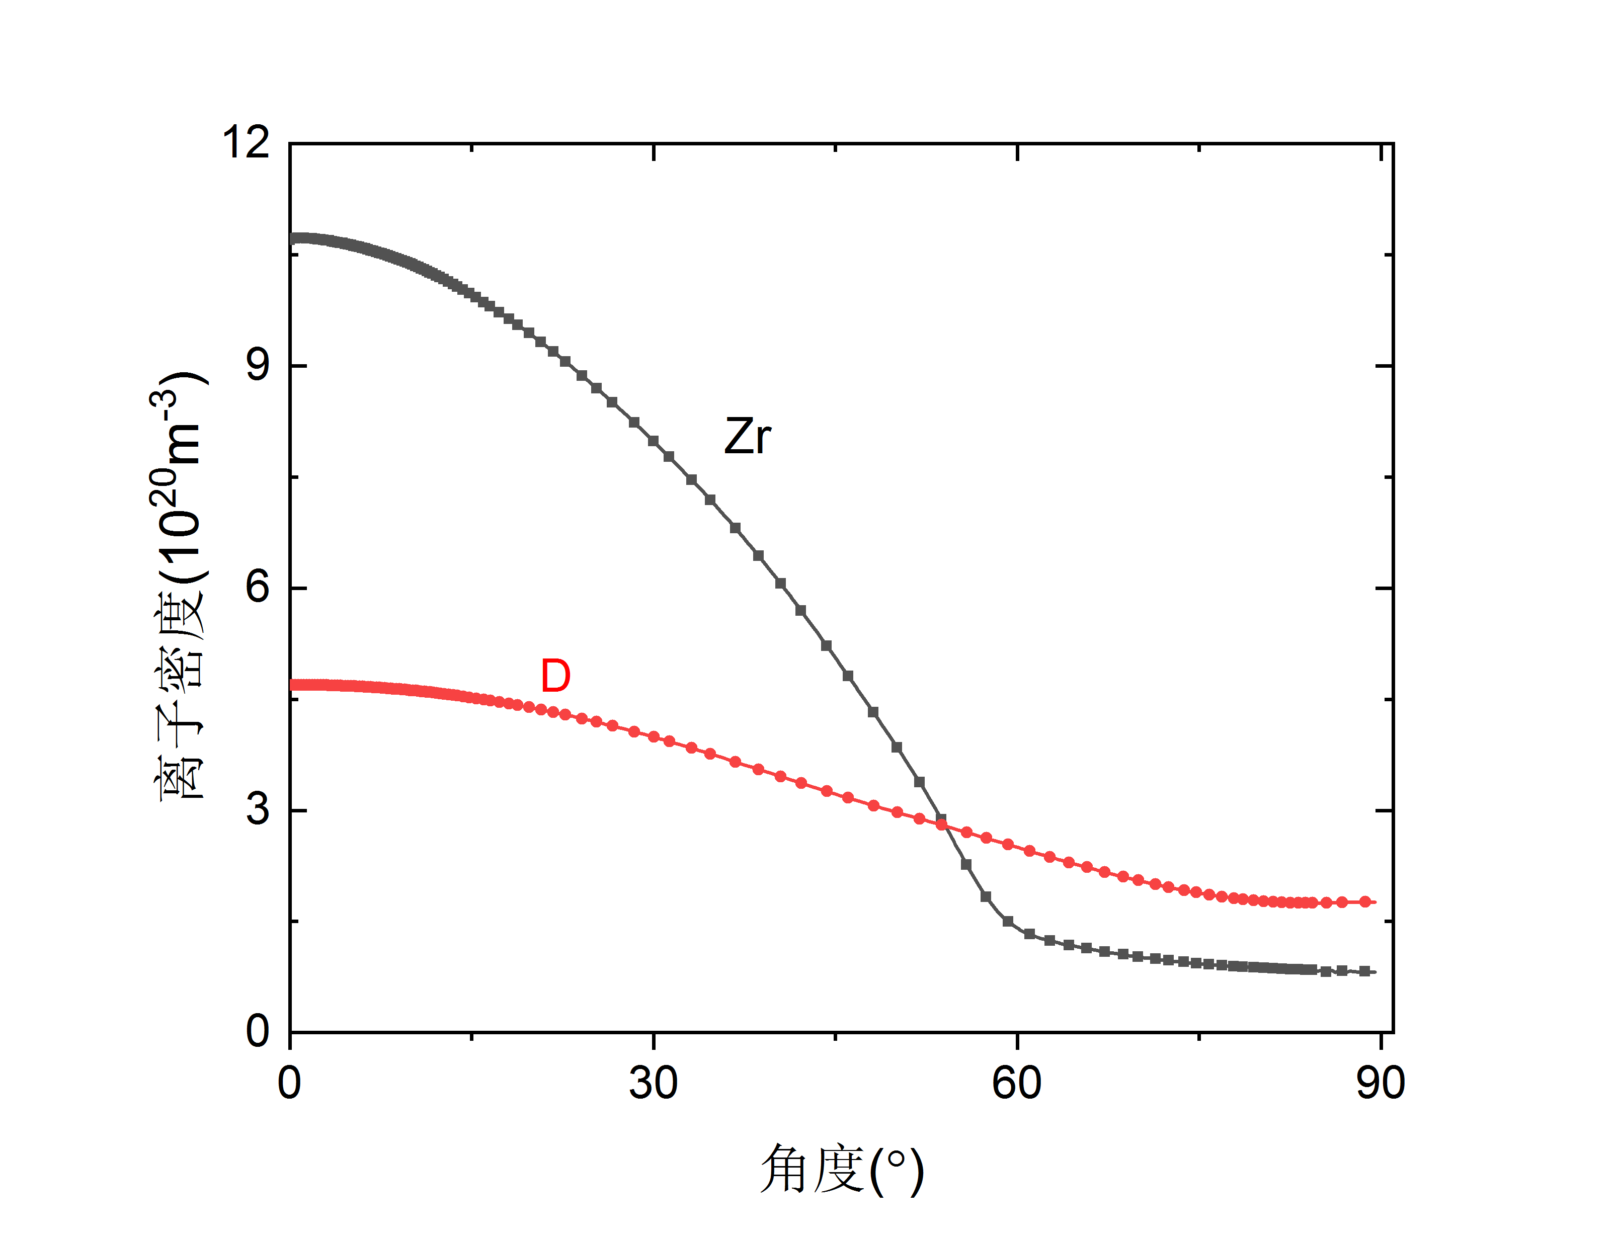
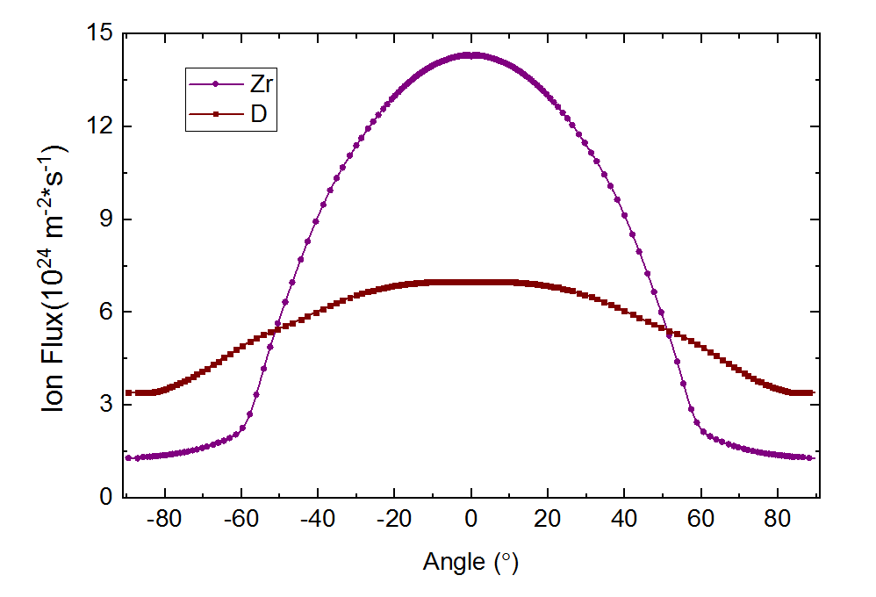
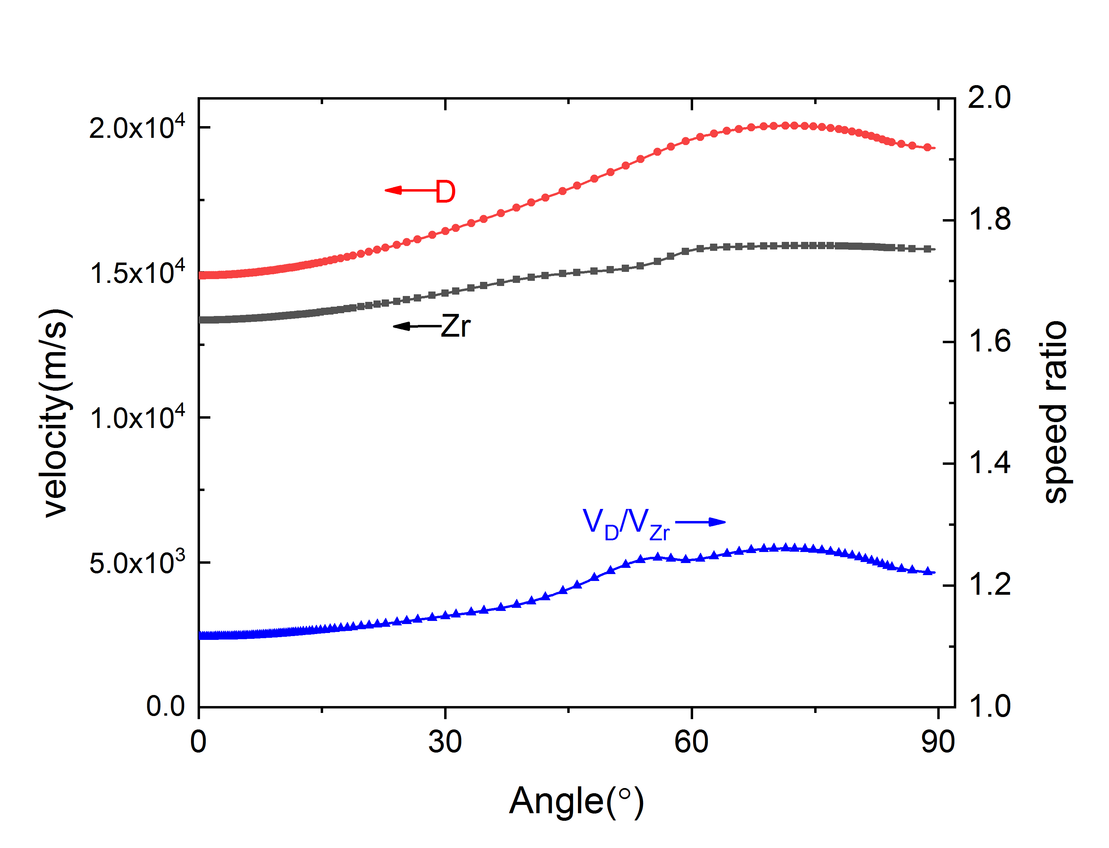
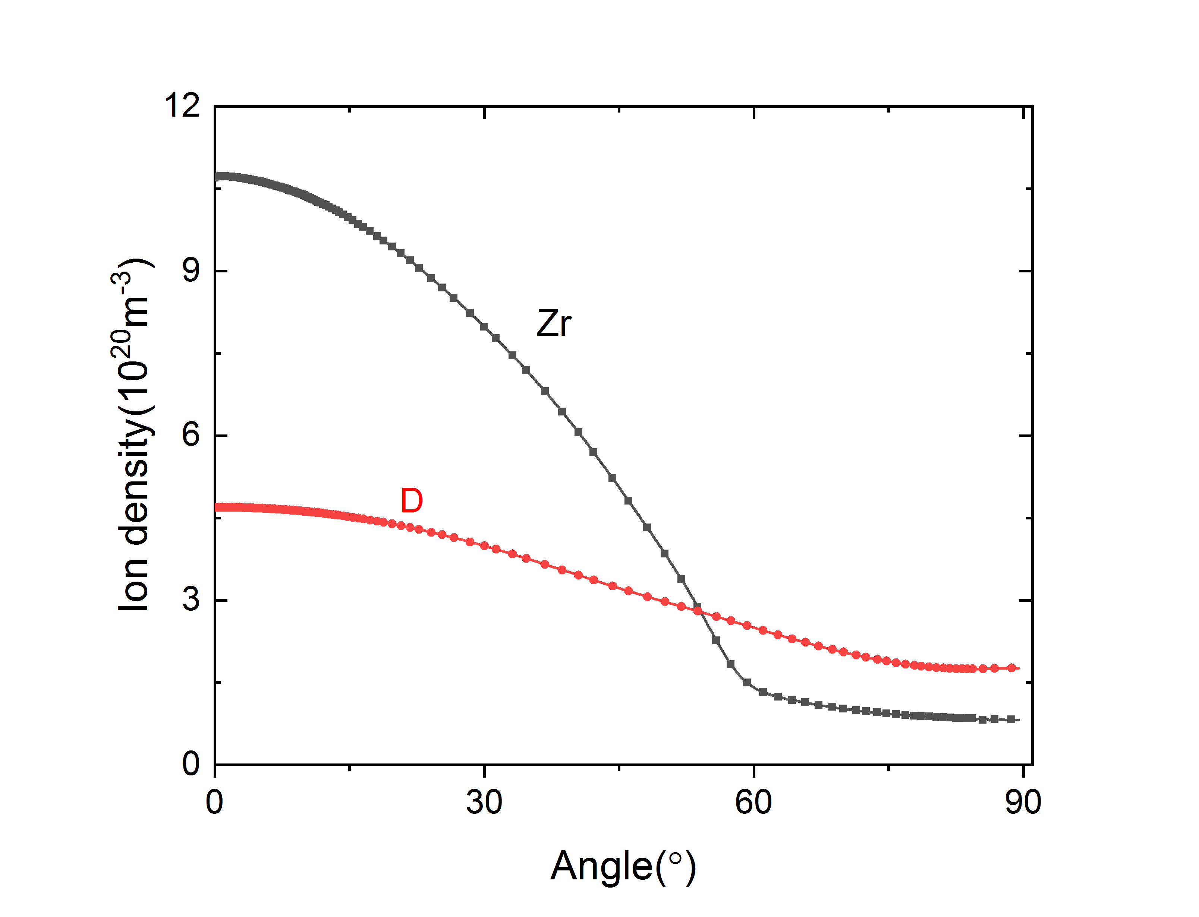
velocity and flux separation of light and heavy ions
angular distribution of ion flux: simulation
angular distribution of ion flux: experiment*
angular distribution of ion velocity: simulation
angular distribution of ion density: simulation
* Nikolaev A G 2019 IEEE Trans. Plasma Sci. 47 3590

Slide 20
The underline mechanism: collision between D-Zr ions
Zr–D ion collision force R_{Zr-D} is close to the pressure gradient of D, but far less than that of Zr. Therefore, R_{Zr-D} has little effect on Zr ions momentum, but significant effect on D ions.
Comparing the situation whether the Zr–D ion collision is considered in the model, the angular distribution of D ions differs substantially, but that of Zr ion is similar (in experiment, angular distribution of heavy ions is similar for pure metal cathode and composite cathode).
D ions
Zr ions
collision term v.s. pressure gradient
The ion flux angular distribution with and without Zr–D collisions
Q. Sun, Q. Zhou* …, Plasma Sources Sci. and Technol. 32 (2023) 085021

Slide 21
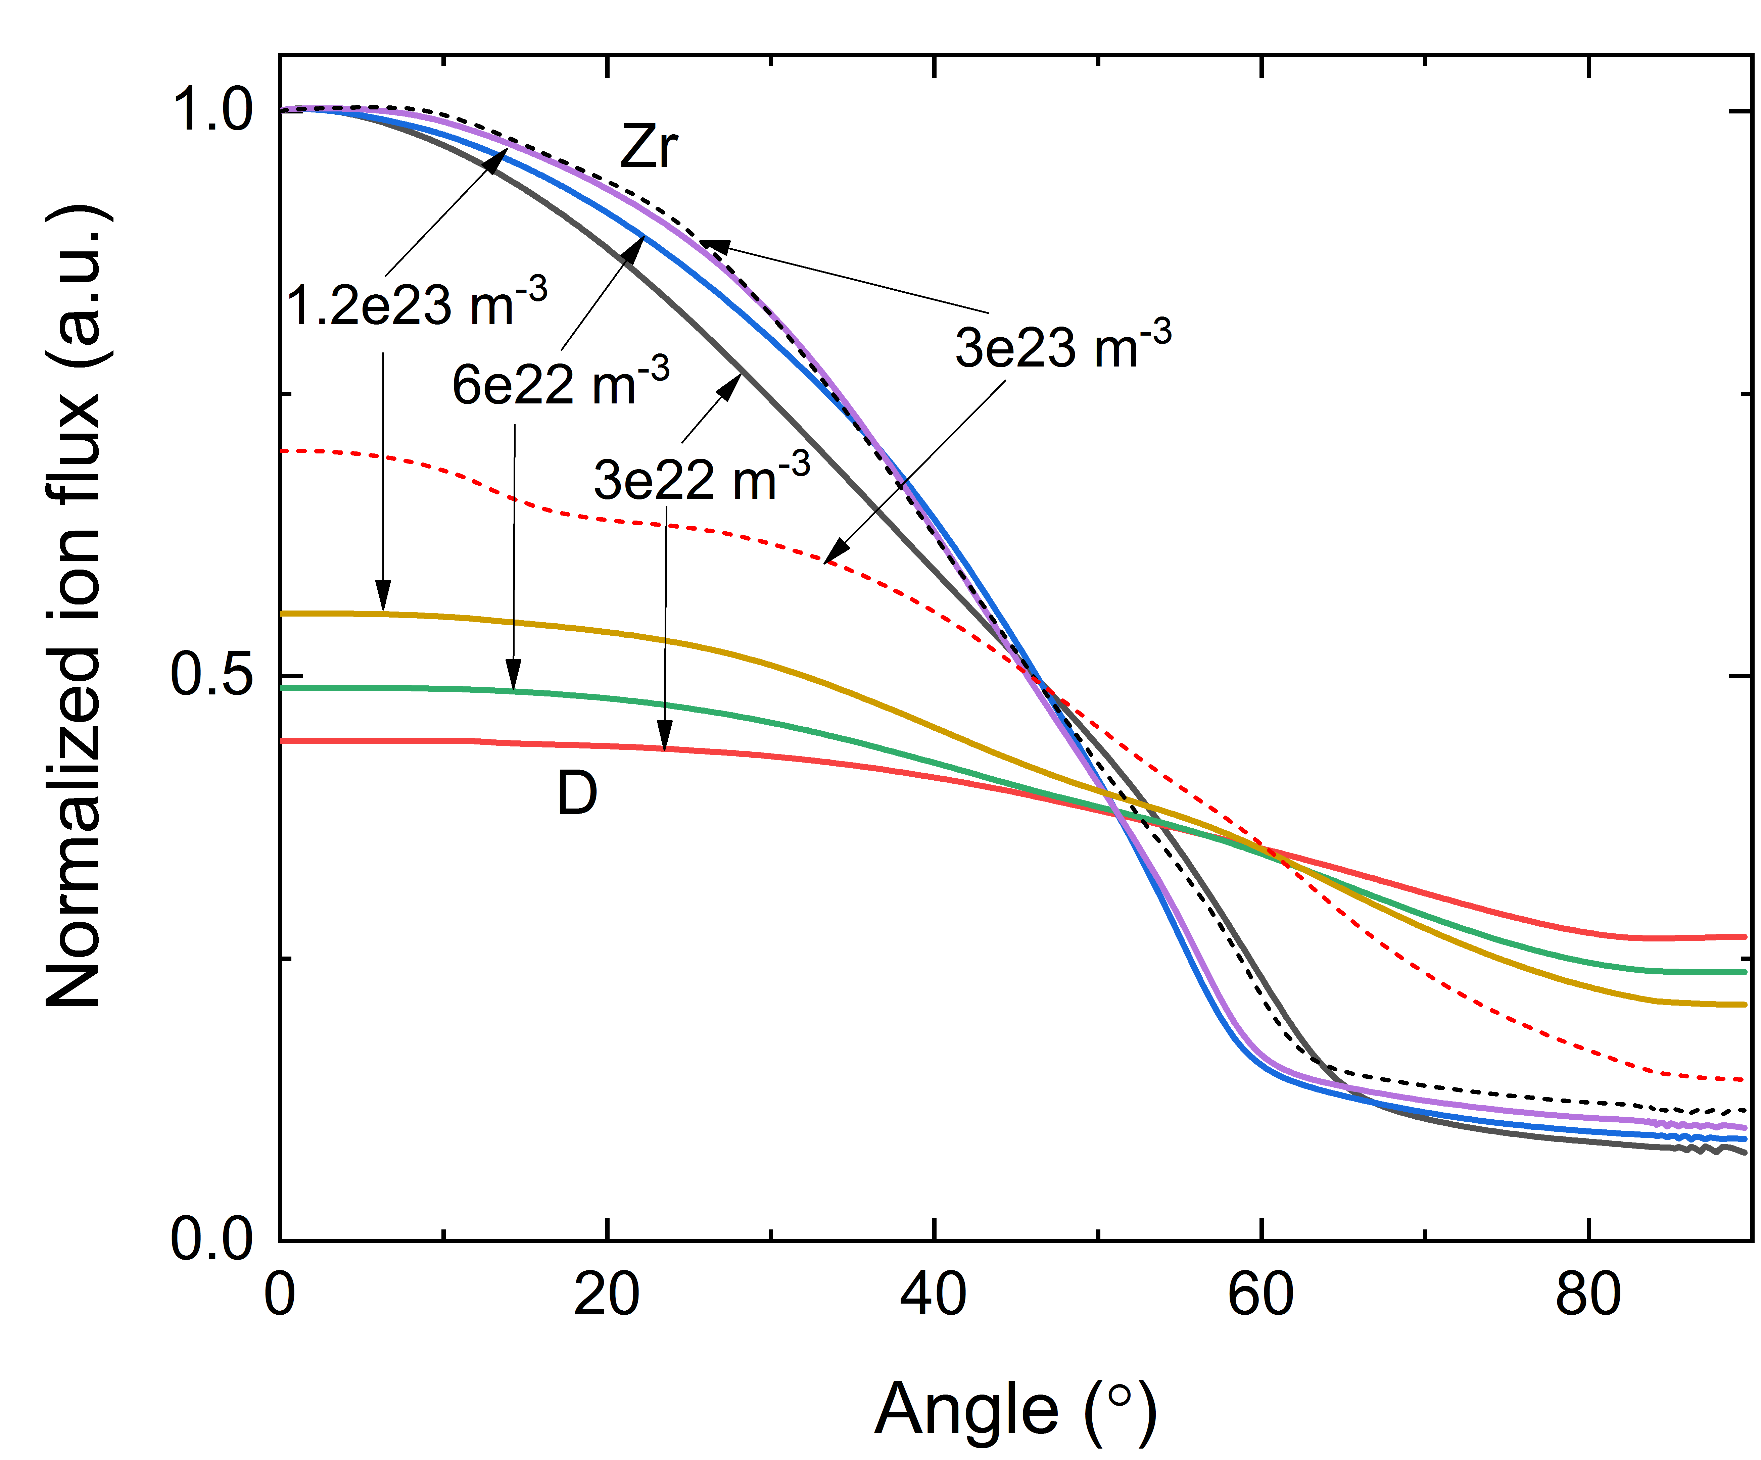
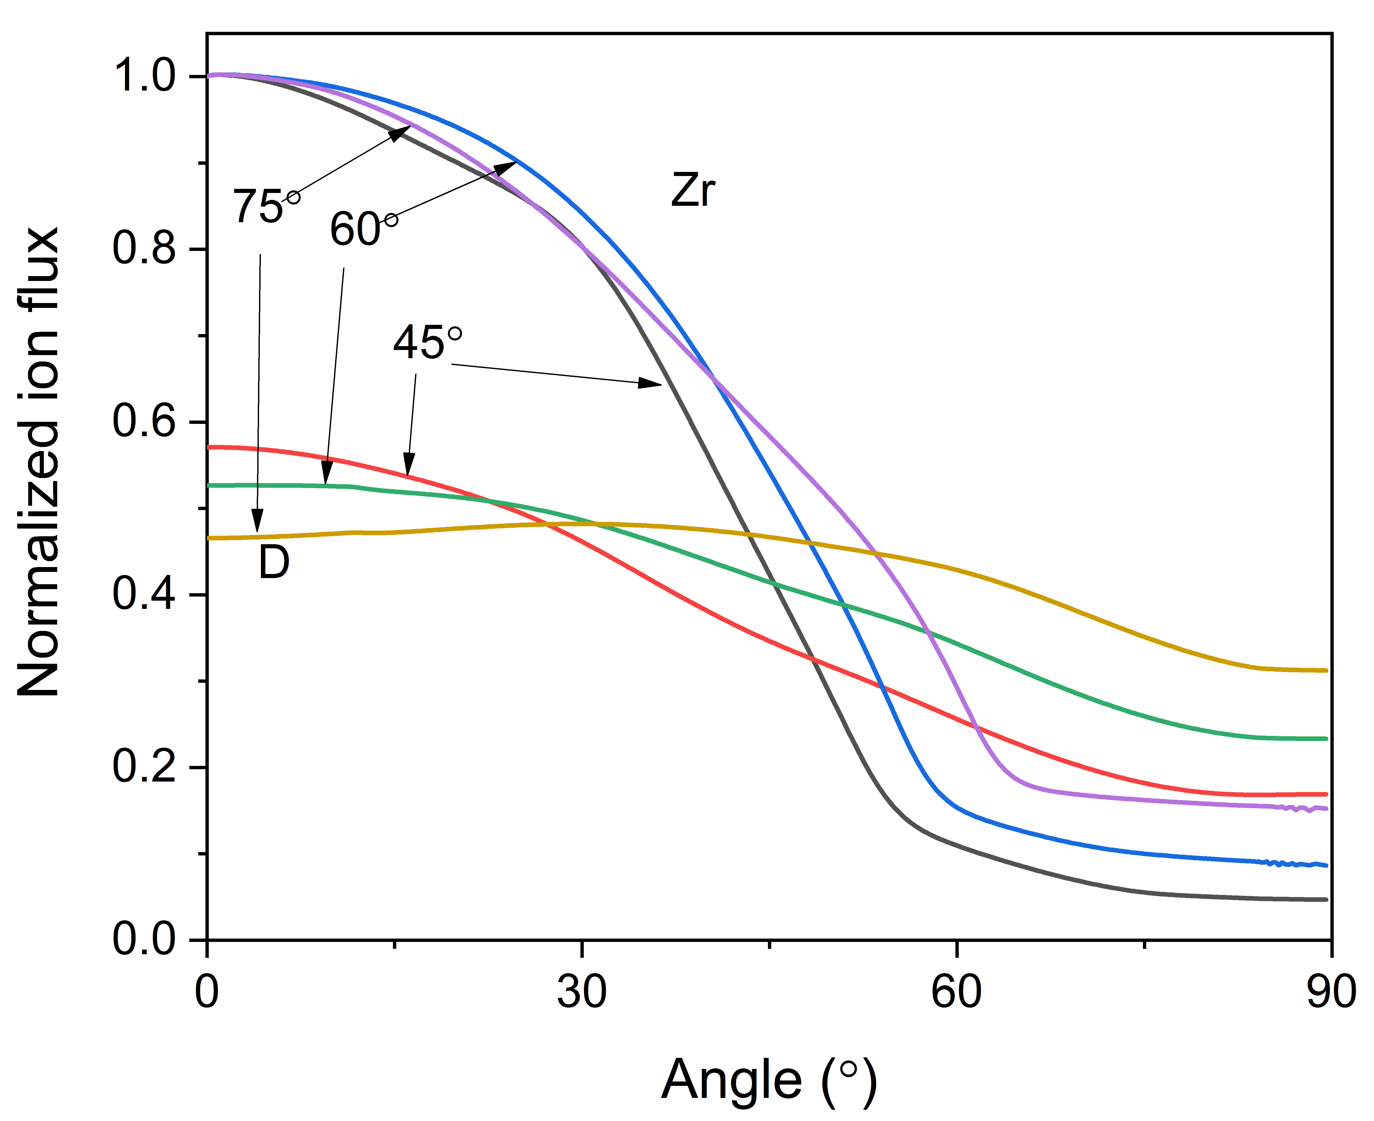
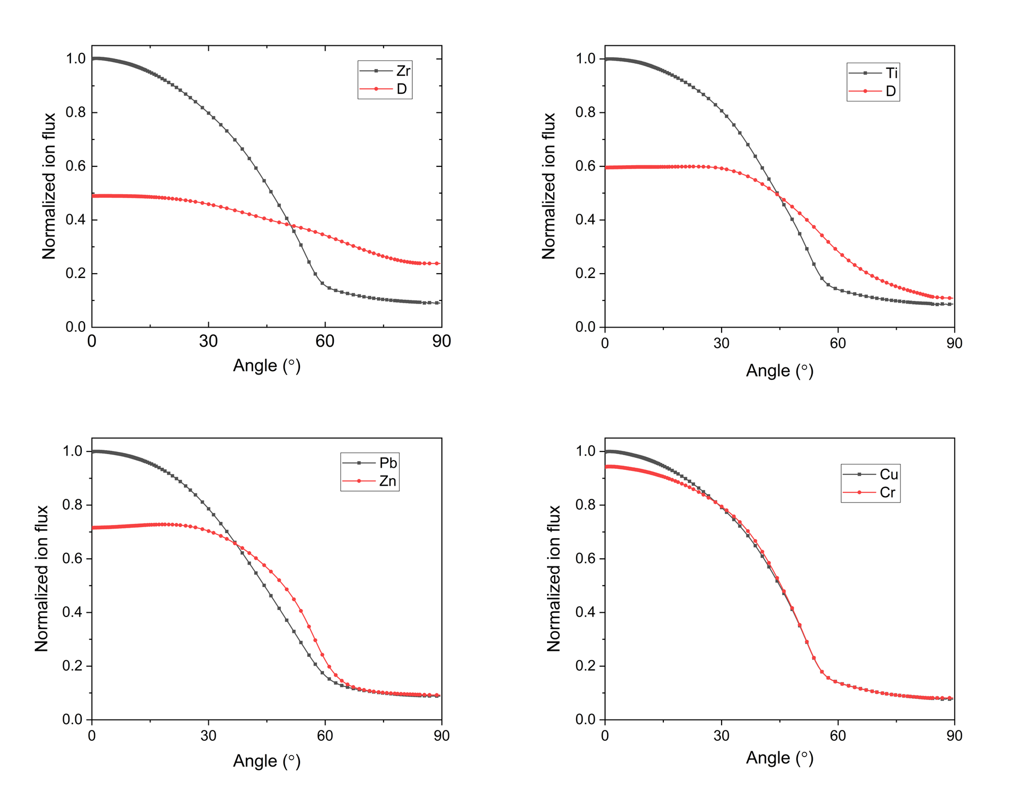

The influencing factors: ion density, temperature and mass
The influence of ion temperature
(via incident angle)
The influence of ion density
The influence of ion mass
The separation of ions can be enhanced by increasing ion temperature, decreasing ion density and selecting electrode components with significant differences in elemental mass.
$$υ_{di}={\left(\frac{m_{e}}{m_{d}}\right)}^{1/2}∙{\left(\frac{T_{e}}{T_{d}}\right)}^{3/2}∙υ_{ei},υ_{ei}=\frac{{Z_{i}}^{2}n_{i}(lnΛ/10)}{3.5×{10}^{10}{(T_{e}\left[ev\right])}^{3/2}}$$
$${{R_{d−i}=n}_{d}m}_{d}υ_{di}({u_{d}−u}_{i})$$

Slide 22
Table of contents
I
Introduction: vacuum arcs of composite electrode
II
Insights from PIC-DSMC simulations
III
Insights from multi-component fluid simulation
IV
Recent results of three-dimension hybrid simulation
V
Conclusions

Slide 23


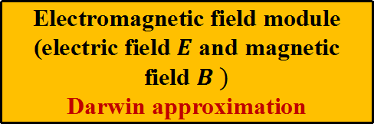


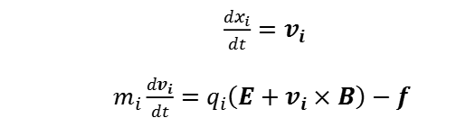
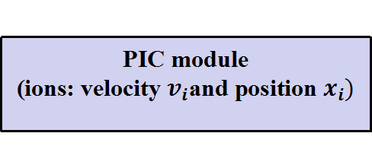
Hybrid model of multi-component plasma jets
Ions are treated as super-particles, and ion kinetics are tracked.
Electrons are treated as mass-less fluids, and electron kinetics is not resolved.
PIC module
(ions: velocity $v_{i}$and position $x_{i})$
$\frac{dx_{i}}{dt}=v_{i}$
$m_{i}\frac{dv_{i}}{dt}=q_{i}\left(E+v_{i}×B\right)−f$
fluid module
(electrons: density, velocity, and temperature)
assumption 1：quasi-neutrality
assumption 2：mass-less fluid
$n_{e}={q_{i}n}_{i}$
$$n_{e}m_{e}\frac{dv_{e}}{dt}=0=−en_{e}\left(E+v_{e}×B\right)−∇p_{e}+\frac{en_{e}j}{σ}$$
$\frac{∂(\frac{3}{2}n_{e}kT_{e})}{∂t}+\frac{3}{2}n_{e}ku_{e}∙∇T_{e}+p_{e}\left(∇∙u_{e}\right)=∇∙\left(k_{e}∇T_{e}\right)+\frac{j^{2}}{σ}−Q_{ei}$
Electromagnetic field module
(electric field $E$ and magnetic field $B )$
Darwin approximation
$$\frac{∂B}{∂t}=−∇×E$$
$0=\frac{1}{μ_{0}}∇×B−j$

Slide 24




Pros and cons of Darwin approximation in hybrid model
Maxwell equation
Darwin approximation
$$\frac{∂B}{∂t}=−∇×E$$
$$\frac{∂B}{∂t}=−∇×E$$
$ε_{0}\frac{∂E}{∂t}=\frac{1}{μ_{0}}∇×B−j$
$0=\frac{1}{μ_{0}}∇×B−j$
generalized Ohm’s law: different forms
$j=σ\left(E+v_{e}×B+\frac{∇p_{e}}{en_{e}}\right)$
$$E=−v_{e}×B−\frac{∇p_{e}}{en_{e}}+\frac{j}{σ}$$
self-consistent treatment of the electromagnetic field, allowing electromagnetic waves to propagate in vacuum or plasma
Fast calculation, low-frequency approximation, ignoring light waves, only need to deal with ion time scales
Pros
cons
In FDTD scheme, the time step size is strictly limited by the speed of light
the transmission of magnetic field in low density or vacuum region is greatly limited

Slide 25
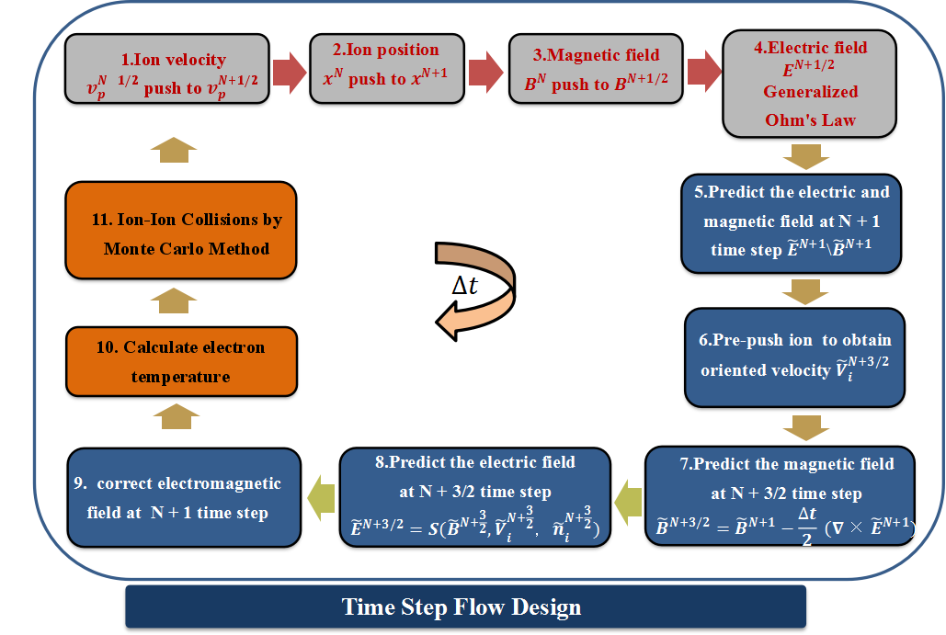
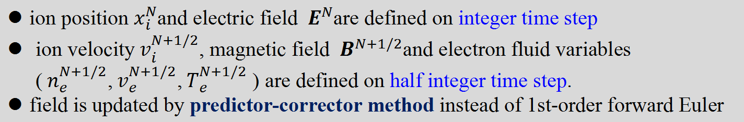
predictor-corrector method for high accuracy field solution
ion position $x_{i}^{N}$and electric field ${ E}^{N}$are defined on integer time step
ion velocity${ v}_{i}^{N+1/2}$, magnetic field ${ B}^{N+1/2}$and electron fluid variables (${ n}_{e}^{N+1/2}$,${ v}_{e}^{N+1/2}$,${ T}_{e}^{N+1/2}$ ) are defined on half integer time step.
field is updated by predictor-corrector method instead of 1st-order forward Euler
D. Winske, Homa Karimabadi, Ari Le, N. Omidi, Vadim Roytershteyn, Adam Stanier. 2022. Hybrid codes (massless electron fluid)

Slide 26

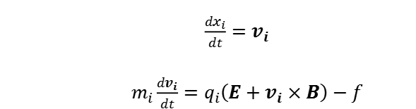
methods for electron-ion and ion-ion collision
electron-ion collision by fluid method
ion-ion collision by Monte-Carlo method
In ion pushing, electron-ion friction force is treated
Post-collision velocity is related to pre-collision velocity according to momentum and energy conservation
$\frac{dx_{i}}{dt}=v_{i}$
$m_{i}\frac{dv_{i}}{dt}=q_{i}\left(E+v_{i}×B\right)−f$
friction force is calculated according to the velocity of electrons and ions
Based on scattering angle and azimuthal angle sampled in Monte-Carlo method, the relative velocity is calculated.
for Zr: $f=\frac{Z_{i}(lnΛ/10)}{3.5×{10}^{10}{[T_{e}\left(eV\right)]}^{3/2}}m_{e}n_{e}(V_{Zr}−V_{e})$
for D: $f=\frac{(lnΛ/10)}{3.5×{10}^{10}{[T_{e}\left(eV\right)]}^{3/2}}m_{e}n_{e}(V_{D}−V_{e})$

Slide 27




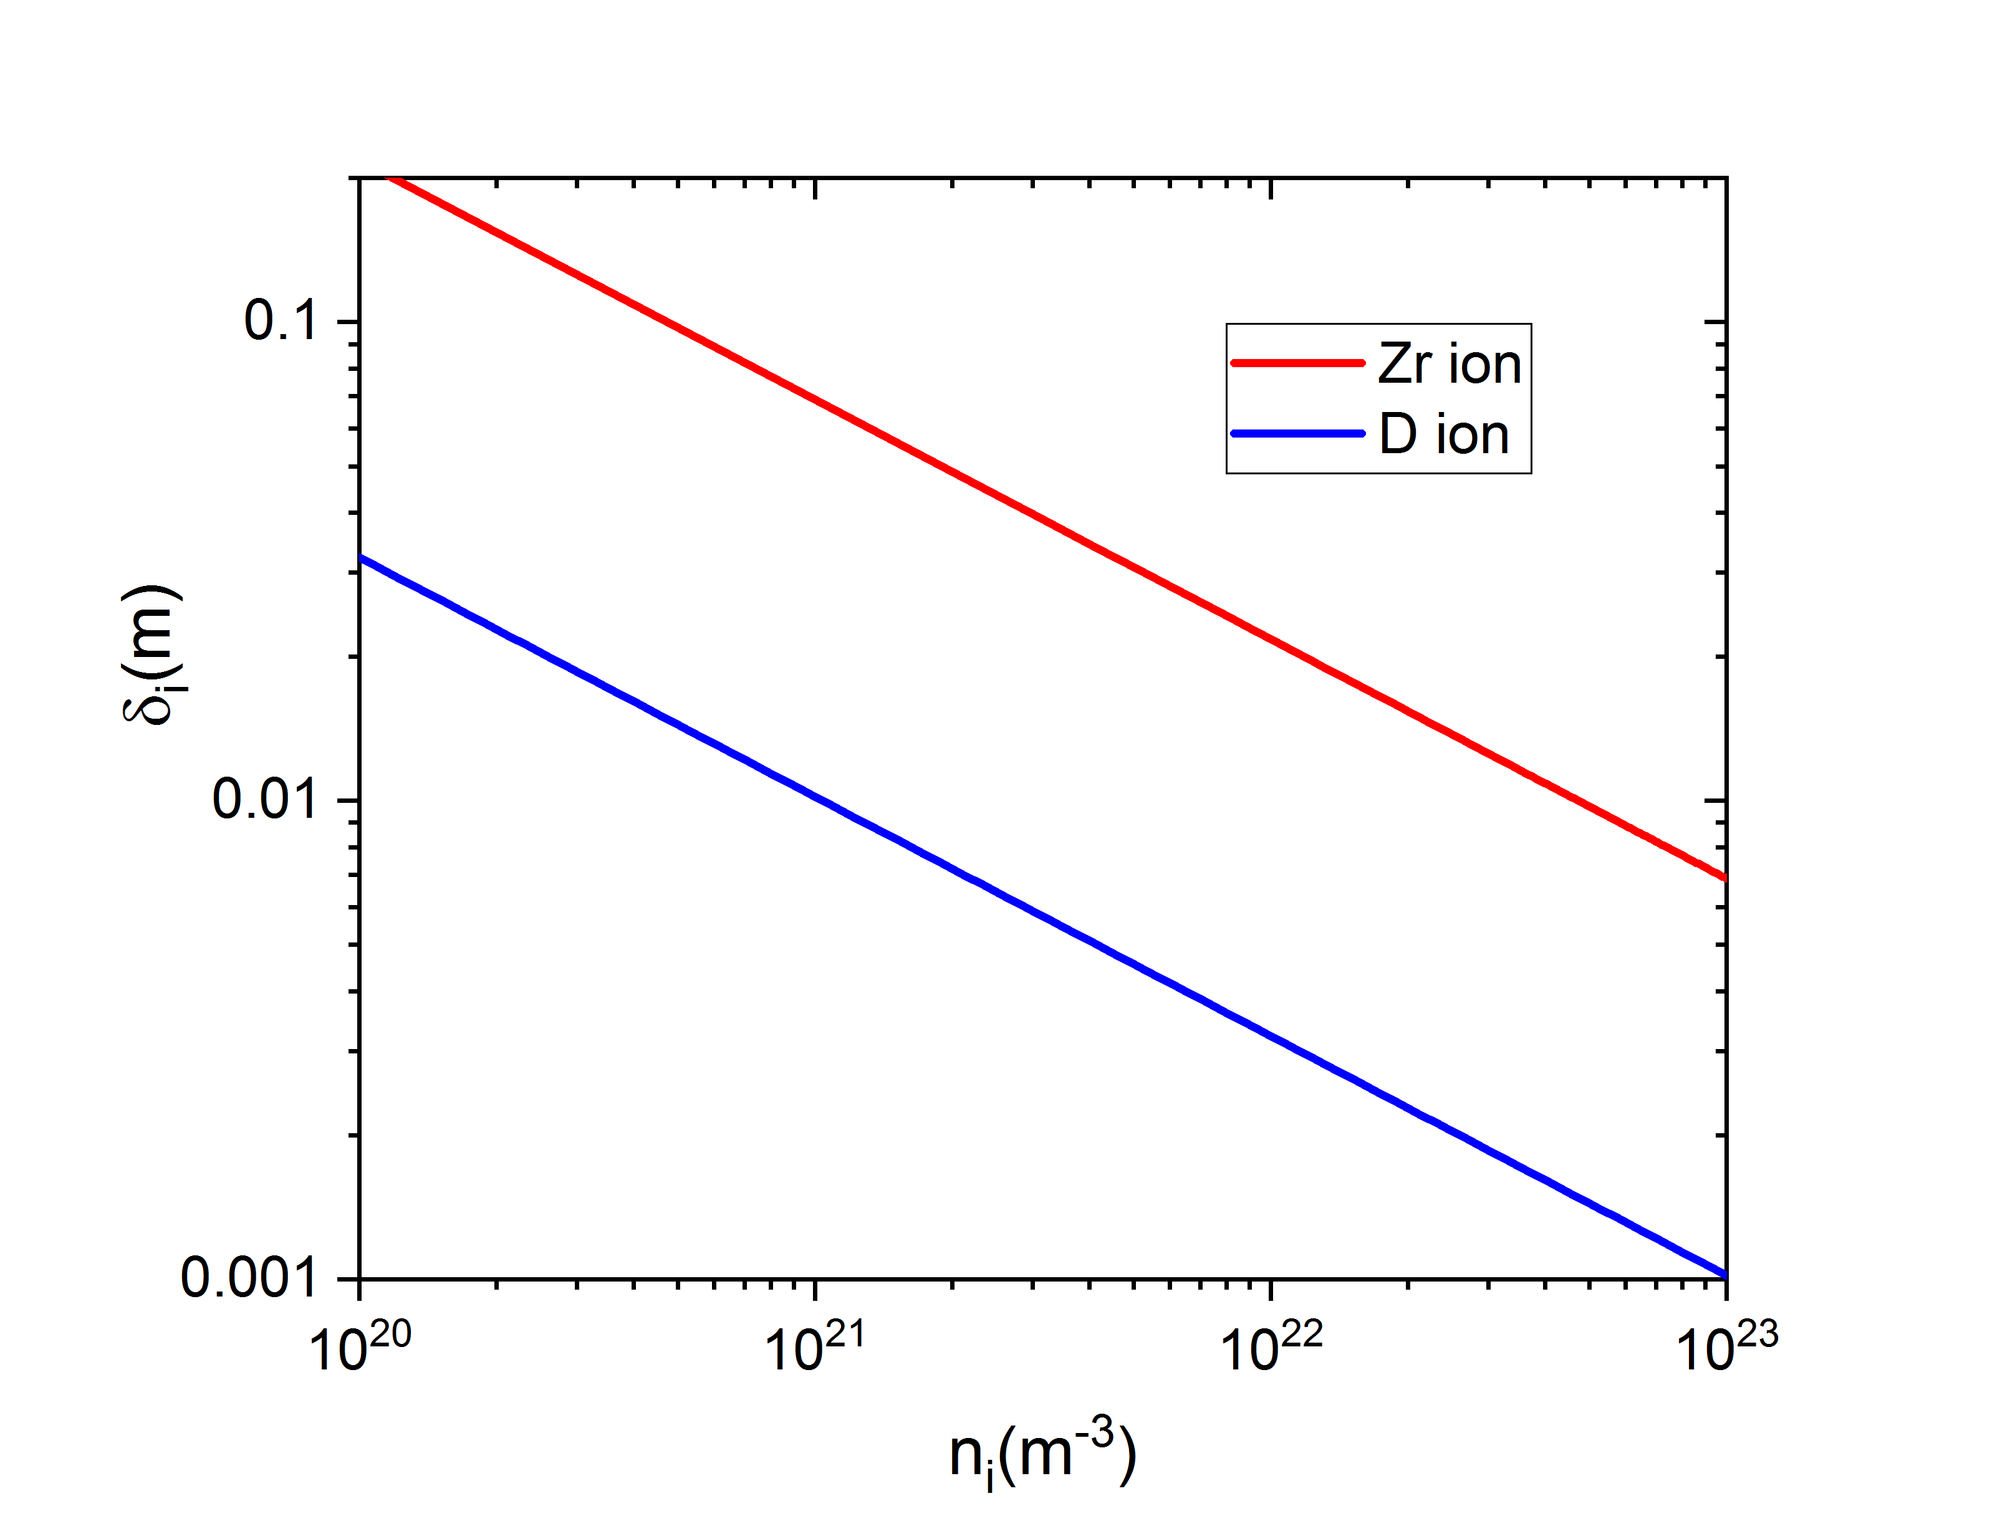
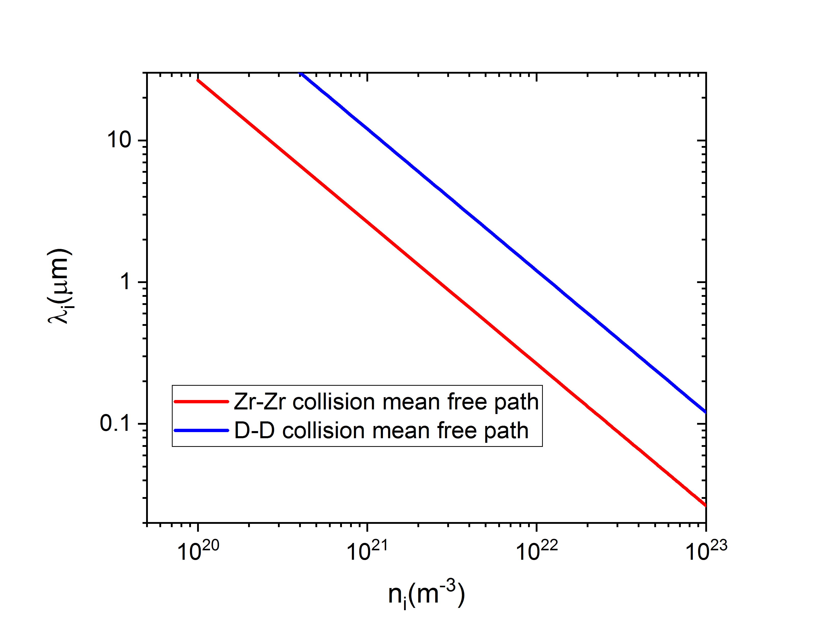
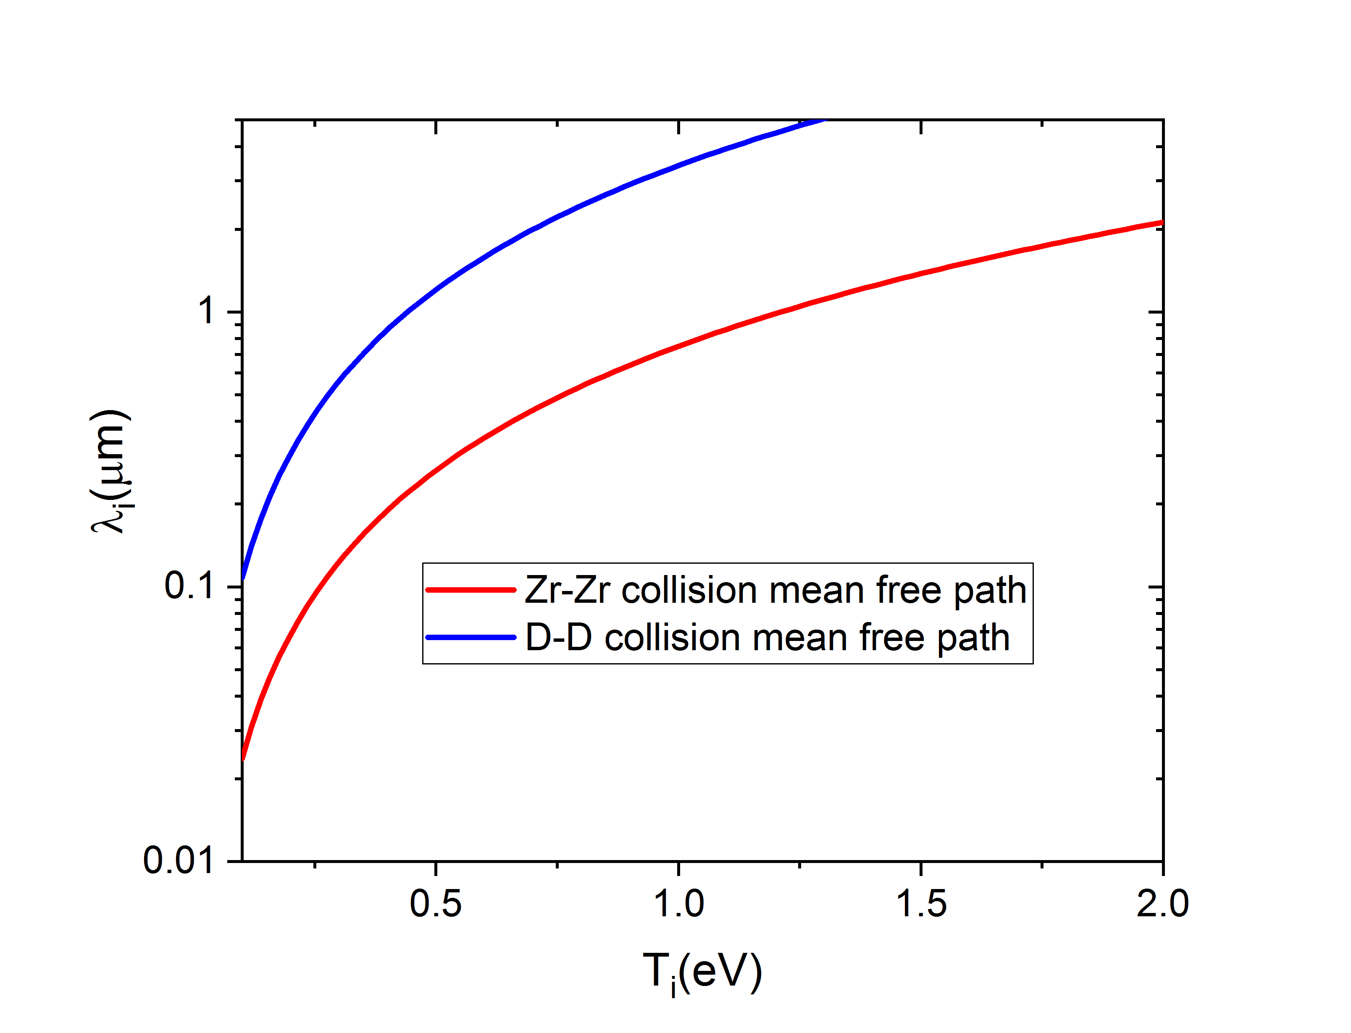
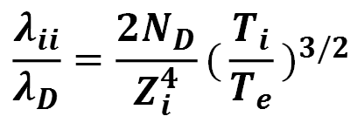
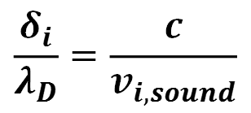
constraint on spatial step in hybrid simulation with collision
the minimum of inertial length and mean free path of ions
ion inertial length
mean free path of ion-ion collision
$$\frac{δ_{i}}{λ_{D}}=\frac{c}{v_{i,sound}}$$
$$\frac{λ_{ii}}{λ_{D}}=\frac{2N_{D}}{Z_{i}^{4}}{(\frac{T_{i}}{T_{e}})}^{3/2}$$

Slide 28
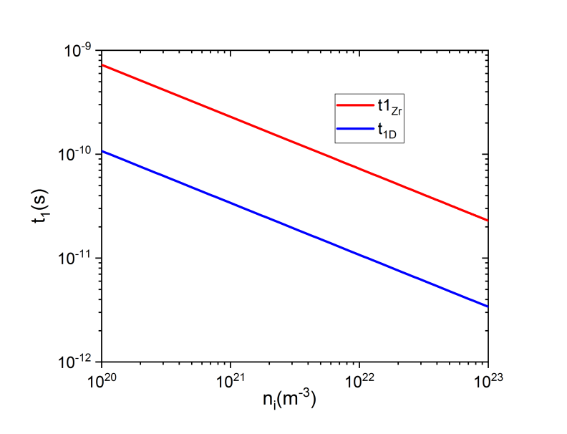
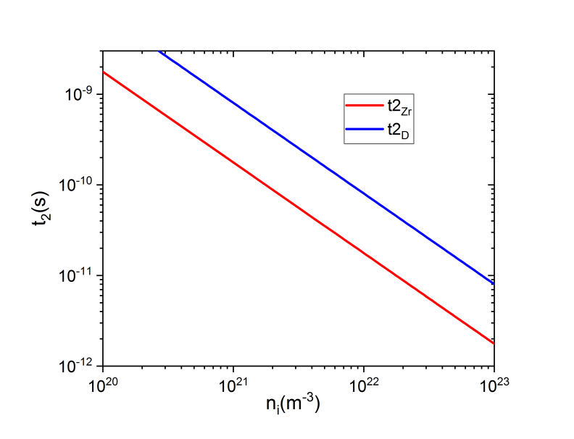

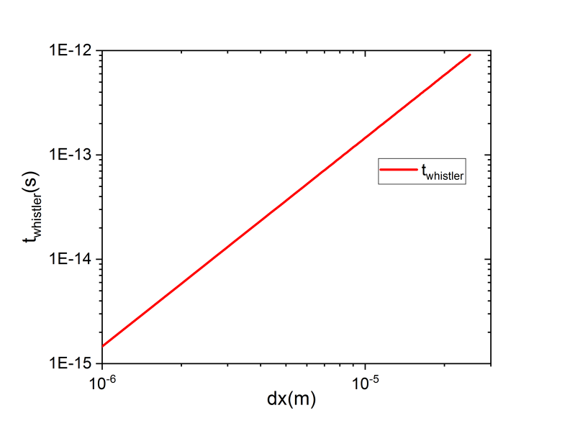
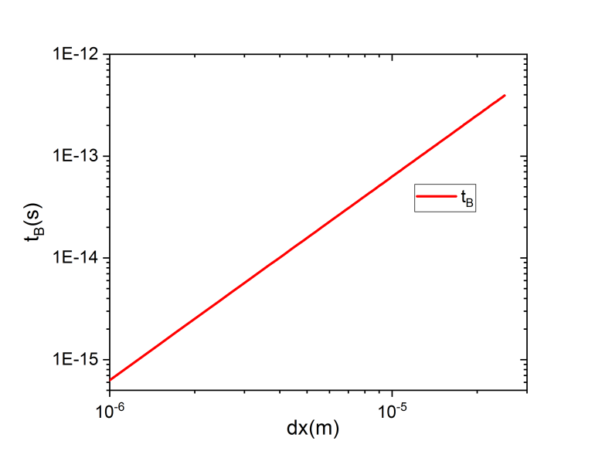




constraint on time step in hybrid simulation with collision
ion collision frequency
ion plasma frequency
CFL stability criterion for waves in the whistler limit
resistive term of magnetic
diffusion equation
M A. Belyaev …, Phys. Plasmas 31, 012902 (2024)

Slide 29
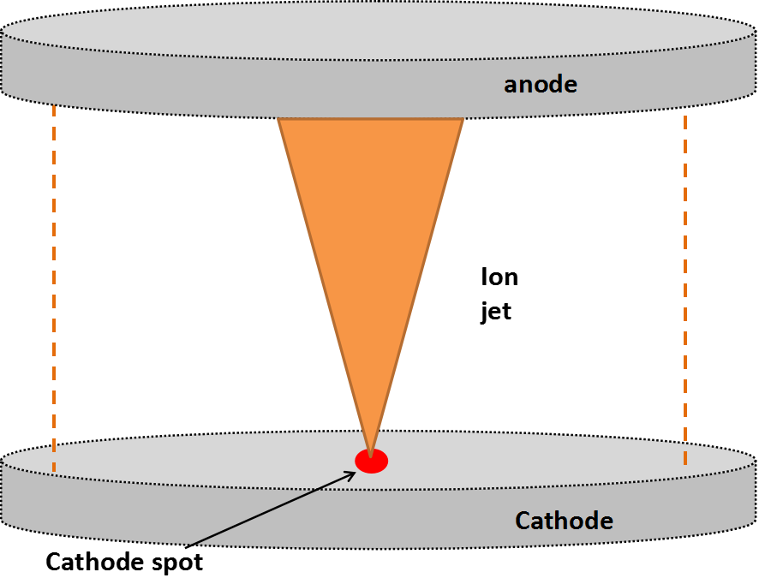
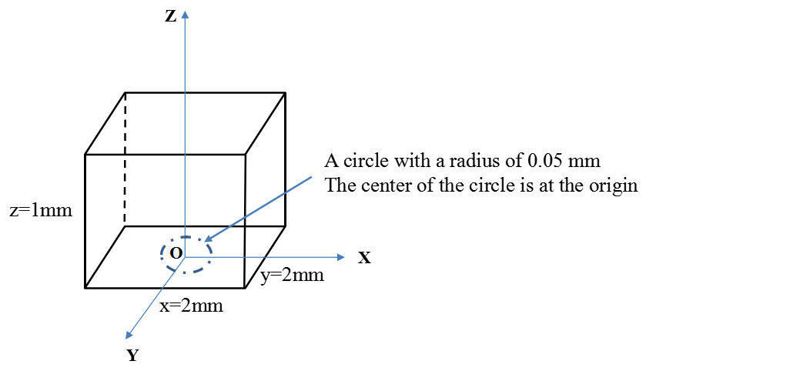
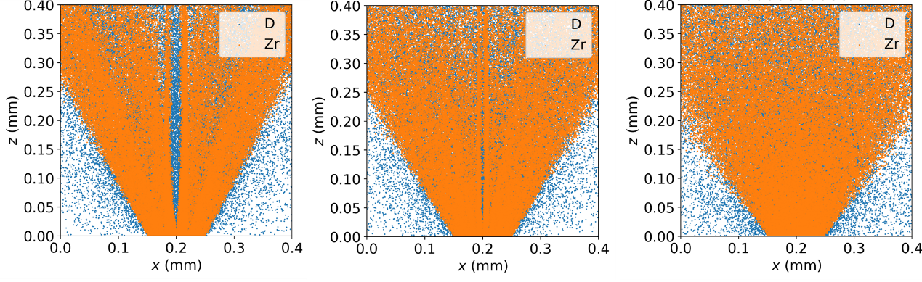
plasma expansion of single CS: influence of spatial grid
Schematic of three-dimension hybrid simulation on plasma expansion of single CS
spatial grid 20 μm
10 μm
5 μm

Slide 30
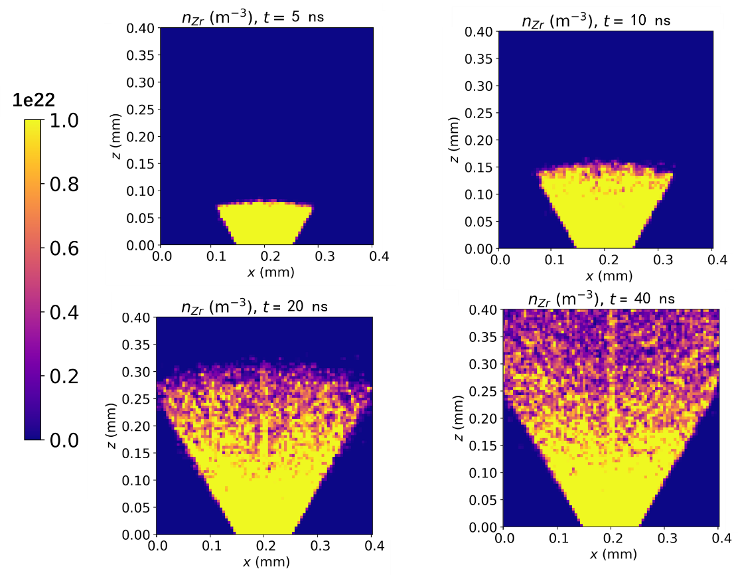
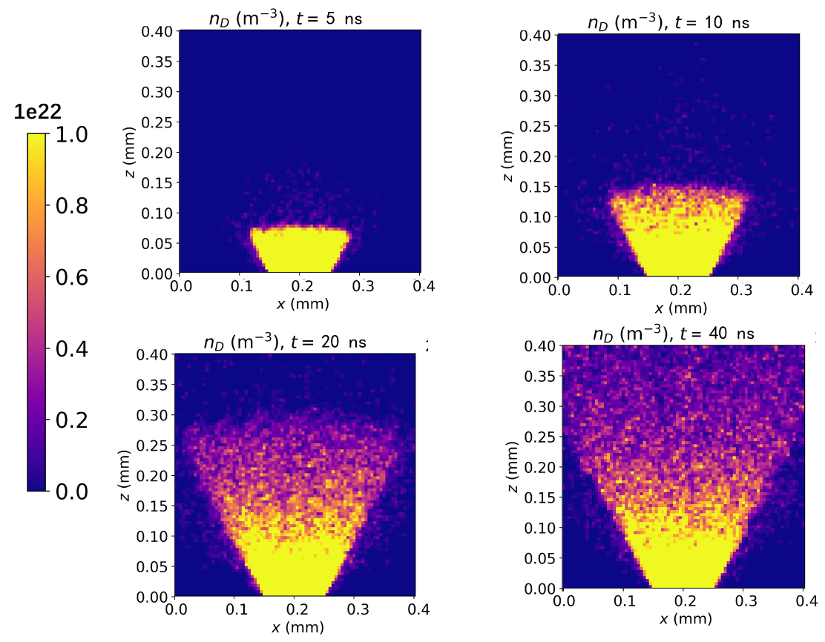
Ion distribution during plasma expansion of single CS
In the XOZ plane, the distribution of ion density does not differ substantially during plasma expansion of single CS.

Slide 31
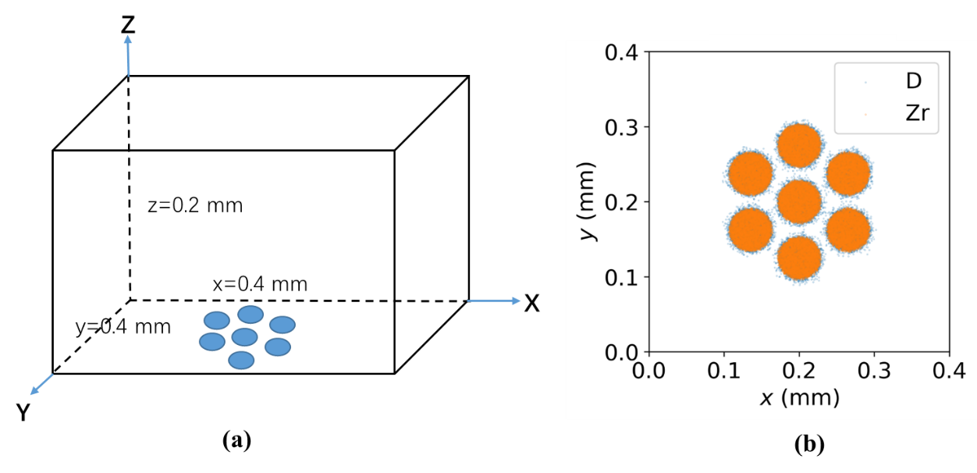
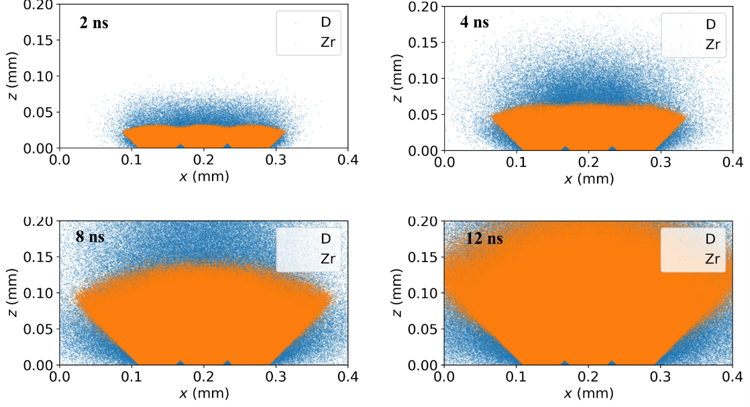
hybrid simulation on plasma jet mixing of multiply CS
The plasma jets originated from the separate CS mix together to form a common arc column after a certain distance from the cathode.

Slide 32
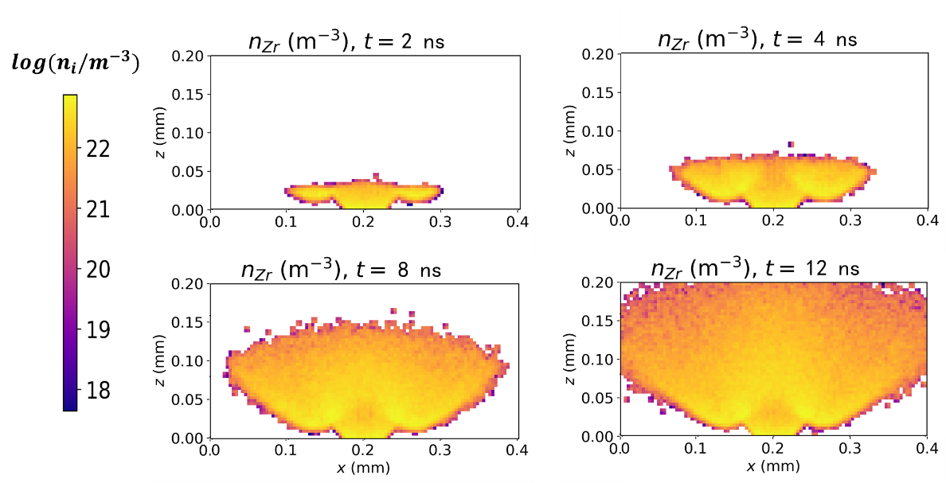
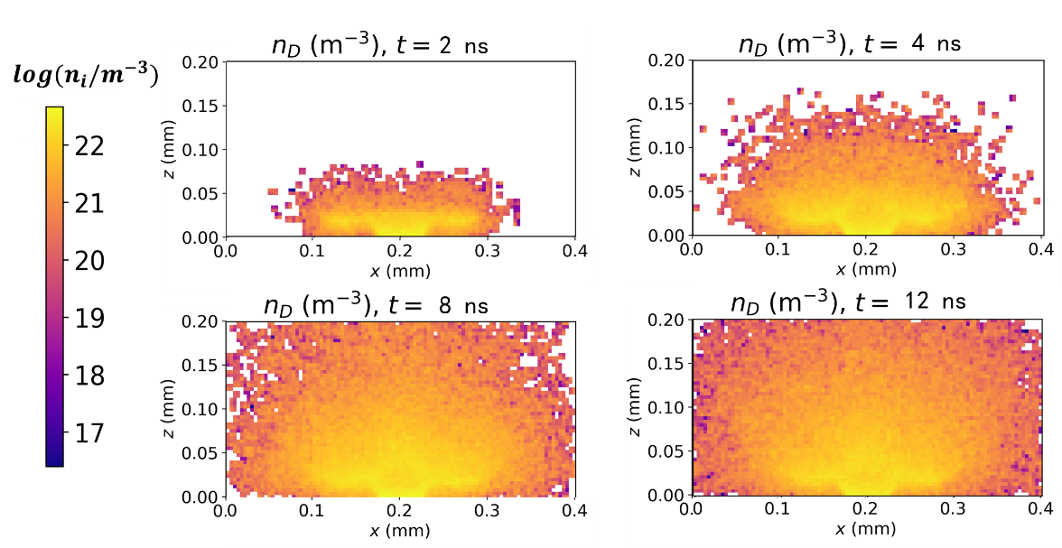
Ion distribution during plasma jet mixing of multiply CS
In the XOZ plane, the distribution of ion density differs for light ion and heavy ion: heavy ions is more concentrated in the central axis, but light ions are distributed in a much broader area.

Slide 33
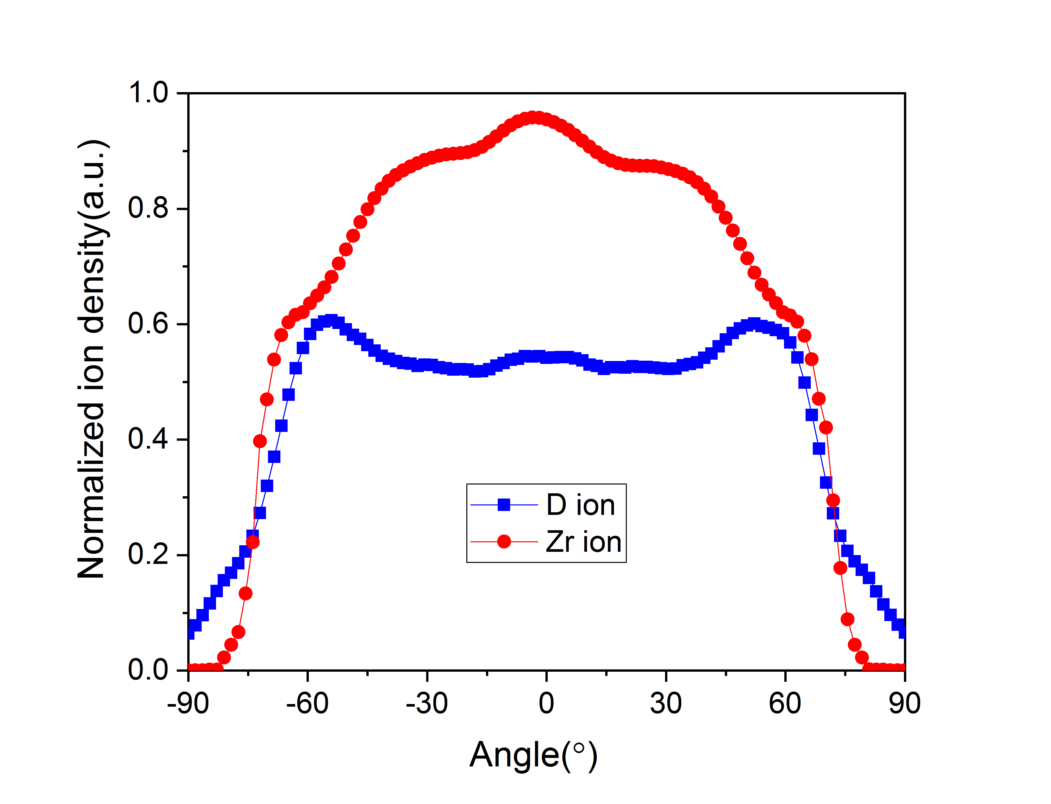
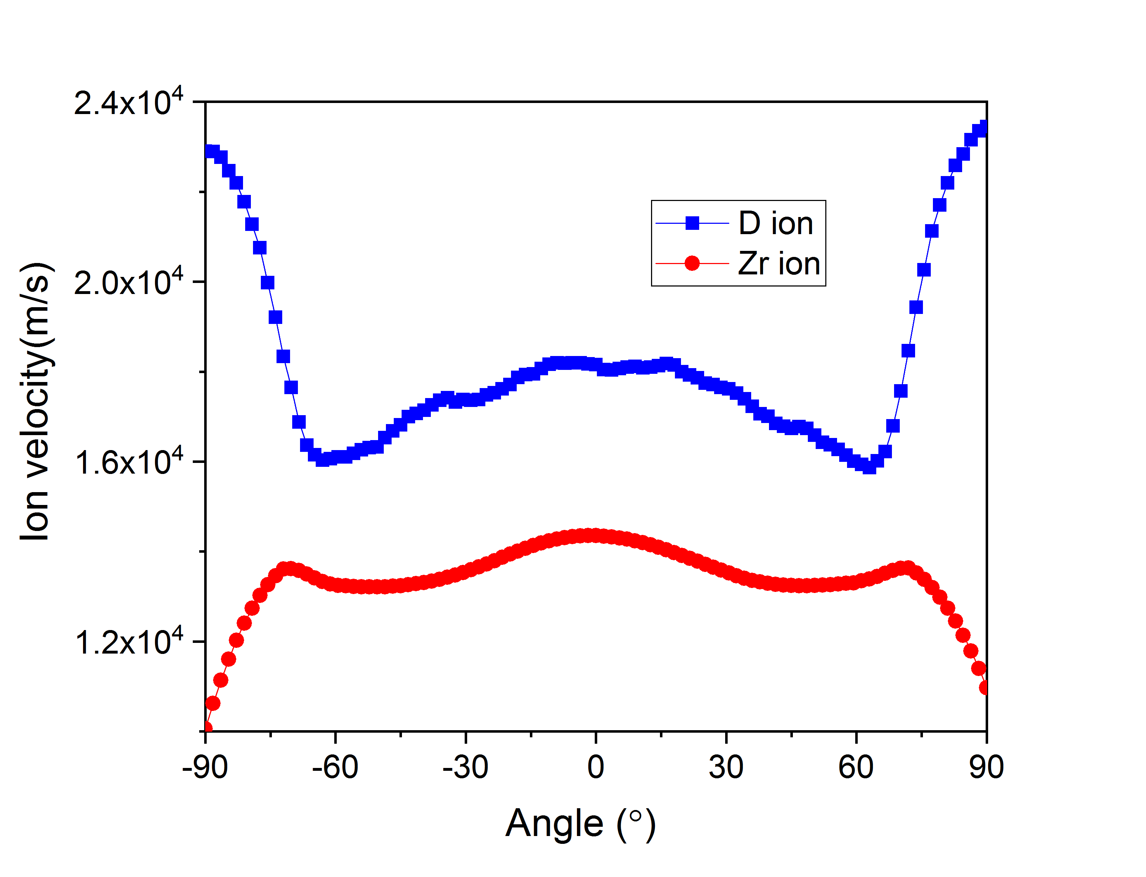
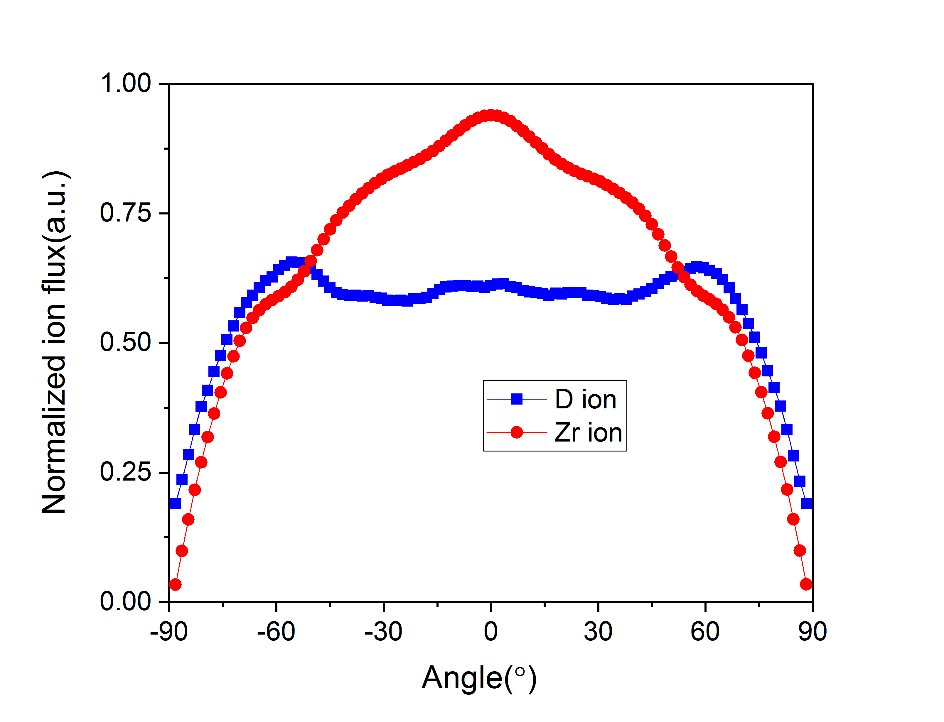
angular distribution of ion density, velocity and flux
The angular distribution of light and heavy ions is confirmed by 3D hybrid simulation on plasma jet mixing of multiply CS.
In the center, the flux of D ions is much smaller than that of Zr; in the edge, the flux of D ions is three times higher than that of Zr.
angular distribution of ion density (left), velocity (middle) and flux (right), at a distance 0.16 mm away from the CS

Slide 34
Table of contents
I
Introduction: vacuum arcs of composite electrode
II
Insights from PIC-DSMC simulations
III
Insights from multi-component fluid simulation
IV
Recent results of three-dimension hybrid simulation
V
Conclusions

Slide 35
Conclusions
Regarding multi-component plasma of vacuum arc discharge with composite cathode, we have developed different numerical approaches including fully kinetic particle method, fluid method, and hybrid method.
During plasma jet mixing, the ion collision is an important factor leading to the separation of light and heavy ions, and three main factors are found: ion mass, ion density and ion temperature.

Slide 36
Thank you for listening!
questions or comments?

