Slide 1
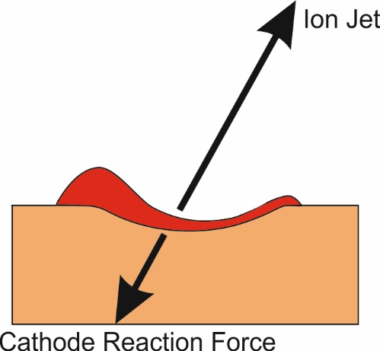
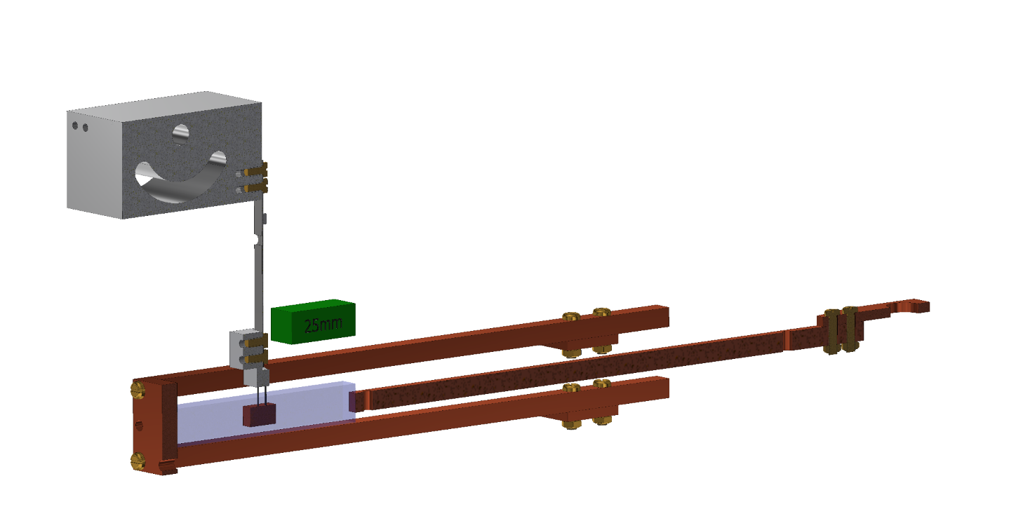
Longitudinal Electromagnetic (EM) Force Demonstration and its Role in Vacuum Arc Ion Jet Acceleration
Neal Graneau
Pulsed Power & Beams Team
Neal.Graneau@awe.co.uk

Slide 2
Outline of Presentation
A highly selective review of the physics of the ion jet in diffuse vacuum arcs (evidence and theories)
The motivation behind a previously published (1993) , diffuse vacuum arc ion acceleration theory based on longitudinal EM force
A description of the almost completely unknown longitudinal EM force
Details of a recent demonstration of longitudinal EM force at AWE
A description of the longitudinal EM force applied to the vacuum arc ion jet mechanism
Conclusions

Slide 3
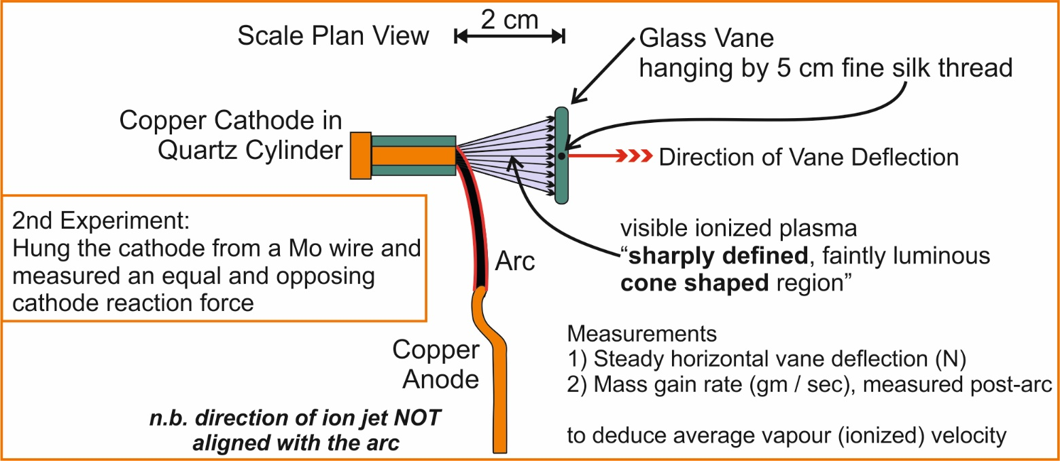
Ion Jets in Vacuum Arcs (1930 - 1965)
Experimentally discovered in the 1920’s by Tanberg [1]
  Vacuum arc cathodes produce high energy, highly anisotropic luminous “vapor jets” [1], (later found to be ionised [2])
  Deduced vapor velocities up to 1.6 x 10⁴ m/s (in agreement with modern ion velocity measurements)
  Measured the force on the cathode and found it to be consistent with and opposed to the vapor acceleration force
  Observed a conical vapor jet - axis directed normal to cathode surface (later found to be independent of arc direction [2])
  Cathode spot temperature deduced to be ~ 5 x 10⁵ °K, to achieve the deduced ion velocity [1], although this was not really believed
figure adapted from [1]
[1] R. Tanberg, Phys.Rev 35, pp1080-89 (1930)
[2] A.A. Plyutto et al, Sov.Phys JETP, 20 (2),
pp.328-337 (1965)

Slide 4
Diffuse Vacuum Arc Ion Jets – Some Known Facts & Deductions
Cathode spot crater radius and spot current are closely related to each other for a given material [3]
Cathode spot current is cathode material related (total arc current is proportional to number of coexistent spots) [3]
Ion jet momentum and energy is also material dependent [4]
  Therefore, cathode current density and ion momentum / energy are linked and are both material dependent
The ion energies are always significantly higher (20-150 eV) than would be predicted by the random thermal velocities associated with the measured electron and ion temperatures (1-2 eV) in the cathode spot. [3]
  The ion acceleration cannot be a simple expansion of the thermal plasma above the cathode spot
The ion flux obeys a cosine or exponential decay distribution with angle defined relative to the “anode direction”) [3]. This is true for all arcs in which the “anode direction” is perpendicular to the cathode surface (which is most vacuum arcs, but not all e.g. Tanberg [1])
  The ion jet is peaked and most accurately defined by the direction normal to the cathode surface
The peaked ion flux distribution is mainly due to a variation in the number density rather than the ion velocity [3]
The cathode receives an equal and oppositely directed force to that accelerating the directed plasma jet [1]
  The ion acceleration mechanism must contain some feature which explains the focussing of ions in the direction normal to the cathode surface as well as the equal and opposite force acting on the cathode
[1] R. Tanberg, Phys.Rev 35, pp1080-89 (1930), [3] B Juttner, IEEE Trans.Plas.Sci PS-15 (5), pp.474-80 (1987), [4] A Anders, G Y Yushkov, J.Appl.Phys 91 (8), pp.4824-32 (2002)

Slide 5
A Brief Review of the Dominant Historical Vacuum Arc Ion Acceleration Theories
Model | Pros | Cons
Potential Hump (PH) : A space charge potential significantly higher than the arc voltage forms near the cathode. Ions created on either side of the hump are accelerated back to the cathode or toward the anode. | An electrostatic ion acceleration mechanism. Ion velocity depends on ion charge state as found by experiment Equal and opposite cathode reaction force | Has not been possible to predict how such a space charge be sustained in a continuous arc. No probe measurement has ever detected this charge layer.
Gas Dynamic (GD) : Ion-Ion and electron-electron pressure gradients in conjunction with electron-ion friction accelerate the ions. | Consistent with a more realistic monotonic electrostatic potential gradient from the cathode to the anode. Electron-ion friction mechanism can cause ion velocity dependence on ion charge, however there is large disagreement on whether the force even increases or decreases with Z [6] J. Kutzner, H.C. Miller, IEEE Trans.Plasma.Sci, 17 (2), pp.688-694 (1989) | Requires unrealistically high electron and ion temperatures Does not predict the ion velocity dependence on material in bi-metallic cathodes (i.e Bi/Cu) Electron-ion friction mechanism is not consistent with arcs perpendicular to ion acceleration which are known to accelerate ions to the same velocities as axial arcs
Transient, Travelling Potential Hump: Latest published model? - Combines explosive cathode plasma emission at the birth of a new spot with a travelling and decaying potential hump. [5] A. Anders, Proc. ISDEIV, Nov 2014 | Consistent with the measured slightly higher ion velocities at the onset of cathode spot formation. Can hybridize the benefits of the PH and GD models. | Model has not yet produced published quantitative vacuum arc ion velocity predictions ? Does not address ion jet anisotropy
None of these models even attempt to predict the high anisotropy of the ion jet perpendicular to the cathode surface.

Slide 6
Is Another Vacuum Arc ion Acceleration Model Required or Even Possible ?
Faced with the imperfections of the Potential Hump and Gas Dynamic models, a new mechanism was proposed in 1993, (prior to the travelling potential hump theory) based on the concept of Electromagnetic (EM) Force [7].
The goal was to seek a model that could explain:
  the very high ion energies
  the ion jet anisotropy perpendicular to the cathode surface and often directly against the electric field
  the equal and opposing cathode reaction force
  retrograde spot motion
Therefore, a mechanism based on Longitudinal EM Force (in the direction of current) was sought and found to provide a numerical explanation of the vacuum arc ion velocities and jet anisotropy [7].
However… What is Longitudinal EM Force ?
[7] N Graneau, Trans.Plasma.Sci, 21 (6), pp.701-713 (Dec. 1993)

Slide 7
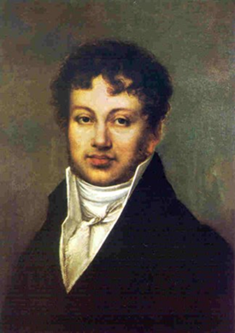
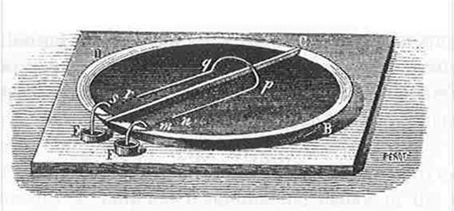
Longitudinal EM Force ?
The possible existence of a longitudinal (aligned with the current) EM force on a macroscopic electric conductor has been debated ever since Ampère first proposed the first Electrodynamic force law in 1822.
Transverse forces perpendicular to the current were soon studied systematically, leading within 10 years to electric motors.
Longitudinal force demonstrations were also attempted, although they were ambiguous and did not lead to any technology development.
In the 19th century, neither force component could be tested to any high degree of quantitative or even qualitative accuracy.
Historically, (rightly or wrongly), the eventual adoption of Maxwellian field theory and the Lorentz force law only allows for the prediction of a transverse force. (F = J x B)
The Lorentz force successfully aided the development of electron and plasma physics as well as the EM machinery driving the development of the modern world and has become the cornerstone of modern physics.
However, despite sporadic experiments over the last 200 years, the existence of a longitudinal EM force component has never been experimentally discounted.
According to Ampère’s force law, this longitudinal component may only become significantly noticeable at high current densities (>10⁹ A/m² ).
Andre Marie Ampère
and his attempt in 1826 to
demonstrate longitudinal EM Force
A summary of the history, experiments and mathematics of the subject can be found in
P. Graneau, N. Graneau, “Newtonian Electrodynamics”, World Scientific (1996)

Slide 8
IF they exist, where would one expect to observe Longitudinal EM Forces ?
Higher current density (>10⁹ A/m²) in Pulsed Power applications including
  Sliding contacts, i.e Railguns
  Frangible conductors , i.e. Exploding wires, Arc explosions
  Vacuum Arc phenomena i.e. High velocity ion jet acceleration by cathode spots
  High energy density plasma, i.e Z-pinch, Liner implosion, Plasma focus
  Flyer Plate Acceleration to generate shock impulses into targets, i.e Foil slap, Cavitation
Lower current density
  Liquid metal pumping without external magnets or moving parts i.e. Smelters, Casting Furnaces, Liquid metal coolant circulation in nuclear reactors
  Motion of solid conductors within liquid metal pools was a hot topic at the AIEE 100 years ago: This is the motivation of the experiment described here (CRE) – Coaxial Recoil Experiment
  Non-thermal conductor expansion (experiment in progress)
Investigation of the longitudinal EM force in pulsed power circuits and unstable arcs has proved fraught with complexity and ambiguity due to transient and explosive phenomena.
Therefore, more accurate measurements at DC low current density are necessary to precisely determine the most accurate physical EM force law, which can then ultimately feed into improved modelling of all electrical applications.

Slide 9
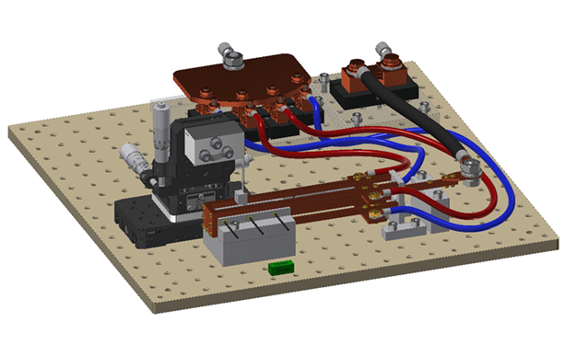
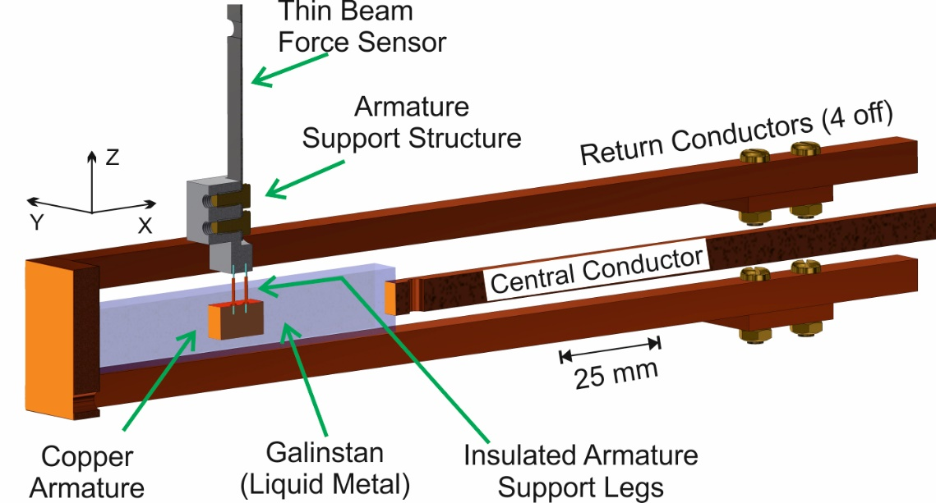
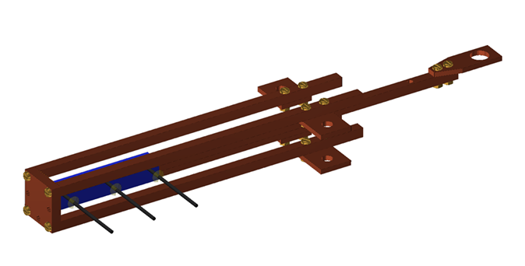
CRE – Coaxial Recoil Experiment [8]
Figure from [8]
Central conductor and liquid metal trough surrounded by 4 symmetrically positioned return conductors. (All parallel to the X-axis with 6 x 6 mm cross section)
The Armature (6 x 6 mm cross section) is connected to a force sensor and is only exposed to the liquid metal through its two end faces (parallel to the Y-Z plane).
Elimination of net transverse EM armature force by symmetry
Use of non-toxic conductive Galinstan (eutectic liquid alloy of Gallium, Indium & Tin)
Current created by a 350 A DC power supply (not shown)
[8] N. Graneau, arXiv:2504.08749 [physics.app-ph]

Slide 10
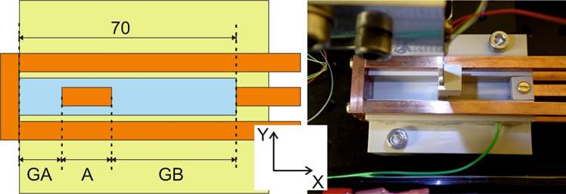
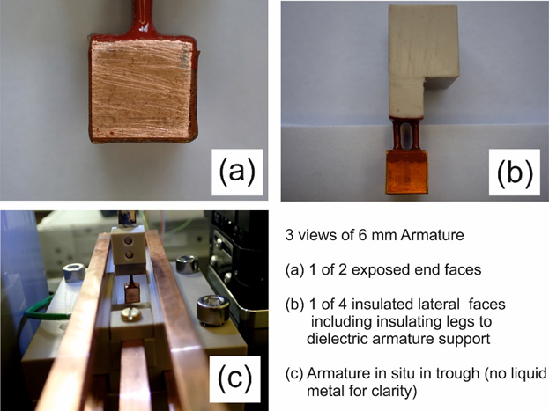
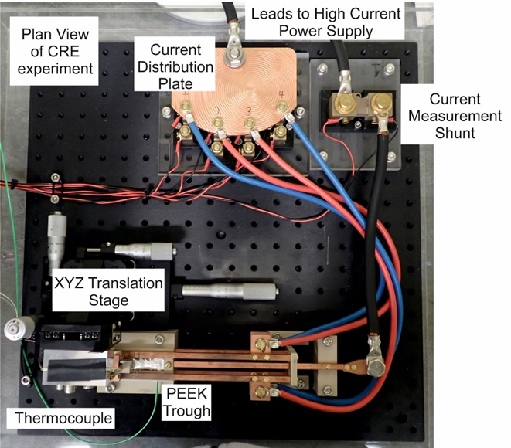
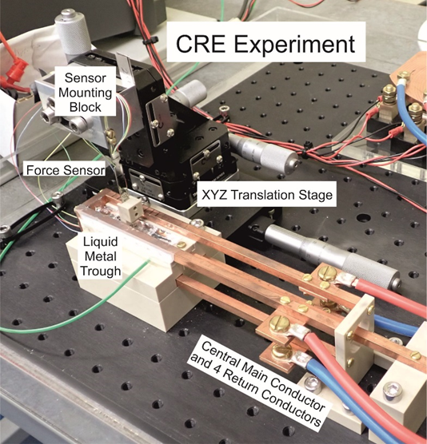
CRE – Equipment Views
mm
(A=6)
Figures from [8] arXiv:2504.08749

Slide 11
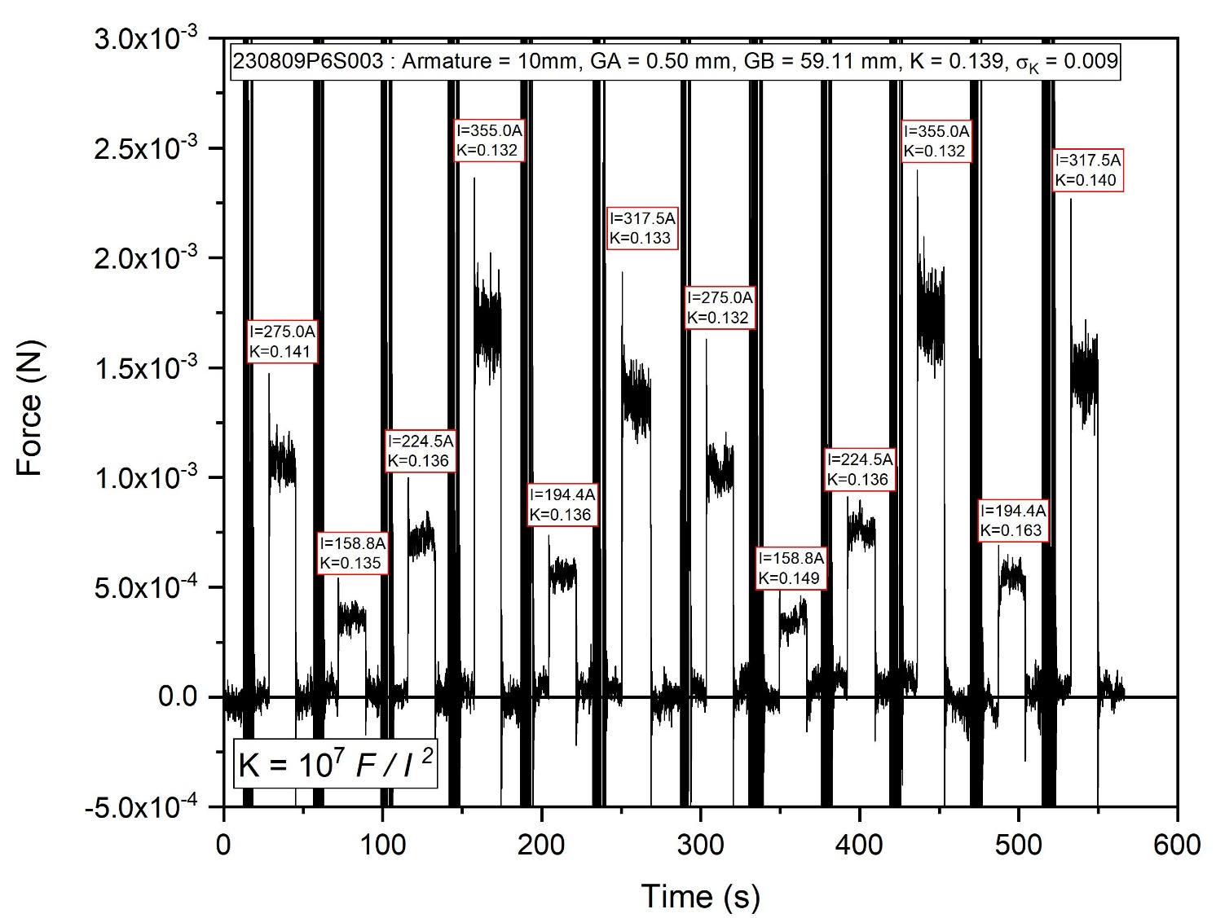
CRE – Raw Data
3 different armature lengths were investigated A = 6, 10, 16 mm.
For a given armature length & location, 12 force measurements were taken using 6 different DC currents.
For all armatures in all locations, the net measured force varied by a factor of 5, but was nevertheless proportional to I² .
Consequently, a current independent force constant, K, and standard deviation, σ_{K} , can be deduced for each armature and location.
During the course of the 12 pulses over ~10 minutes, the Galinstan was heated by 5 – 8 °C, but no effect could be attributed to this thermal change.
This indicates that the net force is likely to be the consequence of 1 or more force mechanisms of EM origin.
Figure from [8] arXiv:2504.08749

Slide 12
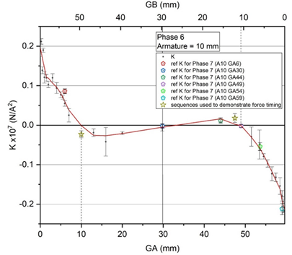
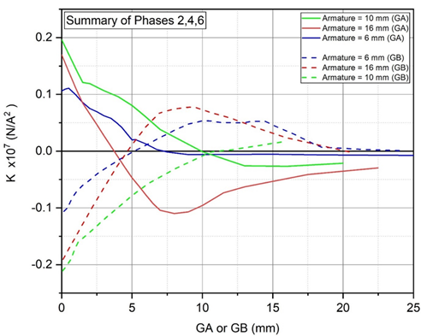
CRE – Phase 2, 4 & 6 - Axial Force data
Each data point in the top graph (Phase 6: A = 10 mm) represents a 12-pulse sequence at 6 different currents and the standard deviation is shown as the error bars. Each Phase produced a similar graph, but with individual and repeatable features. The combination of all 3 phases is shown in the lower graph.
For all experiments, when very near an end of the trough, the armature feels a net force away from the fixed electrode.
The shortest armature (Phase 2: A = 6mm) experiences the smallest net force at the trough ends and the longer armatures receive larger force (Phase 4: A = 16 mm) (Phase 6: A = 10 mm) .
While armature length has a significant effect on measured axial force over the full range of locations, it is clearly difficult to deduce a simple numerical relationship.
Nevertheless in general:
  At GA or GB ~ 0 mm, the net axial force pushes the armature away from the fixed electrode and is greater the longer the armature
  The net force on the armature decreases as the armature is moved away from the trough end. (for short GA or GB)
  The net force on all armatures when in the middle of the trough is approximately zero
Figures from [8] arXiv:2504.08749

Slide 13
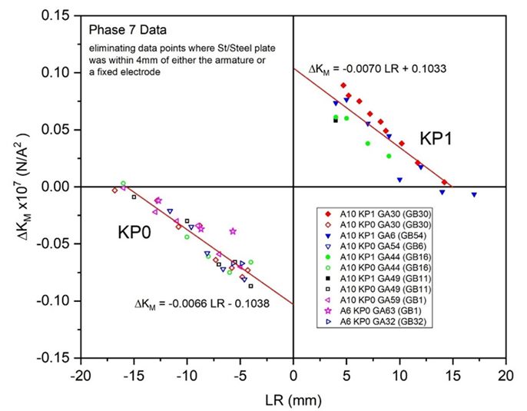
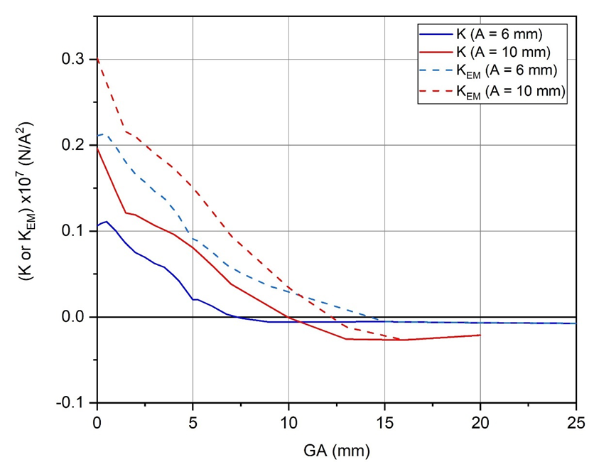
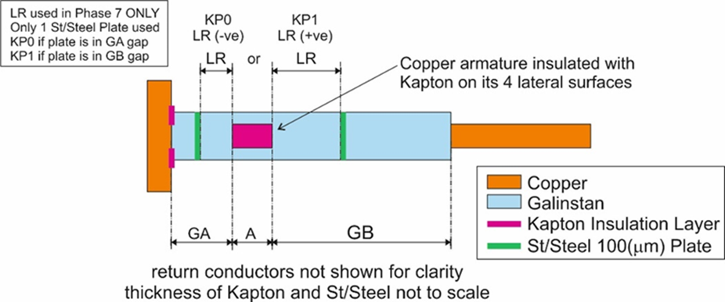

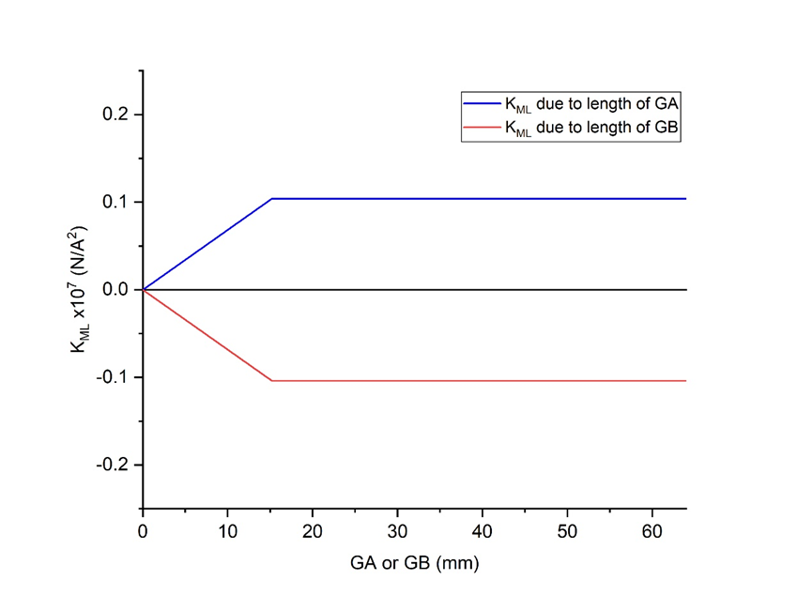
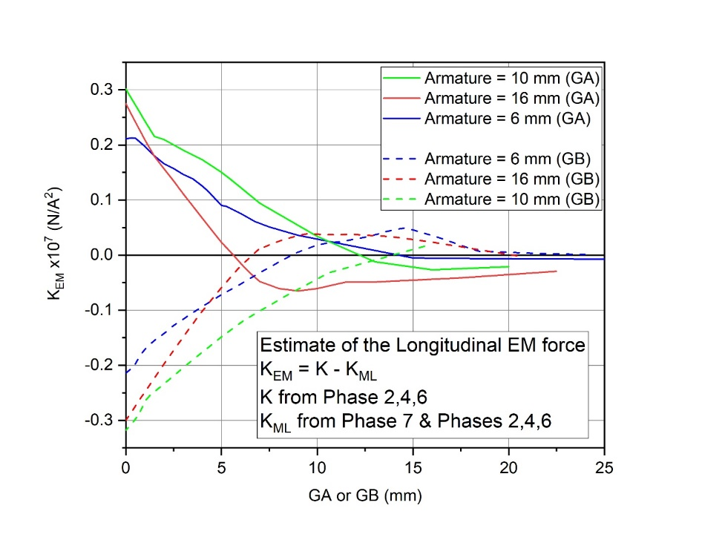
Using a stainless plate to distinguish K _{Mechanical} from K_{EM}
(a)
(c)
K_{EM} = K - K_{ML}
(note K_{EM} and K_{ML} in
opposite directions)
Assume that armature receives oppositely directed length dependent mechanical forces from the Galinstan in GA and GB.
Assume that insertion of a Stainless-Steel barrier does not affect the current streamlines as long as it is more than 4 mm from an end electrode or the armature.
Assume that the stiffness of the barrier reduces the mechanical armature force to be related to only the Modified length LR instead of GA or GB.
Then when |LR|>15mm, the barrier makes no difference.
However, as the barrier is moved toward the armature, (|LR|<15mm) there is progressively less mechanical force applied from that side.
An extrapolation of the data to LR = 0 mm, yields an estimate of the maximum Mechanical column expansion force due to Longitudinal repulsion which was produced by that side of the trough prior to intervention with the barrier to be K_{ML} = ±0.104.
(d)
(b)
K_{ML} = Estimated Mechanical Force
due to Longitudinal Repulsion
Figures from [8] arXiv:2504.08749

Slide 14

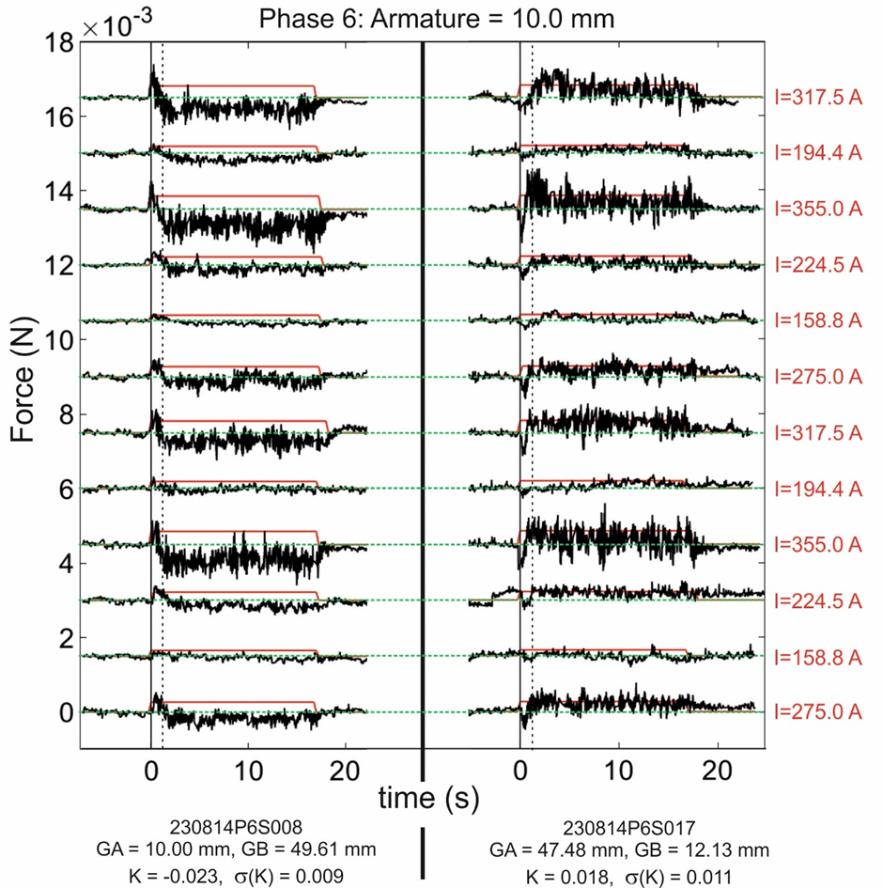

Further evidence of opposing EM and net mechanical force
Figures from [8] arXiv:2504.08749
The zero crossing at GA = GB = 30 is likely to be due to zero EM and mechanical forces
However, the two zero crossings at GA ~ GB ~ 11 may be due to opposing EM and mechanical forces
These two points in the Phase 6 experiments were more closely analysed for each of the 12 current pulses.
The expected signature difference between an EM force and a mechanical force is the time between the start of the current pulse and the onset of the force.
The EM force is expected to start as soon as the current switches on.
However, the mechanical forces are known to take time to develop and thus might only reveal themselves after a time delay.
For these 2 locations, at current onset there is always an initial force, assumed to be direct EM force and the net measured force reverses in sign 1- 1.5 seconds later.
The steady force is likely to be the sum of EM and opposed net mechanical force.
The directions of the EM and mechanical forces agree with previous findings

Slide 15
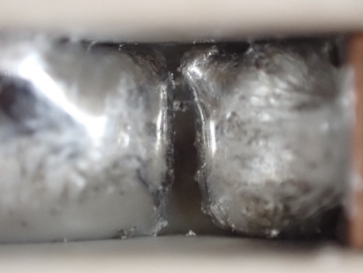
Conclusions from the EM Force Experiment
Measurement of EM force on a copper armature immersed in liquid metal requires a complex analysis of both the EM and mechanical forces acting on it.
It was however possible with the CRE to estimate the axial mechanical force acting on the armature and thus deduce the existence and approximate magnitude of an axial EM force parallel to the direction of the current.
This is therefore a demonstration of a direct longitudinal EM Force acting on the armature, which is not predicted by the standard Lorentz force.
The discovery of a length dependent mechanical expansion force in the liquid metal column is also consistent with the existence of a longitudinal EM force.
Although not in common use, there exist historical non-Lorentzian EM force laws, proposed by Ampère, Weber and others, that do contain a longitudinal EM force component, which demand re-inspection as a consequence of these results.
These discoveries add to the continuing demonstrations of a longitudinal EM force component which will have a significant impact on the modelling and design of many future pulsed power applications.
A Teaser for the Future …
With sufficient current density, a Galinstan column has been observed to rupture without significant pinching and remain open circuit due to surface tension.
What could cause this fissure? The investigations continue…

Slide 16
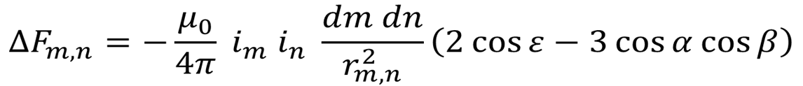
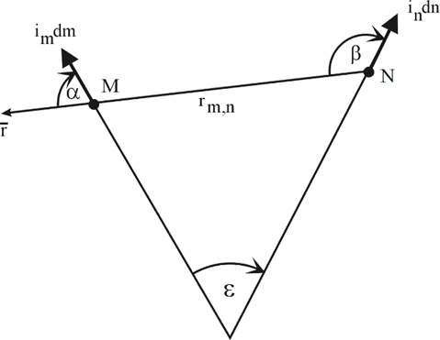
Ampère’s Force Law – A candidate Longitudinal EM Force law
(repulsion or attraction)
“The experimental investigation by which Ampère established the law of mechanical action between electric currents is one of the most brilliant achievements in science. The whole, theory and experiment, seems as if it had leaped, full grown and full armed, from the brain of the ‘Newton of Electricity’. It is perfect in form, and unassailable in accuracy, and it is summed up in a formula from which all the phenomena may be deduced, and which must always remain the cardinal formula of electrodynamics”.
J.C. Maxwell
A Treatise on Electricity and Magnetism, vol 2 (1873)
Publication of sporadic experiments over the last 200 years has meant that a longitudinal EM force component has been supported and never discounted, although certainly never accepted as fact.
However, a longitudinal EM force can never be explained by the Lorentz force law

Slide 17
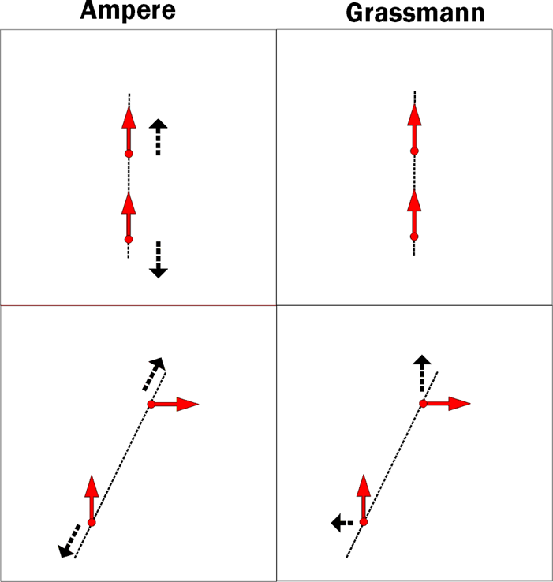
How does Ampère’s Force Law differ from the Lorentz Force Law ?
Ampère
Grassman / Lorentz
Longitudinal Repulsion
No Interaction
Ampère’s force law is a Newtonian instantaneous action at a distance force law between current elements
It does not require the existence of an EM field
It suggests a novel physics paradigm
The Grassman / Lorentz force law represents a violation of Newton’s 3rd law on an element by element basis
Its adoption REQUIRED the development of the Maxwell-Lorentz-Einstein paradigm, yielding the modern EM field capable of transferring momentum and energy divorced from matter (Poynting Vector)
In-Line Elements
Balanced Action / Reaction
Unbalanced Action / Reaction
2 General Elements
Forces between pair of current elements

Slide 18
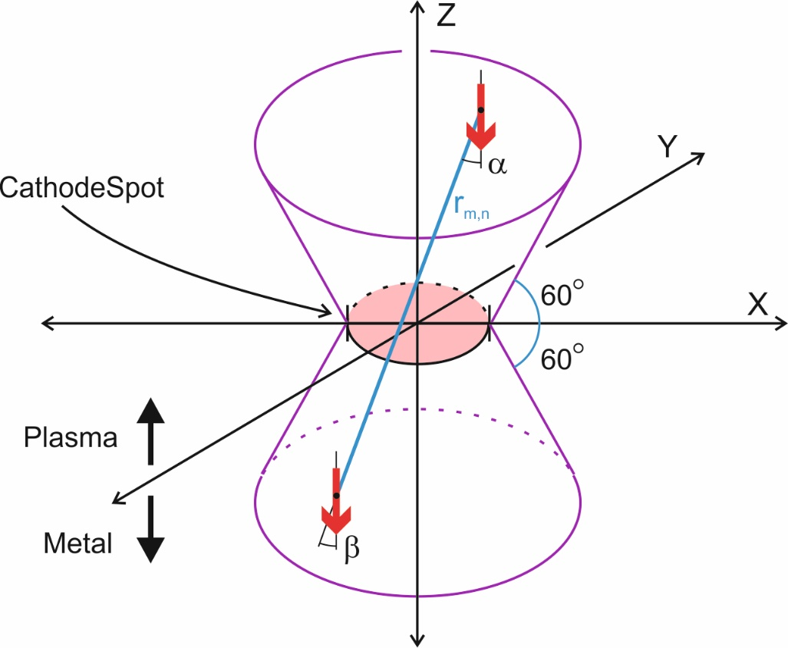
A Vacuum Arc Ion Acceleration Calculation using Ampère’s Force Law [7]
ε = 0 for parallel elements
Space can be filled with Ampèrian current elements, which can be considered to be net charge neutral cubic volumes with a current density, more practically defined by a current im and length, dm
It is therefore reasonable to consider an element to have finite size and be composed of an atom / ion and its local current
All pairs of elements experience a mutual attraction or repulsion along the line joining their centres
Metal / Metal interactions can distort the cathode
Plasma / Plasma interactions can cause plasma expansion, contraction or circulation, but will not accelerate a net flux of plasma away from the cathode surface
Plasma / Metal interactions can cause a net plasma flux acceleration
  hence only these are considered in the acceleration calculation
figure adapted from [6]
[7] N Graneau, Trans.Plasma.Sci, 21 (6), pp.701-713 (Dec. 1993)

Slide 19
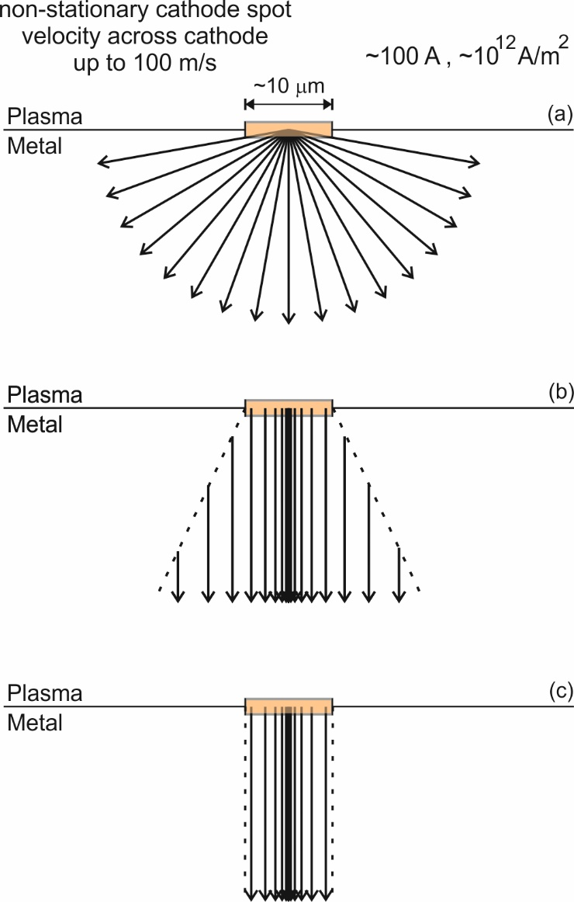
3 Possible 2-D Current Distribution Models in the Bulk Copper Cathode
Copper cathode spot size depends on motion, definition of evidence (plasma ball / erosion patterns etc.) and measurement technique, but 10 μm diameter seems to be an accepted average for a non-stationary spot.
Model (a) is based primarily on thermal considerations in which the more axial current regions below the spot become warmer and thus more resistive, forcing current to be drawn more from the cooler transverse directions.
Model (b) is based on vertical (parallel to axis) Electric field lines, acknowledging some divergence of the current away from the spot diameter. It therefore contains some discontinuity in the total current in the regions further below the spot. Maximum current density in the centre stems from [9] which demonstrated maximum Joule heating at spot centre.
Model (c) is similar to (b) but without the current divergence outside the spot diameter. These outer regions will have lower current density and thus be of less importance. Also model (c) is much more economical with calculation time.
In models (b) and (c) the current density decreased as 1/r away from the axis
figure adapted from [7]
[7] N Graneau, Trans.Plasma.Sci, 21 (6), pp.701-713 (Dec. 1993), [9] J E Daalder, IEEE Trans.Power.App.Syst, PAS-93, pp 1747-58 (1974)

Slide 20
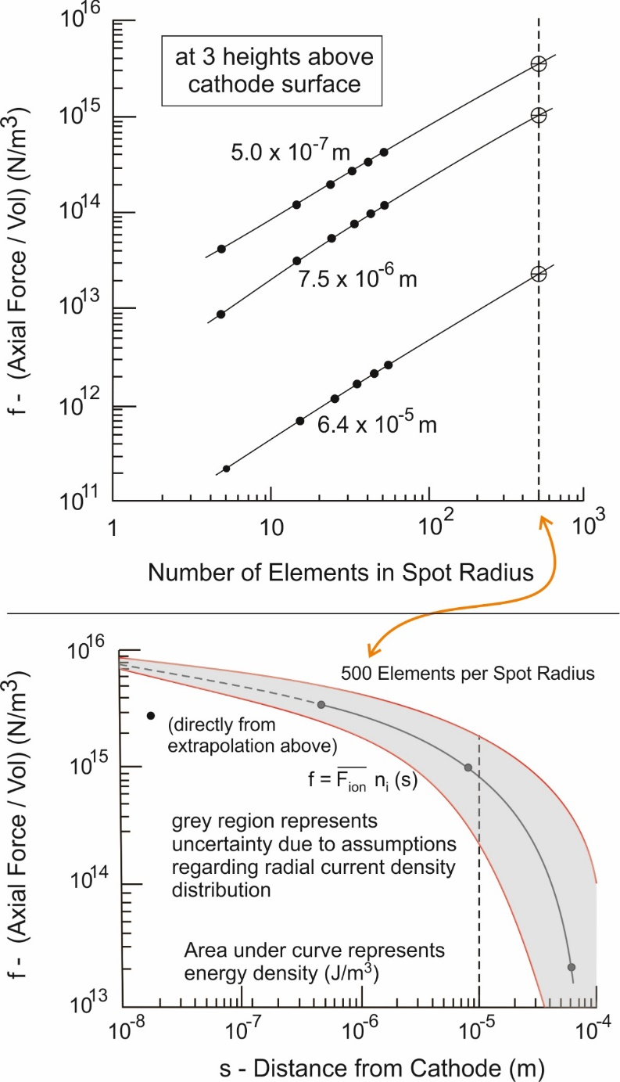
Calculation of Axial Ion Acceleration
Ultimate axial ion velocities are calculated by estimating the varying ion and force densities in the on-axis elements above the copper cathode spot, and then calculating the net acceleration of an ion passing through them based on the assumed ion density.
Plasma/Plasma interactions cannot accelerate the plasma bulk at any time, therefore only interactions between on-axis plasma current elements with all the metal cathode current elements are considered in this calculation.
A current element is a cubic volume passing a current (mostly electron and a small negative ion component) and with an ion density based on its height above the spot.
With large current elements, the axial force density at 3 heights was calculated and extrapolated to 500 elements per spot radius which corresponds to element length ~ 10⁻⁸ m.
Smeets [10] showed the ionization layer is no closer than 10⁻⁸ m from the cathode, hence this is a reasonable minimum side length of a cubic plasma current element.
This allows a force density plot against height from 10⁻⁸ to 10⁻⁵ m which corresponds roughly to the region of high intensity cathode luminosity.
The force density represents the average force per ion times the ion density, however the axial ion density decreases with height.
[7] N Graneau, Trans.Plasma.Sci, 21 (6), pp.701-713 (Dec. 1993), [10] R P P Smeets, Chapter 7, PhD dissertation, Eindhoven Univ. Technol., (1987)
figures adapted from [7]

Slide 21
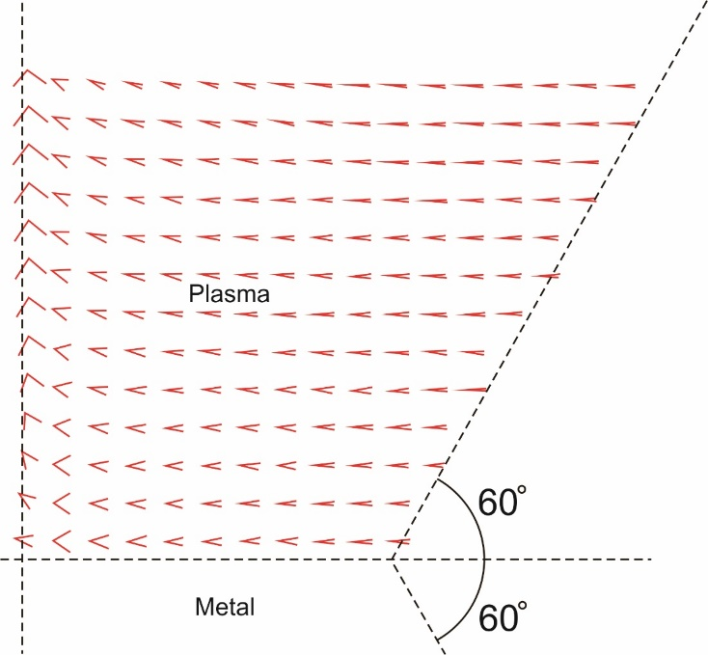
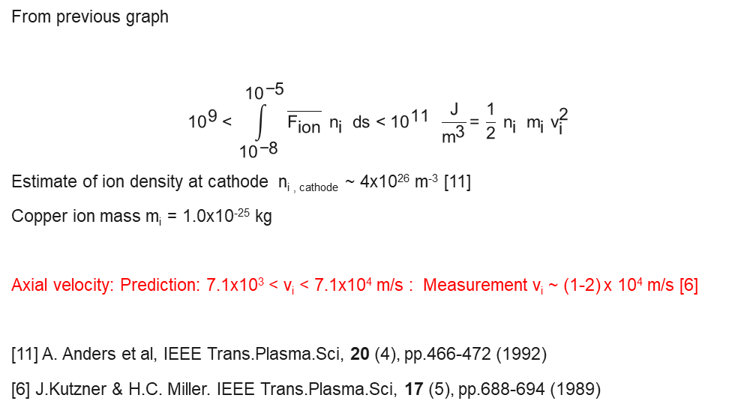
Results from Longitudinal Force Calculations [7]
Ampere Axial Acceleration Calculation
3D Ampere EM Force calculation
From previous graph
$${\text{10}}^{\text{9}} \text{< }\int_{{\text{10}}^{\text{−}\text{8}}}^{{\text{10}}^{\text{−}\text{5}}}{\overline{{\text{F}}_{\text{ion}}}} {\text{n}}_{\text{i} } \text{ds}\text{ < }{\text{10}}^{\text{11}} \frac{\text{J}}{{\text{m}}^{\text{3}}}\text{=} \frac{\text{1}}{\text{2}} {\text{n}}_{\text{i} } {\text{m}}_{\text{i}} {\text{v}}_{\text{i}}^{\text{2}}$$
Estimate of ion density at cathode n_{i , cathode} ~ 4x10²⁶ m⁻³ [11]
Copper ion mass m_{i} = 1.0x10⁻²⁵ kg
Axial velocity: Prediction: 7.1x10³ < v_{i} < 7.1x10⁴ m/s : Measurement v_{i} ~ (1-2) x 10⁴ m/s [6]
[11] A. Anders et al, IEEE Trans.Plasma.Sci, 20 (4), pp.466-472 (1992)
[6] J.Kutzner & H.C. Miller. IEEE Trans.Plasma.Sci, 17 (5), pp.688-694 (1989)
2D radial slice of Ampere force
on the plasma current elements
cathode spot axis
figure adapted from [7]
Plasma current elements were allowed to interact with all other plasma and metal current elements.
The force magnitude is proportional to the length of the arrow base and acts in the direction of the arrow.
The pinch forces will act in opposition to the thermal expansion of the plasma, yielding an MHD prediction of an anisotropic axially oriented ion jet.
[7] N Graneau, Trans.Plasma.Sci, 21 (6), pp.701-713 (Dec. 1993)

Slide 22
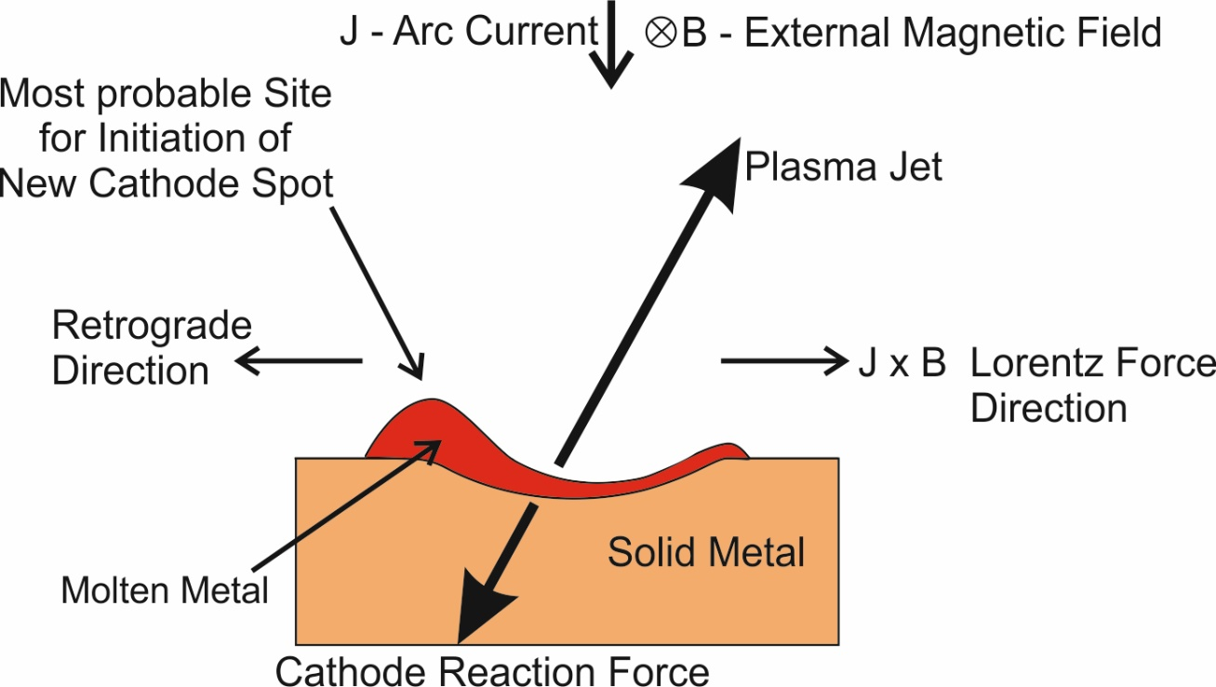
Retrograde Spot Motion
The Newtonian nature of the Ampere Force Law ensures that the cathode sustains an equal and opposite reaction force opposed to the anisotropic plasma jet (ions and electrons) [7].
The effect of an externally applied transverse magnetic field will be to apply a force to the plasma jet parallel to the cathode in the “Lorentz Force Direction”, which will deflect the plasma jet as shown [12].
The consequent Newtonian reaction force on the cathode will therefore be deflected in the opposite direction, here shown as the “Retrograde Direction”.
The molten metal of the diffuse arc cathode spot will therefore be unsymmetrically pushed in the “Retrograde Direction” leading to an unsymmetrical distribution of the molten metal which solidifies at the cooler edges, leaving a raised mound on the retrograde side of the spot.
Spot initiation usually occurs at the rim of the previous crater [13], meaning that the next spot is most likely to form on the retrograde side of the previous one.
This process leads to an explanation of retrograde motion of diffuse vacuum arc cathode spots in externally applied transverse magnetic fields. Other conditions (higher pressure or field) lead to Lorentzian motion.
Model is consistent with [14] describing that dielectric barriers on cathode stop retrograde motion, but not Lorentzian motion.
figure adapted from [7]
[7] N. Graneau, IEEE Trans.Plasma.Sci, 21 (6), pp.701-713
[12] A.E. Robson, A. Von Engel, Phys.Rev, 104, pp.15-16 (1956)
[13] V.I. Rakhovskii, IEEE Trans.Plasma.Sci, PS-4 (2) pp.81-102 (1976)
[14] M.G. Drouet, IEEE Trans.Plasma.Sci, PS-13 (5), pp. 235-241 (1985)

Slide 23
Conclusions
A recent experiment employing a mobile copper armature submerged in a liquid metal channel passing a DC current has added to the small but increasing body of knowledge supporting the existence of longitudinal EM force, contrary to the textbook version of EM force theory (Lorentz force).
A candidate theory for the prediction of the complete EM force is that proposed by Ampere in 1822. However more quantitative future experiments may require alternative theories which are likely to include yet undetermined variables.
The cathode spot of the diffuse vacuum arc is known to produce a highly anisotropic ion jet perpendicular to the cathode surface, with ion velocities that have historically proven difficult to predict quantitatively.
A calculation of axial ion acceleration in a diffuse vacuum arc cathode spot using Ampere’s force law was published in 1993.
  It predicted the order of magnitude of the high ion velocities.
  It predicted the high ion jet anisotropy.
  It led to a natural explanation of diffuse cathode spot retrograde motion.
It is hoped that FEA MHD calculations based on Ampere’s Force Law, can be repeated with modern high-speed computers and possibly AI to discover whether they can further the understanding and predictability of post breakdown vacuum arc cathode spot behaviour and improve technological applications.

Slide 24
Any Questions ?

Slide 25

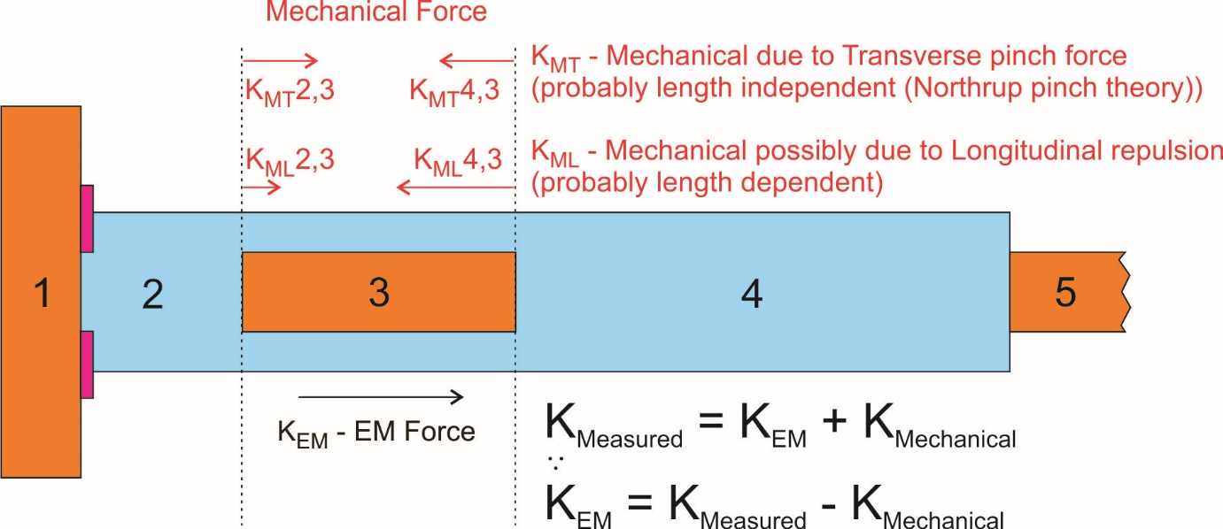
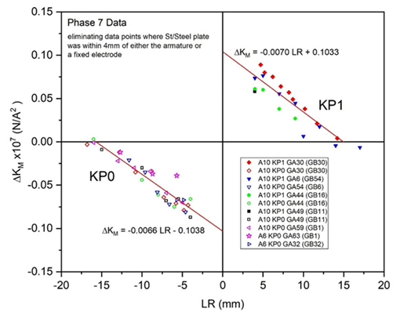
Mechanical & EM Forces
The measured force on the armature (3) will be the combination of a system of EM and mechanical forces.
The mechanical forces on (3) will be a consequence of direct contact with the Galinstan in (2) and (4).
Trough Modified by insertion of St/St plate
ΔK_{M} = K _{Modified} - K
Therefore, the CRE could only reveal the existence and magnitude of an axial EM force if the mechanical force can be estimated.
To attempt this, a series of experiments (Phase 7) was performed to deduce whether the mechanical force depended on the length of the Galinstan section (2) or (4).
Figures from [8] arXiv:2504.08749

