Slide 1
CI Update
O. Stringer, S. Sethi & H. Zhang

Slide 2
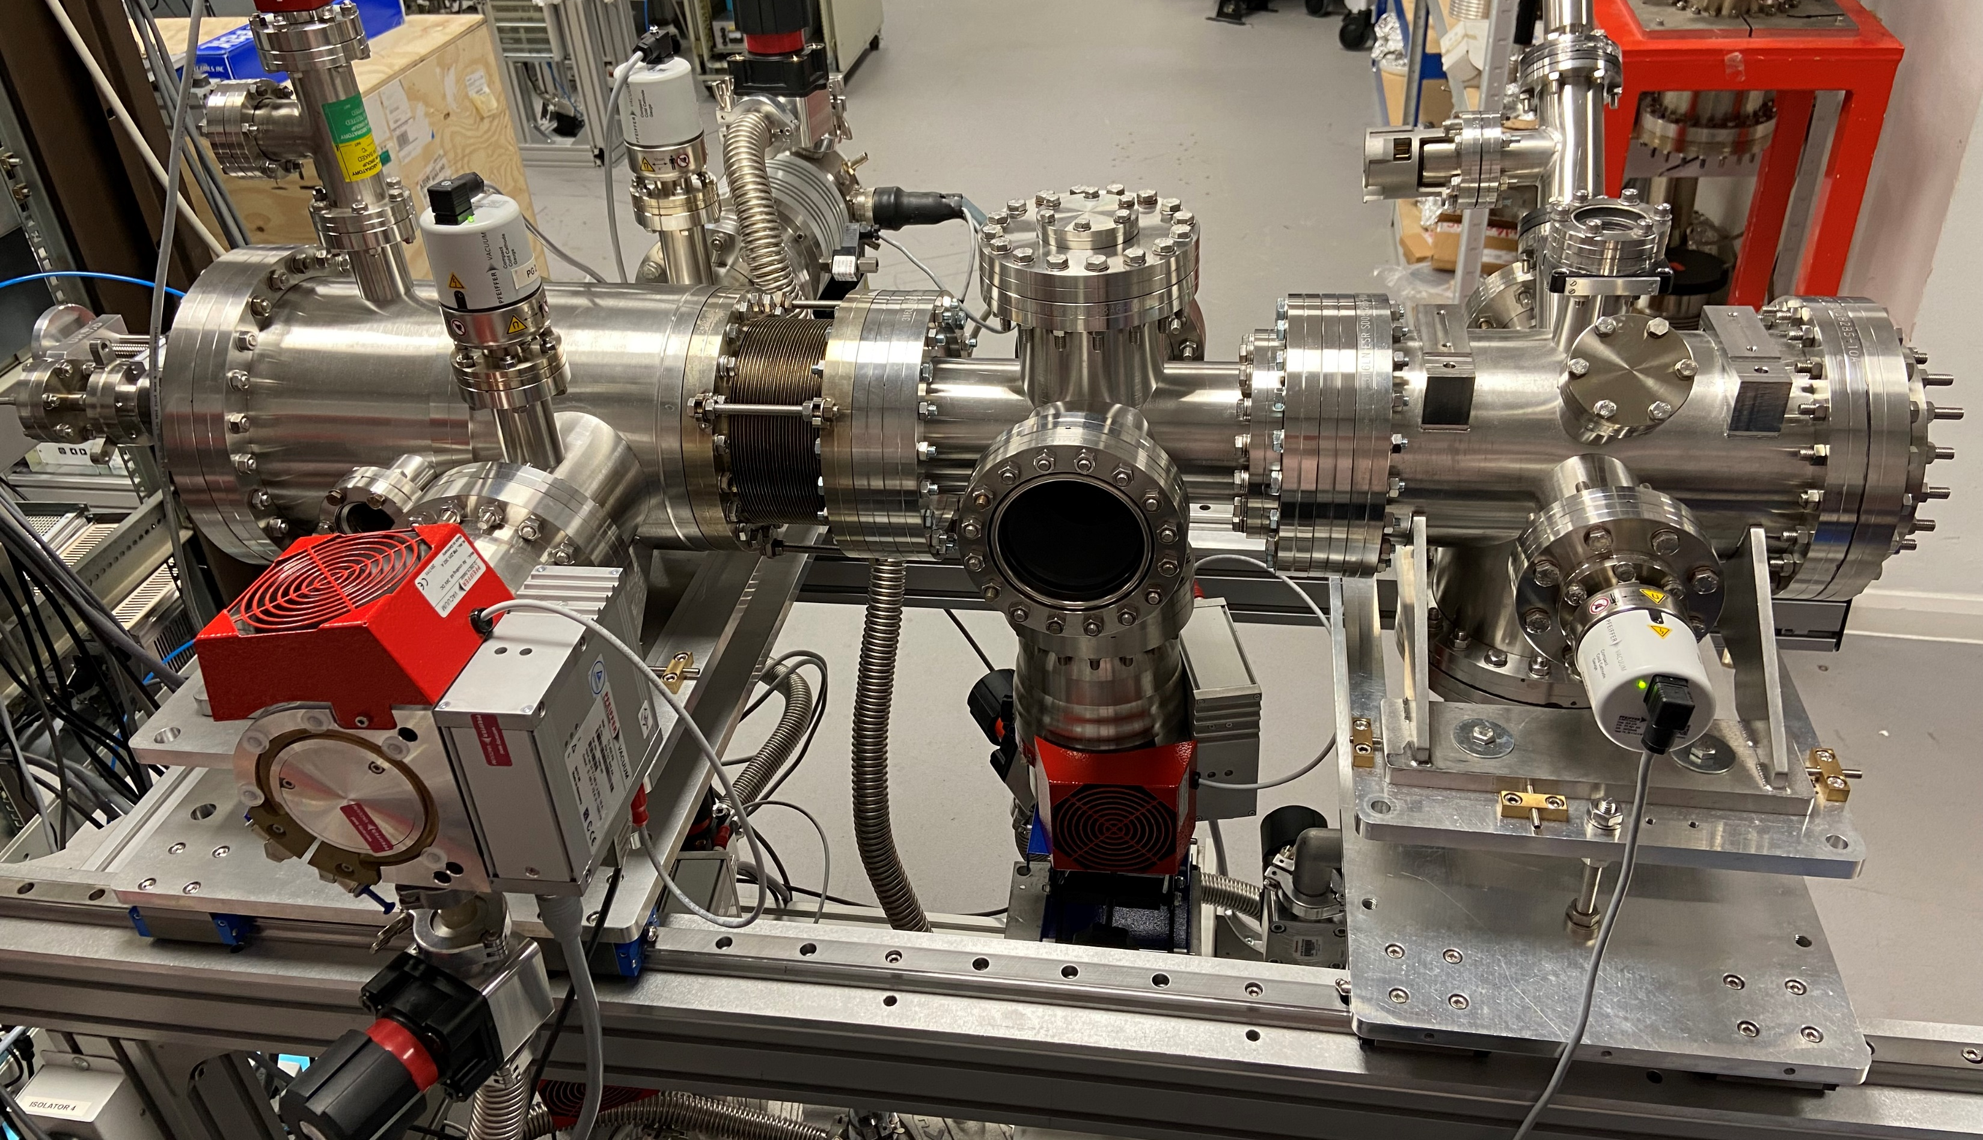
JEREMY Modifications
3rd Skimmer
4th Skimmer
Bellows
Dump Chamber

Slide 3
Study 1 layout options
Nozzle
1st Skimmer
2nd Skimmer
3rd Skimmer
IP
4th Skimmer
Bellows (2-10mm)
Bellows (250-290mm)
*
Chamber | Nozzle | 1st Skimmer | 2nd Skimmer | IP | Dump
Pressure / mbar | 3.5E-3 | 1.1E-4 | 2.4E-5 | 2.73E-7 | 1.9E-7
Nitrogen at 5 bar gauge – plans to include Neon.
*Results for Nozzle-1st 4mm, 2nd – 3rd 270mm

Slide 4
Ongoing work
Pulse jet operation.
HaloJet measurement (mostly done, but need to compare with simulation)
  Need some realistic beam/halo parameter to target?
    Integration time
    S/N ratio
LHC measurement plan/coordination?

