Slide 1
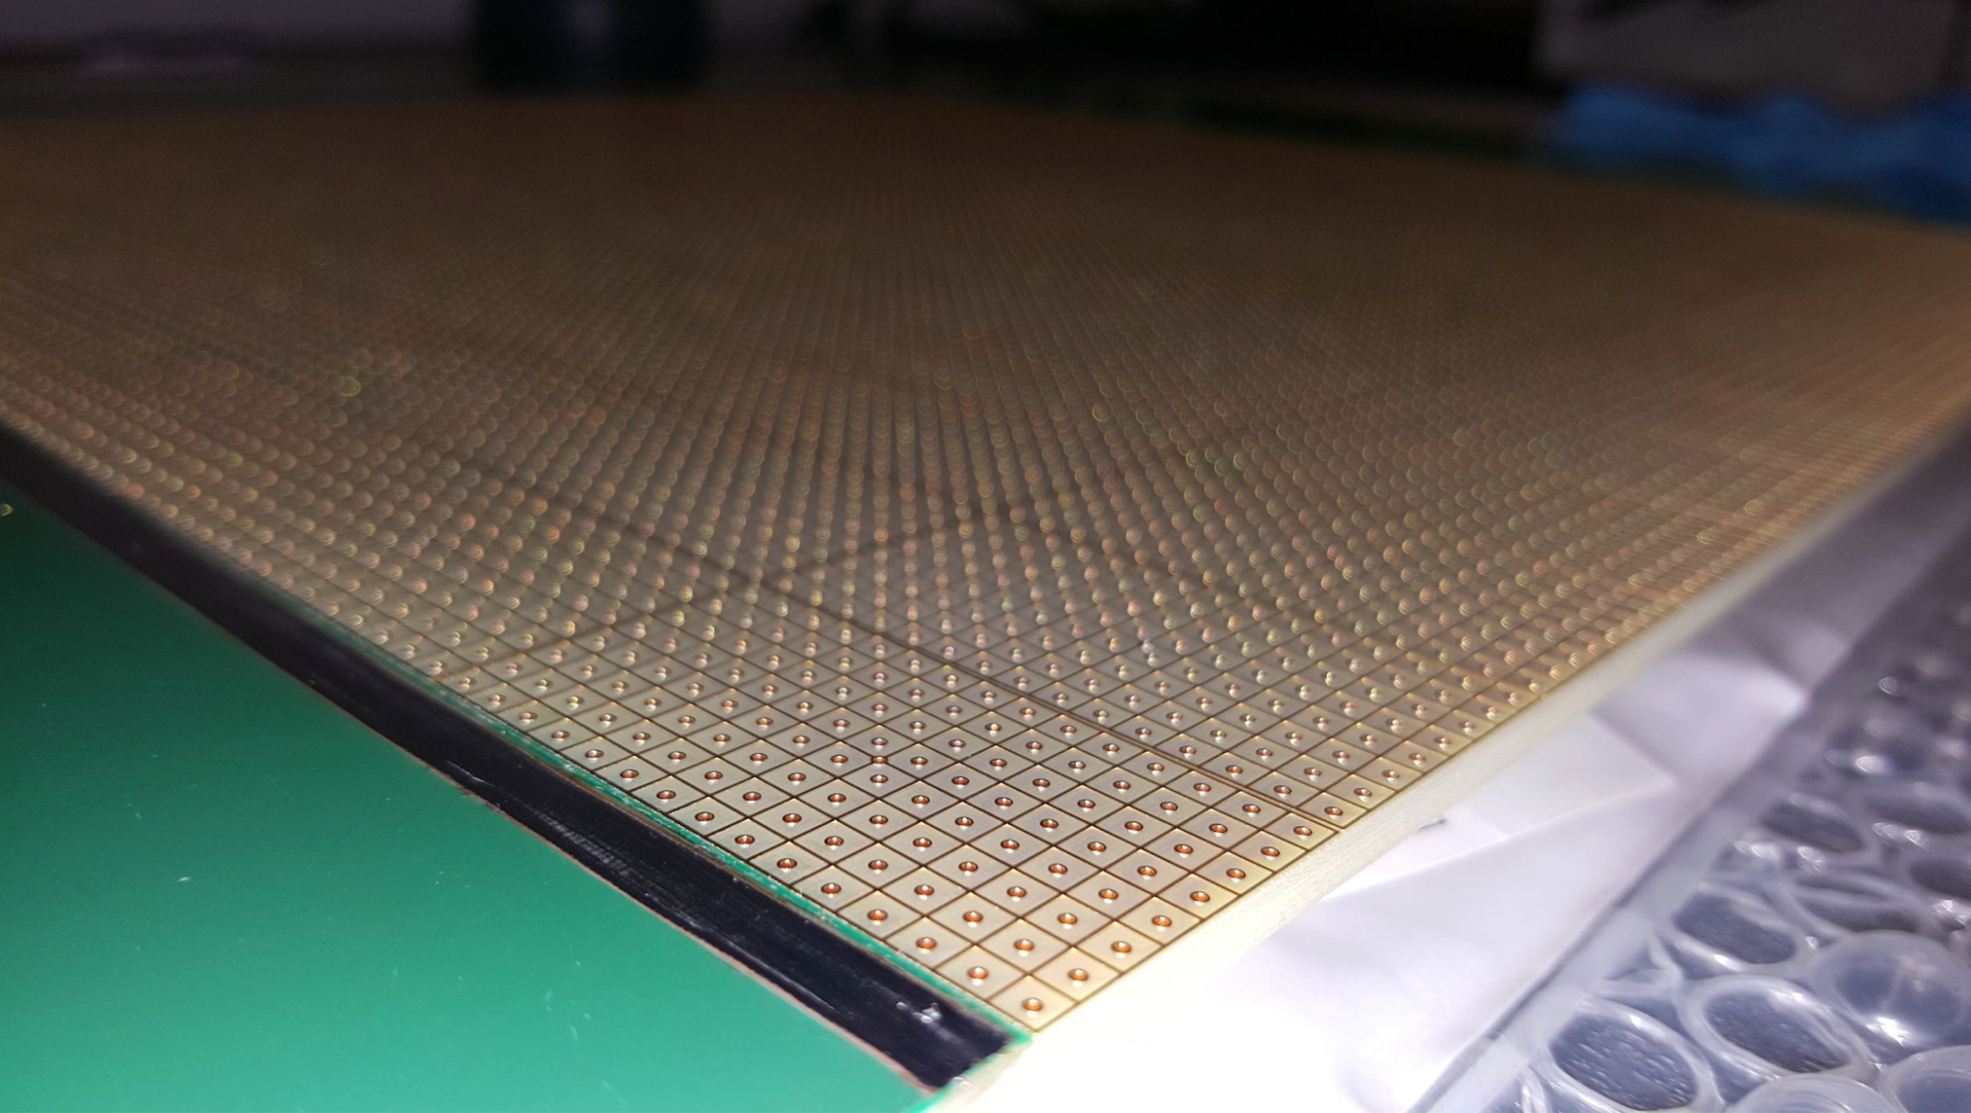
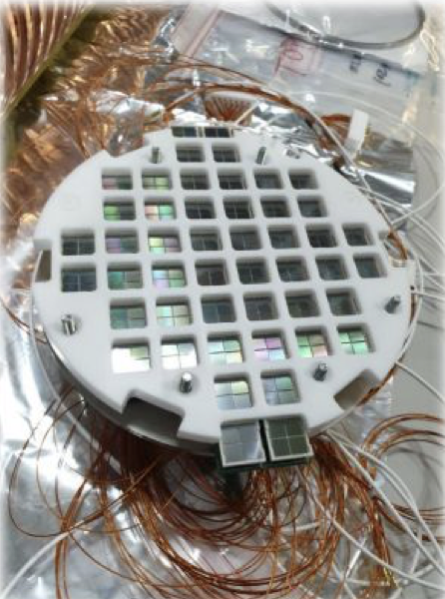
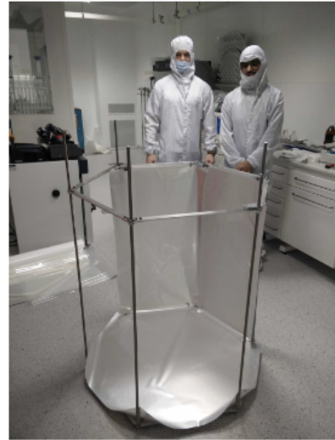
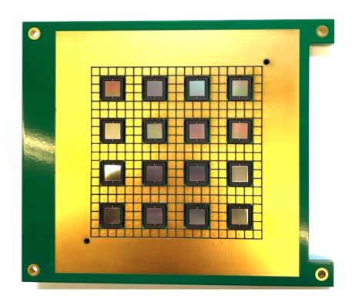
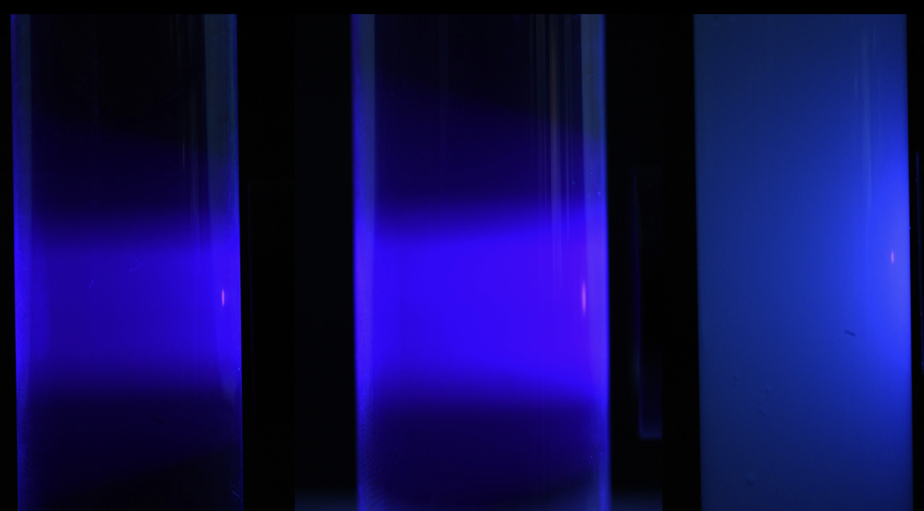
DRD2: Liquid Detectors
Giuliana Fiorillo
Roxanne Guenette
4th Meeting of the DRDC
13 November 2024

Slide 2
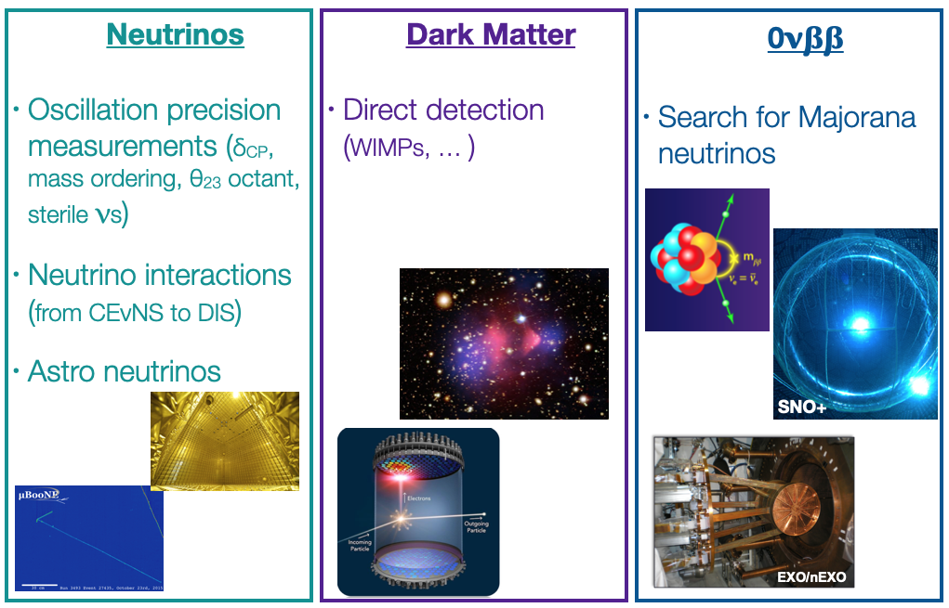
Our scientific communities

Slide 3
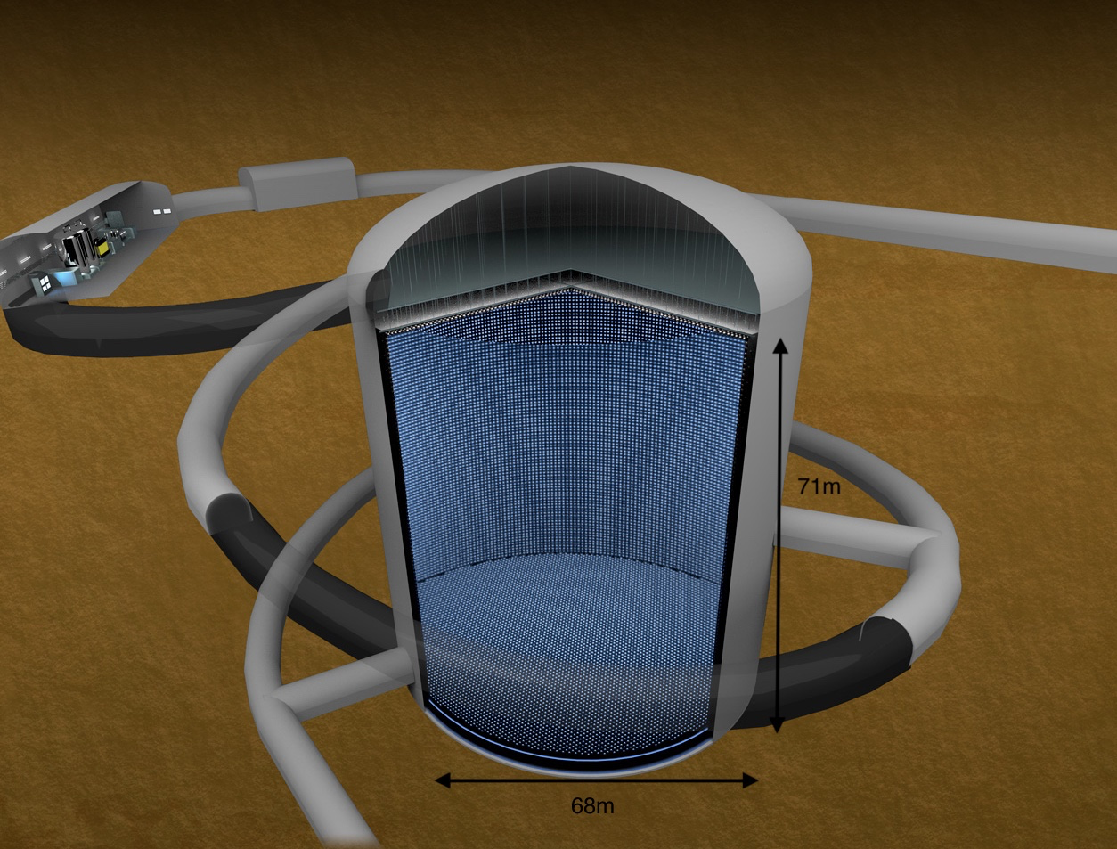
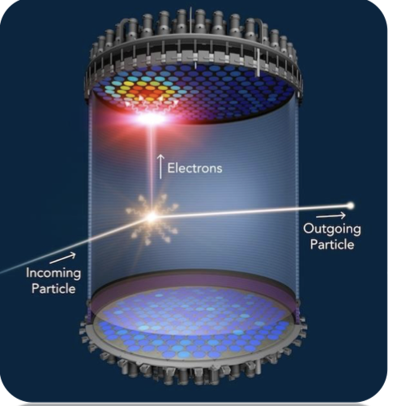
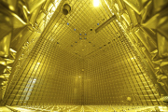
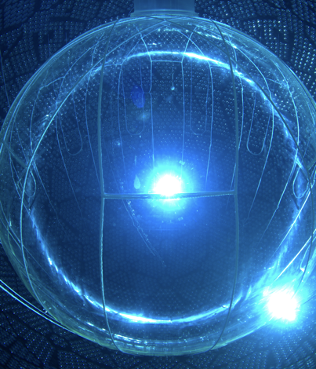
Our technology communities
Noble Elements
Liquid Scintillators
Water Cherenkov
Argon & Xenon
Ionisation charge & transport
VUV Scintillation, light propagation & detection
Visible Scintillation, light propagation
Scintillator properties
Isotope loading
Cherenkov light, light propagation
Doping for n-capture
Notes:
We want to say that other Nobles, like He, Ne could be there in future, but right now not

Slide 4
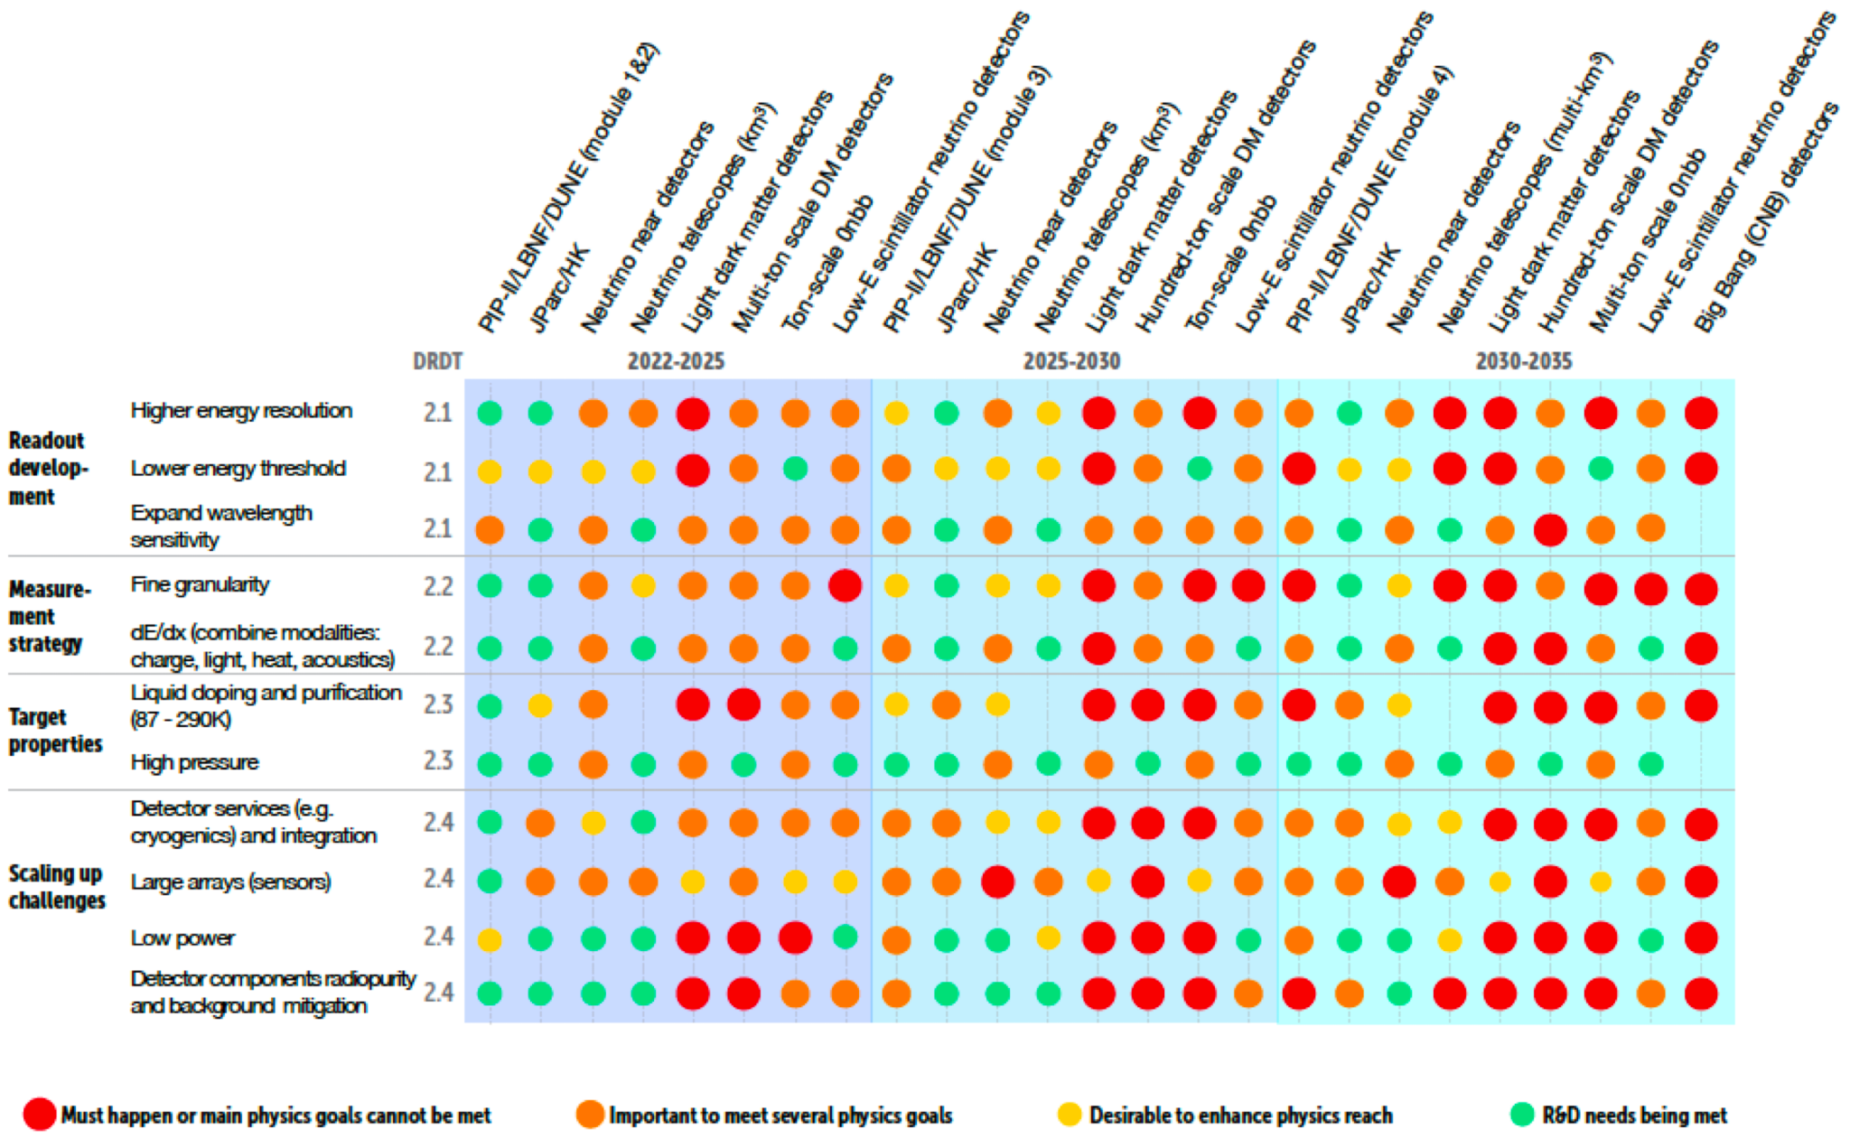
Our roadmap
Main drivers
DUNE programme; Hyper-K programme; neutrino near detectors; neutrino telescopes;
multi-tonne scale dark matter detectors; light dark matter detectors;
tonne-scale 0vbb experiments; low-energy scintillator neutrino detectors.
Detector R&D Research Themes
DRDT 2.1 - Develop readout technology to increase spatial and energy resolution for liquid detectors
DRDT 2.2 - Advance noise reduction in liquid detectors to lower signal energy thresholds
DRDT 2.3 - Improve the material properties of target and detector components in liquid detectors
DRDT 2.4 - Realise liquid detector technologies scalable for integration in large systems

Slide 5
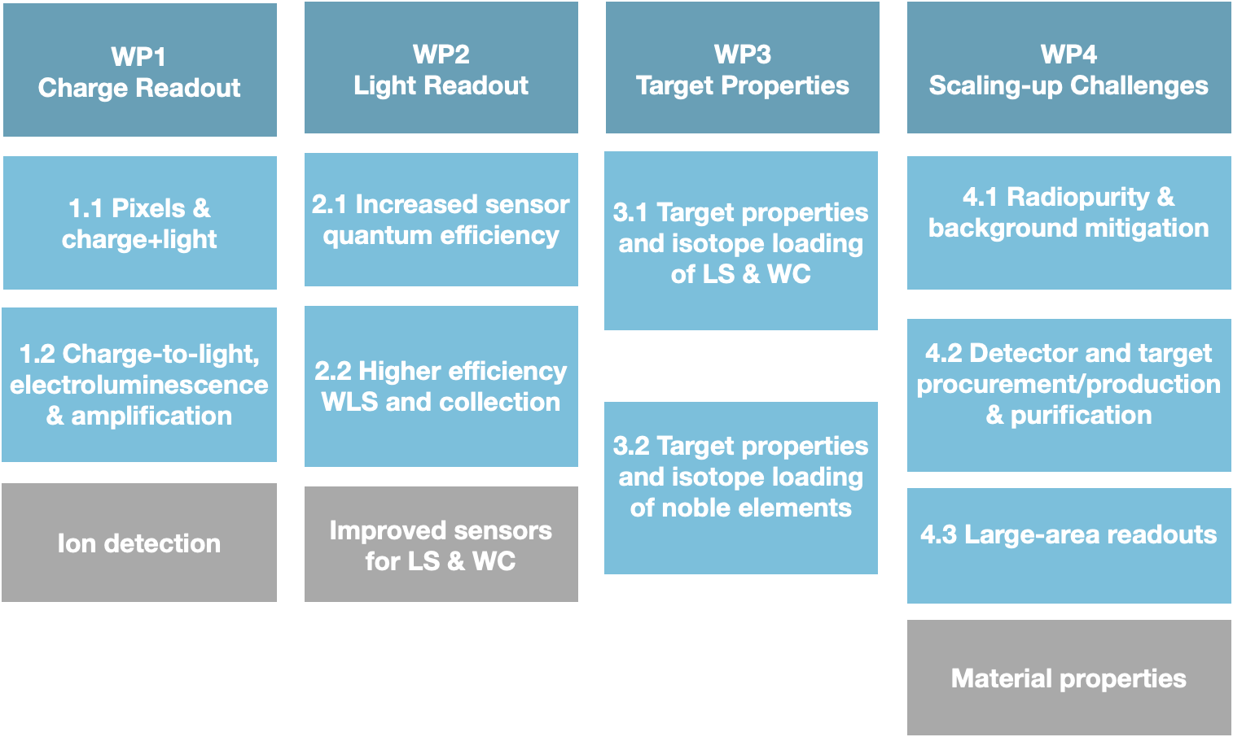
Our scientific strategy: Work Packages
WG A: Common infrastructures & Facilities

Slide 6
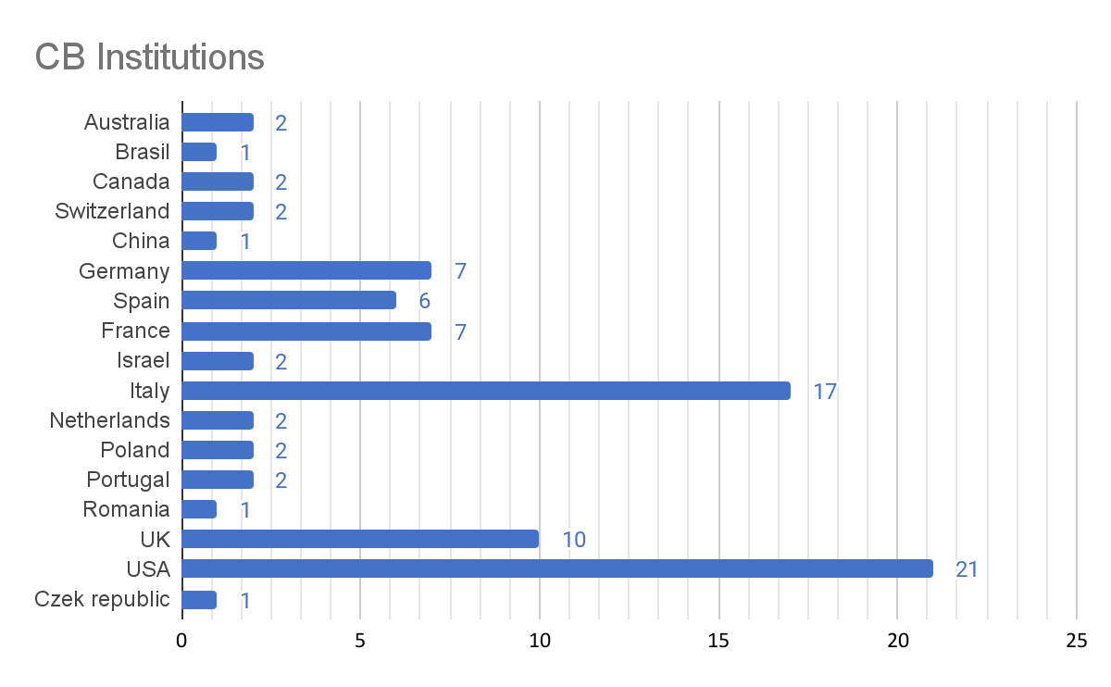
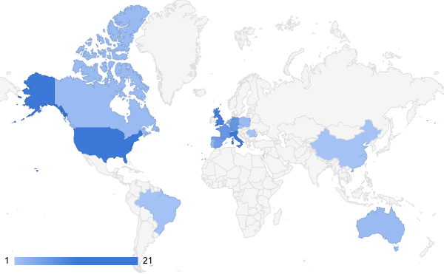
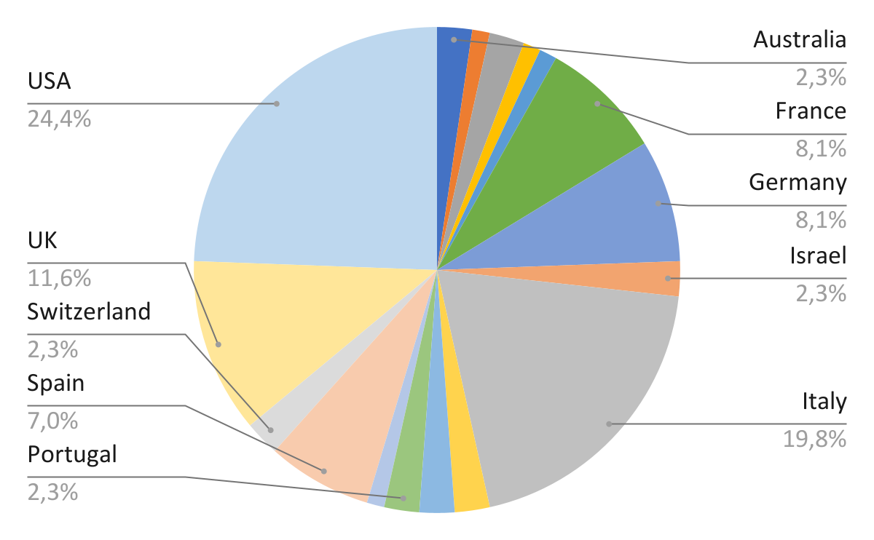
The DRD2 Collaboration
86 Participating Institutions
17 Countries
205 Members

Slide 7
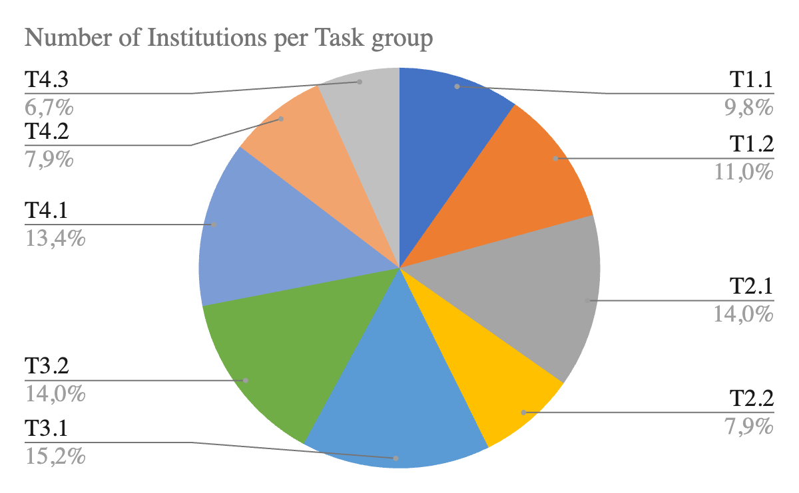
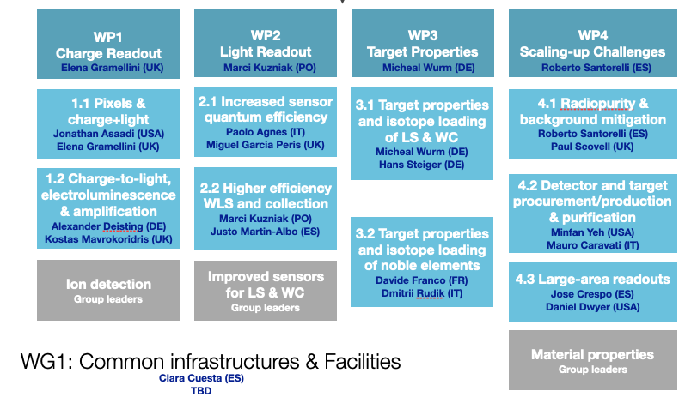
Progress in DRD2 since approval
First Collaboration Meeting (02/2024) (indico link)
CB Chair election: Walter Bonivento
Co-spokespersons election: Giuliana Fiorillo, Roxanne Guenette
All WP/Tasks leaders appointed and approved
Creation of first WG and appointment of 1 convener
Series of Topical Workshop to engage the community (indico meetings)

Slide 8
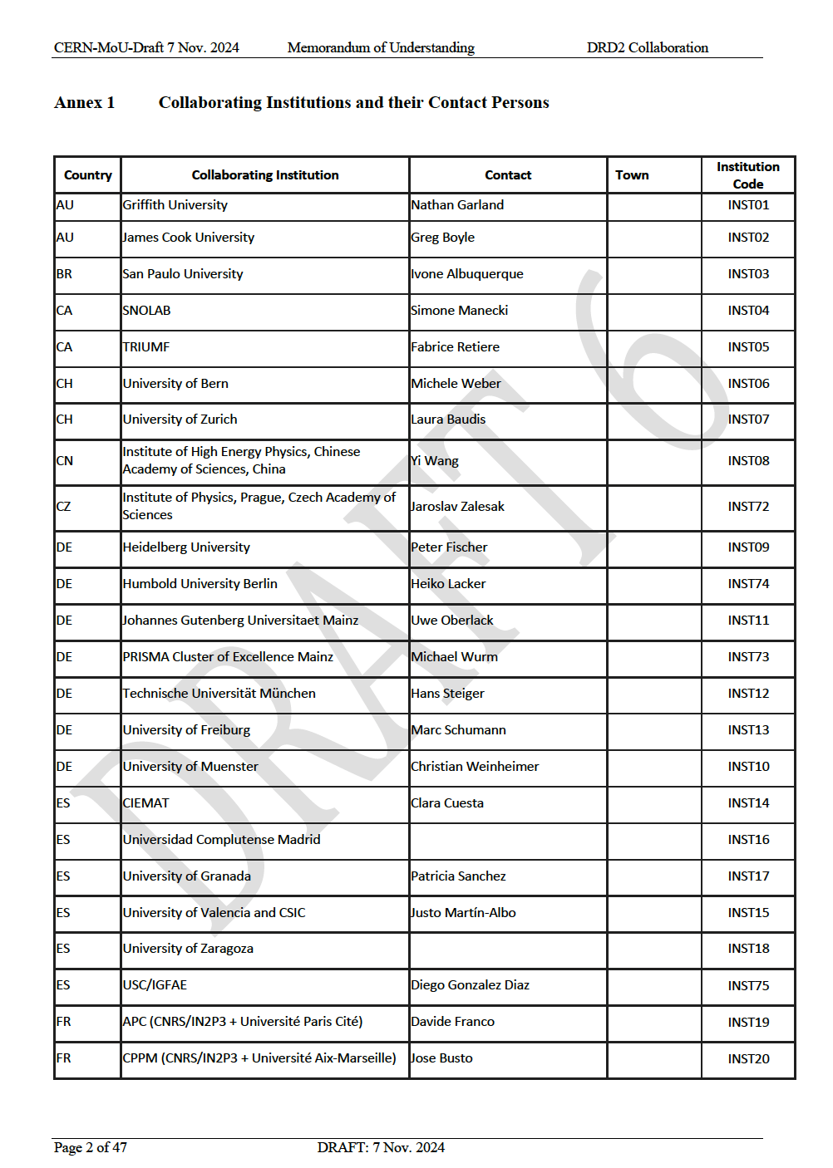
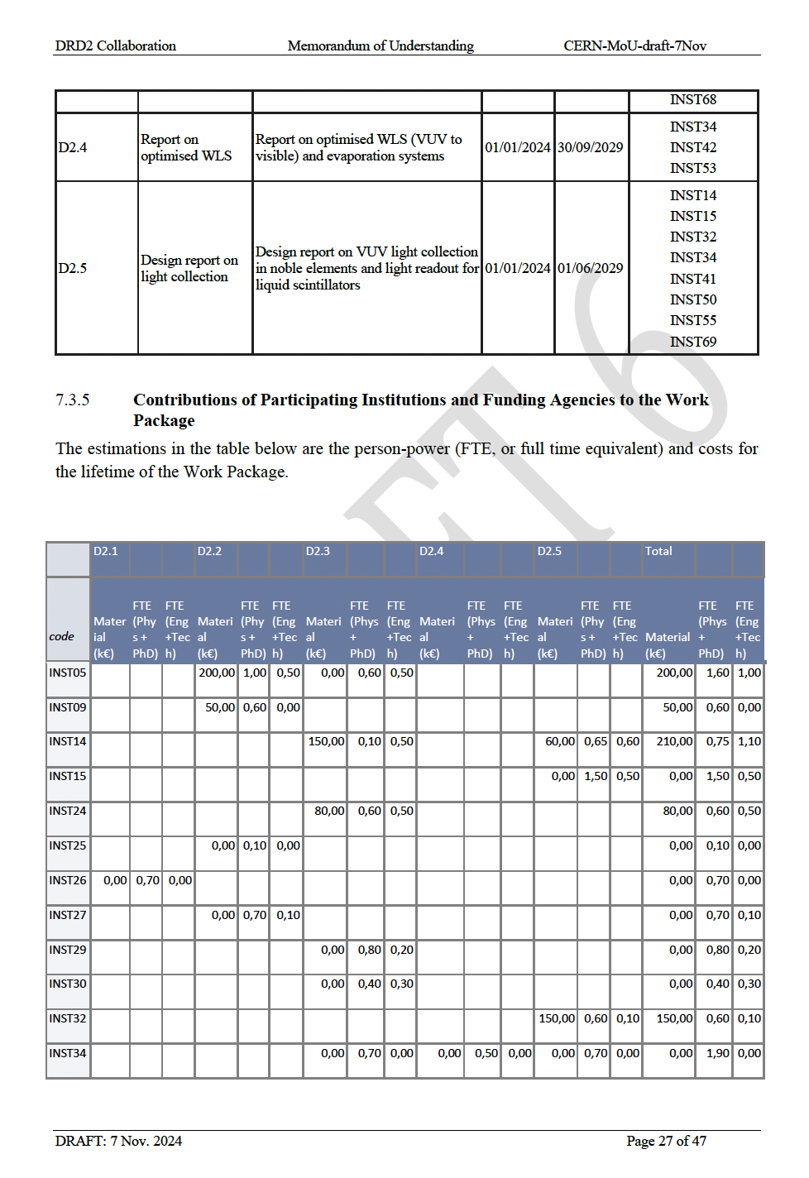
Progress in DRD2 since approval
A lot of work done on consolidating the Deliverables and the “commitments” of each Tasks to prepare the MOU Annexes
Concerns from many of our members on interactions with funding agencies, commitments and lack of funding… under discussion
We send the draft MOU Annexes to Helge Meinhard as requested on 8 Nov., but we need to solve the concerns of our groups before making them public

Slide 9
WP1 Charge Readout: Progress
WP1.1 Pixels & charge+light
(J. Asaadi & E. Gramellini)
Consolidated the scientific programme to 3 Deliverables: TPC pixelation, Pixel scalability, Charge + Light readouts
 | Title | Description | Institutions
D1.1 | Pixel readout prototype | Prototype of lower power and lower pixel thresholds to the limit of CMOS capabilities | 5
D1.2 | Large-scale pixel readout design | Design of a pixel readout with O(100 million) channels | 4
D1.3 | Light-sensitive pixel readout design | Design (simulation and prototype) of maximal photocathode coverage and QE in an integrated fC charge and VUV light sensing scheme for pixel TPCs | 7

Slide 10
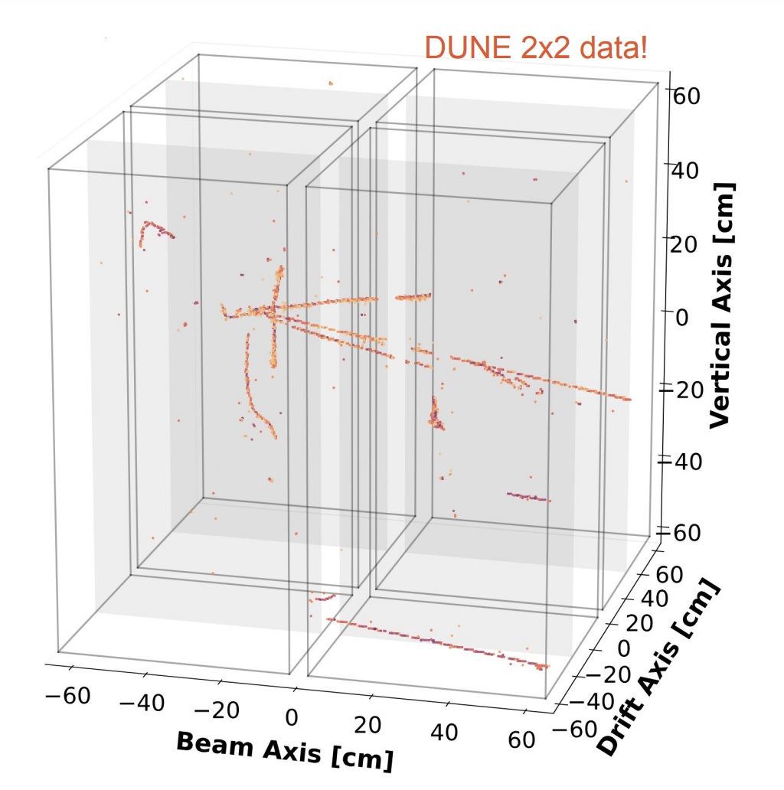
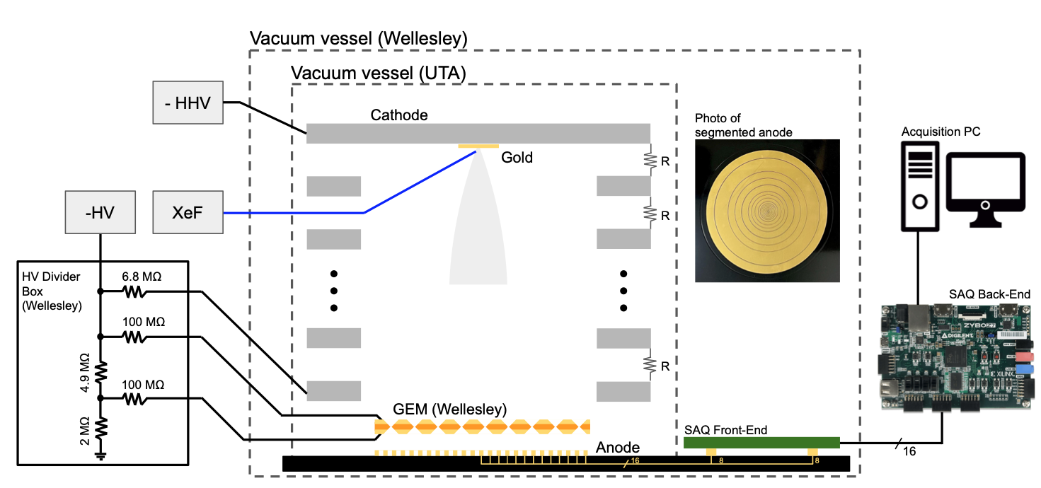
WP1 Charge Readout: Progress
WP1.1 Pixels & charge+light
(J. Asaadi & E. Gramellini)
CH: Bern
ES: University of Granada
IT: INFN BO, MIB
UK: Imperial, Manchester
US: SLAC, MIT, UTA, Wellesley
Scientific progress:
D1.2 Deployment and operation of the LArPix readout concept in the 2x2 demonstrator on the NuMI beam
D1.1 First operation of a multi-channel Q-Pix prototype with COTS component
D1.3 Data analysis from the first SoLAr prototype (accepted in JINST)
(JINST 19 (2024) 06, P06007)
SoLAr
From Andrew Cudd at NuFact
Notes:
2x2 demonstrator is for 300k channels right now, so it is a step towards 1M

Slide 11
WP1 Charge Readout: Progress
WP1.2 Charge-to-light, EL & Amplification
(A. Deisting & K. Mavrokoridris)
Consolidated the scientific programme to 3 Deliverables: camera and SiPM-based particle tracking, novel devices for charge amplification in single- and dual-phase, large-scale demonstrators
 | Title | Description | Institutions
D1.4 | Prototype for imaging light readout | Prototypes for light imaging of charge amplification with cameras and SiPMs | 2
D1.5 | Report on novel charge amplification devices | Report on novel devices for charge amplification in single- and dual-phase detectors | 12
D1.6 | Report on large-scale tests for amplification devices | Report on large-scale tests in single- and dual-phase LAr and LXe detectors | 4

Slide 12
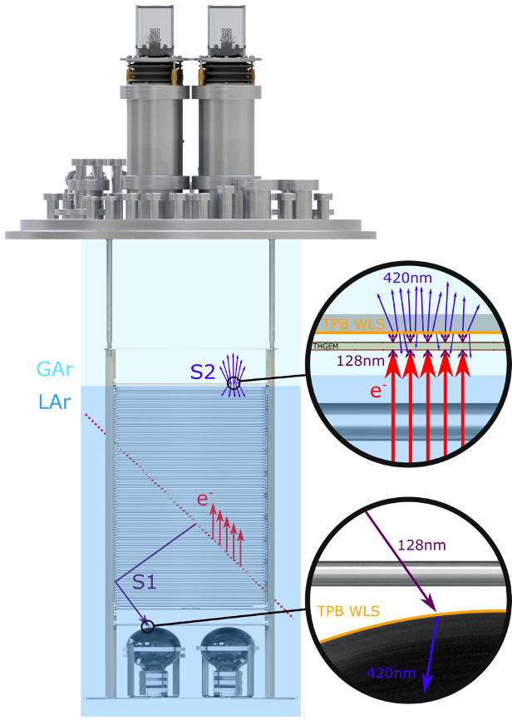
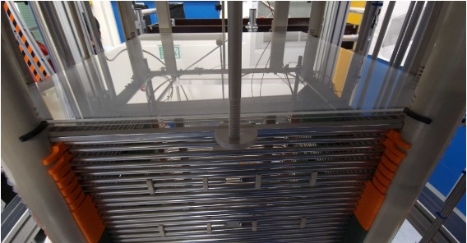
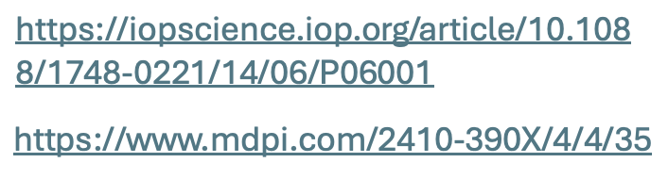
WP1 Charge Readout: Progress
WP1.2 Charge-to-light, EL & Amplification
(A. Deisting & K. Mavrokoridris)
AU: Griffith, James Cook
BR: University of São Paulo
DE: Mainz, Freiburg
FR: LPNHE
IL: Tel Aviv University
NL: Nikhef
PT: LIP Coimbra
UK: Liverpool, Manchester
US: UC Riverside
Scientific Progress:
D1.4 Publications towards imaging light readouts
Demonstration of energy resolution with SiPMs imaging plane (NEXT-White)
Contreras, T., et al., J. High Energ. Phys. 2024, 112
D1.5 New charge amplification structure
ARIADNE, demonstration at scale of full 3D optical TPC:
new ARIADNE run finished in summer 2024: 3 TPX cameras installed, with the remaining ¼ of the detector dedicated to Darkside type SiPMs
Glass THGEMs (54cm x 54cm) for ARIADNE

Slide 13
WP2 Light Readout: Progress
WP2.1 Increase sensor quantum efficiency
(P. Agnes & M. Garcia Peris)
Consolidated the scientific programme to 3 Deliverables: effort targeted at efficiency in the VUV and at cryogenic temperatures, complementarity with WP1 of DRD4
 | Title | Description | Institutions
D2.1 | Sensor development for VUV sensitivity | Development and characterization of organic photosensors, coatings and passivation methods and of SPAD geometry for VUV detection | 7
D2.2 | Prototype SPAD arrays | Prototypes and characterization of new SPAD arrays for 3D-intergrated FSI and BSI, analog BSI and monolitich arrays | 8
D2.3 | Report on VUV-optimized sensor | Report on the performance of new VUV-optimised sensors in term of PDE, noise and application to rare-event seraches | 8

Slide 14
WP2 Light Readout: Progress
WP2.1 Increase sensor quantum efficiency
(P. Agnes & M. Garcia Peris)
D2.2 Arrays & funding updates
Scientific Progress:
3D integrated FSI-SPAD arrays (Sherbrooke+Teledyne-DALSA): First prototypes late 2024
Funding secured for 3D integrated BSI-SPAD arrays (Heidelberg-TRIUMF-Fraunhofer)
BSI-SPAD arrays (Bo-SLAC-FBK): 2 engineering runs (INFN IBIS) 1 planned (INFN IBIS_NEXT). Funding available
Funding secured for a production run of monolithic CMOS-SPAD arrays (Fermilab-GlobalFoundries). First delivery expected in March 2025.
D2.3 Facility networks updates
D2.1 Funding updates
- Detailed characterization setups for detection efficiency.
Setup assembly ongoing at INFN-Naples and INFN-LNGS, CIEMAT.
Setup operational at TRIUMF
Operation in LAr and LXe for noise rates of single photon detection.
Setup operational at INFN-Ferrara and TRIUMF
Funding allocated at INFN-LNGS/GSSI
- Operation for rare-event search experiments.
Funding available at UC Riverside and University of Tel Aviv for small scale TPCs
Funding secured to acquire and test large area organic semiconductors.
Funding available (Open University) for VUV optimised coating technologies for CMOS detectors.
Funding proposal submitted (STFC) to test graphene coating (Oxford, Manchester) on existing SiPM devices.

Slide 15
WP2 Light Readout: Progress
WP2.2 Higher efficiency WLS and collection
(M. Kuzniak & J. Martin-Albo)
Consolidated the scientific programme to 2 Deliverables: WLS and light collection optimization
 | Title | Description | Institutions
D2.4 | Report on optimised WLS | Report on optimised WLS (VUV to visible) and evaporation systems | 3
D2.5 | Design report on light collection | Design report on VUV light collection in noble elements and light readout for liquid scintillators | 10

Slide 16
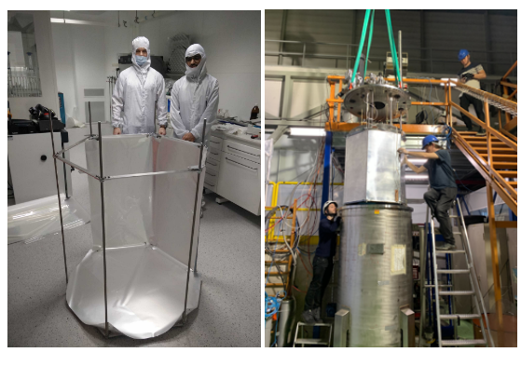
WP2 Light Readout: Progress
WP2.2 Higher efficiency WLS and collection
(M. Kuzniak & J. Martin-Albo)
Scientific Progress:
D2.4: Finalized analysis of a large-scale PEN WLS test at CERN (in collaboration with the Neutrino Platform)
D2.4: other updates
D2.5: Publications
Ongoing efforts on optimized PEN synthesis
  Custom synthesised PEN already as good or better than commercially available PEN, but still less efficient than TPB
Complementary WLS characterization/qualification facilities:
  Setup for cryogenic WLS characterization operational at Astrocent (Choudhary et al., LIDINE 2024)
In parallel, new promising polymeric materials under investigation
  PVN:(Kuźniak et al., LIDINE 2024)
Strong interest in all the above from the DUNE community
Optimal reflector/WLS combination previously selected with bench top measurements (Goldbrunner et al., LIDINE 2023)
4 m² of commercial industry grade PEN + ESR tested over 2 weeks in a 2 tonne LAr dewar
LY consistent with expectation, with no evidence for degradation (V. Gupta et al., LIDINE 2024)
Novel simulation method for large-area metalenses
  A.Martins et al., J. Opt. Soc. Am. B 41, 1261-1269 (2024)
First VUV metalenses
  A.Martins et al., arXiv:2401.11315
Led by Astrocent, CERN, U. Edinburgh, U. Hawaii, Nikhef, TUM, Uni. Zurich

Slide 17
WP3 Target Properties: Progress
WP3.1 Target properties and isotope loading of LS & WC
(H. Steiger & M. Wurm)
Consolidated the scientific programme to 2 Deliverables: hybrid Cherenkov/scintillator systems, opaque scintillators, and isotope loading for neutrinoless double-beta decay (0νββ) searches and neutron tagging
 | Title | Description | Institutions
D3.1 | Ton-scale demonstrators of novel liquid scintillators | Lab- and ton-scale demonstrators for hybrid and opaque scintillators, publication on properties and performances and improved microphysics models | 16
D3.2 | Demonstrators for liquid target loading | Demonstration of high Gd loading at ton-scale and of high concentration of isotope loading | 9

Slide 18
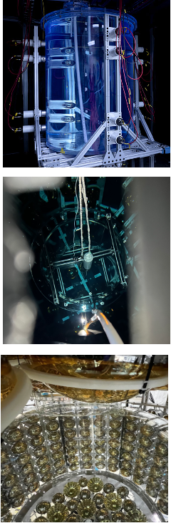
WP3 Target Properties: Progress
WP3.1 Target properties and isotope loading of LS & WC
(H. Steiger & M. Wurm)
Scientific Progress:
D3.1: Progress at ton-scale on hybrid (water-based) scintillators detectors:
BNL prototypes: 1-ton → 30-ton
production, purification and characterization of WbLS
status: construction of 30-ton prototype is on-going
ANNIE (FNAL): SANDI Acrylic Vessel
hybrid reconstruction of beam neutrinos (GeV range)
recent deployment of SANDI vessel with 365kg of Gd-loaded WbLS
→ detection of final-state neutrons
→ Cherenkov/scintillation separation with PMTs & LAPPDs
EOS (Berkeley)
hybrid detection at MeV energies
detector complete, final preparations for filling with WbLS
→ coordinated program of German/US groups
→ link to BUTTON in the UK
D3.1 : demonstration of Cherenkov/scintillation separation in novel bi-solvent slow scintillators
→ with small-scale lab setup (Berkeley)
→ new collaborative effort to demonstrate in larger vessel (30L scale) in a particle beam at INFN-LNL Legnaro (TUM/Padova/Mainz)
D3.1 : group of INFN Milano (Caccianiga) recently joined DRD2 for lab-scale characterization of hybrid scintillators
D3.1 : two joint publications on bi-solvent slow scintillators and water-based liquid scintillator using Triton-X (TUM/Mainz)
D3.2 : tellurium-doping of LAB-based conventional and slow scintillators with high loading factors, using different techniques
→ Oxford/SNOLab, IHEP Beijing (recently joined DRD2), TUM

Slide 19
WP3 Target Properties: Progress
WP3.2 Target properties and isotope loading of noble elements
(D. Franco & D. Rudik)
Consolidated the scientific programme to 2 Deliverables: noble liquids microphysics + properties of mixtures
 | Title | Description | Institutions
D3.3 | Measurement of noble liquid response for low-energy recoils | Characterization of NL response to low-energy recoils and design of low-energy calibration systems | 10
D3.4 | Measurement of noble liquids mixtures properties | Characterization and measurement of properties of NL mixtures | 13

Slide 20
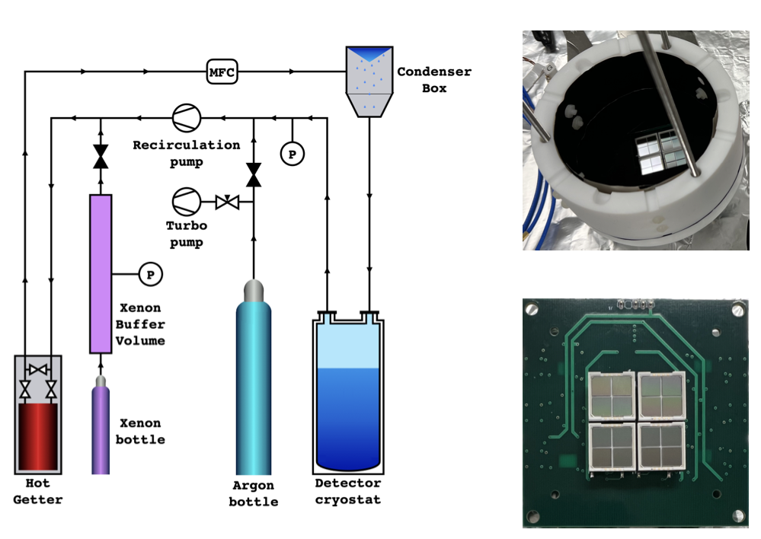
WP3 Target Properties: Progress
WP3.2 Target properties and isotope loading of noble elements
(D. Franco & D. Rudik)
CN: IHEP, CAS
ES: University of Granada
FR: APC, LPNHE, Mines Paris
IT: GSSI, INFN LNS, Milano, Napoli
PT: LIP Coimbra
UK: Uni Edinburgh
US: Colorado State, LLNL, UC Riverside
Scientific Progress:
D3.4: Publication
EUV scintillation from xe-doped LAr
  P.Agnes et al., X-ArT https://arxiv.org/abs/2410.22863

Slide 21
WP4 Scale-up Challenges: Progress
WP4.1 Radiopurity and background mitigation
(R. Santorelli & P. Scovell)
Consolidated the scientific programme to 3 Deliverables: radioassay techniques, low-bckgd materials, bckgd evaluation
 | Title | Description | Institutions
D4.1 | Report on improved radioassay techniques | Demonstration of radioassay techniques at required sensitivity for next generation of rare-event search experiments | 8
D4.2 | Report on low-background materials | Report on the development of novel materials, material selection, and clean treatment/manufacturing processes | 8
D4.3 | New tools for background evaluation | Development of new tools for background simulations and measurements of cross-section materials | 6

Slide 22
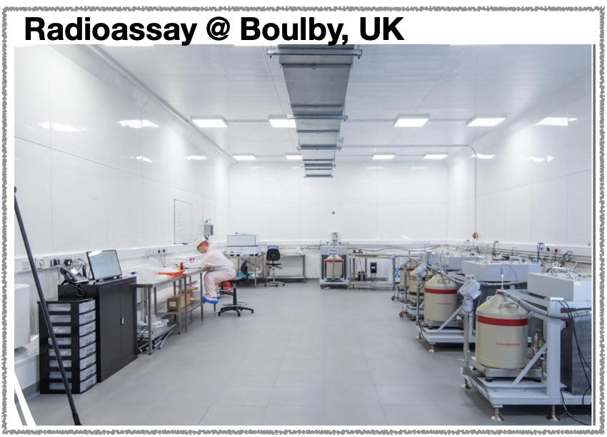
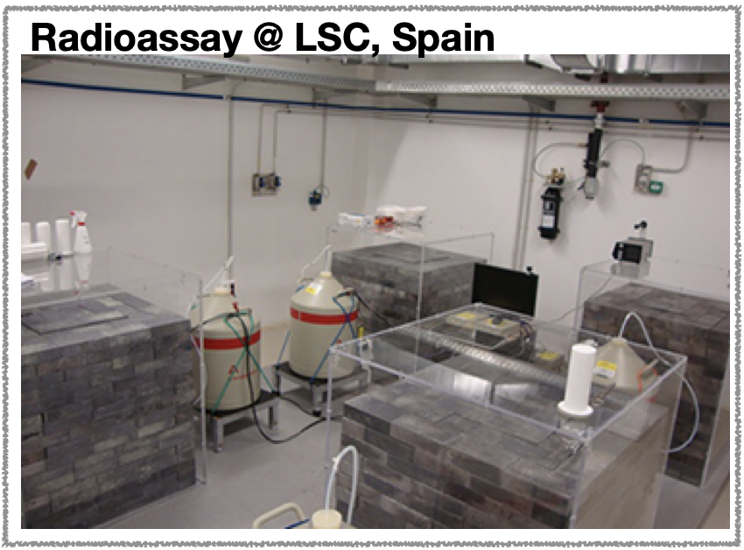
WP4 Scale-up Challenges: Progress
WP4.1 Radiopurity and background mitigation
(R. Santorelli & P. Scovell)
Scientific Progress:
D4.1: Radioassay Techniques
Recent addition of Underground Labs (Canfranc, Boulby, Modane, Rustrel)
  Agreement to coordinate
Plans for a virtual workshop
Notes:
"" means that some lab are not necessary national, but sill scientific labs

Slide 23
WP4 Scale-up Challenges: Progress
WP4.2 Detector and target procurement/production & purification
(M. Caravati & M. Yeh)
Consolidated the scientific programme to 2 Deliverables: production & purification facilities, radiopurity assesment and verification
 | Title | Description | Institutions
D4.4 | Mass production facilities | Purification and production plants for liquid targets | 8
D4.5 | Demonstration of UAr purification technology | Demonstration of improved purification technologies on testbeds | 5

Slide 24
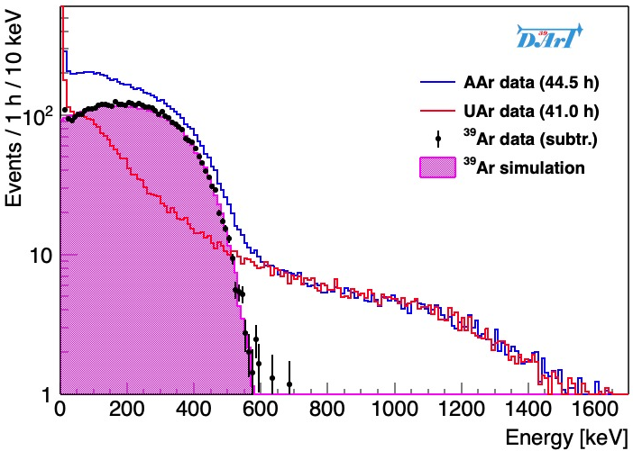
WP4 Scale-up Challenges: Progress
WP4.2 Detector and target procurement/production & purification
(M. Caravati & M. Yeh)
CA: SNOLAB
DE: Muenster, JGU Mainz
ES: CIEMAT
IT: GSSI, INFN Cagliari
UK: University of Oxford
US: BNL, LLNL, UC RIverside
Scientific Progress:
D4.5 Demonstration of UAr purification technology
DArT @ LSC
Concept validated by measurement of ³⁹Ar spectrum by comparing AAr and UAr with DArT in a test cryostat
ArDM detection refurbished for single-phase operation
Full setup for ³⁹Ar ready by January 2025
Single electron
cryogenic setup under advanced testing at INFN Cagliari

Slide 25
WP4 Scale-up Challenges: Progress
WP4.3 Large-area readouts
(J. Crespo & D. Dwyer)
Consolidated the scientific programme to 2 Deliverables: mid-scale and large-scale facilities for integration tests
 | Title | Description | Institutions
D4.6 | Medium-scale integrated testing facilities | Development of mid-scale facilities for large-area readout assembly and characterization at cryogenic temperature | 6
D4.7 | Report on large-area readout | Report on large-scale light and charge readout systems | 5

Slide 26
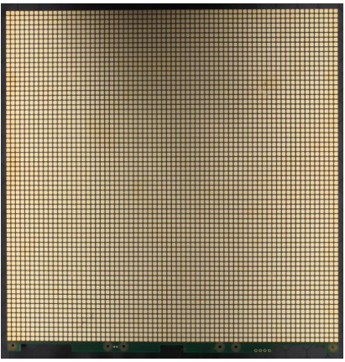
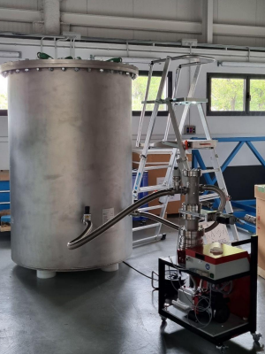
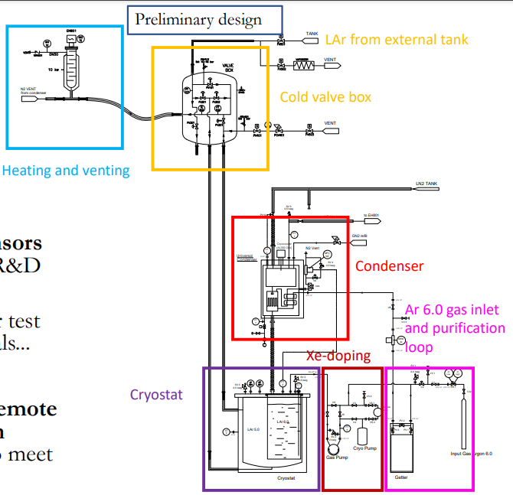
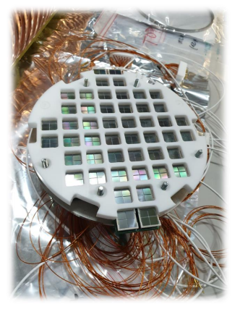
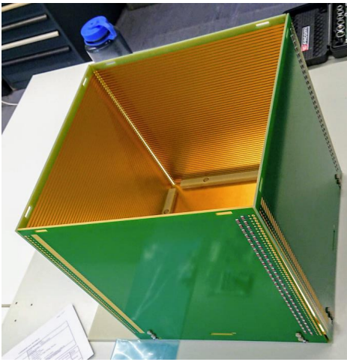
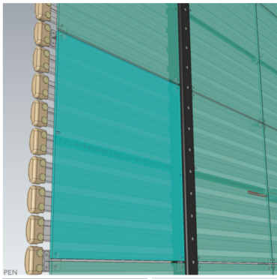
WP4 Scale-up Challenges: Progress
WP4.3 Large-area readouts
(J. Crespo & D. Dwyer)
Scientific Progress:
CH: UZH
ES: CIEMAT
IT: INFN Napoli, LNGS
US: LBL, MIT, Stony Brook
D4.7: Large-scale integration
D4.6: Testing Facilities
LArPix-v2 tile
LArTPC kit
Naples
APEX
CIEMAT
Xenoscope

Slide 27
WG A: Common Infrastructure and Facilities
Slower progress here because nominated one co-convener stepped down, the other one is on parental leave and we needed a better picture of the facilities (work undertaken by the Tasks)
We plan to use the Working Group to mitigate the inclusion of groups who cannot commit to Deliverables

Slide 28
Summary of progress
All Tasks have made progress and have planned for scientific exchange activities (workshops, task meetings…)
General Collaboration Meeting to be held at CERN (TBC) on 11-13 February 2025
We succeeded into bringing together the different communities, we now need to maintain momentum!

Slide 29
Thank You

Slide 30
Backup

Slide 31
WP1.1
D1.1 | Pixel readout prototype | Prototype of lower power and lower pixel thresholds to the limit of CMOS capabilities | T1.1.G1.D1 | Prototype of lower power and lower pixel thresholds to the limit of CMOS capabilities
 |  |  |  | removed
D1.2 | Large-scale pixel readout design | Design of a pixel readout with O(100 million) | T1.1.G2.D1 | Design of a pixel readout with O(100 million)
D1.3 | Light-sensitive pixel readout design | Design (simulation and prototype) of maximal photocathode coverage and QE in an integrated fC charge and VUV light sensing scheme for pixel TPCs | T1.1.G3.D1 | Design (simulation and prototype) of maximal photocathode coverage and QE in an integrated fC charge and VUV light sensing scheme for pixel TPCs
 |  |  |  | removed

Slide 32
WP1.2
D1.4 | Prototype for imaging light readout | Prototypes for light imaging of charge amplification with cameras and SiPMs | T1.2.G1.D1 | Prototype demonstrating particle tracking (2030)
 |  |  |  | removed
 |  |  |  | removed
D1.5 | Report on novel charge amplification devices | Report on novel devices for charge amplification in single- and dual-phase detectors | T1.2.G2.D1 | Report on novel devices to for charge amplification in dual-phase detectors (2027)
 |  |  |  | removed
 |  |  |  | removed
 |  |  | T1.2.G2.D3 | Report on the feasibility of novel amplification strategies for single- and mixed-phase detectors
 |  |  | T1.2.G2.D4 | Theoretical models of electron transport in LAr/LXe, and simulation models of PMT, SIPM pulse shapes
D1.6 | Report on large-scale tests for amplification devices | Report on large-scale tests in single- and dual-phase LAr and LXe detectors | T1.2.G3.D1 | Report on LAr / dual phase Ar large scale tests with TPX readout (2030)
 |  |  | T1.2.G3.D2 | Report on large scale tests with a single-phase LXe and dual-phase Xe charge-to-light conversion stage (2030)

Slide 33
WP2.1
D2.1 | Sensor development for VUV sensitivity | Development and characterizationof organic photosensors, coatings and passivation methods and of SPAD geometry for VUV detection | T2.1.G1.D1 | Characterization of low-noise, high fill-factor organic photosensors
 |  |  | T2.1.G1.D2 | Purpose-optimised coatings and passivation strategies for LAr/LXe wavelengths
 |  |  | T2.1.G1.D3 | Designs of SPAD geometries optimized for VUV sensitivity
D2.2 | Prototype SPAD arrays | Prototypes and characterization of new SPAD arrays for 3D-intergrated FSI and BSI, analog BSI and monolitich arrays | T2.1.G2.D1 | Prototype of 3D integrated FSI-SPAD arrays and characterization
 |  |  | T2.1.G2.D2 | Prototype of 3D integrated BSI-SPAD arrays and characterization
 |  |  | T2.1.G2.D3 | Prototype of analog BSI-SPAD arrays and characterization
 |  |  | T2.1.G2.D4 | Prototypes of cryogenic monolithic SPAD arrays and characterization
D2.3 | Report on VUV-optimized sensor | Report on the performance of new VUV-optimised sensors in term of PDE, noise and application to rare-event seraches | T2.1.G3.D1 | PDE vs. λ,T, angle measurement
 |  |  | T2.1.G3.D2 | Report on sensor noise characterisation
 |  |  | T2.1.G3.D3 | Paper on rare-event search application

Slide 34
WP2.2
D2.4 | Report on optimised WLS | Report on optimised WLS (VUV to visible) and evaporation systems | T2.2.G1.D1 | Technical report of optimized WLS (2027)
 |  |  | T2.2.G1.D2 | Construction of a large-area multi-source evaporation system (2027)
D2.5 | Design report on light collection | Design report on VUV light collection in noble elements and light readout for liquid scintillators | T2.2.G2.D1 | Design report of VUV light collectors at cryogenic temperatures (2028)
 |  |  | T2.2.G2.D2 | Design report of light readout for liquid scintillator (2028)
 |  |  |  | removed

Slide 35
WP3.1
D3.1 | Ton-scale demonstrators of novel liquid scintillators | Lab- and ton-scale demonstrators for hybrid and opaque scintillators, publication on properties and performances and improved microphysics models | T3.1.G1.D1 | Demonstration of hybrid scintillator (hLS) performance in lab-scale and ton-scale experiments (2028)
 |  |  | T3.1.G1.D2 | Demonstration of opaque scintillator (oLS) performance in ton-scale setup (2028)
 |  |  | T3.1.G1.D3 | Publications on properties of novel target media and detector concepts (2027)
 |  |  | T3.1.G1.D4 | Improved microphysics model for organic liquid scintillators (2028)
D3.2 | Demonstrators for liquid target loading | Demonstration of high Gd loading at ton-scale and of high concentration of isotope loading | T3.1.G2.D1 | Demonstration of > 0.1% Gadolinium loading in ton-scale setups (2027)
 |  |  | T3.1.G2.D2 | Demonstration of ββ isotope loading in scintillators on several per-cent level (2028)

Slide 36
WP3.2
D3.3 | Measurement of noble liquid response for low-energy recoils | Characterization of NL response to low-energy recoils and design of low-energy calibration systems | T3.2.G1.D1 | Characterization of NL response to low energy recoils (2028)
 |  |  |  | removed
 |  |  | T3.2.G1.D2 | Design and commissioning of techniques for low-energy calibrations (2029)
 |  |  |  | removed
 |  |  |  | removed
 |  |  |  | removed
D3.4 | Measurement of noble liquids mixtures properties | Characterization and measurement of properties of NL mixtures | T3.2.G2.D1 | Characterization of thermodynamics of Xe-doped LAr (2028)
 |  |  |  | removed
 |  |  | T3.2.G2.D2 | Measurement and modeling of doped NL response (2028)

Slide 37
WP4.1
D4.1 | Report on improved radioassay techniques | Demonstration of adioassay techniques at required sensitivity for next generation of rare-event search experiments | T4.1.G1.D1 | Demonstration of improved sensitivity for surface contamination, Rn emanation, and bulk contamination assays.
 |  |  | T4.1.G1.D2 | Report on a comprehensive cross-calibration for low background screening and assay across EU
 |  |  |  | removed
D4.2 | Report on low-background materials | Report on the development of novel materials, material selection, and clean treatment/manufacturing processes | T4.1.G2.D1 | Development and demonstration of novel materials for background suppression
 |  |  | T4.1.G2.D2 | Technical report on surface treatments and clean protocols for low background experiment
 |  |  |  | removed
 |  |  |  | removed
D4.3 | New tools for background evaluation | Development of new tools for background simulations and measurements of cross-section materials | T4.1.G3.D1 | Improvement of the Codes for tracking and estimating backgrounds in rare event searches
 |  |  | T4.1.G3.D2 | Measurement of cross-section for materials relevant to low-background experiments
 |  |  |  | removed
 |  |  |  | removed

Slide 38
WP4.2
D4.4 | Mass production facilities | Purification and production plants for liquid targets | T4.2.G1.D1 | Scale-up Purification and Production facility for (Metal doped & Water based) LS/WC (2027)
 |  |  | T4.2.G1.D2 | Massive xenon production and purification plant (2027)
 |  |  |  | removed
 |  |  | T4.2.G1.D3 | Pilot-scale UAr purification technology development (2027)
D4.5 | Demonstration of UAr purification technology | Demonstration of improved purification technologies on testbeds |  | removed
 |  |  |  | removed
 |  |  | T4.2.G2.D1 | Facilities for liquid argon radioactivity, purity, and single electron emission characterization (2027)

Slide 39
WP4.3
D4.6 | Medium-scale integrated testing facilities | Development of mid-scale facilities for large-area readout assembly and characterization at cryogenic temperature | T4.3.G1.D1 | Photodetector facility (2026)
 |  |  | T4.3.G1.D2 | TPC-testing facility (2026)
 |  |  | T4.3.G1.D3 | Distributed pixel LArTPC systems (2026)
 | removed |  |  | removed
 |  |  | T4.3.G2.D4 | Scalable readout for large photodetector systems (2029)
D4.7 | Report on large-area readout | Report on large-scale light and charge readout systems | T4.3.G2.D1 | Report on large scale photodetection in a field cage (2026)
 |  |  | T4.3.G2.D2 | Design of O(10 million) pixel readout (2029)
 |  |  | T4.3.G2.D3 | Report on operation of large fill-factor UV sensors in LXe (2026)

