Slide 1
Proposal DRD8:
Mechanics & Cooling of Future Vertex and Tracking Systems
Georg Viehhauser for the DRD8 collaboration

Slide 2
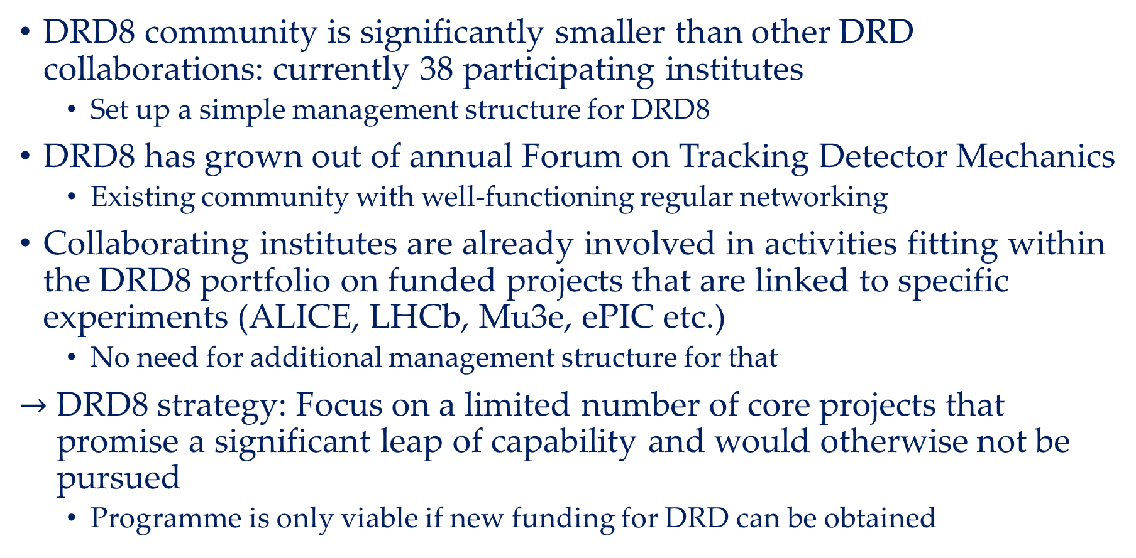
Introduction
DRD8 community is significantly smaller than other DRD collaborations: currently 38 participating institutes
  Set up a simple management structure for DRD8
DRD8 has grown out of annual Forum on Tracking Detector Mechanics
  Existing community with well-functioning regular networking
Collaborating institutes are already involved in activities fitting within the DRD8 portfolio on funded projects that are linked to specific experiments (ALICE, LHCb, Mu3e, ePIC etc.)
  No need for additional management structure for that
$→$ DRD8 strategy: Focus on a limited number of core projects that promise a significant leap of capability and would otherwise not be pursued
  Programme is only viable if new funding for DRD can be obtained

Slide 3
Work packages
DRD8 will be divided into four work packages
  WP1: Global system design and integration
  WP2: Low-mass mechanics and thermal management
  WP3: Detector cooling
  WP4: Design and qualification tools
Each WP will cover three aspects
  Each WP comprises two research projects
    Two for now, can be increased in the future
  As most of the groups in the collaboration are already in funded projects: Improve opportunities for networking, information exchange and access to equipment and/or facilities
    No specific R&D projects are defined in this proposal for these rather well defined existing detector projects
  Research activities undertaken by member groups that will not be managed by the DRD8 organisation, but address research goals within the DRD8 portfolio
    These are typically small collaborations or single institutes
    For endorsement by the DRD8 Steering Committee, to strengthen their case when applying for funding
    DRD8 will organize reviews if requested

Slide 4
Projects
Projects have been chosen by WP coordinators based on suggestions from the community
  Project 1.1: The Vertex Region of Future Particle Physics Experiments
  Project 1.2: Robots in the HEP Experimental Caverns
  Project 2.1: Advanced Mechanical Tracker Structures
  Project 2.2: Characterisation of Material Properties and Database Development
  Project 3.1: New Evaporative Cooling Fluids and Systems
  Project 3.2: Microchannel Cooling Substrates
  Project 4.1: Extended Reality (XR) Development
  Project 4.2: Connection of Engineering Design Tools with Physics Simulation Software
Interesting range of topics from tools with very clear focus, to blue skies creative thinking with a wide open field of possible solutions
Currently between 3 and 16 participating institutes per project
  Depending on breadth of anticipated activities

Slide 5
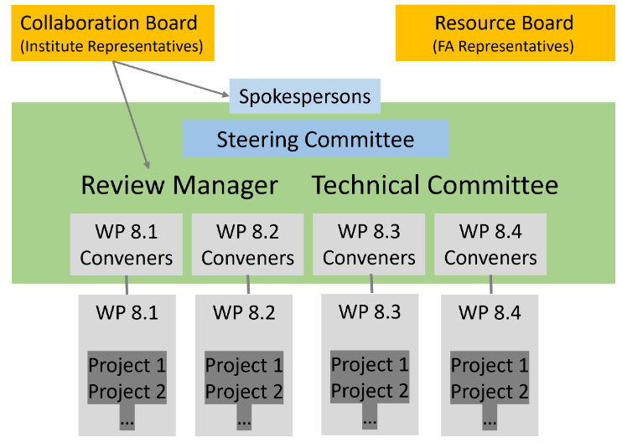
Governance
Work Packages led by Conveners (two per WP) who manage the R&D projects
Steering Committee (SC) guides collaboration and represents it to outside world
Chaired by spokesperson and deputy
WP Conveners and SC collectively form the Technical Committee (TC)
The Collaboration Board (CB) is the scientific and technical representation of the collaborating institutions
  Each contributing institute sends one representative to the CB
The Review Manager (RM) sets up regular technical reviews of the projects
The Resources Board (RB) represents funding agencies supporting the projects in the collaboration

Slide 6
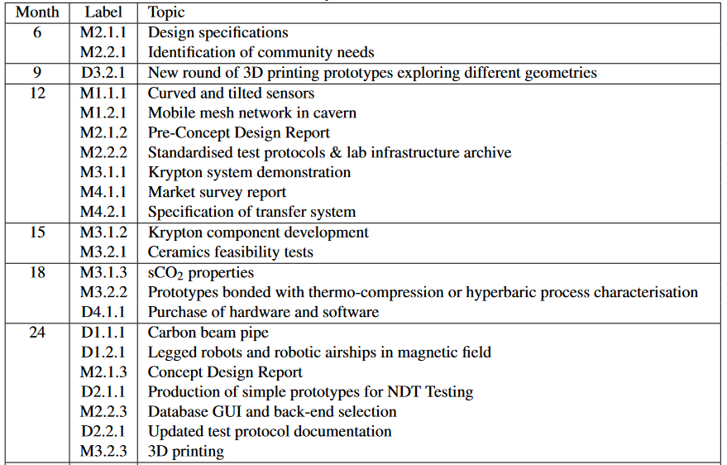
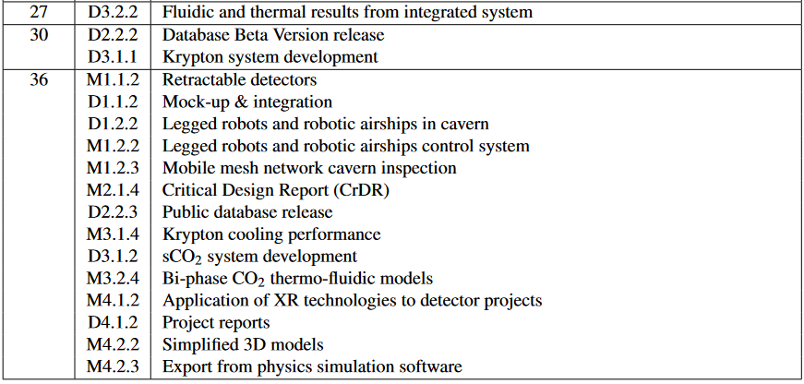
Milestones and deliverables
For now DRD8 proposal for 3 years
  But we hope that we can continue this programme beyond this time
Each project has between 4 and 6 milestones/deliverables spread over the duration of the programme to allow to monitor progress of the research project

Slide 7
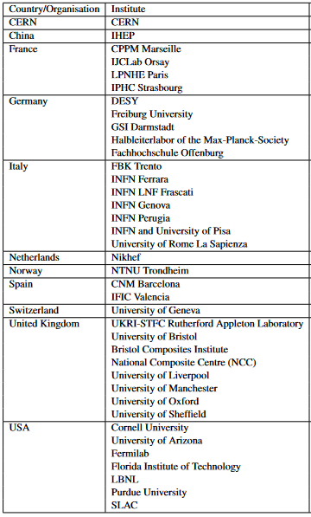
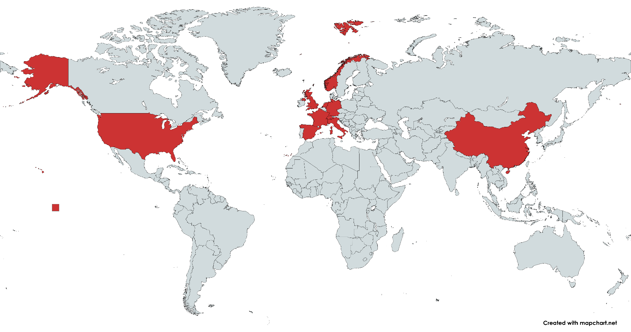
Participating institutes
Open to additional collaborators (some already under negotiation)
Encouraging industrial partners (one industrial partner already part of proposal)

Slide 8
Relations to other DRDs
Research activities in DRD8 cover non-active supporting aspects for future tracking systems
Requirements & specifications for DRD8 will be heavily influenced by needs & opportunities of future sensor & readout technologies
Close interactions with DRD3 and DRD7 will be an important aspect
In the long run, success of the DRD8 research programme will require the construction of one or more demonstrator(s)
  Large enough, representative advanced sensors and electronics prototypes, operation in a realistic environment
  Currently can conceive of two such demonstrators
    One for low-power (LP) operation (future e⁺e⁻ collider)
    The other for a future high-intensity (HI) tracker (future hadron collider)
  Will require common participation of DRD3, DRD7 and DRD8
  Near-term task will be the creation of management and planning structure with DRD3 and DRD7 and development of specifications for demonstrator(s)

Slide 9
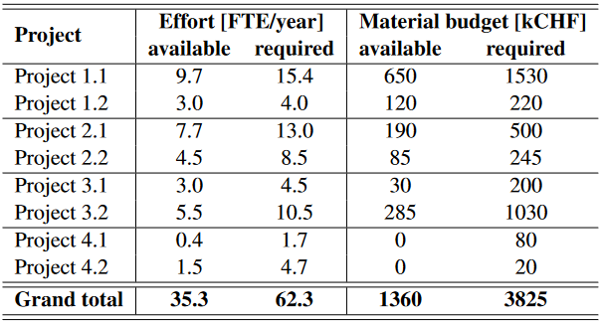
Resources
Available resources are resources on activities within the DRD portfolio
  Typically funded for specific experiments
  Technically these are not DRD8
  Will focus on the completion of their projects and proceed under any circumstances
  Exact assignment difficult, but probably a reasonable estimate of the this effort
Required resources are what we think will achieve a credible scientific programme that will realise our research goals
  Not guaranteed, contingent on funding
The difference constitutes the added value that DRD8 will bring

Slide 10
Miscellaneous
Meetings
  DRD8 collaboration meetings twice a year
    Once in conjunction with the Forum on Tracking Detector Mechanics (abroad)
    The other likely to be at CERN
  WP meetings will be organised by WP conveners regularly as useful for advancing the research programme
Education and training
  DRD8 too small and its research topics too narrow to justify stand-alone schools or similar
  Will identify lecturers for lecture courses on relevant topics, and facilitate exchange of educational material among these lecturers
  Lecturers are ready to participate in schools within the DRD collaborations and outside (e.g. CERN summer school, ECFA summer school, EDIT)

Slide 11
Next steps
Attract additional collaborators, also from industry
Write and agree on MoU, which will detail the role of participating institutes and companies
Most important: Acquire funding
  Due to the nature of the work we should be open for unusual (non-PP) funding streams
  Making sure that the participating institutes pursue this aggressively will be the first task for the DRD8 management
Collaboration meeting in May/June 2025 in conjunction with Forum on Tracking Detector Mechanics 2025 in Bristol
  2d DRD8, 3d Forum

Slide 12
Further material

Slide 13
Project 1.1: The Vertex Region of Future Particle Physics Experiments
New design solutions for future beam pipes and vertex systems
  Challenges: minimum material budget, mechanical stability, and proximity to the beamline, integration of inner vertex layers with accelerator optics
  Crucial for preparing the ambitious design of future beam pipe and detector mechanics
Research topics
  Curved sensors: Reduce the material budget significantly and bring first hit point outside the beam pipe closer to the interaction point
  Ultra-thin beam pipes: Alternative beam pipe materials like alloys of beryllium and aluminium (Albemet), and carbon composites
  Retractable detectors: Bring first layer closer to interaction point, while addressing apertures, impedance and vacuum stability which are important for the beam
  Integration of accelerator and vertex detectors: cope with tight positioning requirements to guarantee high luminosity, and at the same time allow operations and maintenance of detector elements difficult to access
  Low-mass hardware alignment systems for future tracking detectors: Develop solutions that are complementary to that available through track-based alignment algorithms (weak modes) and that is low-mass and radiation-hard
CERN, IHEP/CAS, GSI Darmstadt, INFN Pisa, INFN Perugia, INFN Frascati, Nikhef, IPHC Strasbourg, IFIC Valencia, University of Geneva, University of Liverpool, University of Oxford, University of Bristol, University of Freiburg

Slide 14
Project 1.2: Robots in the HEP Experimental Caverns
Develop robotic systems for access and maintenance in underground particle detector areas consisting of large semi-structured caverns with high magnetic fields and radiation levels
  Autonomous and on-demand inspections and 3D environmental mappings to reduce accelerator down-time, prevent unnecessary beam dumps due to false alarms, detect anomalies at an early stage, monitor operation of experiments
  In future, will also aim at developing robotic manipulation systems for first intervention, and detector maintenance or removal
Ground and aerial platforms
  Legged ground robotic platforms
  Robotic airships
  Mobile mesh network (swarm of mini robots)
CERN, IHEP/CAS, Roma I (La Sapienza), University of Arizona

Slide 15
Project 2.1: Advanced Mechanical Tracker Structures
Challenge particle physics tracking detector design paradigms with an unhindered and blue-sky approach
  Make use of modern materials as well as design and manufacturing techniques
  Pursue new, unconventional geometries
Research topics:
  Orthotropic materials: optimise mechanical and thermal performance in critical directions
  Non-planar structures, and complex geometries: utilise Advanced Digital Manufacturing (ADM) techniques such as Additive Manufacturing (AM), Hybrid Manufacturing and tow-steering
  Integration of services into mechanical structures
  Tools to help predict and optimise the performance of detector support structures featuring orthotropic materials, complex geometries and/or integrated services produced with advanced manufacturing techniques
  Non-Destructive Testing (NDT) and other forms of Quality Assurance/Quality Control (QA/QC) that will guarantee quality of non-traditional, homogeneous or isotropic structures
CERN, DESY, GSI Darmstadt, Nikhef, Purdue University, University of Oxford, University of Liverpool, Bristol Composites Institute, UK National Composites Centre, STFC-RAL, INFN PISA

Slide 16
Project 2.2: Characterisation of Material Properties and Database Development
Development of centralized database with validated material data
  To optimise the resources allocated to material testing
  Avoid redundancies
  Standardised procedures for testing and reporting material properties
  Make data available for thermo-mechanical simulations and informed detector designs
Research topics
  Material testing protocols: Identify ISO / ASTM standard test procedures, document step-by-step testing procedures including specimen preparation, testing equipment, environmental conditions, and measurement techniques that can be recreated across the laboratories using controlled environmental conditions
  Documentation and database development: Development of database, covering material characterisation data and offering a standardised documentation of testing campaigns across the participating laboratories
CERN, DESY, University of Oxford, Bristol Composites Institute, INFN Perugia, Purdue University, Cornell Laboratory, Florida Institute of Technology

Slide 17
Project 3.1: New Evaporative Cooling Fluids and Systems
Develop sustainable cooling solutions in both the warm and cold domain
  Cold (cooling temperatures in the range of -90°C / -50°C): Krypton
    Transcritical cooldown in a compressor cycle
    Requires specific components to be developed or modified from standard
  Warm (above 0°C): Supercritical carbon dioxide (sCO2):
    Electrically non-conductive fluid with much lower viscosity than water and allowing for higher heat transfer coefficients operating at high pressure and temperatures above 31.7°C
CERN, NTNU, DESY, FH Offenburg, University of Sheffield, Cornell University, DORIN (industrial partner)

Slide 18
Project 3.2: Microchannel Cooling Substrates
Covering different manufacturing techniques and materials
  Silicon microchannels via buried channels:
    Development of a microchannel cooling technology fully compatible with (CMOS) sensors in the same substrate
    Development of ”active interposers” which hold mechanical support and buried micro-channels to provide local, high-efficient, together with interconnection capabilities to cover the electrical connection between detector and front-end electronics with the back-end electronics and rest of the system to provide re-distribution of the I/O signals (readout, control signals), plus power lines
  Silicon microchannels via thermocompression
    Set up a dedicated cooling test bench
    Fabrication of cooling plates with micro-channels of various geometrical and surface form factors
    Development of numerical 3D models and implementation in numerical simulation tools
    Development of low-cost silicon cooling-platesfabrication process, based on hyperbaric bonding (uses a thin layer of gold - similarly to thermo-compression - and is performed at room temperature inside a hyperbaric chamber)
    Development of cooling-plates interconnects to allow fabrication of heat exchangers covering large areas
  Low-temperature co-firing ceramic (LTCC) and high-temperature co-firing ceramic (HTCC):
    Different ceramic layers to enclose the channels, offers possibility to integrate high conductivity materials between layers
  3D metal printing
    High level of design flexibility, fast turn-around processing time, and cost-effectiveness, especially in electronics-dense areas with limited space
    Surface finishing and potential of the material budget improvement will be explored via post-processing techniques
University of Manchester, French Collaboration, IMB-CNM, IFIC and DESY, CERN, Nikhef, MPG HLL, University of Sheffield, Italian Consortium

Slide 19
Project 4.1: Extended Reality (XR) Development
Bridge the gap between the physical and digital world
  Technologies that are being adopted by leading industries and institutions
Research topics
  Augmented Reality (AR): Enhances the physical world by overlaying digital content onto real-world environments, can display in real-time digital working instructions or safety instructions in physical equipment
  Virtual Reality (VR): Full immersion into digital environment, can be used for virtual interventions in experimental and accelerator areas while these are not accessible
  Mixed Reality (MR): Interact with both virtual and physical worlds simultaneously, for example allows for connecting remotely with colleagues located in a collaborating institute
CERN, GSI Darmstadt, University of Sheffield

Slide 20
Project 4.2: Connection of Engineering Design Tools with Physics Simulation Software
Communication between CAD design tools, used for designing and integrating particle physics equipment, and physics simulation software (e.g. GEANT)
  Automatise the transfer of simplified engineering models, including geometry and material metadata, from engineering design software to physics simulation tools (e.g. Geant4, FLUKA)
Phase 1: Define data exchange requirements by identifying the inputs and outputs of both engineering design and physics simulation software
Phase 2: Develop tools to generate essential geometry data and material metadata in the engineering design software, ensuring compatibility and seamless transfer with physics simulation software
CERN, IHEP, GSI Darmstadt, Oxford University, INFN-LNF Frascati, Purdue University

Slide 21
Governance details
WP conveners
  Organise regular meetings of their WP
  Chair WP sessions during DRD8 collaboration meetings
  Aggregate material for annual DRD8 progress report
  Ensure that results and data of general interest are stored in DRD8 repository
  Usual term 3 years
SC
  Follows progress and activities of WPs
  Updates R&D vision of the collaboration
  Calls regular DRD8 meetings to report publicly on progress of the R&D effort
  Issues annual DRD8 progress report and presents it to CB
  Consists of six to eight members
    Term of membership in SC is normally three years, renewable once
    Each year up to two members of the SC will be replaced
    Two places within SC should be reserved to junior members of the community
  Nominates WP Conveners and proposes chairperson and deputy (both to be approved by CB)
Spokesperson and deputy
  Term one year, rotation among SC members is desired
TC
  Tracks projects
  Organises internal reviews and monitors progress
  Issues recommendations to projects
  Drafts the annual DRD8 progress report.
  Will approve presentations and publications
CB
  Scientific and technical representation of the collaborating institutions
  Each contributing institute sends one representative to CB
  Meets at least once per year to discuss progress and vision
  Approves annual DRD8 progress report, proposals for new projects, work packages and contributors
  Appoints SC members and endorses the Spokesperson & Deputy Spokesperson and the WP Conveners
  Members of the CB should not be members of the TC
  CB elects chairperson from among its members
  Chairperson will serve for a period of two years
RM
  Sets up review panel (with some participation of experts outside DRD8 encouraged) and its chair
  Defines together with the WP conveners the remit for each review
  Sets the time and place of the review in coordination with all parties involved
  After the review the RM will ensure that a written report of the findings of the panel is distributed to the parties involved
  The RM can supply funding agencies with the review reports on request
  On request by the involved parties, the RM will provide the same support for the review of other research activities within the framework of DRD8
CB
  Meets at least annually
  Approves annual DRD8 progress report and proposals for new projects and contributors
  Representation can be through representatives of collaborating institutions, or delegated to a body acting on behalf of one or several institutions

