Slide 1

BE-CSS and SY-ABT activities
A. Huschauer, V. Kain, M. Schenk, F. Velotti
on behalf of the extended EPA & accelerator communities
Potential collaboration synergies between CERN & MOVES in Formal Methods 04. July 2024

Slide 2
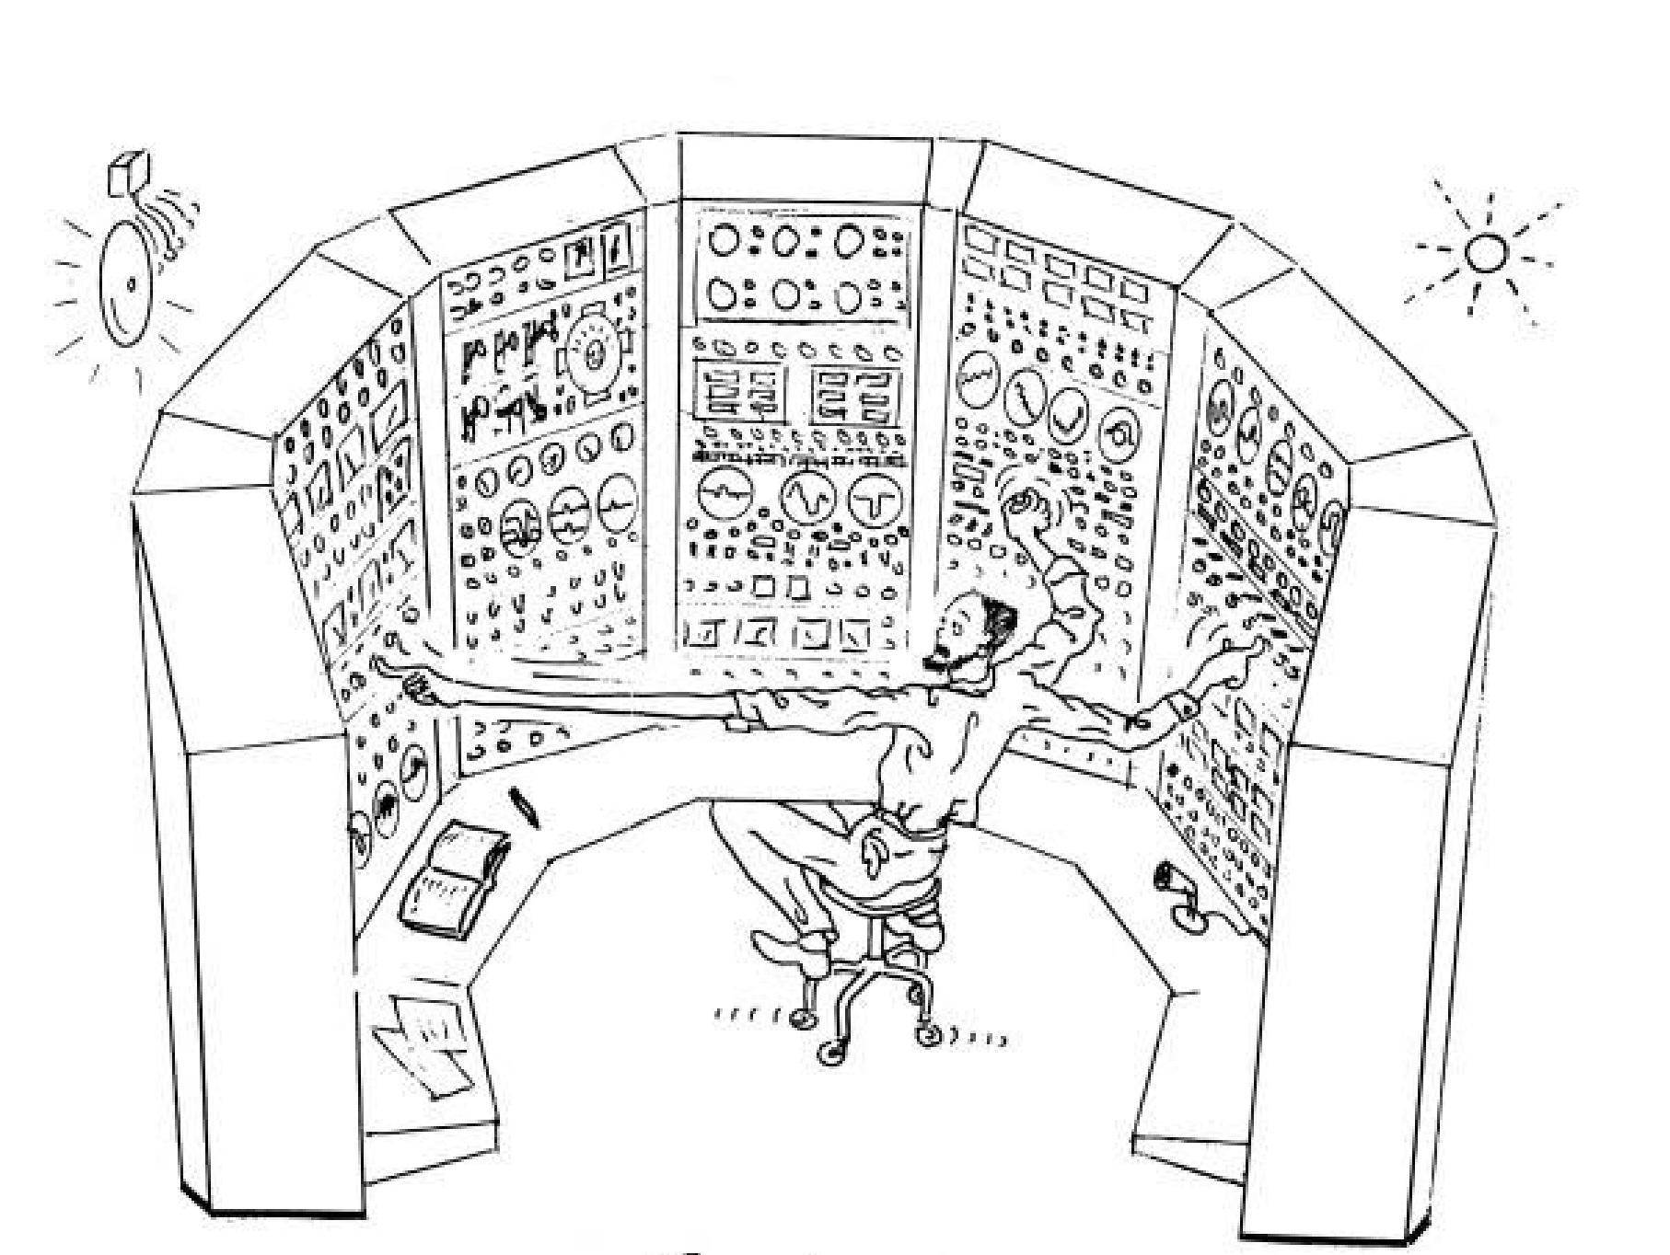
Intro
ML & NNs for applications in beam operations and beam transfer
Dealing with a very diverse landscape of problems & data
  Controllers: parameter optimisation & drift compensation (on-demand or
  continuous), feed-backs / feed-forward corrections, scheduling
  Monitoring: forecasting, virtual / enhanced diagnostics, anomaly detection
  Other: project on LLMs (knowledge retrieval)
No “one size fits all”
  (Meta-)RL, BO, model-predictive control (GP-MPC), physics-informed methods, transformers, numerical optimisers (gradient free) & classical control
  often in combination with simulations or surrogate models
  Anomaly detection: typically auto-encoders, but also SVMs, isolation forests, …
  Challenges: no online training (sample efficiency) → sim2real gap, exploitation vs exploration / continual learning, running safely & reliably 24/7, lack of beam observation / diagnostics, …
Remarks on safety
  Above everything, we have an independent machine protection system^{(*)}
  Controllers typically work in bounded parameter space
  Can still have undesirable consequences if controllers unsafe: degraded beam quality, increased particle loss
  and radio-activation, machine downtime
^{(*)}ML-free

Slide 3
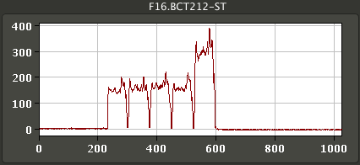

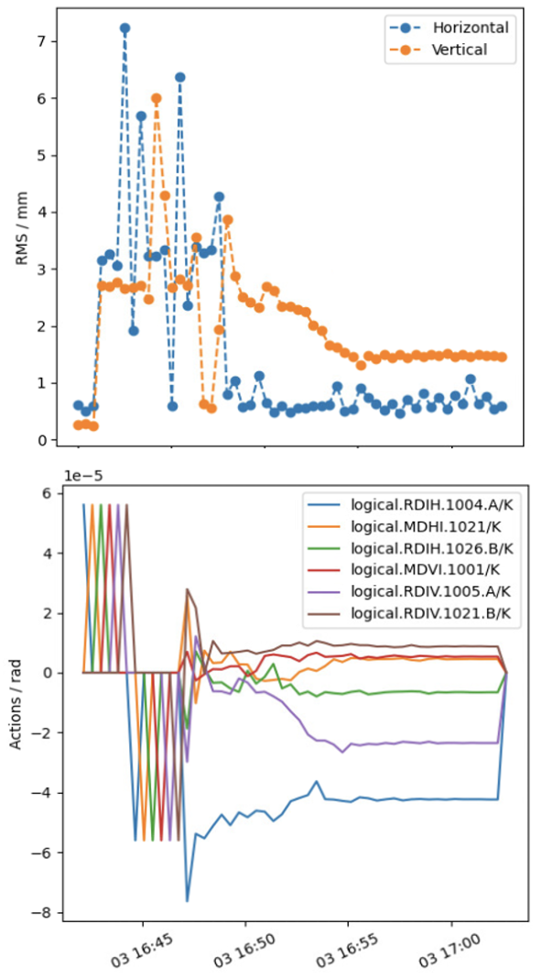
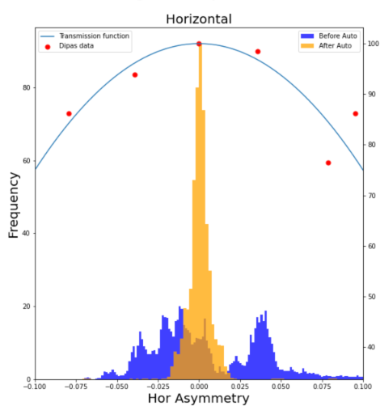
Examples using classical control
PS Multi-Turn Extraction
  Automatic drift compensation
  Successfully tested and tuned in MDs
  Hybrid agent: continuous controller interleaved with optimizer when far off
supercycle change
A. Huschauer, M. Schenk, C. Uden
ES
BOBYQA
ES
  Trajectory steering framework
  using acc-geoff4ucap
PS EAST: fixed target beam steering
    Versatile objective
    Beam position, beam loss, …
    Various algorithms
    incl. Micado / SVD, numerical opt.
    In 2024: PS2SPS, SPS2LHC
  PID regulator on UCAP
  Simple & effective
  Similar controller for TL towards AD
G. Trad, F. Velotti
J. McCarthy

Slide 4
Examples using classical control
PS Multi-Turn Extraction
  Automatic drift compensation
  Successfully tested and tuned in MDs
  Hybrid agent: continuous controller interleaved with optimizer when far off
  Generally easier to validate than ML-based methods
    Bounded parameter spaces
    Predictable / deterministic behaviour
    Can still run into unforeseen situations over
    longer time scales
supercycle change
A. Huschauer, M. Schenk, C. Uden
ES
BOBYQA
ES
  Trajectory steering framework
  using acc-geoff4ucap
PS EAST: fixed target beam steering
    Versatile objective
    Beam position, beam loss, …
    Various algorithms
    incl. Micado / SVD, numerical opt.
    In 2024: PS2SPS, SPS2LHC
  PID regulator on UCAP
  Simple & effective
  Similar controller for TL towards AD
G. Trad, F. Velotti
J. McCarthy

Slide 5
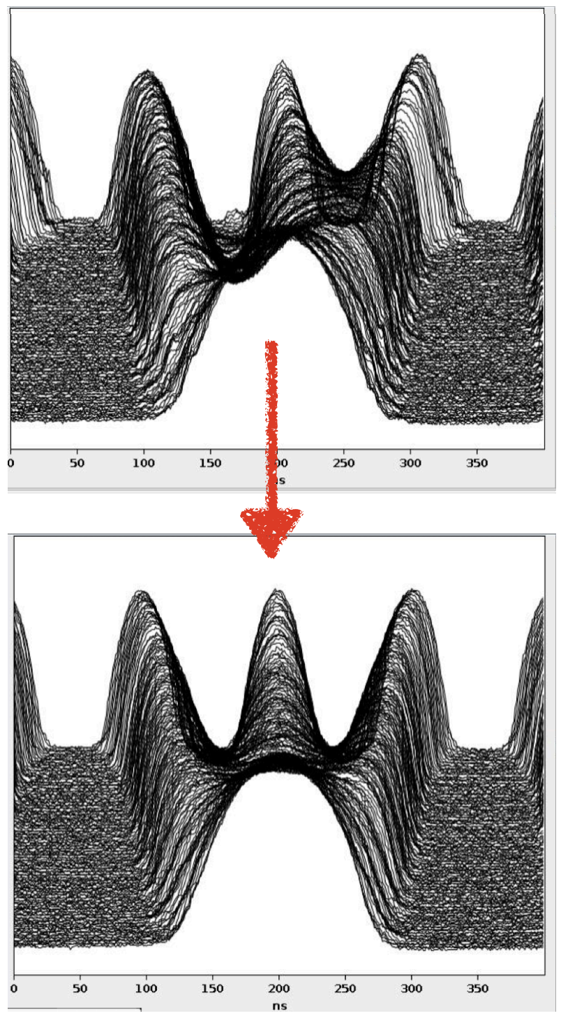
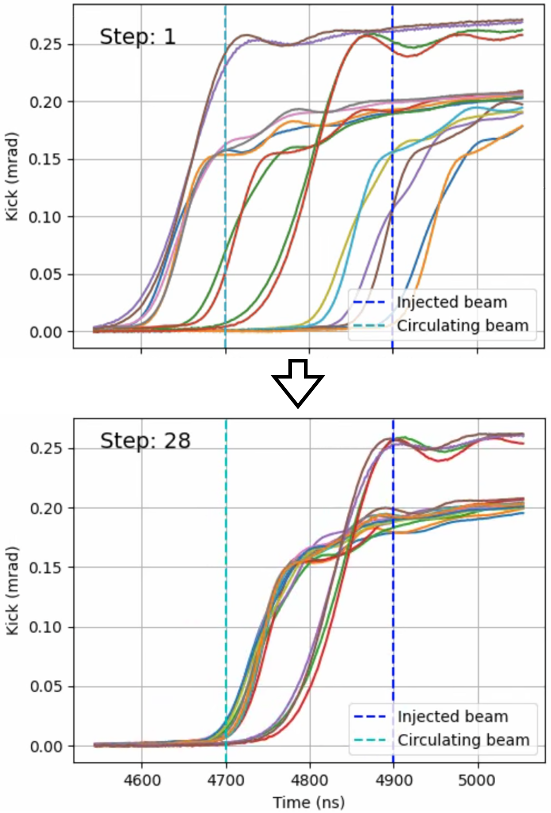
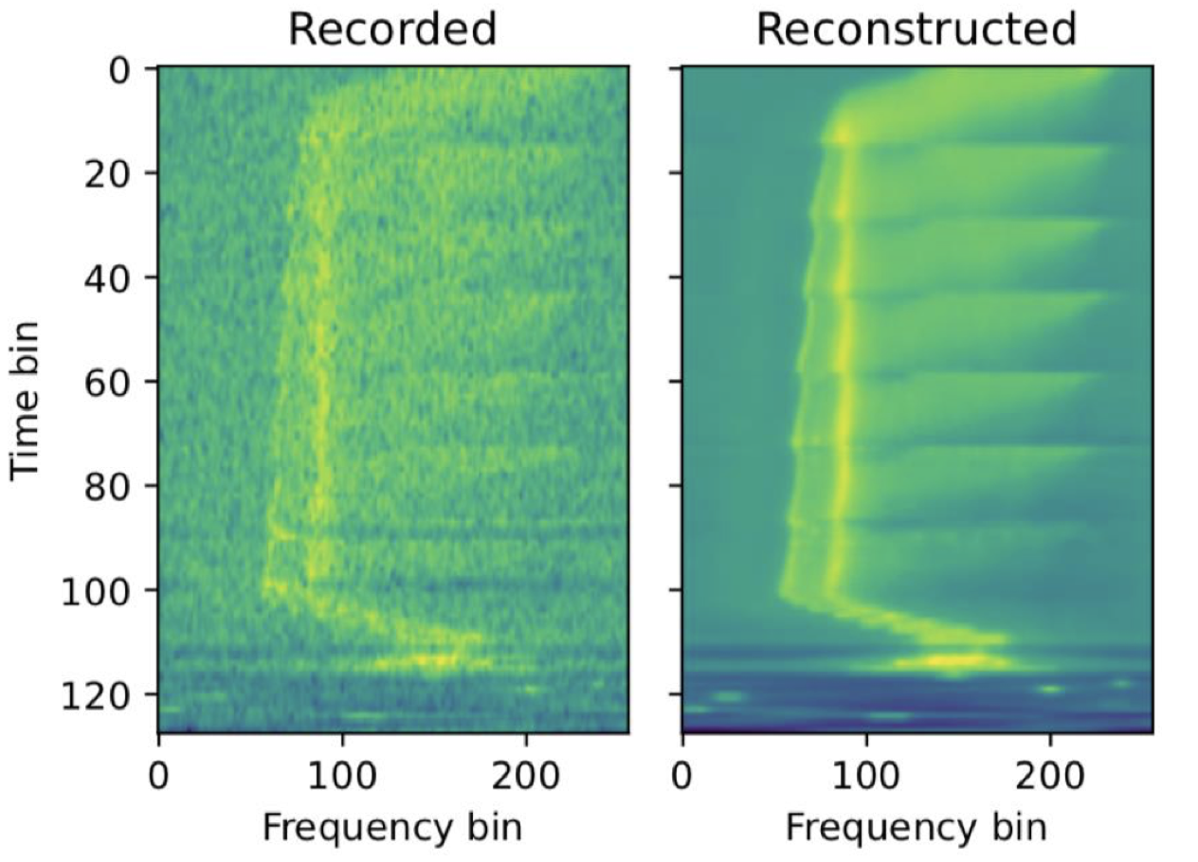
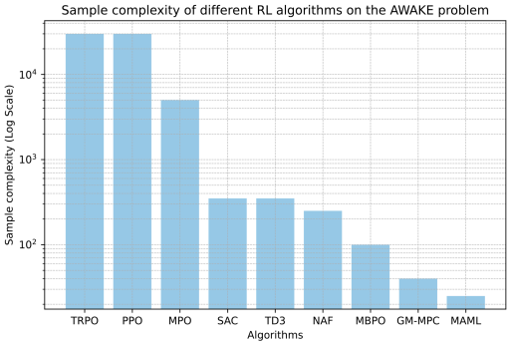
Examples using RL
PS
PS to SPS
Correct RF phase & voltage for uniform bunch splitting (LHC beams)
Multi-agent (SAC) & CNN for initial guess
Successful sim2real transfer
If things go wrong: degraded beam
Adjust fine delays of SPS injection kicker
RL agent (PPO) trained on data-driven dynamics model
If things go wrong: beam loss, activation
A. Lasheen, J. Wulff
M. Remta, F. Velotti
LINAC3 / LEIR
AWAKE
Achieve optimal injection into LEIR
RL state based on β-VAE-encoded Schottky spectra
Agent trained on data-driven dynamics model
If things go wrong: beam loss, activation, equipment trips
Steer electron beam in AWAKE line
Test-bed for different RL algorithms & sim2real transfer
Large improvements in sample efficiency (Meta RL)
If things go wrong: not critical
V. Kain, N. Madysa, B. Rodriguez
S. Hirlaender, V. Kain

Slide 6
Examples using RL
PS
PS to SPS
Correct RF phase & voltage for uniform bunch splitting (LHC beams)
Multi-agent (SAC) & CNN for initial guess
Successful sim2real transfer
If things go wrong: degraded beam
Adjust fine delays of SPS injection kicker
RL agent (PPO) trained on data-driven dynamics model
If things go wrong: beam loss, activation
  RL training “by definition” unsafe (trial and error learning)
  there are some ways to add safety to RL …
  RL policies typically hard to validate: true for all NNs, even if RL policy networks are typically small
  are all actions safe for all possible states?
  For us
    Usually no online training possible (safer)
    Instead sim2real transfer either using simulation or data-driven dynamics model (might be safety issue, depending on sim2real gap)
    Continuous state-action spaces
A. Lasheen, J. Wulff
M. Remta, F. Velotti
LINAC3 / LEIR
AWAKE
Achieve optimal injection into LEIR
RL state based on β-VAE-encoded Schottky spectra
Agent trained on data-driven dynamics model
If things go wrong: beam loss, activation, equipment trips
Steer electron beam in AWAKE line
Test-bed for different RL algorithms & sim2real transfer
Large improvements in sample efficiency (Meta RL)
If things go wrong: not critical
V. Kain, N. Madysa, B. Rodriguez
S. Hirlaender, V. Kain

Slide 7
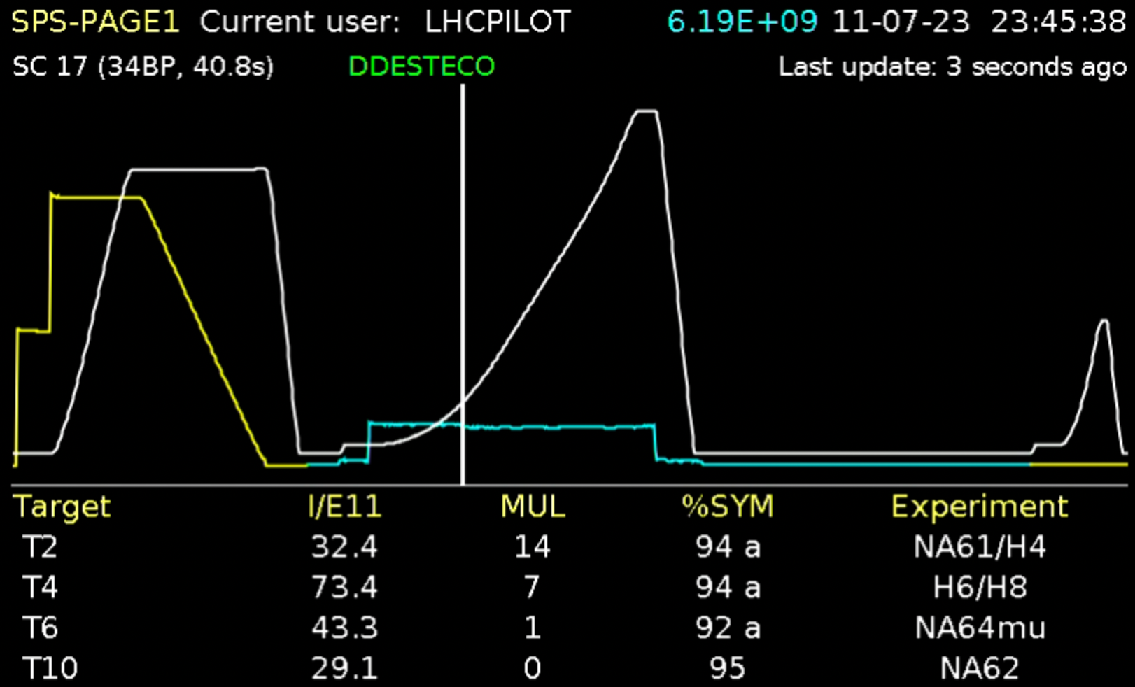
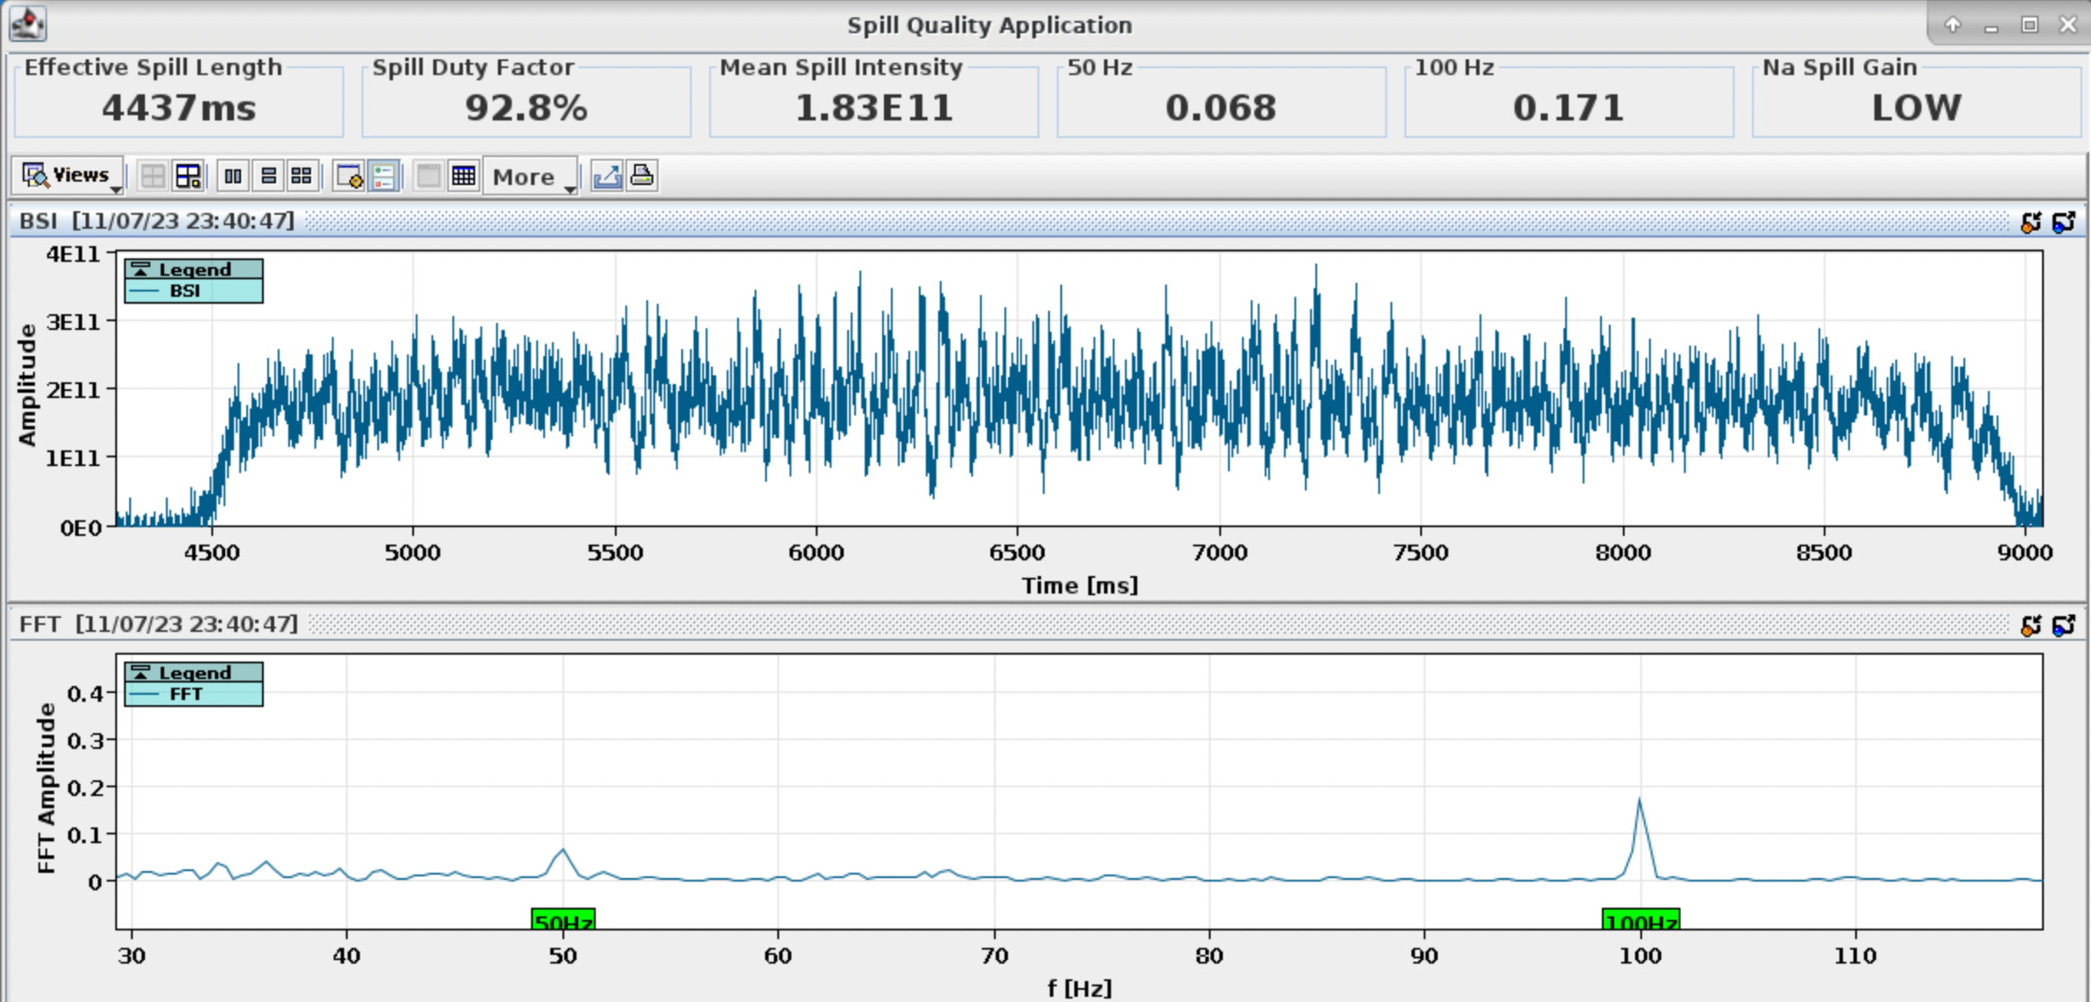
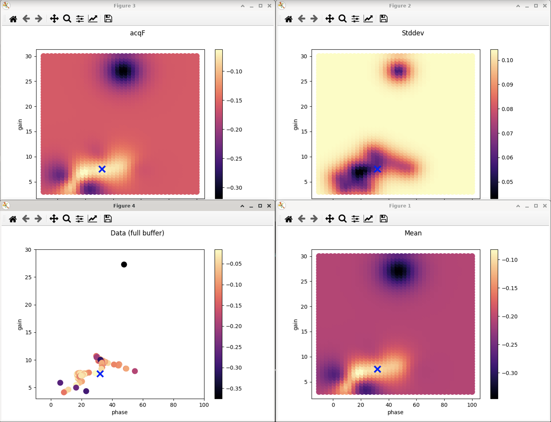
Example using BO
Spill noise cancellation
SPS slow-extracted beam has 50 Hz & 100 Hz noise originating from quadrupole power converter ripple
Continuous controller for active noise cancellation
  Adaptive Bayesian optimisation
  Spatio-temporal Gaussian Process model
  Low dimensional: two spatial parameters + time
Challenges
  Exploration vs exploitation
  Jumping to bounds occasionally
  under control with proximal biasing
  Time dependence: model updates on-the-fly, has sometimes ended up in “degenerate state”, but does usually recover
If things go wrong: degraded beam and potentially time lost for physics experiments
N.B.: there is SafeOpt for safety-critical BO
Data
GP prediction

Slide 8
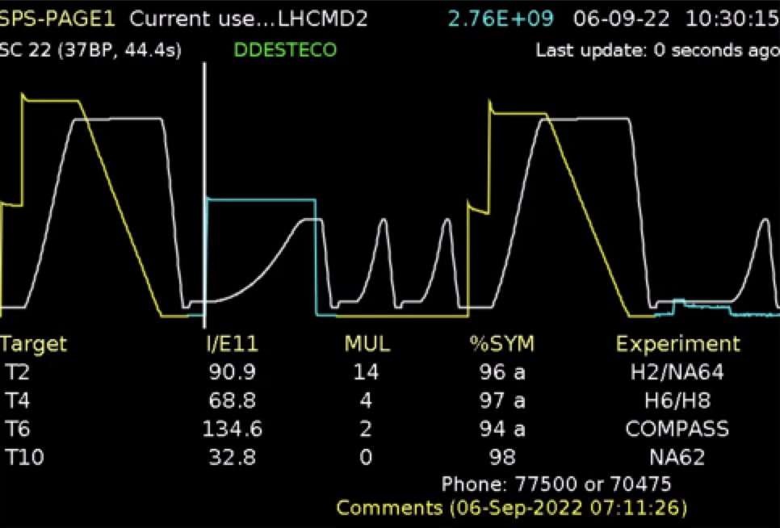
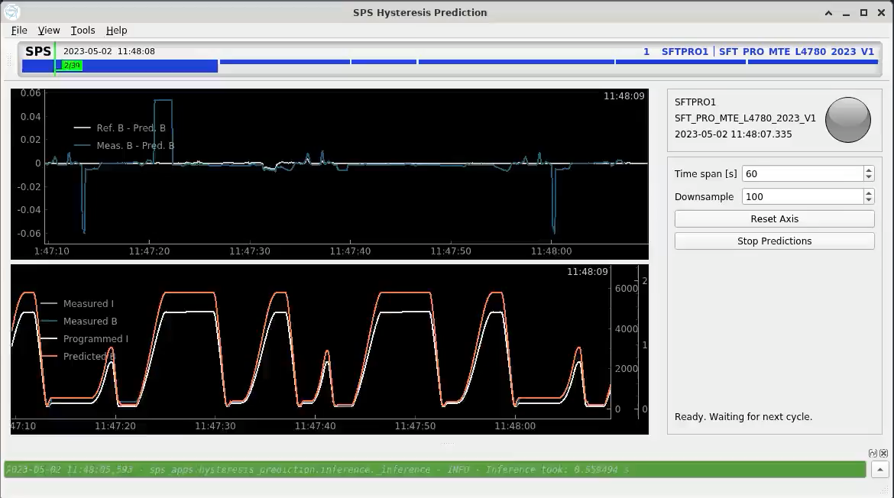
Example using PhyLSTM / transformers
Hysteresis & eddy-current compensation
Context
  Multipole magnets define beam trajectory, size, oscillation, and some aspects of collective beam behaviour
  Many CERN accelerators are multi-user machines each with a different magnetic cycle
  Magnetic hysteresis introduces change in beam dynamics for identical cycles which is problematic in many ways
Method & challenges
  Feed-forward correction on magnetic strength to provide reproducible fields
  PhyLSTM & Transformer models trained on dipole data
  Generalisability & accuracy of model
Safety aspect
  PhyLSTM: typically well behaved, even when extrapolating
  Transformer-based models: hard to validate ”for all possible inputs” / to some degree unpredictable
  Add safeguard at model output to limit allowed change of magnetic field
A. Lu, V. Kain, V. Di Capua

Slide 9
Equipment-related ML
Define new paradigm of smart and agile equipment
e.g. adding context-awareness: beam parameters, machine state, etc.
automate setup, fault analysis, and recovery
  Ongoing pilot studies
    Potentially safety-critical: mix-in ML models to decide whether equipment can be reset automatically
    e.g. anomaly detection for vacuum interlock spikes on kicker magnet using VAE
    Adding safety: e.g. Conv AE for SPS beam dump anomaly detection, kicker magnet temperature forecasting
  Systematic studies in that direction have started relatively recently
    Validation / safety could become more relevant in the coming years

Slide 10
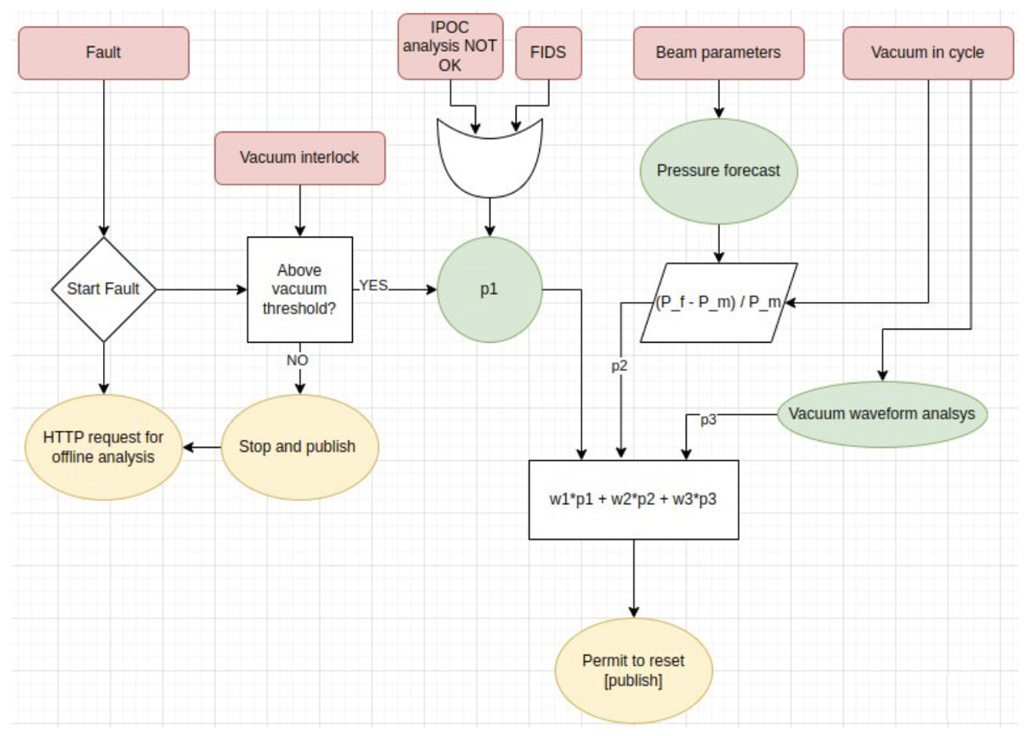
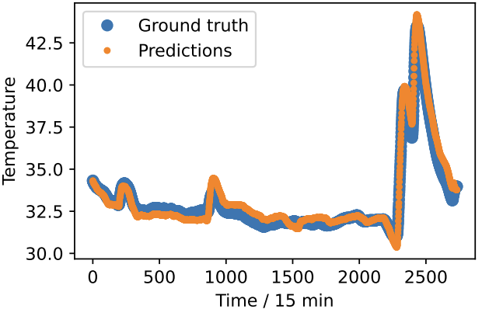
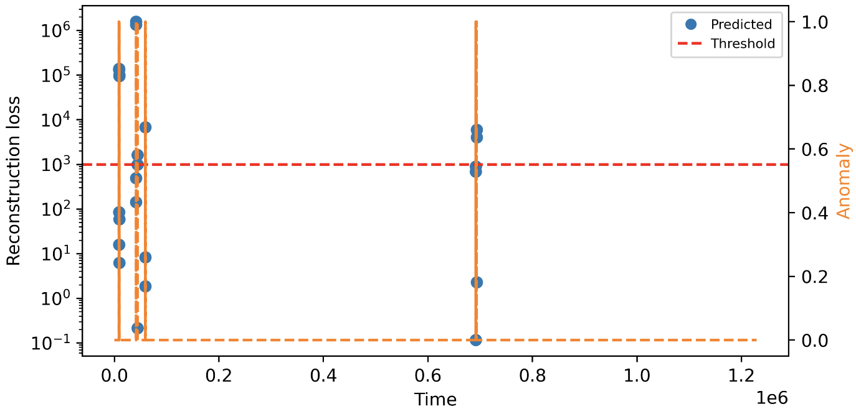
Equipment-related ML
Temperature forecasting & pressure anomalies
Example 1
Kicker magnet temperature forecasting
  Kicker temperatures limit SPS high-intensity operation (beam-induced heating)
  Goal: create temperature forecast using online measurement, current machine operation and future planning
  Method: Light Gradient Boosting Machine and using beam-induced heating equation
Example 2
Auto-reset of SPS kicker following vacuum interlock
  Goal: correctly classify vacuum “spikes” to avoid unnecessary downtime
  Method: VAE trained on historical time-series data
  Auto-reset and automatic e-mail with diagnostics plots to experts
VAE for anomaly detection from vaccum pressure data
F.M. Velotti et al.

Slide 11
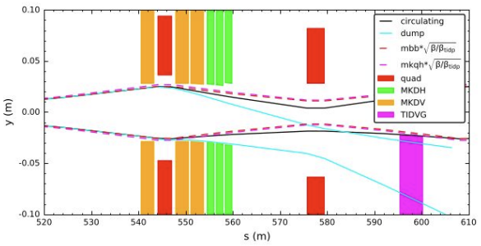
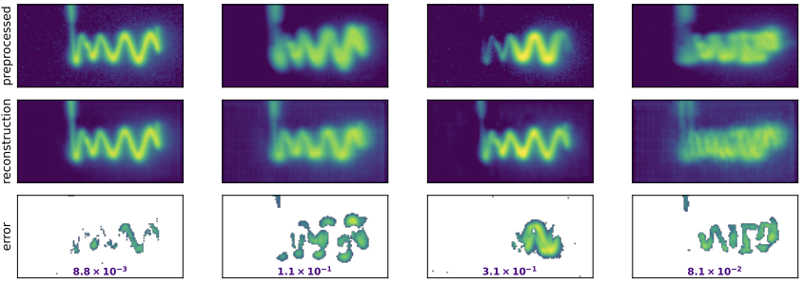
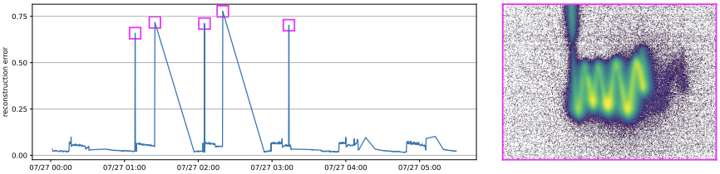
Equipment-related ML
Beam dump system failure
F. Huhn, F.M. Velotti, B. Goddard
SPS beam dump system (SBDS)
  Machine-safety critical
  Malfunctioning may result in unwanted activation or damage
Goal: detect anomalous beam dump patterns from BTV images
  Challenges: unlabelled data, be robust to both seen and unseen anomalies, high variability due to other effects, …
  Heavily biased towards “normal” images: train convolutional AE and use reconstruction loss to identify anomalies
Results
  Anomalous SBDS behaviour: ~5 - 20 x higher reconstruction error
  Additional info on localisation of error (helpful to diagnose)
  Deployed and running operationally
Safety aspect
  Adds additional diagnostic and safety check for the
  beam dump kickers
  At the moment just monitoring
BTV
normal
anomalous
“unseen” MKDH failures

