Slide 1
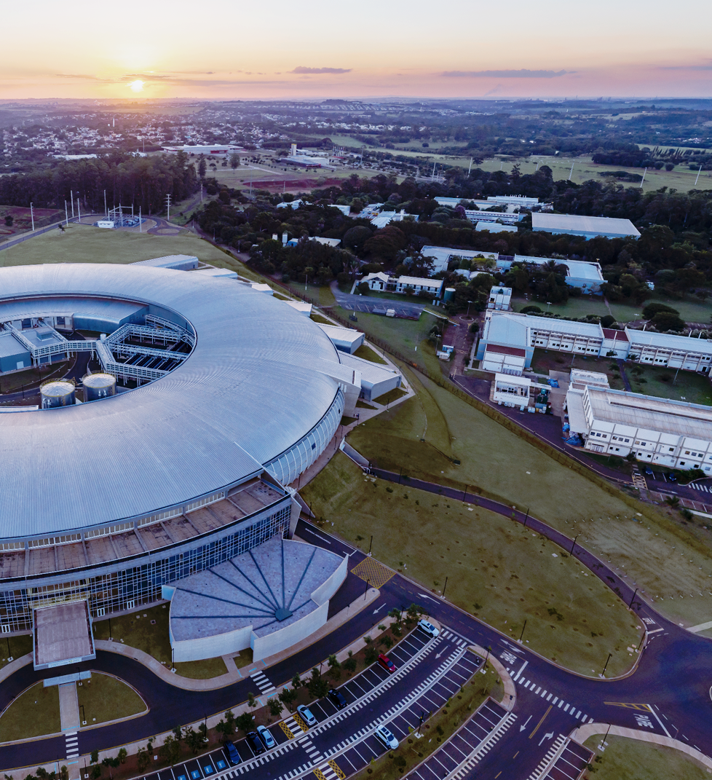

CNPEM's First Superconducting Device Development: A Wavelength Shifter for Sirius Hard X-ray Beamline
`
TE-MSC Seminar
27th June 2024
Rafael Molena Seraphim
(Head of the Systems Engineering Division)
On behalf of the Technology Unit

Slide 2
Outline
Brief Overview of CNPEM
CNPEM engages in superconductivity initiatives
SWLS Overview
  Electromagnetic design
  Coils fabrication
  Mechanical design
  Cryogenic design
  Electrical systems
  Magnetic characterization approach
  Assembly and Sirius Installation
  Schedule and summarized development status

Slide 3
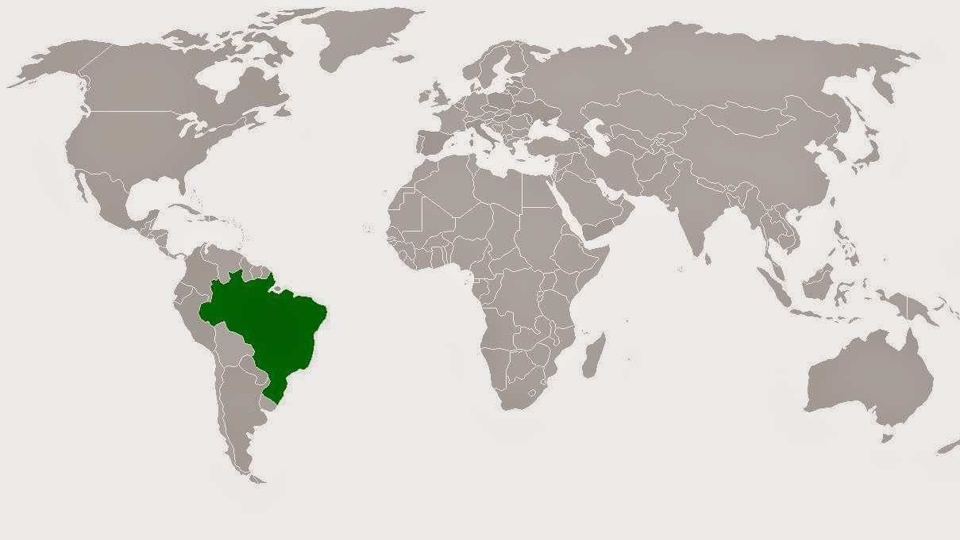
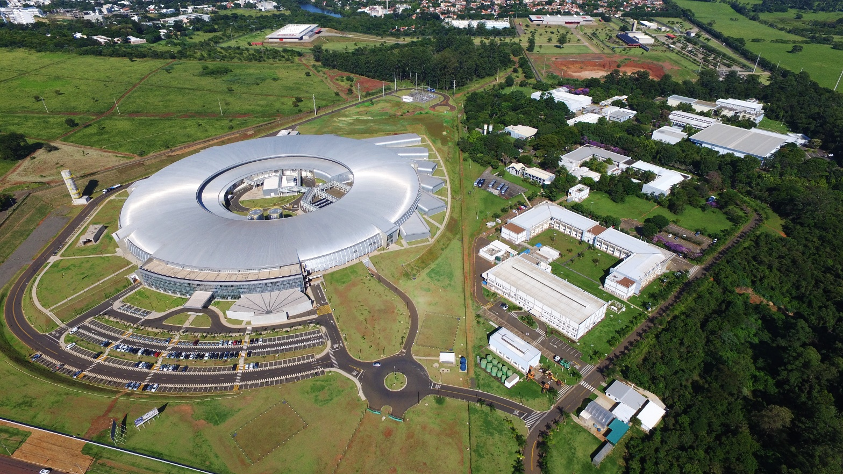
We are located at Campinas (a city of ~1.1 million people), about 100 km from Sao Paulo
530,000 m²

Slide 4
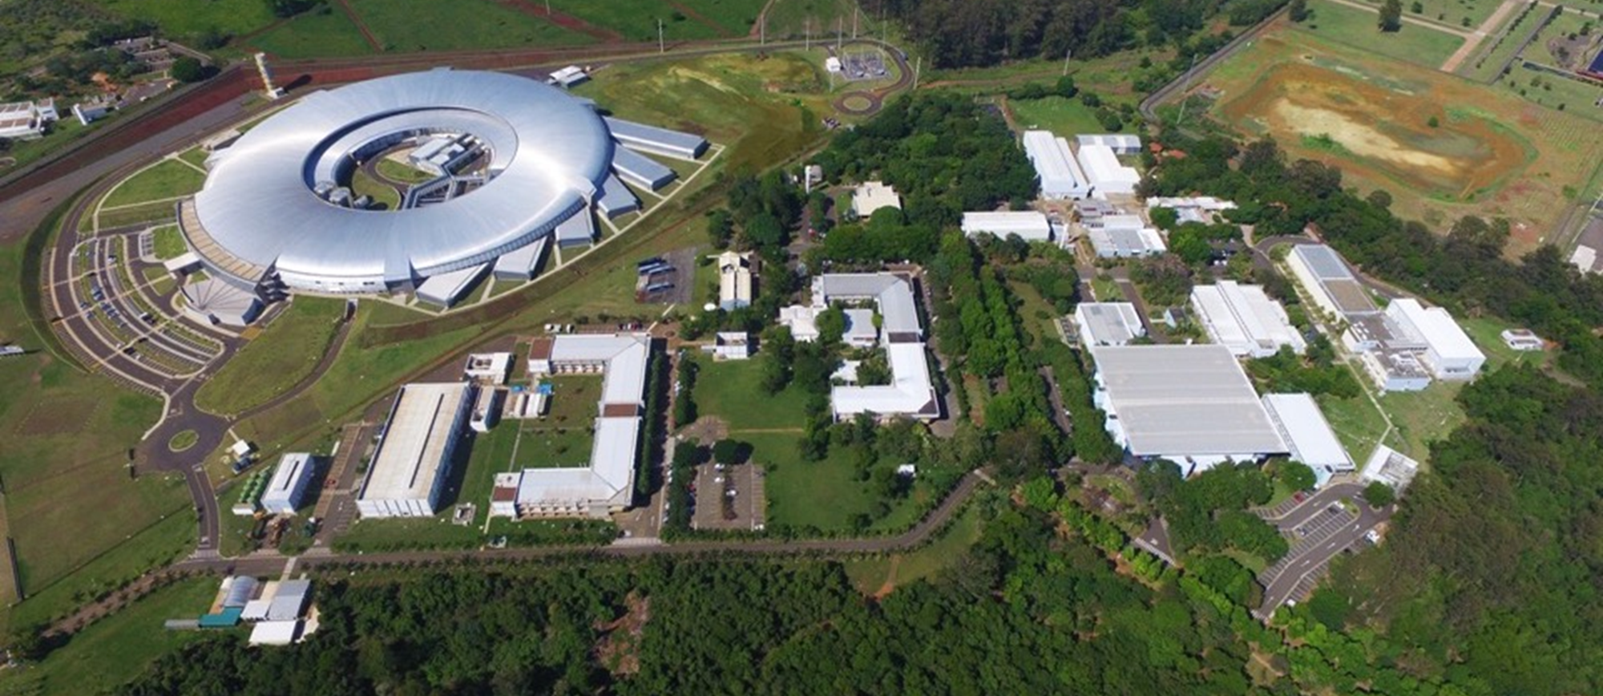










CNPEM is a private, nonprofit organization, working under contract with the Brazilian Ministry of Science, Technology, Innovation (MCTI)
Technology Unit
Systems Eng.
Mechanical Eng.
Materials Eng.
Electrical Eng.
Computational Eng.
DSC
~860 employees
~450-560 trainees, pos-docs, students and outsourced personnel

Slide 5
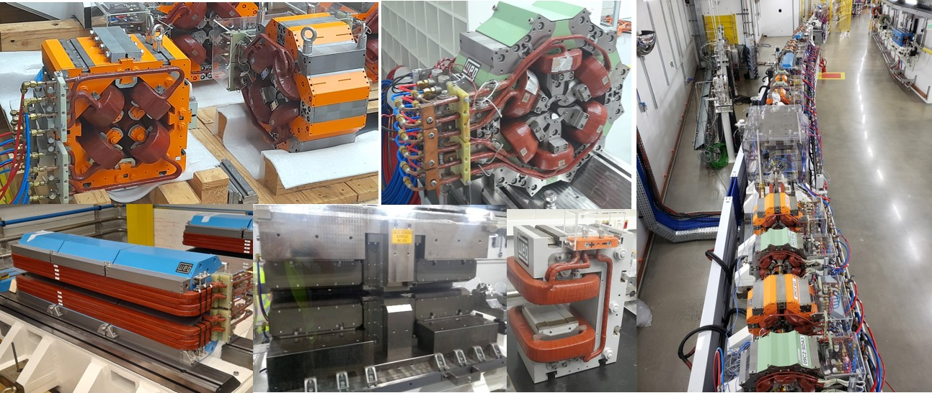
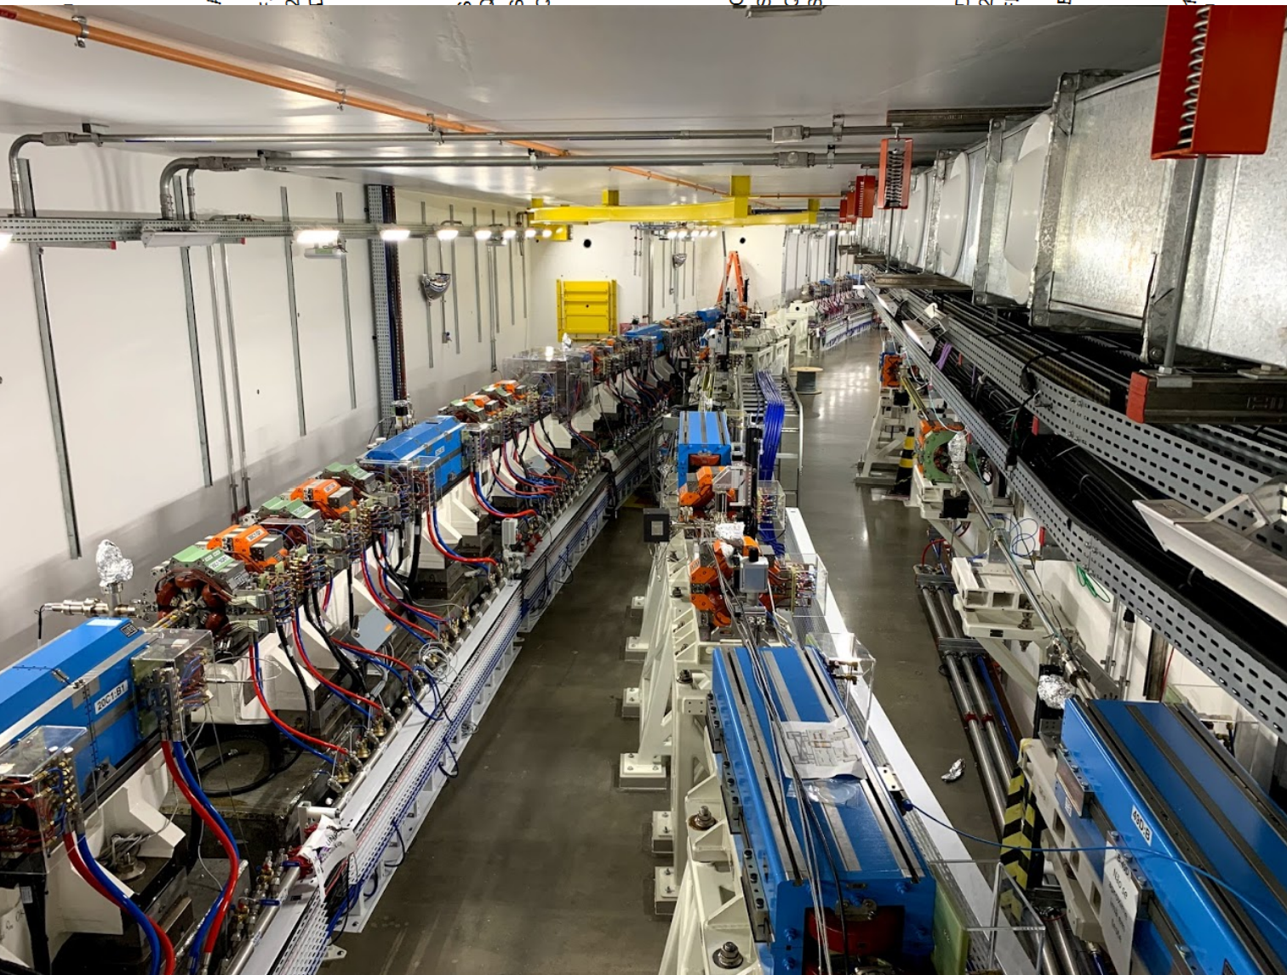
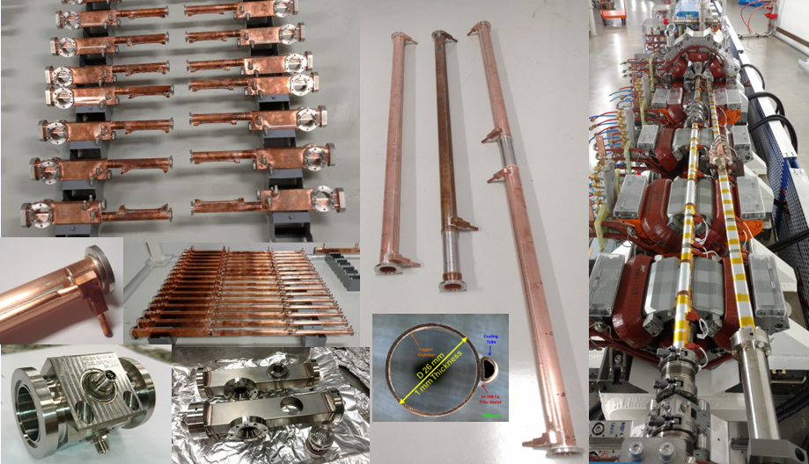
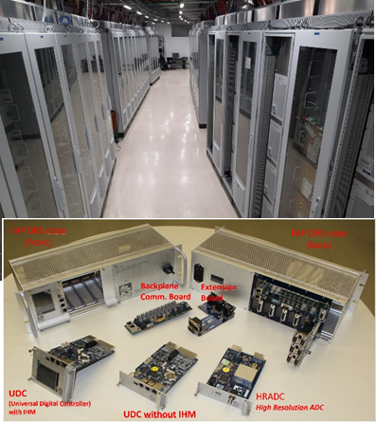
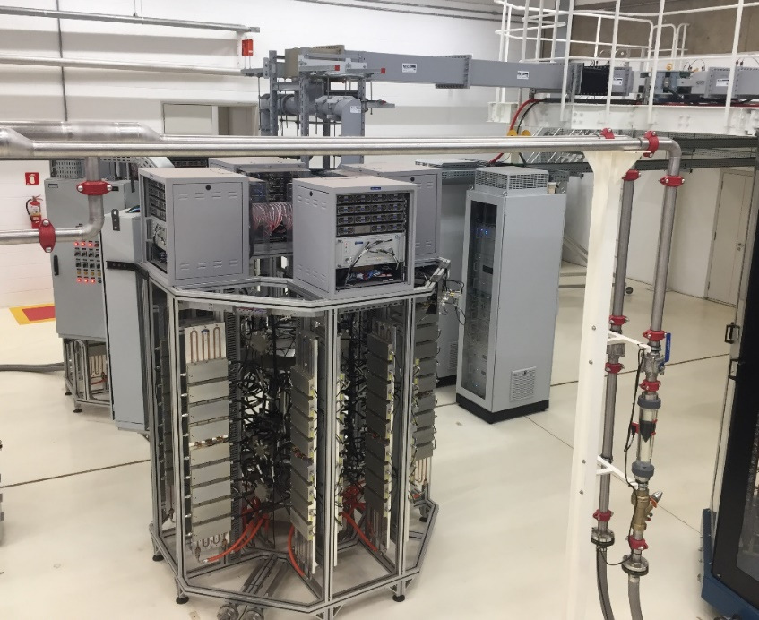
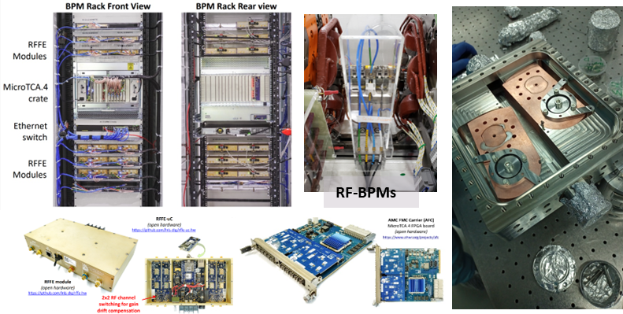
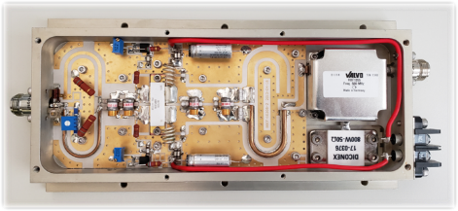
Sirius Highlights
(Some numbers only considering the storage ring)
More than 1000 magnets (developed in a partnership w/ WEG)
~85% index of nationalization
Sirius
4th gen.
E = 3 GeV
C = 520 m
40 beamlines
ε = 0.25 nm.rad
520 m of fully NEG-coated vacuum chambers (developed in-house)
More than 35 power Supplies powering families of magnets (developed in-house)
RF amplifier tower
180 RF BPMs and electronics; beam scrappers etc. (developed in-house or w/ partnerships)
4 towers of RF solid-state amplifier, 65 kW each (developed in-house)
550 W module, produced by BBEF

Slide 6
Outline
Brief Overview of CNPEM
CNPEM engages in superconductivity initiatives
SWLS Overview
  Electromagnetic design
  Coils fabrication
  Mechanical design
  Cryogenic design
  Electrical systems
  Magnetic characterization approach
  Assembly and Sirius Installation
  Schedule and summarized development status

Slide 7
Superconductivity Initiatives
Motivation:
late 2019
Sirius accelerators were delivered
The accelerator's engineering division was separated from LNLS, and the Technology Unit was created – work on other engineering projects of the center and partnerships with Brazilian industry:
Knowledge gap: lack of expertise in superconducting technology -> Need to bring this expertise to CNPEM, focusing on the center's main actuation fields
mid 2020
Main fields of interest
Energy
Accelerators
Medical
Materials
Electric motors, generators, power transmission lines, SMESs
Magnets, insertion devices, RF cavities
Magnetic resonance devices (MRI and NMR), cyclotrons for therapy
Low and high temperature superconducting materials development and characterization
    An agreement was signed between CNPEM and CERN for transferring know-how and technology in superconducting magnets
late 2020
      First initiative in superconductivity was started at CNPEM with CERN’s help: build a team at CNPEM and design of the first magnet
2021

Slide 8
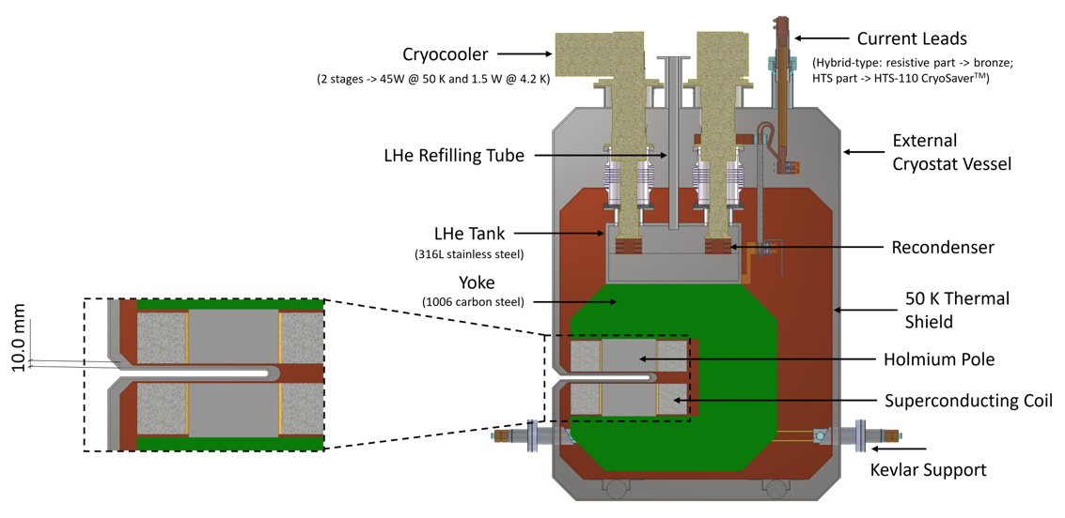

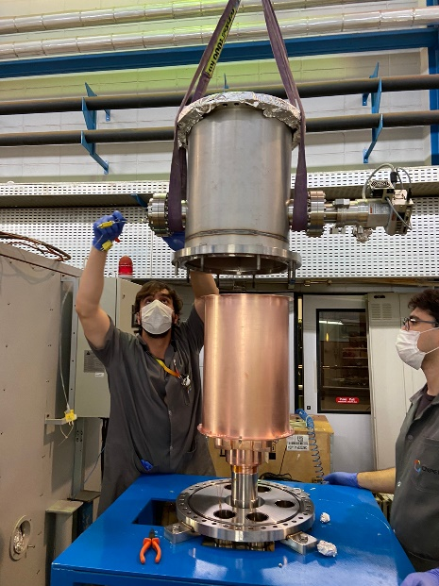
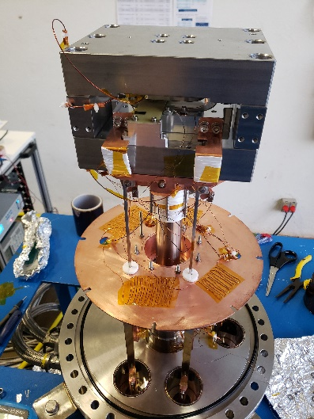
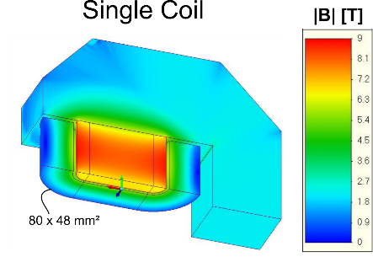
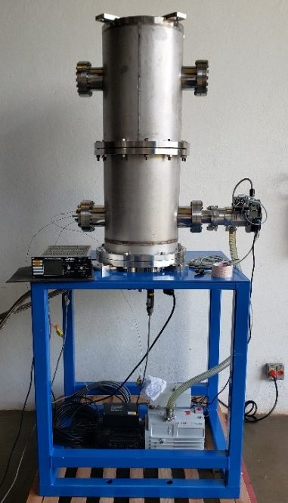
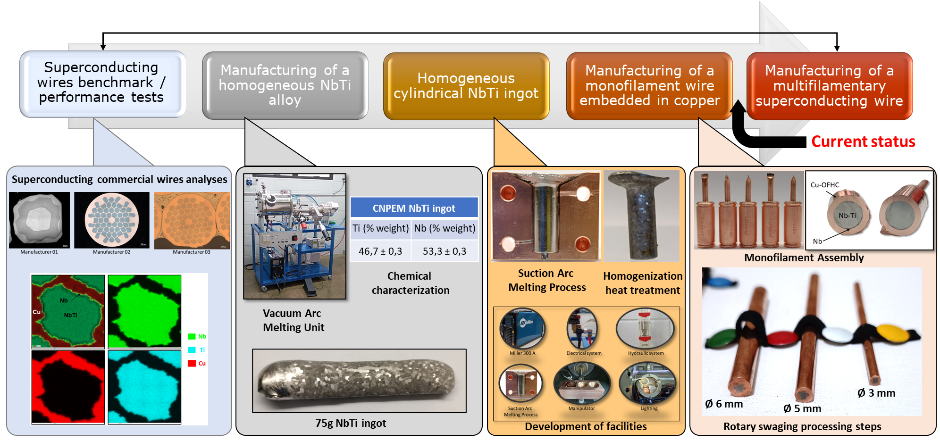
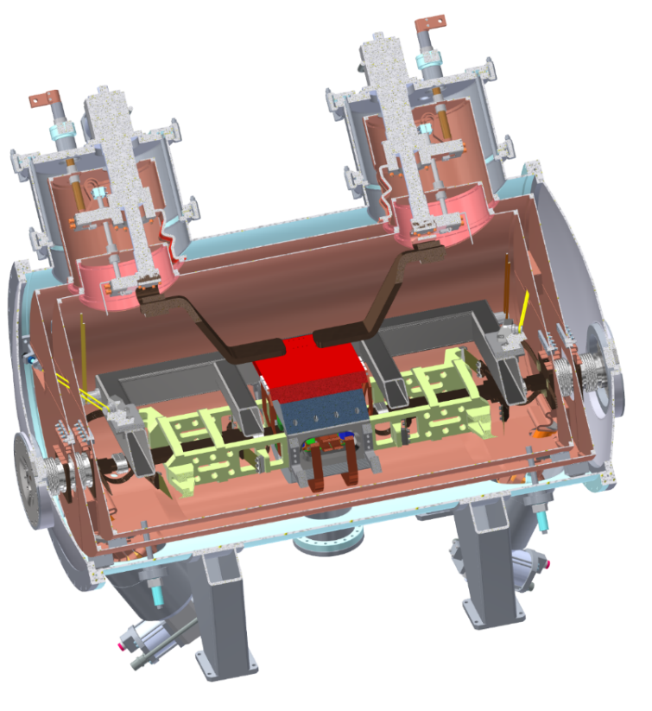
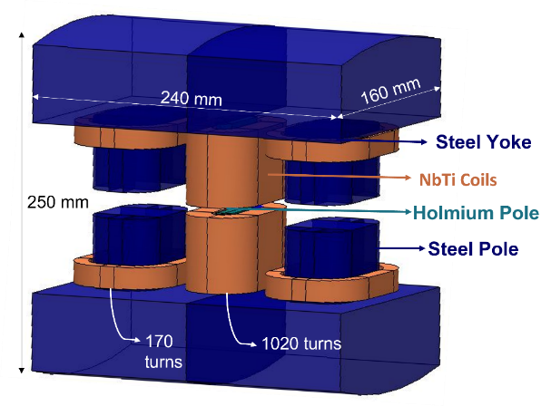
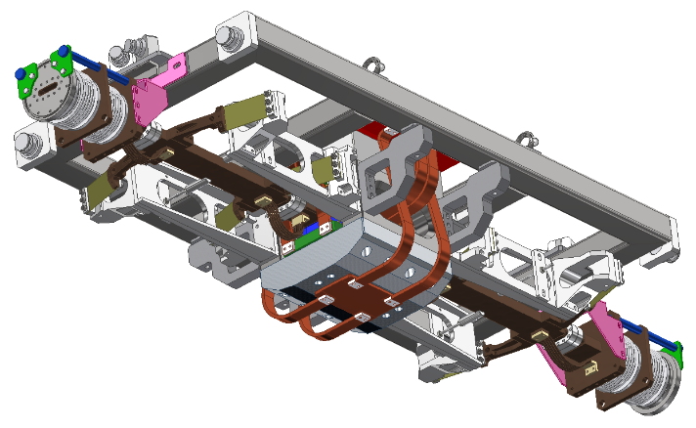
Superconductivity Initiatives – CNPEM/CERN/Universities (USP and UFSCar) partenership
2021
Superconducting Dipole of 6.4 T (project on hold)
2022
Vertical Cryostat for Testing Superconducting Coils
Setup for testing coils
Superconducting Wavelength Shifter of 6.6 T (ongoing project – FDR phase)
Manufacture and Characterization of NbTi Wires (ongoing project) – CNPq InovaNióbio Project
2021
2023

Slide 9
Superconductivity Initiatives – CNPEM/CERN/Universities (USP and UFSCar) partenership
2021
Superconducting Dipole of 6.4 T (project on hold)
2022
Vertical Cryostat for Testing Superconducting Coils
Setup for testing coils
Superconducting Wavelength Shifter of 6.6 T (ongoing project – FDR phase)
Manufacture and Characterization of NbTi Wires (ongoing project) – CNPq InovaNióbio Project
2021
2023

Slide 10
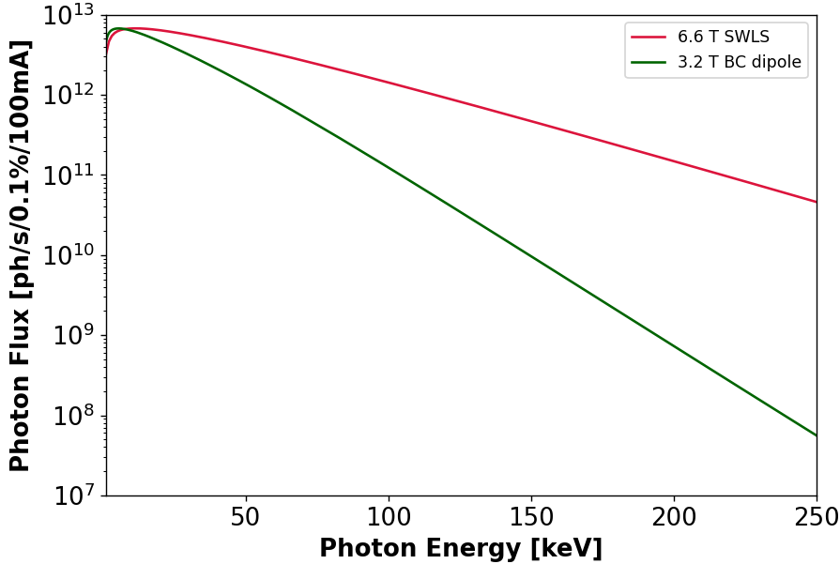
SWLS - Motivation
Sirius phase 2 - new hard X-ray beamlines -> Need for high energy photons
Current non-superconducting magnets of 3.2 T do not produce reasonable photon flux above 100 keV
Two beamline candidates
11x
Beamline | Exp. Technique | Energy Range [keV]
SUSSUARANA | X-ray Diffraction | 30 - 200
MANATI | X-ray Tomography | 80 - 150
49x
204x
(current beamlines focus on photon energies below 70 keV)
Aperture: 1x1 mrad²

Slide 11
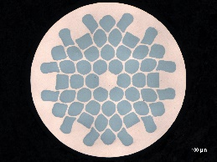
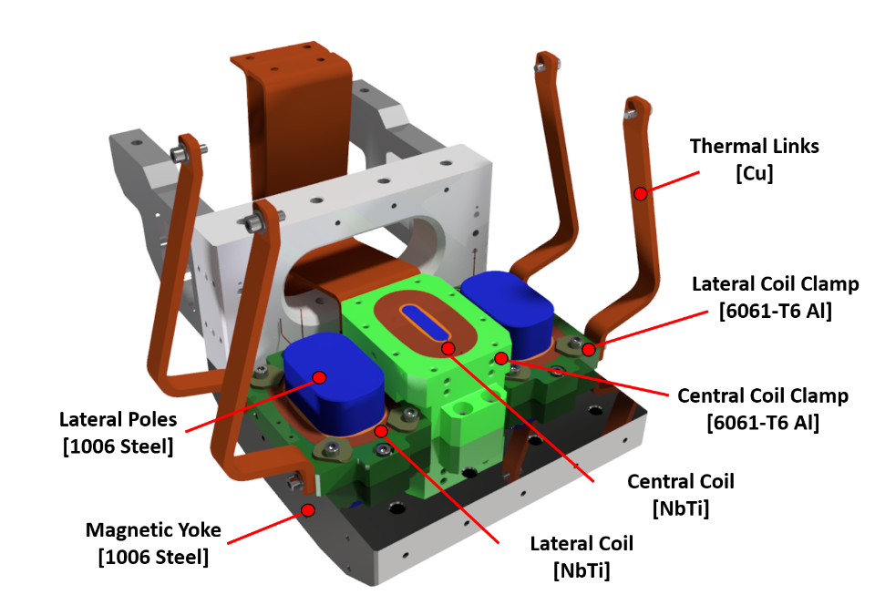
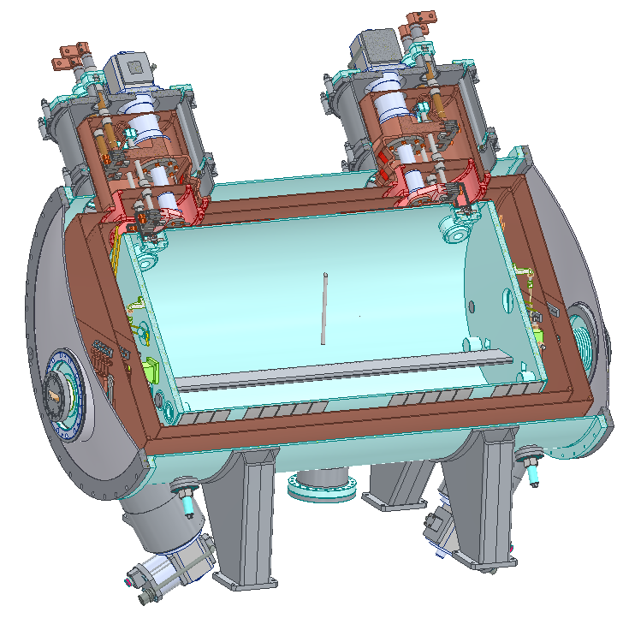
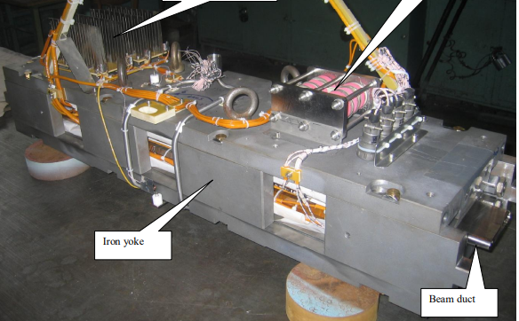
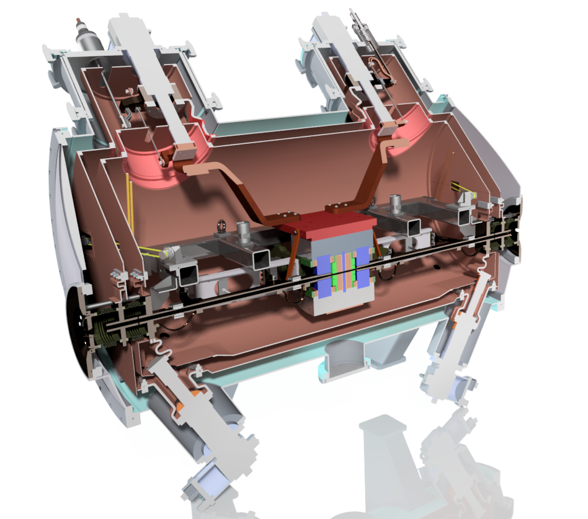
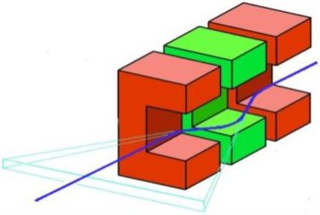
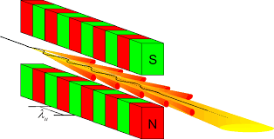
SWLS – Design Premises
Build a superconducting magnet, cryogen-free, with magnetic field higher than 6 T and compatible with one of the Sirius low-beta straight sections
The magnet must not impact the Sirius emittance and beam dynamics
Use NbTi wires
Reuse components from a deactivated 4 T Superconducting Wiggler
SWLS NbTi wire
Ø = 0.90 mm
Cu/NbTi = 0.97
Nova estrutura eletromagnética
4 T SCW
SWLS
Cold mass
(In LHe bath)
Conceito de WLS
Bought from Budker Institute of Nuclear Physics
Schematic of a Wiggler

Slide 12
Outline
Brief Overview of CNPEM
CNPEM engages in superconductivity initiatives
SWLS Overview
  Electromagnetic design
  Coils fabrication
  Mechanical design
  Cryogenic design
  Electrical systems
  Magnetic characterization approach
  Assembly and Sirius Installation
  Schedule and summarized development status

Slide 13
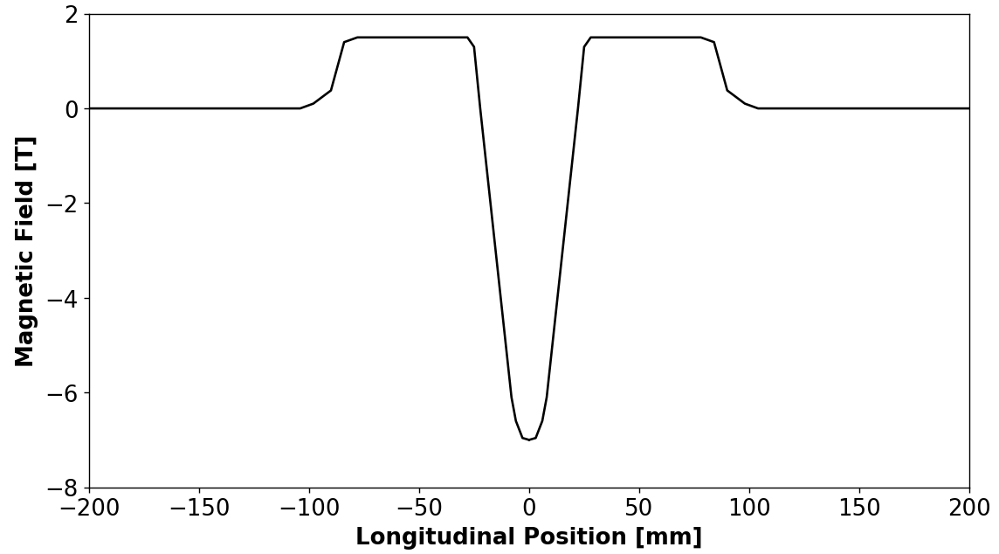
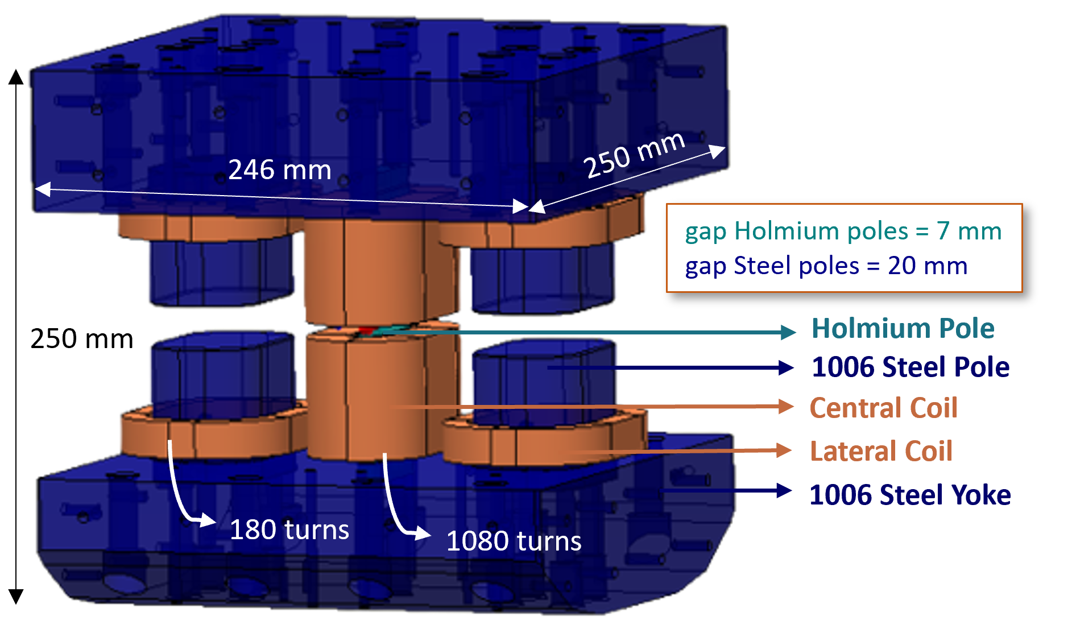
Electromagnetic Design
Basic Parameters
Target magnetic field profile (Accelerators Physics group)
Parameters | Targets
Current | < 300 A
Peak field | > 6 T
FWHM of central peak | < 30 mm
1st magnetic field integral | < 200 G.cm
Margin @ 5.0 K | > 20%
FWHM < 30 mm
Proposed electromagnetic model
7 T
Ho pole (12 mm) ferromagnectic below 20 K
  A very narrow central peak field not to impact the beam emittance

Slide 14
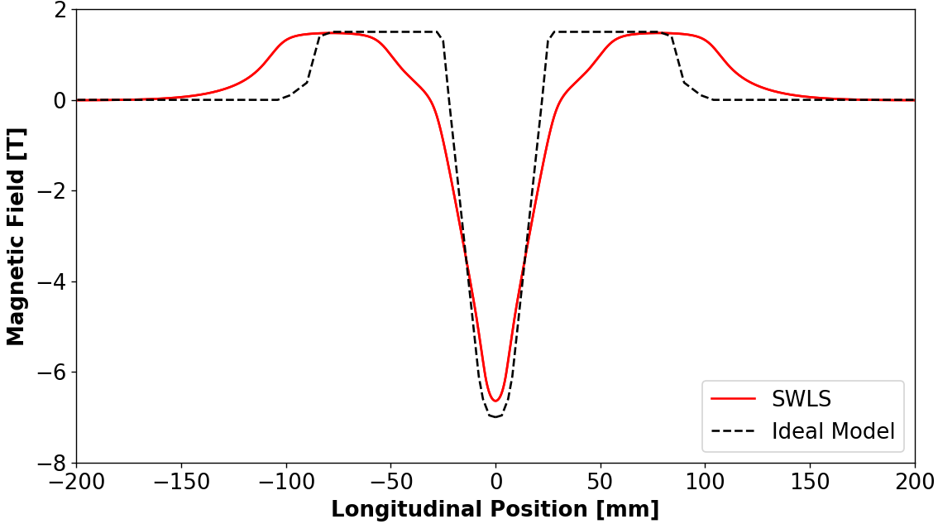
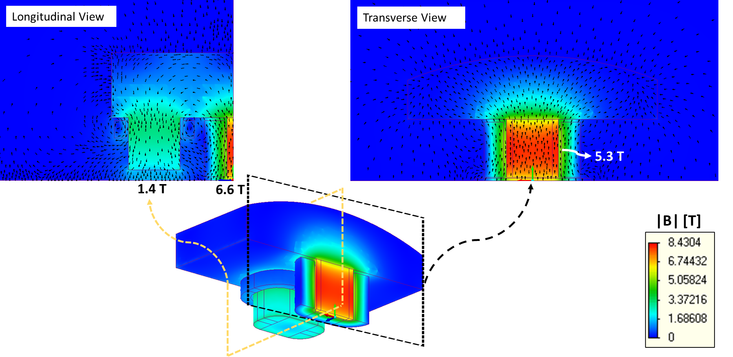
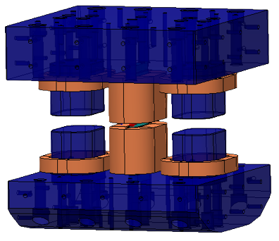
Electromagnetic Design
Electromagnetic Design Analysis and Optimization:
Geometry of the model
Magnetic field plots
Field integrals and multipoles
Fabrication errors
Load line operating margin
Energy Losses
SME and Inductance
Photon flux emission
Main results
Simulated field profile
Parameters | Targets | Results
Current | < 300 A | 228 A
Peak field | > 6 T | 6.6 T
FWHM of central peak | < 30 mm | 29.6 mm
1st magnetic field integral | < 200 G.cm | 72 G.cm
Margin @ 5.0 K | > 20% | 24%
1.4 T
29.6 mm
6.6 T
Field maps
Additional results
Parameters | Results
Roll-off of peaks (± 5 mm) | 0.16%
2nd magnetic field integral | 6.7 kG.cm²
Total integrated quadrupole | 0.13 T
Total integrated sextupole | 5.7 T/m
Current sharing temperature | 6.1 K
Total AC loss during ramp-up (time = 5 min) | 0.314 W
Stored magnetic energy | 3.37 kJ
Inductance | 130 mH
I_{op} ≈ 228 A

Slide 15
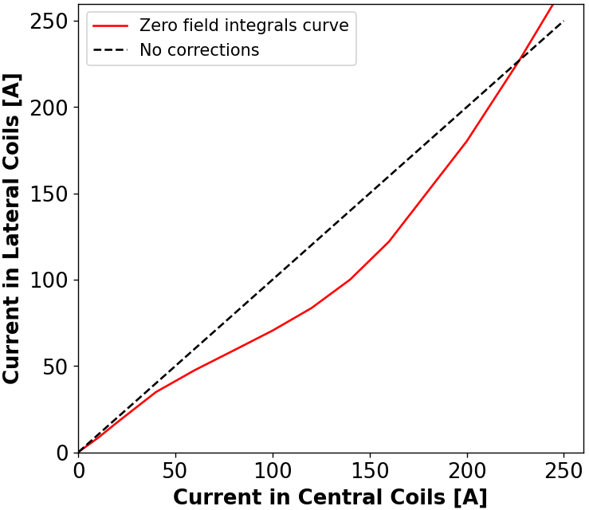
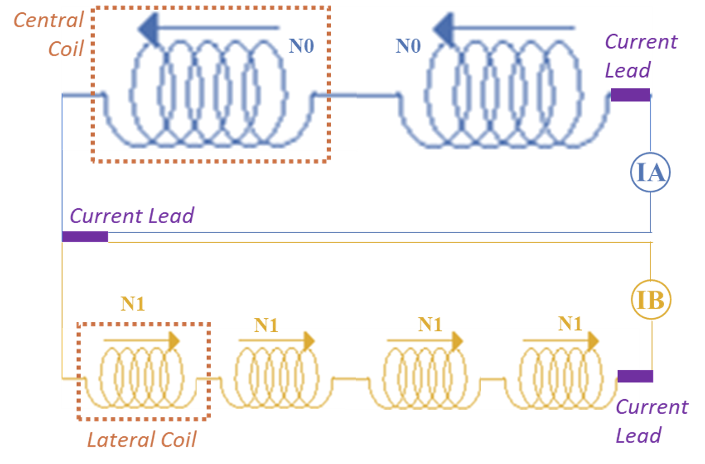
Electromagnetic Design – Current ramp-up
Independent power supplies used to central and lateral coils:
Allows correction of the field integrals during the current ramp-up
Minimize perturbations on the beam
Operating current

Slide 16
Outline
Brief Overview of CNPEM
CNPEM engages in superconductivity initiatives
SWLS Overview
  Electromagnetic design
  Coils fabrication
  Mechanical design
  Cryogenic design
  Electrical systems
  Magnetic characterization approach
  Assembly and Sirius Installation
  Schedule and summarized development status

Slide 17
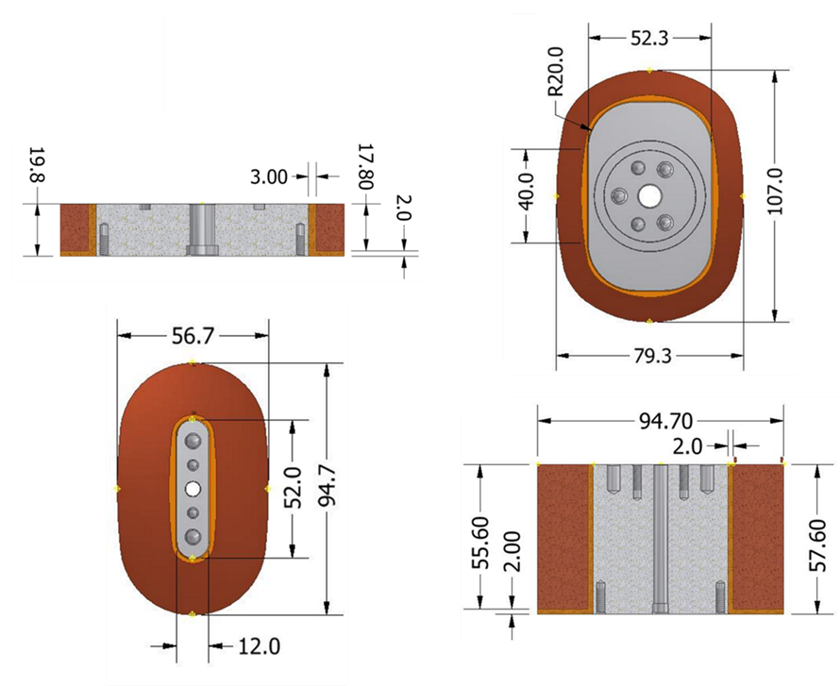
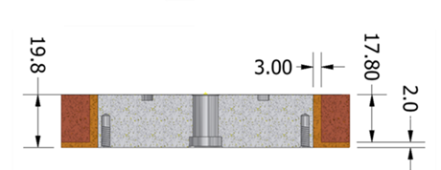
Coils fabrication
Geometry and dimensions
The coils have slightly oval shape to better maintain the tension on the wires during winding process
Lateral coil (180 turns)
Central coil (1080 turns)
Notes:
Slide status e validações futuras

Slide 18

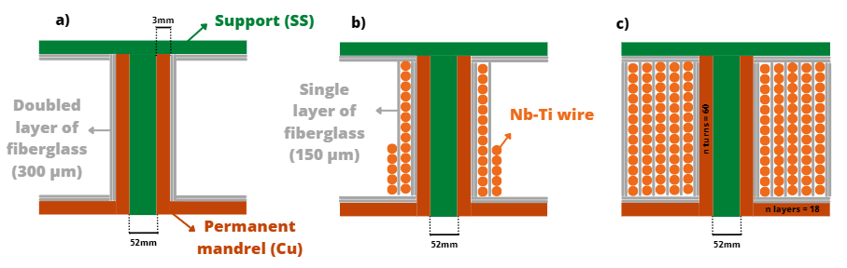
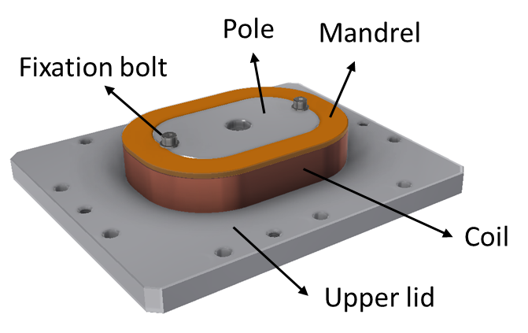
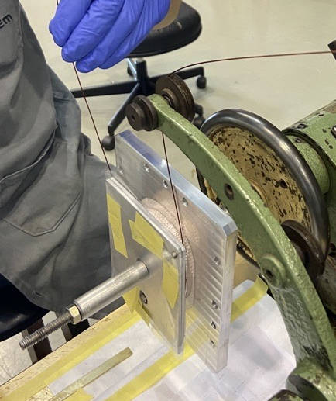
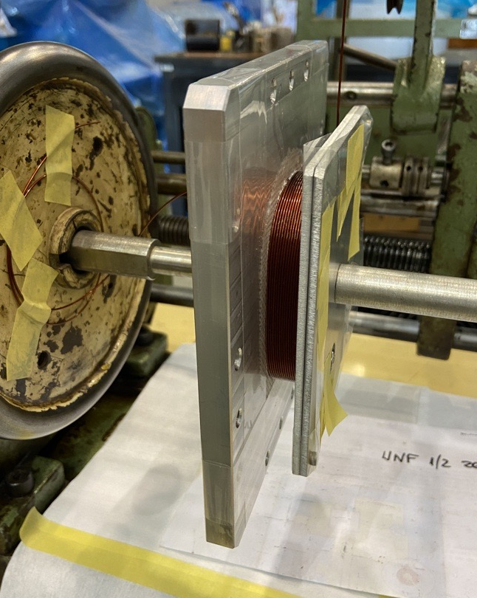
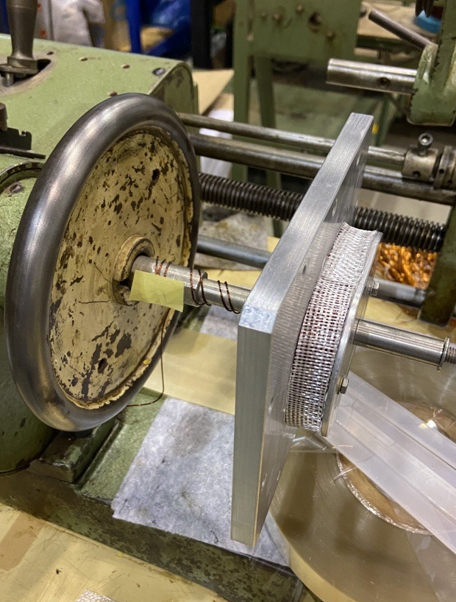
Coil prototyping – winding process
Winding structure: Mandrel + pole + support (Upper lid)
Edges insulation: 300 µm fiberglass
Winding process: layer by layer
Interlayer insulation: 150 µm fiberglass
Notes:
Isa

Slide 19
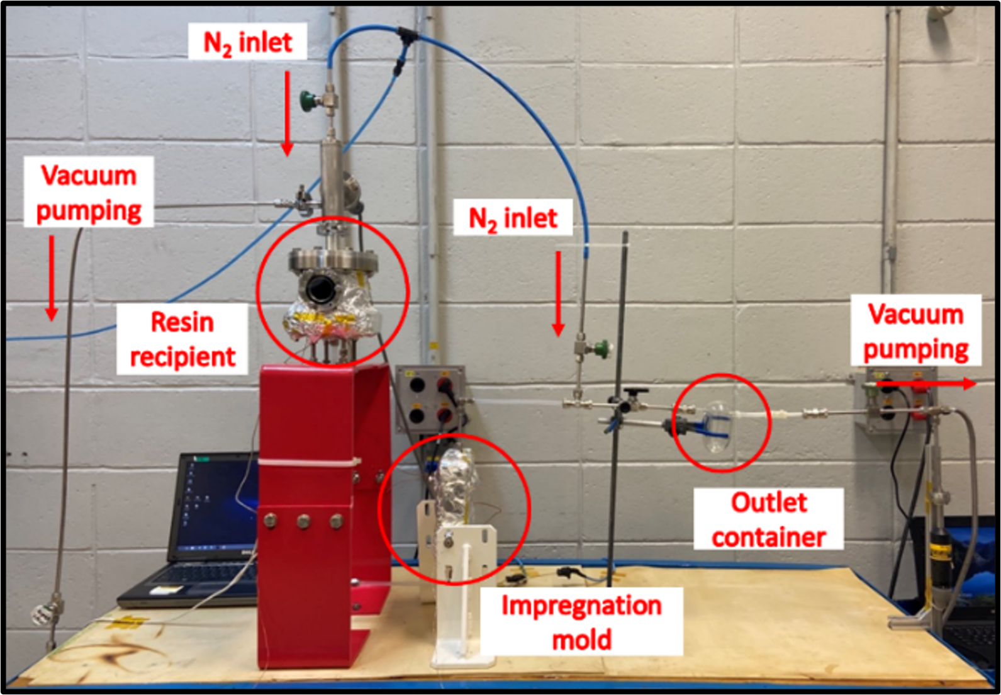
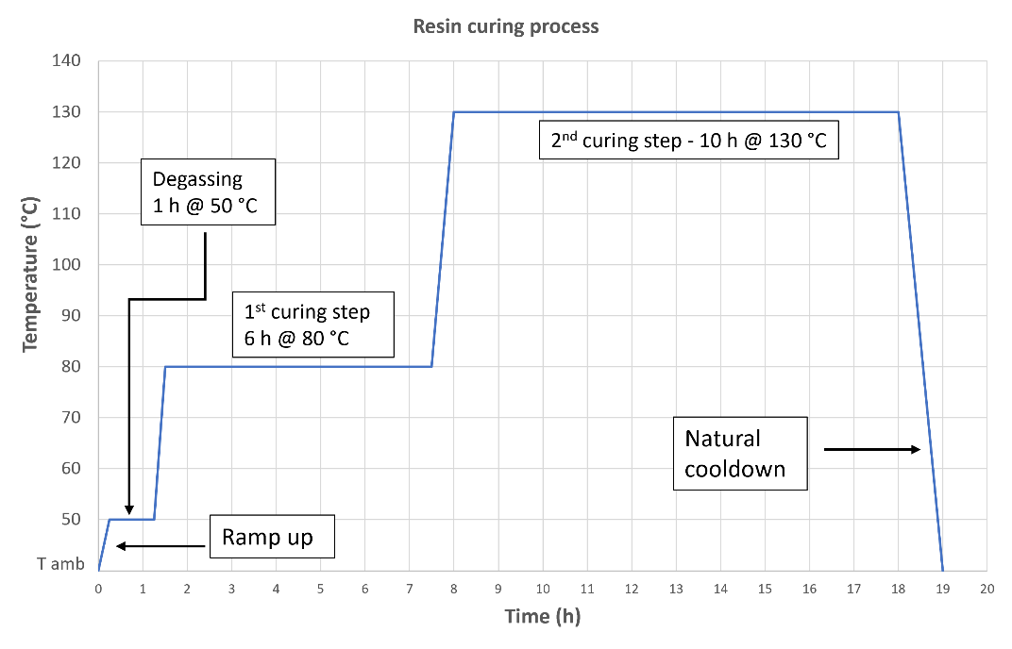
Coils fabrication – impregnation setup and procedure
Pre-impregnation process:
Room temperature pump down (24h) and bake-out (24h@80°C): pressure 10⁻² mbar
Resin overnight at room temperature with vacum pump
Impregnation process:
Degass the resin: 1h@50°C
Open valve and apply 100 mbar nitrogen pressure to control the velocity of the flow
Milking and reversed milking with 1 atm pressure (about 5 – 7 times)
Used resin:
Araldite F (100 pbw)
Hardener HY 905 (100 pbw)
Flexibilizer DY 040 (10 pbw)
Accelerator DY 062 (1 pbw)
(pbw = parts by weight)
Resin curing process
Notes:
Isa

Slide 20
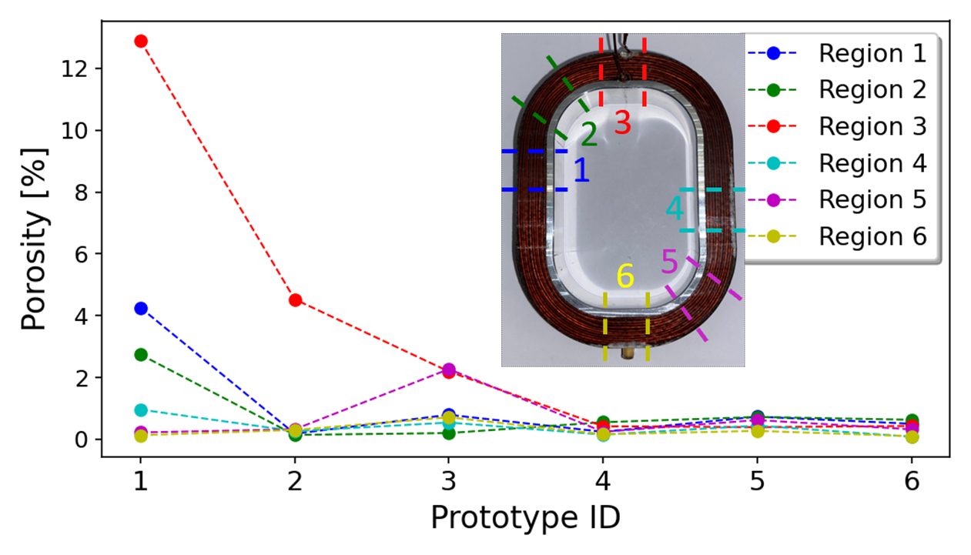
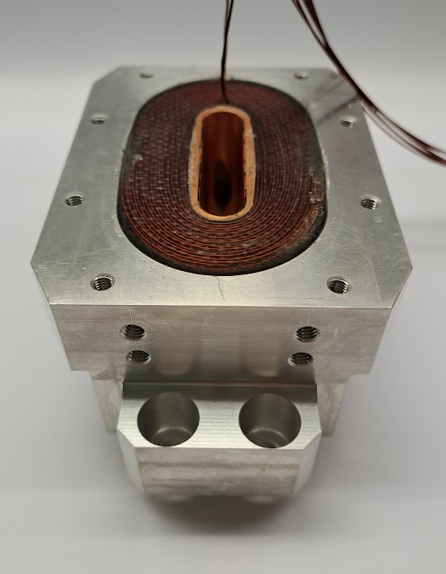
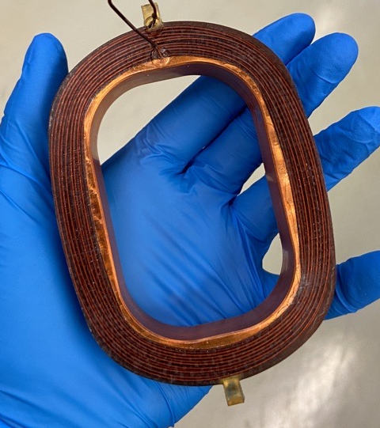
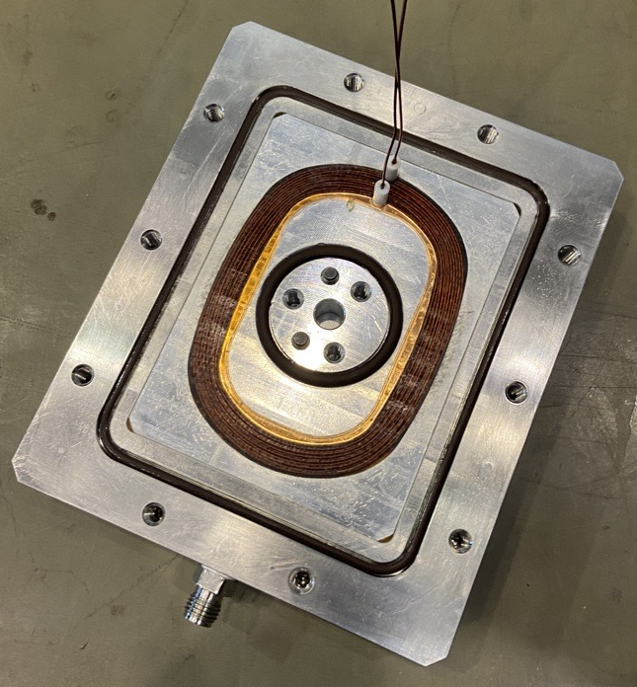
Coils fabrication - prototypes
Impregnation process was optimized using copper prototypes
After few copper prototypes, NbTi coils were successfully prototyped
Prototyped coils were successfully tested at the vertical cryostat
NbTi lateral coil prototype
NbTi central coil prototype
Copper prototyoes – porosity evolution
Notes:
Slide status e validações futuras

Slide 21
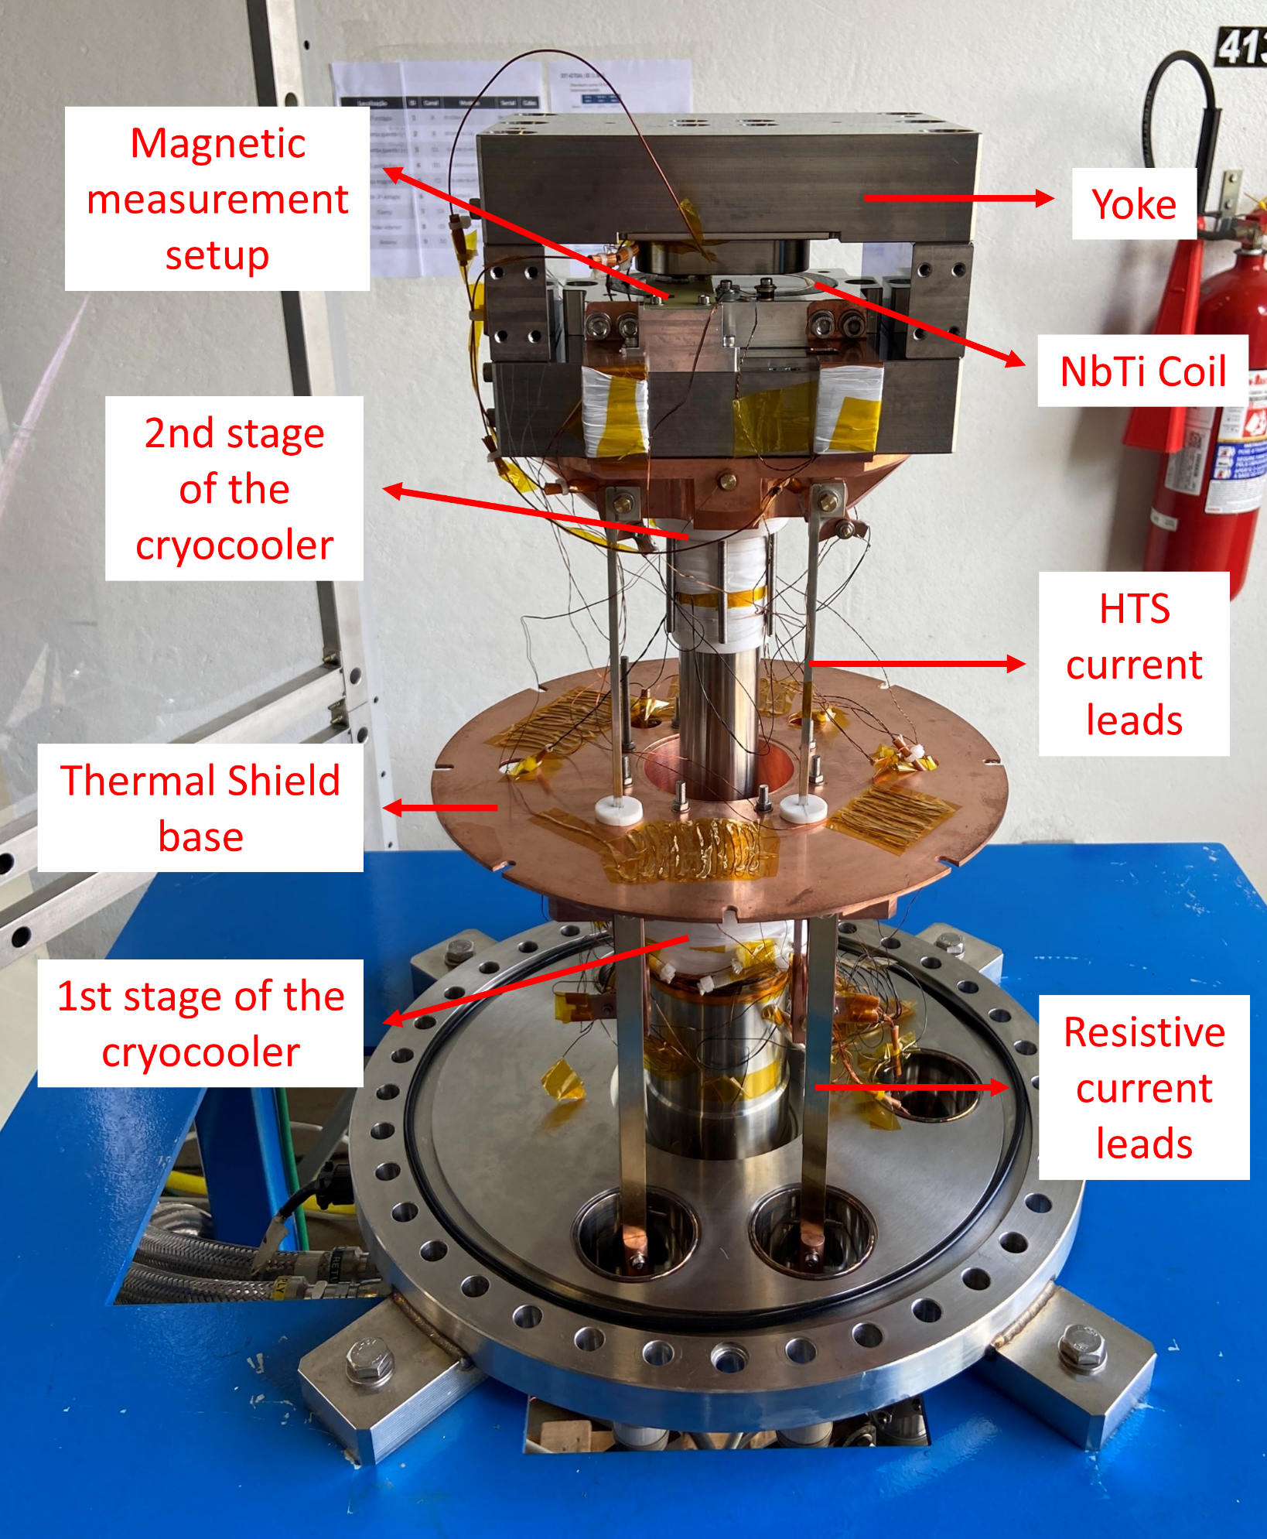
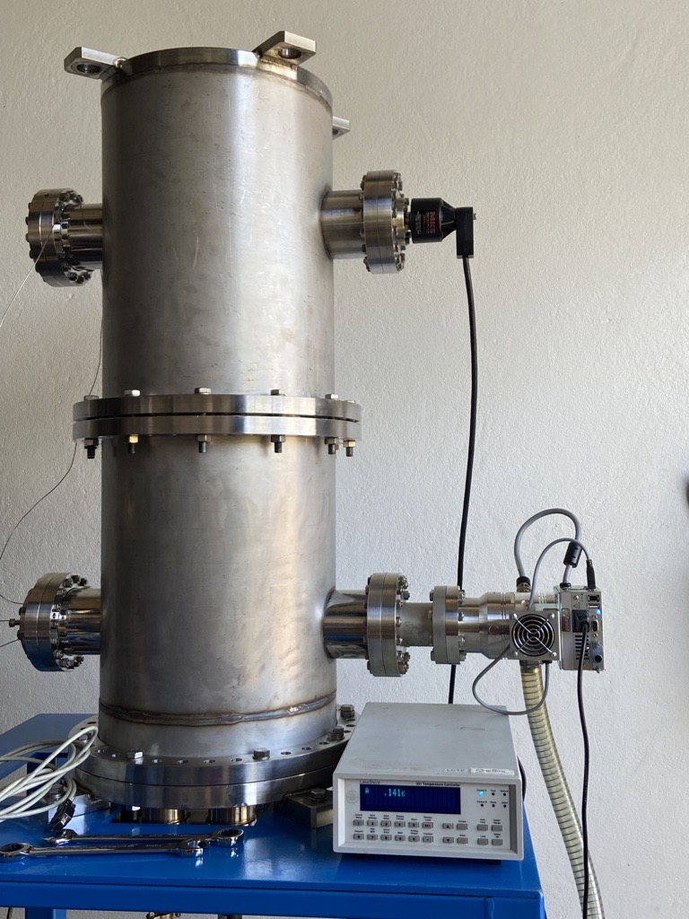

Vertical Cryostat
Cryostat Design and Features:
The cryostat follows the same principles as the SWLS: conduction cooling, current leads, thermal shield, etc.
Applications and tests planned
Thermal and magnetic tests of superconducting coils
Thermal performance of components at cryogenic temperatures
Mechanical component fixation at cryogenic temperatures
Splice box performance evaluation
Quench protection system testing
Control system testing and evaluation
Notes:
Slide status e validações futuras

Slide 22





Coils fabrication – tests in the vertical cryostat
Mirror yokes were designed to test the coils
PCB boards with 3 Hall sensors (HGT-2101) were used to measure the magnetic field
Results: Lateral coil
Simulated magnetic profile for the mirror yokes
Hall Probes
Field in 300 A

Slide 23


Coils fabrication – tests in the vertical cryostat
1006 steel and Holmium poles were tested
Quench protection was also tested and validated
Results: Central coil
Quench training: central coil

Slide 24
Outline
Brief Overview of CNPEM
CNPEM engages in superconductivity initiatives
SWLS Overview
  Electromagnetic design
  Coils fabrication
  Mechanical design
  Cryogenic design
  Electrical systems
  Magnetic characterization approach
  Assembly and Sirius Installation
  Schedule and summarized development status

Slide 25

Mechanical design
Electromagnetic structure
Electron beam vacuum chamber
1
3
Thermal circuit
Supports
2
4
2
4
1
3

Slide 26




Mechanical design – electromagnetic structure
Main Concepts
Large thermal contraction of Al clamps to pre-load the coils
Central coils’ clamps with conical shape to prevent magnet’s gap closing
Invar washers to prevent bolt loosening
$$VM Stress_{max}=230MPa (<260 MPa)⁡$$
Central coils’ conical clamps
0.6°
$$VM Stress_{max}=130 MPa$$
$$(<200 MPa)$$
Simulation Results of Thermal Contraction and Magnetic Forces for Coils and Clamps

Slide 27






Mechanical design – vacuum chamber
Main Concepts
Tripartite CuCrZr chamber
Total length of 1.2m
Very thin central part (5mm vertical aperture; 0.5mm wall)
Optimized internal profile to withstand the pressure difference at the central part
6mm
0.5mm
5mm
Pressure gradient simulation for optimization of the internal profile
$Deformation_{max}=40μm$ (each side)
$$VM Stress_{max}=56MPa⁡$$
Longitudinal external profile in the assembly
38mm

Slide 28



Mechanical design – structure supports
Main Concepts
Base frame supports the whole structure
Kevlar straps suspension:
  Minimize thermal conduction with low thermal contraction
  Provide vertical (adjustable out of vacuum) and horizontal alignment
Lateral Yoke serves as an anchoring point for the supports (unique connection between base frame, vacuum chamber and yoke)
Kevlar Straps
Lateral Yoke
[316L SS]
Base frame
[304 SS]
Chamber Supports
[316L SS]

Slide 29




Mechanical design – chamber supports
Main concepts
  Flexures ensure high transversal stiffness and low longitudinal stiffness (to accommodate thermal contraction)
  Flexures’ anchoring points forms perpendicular lines pointing to the magnet’s center avoiding its displacement
  Materials:
    316L SS provides good mechanical strength with relatively low thermal conductivity and low heat capacity (improving cooldown)
    G10 minimizes heat transfer between 4K and 20K circuits due to its low thermal conductivity
  Hydroformed bellows with modified comb-type RF shield:
    Isolate the vacuum (cryostat/beam)
    Provide longitudinal elasticity for thermal contraction
    Minimize heat transfer between chamber (20K) and cryostat (300K) with low machine impedance impact
Chamber supports
[316L SS]
Hydroformed Bellows
[316L SS]
Thermal Insulators
[G10 / PEEK]
Flexures
[316L SS]
Thermal Contraction Analysis
Comb-type RF-shield
300K-20K Transition
1.8 mm

Slide 30







Mechanical design – validations and next steps
Validations already carried out
Supports validation
(static and dynamic studies)
Disassembly and inspection of the 4T SCW
  Kevlar straps mechanically characterized
  Alignment procedure
  Suspension stiffness
  Vibration
Assembly and fiducialization
More details in the following slides
  Mechanical detachment tests of Ho poles and clamps
  Contraction accommodation
  Stiffness
  Vibration

Slide 31
Outline
Brief Overview of CNPEM
CNPEM engages in superconductivity initiatives
SWLS Overview
  Electromagnetic design
  Coils fabrication
  Mechanical design
  Cryogenic design
  Electrical systems
  Magnetic characterization approach
  Assembly and Sirius Installation
  Schedule and summarized development status

Slide 32


Cryogenic concept
SRDK-415D
(55W @ 60K & 1.5W @ 4.2K, 60 Hz)
300K
Cryostat Vac Vessel 10⁻⁶ ~ 10⁻⁸ mbar
Central flange – access to the central Lhe tank
LHe tank for the coils ~4.2 K
Kevlar supports
60K
1st Thermal Shield:
Cooled by 1st stage of the 4 cryocoolers
20K
E beam vac. Chamber and supports: Cooled by the 2nd stages of SRDK-408S
20K
2nd Thermal shield:
Cooled by the 2nd stage of SRDK-408S
4K
Cold mass:
Cooled by the 2nd stages of SRDK-415D
4 T SCW
(in bath cooling)
SRDK-408S
(50W @ 60K & 12.5W @ 20K, 60 Hz)
300K – 20 K
e- beam chamber transition inner: 10⁻¹⁰ mbar
outside: 10⁻⁸ mbar
6.6 T SWLS
(cryogen-free cooling)

Slide 33


Thermal links
Cold source ~4 K
Flexible element
Copper
Busbar
Copper
Cold source ~4 K
Cold bus and
counterweight
Copper
Thermal links connecting the coils to the cold source
Copper

Slide 34

Heat Loads and Cooling Circuits
Heat loads
Design Temperatures
Cooling Circuits
Heat Source | 60 K [W] | 20 K [W] | 4 K [W]
Radiation | 7.95 | 0.3 | 0.007
Conduction | 13.82 | 0.77 | 0.17
Current leads@228A | 39 | - | 0.65
Beam Chamber | 37.2 | 8.65 | -
Total | 97.97 | 9.72 | 0.827
Cooling Capacity | 210 | 25 | 3
Cooling capacity higher than the heat loads

Slide 35


Thermal Simulaitons – main considerations
The cooling power of the cryocoolers' stages as a function of their temperatures
(based on the models' load map)
Thermal Contact Conductances
considered in the simulations
(literature and measured values)
The heat loads were considered in the model with their calculated values
and locations along each thermal circuit

Slide 36

Temperature distribution – 60K Circuit

Slide 37

Temperature distribution – 20K Circuit
Without 3rd Harmonic cavity – short e- beam bunch
(Power dissipated in the chamber: ~15 W)

Slide 38

Temperature distribution – 20K Circuit
With 3rd Harmonic cavity – long e- beam bunch
(Power dissipated in the chamber: ~1.75 W)

Slide 39

Temperature distribution – 4K Circuit
Assymetric thermal load:
1x HTS Current Lead on the lef side
2x HTS Current Leads on the right side
High ΔT, under evaluation to be improved*
* By increasing the section and improving the quality of the contacts by brazing, without compromising flexibility, assembly, and manufacturing
Coils’ temperature around 4.3 K

Slide 40


Cooldown and warm-up time
Cooldown
Warm-up
About 75 hours to achieve operating temperature
About 30 hours for complete warm-up
Total time for a shutdown needs to fit in one week!

Slide 41


Coils temperature after current ramp-up
Temperature distribution after 10 minutes current ramp-up
AC losses heat up prevents current ramp-up shorter than 10 minutes

Slide 42



Tests and validations already carried out
  Validation of fastening and tightening methods at cryogenic temperatures
  Vacuum sealing concept of the CuCrZr flanges at cryogenic temperatures
  Characterization of thermal elements and their contacts at low temperatures

Slide 43
Outline
Brief Overview of CNPEM
CNPEM engages in superconductivity initiatives
SWLS Overview
  Electromagnetic design
  Coils fabrication
  Mechanical design
  Cryogenic design
  Electrical systems
  Magnetic characterization approach
  Assembly and Sirius Installation
  Schedule and summarized development status

Slide 44




Current leads and cryogenic electrical circuits
Current Leads: 300K – 4K
  Main heat load in the cryogenic system
Links: between SC wires and coils
  Coils wound with long extensions
  Minimize connections
Splices: electrical connection between coils
  Connections located at good cooling capacity regions
  Unique resistive part between coils
  Pre-requisite: R < 500 nΩ @ 4 K
Feedthrough
Resistive Current Lead
Brass
C26800
Flexible thermoelectric link
Copper
Current Lead
HTS (SS ballasted)
SC wires
Bi-2223
  Next steps:
  Test the new mechanical fixture of the current leads
Splice box installed at the vertical cryostat
Preliminary results: R < 10 nΩ @ 4 K

Slide 45



Power supply
Plan A
Resonant converter (discontinuous parallel resonant converter): in-house development
  3 kW, 300 A, and 10 V, and ripple lower than 10 ppm
4T SCW power supplies: Danfysik MP8443
  3 kW, 300 A and 10 V, ripple of 25 ppm
  Obsolete hardware and software
  No technical support anymore
Plan B
Control system
Can operate with the load in short-circuit
Topology of the developed resonant converter
Ripple ~ 7 ppm (1 ppm = 0.3 mA)
Resonant converter
  Next steps:
  Final test of the developed power supply in the vertical cryostat with SC coils
DC Link
(300 V)

Slide 46





Quench protection
Redundant voltage taps
Detection by overvoltage and coil unbalance
Redundant extraction switches
Premises:
  Provide redundant detection and protection
  Design to keep max hot-spot temp < 100 K
Detection: voltage measurement – voltage taps
  Detection circuit: Analog vs Digital using FPGA:
    FPGA can be scalable and optimizable for the SWLS
Protection: Active method with external energy extraction
  The detection circuit sends a signal to the extraction circuit
  The power supply is turned off, and the contactors are activated
  Dump resistors in the extraction circuit dissipate the stored energy
Quench Detection prototype (analog circuit) and Extraction circuit
Detected quench during tests of the coils
  Next steps:
  Validate the FPGA prototype in the vertical cryostat
  Robustness and reliability of the FPGA concept for the SWLS
Quench protection archtecture

Slide 47
Outline
Brief Overview of CNPEM
CNPEM engages in superconductivity initiatives
SWLS Overview
  Electromagnetic design
  Coils fabrication
  Mechanical design
  Cryogenic design
  Electrical systems
  Magnetic characterization approach
  Assembly and Sirius Installation
  Schedule and summarized development status

Slide 48







Magnetic characterization plans
Developments of mechanical rod and antichamber for Plan A
Thermal and vacuum studies in progress
Challenges: Small gap; cold vacuum chamber; high field calibration
Two proposed solutions: Characterization in air (“Plan A”); Characterization in vacuum (“Plan B”)
Measurements: Mapping of the magnetic field profile; measurement of field integrals
Total length of vacuum chamber: 1782 mm
$f$ ~ 4, 20, 60 Hz preliminary study
Plan A
Plan B
with Hall Sensor and Scan/Insert Coil
PCB coils and Hall sensors developments for Plan B
Antichamber for RT* measurements
Measurements inside SWLS vacuum chamber
Hall sensor setup adaptations
New Hall sensor setup and calibration at CT**
Mechanical rod or Hall sensor carriage
New vacuum actuation system
Stretched wire for field integrals measurements
PCB coils for field integrals measurements
* Room Temperature
** Cryogenic Temperature

Slide 49
Outline
Brief Overview of CNPEM
CNPEM engages in superconductivity initiatives
SWLS Overview
  Electromagnetic design
  Coils fabrication
  Mechanical design
  Cryogenic design
  Electrical systems
  Magnetic characterization approach
  Assembly and Sirius Installation
  Schedule and summarized development status

Slide 50

Assembly
Challenges
  Centering the magnetic field:
    Before cooldown: ensuring precise alignment with geometric references
    After cooldown: maintaining precise positioning with limited access for correction
  Cabling and thermal links integration: Planned assembling sequence to simplify the connections

Slide 51

Assembly
Main Concepts
  Measurement-assisted alignment concept (before cooldown):
    Geometric center alignment: assembling and measuring components in respect to fiducial points – reference points transferred from the electromagnetic structure to the external cryostat
    Magnetic center alignment: the measurement of permanent magnets center, located in fiducial points outside the cryostat, allows to correlate the magnetic center with the geometric reference – using the same magnetic measurement system
  Accommodation of thermal contraction (after cooldown):
    Position the structure considering simulated thermal contractions (validation needed)
    Vertical alignment can be adjusted using screws outside the cryostat (validation needed)
Alignment tolerances are still being defined together with the Accelerator Physics Group

Slide 52

Sirius installation
e⁻ beam

Slide 53
Outline
Brief Overview of CNPEM
CNPEM engages in superconductivity initiatives
SWLS Overview
  Electromagnetic design
  Coils fabrication
  Mechanical design
  Cryogenic design
  Electrical systems
  Magnetic characterization approach
  Assembly and Sirius Installation
  Schedule and summarized development status

Slide 54

Schedule
DESIGN

Slide 55
Summarized development status
PROGRESS
Simulations and analysis of the magnetic field profile
SC coils fabrication
Testing of the coils in the vertical cryostat
Final validation of the electromagnetic design of the SWLS
Development of hor/ver correctors
Electromagnetic Design
70% completed
Simulations and analysis of temperature distribution
Simulations and analysis of force distribution in mechanical elements
Validation of refrigeration concepts using the vertical cryostat
Development of electron chamber components
Evaluation and inspection of the superconducting wiggler structure
Mechanical and Cryogenic Design
60% completed
Electrical Systems
Development, testing, and validation of cryogenic electrical circuit
Manufacturing, improvement, and testing of resonant power converter
Development of quench detection and protection system
Development of hardware and software for control and monitoring
70% completed
Validations and Characterizations
Development of setup for magnetic characterization
Integration, assembly, and fiducialization strategy
Evaluation of the impact of device vibration on the machine
Final magnetic characterization of the SWLS
30% completed

Slide 56


Thank you!
Acknowledgements:
CERN
David Tommasini
Gerard Willering
Salvatore Mele
Attilio Milanese
Emmanuele Ravaioli
Louis de Mallac
Miguel Cerqueira Bastos
Torsten Koettig
Carlo Petrone
Amalia Ballarino
CNPEM development team
cnpem.br

