Slide 2
Nb₃Sn Conductors for HFM
Simon Hopkins, Jerome Fleiter, Thierry Boutboul
TE-HFM Workshop, CERN, 19th of September 2024
TE-HFM Workshop, Nb₃Sn conductors for HFM, T. Boutboul, 19/09/2024

Slide 3
Introduction
One of the two main objectives for the HFM programme, as identified by the update of the European Strategy for Particle Physics, is to demonstrate Nb₃Sn magnet technology for large-scale use.
In terms of conductor development, this includes:
  Overcoming the current limitations linked to stress/strain sensitivity and resulting performance degradation,
  Pushing the Nb₃Sn performance to its ultimate limits, towards the 16 T/4.2 K target required for the FCC-hh dipoles (i.e. 1500 A/mm²) and
  Driving the industrialization of improved superconductors.
Due to challenging needs in both conductor and coil performance, requiring serious technological breakthrough, the HFM programme is divided into two sub-programmes:
  the 12 T value-engineered (VE) dipole and
  the 14+T dipole.
TE-HFM Workshop, Nb₃Sn conductors for HFM, T. Boutboul, 19/09/2024

Slide 4
Nb₃Sn Conductor: approach for 12 T dipole
For the conductor of 12 T VE dipole sub-programme, the approach is:
  Continue partnership with Bruker OST for R&D and in synergy with HL-LHC;
  Procure and characterize strands for HFM needs of both CERN and collaborators;
  Manufacture and characterize cables for HFM needs of both CERN and collaborators;
  To pursue efforts to qualify additional suppliers on top of Bruker OST for the production at industrial scale of wires starting with MQXF-type requirements (i.e. non-Cu J_{c} ≥ 1000 A/mm², 16 T and 4.2 K, technical requirements to be potentially reviewed in due time). This is of crucial importance in order to mitigate risk and high cost of sole supplier.
TE-HFM Workshop, Nb₃Sn conductors for HFM, T. Boutboul, 19/09/2024

Slide 5
Nb₃Sn Conductor: approach for 14+T dipole
The non-Cu J_{c} target for 14+ T is at least 1500 A/mm² at 16 T/4.2 K: a salient breakthrough vs ~ 1100 A/mm² for current wire designs, e.g. 108/127 (MQXF).
This target will not be achievable within 2-3 years, therefore there is a need to select conductor based on known designs.
For the short term, existing wire/cable designs to be used for collaborators to develop 14+ T technology (e.g. CEA to use RRP 162/169 for R2D2 HF).
The idea is to review different strand/cable designs and see if one could be more promising as 14+T wire for medium term. Designs RRP 162/169, 132/169, 150/169, 120/127 and 108/127 to be considered and tested for:
  V-I stability measurements made on strands extracted from existing cables,
  Virgin strands measured under compressive stress at UNIGE,
  Heat treated/impregnated cable samples submitted to various levels of transverse stress and cable cross-sections examined for defects/broken sub-elements.
  Combined study to allow selecting adequate strand/cable design.
In parallel, continue ongoing heat treatment optimization of BOST wires (e.g. to optimize balance of stability, J_{c} and RRR) and ongoing R&D efforts to achieve 1500 A/mm² at 16 T/4.2 K, e.g. by the Internal Oxidation process.
TE-HFM Workshop, Nb₃Sn conductors for HFM, T. Boutboul, 19/09/2024

Slide 6
Progress update: needs of Nb₃Sn wire for HFM (1)
Cabling machine of B103 to manufacture Rutherford cables for both CERN and collaborating institutes (CEA, CIEMAT, INFN, PSI) in coming months/years (more details on cables to be produced later on).
Coil designs may evolve (e.g. CIEMAT) thus wire quantities as well. For 12 T, original estimates (based on MQXF cable for 12 T) were of ~15 km of cable needed, corresponding to about 600 km of wire. On this basis, on top of ~360 km of RRP 108/127 wire at longer term (2028), it was needed to order ASAP from BOST:
  33 km of RRP 162/169, 1.1 mm,
  41 km of RRP 60/91, 0.7 mm,
  80 km of MQXF wire, RRP 108/127, 0.85 mm.
However, intention of HFM Programme to align 12 T VE dipole with FalconD
It is worthwhile to compare the wire/cable types used in each case (next slides):
  RRP 162/169 at 1.0 mm (FalconD)
  RRP 108/127 at 0.85 mm (MQXF)
TE-HFM Workshop, Nb₃Sn conductors for HFM, T. Boutboul, 19/09/2024

Slide 7
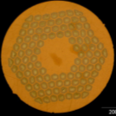
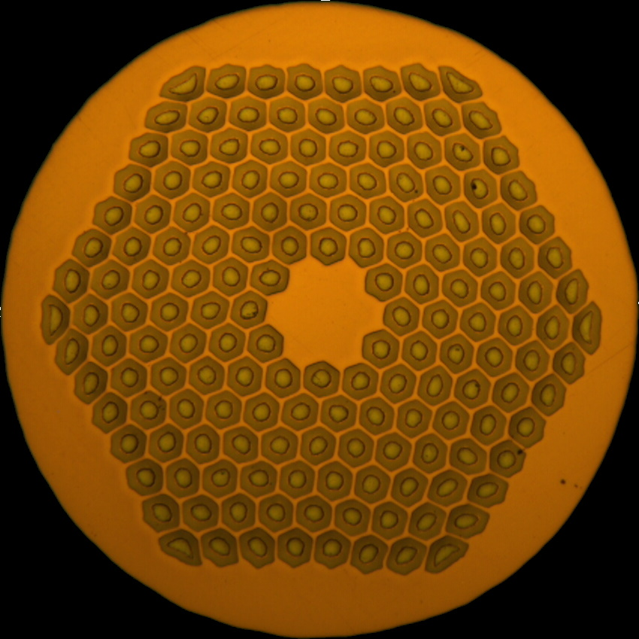
Progress update: needs of Nb₃Sn wire for HFM (2)
The ERMC-1 wire has a J_{c} higher than that of MQXF by up to 9 %, but poorer stability
  J_{c} difference of ~2 % if heat treatment adjusted for improved stability
In addition, it has a low Cu/non-Cu ratio of ~0.9 as compared to ~1.2
Altogether, higher J_{e} by up to ~27%
In terms of production maturity:
  21 tons of MQXF wire produced versus 2 tons for 162/169 wire
  Production yield higher for MQXF wire
  Recent production at BOST has shown degraded yield, I_{c} and RRR for 162/169, hence 40% higher cost (by weight!)
 |  | MQXF | FalconD
Layout |  | 108/127 | 162/169
Diameter (mm) |  | 0.85 | 1.0
Cu/non-Cu |  | 1.2 | 0.9
at 12 T 4.3 K | J_{c} (A/mm²) | 2890 ª | 3160 ^{b} / 2950 ^{c}
 | I_{c} (A) | 753 ª | 1323 ^{b} / 1234 ^{c}
 | J_{e} | Ref. | + 27 % ^{b} / + 18 % ^{c}
Optical micrograph
ª 665 °C 50 h
^{b} 650 °C 50 h
^{c} 650 °C 30 h
 | 108/127 | 162/169
Yield | 97 % | 90 %
Price per kg | Ref. | + 40 %
Mean piece length (m) | 2907 | 1386 (1.1 mm) 2243 (1.0 mm)
TE-HFM Workshop, Nb₃Sn conductors for HFM, T. Boutboul, 19/09/2024

Slide 8
Progress update: needs of Nb₃Sn wire for HFM (3)
From cable point of view:
  >50 km of MQXF cable produced at CERN vs ~0.7 km for FalconD.
  Mean I_{c} degradation due to cabling < 3 % for MQXF, cf. > 5 % for FalconD (but limited statistics).
Layout | d (mm) | Cable | I_{c} degradation (%)
108/127 | 0.85 | MQXF | 2.6 ± 1.1
162/169 | 1.0 | FalconD | 5.8 ± 0.8
 |  | cf. eRMC | 4.3 ± 1.4
 | 1.1 | cf. R2D2 HF | 3.3 ± 1.4
Therefore, MQXF wire and cable designs appear to be more standard and reproducible as compared to FalconD wire (still under development, riskier choice).
Intensive discussions held with HFM PL and TE-MSC GL and GL deputy.
TE-HFM Workshop, Nb₃Sn conductors for HFM, T. Boutboul, 19/09/2024

Slide 9
Progress update: needs of Nb₃Sn wire for HFM (4)
It was agreed to order from BOST:
This provides strategical reserve for 60/91 (0.7 mm) and ~2 km margin for 162/169 (1.1 mm).
20 km of 150/169 (1 mm) ordered for cabling trials and backup option to 162/169. 162/169 and 150/169 to have an option to be drawn down to 1 mm as well. 108/127 wire (1/1.1 mm) to be ordered for cabling trials as another backup option.
In case both 162/169 and 150/169 options would fail, we have the possibility to use part of 108/127 (BOST amendment #7) for HFM.
TE-HFM Workshop, Nb₃Sn conductors for HFM, T. Boutboul, 19/09/2024

Slide 10
Progress update: needs of Nb₃Sn wire for HFM (5)
This order provides some agility with a few backup options.
Final offer expected from BOST imminently.
Last but not least, due to very high tension in Nb market, lead-time of ~2 years, i.e. delivery expected Q4 2026.
Therefore, important to give priorities between various HFM project needs (more details to be provided later on).
TE-HFM Workshop, Nb₃Sn conductors for HFM, T. Boutboul, 19/09/2024

Slide 11
Progress update: Nb₃Sn cabling for HFM (1)
12 T VE dipole (RRP 108/127, 0.85 mm):
9 ULs of 200 m each already manufactured – but is it still relevant?
 |  | Delivery dates
 |  | Bare conductor for insulation | Actual completion date |  | Associated development
70 m + 1 unit |  | Feb 24 | Dec-23 |  | winding coil trials
1 unit |  | Feb 24 | Dec-23 |  | Practise coil
2 units |  | Jun-24 | Dec-23, Apr-24 |  | First of series AP
2 units |  | Jun-24 | Apr-24 |  | Mirror AP
2 units |  | Jan-25 | May-24 |  | Single AP Model 1
2 units |  | Jan-25 | 1 unit in May 2025 |  | Single AP Model 2
4 units |  | March 25 | June 25 |  | Double AP Model 3
TE-HFM Workshop, Nb₃Sn conductors for HFM, T. Boutboul, 19/09/2024

Slide 12
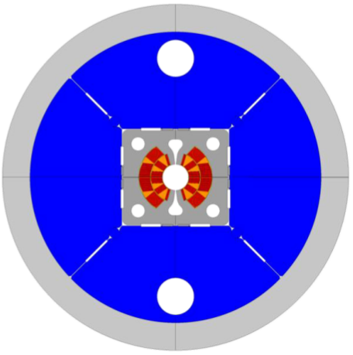
Progress update: Nb₃Sn cabling for HFM (2)
FalconD (RRP 162/169, 1.0 mm):
Originally, FalconD cables only for INFN Genoa but now interest for CERN as well (see tables below).
Wire for the last two units (140 m each) available only end of 2026.
 |  | Delivery dates (INFN)
 |  | Bare conductor for insulation | Actual completion date
Dummy Cu cable |  | done acc. to INFN | Sep-22
2 units + 50 m |  | end April 24 | Apr-24
2 units |  | end April 24 | Apr-24
2 units |  | Oct-24 | On time
1 unit |  | Oct-24 | On time
 |  | Delivery dates (CERN)
 |  | Bare conductor for insulation | Actual completion date
Dummy Cu cable |  | Mar-25 | On time
2 units (practise) |  | Sep-25 | On time
3 units |  | Jan-26 | On time
2 units |  | Jun-26 | Strand available end of 2026
TE-HFM Workshop, Nb₃Sn conductors for HFM, T. Boutboul, 19/09/2024

Slide 13
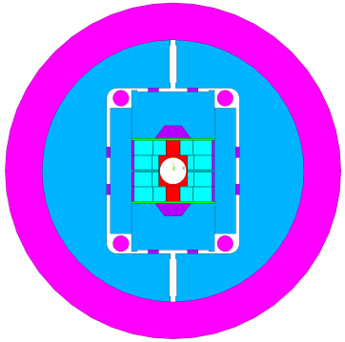
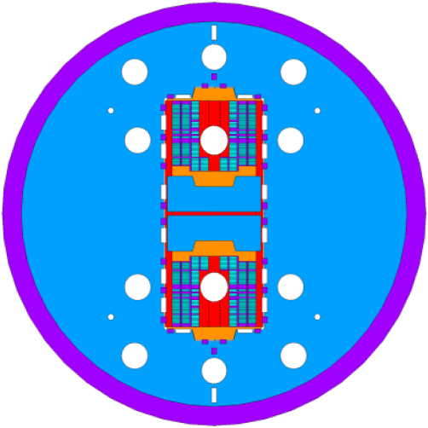
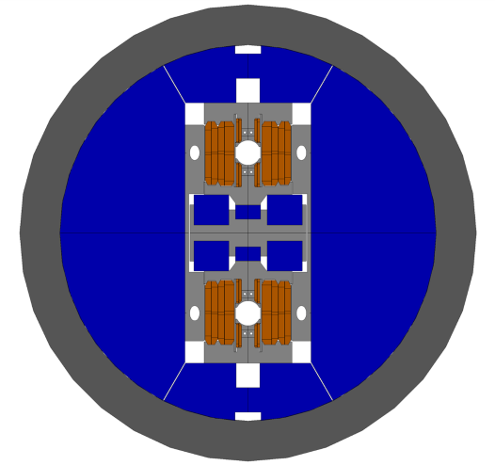
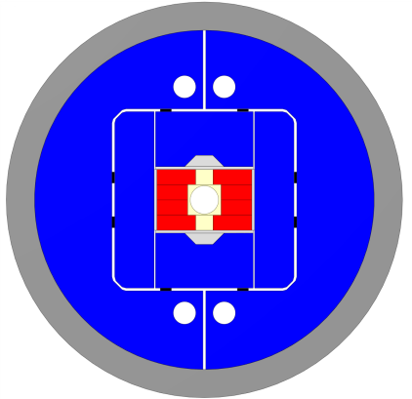
Progress update: Nb₃Sn cabling for HFM (3)
RRP 162/169, 1.1 mm:
Cable of RRP 162/169 1.1 mm wire is needed for:
CEA (R2D2, FD, F2D2) – 200 m of R2D2 HF cable produced
  No further need before 2nd half of 2026, TBC
PSI (14 T stress managed) – 170 m of R2D2 HF cable produced
  No further need before 2nd half of 2026, TBC
CIEMAT (14 T common coil) – needs not yet finalised, ~15 km of strand expected around 2nd half of 2026
  Could wait for new strand delivery Q4 2026, TBC
CERN (14 T block) – planning 8 × 180 m ULs (1440 m) of 44-strand cable, to be cabled at LBNL, corresponding to ~70 km of strand.
  The idea is to get 4 ULs of 180 m cabled at LBNL in Q1 2025 (~35 km of wire). This is defined as the highest priority and it will deplete completely the stock of RRP 162/169 (1.1 mm) before the new strand delivery (Q4 2026).
TE-HFM Workshop, Nb₃Sn conductors for HFM, T. Boutboul, 19/09/2024

Slide 14
Progress update: Nb₃Sn wire R&D (1)
R&D at BOST
The new strand order from BOST includes an R&D billet with more sub-elements (SEs), RRP 180/217, to be produced in a larger billet (~60 kg versus ~45 kg).
As well as a step towards up-scaling, increasing billet mass/diameter should facilitate assembly of higher count of SEs into the re-stack billet, for strand with smaller filament diameter.
KEK/CERN collaboration
A new collaboration agreement signed on 19/08/24 with KEK for the development of advanced Nb₃Sn wires for high-field magnets. The KoM will take place on 29-30 October 2024 in Japan.
The scope is:
  To qualify a new wire supplier (JASTEC) for wire performance equivalent to that of MQXF wire (i.e. J_{c} ≥ 1100 A/mm², 16 T and 4.2 K),
  Reinforcement of wire to increase mechanical strength and improve electromechanical characteristics of wire, and
  To further enhance J_{c} performance towards 1500 A/mm², 16 T/4.2 K.
TE-HFM Workshop, Nb₃Sn conductors for HFM, T. Boutboul, 19/09/2024

Slide 15
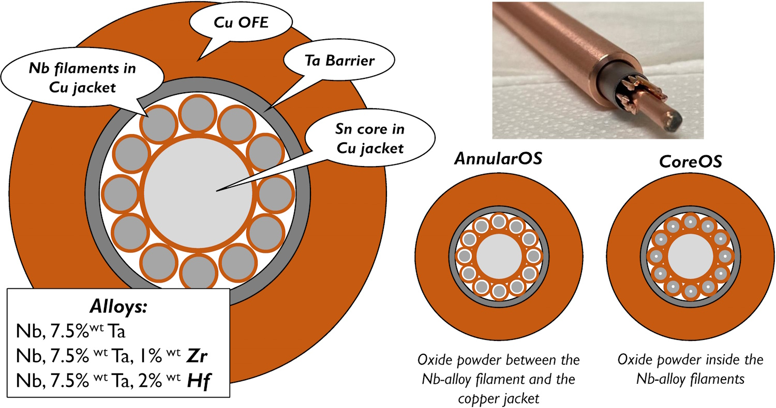
Progress update: Nb₃Sn wire R&D (2)
R&D at UNIGE (Internal Oxidation)
Studies have:
  demonstrated J_{c} enhancement from internal oxidation, with Zr and Hf alloying and alternative SnO₂ oxygen source locations
  distinguished the pinning contributions of precipitates and grain refinement
Two billets of sub-elements with alternative oxygen source layouts are currently being processed. Extrusion, drawing and restack attempts are planned to be completed by end of the year.
Based on results, an oxygen source layout will be selected and the optimized sub-element will be designed and produced in 2025.
Adding SnO₂
TE-HFM Workshop, Nb₃Sn conductors for HFM, T. Boutboul, 19/09/2024

Slide 16
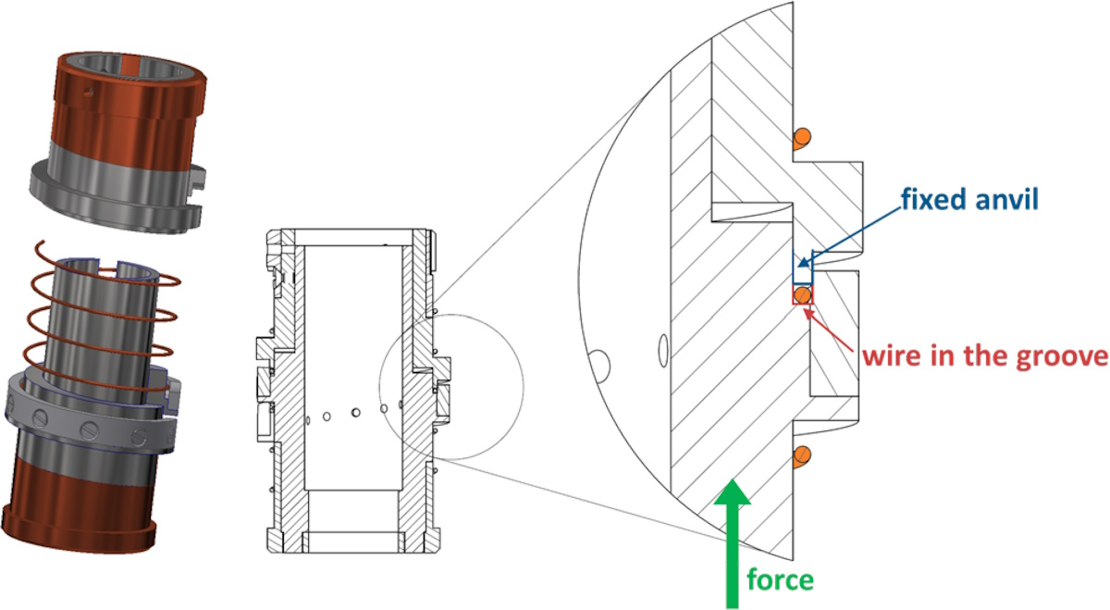
V-I stability measurements on strands extracted from various strand/cable designs :
  First measurements (1 heat treatment) completed for each wire layout
  Second heat treatment cycle early in 2025, with additional tests to follow by end 2025
UNIGE critical current measurements under transverse compressive stress on virgin strands on-going and expected to be completed by early 2025.
CERN heat treated and impregnated cable samples submitted to transverse stress and cable cross-sections examined for cracks:
  Tooling in production, due in 2025
  Preparatory studies starting now:
    Method development for image analysis
    Microstructure comparison of reacted wires (without stress) vs. heat treatment
  Initial results by end 2025.
Progress update: 14+ T conductor selection
120/127
UNIGE
TE-HFM Workshop, Nb₃Sn conductors for HFM, T. Boutboul, 19/09/2024

Slide 17
The main tasks of the WP1.1 are to procure, cable and characterize the Nb₃Sn strand for both CERN and Collaborators, while further developing the Nb₃Sn wire towards the challenging performance targets of FCC.
There is absolutely no problem with the Rutherford cabling capacity of the cabling line of B103.
The issue is about the current stock of HFM strand (in particular RRP 162/169 and 60/91) and the long lead-time (~ 2 years) for wire procurement due to global Nb market under stringent tension.
An HFM strand order of ~200 km of wire will be soon placed to BOST to cope with the needs of HFM. This order will provide some flexibility on the design of the 1.1 mm strand.
It is very important to communicate ASAP any change in the program or any new need for cable lengths due to mentioned long lead-time.
Conclusions
TE-HFM Workshop, Nb₃Sn conductors for HFM, T. Boutboul, 19/09/2024

Slide 18
Spare Slides
TE-HFM Workshop, Nb₃Sn conductors for HFM, T. Boutboul, 19/09/2024

Slide 19
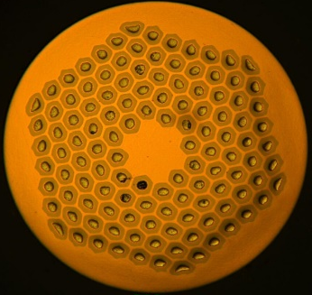
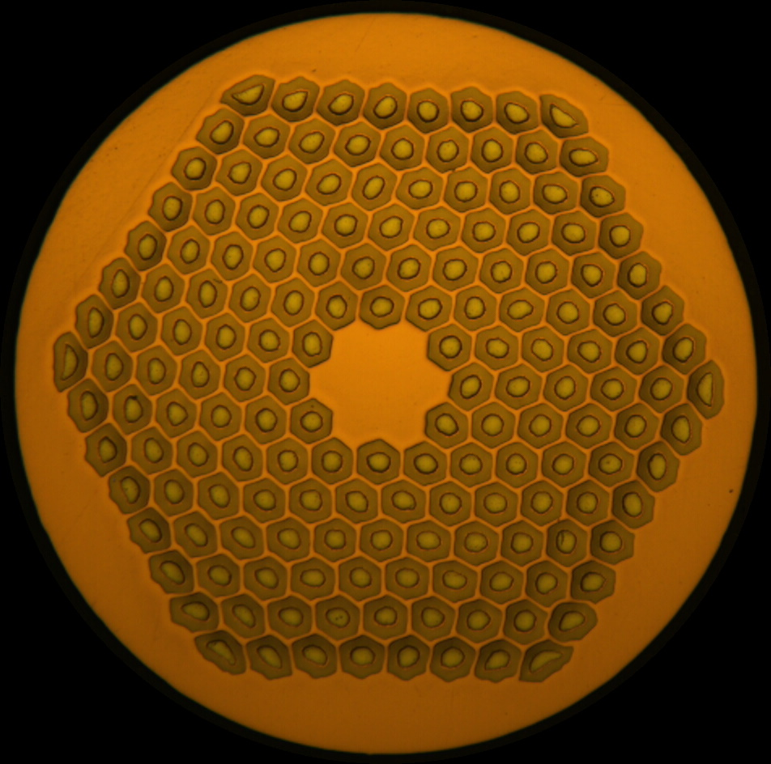
Spare slide: RRP® Strand Characteristics
BOST (NJ, USA) can produce Nb₃Sn wire by RRP® (Restacked Rod Process) with different designs.
Various designs of interest are given, showing the various important parameters, in the following table.
 | Comparisons |  |  |  | HFM
 | MQXF | ERMC#101 | FRESCA 2 | ERMC#102 | ERMC-1 | DEM-1.1
d (mm) | 0.85 | 1.0 | 1.0 | 1.0 | 1.0 | 1.1
Layout | 108/127 | 120/127 | 132/169 | 150/169 | 162/169 | 162/169
d_{s} (µm) | 54 | 64 | 58 | 57 | 58 | 64
Cu/non-Cu | 1.2 ± 0.1 | 1.06 ± 0.1 | 1.25 ± 0.1 | 1.08 ± 0.1 | 0.9 ± 0.2
Nb:Sn | 3.6 (red. Sn) | M-grade | 3.4 (std. Sn) | 3.6 (red. Sn) | 3.4 (std. Sn)
Ref. HT | 665 °C 50 h | 665 °C 50 h | 650 °C 50 h | 665 °C 50 h | 650 °C 50 h | 665 °C 50 h
TE-HFM Workshop, Nb₃Sn conductors for HFM, T. Boutboul, 19/09/2024

Slide 20
Spare slide: Wire Characteristics and Specification
The wire designs and the technical specification, for both RRP 108/127 (MQXFB) and RRP 162/169 (FalconD), can be found in the tables below.
 |  | MQXF | FalconD
d (mm) |  | 0.850 ± 0.003 | 1.000 ± 0.003
Layout |  | 108/127 | 162/169
d_{s} (µm) |  | < 55 | < 60
Cu/non-Cu |  | 1.2 ± 0.1 | 0.9 ± 0.2
Nb:Sn |  | 3.6 (red. Sn) | 3.4 (std. Sn)
Heat treat. |  | 665 °C 50 h | 650 °C 50 h
I_{c} (A) | 4.22 K, 12.0 T | > 590
 | 4.22 K, 15.0 T | > 331 | > 508
 | 4.22 K, 16.0 T |  | > 395
n-value |  | > 30 | > 30
RRR | Round | > 150 | > 150
 | Rolled | > 100 | > 100
TE-HFM Workshop, Nb₃Sn conductors for HFM, T. Boutboul, 19/09/2024

Slide 21
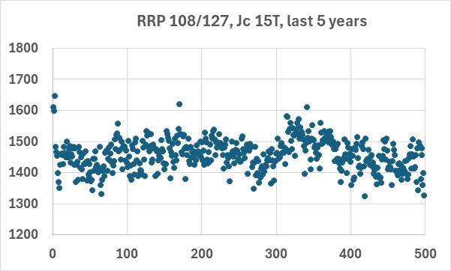
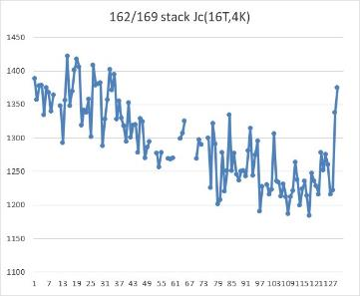
Spare slide: Wire performance variability
For RRP 108/127 wire, J_{c} is stable over production
For RRP 162/169, J_{c} was up to 9% higher than 108/127 early in production (CERN procurement), but over time, a decrease in J_{c} of several % was observed at BOST (see graph at bottom right):
No explanation was found so far
TE-HFM Workshop, Nb₃Sn conductors for HFM, T. Boutboul, 19/09/2024

Slide 22
Spare slide: Magneto-thermal stability
108/127 vs. 162/169 at 1 mm
108/127
162/169
At 1.0 mm diameter:
  108/127 (Cu/non-Cu ~1.2):
    no stability limitation at 4.3 K (similar to 0.85 mm)
    at 1.9 K, limitations at 9 T and below only, quench current > 1600 A
  162/169 (Cu/non-Cu ~0.9 ):
    premature quenches significantly below I_{c}
    significant variability between samples, see full reports:
      1.0 mm FalconD: EDMS 3064867, 1.1 mm R2D2: EDMS 3064865
TE-HFM Workshop, Nb₃Sn conductors for HFM, T. Boutboul, 19/09/2024

Slide 23
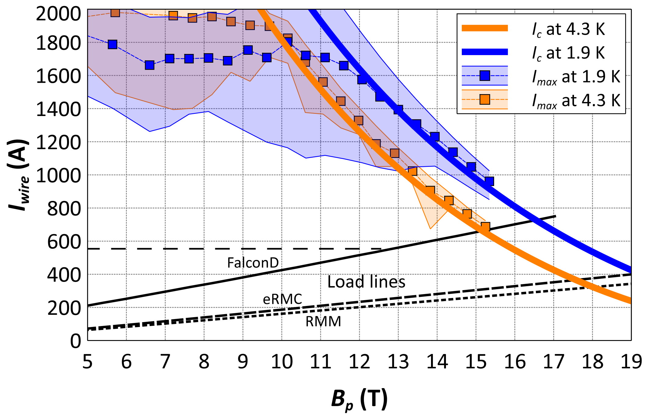
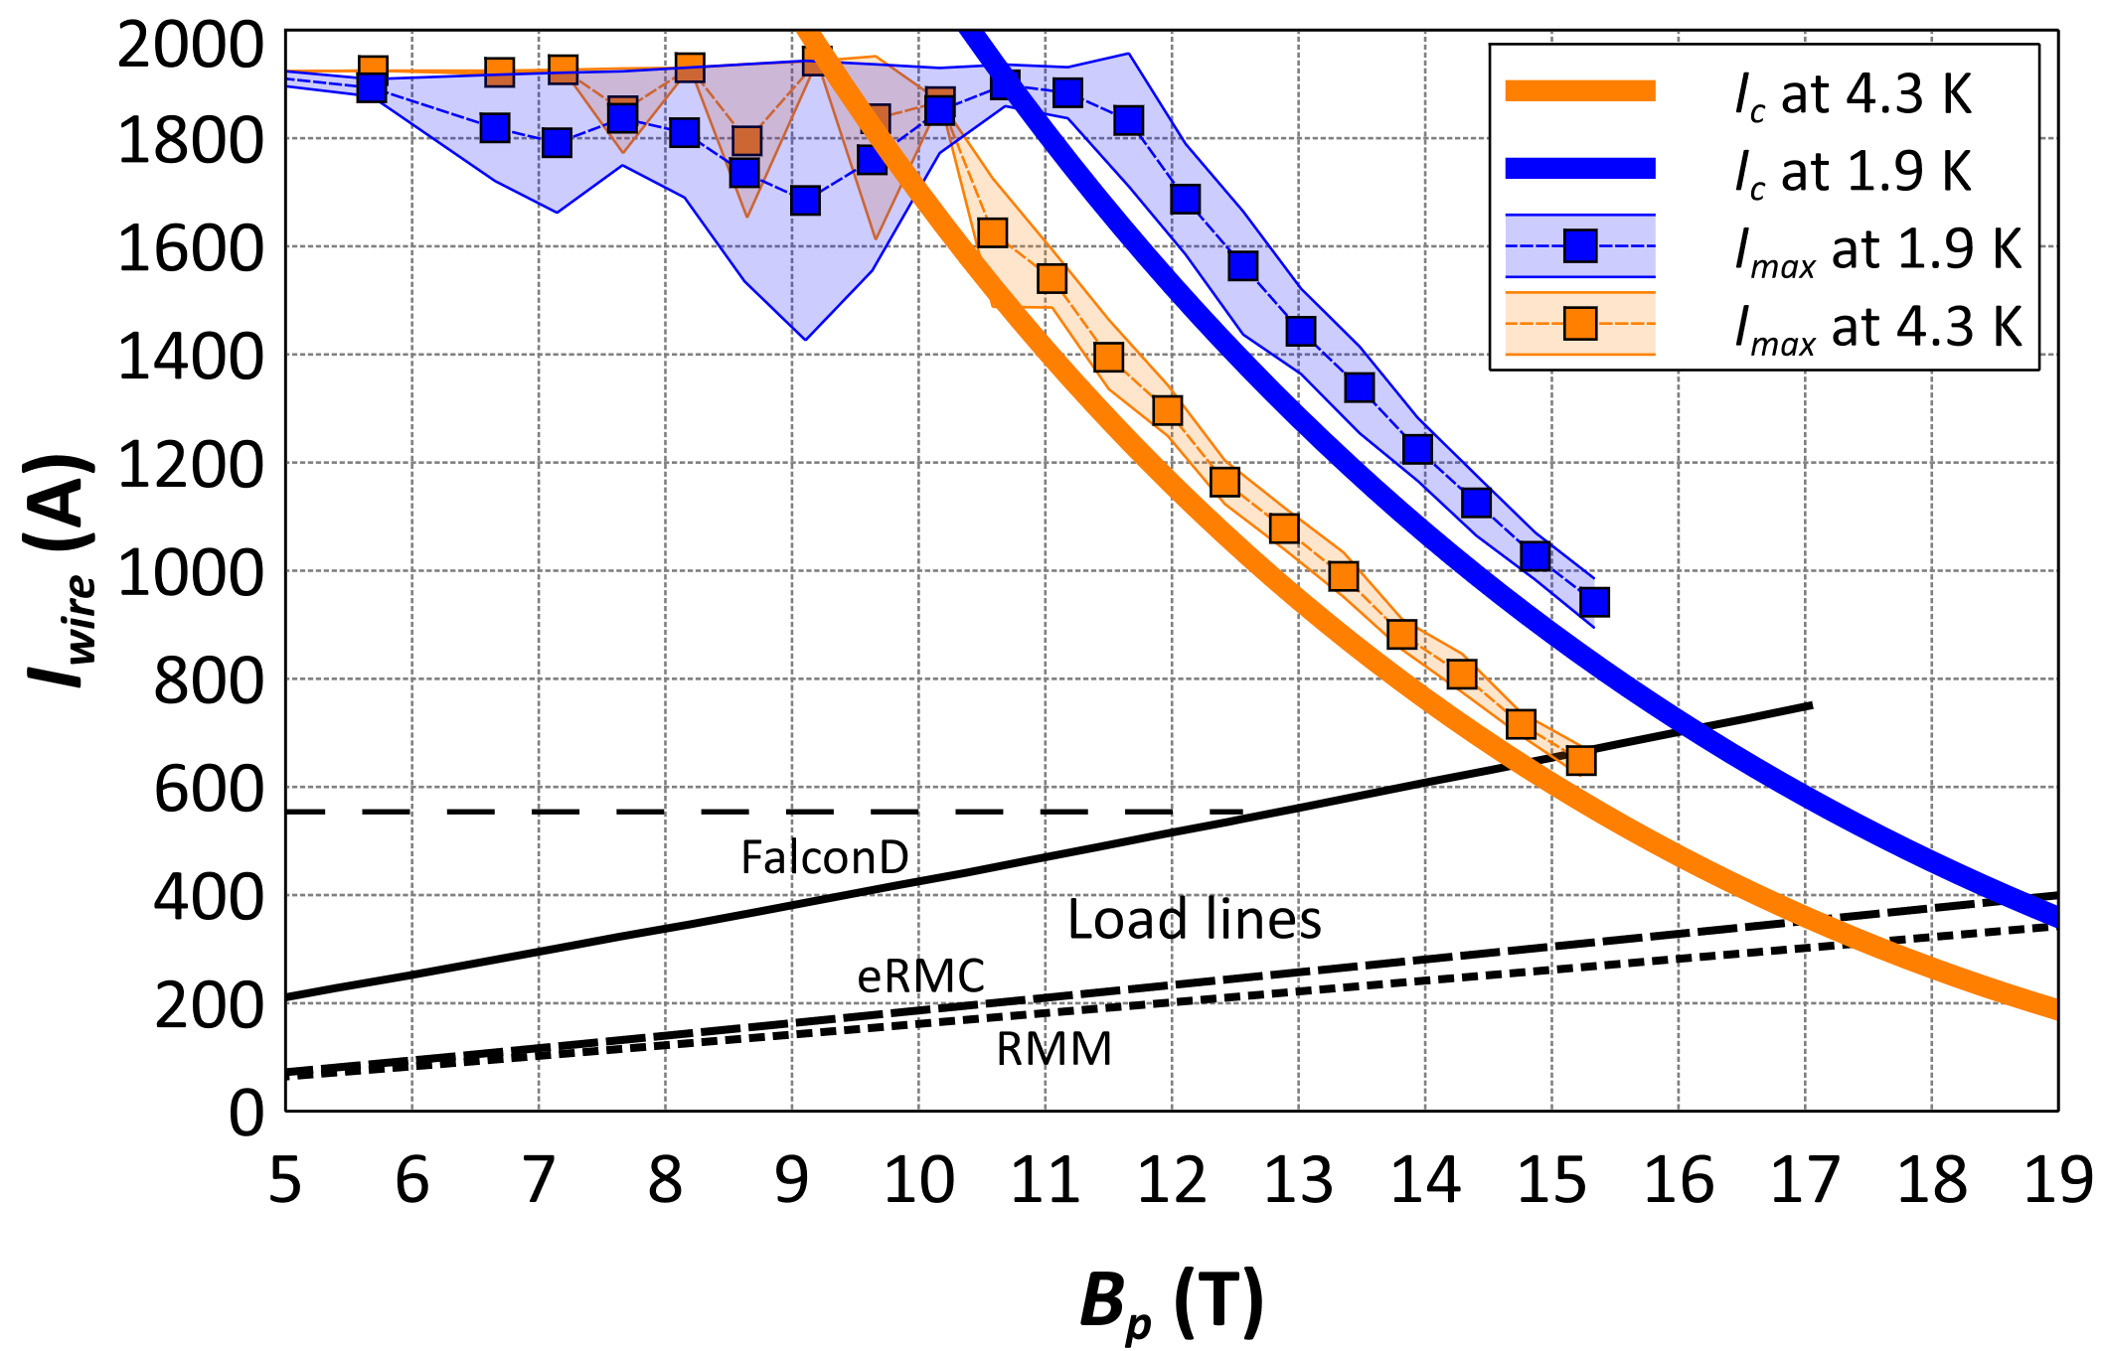
Spare slide: Magneto-thermal stability
162/169 1.0 mm with heat treatment optimisation
50 h → 30 h
650 °C 50 h
650 °C 30 h
Significant variability between samples (coloured bands), but…
Reducing heat treatment duration significantly improves stability at the expensive of ~5 % in I_{c}
 | I_{c} (B_{p}=12.5 T, 4.3 K) |  | RRR
 | I_{c} (A) | Δ (%) | RRR | Δ (%)
665 °C 50 h | 1243 | + 3.5 % | 108 | - 33.8 %
650 °C 50 h | 1189 | (ref.) | 205 | (ref.)
650 °C 30 h | 1136 | - 5.1 % | 324 | + 21.4 %
TE-HFM Workshop, Nb₃Sn conductors for HFM, T. Boutboul, 19/09/2024

Slide 24
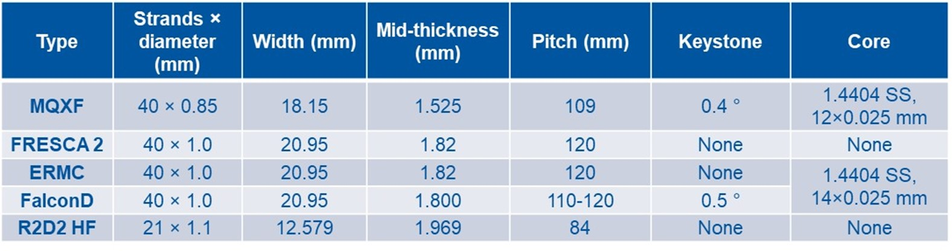
Spare slide: Cable comparison (1)
Both MQXF and FalconD cables are made of 40 strands (see more details in the table below).
Between 2019 and 2024, CERN fabricated 53 MQXFB series ULs for HL-LHC use (~760 m each); this represents altogether more than 40 km.
This needs to be compared to FalconD for which only 7 cable lengths have been produced for HFM use: three short lengths (10, 30 and 60 m) and 4 lengths of 150 m each), altogether around 700 m only.
TE-HFM Workshop, Nb₃Sn conductors for HFM, T. Boutboul, 19/09/2024

Slide 25
Spare slide: Cable comparison (2)
All cable geometrical parameters for the 53 MQXF cable lengths produced to date were well within specification and under tight control.
For FalconD, geometrical parameters well within specification but quite low statistics.
For MQXFB, moderate I_{c} degradation at 4.2 K and 12 T due to cabling in 1.3-3.7% range, well below the 5% specification limit. Wires extracted from MQXFB cables show very high RRR values: 291 as averaged over 48 series ULs (minimum value measured: 244).
For FalconD, much less statistics (single cable so far tested), typical I_{c} degradation of 5-7%, higher than for MQXFB cable and borderline, and RRR for extracted strand around 206 in average (lower as well than MQXFB).
TE-HFM Workshop, Nb₃Sn conductors for HFM, T. Boutboul, 19/09/2024

Slide 26
Spare slide: HFM cables already produced
Cable type | Description | Cable reference | Cable length [m] | Unit length | Production completed date
R2D2 HF | 21x1.1 mm (DEM1.1, RRP 162/169) | C02OC0442A | 200 | R2D2 coil v1+v2, HF | 16/05/2023
R2D2 HF | 21x1.1 mm (DEM1.1, RRP 162/169) | C02OC0442B | 220 | Not known yet | 16/05/2023
R2D2 LF | 34x0.7 mm (DEM0.7, RRP 60/91) | C03OC0448A | 410 | R2D2 coil v1+v2, LF | 27/06/2023
12 T VE short | MQXF-type cable, 40x0.85 mm | C05OC0459A | 200 | UL1, Practise coil | 18/12/2023
12 T VE short | MQXF-type cable, 40x0.85 mm | C05OC0459A | 200 | UL2, First of series AP 1/2 | 18/12/2023
12 T VE short | MQXF-type cable, 40x0.85 mm | C05OC0459A | 100 | winding coil trials | 18/12/2023
12 T VE short | MQXF-type cable, 40x0.85 mm | C05OC0459B | 104 | winding coil trials | 19/12/2023
Falcon D | 40x1.0 mm, copper wire | C01UC0424A | 155 | Dummy copper cable | 28/09/2022
Falcon D | 40x1.0 mm, copper wire | C01UC0424B | 100 | Dummy copper cable | 28/09/2022
Falcon D | 40x1.0 mm (ERMC1.0, RRP 162/169) | C01OC0466E | 53 | Additional length | 15/04/2024
Falcon D | 40x1.0 mm (ERMC1.0, RRP 162/169) | C01OC0466A | 152 | UL1 | 15/04/2024
Falcon D | 40x1.0 mm (ERMC1.0, RRP 162/169) | C01OC0466B | 152 | UL2 | 15/04/2024
Falcon D | 40x1.0 mm (ERMC1.0, RRP 162/169) | C01OC0466C | 152 | UL3 | 15/04/2024
Falcon D | 40x1.0 mm (ERMC1.0, RRP 162/169) | C01OC0466D | 152 | UL4 | 15/04/2024
12 T VE short | MQXF-type cable, 40x0.85 mm | C05OC0467A | 200 | UL3, First of series AP 2/2 | 25/04/2024
12 T VE short | MQXF-type cable, 40x0.85 mm | C05OC0467A | 200 | UL4, Mirror AP 1/2 | 25/04/2024
12 T VE short | MQXF-type cable, 40x0.85 mm | C05OC0467A | 200 | UL5, Mirror AP 2/2 | 25/04/2024
12 T VE short | MQXF-type cable, 40x0.85 mm | C05OC0468A | 200 | Single AP Model 1 (1/2) | 06/05/2024
12 T VE short | MQXF-type cable, 40x0.85 mm | C05OC0468A | 200 | Single AP Model 1 (2/2) | 06/05/2024
12 T VE short | MQXF-type cable, 40x0.85 mm | C05OC0468A | 200 | Single AP Model 2 (1/2) | 06/05/2024
TE-HFM Workshop, Nb₃Sn conductors for HFM, T. Boutboul, 19/09/2024

Slide 27
Spare slide: HFM strand current stock
Strand type | Design | Diameter (mm) | Stock (km)*
ERMC-1 | 162/169 | 1.0 | 60.4
DEM-1.1 | 162/169 | 1.1 | 36.1
DEM-0.7 | 60/91 | 0.7 | 14.5
ERMC-0.7 | 78/91 | 0.7 | 41.0
* on 18/09/2024, in piece lengths exceeding 150 m
TE-HFM Workshop, Nb₃Sn conductors for HFM, T. Boutboul, 19/09/2024

