Slide 2
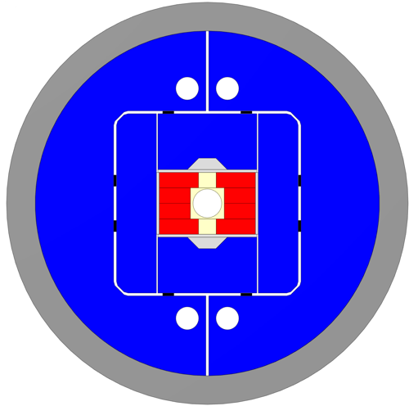
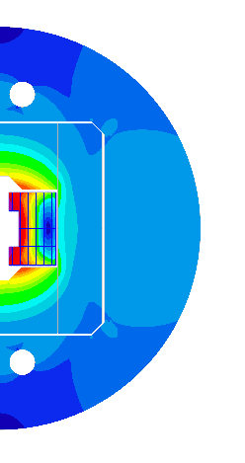
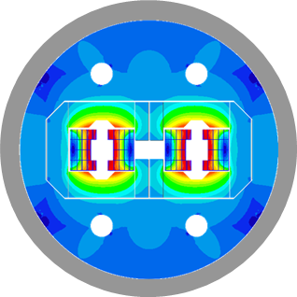
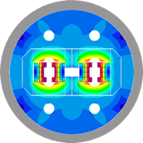
WP3.5
14 T Dipole
Nb₃Sn ultimate performance dipole model
TE-HFM Workshop September 2024
J. C. Pérez, G. Bellini, E. Fernandez, J. Ferradas, A. Haziot, S. Izquierdo, E. Todesco
https://indico.cern.ch/event/1425262/

Slide 3
Table of contents
Scope of the Work Package 3.5
14 T design parameters
Cable and winding tests
Present design status
eRMC & RMM activities overview
14 T magnet development plan & schedule
Summary

Slide 4
Table of contents
Scope of the Work Package 3.5
14 T design parameters
Cable and winding tests
Present design status
eRMC & RMM activities overview
14 T magnet development plan & schedule
Summary

Slide 5
Scope of the Work Package
WP3.5: Nb₃Sn ultimate performance dipole models
Pursue the work started in the frame of the FCC Magnet Development Program towards 16 T dipole models.
  Demonstrate Nb₃Sn ultimate performance in a 14 T block-type dipole at 4.5 k.
  Design and construction of a 14 T accelerator quality dipole model magnet.
  The short model magnet should reach 15-15.5 T field.
  Explore alternatives and develop design and technology for ultimate performance Nb₃Sn magnets.

Slide 6
Table of contents
Scope of the Work Package 3.5
14 T design parameters
Cable and winding tests
Present design status
eRMC & RMM activities overview
14 T magnet development plan & schedule
Summary

Slide 7
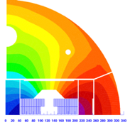
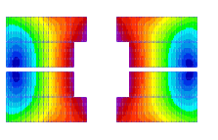
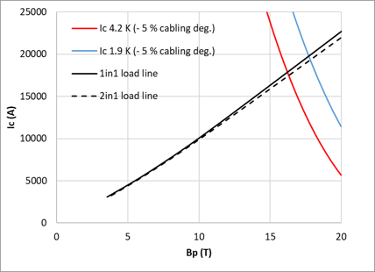
14 T+ initial design parameters
Started in 2023
> 14 T bore field with ≈ 20 % load line margin (at 14 T).
Protection time margin*¹ > 40 ms.
Aperture = 50 mm.
Eq. coil width*² < 60 mm → “accelerator coil size”.
Field quality within 10 units at all current levels (excluding PC effects).
Magnet OD: take EuroCircol dimensions as reference.
  Intra-beam distance: 250 mm.
  Cold mass OD: 800 mm and Magnet OD : 760 mm.
  For the 1 in 1, we will scale down.
The Electro-magnetic design studies for a 40 mm aperture magnet were presented in October 2023
(see presentation https://indico.cern.ch/event/1302031/)
40 mm
B_{ap} = 14 T, I = 15.36 kA
 |  | RMM | 14 T 2in1 | 14 T 1in1
strand diameter | mm | 1 | 1 | 1
Cu/SC | -- | 1 | 0.9 | 0.9
# of strands/cable | -- | 40 | 40 | 40
# turns/quadrant | -- | 132 | 59 | 59
Eq. coil width | mm | 86 | 55 | 55
I_{nom} | A | 11546 | 15363 | 15757
J_{overall} | A/mm² | 248 | 330 | 338
J_{cu} | A/mm² | 735 | 1032 | 1059
J_{sc} | A/mm² | 735 | 929 | 953
B₀ at I_{nom} | T | 16.07 | 14.00 | 14.00
B_{p} at I_{nom} | T | 16.06 | 14.54 | 14.56
B_{ss} at 1.9 K* | T | 18.77¹ | 17.83² | 17.73²
B_{ss} at 4.2 K* | T | 17.07¹ | 16.31² | 16.23²
F_{x}/h at I_{nom} | MPa | 122 | 123 | 123
F_{y}/w at I_{nom} | MPa | -46 | -38 | -39
F_{z}/aperture at I_{nom} | MN | 2.16 | 0.85 | 0.85
Stored energy density (overall) | MJ/m³ | 87.95 | 77.79 | 77.39
*¹ Defined as the time available to react and to quench all the coil before the magnet reaches T_{max}
E. Todesco, “Quench limits in the next generation of magnets,” in Proc.Workshop Accel. Magn. Supercond. Des. Optim.
*² Width of a 60° sector coil whose area is the same of the area of the layout that we are considering.
E.Todesco, ”Masterclass - Design of superconducting magnets for parti-cle accelerators. Chapter 4,” Available at https://indico.cern.ch/category/12408/.
Courtesy of S. Izquierdo

Slide 8
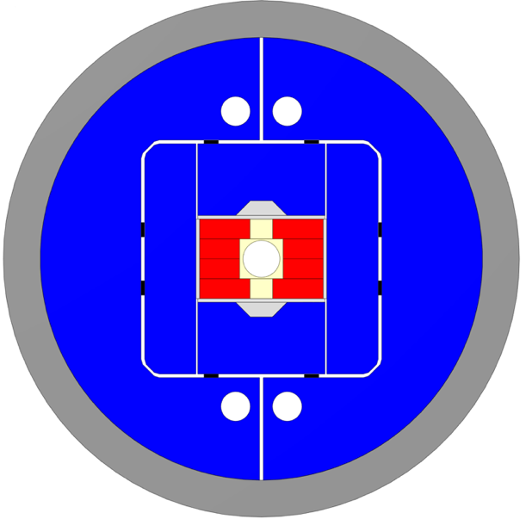
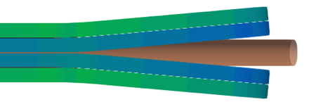
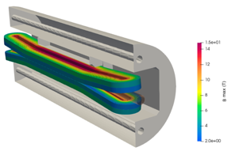
New 50 mm aperture magnet design criteria
In January 2024, the decision was made to go back to the design of a 50 mm aperture magnet, with 14 T bore field target, using a large cable made of 44 strands.
14 T bore field with ≈ 20 % load line margin (at 14 T).
Protection time margin*¹ > 40 ms.
Aperture = 50 mm.
Eq. coil width*² < 60 m → “accelerator coil size”.
Field quality within 10 units at all current levels (excluding PC effects).
Magnet OD: take EuroCircol dimensions as reference
  Intra-beam distance: 250 mm.
  Cold mass OD: 800 mm and Magnet OD : 760 mm.
  For the 1 in 1, we will scale down.
Coil
Vertical pad
Al shell
Horizontal pad
Key
Coil |  | Single | Double
No. of turns per pole |  | 52
Insulated cable surface | [mm²] | 12889
Equivalent coil width | [mm] | 57.3
Coil efficiency *¹ | [T.mm/A] | 0.00075 | 0.00078
Ti post
Iron yoke
*³ Coil efficiency: Ratio between the field and the current times the coil width, given in [T.mm/A].
E.Todesco, ”Masterclass - Design of superconducting magnets for parti-cle accelerators. Chapter 4,” Available at https://indico.cern.ch/category/12408/.
Courtesy of G. Bellini. J. Ferradas & A. Haziot

Slide 9
Table of contents
Scope of the Work Package 3.5
14 T design parameters
Cable and winding tests
Present design status
eRMC & RMM activities overview
14 T magnet development plan & schedule
Summary

Slide 10
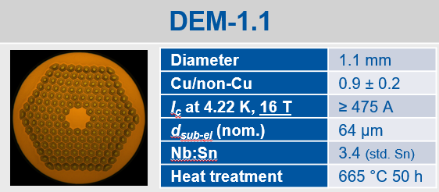
Cable configuration
Cable
Material |  | Nb3Sn (RRP)
Strand |  | DEM-1.1 (162/169)
No. strand |  | 44
Strand diam. | [mm] | 1.100
Cu/NonCu |  | 0.9
RRR |  | 150
Keystone | [º] | 0
Bare cable thickness (R*⁴) | [mm] | 2.060
Bare cable width (R*⁴) | [mm] | 25.957
Insulation thickness | [mm] | 0.150
Filling factor |  | 0.36
A large-dimension cable is required for the construction of a block coil-type magnet with a 50 mm aperture.
The current cabling machine at CERN limits us to producing cables with 40 strands.
To overcome this limitation, a collaboration with LBNL is being established.
LBNL has the capability to produce cables with 44 strands or more, and CERN may profit of the experience gained during the development of the TFD cable.
*⁴ Reacted cable dimension

Slide 11
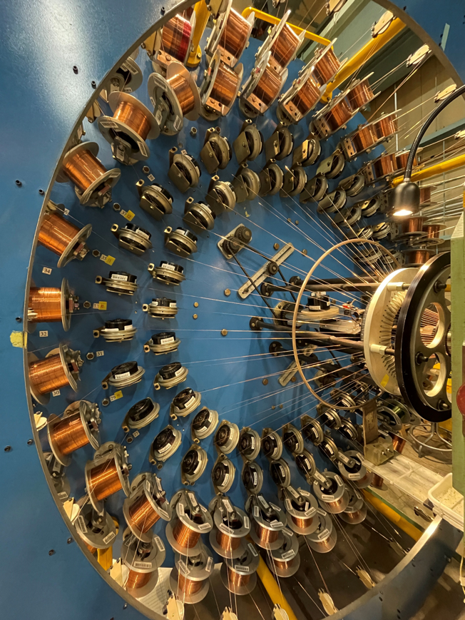
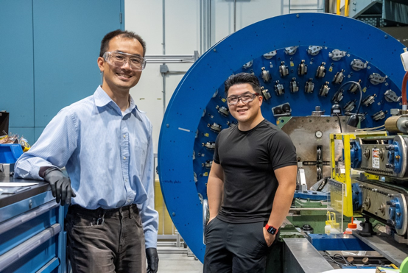
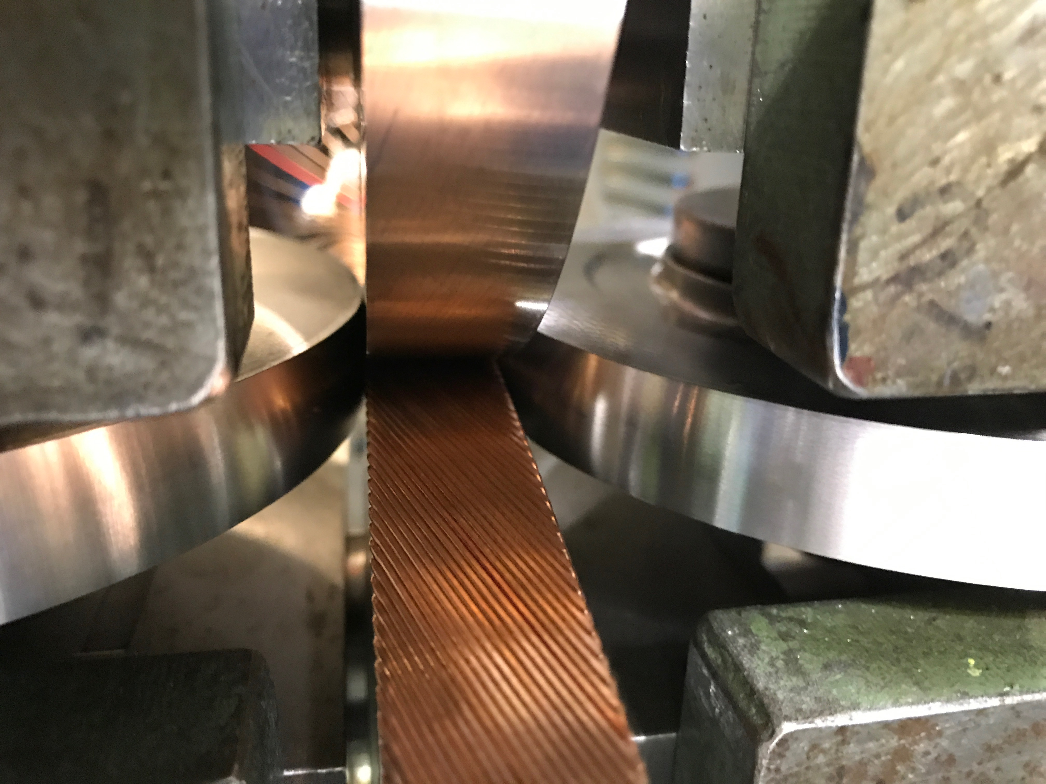
Cable fabrication @ LBNL
Discussions are underway with the management of LBNL to establish the conditions for a collaboration between the two laboratories for the manufacturing of a wide cable composed of 44 strands (TFD like).
The first TFD cabling run at LBNL is scheduled in October 2024.
CERN will send in September a spool of 17.5 km of 1.1 mm of copper wire in store to produce a unit-length of 250 m of copper cable.
The next cabling run is scheduled by early summer 2025.
35 km of DEM-1.1 wire will be shipped to produce 4 Uls of Nb₃Sn cable.
The 4 Uls will be delivered to CERN in summer 2025.

Slide 12
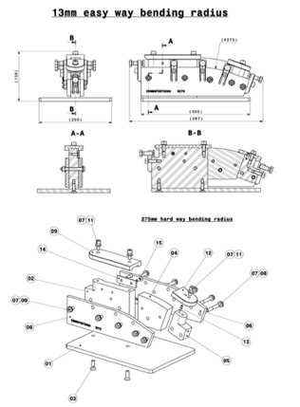
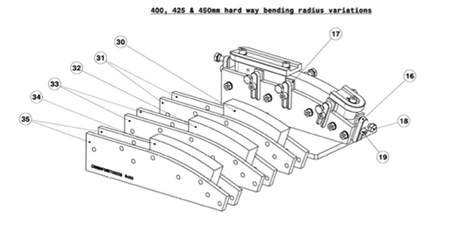
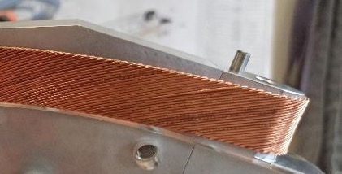
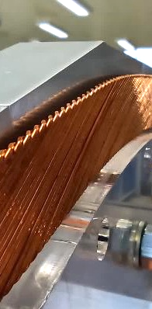
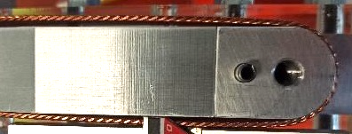
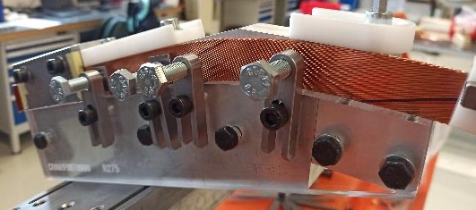
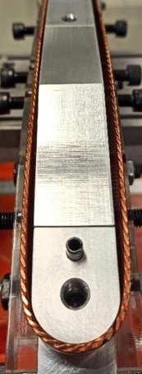
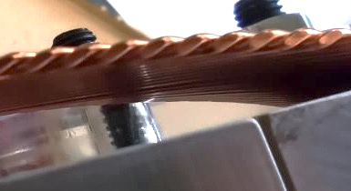
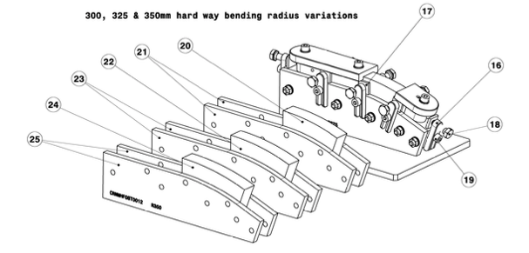
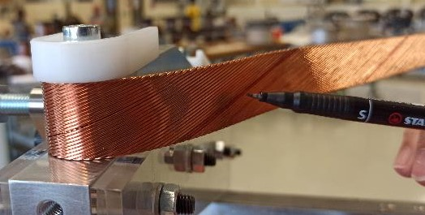
Winding tests preparation
From the experienced gained during the previous qualification process of cables for FRESCA2, MQXFS and HepDipo magnets, a specific tooling has been designed and produced to validate the large 14 T Dipole cable.
Courtesy of E. Fernandez Mora

Slide 13
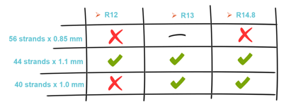
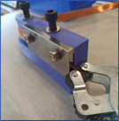
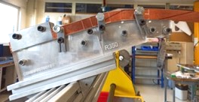
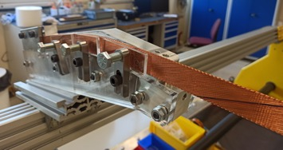
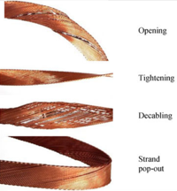
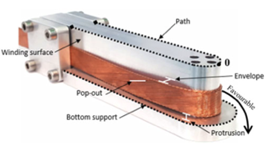
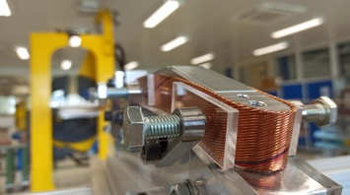
Winding tests at CERN
Objectives
Initial tests performed
Final tests
  Evaluate the different cable proposal.
    56 strands x 0.85 mm
    44 strands x 1.1 mm (baseline)
    40 strands x 1.0 mm
  Study the cable behavior and stability.
  Easy-way bending tests
  Experimental validation and consolidation of the new baseline
  Additional winding test to explore the impact of the winding tension.
    R_{easy-way} = 12 mm
    R_{easy-way} = 13 mm
    R_{easy-way} = 14.8 mm
    For our baseline cable architecture (44 strands x 1.1 mm), all tests were successfully completed.
  Combined easy-way and hard-way bending tests → Focus on 44 strands x 1.1 mm
    R_{easy-way} = 13 mm & R_{hard-way} from 275 to 450 mm
      Strand instabilities and pop-outs identified.
    R_{easy-way} = 15 mm & R_{hard-way} 350 and 450 mm
      For 450 mm → feasible. In general, cable stable.
      No pop-outs identified.
    Decision made to take a safety margin and to align with previous experience (FRESCA2) → increase the R_{hard-way} to 750 mm (small impact in coil length, ~52 mm)
Courtesy of D. Pulikowski, PhD. Thesis
[https://cds.cern.ch/record/2641140/files/CERN-THESIS-2018-181.pdf]
    New design baseline: R_{easy-way} = 15 mm & R_{hard-way} = 750 mm
Courtesy of E. Fernandez Mora

Slide 14
Table of contents
Scope of the Work Package 3.5
14 T design parameters
Cable and winding tests
Present design status
eRMC & RMM activities overview
14 T magnet development plan & schedule
Summary

Slide 15
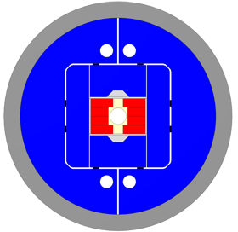
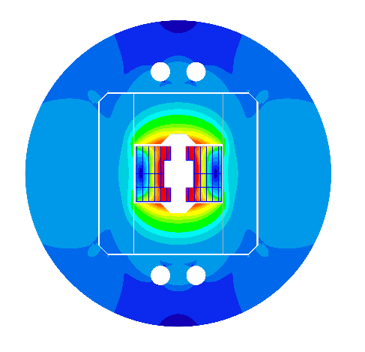
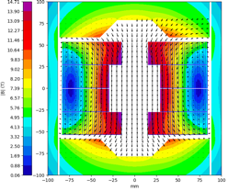
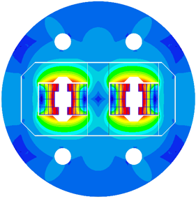
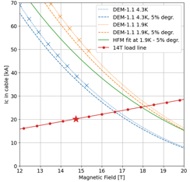
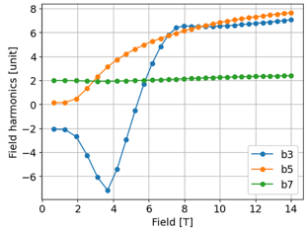
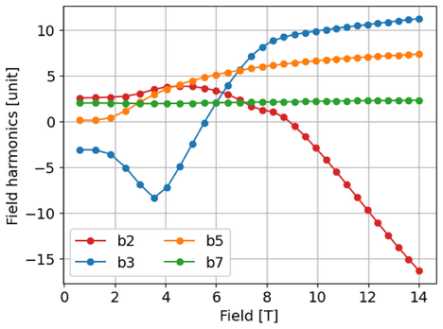
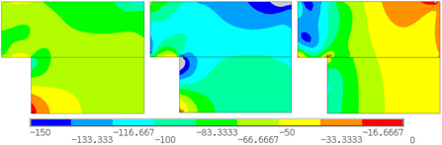
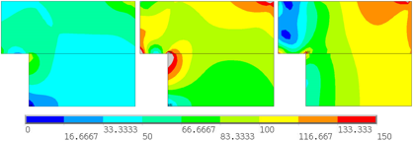
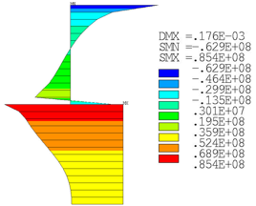
Present Design status (1/2)
The 2D electromagnetic design for the single and double aperture configuration has been completed.
Magnet |  | Single | Double
Aperture | [mm] | 50 | 50
Intra-beam distance | [mm] | - | 250
Yoke diameter | [mm] | 540 | 680
Shell diameter | [mm] | 640 | 780
Nominal current | [kA] | 20.135 | 19.380
J overall | [A/mm2] | 325 | 313
J strand (eng.) | [A/mm2] | 482 | 463
Nominal field | [T] | 14.00 | 14.00
Peak field | [T] | 14.74 | 14.53
Ap. to peak field ratio | [%] | 5.3 | 3.8
Load line fraction | [%] | 79.1 | 78.0
Temperature margin | [K] | 4.36 | 4.47
Inductance | [mH/m] | 4.58 | 10.04
Stored energy | [MJ/m] | 0.900 | 2.028
X-component of stress (MPa) during assembly (left), cool down (centre), and powering (right).
Von Mises stresses (MPa) during assembly (left), cool down (centre), and powering (right).
Courtesy of G. Bellini. J. Ferradas & A. Haziot

Slide 16
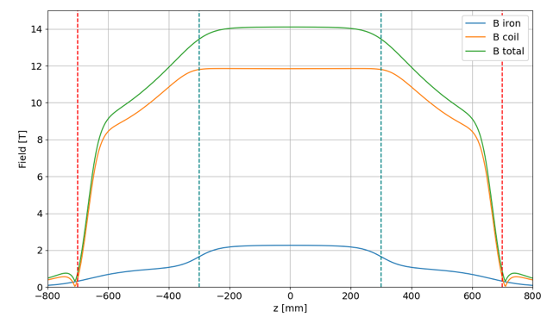
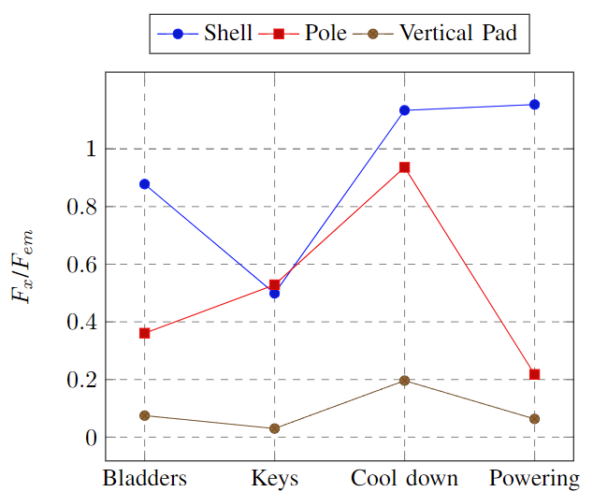

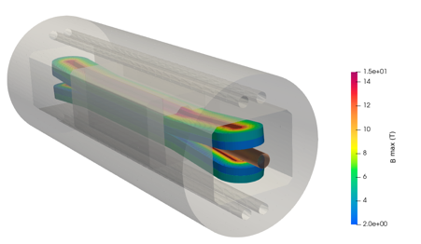
Present Design status (2/2)
Preloading dynamics
Iron pads
The shell provides all azimuthal force pre-loading the coils. This force is almost doubled when the magnet is cooled down to cryogenic temperature due to the differential thermal contraction between the external cylinder and the rest of the magnet components.
Iron yoke
Flared end curvature radius | mm | 750
Flared end angle | º | 5
Flared end straight section | mm | 250
3D mechanical design for single aperture will be completed in October 2024
2D mechanical design for the double aperture in progress
Ratio between horizontal total e.m. force per quadrant and the azimuthal force provided by the shell and received by the coil and vertical pad.
Courtesy of G. Bellini. J. Ferradas & A. Haziot

Slide 17
Table of contents
Scope of the Work Package 3.5
14 T design parameters
Cable and winding tests
Present design status
eRMC & RMM activities overview
14 T magnet development plan & schedule
Summary

Slide 18
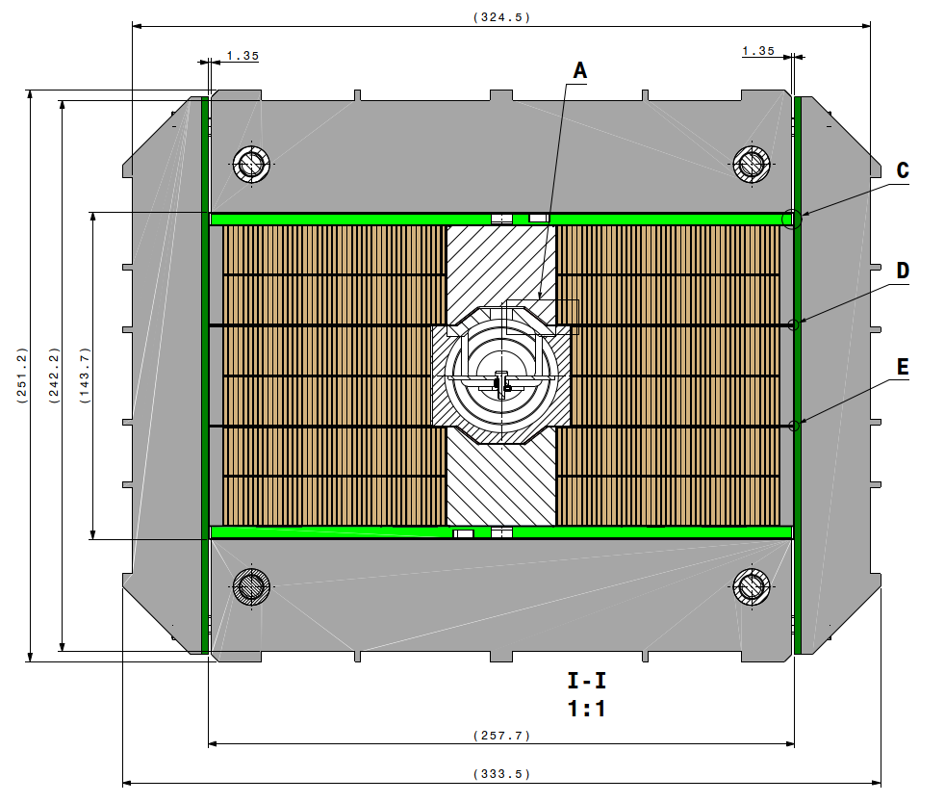
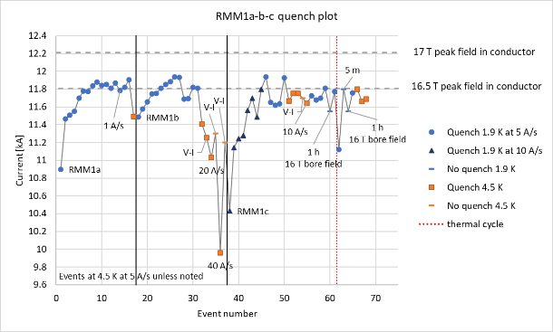
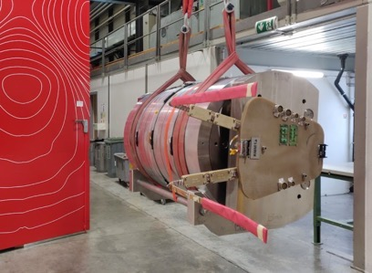
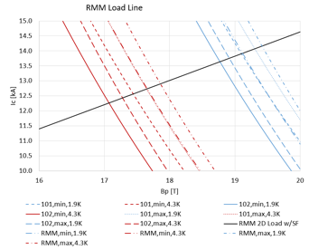
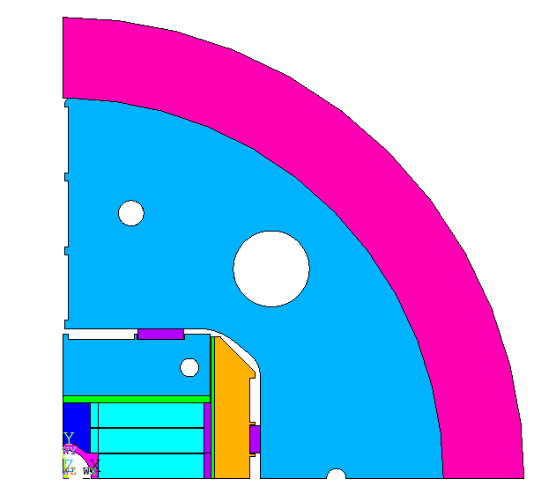
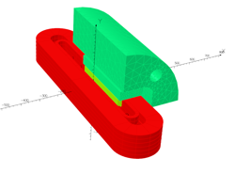
RMM activities
RMM is a Racetrack Model Magnet, with a 50 mm closed cavity made of 2 eRMC coils & 1 RMM coil in the middle.
The objective is to explore high field straight section region of a 16+ T dipole, focusing on mechanical aspects.
3 RMM assemblies have already successfully been tested and the magnet reached 16.5 T in the 50 mm diameter and 431 mm long closed cavity.
eRMC coil
RMM coil
eRMC coil
(HFMMHRMM0080)
RMM1a | I (kA) | Bp (T) | Bo (T)
Short Sample @4.3 K | 12.26 | 17.07 | 16.85
Short Sample @1.9 K | 13.64 | 18.77 | 18.51
RMM1d has been assembled with increased preload w.r.t. RMM1c and is waiting for powering test in SM18.

Slide 19







eRMC
The production of 3 eRMC coils has started in 927 laboratory to prove the repeatability of the results obtained with the first set of coils and try to overcome the 16.5 T limit seen on RMM1.
  eRMC coil #104 is ready for impregnation.
  eRMC coil #105 is being instrumented.
  eRMC coil #106 is being wound.
eRMC2 magnet will be assembled when RMM1d powering tests will be completed (Q4-2024).
The assembly of RMM2 is scheduled Q2-2025.
eRMC
(enhanced Racetrack Model Coil)
RMM
(Racetrack Model Magnet)

Slide 20
Table of contents
Scope of the Work Package 3.5
14 T design parameters
Cable and winding tests
Present design status
eRMC & RMM activities overview
14 T Magnet development plan & schedule
Summary

Slide 21
14 T Magnet development plan
Cold Powering Tests Magnet #1
2D FEM
Magnetic & Mechanics
First Single Aperture Magnet assembly
CAD Mechanical Structures
Analysis
Iterative engineering design
Insulated Nb₃Sn Cable delivery
Trial Copper Coil
CAD Impregnation Tooling
1st Nb₃Sn Coil
Today
Q3_2024
Q4_2024
Q1_2025
Q2_2025
Q3_2025
Q4_2025
Q1_2026
Q2_2026
ANSYS 3D
Structures Characterisation
First dummy copper cable at CERN
3D Opera & ROXIE
Single & Double aperture
Mech. structure at Cern
Coil CAD Design
Winding & Reaction Tooling
at CERN
Impregnation tooling
at CERN
Magnet #2 assembly
CAD Winding & Reaction tooling

Slide 22
Table of contents
Scope of the Work Package 3.5
14 T design parameters
Cable and winding tests
Present design status
eRMC & RMM activities overview
14 T magnet development plan & schedule
Summary

Slide 23
Summary
After several iterations, we have finalized the option of manufacturing a dipole magnet with a 50 mm aperture.
The winding tests conducted with the TFD-type cable have not revealed any blocking issues, allowing us to proceed with the design.
Due to the limitation of the CERN cabling machine, which can handle a maximum of 40 strands, a collaboration agreement is being discussed to produce the cable for the 14T magnet at LBNL.
The first tests on a copper cable are scheduled for October, with Nb₃Sn cable production planned for spring 2025.
CAD drawings for the coils and components will begin in Q4 2024 after the 3D design is finalized.
The tooling for the first test coil should be available by late summer 2025, and the validation of the single aperture mechanical structure is expected by fall 2025.
This will be followed by the assembly of the first magnet, which should be tested in early 2026.
The validation of the double-aperture structure will be delayed by approximately three months compared to the single-aperture version.
If the four coils produced with the 2025 cable meet the specifications, the assembly of the first double-aperture magnet could be considered by late 2026.
We are collaborating with CEA and LBNL to share our experiences and apply the lessons learned over the past years.

Slide 24
Thank you for your attention

