Slide 2
Infrastructure Needs for Conductors
J. Fleiter, S. Hopkins and T. Boutboul
TE-HFM Workshop, CERN, 19th of September 2024

Slide 3
Introduction
For HFM program, there is a strong need to upgrade the B163/103 facilities to cope with characterization and cabling requirements, in particular:
Critical current station with solenoid magnet of 20 T (vertical field):
In order to develop high-field accelerator magnets in 14-20 T range, need to have adequate test stations for characterizing potential superconductors for use in such magnets (current capacity up to 15 T).
Critical current station with 10 T split-pair magnet (horizontal field):
Test stations with vertical solenoidal field only enable characterization of MgB₂ and HTS wires and tapes in most favorable orientation (i.e., with field parallel to sample axis) due to bending requirements (e.g., 100 mm minimum curvature radius for MgB₂). This new station will allow to characterize transport current properties of HTS materials, very sensitive on field orientation, as function of temperature, field and field orientation.
New Rutherford cabling machine (up to 60 strands):
Current cabling machine in B103 can manufacture Rutherford cables with up to 40 strands. For HFM, on-going block-coil designs require larger cable widths, 44-56 strands appear to be necessary.
TE-HFM Workshop, Infrastructure needs for conductors, J. Fleiter, 19/09/2024

Slide 4
Technical contents of WP5.2 (1)
RD5 | WP5.2 | WP5.2 | Infrastructure needs for conductors - CERN | Fri 30/09/22 | Sat 01/07/28
RD5 | WP5.2 | WP5.2-T1 | Infrastructure for Cabling and Characterisation | Fri 30/09/22 | Mon 30/11/26
RD5 | WP5.2 | WP5.2-T1-D1 | Procurement and installation of new critical current stations (B≥18T and 10T split magnet) | Fri 30/09/22 | Sun 01/11/26
RD5 | WP5.2 | WP5.2-T1-D1-M1 | Conceptual design including integration in B163 and ancillaries (e.g. current leads, sample power supply, cryogenics…) | Fri 30/09/22 | Wed 01/03/23
RD5 | WP5.2 | WP5.2-T1-D1-M2 | Elaboration of specifications including interfaces and drawings of components manufactured by CERN | Fri 31/03/23 | Fri 01/12/23
RD5 | WP5.2 | WP5.2-T1-D1-M3 | Tender process, procurement and fabrication of magnets and test station ancillaries | Thu 28/09/23 | Tue 31/03/26
RD5 | WP5.2 | WP5.2-T1-D1-M4 | Assembly of the critical current stations including Data Acquisition software | Sat 31/01/26 | Mon 01/06/26
RD5 | WP5.2 | WP5.2-T1-D1-M5 | Commissioning of the stations | Thu 30/04/26 | Mon 30/11/26
RD5 | WP5.2 | WP5.2-T1-D2 | Procurement and installation of new cabling machine (up to about 60 strands) | Sat 01/10/22 | Mon 30/11/26
RD5 | WP5.2 | WP5.2-T1-D2-M1 | Elaboration of Technical Specification of cabling machine | Sun 01/01/23 | Sat 01/06/24
RD5 | WP5.2 | WP5.2-T1-D2-M2 | Tender process | Sat 01/06/24 | Mon 30/09/24
RD5 | WP5.2 | WP5.2-T1-D2-M3 | Electronics and software for cabling and QA/QC | Sat 30/09/23 | Sun 30/11/25
RD5 | WP5.2 | WP5.2-T1-D2-M4 | Study for installation of potential insulation/braiding machines | Sat 01/10/22 | Thu 30/10/25
RD5 | WP5.2 | WP5.2-T1-D2-M5 | Procurement and fabrication of the cabling machine | Mon 30/09/24 | Tue 31/03/26
RD5 | WP5.2 | WP5.2-T1-D2-M6 | Installation and commissioning of cabling machine | Wed 01/04/26 | Mon 30/11/26
TE-HFM Workshop, Infrastructure needs for conductors, J. Fleiter, 19/09/2024

Slide 5
Technical contents of WP5.2 (2)
RD5 | WP5.2 | WP5.2-T1-D3 | Upgrade of FRESCA stations | Fri 31/01/25 | Sun 30/05/27
RD5 | WP5.2 | WP5.2-T1-D3-M1 | Sample insert design and fabrication for 60-strand cables and including transverse pressure (FRESCA 2) | Fri 31/10/25 | Sat 30/01/27
RD5 | WP5.2 | WP5.2-T1-D3-M2 | FRESCA 2 testing of 60-strand cable sample | Wed 31/03/27 | Sun 30/05/27
RD5 | WP5.2 | WP5.2-T1-D3-M3 | Conceptual study for potential FRESCA 3 station with B≥15T (size, requirements and cost) | Fri 31/01/25 | Sun 31/01/27
RD5 | WP5.2 | WP5.2-T1-D4 | Procurement and installation of additional infrastructure | Sun 01/01/23 | Sat 01/07/28
RD5 | WP5.2 | WP5.2-T1-D4-M1 | Supply of spare solenoid for existing Ic stations (B=15-17 T), upgrade VSM and magnetization measurements of cables and consolidation of interstrand/intertape contact resistance station | Sun 01/01/23 | Sat 01/07/28
RD5 | WP5.2 | WP5.2-T1-D4-M1a | Supply of spare solenoid for existing Ic stations (B=15-17 T), upgrade VSM and magnetization measurements of cables and consolidation of interstrand/intertape contact resistance station: equipment for station upgrade (1) | Sun 01/01/23 | Sun 01/06/25
RD5 | WP5.2 | WP5.2-T1-D4-M1b | Supply of spare solenoid for existing Ic stations (B=15-17 T), upgrade VSM and magnetization measurements of cables and consolidation of interstrand/intertape contact resistance station: equipment for station upgrade (2) | Sun 01/06/25 | Tue 01/12/26
RD5 | WP5.2 | WP5.2-T1-D4-M1c | Supply of spare solenoid for existing Ic stations (B=15-17 T), upgrade VSM and magnetization measurements of cables and consolidation of interstrand/intertape contact resistance station: spare solenoid (3) | Tue 01/12/26 | Sat 01/07/28
RD5 | WP5.2 | WP5.2-T1-D4-M2 | Design and fabrication of adapted sample insert and sample holder for HTS and special measurements | Mon 01/09/25 | Mon 01/03/27
RD5 | WP5.2 | WP5.2-T1-D4-M3 | Study of infrastructure requirements for HTS conductors | Wed 01/01/25 | Fri 01/01/27
RD5 | WP5.2 | WP5.2-T1-D4-M4 | Supply of a furnace for thermal expansion measurement during heat treatment including commissioning | Wed 01/04/26 | Thu 01/04/27
RD5 | WP5.2 | WP5.2-T1-D4-M5 | Supply of a reaction oven for strand/cable samples | Wed 01/01/25 | Wed 01/07/26
RD5 | WP5.2 | WP5.2-T1-D4-M6 | Supply of a tensile/twisting machine for cable check | Tue 01/10/24 | Sat 01/11/25
RD5 | WP5.2 | WP5.2-T1-D4-M7 | Design and construction of a test facility for current leads, cables and splices | Thu 01/05/25 | Tue 01/09/26
RD5 | WP5.2 | WP5.2-T1-D4-M8 | Inserts for split coil (10 T) and solenoid (20 T) | Mon 01/06/26 | Thu 30/09/27
TE-HFM Workshop, Infrastructure needs for conductors, J. Fleiter, 19/09/2024

Slide 6
Progress update: 20 T solenoid station (1)
Procurement and installation of upgraded I_{c} station (up to 20 T vertical field).
Full magnet system including magnet, cryostat, magnet PS/current leads, protection systems and ancillaries to be procured from industry.
CERN will cope for station upgrade/construction for civil engineering, cryogenic/electrical connections and racks…
Combined Market Survey for both 20 T solenoid and 10 T split-pair magnet systems launched in June 2023.
Individual invitation to tender issued for 20 T system on September 28th, 2023. Contract F809 awarded to OXFORD INSTRUMENTS and signed on 26th of March 2024.
Contract includes commissioning of the magnet system.
OXFORD INSTRUMENTS currently designs magnet system (expected to be completed by end of 2024).
Solenoid magnet expected to be manufactured and tested in Q4 2025, delivered in Q1 2026.
20 T station planned to be commissioned Mid-2026 (see planning next slide).
TE-HFM Workshop, Infrastructure needs for conductors, J. Fleiter, 19/09/2024

Slide 7
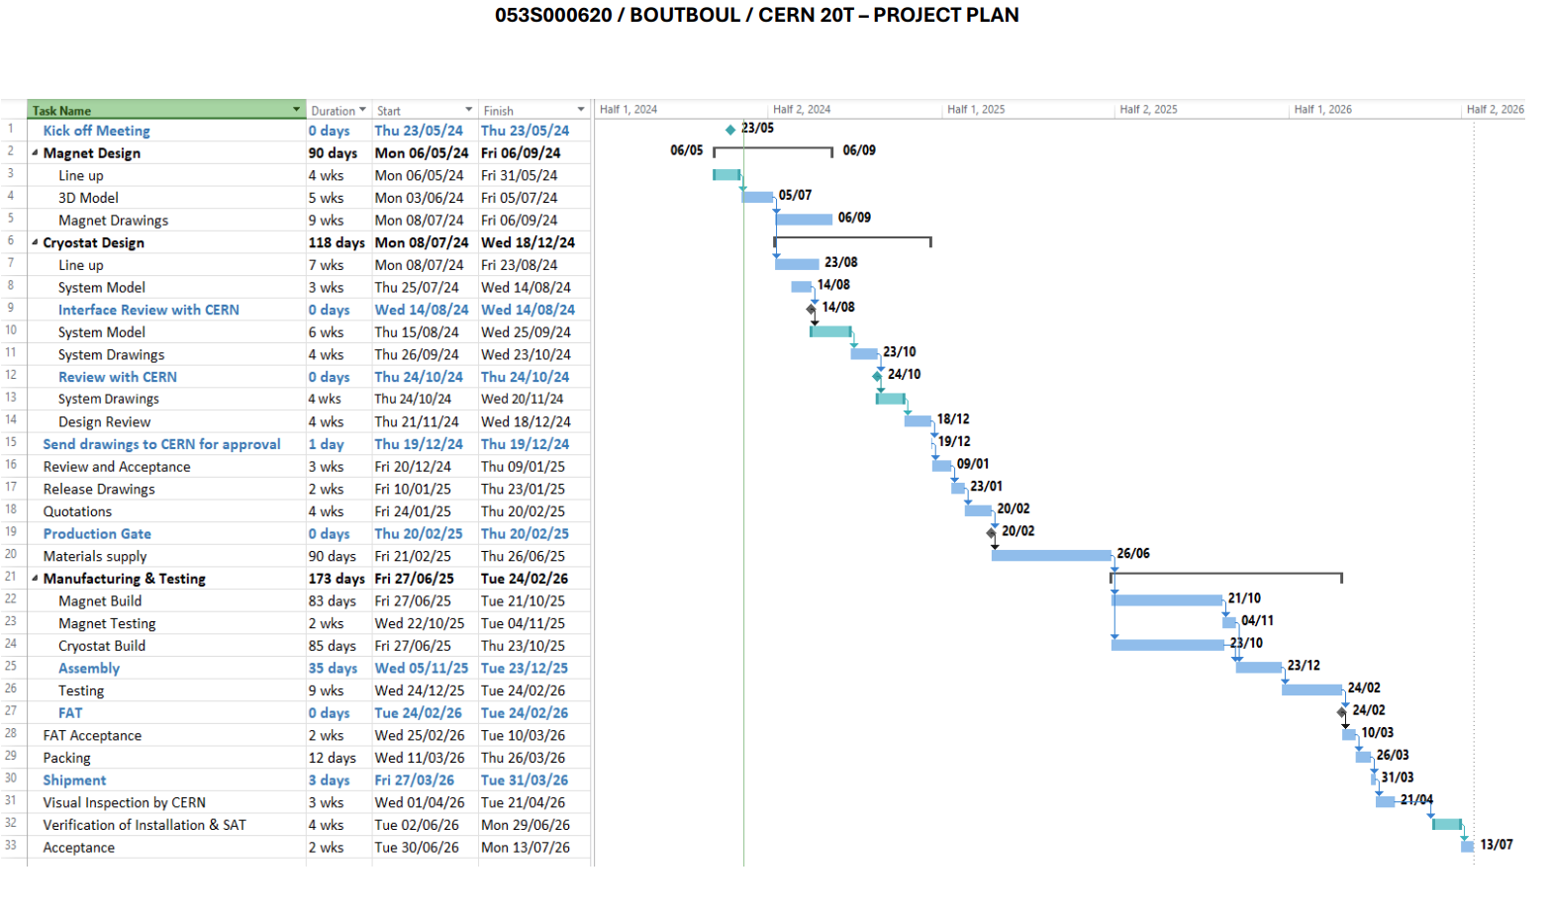
Progress update: 20 T solenoid station (2)
TE-HFM Workshop, Infrastructure needs for conductors, J. Fleiter, 19/09/2024

Slide 8
Progress update: 10 T split-pair station (1)
Procurement and installation of new I_{c} station (up to 10 T horizontal field).
Full magnet system including magnet, cryostat, magnet PS/current leads, protection systems and ancillaries to be procured from industry.
CERN will cope to station upgrade/construction for civil engineering, cryogenic/electrical connections and racks…
Combined Market Survey for both magnet systems launched in June 2023.
Invitation to tender issued for 10 T system on December 8th, 2023. Contract F810 awarded to OXFORD INSTRUMENTS and signed on 26th of March 2024.
Contract includes commissioning of the magnet system.
OXFORD INSTRUMENTS currently designs magnet system with a lower priority than 20 T (expected to be completed by March 2025).
10 T magnet expected to be manufactured and tested in Q1 2026, delivered in Q3 2026.
10 T station expected to be commissioned Sept 2026 (see planning next slide).
TE-HFM Workshop, Infrastructure needs for conductors, J. Fleiter, 19/09/2024

Slide 9
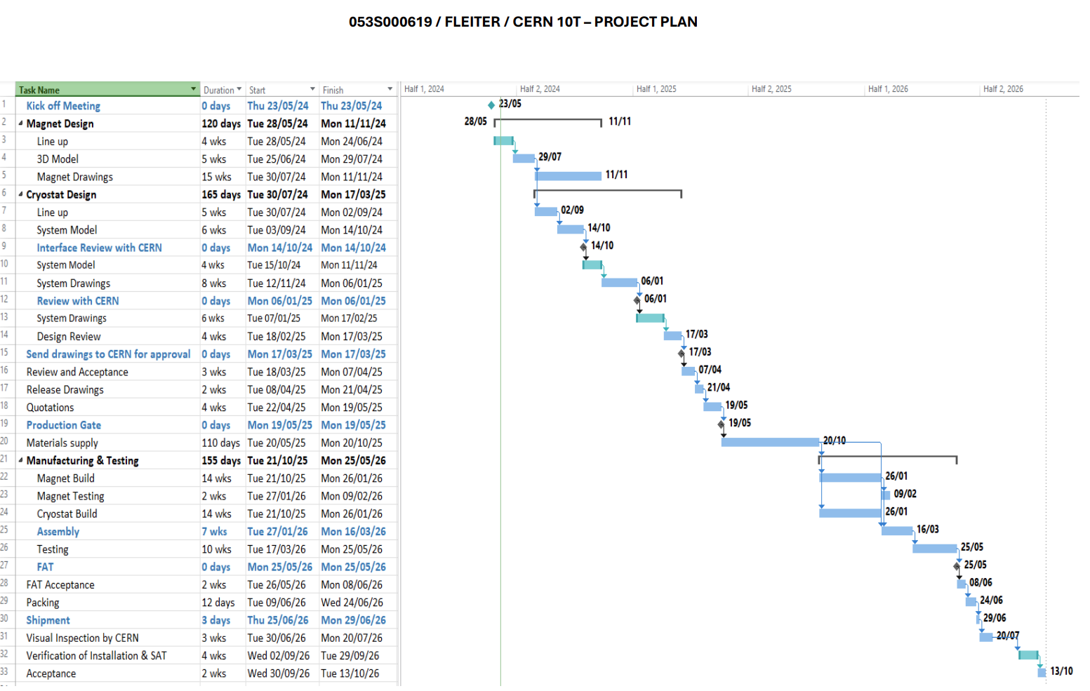
Progress update: 10 T split-pair station (2)
TE-HFM Workshop, Infrastructure needs for conductors, J. Fleiter, 19/09/2024

Slide 10
Progress update: New Cabling Machine
Procurement and installation by the industry of a new cabling machine for the manufacturing of Rutherford-type cables of up to 60 strands.
Market Survey launched on September 15th, 2023; feedback received so far from 4 companies (MS not yet closed).
Invitation to Tender: tender documentation currently under elaboration and IT expected to be launched by end of 2024 or Q1 2025.
Contract expected to be signed in Q3 2025.
Cabling machine expected to be installed and commissioned by the supplier in B927 in Q2 2027.
TE-HFM Workshop, Infrastructure needs for conductors, J. Fleiter, 19/09/2024

Slide 11
Progress update: Consolidation of the VSM station
The Vibrating Sample Magnetometer (VSM) facility of B163 has been consolidated in 2024:
The magnetic field has been calibrated by means of an NMR probe.
The temperature calibration and regulation have been investigated to ensure that the sample temperature is under control. Then the temperature calibration has been confirmed based on pure Indium and Niobium samples for which the critical temperature is well known.
Afterwards, the magnetic moment calibration was performed by means of two reference spheres provided by NIST.
Finally, both Nb₃Sn and HTS samples were measured and benchmarked against measurements performed at UNIGE, with a good agreement.
The VSM test station of B163 is now more reliable.
Work on data acquisition, software and mechanical components is planned for 2025
TE-HFM Workshop, Infrastructure needs for conductors, J. Fleiter, 19/09/2024

Slide 12
Conclusions
The main tasks of the WP5.2 are to upgrade the infrastructure needs for conductors.
The procurement of new high field test station was launched:
  Contract for magnet systems and cryostat awarded in Q1 2024
  20 T solenoid to be commissioned in Q3 2026
  10 T split pair to be commissioned in Q4 2026
The Procurement and installation of new cabling machine (up to about 60 strands) was started:
  MS issued in Sept 2023, IT expected to be launched by Q4 2024.
  Contract expected to be signed in Q1 2025.
  Cabling machine expected to be installed and commissioned by the supplier in B927 in Q2 2027.
The VSM test station has been consolidated in 2024. Work on data acquisition, software and mechanical components is planned for 2025.
TE-HFM Workshop, Infrastructure needs for conductors, J. Fleiter, 19/09/2024

