Slide 1
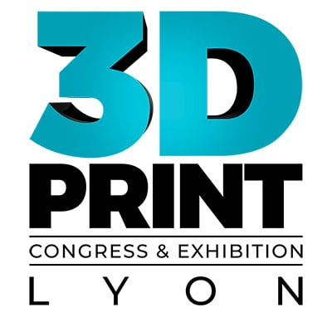
J-S. Rigaud / S. Clément
04.06.2024 Lyon Eurexpo

Slide 2
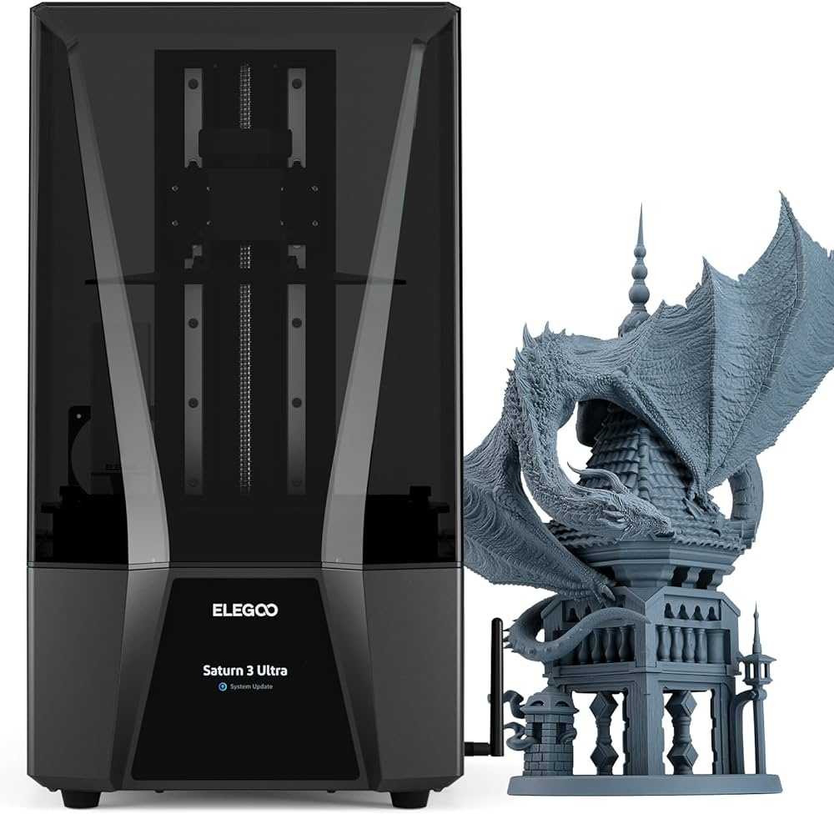
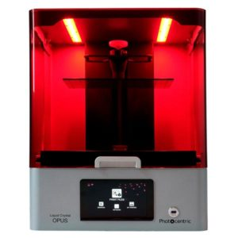
Resin 3D Printers
Saturn 4 Ultra
Technology: LCD
Build volume: 219x123x220mm
Resolution: 24 µm
Materials: UV resin 405nm
Made in: China
Brand: Elegoo
LC Opus
Technology: LCD
Build volume: 310x174x220mm
Resolution: 81 µm
Materials: UV resin 405nm
Made in: England
Brand: Photocentric
Commentary: could print RG35
Source: https://www.3djake.com/elegoo/saturn-4-ultra
Source: https://lemantek.com/lc-opus/

Slide 3
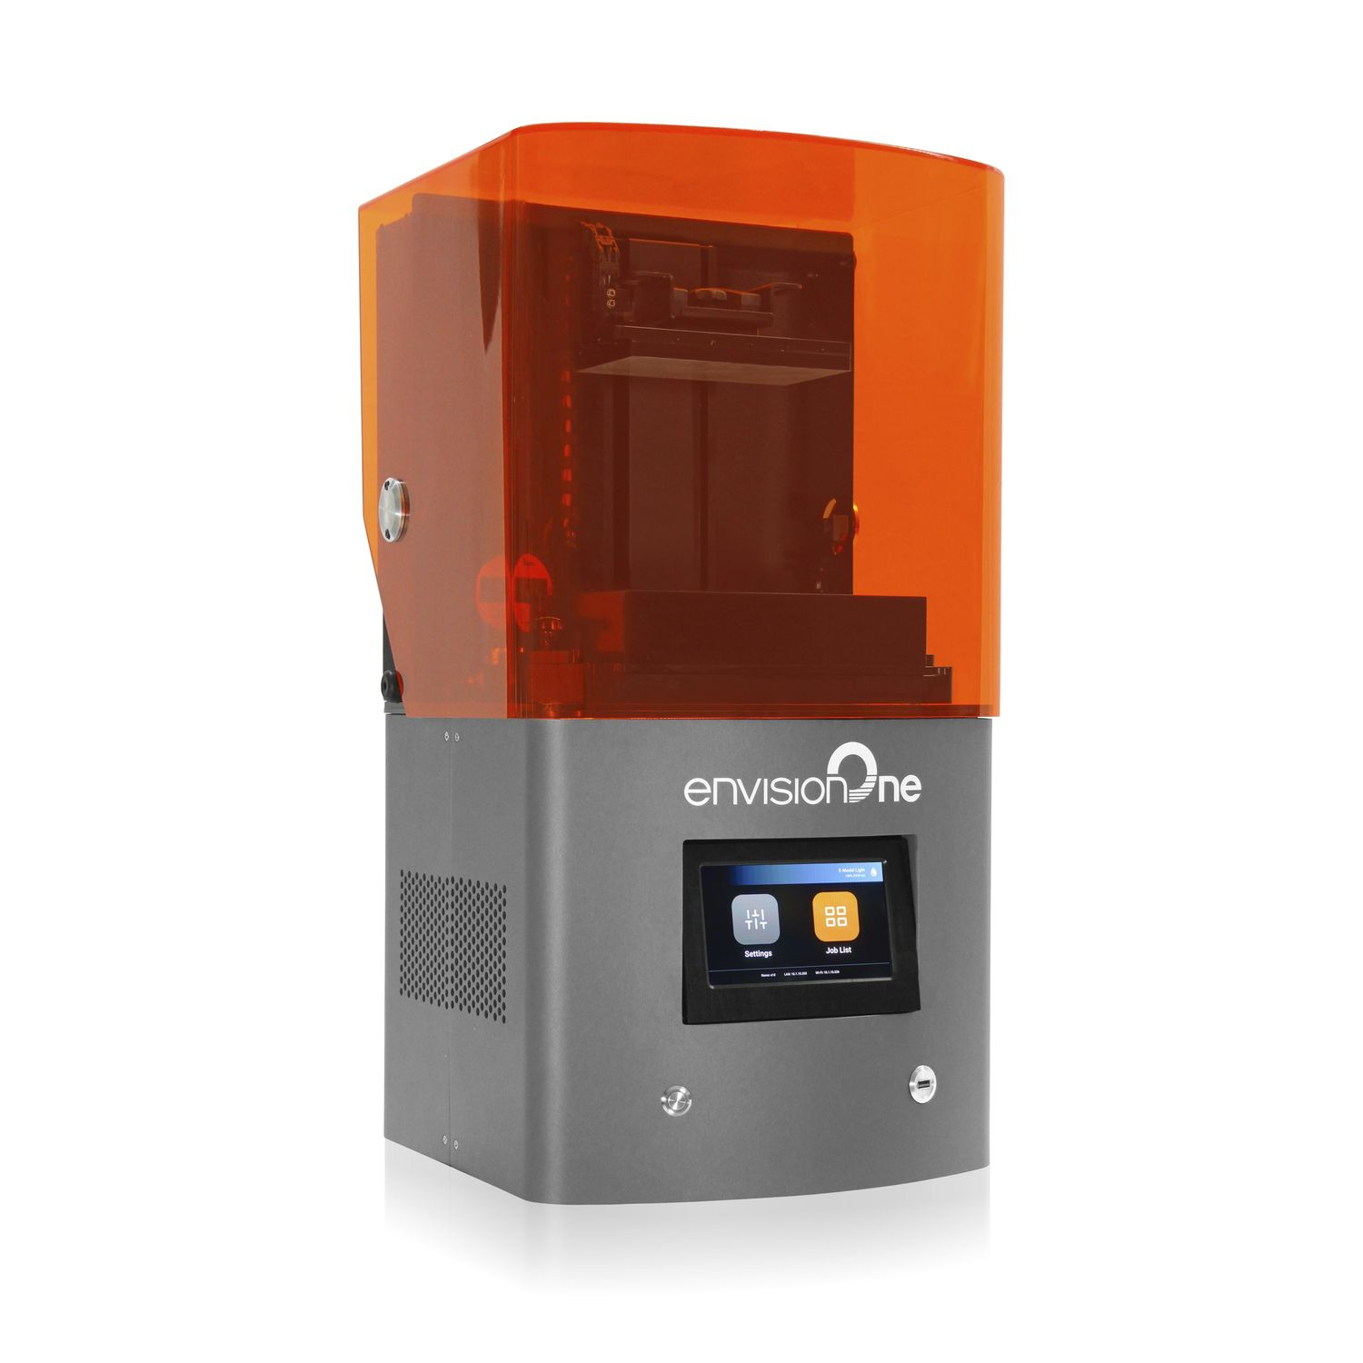
Resin 3D Printers
Envision One
Technology: LCD
Build volume: 180x101x175mm
Resolution: 93 µm
Materials: UV resin 385nm
Made in: USA
Brand: EnvisionTech
Source: https://etec.desktopmetal.com/product/envisionone/

Slide 4
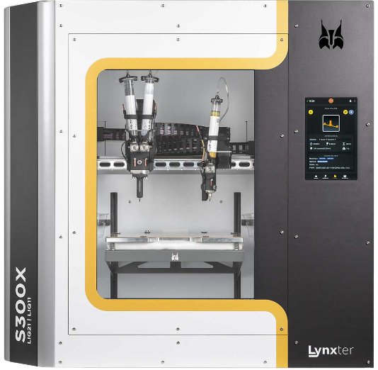
Silicones & Polyurethanes 3D Printer
S300X
Technology: Materials extrusion
Build volume: 300x250x200mm
Resolution: 24 µm
Materials: Silicones RTV & Polyurethanes
Made in: France
Brand: Lynxter
Source: https://lynxter.fr/blog/guide-conseils/s300x-liq21-liq11-defiez-les-limites-de-limpression-3d-silicone-et-polyurethane/

Slide 5
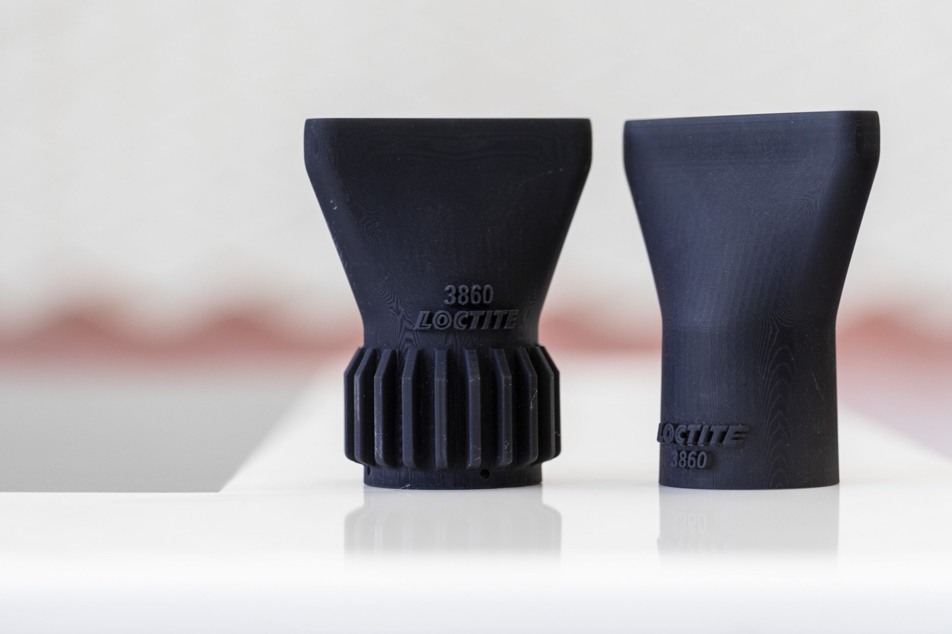
Rigid resin with high temperature resistance
Rigid resin that withstands high temperature stress and it is ideal for applications where high resolution and high HDT is required.
Printed articles made from LOCTITE 3D 3860 exhibit high heat deflection temperature (HDT) and good print resolution.
It is a low viscosity liquid, printable at room temperature across various DLP Platforms.
High temperature resin
LOCTITE 3D 3860

Slide 6
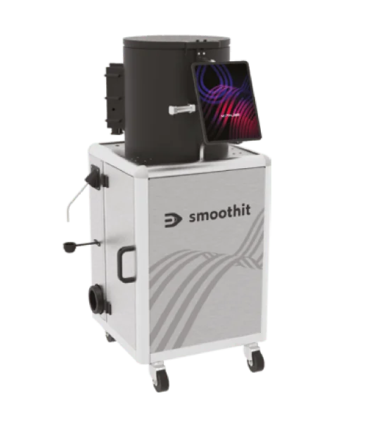
Metalization device
Device to prepare the parts before the coating

