Slide 1
2nd Open Science Practitioners Forum
18 June 2024

Slide 2
CERN Open Science Policy in brief
Captures current practice and states vision across multiple Open Science domains:
Policy to be regularly updated to reflect changes in landscape, practices, funder requirements & community demands
V1.0, Oct 2022: https://cds.cern.ch/record/2835057
Open Access to Publications | Research Integrity, Reuse & Reproducibility
Open Research Data | Infrastructure for Open Science
Open Software | Research Assessment & Evaluation
Open Hardware | Education, Training & Outreach
 | Citizen Science

Slide 3
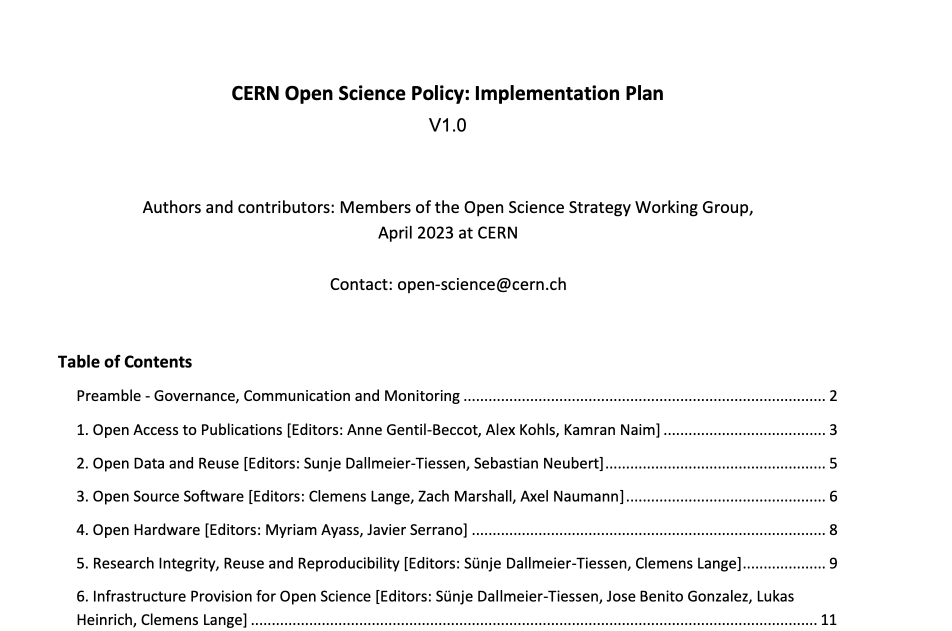
Implementation Plan
Available in CDS
https://cds.cern.ch/record/2856044

Slide 4
CERN OS Governance Framework
Directorate
Open Science Steering Board
Responsible for OS strategy & policy
Consists of department/experiment reps
OS Practitioners Forum (OSPF)
Chair: Clemens Lange
Open forum for CERN-wide exchange
Meets at least 2x per year
OS Office
Open Data WG
CoARA Implementation WG
SIPB
… WG
… Interest Group
OSPO
Ensures OS implementation
Provides input to annual OS Report

Slide 5
Open Science Report
Open Science report every two years
First reporting period 2023-2024, 1st report due beginning of 2025
To be approved by OSSB, then submitted to the Directorate of Research and Computing
Content
Update on all chapters/elements from the policy/implementation plan
Including relevant monitoring elements, e.g. KPIs or qualitative indicators
Writing/compilation coordinated by OS Office, contributions by expert groups (e.g. OSPO)
Expectation for first report
Update given OS element by element: OA, Open Data, Open Source Software…
Different maturity levels of measures and observations
More qualitative observations for “early“ elements

Slide 6
OSPF = Better together
Everyone is working on different topics and has different angles to Open Science
Let’s learn from each other
Let’s take things that work and apply them elsewhere or make them better
Tackle (new) challenges together
Create new things together
Collaboration is what makes CERN successful (among other things of course)
OSPF shall be a place to enable collaboration on OS topics/projects
Goal: we continue being a leader in Open Science

Slide 7
How to stay informed?
CERN Open Science Website: https://openscience.cern
If you organize any activity/event related to Open Science, please let us know, we can publish it on the website.
Subscribe to the egroup:
  https://e-groups.cern.ch/e-groups/Egroup.do?egroupId=10585227

Slide 8
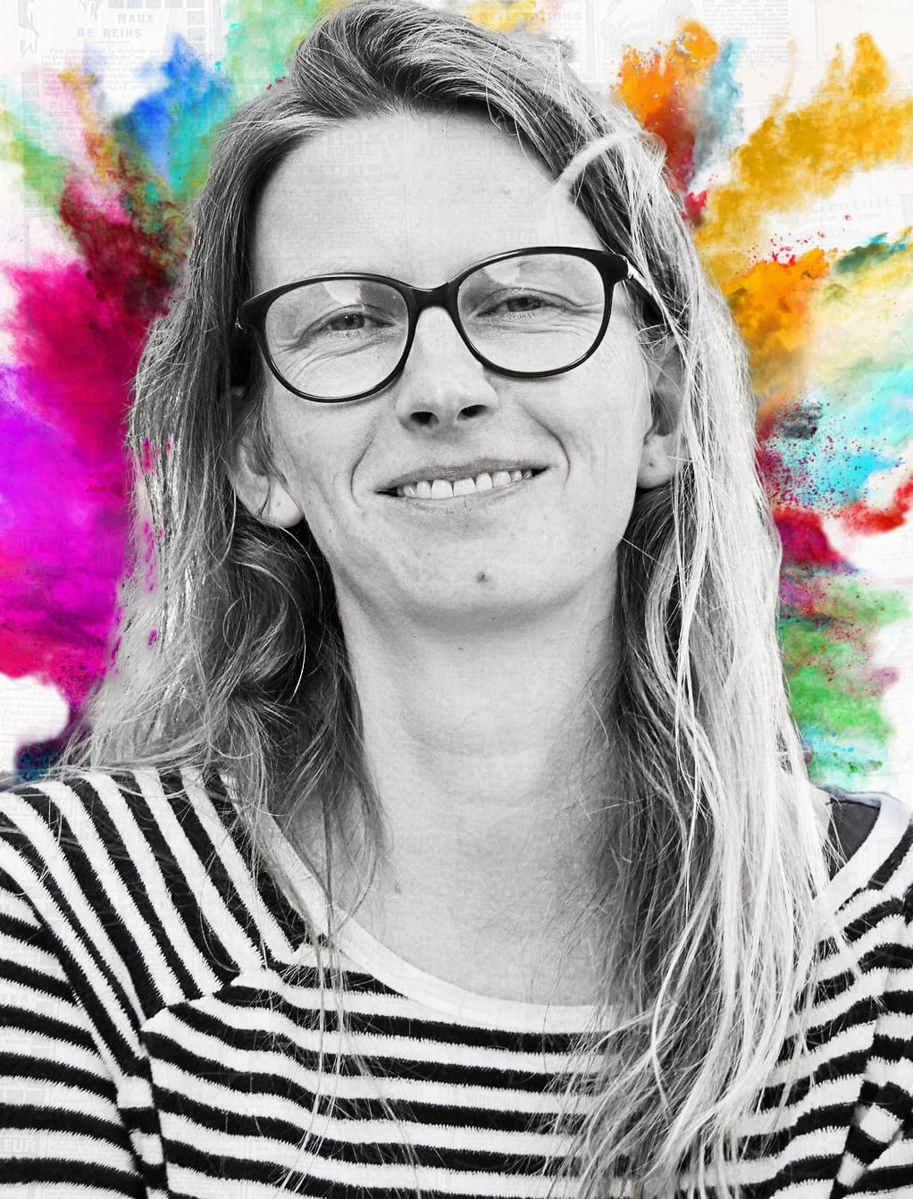
Thank you!
Thank you for your outstanding efforts in enabling, promoting, and incentivizing Open Science at CERN!

Slide 9
Today‘s agenda
Update from OSPO (Axel Naumann)
Update from Open Data Working Group (Jamie Boyd)
Open Science Monitoring Framework (Iris Kyranou)
SCOAP3 Phase 4 (Kamran Naim)
Update on Coalition for Advancing Research Assessment: CoARA (Antonia Winkler)
A.O.B

Slide 10
Moving forward
The OSPF is a forum where the Open Science practitioners come together
The OS policy and its implementation plan give us quite some leverage to enable us to "conduct" Open Science
Please provide feedback (clemens.lange@cern.ch):
  If you run into any obstacles
  If you think the policy or its implementation plan are lacking/need updates
  If you think we need/could profit from having additional working groups
  If you have any other suggestions/concerns
Open Science at CERN will only work with your contributions

Slide 11
Next OSPF events
End of September: topical meeting on KPIs to get reports from the different groups
  Consultation with the different practitioner groups
  Newdle to be sent out
October: meeting with other labs in the field
  Idea: find out what they are doing, how we can help each other
  If you know potential interesting participants, please reach out! (anne.gentil-beccot@cern.ch)
November: Meeting focused on Open Science report.
Also open to organising additional topical meetings in line with the needs of practitioner groups
  Please reach out if you have any suggestion! (anne.gentil-beccot@cern.ch)

