Slide 1
Eigenstate Thermalization Hypothesis
Ibrahim Mohamed — Dr. Ali Nassar
202000394 PEU Major, Zewail City

Slide 2
Quantum Mechanically, how to produce Thermodynamics?

Slide 3
Classically, Ergodicity is the hypothesis.

Slide 4
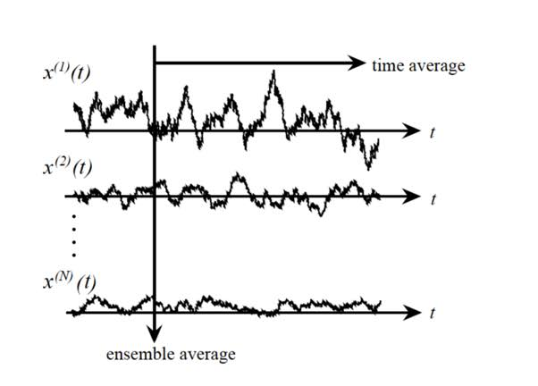
Classically, Ergodicity is the hypothesis.

Slide 5
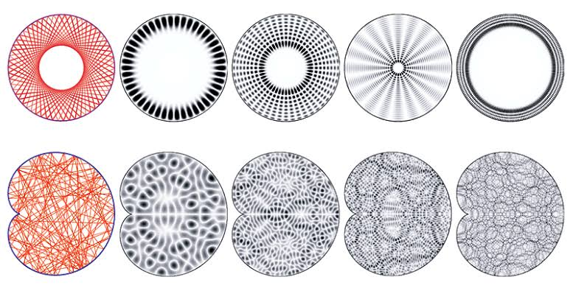
Classically, Ergodicity is the hypothesis.

Slide 6
Find Criteria, then look for its applicability

Slide 7
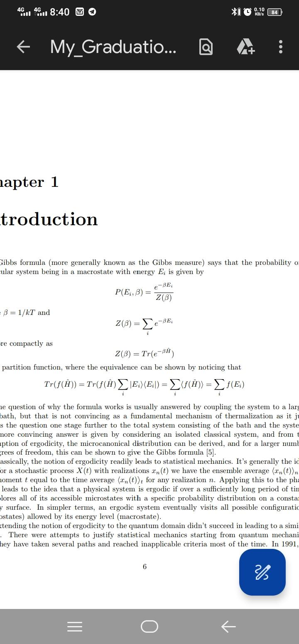
Derivation of the Criteria
Classical Statistical Mechanics

Slide 8
Derivation of the Criteria

Slide 9
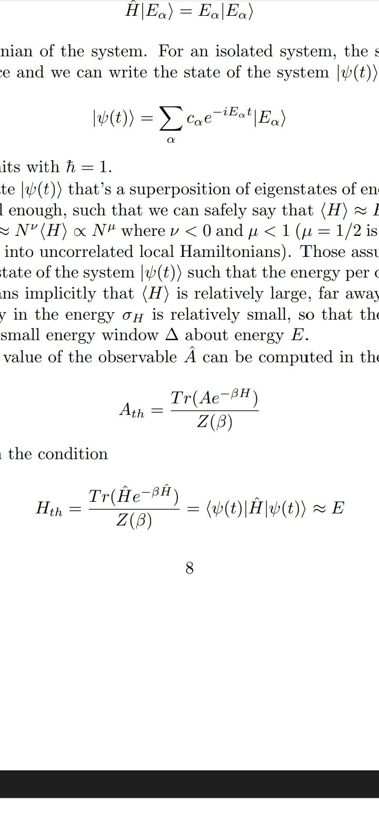
Derivation of the Criteria

Slide 10
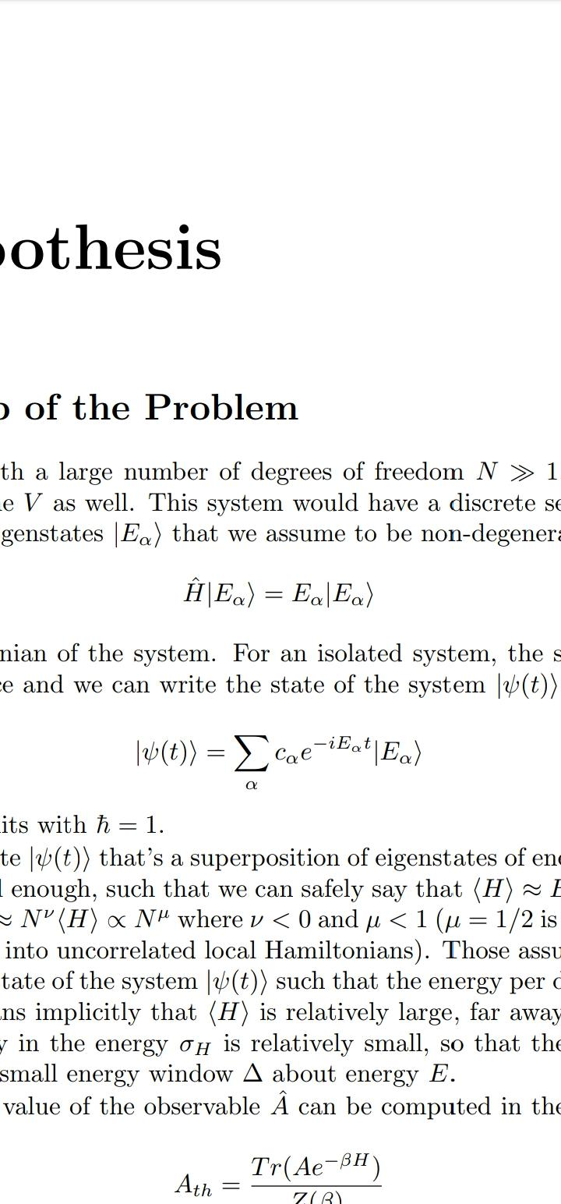
Derivation of the Criteria
Quantum Mechanics
Constraints in Energy and type of Superposition

Slide 11
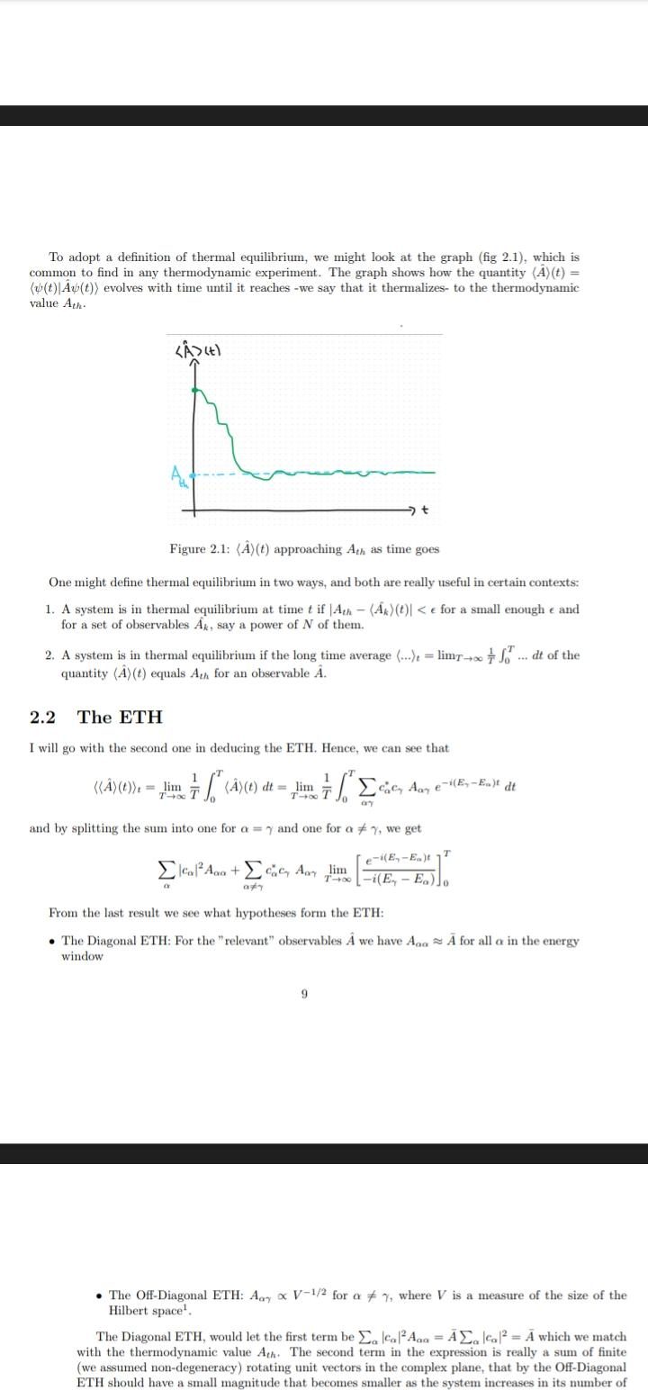
Derivation of the Criteria
Defining thermal equilibrium

Slide 12
Derivation of the Criteria

Slide 13
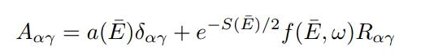
Derivation of the Criteria
ETH (Mark, 1994)

Slide 14
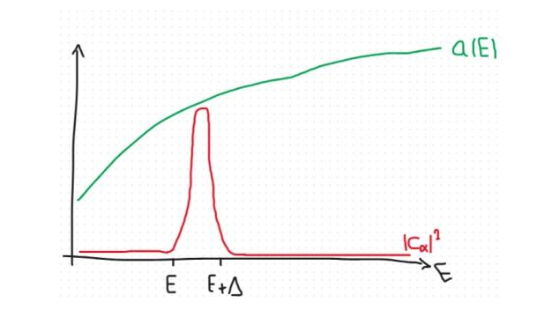
Justification of Diagonal terms

Slide 15
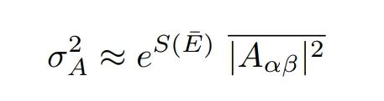
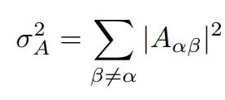
Justification of Off-Diagonal terms

Slide 16
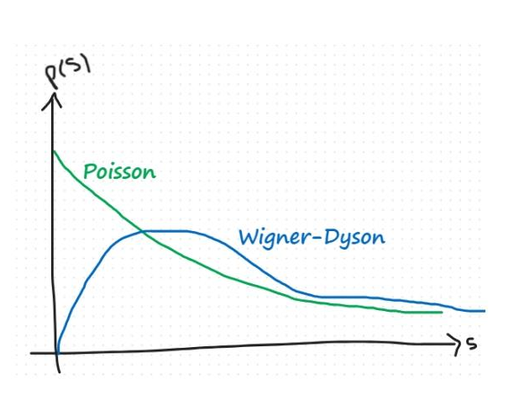
Diagnostic
When does an integrable system become chaotic so that ETH applies?

Slide 17
Thanks for your attention!
Questions?

