Slide 1


Conformal Bootstrap
By: Bahy Elsisi
Supervised by: Dr. Ali Nassar
Department of Physics of Earth and Universe, University of Science and Technology at Zewail City

Slide 2



Background
Conformal Field Theories (CFTs): Quantum field theories with a special kind of symmetry called conformal symmetry. This symmetry allows for transformations that preserve angles but not necessarily lengths.
Conformal transformations are transformations that preserve local angles even if the lengths are not preserved.

Slide 3


Introduction to Conformal Bootstrap
Due to researchers failing to use perturbative methods to solve strongly interacting systems, a new method was proposed in the eighties.
Conformal bootstrap is a non-perturbative solving method that can solve 2D and 3D conformal field theories.
New numerical techniques were introduced based on semi-definite programming to solve such cases.

Slide 4

Conformal Bootstrap
What it is? A powerful framework to study CFTs.
How it works?
  Exploits constraints from conformal symmetry, unitarity (probabilities must add up), and crossing symmetry (exchanging particles in scattering).
  Uses the operator product expansion (OPE), a way to simplify complex interactions.
My goal is to determine the spectrum of scaling dimensions (how quantities change with scale) and OPE coefficients (strength of interactions).

Slide 5

Applications in Quantum Mechanics
  Large N Matrix Quantum Mechanics: A simplified model used to understand quantum gravity.
  Bootstrap helps to find the spectrum (energy levels) and expectation values (average values of observables).
  Simple Quantum Mechanical Systems: Bootstrap can be used to find the energy levels and wave functions of systems with known potentials (like the hydrogen atom or harmonic oscillator).

Slide 6


Quantum Anharmonic Oscillator
Using the Hamiltonian of the oscillator $H=p^{2}+x^{2}+gx^{4},$ as well as using the identity where $〈\left[H,O\right]〉=0$ for a generalized form $O=x^{t}p$ we reach a relation of the form $4 t\left\langle x^{t−1}p^{2}\right\rangle =8g\left\langle x^{t+3}\right\rangle +4\left\langle x^{t+1}\right\rangle −t(t−1)(t−2)⟨x^{t−3}⟩$.
We then get rid of the momentum operator by using the energy to get a recursion relation of the form $4tE\left\langle x^{t−1}\right\rangle +t\left(t−1\right)\left(t−2\right)\left\langle x^{t−3}\right\rangle −4\left(t+1\right)\left\langle x^{t+1}\right\rangle −4g(t+2)⟨x^{t+3}⟩=0,$ meaning we can measure the moments by just knowing the energy and the expectation value of $x^{2}$.
Invoking a positivity constraint on the observable O, where which allows us to construct the Hankel matrix.

Slide 7

Simple Quantum Mechanical Systems

Slide 8

Examples (Coulomb Potential, Harmonic Oscillator)
• Equipped with the recursion relation we can start solving quantum mechanical systems with known analytical energies.
• With the Hamiltonian of the hydrogen atom $H=\frac{1}{2}p_{r}^{2}+\frac{l\left(l+1\right)}{2r^{2}}−\frac{1}{r}$ ,we substitute in the recursion relation to calculate the moments needed to construct the Hankel matrix.
• We use different energies with different depths of K to capture the effect of the bootstrap compared to the analytical solution.
• We recreate the same steps with the Hamiltonian of the harmonic oscillator.

Slide 9
Results

Slide 10
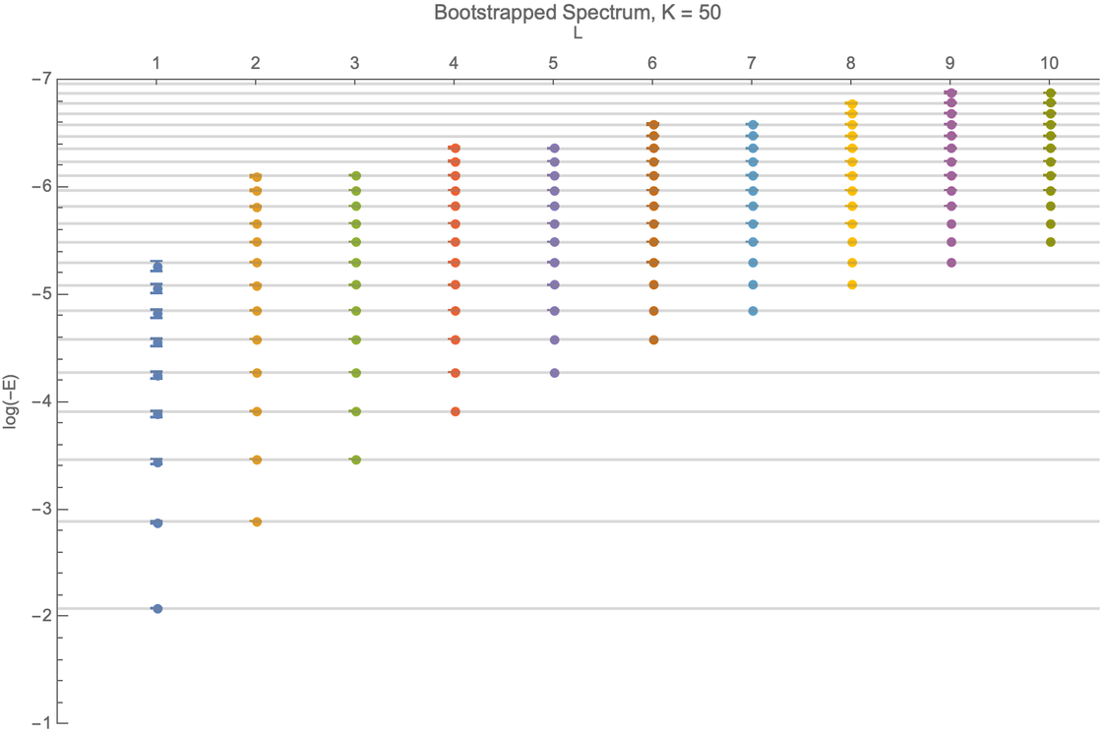
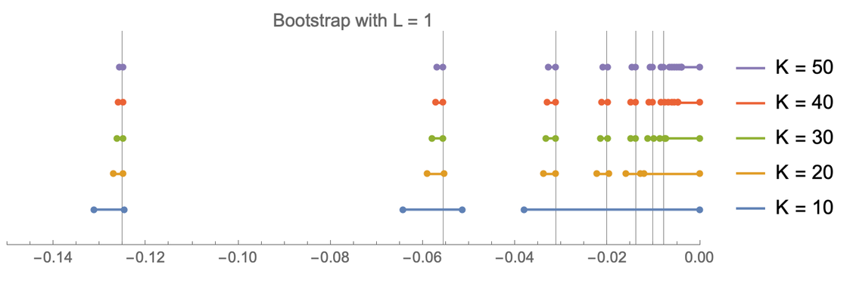
The bootstrapped hydrogen spectrum for K=50 and different values of l, with the exact spectrum in grey.
The bootstrapped energy values E at different K values and l = 1. The horizontal axis is the various values of the energy

Slide 11
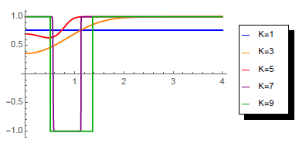
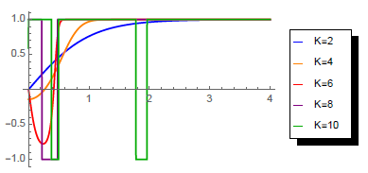
Visualized constraint regions for KxK matrices where the left graph
is for even columns of the matrix and the right graph for the odd columns. We
represent the our guesses for the energy by the grey horizontal line. These plots
represent the plotting of tanh(det(Me,o)) with different sizes for the matrices. To
satisfy the positivity constraint, only the region where all curves are positive is
valid(to ensure the satisfaction of the positivity constraint for all matrices).

Slide 12
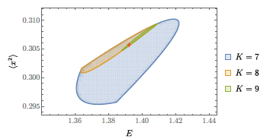
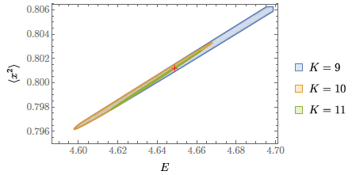
These are the allowed bootstrap regions(shaded regions) for the anharmonic oscillator with g=1, near the ground state solution which is marke by
the red dot (different values of K are used).
These are the allowed bootstrap regions(shaded regions) for the anharmonic oscillator with g=1, near the excited state solution which is marked by the red dot(different values of K are used).[

Slide 13
Conclusions
  Conformal bootstrap is a powerful tool for studying CFTs and quantum mechanical systems.
  It provides a non-perturbative way to access information about strongly interacting systems.
  The method is successful in both complex matrix models and simple quantum systems.
  Future work can explore more applications and refine the techniques.

Slide 14
Thank You

