Slide 1
Variational Auto-Encoders for Anomaly Detection in Particle Physics
Institution: University of Science and Technology at Zewail City
Submitted by Abdullah Saber Soliman
Supervised by: Dr. Ahmed Ali Abdelalim

Slide 2
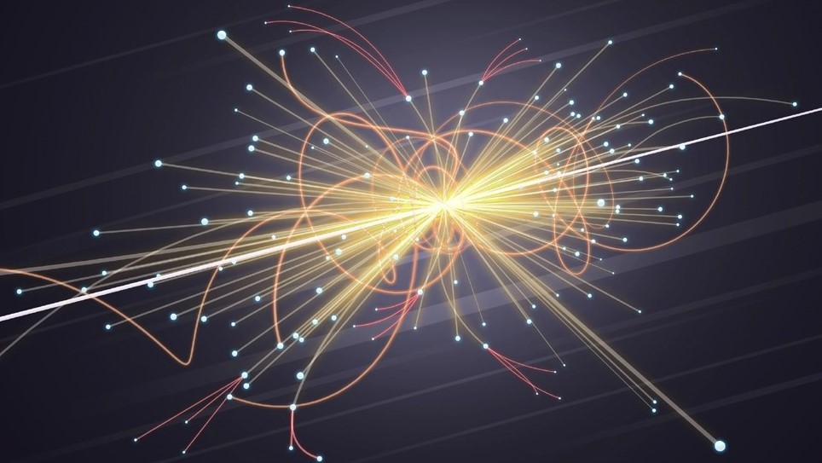
Introduction
Motivation: The need for new physics beyond the Standard Model.
Objective: Utilizing variational autoencoders for detecting anomalies in particle collision data.

Slide 3
Advantages of Machine Learning
Anomaly Detection: ML algorithms, particularly unsupervised learning techniques, can detect anomalies and rare events that may indicate new physics.
No Event Selection: Defining selection criteria to isolate events likely to be from the decay of the new particle may decrease statistical significance.
Look-else-where-effect: Conducting multiple independent tests decreases significance.
Model Agnostic: They can learn patterns and make predictions based on the data provided, regardless of the source or the field of study.

Slide 4
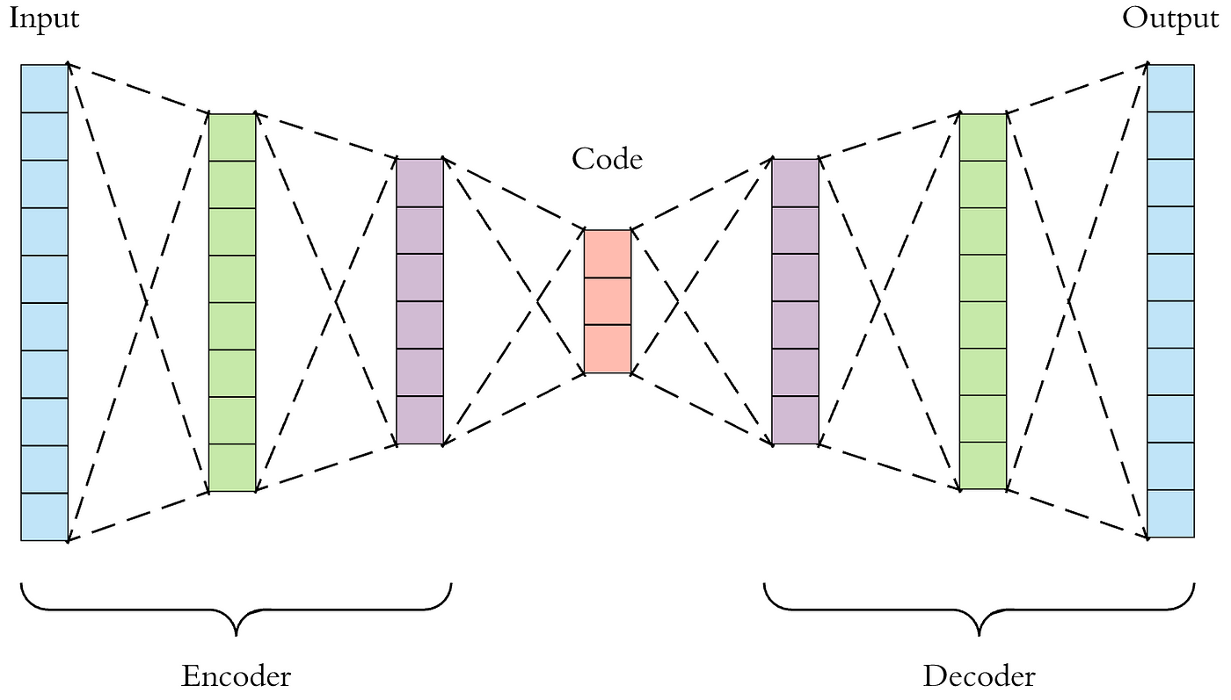
Auto-Encoder Architecture

Slide 5
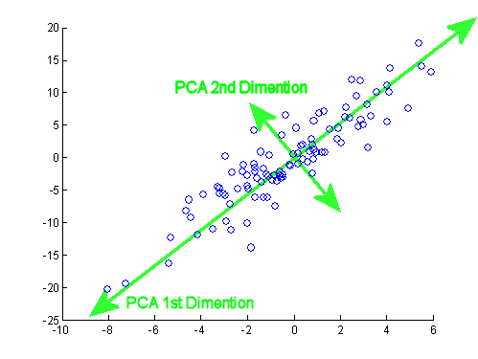
Auto-Encoder Architecture
The simplest auto-encoder with is equivalent to PCA with components equal to latent space dimension.

Slide 6
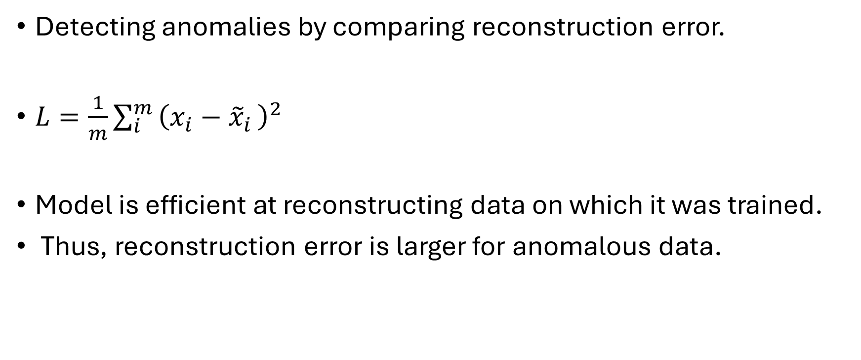
Auto-Encoder Architecture
Detecting anomalies by comparing reconstruction error.
$L=\frac{1}{m}\sum_{i}^{m }{{\left(x_{i}−{\tilde{x}}_{i }\right)}^{2}}$
Model is efficient at reconstructing data on which it was trained.
Thus, reconstruction error is larger for anomalous data.

Slide 7
Data Description and Preprocessing
The dataset consists of simulated events from the Large Hadron Collider (LHC) at a center-of-mass energy of 13 TeV.
Events include both background and signal processes generated at leading order (LO) with up to two additional partons using MG5 aMC@NLO v6.3.2 (Madgraph).
The dataset is stored in a CSV file with one line per event. Each line contains: Event ID, Process ID, and kinematic features.

Slide 8
Data Description and Preprocessing
Data was normalized to speed up training. Kinematic variables were log-transformed to handle right-skew.
Correlations between kinematic features were calculated to identify multicollinearity, which can lead to variance inflation.
The preprocessed dataset was split into training instances with dimensions (214185,20,6), indicating 214,185 training instances of (20,6) 2D arrays. The arrays were zero-padded for missing values, which did not significantly affect model training.

Slide 9
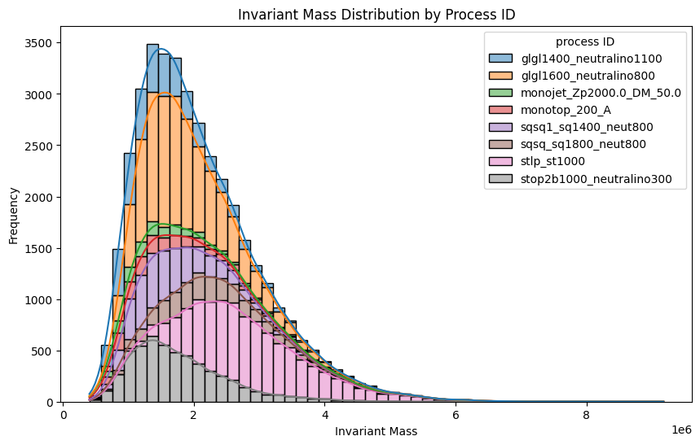
Data Preprocessing
Invariant mass distribution is right-skewed.

Slide 10
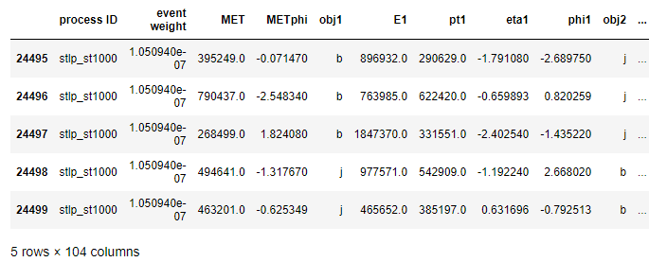
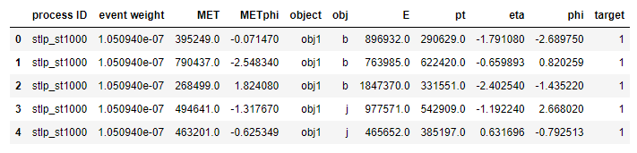
Data Description and Preprocessing

Slide 11
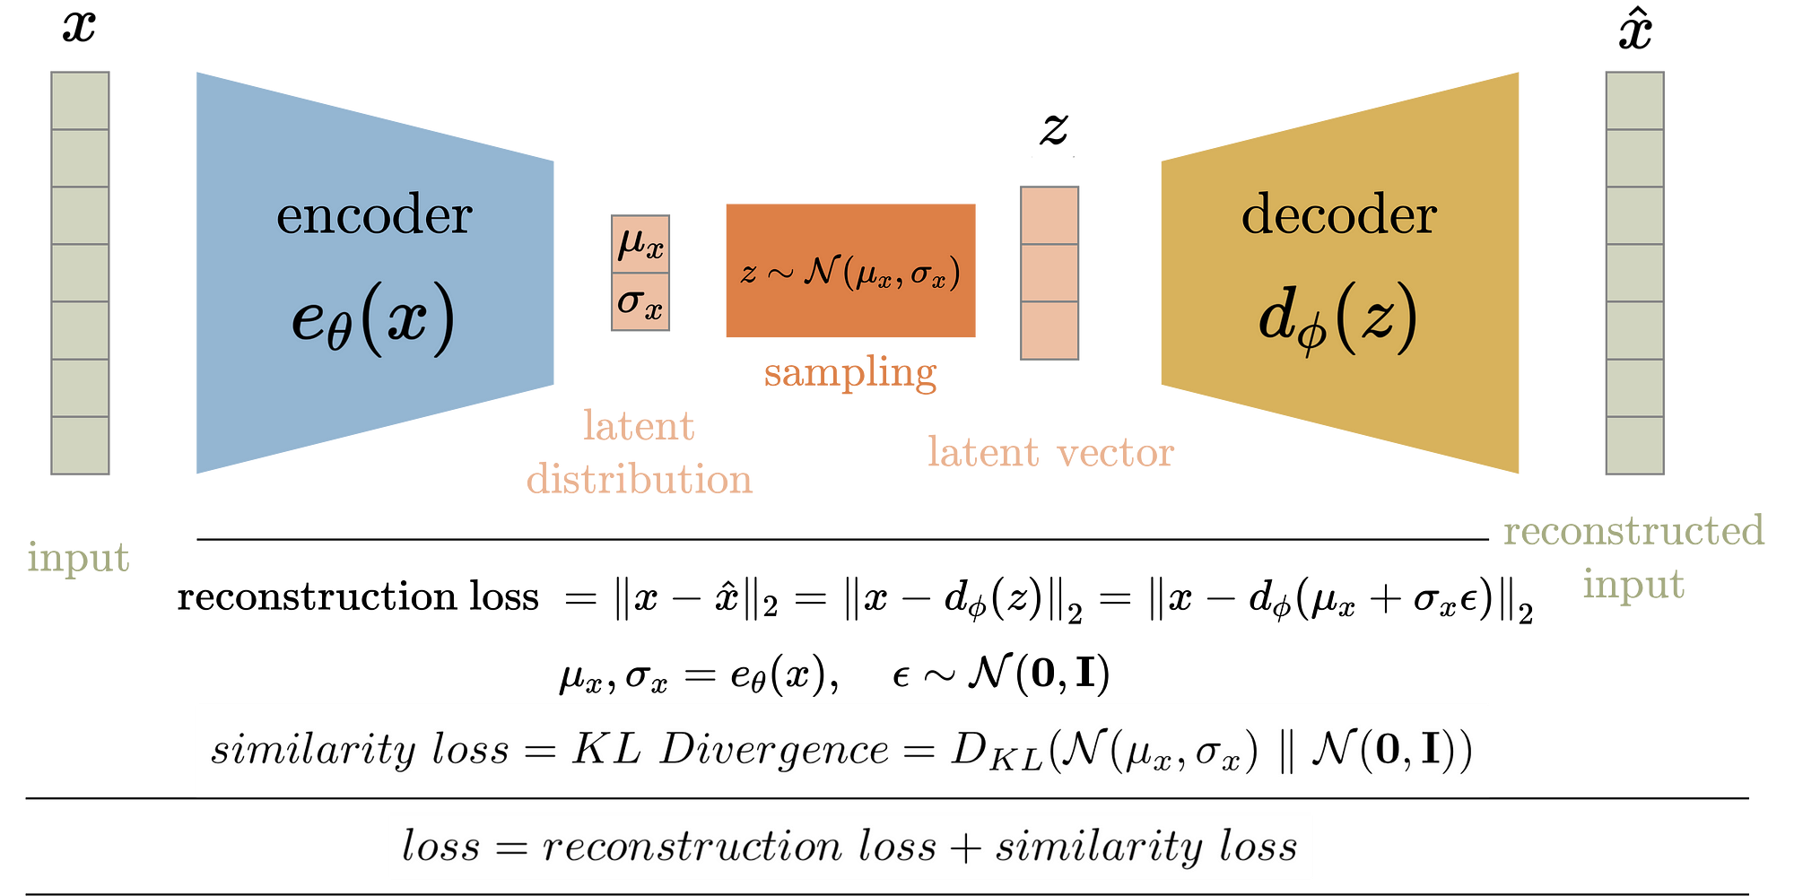
Methodology
Simple vs. variational auto-encoder

Slide 12
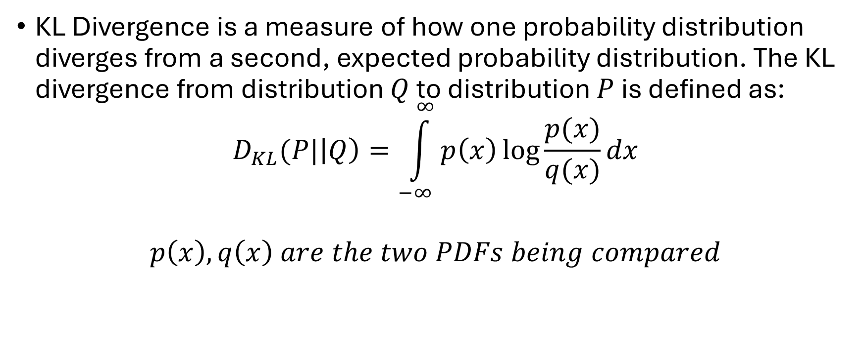
Methodology
KL Divergence is a measure of how one probability distribution diverges from a second, expected probability distribution. The KL divergence from distribution $Q$ to distribution $P$ is defined as:
$$D_{KL}(P|\left|Q\right)=\int_{−∞}^{∞}{p\left(x\right)\log{\frac{p(x)}{q(x)}dx}}$$
$$p\left(x\right), q\left(x\right) are the two PDFs being compared$$

Slide 13
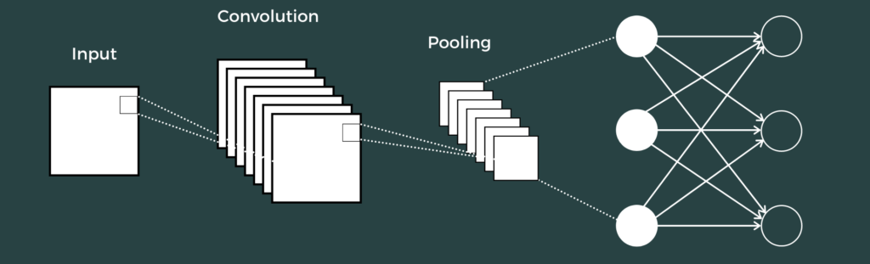
Convolutional Neural Networks

Slide 14
Training Process
Model Architecture
Encoder:
  Input layer with 30 neurons (corresponding to the 30 features in the dataset).
  Two hidden layers with 128 and 64 neurons respectively, both using ReLU activation.
  Latent space represented by two vectors: mean (z_mean) and standard deviation (z_log_var).
Decoder:
  Two hidden layers with 64 and 128 neurons respectively, both using ReLU activation.
  Output layer with 30 neurons to reconstruct the input data.
Sampling Layer:
  Combines z_mean and z_log_var to generate a latent vector using the reparameterization trick.

Slide 15
Training Process
Training Configuration
Loss Function:
  VAE loss composed of reconstruction loss (mean squared error) and KL divergence.
Optimizer:
  Adam optimizer with a learning rate of 0.001.
Batch Size:
  256 samples per batch.
Epochs:
  Trained for 100 epochs.

Slide 16
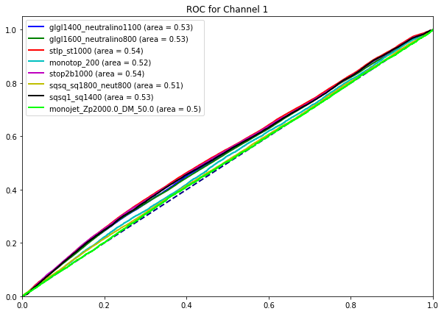
Results
ROC-AUC Curve:

Slide 17
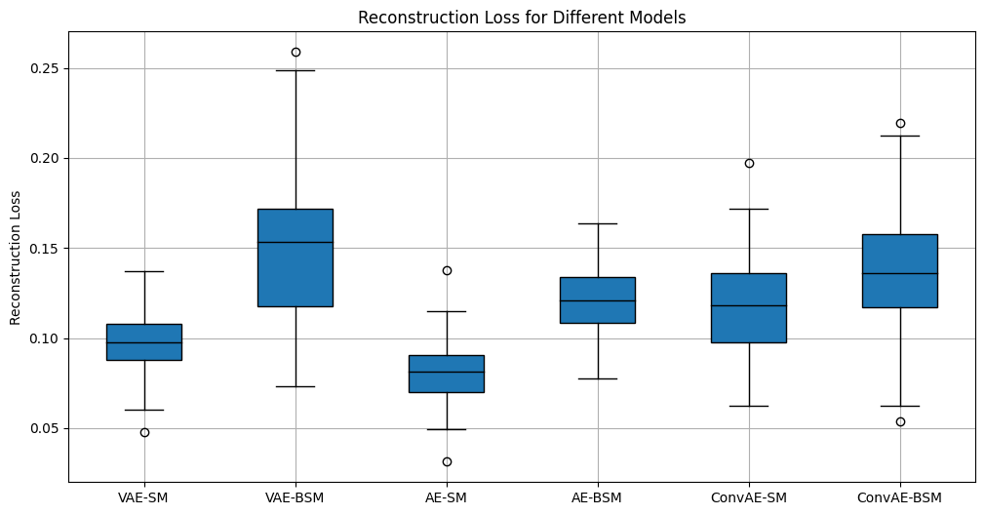
Results

