Slide 1


Slide 2
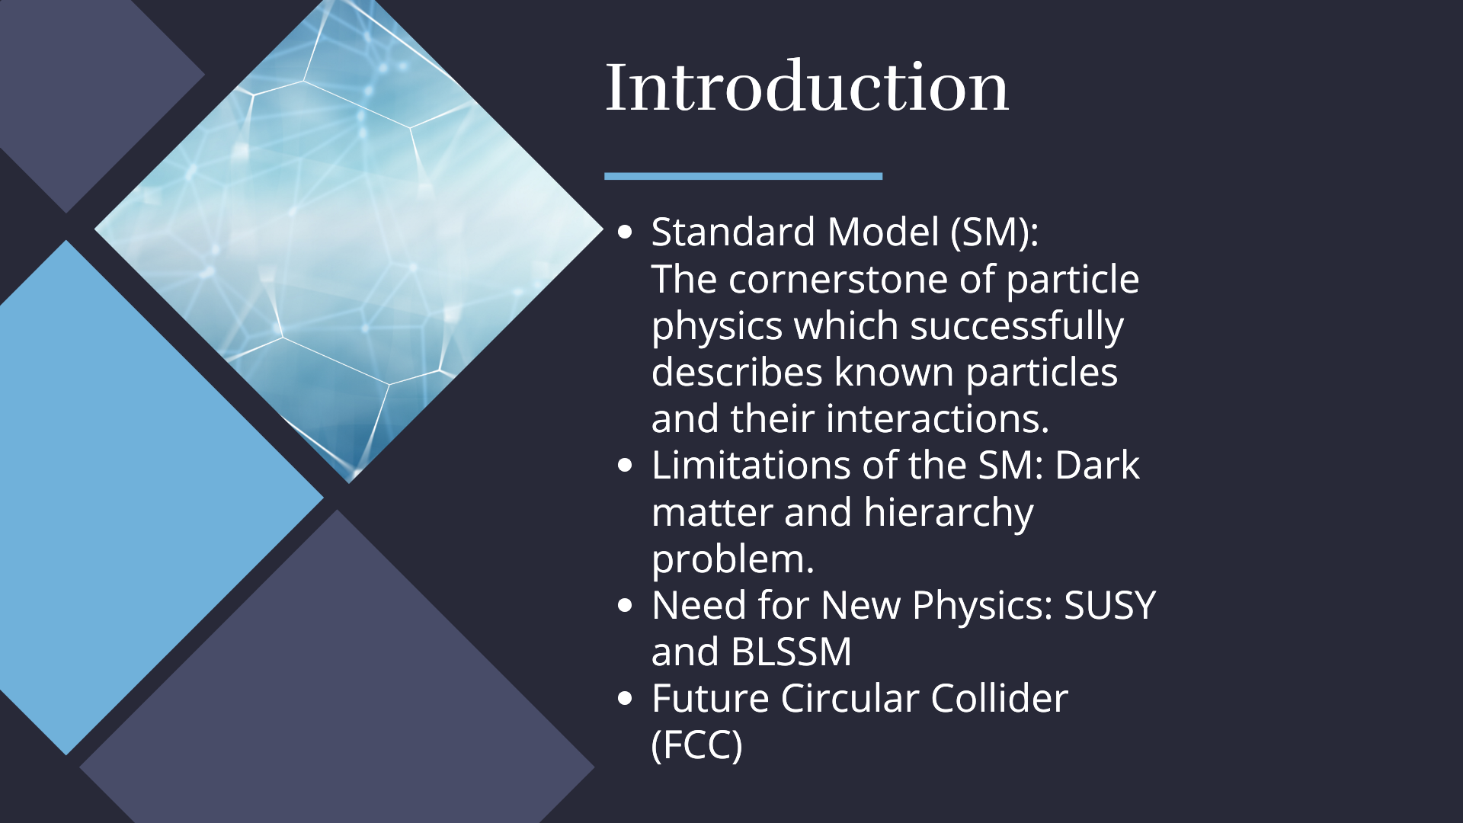

Slide 3
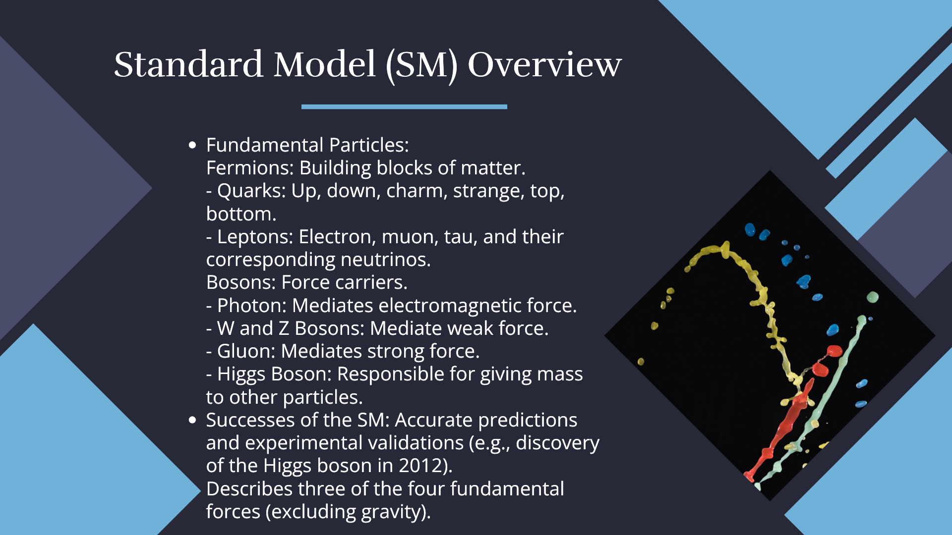

Slide 4
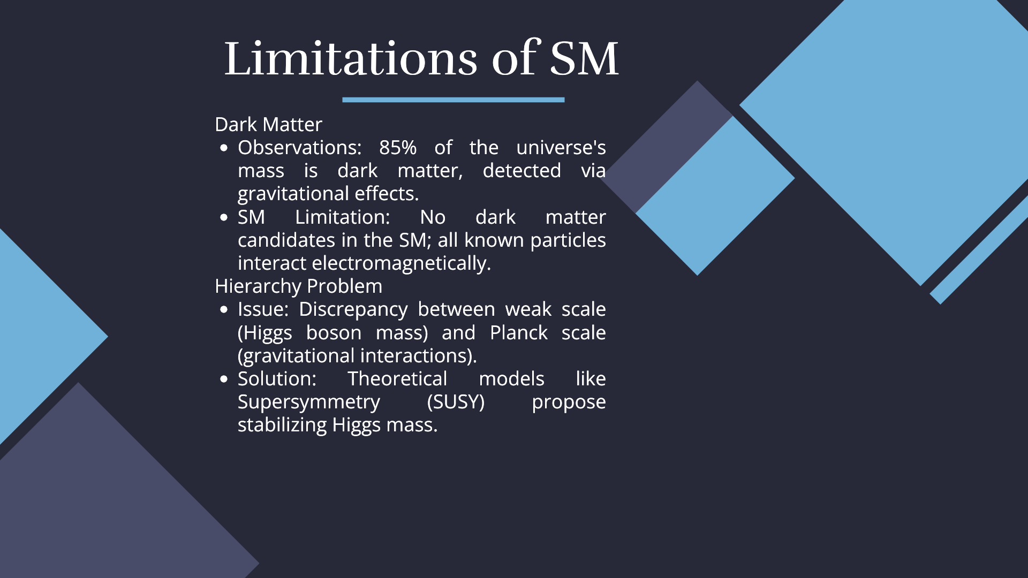

Slide 5

BLSSM
B-L Symmetry: Incorporates an additional U(1)_{𝐵−𝐿}​ gauge symmetry. Where B: Baryon number and L: Lepton number
Key Features
Right-Handed Neutrinos: Provides a mechanism for neutrino masses.
New Gauge Boson (Z' Boson): Mediates B-L interactions. Potentially detectable at future colliders.
Stabilization of the Higgs Mass: Similar to SUSY, helps address the hierarchy problem.

Slide 6
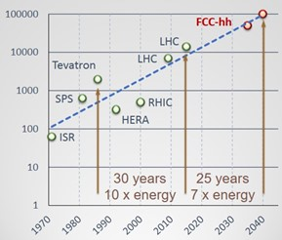
Comparison Between LHC and FCC-hh
Large Hadron Collider (LHC):
  Energy: 13 TeV
  Circumference: 27 kilometers
  Achievements: Higgs boson discovery in 2012 and Precision measurements of SM parameters
Future Circular Collider - Hadron Collider (FCC-hh)
  Energy: 100 TeV
  Circumference: 100 kilometers
  Goals: Explore physics beyond the Standard Model.
  Search for new particles and forces (e.g., Z' bosons)
  Advantages Over LHC: Higher collision energy increases potential to discover new particles.
  Greater luminosity for more precise measurements

Slide 7
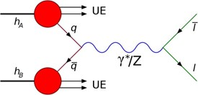
The Drell-Yan Process
Definition: A major mechanism for Z boson production in hadron colliders. Named after Sidney Drell and Tung-Mow Yan.
Process: Quark (q) from one proton and anti-quark (𝑞ˉ) from another proton annihilate. Produce a virtual photon (𝛾∗) or Z boson (Z) which decays into a lepton pair (𝑙⁺𝑙⁻ ).
Key Features: Invariant Mass: The mass of the lepton pair equals the mass of the Z boson.
Significance: Vital for studying electroweak interactions and testing Standard Model predictions.

Slide 8
Z' (Z Prime) Gauge Boson.
Hypothetical heavier counterpart of the Z boson.
Predicted by several extensions of the Standard Model (e.g., BLSSM).
Characteristics:
  Higher mass than the Z boson.
  Similar decay modes, often into lepton pairs.
Searches and Significance:
  Current experiments focus on detecting Z' through high-energy pp collisions.
  Discovery would indicate new physics beyond the Standard Model

Slide 9
Signal Simulation Process
Proton-Proton Collisions:
Simulated at 100 TeV center of mass energy.
MadGraph:
  Utilizes Monte Carlo techniques for probabilistic outcome estimation.
  Generates particles predicted by models beyond the Standard Model.
Delphes: Produces high-fidelity collision data.
PYTHIA: Facilitates event generation.

Slide 10
Signal and Background Generation
Signal Generation
Process: Proton-proton collision → Heavy gauge boson (Z') → Muon + Antimuon.
Model Used: BLSSM
Simulation Output:
  Events Generated: 10,000 events.
  Cross Section: 0.1722 pb.
Background Generation
Interactions:
  Four proton-proton interactions producing muon and antimuon but
  Different mediators (not Z') based on Standard Model particles.
Simulation Output:
  Events Generated: 100,000 events per background.

Slide 11
Background
1. p + p → µ⁺ + µ⁻
2. p + p → w⁺ + w⁻, w⁺ → µ⁺ + µ⁻, w⁻ → µ⁺ + µ⁻
3. p + p → z + z, z → µ⁺ + µ⁻, z → µ⁺ + µ⁻
4. p + p → w + z, w → µ⁺ + µ⁻, z → µ⁺ + µ⁻

Slide 12
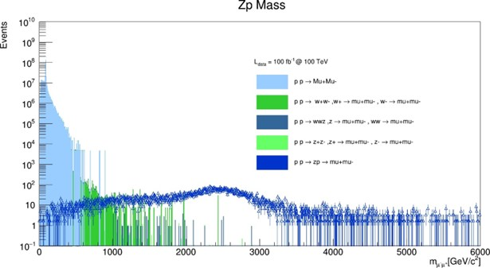
Results

Slide 13
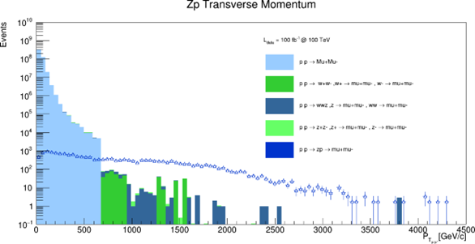
Results

Slide 14
Conclusion
the extensive energy capabilities and high interaction rates of future colliders render them essential in the quest for new phenomena that could address unresolved issues in particle physics and transform our understanding of nature. Although no definitive evidence for new bosons has been discovered yet, future collider experiments are among the most promising methods for uncovering new physics and making groundbreaking discoveries. Our analyses indicate that future colliders have significant potential to discover or rule out a wide range of Z’ particles over a compelling mass range.

Slide 15


