Slide 1
Welcome to CERN
Maarten Litmaath
CERN IT
January, 2025
Based also on material graciously provided by
Prof Dr Freya Blekman
DESY and University of Hamburg

Slide 2
What is CERN about?
CERN
  Original meaning: Conseil Européen pour la Recherche Nucléaire
  Current meaning: European Organization for Nuclear Research
Quick summary of its main goals
  C → collaboration
  E → education
  R → research
  N → new technologies

Slide 3
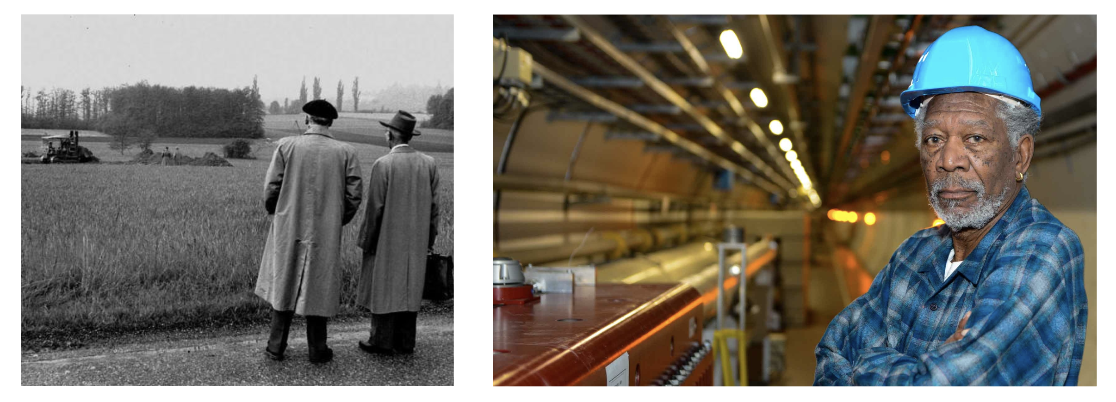
Important dates
1949: first steps towards civilian research in nuclear technology
1952: foundation of CERN under auspices of UNESCO
1953: Signing of the CERN charter
1954: Completion of the ratification by the 12 founding states

Slide 4
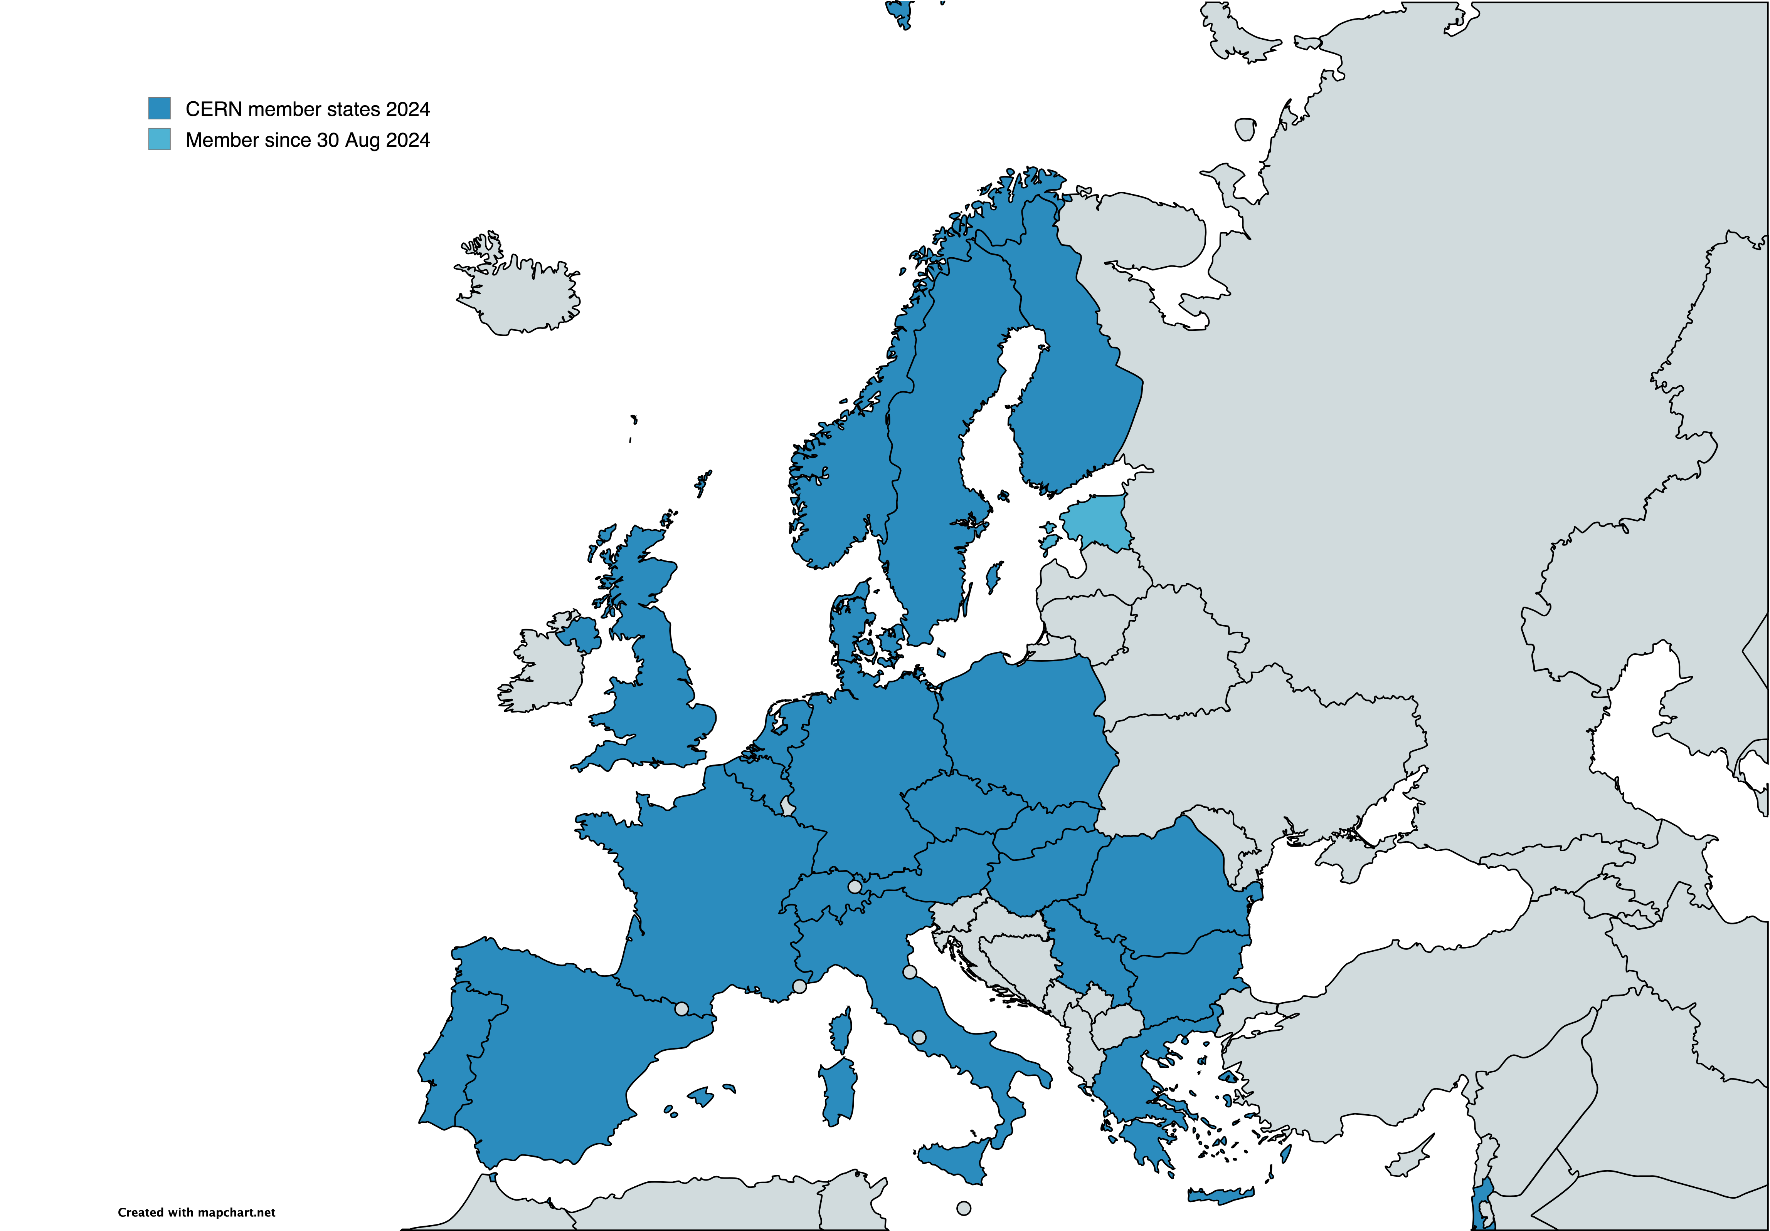
Contributions from member states in 2024
Austria | 2.2% | Italy | 9.9%
Belgium | 2.8% | Netherlands | 4.7%
Bulgaria | 0.4% | Norway | 2.2%
Czechia | 1.2% | Poland | 3.1%
Denmark | 1.9% | Portugal | 1.1%
Estonia | (*) | Romania | 1.3%
Finland | 1.4% | Serbia | 0.3%
France | 13.4% | Slovakia | 0.5%
Germany | 21.1% | Spain | 7.0%
Greece | 1.0% | Sweden | 2.7%
Hungary | 0.7% | Switzerland | 3.8%
Israel | 2.2% | UK | 15.1%
CHF 1'222 M
Associate members:
Cyprus, Estonia (*), Slovenia
Brazil, Croatia, India, Latvia,
Lithuania, Pakistan, Türkiye, Ukraine
CHF 33 M
Observers: EU, Japan, (JINR), UNESCO, USA

Slide 5
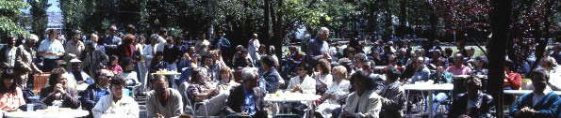
Who works at CERN?
~3000 people employed by CERN
  Physicists, engineers, computer scientists, mathematicians, technicians, secretaries, fire brigade, health & safety experts, security, etc
>10000 physicists associated with CERN
  From all over the world!

Slide 6
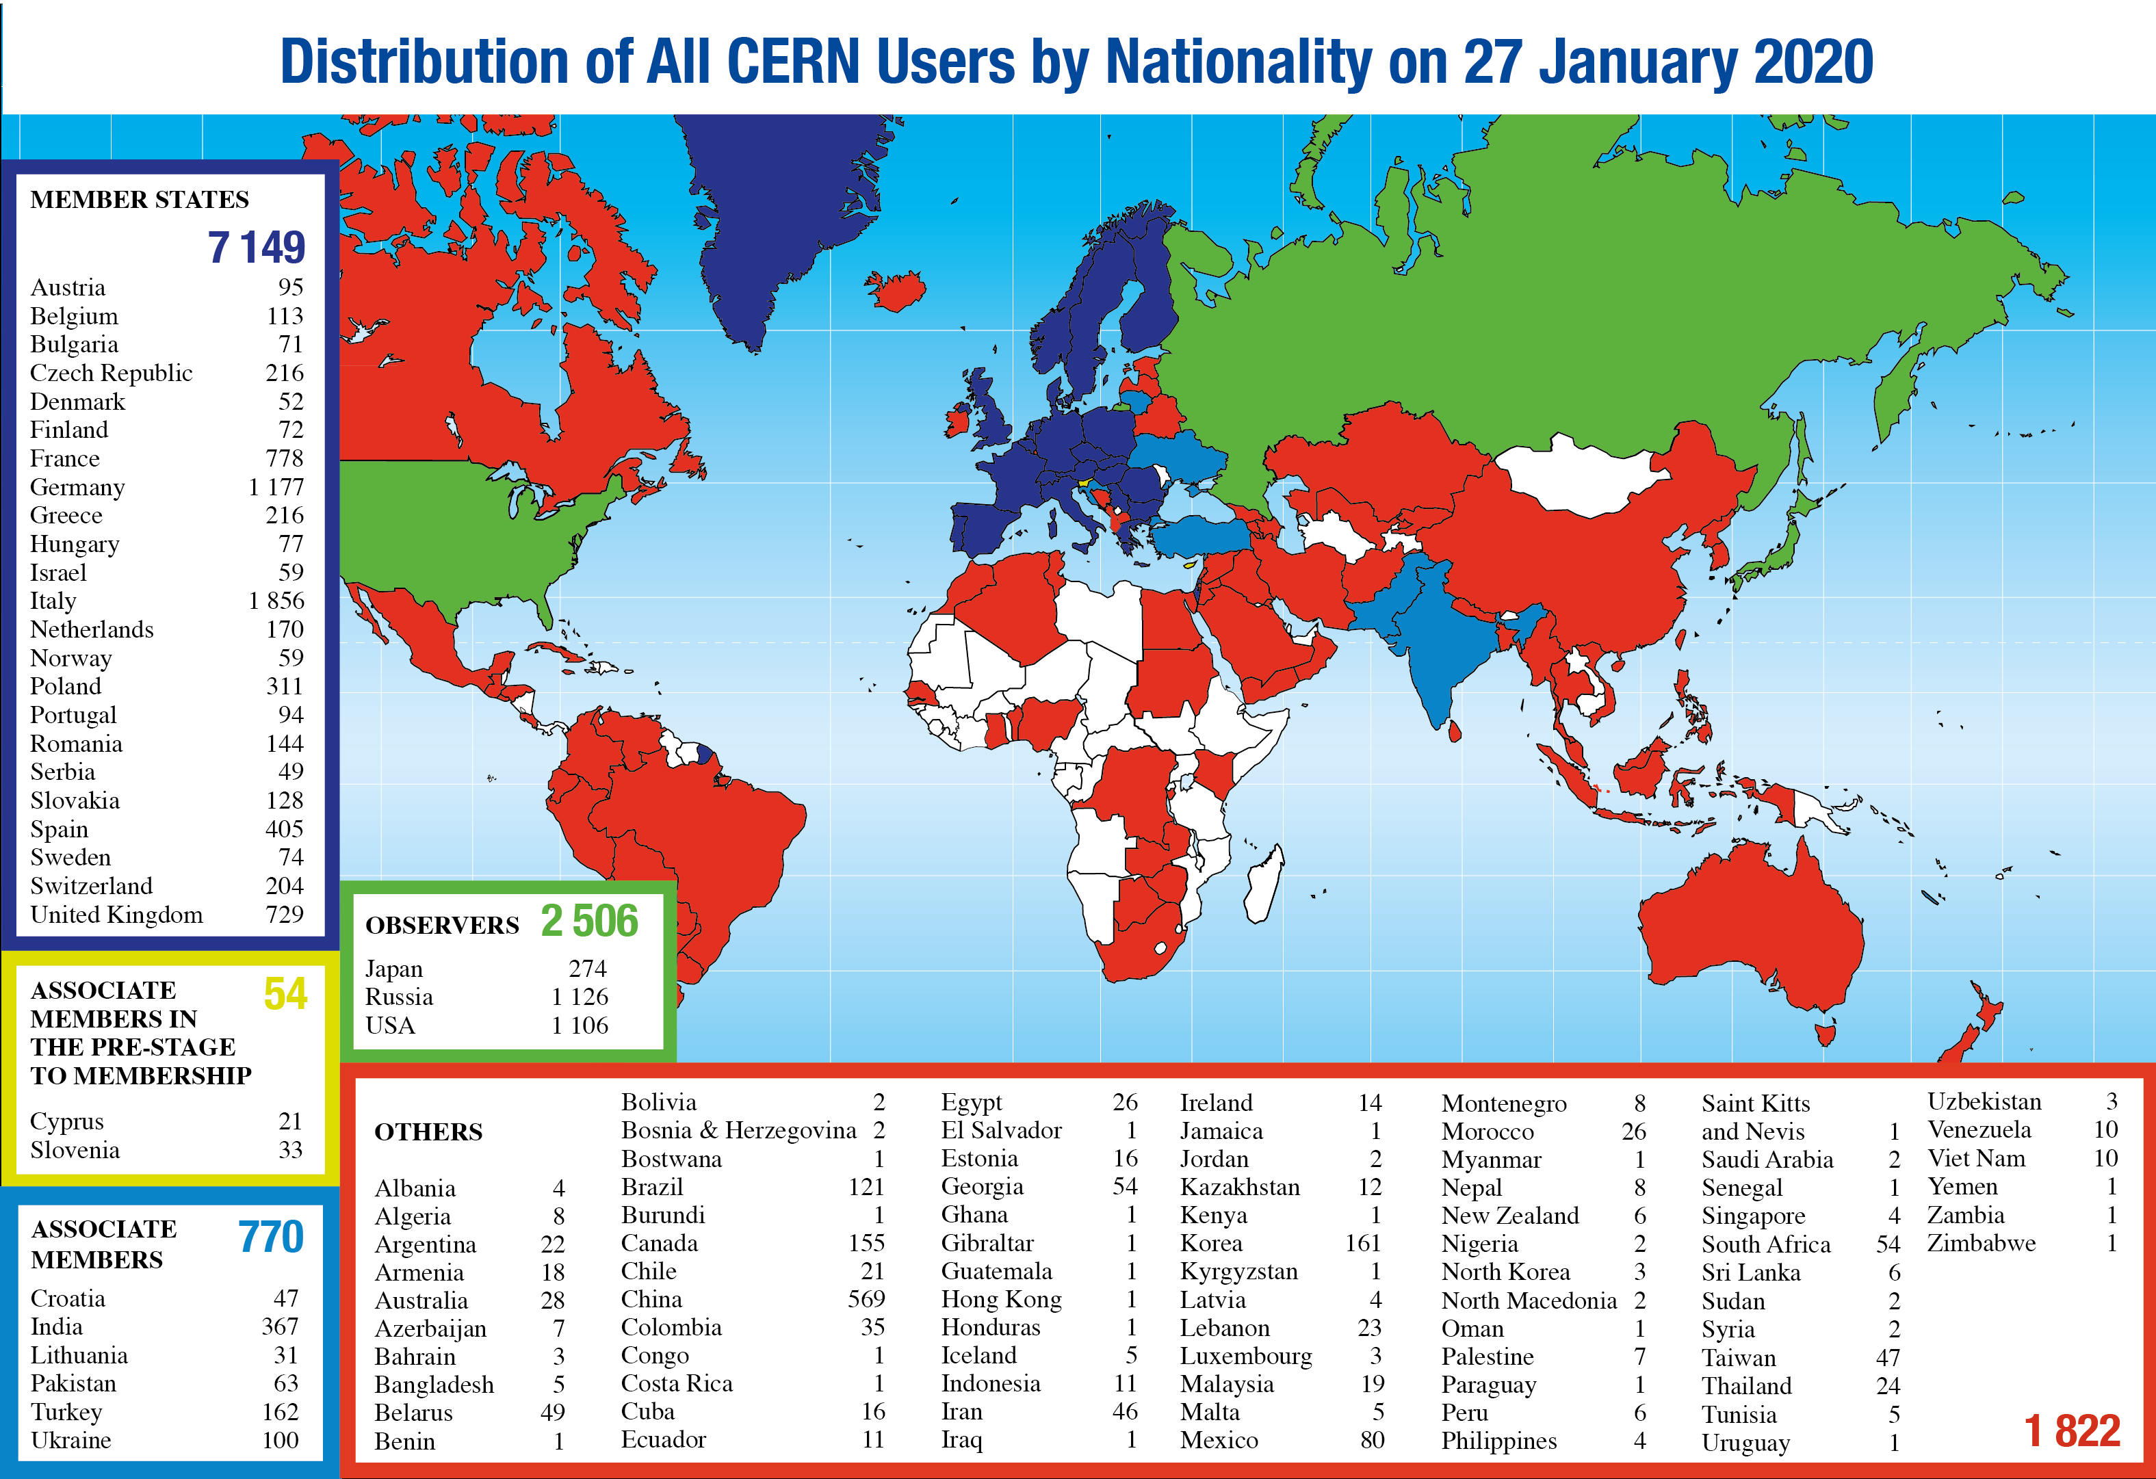

Slide 7
Who visits CERN
CERN is an open laboratory
  With certain constraints and regulations
Every year, ~130’000 people have visited CERN since many years
Open days September 2019: 75’000 people visited in 2 days!!!
The foresees 300’000 - 500’000 visitors per year!
Science Gateway

Slide 8
Basic vs applied research
Two types of science research
  Basic research (how do things work)
  Applied research (how do I make...)
Applied research often builds on basic research
CERN only does basic research
  But we often need to innovate to build things that do not exist yet...

Slide 9
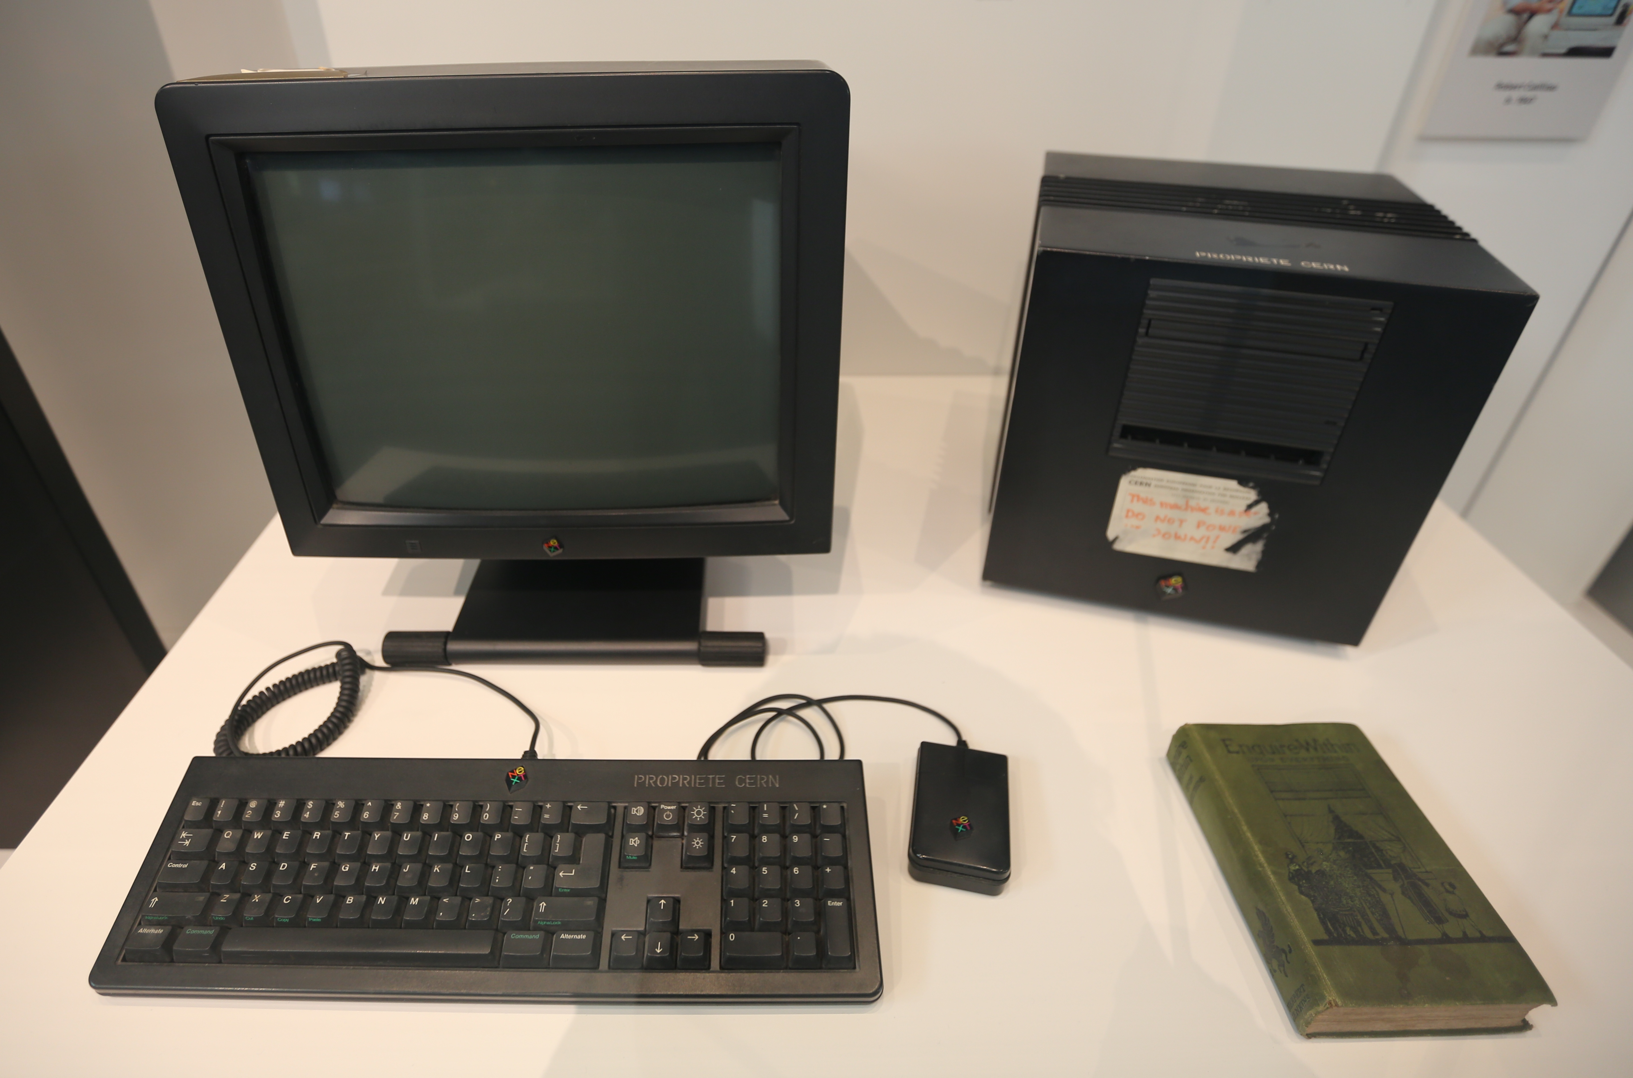


For example, the World Wide Web!
Tim Berners-Lee

Slide 10
But also...
CERN against COVID-19
Reuse CERN techniques
and technologies to help
the global battle against
the COVID-19 pandemic:
Low-cost ventilators
for breathing devices
Zenodo space for fast
and easy publication
of research data sets
and results
Using part of WLCG
for Folding@Home
…
Medical applications
  PET / CT / MRI scan technologies
    Detectors, superconducting magnets, cryogenics, vacuum
  Radiation therapy: accelerators, detectors
Space applications
  High-radiation environment materials / devices
Other computing developments
  Data analysis & simulation frameworks
  Grid middleware
  Indico – meeting and conference management
  Invenio, Zenodo – digital library management
And more

Slide 11
Basic Questions
What is everything around us made of?
How does matter stick together?
What, really, is mass?
  And does the Higgs particle indeed play a role in the creation of mass?
Are there really only 3 spatial dimensions?
Are the smallest particles we know fundamental?
Where did the anti-matter go?
Where’s the rest of the matter anyway?

Slide 12
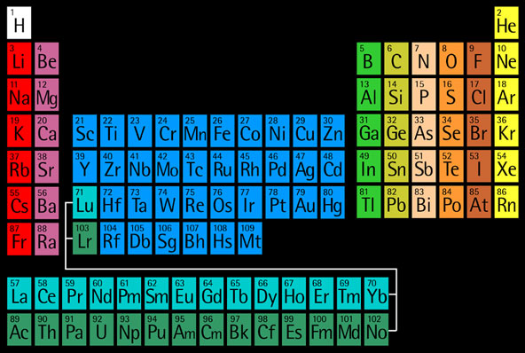
What is everything around us made of?

Slide 13


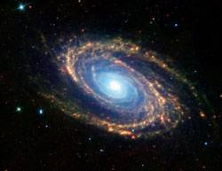
At different scales…
Mainly O, C, H
Mainly Fe, O, Si
Mainly H and He
96% out there unknown!
13

Slide 14
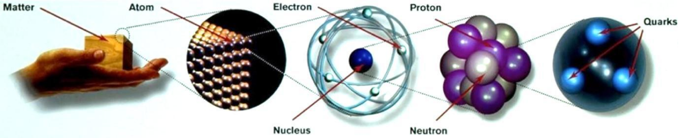
What is everything around us made of?

Slide 15
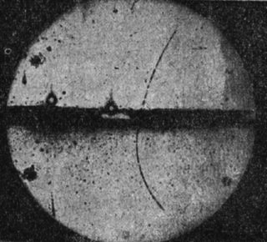
Anti-matter
Anti-matter: discovered in 1923
  Predicted by theory
Almost the same as matter...
But oppositely charged +
some subtle effects…
Problem: at the Big Bang there would have been just as much anti-matter as matter... Where did all that anti-matter go?

Slide 16
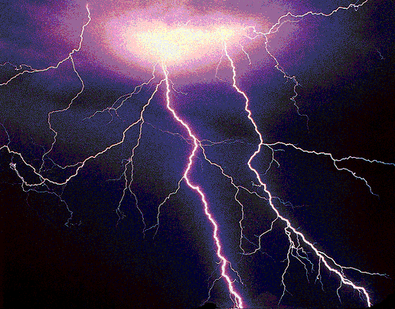
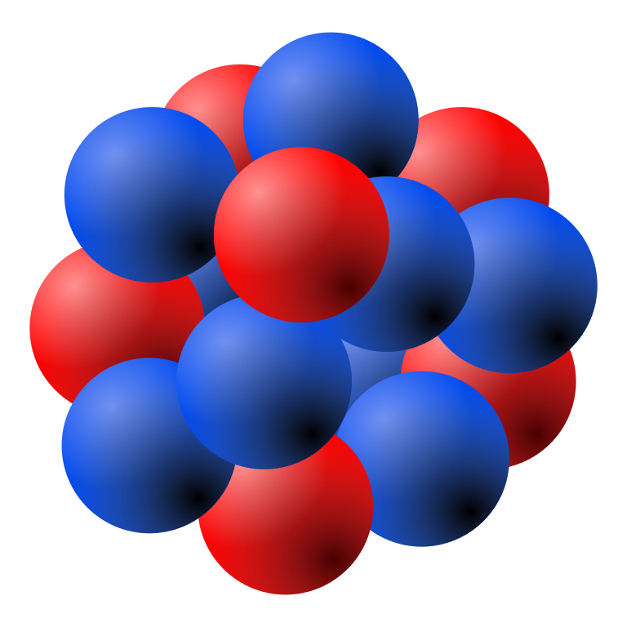

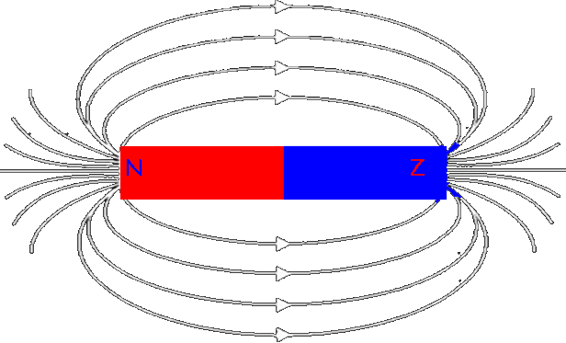
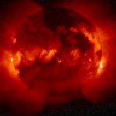
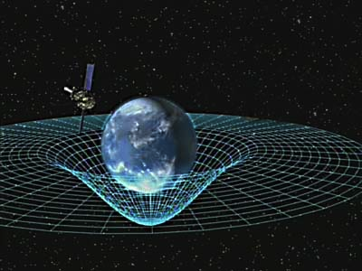
The four fundamental forces
Electro-magnetic force
Strong force
?
Weak force
Gravity
16

Slide 17
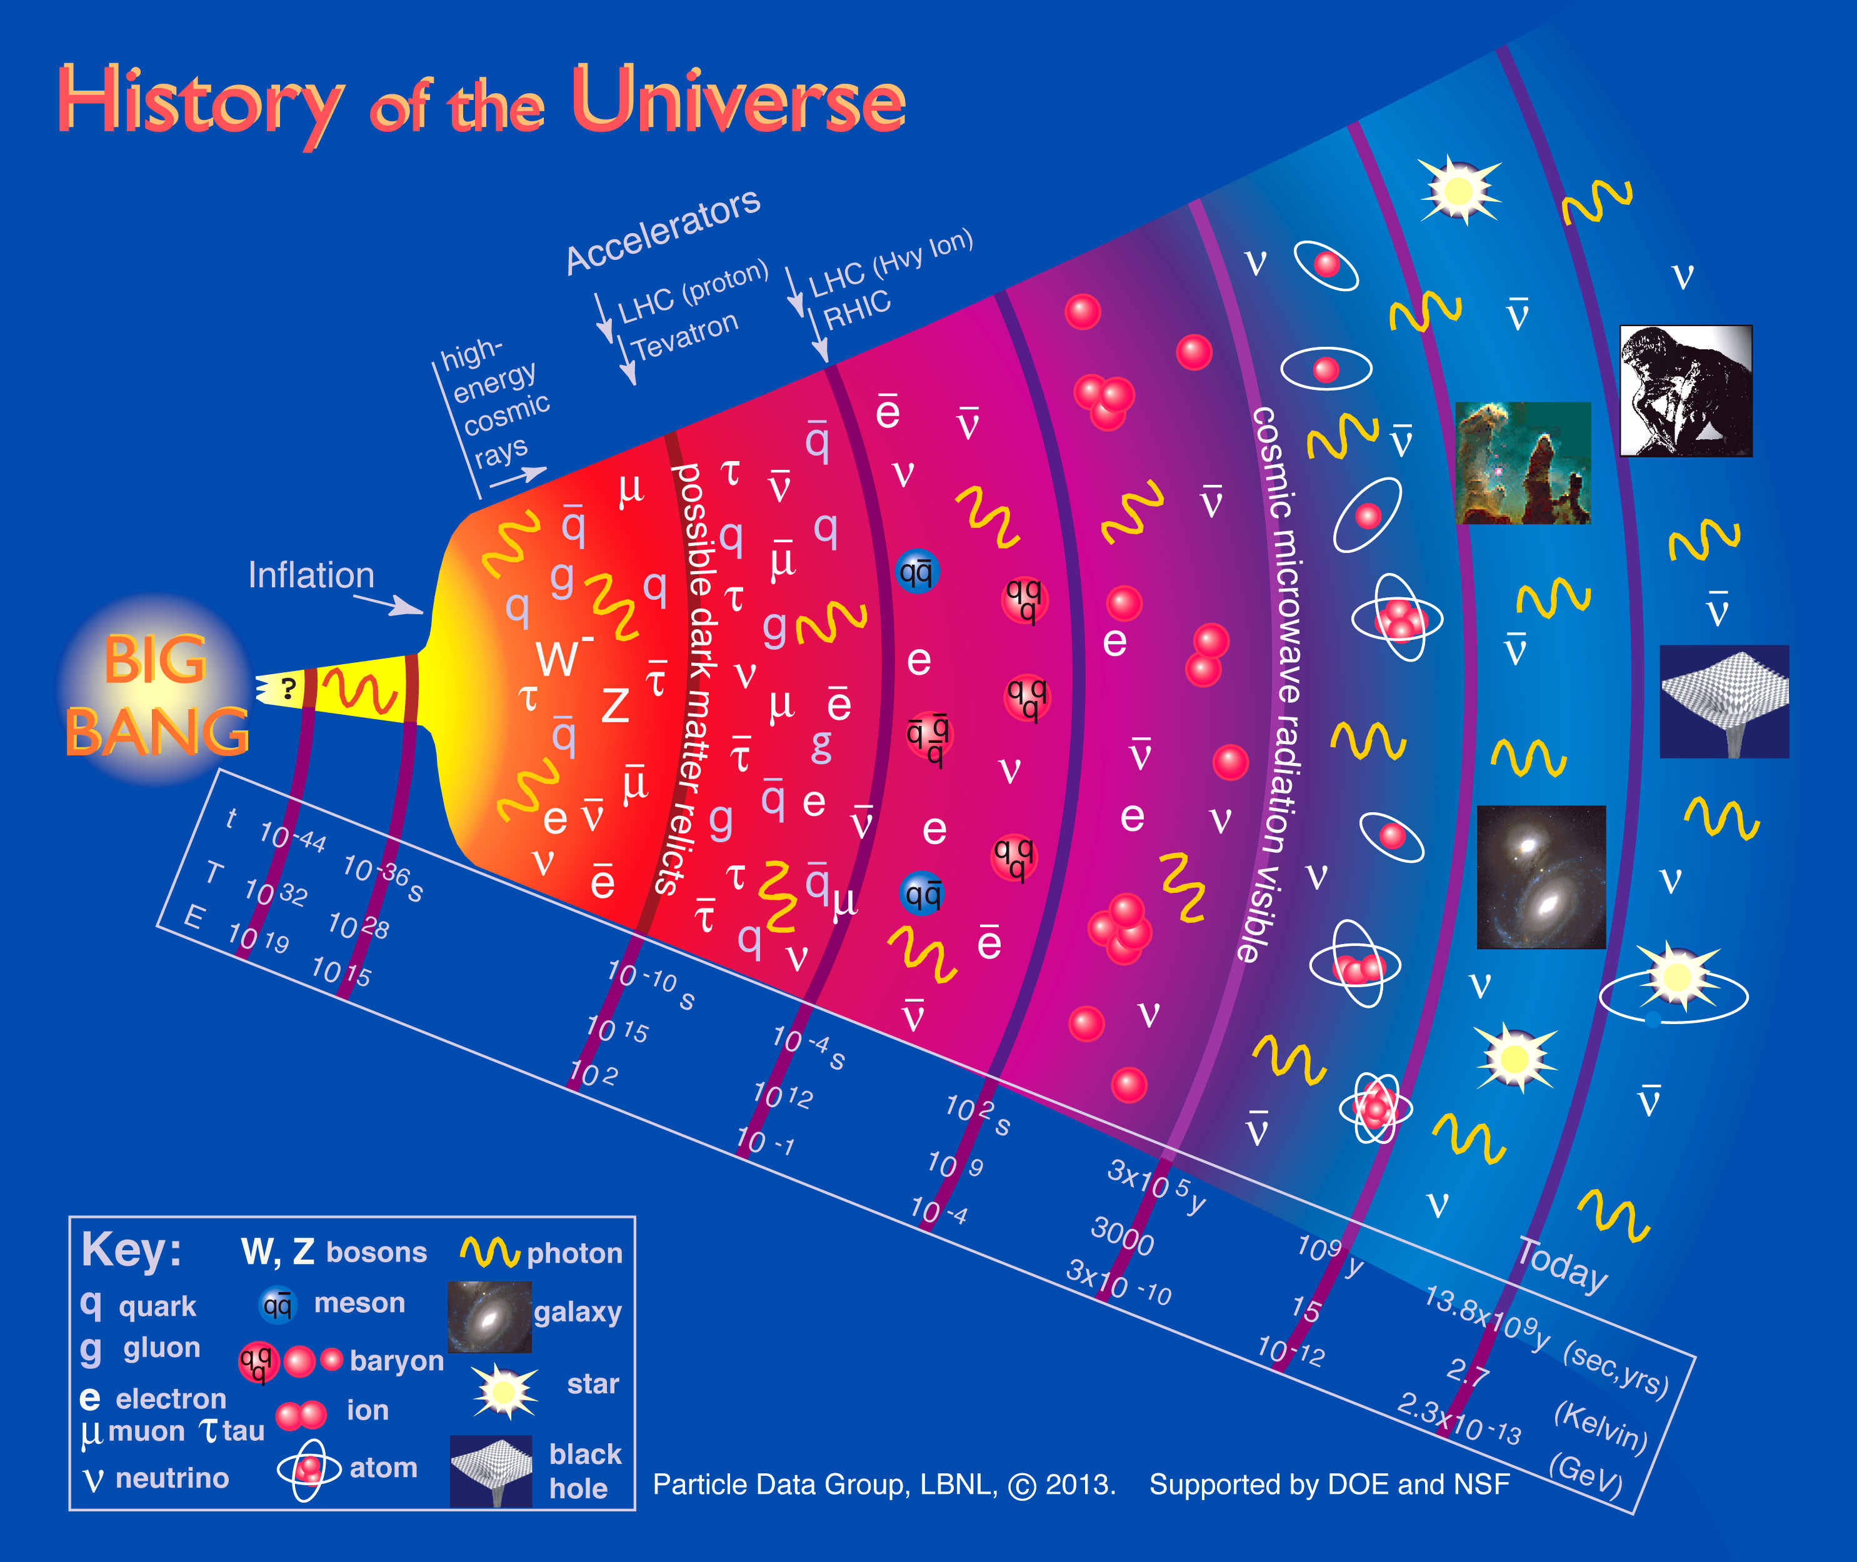

Slide 18
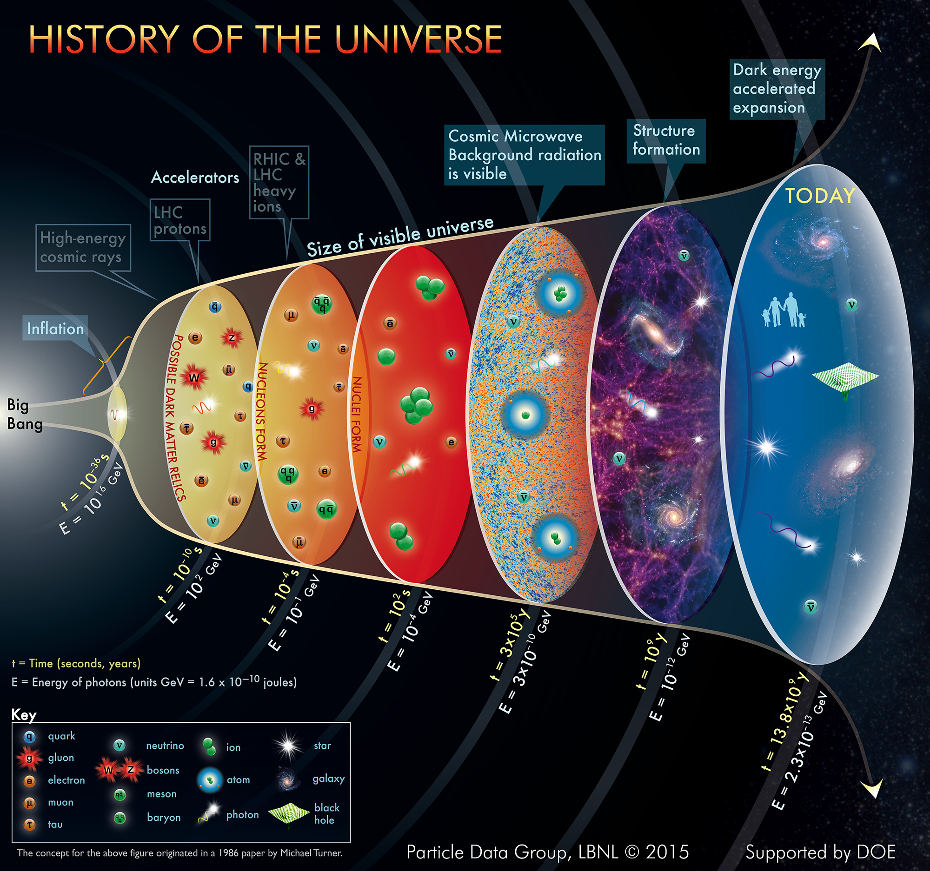

Slide 19
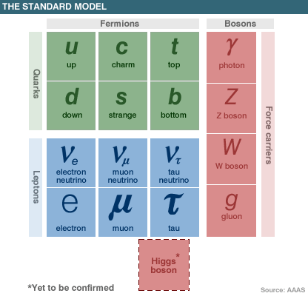
The standard model before July 4, 2012

Slide 20
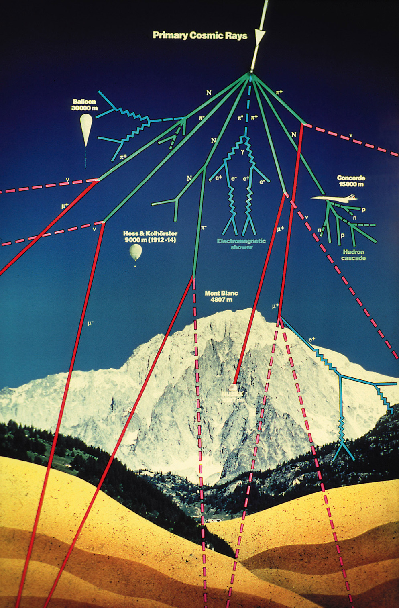
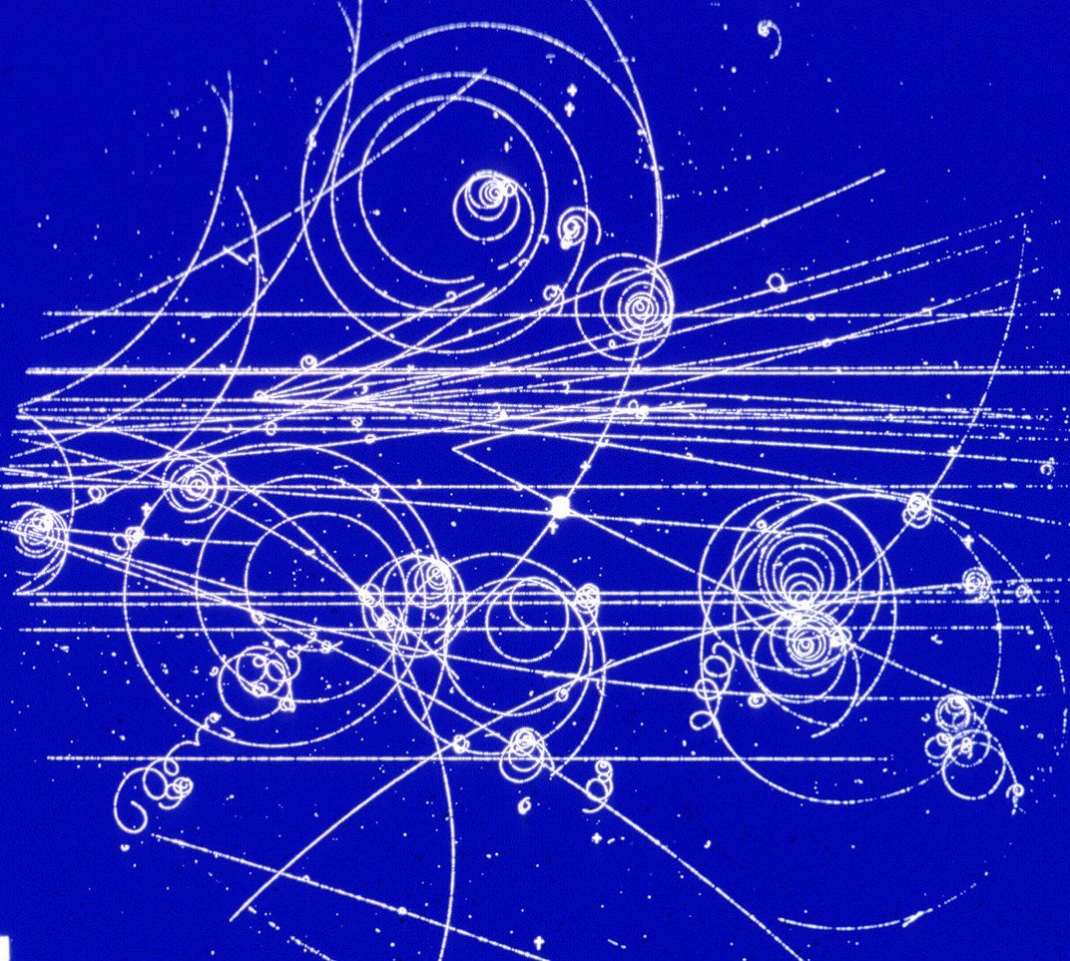
How do we know all this?
Cosmic
rays
Accelerator experiments
Radioactivity experiments
And about 100 years of hard work by many people...

Slide 21
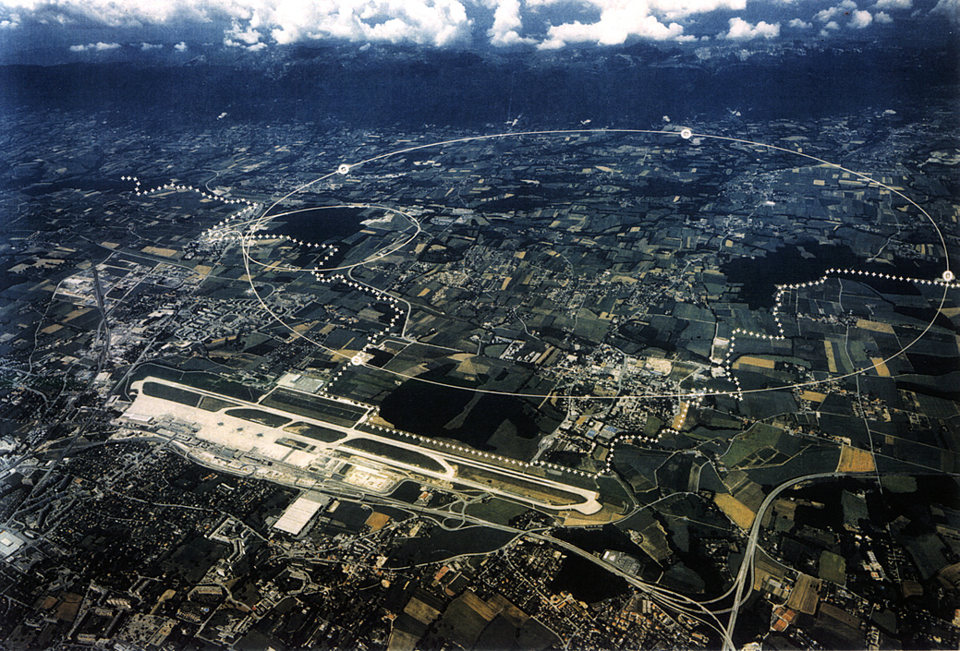
The Large Hadron Collider

Slide 22
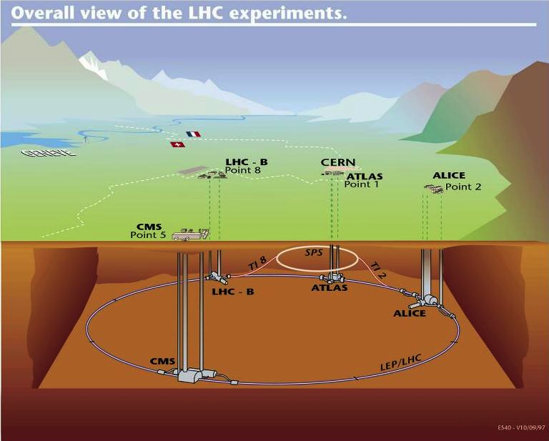

Slide 23

Huge experiments can investigate extremely small scales …

Slide 24
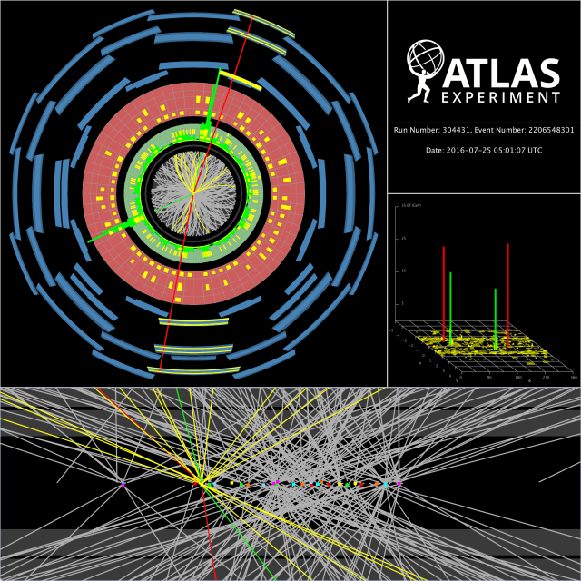
… by identifying what is produced in collisions!

Slide 25
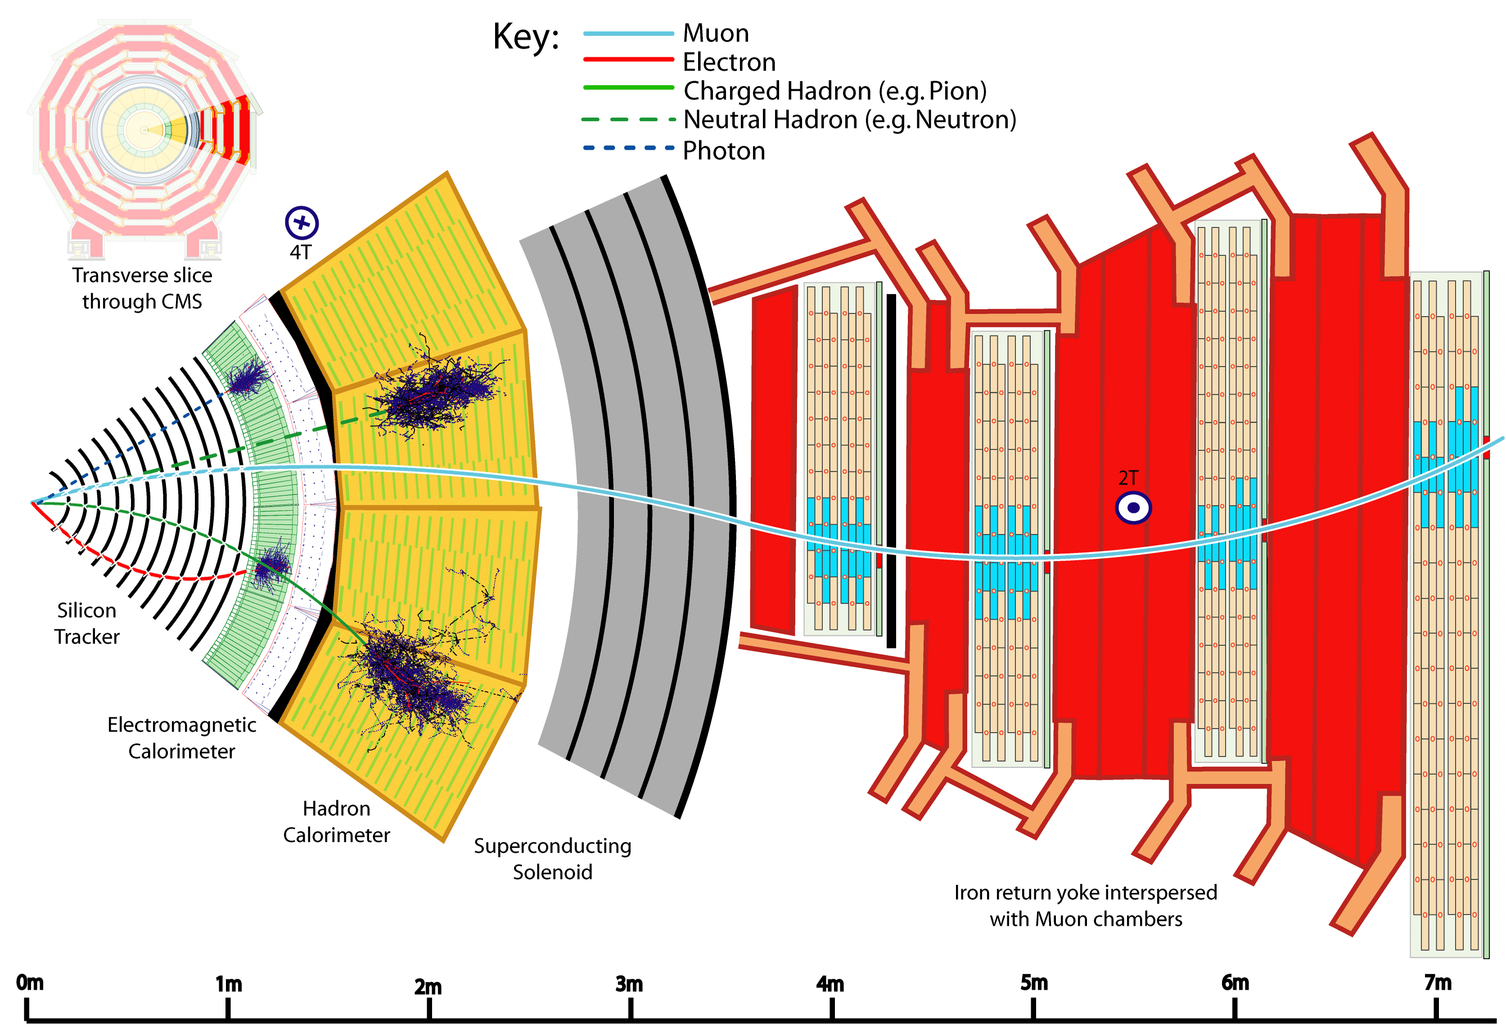
Different detector layers help distinguish particle types
25

Slide 26
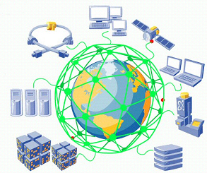
Computing challenges
The LHC experiments generate
> 200 Petabytes per year
To store and process such huge
quantities of data, the experiments
make use of a worldwide collaboration
of partner universities and laboratories:
the Worldwide LHC Computing Grid

Slide 27
More open questions
Are the quarks and leptons elementary particles?
Are there other particles we have not seen yet?
Why are the masses different?
Matter/Antimatter asymmetry in universe?
What about gravity? Or superstrings? Or extra dimensions?
Properties of the neutrino?
Solving any of these puzzles is worth a Nobel Prize!

Slide 28
Other accelerators and many more experiments

Slide 29
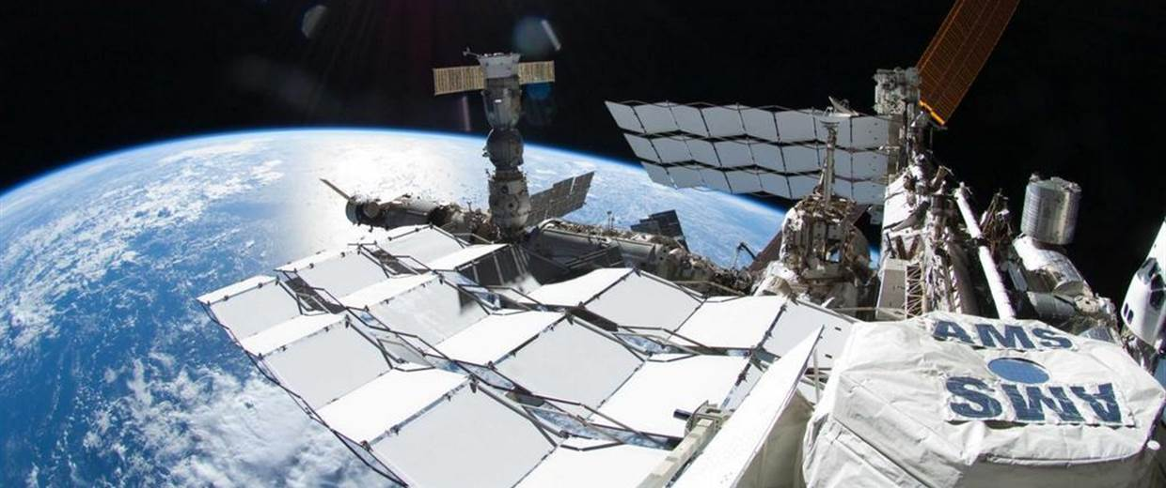
Even in space!

Slide 30
Summary
CERN is about:
  International collaboration
  Fundamental research
  Technology innovation
  Knowledge sharing
CERN has particle accelerators and many experiments to discover and study the building blocks of the universe
Enjoy your stay at CERN !

