Slide 1
IPPOG Collaboration Board – Wednesday the 27th of November 2024
17th IPPOG Collaboration Board Meeting
P. Abreu, LIP and IST, (Co-)Chair
C. Adam, LAPP, (Co-)Chair
F. Cacciatori, U.Notre-Dame, Coordination Team
H. Olgunsoy, CERN, Coordination Team

Slide 2
Collaboration Board Meeting
Agenda
  Welcome to new members
  Adoption of agenda and establishing the quorum
  Approval of minutes from 16th Collaboration Board (May 2024) [vote]
  Forum and Author Lists updates
  IFAAB updates (endorsement)
  Working Groups updates (endorsement)
  European Strategy for Particle Physics Update Contribution
  Budget for 2025 (vote)
  IPPOG Chairs Search Committee (endorsement)
  Fall 2025 meeting at CERN (vote)
  NEW: Proposal for a CB Chair (to be confirmed by CB vote)
  AOB

Slide 3
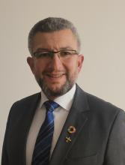
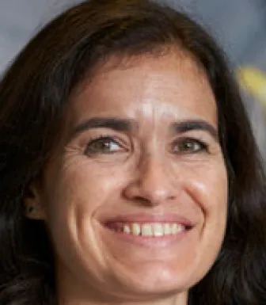
Welcome to the Collaboration Board
CERN
replacing
Welcome
Sascha Schmeling
Thank you,
Ana Godinho

Slide 4
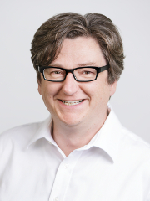
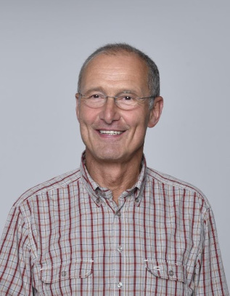
Welcome to the Collaboration Board
DESY
replacing
Welcome
Christian Schwanenberger
Thank you,
Thomas Naumann

Slide 5
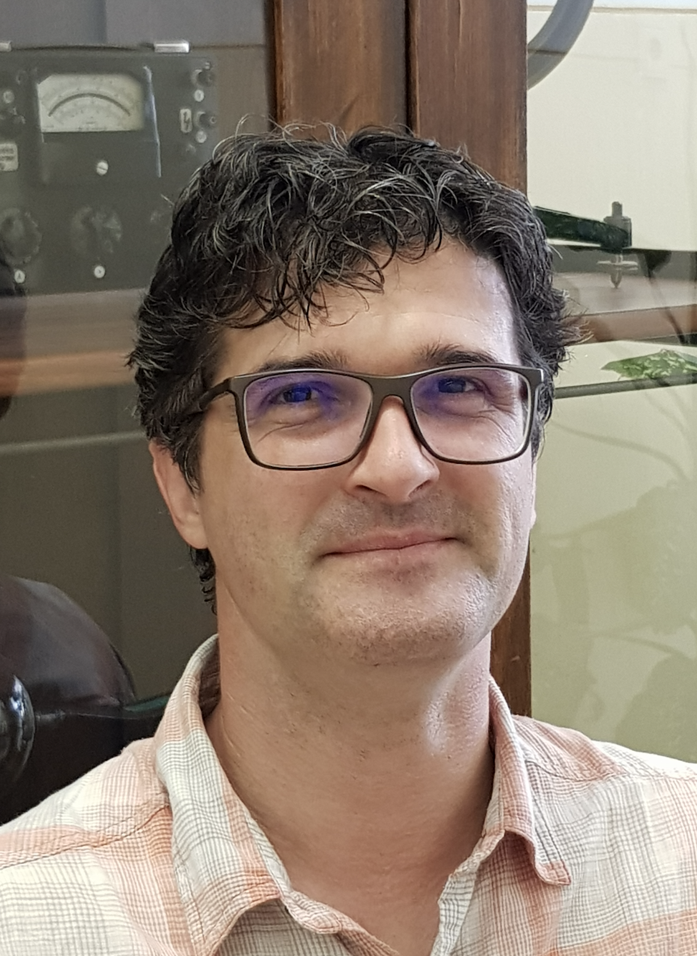
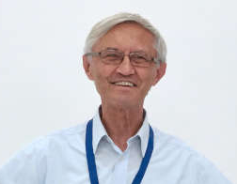
Welcome to the Collaboration Board
Hungary
replacing
Welcome
Balazs Ujvari
Thank you,
Deszö Horváth

Slide 6
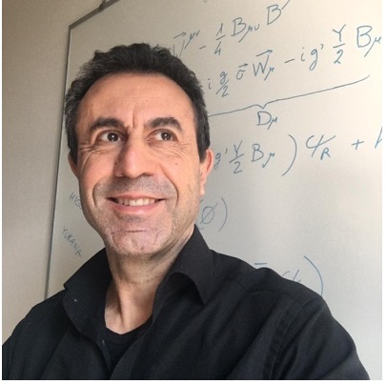
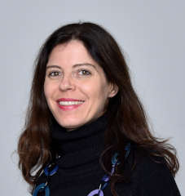
Welcome to the Collaboration Board
Italy
replacing
Welcome
Ezio Torassa
Thank you,
Catia Peduto

Slide 7
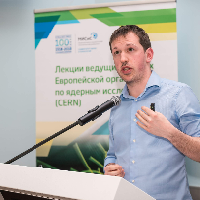
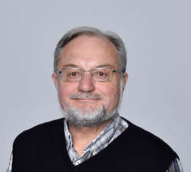
Welcome to the Collaboration Board
LHCb
replacing
Welcome
Federico Leo Redi
Thank you,
Bolek Pietrzik

Slide 8
Establishment of Quorum
Current IPPOG Members
  34 Countries
  7 Experiments
  1 International Laboratory (CERN)
Current IPPOG Associate Members
  2 National Laboratories (DESY, GSI)
Quorum
  Number of Members x 2/3 = 42 x 2/3 = 28 → Need 28 members.
  We have 31 members registered as of Wednesday 13:00 (CET – UTC+1).
Do you approve the agenda for this meeting? (with the new item?)

