Slide 1
UQDS - IT– Reliability Analysis – Quench protection function
11/06/2024

Slide 2
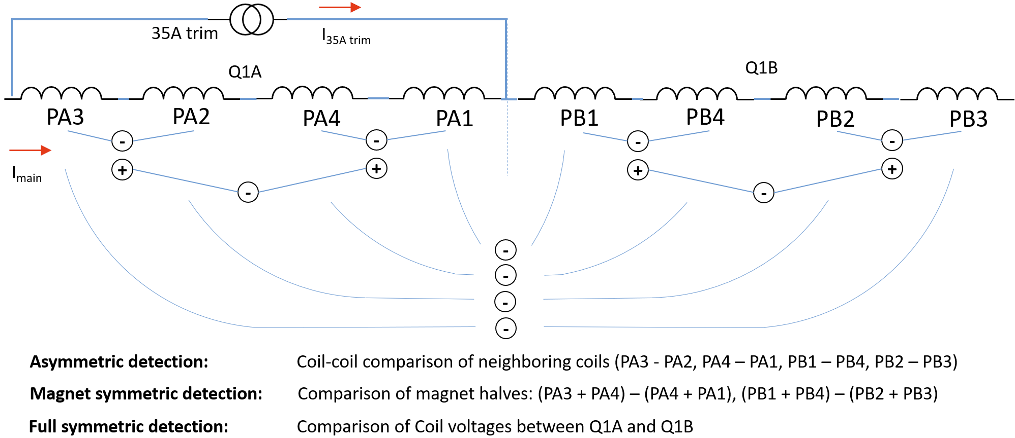
Quench scenario
Is a single quench the most likely quench scenario? Yes

Slide 3
Quench scenario

Slide 4
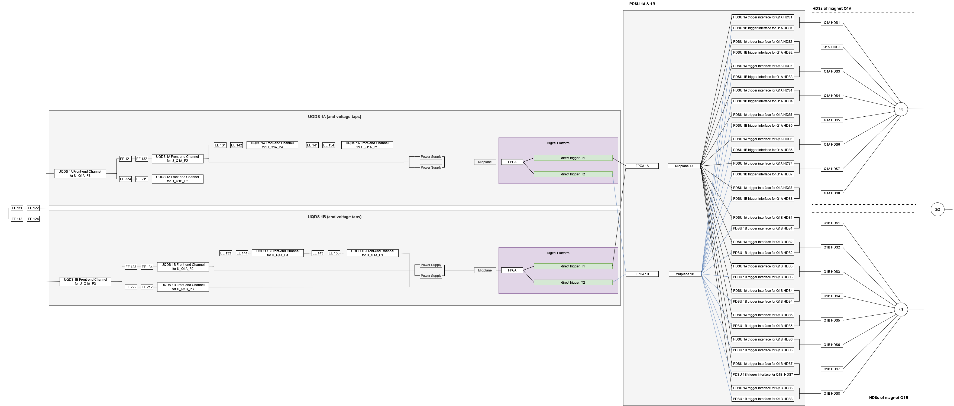
Reliability Block Diagram for a single quench in a magnet (e.g. Quench in Coil PA3) for current < 3 kA
x3
V-taps
UQDS
PDSU
DQHDS

Slide 5
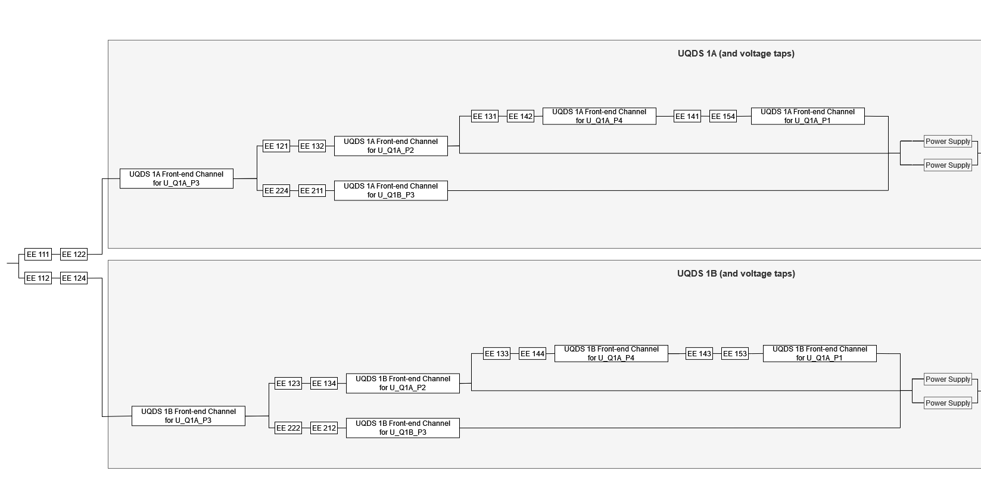
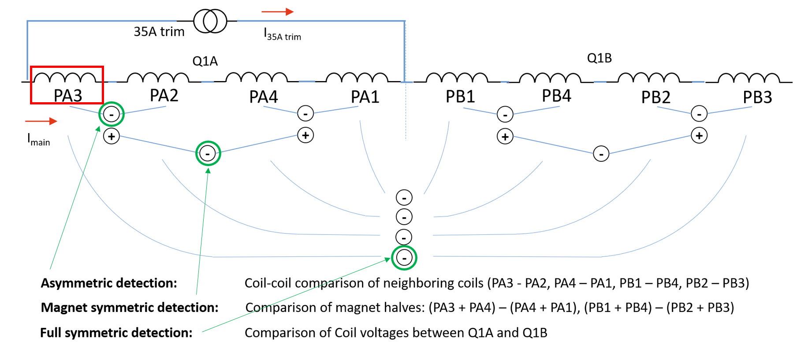
Reliability Block Diagram for a single quench in a magnet (e.g. Quench in Coil PA3)

Slide 6
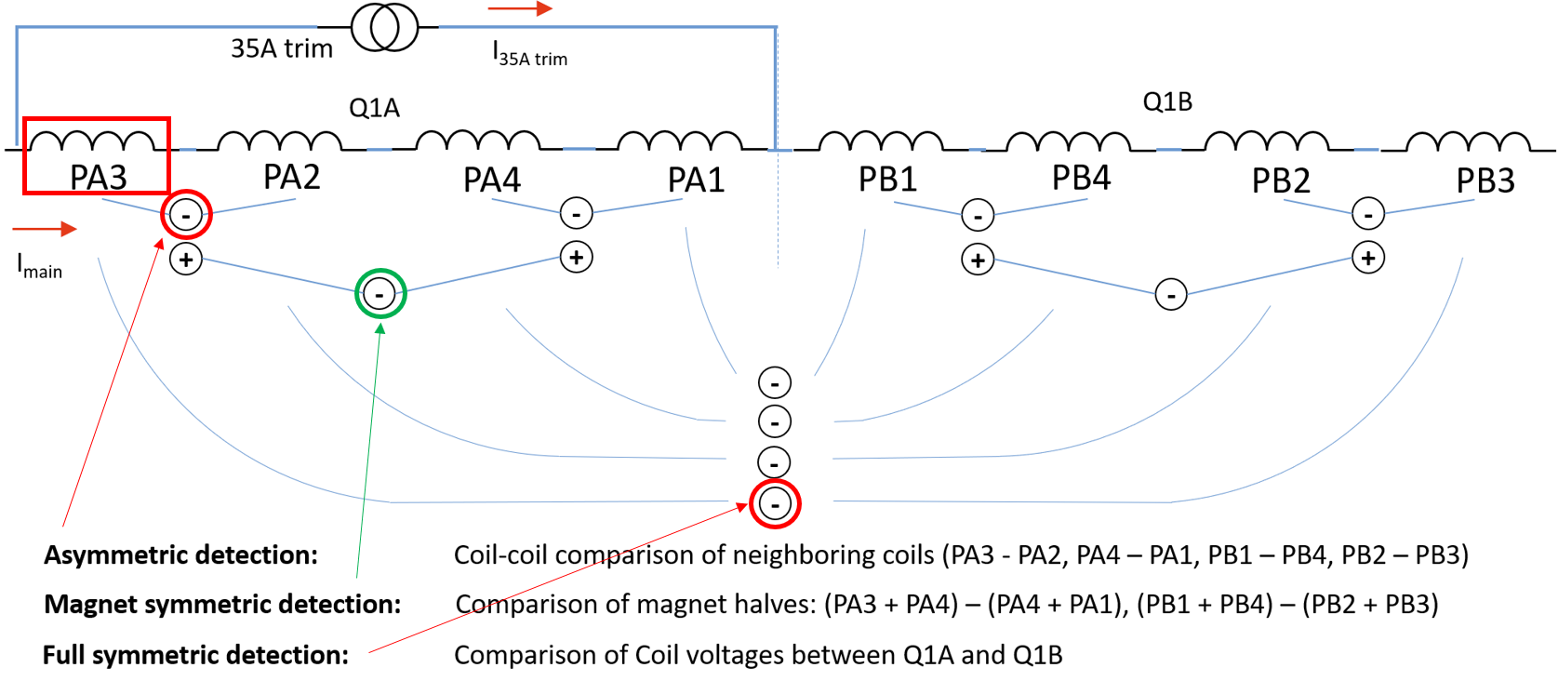
Reliability Block Diagram for a single quench in a magnet (e.g. Quench in Coil PA3)
Pessimistic scenario

Slide 7
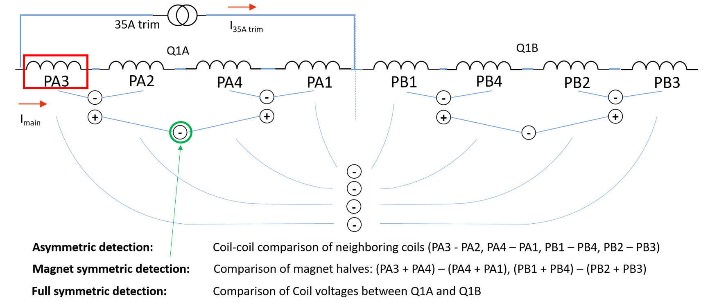
Reliability Block Diagram for a single quench in a magnet (e.g. Quench in Coil PA3)
Pessimistic scenario

Slide 8
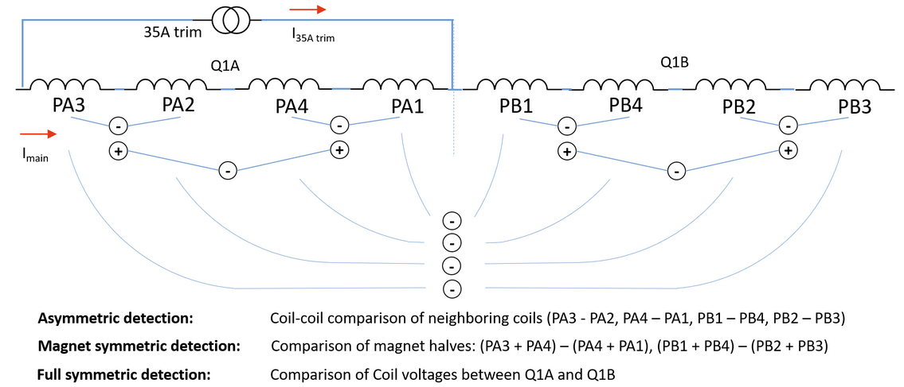
Why so pessimistic?
Scenario 1
Quench in 2 coils
Scenario 1
Asymmetric
Magnet symmetric ((PA1+PA4) – (PA2-PA3))
Full Symmetric (PA3-PB3) & (PA2-PB2)
Scenario 2
Asymmetric
Magnet symmetric ((PA1+PA4) – (PA2-PA3)) and …
Full Symmetric
Scenario 3
Asymmetric
Magnet symmetric ((PA1+PA4) – (PA2-PA3)) and …
Full Symmetric (PA3-PB3) & (PA2-PB2)
Scenario 2
Scenario 3
→ Depending on the quench scenario certain redundancies could be bypassed.

Slide 9
Reliability Targets – Top Level FMECA (uQDS + PDSU)
situation | functions | description | failure modes | effects/consequence | recovery time | reliability target
quench | magnet protection + beam dump request | For this the UQDSs must detect a quench in a magnet (or SC links and the BBs) | fail to detect | no magnet protection no dump via PDSU/PIC | months ? (beam dump via BLMS fast enough?) | 1/1000 years
 |  | The UQDSs must send a signal to the PDSUs when a quench is detected. | fail to transmit to PDSU | no magnet protection no dump via PDSU | months | 1/1000 years
 | triggering of the CLIQs/HDSs | The PDSUs must trigger the CLIQs and/or HDSs. | fail to trigger the protection devices | no magnet protection | months | 1/1000 years
 |  |  | insufficient re-/triggering (not enough CLIQs and/or HDS are triggered) | insufficient magnet protection | months | 1/1000 years
 | dedicated beam dump request transmission - direct to BIS | The PDSUs have to trigger the beam dump request on time | fail to transmit beam dump request | no dump via PDSU-BIS connection | months | 1/1000 years

Slide 10
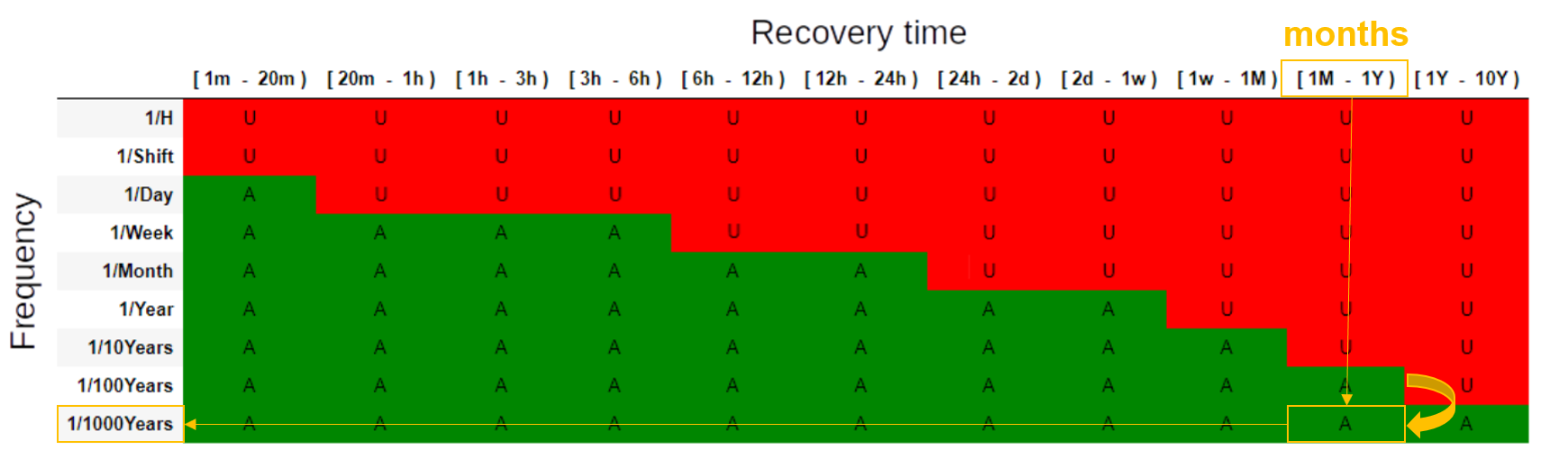
Reliability Targets
For a downtime of months, a frequency of 1/100 years or lower is acceptable.
Frequency 1/1000 years was chosen because of other system types (BIS, LBDS, BLMs, SMP, …) that can cause the same downtime.

Slide 11
Reliability Targets
For a downtime of months, a frequency of 1/100 years or lower is acceptable.
Frequency 1/1000 years was chosen because of other system types (BIS, LBDS, BLMs, SMP, …) that can cause the same downtime.
How many critical systems have a quench protection system with a UQDS?

Slide 12
Reliability Targets
For a downtime of months, a frequency of 1/100 years or lower is acceptable.
Frequency 1/1000 years was chosen because of other system types (BIS, LBDS, BLMs, SMP, …) that can cause the same downtime.
How many critical systems have a quench protection system with a UQDS?
  4 Inner Triplets
  533 circuits with a quench loop
  72 circuits with a UQDS and 126 UQDS units in total
  9436 Quench Detection Systems

Slide 13
Components and their failure rate/reliability
Based on PCB design files, a first worst-case component based reliability estimate has been done:
 |  | Inspection after 1 operational year |  | Inspection after 3 operational years
components | Inspection interval | FITs | R | FITs | R
Tap + UQDS (without trigger out) |  | 4221.39 | 0.9701 | 12664.17 | 0.9129
Tap |  | 13.83 | 0.9999 | 41.49 | 0.9997
Channel |  | 70.29 | 0.9995 | 210.87 | 0.9985
PSU |  | 874.70 | 0.9937 | 2624.10 | 0.9813
FPGA (Digital Platform) |  | 1675.00 | 0.9880 | 5025.00 | 0.9645
Midplane |  | 38.42 | 0.9997 | 115.26 | 0.9992
trigger out (UQDS) |  | 7.00 | 0.9999 | 21.00 | 0.9998
FPGA/Digital Platform + Midplane (PDSU) |  | 3296.16 | 0.9765 | 9888.48 | 0.9313
Trigger Interface (PDSU) |  | 7.00 | 0.9999 | 21.00 | 0.9998
HDS |  | 435.22 | 0.9969 | 1305.65 | 0.9906
PS24V |  | 54.36 | 0.9996 | 163.08 | 0.9988
trigger |  | 27.18 | 0.9998 | 81.54 | 0.9994
thyristor |  | 13.59 | 0.9999 | 40.77 | 0.9997
charger |  | 27.18 | 0.9998 | 81.54 | 0.9994
capacitor |  | 4.53 | 1.0000 | 13.59 | 0.9999
Strip |  | 326.16 | 0.9977 | 978.47 | 0.9930
current breaker |  | 163.08 | 0.9988 | 489.24 | 0.9965
Sum |  | 201.69 | 0.9985 | 1800.69 | 0.9957
Failures in 1000 years |  | 1.45 |  | 12.96
What are the Inspection intervals for the different components?
Are there faults in the instrumentation that can only be detected with Electrical Quality Assurance (ELQA)?
When considering a continuous demand (if there is a failure of the system, there is always a quench).
1 operational year = 300 days
3 operational years = 1095 days

Slide 14
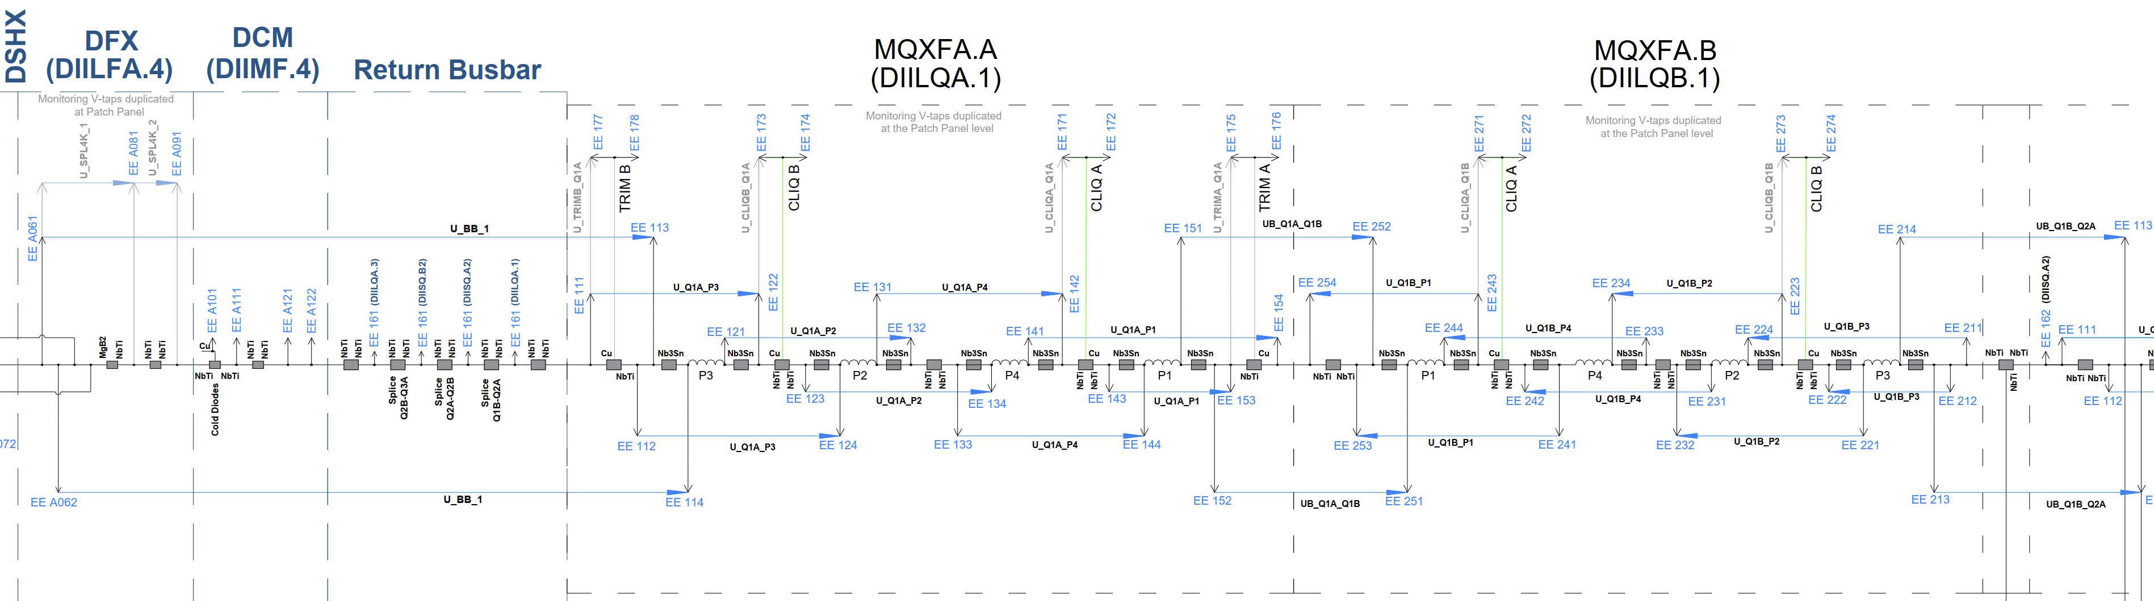
UQDS – Busbars
Can the two UQDSs BB of one IT detect a quench in the Busbars in between the magnets and the return busbars? Yes
Are there in total 4 voltage taps for each type of Busbar? Yes, but they are sometimes shared with the taps used for the magnet coils.

