Slide 1
UQDS - IT– Reliability Analysis
12/07/2024

Slide 2
Progress since last meeting
Analysis of the failure rate apportionment of the Digital Platform
Continuous demand
  Calculation of the failure rate
    Below 3kA (4oo8 QHDS) and above 3kA (7oo8 QHDS or 1 CLIQ)
    1 year and 3 years Inspection interval
  Sensitivity Analysis
    Determined for which inspection interval the reliability target can be met
No Continuous demand
  Determined a model, which can be used for simulations
  Started to do simulations for different demand rates and inspection intervals

Slide 3
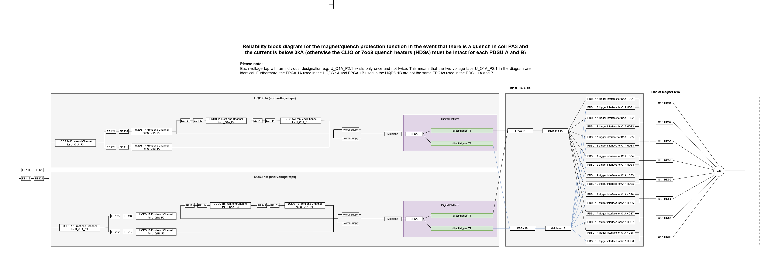
Reliability Block Diagram for a single quench in a magnet (e.g. Quench in Coil PA3)
x6

Slide 4
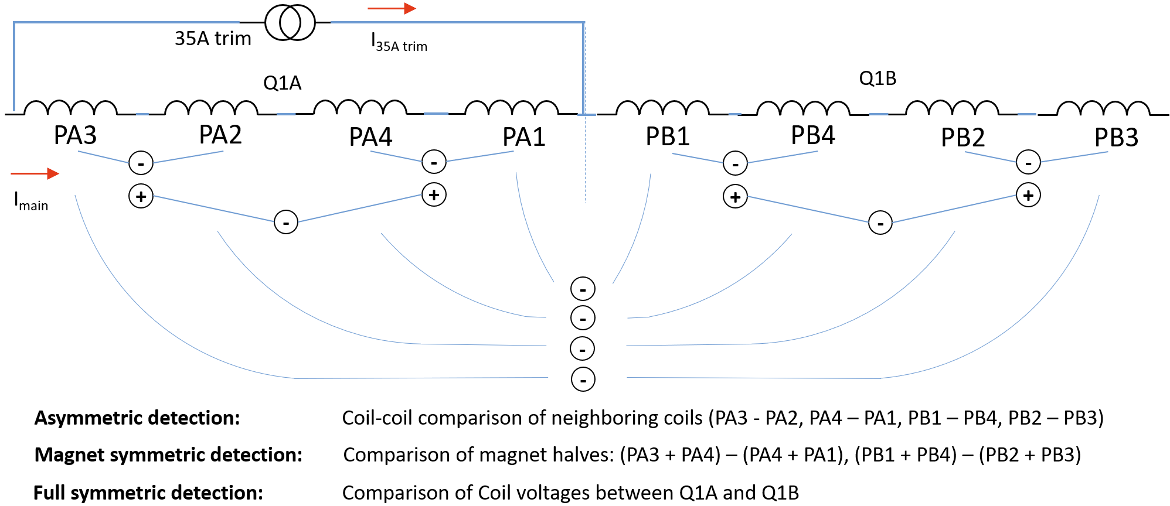
Quench scenario

Slide 5
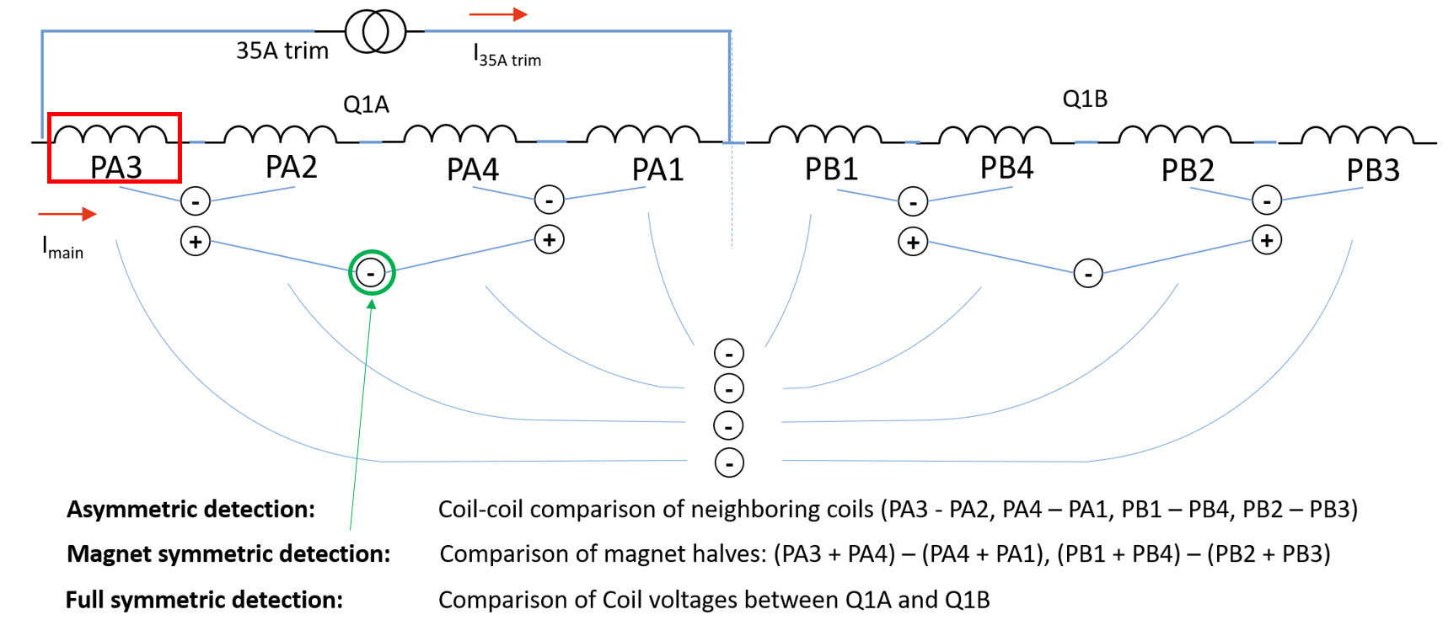
Reliability Block Diagram for a single quench in a magnet (e.g. Quench in Coil PA3)
Pessimistic scenario

Slide 6
Failure rates
System/Component | Failure rate/FITs
Voltage Tap | 13.38
UQDS
Channel | 70.29
PSU | 874.70
Midplane | 38.42
FPGA | 1183.00
Trigger Interface | 7.00
PDSU
PSU | 0
FPGA | 1183.00
Midplane | 46.16
QHDS/CLIQ Trigger Interface | 7.00

Slide 7
Failure rates
System/Component | Failure rate/FITs
Voltage Tap | 13.38
UQDS
Channel | 70.29
PSU | 0
Midplane | 38.42
FPGA (Digital Platform) | 1183.00
Trigger Interface | 7.00
PDSU
PSU | 0
FPGA (Digital Platform) | 1183.00
Midplane | 46.16
QHDS/CLIQ Trigger Interface | 7.00
PSU only influences the availability.

Slide 8
Failure rates
-221 FITs
System/Component | Failure rate/FITs
Voltage Tap | 13.38
UQDS
Channel | 70.29
PSU | 0
Midplane | 38.42
FPGA (Digital Platform) | 962.00
Trigger Interface | 7.00
PDSU
PSU | 0
FPGA (Digital Platform) | 1183.00
Midplane | 46.16
QHDS/CLIQ Trigger Interface | 7.00
Only the failure mode short of the Capacitors of the DSP card – FPGA power delivery can cause blind failures.
-> Is a protection against this failure mode possible?

Slide 9
Failure rates
System/Component | Failure rate/FITs
Voltage Tap | 13.38
UQDS
Channel | 70.29
PSU | 0
Midplane | 38.42
FPGA (Digital Platform) | 962.00
Trigger Interface | 7.00
PDSU
PSU | 0
FPGA (Digital Platform) | 1183.00
Midplane | 46.16
QHDS/CLIQ Trigger Interface | 7.00
Can a safe failure fraction be defined (in particular for the Digital Platform)?
UQDS v3
When will the new version of the system be released?
By what Percentage will the number of which components increase?
PDSU
Can the same assumptions for the Digital Platform of the UQDS also be made for the PDSU?
  PSU only influences the availability
  Only the failure mode short must be considered for the capacitors of the DSP card – FPGA power delivery

Slide 10
Calculations – Continuous Demand
Assumptions
Continuous Demand (if there is a failure of the system, there is always a quench)
Reliability Target of maximum 1 allowed failure in 1.000 years
  No magnet protection leads to a downtime of months, which leads to a target of max. 1 failure/100 years
  Multiplied by 10 because of other systems that can cause a similar downtime
  We don’t have 1 system but ~5000 QDS systems
 | below 3kA (4oo8 QHDS) |  | above 3kA (7oo8 QHDS or 1 CLIQ)
Inspection Interval | 1 year | 3 years | 1 year | 3 years
Failures per system in 1000 years | 0.3329 | 1.1916 | 0.3329 | 1.1916

Slide 11
Sensitivity Analysis – Continuous Demand
Failures per 1000 years, when considering the 5000 QDS systems:
Inspection Interval | above 3kA (7oo8 QHDS or 1 CLIQ)
1 year | 1664.4
1 month (30 days) | 167.56
1 week | 39.12
5 hours | 1.16
4 hours | 0.93
The reliability target can be met for an Inspection Interval of ~ 4-5 hours

Slide 12
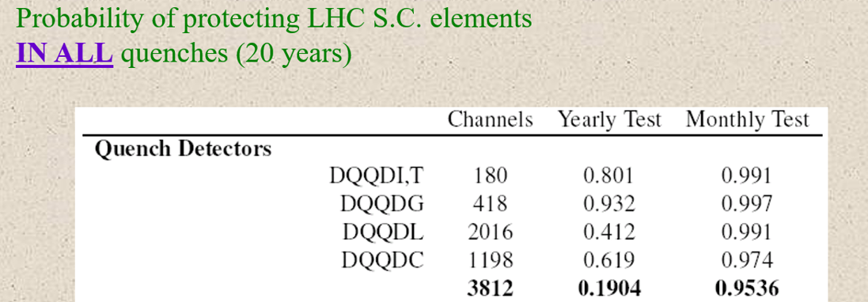
Comparison with results from QPS Analysis in 2004
2004
Now
Probability of protecting LHC S.C. elements in all quenches (20 years) when considering 5000 QDS and a continuous demand.
Inspection Interval | above 3kA (7oo8 QHDS or 1 CLIQ)
1 year | 0.0000
1 month | 0.0179

Slide 13
Conclusion
The reliability target can not be met with a continuous demand and an Inspection Interval above ~4-5 hours.
We have to check whether we can lower the failure rate of the boards by excluding certain components or failure modes which do not cause a blind failure.
We have to and and also started to check for
  different inspection intervals,
  for which demand rate
  the reliability target can be met.

