Slide 1
CERN Scientific Information Service
An introduction
Alexander Kohls
12 June 2024

Slide 2
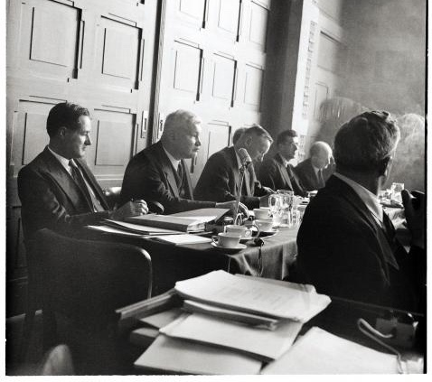

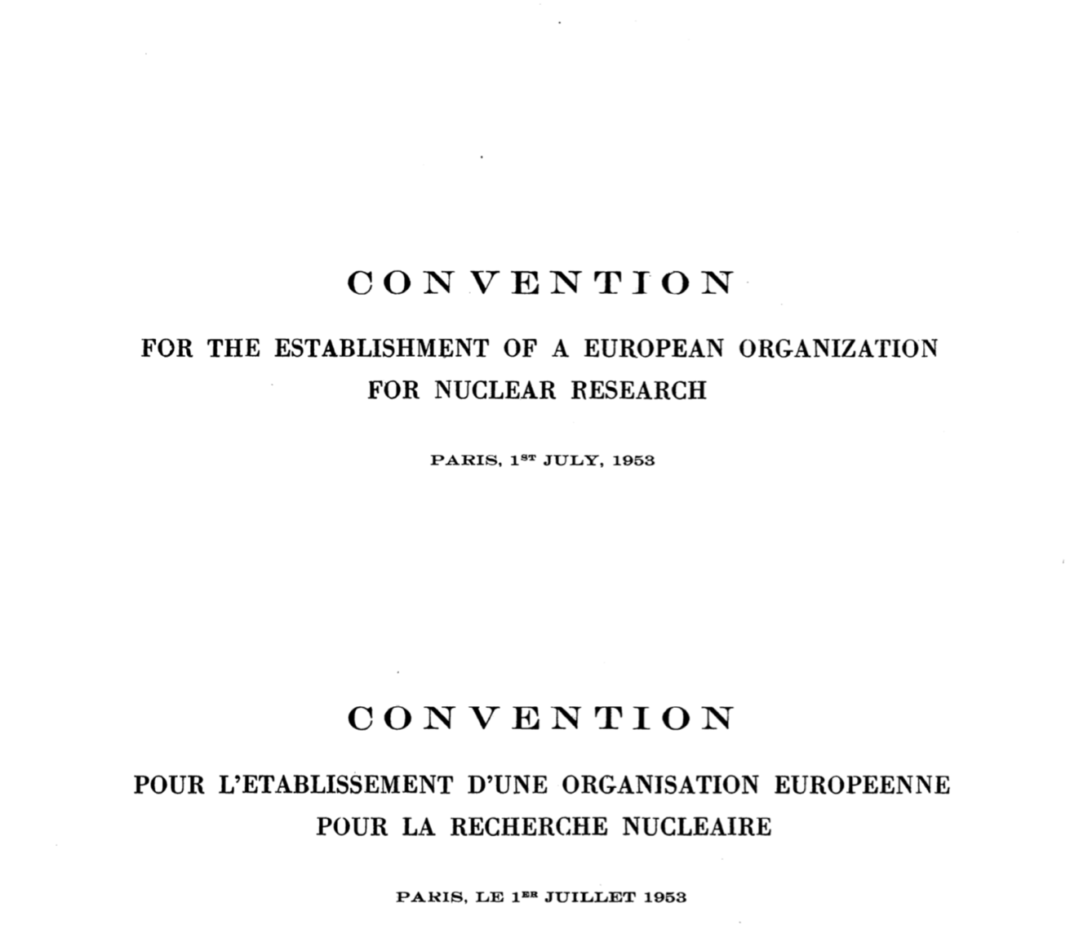
CERN was built for openness of information.

Slide 3
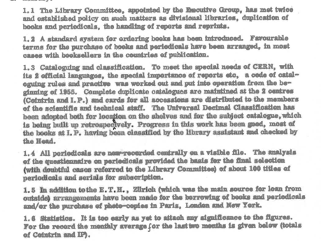
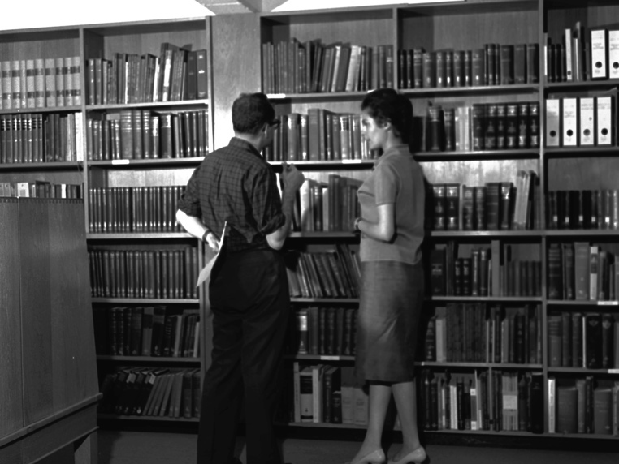
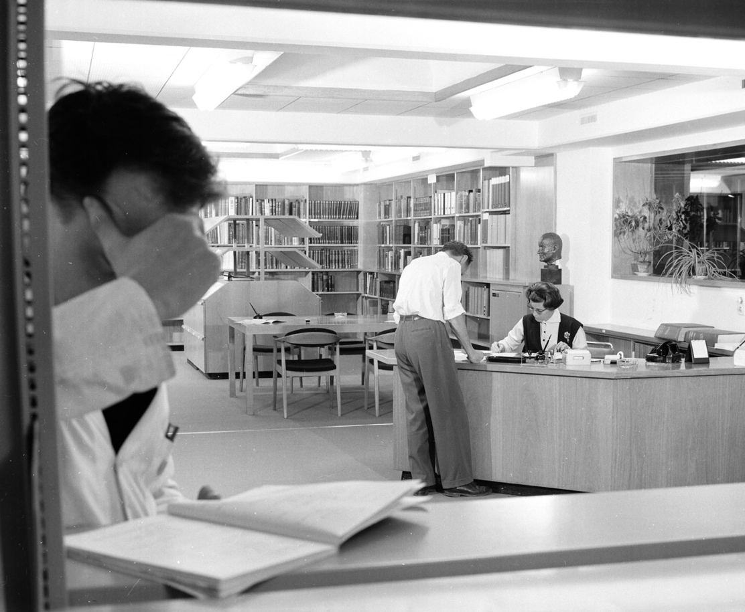
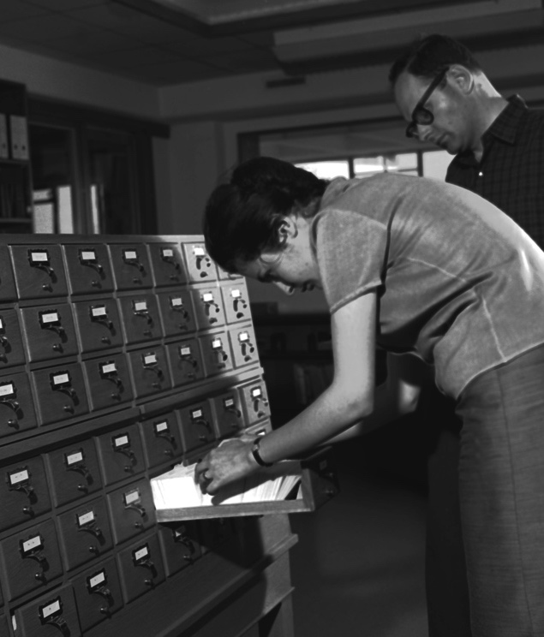

The Scientific Information Service (SIS) has existed throughout these 70 years but its role has evolved over time.

Slide 4








CERN Scientific Information Service activities today
Manage, preserving and disseminate knowledge
Preserve, safeguard and exploit the historic knowledge and heritage of CERN
Provide access to all required scientific literature to the CERN community
and openly disseminate the organisational research products
Enable accessibility, preservation, reuse and reproducibility of HEP research
Promote and enable best practices on open and collaborative science in
particle physics and beyond
CERN OSPO
12 June 2024
4

Slide 5
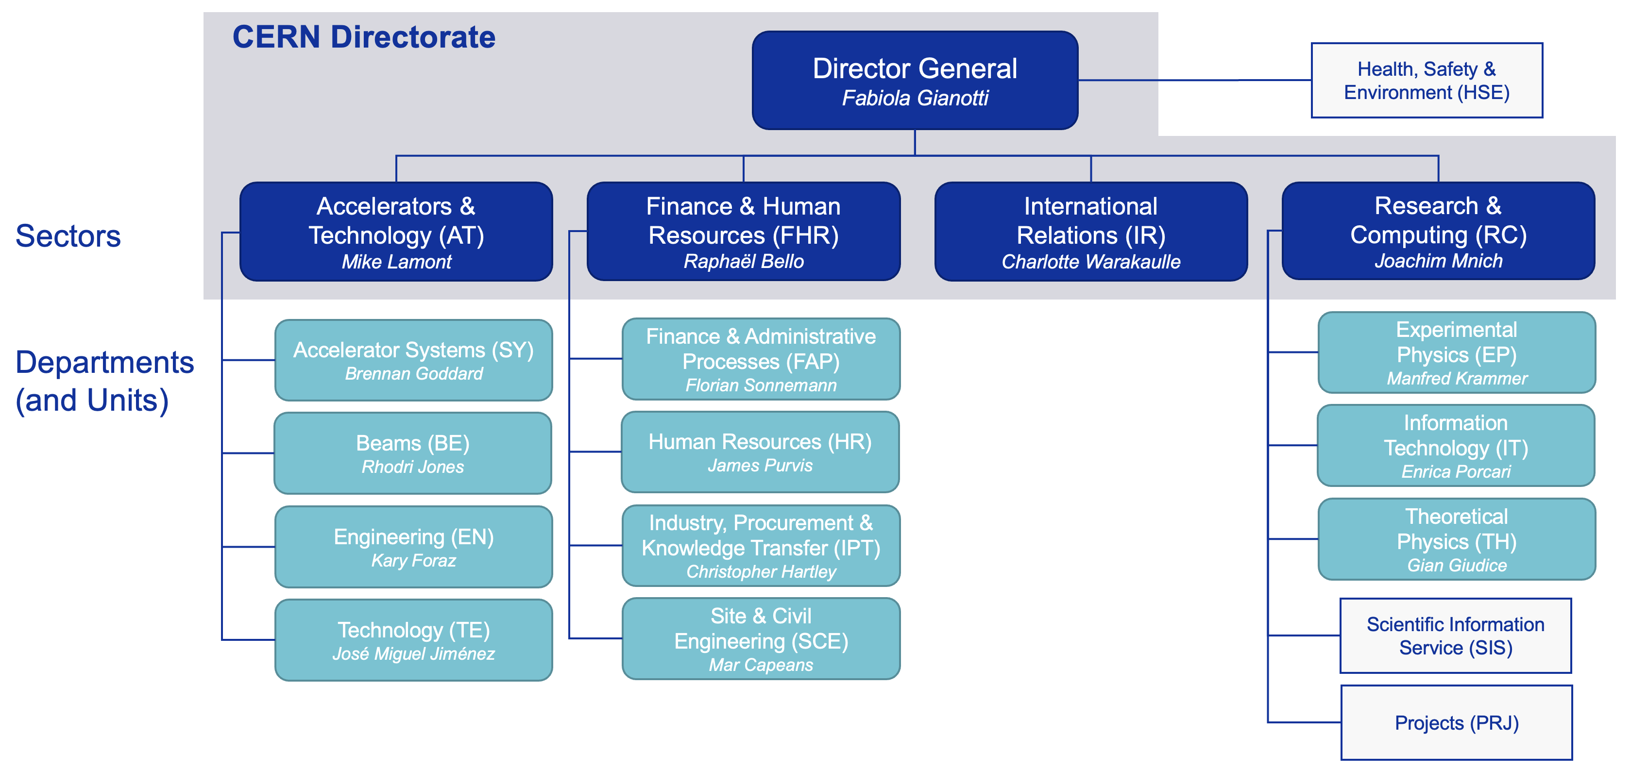
SIS within CERN
A central unit supporting all CERN departments

Slide 6
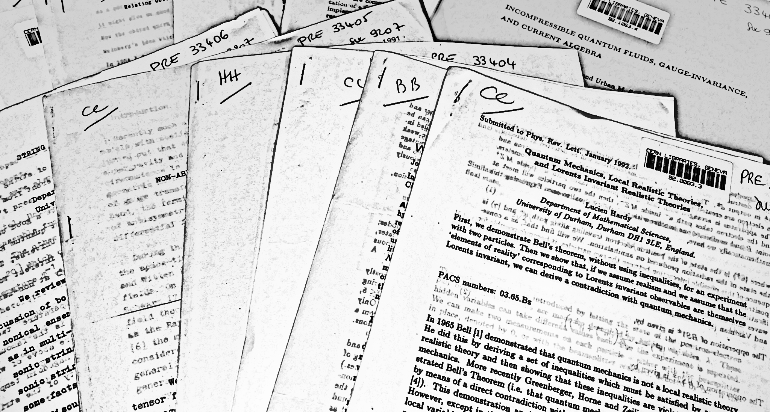
Preprints used to be distributed on paper.

Slide 7
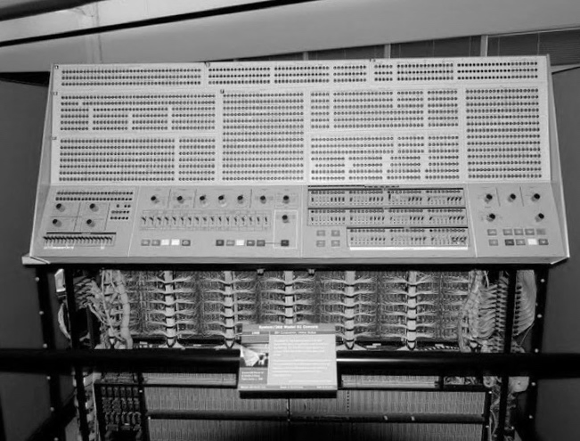
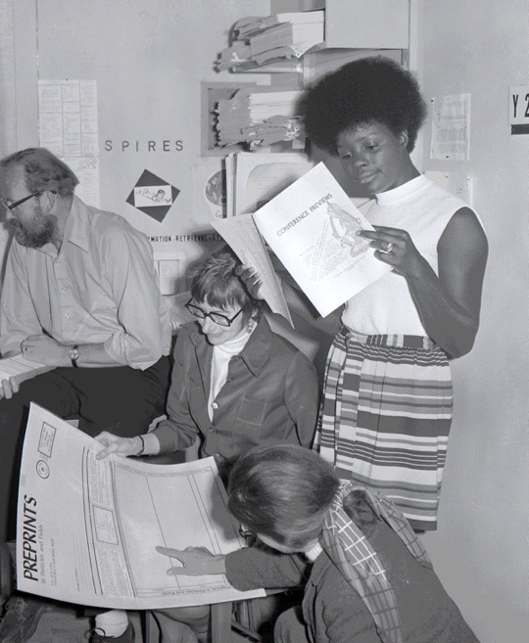
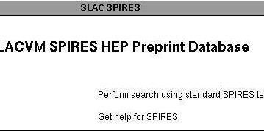
The first electronic preprint catalogue was established at SLAC.
1969

Slide 8
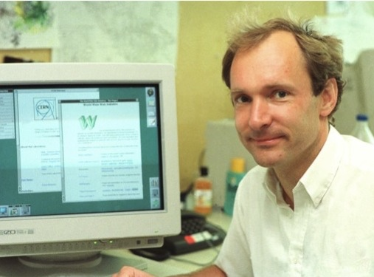
The WWW changed everything
1989

Slide 9
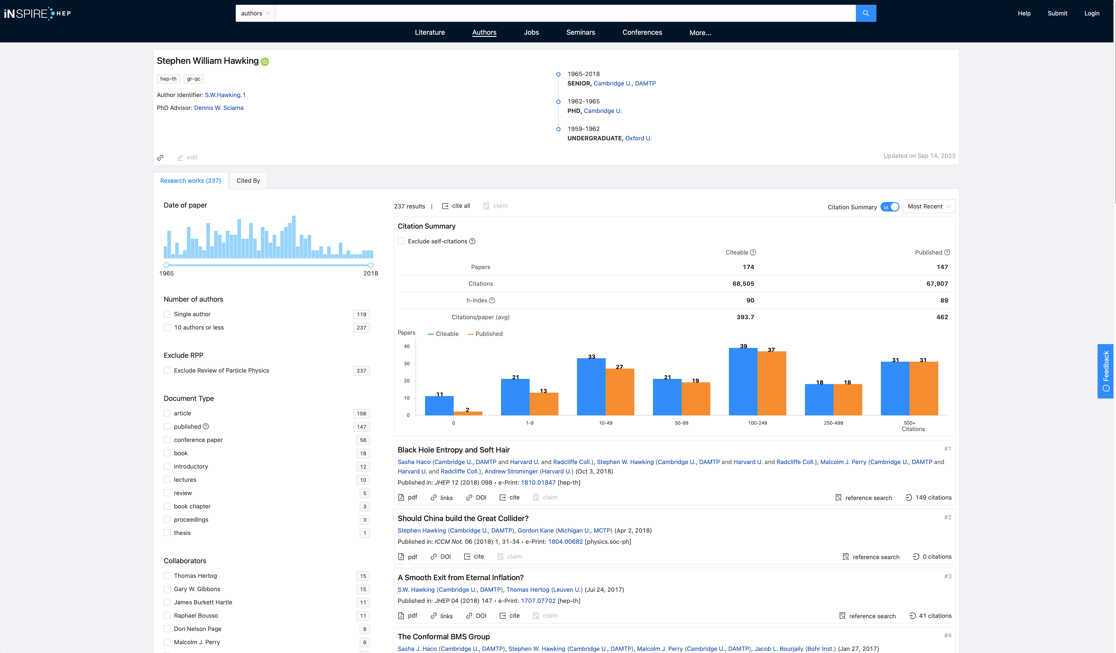
The preprint catalogues SPIRES has evolved into INSPIREhep
a global knowledge hub for particle physics, hosted by CERN.

Slide 10
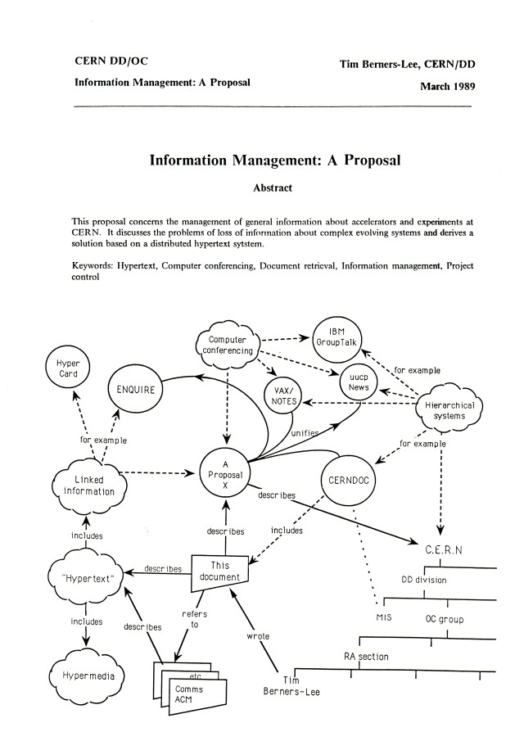




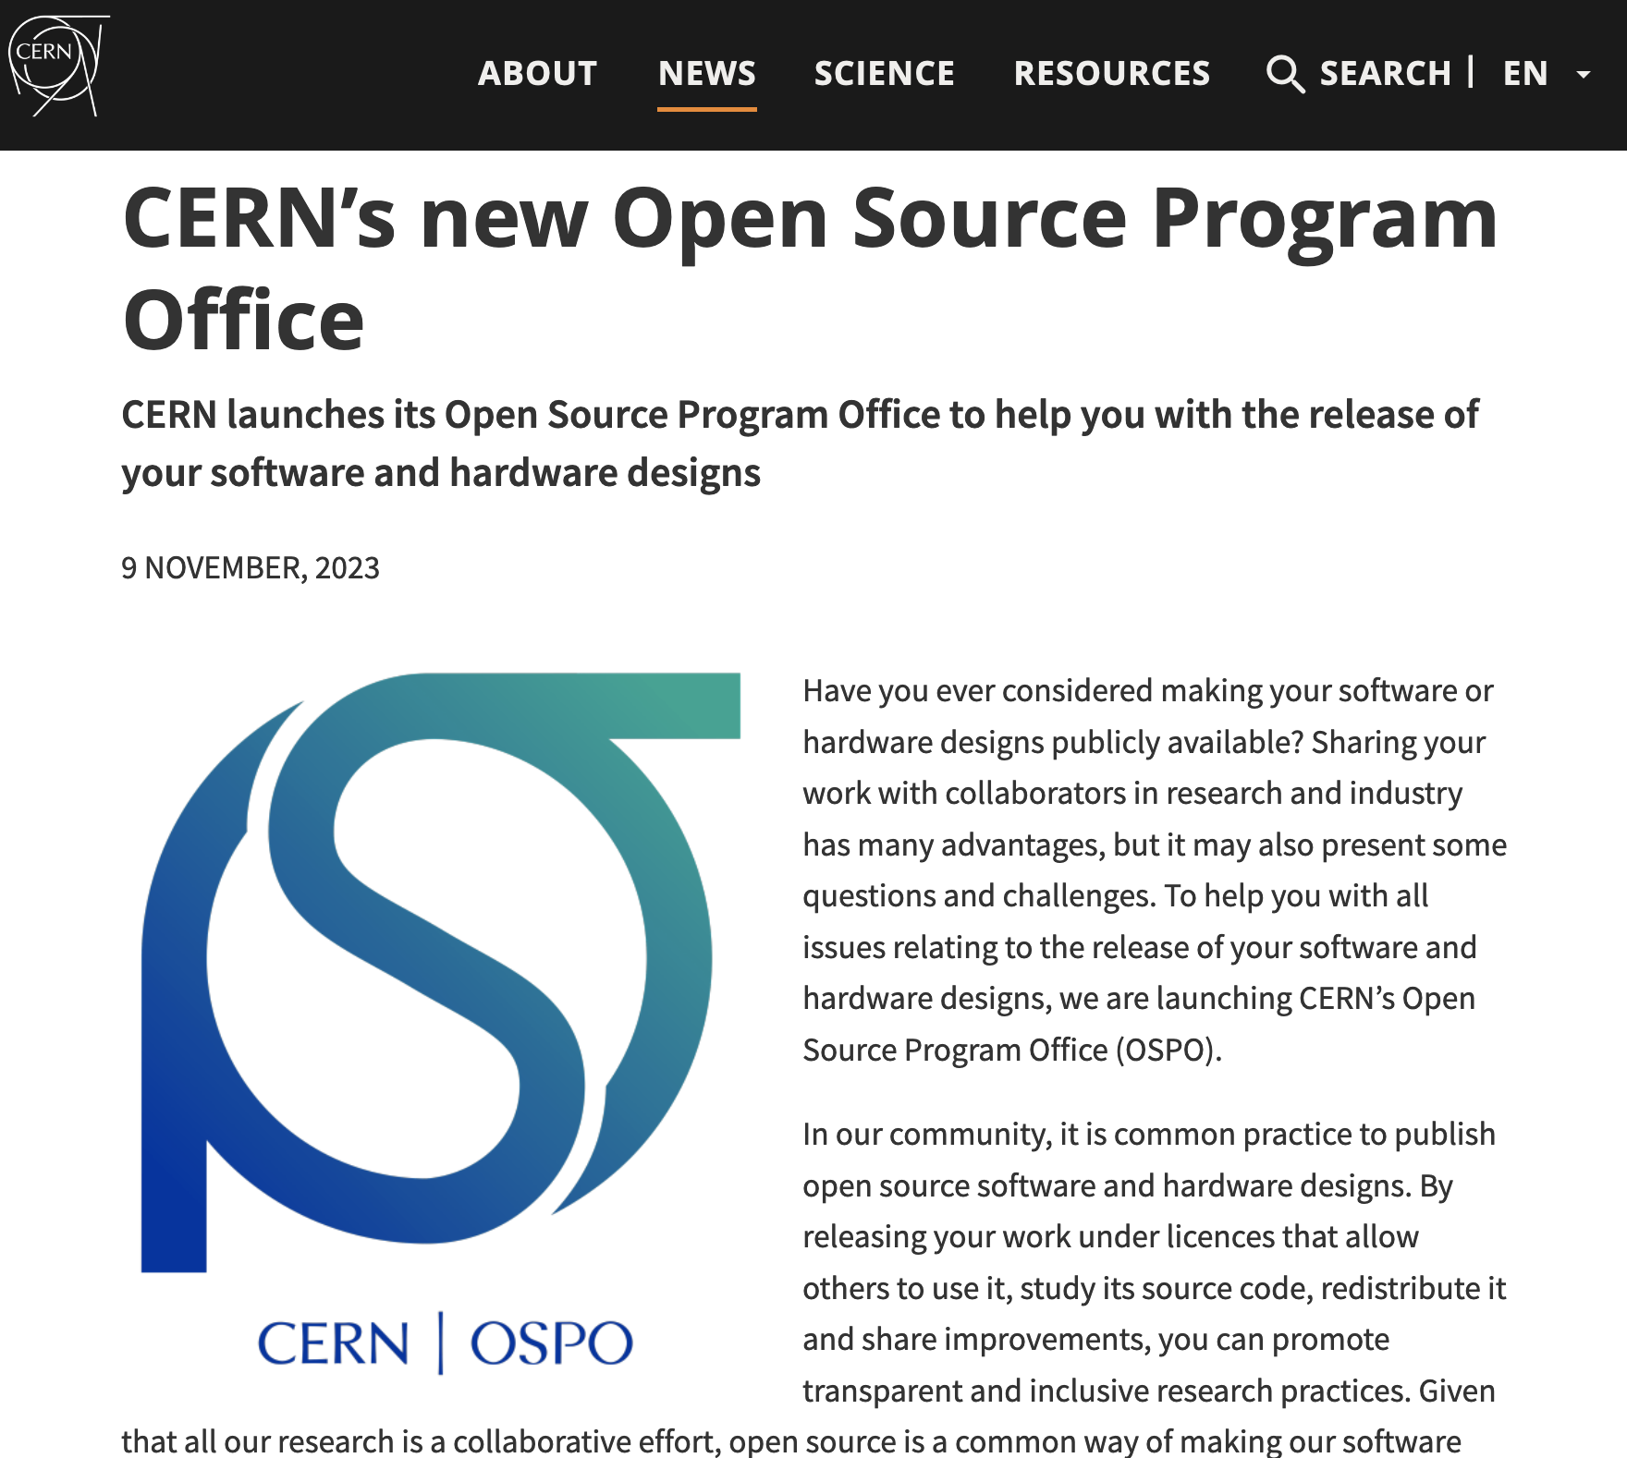



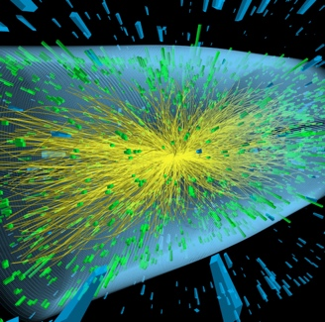

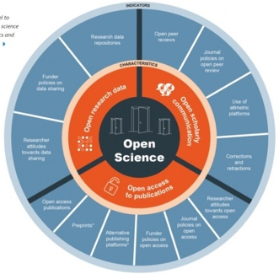

CERN – Open Science Highlights 1989-2023
SIS has played a key role and is coordinating OS at CERN
Article/Data
linking
SCOAP3: 90% OA
Open Data Policy
OSPO
WWW
OA Policy
1989
1991
2011
2014
2018
2020
2022
2023
Open Hardware License V1.0
Launch Open Data Portal
Reuse and Reproducability Framework
Open Science Policy

Slide 11



The Library is still there – but looks a bit different now.

Slide 12
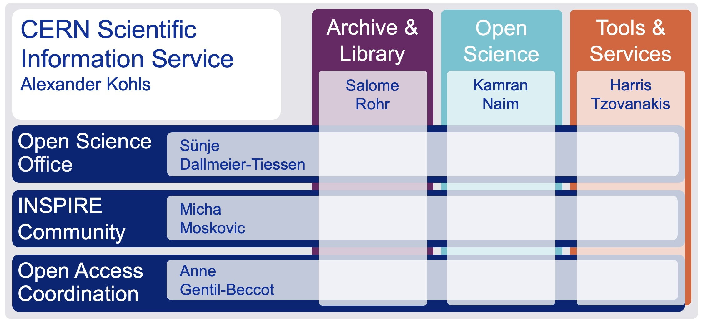

The CERN Scientific Information Service 2024
Connecting the CERN Community with global research
The CERN Scientific Information Service aims at efficiently managing, preserving and disseminating scientific information to make it openly accessible and reusable to CERN and the worldwide High-Energy Physics community.
Le Service d’Information Scientifique du CERN a pour mission de gérer, conserver et diffuser efficacement l’information scientifique afin de la rendre accessible et utilisable pour le CERN et pour la communauté mondiale de la physique des hautes énergies.

Slide 13
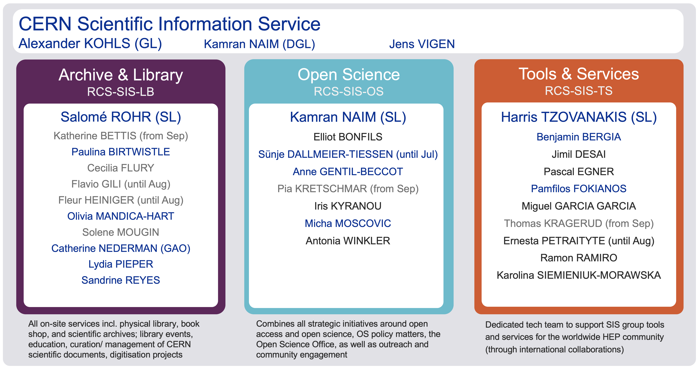
The CERN Scientific Information Service 2024

Slide 14
CERN OSPO

