Slide 1
Rénovation de la bibliothèque du CERN
Salomé Rohr
12 June 2024

Slide 2
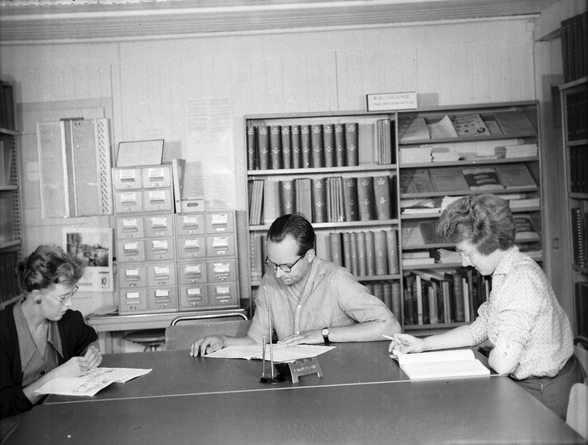
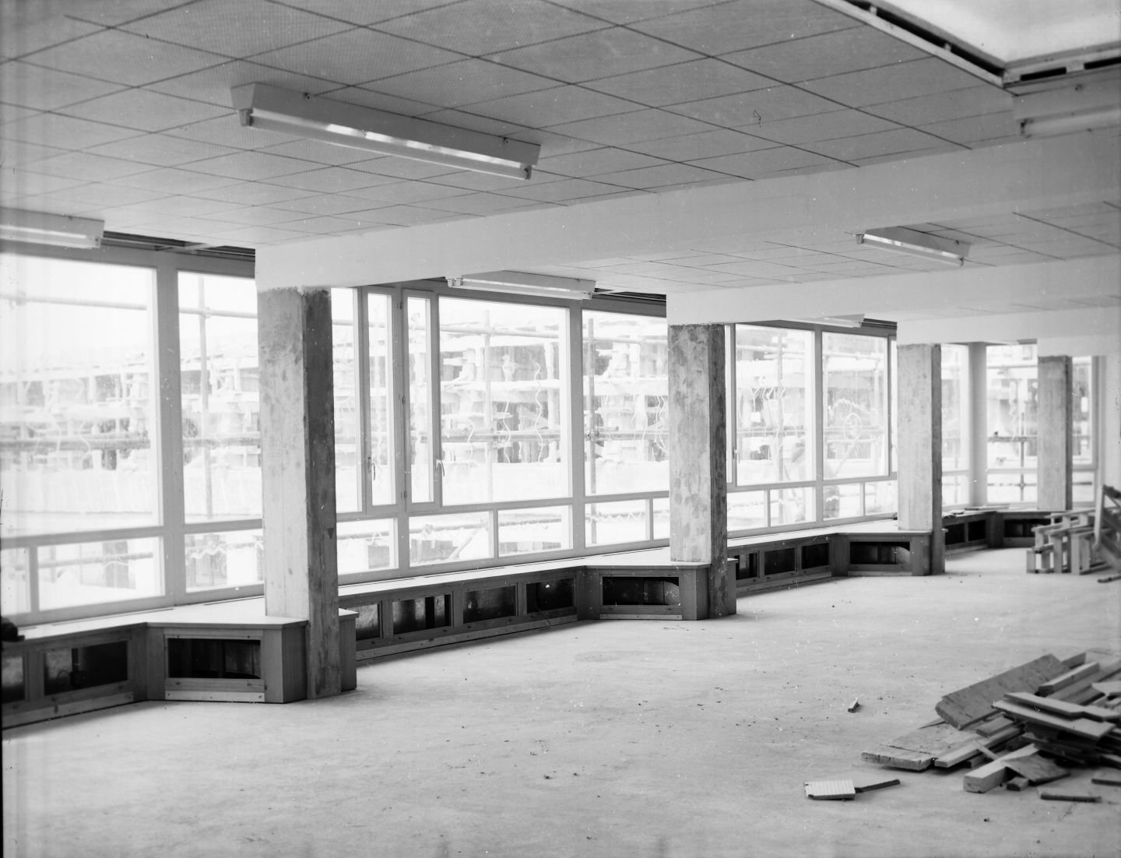
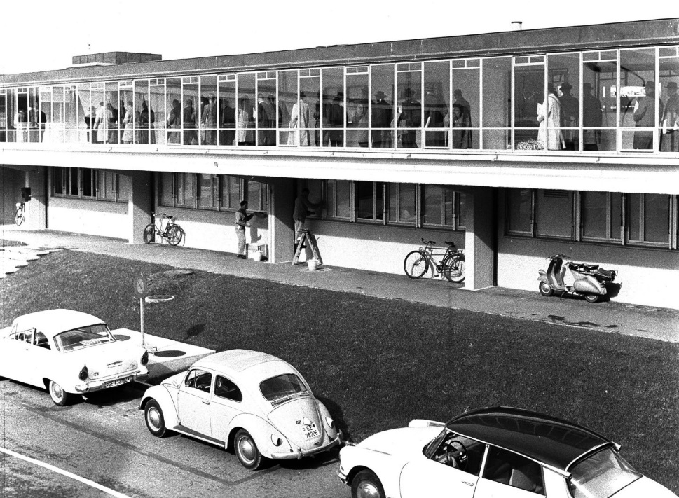
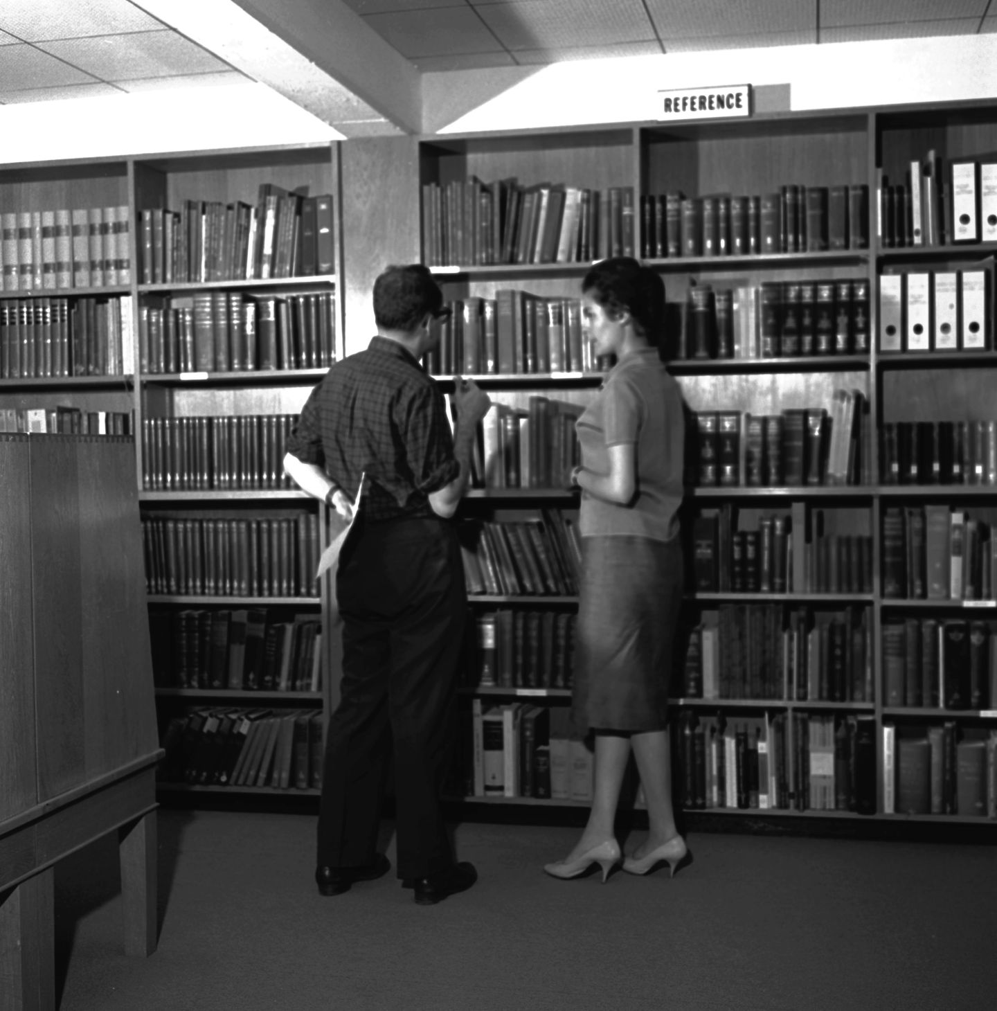
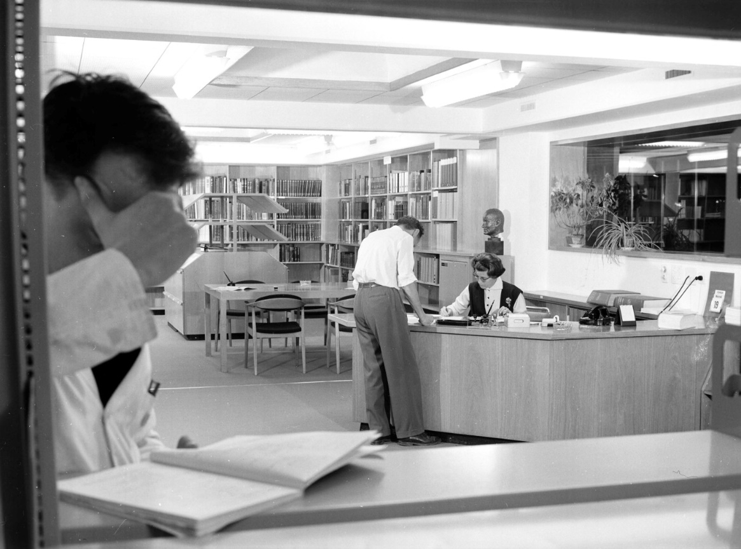
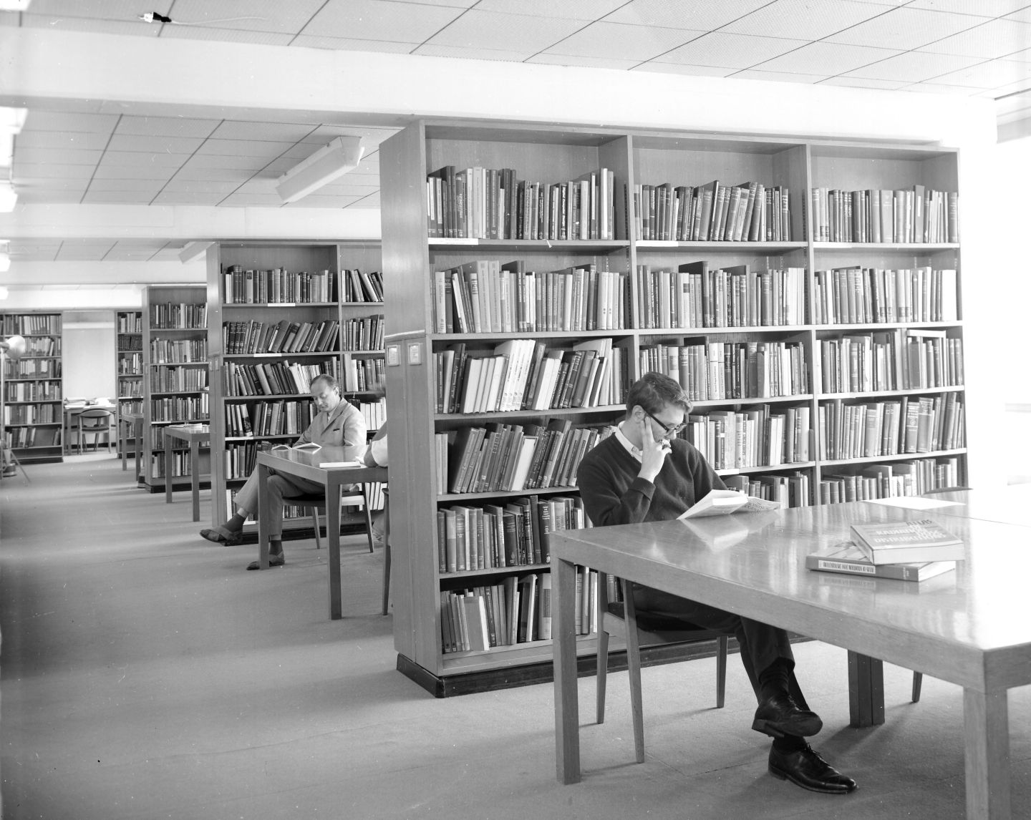
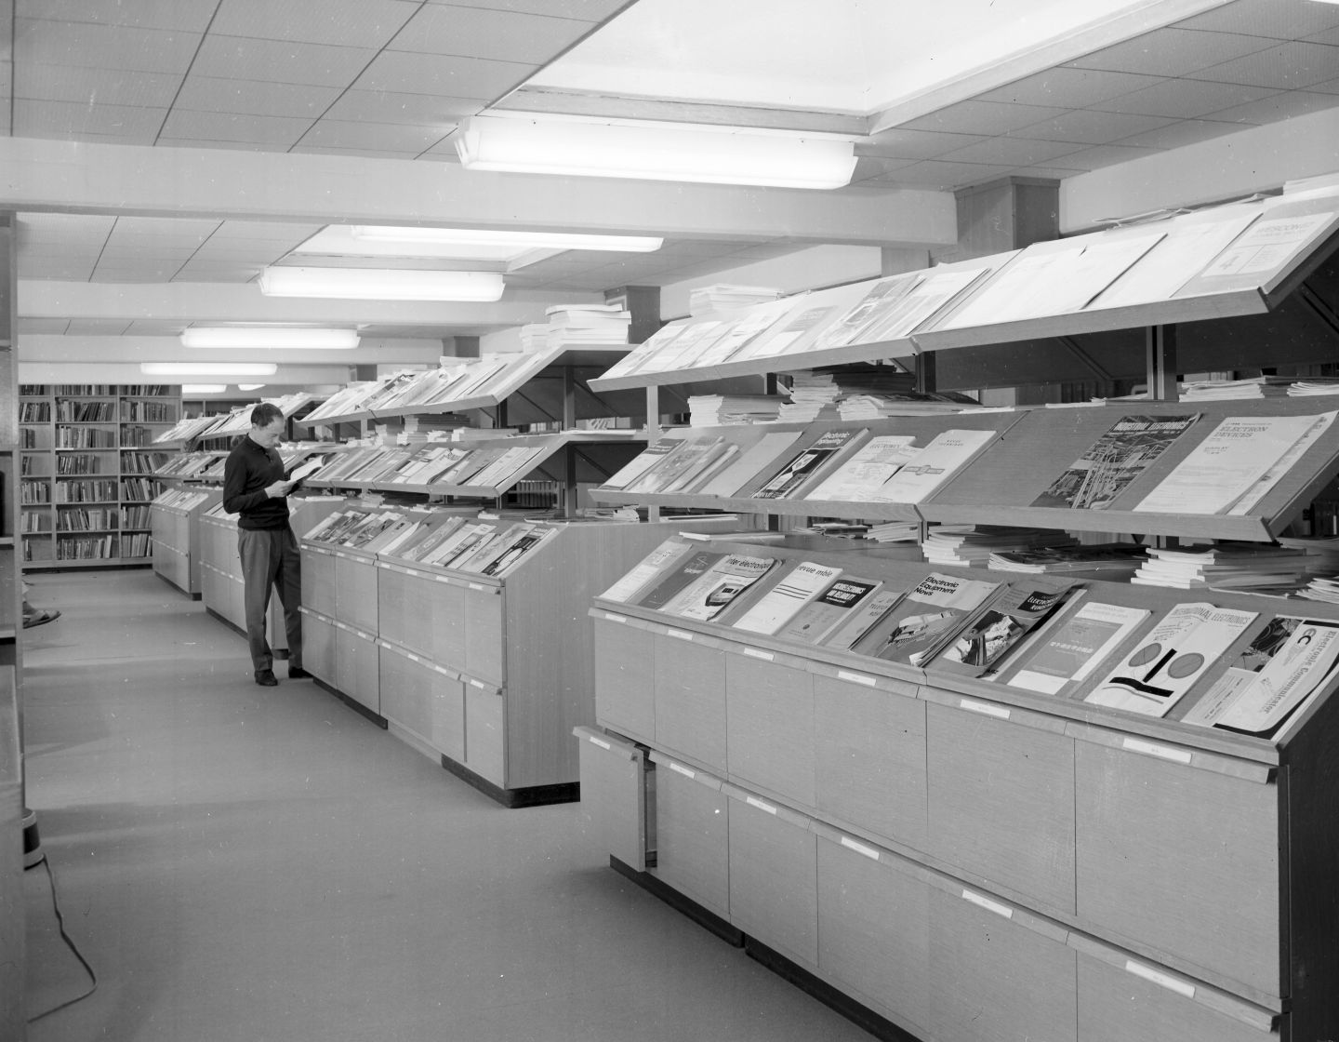
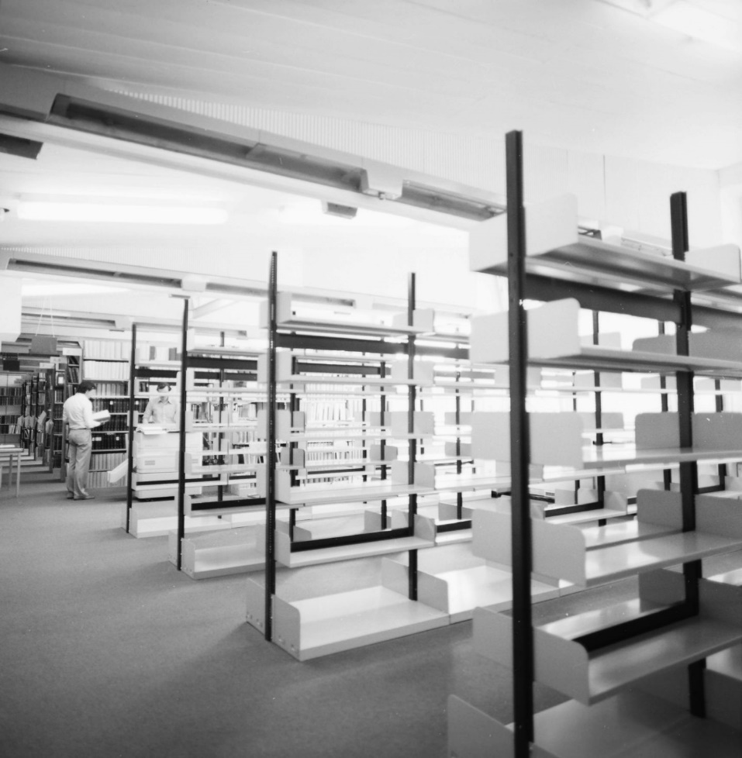
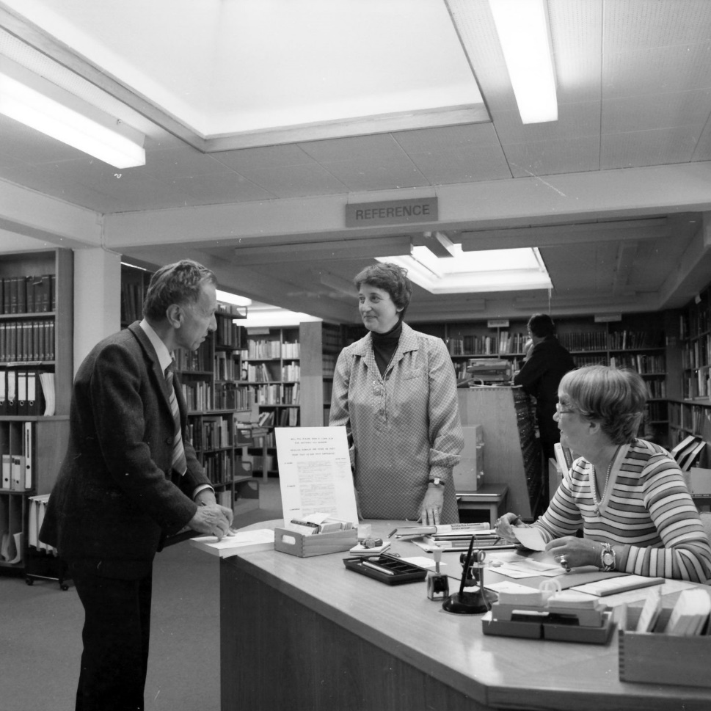
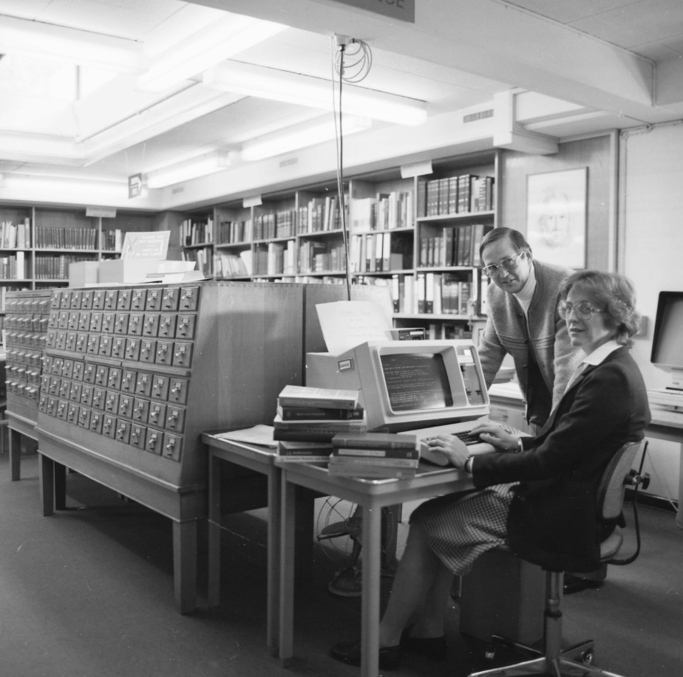
Histoire de la bibliothèque du CERN
11 July 1957 - Central Library when it was housed in the barracks of Cointrin. The Library staff reading.
14 August 1957 - Construction of the Central Library reading rooms. CERN Building 52, Meyrin.
1961 - The Central Library corridor seen from outside. CERN Building 52, Meyrin.
August 1963 - In the CERN Library, librarian, with a CERN visiting scientist.
February 1964 - CERN Central Library. Library desk.
September 1968 – View from the Central Library.
September 1968 – View from the Central Library.
August 1979 - Extension of the Central Library into building 3.
May 1981 - Working at the Library.
October 1983 - An electronic catalogue for the CERN Library.
Salomé Rohr | Library renovation
2

Slide 3
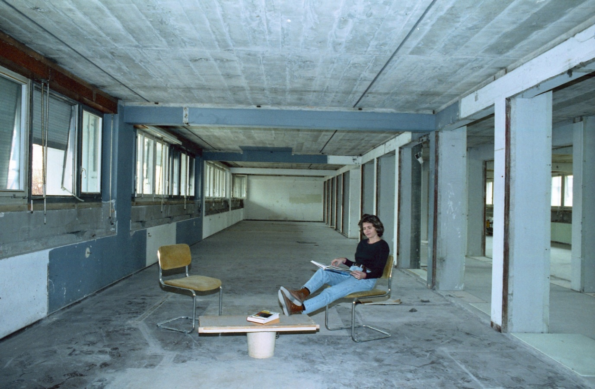
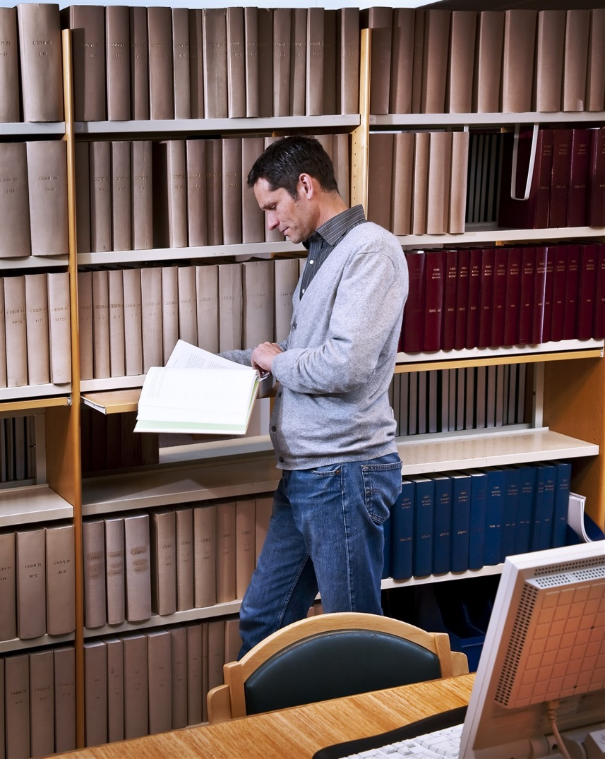
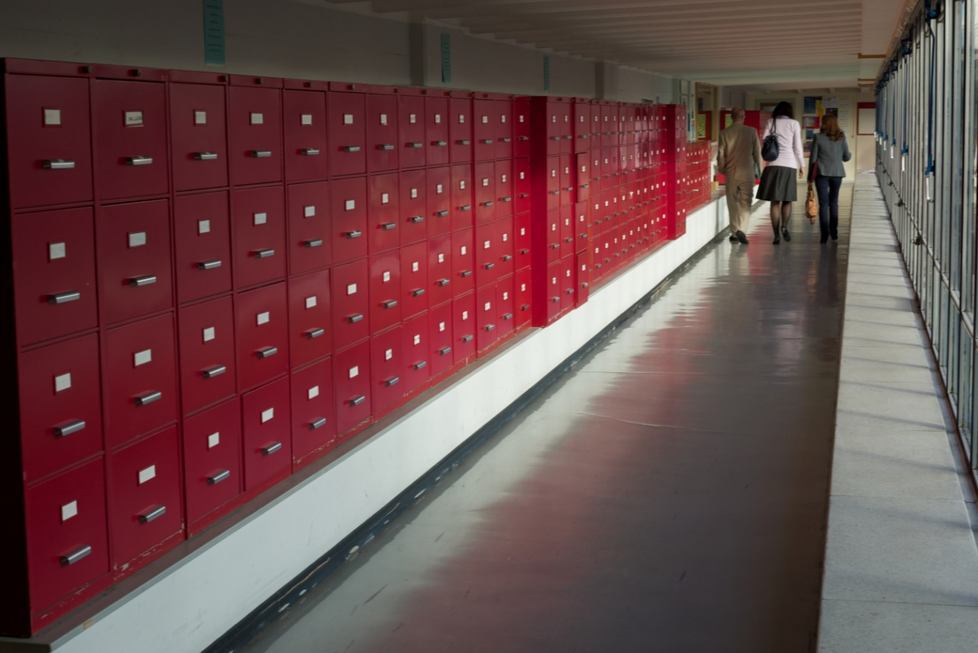
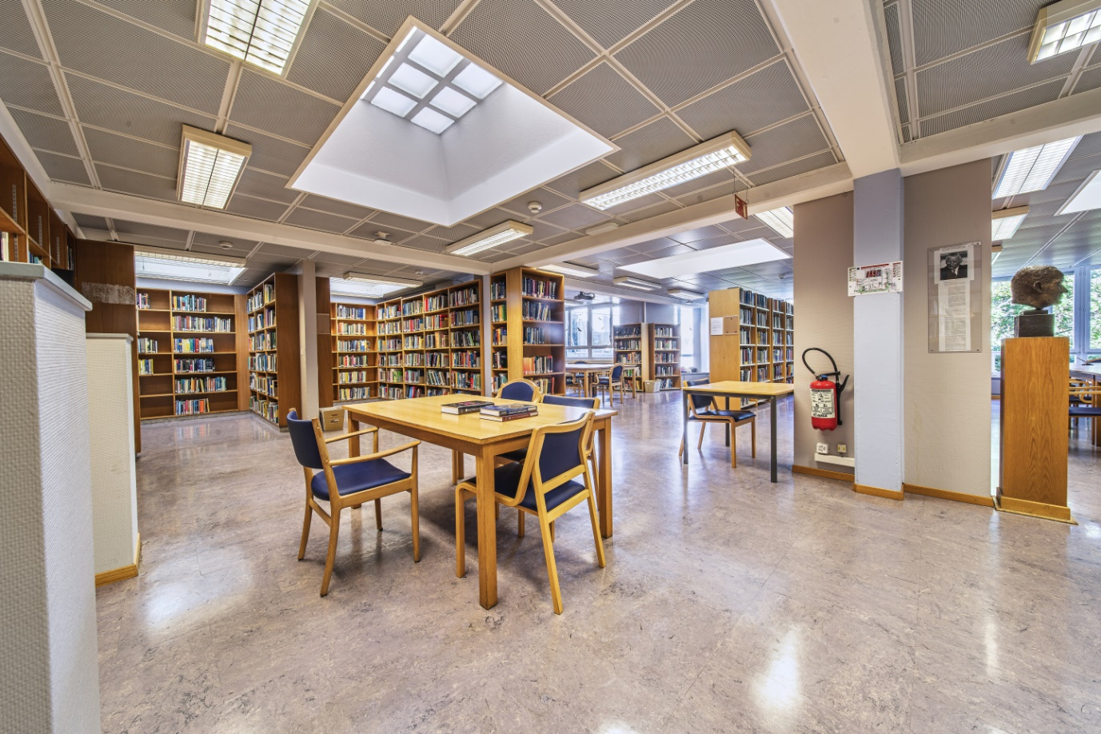
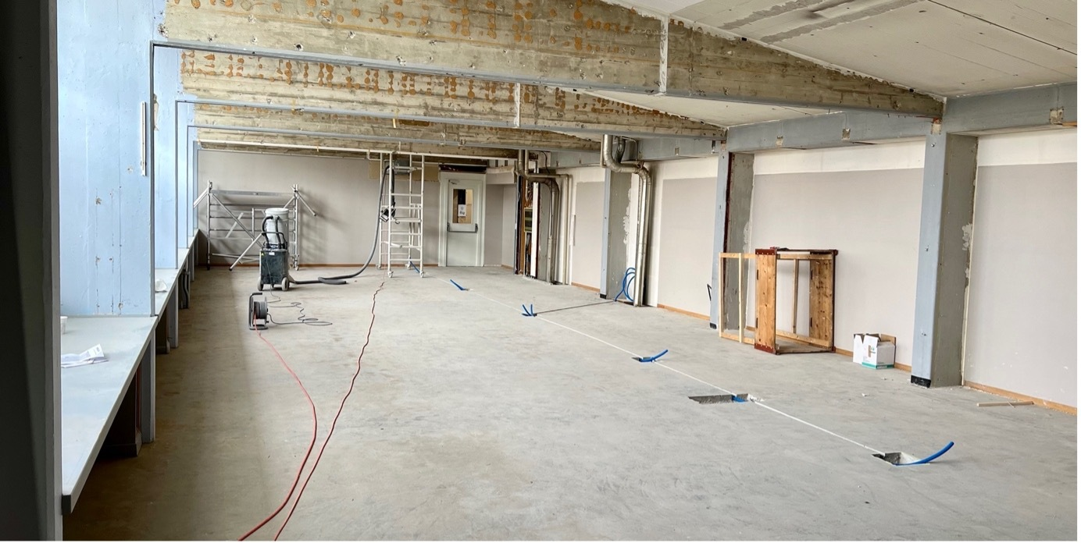
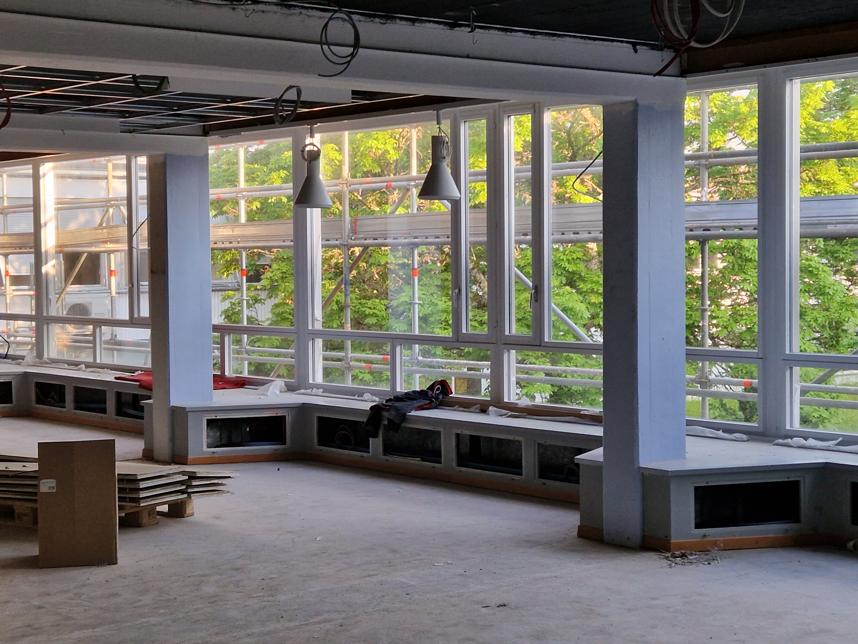
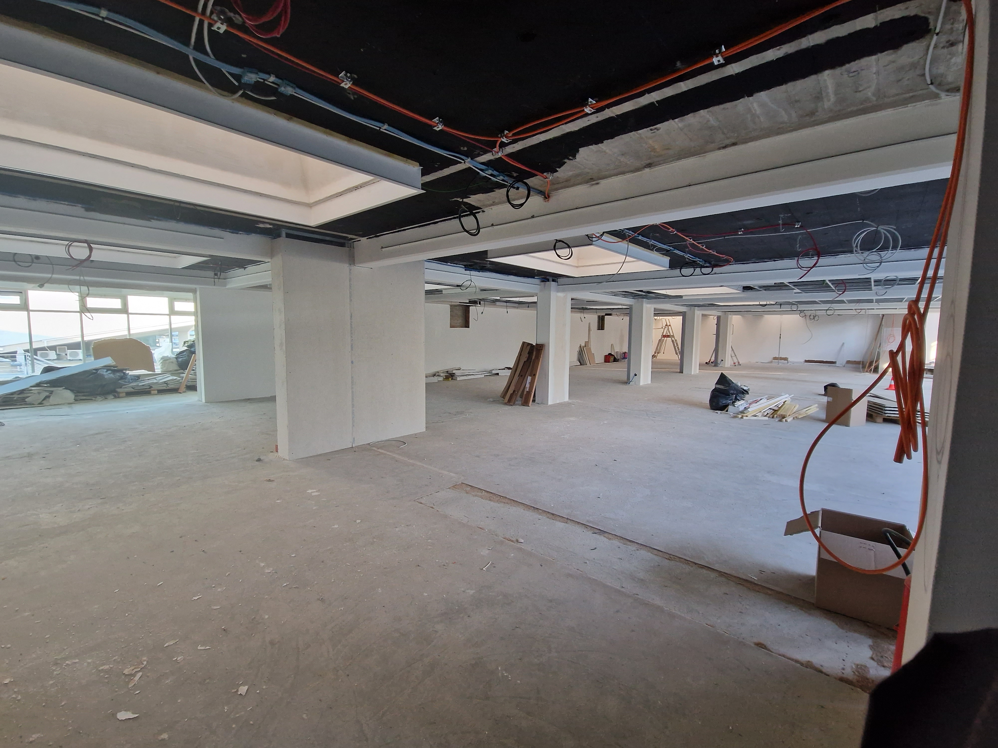
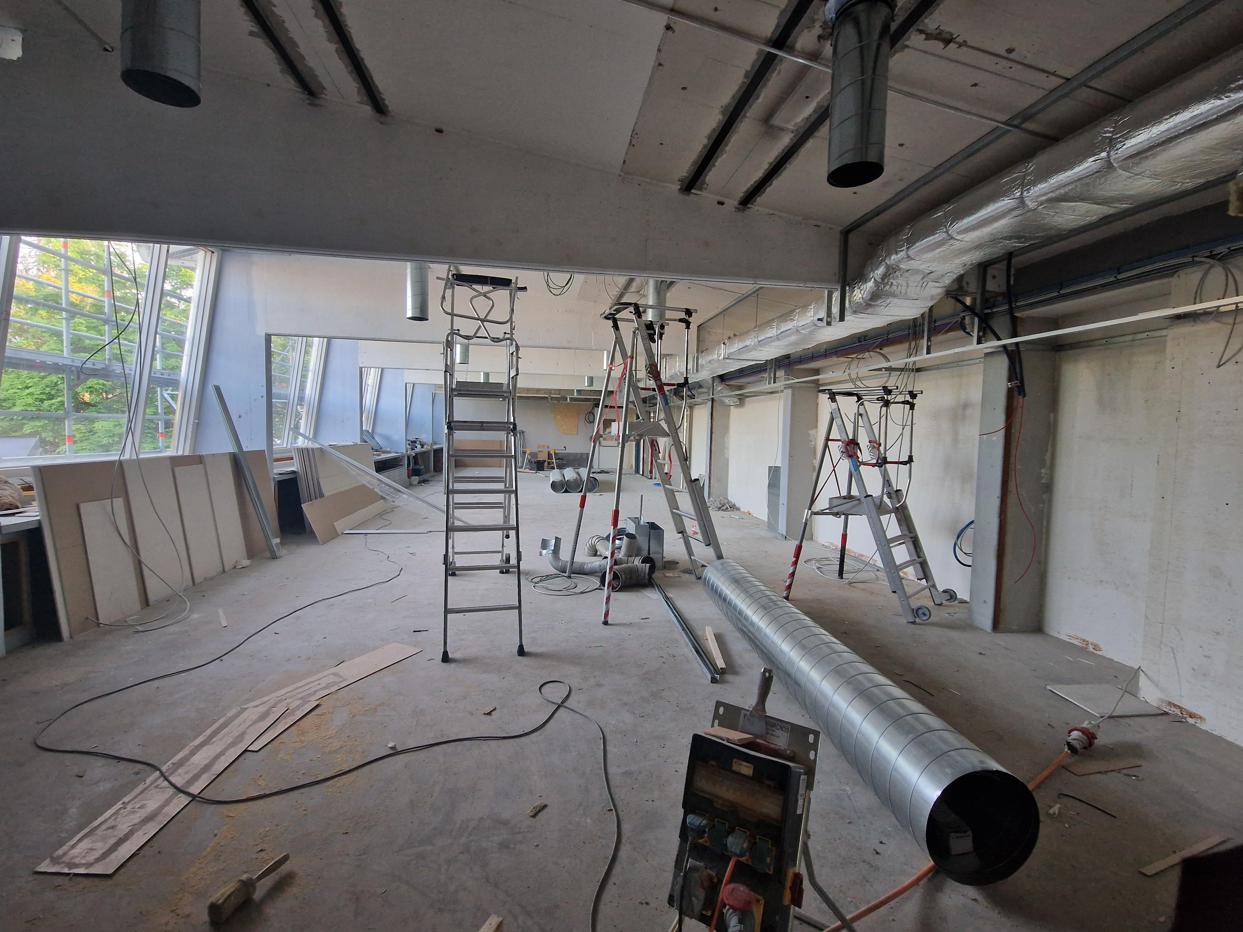
Histoire de la bibliothèque du CERN
April 1996 - Expansion of the Library to the ground-floor of building 52.
25 March 2009 - Working in the CERN Library.
6 November 2012 – Library red cabinets. Preprints collection.
21 October 2019 - Library overview.
January 2023 - Library reading area under renovation.
Salomé Rohr | Library renovation
3

Slide 4
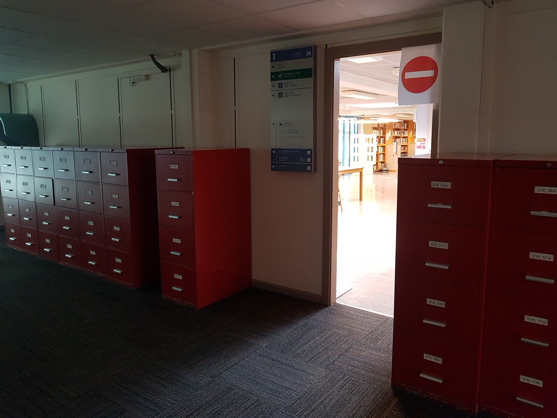

Slide 5
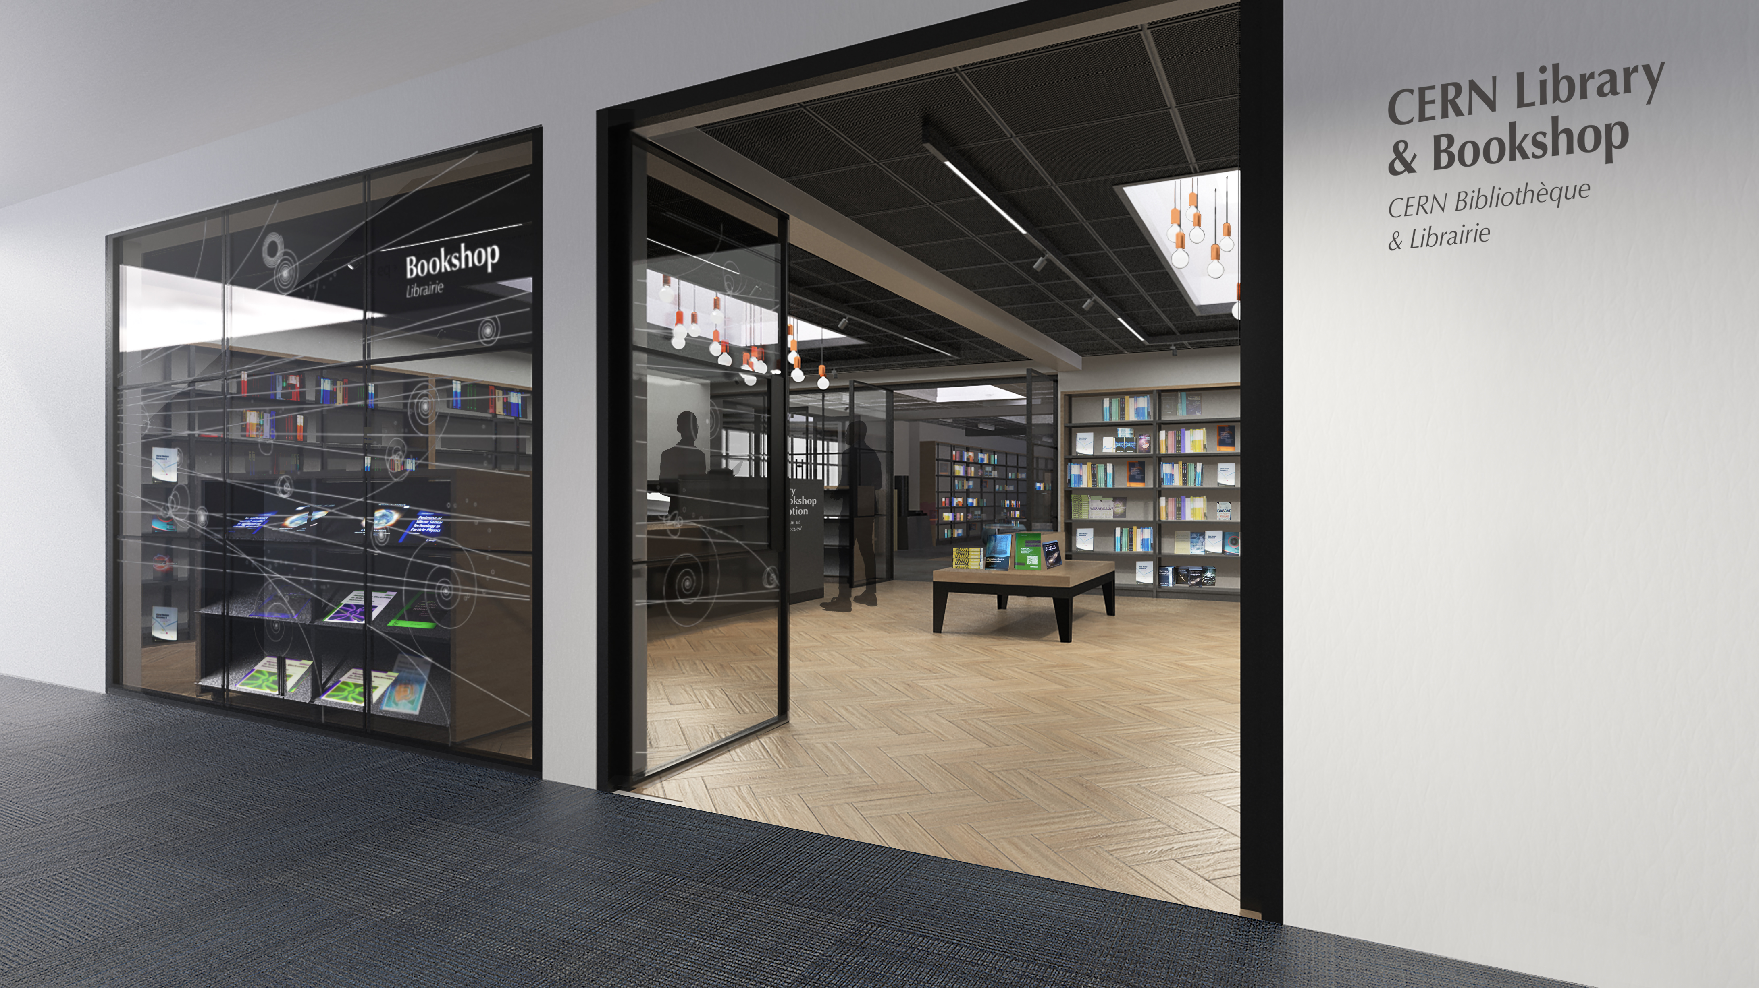

Slide 6
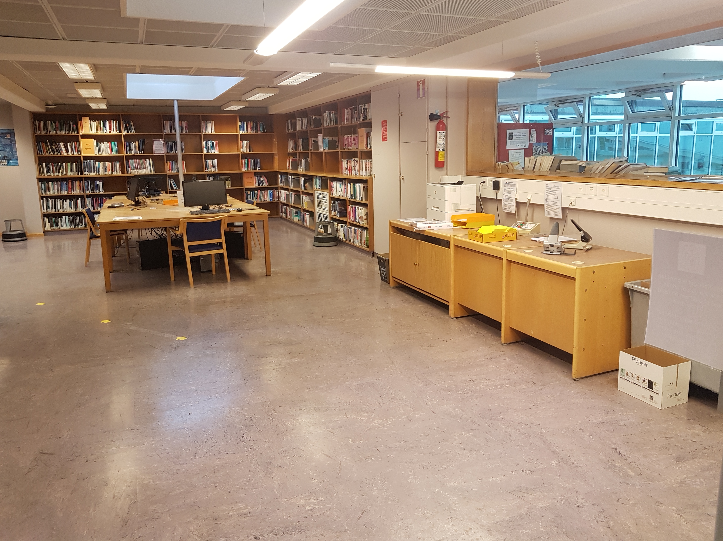

Slide 7
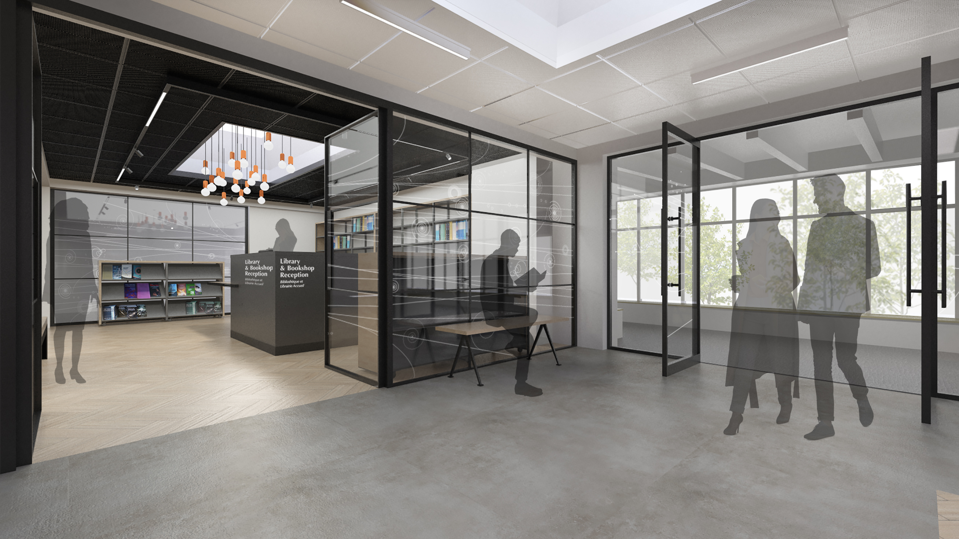

Slide 8
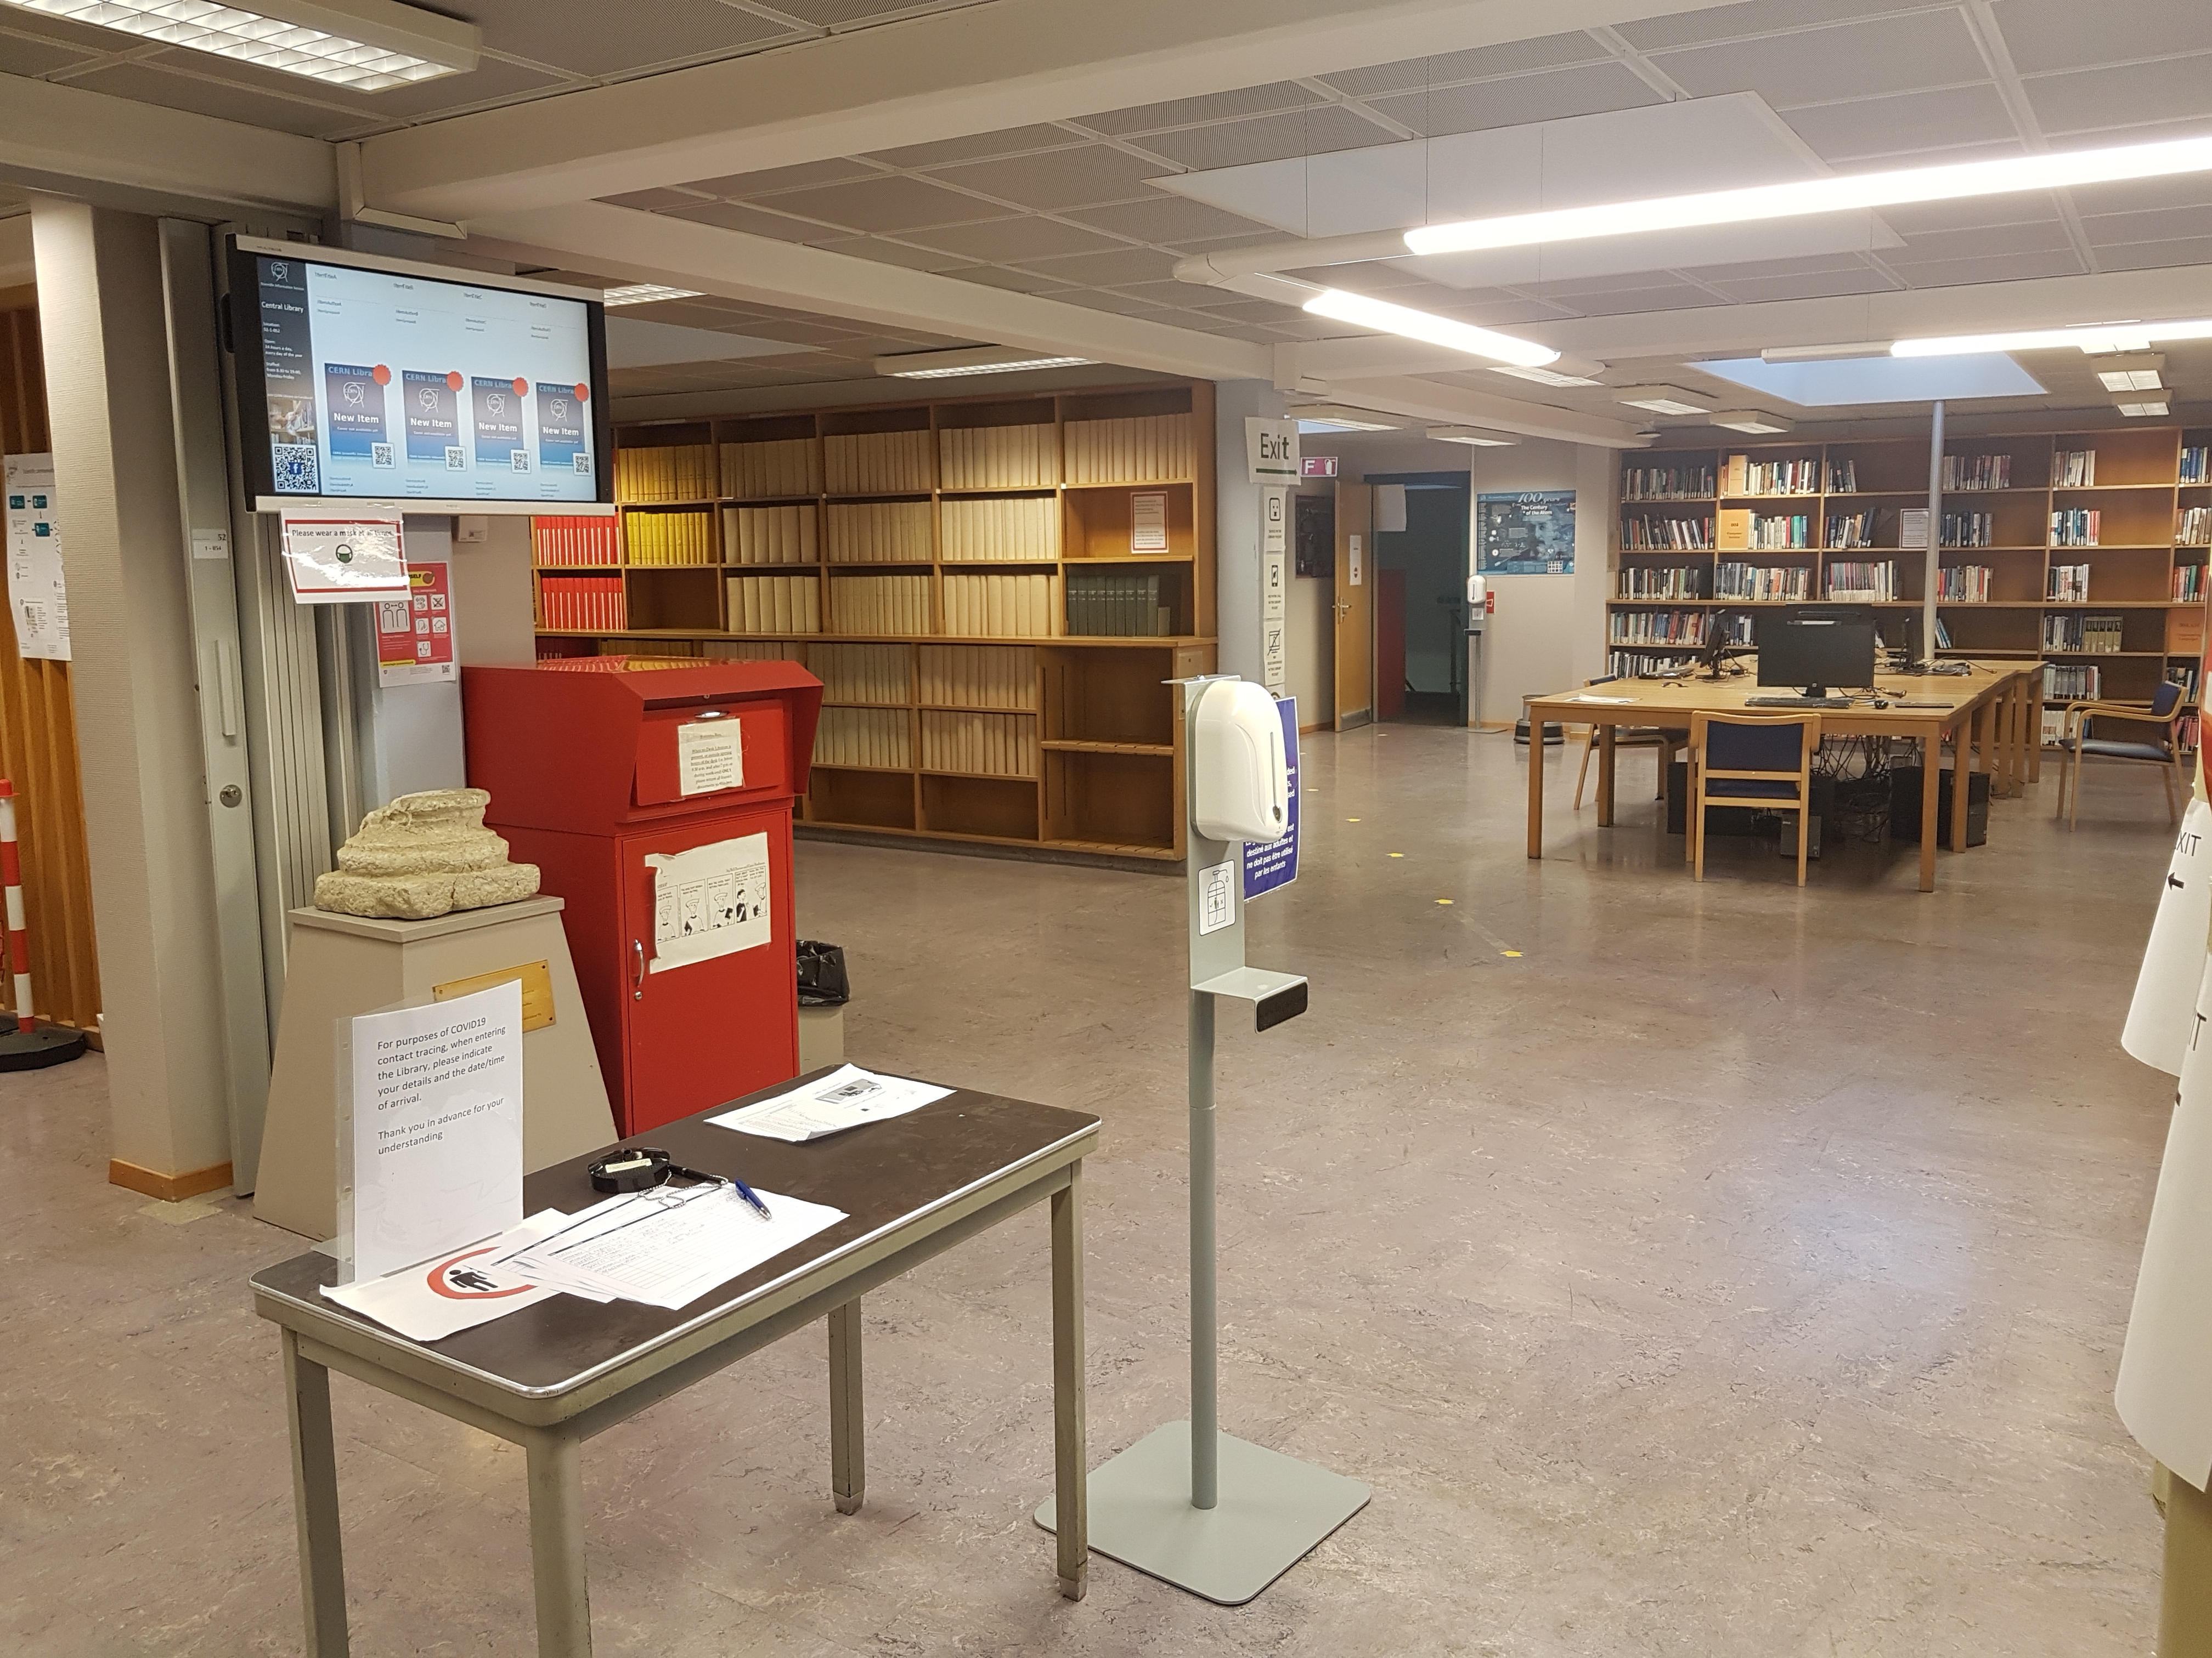

Slide 9
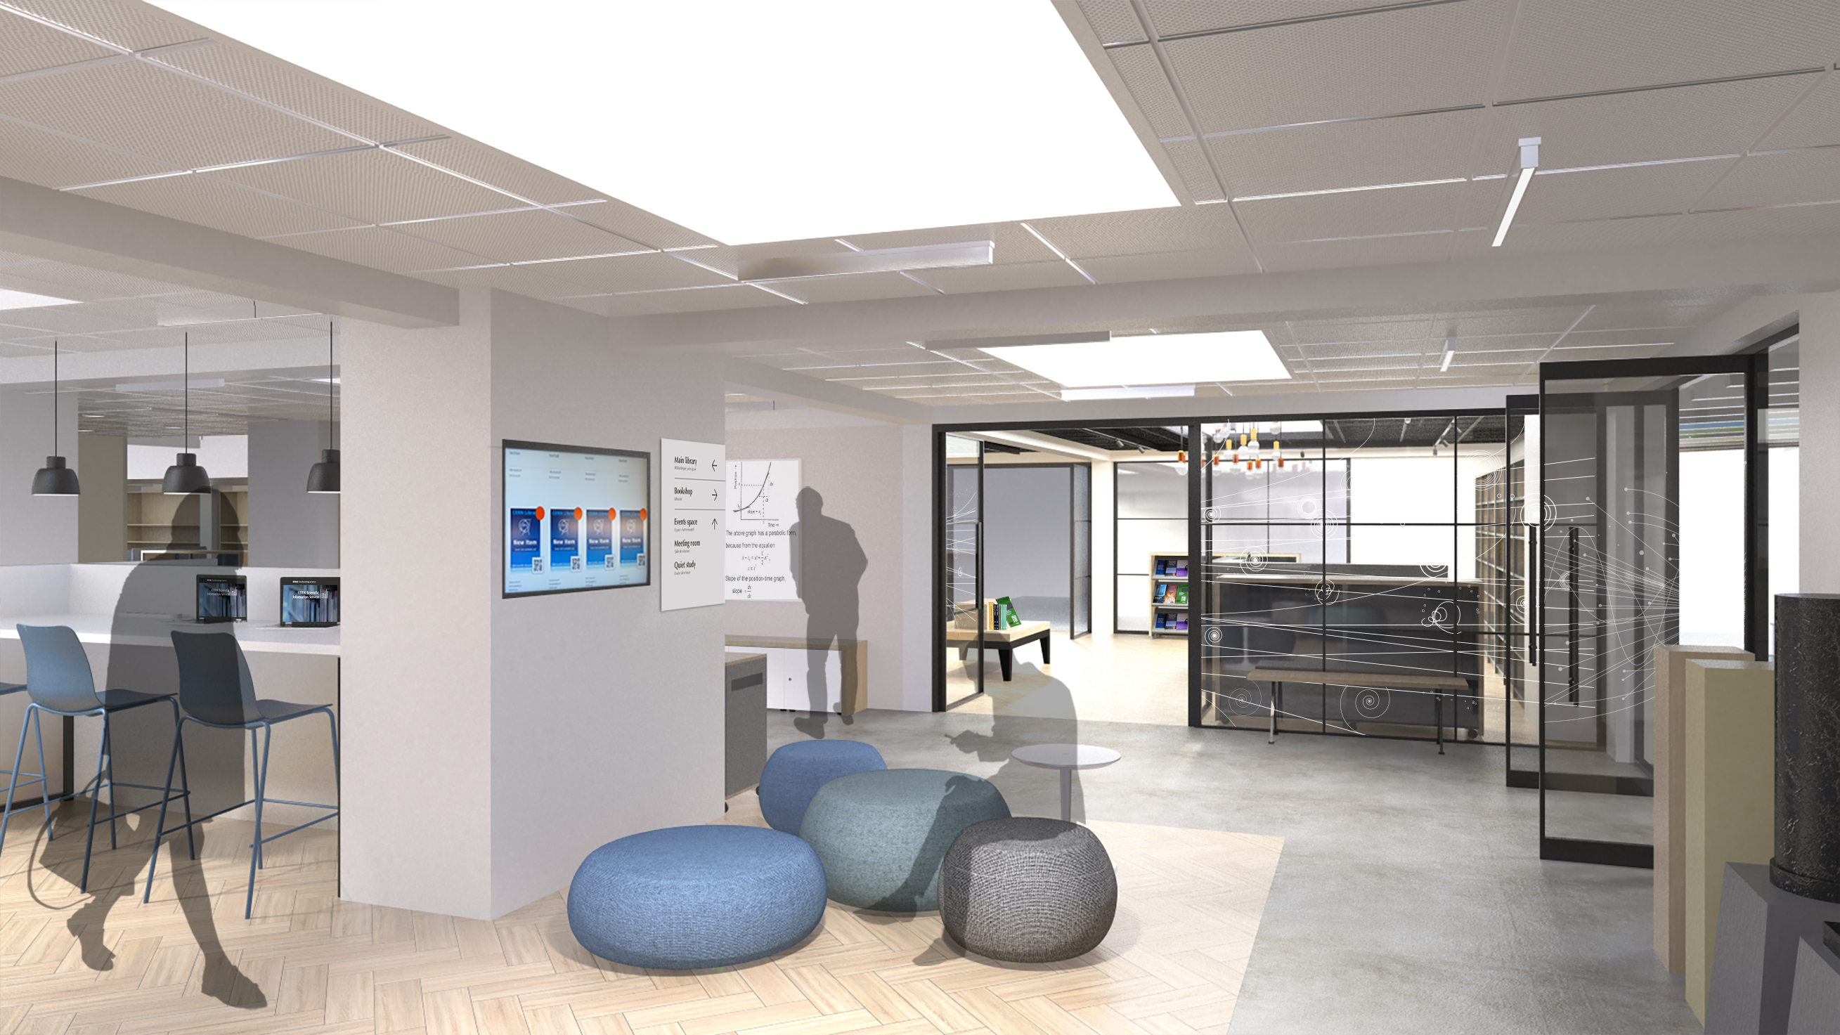

Slide 10
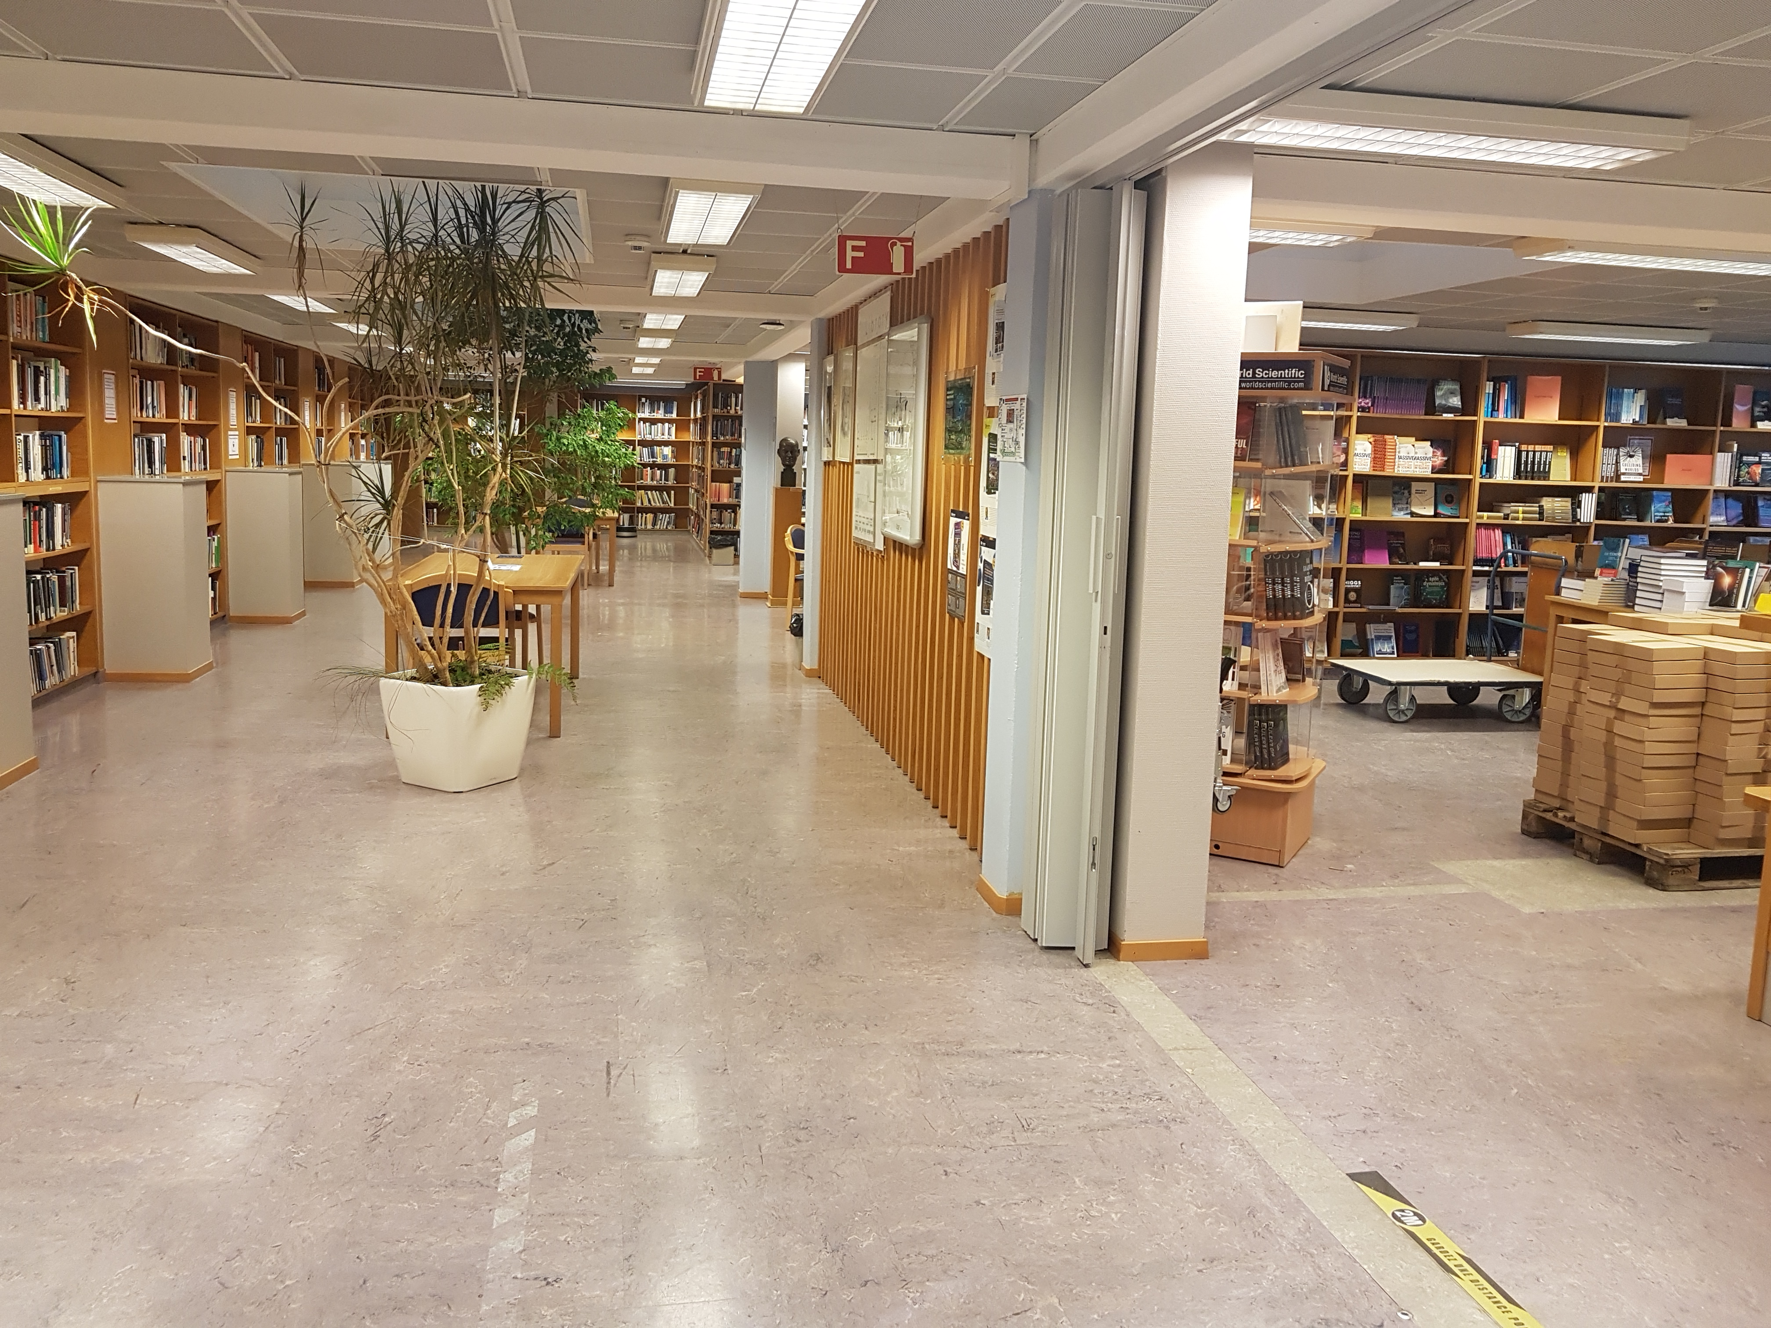

Slide 11
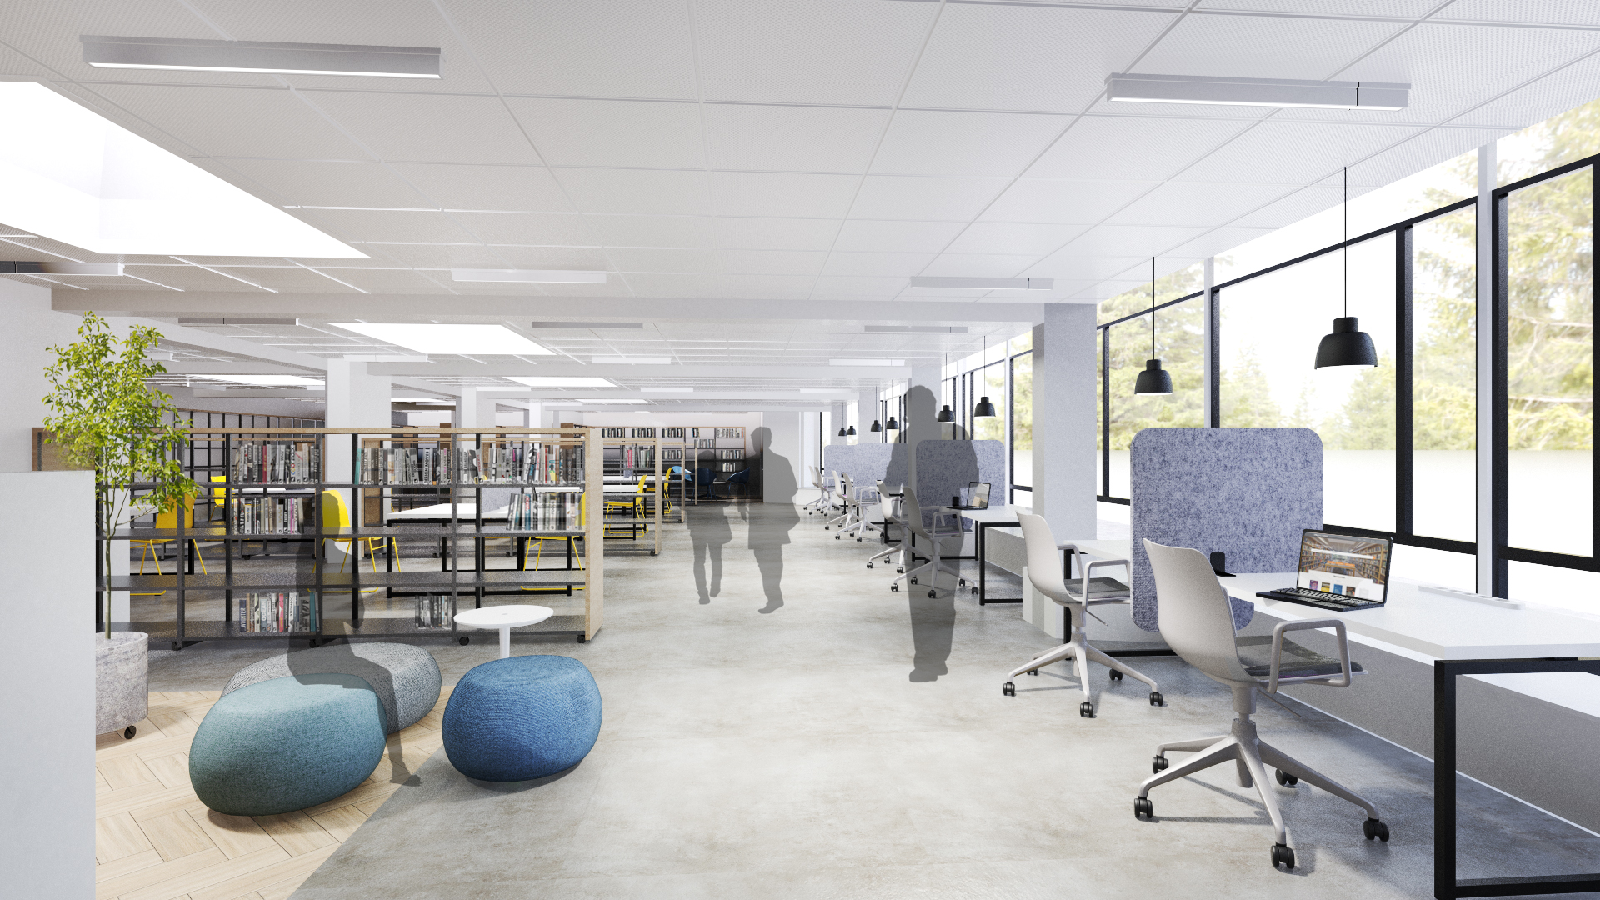

Slide 12
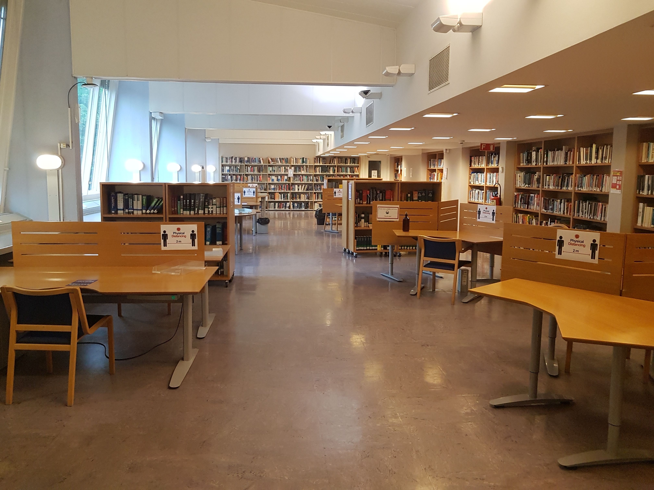

Slide 13
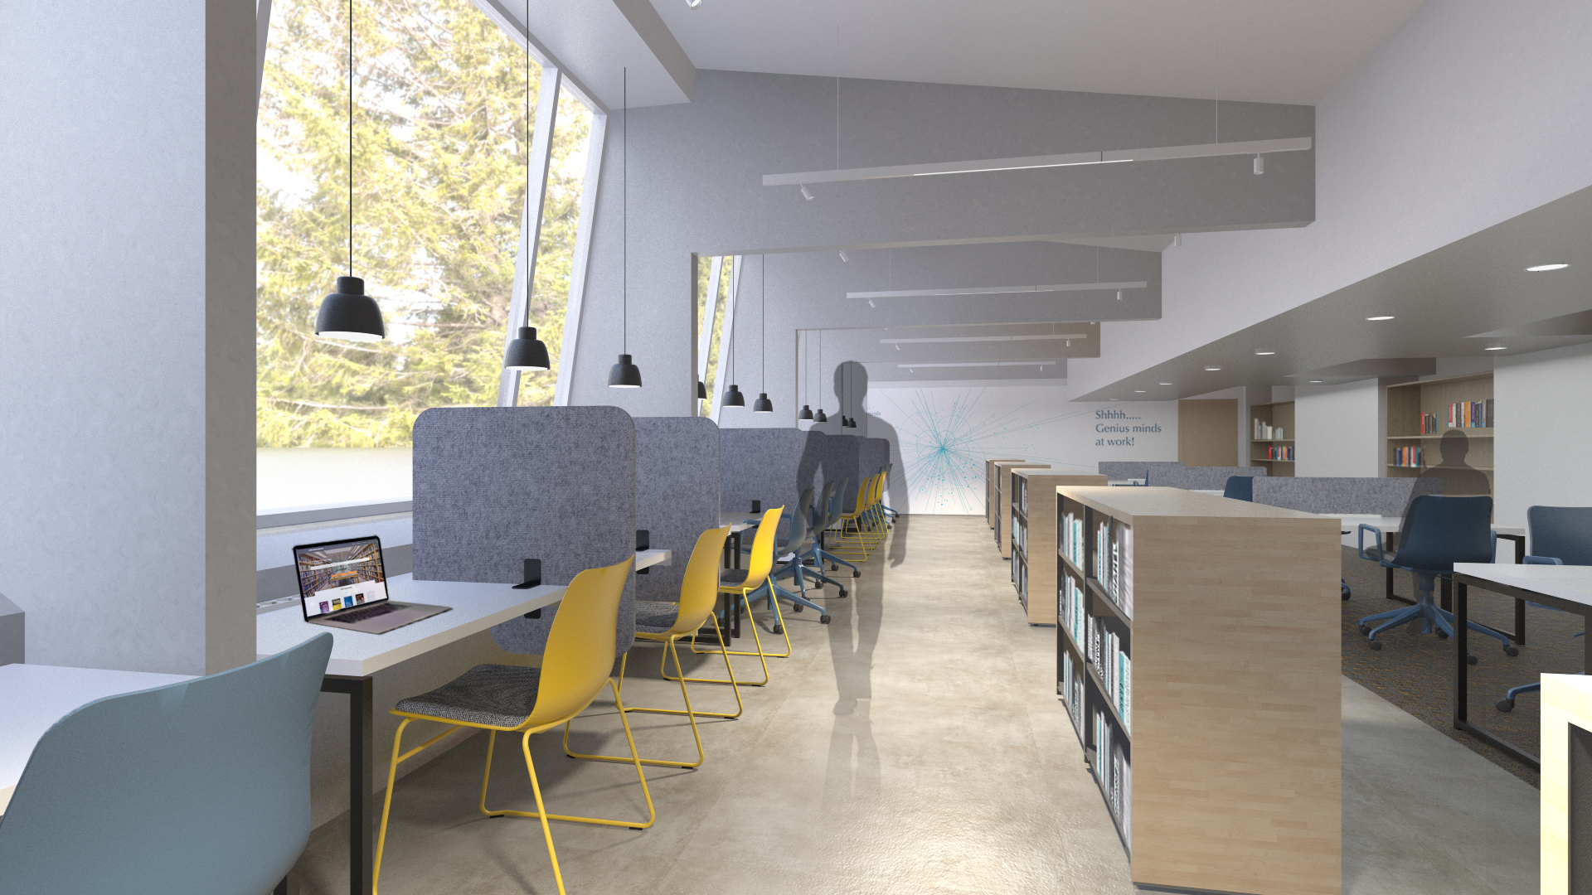

Slide 14
Visite de la bibliothèque

