Slide 1
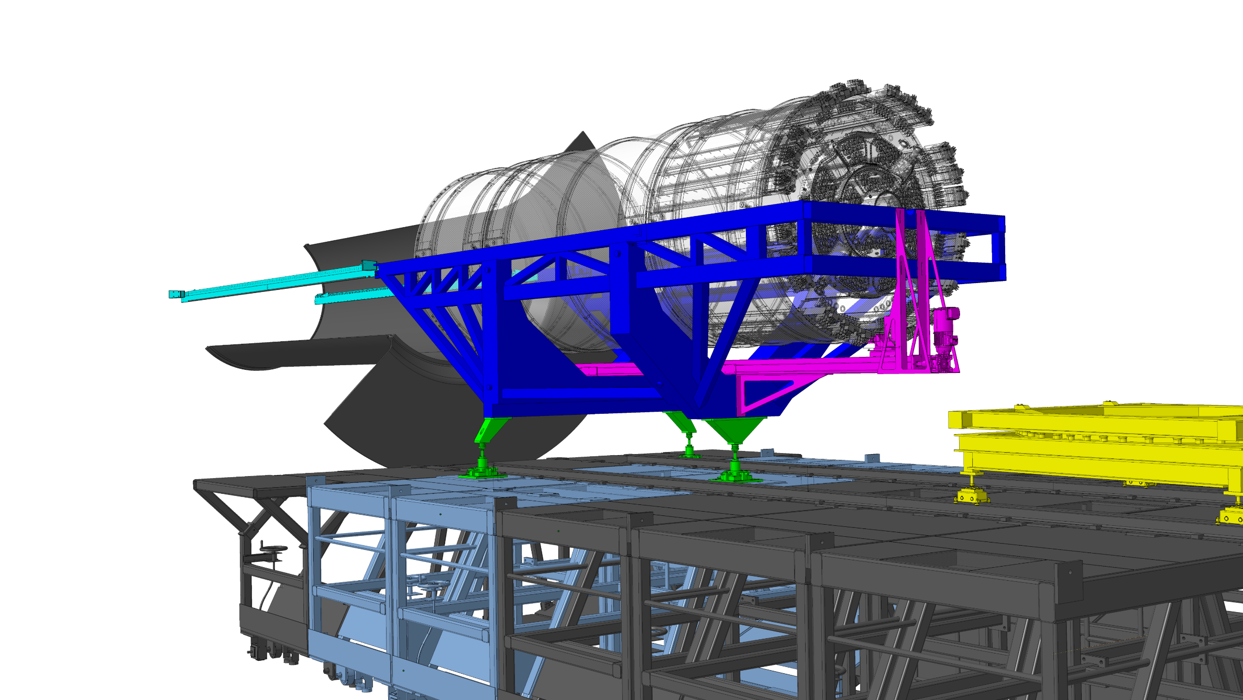
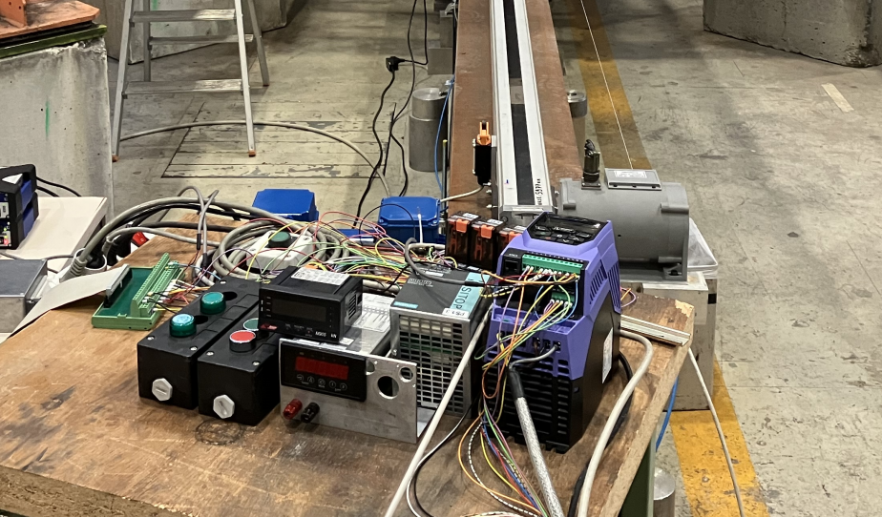
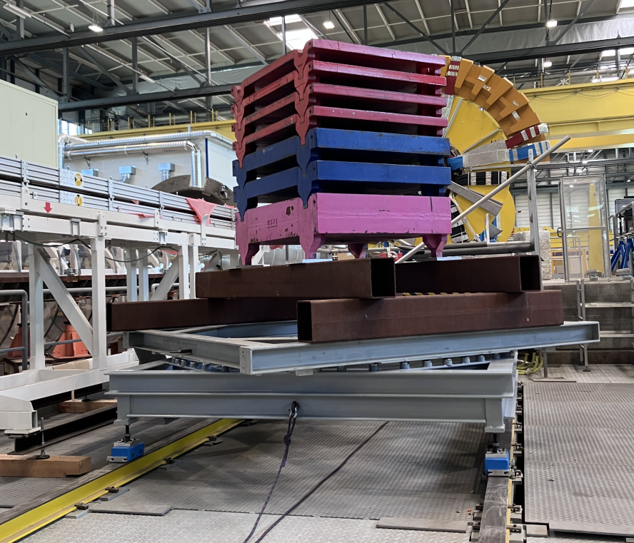
ITk installation tooling
2023
Rail system
From SR1 to : SX1 – UX15 – Z0
ITk
Linear actuator:
Design completed
Manufacturing and assembly finished in 2023
Extensively tested in 2023 (EDMS # 2942895)
Ongoing during spring 2024 : clean integration of control system in electrical cabinet.
Insertion Cradle :
Rotating table :
Reinforcement completed in 2023.
Proof tested at 7000 kg. Rotation confirmed to be reasonable by manual pushing.
Traction system (manual winch)
Manufacturing nearing completion
To be tested in summer 2024
ID configuration to be restored for LS3.
Alignment feet :

Slide 2
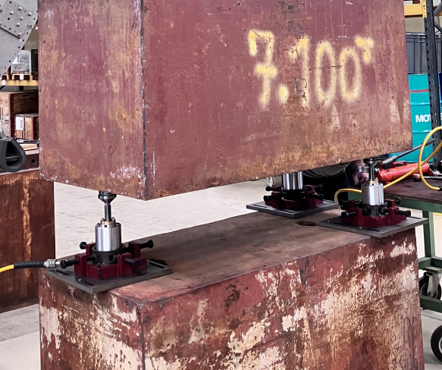
ITk installation tooling
2024
Rail system (2 sets needed) :
Procurement strategy (flatness tolerance of 0.1 mm on 3.4m long parts remains challenging) :
Tendering for the 2 sets
Set #1 (mockup) targeted for end 2024
Set #2 (UX15) targeted in 2025 (same manufacturer)
Validation of torque-pretension relationship for M5 screws.
From SR1 to : SX1 – UX15 – Z0
ITk
Linear actuator:
Insertion Cradle :
Procurement process just started. Targeting ≈ 6-7 months
Manufacturing will be performed with a 1.0 mm flatness tolerance (to reduce cost). A correction will be performed at CERN with a set of 60 shims per rail to individually machine after laser tracker survey. Final tolerance targeted at 0.1 mm
Rotating table :
Alignment feet :
Manufactured and load tested at 7000 kg in April 24
A few parts remain to be zinc-plated

Slide 3
ITk installation tooling
2024-25
Test platform in b180 :
The IWV is currently undergoing modifications to allow rails installation :
Cleaning
Full bolting of the flanges
TSR (tracker support rail) extensions have been manufactured in may 2024
Additional brackets are designed and awaiting production in summer 2024
Elastic support for cradle (to emulate minivans stiffness) to be defined (likely spring washers)

