Slide 1
Services activities for 2024-2025
24-June-2024
Marco Ciapetti

Slide 2
Introduction
The main activities involving TC related to services are the following:
Preparation of activities “Pre-YETS” to be carried out in SR1
Preparation of activities for the YETS 2024-2025
  USA15
    Installation of cables for CO2 detectors and flashing lights in CV room
    Installation of cable trays in CV room
    Installation of cables for CO2 cooling early installation in CV room
  UX15:
    Installation of copper pipes for RPC gas system upgrade
    Installation of additional cable trays for RPC cables inside Toroid
    Displacement of the Tile Star Boxes on EndCap A and EndCap C
Continue the routing study and installation procedure for LS3 services installation
  Routing study
  Accesses study
  Scheduling

Slide 3
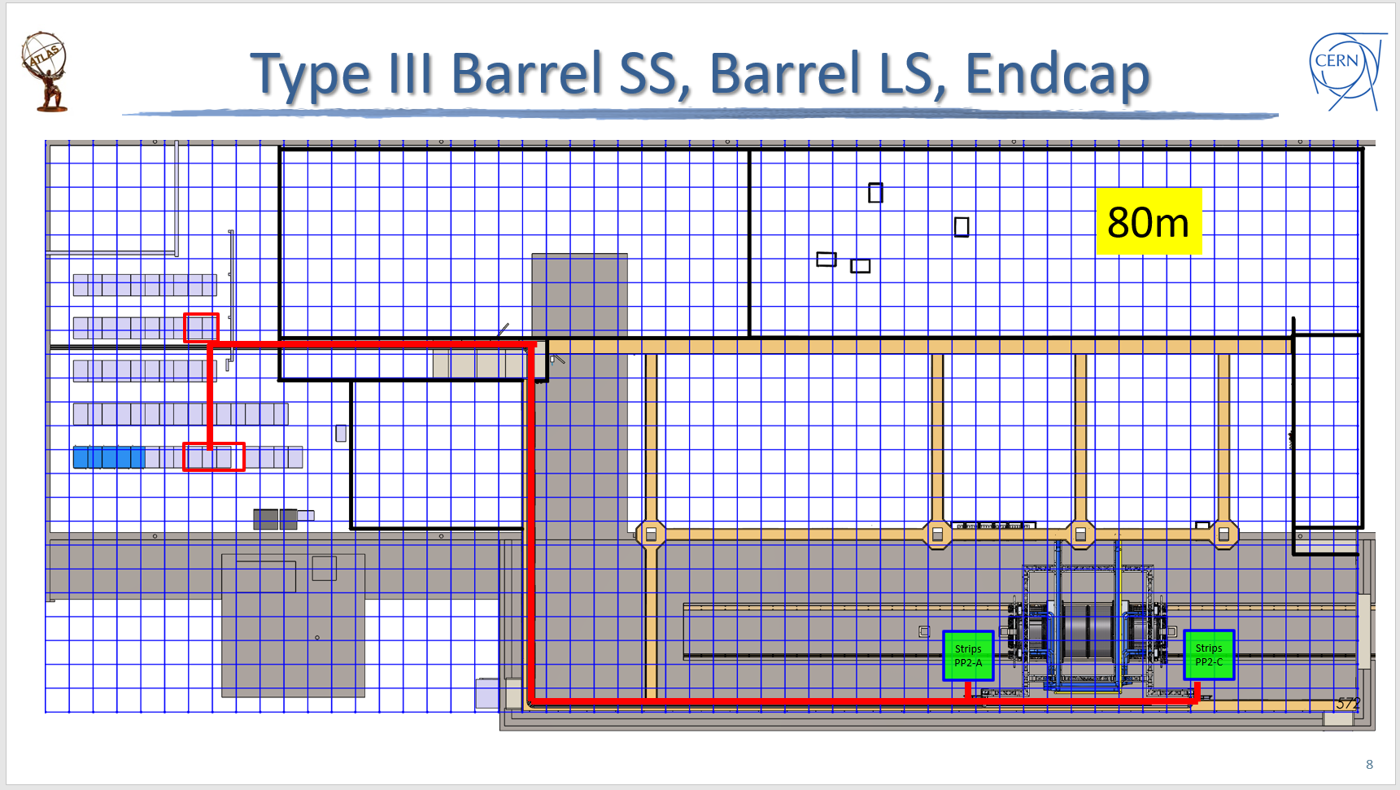
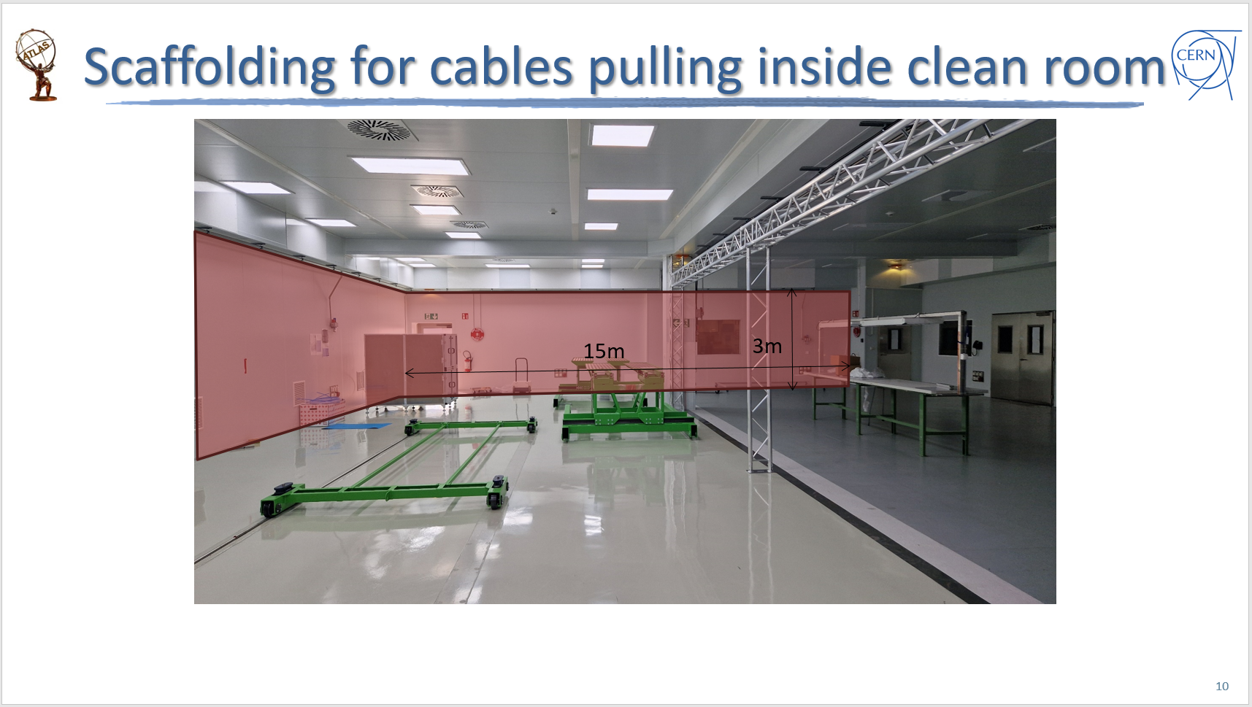
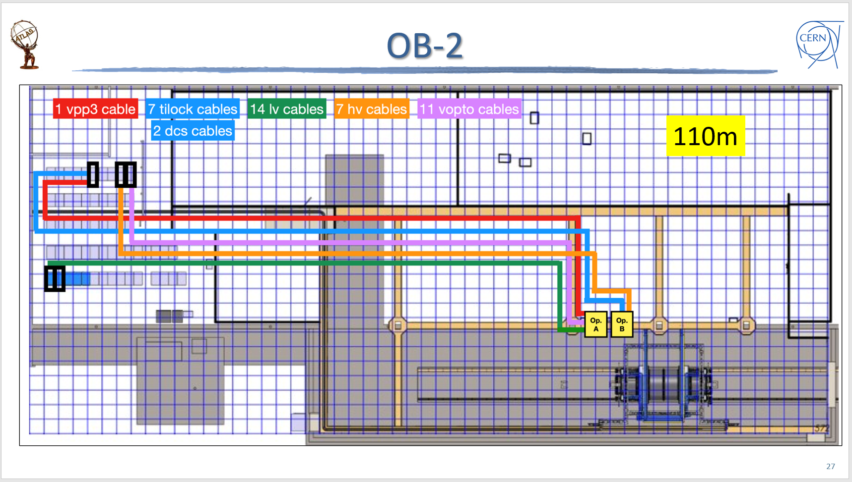
Activities “Pre-YETS” to be carried out in SR1
For the building and testing of ITk in building SR1 (2175), both Strips and Pixel will have the need to install cables from the various areas of the clean room, radiation lab, test area to the racks located in the rack room.
The preparation of the activity is completed and the related cabling study document is stored in EDMS (AT2-I-IN-0001)
The activity will be carried out in two sessions by the TC Cabling Team:
Strips cables: ≈200 cables during August 2024 → Mito + Pasang + Russian crew (3 people)
Pixel cables: ≈250 cables during November 2024 → Mito + Pasang + Pakistani crew (3 people)

Slide 4
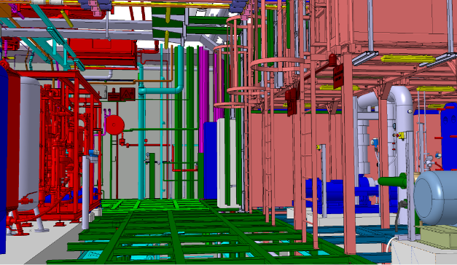
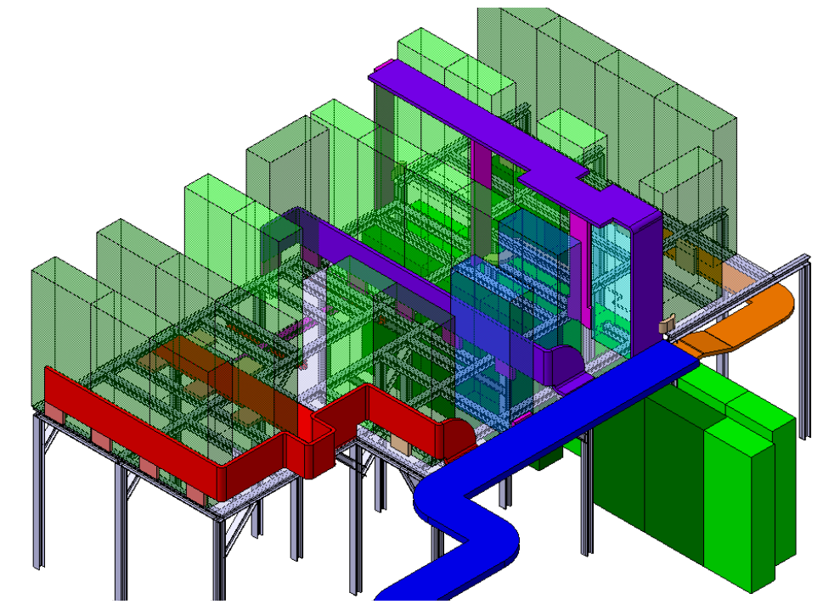
Activities for the YETS 2024-2025
The services activities to be carried out during the next YETS are mainly foreseen in USA15 CV room and UX15.
Activities concerning piping are mostly mentioned in other presentations.
Regarding cables, in USA15 CV room there will be the need to:
Install cables for CO2 detectors and flashing lights in CV room (TC Cabling Team)
TC is in contact with EN-AA-AS to get the list of cables
Once the list will be provided, TC can study the routing and estimate the lengths
(Jan Brajer)
Install several new trays (TC Cabling Team)
Study is complete (Jan Brajer)
Install ≈230 cables for the “Early Installation” (all cables serving the racks that will be installed during the YETS). The routing study is currently on-going (Jan Brajer)

Slide 5
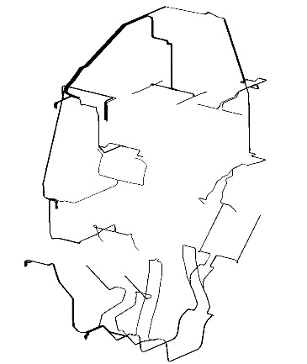
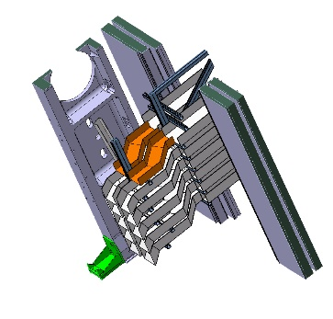
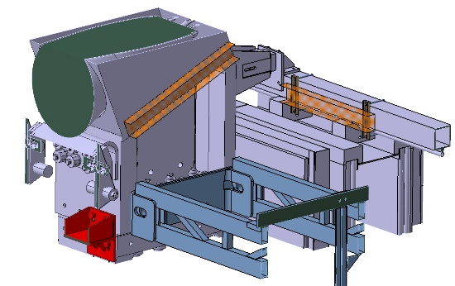
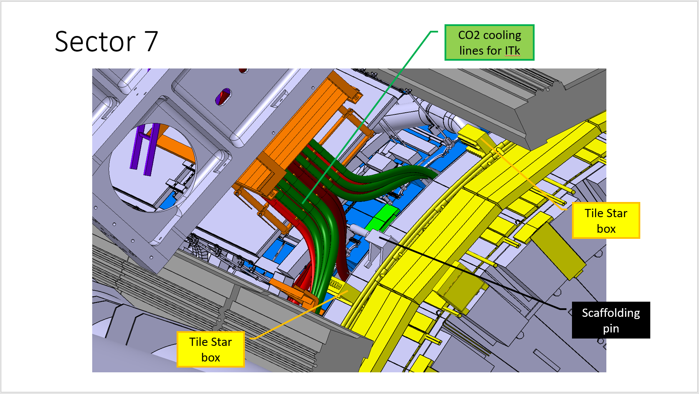
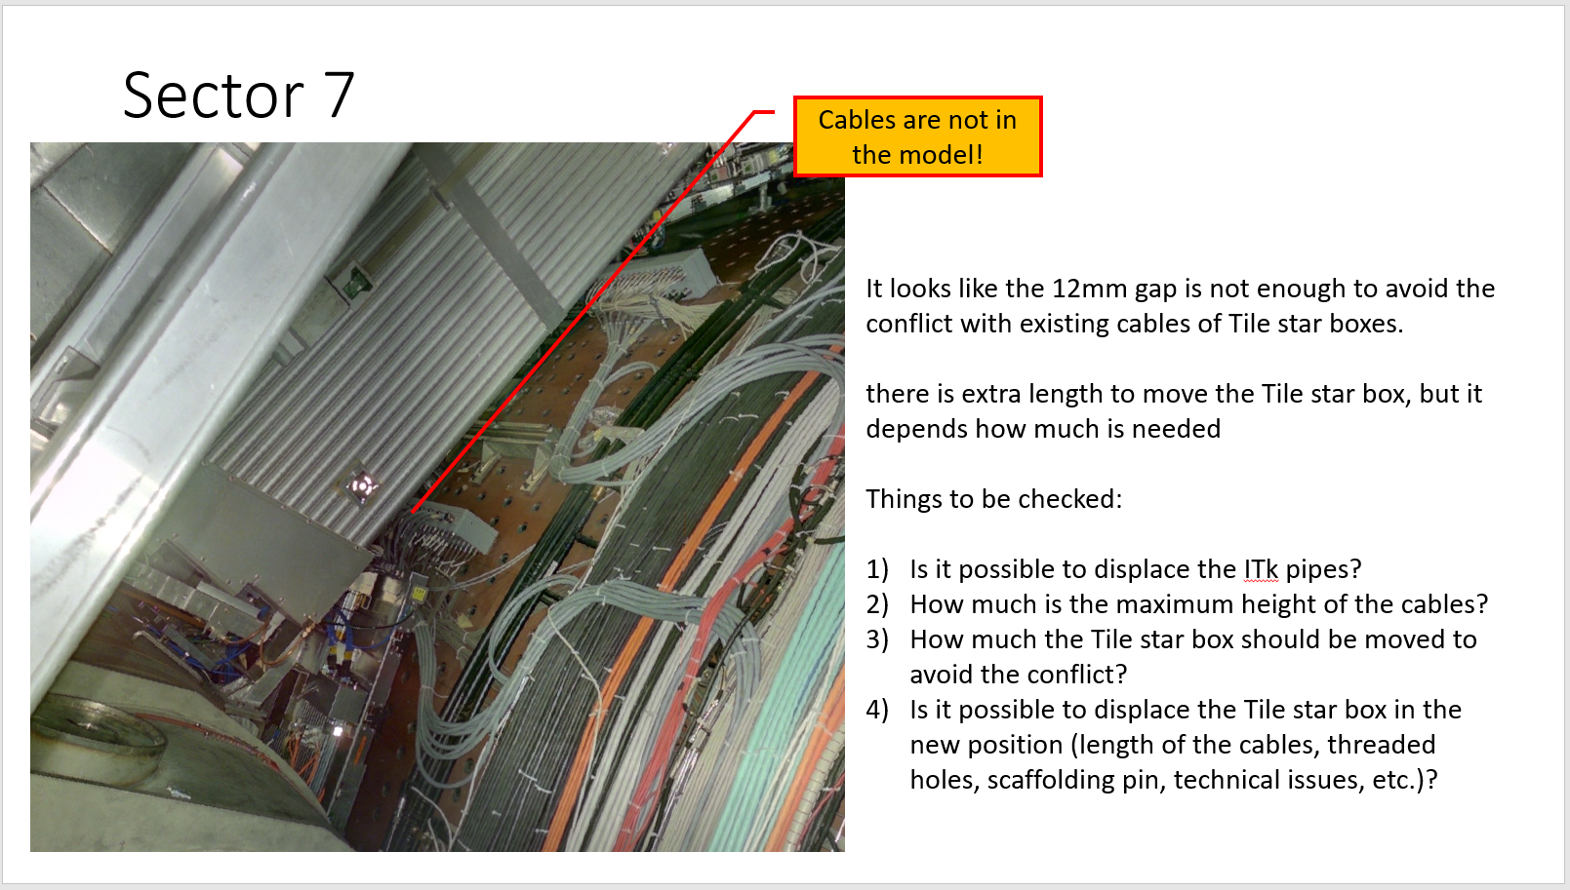
Activities for the YETS 2024-2025
In UX15, so far, the requests are to:
Install the copper pipes for RPC gas system upgrade (TC Cooling Team)
Routing study is almost complete (Rashid Mahmood)
Install additional cable trays for RPC cables inside Toroid (TC Cabling Team)
Study is almost complete (Rashid Mahmood)
Displace the Tile Star Boxes on EndCap A and EndCap C, which will be in conflict with the MTL and HGTD services
(Peter Kulka)

Slide 6
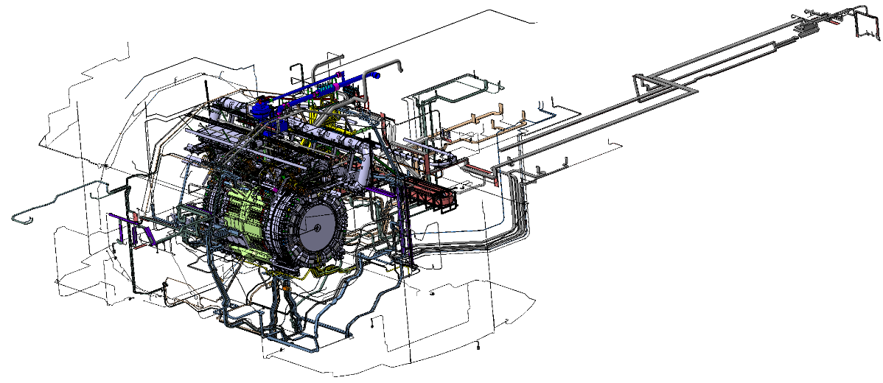
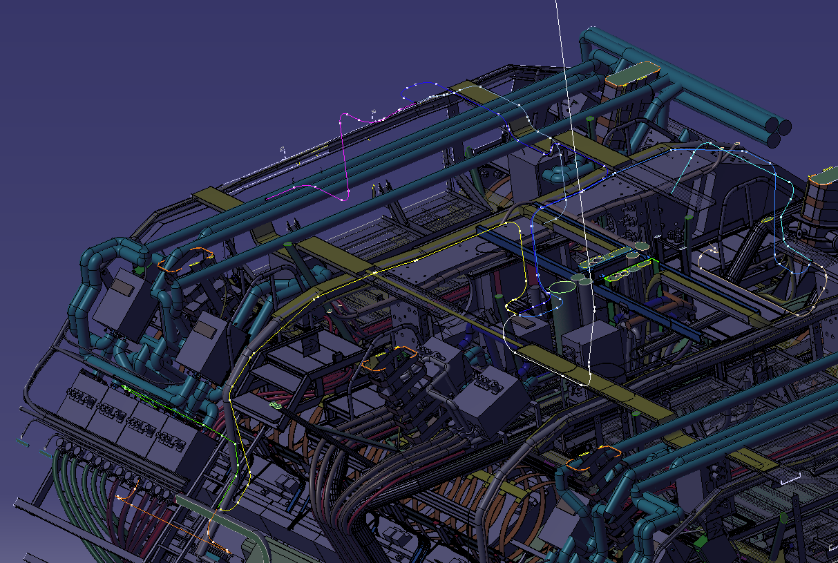
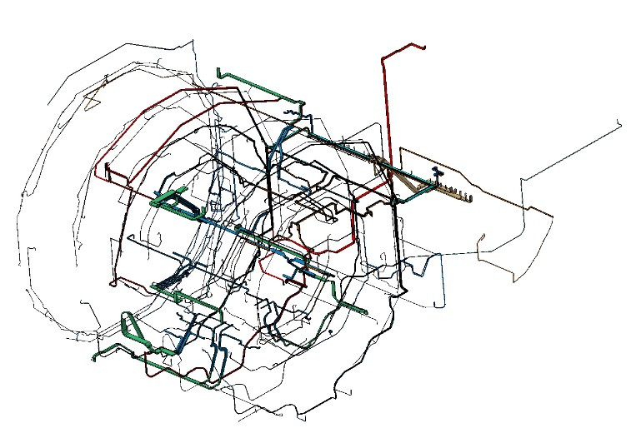
Activities for LS3
The LS3 services study started even before LS2 and it is currently still on-going.
The current activities of TC cabling team at the moment are the following:
Retrieval of information from all sub-detectors → Almost completed (Marco Ciapetti)
Preparation of list of cables to be removed → Almost completed (Marco Ciapetti)
Preparation of summary tables for new cables → On-going (Marco Ciapetti)
Studying of the various cable paths on the CAD → On-going (Peter Kulka, Rashid Mahmood, Alexandre Seletskiy, Martin Smetana)
Lengths estimation for various paths → On-going (Peter Kulka, Rashid Mahmood, Alexandre Seletskiy, Martin Smetana, Mito Tasevsky)
Surveys in the pit to check the feasibility of proposed paths → (Marco Ciapetti, Peter Kulka, Rashid Mahmood)
Various Subsystems
(ITk, LAr, Tile, HGTD, etc.)
Only Muons

Slide 7
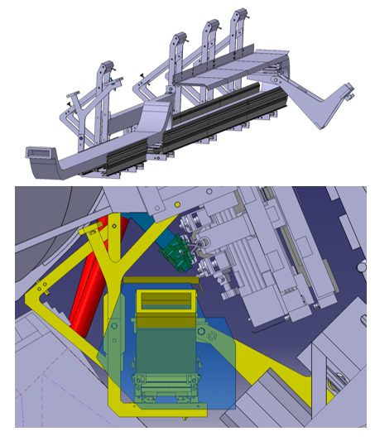
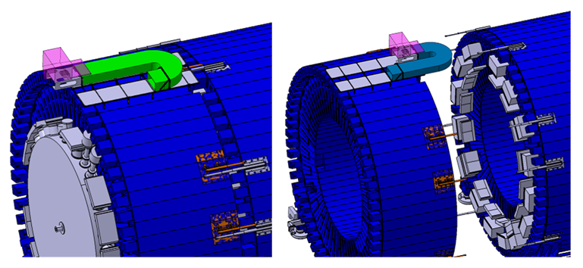
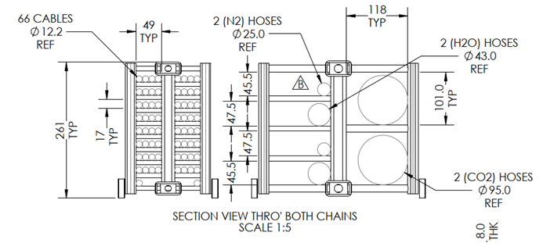
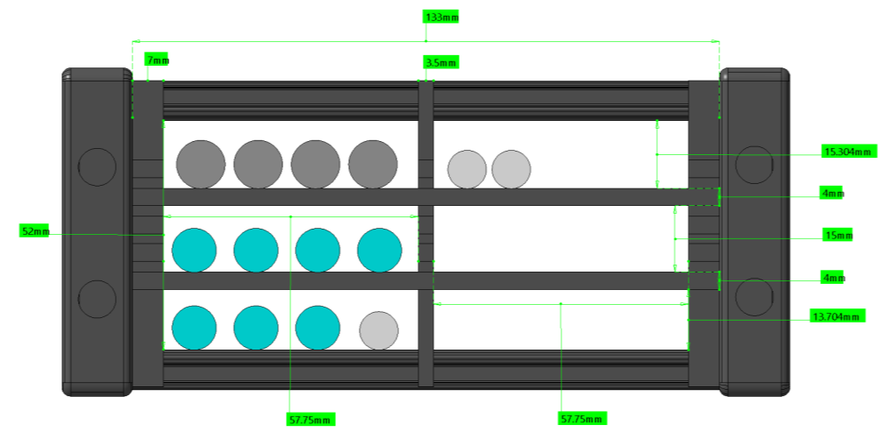
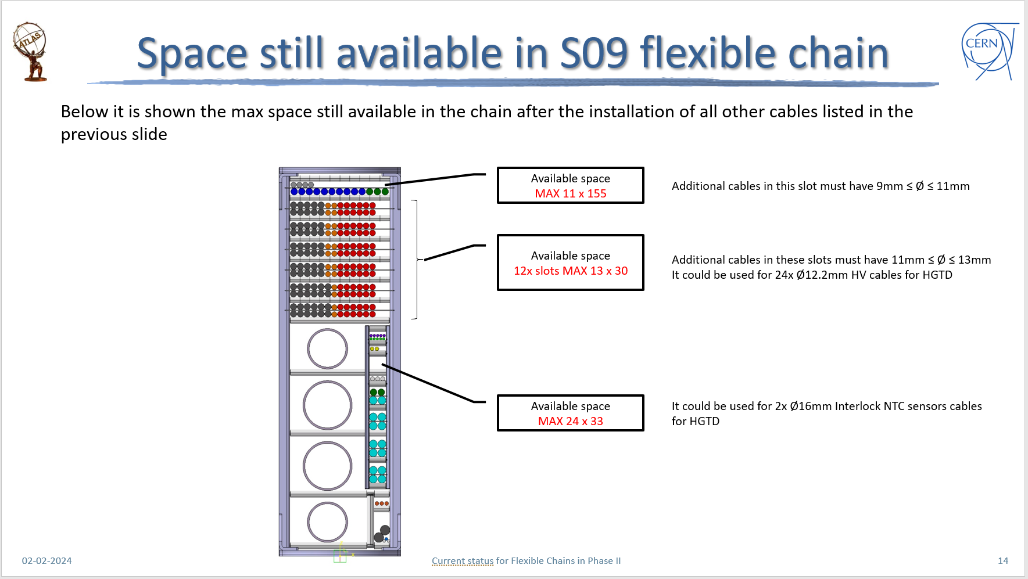
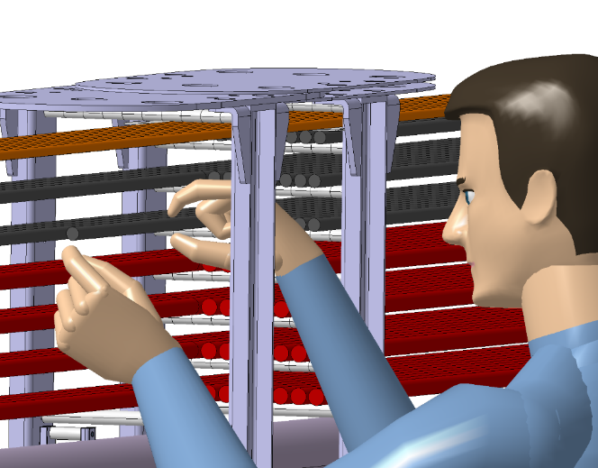
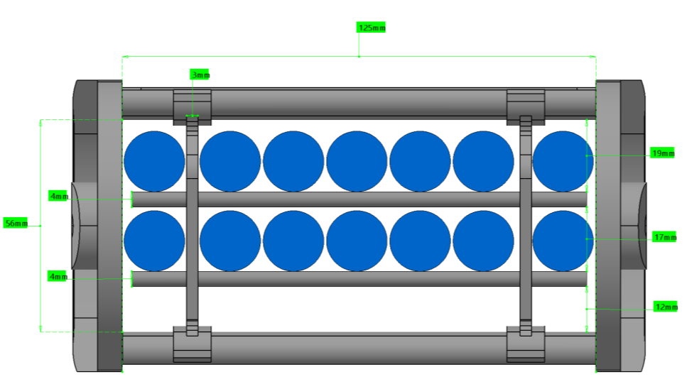
Activities for LS3
Design of new flexible chains → On-going (Raphael Vuillermet, Daniele Olivieri)
Study of the usage of existing flexible chains → On-going (Marco Ciapetti)

Slide 8
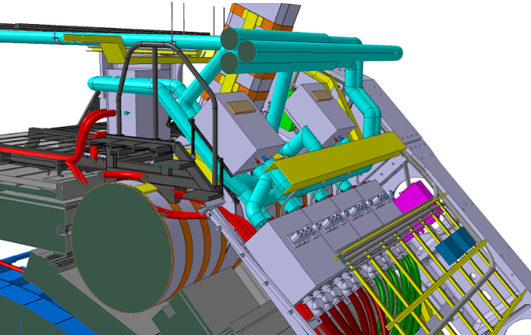
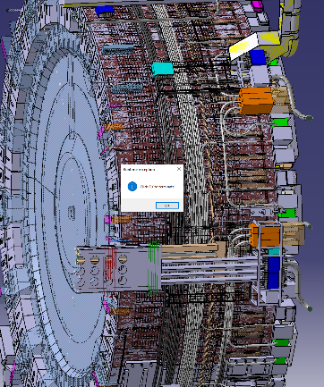
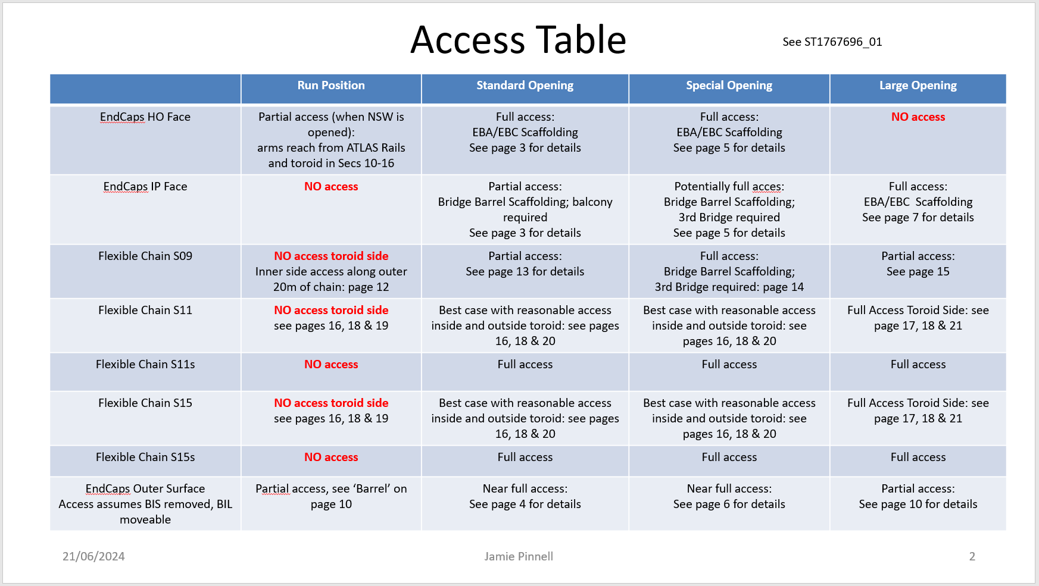
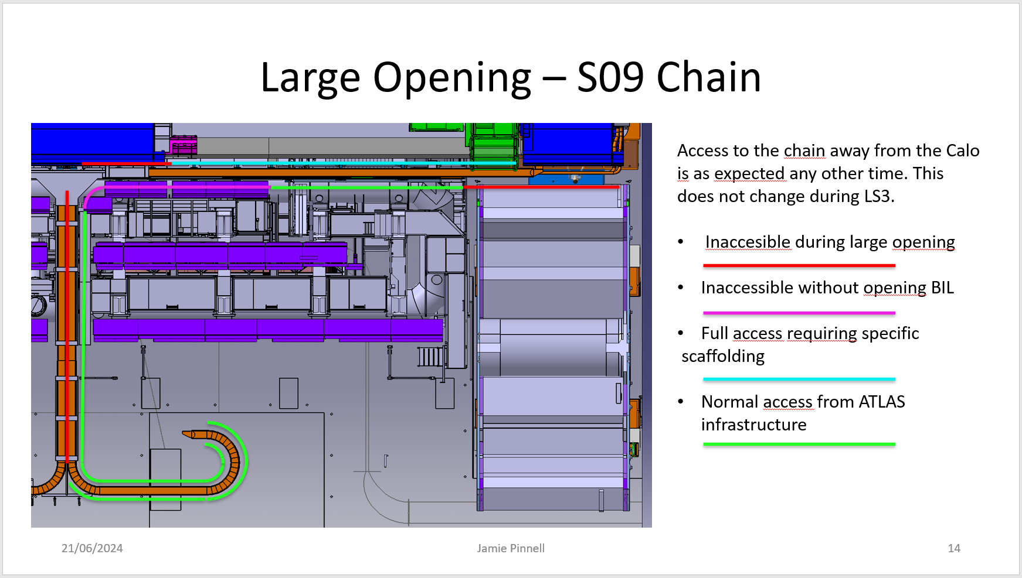
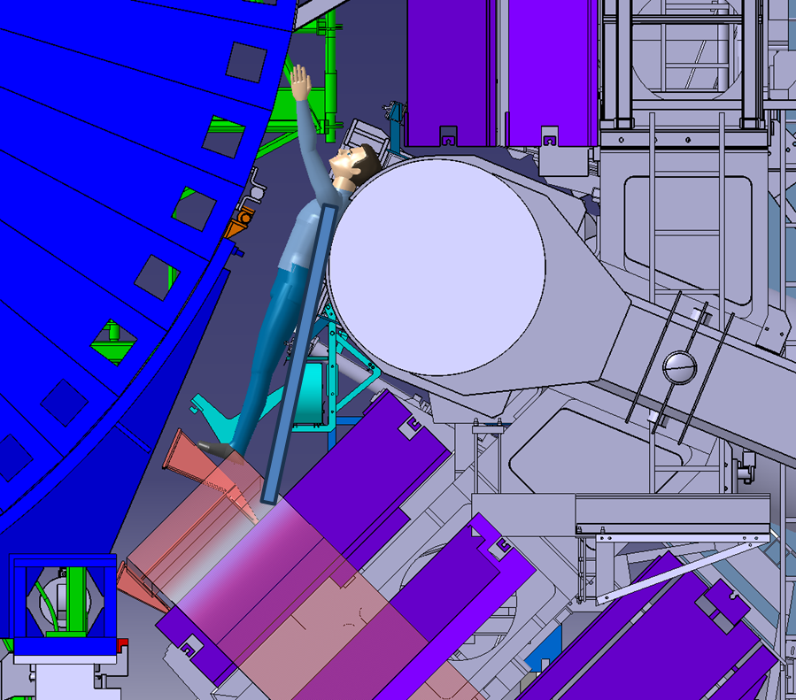
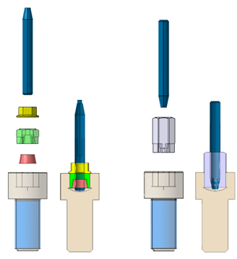
Activities for LS3
Integration of electronics → On-going (Tatiana Klioutchnikova, Peter Kulka, Lorenzo Quercia, Alexandre Seletskiy, Martin Smetana)
Accesses studies and design of needed tools → On-going (Albert Davletov, Jamie Pinnell)
Preparation of cables routing study documents → To be started (Marco Ciapetti, Peter Kulka, Rashid Mahmood)
Preparation of the Services Installation schedule → On-going (Marco Ciapetti)

Slide 9
















TC people involved in services activities
TC Cabling Team:
In the office: Marco Ciapetti Peter Kulka Rashid Mahmood
On the field Mito Tasevsky Pasang Nuri Sherpa Crew
ATLAS Project Office:
Raphael Vuillermet Jan Brajer Albert Davletov Tatiana Klioutchnikova
Daniele Olivieri Jamie Pinnell Lorenzo Quercia Alexandre Seletskiy
Martin Smetana
TC Cooling Team:
Martin Doubek David Schmid with the support of EP-DT Control

Slide 10
Back-up slides

Slide 11
Services activities requested for LS3
LS3
Muons
LAr
RPC
Replace all current LAr trigger cables, with optical fibres
Install all needed services for the displaced LVPS
sMDT
BIS MDT (sMDT) replacement of all fibers, LV, HV, alignment, etc. cables
Routing of fibres bundles for all other MDT chambers
ITk
Removal of all services coming out from IDEP
Installation of new cables for Pixel
ZDC
HV multi-conductor cables
BI RPC full services replacement (gas, HV, LV for both FE and trigger, control/monitoring, fibers)
All other RPC only fibres replacement
TGC
Routing of fibres bundles and installation of patch panels for BW
Tile
HGTD
Routing all services for this new detector
Replace all current Tile trigger cables, with optical fibres
Replacement of analog signal cables from TANXs to USA15
Installation of additional air-core cables
Others
Lucid:
Removal of obsolete cables
Installation of short Signal, LED, HV cables
Forward detectors (AFP, ALFA, BRAN, LHCf):
Removal of obsolete cables
L1 Calo:
Removal of obsolete cables
TDAQ:
Removal of obsolete cables
Installation of new ATCA, FOX, LAr, Tile, Muons TDAQ cables
Network:
Removal of obsolete cables
Installation of new ATCN and TDAQ cables
Magnets?
Installation of new cables for Strips
Install needed cables for Cs system
Routing of fibres bundles and power and control cables for EIL4

Slide 12
Services activities requested for LS3
ITk: Remove all ID (Pixel, SCT, TRT, common, etc.) services not needed for Phase II (estimated to be ≈16k cables and pipes). ≈5k existing services must be kept and reused. ≈4k new cables are needed
Tile: Removal of analogue trigger, TTC+ROD redout fibres and CANbus cables (estimated to be ≈600 cables). Install new Optical trunk redout cables, HV cables and Cs system cables (≈400 cables) [EDMS 2670551]
LAr: Removal of analogue trigger, TTC, Data and SPAC redout fibres (estimated to be ≈500 cables). Install new Optical trunk redout cables, LVPS cables (≈400 cables) [EDMS 2682301]
Muons (TGC, MDT, RPC): Remove all fibres not needed for Phase II (estimated to be ≈1k cables). Install all needed cables for all BI upgrade (≈9k cables), EIL4 (≈200 cables), BW (≈150 cables), BM (≈300 cables), BO (≈300 cables), EO+EE+BEE (≈150 cables) for a total of more than 10k cables
HGTD: Installation of all services (estimated to be ≈500 cables)
ZDC: Remove all signal cables from TANs to USA15 (estimated to be ≈80 cables). Install new analog signal cables from TANXs to USA15 (estimated to be ≈60 cables) + 10 new air-core cables (not done by TC)
CO2 cooling: Installation of all services (estimated to be ≈400 cables)
Network: Remove (permanently or temporarily) ≈4.5k cables (2k ROL, 100 ROS, 2.4k TDAQ) . Install ≈320 cables (120 ATCN, 100 TDAQ)
TDAQ (ATCA): still under evaluation, but the estimation is more than 2k cables
OTHERS (Lucid Forward detectors, L1 Calo, TDAQ, Network, etc.): Remove obsolete cables and installation of new ones

