Slide 1


EP-ADO Meeting
EYETS Preparation and infrastructure activities
Gerardo Velazquez Gutierrez (CERN)

Slide 2

Update on Hostlab Program
YETS 22-23
2023 Run
YETS 23-24
2024 Run
EYETS 24-25
2025 Run
2026 (LS3)
2027 (LS3)
2028 (LS3)
SXSN1 building completion
SU1 cooling upgrade
SU1 cooling upgrade
ATLAS: R744 primary installation & commissioning
CO2 electrical supply
SU1 power upgrade
SU1 power upgrade
TDAQ upgrade - containers
CO2 completion
SXSN1 installation of EL/CV services
ATLAS/CMS: CO2 electrical supply
CO2 electrical supply
Main transfer line inst. in USA15
TDAQ containers: Start of CE
USA15 CV room HVAC upgrade
2PACL works
Preparations of USA15 CV room
DEMO inheritance CO2 cooling plant installation
Preparations of USA15 CV room
Partial 2PACL install. in USA15 CV room
2PACL early commissioning
TDAQ SDX1 upgrade
CO2 extraction installation
New ATCA area EL/CV upgrade
Main transfer line inst. in USA15
CO₂ related
EN-CV related
2PACL works
EN-EL related
SCE related
SXSN1:
  R744 – primary cooling: first compressors and switchboards already on site.
  Electricity: works on going to supply the EN-CV equipment.
SU1:
  New raw water station being commissioned.
  Pipes from SU1 to SDX1 will be installed before the YETS
Engineering:
  Many studies on going: integration, CFD, engineering specs, etc.
(Partial) system expected to be ready before EYETS 24-25 for early installation
Gerardo Velazquez Gutierrez (CERN)

Slide 3
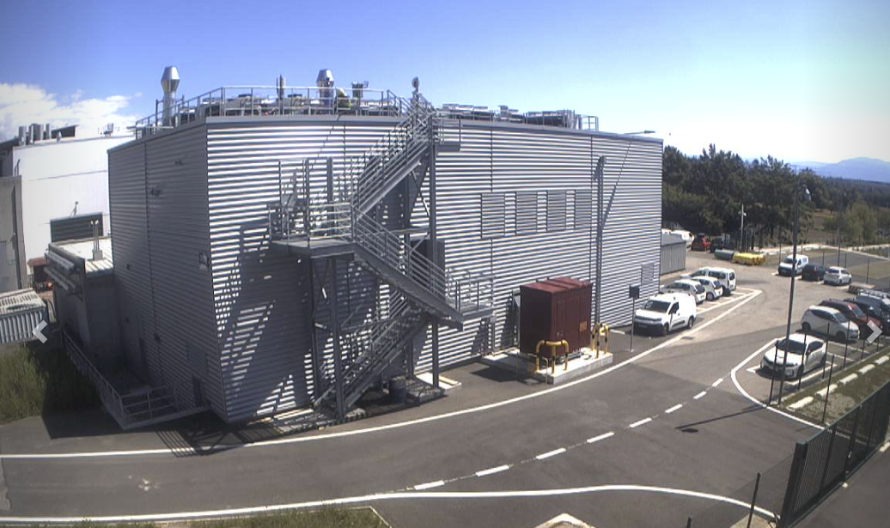
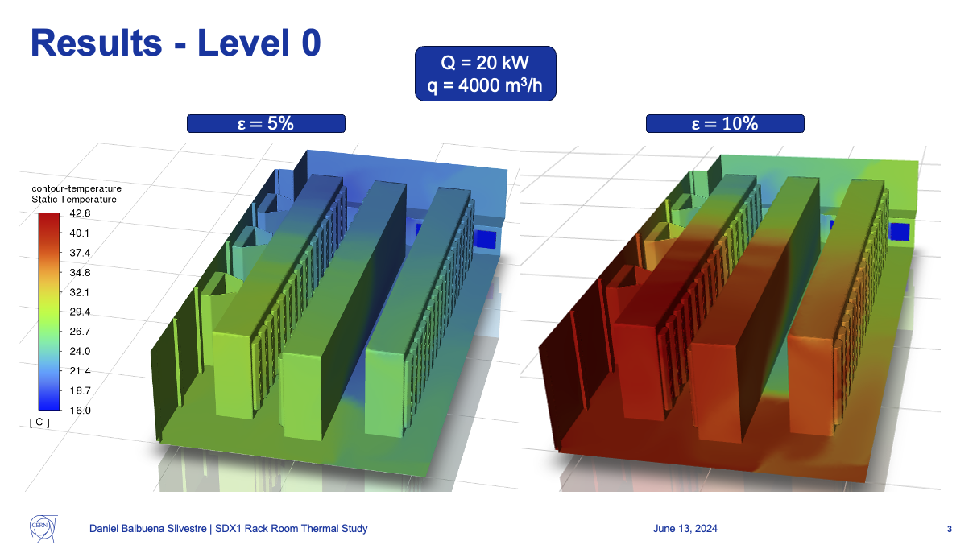
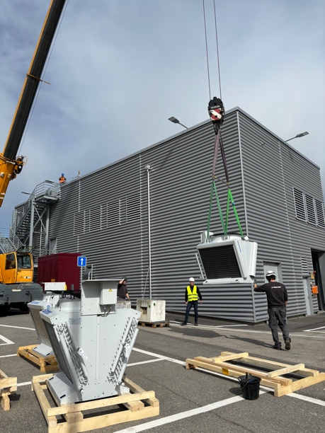
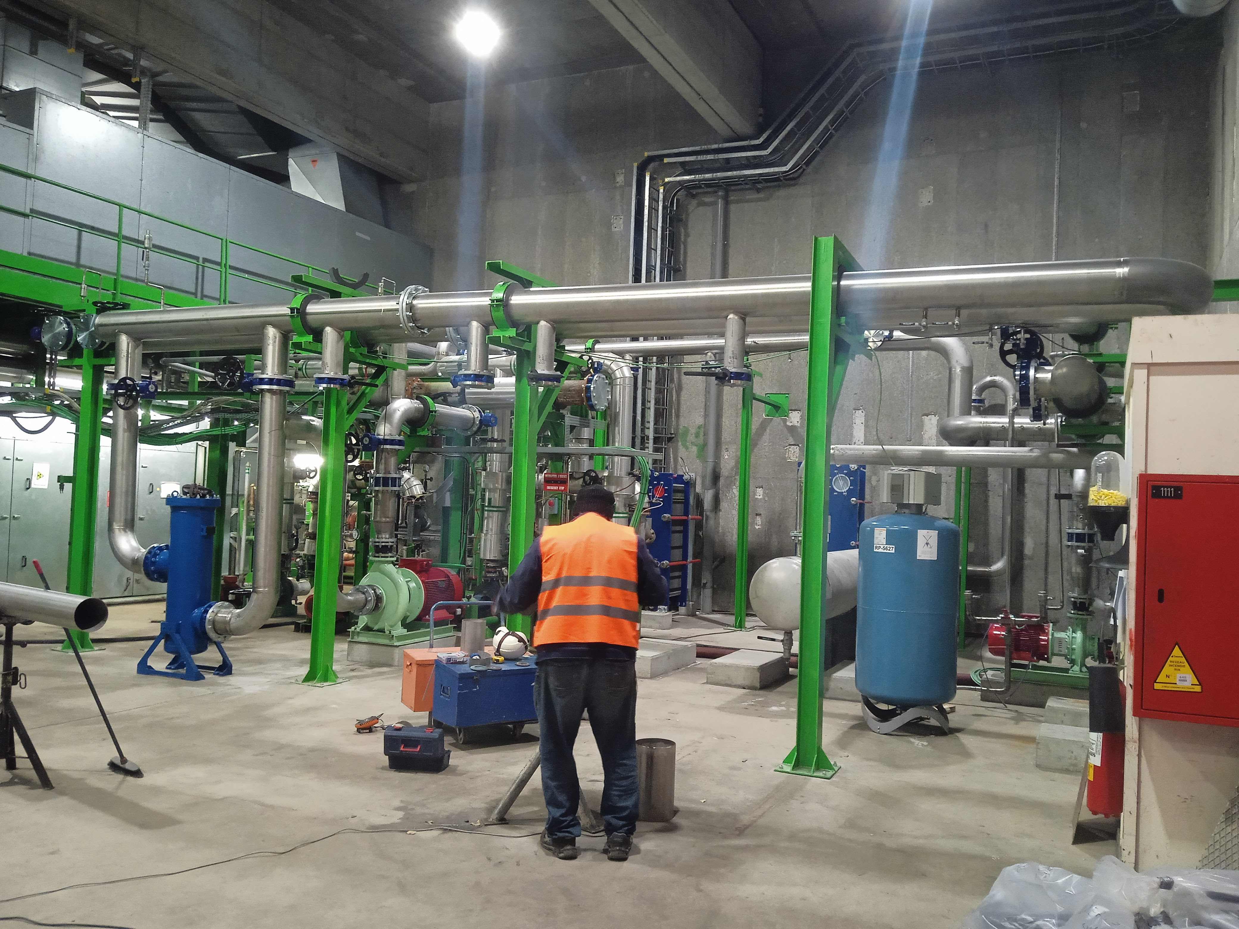
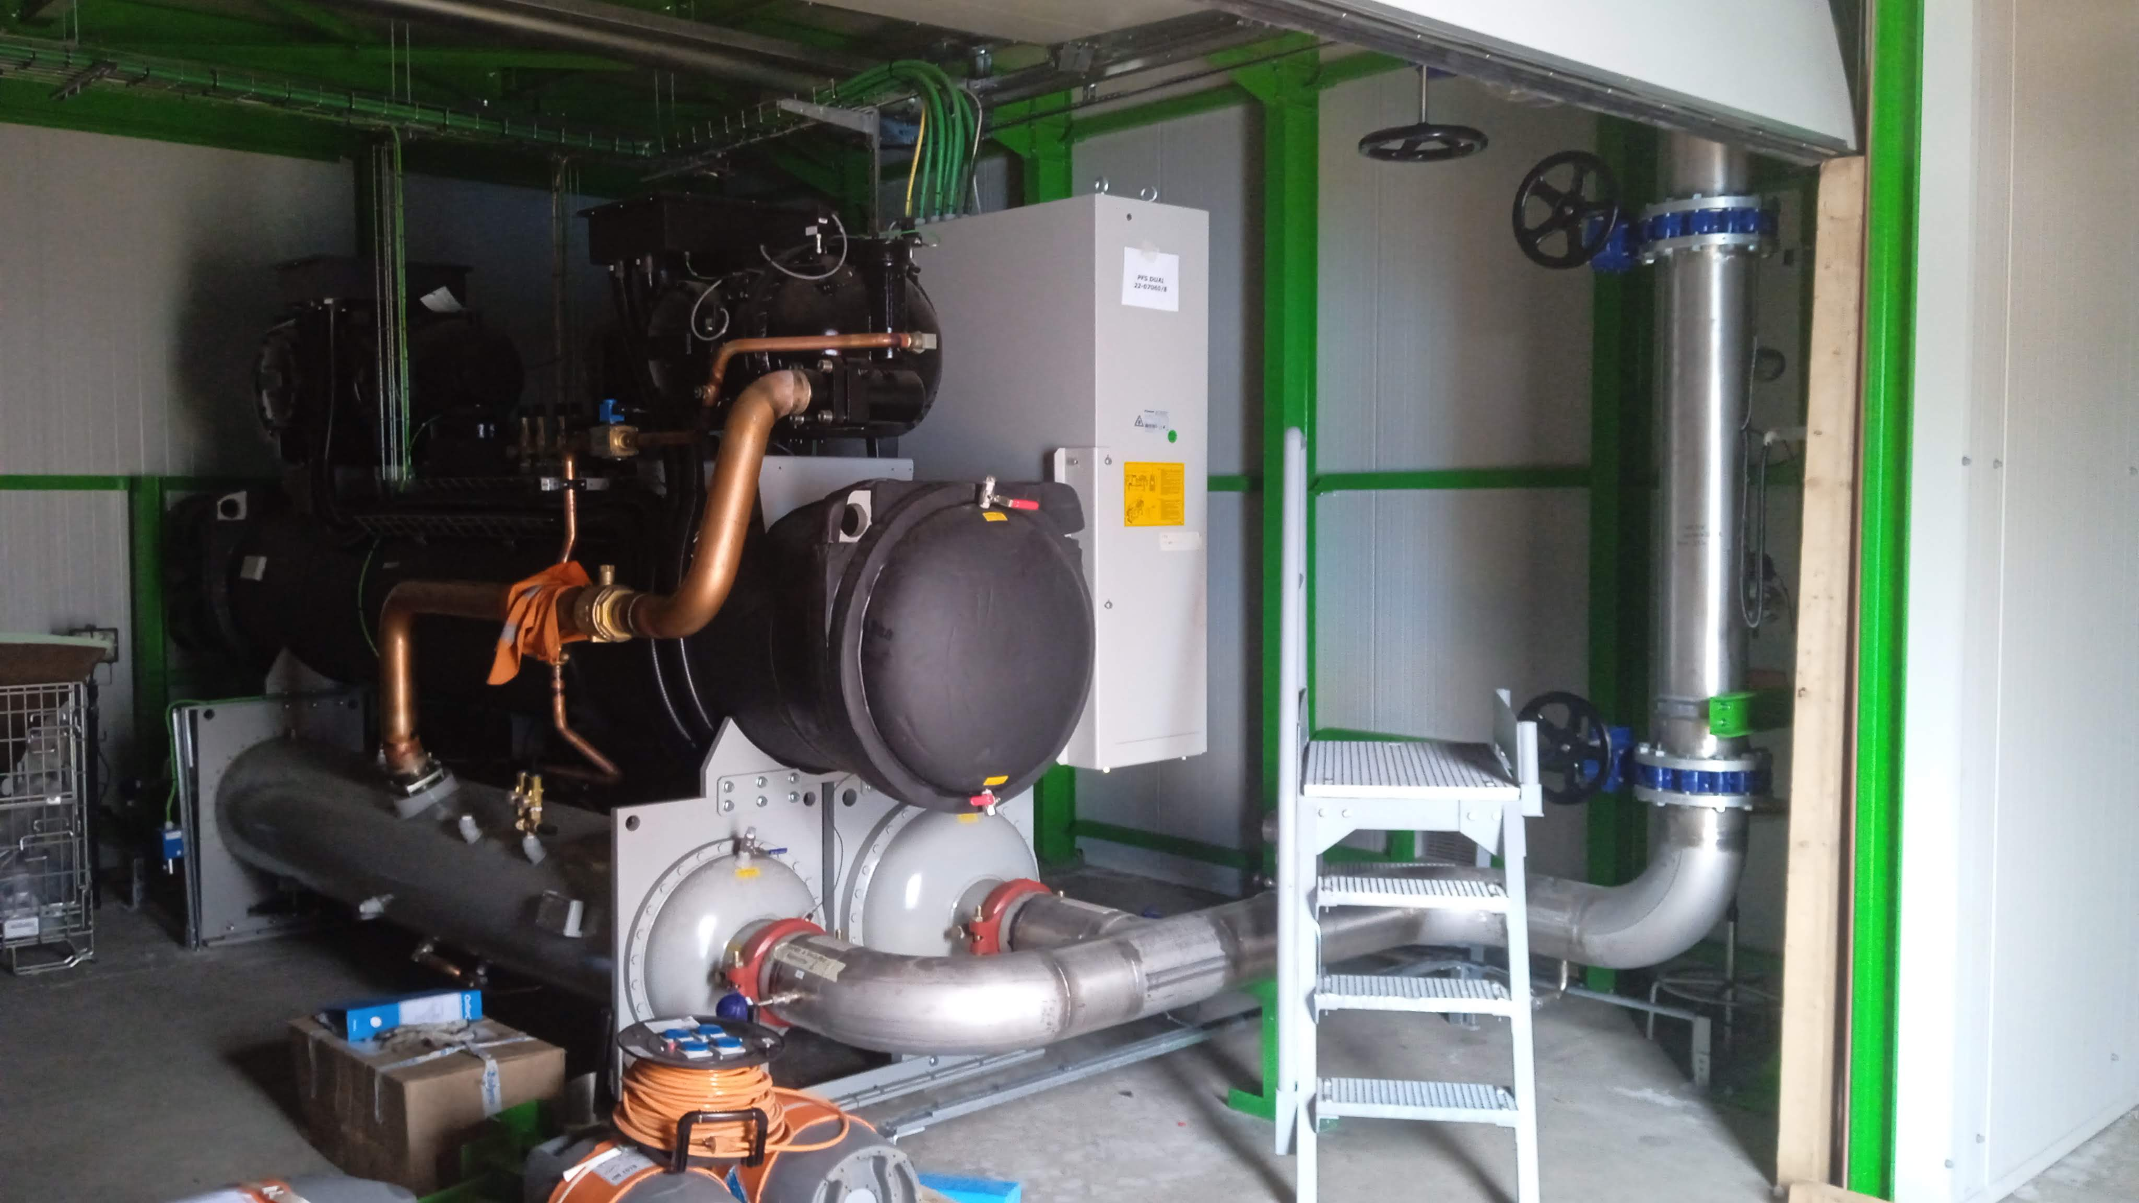
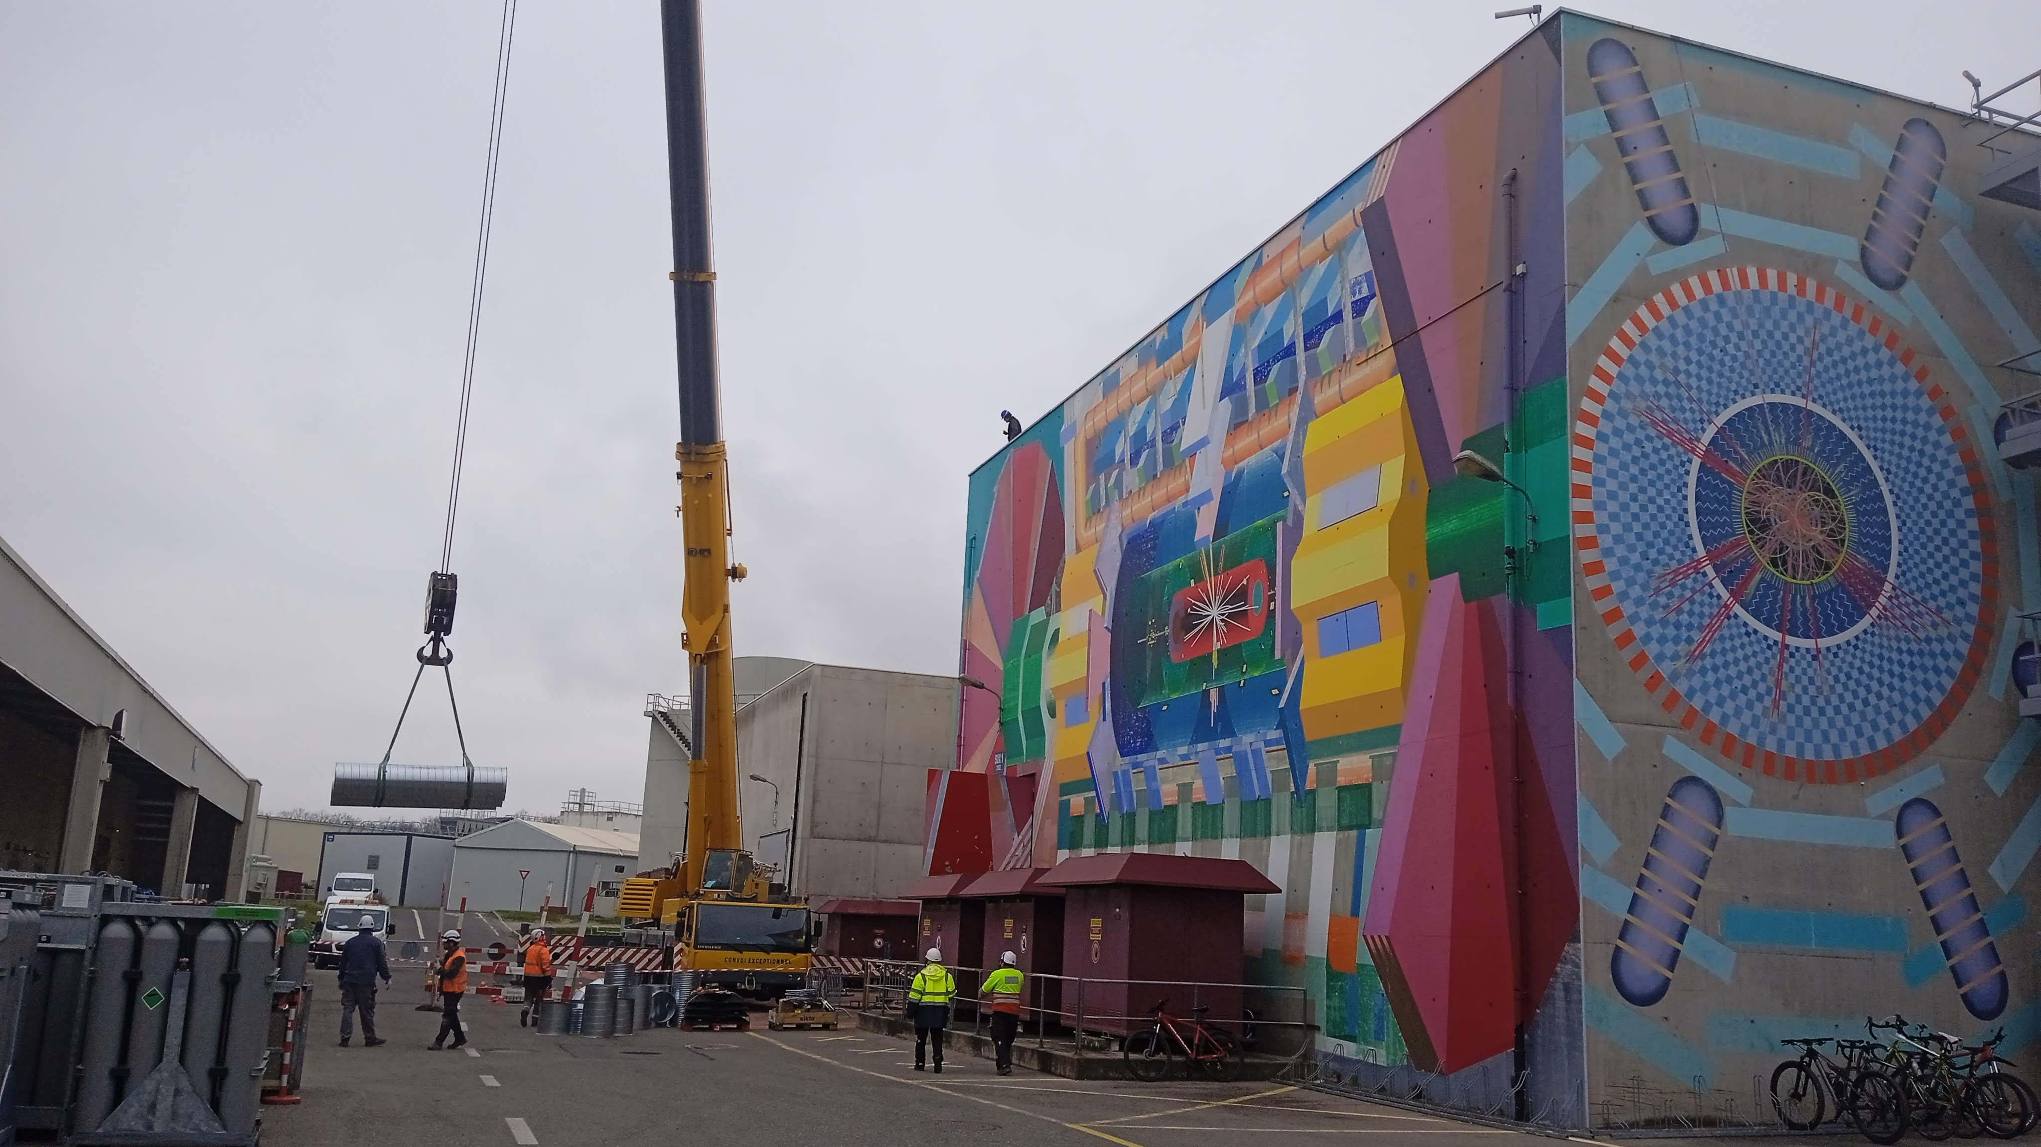
Update on Hostlab Program
Gas coolers
SXSN1 building
CFD SDX1
SU1 station
CO2 extraction duct
Gerardo Velazquez Gutierrez (CERN)

Slide 4
EYETS 24 -25
EYETS will be 19 weeks long (beam to beam)
➢ Main milestones from LHC
    Start on 25th November 2024
    UX15 cavern closed on 1st April 2025
    Machine check-out: 2nd – 7th April 2025
    Start of LHC operation on 7th April 2025
➢ Electrical tests
    AUG test at P1 -> 7th January 2025
    Test “normal/secours”: 8th January 2025 (6:00 – 6:10 am)
    Auto-transfer test: 21st -23rd January 2025 (current limited to 240 amp on 18 kV)
➢ Access limitations
    AUG test: no access to underground
    DSO test, 14th March 2025: no access to UX15 and US15
➢ Admin days (at CERN level): 6th – 9th January 2025
Gerardo Velazquez Gutierrez (CERN)

Slide 5
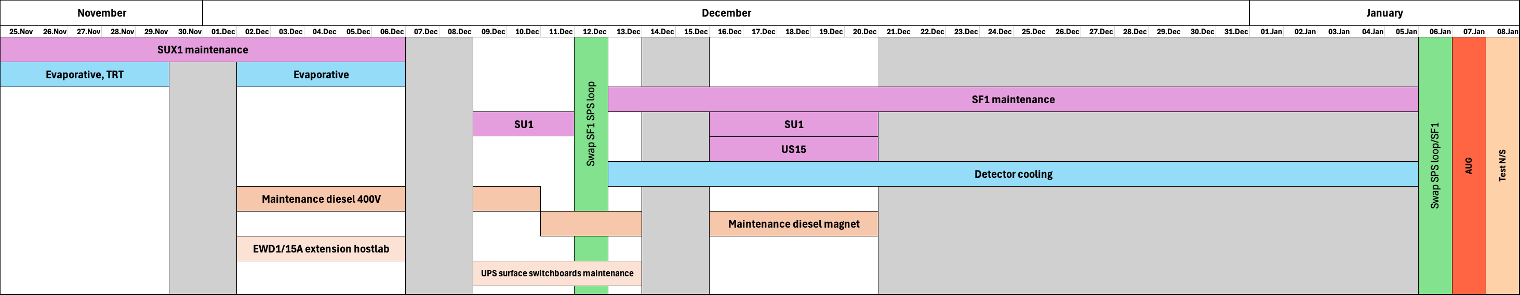
EYETS 24 -25
Cooling and electricity maintenance:
Many impacting activities at the beginning of the EYETS but, from the third week of January, this part of the infrastructure will be in nominal conditions.
Many disruptive Hostlab activities are hidden behind the maintenance to avoid several perturbations on the systems.
USA15 works for 2PACL will start on January 2025
  A limited amount will start the last weeks of December.
Gerardo Velazquez Gutierrez (CERN)

Slide 6
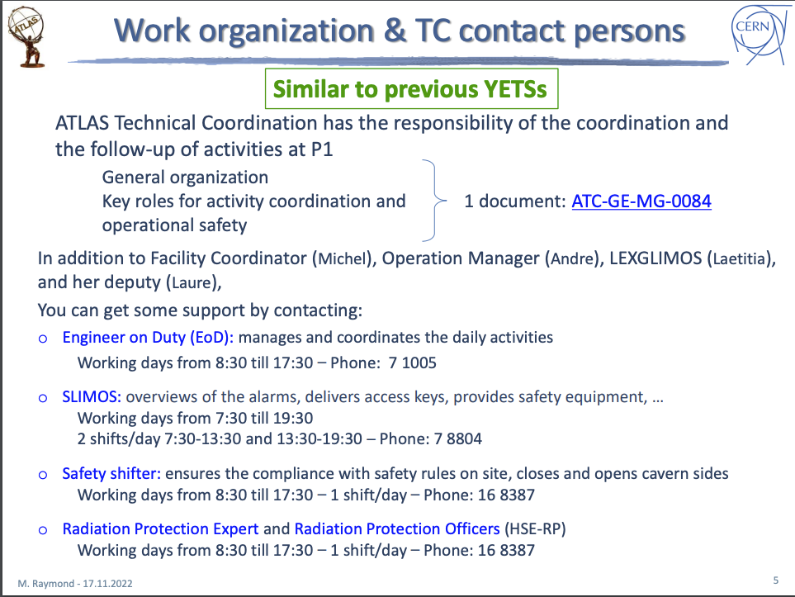
EYETS 24 -25
Monday follow-up meeting with services to monitor the CO2 & Hostlab activites.
Gerardo Velazquez Gutierrez (CERN)

