Slide 1


ADO-PO – TC meeting
ATLAS Safety – Laure Tranchand
24 June 2023

Slide 2

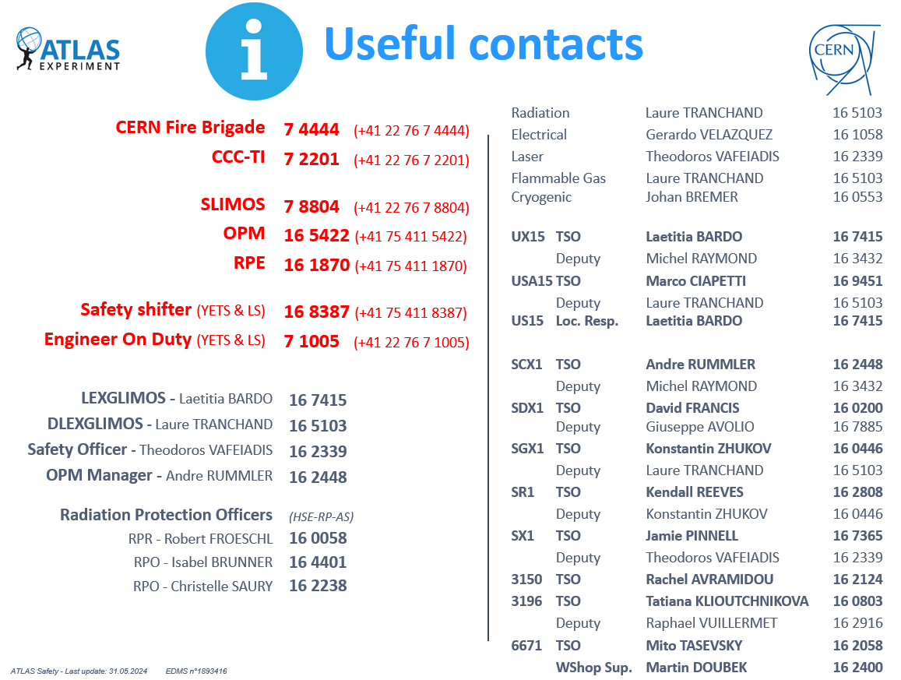
Safety Officers
+
ATLAS TSO and DTSO in buildings not under ATLAS responsibility but with ATLAS occupants/activities:
B175 – TSO: Louis Rose-Dulcina
B191 – TSO: Laure Tranchand
DTSO: Frederic Rosset
B180 – DTSO: Stefan Guindon
B188 – TSO: Tiesheng Dai
DTSO: Rachel Avramidou
B104 – DTSO: Rachel Avramidou
B602 – TSO: Gustavo Uribe
DTSO: Laetitia Bardo (replacing Mathilde Carlotta)
BB5 – TSO: Theodoros Vafeiadis

Slide 3

Run period and short accesses
RPE Team
Laure Tranchand (RSO)
Laetitia Bardo (dRSO)
Andre Rummler
Carlos Solans Sanchez
Florian Haslbeck (Trained in 2023)
Theodoros Vafeiadis (Trained in 2023)
Christos Parakevopoulos
Kendall Reeves
Ignacio Asensi Tortajada
Mathilde Carlotta
Thanks to all RPEs for the shifts taken
Very coordination between Run coordination, RPEs, SLIMOS, safety team, EN-AA for opening the cavern.
Constant number of short accesses over the years, but with an increase of accesses in the Toroid area since RUN3
Muon’s material measurement during YETS-LS
Help for cavern survey
Left in 2024
Number of short accesses during Run period since 2017
23rd May

Slide 4

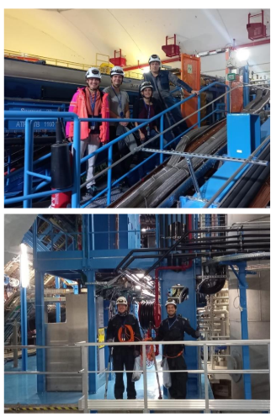
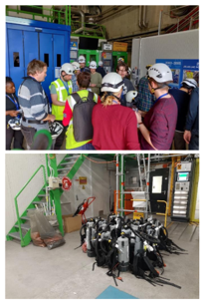
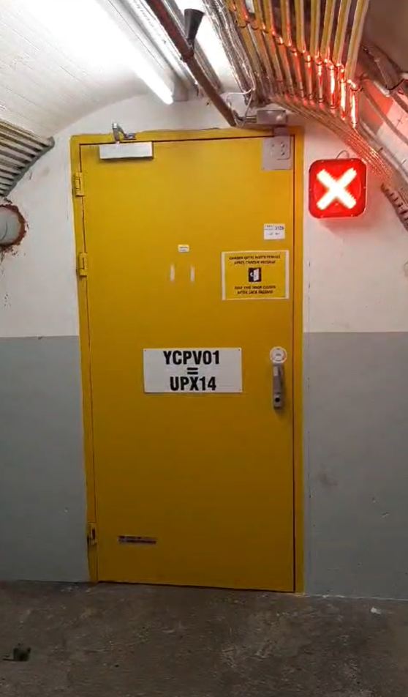
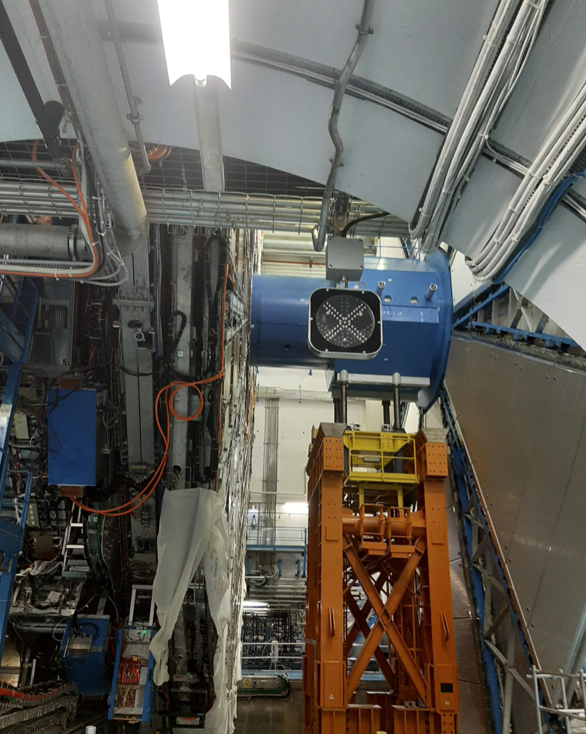
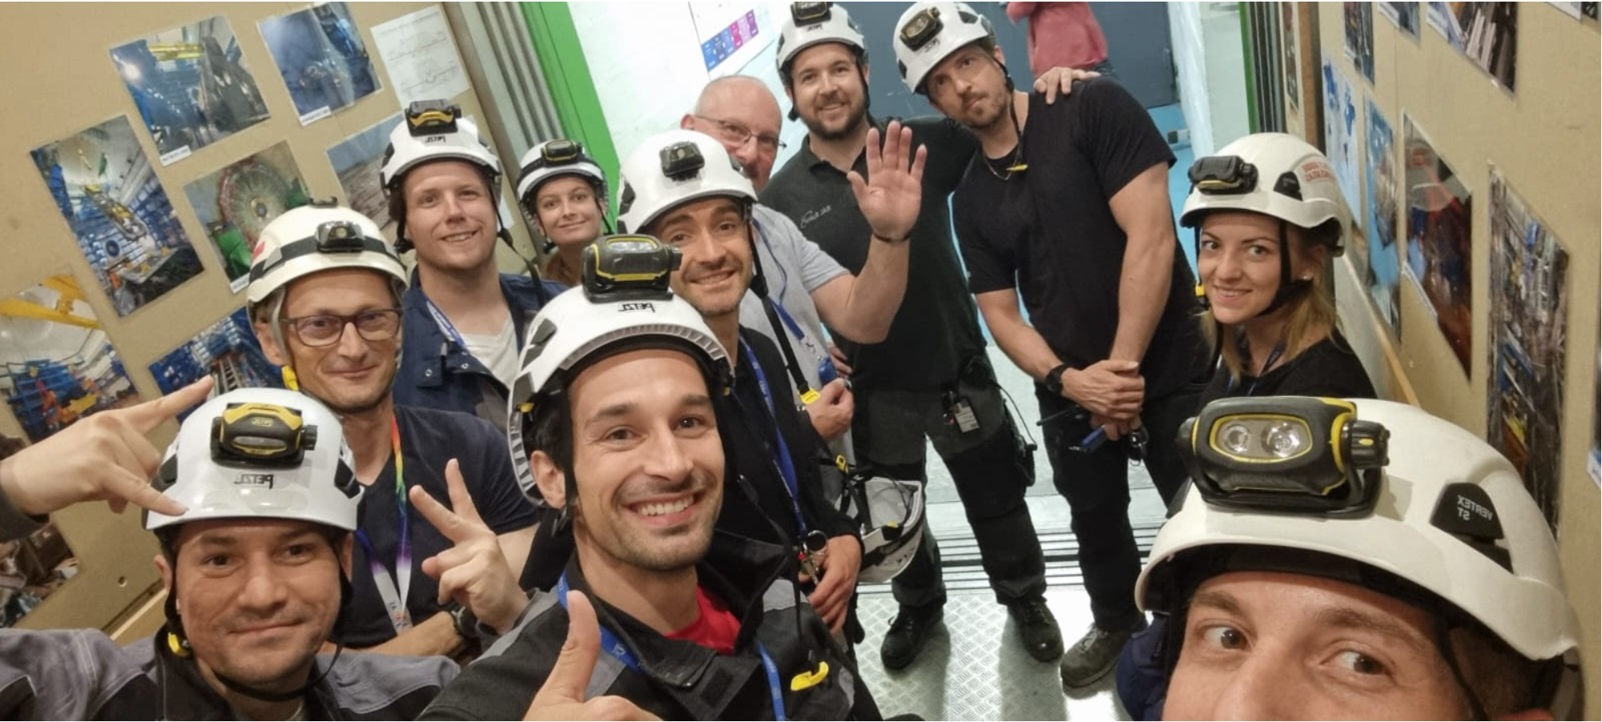
Feedback YETS 2023-2024
Safety support
Thanks a lot for the support of the Safety shifters, SLIMOS, RPEs, Patroller, Cleaners, … everything went well
Radioprotection
Work and dose planning and IMPACT made in advance, prior to the interventions
The dose received by people intervening are not exceeding ALARA level 1, in ATLAS caverns.
Better distribution of the dose rate among the team
Cooldown has noticeable effect on the measurements and the dose received
Cavern Sides closing – TS1
Installation of red cross started and already operational on side A
TC team opening
Collective dose = 70 µSv (184 µSv)
Individual dose max= 34 µSv (58 µSv)
TC team closure
Collective = 47 µSv (47 µSv)
Individual dose max = 15 µSv (17 µSv)

Slide 5

Thank you for your attention
We are preparing for LS3, but before, still the YETS to come with many activities …
… We will need your help for the safety shifts during the YETS ☺ !

