Slide 1
Recently network R&D work in IHEP
Shan Zeng
on behalf of IHEP network group
Funded by NSFC (No. 12175258)
zengshan@ihep.ac.cn
2024/12/12

Slide 2
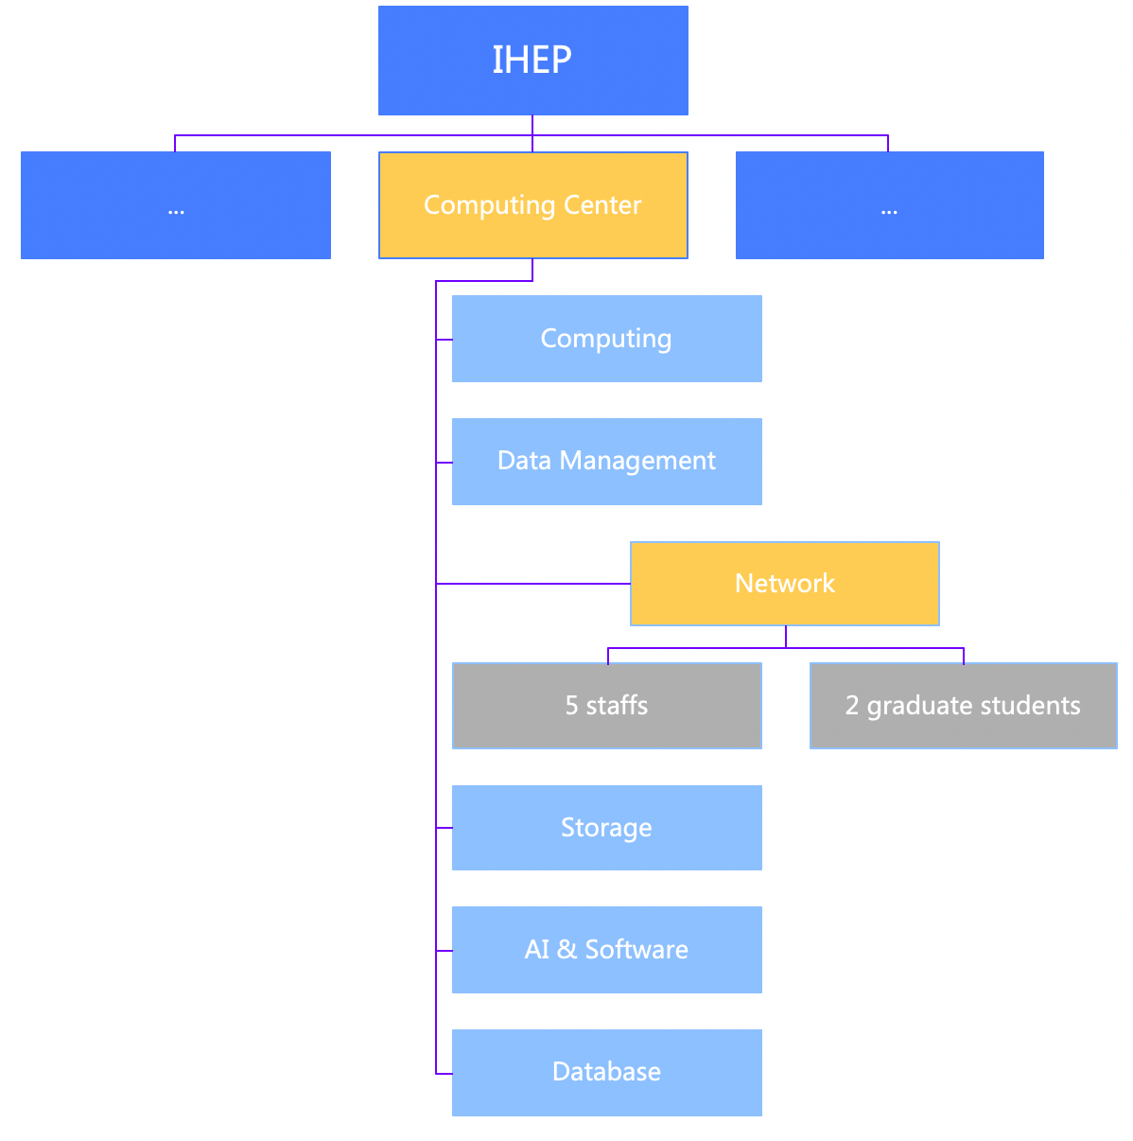
About our team
  Network is one of the disciplinary directions in IHEP CC
  I am the network team leader of IHEP CC
  5 staffs and 2 graduate students
  Mission of our team
  In charge of the network design, construction and maintenance of all the network environment of IHEP both in Beijing as well as the remote sites
    Campus network
    Data center network
    Wide area network
    Beamline control network
  Network R&D work related to network maintenance
    Help to improve the network service quality

Slide 3
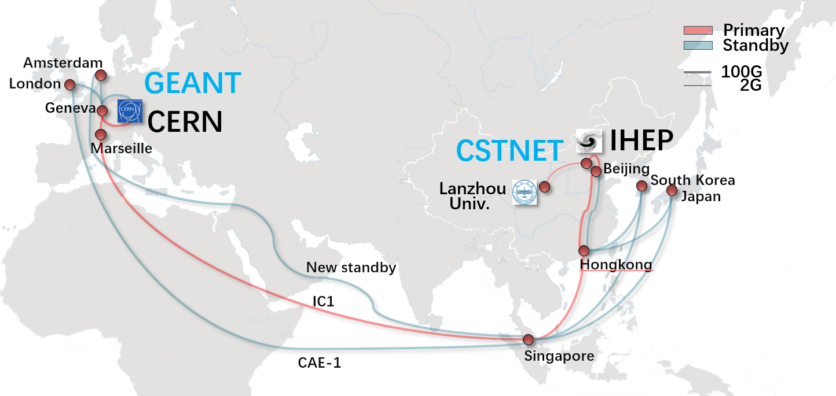
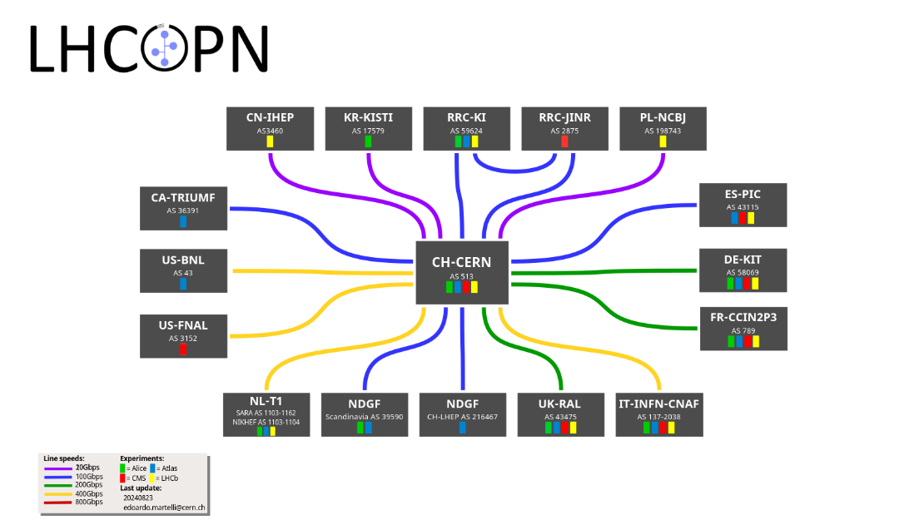
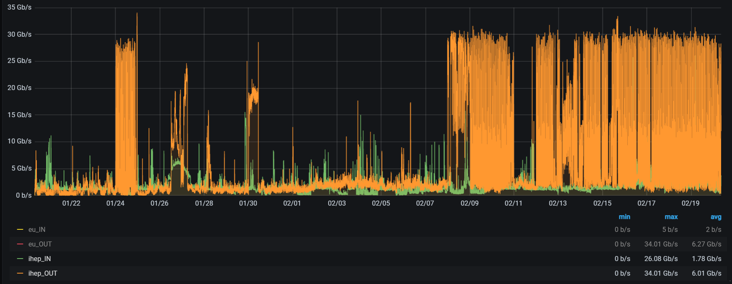
Background
  IHEP endorsed as a new WLCG Tier-1 site (June,2024), WAN bandwidth was upgraded from 40Gbps to 100Gbps
  LHCOPN@IHEP
    20Gbps bandwidth guaranteed
    3 links redundancy
    ~ 200ms latency
  LHCONE@IHEP
    100Gbps bandwidth shared

Slide 4
Background：network challenges
  Network is a critical part of WLCG’s infrastructure, becomes more and more important to assure the site availability and reliability
  Many network challenges from daily network operation
  Issue debugging is difficult and time-consuming
  How to thoroughly and vividly demonstrate various network measurement results to the application
  How to promptly detect and resolve the network issues
  How to make full use of the limited and expensive dedicated links

Slide 5
What we are currently doing?
  NPM: Network Performance Manager
  Mirroring key application related network traffic, stored it and analyze it
  Coordinated monitoring of the network and application tiers
  Network session analysis: based on tshark
  Return the network and application performance KPIs to debugging issues
  Detect the network anomalies and return the anomaly type and time occurred
  Network QoS assurance done by a self-defined SDN controller
  Background: many applications shared a limited dedicated link, while certain key application (JUNO Raw data movement: HiDTS) needs bandwidth assurance
  To make full use of the limited dedicated link, we dynamically predict the needed bandwidth based on the data volume which needs to be transferred

Slide 6
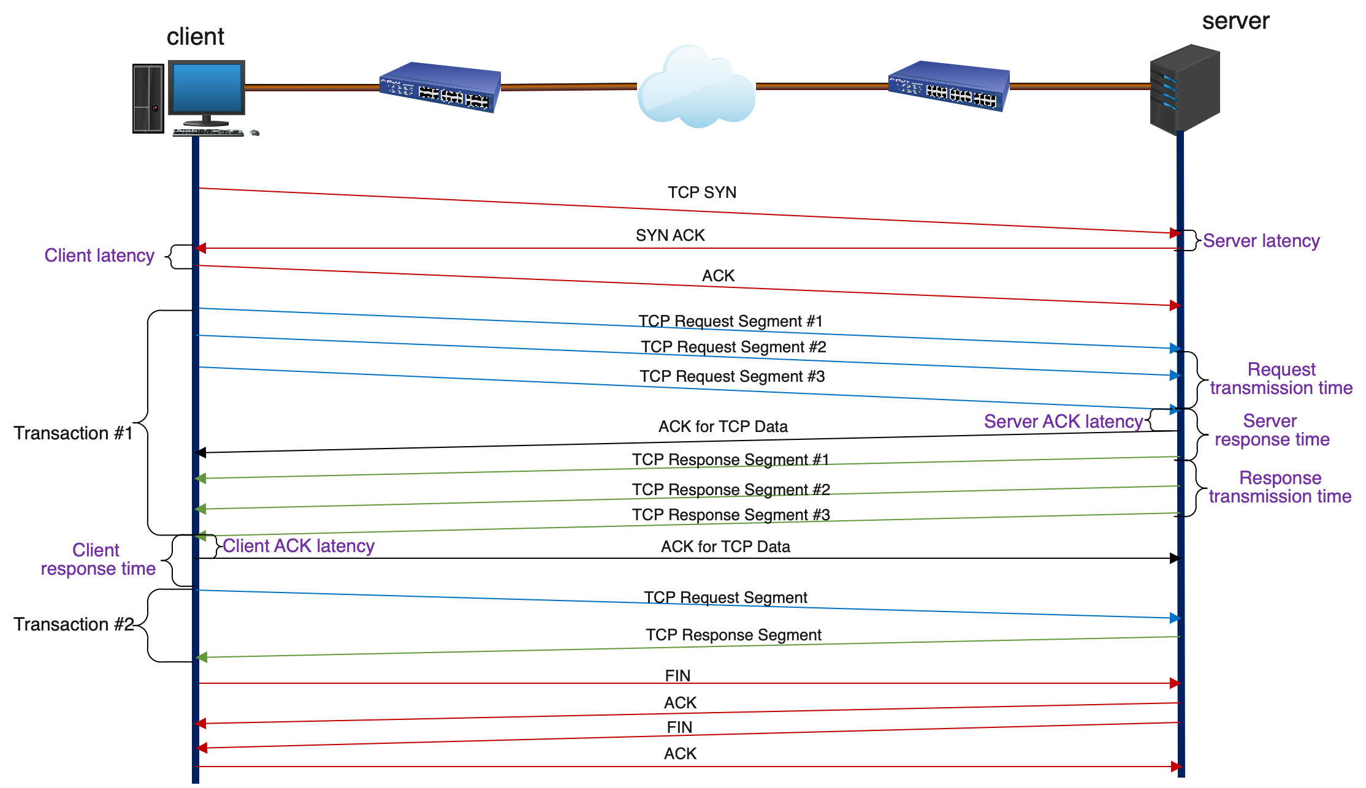
Some performance KPIs defined in NPM
Key KPIs
Server latency
Client latency
Server ACK latency
Client ACK latency
Server response time
Client response time
Request transmission time
Response transmission time
……
Notes:
客户端和服务器延时都是通过TCP建连的时候计算的
服务器延迟：指的是
服务器响应时间：指在一个transaction中，服务器回应给客户端第一个带数据的包和客户端发送给服务器端最后一个请求数据的包之间的时间差

Slide 7
Ideas of the NPM
  Analyze each TCP session packet by packet through tshark
  Define the significant application through five-tuple information
  Calculate the performance KPIs and stored them in the data warehouse
  Create the KPI baseline of the connection between client and servers
  Based on ML method to detect anomalies

Slide 8
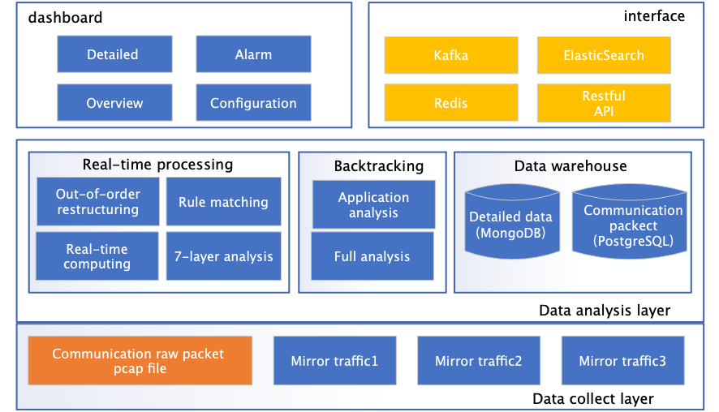
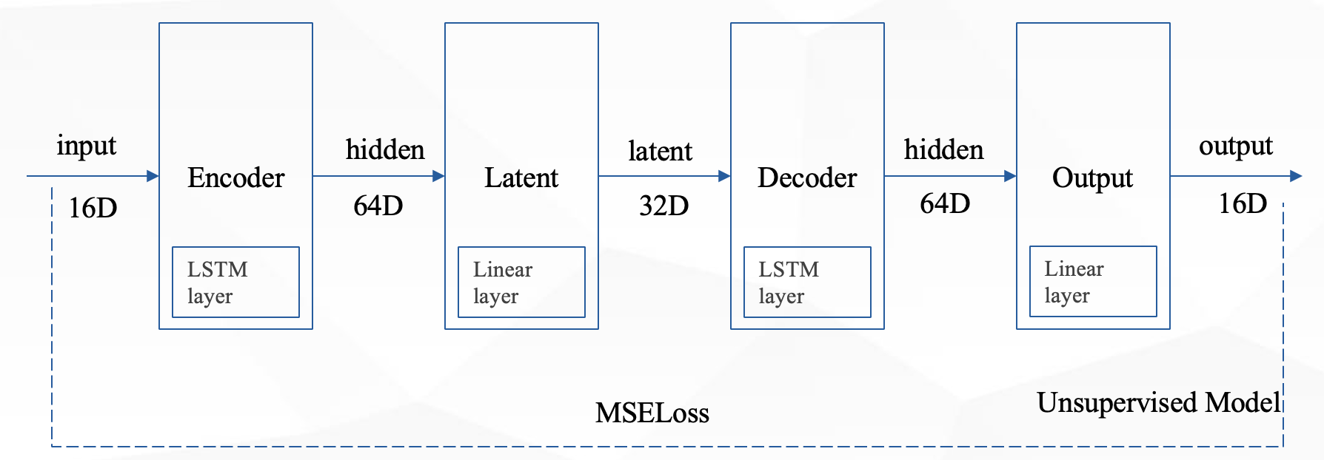
NPM work progress
  NPM work is really huge and time-consuming
  Architecture has been designed
  Network traffic packet has been captured and stored
  Data warehouse has been created and established
  Calculate algorithm of the network performance KPIs have been designed
  The unsupervised model based on LSTM-AE for anomaly detection has been deployed

Slide 9
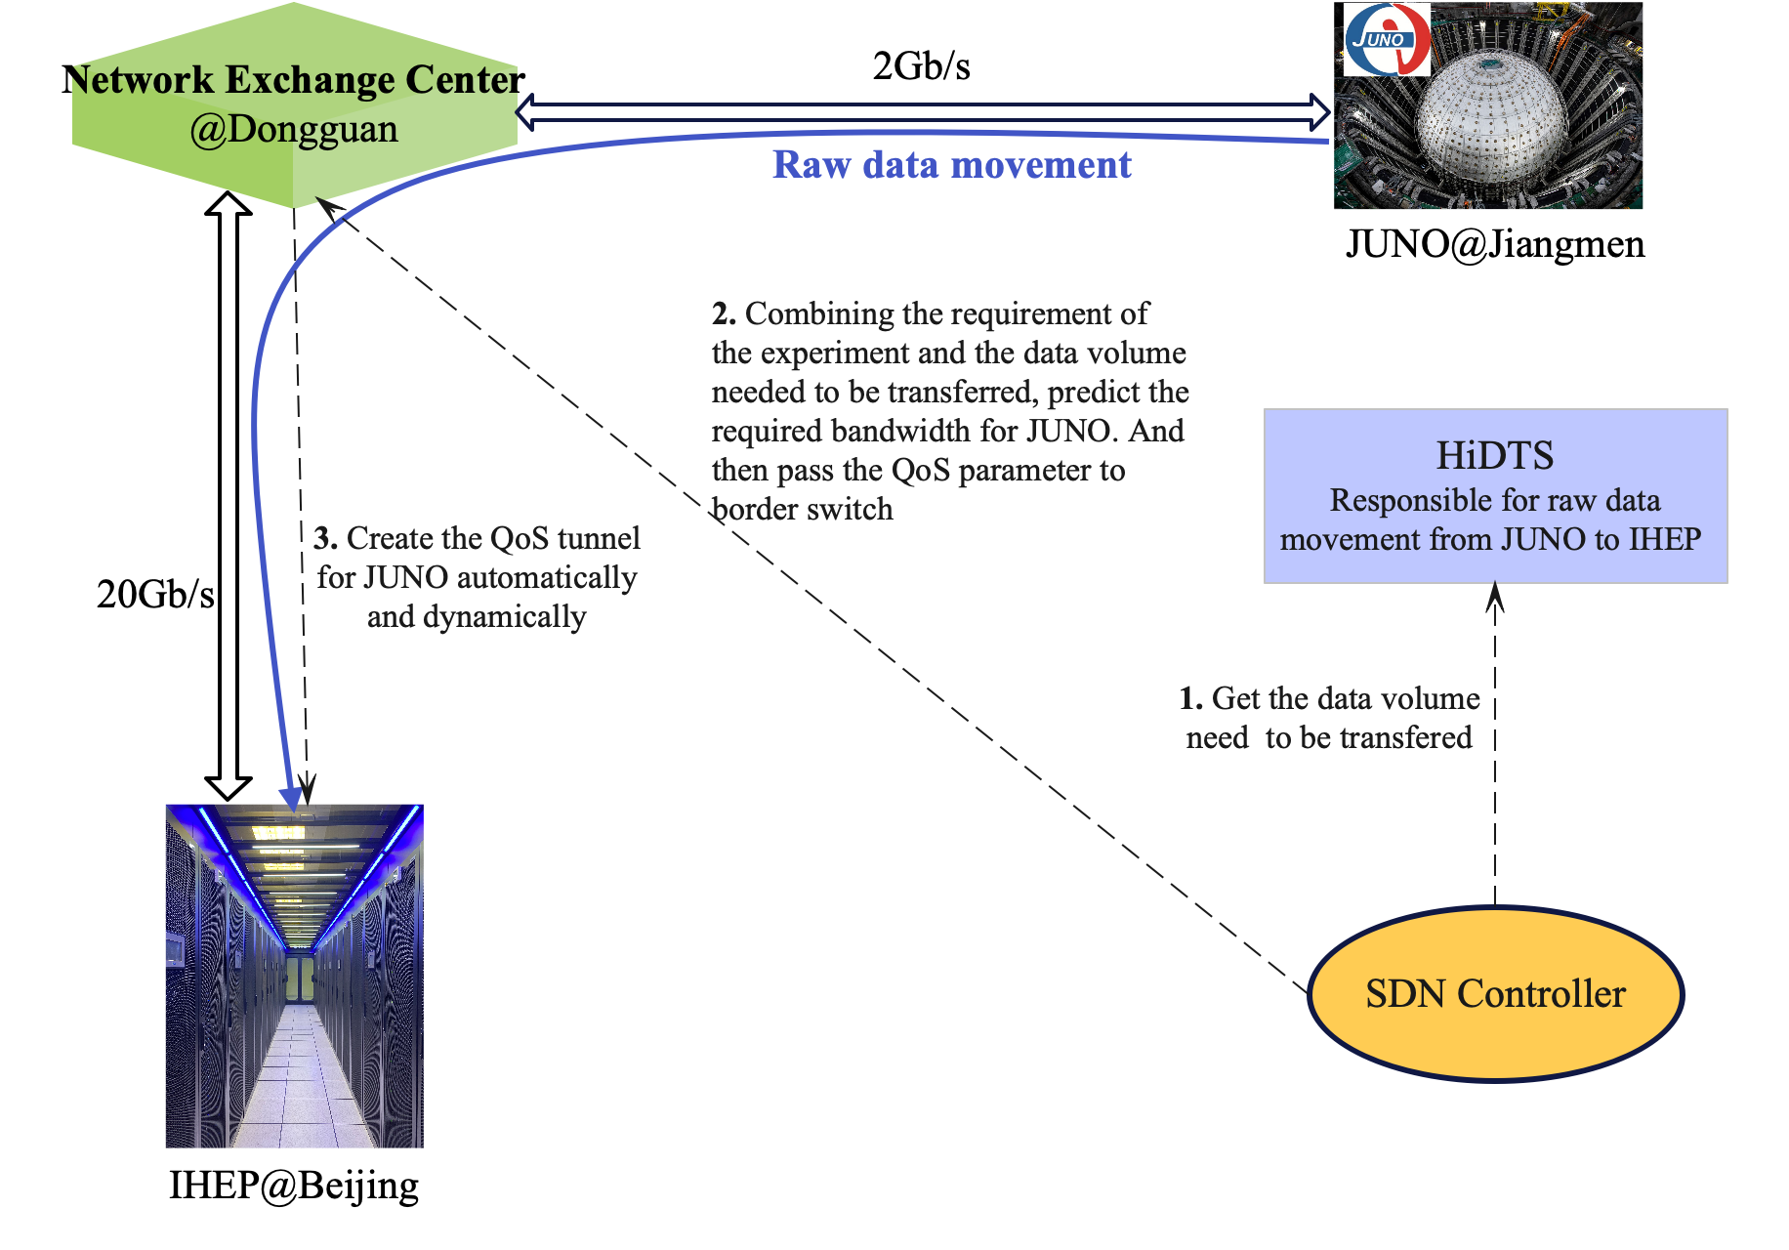
Network QoS assurance work progress
  SDN Controller has been developed
  Joint-test with the border switch has been finished and successfully
  The program to create the QoS tunnel for JUNO automatically and dynamically has been developed and tested
  The whole system will be online in the next few weeks

Slide 10
Future plan
  Develop the real-time processing and backtracking module to get the performance KPIs
  Based on data set of the performance KPIs, train the anomaly detection model
  NPM work is just started and all collaborations are welcomed

Slide 11
Thanks for your attentions
Questions, Comments, Suggestions?

