Slide 1
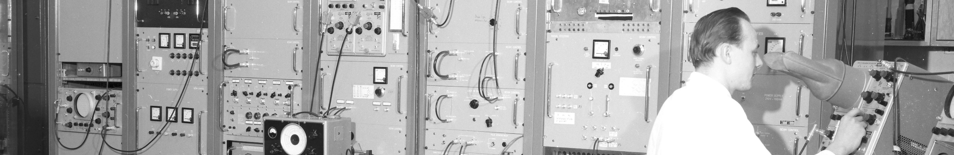
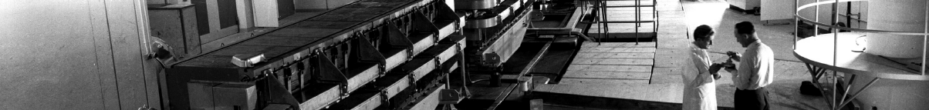
PS Report week 24
Many thanks
to the PS OP and coordination teams as well as all equipment experts and support teams!
A. Lasheen SY-RF-BR
1

Slide 2
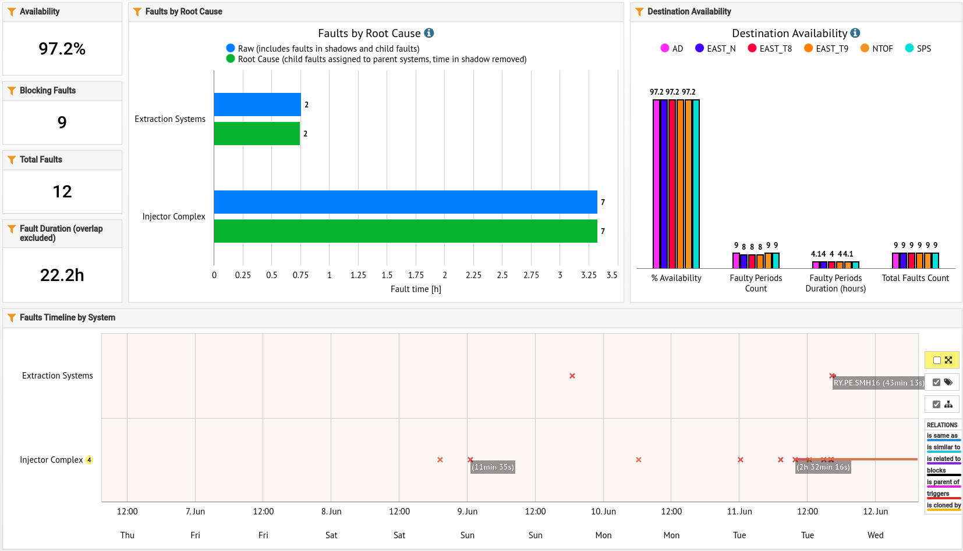
Availability W23/24 (Thu – WED 7:30am)
Degraded mode PSB (missing R2)
A. Lasheen SY-RF-BR

Slide 3
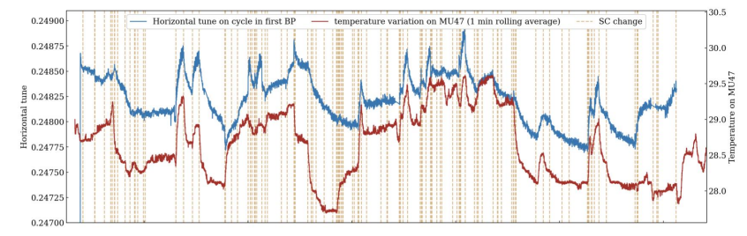
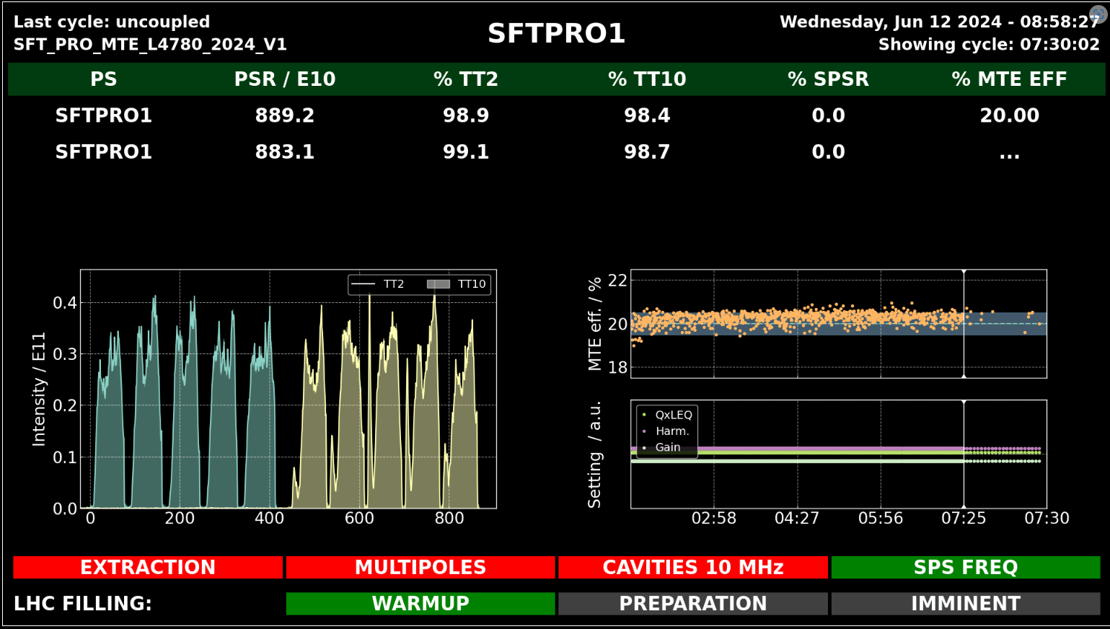
Tune evolution, MU47 magnet temperature correlation, supercycle changes
Main issues and activities
Excellent availability in W23 and start of W24!
Main fault is stripping foil of PSB Ring2, running only with ¾ PSB Rings
  PS ran in degraded mode from Tuesday morning until Technical Stop
  TOF adjusted for production with dedicated cycles only using PSB Ring3
  Beam produced for SFTPRO at lower intensity, following magnet exchange in SPS
  AD produced with 4 bunches and asymmetric pattern
Preparation of TOF beam with 44ns at extraction ongoing (completion at restart following stop)
Optimization of EAST_N cycle (reduced losses, increased intensity on target), to be propagated on EAST_T9
Continuous effort for SFTPRO beam to understand fluctuations of MTE efficiency and tests at highest intensity (3.5-4e13 ppp)
SFTPRO with missing PSB Ring2
A. Lasheen SY-RF-BR

Slide 4
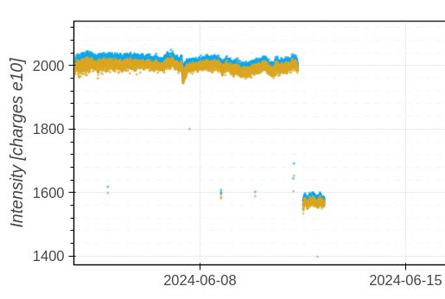
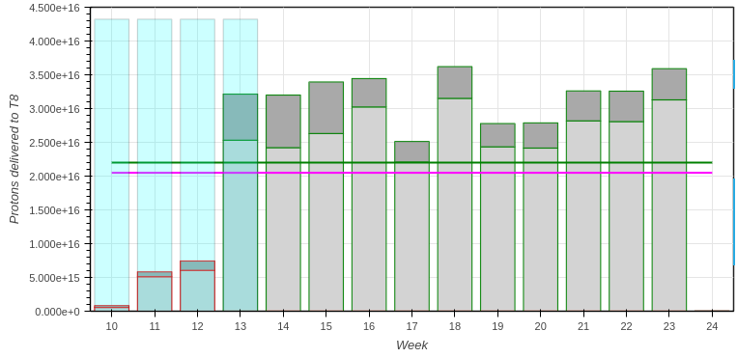
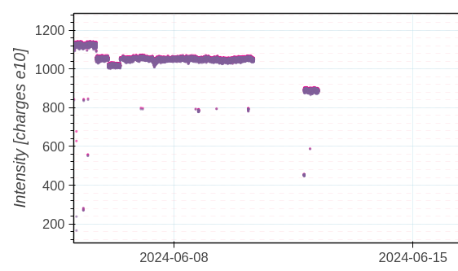
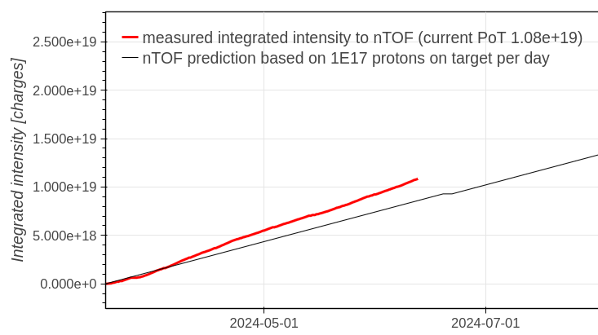
Delivered intensity
** PSB R2
AD
EAST T8
SFTPRO
TOF
A. Lasheen SY-RF-BR
https://bpt.web.cern.ch/

Slide 5

Questions and Comments
PS Coordinator for week 24 – Alexandre Lasheen
PS Coordinator for week 25 – Ewen Maclean
9:00 live meeting at the CCC on Wednesday/Friday
Zoom link to follow the meeting on remote: https://cern.zoom.us/j/9372114100?pwd=L29BcmlHUENCdFBRSytXYVcrM1B4Zz09
Meeting ID : 937 211 4100
Passcode: 525463
A. Lasheen SY-RF-BR
5

