Slide 1


University of Oklahoma
Network Connectivity

Slide 2
Connection Suite
Three Campus Location
Norman
Oklahoma City
Tulsa
Cameron University
Rogers State University
Internet
Services
Shared
Services
Four Geographical Location
North Campus.
Main Campus.
South Campus.
Research Campus.
Edge
Legacy
Data
Center
Core
Research
Campus
VoIP
Functional Connections
Internet Connectivity
Campus Connectivity
Local Data Center (aka Legacy DC)
Data Center (aka S2 DC)
VoIP
Peering Connections
North
Campus
South
Campus
Peers
Main
Campus
Notes:
Our approach to the campus network can be divided into two categories:
Geographical Location
Functional Connectivity

Slide 3

Campus Backbone
Internet Service Provider
(OneNet)
Architecture
DataCenter
(OKC)
DataCenter
(Tulsa)
Buildings connections = 1/10 Gbps
Wireless Controllers = 40 Gbps
Campus Backbone = 40 Gbps
10 Gbps
10 Gbps
100 Gbps
10 Gbps
Core
Core/Edge
Firewall Appliance
4 x 10 Gbps
4 x 10 Gbps
Firewall
Appliance
Main Campus
South Campus
Research Campus
Legacy DC
Distribution
Layer
40gig interfaces
Football Stadium
NC
MDF
(Merrick)
South Campus
Research Campus
Main Campus
Data Center
( ie. NOC, SRTC, 4PP )
Access
Layer
1gig interfaces
2.5/5 gig
10gig interfaces
25gig interfaces
North Campus
This document may contain information that is privileged, confidential and/or exempt from disclosure under applicable law. If you are not an Employee of the University of Oklahoma, you are hereby notified that any disclosure, copying, distribution or use of the information contained herein is STRICTLY PROHIBITED. If you received this information in error, please immediately contact the sender and destroy the material in its entirety, whether electronic or a hard copy format.
INFORMATION
TECHNOLOGY

Slide 4
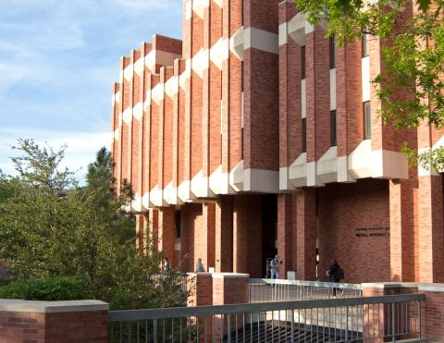






Campus Architecture
Geographic Locations
North & Main Campus
Core
Core/Edge
Firewall Appliance
Firewall
Appliance
Main Campus
Leadership
Main Campus
This document may contain information that is privileged, confidential and/or exempt from disclosure under applicable law. If you are not an Employee of the University of Oklahoma, you are hereby notified that any disclosure, copying, distribution or use of the information contained herein is STRICTLY PROHIBITED. If you received this information in error, please immediately contact the sender and destroy the material in its entirety, whether electronic or a hard copy format.
INFORMATION
TECHNOLOGY

Slide 5
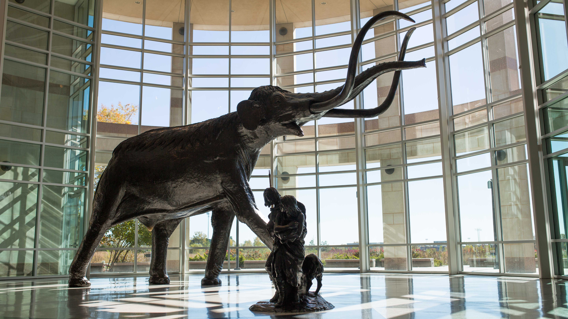




Campus Architecture
Geographic Locations
South Campus
Core
Core/Edge
Firewall Appliance
Firewall
Appliance
South Campus
Museum of Natural History
This document may contain information that is privileged, confidential and/or exempt from disclosure under applicable law. If you are not an Employee of the University of Oklahoma, you are hereby notified that any disclosure, copying, distribution or use of the information contained herein is STRICTLY PROHIBITED. If you received this information in error, please immediately contact the sender and destroy the material in its entirety, whether electronic or a hard copy format.
INFORMATION
TECHNOLOGY

Slide 6

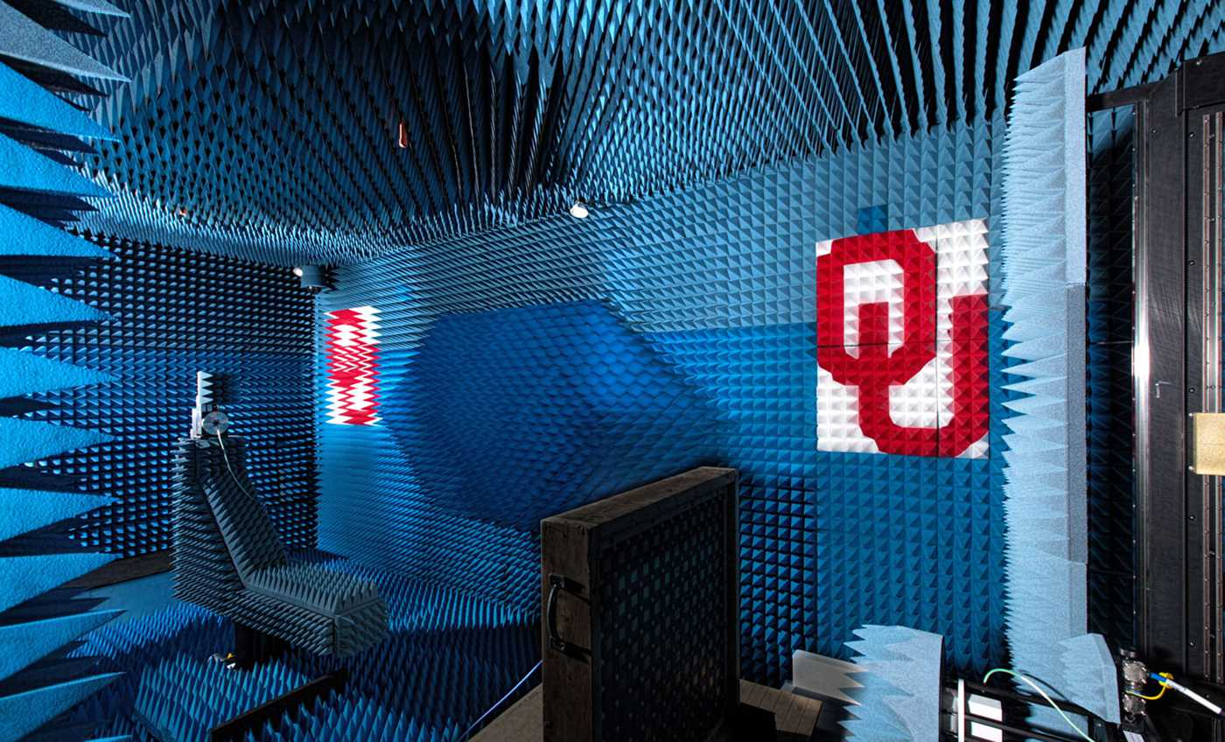


Campus Backbone
Research Campus
Core
Core/Edge
Firewall Appliance
Firewall
Appliance
Research Campus
National Weather Center
Supercomputer
Networks
Services
ESNET
Peering
Research Campus
* OU Research Disk (OUR Disk) is a ceph infrastructure. It provides a high performance disk resource that is available both on OU IT's supercomputer, servers in the data center and devices residing on campus.
Radar
Innovation Lab
Research Tenants
This document may contain information that is privileged, confidential and/or exempt from disclosure under applicable law. If you are not an Employee of the University of Oklahoma, you are hereby notified that any disclosure, copying, distribution or use of the information contained herein is STRICTLY PROHIBITED. If you received this information in error, please immediately contact the sender and destroy the material in its entirety, whether electronic or a hard copy format.
INFORMATION
TECHNOLOGY

Slide 7

Solutions @ Work
Data Center Network Architecture

Slide 8
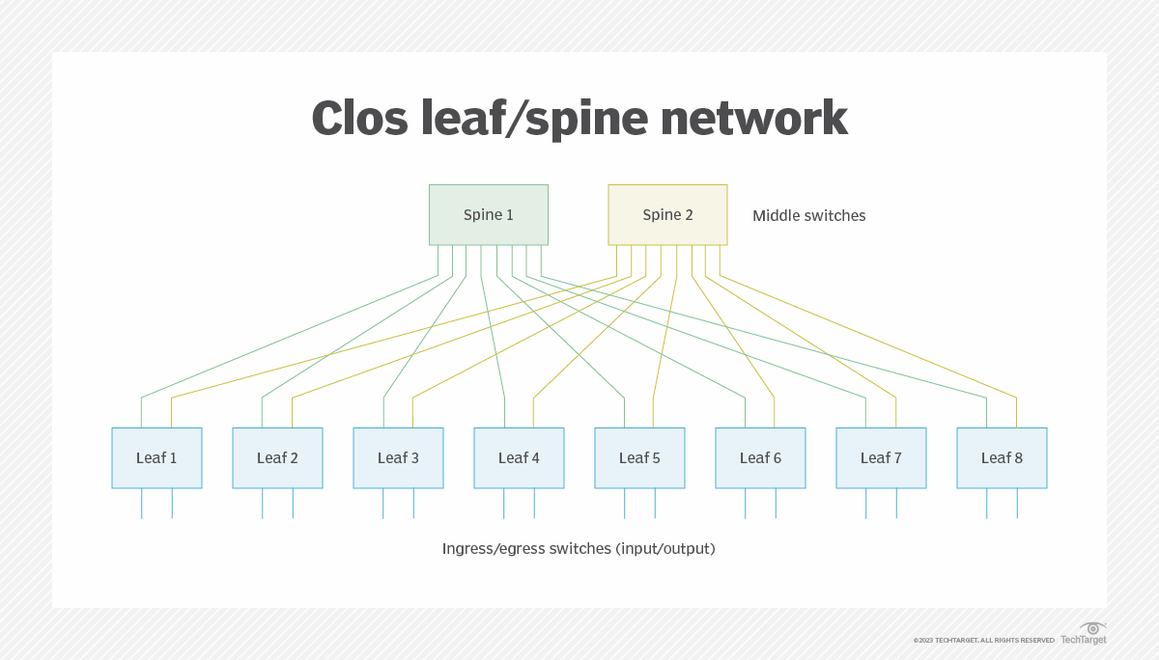
Network Architecture
Leaf Nodes
Dual uplink, with an uplink to each spine.
Each uplink is connected at 100Gbps.
Spine
Compute Leaf Nodes
Responsible for providing connectivity to endpoints such servers, compute nodes and storage appliances.
Border Leaf Nodes
In place to support endpoints such as routers, firewalls, load balancers or uplinks to other network devices.
Responsible for providing layer 2 and layer 3 connectivity between the data center fabric and anything outside of the data center.
Baremetal
servers
Hypervisors

Slide 9
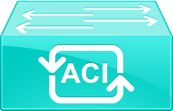
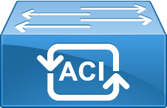
Multi-pod Deployment
Ease of Administration: Single data center fabric and single management cluster.
Resiliency: Each pod runs its own instance of a control-plane. A pod failure does not impact another pod.
Region 1 - OKC
Region 2 - Norman
Region 3 - Tulsa

Slide 10

Multi-pod Deployment
East / West Traffic
An Inter-Pod Network (IPN) is deployed at each pod. This provides Pod-to-Pod communication (also known as east-west traffic).
The IPN represents an extension of the ACI fabric underlay infrastructure.
All inter-pod traffic is encapsulated with VXLAN
OKC-IPN1
Tulsa-IPN2
OU
DWDM
100 Gbps
OKC-IPN2
Tulsa-IPN1
Norman-IPN1
Norman-IPN2
Region 1 - OKC
Region 2 - Norman
Region 3 - Tulsa

Slide 11
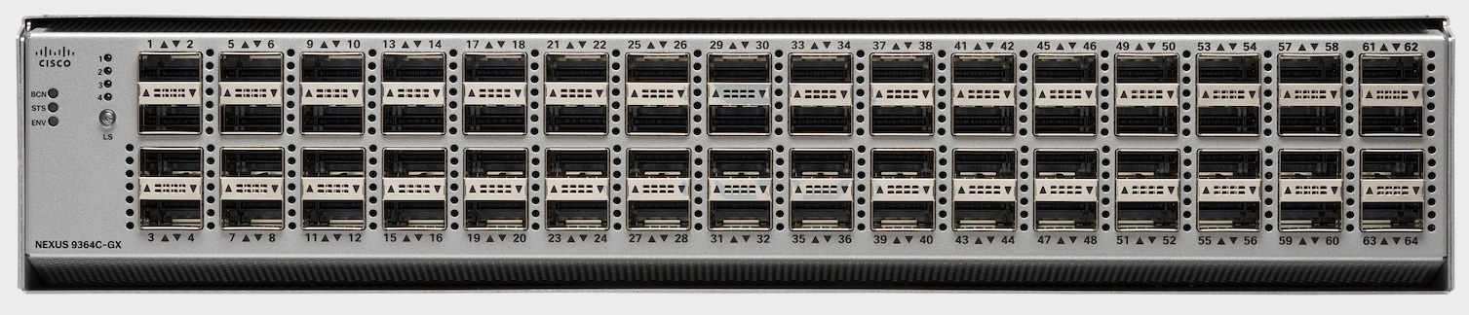
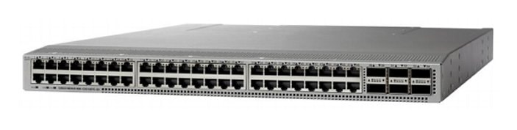

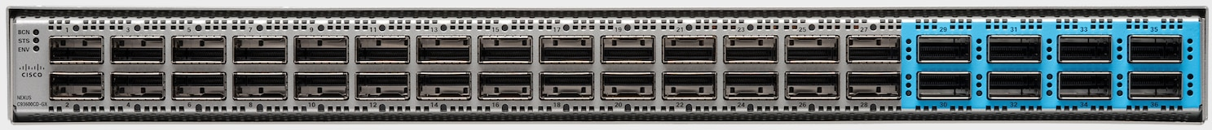
Hardware
Model | Topology Layer | Media | Port Speeds | Port Quantity Per Switch
N9K-C9364C-GX | Spine | QSFP+ | 100 Gigabit Ethernet | 64 x 100 Gigabit Ethernet
N9K-C93180YC-FX3 | Leaf | SFP+ | 10 Gigabit Ethernet 25 Gigabit Ethernet 100 Gigabit Ethernet | 48 x 10/25 Gigabit Ethernet 6 x 100 Gigabit Ethernet
Nexus 93108TC-EX | Leaf | Copper | 100 Megabit Ethernet 1 Gigabit Ethernet 10 Gigabit Ethernet 100 Gigabit Ethernet | 48 x 100 Mbp, 1,10 Gigabit Ethernet 6 x 100 Gigabit Ethernet
N9K-C93600CD-GX | IPN, Leaf | QSFP+ | 40/100 Gigabit Ethernet 400 Gigabit Ethernet | 28 x 100 Gigabit Ethernet 8 x 400 Gigabit Ethernet
Nexus 93108TC-EX
N9K-C9364C-GX
N9K-C93180YC-FX3
N9K-C93600CD-GX

Slide 12
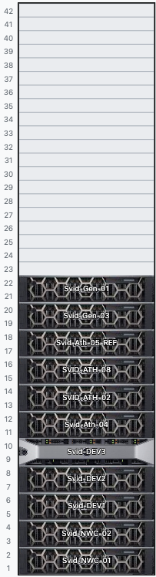
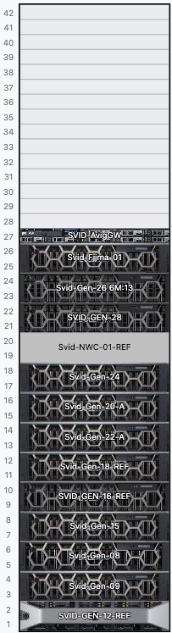


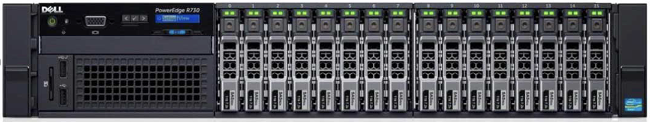
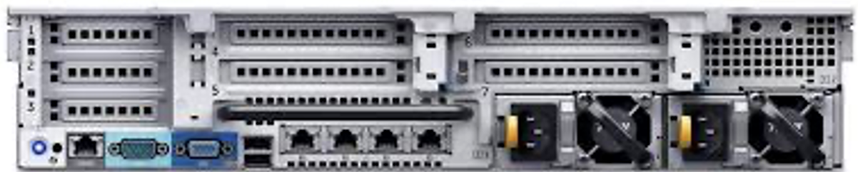
Hosting Endpoints
Pod Deployment: 3 switches (1 x copper and 2 x SFP).
Pod supports up to three racks of servers.
Pod supports dual connectivity of servers.
Rack 1
Rack 2
Rack 3
SAMPLE RACK
SAMPLE Pod
SAMPLE RACK
Leaf Nor-2213 (copper)
Leaf Nor-2214 (SFP)
Leaf Nor-2215 (SFP)
Leaf Nor-2213
Leaf Nor-2214
Leaf Nor-2215
Baremetal Host

Slide 13
Hosting Endpoints
Each leaf has the ability to host different endpoints.
Each port will be assigned to an Endpoint Groups (EPGs).
The EPG will be responsible for defining both forwarding policy and security segmentation simultaneously.
Leaf Nor-2201
( Border Leaf )
Leaf Nor-2214
Leaf Nor-2215
Edge
Router/FW
DC
Host
DC
Baremetal
DC
Baremetal

Slide 14


Hosting Endpoints
Each leaf has the ability to host different endpoints.
Each port will be assigned to an Endpoint Groups (EPGs).
The EPG will be responsible for defining both forwarding policy and security segmentation simultaneously.
Leaf Nor-2201
( Border Leaf )
Leaf Nor-2209
Leaf Nor-2210
DC
Baremetal
DC
Baremetal
Tenant
Baremetal
Research
Baremetal
Research
Baremetal
Enterprise
Edge
(Firewall)
Research Edge
Tenant
ISP
DC
Host
DC
Host

Slide 15
Hosting Endpoints
Sample Interface Policy
CEPH_Cloud_Trunk_PolicyGroup
CDP Policy: disabled
LLDP Policy: enable
Attached Entity Profile (VLANs allowed): VLAN 112,212,1062, trunk
Baremetal_Trunk_PolicyGroup
CDP Policy: disabled
LLDP Policy: enable
Attached Entity Profile (VLANs allowed): VLANs 2-200, trunk
Interface Polices
Interface polices define interface behavior and features to be configured on a specific interface. The goal is for objects to be reused.
1G-auto
10G-auto
LLDP-on
LLDP-off
LACP-active
LACP-active
CDP
enable
IDRAC_V251_PolicyGroup
CDP Policy: disabled
LLDP Policy: enable
Attached Entity Profile (VLANs allowed): VLANs 251, untagged
CDP
Policy (off)
Access Port
LLDP Policy (enable)
Interface
Policy Group
(template)
Attatching Profile
Interface
Policy Group
(template)
Other
options
Port-Channel
VLANs used
Domain type
Other
options
vPC

Slide 16

Looking Ahead

Slide 17
Edge Routers
Tri-Campus WAN Connectivity
Internet Connectivity
Campus to Data Center Connectivity
Physical Connectivity: 100 Gbps
100 Gbps
Onenet
Internet
100 Gbps
Norman-Edge
Routers
Tulsa-Edge
Routers
OKC-Edge
Routers
Campus
Backbone
Data Center
Fabric
Campus
Backbone
Data Center
Fabric
Campus
Backbone
Data Center
Fabric
Norman
Tulsa
OKC

Slide 18
Hardware
Model | Topology Layer | Media | Port Speeds | Port Quantity Per Switch
DCS-7280CR3K-32D4-F | - | - | 100 Gigabit Ethernet 400 Gigabit Ethernet | 32 x 100 Gigabit Ethernet and 4 x 400 Gigabit Ethernet
DCS-7280CR3K-32D4-F

Slide 19
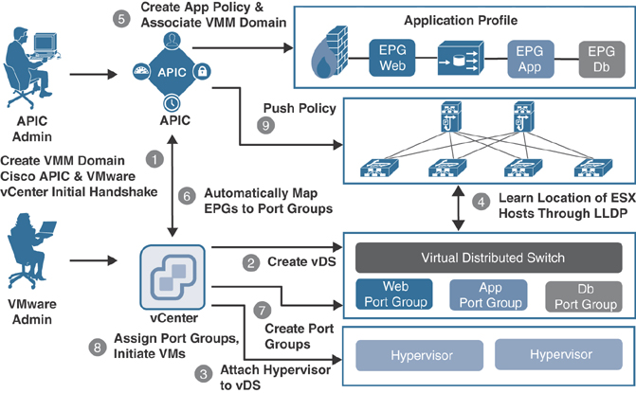
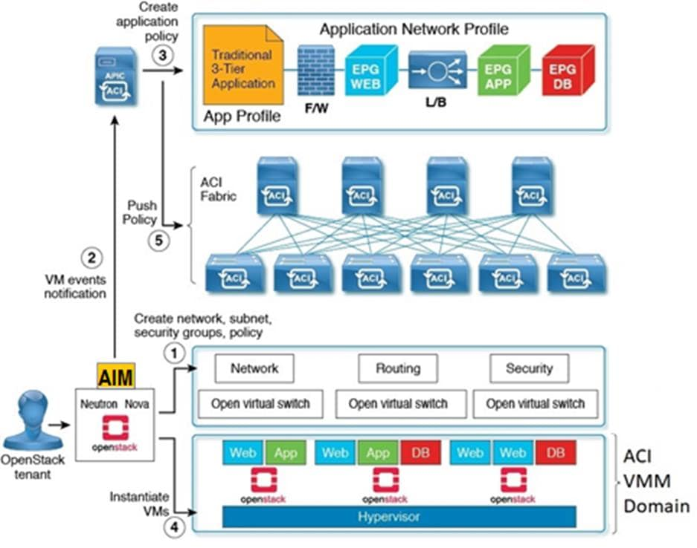
Virtual Machine Managers Integration
Simplifying tasks by automating network functions.
Manage network policies in your virtual environment.
ACI Integrates with the following VMM
Microsoft
Vmware
Red Hat
OpenStack
ACI Integrates with the following Container Domain
Cloud Foundry
Kubernetes
OpenShift

Slide 20
END

