Slide 1
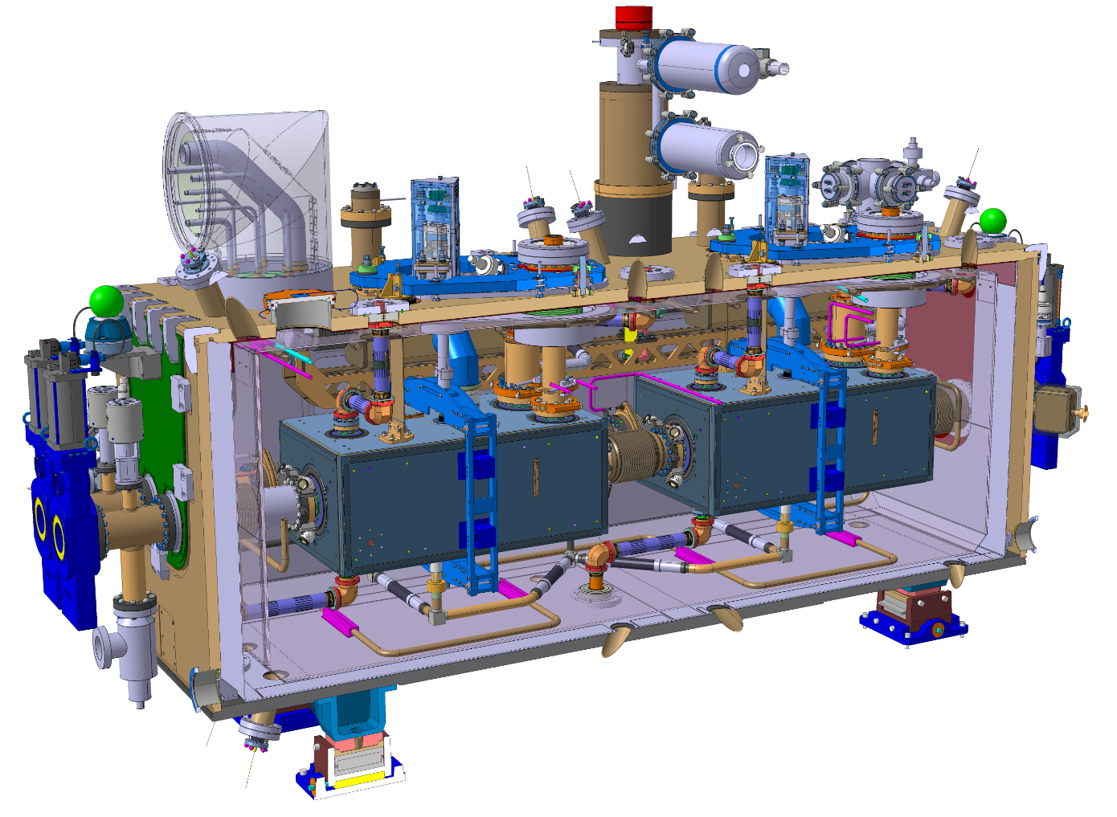
WP4-WP9 Crab Cavities
Experience from RFD proto CM test at CERN SM18 – M7 bunker
RFD proto
Thursday, July 4th, 2024 - on Indico: 1426215
HL-LHC – Crab Cavities RFD Proto CM test @ CERN – TE-CRG

Slide 2

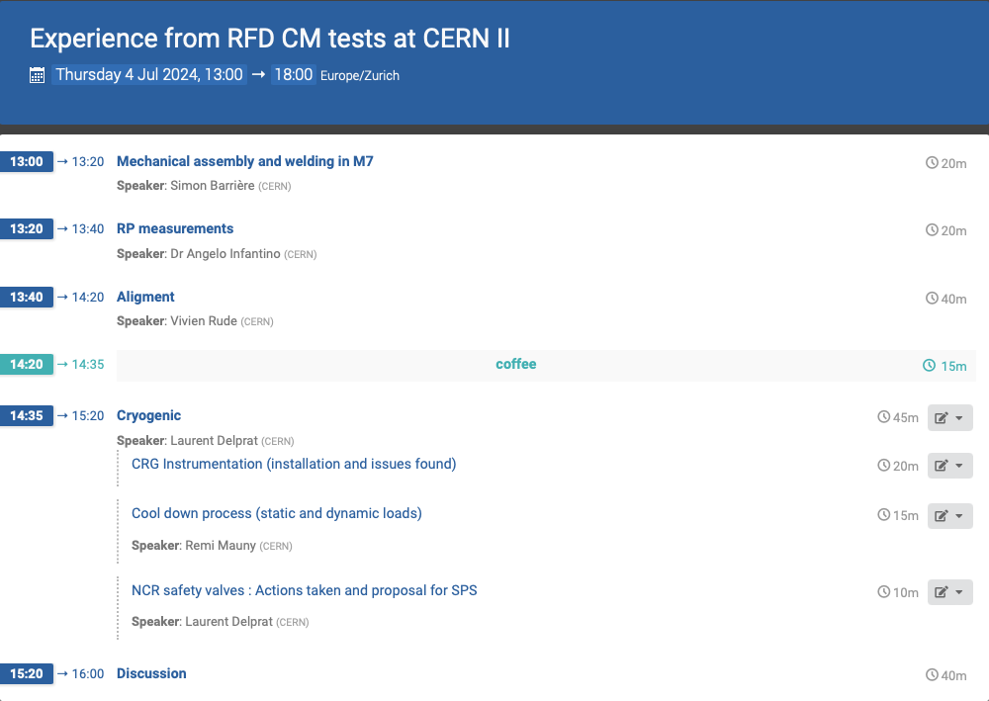
Introduction
2023 highlights
Focus on instrumentation aspects
Focus on process aspects
NC relief valve
Next steps
Thursday, July 4th, 2024 - on Indico: 1426215
HL-LHC – Crab Cavities RFD Proto CM test @ CERN – TE-CRG

Slide 3
2023 HIGHLIGHTS
Thursday, July 4th, 2024 - on Indico: 1426215
HL-LHC – Crab Cavities RFD Proto CM test @ CERN – TE-CRG

Slide 4
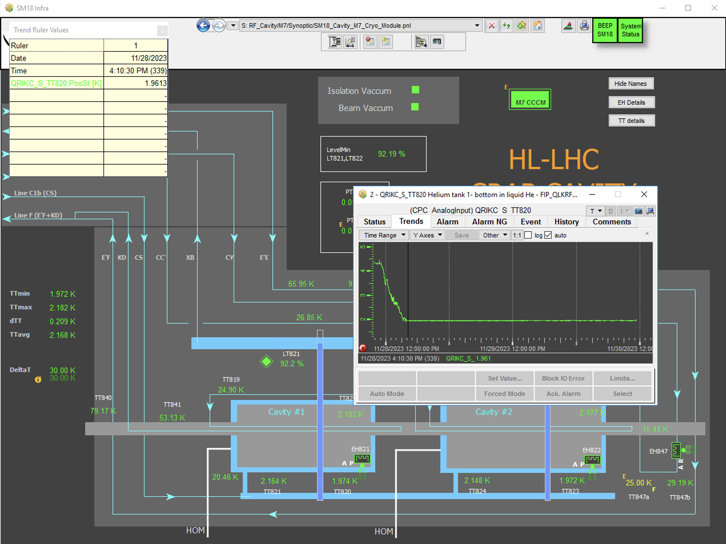
2023 HIGHLIGHTS
Dec’22
Jan’23
Feb
Mar
Apr
May
Jun
Jul
Aug
Sep
Oct
Nov
Dec
Jan’24
RFD proto
SM18 M7 bunker preparation for commissioning @ cold
Instrum installation phase 1 / UK
RFD proto delivered @ CERN
Installation, SVs NCR treatment, commissioning
4.5 K
24.11.2023
2 K
28.11.2023
Thursday, July 4th, 2024 - on Indico: 1426215
HL-LHC – Crab Cavities RFD Proto CM test @ CERN – TE-CRG

Slide 5
INSTRUMENTATION
(feedback CRG-IC/ T. Feniet / N. Vauthier)
Thursday, July 4th, 2024 - on Indico: 1426215
HL-LHC – Crab Cavities RFD Proto CM test @ CERN – TE-CRG

Slide 6
Instrumentation aspects (1/2)
Organization
  Instrumentation shipping to optimize: the cryomodule builder should receive only the instrumentation he will install => clarification of the installation responsibilities (+ at which phase)
Instrumentation mounting, training on site
  Very positive and productive, to be re-conducted – CRG-IC, in charge, should have 1 direct contact with the cryomodule builder (no intermediate with EN-MME, to facilitate the communication), ideally the people in charge of the instrum installation on site
  Need for CRG-IC to know the profile of the people in charge on site, to better prepare their training & qualification
Installation on site by STFC
  Quality assurance
    cables labels were removed by STFC without CERN approval
    Pinning strategy not 100% respected by STFC
    Some TTs were not installed by STFC => had to be done by CERN once delivered
  Tuners: is there a need for sockets on TT/EH 861/62, to allow their dismounting without removing the sensors?
3D integration model & drawings
  To be included in the model:
    the sensor wire + its bending radius, the feedthroughs + the connectors, the cabling routing inside & outside the vacuum vessel, the electrical connecting box
  Quality assurance: actual drilling diameter for the orifices of the Acim Jouanin cartridges was not always consistent with the drawings
Thursday, July 4th, 2024 - on Indico: 1426215
HL-LHC – Crab Cavities RFD Proto CM test @ CERN – TE-CRG

Slide 7
Instrumentation aspects (2/2)
Necessary pending reviews
  After cold tests: are all the flange heaters necessary? => check their operation (if any), room for simplification
  Operation: TT847a not operational, to be checked with IC
  P&ID:
    TAGs update (TT819a/b to be replaced by 1TT819/2TT819)
    Add thermocouples on the EH821 & 822 foil heaters (TT827 & 828)
    Include all existing and physically installed EH on the P&ID (FPC)
    EH876/877/878/879 (flexible band heaters): they are all equipped with 2 heaters and 2 PT100 => update P&ID accordingly
    RFD series cryomodules: TT842 to be removed, TT814 & 816 to be added
    Safety port: import the DQW drawing into the RFD P&ID (1 flange for the chimney, 1 flange for the burst disc)
FTEs for M7 operation
  Reception + installation + commissioning: 2 FTEs for 2 weeks, continuous
  Dismounting: 2 FTEs for 3 days, continuous
Cryomodules reception at CERN
  Schedule already available?
  Quid storage conditions (for the instrum) after M7 dismounting and before LHC installation? Storage duration and conditions (where)?
Thursday, July 4th, 2024 - on Indico: 1426215
HL-LHC – Crab Cavities RFD Proto CM test @ CERN – TE-CRG

Slide 8
CRYO PROCESS
(feedback CRG-ML / R. mauny)
Thursday, July 4th, 2024 - on Indico: 1426215
HL-LHC – Crab Cavities RFD Proto CM test @ CERN – TE-CRG

Slide 9
Cryo process aspects – intro & overview
2 main documents used to write the logic specification :
  «Functionnal description of operation modes» [HiLumi-LHC-CC-Cryo-N-39; EDMS 2647024]
  Engineering specification HL-LHC CC : cryomodules for crab cavities [LHC-ACF_A-ES-0001; EDMS 2043014]
3 main phases for cool down :
  Cool down from 300 K to 130 K: with controlled inlet temperature ; dTmax = 50 K.
  Cool down from 130 K to 4.5 K: by direct LHe injection into CCCM ; no limitation with dTmax below TTmax = 130 K; cooldown as fast as possible (AFAP).
  During these 2 phases, specific attention needed to CCCM pressure (< 1.5 bar)
  Pumping phase from 4.5 K to 2 K: beam screen (BS) circuit put in service, then pumping.
  ------------------------------------------------------------------------------------------------------------------------
1st RFD proto operation : 21 Nov. – 10 Dec 2023 (Logbook event 117205)
2nd RFD proto operation : 11 April – 14 June 2024 (Logbook event 119101)
Thursday, July 4th, 2024 - on Indico: 1426215
HL-LHC – Crab Cavities RFD Proto CM test @ CERN – TE-CRG

Slide 10
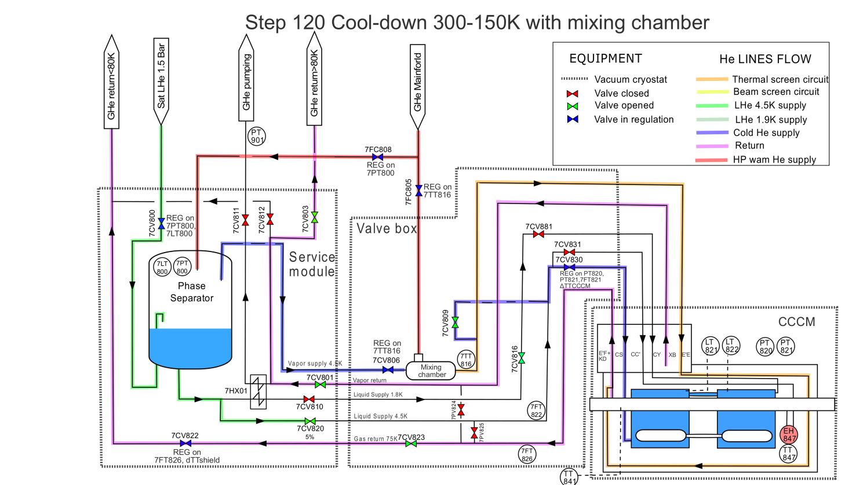
Cryo process aspects – PFD1- CD 300K-130K – dTmax 50K
Step 120 : CoolDown 300-130K with mixing chamber
Thursday, July 4th, 2024 - on Indico: 1426215
HL-LHC – Crab Cavities RFD Proto CM test @ CERN – TE-CRG

Slide 11
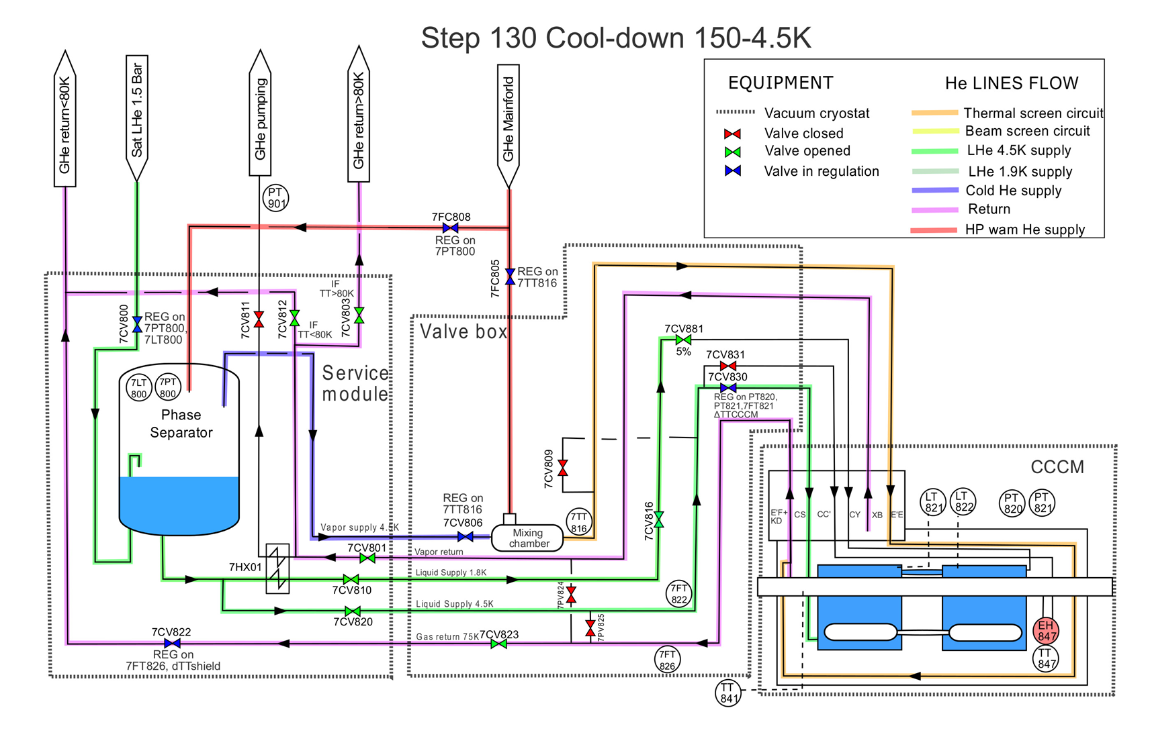
Cryo process aspects – PFD2- CD 130K- 4.5K – AFAP
Step 130 : CoolDown 130 K- 4.5 K - As fast as possible
Thursday, July 4th, 2024 - on Indico: 1426215
HL-LHC – Crab Cavities RFD Proto CM test @ CERN – TE-CRG

Slide 12
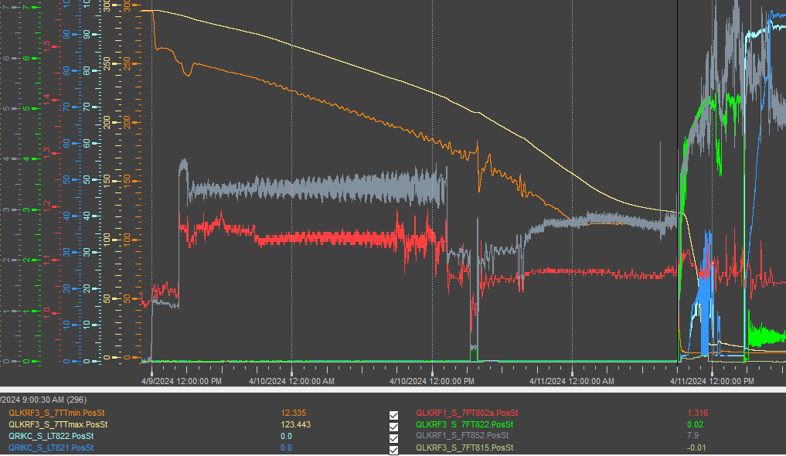
Process aspects – Cool Down 300 K -> 4.5 K
CD with mixing chamber – dT 50K
CD AFAP
Filling
Cool Down time (300 K -> 130 K – dT 50 K) | 46 h
Cool Down time (130 K -> 4.5 K - AFAP) | 2 h
Flow during CD in cryomodule | ~2.2 – 3 g/s
Flow during CD in TS | ~1.3 g/s
Filling | 6 h
Flow during filling | ~ 5.2 g/s
Flow to maintain cav filled at 4.5 K | ~ 4 g/s
Tot. CD time to 4.5 K | 54 h
Constraint : keep Pressure < 1.4 bar
Thursday, July 4th, 2024 - on Indico: 1426215
HL-LHC – Crab Cavities RFD Proto CM test @ CERN – TE-CRG

Slide 13
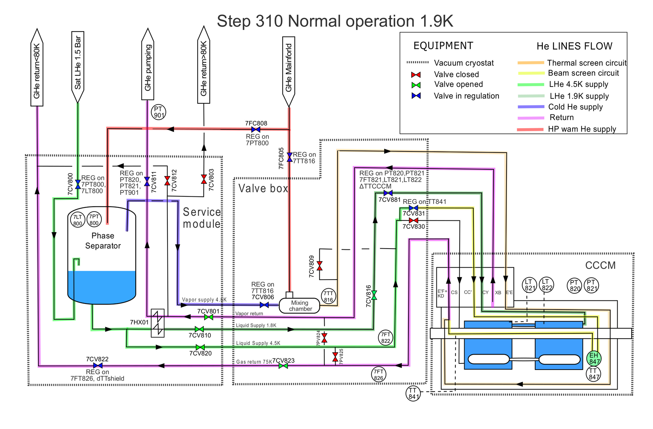
Cryo process aspects – PFD 3 - Nominal operation @ 2 K
Thursday, July 4th, 2024 - on Indico: 1426215
HL-LHC – Crab Cavities RFD Proto CM test @ CERN – TE-CRG

Slide 14
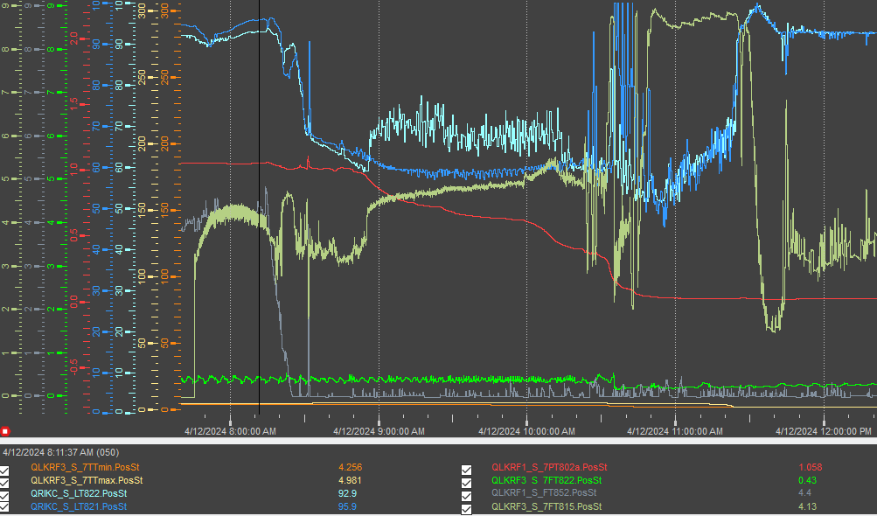
Process aspects – Pumping down to 2 K
Lhe level decreases during pumping phase
Pumping time to 30 mbar | 2.5 h
Min LHe level during pumping step | 60 %
Flow during pumping step | ~5 g/s
Refill time at 30 mbar | 40 min
Flow during refill step | ~8.5 g/s
Total Time for CD 300 K -> Cryo_Ok (without interruption) | 58 h (2.5 days)
refill
1.05 bar
30 mbar
Thursday, July 4th, 2024 - on Indico: 1426215
HL-LHC – Crab Cavities RFD Proto CM test @ CERN – TE-CRG

Slide 15
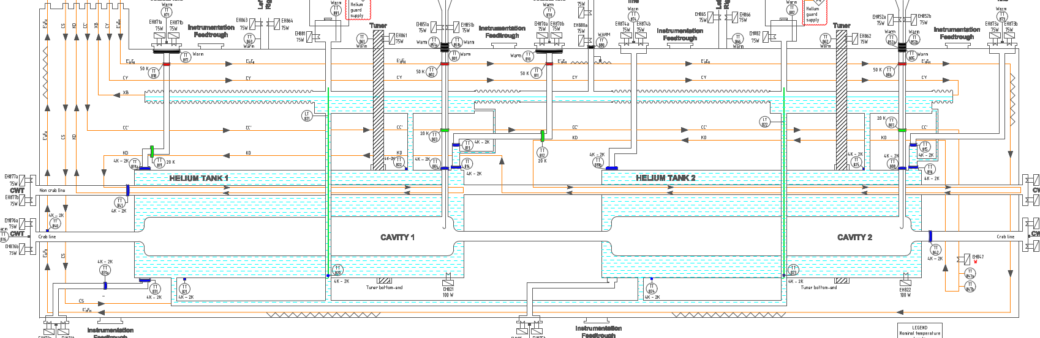
Process aspects – Nominal operation @ 2 K
Flow during nominal operation @ 2 K : 3.5 g/s [Eq. Heat load: 70 W]
Flow through Thermal Screen + Beam screen : 2.4 g/s + 0.3 g/s
Limitation of instabilities during RF conditioning :
LHe level not easy to maintain with dynamic heat load. It can drop suddenly due to geometrical aspects (chimney)
  Setting level controller with reactive PID parameters.
Adaptation of Cryo_Ok logic to gain margin
  Bigger margin with LT threshold (Low level set at 80% instead of 88% before)
  Pressure SetPoint lowered from 30 to 20 mbar
Lhe buffer too thin
HL-LHC – Crab Cavities RFD Proto CM test @ CERN – TE-CRG

Slide 16
Process aspects - conclusion
What went well
  cooldown & warm-up
Engaged manpower / resources, time spent for preparation
  3 days for cool down; 3 days for warmup
What could have gone better
  Bigger LHe buffer on top of the cavities
    => to have more operational margin on liquid helium level regulation
Thursday, July 4th, 2024 - on Indico: 1426215
HL-LHC – Crab Cavities RFD Proto CM test @ CERN – TE-CRG

Slide 17
NC RELIEF VALVE
Thursday, July 4th, 2024 - on Indico: 1426215
HL-LHC – Crab Cavities RFD Proto CM test @ CERN – TE-CRG

Slide 18
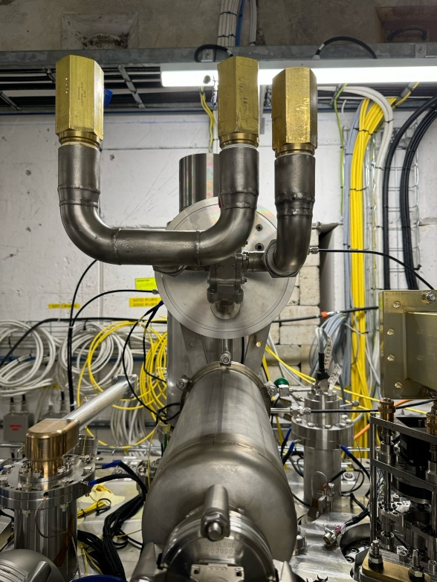
NC relief valve
Valves found leaky on Nov. 10th’24
  Reference: EDMS document 2998467 v0.1
  HSE test outcome: all 4 valves leaky between 160 mbarg and 220 mbarg (for a set pressure of 350 mbarg)
Mitigation for M7 operation in 2023-2024
  Removal of the PRV HeGuard
  Use of 1 single relief valve (Circle Seal) with set pressure of 700 mbarg
Retained setup
References of the Circle Seal relief valves used for the RFD prototype cooldown and warmup in M7
Thursday, July 4th, 2024 - on Indico: 1426215
HL-LHC – Crab Cavities RFD Proto CM test @ CERN – TE-CRG

Slide 19
NEXT STEPS
Thursday, July 4th, 2024 - on Indico: 1426215
HL-LHC – Crab Cavities RFD Proto CM test @ CERN – TE-CRG

Slide 20
Next steps
Complete the tests of RFD prototype in SM18
Review the series P&IDs (+ update instrum list)
Solve every non-conformity
  CRG side: replace the currently installed pressure relief valve and re-install the associated HeGuard
Get prepared for SPS BA6 operation of the RFD prototype
  Installation & Commissioning with cryogenic test facility at SPS BA6
Thursday, July 4th, 2024 - on Indico: 1426215
HL-LHC – Crab Cavities RFD Proto CM test @ CERN – TE-CRG

Slide 21
THANK YOU
Thursday, July 4th, 2024 - on Indico: 1426215
HL-LHC – Crab Cavities RFD Proto CM test @ CERN – TE-CRG

Slide 22
SPARES
Thursday, July 4th, 2024 - on Indico: 1426215
HL-LHC – Crab Cavities RFD Proto CM test @ CERN – TE-CRG

Slide 23
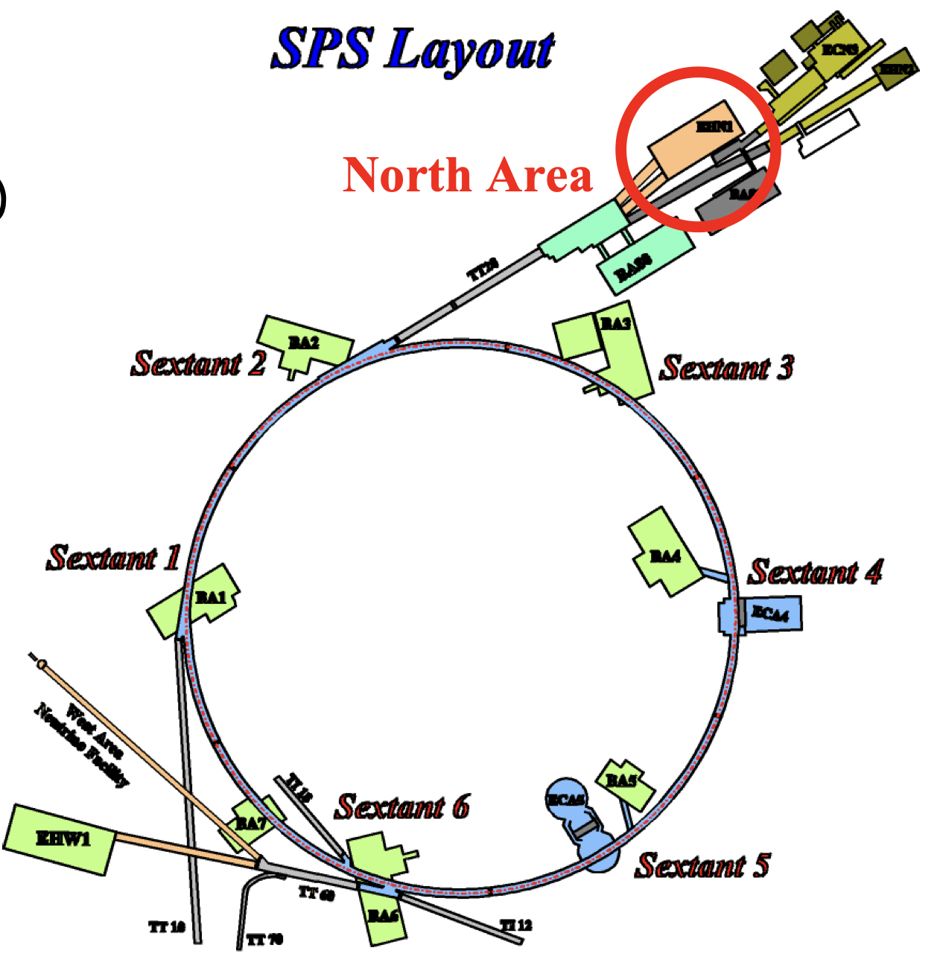
10 series cryomodules
2 prototypes
1 from CERN (CH)
DQW
4 from STFC (UK)
RFD **
1 from STFC (UK)
DQW: double quarter wave
** Being manufactured at STFC
DQW being tested at cold in SPS BA6
Later on: RFD to be installed / tested at cold in SPS BA6
LHC
Run 4 configuration: RFD in P1, DQW in P5
Later on: possibility to swap them
SPS
RFD: RF dipole
DQW *
1 from CERN (CH)
RFD
5 from TRIUMF (CA)
* Currently operated in SPS BA6 @ CERN

