Slide 1
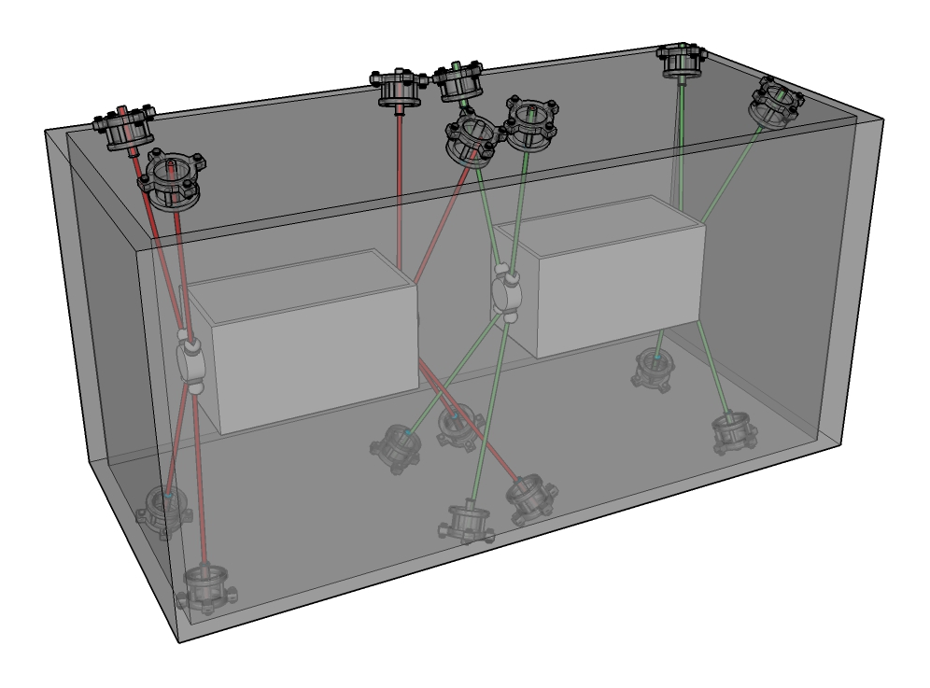
Results of the cold test on the RFD prototype
Oct 2023-May 2024
Vivien RUDE
2024-07-04
On behalf :
Praneeth Sarvade,
Daniel Szarata
Clara Cala Franco
Julia Calmels
Mateusz Sosin

Slide 2
Outline
Introduction
Measurement at ambient pressure
Measurement under vacuum
Measurement at COLD
Warm-up
Conclusion

Slide 3
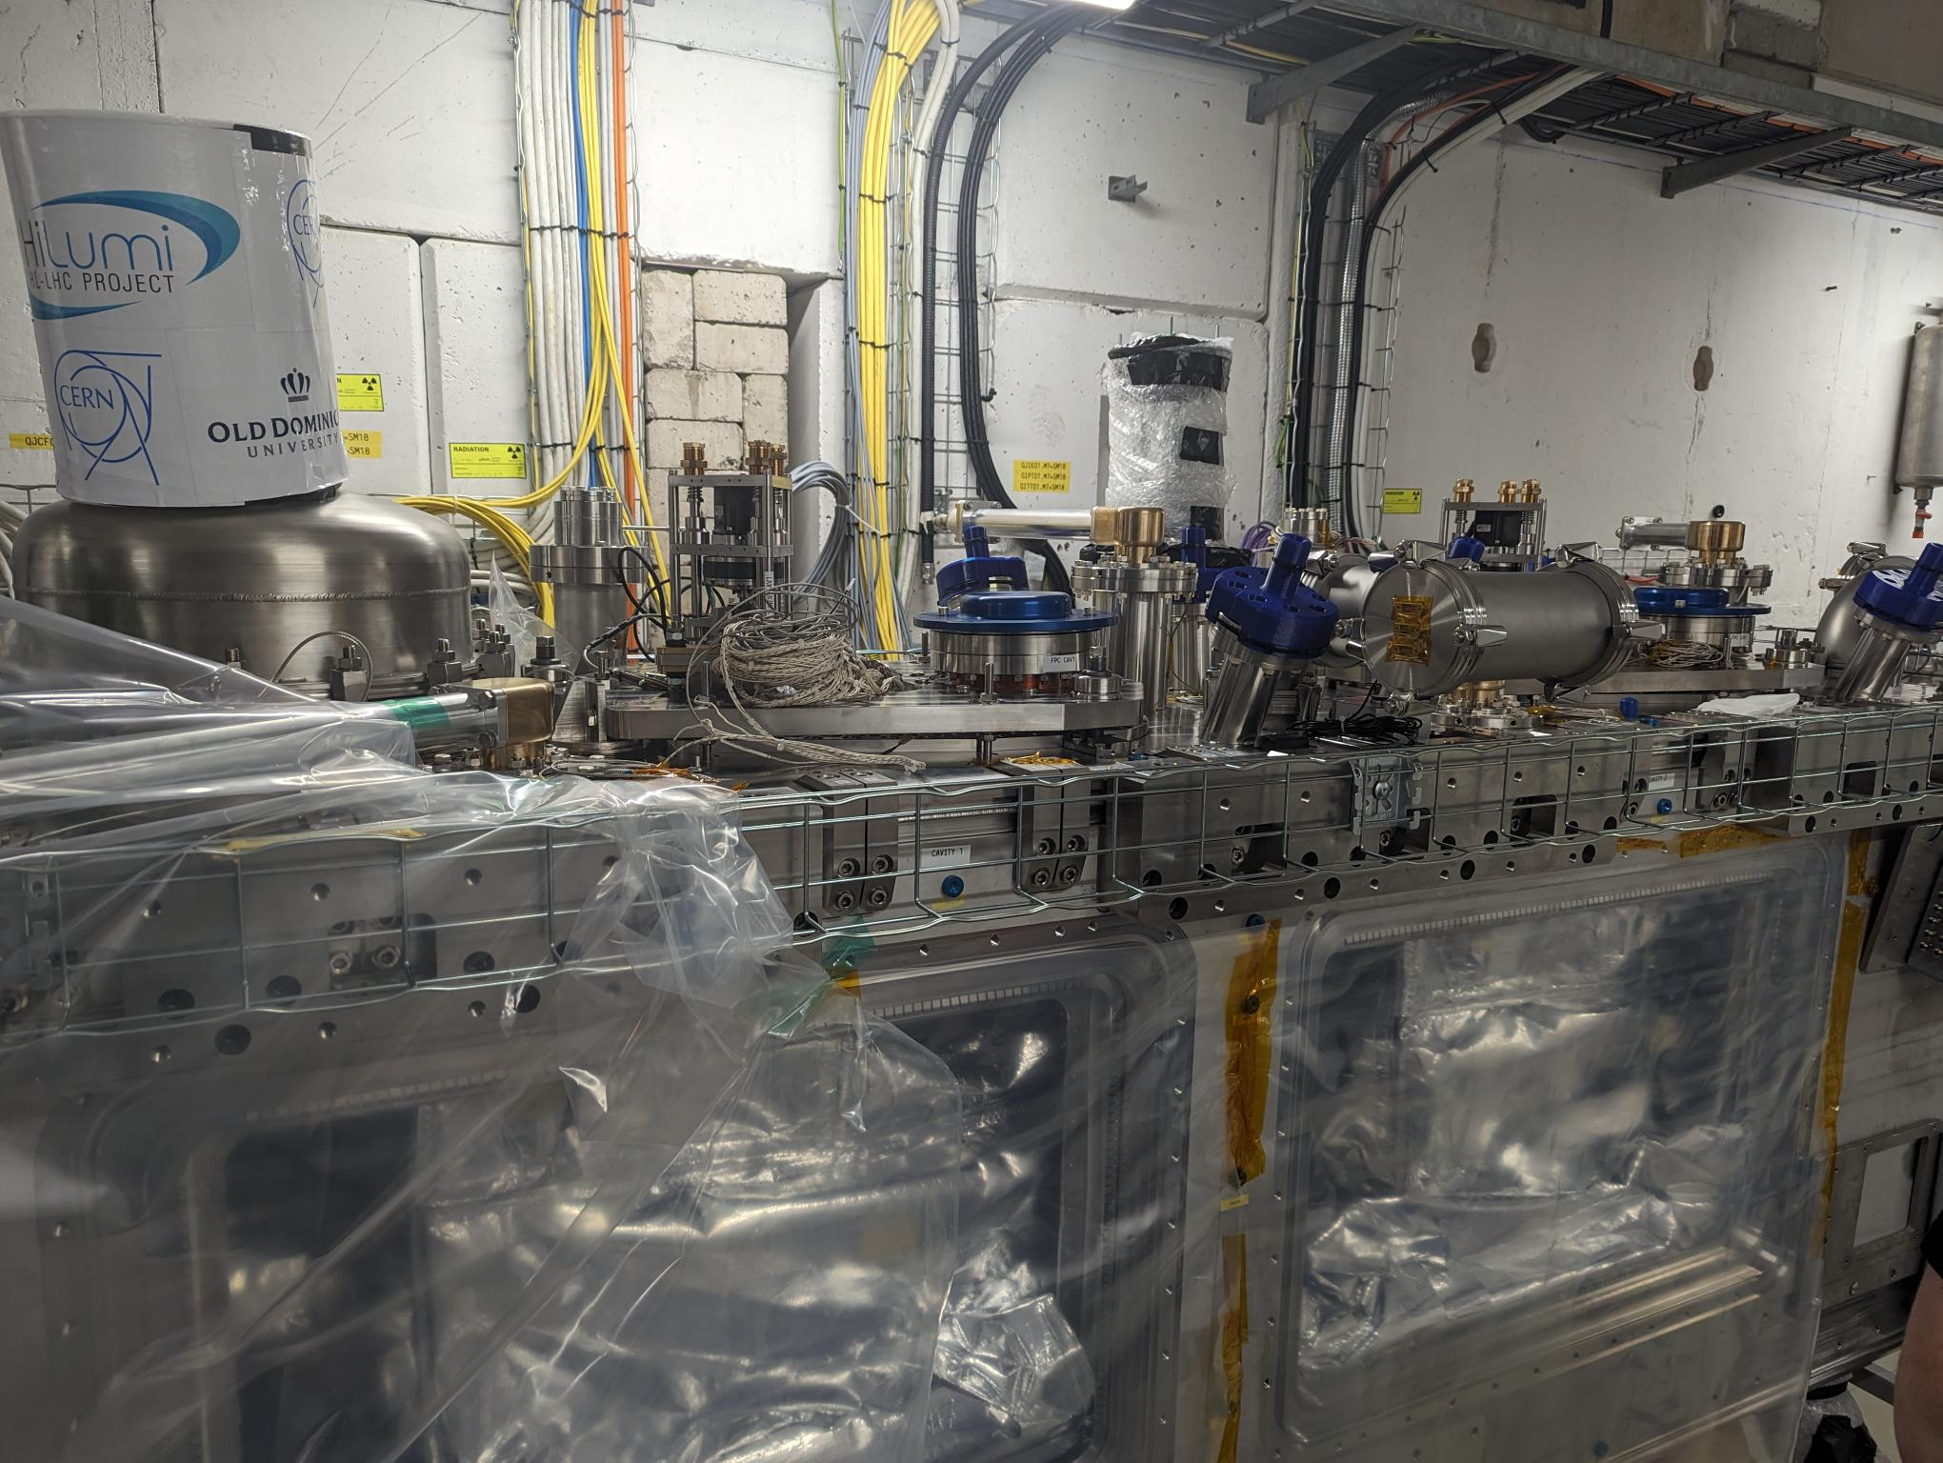
Introduction

Slide 4
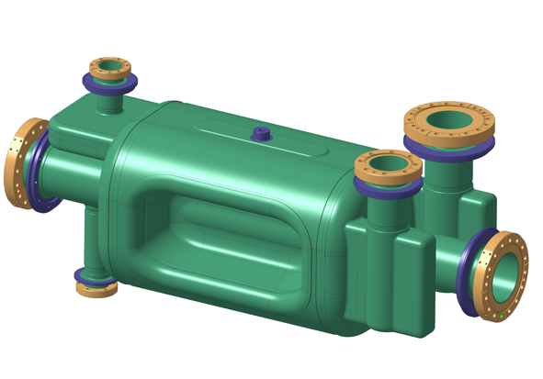
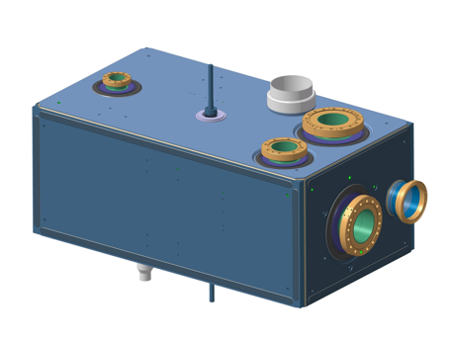
Axis of the capacitive plates
Z
V_HOM
Plot
tuning
H_HOM
V_HOM
FPC
H_HOM
A
FPC
X
B
Y
Side view
(VERTICAL)
Pick-up
A
B
Z
Rod
tuning
V_HOM
H_HOM
A
FPC
X
Y
Pick up
B

Slide 5
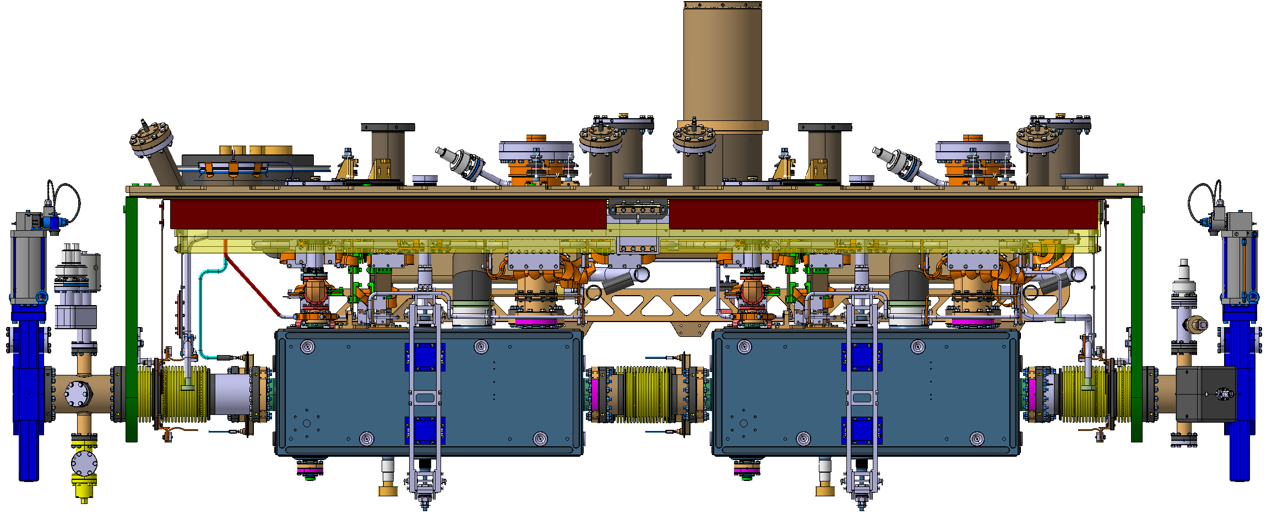
Alignment of the axis of the capacitive plates on the cryomodule
Y
Z

Slide 6
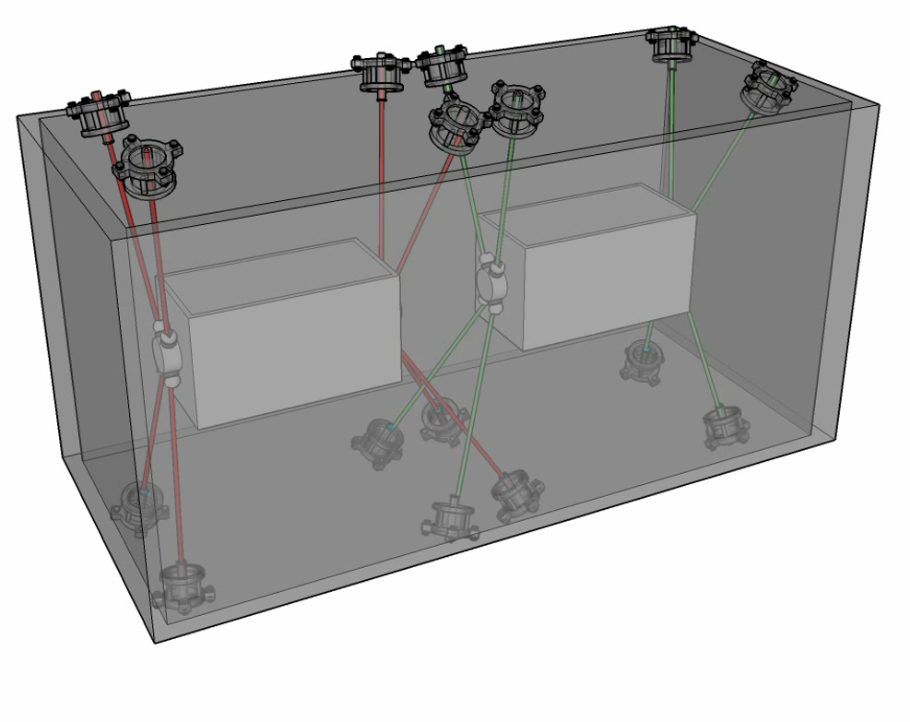
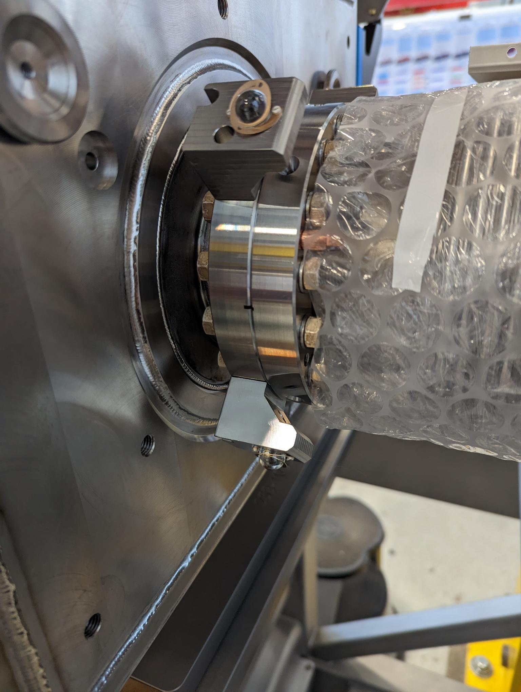
FSI configuration
Y
Z

Slide 7
Ambient pressure : 10 November 2023
EDMS : 2996397

Slide 8
Vertical position : 10 November 2023
Ry = -3668 μrad [0]
Ry = -710 μrad [0]
Nominal pos.
At COLD
2023-11-13.
Cav 1 : Warm
Nominal pos.
Cav 1 : Warm
Nominal pos.
Cav 2 : Warm
2023-11-13.
Cav 2 : Warm
Vertical Accuracy : +/- 0.03 mm

Slide 9
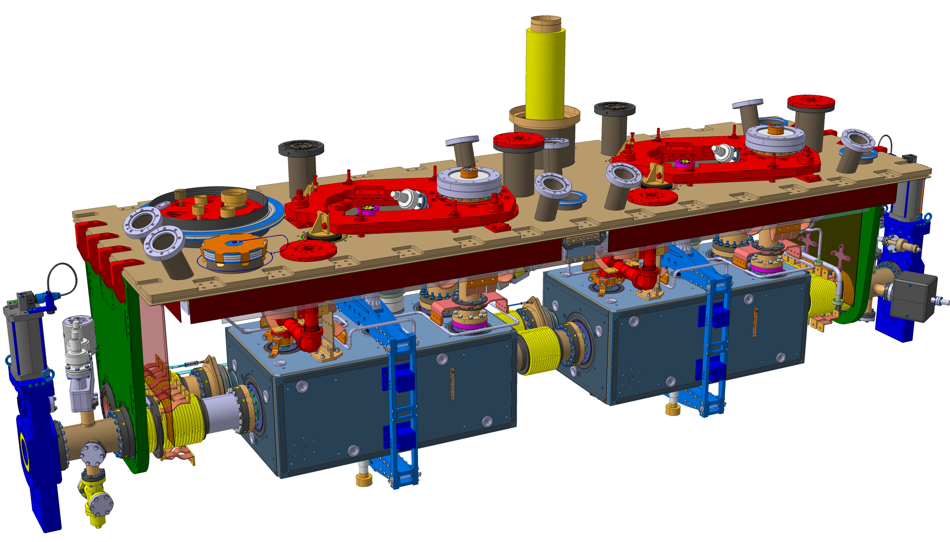
Radial position : 10 November 2023
Nominal pos.
Cav 1 : Warm
Nominal pos.
Cav 2 : Warm
2023-11-13.
Cav 2 : Warm
2023-11-13.
Cav 1 : Warm
Nominal pos.
At COLD
Ty = 813.638 mm [809.6]
Ty = 1995.282 mm [1992.1]
Cavity 1 : Radial Accuracy : +/- 0.10 mm
Cavity 2 : Radial Accuracy : +/- 0.05 mm

Slide 10
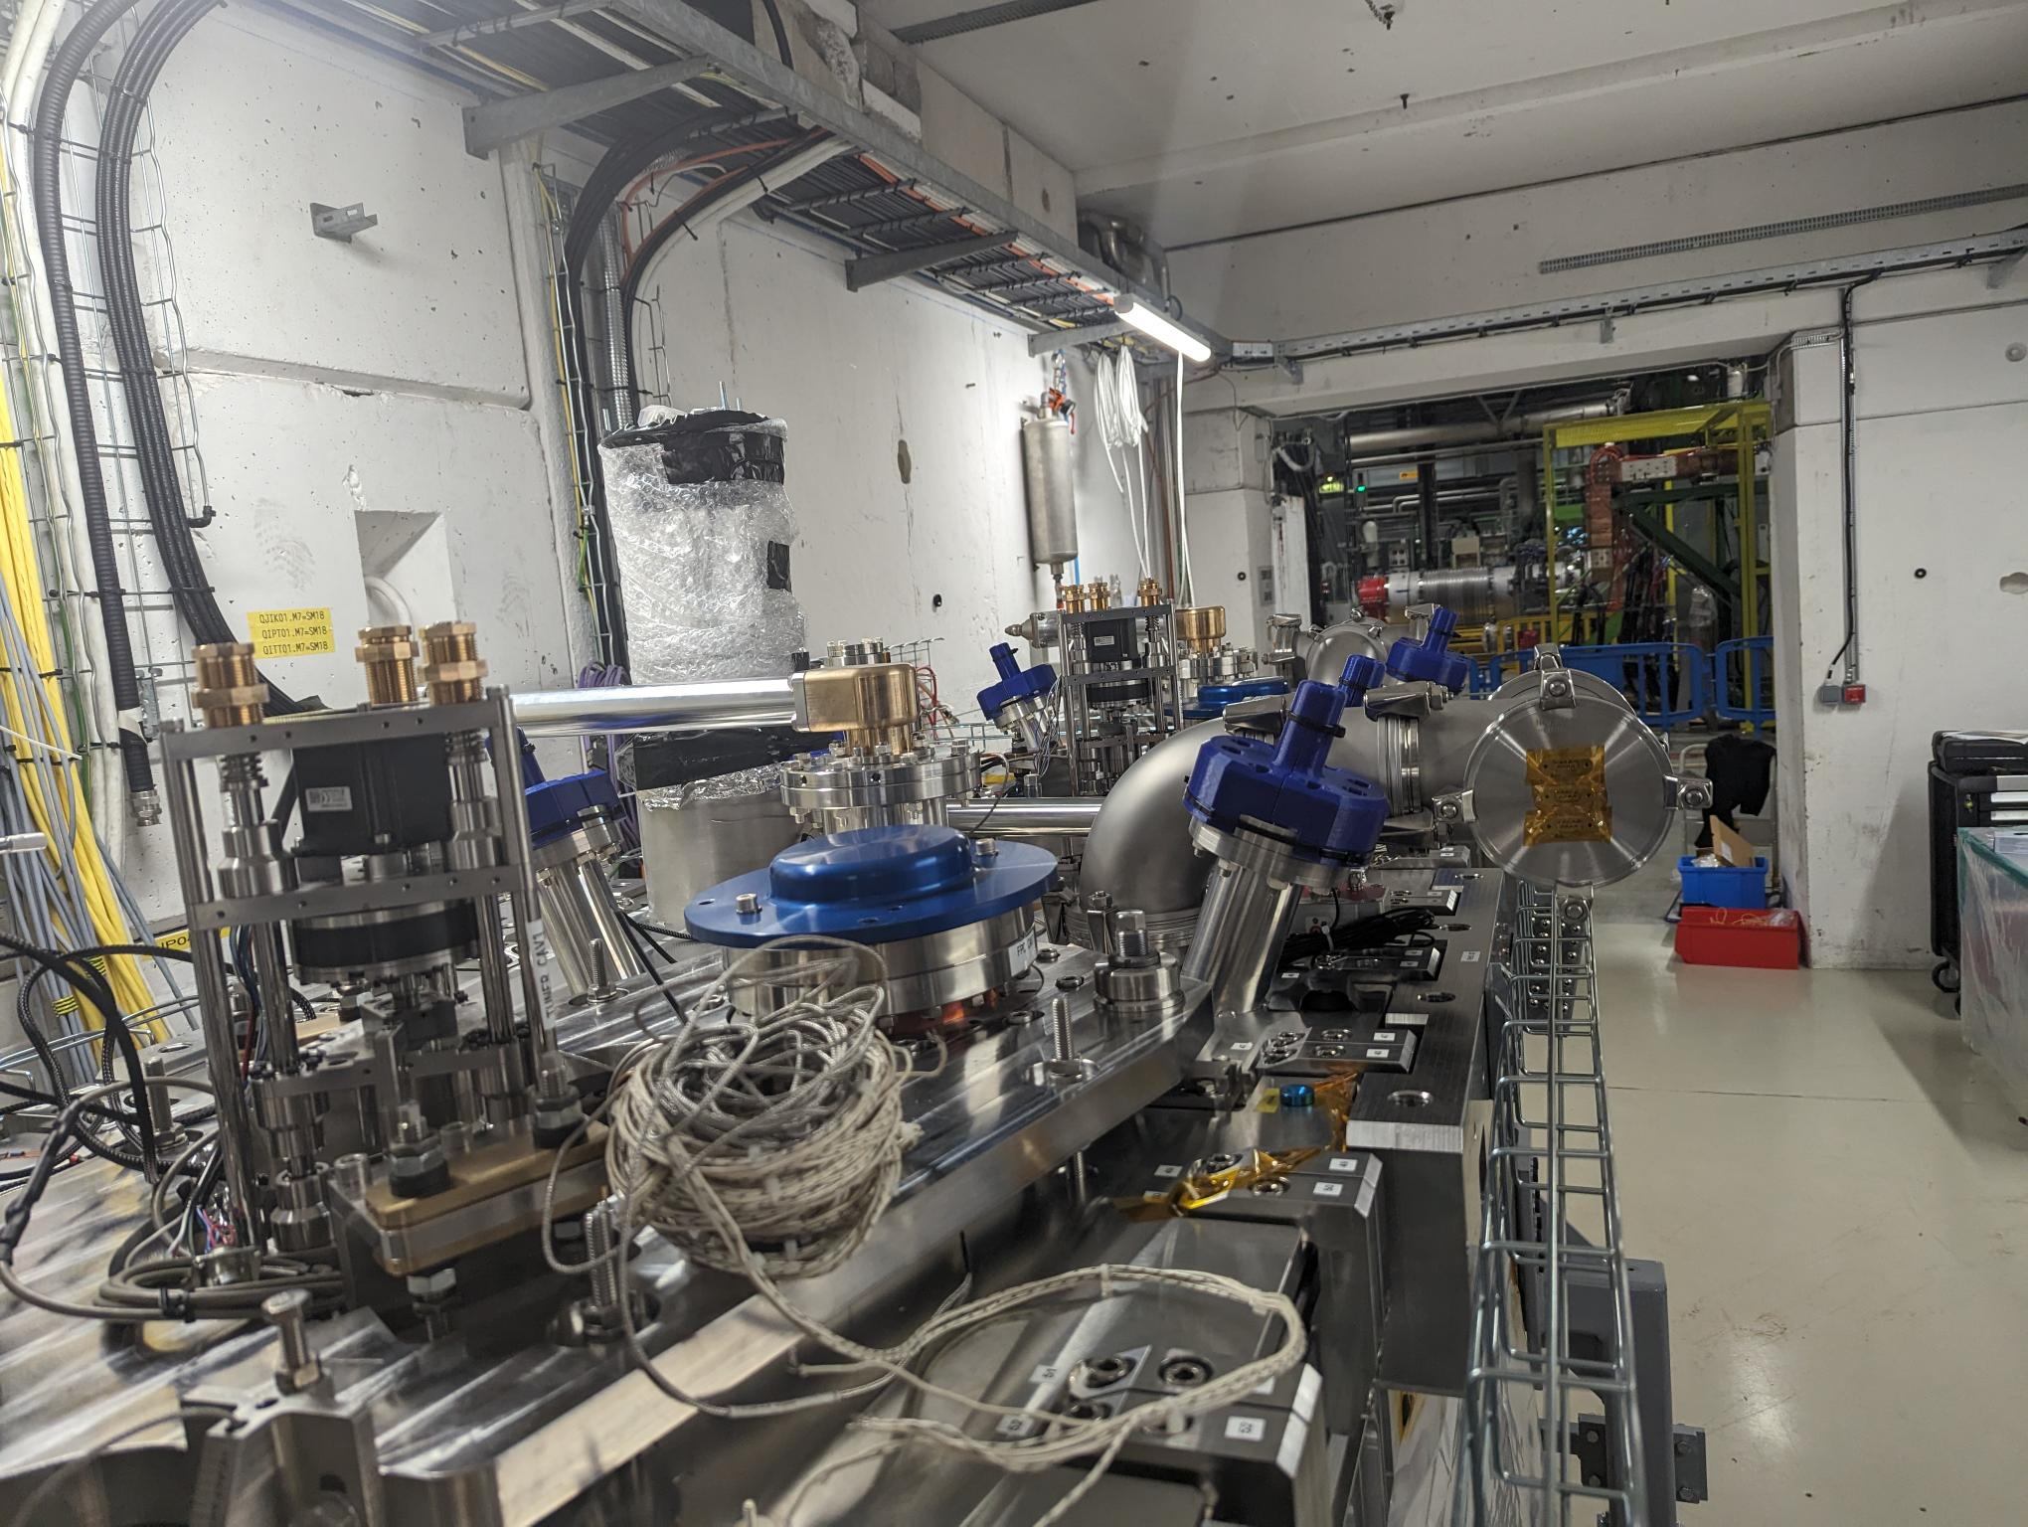
Under vacuum : 15 November 2023
EDMS : 2999338

Slide 11
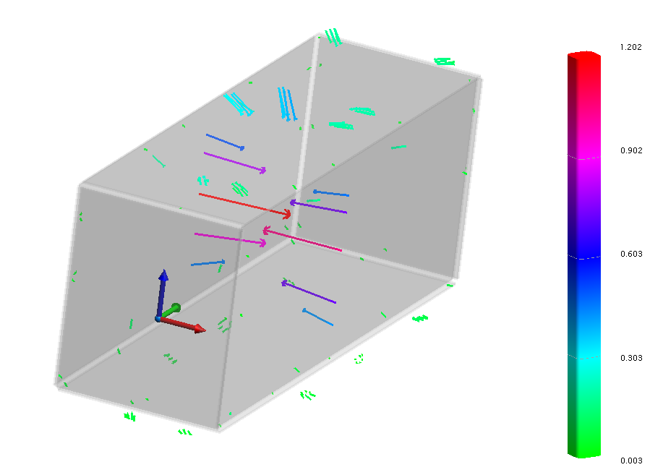
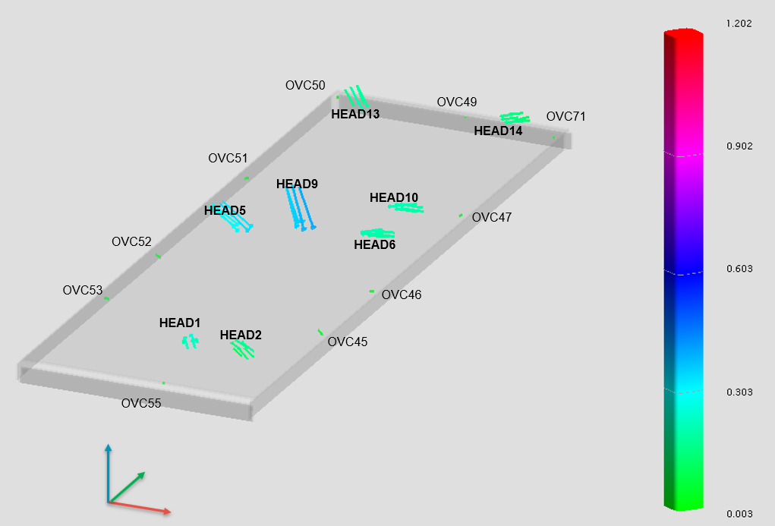
Impact of vacuum on cryomodule
Zoom on the top plate
Top plate
Bottom plate
of the OVC
Fiducials on top plate
Fiducials on bottom plate
FSI Heads on top plate
FSI Heads on bottom plate
 | ΔX (mm) | ΔY (mm) | ΔZ (mm)
OVC45 | -0.04 | -0.01 | 0.05
OVC46 | -0.03 | -0.02 | 0.00
OVC47 | -0.04 | 0.00 | -0.01
OVC49 | 0.00 | 0.00 | 0.00
OVC50 | 0.00 | 0.00 | 0.02
OVC51 | 0.04 | 0.02 | 0.01
OVC52 | 0.05 | 0.00 | -0.02
OVC53 | 0.05 | 0.00 | 0.00
OVC55 | -0.01 | 0.00 | -0.03
OVC71 | -0.01 | 0.01 | -0.02
 | ΔX (mm) | ΔY (mm) | ΔZ (mm)
OVC57 | -0.02 | -0.02 | 0.02
OVC58 | -0.01 | -0.02 | 0.02
OVC59 | 0.00 | 0.01 | 0.00
OVC61 | 0.05 | 0.04 | -0.01
OVC62 | -0.04 | -0.01 | 0.02
OVC63 | -0.05 | 0.01 | 0.04
OVC66 | -0.03 | 0.00 | 0.06
OVC67 | -0.03 | -0.02 | 0.05
OVC68 | -0.02 | -0.02 | 0.04
 | ΔX (mm) | ΔY (mm) | ΔZ (mm)
HEAD1 | -0.10 | 0.20 | -0.03
HEAD2 | -0.12 | 0.07 | 0.03
HEAD5 | 0.25 | 0.01 | -0.18
HEAD6 | -0.20 | 0.01 | -0.03
HEAD9 | 0.11 | 0.01 | -0.35
HEAD10 | -0.21 | 0.00 | -0.02
HEAD13 | 0.12 | -0.07 | -0.12
HEAD14 | -0.14 | -0.01 | -0.04
 | ΔX (mm) | ΔY (mm) | ΔZ (mm)
HEAD3 | -0.03 | -0.01 | 0.04
HEAD4 | -0.02 | 0.02 | 0.06
HEAD7 | 0.04 | 0.00 | -0.03
HEAD8 | -0.03 | -0.04 | -0.02
HEAD11 | -0.01 | 0.03 | -0.02
HEAD12 | -0.04 | 0.01 | -0.06
HEAD15 | -0.09 | 0.03 | 0.00
HEAD16 | -0.04 | 0.01 | 0.02

Slide 12
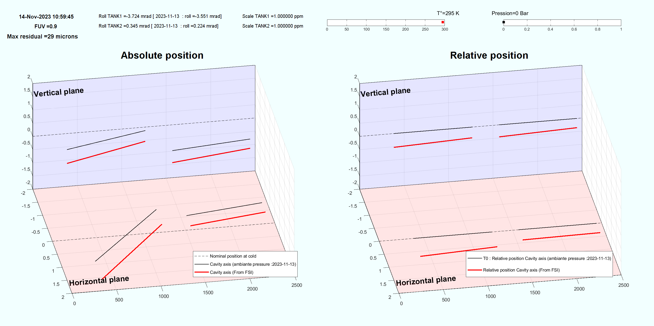
Impact of vacuum on alignment of the cavities
Nominal position at cold
T0 : Relative position to the cavities on 10th November 2023
(ambient pressure)
Cavity axis (ambient pressure : 10th November 2023)
Cavity axis (Under vacuum : 14th November 2023)
Relative movement of the cavities due to vacuum
Cavity 1 : Radial Accuracy : +/- 0.20 mm
Cavity 1 : Vertical Accuracy : +/- 0.05 mm
Cavity 2 : Radial Accuracy : +/- 0.10 mm
Cavity 2 : Vertical Accuracy : +/- 0.05 mm

Slide 13
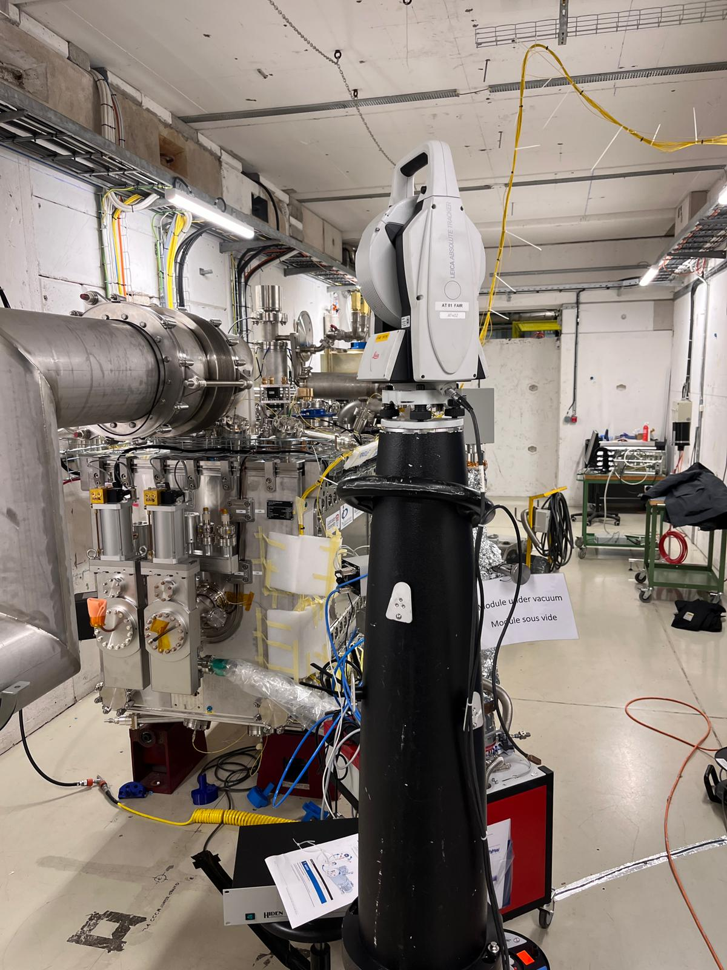
Cold condition : 30 November 2023
EDMS : 3009547

Slide 14
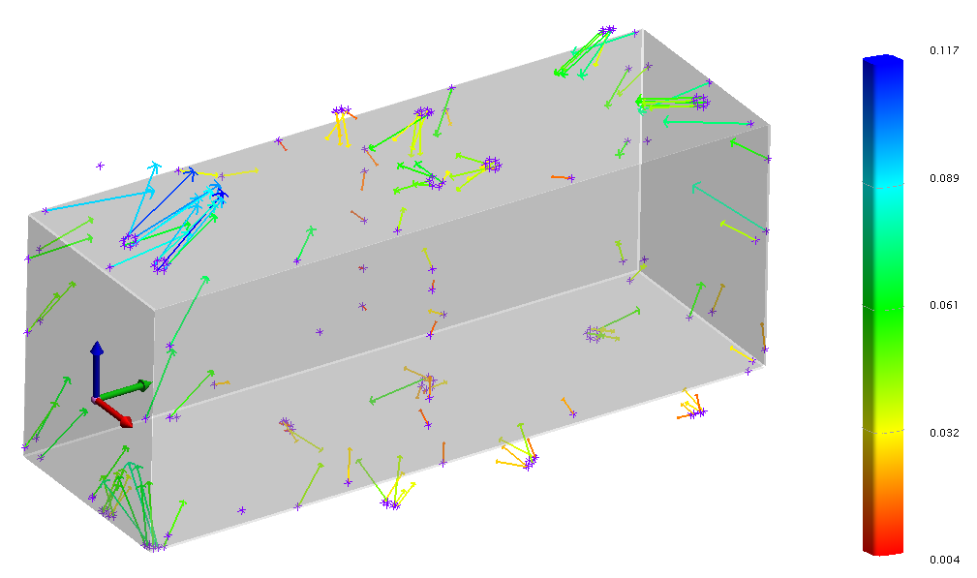
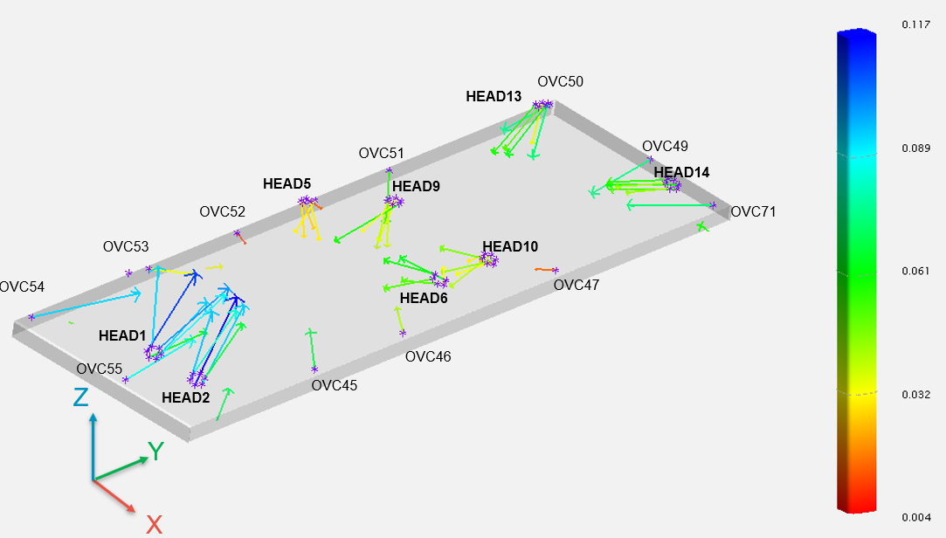
Impact of cold on cryomodule
Zoom on the top plate
Top plate
Bottom plate of the OVC
Fiducials on top plate
Fiducials on bottom plate
FSI Heads on top plate
FSI Heads on bottom plate
 | ΔX (mm) | ΔY (mm) | ΔZ (mm)
OVC45 | -0.05 | 0.05 | -0.01
OVC46 | -0.03 | 0.03 | 0.00
OVC47 | -0.01 | -0.01 | 0.00
OVC49 | 0.01 | -0.08 | 0.00
OVC50 | 0.02 | -0.07 | 0.01
OVC51 | 0.04 | -0.04 | -0.02
OVC52 | 0.01 | 0.00 | -0.01
OVC53 | 0.03 | 0.02 | 0.00
OVC54 | 0.03 | 0.09 | 0.01
OVC55 | -0.01 | 0.09 | 0.00
OVC71 | -0.03 | -0.07 | 0.01
 | ΔX (mm) | ΔY (mm) | ΔZ (mm)
OVC57 | 0.02 | 0.01 | 0.05
OVC58 | -0.01 | 0.03 | 0.03
OVC59 | -0.01 | 0.01 | 0.01
OVC62 | 0.03 | -0.01 | 0.05
OVC63 | 0.03 | 0.00 | 0.03
OVC67 | 0.03 | 0.03 | 0.05
OVC68 | 0.02 | 0.02 | 0.05
 | ΔX (mm) | ΔY (mm) | ΔZ (mm)
HEAD1 | -0.03 | 0.08 | 0.01
HEAD2 | -0.04 | 0.08 | 0.02
HEAD5 | 0.01 | -0.01 | -0.02
HEAD6 | -0.05 | 0.01 | -0.02
HEAD9 | 0.00 | -0.02 | -0.03
HEAD10 | -0.03 | -0.01 | -0.02
HEAD13 | 0.02 | -0.05 | -0.02
HEAD14 | -0.02 | -0.04 | 0.00
 | ΔX (mm) | ΔY (mm) | ΔZ (mm)
HEAD3 | -0.02 | -0.01 | 0.06
HEAD4 | 0.01 | 0.00 | 0.04
HEAD7 | 0.00 | 0.01 | 0.03
HEAD8 | 0.01 | 0.00 | -0.01
HEAD11 | -0.01 | -0.01 | 0.02
HEAD12 | 0.01 | -0.02 | 0.01
HEAD15 | 0.00 | -0.01 | 0.02
HEAD16 | 0.03 | 0.00 | 0.02

Slide 15
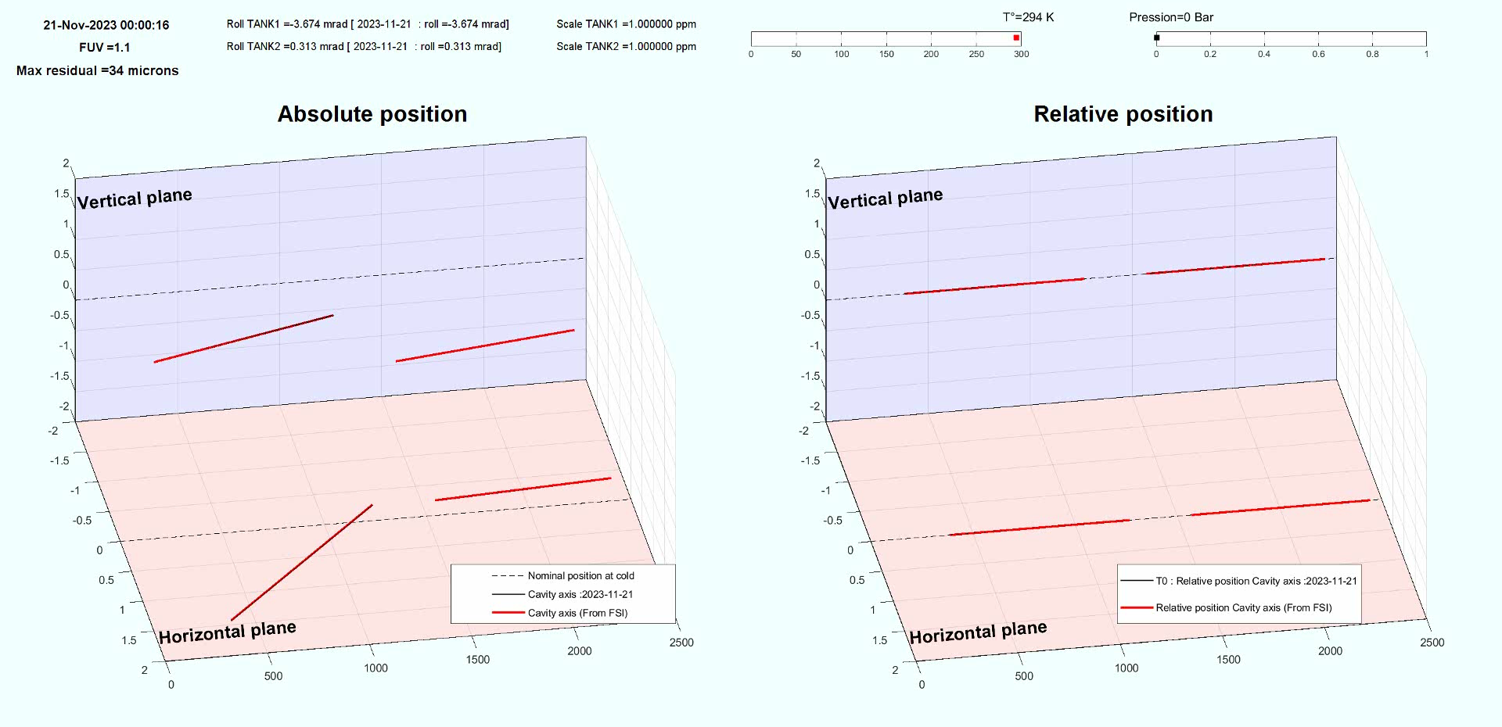
Impact of cold on alignment of the cavities
Cavity 1 : Radial Accuracy : +/- 0.20 mm
Cavity 1 : Vertical Accuracy : +/- 0.05 mm
Cavity 2 : Radial Accuracy : +/- 0.10 mm
Cavity 2 : Vertical Accuracy : +/- 0.05 mm

Slide 16
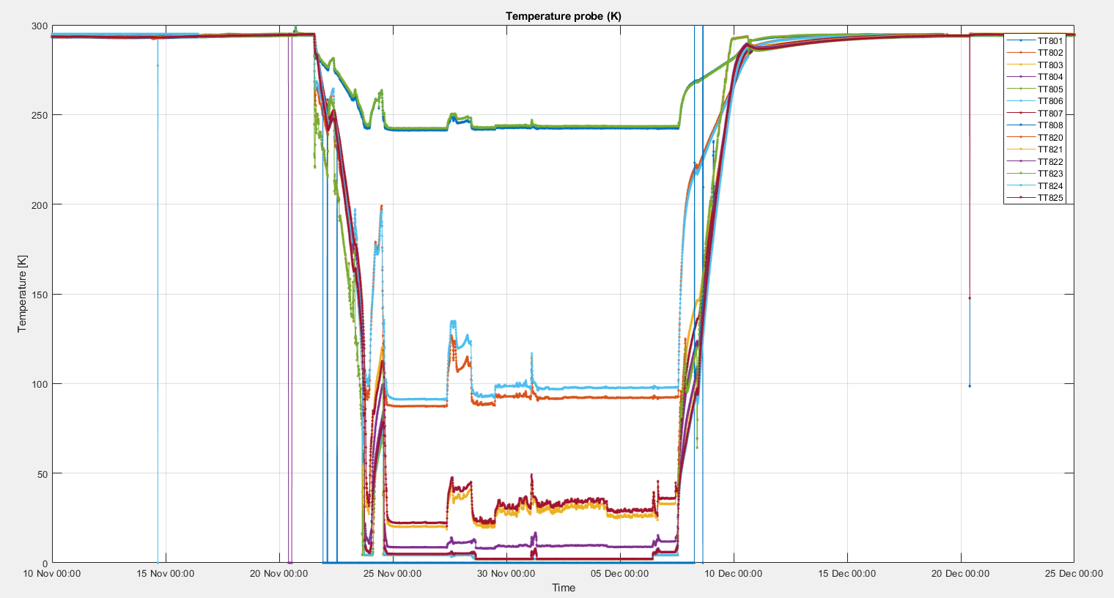
Warm up :

Slide 17
Vertical : Relative motion of the cold mass inside the cryomodule
Ambient
pressure
Under
vacuum
transient
COLD
transient
Under
vacuum
Ambient
pressure

Slide 18
Radial : Relative motion of the cold mass inside the cryomodule
Ambient
pressure
Under
vacuum
transient
COLD
transient
Under
vacuum
Ambient
pressure

Slide 19
Conclusion of the first cooling down
For cavity 2
 | Vertical |  | Radial
 | IN (mm) | OUT (mm) | IN (mm) | OUT (mm)
Impact of vacuum | -0.44 +/-0.05 | -0.33 +/-0.05 | +0.44 +/-0.20 | +0.42 +/-0.20
Impact of cooling | +1.24 +/-0.05 | +1.00 +/-0.05 | 0.00 +/-0.20 | -0.10 +/-0.20
TOTAL | +0.80 | +0.67 | +0.44 | +0.32
 | Vertical |  | Radial
 | IN (mm) | OUT (mm) | IN (mm) | OUT (mm)
Simulation (from Teddy) | [+0.90] | [+0.73] | [+0.88] | [+0.68]
 | Vertical |  | Radial
 | IN (mm) | OUT (mm) | IN (mm) | OUT (mm)
Difference | - 0.10 mm | - 0.06 mm | - 0.44 mm | -0.36 mm

Slide 20
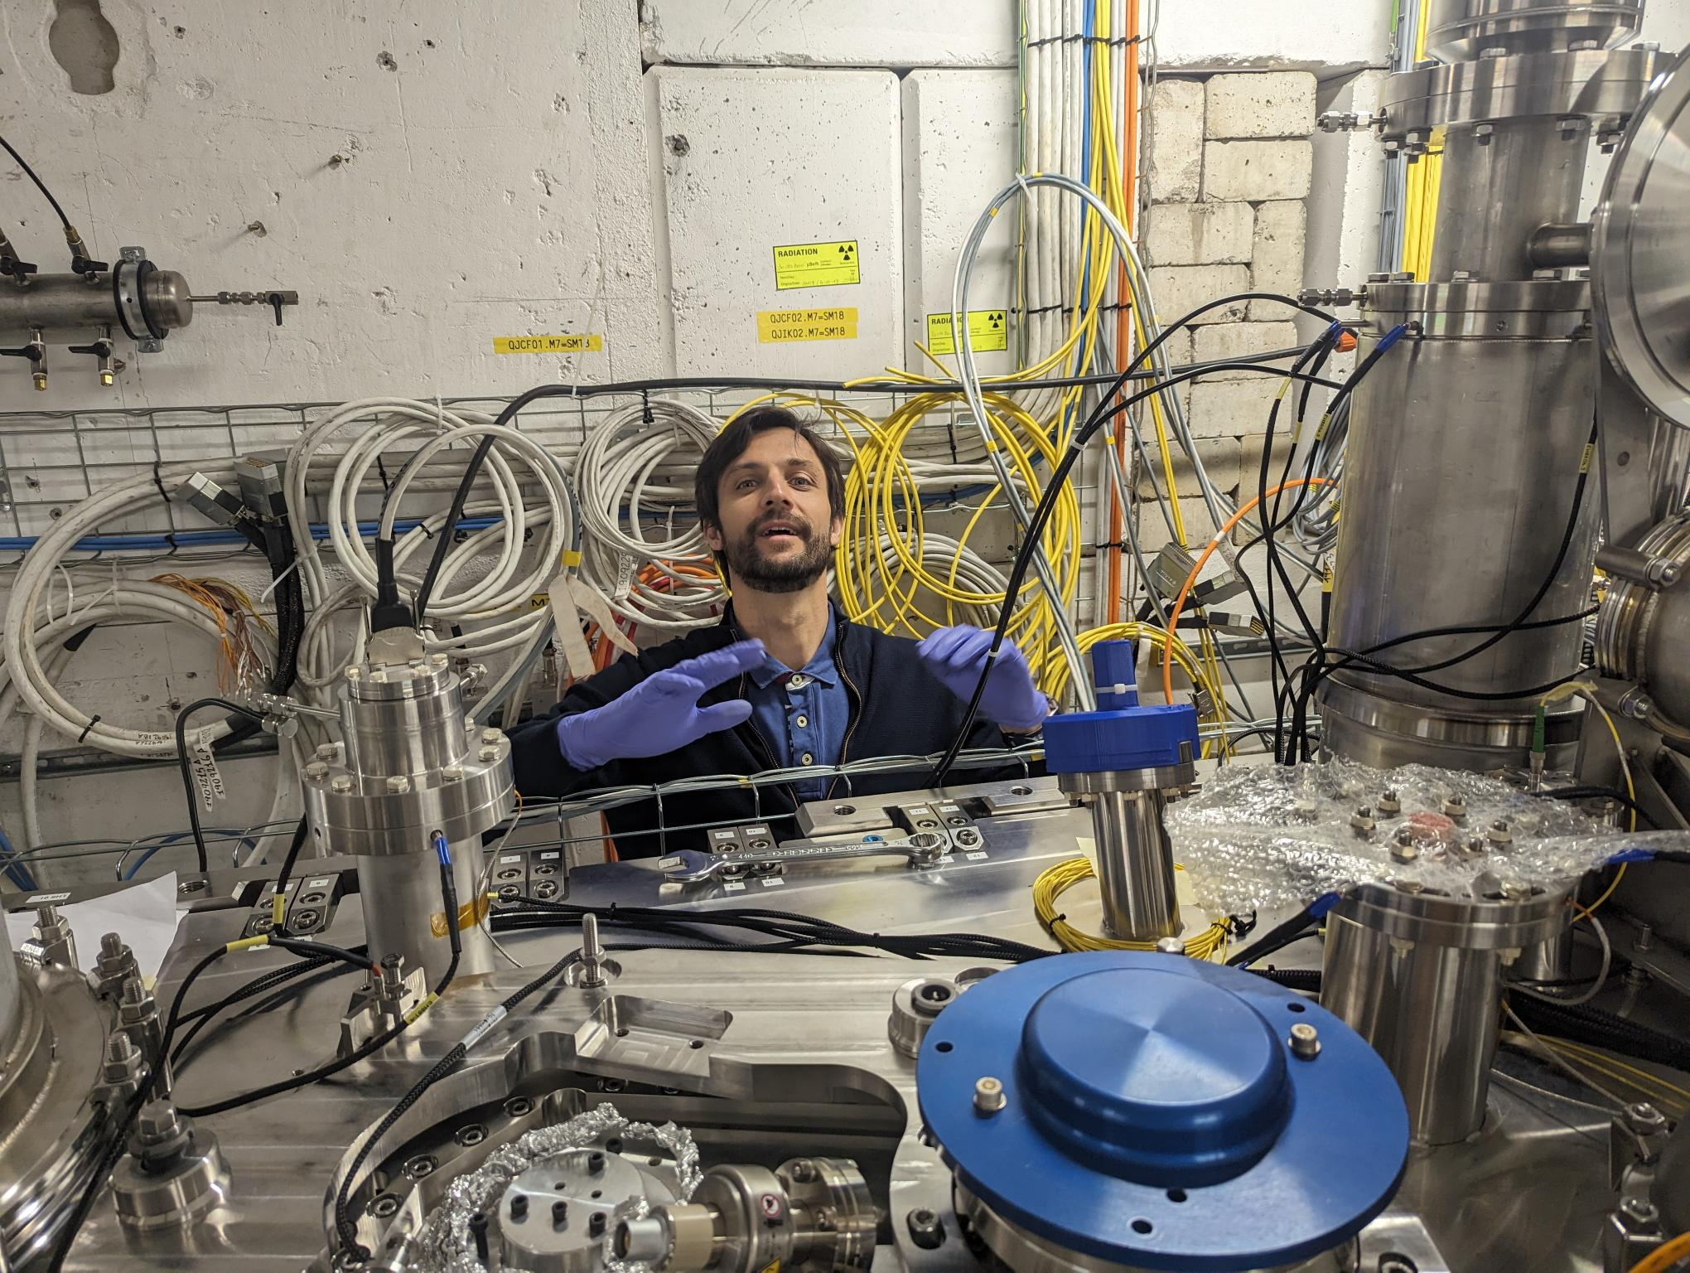
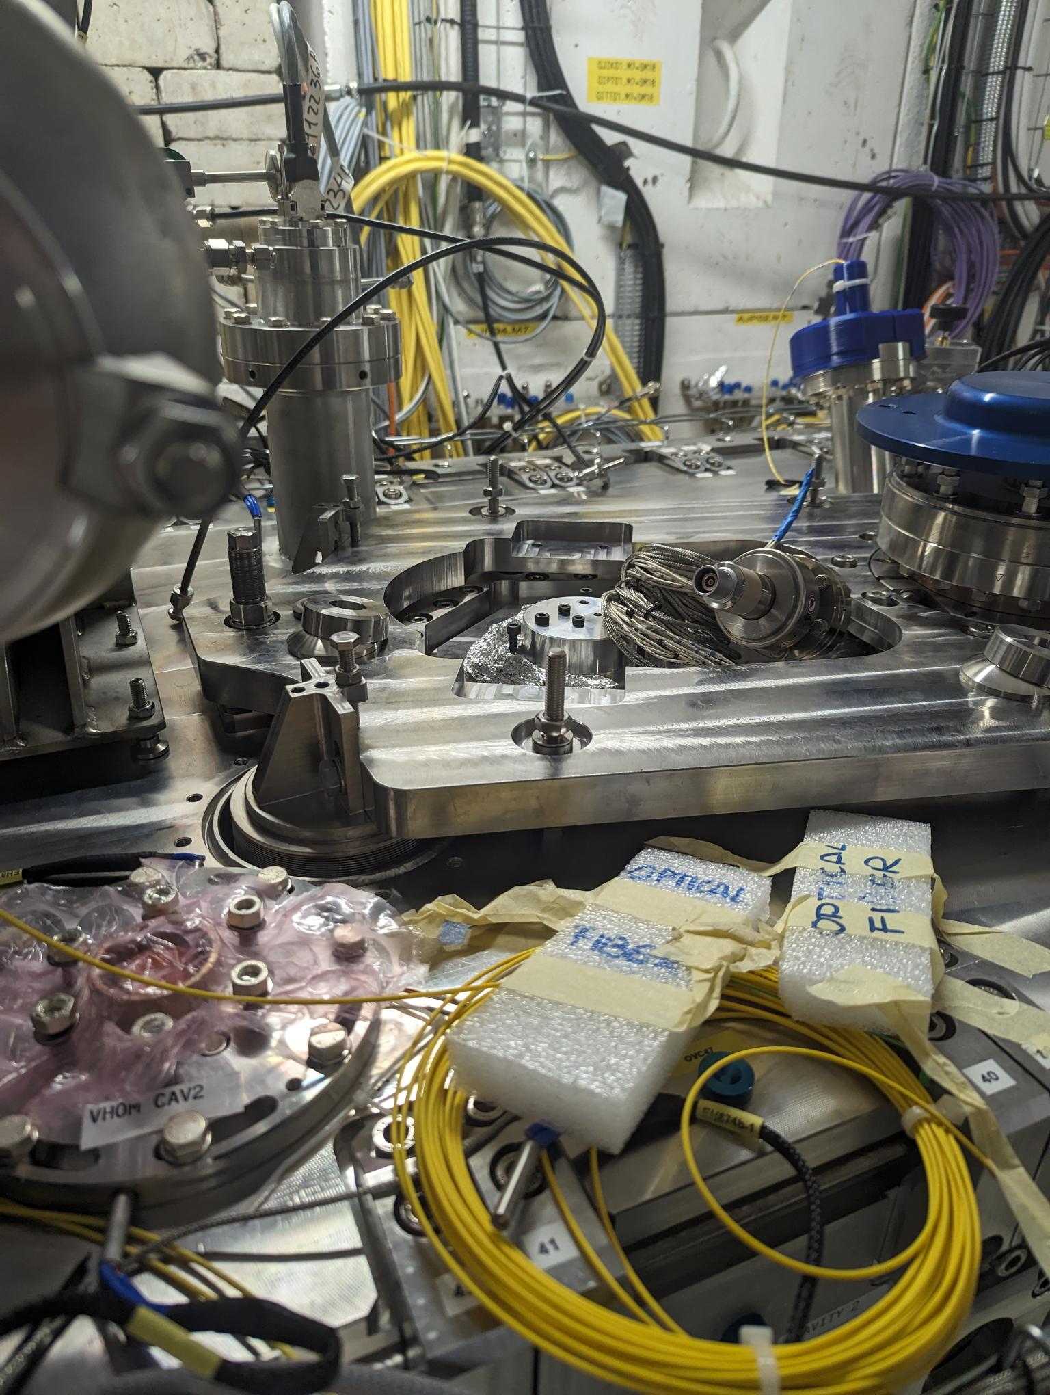
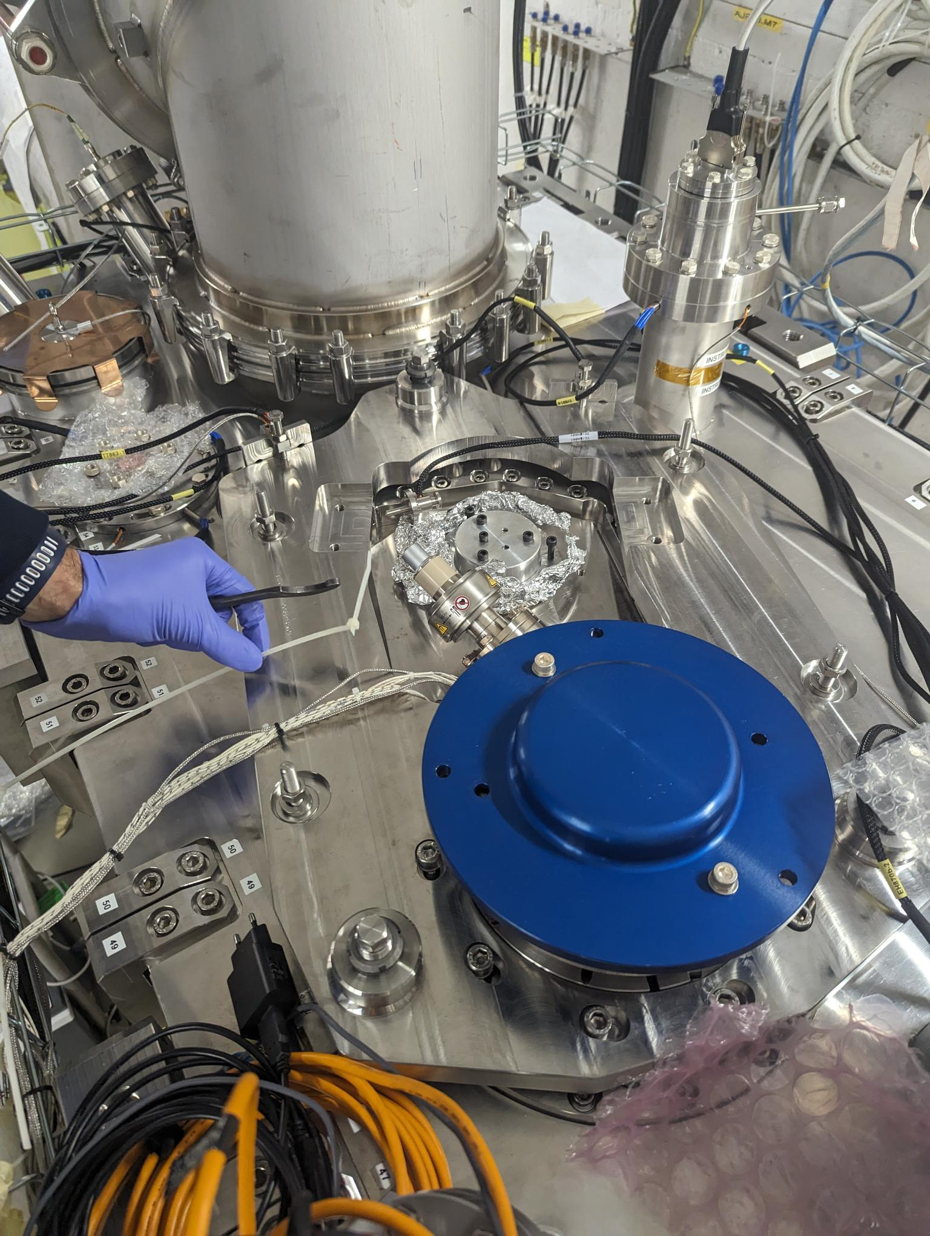
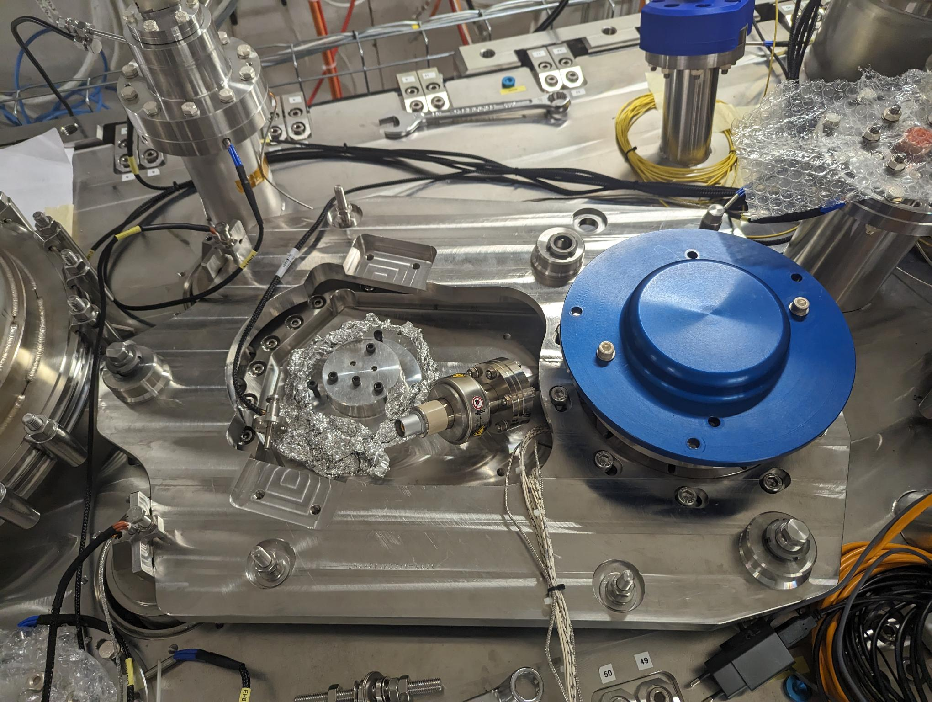
Alignment of cavities (March 2024)
EDMS : 3065306

Slide 21
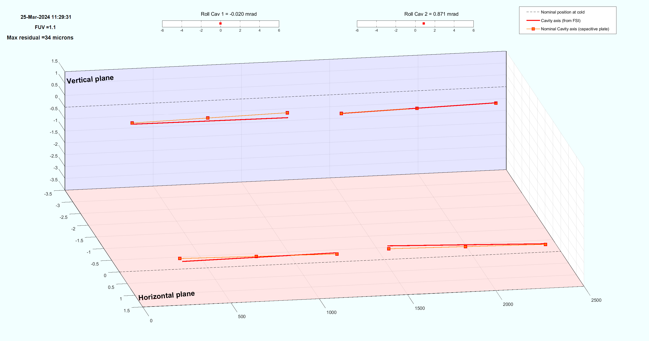
AFTER alignment
Cavity 1, roll
Δroll = -0.020 mrad
[0+/-0.4 mrad]
Cavity 2, roll
Δroll = -0.871 mrad
[0+/-0.4 mrad]
Cavity 2 (Z)
Cavity 1 (Z)
 | Axe | Nominal from experience Nov 2023 | Cav 1 Value (mm) | Cav 2 Value (mm)
Plaque capacitive IN | X (mm) | -0.44 | -0.38 | -0.57
 | Z (mm) | -0.80 | -0.85 | -0.79
Plaque capacitive OUT | X (mm) | -0.32 | -0.38 | -0.36
 | Z (mm) | -0.67 | -0.89 | -0.65
Cavity 2 (X)
Cavity 1 (X)
Cavity 1, longitudinal
ΔY = + 3.55 mm
[0+/-0.1 mm]
Cavity 2, longitudinal
ΔY = + 2.54 mm
[0+/-0.1 mm]

Slide 22
Shape of the cryomodule
Repeatability :
Ambient pressure
Under vacuum
At cold

Slide 23
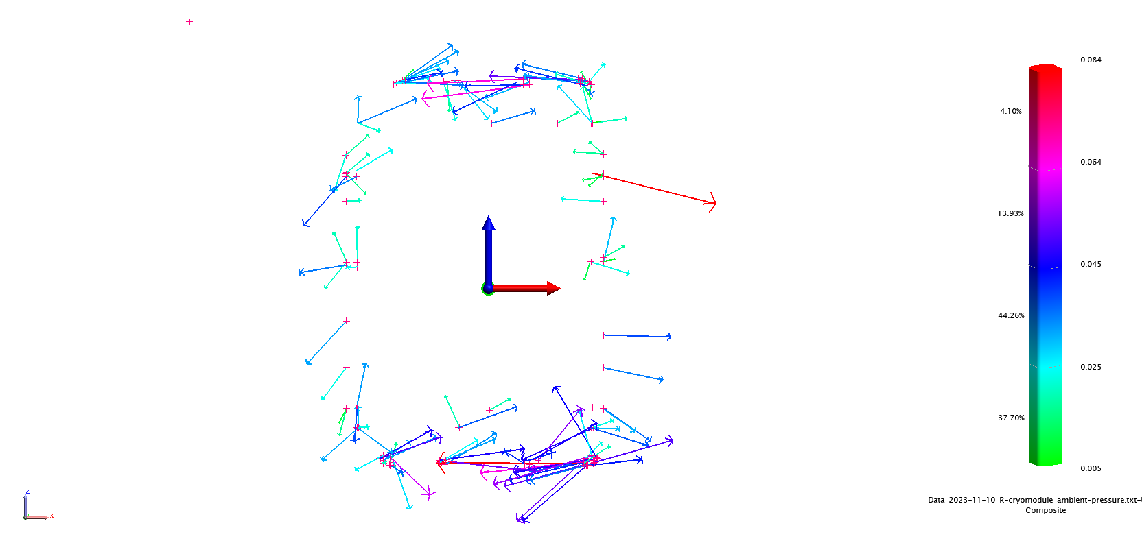
Ambient pressure : 27 March 2024
The differences between the two measurements indicate an oval-shaped deformation since the cold test conducted in December 2023.
Repeatability : 40 microns at 1 sigma
EDMS : 3065306

Slide 24
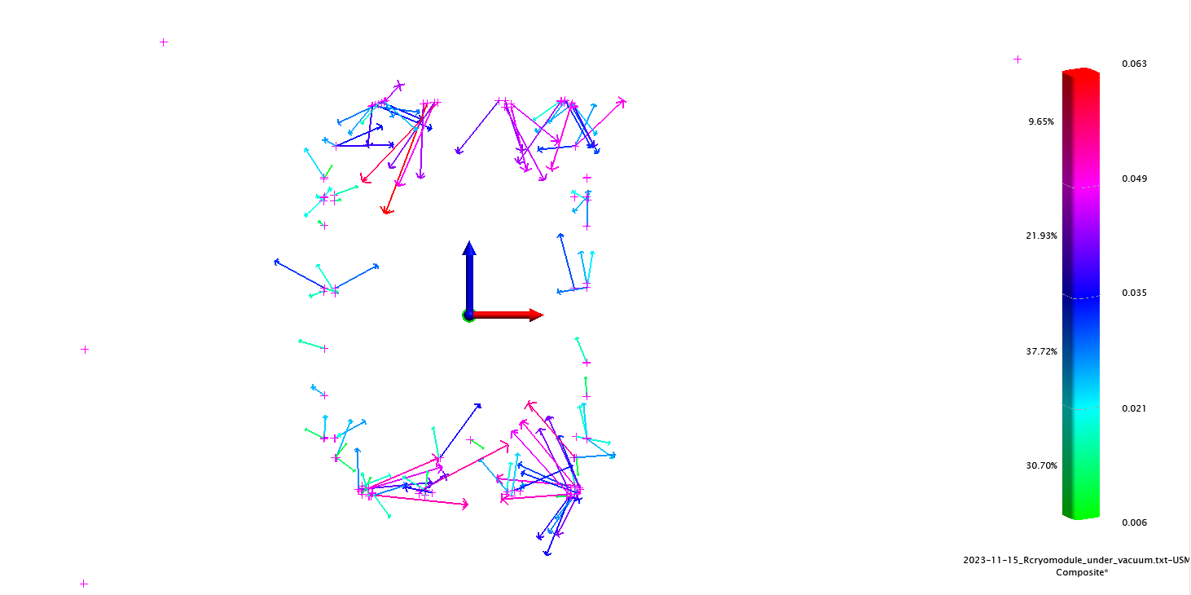
Under Vacuum: 3 April 2024
Repeatability : 40 microns at 1 sigma
EDMS : 3065227
Under vacuum in November2023
Under vacuum in March2024

Slide 25
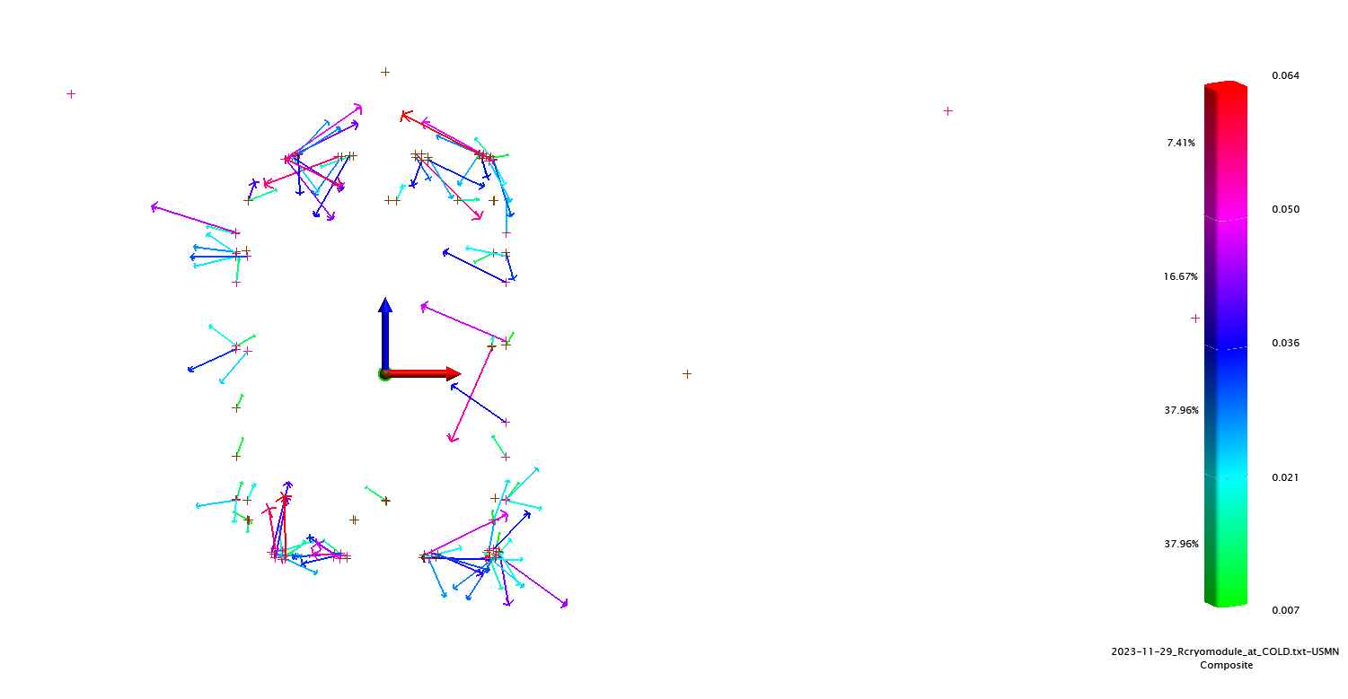
Cold : 16 April 2024
Repeatability : 40 microns at 1 sigma
EDMS : 3065237
Under vacuum in November2023
Under vacuum in March2024

Slide 26
Conclusion of the second cooling down
For cavity 2
Experience from first cooling down Nov 2023 | Vertical |  | Radial
 | IN (mm) | OUT (mm) | IN (mm) | OUT (mm)
Impact of vacuum | -0.44 +/-0.05 | -0.33 +/-0.05 | +0.44 +/-0.20 | +0.42 +/-0.20
Impact of cooling | +1.24 +/-0.05 | +1.00 +/-0.05 | 0.00 +/-0.20 | -0.10 +/-0.20
TOTAL | +0.80 | +0.67 | +0.44 | +0.32
Experience from second cooling down May 2024 | Vertical |  | Radial
 | IN (mm) | OUT (mm) | IN (mm) | OUT (mm)
Impact of vacuum | -0.48 +/-0.03 | -0.35 +/-0.03 | +0.39 +/-0.10 | +0.40 +/-0.10
Impact of cooling | +1.22 +/-0.03 | +1.10 +/-0.03 | +0.35 +/-0.10 | +0.02 +/-0.10
TOTAL | +0.74 | +0.75 | +0.74 | +0.43
 | Vertical |  | Radial
 | IN (mm) | OUT (mm) | IN (mm) | OUT (mm)
Simulation (from Teddy) | [+0.90] | [+0.73] | [+0.88] | [+0.68]

Slide 27
Conclusion
Repeatability deformation of the cryomodule : 40 microns at 1 sigma
 | Initial baseline | Today
Hypothesis | A-priori Sigma = 20μm (1σ) | A-priori Sigma = 40μm (1σ)
Tx (mm) Radial | 0.040 | 0.080
Ty (mm) Longitudinal | 0.040 | 0.090
Tz (mm) Vertical | 0.025 | 0.050
Rx (rad) | 0.000030 | 0.00060
Ry (rad) | 0.000200 | 0.000400
Rz (rad) | 0.000080 | 0.000160
Scale | 0.000050 | 0.000100
Goal : < 0.25 mm (3σ)
Repeatability displacement of cavities between the 2 cooling down
Total displacement (vacuum + cold) | Vertical |  | Radial
 | IN (mm) | OUT (mm) | IN (mm) | OUT (mm)
First cooling down (Nov 2023) | +0.80 +/-0.05 | +0.67 +/-0.05 | +0.44 +/-0.20 | +0.32 +/-0.20
Second cooling down (May 2024) | +0.74 +/-0.03 | +0.75 +/-0.03 | +0.74 +/-0.10 | +0.43+/-0.10

Slide 28
Thank you
for your attention

Slide 29
Spare

Slide 30
For cavity 1
Experience from first cooling down Nov 2023 | Vertical |  | Radial
 | IN (mm) | OUT (mm) | IN (mm) | OUT (mm)
Impact of vacuum | -0.48 | -0.40 | +0.58 | +0.60
Impact of cooling | +1.38 | +0.98 | +0.14 | +0.05
TOTAL | +0.90 | +0.59 | +0.72 | +0.65
Experience from first cooling down Nov 2023 | Vertical |  | Radial
 | IN (mm) | OUT (mm) | IN (mm) | OUT (mm)
Impact of vacuum | -0.57 | -0.47 | +0.54 | +0.52
Impact of cooling | +1.36 | +0.92 | +0.56 | +0.15
TOTAL | +0.79 | +0.45 | +1.11 | +0.66

