Slide 1


Physics beyond the Standard Model from the study of weak interactions
Sabin Stoica
International Center for Advanced Training and Research in Physics
(CIFRA), Bucharest-Măgurele, Romania
S. Stoica, SM&B, CORFU24, August 26, 2024

Slide 2
Outline
Beta (BD) and double beta decay (DBD) processes
Computation of the kinematic part of the decay rates: PSF, electron energy spectra and angular correlation
Application to:
i) search of Lorentz invariance violation in 2νββ decay
ii) description of the EC processes
Results and discussions
Conclusions
S. Stoica, SM&B, CORFU24, August 26, 2024

Slide 3
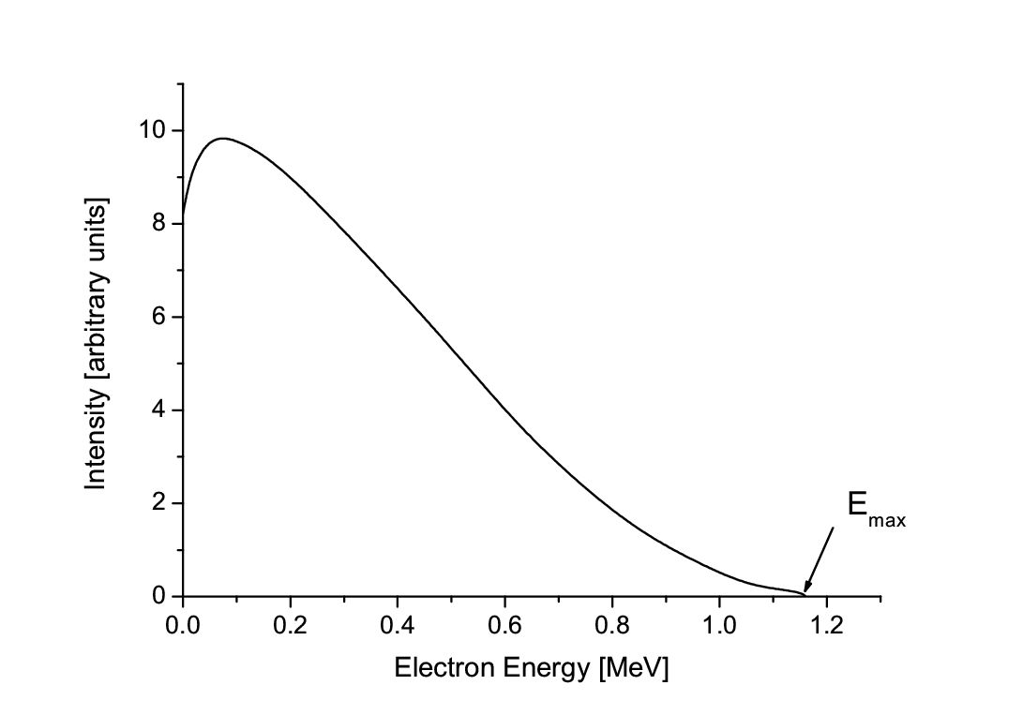
Transition | L | ΔI | Δπ
Fermi | 0 | 0 | 0
Gamow–Teller | 0 | 0, 1 | 0
1st-forbidden (parity change) | 1 | 0, 1, 2 | 1
2nd-forbidden (no parity change) | 2 | 1, 2, 3 | 0
3rd-forbidden (parity change) | 3 | 2, 3, 4 | 1
4th-forbidden (no parity change) | 4 | 3, 4, 5 | 0
Weak processes with electron/positron emission
^{A}_{Z}X → ^{A}_{Z+1}X′ + e⁻ + ύ_{e}
^{A}_{Z}X → ^{A}_{Z−1}X′ + e⁺ + ν_{e}
^{A}_{Z}X + e⁻ → ^{A}_{Z−1}X′ + ν_{e}
^{A}_{Z}X + 2e⁻ → ^{A}_{Z−2}X′ + 2ν_{e}
Beta decays
Beta decay.
Offers opportunities to explore several domains: nuclear structure, exotic nuclei; stellar processes, etc; beyond BSM: direct measurement of absolute ν mass; investigating deviations from the pure V–A theory; right-handed currents ; violation of Lorentz invariance through the analysis of electron spectra measurements; EC: applications in nuclear metrology and nuclear medicine; background characterization in DM&DBD experiments, etc.
S. Stoica, SM&B, CORFU24, August 26, 2024

Slide 4
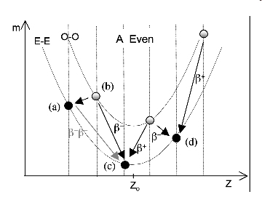
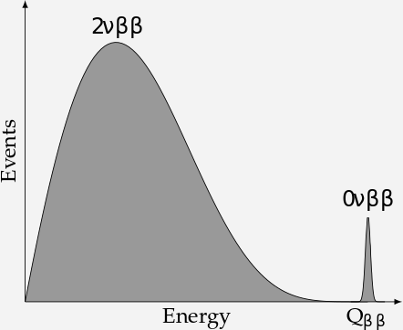
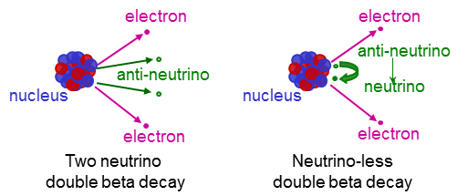
Double-beta decay modes
the rarest known radioactive decay
measured until now, by which an e-e nucleus transforms into another e-e nucleus with the same mass but with its nuclear charge changed by two units. It occurs whatever single β decay can not occur due to energetical reasons or it is highly forbidden by angular momentum selection rules
Isotope | Q_{ββ}[MeV] | T^{2ν} [yr] [1]
⁴⁸Ca | 4.272 | 4.40 x 10¹⁹(d)
⁷⁶Ge | 2.039 | 1.65 x 10²¹(d)
⁸²Se | 2.995 | 9.20 x 10¹⁹(d)
⁹⁶Zr | 3.350 | 2.30 x 10¹⁹(d)
¹⁰⁰Mo | 3.034 | 7.10 x 10¹⁸(d)
¹¹⁶Cd | 2.814 | 2.87 x 10¹⁹(d)
¹²⁸Te | 0.866 | 2.00 x 10²¹(g)
¹³⁰Te | 2.527 | 6.90 x 10²⁰(d&g)
¹³⁶Xe | 2.458 | 2.19 x 10²¹(d)
¹⁵⁰Nd | 3.371 | 8.20 x 10¹⁸(d)
²³⁸U | 1.450 | 2.00 x 10²¹(r)
²³⁵Ba(2νECEC) | 2.619 | ~ 1.0 x 10²¹ (g)
¹⁰⁰Mo-¹⁰⁰Ru(0₁) | 1.903 | 6.70 x 10²⁰(d)
¹⁵⁰Nd-¹⁵⁰Sm(0₁) | 2.630 | 1.20 x 10²⁰ (d)
2νβ⁻β⁻ 0νβ⁻β⁻
2νβ⁺β⁺ 0νβ⁺β⁺
2νECβ⁺ 0νECβ⁺
2νECEC 0νECE
S. Stoica, SM&B, CORFU24, August 26, 2024

Slide 5
DBD potential to explore BSM physics
Double-beta decay :
- Check of lepton number conservation (ΔL = 2);
- Neutrino properties: Dirac or Majorana; limits on <m_{νe}>
sterile ν_{s} → limits on <m_{N}>
neutrino mass hierarchy
- Distinguishing and constraining of different BSM scenarios for 0νββ: Majoron existence, SUSY particles, L-R theories, Ǝ of RH currents
- Check of other symmetries: CP, Lorentz invariance
S. Stoica, SM&B, CORFU24, August 26, 2024

Slide 6

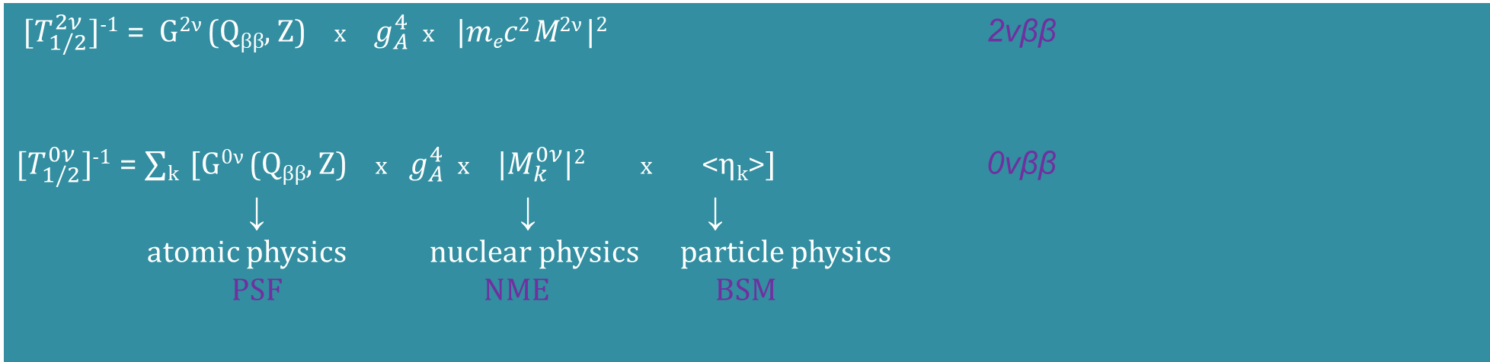
DBD lifetimes
${ [T}_{1/2}^{2ν}]$⁻¹ = G^{2ν} (Q_{ββ}, Z) x$g_{A}^{4}$x |$mec2$M^{2ν} |² 2νββ
${[T}_{1/2}^{0ν}]$⁻¹ = ∑_{k} [G^{0ν} (Q_{ββ}, Z) x$g_{A}^{4}$x |$M_{k}^{0ν}$|² x<η_{k}>]0νββ
↓ ↓ ↓
atomic physics nuclear physics particle physics
PSFNME BSM
G^{(2,0)ν}(E₀, Z) phase space factors (PSF)
M^{(2,0)ν} = nuclear matrix elements (NME)
Σ_{k} M^{0ν}_{k} = |M^{0ν}_{ν}|² <m_{ν}>² + |M^{0ν}_{N}|² <m_{N}>² + |M^{0ν}_{λ}|² <η_{λ}>² + |M^{0ν}_{q}|² <η_{q}>² + ….
<η_{l}> = BSM parameter specific the 0νββ mechanism; g_{A} = axial-vector constant
Precise calculations of PSF and NME are needed to predict lifetimes, derive neutrino parameters, extract information on neutrino properties
S. Stoica, SM&B, CORFU24, August 26, 2024

Slide 7
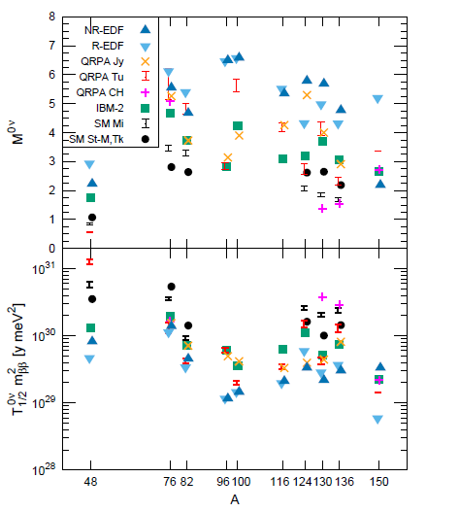
Engel&Menendez-RPP2017
S. Stoica, SM&B, CORFU24, August 26, 2024

Slide 8
NME computation - a long standing problem
Traditional methods give differences between NME values of up to 3-5 times and it’s hard to compare and assess the correctness of the results, because is difficult to distinguish between errors/uncertainties due to different input parameters and shortcomings of the methods. Uncertainties in the NME values are further amplified, since they enter at the power of two in the inverse DBD lifetime formula.
they each use empirical interactions that are not appropriate for other methods, and they each make ad-hoc assumptions
about the short-range correlation effects on the transition.
Goal: to compute 0νββ NME with minimal model dependence and quantified theoretical uncertainty
It is expected that chiral EFT combined with Lattice-QCD to specify the form of the decay operator determining the constants that multiply particular terms in the operator and ab-initio calculations to produce reliable NME with quantified uncertainties.
Current situation
There are NME calculations with modern no-core nuclear methods only for the lightest DBD isotopes ⁴⁸Ca, ⁷⁶Ge and ⁸²Se. Also, calculations with EFT combined with lattice QCD still face difficulties to provide the form of decay operator.
S. Stoica, SM&B, CORFU24, August 26, 2024

Slide 9
Statistical model (Horoi , Neacsu, Stoica, PRC2022,PRC2023; Horoi, Neacsu, Universe 2024)
for analysing the stability and distribution of the 0νββ NME calculated with ISM for ¹³⁶Xe, ⁴⁸Ca and ⁴⁸Se.
Goal: the stability of the NME values against small random changes of the TBME (±10%).
The calculations are performed using 3 independent effective Hamiltonians appropriate for each isotope.
(i) distribution of the NME values;
(ii) correlations of 0νββ NME with other observables (accessible experimentally): 2νββ, GT transitions, excited states, occupancies, B(E2); in total 24 observables
(iii) the theoretical ranges for each observables;
(iv) the shape of different distributions for each observables and starting Hamiltonians;
(iv) the weighted contributions from different starting Hamiltonians to the ”optimal” distribution of the 0νββ NME;
(v) an ”optimal” value of the 0νββ NME and its predicted probable range (theoretical error).
NME(¹³⁶Xe): (1.55 - 2.65) at 90\% CL with 1.95 mean value
NME(^{48Ca}): (0.45 - 0.65) at 90\% CL with 0.68 mean value
S. Stoica, MEDEX’23, Prague, September 5, 2023

Slide 10


Calculation of the phase space factors for DBD
Topics of interest in this treatment are the energy and angular distributions of the emitted electrons, which are calculated by using exact Dirac wave functions with finite nuclear size and electron screening.
Information from kinematic quantities:
Single state dominance (summation over N reduces to one state and <E_{N}> = 1⁺
Transitions to excited 2⁺ states (single and summed energy electron spectra from transitions to g.s and to 2⁺ states differ each other)
Mechanisms (for 0νββ – single electron spectra and angular correlation are different each other for light ν exchange mechanisms and RH contributions)
single electron spectra
summed energy
electron spectra
electron angular
correlation
Β-decay
S. Stoica, SM&B, CORFU24, August 26, 2024

Slide 11

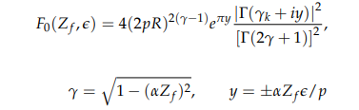
Computation of the kinetic part of BD &DBD
Electron wave functions and Fermi functions
essential ingredients to compute PSF, electron spectra and all other needed kinematic quantities
Non-relativistic treatment
Primakov&Rosen RPP22(1959)
A
Relativistic treatment: solution of a Dirac
equation in a point charge Coulomb potential
Suhonen&Civitarese, PR 301 (1998); Doi&Kotani, PTP1985
FNS and screening effects were not taken into account.
B
Fermi function built up from the radial solution
of a Dirac equation in a Coulomb-type potential
Kotila&Iachello,PRC85(2012);
Stoica&Mirea PRC88(2013); RRP63(2015)
C
D electron wave functions are obtained
with the DHFS method using a different Coulomb
potential. More suitable for describing EC processes: additional
atomic effects can be included; screening effect is taken into account
Nitescu,Stoica,Simkovic, PRC107(2023)
S. Stoica, SM&B, CORFU24, August 26, 2024

Slide 12
Stoica, Mirea, Frontiers in Physics 7 (2019)
S. Stoica,Mirea, Phys. Rev. C 88 (2013)
Mirea, Pahomi, Stoica Rom.Rep.Phys. 67(2015)
S. Stoica, NSP2022, Kirikkale, 28 June, 2022

Slide 13
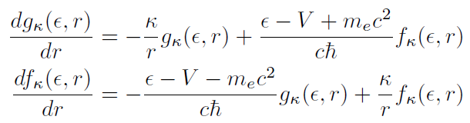
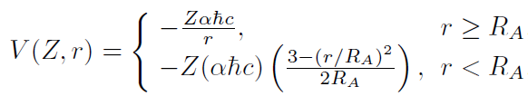
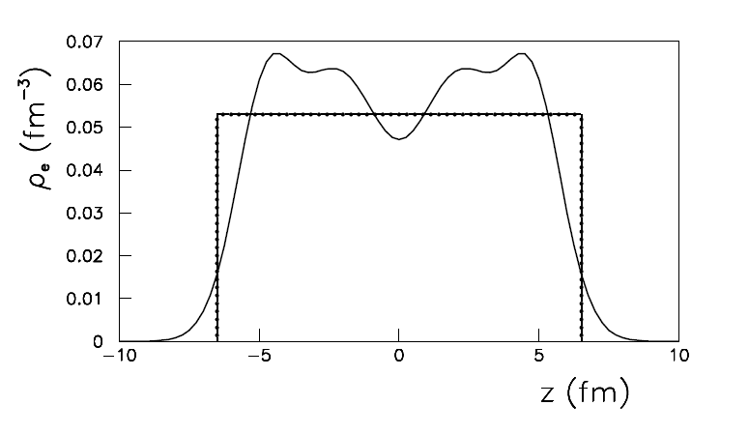

C method
Stoica&MireaPRC88(2013); Rom.Rep.Phys.67(2015)
Fermi functions from exact electron w.f. obtained as solutions of a Dirac equation with Coulomb-type potential built with a realistic proton density in nucleus, with inclusion of FNS and screening effects
S. Stoica, SM&B, CORFU24, August 26, 2024

Slide 14
Phase space for 2νββ
S. Stoica, SM&B, CORFU24, August 26, 2024

Slide 15
Lorentz invariance violation in weak decays
The general framework characterizing LIV is the Standard Model Extension (SME).
In minimal SME (operators dimension ≤ 4) there are operators that couples to ν_{s} and affect ν flavor oscillations, ν velocity or ν phase spaces (β, ββ decays).
First LIV searches in the ν sector were perform in ν oscillation experiments.
LIV can now be also investigated in β and ββ decays by a precise analysis of the electron spectra.
Since 2016 deviations to Lorentz symmetry began to be also investigated in DBD experiments: EXO (PRD93-2016), GERDA (arXiv22), AURORA(PRD98-2018), NEMO3 (EPJC79-2019), CUPID0 (PRD100-2019), CUORE (Front.Phys.2019).
There is a q-independent component of the so-called counter-shaded operator, which doesn’t affect the ν oscillations, and hence can not be detected in ν oscillation experiments, but can affect the electron spectra of 2νββ decay, namely: the summed energy spectra of electrons, or single energy spectra of electrons and electron angular correlation (the last can be investigated in experiments with tracking systems for the individual electrons).
In the absence of observation of LIV deviations one can constrain the å⁽³⁾_{of} coeﬃcient that governs the isotropic (like-time) component of the counter-shaded operator.
S. Stoica, SM&B, CORFU24, August 26, 2024

Slide 16
The coupling of the neutrino to the counter-shaded operator modifies the neutrino momentum :
q^{α} (ω, q) → q^{α} (ω, q + a⁽³⁾_{of} + ȧ⁽³⁾_{of} q/q )
This, further, modifies the 2νββ transition amplitude, so the decay rate can be written as a sum of the standard term and a perturbation due to LVββ (J.S. Diaz, PRD89(2014) )
Γ^{(2ν)} = Γ₀ ^{(2ν)} + dΓ ^{(2ν)}
Γ₀ ^{(2ν)} = G₀^{2ν}(E₀, Z) x g_{A}⁴ x |m_{e}c² M^{2ν}|²
dΓ ^{(2ν)} = dG₀^{2ν}(E₀, Z) x g_{A}⁴ x |m_{e}c² M^{2ν}|²
G₀^{2ν} = C ∫₀^{Q} dε₁ F(Z, ε₁) [ε₁(ε₁ +2)]^{1/2} (ε₁ +1) ∫₀^{Q-ε1} dε₂ F(Z, ε₂) [ε₂(ε₂ +2)]^{1/2} (ε₂ +1)(Q- ε₁- ε₂)⁵
dG^{2ν} = 10å⁽³⁾_{of} C ∫₀^{Q} dε₁ F(Z, ε₁) [ε₁(ε₁ +2)]^{1/2} (ε₁ +1) ∫₀^{Q-ε1} dε₂ F(Z, ε₂) [ε₂(ε₂ +2)]^{1/2} (ε₂ +1)(Q- ε₁- ε₂)⁴
C = G_{F}⁴ |V_{ud}|⁴m_{e} /240π⁷ t_{1,2} = ε_{1,2} -1;
F^{NR}(Z_{f}ϵ) = 2πη/(1-e^{-2πη})
S. Stoica, SM&B, CORFU24, August 26, 2024

Slide 17


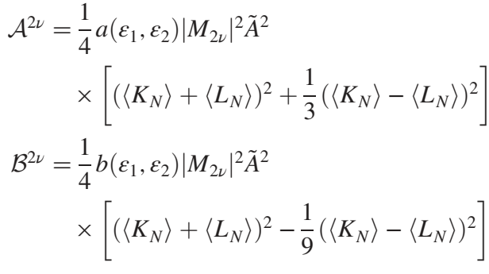
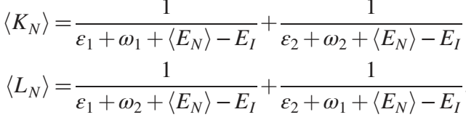
Formalism for Lorentz invariant violation in DBD
Nitescu, Ghinescu, Mirea, Stoica, JPG 47(2020)
Nitescux, Ghinescu, Stoica, PRD103 (2021)
Ghinescu, Nitescu, Stoica, PRD105(2022)
Differential rate for 2νββ decay for ground states to ground states transitions
ε, ω = electron and neutrino energies;
p = electron momenta; ϴ = angle between electrons;
K, N = kinematic factors
S. Stoica, SM&B, CORFU24, August 26, 2024

Slide 18








angular correlation coefficient
→
S. Stoica, SM&B, CORFU24, August 26, 2024

Slide 19









S. Stoica, SM&B, CORFU24, August 26, 2024

Slide 20
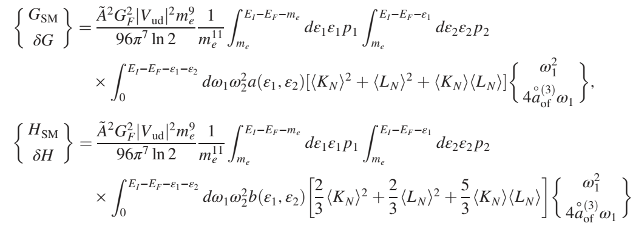
S. Stoica, SM&B, CORFU24, August 26, 2024

Slide 21
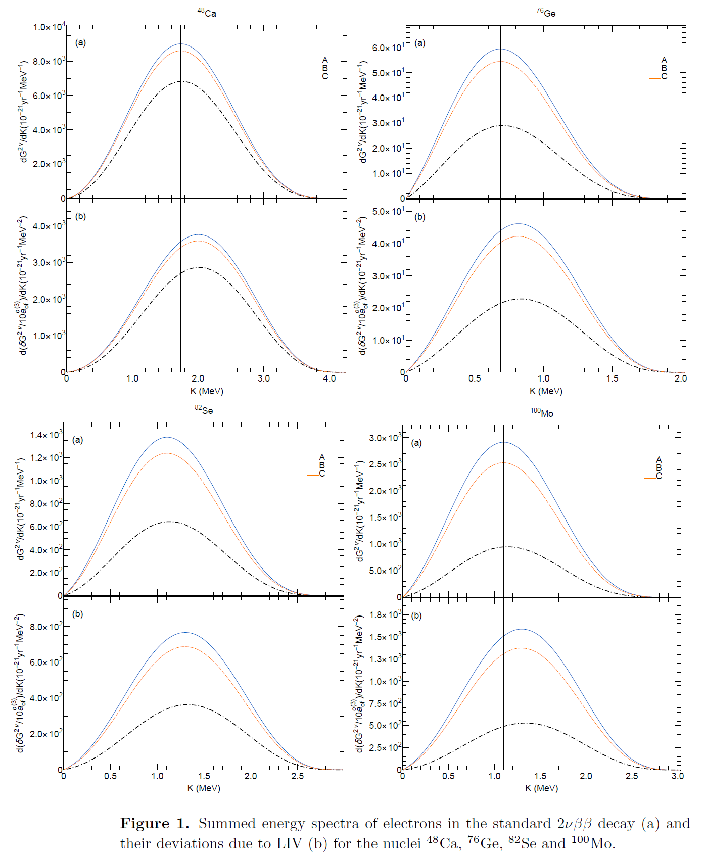
Results and discussions
Summed energy spectra of electrons in DBD
Summed energy spectra of electrons in the approximations A, B and C
A= NR approx. is inadequate in precise electron spectra analyses
B = approx. (analytical Fermi function); non-inclusion of FNS and screening effects: differences up to 30% as compared with “exact” Fermi function
C = exact Fermi functions, screening effect, “realistic” Coulomb-type potential
Nitescu, Ghinescu, Mirea, Stoica, JPG 47, 055112 (2020)
S. Stoica, SM&B, CORFU24, August 26, 2024

Slide 22
S. Stoica, SM&B, CORFU24, August 26, 2024

Slide 23
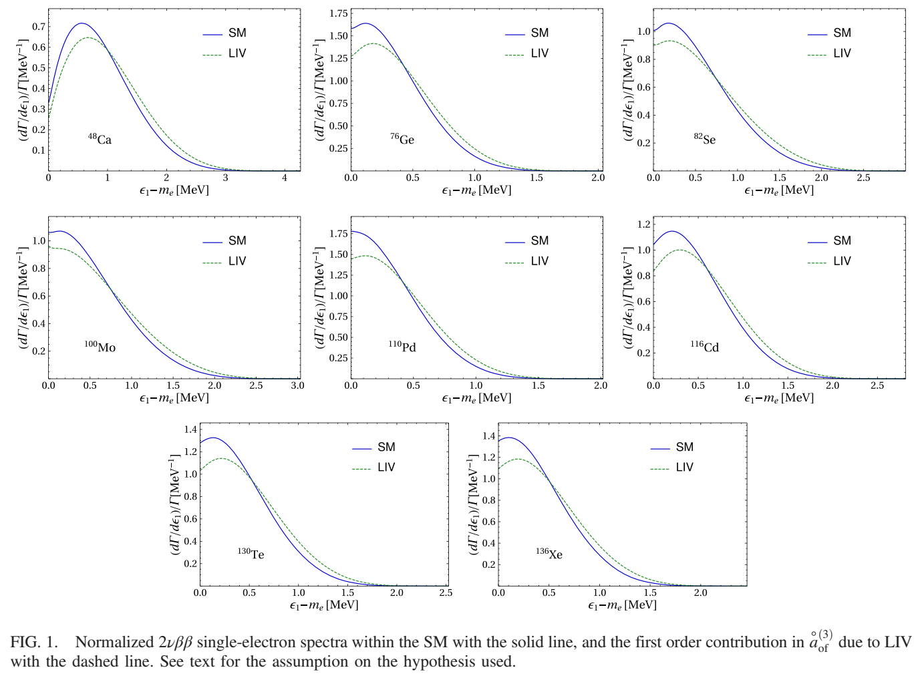
Nitescu, Ghinescu, Stoica
PRD103(2021); 105(2022)
S. Stoica, SM&B, CORFU24, August 26, 2024

Slide 24
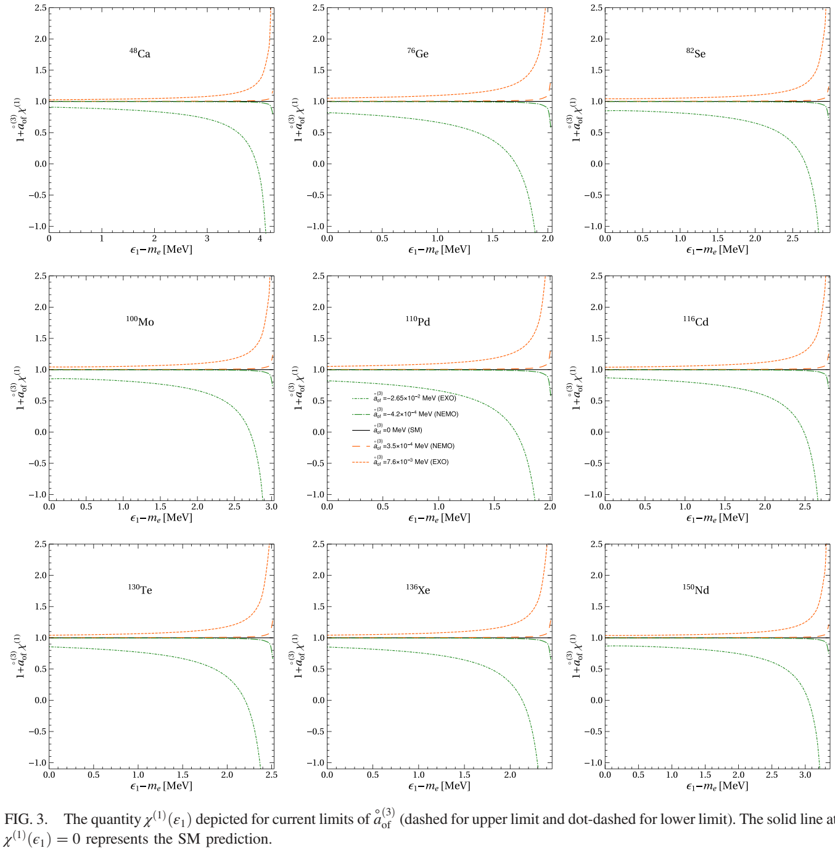
Nitescu, Ghinescu, Stoica
PRD103(2021); 105(2022)
S. Stoica, SM&B, CORFU24, August 26, 2024

Slide 25
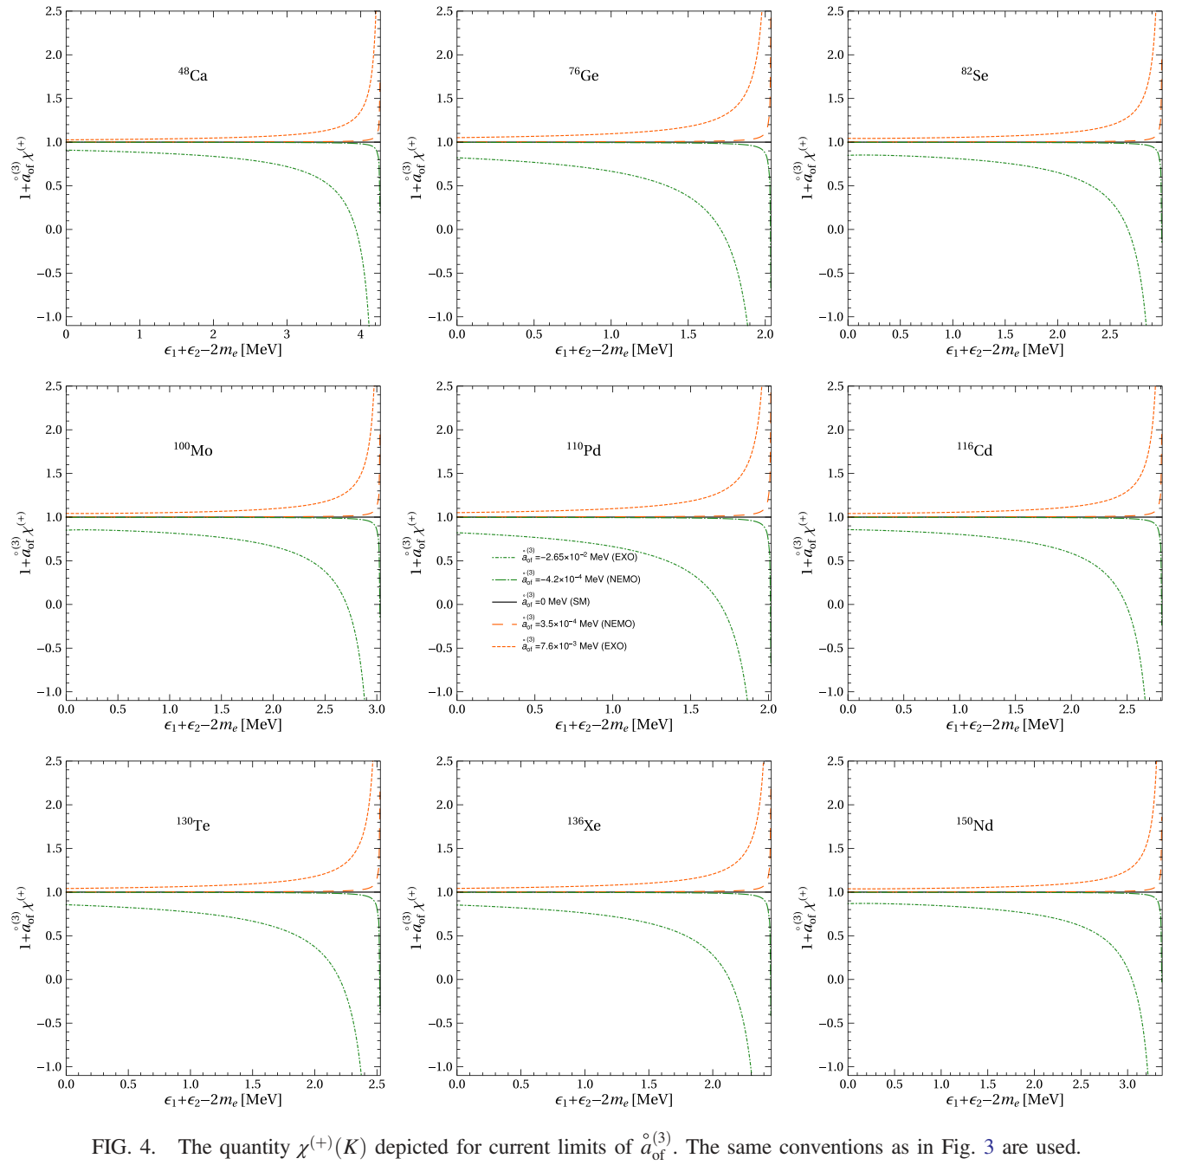
Nitescu, Ghinescu, Stoica
PRD103(2021); 105(2022)
S. Stoica, SM&B, CORFU24, August 26, 2024

Slide 26
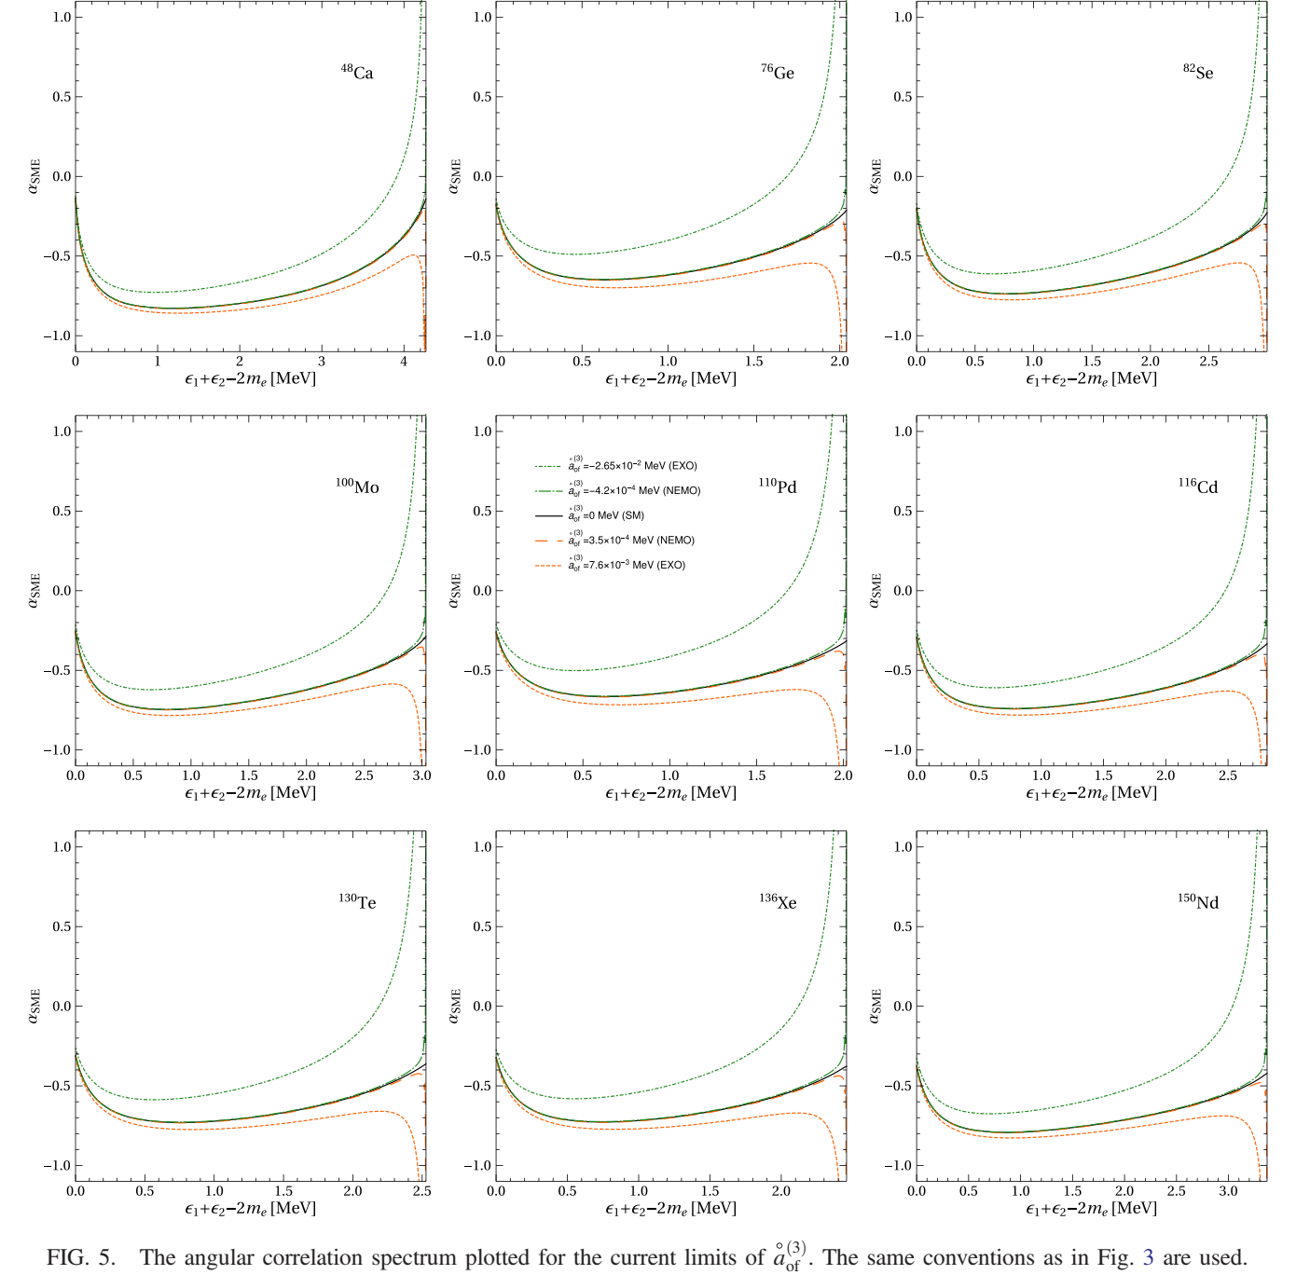
Nitescu, Ghinescu, Stoica
PRD105(2022)
S. Stoica, SM&B, CORFU24, August 26, 2024

Slide 27
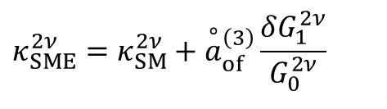
Angular correlation coefficient
$$\begin{matrix}κ_{SME}^{2ν}=κ_{SM}^{2ν}+{\overset{∘}{a}}_{of}^{\left(3\right)}\frac{δG_{1}^{2ν}}{G_{0}^{2ν}} & \\ & \end{matrix}$$
On the other hand, the angular correlation
coefficient can be determined experimentally via
forward-backward asymmetry
S. Stoica, SM&B, CORFU24, August 26, 2024

Slide 28
Electron capture (EC) processes
Sevestrean et al, PRA (2022)
a comprehensive investigation of electron capture (EC) ratios spanning a broad range of atomic numbers. The study employs a self-consistent computational method that incorporates important atomic effects, including overlap and exchange corrections, as well as shake-up and shake-of effects within the EC formalism. The electronic wave functions are computed using the DHFS framework, which accurately describes electron screening and in the atomic structure.
In the case of EC and ECEC, energetic rearrangements processes are essential in the accurate measurement of the decay rates. Also, they are essential to be taken into account in the theoretical calculations and predictions of these processes.
- Great interest for theoretical description: program of systematically and precisely computation of EC processes
Applications
radionuclide metrology and nuclear medicine (the relevance is that most Auger electrons emitted during EC processes possess kinetic energies in the range of a few keV, enabling precise deposition within a confined area, thus allowing targeted irradiation of tumour sites.)
fundamental physics research like nuclear astrophysics & DM and DBD experiments
specifically, in liquid Xenon experiments EC signals can produce misleading signatures that resemble with those of WIMPS and CEνNS
measurement of the 2νECEC in ¹²⁴Xe: a critical background contribution emerges from ¹²⁵I EC, as its decay peak closely aligns with that of the 2νECEC peak.
S. Stoica, SM&B, CORFU24, August 26, 2024

Slide 29


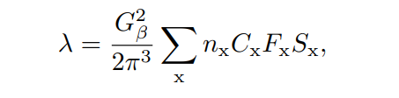



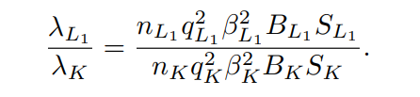

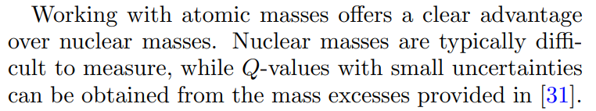
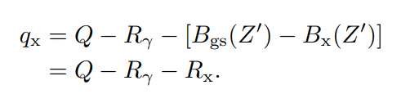
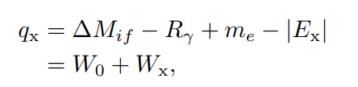
EC formalism
Transition probability per unit time
Atomic effects
Exchange and overlap effects
Shake-up & shake-off processes
n _{x} = occupation number of the shell x; C_{x} = NME; S_{x} = shake-up; shake-off effects; q_{x} =neutrino energy; β_{x} = Coulomb amplitude; B_{x} = overlap & exchange effects; B
Energetics
S. Stoica, SM&B, CORFU24, August 26, 2024

Slide 30
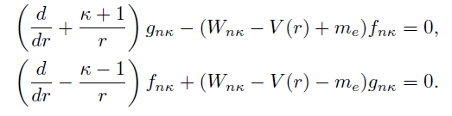
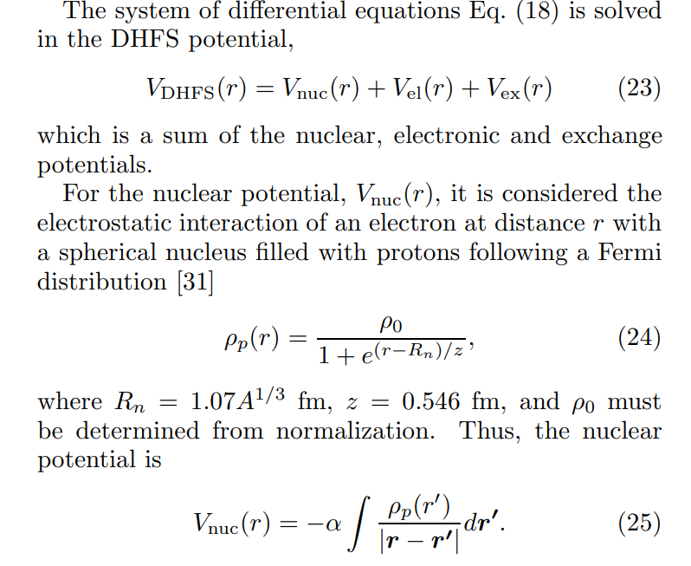
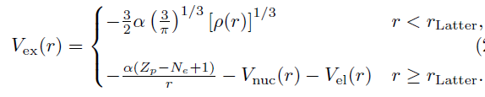


S. Stoica, SM&B, CORFU24, August 26, 2024

Slide 31
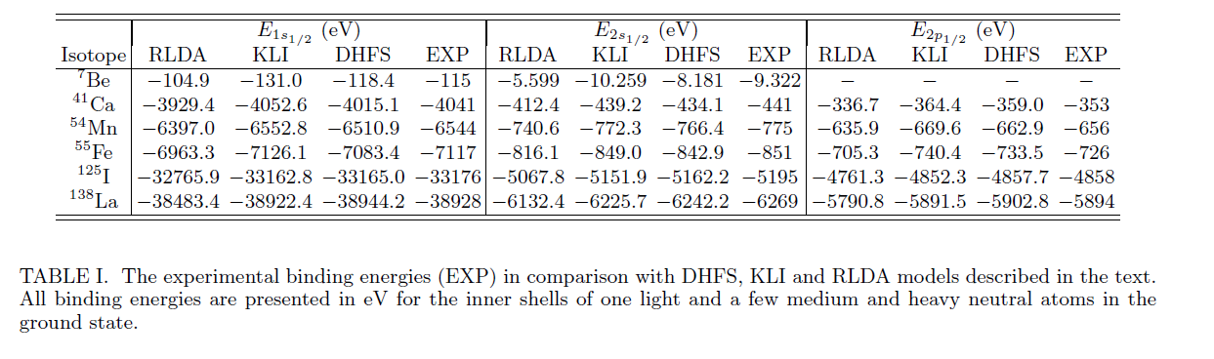
S. Stoica, SM&B, CORFU24, August 26, 2024

Slide 32
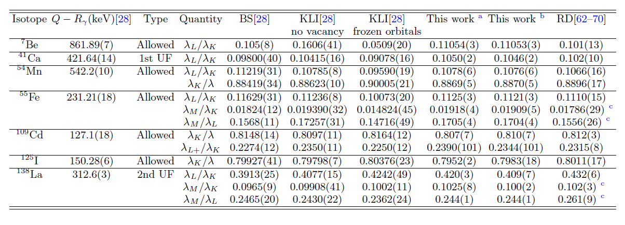
S. Stoica, SM&B, CORFU24, August 26, 2024

Slide 33
Exchange correction for allowed β decay (see Nitescu presentation) Niţescu,Stoica,Šimkovic PRC 107-2023
Investigation of the exchange effect between the final atom's bound electrons and those emitted in the allowed β decay of the initial nucleus. This refers to the interchange of the emitted electrons from different β transitions with the bound electrons from only the 1s orbital.
The importance of the exchange corrections was first proved for tritium β decay and then confirmed for other nuclear β decays (e.g. the allowed β transitions of ¹⁴C, ³⁵S, ¹⁰⁶Ru and the non-unique first forbidden β transition of ²⁴¹Pu. The β spectrum better agrees with the experimental one when exchange corrections are included (the effect is more pronounced at low energies)
The exchange effect is also important for excluding background β events in experimental analysis, e.g., LUX-ZEPLIN, XENON (1T&nT) experiments (in this regard in case of the unique first forbidden transition of ⁸⁵Kr and non-unique first forbidden transitions of ²¹²Pb.
First, we calculate the exchange effect for the low-energy β transitions in ¹⁴C, ⁴⁵Ca, ⁶³Ni, and ²⁴¹Pu, recently investigated in the literature.
Next, we compute the total exchange correction for a large number of β emitters, with Z ϵ (1-102)

Slide 34
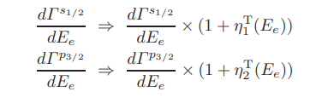


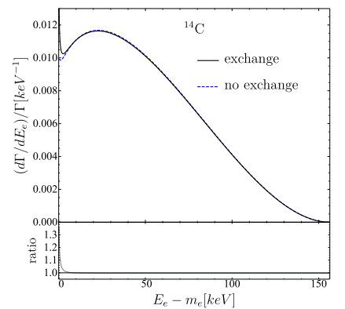

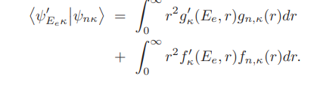
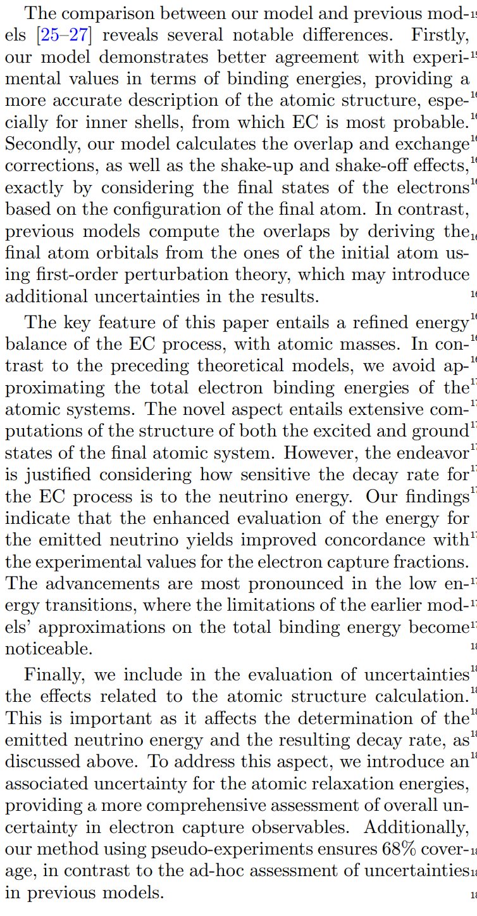
Exchange corrections
S. Stoica, SM&B, CORFU24, August 26, 2024

Slide 35
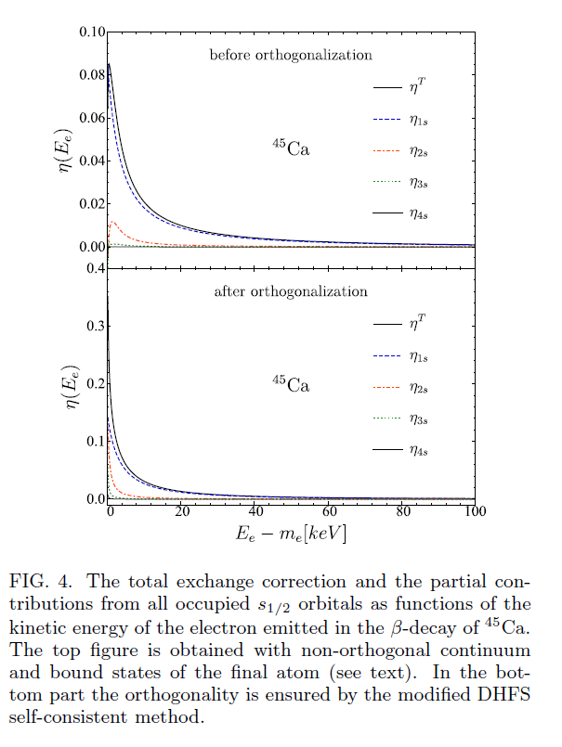
A key ingredient of this work was to ensure the orthogonality between the continuum and bound electron states, in the potential of the final atom, by modifying the last iteration of the DHFS self-consistent method. After imposing the orthogonality, we found considerable differences in magnitude and energy dependence compared to previous results.
Total exchange effect: presents a completely different energy dependence and the orthogonality of the wave functions strongly also influences its magnitude. The downturn observed at very low energy in the case of non-orthogonality between the bound and continuum electron states disappears when the orthogonality is assured. Therefore, the calculation of the exchange correction for ultra-low Q-value β transitions should address the orthogonalization between the continuum and bound wave functions for the final atom.
extending the study to a large range of isotopes, we provide an analytical expression of the total exchange correction for each atomic number for easy implementation in experimental investigations.

Slide 36
Conclusions
Beta decay and double-beta decay continuous to be current topics of great interest for several domains of physics: atomic, nuclear, particle, astro-physics and have also a broad potential to explore different aspects of BSM physics : neutrino properties, conservation and symmetry laws, constrain different scenarios for 0νββ decay .
I presented a brief review on some recent results related to the computation of the kinetic part of the decay rates of these weak processes: obtaining of accurate electron wave functions, and then predictions of electron and angular correlation spectra and computation of several atomic effects.
These calculations were applied to the investigation of LIV in 2νββ decay and description of EC processes
We provide the formalism for investigating LIV effects in summed and single energy electron spectra and angular correlation and show that other possible signatures may also be observed in these spectra. Next, we propose an alternative, new method for constraining the å⁽³⁾_{of} coefficient from the measurement of the forward-backward asymmetry of the emitted electrons.
EC processes are of great interest both for practical applications in nuclear metrology and nuclear medicine and for providing information about the backgorund composition in DM and DBD experiments.
I presented calculations that provide a complete description of these processes , including obtaining precise electron w.f. for continuous and bound states, and with inclusion of several, essential atomic corrections: FNS, screening, exchange and overlap, shake-up and shake off effects.
S. Stoica, SM&B, CORFU24, August 26, 2024

Slide 37
Thank You
Team
Andrei Neacsu (CIFRA) Fedor Simkovic (Bratislava)
Ovidiu Nitescu (CIFRA, Bratislava) R. Dvornick´y (Bratislava)
Stefan Ghinescu (CIFRA) Jouni Suhonen (Jyvaskyla, CIFRA)
Vasile Sevestrean (CIFRA) Jenni Kotila (Jyvaskyula, CIFRA)
Sabin Stoica (CIFRA) Mihai Horoi (CMU, CIFRA)
Project NEPTUN (Neutrino Properties Through Use of Nuclei) (CIFRA-Jyvaskyula-CMU)
PI: Jouni Suhonen
S. Stoica, SM&B, CORFU24, August 26, 2024

