Slide 1
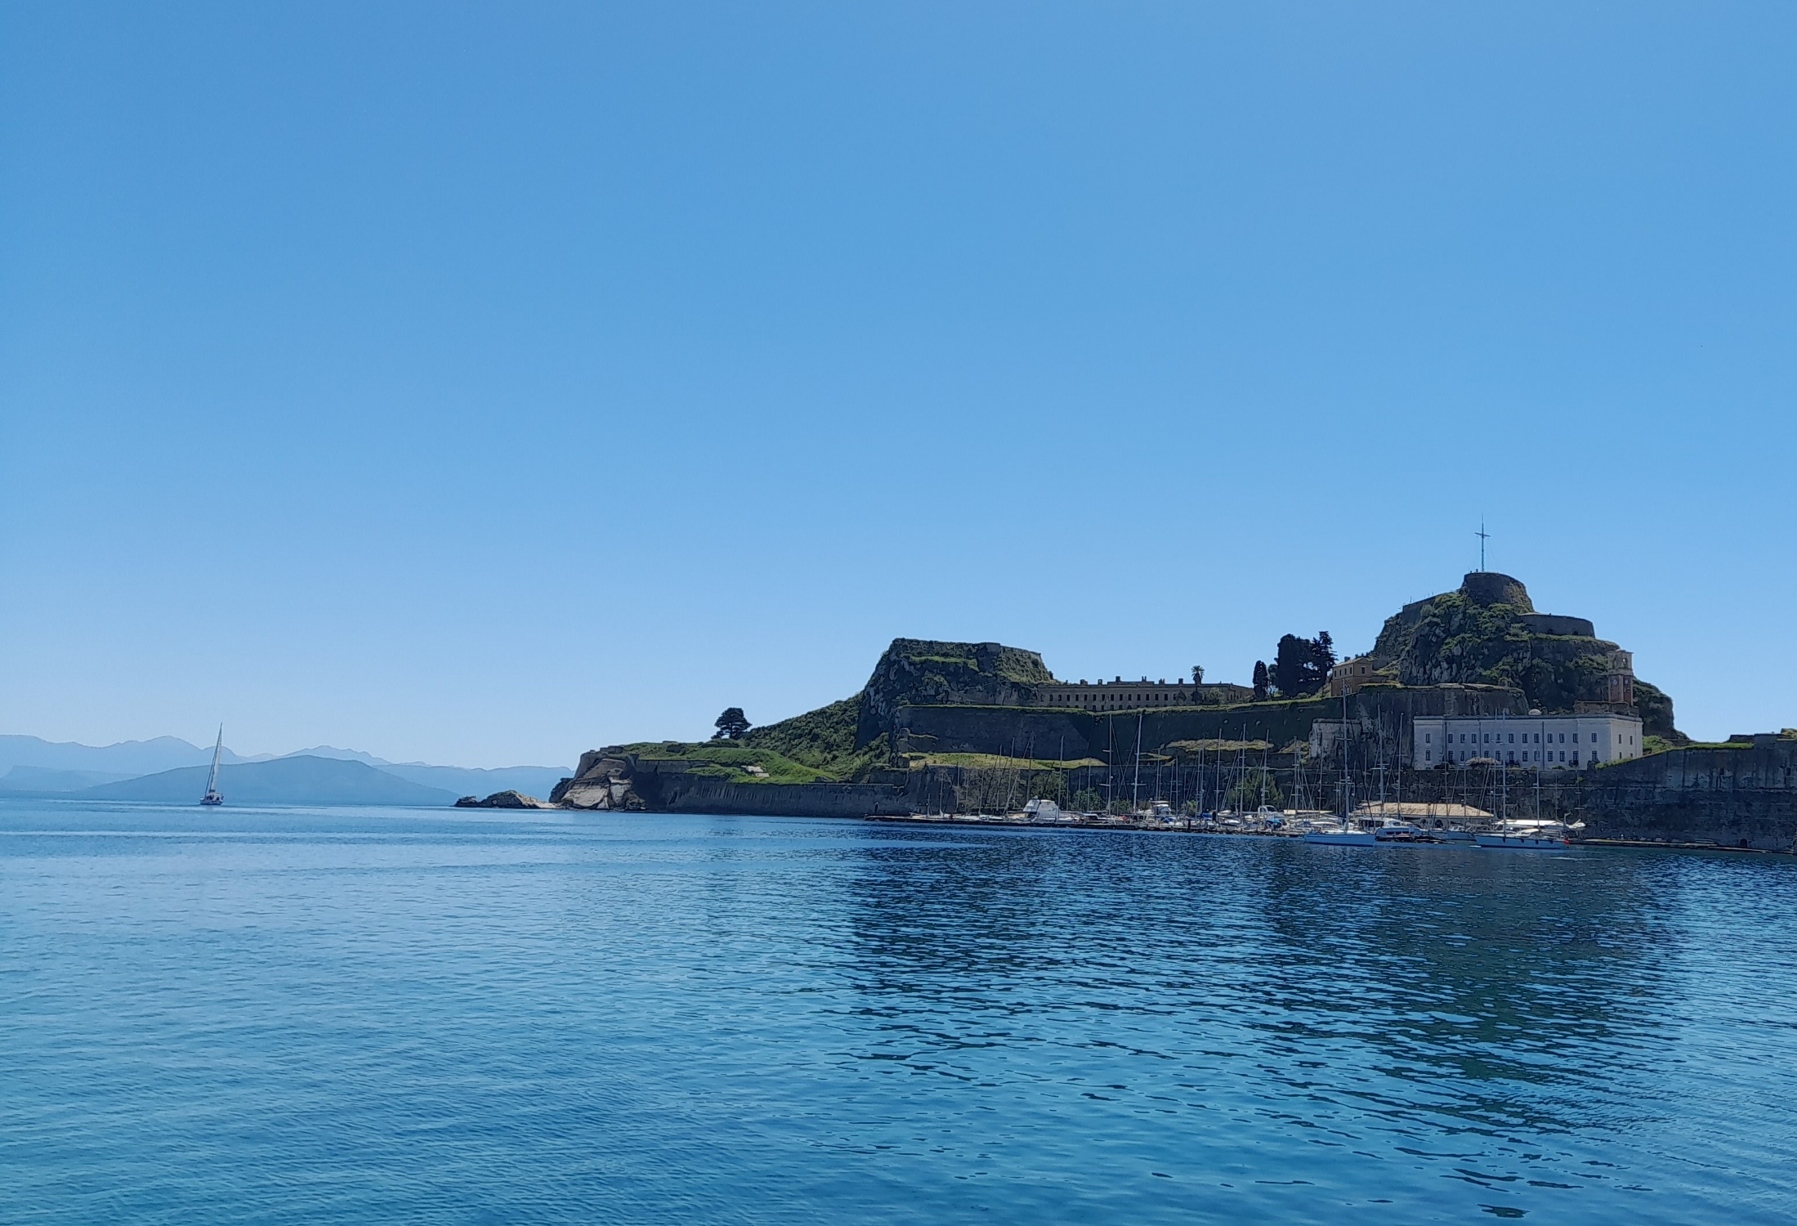
The Big Questions in Neutrino Physics
Alain Blondel Paris-Sorbonne and University of Geneva

Slide 2
The Big Questions in Neutrino Physics
The big questions of particle physics and neutrinos
-- How was the Universe born and how it works
-- Matter exists, but what happened to antimatter?
-- dark matter and dark energy
-- The Standard Model
Who are neutrinos?
-- neutral, left-handed, massive, mixing and oscillating (we know all that)
Neutrino questions and future
-- are neutrinos violating time-reversal (C.P or T) invariance
-- are neutrinos able to transform into antineutrinos
-- fermion number conservation?
-- The neutrino mass be explained in the Standard Model
-- how can we check all that?
-- Neutrino mass measurements (in 0vββ and cosmology)
-- Neutrino oscillations and CP violation future neutrino program
-- How can we discover that neutrinos have a Majorana mass term?

Slide 3
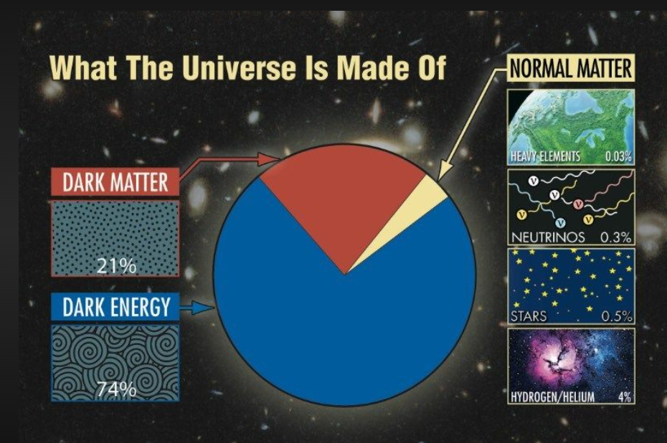
How come there is ‘normal matter’ at all?
The simplest Big Bang is ‘just energy’ at Time =0
-- particle physics only ever sees equal amounts
of matter and antimatter created from energy
+ matter and antimatter annihilate
-- where is antimatter gone?

Slide 4
Dark matter is observed as modifications of the laws of gravitation in galaxies
-- interacting gravitationally
-- Particle physics knows no particle that could play the role of dark matter
could be many things from light ‘sterile’ particles to small black holes
popular: Lightest Supersymmetric Particle, a.k.a.
WIMP (Weakly Interacting Massive Particle) from GeV to few TeV

Slide 5
Dark energy is a nick-name for an unknown effect that leads to the observed
acceleration of the extension of the Universe.
-- *Might* be related to a modification of the space time properties
by physics at a higher energy than we have explored yet

Slide 6
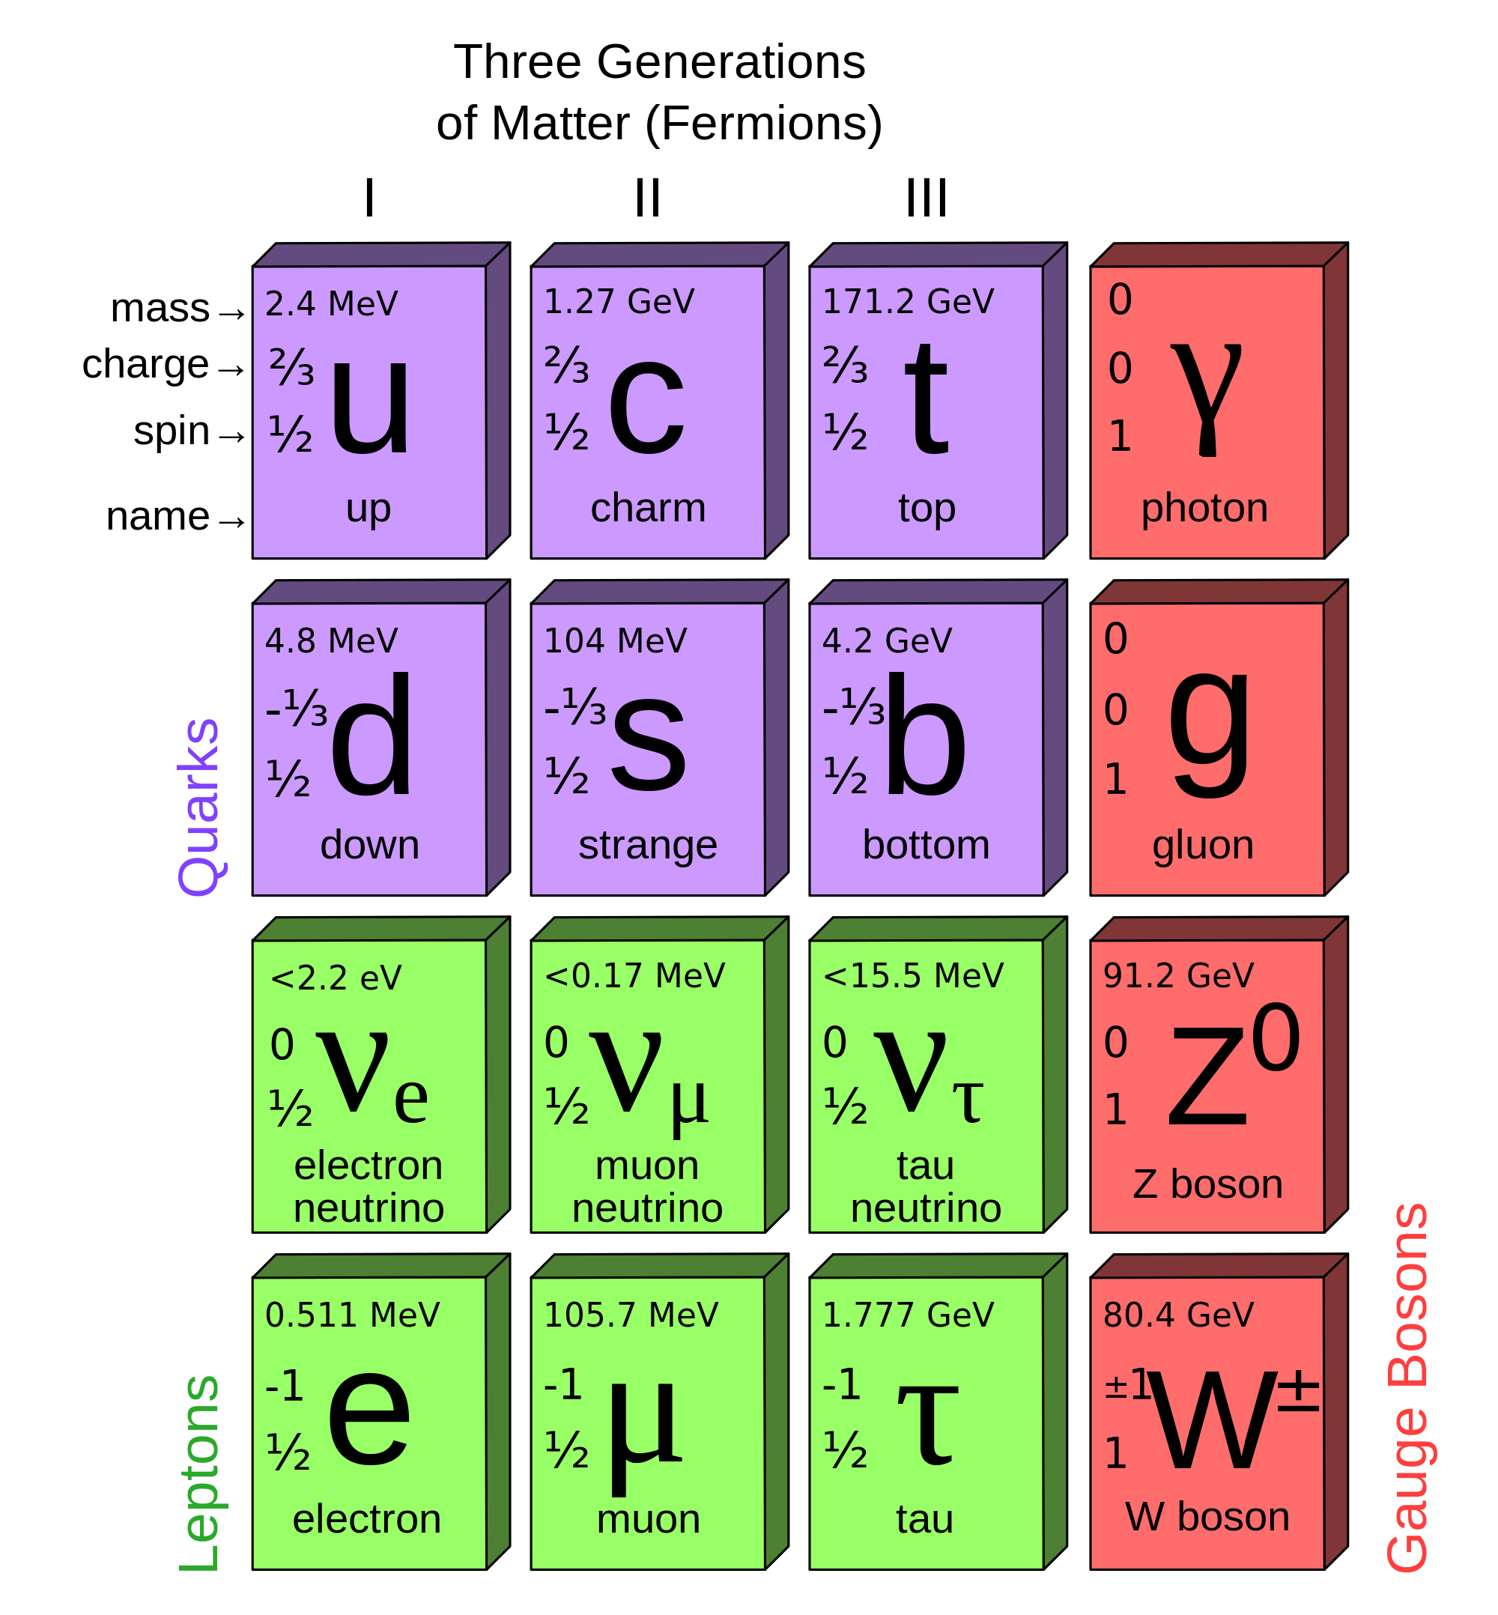
Particle Physics: the STANDARD MODEL
← Bosons →
Each fermion
also appears as
Anti-fermion
with opposite
charge ans helicity
2012
125.6 GeV
0
0
Higgs boson
H
0 ≤m< 0.3 eV
0<m<0.3 eV
0<m<0.3 eV
1
2
3
mass eigenstates!
1897
Number of fermions is ∼conserved number of bosons as energy permits

Slide 7

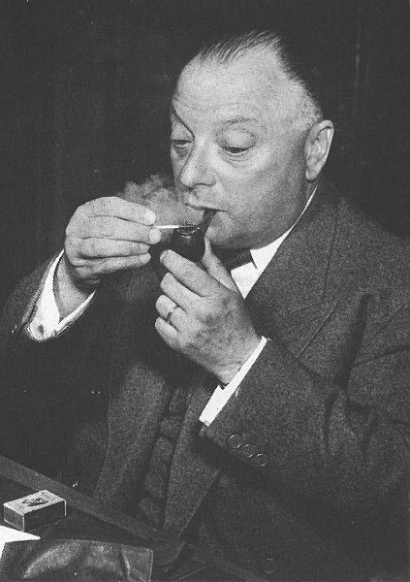
1930
Neutrinos: the birth of the idea
‾ν_{e}
Pauli's letter of the 4th of December 1930
Dear Radioactive Ladies and Gentlemen,
As the bearer of these lines, to whom I graciously ask you to listen, will explain to you in more detail, how because of the "wrong" statistics of the N and Li6 nuclei and the continuous beta spectrum, I have hit upon a desperate remedy to save the "exchange theorem" of statistics and the law of conservation of energy. Namely, the possibility that there could exist in the nuclei electrically neutral particles, that I wish to call neutrons, which have spin 1/2 and obey the exclusion principle and which further differ from light quanta in that they do not travel with the velocity of light. The mass of the neutrons should be of the same order of magnitude as the electron mass and in any event not larger than 0.01 proton masses. The continuous beta spectrum would then become understandable by the assumption that in beta decay a neutron is emitted in addition to the electron such that the sum of the energies of the neutron and the electron is constant...
I agree that my remedy could seem incredible because one should have seen those neutrons very earlier if they really exist. But only the one who dare can win and the difficult situation, due to the continuous structure of the beta spectrum, is lighted by a remark of my honoured predecessor, Mr Debye, who told me recently in Bruxelles: "Oh, It's well better not to think to this at all, like new taxes". From now on, every solution to the issue must be discussed. Thus, dear radioactive people, look and judge.
Unfortunately, I cannot appear in Tubingen personally since I am indispensable here in Zurich because of a ball on the night of 6/7 December. With my best regards to you, and also to Mr Back.
Your humble servant
. W. Pauli
e⁻ spectrum in beta decay
dN
dE
few MeV
E
Wolfgang Pauli

Slide 8
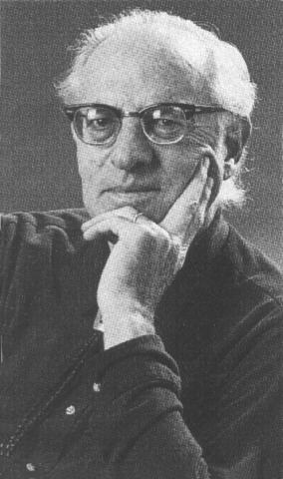
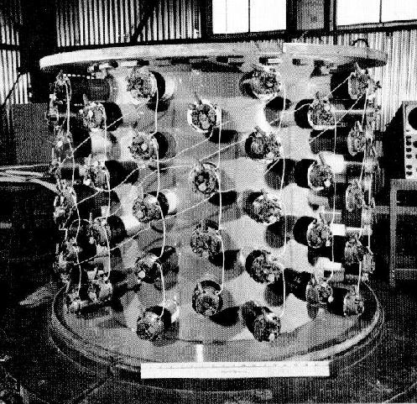
Reines and Cowan
1953
Neutrinos: direct detection
The target is made of about 400 liters of water mixed with cadmium chloride
The anti-neutrino coming from the nuclear reactor interacts with a proton of the target, giving a positron and a neutron.
The positron annihilates with an electron of target and gives two simultaneous photons (e⁺ + e⁻ →γγ) .
The neutron slows down before being eventually captured by a cadmium nucleus, that gives the emission of 2 photons about 15 microseconds after those of the positron.
All those 4 photons are detected and the 15 microseconds identify the "neutrino" interaction.
4-fold delayed coincidence

Slide 9
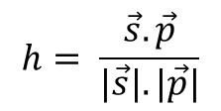




Parity violation in Co beta decay: electron is left-handed (C.S. Wu et al)
electrons with negative helicity
interact with weak interaction
positrons with positive helicity
Neutrino helicity measurement
M. Goldhaber et al Phys.Rev.109(1958)1015
(anti)neutrinos have negative(positive) helicity
(If massless this is the same as left-handed)
}
ν_{e}
ν_{e}
h= +1 , right-handed, not observed!
h= -1 , left-handed

Slide 10
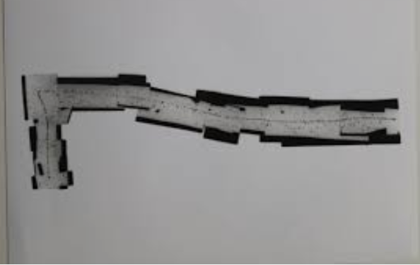
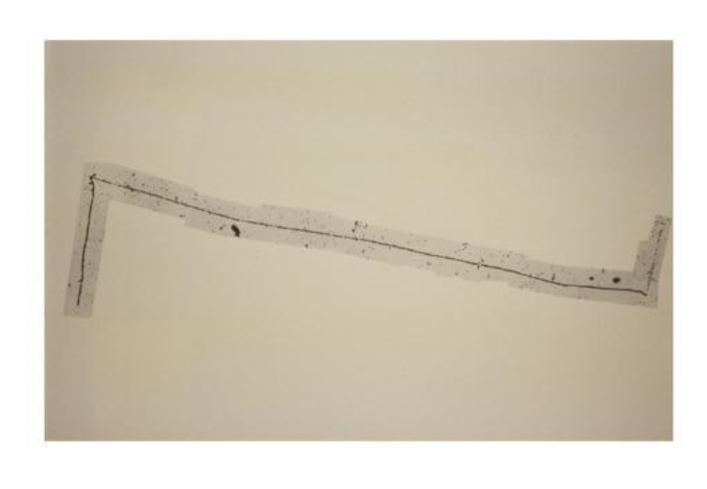
Another neutrino was detected in 1947 with the discovery of the pion.
(Powell et al, 1947). Maybe it was the same neutrino than in beta decay?
These emulsions were made of photographic gel and stacked.
Placed in high altitude balloons at up to 10km altitude, they allowed the observation of
strongly interacting particles which are otherwise stopped by the atmosphere.
ν
←
μ+
e+
π+
monochromatic
←
←
ν
ν
Emulsions played an important role in establishing the nature of the tau neutrino
(E531, 1986) and detection of ν_{τ} interactions (DONUT and OPERA experiments)

Slide 11
Unrelated Preamble
Why do pions decay into π⁺ →μ⁺ ν_{μ} much much more than into π⁺ →e⁺ ν_{e} ?
Imagine the π decay at rest. (obviously the decay fraction is Lorentz invariant)
μ⁺
μ⁺
π⁺
W⁺
u
‾d
π⁺
π⁺
ν_{μ}
ν_{μ}
momenta are equal and opposite: (P_{μ},_{ν})² =(m²_{π} - m²_{μ} - m²_{ν})/2 m_{π}
How are the spins? The μ⁺ and ν_{μ} originate from weak interaction
μ⁺ and ν_{μ} are chirality left-handed … however the pion has spin 0
If helicity and chirality were identical
we would have violation of
angular momentum conservation!
However they are not.
|R>, |L> chirality states; |+ >, |- > helicity states
| L > = | - > + m/E |+ >
|‾L > = |+ > + m/E | - >
thus the decay rate is proportional to
||<‾L|->||² = (m_{μ} /E_{μ})²
Also multiply by the phase space factor
proportional to (Pμ)² =(m²_{π} - m²_{μ} - m²_{ν})/2 m_{π}
μ⁺
μ⁺
really:
spin 0
π⁺
spin 0
π⁺
⁺
no!
ν_{μ}
YES!
ν_{μ}

Slide 12

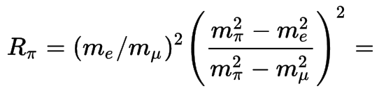
However they are not.
|R>, |L> chirality states; |+ >, |- > helicity states
| L > = | - > + m/E |+ >
|‾L > = |+ > + m/E | - >
thus the decay rate is proportional to
||<‾L|->||² = (m_{μ} /E_{μ})²
Also multiply by the phase space factor
proportional to (Pμ)² =(m²_{π} - m²_{μ} - m²_{ν})/2 m_{π}
1.2351(2) 10⁻⁴ (theory)
1.230(4) 10⁻⁴ (exp)
It is very well established that the fermions that interact with the W are
chirality (Lorentz invariant) left-handed
(one also calls the antiparticle Left-handed, although this corresponds to the
opposite sign for the helicity)

Slide 13
Ray Davis established that
(anti) neutrinos from reactors do not interact with chlorine to produce argon
reactor : n → p e⁻ ν_{e} or ν_{e} ?
these ν_{e} don’t do ν_{e} + ³⁷Cl → ³⁷Ar + e⁻
they do this:
they are called anti-neutrinos!
Introduce a lepton number which is
+1 for e⁻ and ν_{e}
and
-1 for e⁺ and ‾ν_{e}
which is (so far) observed to be conserved in weak/EM/Strong interactions

Slide 14
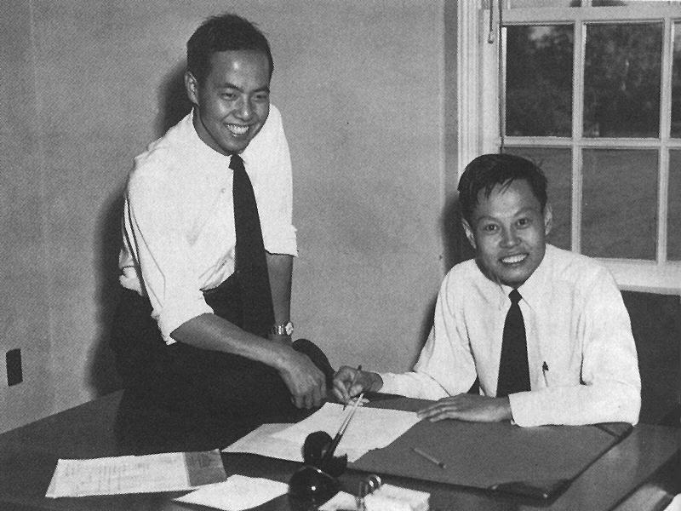
Neutrinos
the properties
1960
In 1960, Lee and Yang realized that if a reaction like
μ⁻ → e⁻ + γ
is not observed, this is because two types of neutrinos exist
ν_{μ} and ν_{e}
μ⁻ → e⁻ + ν_{μ} + ν_{e}
otherwise μ⁻ → e⁻ + ν + ν
has the same Quantum numbers as μ⁻ → e⁻ + γ
Lee and Yang

Slide 15
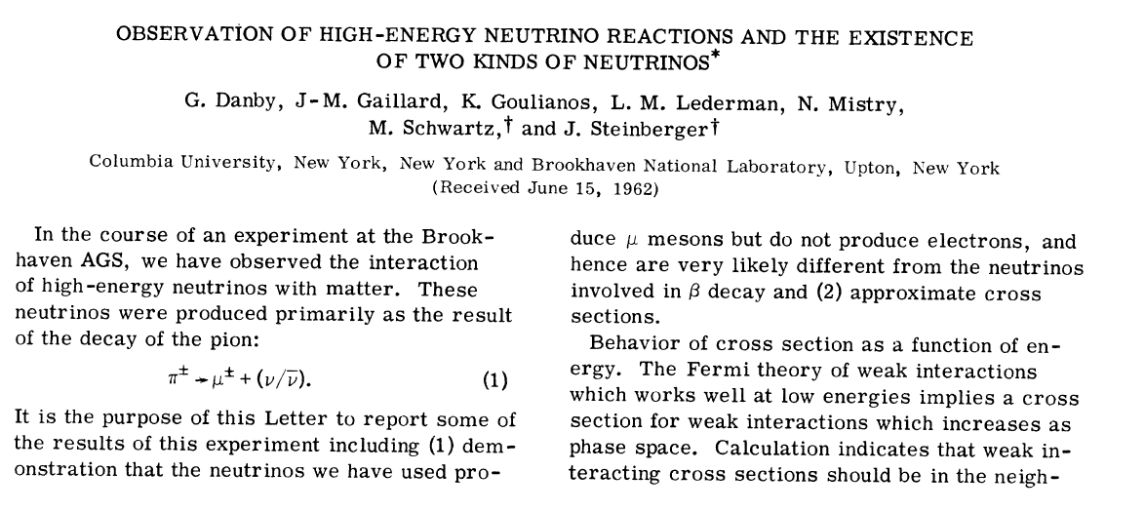
1962 discovery of the muon neutrino
The question was not whether there was a neutrino produced in tau decays,
but whether this neutrino was a new one!
pion

Slide 16
1962 discovery of the muon neutrino
This also was the first neutrino beam!

Slide 17
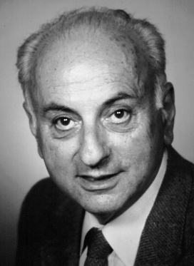
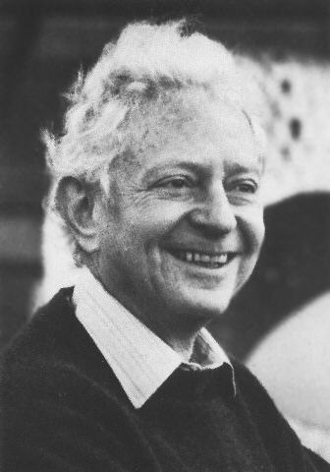
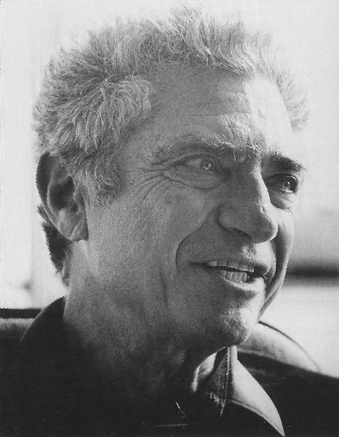
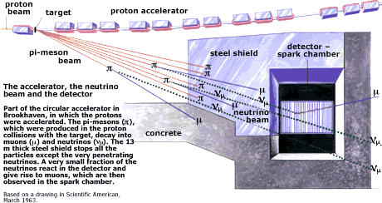
Two Neutrinos
1962
AGS Proton Beam
Schwartz Lederman Steinberger
_{μ}⁻
Neutrinos from
π-decay only
produce muons
(not electrons)
when they interact
in matter
ν_{μ}
_{hadrons}
W⁻
N
SPARK CHAMBERS:
HeNe+ HV Al plates +scintillators

Slide 18
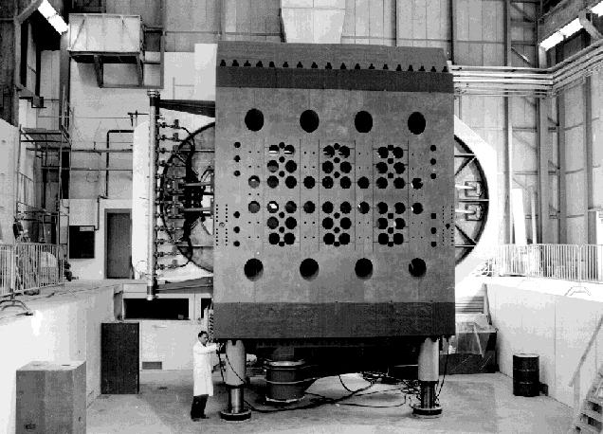
Neutrinos
the weak neutral current
Gargamelle Bubble Chamber
CERN
Discovery of weak neutral current
ν_{μ} + e → ν_{μ} + e
ν_{μ} + N → ν_{μ} + X (no muon)
previous searches for neutral currents had been performed in particle decays
(e.g. K⁰->μμ) leading to extremely stringent limits (10⁻⁷ or so)
early neutrino experiments had set their trigger on final state (charged) lepton!

Slide 19
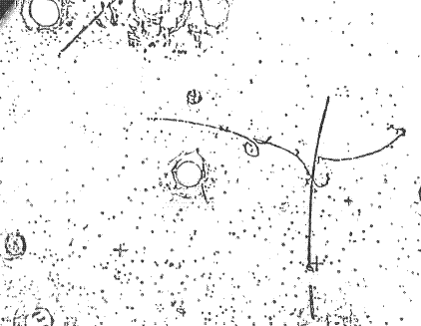
ν_{μ}
ν_{μ}
Z
e⁻
e⁻
elastic scattering of neutrino
off electron in the liquid
1973 Gargamelle
First manifestation of the Z boson
experimental birth of the Standard model

Slide 20
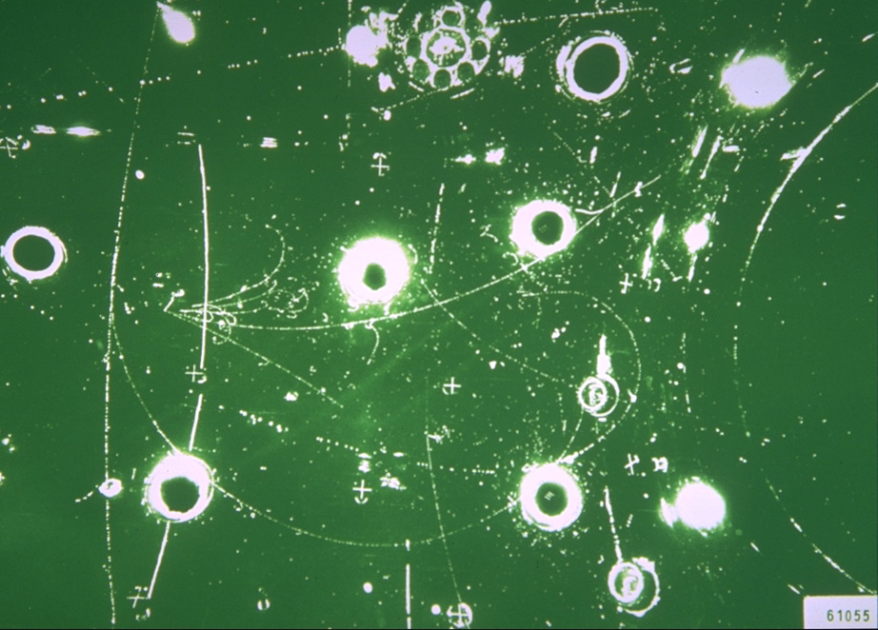
Gargamelle Charged Current event

Slide 21
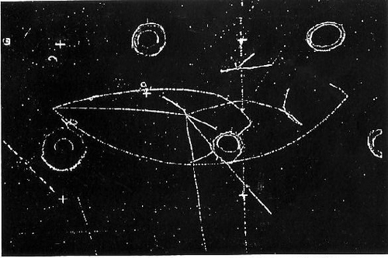
Gargamelle neutral current event (all particles are identified as hadrons)

Slide 22

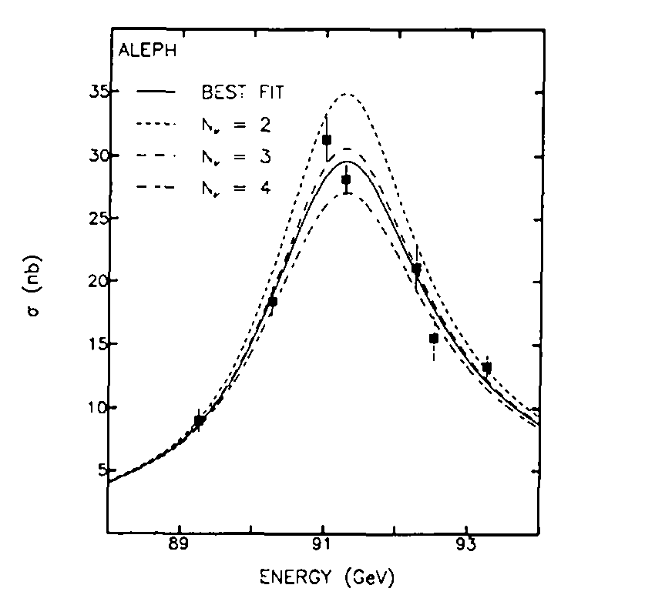
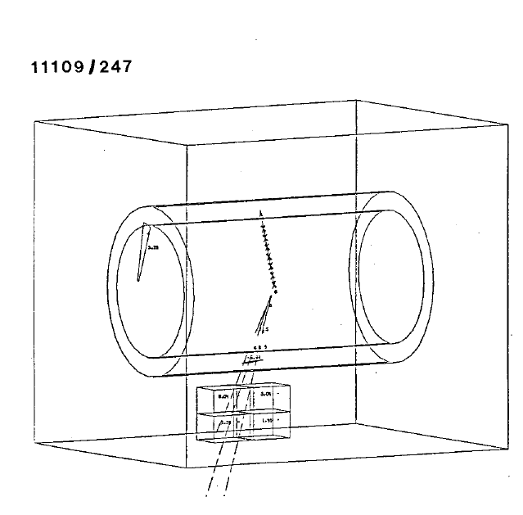
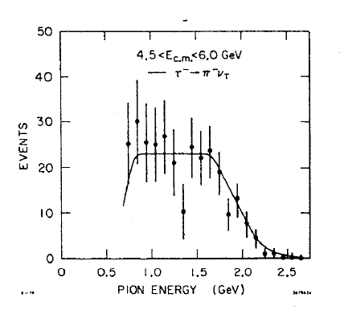
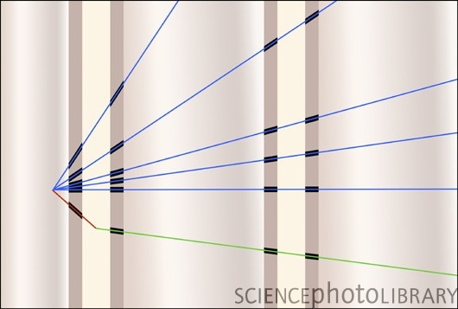
The Third (and last) Family of (light) Neutrinos ν_{τ}
A.B. arXiv:1812.11362
LEP 1989 only 3 families!
1985 UA1 W→τν_{τ} ≅ W→eν_{e}
1986 E531: no taus in ν_{μ,e} beam
1977: Discovery in tau decays (e+e- collisions @SPEAR)
1982 Particle Data Group: “ν_{τ} established”
2000 observation of ν_{τ} interactions

Slide 23
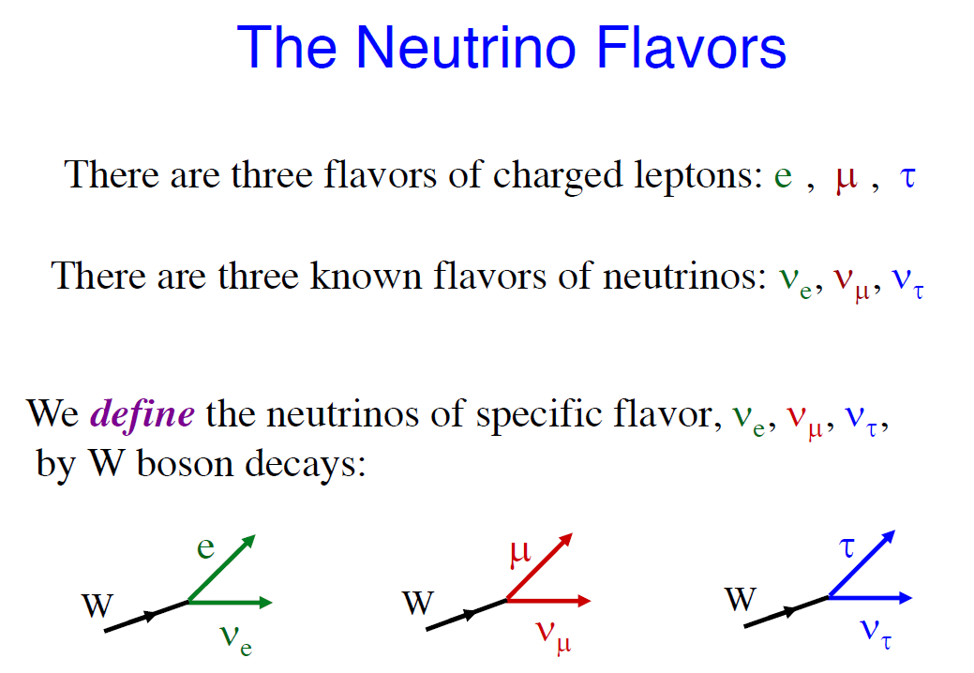
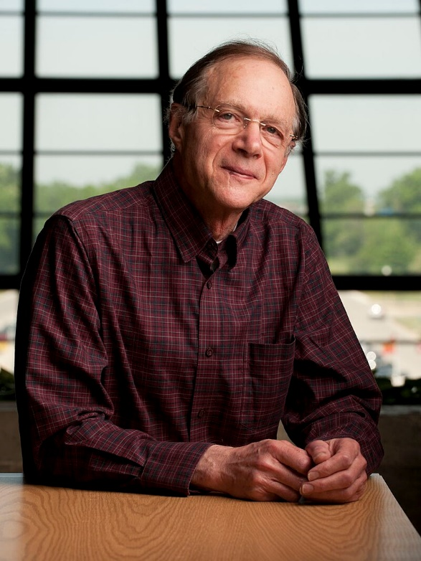
W decay is precisely what we use to define the neutrino flavours.
Boris Kayser (1938-2024)
VIIth Pontecorvo School, 2017
the existence of the three W decay modes with similar branching ratios (1985-1998)
establishes the tau and its neutrino as a new sequential heavy lepton doublet

Slide 24
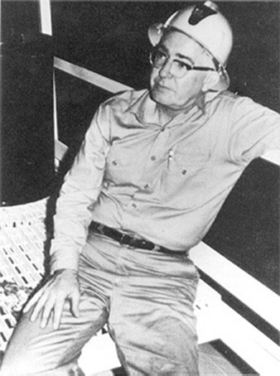
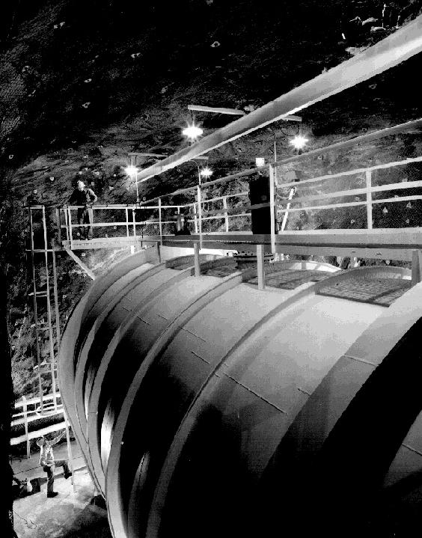
Neutrinos
astrophysical neutrinos
Ray Davis
since ~1968
Homestake Detector
Solar Neutrino Detection
600 tons of chlorine.
Detected neutrinos E> 1MeV
fusion process in the sun
solar : pp → pn e⁺ ν_{e} (then D gives He etc…)
these ν_{e} do ν_{e} + ³⁷Cl → ³⁷Ar + e⁻
they are neutrinos
The rate of neutrinos detected is
three times less than predicted!
solar neutrino ‘puzzle’ since 1968-1975!
solution: 1) solar nuclear model is wrong or 2) neutrinos oscillate

Slide 25
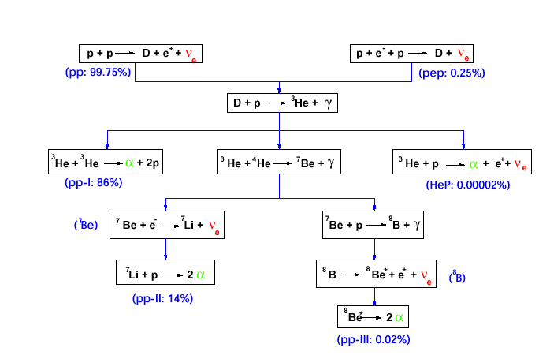
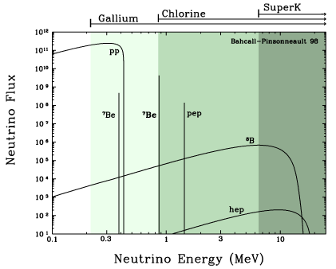
ν_{e} solar neutrinos
Sun = Fusion reactor
  Only ν_{e} produced
Different reactions
  Spectrum in energy
Counting experiments vs
flux calculated by SSM
BUT ...

Slide 26
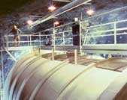
The Pioneer: Chlorine Experiment
³⁷Cl(ν_{e},e)³⁷Ar (E_{thr} = 813 keV)
K_{shell} EC τ = 50.5 d
³⁷Cl + 2.82 keV (Auger e⁻, X)
The interaction
pep+hep 0.15 SNU ( 4.6%)
⁷Be 0.65 SNU (20.0%)
⁸B 2.30 SNU (71.0%)
CNO 0.13 SNU ( 4.0%)
Tot 3.23 SNU ± 0.68 1σ
ν Signal Composition:
(BP04+N14 SSM+ ν osc)
Expected Signal
(BP04 + N14)
8.2 SNU ^{+1.8}_{–1.8} 1σ
S.N.U. = Solar Neutrino Unit
(electron-) neutrino flux producing 10⁻³⁶ captures per target atom per second

Slide 27
Generalities on radiochemical experiments
 | Data used for R determination | N runs | Average efficiency | Hot chem check | Source calib | R_{ex} [SNU]
Chlorine (Homestake Mine);South Dakota USA | 1970-1993 | 106 | 0.958 ± 0.007 | ³⁶Cl | No | 2.55 ± 0.17 ± 0.18 6.6% 7% 2.6 ± 0.3
GALLEX /GNO LNGS Italy | 1991-2003 | 124 |  | ³⁷As | Yes twice ⁵¹Cr source | 69.3 ± 4.1 ± 3.6 5.9% 5%
SAGE Baksan Kabardino Balkaria | 1990-ongoing | 104 |  | No | Yes ⁵¹Cr ³⁷Ar | 70.5 ± 4.8 ± 3.7 6.8% 5.2% 70.5 ± 6.0
expected (no osc)
8.5+-1.8
131+-11
131+-11

Slide 28
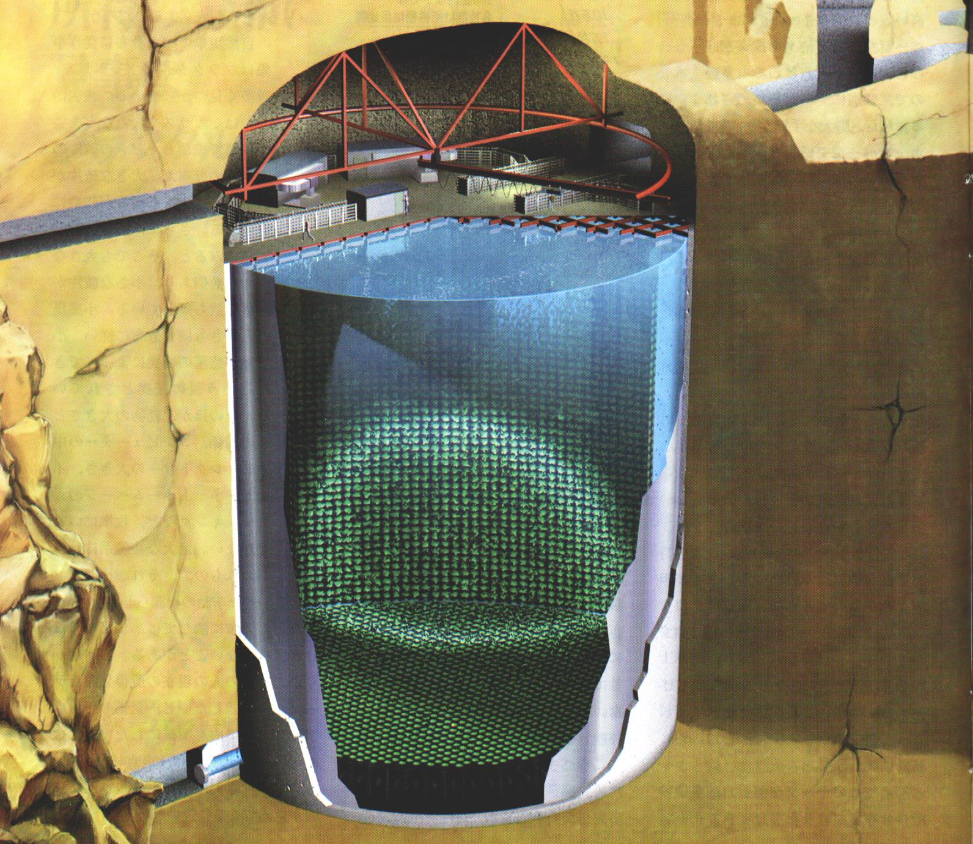
Super-K detector
Water Cerenkov
detector
50000 tons of
pure light water
≈10000 PMTs
41.3 m
39.3 m
C Scientific American

Slide 29
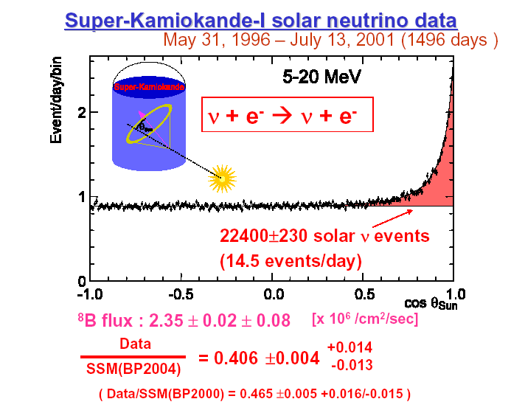

Slide 30
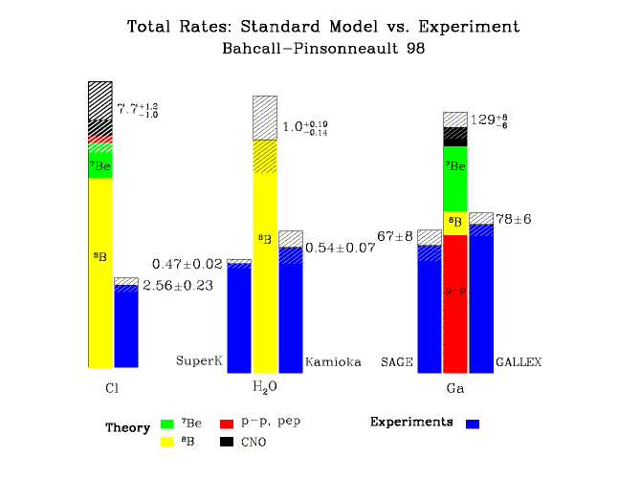
Missing Solar Neutrinos
Possible explications:
wrong SSM
  NO. Helio-seismology
wrong experiments
  NO. Agreement between different techniques
or
  ν_{e}’s go into something else
  Oscillations?
Only fraction of the expected flux is measured !

Slide 31
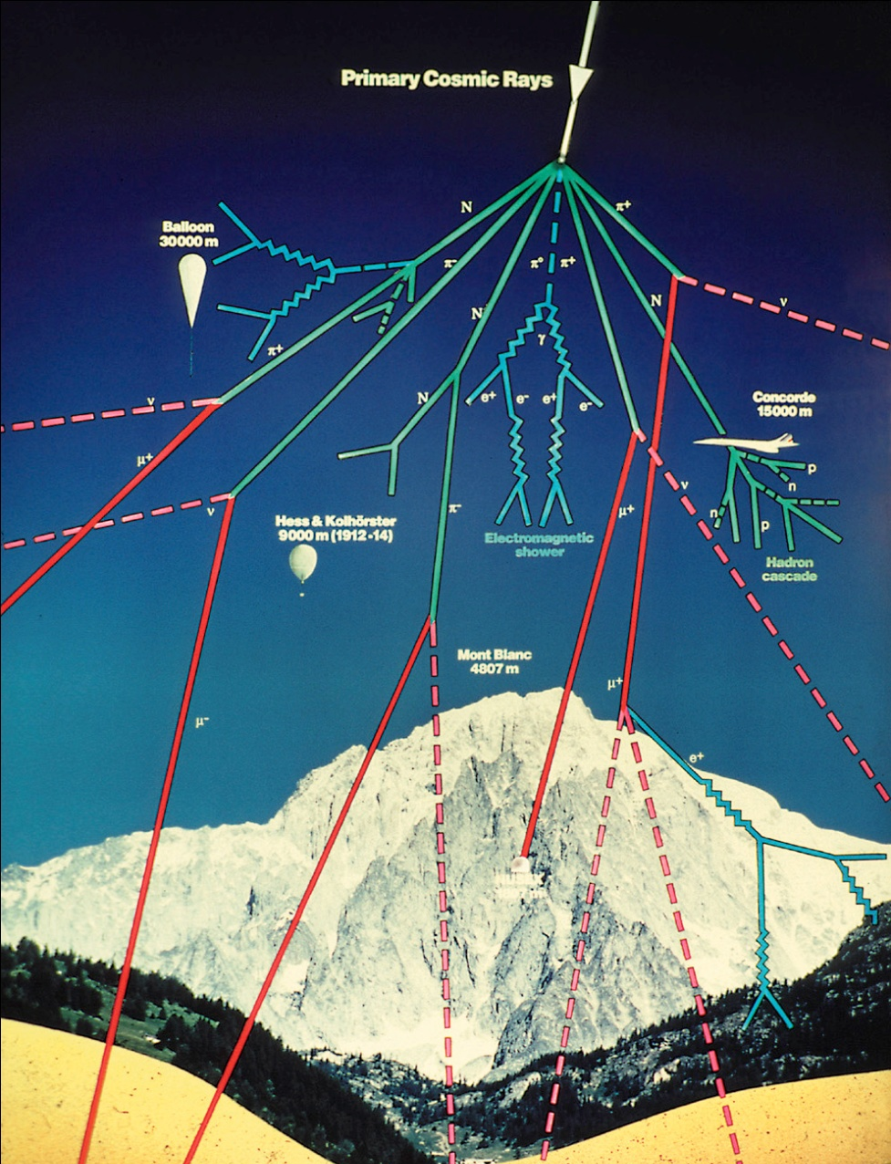
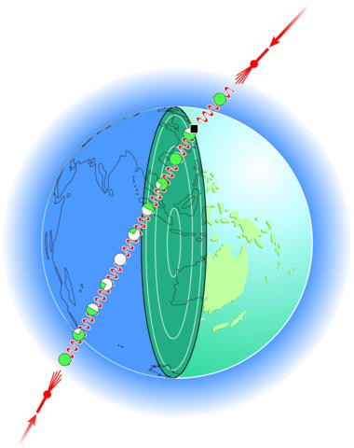
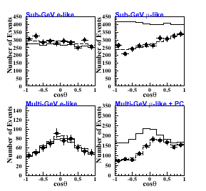
Atmospheric ν : up-down asymmetry
Super-K results
ν_{e}
ν_{μ}
up
down

Slide 32
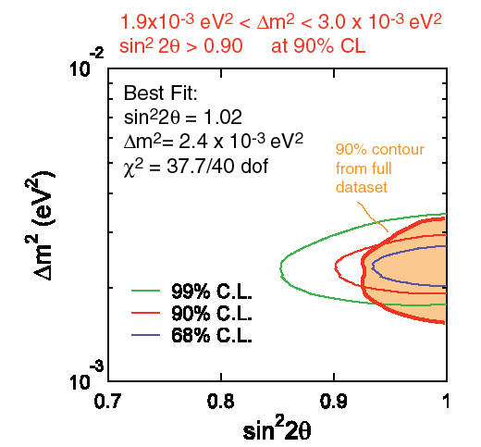
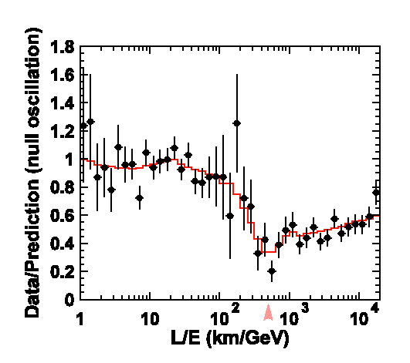
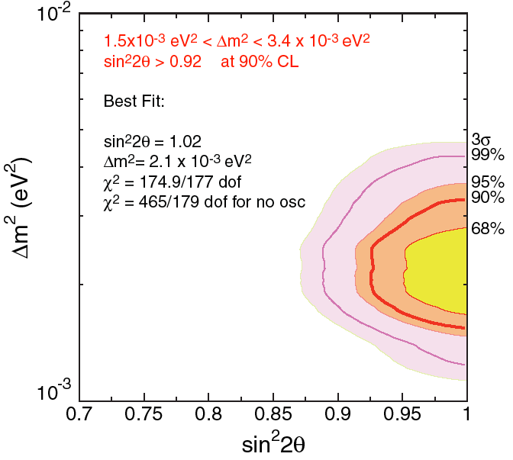
Atmospheric Neutrinos
SuperKamiokande Atmospheric Result

Slide 33
Neutrino mass…
The simple fact that neutrinos transform during their flight
from source to detector is a proof that they have mass.
Particle that has no mass cannot transform:
τ_{lab} = γ τ_{particle} = E/m τ_{particle} if m → 0 ➔ τ_{lab} → ∞ !

Slide 34
neutrino definitions
the electron neutrino is present in association with an electron (e.g. beta decay)
the muon neutrino is present in association with a muon (pion decay)
the tau neutrino is present in association with a tau (W→τν decay)
these flavor-neutrinos are not (as we know now) quantum states of well defined mass (neutrino mixing)
the mass-neutrino with the highest electron neutrino content is called ν₁
the mass-neutrino with the next-to-highest electron neutrino content is ν₂
the mass-neutrino with the smallest electron neutrino content is called ν₃

Slide 35
Neutrino Oscillations (Quantum Mechanics lesson 5)
since Pontecorvo)
source
propagation in vacuum -- or matter
detection
L
weak interaction
produces
‘flavour’ neutrinos
e.g. pion decay π → μν
¦ν_{μ}> = α ¦ν₁ > + β ¦ν₂ > + γ ¦ν₃ >
weak interaction: (CC)
ν_{μ} Ν → μ⁻ Χ
or ν_{e} Ν → e⁻ Χ
or ν_{τ} Ν → τ⁻ Χ
P ( ν_{μ} → ν_{e}) = ¦ < ν_{e} ¦ ν (t)>¦²
Energy (i.e. mass) eigenstates
propagate
¦ν (t)> = α ¦ν₁ > exp( i E₁ t)
+ β ¦ν₂ > exp( i E₂ t)
+ γ ¦ν₃ > exp( i E₃ t)
t = proper time ∝ L/E
α is noted U_{1μ}
β is noted U_{2μ}
γ is noted U_{3μ} etc….

Slide 36
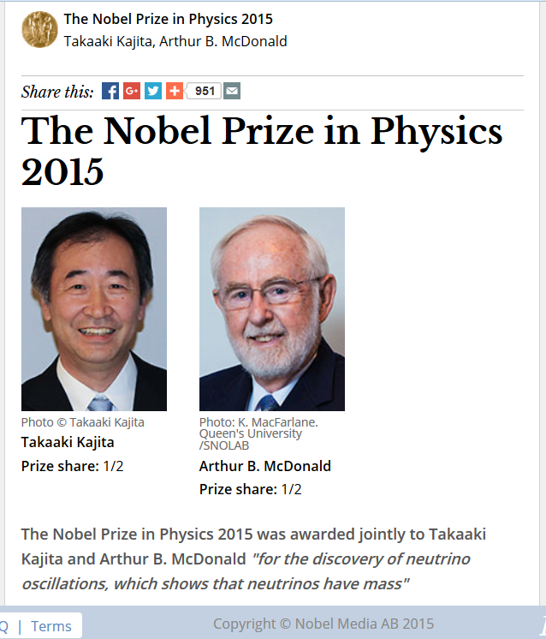

Slide 37
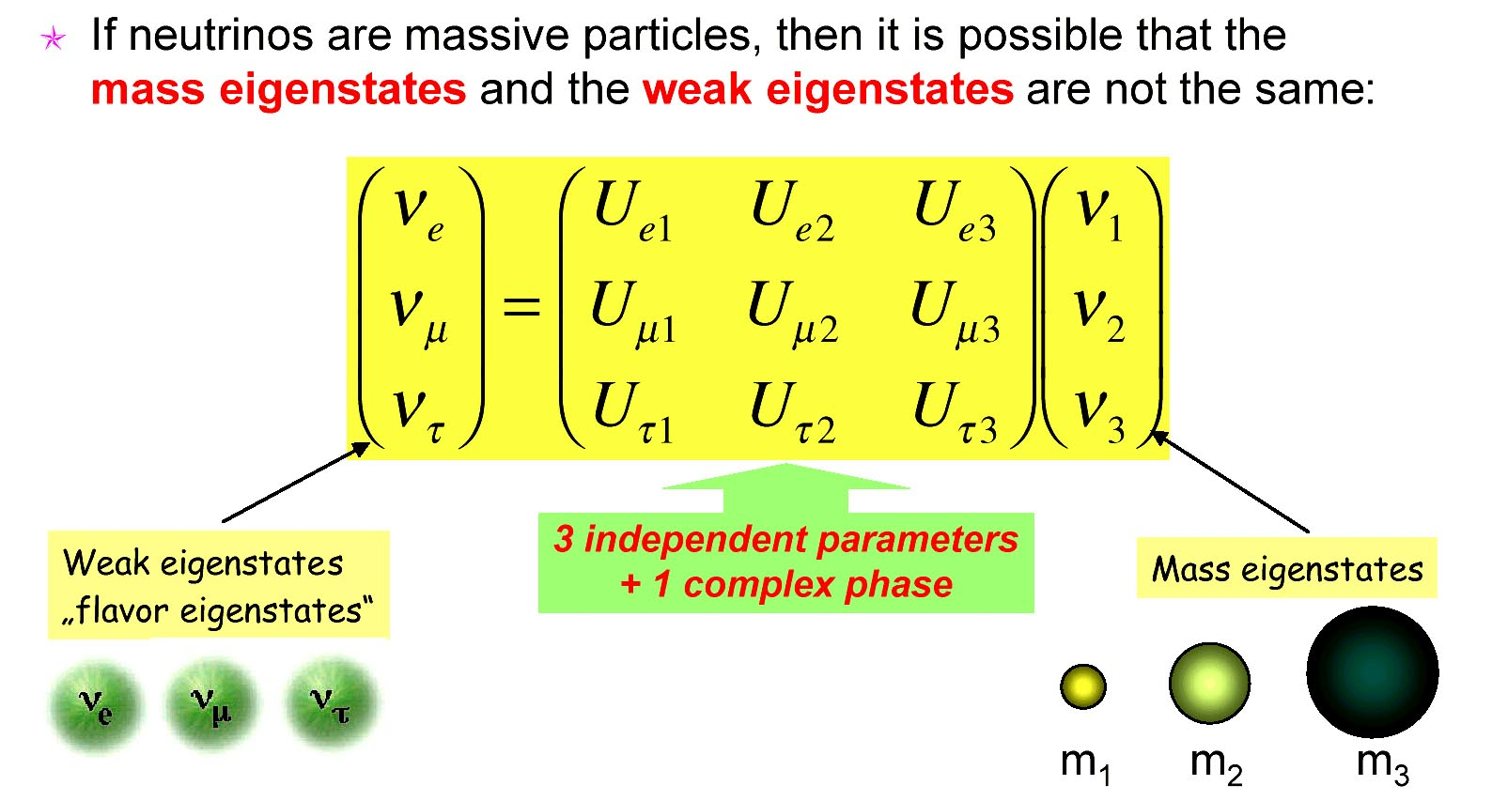
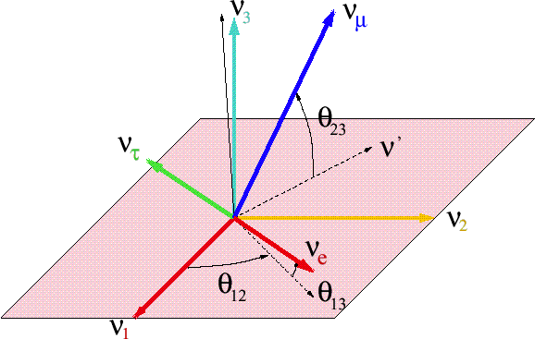
Lepton Sector Mixing
Pontecorvo 1957

Slide 38
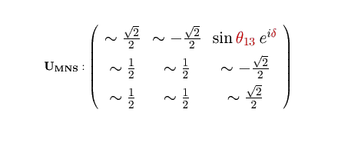
The neutrino mixing matrix:
3 angles and a phase δ
ν₃
Δm²₂₃= 2 10⁻³eV²
ν₂
ν₁
Δm²₁₂= 8 10⁻⁵ eV²
OR?
ν₂
ν₁
Δm²₁₂= 8 10⁻⁵ eV²
ν₃
Δm²₂₃= -2 10⁻³eV²
Unknown or poorly known phase δ , sign of Δm₂₃
2

Slide 39
food for thought: (simple)
what result would one get if one measured the mass of a ν_{e} (in K-capture for instance)?
what result would one get if one measured the mass of a ν_{μ} (in pion decay) ?
Is energy conserved when neutrinos oscillate?
ν_{e}
ν_{μ}
would measure a distribution with three values of mass with the following probabilities
¦U_{1e}¦² ¦U_{2e}¦² ¦U_{3e}¦²
<m _{νe}>=¦U_{1e}¦² m₁ + ¦U_{2e}¦² m₂ + ¦U_{3e}¦² m₃
ν₁
ν₂
ν₃
m
ν₁
ν₂
ν₃
m

Slide 40
Is energy conserved when neutrinos oscillate?
Energy (i.e. mass) eigenstates
propagate
¦ν (t)> = U_{1e} ¦ν₁ > exp( i E₁ t)
+ U_{2e} ¦ν₂ > exp( i E₂ t)
+ U_{3e} ¦ν₃ > exp( i E₃ t)
P(ν₁) = ¦U_{1e}¦²
P(ν₂) = ¦U_{2e}¦²
P(ν₃) = ¦U_{3e}¦²
are conserved during propagation

Slide 41
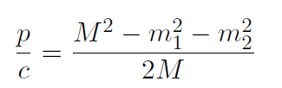
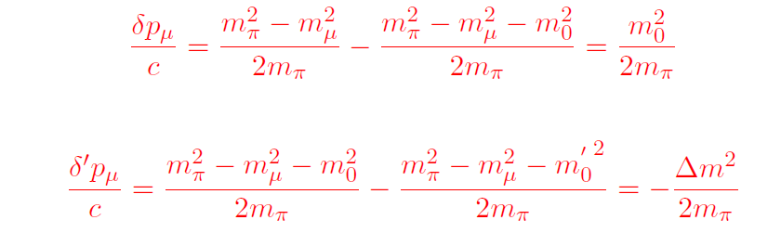


Why do neutrinos oscillate?
take π→μν decay M=m_{π} m₁= m_{μ} m₂=m_{ν}
muon momentum:
variation of muon momentum upon neutrino mass and mass differences
for m_{v}= 2eV/c²
for Δm²_{v}= 2 10-³(eV/c²)²

Slide 42
However we need to take into account the width of the pion since it decays
with a life time of 26ns or cτ=7.8m (hbar.c = 200 MeV.fm)
Δm_{π} = hbar/τ ~4 10⁻¹⁴ MeV/c² ➔ Δp_{μ} ~ 3 10⁻¹⁴ MeV/c
the uncertainty due to the pion decay width is much larger than the difference
in momentum between the neutrino mass eigenstates.
This is the same relationship that ensures that interference happens between
light coming from different holes. (can’t tell which hole the light went through)
Neutrinos oscillate for the fundamental quantum reason that the width of the
decaying parent makes it impossible to tell the neutrino mass
by measuring its mass from kinematics.
from Δm_{π}
much amplified: the central value of p_{μ}(ν1), p_{μ}(ν2), p_{μ}(ν3) distribution

Slide 43
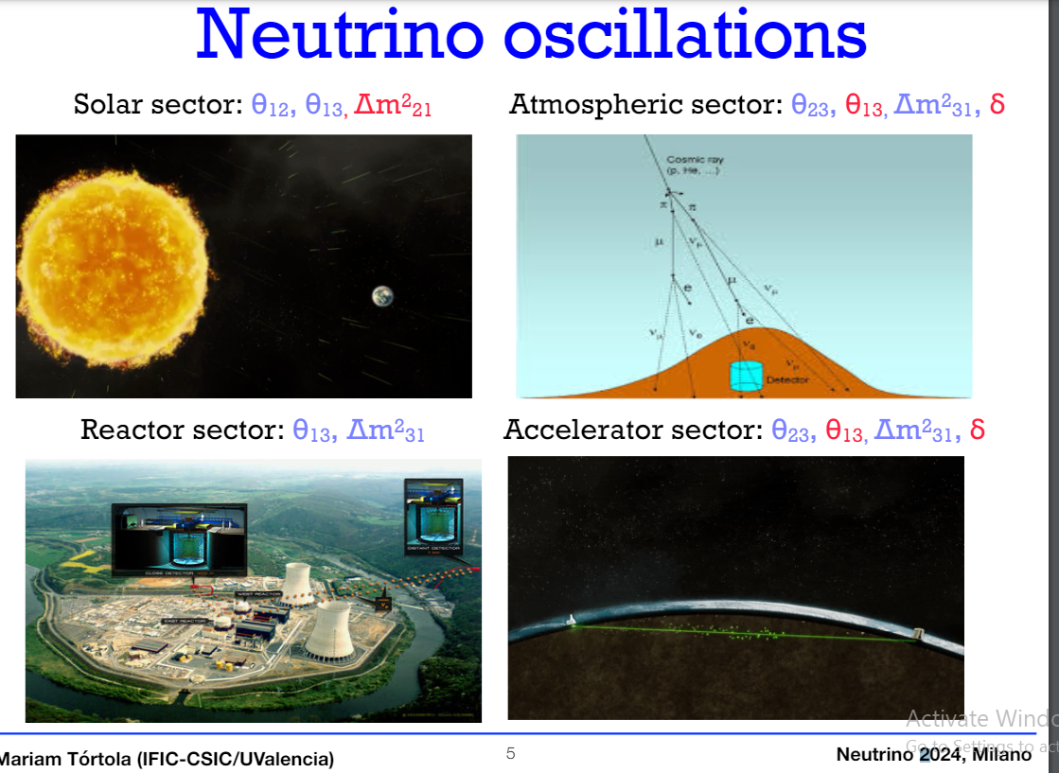
__
_____
2
±
__
__
2
±

Slide 44
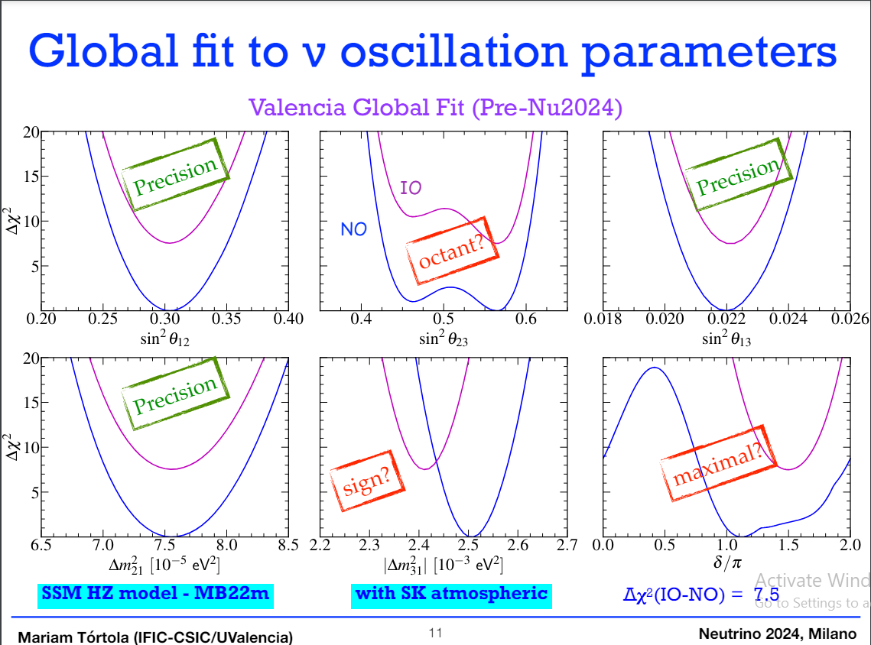
So far νμ↔ντ osc.
∝ sin²2θ₂₃
Improve w. νμ↔νe osc.
No conclusion yet concerning the mass ordering or the T (CP) violation! 5σ wanted

Slide 45
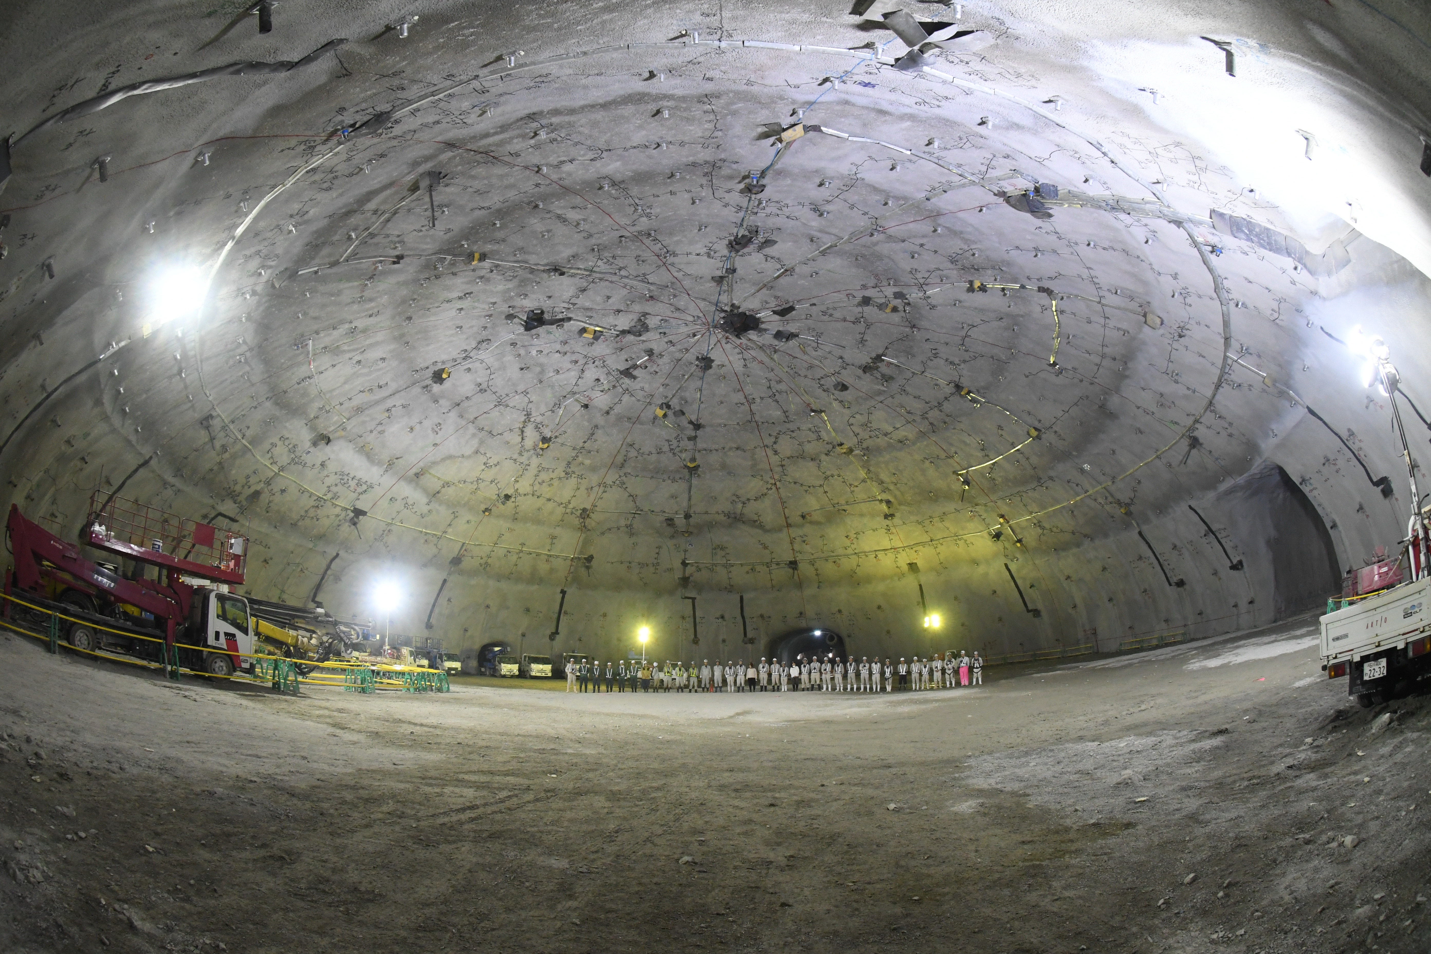
HyperKamiokande water Cherenkov detector
T2K beam with upgrade to 1.3MW (presently 800KW running)
Upgraded near detector (angular coverage) and (later) new off axis WC
And a formidable 180kton fid. far detector (SK x 8) beam in 2027/8

Slide 46
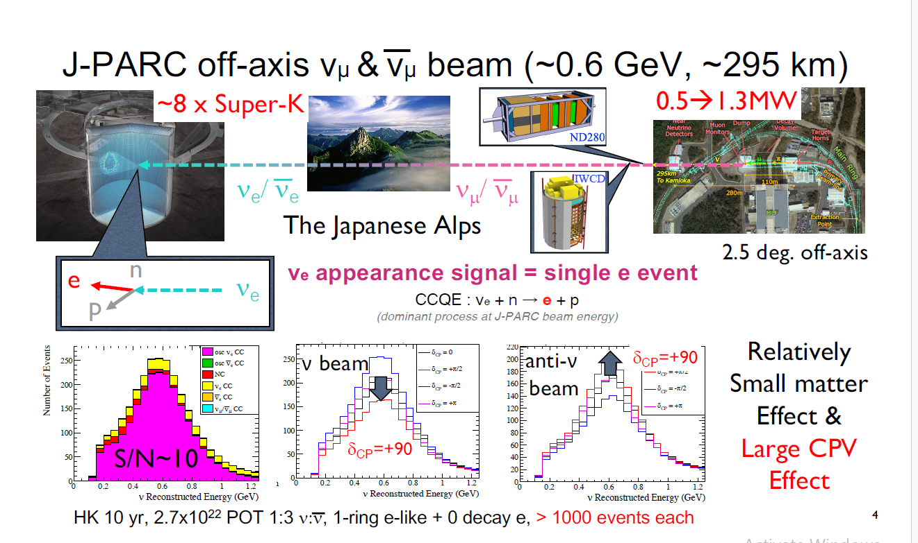


Slide 47

HyperKamiokande water Cherenkov detector

Slide 48


Near detector includes
On and off axis var. angle
Detectors.
ν_{μ}
ν_{e}
Far site excavation is complete
● Building & Site Infrastructure work mid-2025
● Far Detector installation in 2026-27
● Physics in 2028/early 2029
● Beam physics with Near Detector
+ 2 far modules: 2031

Slide 49


Time 0 = 2031
5sigma for δ_{CP}=-pi/2
After 8yrs w. 4 detectors

Slide 50
JUNO : a high precision program
Proposed 2008 (PRD78:111103,2008; PRD79:073007,2009)
53km from 2 nuclear reactors. Far (JUNO) and near (JUNO-Tao) detectors
20 kton LS, 3% energy resolution, 700 m underground
Approved in 2013 Construction in 2015-2024 (2025 conferences!)
almost finished!
reactor (anti-neutrino)+
solar, supernova, atmospheric, geo-neutrinos, proton decay, exotic searches

Slide 51


JUNO will make legacy
measurements on solar sector
and sin²θ₁₃
AND
determine the mass hierarchy
from the phase of the oscillation!

Slide 52
Neutrino mass…
The simple fact that neutrinos transform during their flight
from source to detector is a proof that they have mass.
Particle that has no mass cannot transform:
τ_{lab} = γ τ_{particle} = E/m τ_{particle} if m → 0 ➔ τ_{lab} → ∞ !
Neutrino oscillations are sensitive to mass differences Δm_{ij}²
How can one detect the neutrino mass itself?
There are presently 4 different methods:
-- kinematic method (the most direct and most difficult)
-- effect of neutrino mass on the early universe
-- neutrinoless double beta decay
-- detect directly the heavy right-handed neutrinos

Slide 53

Electron antineutrino mass measurement in tritium β decay

Slide 54



What is measured
e- spectrum in β decay
The only variable measured is electrons kinetic energy
The goal of the measurement is to determine a value for the mass of the electron antineutrino
Tritium is chosen for very small Q-value
➔small electron energy, relatively larger effect
Also practical questions e.g. lowest dE/dx

Slide 56
Physics run in 2019-2025!

Slide 57

Take electrons of any momentum orientation in high B-field ( B = 3.5 T)
and make the adiabatic transformation to longitudinal momentum
in very small B-field (B_{min} = 3.36 G) (1T = 10’000 G)
Conservation of angular momentum
L = P_{T}.R with R= P_{T}/0.3B ➔ L= P_{T} ²/0.3B =Cte ➔ P_{T} scales as 1/sqrt(B)

Slide 58


Slide 59

Alexey Lokhov, Neutrino 2024 agenda.infn.it/event/37867/
Δm²=2.5 10⁻³ eV² ➔ m(heaviest) > 0.05 eV

Slide 60

What IS the neutrino mass?????
The future of neutrino physics
There is a long way to go to match direct measurements of neutrino masses with oscillation results
and cosmological constraints

Slide 61


Slide 62


Slide 63
Direct exploration of the Big Bang -- Cosmology
measurements of the large scale structure of the universe
using a variety of techniques
-- Cosmic Microwave Background
-- observations of red shifts of distant galaxies with a variety of candles.
Big news in 2002 : Dark Energy or cosmological constant
large scale structure in space, time and velocity
is determined by early universe fluctuations, thus by mechanisms of energy release
(neutrinos or other hot dark matter)
The early universe is sensitive to neutrinos which are
carriers of fast, weakly interacting, kinetic energy.
Number of neutrino (or neutrino-like) degrees of freedom
controls the size of the effects
Mass of neutrinos
controls the velocity of neutrinos and the energy at which
they stop being relevant

Slide 64

Maria Archidiacono NEUTRINO 2024

Slide 65


Slide 66





Formation of Structure
Smooth
Structured
Structure forms by
gravitational instability
of primordial
density fluctuations
A fraction of hot dark matter
suppresses small-scale structure

Slide 67

Halzen
adding hot
neutrino dark
matter erases
small structure
m_{ν} = 0 eV
m_{ν} = 1 eV
m_{ν} = 7 eV
m_{ν} = 4 eV

Slide 68

Present boundary
N_{eff}=3.1±0.17(95%CL)
This is valid for the eV scale sterile neutrinos
Sensitivity depends on mass with unclear upper value (eV?, keV, MeV?)

Slide 69

Cosmology (CMB, Large scale structure) sensitive to light neutrino masses
But model-dependence is strong.
➔knowledge of neutrinos would open new exploration power from cosmology!

Slide 70
How come there is ‘normal matter’ at all?
The simplest Big Bang is ‘just energy’ at Time =0
-- particle physics only ever sees equal amounts
of matter and antimatter created from energy
+ matter and antimatter annihilate
-- where is antimatter gone?

Slide 71
How come there is ‘normal matter’ at all?
Sakharov conditions:
-- out of equilibrium (Big Bang)
-- time reversal (CP) violation (neutrino oscillations?)
-- matter-antimatter transition (fermion number non-conservation)

Slide 72
Neutrinos have mass and mix
This is NOT the conventional Standard Model
why cant we just add masses to neutrinos?

Slide 73
Fermion number conservation
Is *not* in itself a law or a symmetry of the Standard Model
For charged fermions (e/mu/tau and the quarks) it is not possible to transform
a fermion into an antifermion because of charge conservation
For neutrinos, which are neutral, the SM assumes they are massless.
neutrino is left-handed (identical if massless to negative helicity)
and the antineutrino has positive helicity
neutrino <-> antineutrino transition is forbidden by angular momentum conservation
This results in practice in apparent, accidental, conservation of fermion number
The existence of massive neutrinos allows for spin flip and thus in principle a neutrino-antineutrino transition
since a left-handed field (EW eigenstate) has a component of the opposite helicity (EW state ≠ physical state)
ν_{L} ≈ ν₋ + ν₊ m/E (mass is what allows to flip the helicity)
for allowed masses of light neutrinos this is tiny: for m_{ν} =50 meV and P*_{π} =30 MeV ➔ (m/E)² = 10⁻¹⁸
This can be observed in neutrino less double beta decay
or by searching directly for the right-handed neutrinos

Slide 74










NEUTRINO MASSES
my SM training in 1976
$$\left({e \atop v_{e}}\right)$$
$$\left({ \atop v_{μ}}\right)$$
$$\left({ \atop v_{τ}}\right)$$
$$\left(e\right)$$
$$\left(\right)$$
$$\left(\right)$$
Q= -1
Electroweak eigenstates
R
R
R
L
L
L
$$\left(_{e}\right)$$
$$\left(_{μ}\right)$$
$$\left(_{τ}\right)$$
Q= 0
R
R
R
I = 1/2
I = 0
Right handed neutrinos
are singlets
no weak interaction
no EM interaction
no strong interaction
can’t produce them
can’t detect them
-- so why bother? –
Also called ‘sterile’
NB unlike for v_{L} , nothing distinguishes the particle and antiparticle of v_{R} which is a singlet (no ‘charge’)
→ naturally a Majorana particle

Slide 75


It is all about mass!

Slide 76

Neutrino masses occur via processes which are intimately related to the Higgs boson
what are the couplings of the H(125) to neutrinos?
Let us follow the steps of the Standard Model to construct a minimal neutrino mass model
Adding neutrino masses to the Standard model 'simply' by adding a Dirac mass
➔ right-handed neutrino
m_{D} is the Higgs Yukawa coupling (like everybody else). Then the right handed neutrinos are sterile, (except that they couple to both the Higgs boson and gravitation).
Things become more interesting: a Majorana mass term arises (So-called Weinberg Operator) using the Higgs boson and the neutrino Yukawa coupling:
B. Kayser 1989
Majorana mass term is extremely interesting as this is the
particle-to-antiparticle transition that we want
in order to explain
the Baryon asymmetry of the Universe
(+ CP violation in e.g. neutrinos)
M_{R}
+ restores SU(2) symmetry!
Pilar Hernandez, Silvia Pascoli
Granada 2019-05

Slide 77
The minimal neutrino Standard Model
is type I see-saw (just complete with RH ν’s)

Slide 78


Having two mass terms per family , neutrinos undergo level splitting ➔ Mass eigenstates
See-saw type I :
M_{R} ≠ 0
m_{D} ≠ 0
Dirac + Majorana
mass terms
see-saw
M_{R} = 0
m_{D} ≠ 0
Dirac only, (like e- vs e+):
ν_{L} ν_{R} ‾ν_{L} ‾ν_{R}
½ 0 ½ 0
4 states of equal masses
M_{R} ≠ 0
m_{D} = 0
Majorana only
ν_{L} ‾ν_{R}
½ ½
2 states of equal masses
M_{R} > m_{D} ≠ 0
Dirac + Majorana
ν N ‾ν N
½ 0 ½ 0
4 states , 2 mass levels
m
m
m
I_{weak}=
I_{weak}=
dominantly:
I_{weak}=
Some have I=1/2 (active)
Some have I=0 (sterile)
All have I=1/2 (active)
m₁ have ~I=1/2 (~active)
m₂ have ~I=0 (~sterile)

Slide 79






Manifestations of right handed neutrinos
$v$ = light mass eigenstate
N = heavy mass eigenstate HNL
≠ $vL$ , active neutrino
which couples to weak inter.
and ≠ N_{R}, which does’nt.
one family see-saw :
θ ≈ (m_{D}/M)
$mv$ ≈ $\frac{mD2}{M}$
m_{N} ≈ M
|U|² ∝ θ² ≈ $mv$/ m_{N}
ν = ν_{L} cosθ - ${Nc}_{R }^{} sin$θ
$N=N_{R}^{} \text{cos}\text{θ}+ vL$ ^{c} sinθ
what is produced in W, Z decays is:
$vL= v$ cosθ + $N_{ }^{}sin$θ
-- mixing with active neutrinos leads to various observable consequences
-- observation of neutrinoless double beta decay
-- if very light (eV) , possible effect on neutrino oscillations (‘eV sterile neutrino’ (LSND/miniBooNE/reactor anomalies etc... but ruled out since PLANCK mission MINOS/ICECUBE/DAYABAY/microBooNE. Search still ongoing in broader region)
-- if in 5-100 keV region (dark matter), monochromatic photons from galaxies with E=m_{N}/2, KATRIN
-- possibly measurable effects at High Energy
➔ If N is heavy it will decay in the detector → spectacular
➔ Higgs, Z, W visible exotic decays H→ ν_{i}‾Ν_{i} and Z→ ν_{i}‾Ν_{i} , W-> l_{i} ‾Ν_{i}
➔ also in K, charm and b decays via W*-> l_{i} ±‾Ν , Ν → l_{j} ±
with any of six sign and lepton flavour combination
➔ violation of unitarity and lepton universality in Z, W or τ decays
➔ PMNS matrix unitarity violation and deficit in Z «invisible» width
-- etc... etc...
-- Couplings are very small (|U|² = $mv$/ m_{N}) for one family. For three families they can be somewhat larger
but most interesting region is near the one-family see-saw limit

Slide 80
Pion decay with massive neutrinos
π⁺
μ⁺
π⁺
μ⁺
+
ν_{L}
ν_{L}
ν_{L}^{c =}
ν_{L}
1
(m_{ν} /E)²
in case of pure Dirac:
transition to sterile right handed neutrinos
in case of pure Majorana:
transition to anti-neutrino
in case of see-saw:
if possible, transition to heavy RH neutrino
(.05/30 10⁶)² = 10⁻¹⁸
no problem

Slide 81


Slide 82


Slide 83





Neutrino-less Double Beta Decay
SNO+ (Te)
nEXO (Xe)
LEGEND (Ge)
CUPID (Mo)
KAM-ZEN (Xe)
There are a number of experiments in operation and others in development with several different isotopes. This will be an advantage in the advent of a discovery
Detailed nuclear theory calculations are needed to interpret these measurements and are an important part of the field.
There is a question of quenching of g_{A} that could reduce the sensitivity of these experiments to effective neutrino mass by a factor of 2 to 4.

Slide 84
Summary plot from NSAC LRP White Paper (Augmented) (Values provided by experiments)
(Assuming that process is mediated by low mass neutrinos and g_{A} is not quensched)
AMORE
XLZD
NEXT Bold
3-MANTIS
LEGEND 6000
MANTIS
Inverted Order Minimum
CUPID 1T
SELENA
Long Term
Top of Normal Ordering for lightest mass
From: Fundamental Symmetries, Neutrons, and Neutrinos (FSNN):
Whitepaper for the 2023 Nuclear Science Advisory Committee Long Range Plan: arXiv:2304.03451iv:2304.03451

Slide 85










Direct Search Processes (I)
m_{N} Below m$e$:
N→ 3ν; N→ νγ w E_{γ}=m_{N}/2
Meson decay (π,K,D and neutrino beams) examples:
π,K,
Long life, dark matter candidate
Search for gamma emission line
(such as 3.5 keV line)
Drewes et al; arXiv:1602.04816v1
$$×\frac{Pν }{45GeV/c}$$
Decay via W gives at least two charged particles, and amounts to ~60% of decays.
Searches for long lived decays in neutrino beams PS191, NuTeV, CHARM; SHIP and DUNE

Slide 86


Next generation heavy neutrino search experiment SHIP
-- focuses on neutrinos from charm to cover 0.5 – 2 GeV region
-- uses beam dump to reduce background from neutrino interactions from pions and Kaons
and bring the detector as close as possible to source.
-- increase of beam intensity and decay volume
status: proposal, physics report and technical report exist. R&D phase approved at CERN
arXiv:1504.04855
arXiv:1504.04956

Slide 87


Slide 88


Slide 89


Slide 90









Processes (II)
Search for heavy right-handed neutrinos in F.T. or collider experiments.
B factories
Hadron colliders
+
+
or$l$±ν
(*)
-
Z factory (FCC-ee, Tera-Z)
HE Lepton Collider (LEP2, CEPC, CLIC, FCC-ee, ILC, μμ)
arXiv:1411.5230

Slide 92


Heavy Neutral Leptons -- recent litterature
777 references!

Slide 93

Heavy Neutral Leptons at the Z factory
courtesy
Panos Charitos

Slide 94


This picture from the briefing book is relevant to Neutrino, Dark sectors and High Energy Frontiers.
FCC-ee (Z) compared to the other machines for right-handed (sterile) neutrinos
How close can we get to the ‘see-saw limit’?
-- the purple line shows the 95% CL limit if no HNL is observed. (here for 10¹² Z),
-- the horizontal line represents the sensitivity to mixing of neutrinos to the dark sector,
using EWPOs (G_{F} vs sin²θ_{W}^{eff} and m_{Z}, m_{W}, tau decays) which extends sensitivity
to 10⁻⁵ mixing all the way to very high energies (500-1000 TeV at least). arxiv:2011.04725

Slide 95
FCC-hh
We have seen that the Z factory offers a clean method
for detection of Heavy Right-Handed neutrinos
Ws are less abundant at the lepton colliders
At the 100 TeV pp W is the dominant particle,
Expect 10¹³ real W’s.
There is a lot of /pile-up/backgrounds/lifetime/trigger issues which need to be investigated.
BUT.... in the regime of long lived HNLs the simultaneous presence of
-- the initial lepton from W decays
-- the detached vertex with kinematically constrained decay
allows for a significant background reduction.
But it allows also a characterization both in flavour and charge of the produced neutrino, thus
information of the flavour sensitive mixing angles and a test of the fermion violating nature
of the intermediate (Majorana) particle.
VERY interesting...

Slide 96
Conclusions
Neutrinos, at this moment in time, provide beautiful and intriguing mysteries
-- is time reversal violated in neutrino oscillations
-- is there a matter-antimatter transition in neutrinos
-- do right-handed neutrinos exist?
-- is the origin of neutrino masses the same (SM Higgs coupling)
as that of the other fermions?
The answer to which have great chances to provide the explanation
of the very existence of our ‘matter’ Universe
The solution of these mysteries requires an all-fronts program of research
involving
-- theoretical understanding and calculations
-- neutrino beam experiments (but for how long?)
-- nuclear physics experiments (0vββ)
-- fixed target experiments (e.g. SHIP at CERN)
-- collider experiments (see you tomorrow ;-) !
-- you invent it!

