Slide 1
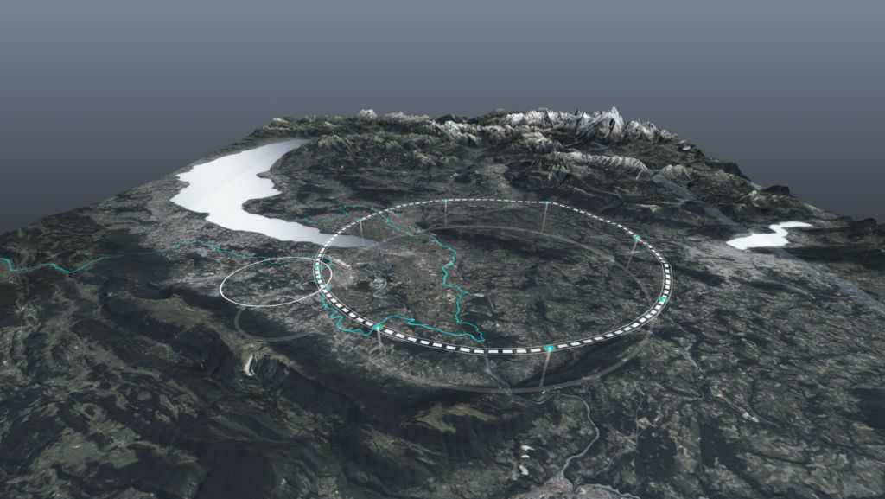









FCC Feasibility Study Status
Workshop on Standard Model and Beyond
Corfu Summer Institute
27 August 2024
Ghislain ROY, CERN
on behalf of FCC collaboration & FCCIS DS team
and with slides from M. Benedikt, F. Zimmermann, E. Tsesmelis et al.
http://cern.ch/fcc
Work supported by the European Commission under the HORIZON 2020 projects EuroCirCol, grant agreement 654305; EASITrain, grant agreement no. 764879; iFAST, grant agreement 101004730, FCCIS, grant agreement 951754; E-JADE, contract no. 645479; EAJADE, contract number 101086276; and by the Swiss CHART program
photo: J. Wenninger

Slide 2

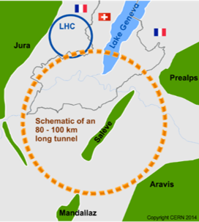
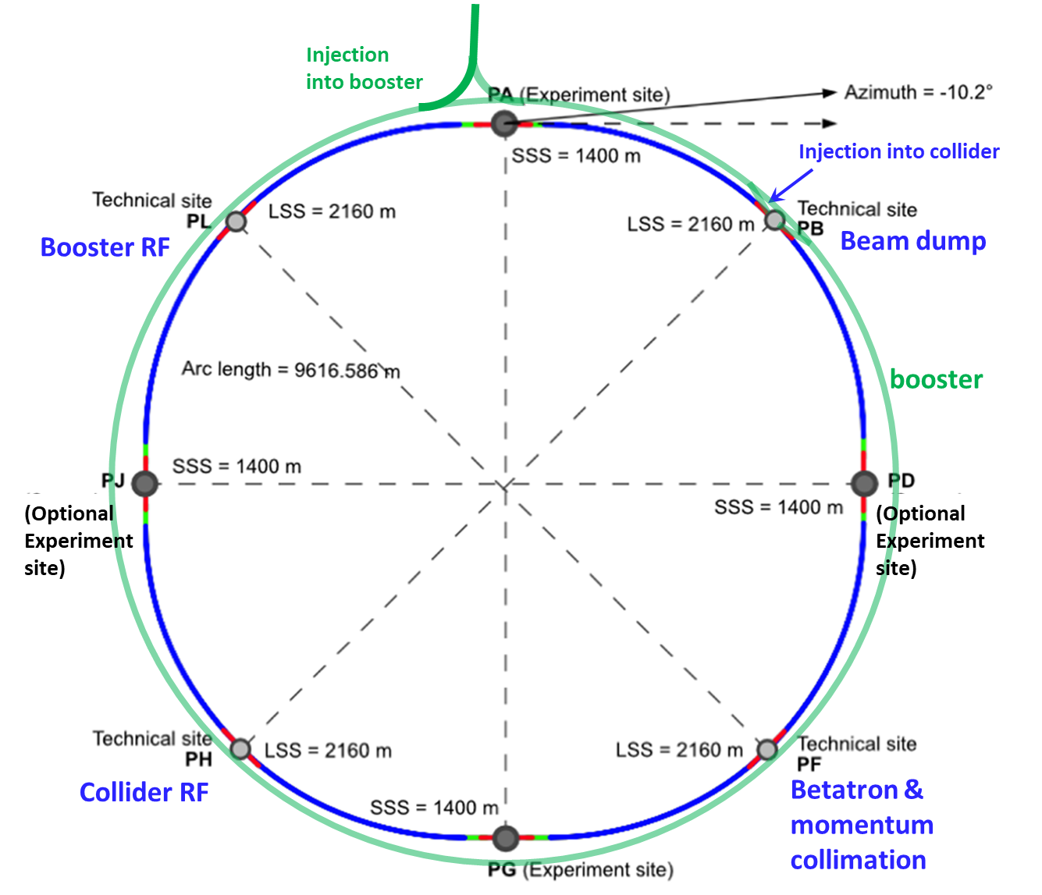
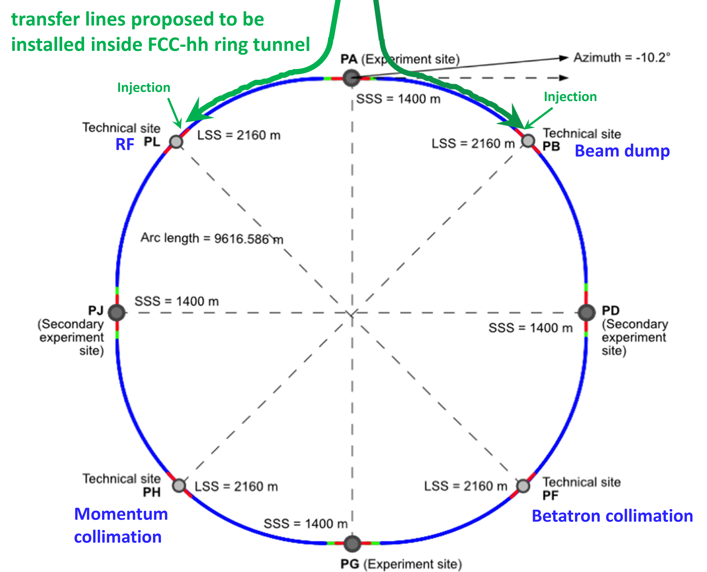
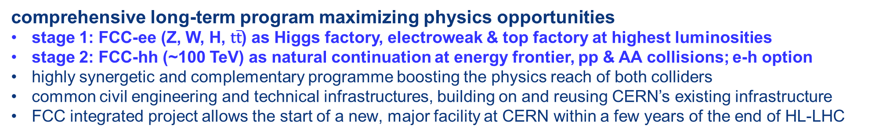
FCC integrated program
comprehensive long-term program maximizing physics opportunities
stage 1: FCC-ee (Z, W, H, $\text{t}\overline{\text{t}}$) as Higgs factory, electroweak & top factory at highest luminosities
stage 2: FCC-hh (~100 TeV) as natural continuation at energy frontier, pp & AA collisions; e-h option
highly synergetic and complementary programme boosting the physics reach of both colliders
common civil engineering and technical infrastructures, building on and reusing CERN’s existing infrastructure
FCC integrated project allows the start of a new, major facility at CERN within a few years of the end of HL-LHC
FCC-ee
FCC-hh
2020 - 2046
2045 - 2060
2070 -

Slide 3
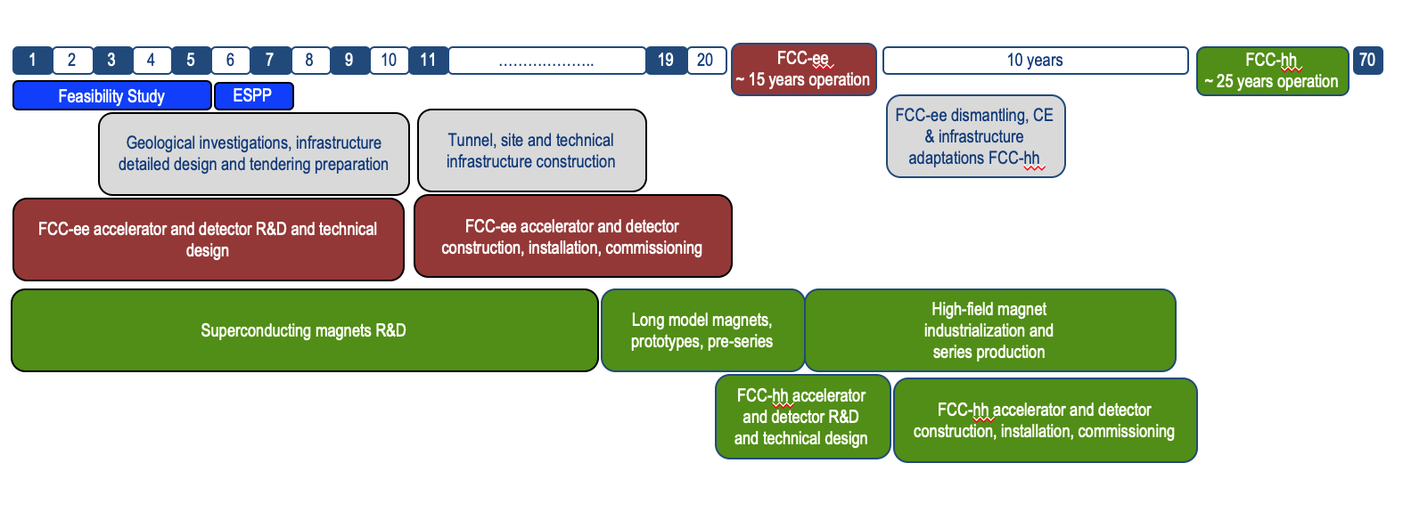
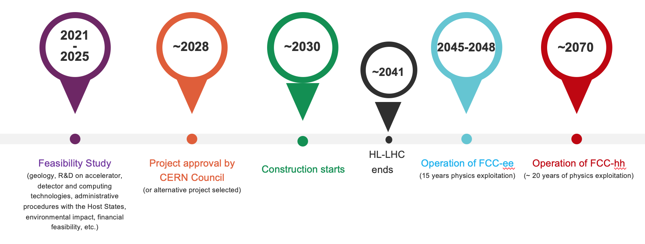
FCC integrated program - timeline
Note: FCC Conceptual Design Study
started in 2014 leading to CDR
in 2018
“Realistic” schedule taking into account:
past experience in building colliders at CERN
approval timeline: ESPP, Council decision
that HL-LHC will run until 2041
Can be accelerated if more resources available
2032
2045
2070

Slide 4
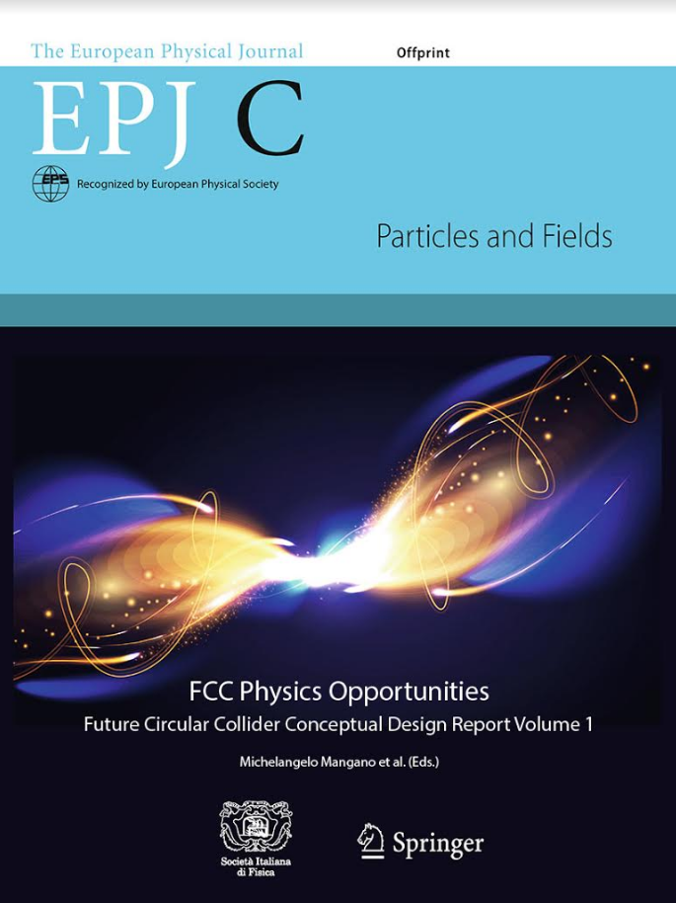
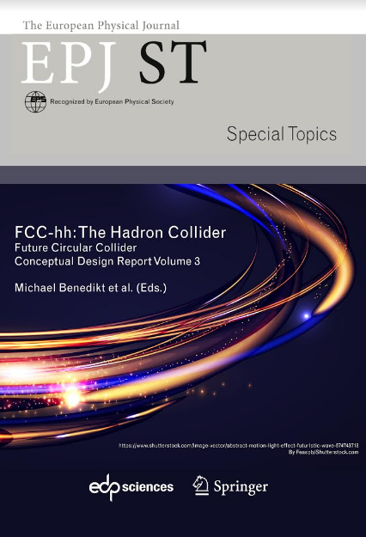
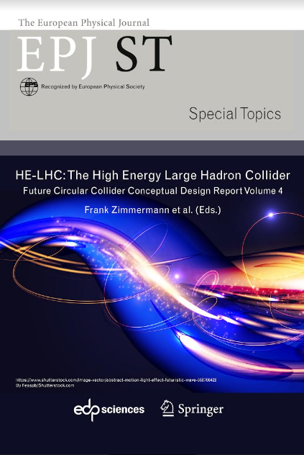
European Strategy for Particle Physics
2013 Update of European Strategy for Particle Physics:
“CERN should undertake design studies for accelerator projects in a global context, with emphasis on proton-proton and electron-positron high-energy frontier machines.”
→ FCC Conceptual Design Reports (2018/19)
2020 Update of European Strategy for Particle Physics:
“Europe, together with its international partners, should investigate technical and financial feasibility of a future hadron collider at CERN with a centre-of-mass energy of at least 100 TeV and with an electron-positron Higgs and electroweak factory as a possible first stage.”
  Vol 1 Physics, Vol 2 FCC-ee, Vol 3 FCC-hh, Vol 4 HE-LHC
  CDRs published in European Physical Journal C (Vol 1) and ST (Vol 2 – 4)
  EPJ C 79, 6 (2019) 474 , EPJ ST 228, 2 (2019) 261-623 , EPJ ST 228, 4 (2019) 755-1107 , EPJ ST 228, 5 (2019) 1109-1382

Slide 5
FCC Feasibility Study (2021-2025): high-level objectives
demonstration of the geological, technical, environmental and administrative feasibility of the tunnel and surface areas and optimisation of placement and layout of the ring and related infrastructure;
pursuit, together with the Host States, of the preparatory administrative processes required for a potential project approval to identify and remove any showstopper;
optimisation of the design of the colliders and their injector chains, supported by R&D to develop the needed key technologies;
elaboration of a sustainable operational model for the colliders and experiments in terms of human and financial resource needs, as well as environmental aspects and energy efficiency;
development of a consolidated cost estimate, as well as the funding and organisational models needed to enable the project’s technical design completion, implementation and operation;
identification of substantial resources from outside CERN’s budget for the implementation of the first stage of a possible future project (tunnel and FCC-ee);
consolidation of the physics case and detector concepts for both colliders.
Results will be summarised in a Feasibility Study Report to be released at end 2025
F. Gianotti

Slide 6
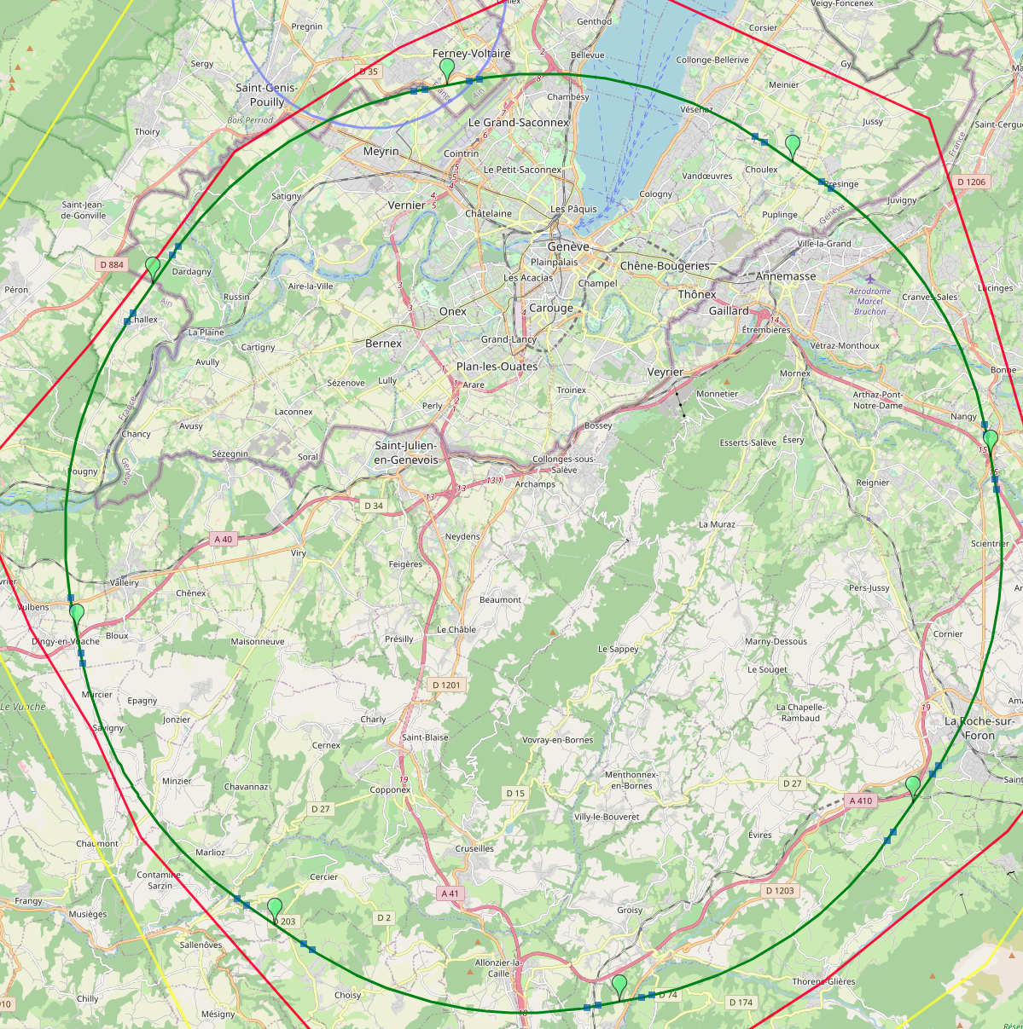
Optimized placement and layout for feasibility study
V. Mertens,
J. Gutleber
Layout chosen out of ~ 100 initial variants, based on geology and
surface constraints (land availability, access to roads, etc.), environment, (protected zones), infrastructure (water, electricity, transport), machine performance etc.
“Avoid-Reduce-Compensate” principle of EU and French regulations
PA: Experiment
PB: technical
PL: technical
Overall lowest-risk baseline: 90.7 km ring, 8 surface points,
Whole project now adapted to this placement
Number of surface sites | 8
Surface requirements | ~40 ha
LSS@IP (PA, PD, PG, PJ) | 1400 m
LSS@TECH (PB, PF, PH, PL) | 2032 m
Arc length | 9.6 km
Sum of arc lengths | 76.9 m
Total length | 90.7 km
PD: experiment
PJ: experiment
PF: technical
PH: technical
6
PG: experiment

Slide 7
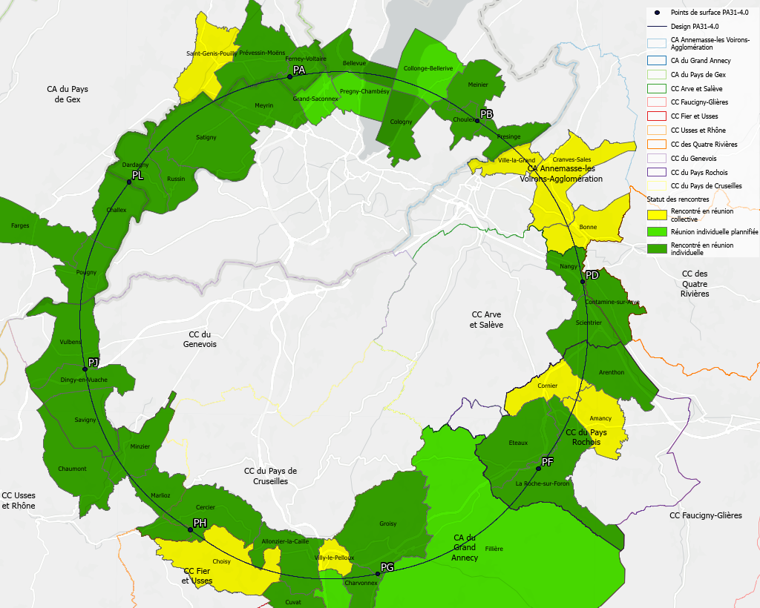
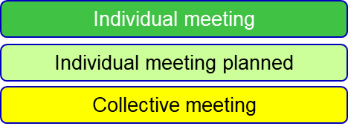
Regional implementation activities
Meetings with municipalities concerned
in France (31) and Switzerland (10)
PA – Ferney Voltaire (FR) – experiment site
PB – Présinge/Choulex (CH) – technical site
PD – Nangy (FR) – experiment site
PF – Roche sur Foron/Etaux (FR) – technical site
PG – Charvonnex/Groisy (FR) – experiment site
PH – Cercier (FR) – technical site
PJ – Vulbens/Dingy en Vuache (FR) experiment site
PL – Challex (FR) – technical site
Detailed work with municipalities and host states
identify land plots for surface sites
understand specific aspects for design
identify opportunities (waste heat, tec.)
reserve land plots until project decision
Status 1 June 2024
The support of the host states is greatly appreciated and essential for the study progress!

Slide 8
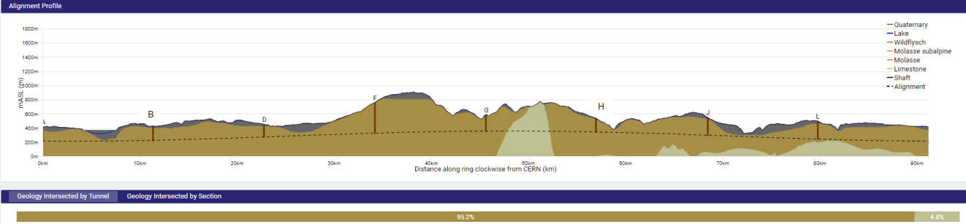
FCC tunnel implementation
Tunnel implementation summary
91 km circumference
95% in molasse geology for minimising tunnel construction risks
Site investigations in zones where tunnel is close to geological interfaces: moraines-molasse-limestone

Slide 9
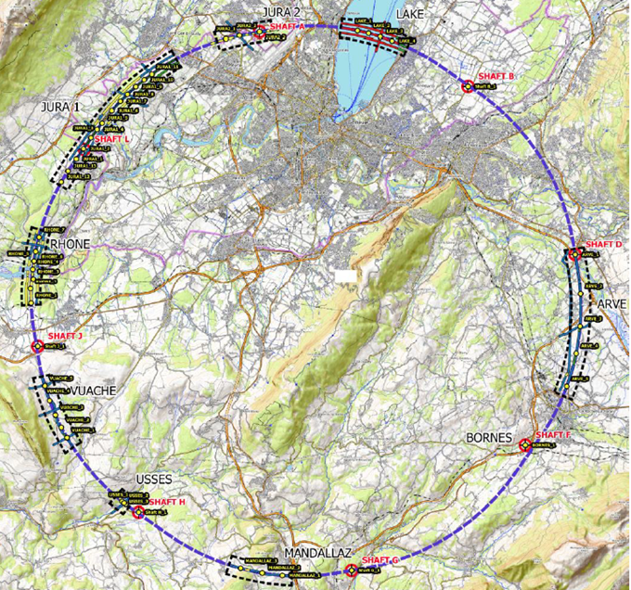
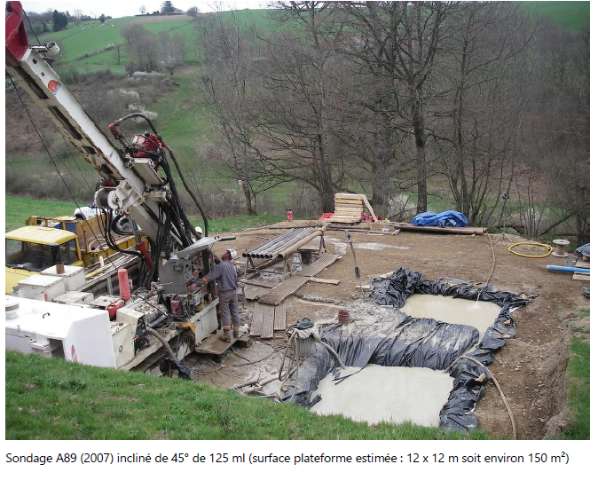
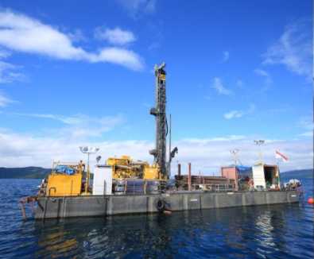
Status site investigations
Site investigations to identify exact location of geological interfaces:
Molasse layer vs moraines/limestone
~30 drillings and
~100 km seismic lines
Start in July 2024
→ Vertical position and inclination of tunnel
Drilling works on the lake

Slide 10
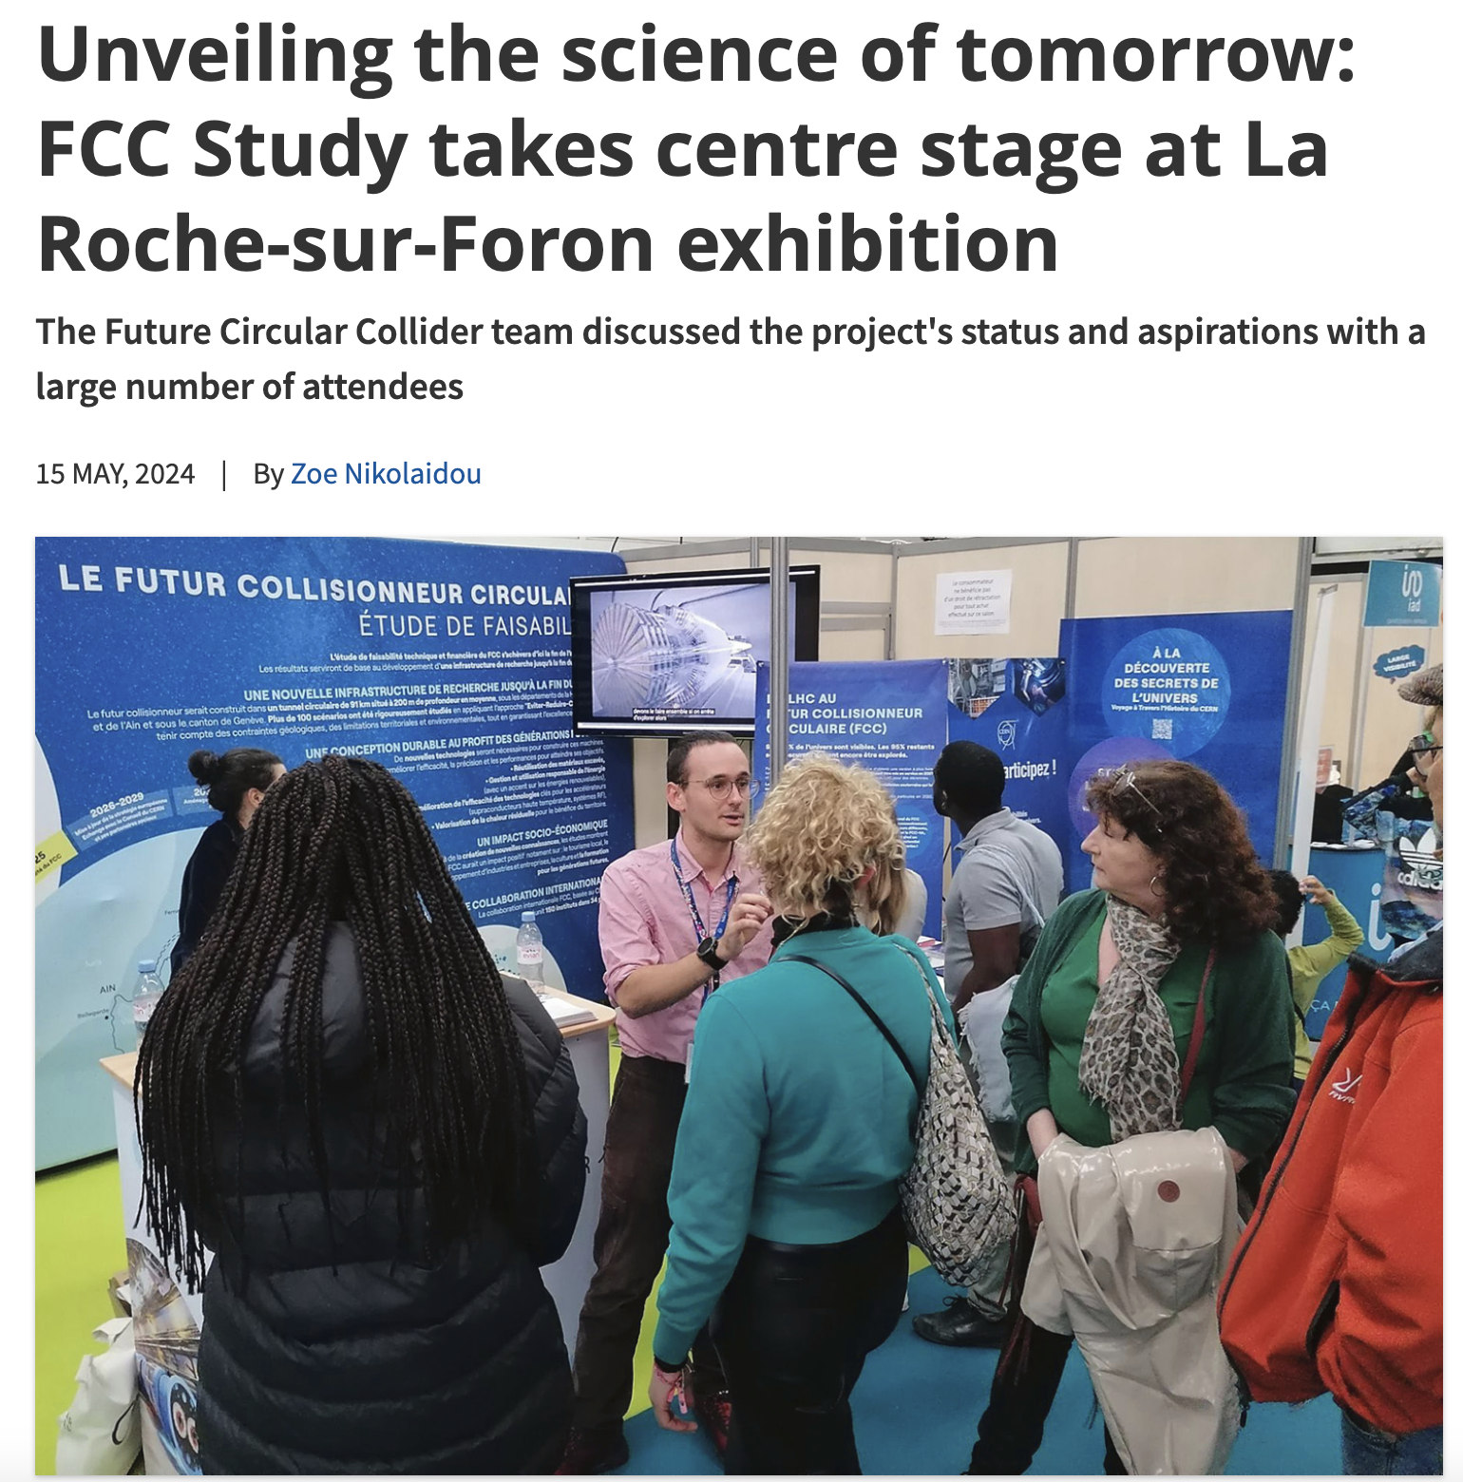
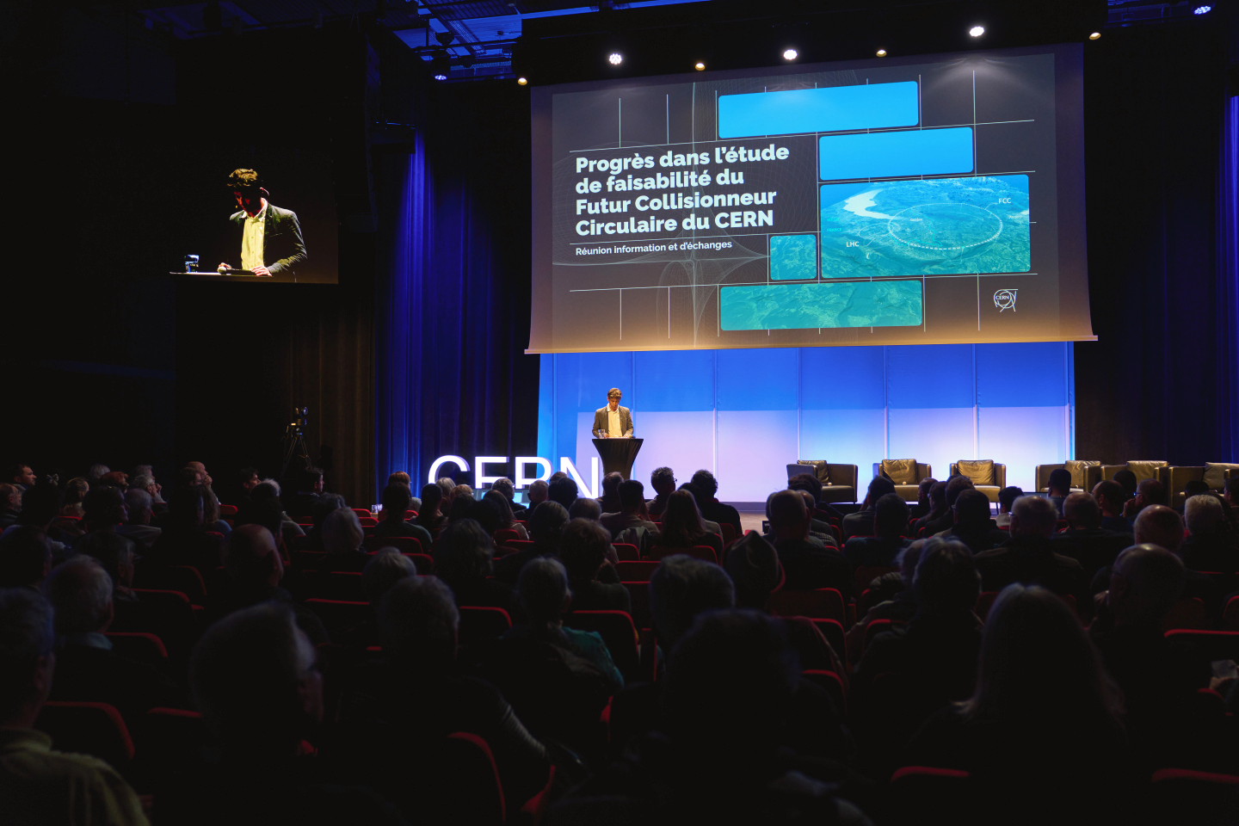
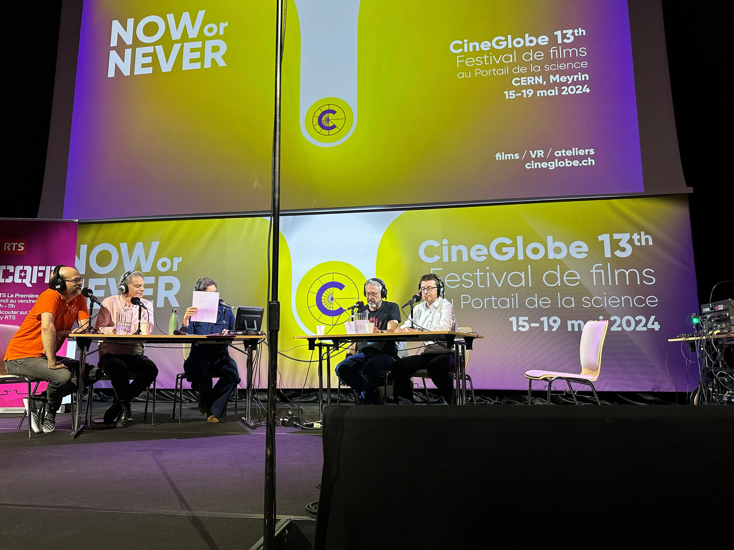
Start of public information & engagement sessions
First public information and discussion meeting at the Science Gateway on the 24th April at CERN.
The meeting was organised for the local community of our Host States, France and Switzerland, in the Science Gateway. The "Progress of the feasibility study of the Future FCC circular collider" was followed by a discussion with the participants.
La Roche-sur-Foron - Haute Savoie international fair April 27 to May 6
CERN’s participation in the International Fair of Haute-Savoie/Mont Blanc, enhanced by the valuable help of volunteers from the FCC team, resulted in meaningful discussions with more than 2000 members of the local community on topics ranging from the required technological advancements to sustainability measures.
On 15 May, RTS (Radio Télévision Suisse) broadcasted a special program celebrating CERN’s 70th anniversary and hosted at CERN’s Science Gateway.
The event featured a comprehensive look at CERN's illustrious history, groundbreaking achievements, and future ambitions, including the prominently featured Future Circular Collider (FCC) project with study experts interacting with the audience.

Slide 11
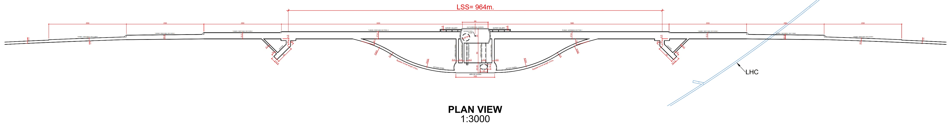
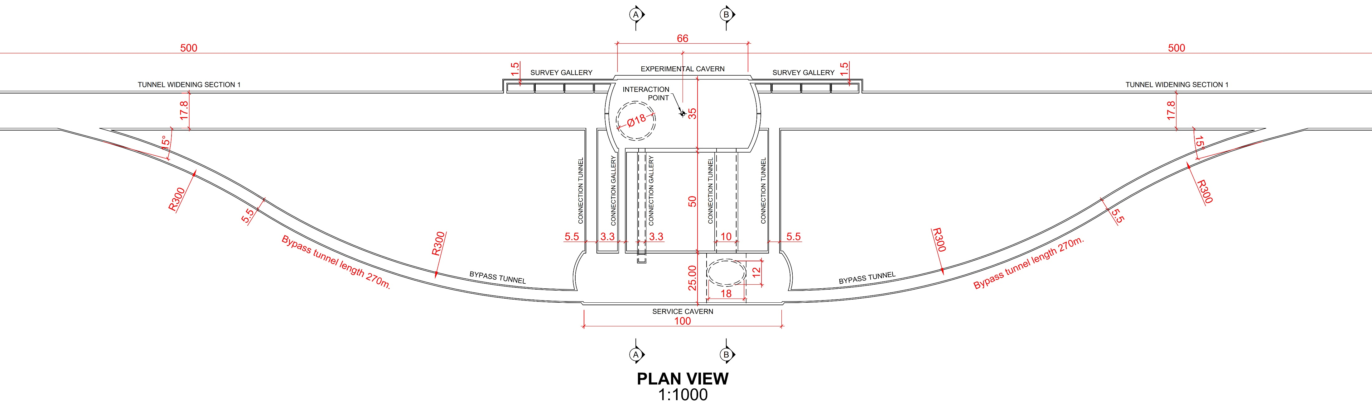
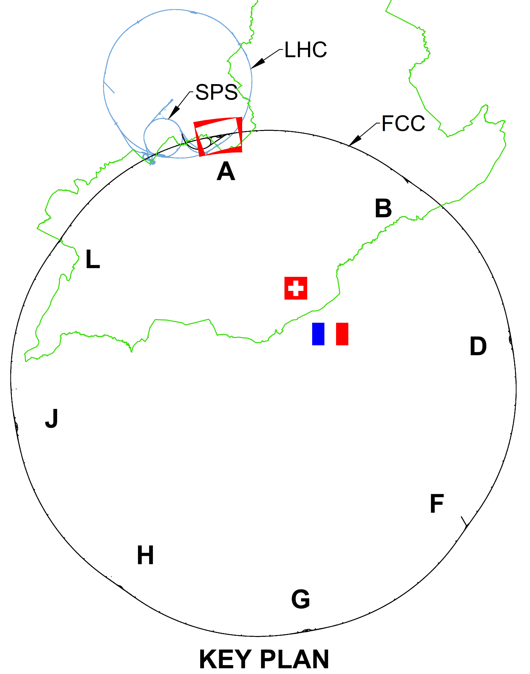
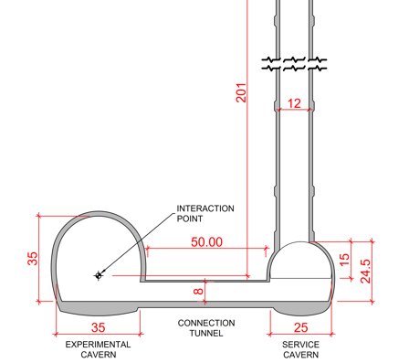
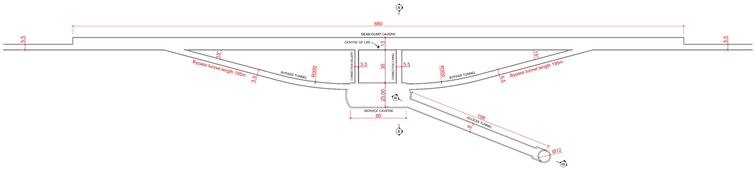
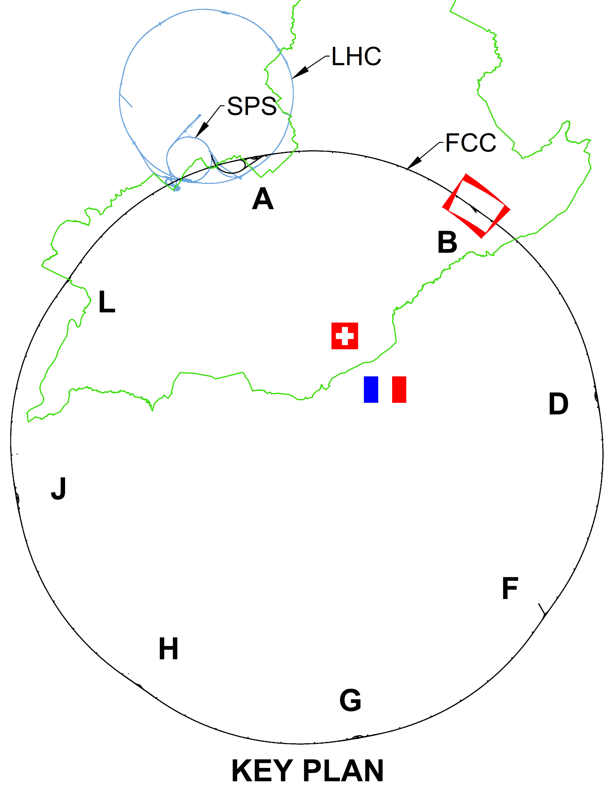
CE underground progress
Full 3D model of underground structures as basis for costing exercies
Experiment Site (PA)
Update of scheduling and costing with external consultant ongoing
Independent second costing exercise based on same bill of quantities will be done
Technical Site (PB)

Slide 12

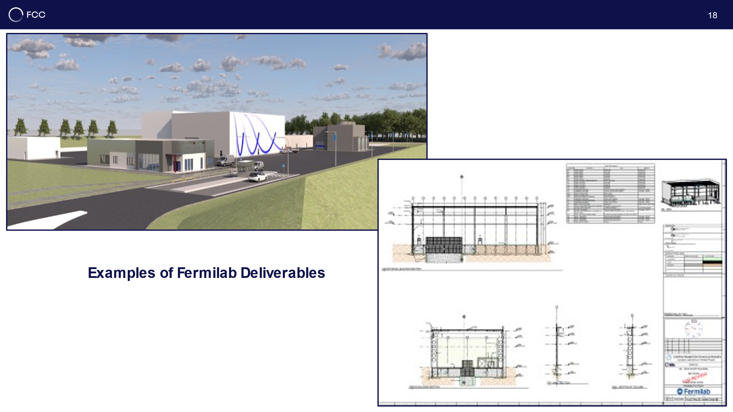
CE surface progress
Generic study of experiment site and technical site by FNAL
bills of quantities extracted from FNAL designs
basis for cost estimate by consultant with experience on industrial constructions in CH-FR area.

Slide 13
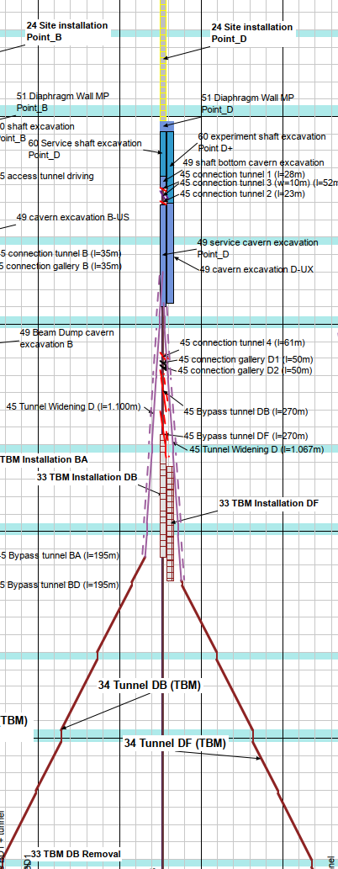
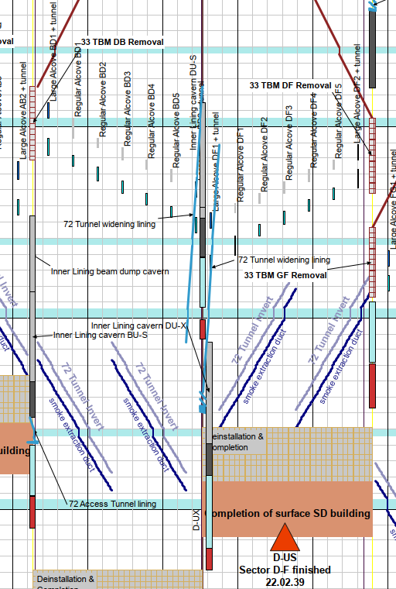
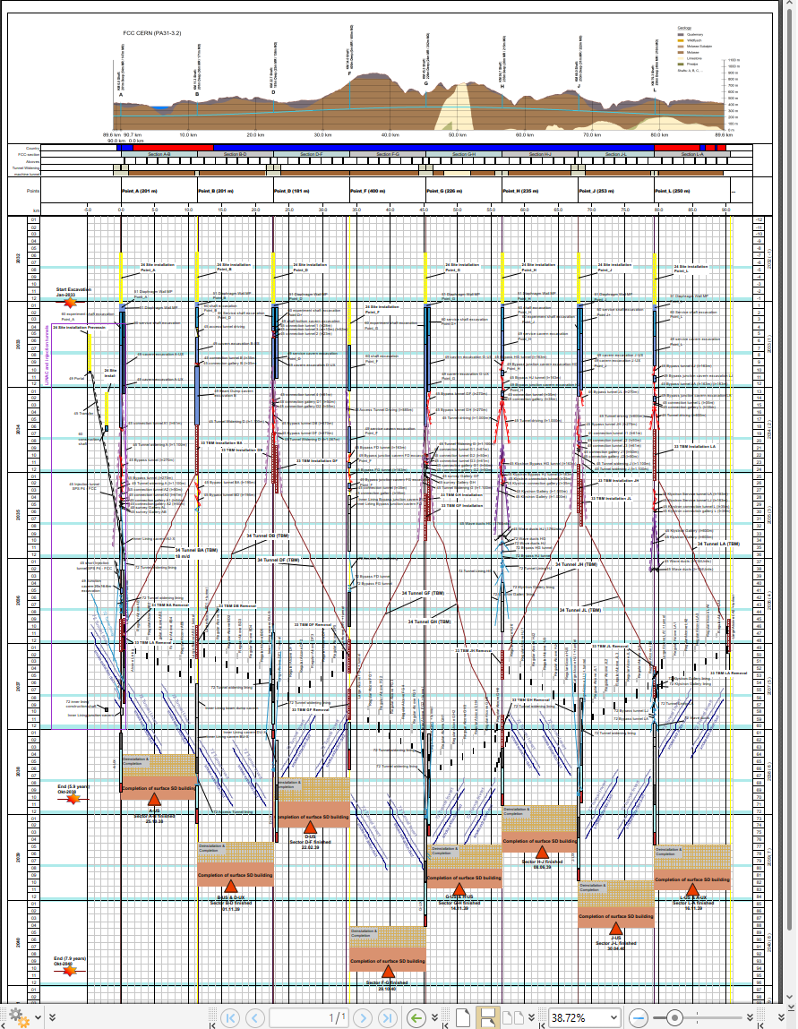
CE construction schedules (example)
T. Watson
CE linear construction schedule
Point D – Example of linear schedule

Slide 14
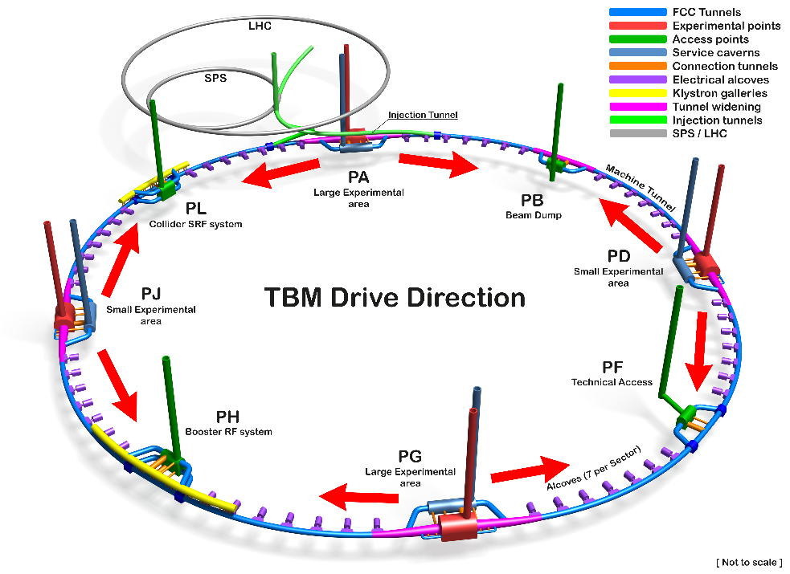
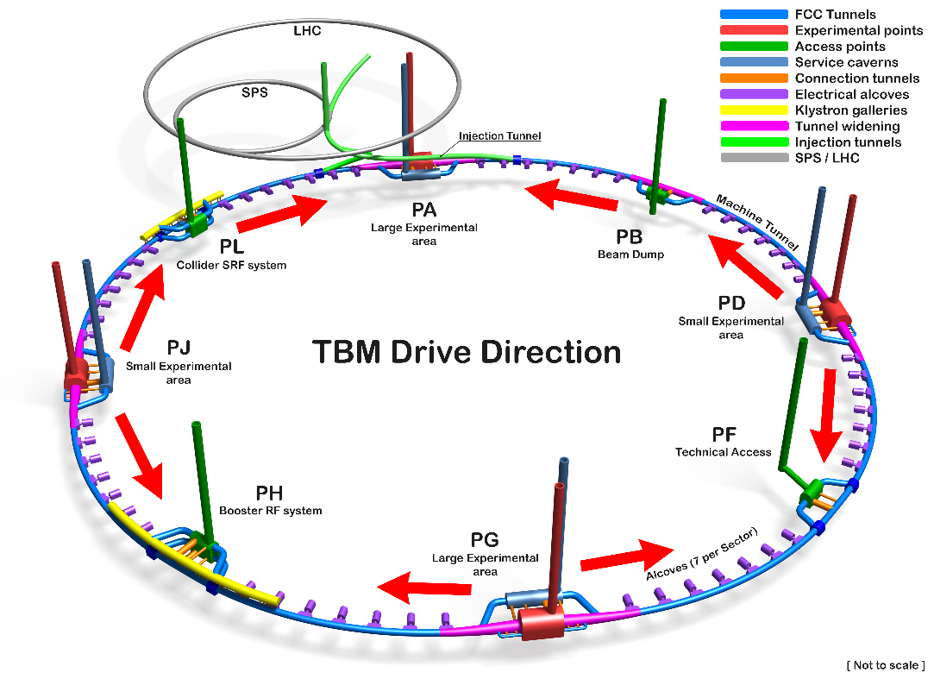
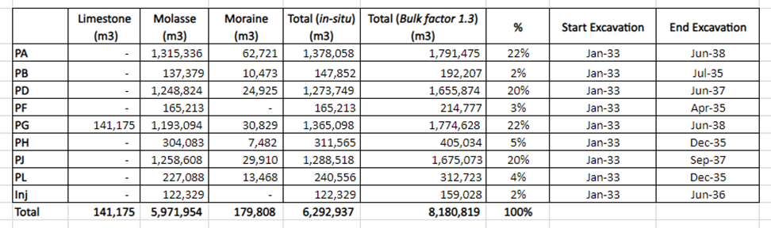
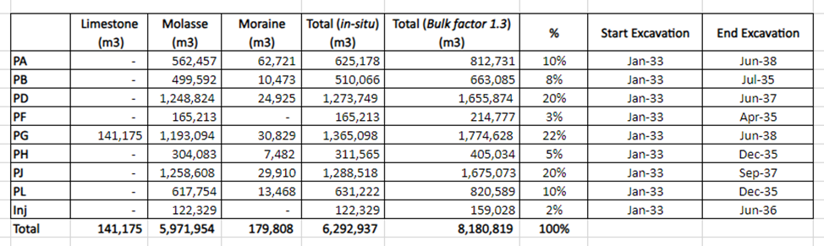
Studies on excavation strategy and material quantities
2 TBMs from each experimental point Alternative with no TBMs from PA

Slide 15
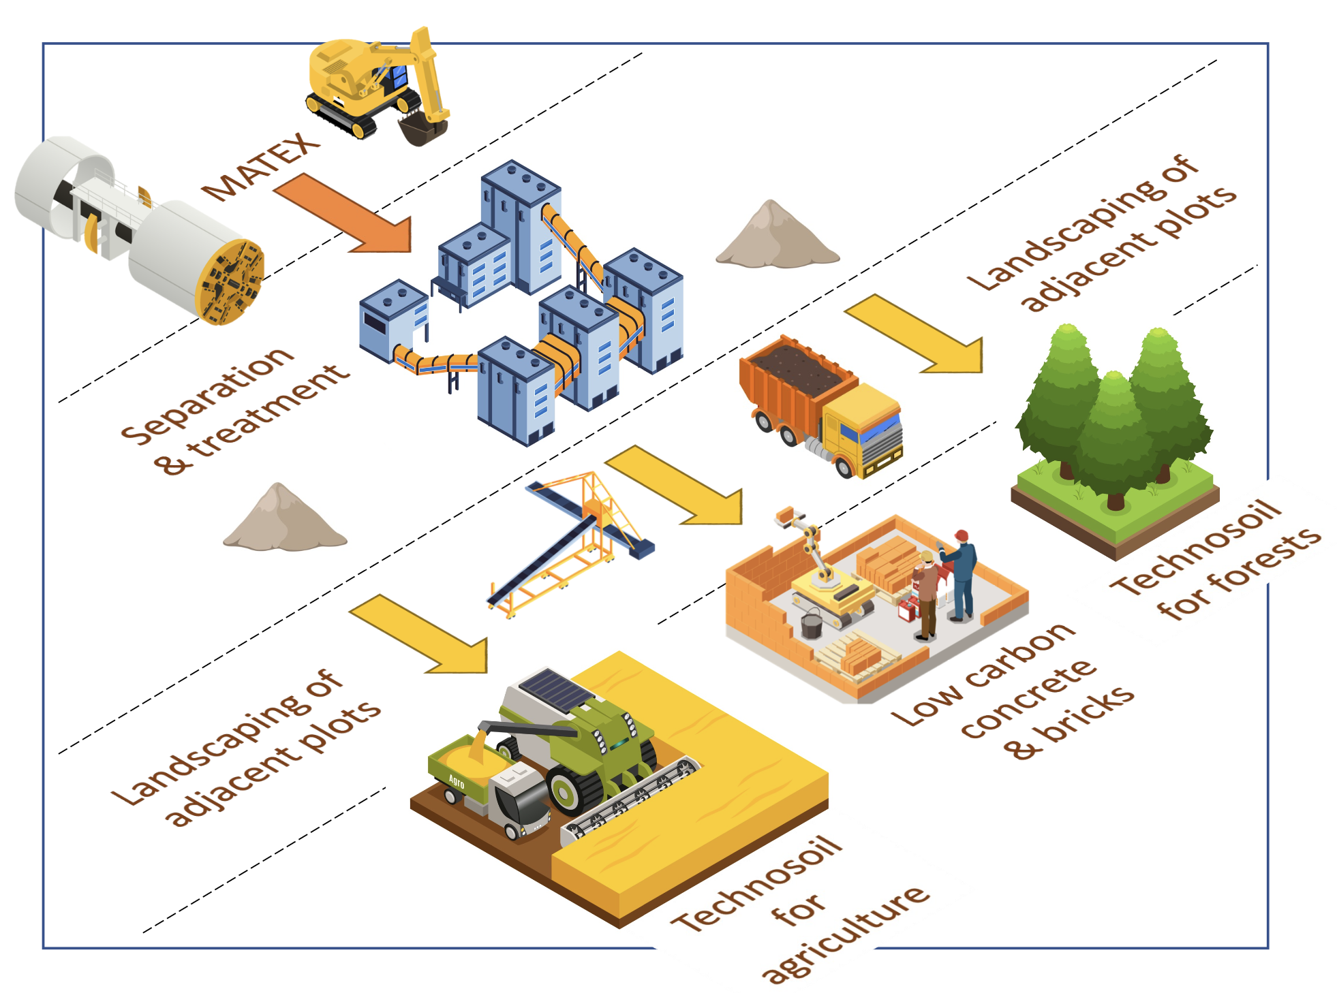
Excavation material management
An innovative local approach for excavated materials:
Excavated material from FCC subsurface infrastructures: 6.5 Mm³ in situ, 8.4 Mm³ excavated (bulk factor 1.3)
2021-2022: International competition “ Mining the Future”, launched with the support of the EU Horizon 2020 grant agreement 951754, to find innovative and realistic ideas for the reuse of Molasse (95% of excavated materials)
2023: Definition of the “OpenSky Laboratory” project:
Objective: Develop and test an innovative process to transform sterile “molasse” into fertile soil for agricultural use and afforestation.
Duration: 4 years (2024-2027)
CERN LHC point 5 CMS
Courtesy: J. Gutleber

Slide 16
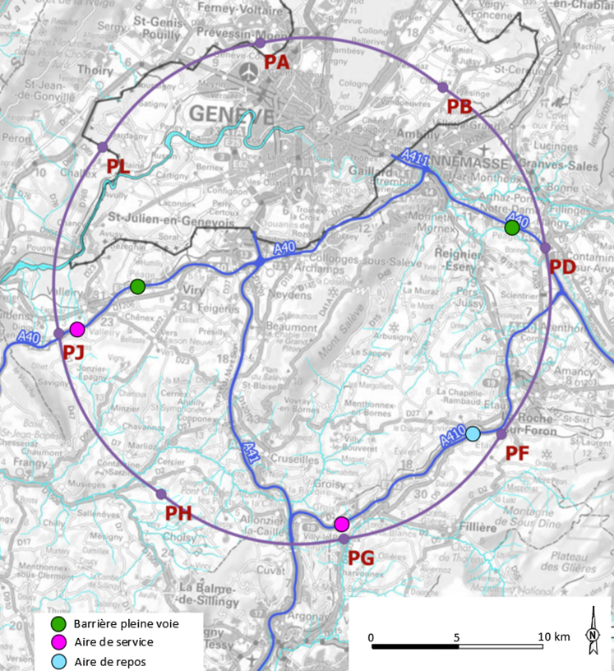
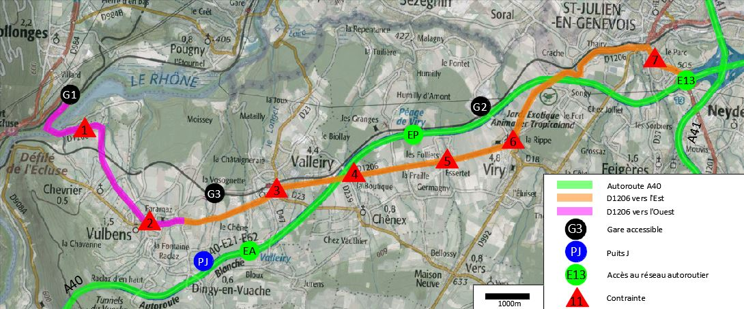
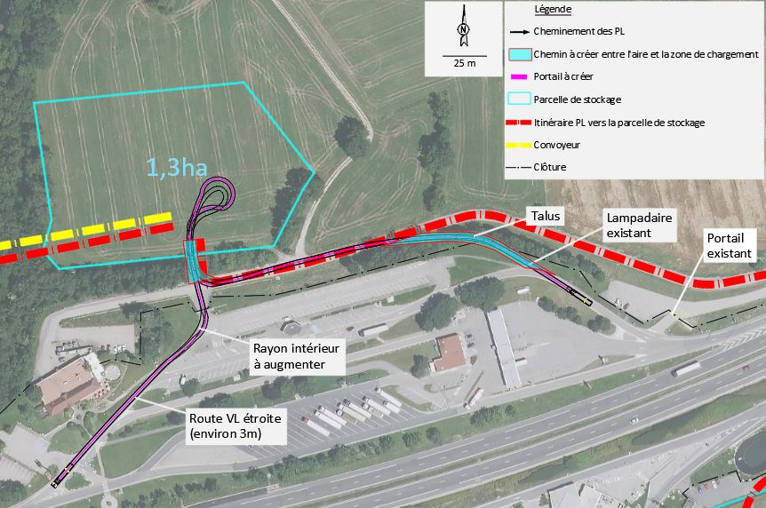
Connections to transport infrastructure
Road accesses identified and documented for all 8 surface sites
Four possible highway connections defined (materials transport)
Total amount of new roads required < 4 km (at departmental road level)
Detailed road access scenarios & highway access creation study carried out by Cerema, including regulatory requirements in France
E.g. Valleiry Nord

Slide 17
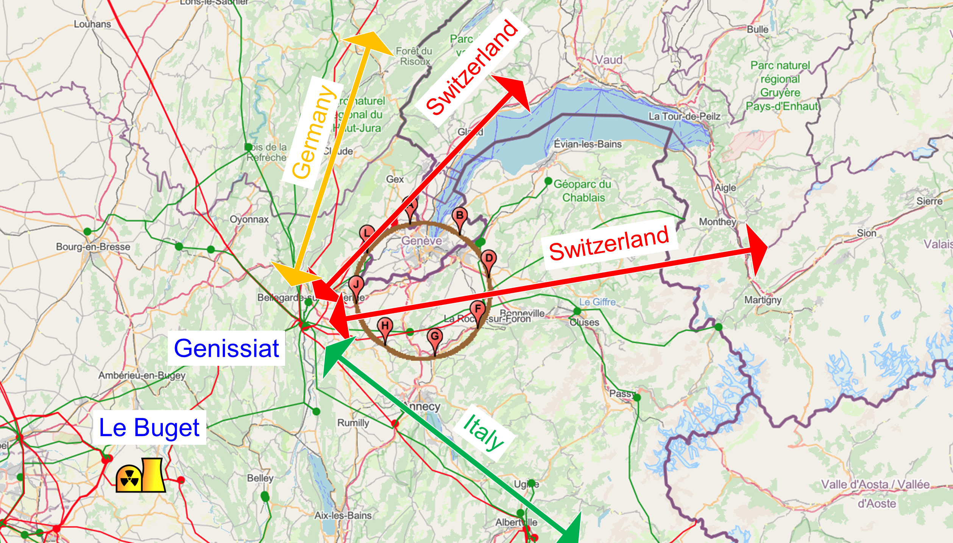
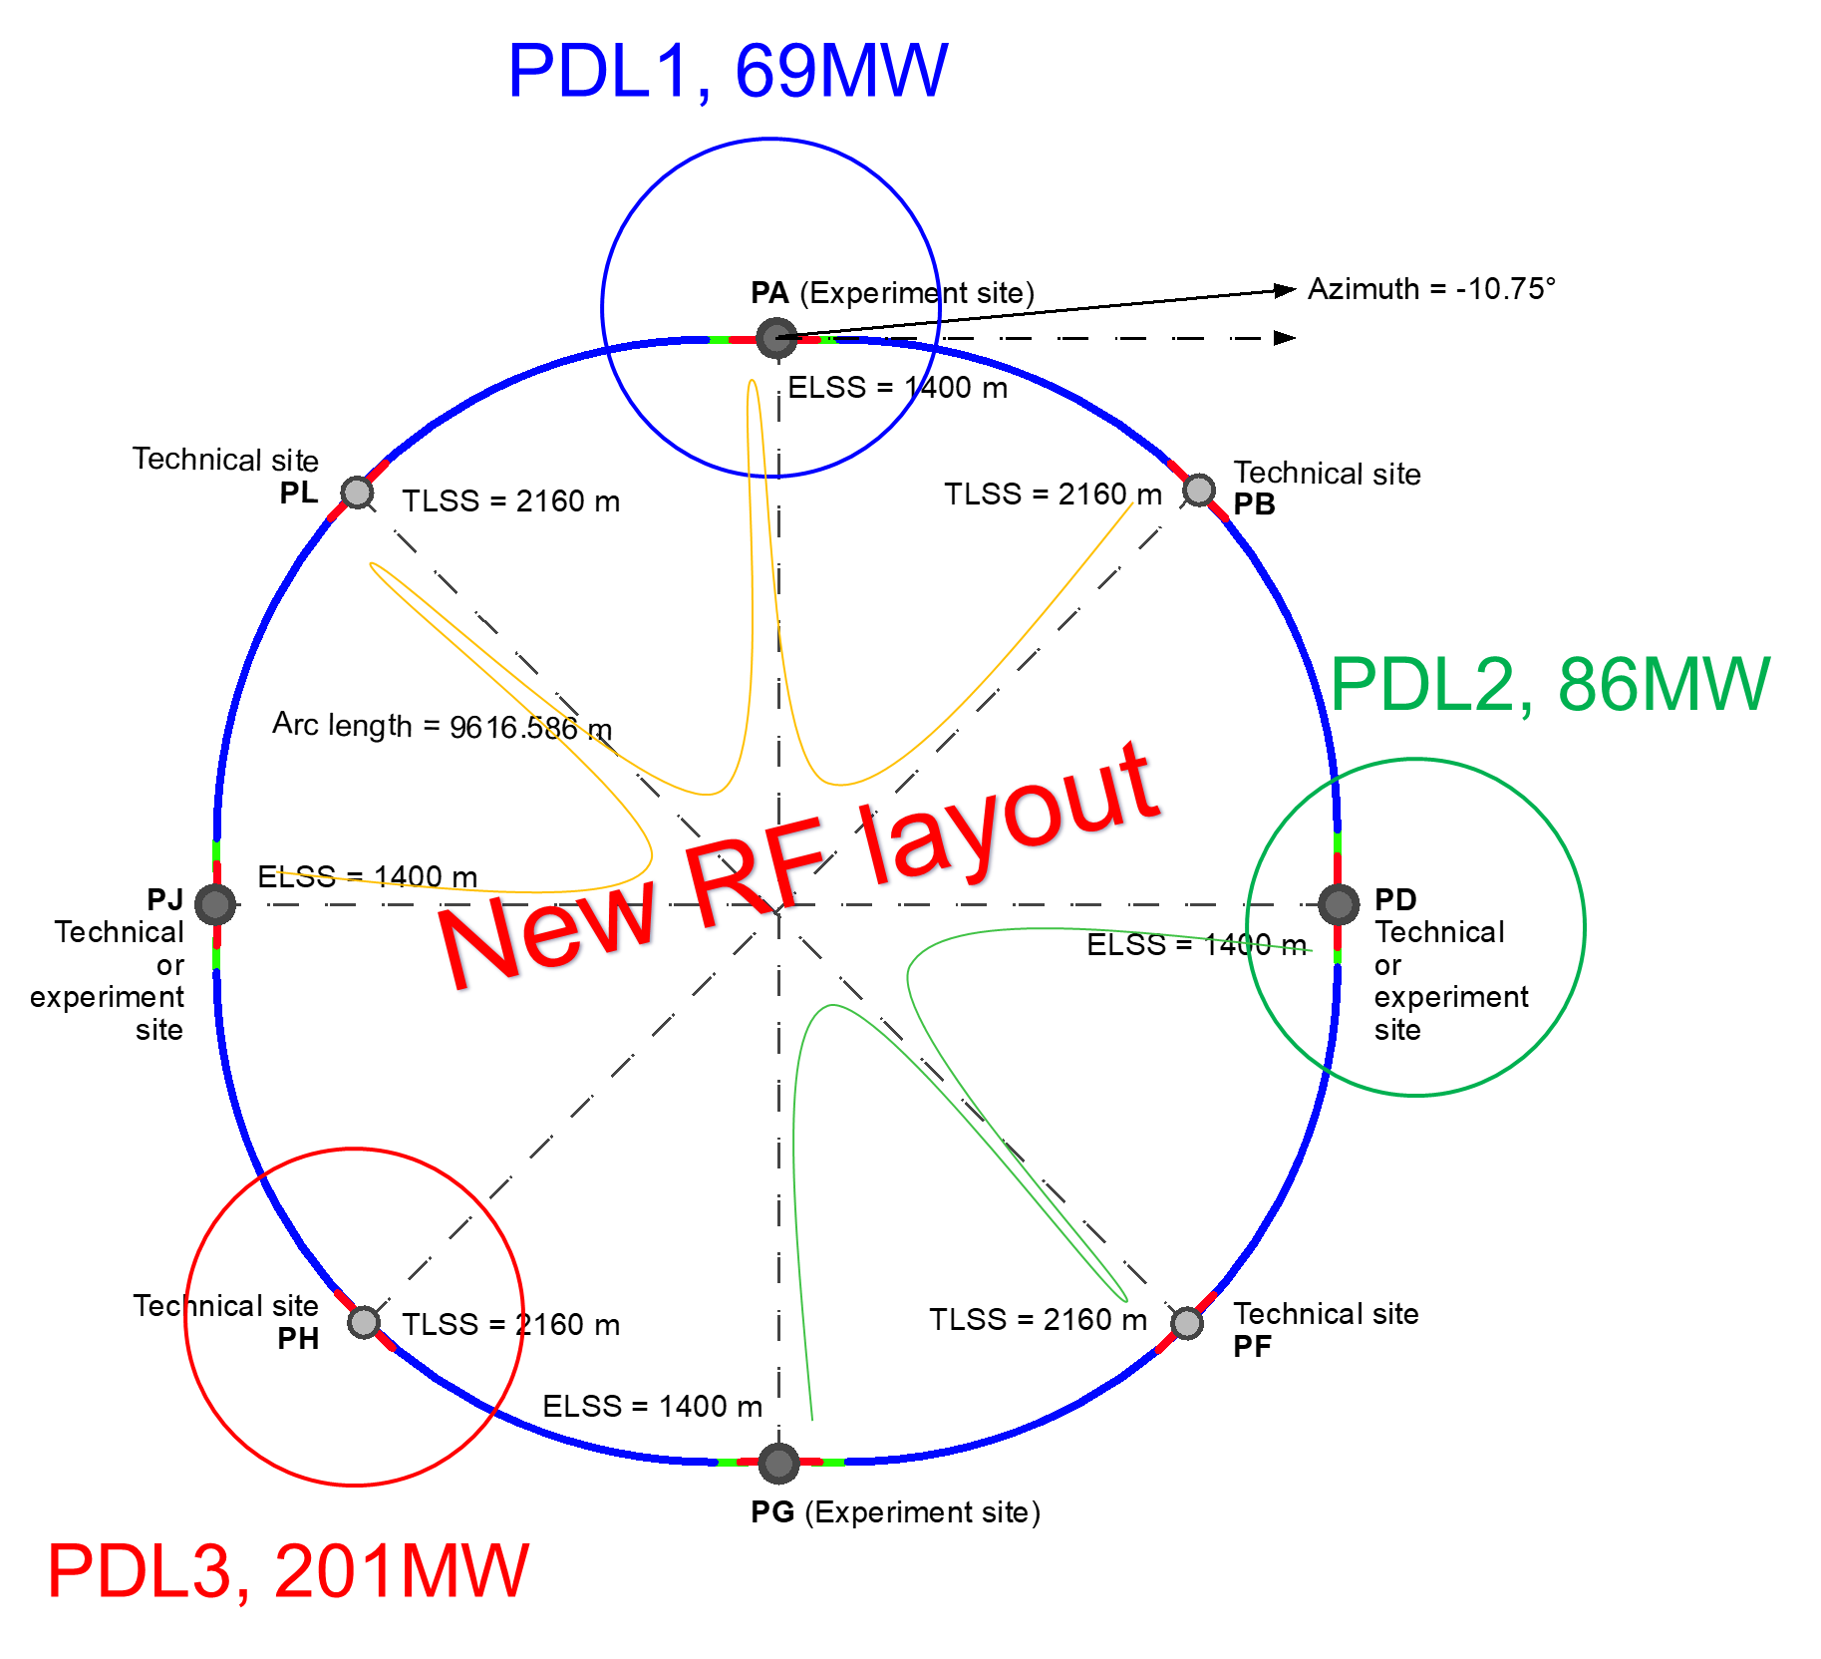

Connections to electrical grid infrastructure
Updated FCC-ee energy consumtion | Z | W | H | TT
Beam energy (GeV) | 45.6 | 80 | 120 | 182.5
Max. Power during beam operation (MW) | 222 | 247 | 273 | 357
Average power / year (MW) | 122 | 138 | 152 | 202
Total FCC-ee yearly consumption (TWh) | 1.07 | 1.2 | 1.33 | 1.77
Yearly consumption CERN & SPS (TWh) | 0.70 | 0.70 | 0.70 | 0.70
Total yearly consumpt. CERN & SPS & FCC-ee (TWh) | 1.77 | 1.90 | 2.03 | 2.47
The loads could be distributed on three main sub-stations (optimally connected to existing regional HV grid):
Point D with a new sub-station covering PB – PD – PF – PG
Point H with a new dedicated sub-station for collider RF
Point A with existing CERN station covering PB – PL – PJ
Connection concept was studied and confirmed by RTE (French electrical grid operator) ➔ requested loads have no significant impact on grid
Powering concept and power rating of the three sub-stations compatible with FCC-hh
R&D efforts aiming at further reduction of the energy consumption of FCC-ee and FCC-hh

Slide 18




Expected time line till start of construction
2024 |  |  |  | 2025 |  |  |  | 2026 |  |  |  | 2027 |  |  |  | 2028 |  |  |  | 2029 |  |  |  | 2030 |  |  |  | 2031 |  |  |  | 2032 |  |  |  | 2033
Q1 | Q2 | Q3 | Q4 | Q1 | Q2 | Q3 | Q4 | Q1 | Q2 | Q3 | Q4 | Q1 | Q2 | Q3 | Q4 | Q1 | Q2 | Q3 | Q4
Feasibility Study
Pre-TDR Phase
TDR Phase
Construction →→→
FS Report
cost update
ESPPU
2025/26
pre TDR
cost update
TDR
cost update
Project Decision
accelerator design, technical infrastructure design, R&D, towards TDR
engineering design →
Environmental Impact study & Authorization Process
Phase 1 Site Investigations
Phase 2 Site Investigations
CE Concept Design update
CE Tender Design
Construction Design
Start construction
Detector EOI submissions
FC³ formation, call for CDRs
Detector CDRs submitted to FC³

Slide 19
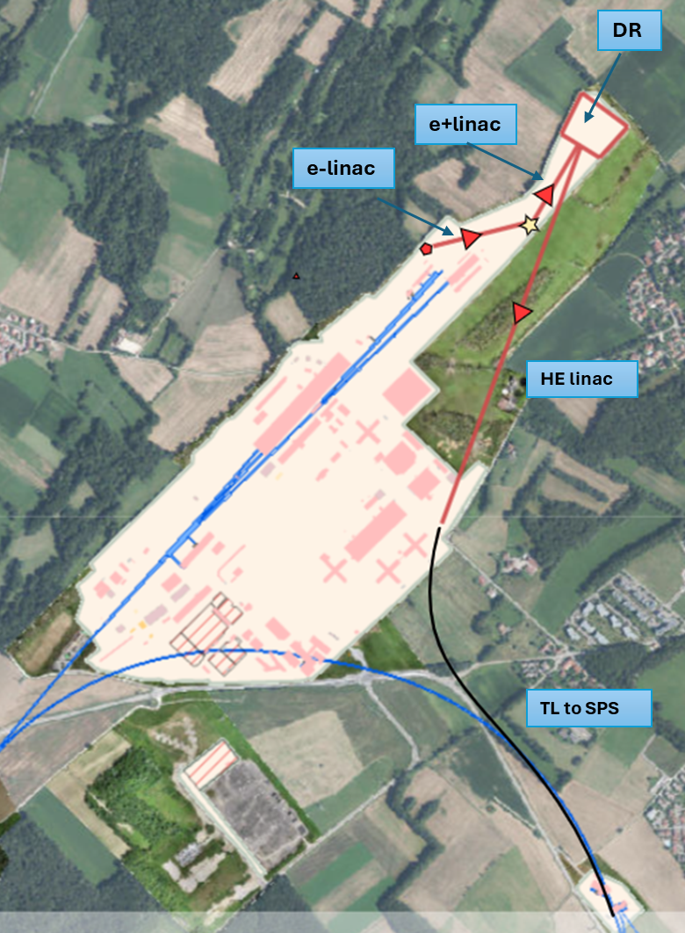
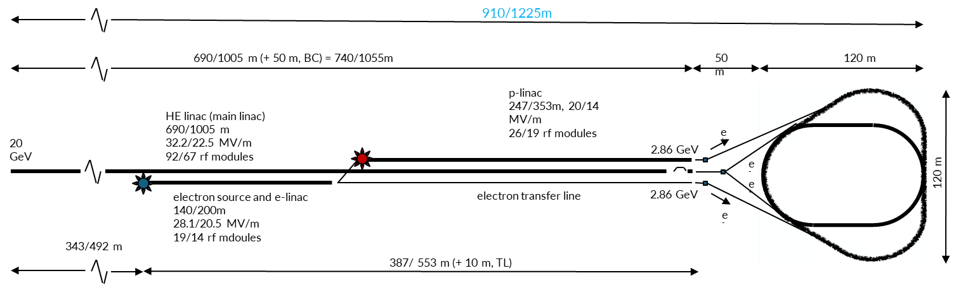
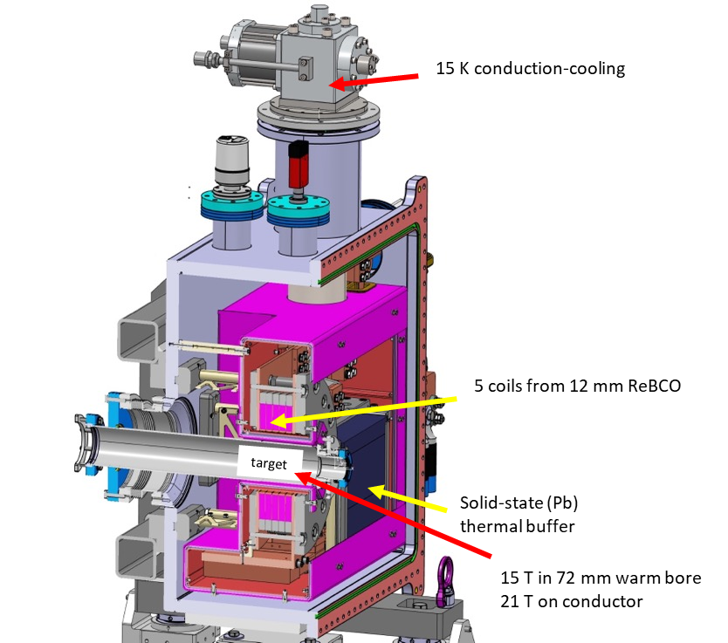
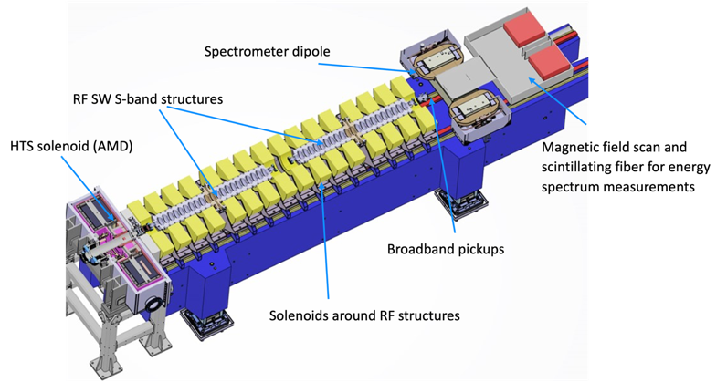
FCC-ee Injector
Overall injector parameter optimisation
  Operation frequency, gradient, etc…
  Positron production energy, damping ring energy
Injector implementation study on
CERN Prevessin Site
“Positron production experiment” at PSI’s SwissFEL,
beam tests from 2025/26
HTS NI target solenoid
P. Craievich, W. Bartmann, Y. Papaphilippou, C. Milardi
J. Kosse, T. Michlmayr, H. Rodrigues

Slide 20
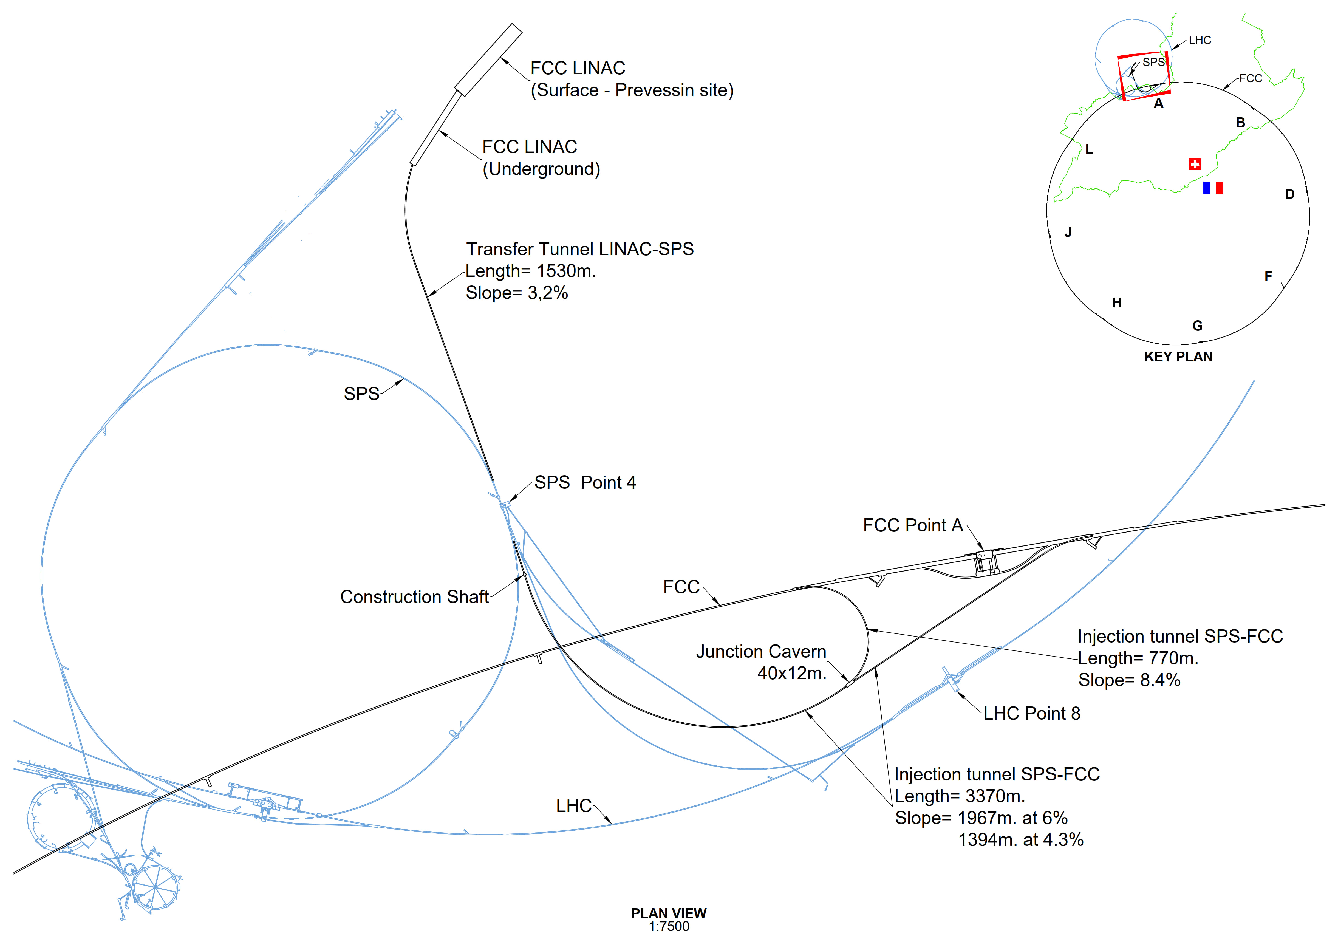
Transfer line FCC-ee (option with SPS for FCC-hh)
LINAC and Injection Tunnels
Designed to enable injection either from SPS as pre-booster or from a new HE Linac sited at Prevessin
Single tunnel with spur to enable anti-clockwise injection
Design allows re-use for FCC-hh if injector in the SPS tunnel (SC-SPS option)
  SPS Point 4 to FCC (clockwise)
  SPS Point 6 to FCC (counter-c.w.)

Slide 21

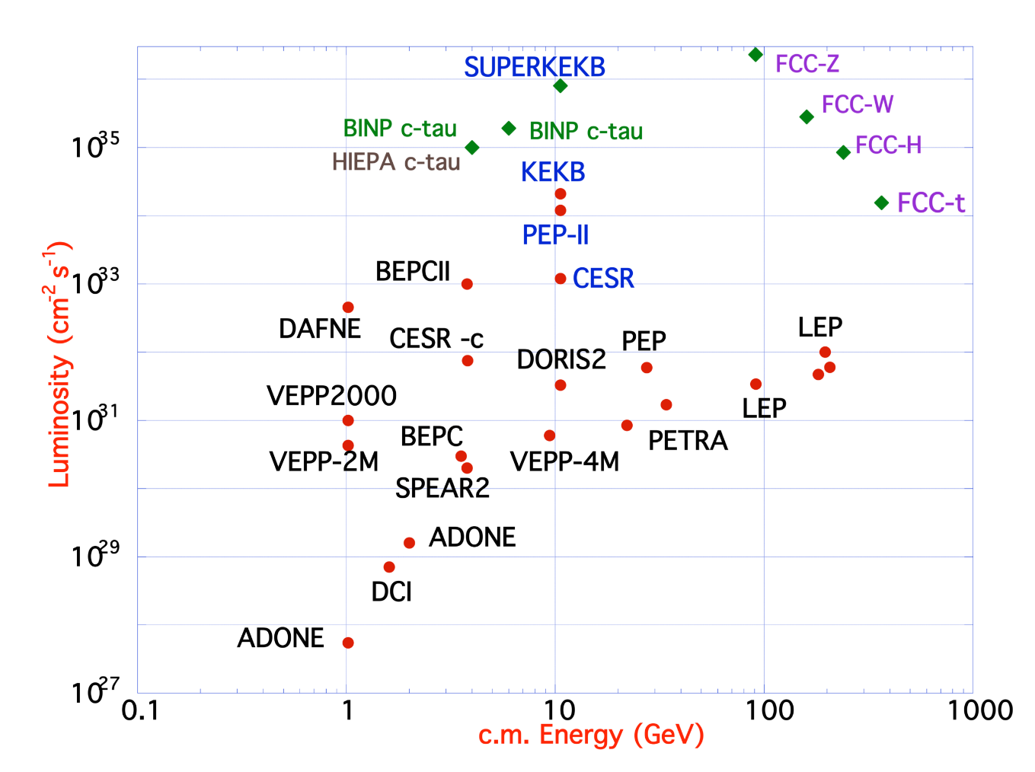
FCC-ee Design Concept
Based on lessons and techniques from past colliders (last 40 years)
B-factories: KEKB & PEP-II:
double-ring lepton colliders,
high beam currents,
top-up injection
DAFNE: crab waist, double ring
S-KEKB: low β_{y}*, crab waist
LEP: high energy, SR effects
VEPP-4M, LEP: precision E calibration
KEKB: e⁺ source
HERA, LEP, RHIC: spin gymnastics
Marica Biagini
Marica Biagini
combining successful ingredients of several recent colliders → highest luminosities & energies
E. Tsesmelis

Slide 22

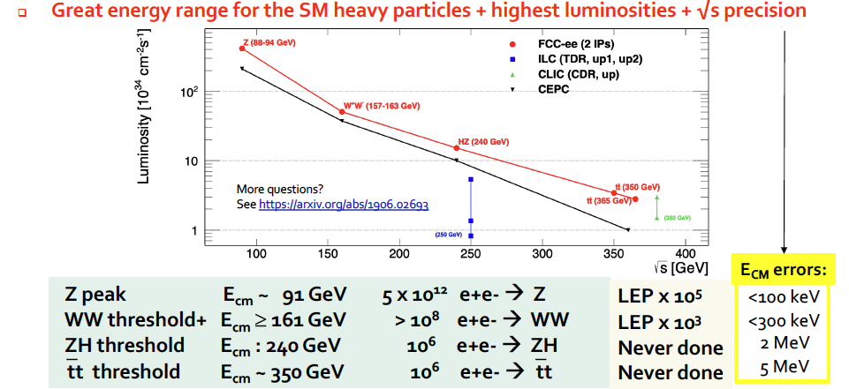
FCC-ee Higgs and Electroweak Factory
Increasing international collaboration as a prerequisite for success:
links with science, research & development and high-tech industry will be essential to further advance and prepare the implementation of FCC
P. Janot

Slide 23
FCC-ee main machine parameters
Parameter | Z | WW | H (ZH) | ttbar
beam energy [GeV] | 45.6 | 80 | 120 | 182.5
beam current [mA] | 1270 | 137 | 26.7 | 4.9
number bunches/beam | 11200 | 1780 | 440 | 60
bunch intensity [10¹¹] | 2.14 | 1.45 | 1.15 | 1.55
SR energy loss / turn [GeV] | 0.0394 | 0.374 | 1.89 | 10.4
total RF voltage 400/800 MHz [GV] | 0.120/0 | 1.0/0 | 2.1/0 | 2.1/9.4
long. damping time [turns] | 1158 | 215 | 64 | 18
horizontal beta* [m] | 0.11 | 0.2 | 0.24 | 1.0
vertical beta* [mm] | 0.7 | 1.0 | 1.0 | 1.6
horizontal geometric emittance [nm] | 0.71 | 2.17 | 0.71 | 1.59
vertical geom. emittance [pm] | 1.9 | 2.2 | 1.4 | 1.6
vertical rms IP spot size [nm] | 36 | 47 | 40 | 51
beam-beam parameter ξ_{x} / ξ_{y} | 0.002/0.0973 | 0.013/0.128 | 0.010/0.088 | 0.073/0.134
rms bunch length with SR / BS [mm] | 5.6 / 15.5 | 3.5 / 5.4 | 3.4 / 4.7 | 1.8 / 2.2
luminosity per IP [10³⁴ cm⁻²s⁻¹] | 140 | 20 | ≥5.0 | 1.25
total integrated luminosity / IP / year [ab⁻¹/yr] | 17 | 2.4 | 0.6 | 0.15
beam lifetime rad Bhabha + BS [min] | 15 | 12 | 12 | 11
Design and parameters to maximise luminosity at all working points:
allow for 50 MW synchrotron radiation per beam.
Independent vacuum systems for electrons and positrons
full energy booster ring with top-up injection, collider permanent in collision mode
4 years
5 x 10¹² Z
LEP x 10⁵
2 years
> 10⁸ WW
LEP x 10⁴
3 years
2 x 10⁶ H
5 years
2 x 10⁶ tt pairs
x 10-50 improvements on all EW observables
up to x 10 improvement on Higgs coupling (model-indep.) measurements over HL-LHC
x10 Belle II statistics for b, c, τ
indirect discovery potential up to ~ 70 TeV
direct discovery potential for feebly-interacting particles over 5-100 GeV mass range
Up to 4 interaction points → robustness,
statistics, possibility of specialised detectors
to maximise physics output
F. Gianotti

Slide 24
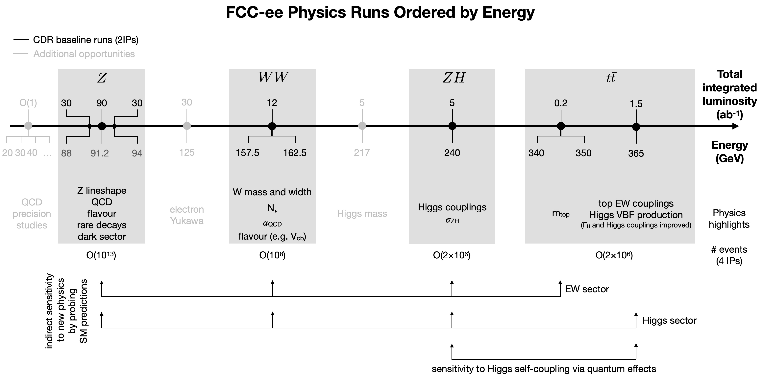
FCC-ee Collider Programme
Opportunities beyond the baseline plan (√s below Z, 125GeV, 217GeV; larger integrated lumi…)
Opportunities to exploit FCC facility differently (to be studied more carefully):
  using the electrons from the injectors for beam-dump experiments,
  extracting electron beams from the booster,
  reusing the synchrotron radiation photons.
C. Grojean

Slide 25
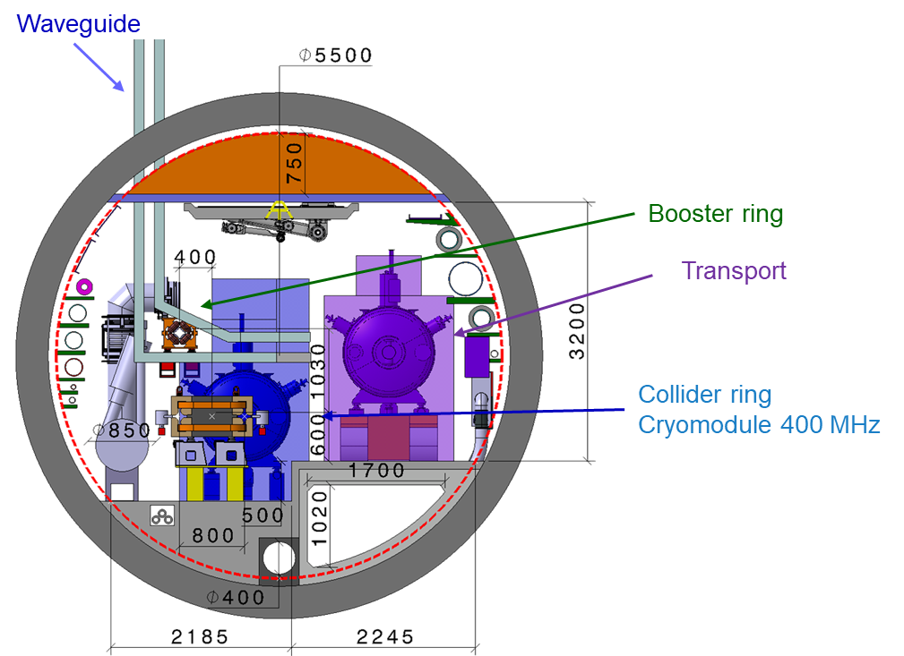
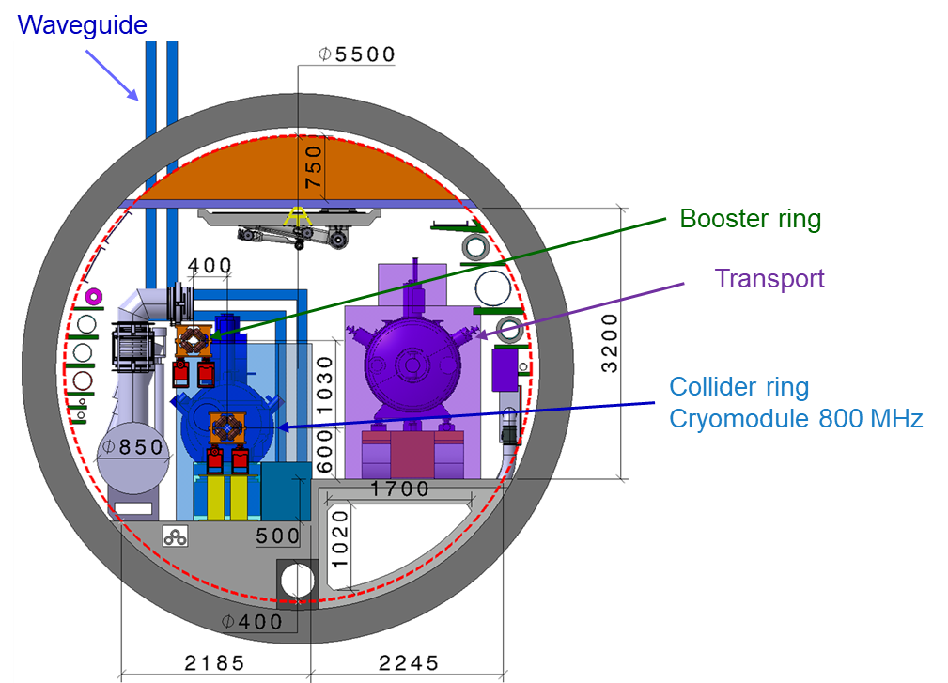


modified FCC-ee RF layout
RF for collider and booster in separate straight sections H and L.
fully separated technical infrastructure systems (cryogenics)
collider RF (highest power demand) in point H with optimum connection to existing 400 kV grid line and better suited surface site
Collider RF - Point H (400 and 800 MHz)
Booster RF - Point L
(800 MHz only)
J.-P. Burnet
F. Valchkova, F. Peauger

Slide 26




Operation sequences for FCC-ee and RF configuration
Evolution of RF configuration of collider and booster with beam energies and physics operation points
Long-term R&D for SRF, 400 MHz Nb on Cu, 800 MHz bulk Nb system

Slide 27





RF R&D activities
RF system R&D is key for increasing energy efficiency of FCC-ee
Nb on Cu 400 MHz cavities, seamless cavity production, coating techniques
Bulk Nb 800 MHz cavities, surface treatment techniques, cryomodule design
RF power source R&D in synergy with HL-LHC.
800 MHz cavity and CM design collaborations with JLAB and FNAL
high-efficiency klystron R&D
in collaborations with THALES & CANON
400 MHz cavity production
in collaboration with KEK
800 MHz segmented design, based on PIP-II
~7 m
monoblock prototype

Slide 28

Collider and Booster design
Complete accelerator design and layout
consolidated beam parameters throughout entire chain & different operation modes
definitive collider and booster, optics and layout
beam-based alignment procedures, tolerances and requirements
complete impedance models for booster and collider rings
specifications for design of components and technical infrastructure
full inventory for integration studies and requirements for civil engineering
K. Oide
P. Raimondi

Slide 29


Arc layout and integration optimization
Arc cell optimisation – 80 km total length, dedicated working group active.
Including support, girder and alignment systems, shielding systems
vacuum system with antechamber + pumps, dipole, quadrupole + sext. magnets, BPMs,
cabling, cooling & technical infrastructure interfaces.
Safety aspects, access and transport concept,
  → Confirmation of tunnel diameter
FCC-ee arc half-cell mock up
F. Carra, CERN; F. Valchkova

Slide 30




prototypes of FCC-ee low-power magnets
Twin-dipole design with 2× power saving
16 MW (at 175 GeV), with Al busbars
Twin F/D arc quad design with 2× power saving
25 MW (at 175 GeV), with Cu conductor
prototype
prototype
even more efficient alternative magnet designs are being explored

Slide 31





HTS option for FCC-ee arc quads and sextupoles
CDR: 2900 quads & 4700 sextupoles
Normal conducting, ~50 MW @ ttbar
3 different types of short straight sections
“HTS4” project within CHART collaboration
Nested SC sextupole and quadrupole.
HTS conductors operating at around 40K.
Cryo-cooler supplied cryostat
Produce a $\sim$1m prototype by 2026
CDR arc lattice
CAD design of HTS short
sextupole demonstrator based on CCT coils
HTS option proposal
“HTS4” potential
Power saving
Reduced length and increased dipole filling factor
Optics flexibility
M. Koratzinos, B. Auchmann

Slide 32

Synchrotron radiation in tunnel
A. Lechner et al.
Source term comparable to LEP operation, higher critical energy for ttbar run.
Baseline with distributed (water cooled) photon stops every ~6 m.
Different shielding strategies for (Z, W, ZH) vs ttbar?

Slide 33




Machine detector interface
Key topics:
SC IR magnet system &Cryostat design
3D integration
IR mock-up / INFN
Q1 prototype tested at cold in SM18 (CERN), October ‘23
J. Seeman, SLAC
P. Tavares , CERN
M. Koratzinos, PSI
M. Boscolo, F. Palla, INFN

Slide 34

FCC-ee detector concepts under study
M. Dam, et al.

Slide 35
FCC-hh main machine parameters
parameter | FCC-hh | HL-LHC | LHC
collision energy cms [TeV] | 84 – 120 | 14
dipole field [T] | 14 – 20 | 8.33
circumference [km] | 90.7 | 26.7
arc length [km] | 76.9 | 22.5
beam current [A] | 0.5 | 1.1 | 0.58
bunch intensity [10¹¹] | 1 | 2.2 | 1.15
bunch spacing [ns] | 25 | 25
synchr. rad. power / ring [kW] | 1020 - 4250 | 7.3 | 3.6
SR power / length [W/m/ap.] | 13 - 54 | 0.33 | 0.17
long. emit. damping time [h] | 0.77 – 0.26 | 12.9
peak luminosity [10³⁴ cm⁻²s⁻¹] | ~30 | 5 (lev.) | 1
events/bunch crossing | ~1000 | 132 | 27
stored energy/beam [GJ] | 6.1 - 8.9 | 0.7 | 0.36
Integrated luminosity/main IP [fb⁻¹] | 20000 | 3000 | 300
With FCC-hh after FCC-ee: significant amount of time for high-field magnet R&D,
aiming at highest possible collision energies
Target field range for cryo-magnet R&D
Formidable challenges:
high-field superconducting magnets: 14 - 20 T
power load in arcs from synchrotron radiation: 4 MW → cryogenics, vacuum
stored beam energy: ~ 9 GJ → machine protection
pile-up in the detectors: ~1000 events/xing
optimization of energy consumption: → R&D on cryo, HTS, beam current, …
Formidable physics reach, including:
Direct discovery potential up to ~ 40 TeV
Measurement of Higgs self to ~ 5% and ttH to ~ 1%
High-precision and model-indep (with FCC-ee input)
measurements of rare Higgs decays (𝛄𝛄, Z𝛄, µµ)
Final word about WIMP dark matter
F. Gianotti

Slide 36



Key activities on FCC-hh: cryo magnet system, optics design
Optics design activities:
adaptation to new layout and geometry
shrink β collimation & extraction by ~30%
optics optimisation (filling factor etc.)
betatron collimation straight
experimental straight
M. Giovannozzi. G. Perez, T. Risselada
High-field cryo-magnet system design
Conceptual study of cryogenics concept and temperature layout for LTS and HTS based magnets, in view of electrical consumption.
Update of integration study for the ongoing HFM designs and scaling to preliminary HTS design.
  → Confirmation of tunnel diameter!
HFM R&D (LTS and HTS) on technology and magnet design, aiming also at bridging the TRL gap between HTS and Nb₃Sn.
Collider Center
F. Valchkova

Slide 37



Status of FCC global collaboration
Increasing international collaboration as a prerequisite for success:
→links with science, research & development and high-tech industry will be essential to further advance and prepare the implementation of FCC
FCC Feasibility Study:
Aim is to increase further the collaboration,
on all aspects, in particular on
Accelerator and Particle/Experiments/Detectors
141 Institutes
32 countries
+
CERN

Slide 38


FCC Week 2024
The complete status of the FCC and all the latest advancements were presented at the Future Circular Collider (FCC) Week 2024,
in San Francisco:
https://fccweek2024.web.cern.ch/

Slide 39



Progress on international collaboration
26 April 2024
White House Office of Science and Technology Policy Principal Deputy U.S. Chief Technology Officer Deirdre Mulligan signed for the United States while Director-General Fabiola Gianotti signed for CERN.

Slide 40

Early Career Researchers – session at FCCW2024

Slide 41
FCC Main Goals for Coming Years
Next milestone: completion of the FCC Feasibility Study by March 2025
By 2027-2028, possible FCC project approval, start of CE design contract:
  specifications to enable CE tender design by 2028
  refined input for environmental evaluation and project authorisation process
  requires overall integration study and designs based on technical pre-design of accelerators, technical infrastructure and detectors
By 2031-32, possible start of CE construction:
  CE groundbreaking
  TDR to enable prototyping, industrialization towards component production
Strong collaboration with US and further international partners is essential for success!

