Slide 1
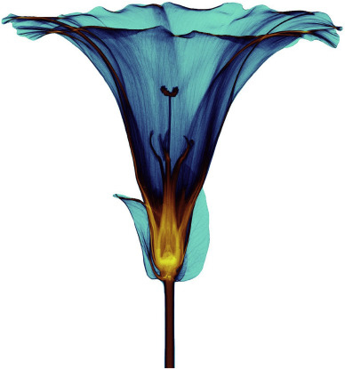
MEDIPIX
DETECTORS
Pinelopi Christodoulou, PhD student Czech Technical University in Prague
Pinelopi.Christodoulou@cern.ch

Slide 2
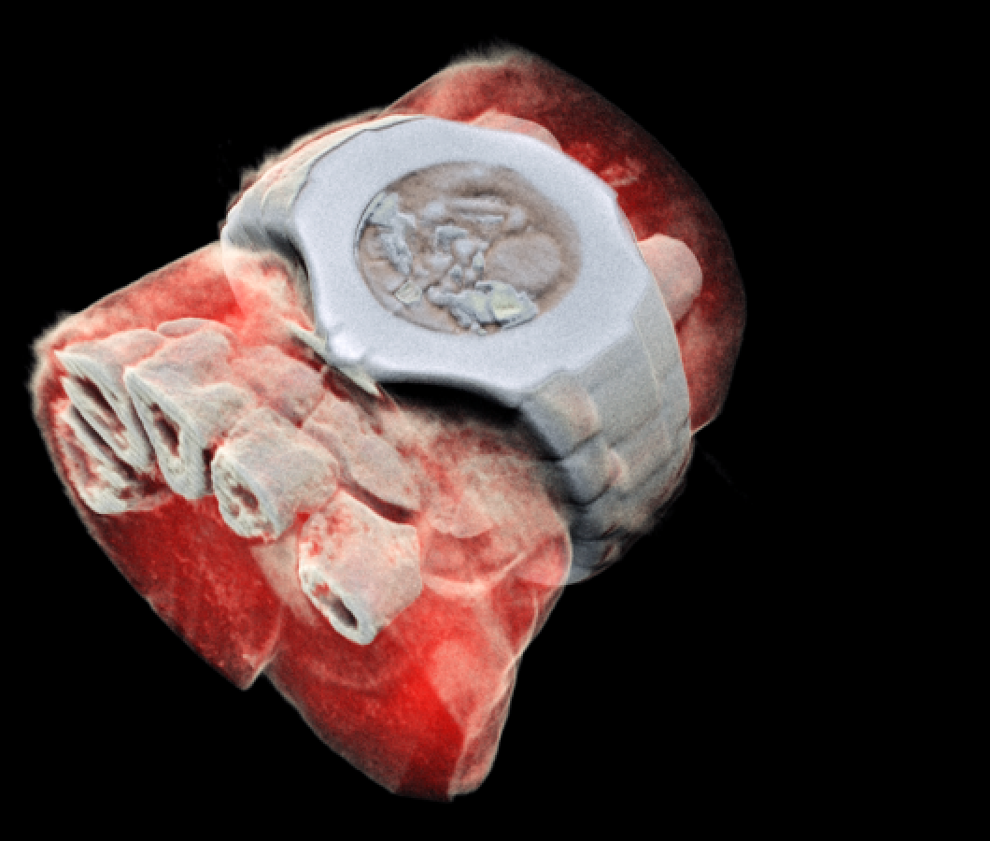
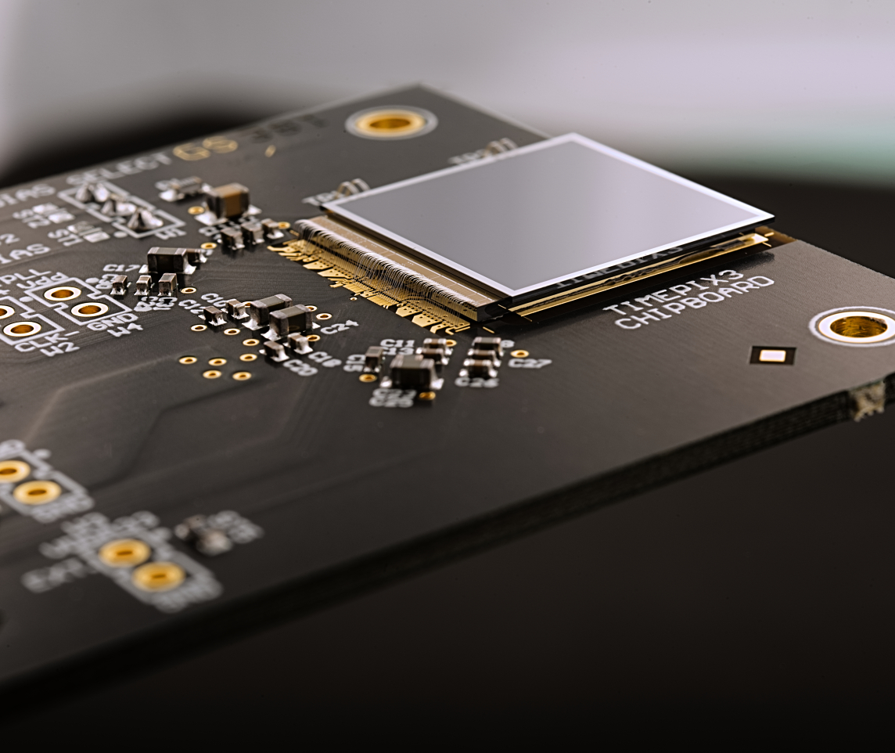
Outline
Interaction of radiation with matter
Photon counting detectors
COOL applications of the detectors
Hands on experience with Minipix-EDU

Slide 3
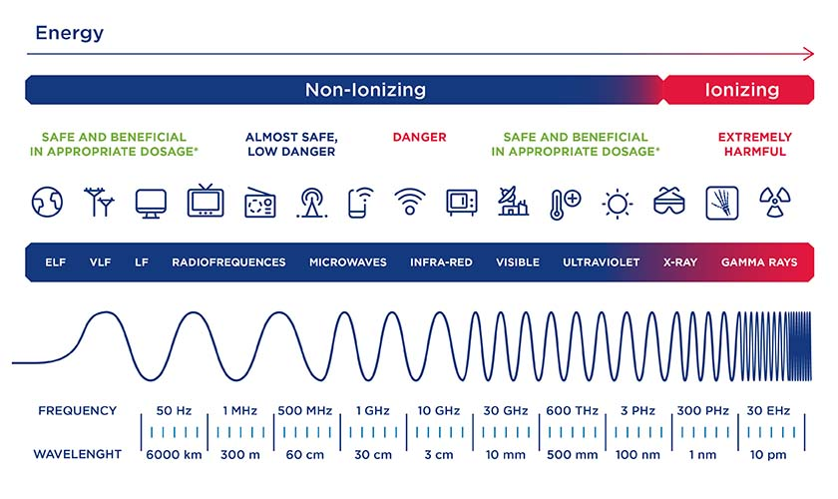
Introduction about Radiation
Radiation is the emission or transmission of energy in the form of waves or particles through space or through a material medium.
Radiation is often categorized as either ionizing or non-ionizing
https://www.safework.nsw.gov.au/hazards-a-z/ionising-and-non-ionising-radiation

Slide 4
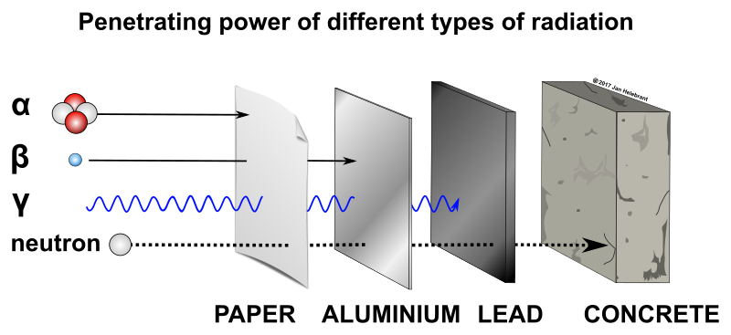
Ionizing irradiation: alpha, beta, gamma particles

Slide 5

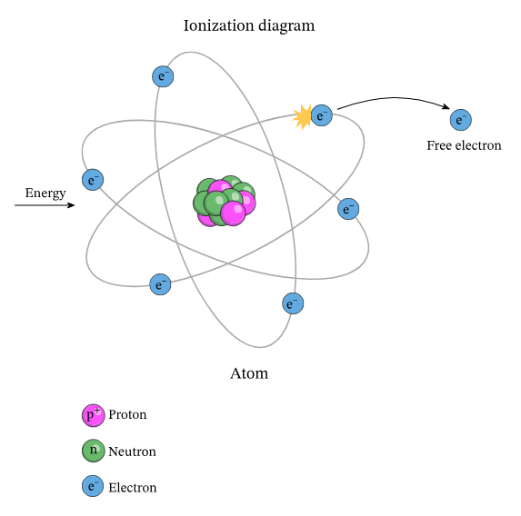
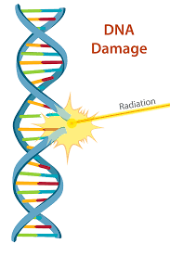
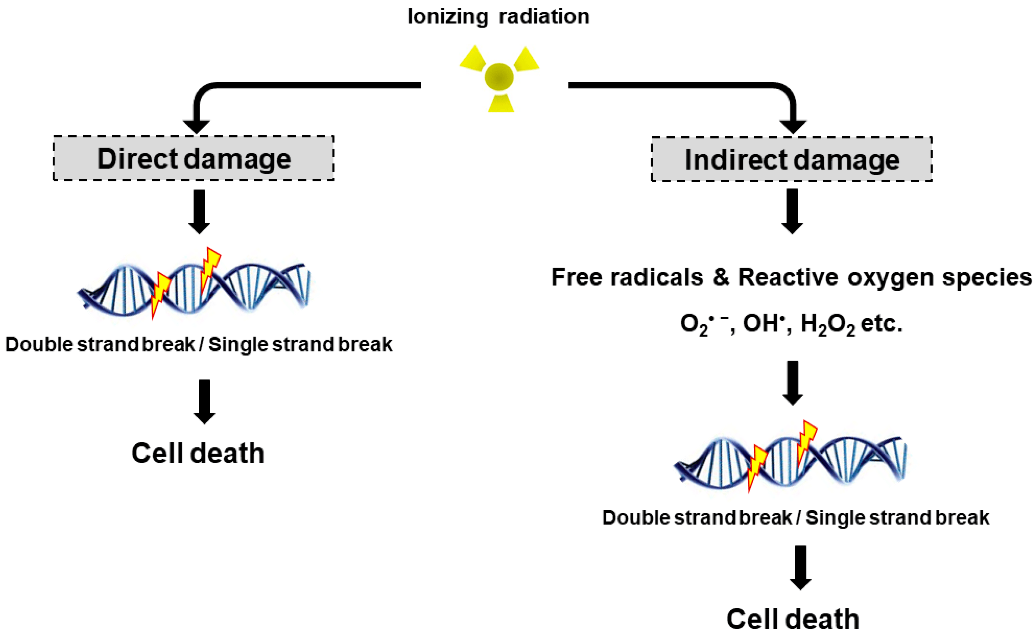
What is Ionization?
Ionization is the ejection of one or more electrons from an atom or molecule to produce a fragment with a net positive charge (positive ion)
Effects of Ionization to the body!
https://www.nagwa.com/en/explainers/840185315807/
https://www.cnsc-ccsn.gc.ca/eng/resources/radiation/radiation-health-effects/
https://www.mdpi.com/1422-0067/18/12/2749

Slide 6

Photon counting detectors

Slide 7
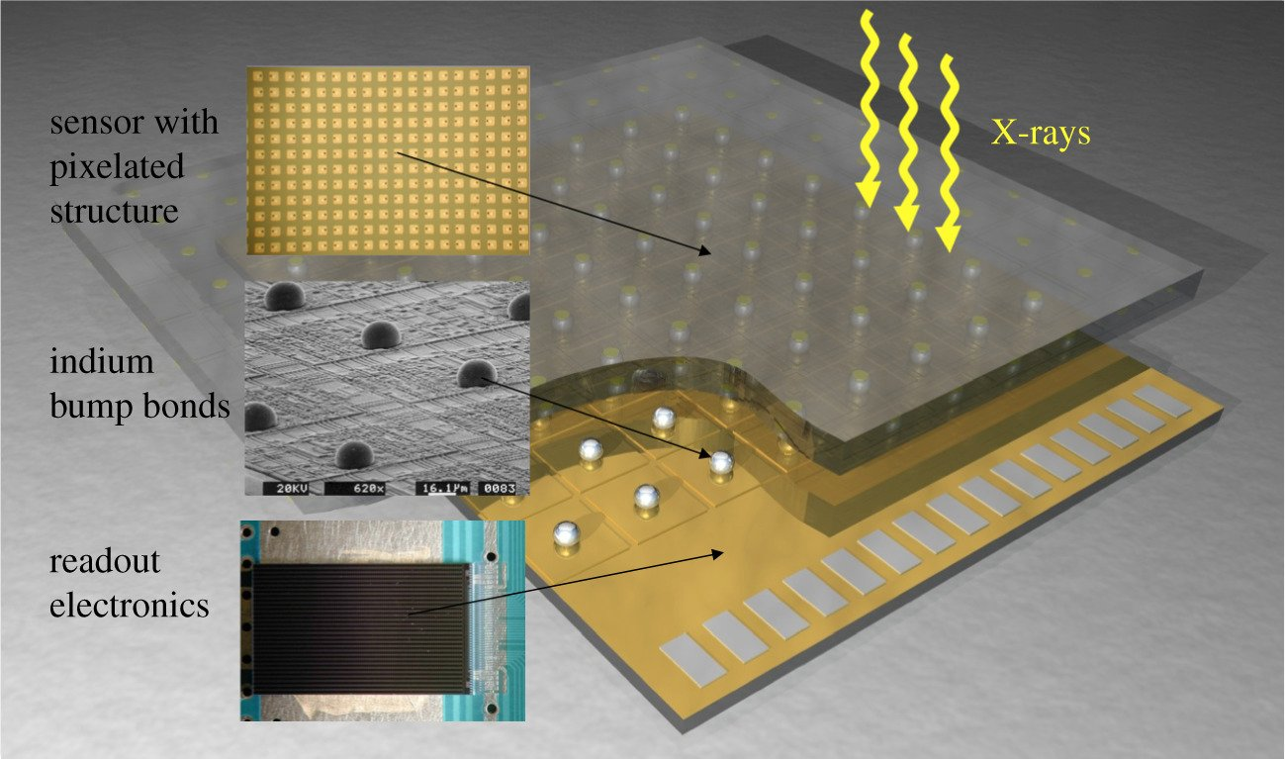
Pixel Detectors
https://www.dectris.com/en/landing-pages/transforming-x-ray-detection/

Slide 8
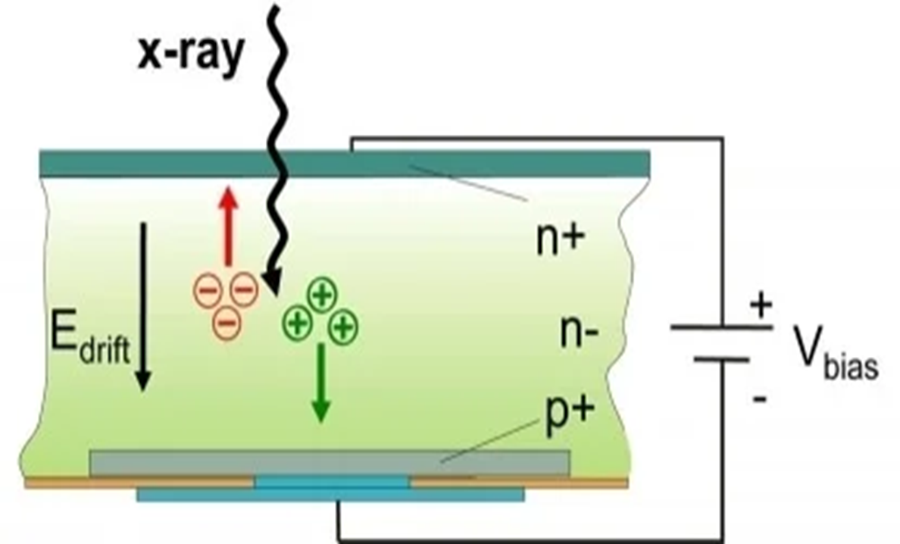
Interaction of radiation with sensor
The mechanisms of interaction for ionizing radiation in the form of x-rays and gamma-rays include the:
Photoelectric effect,
Compton scattering and at high enough energies,
Electron positron pair production.

Slide 9
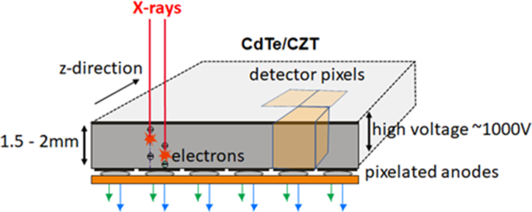
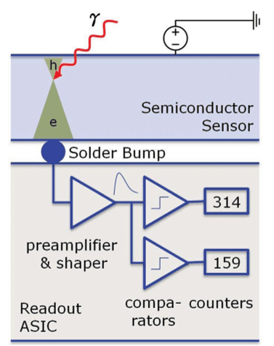
Sensor in pixel detectors
When ionising radiation strikes the detector its energy is deposited in the sensor material (Silicon or Cadmium (Zinc) Telluride).
This is then converted into an electrical signal and amplified.
https://link.springer.com/article/10.1007/s00330-023-09545-9
https://ebrary.net/135261/engineering/introduction

Slide 10
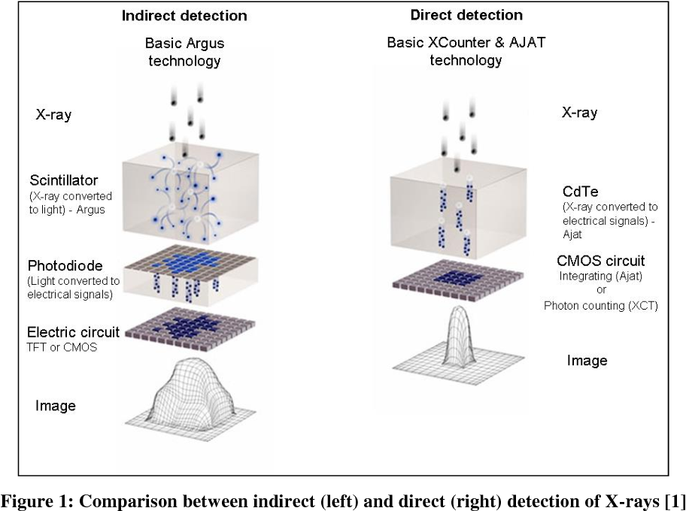
Comparison between indirect and direct detection
Better spatial resolution!
https://www.semanticscholar.org/paper/Photon-counting-and-energy-discriminating-x-ray-and-Schumacher-Zscherpel/7c7035c31b1f6fb3cdbddd6b01e945e6f5dc4e9c

Slide 11
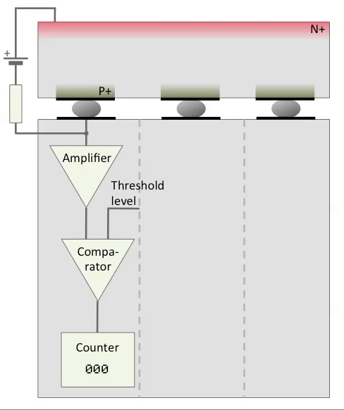
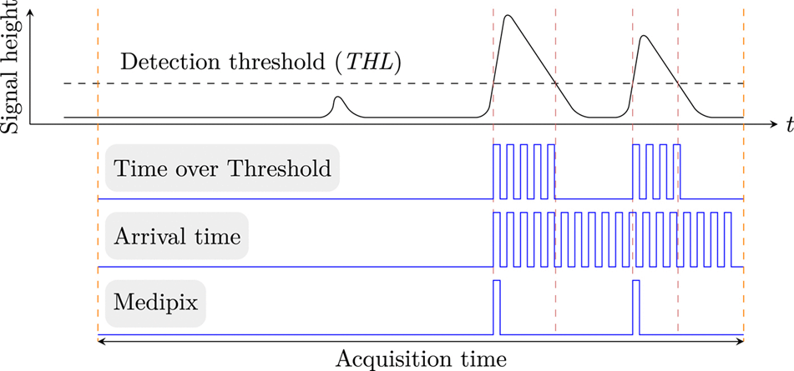
Electronic circuit
Each pixel has its own electronic circuit!
https://www.technos.in/hybrid-pixel-detectors.php

Slide 12
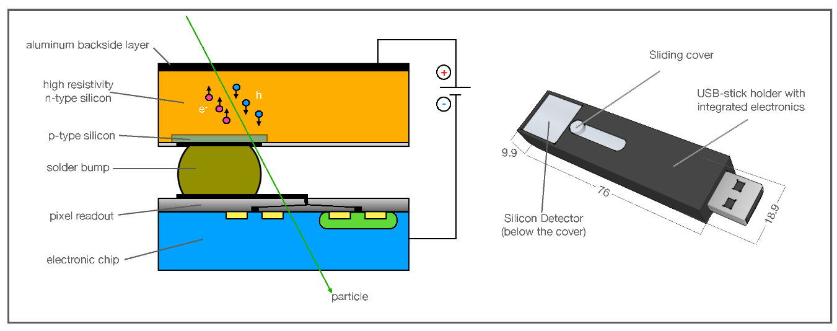
Minipix-EDU: a photon counting detector How does it work?
Cross section view of the Minipix Edu chip.
Rizzo, A.; Cardellini, F.; Poggi, C.; Borra, E.; Ciciani, L.; Narici, L.; Sperandio, L.; Vilardi, I. Novel Algorithm for Radon Real-Time Measurements with a Pixelated Detector. Sensors 2022, 22, 516. https://doi.org/10.3390/s22020516
1. Hybrid pixelated (256 x 256 pixels of 55um pitch) semiconductor detector.
2. Information about the position, deposited energy and time stamp of each particle interacting in the sensor.

Slide 13
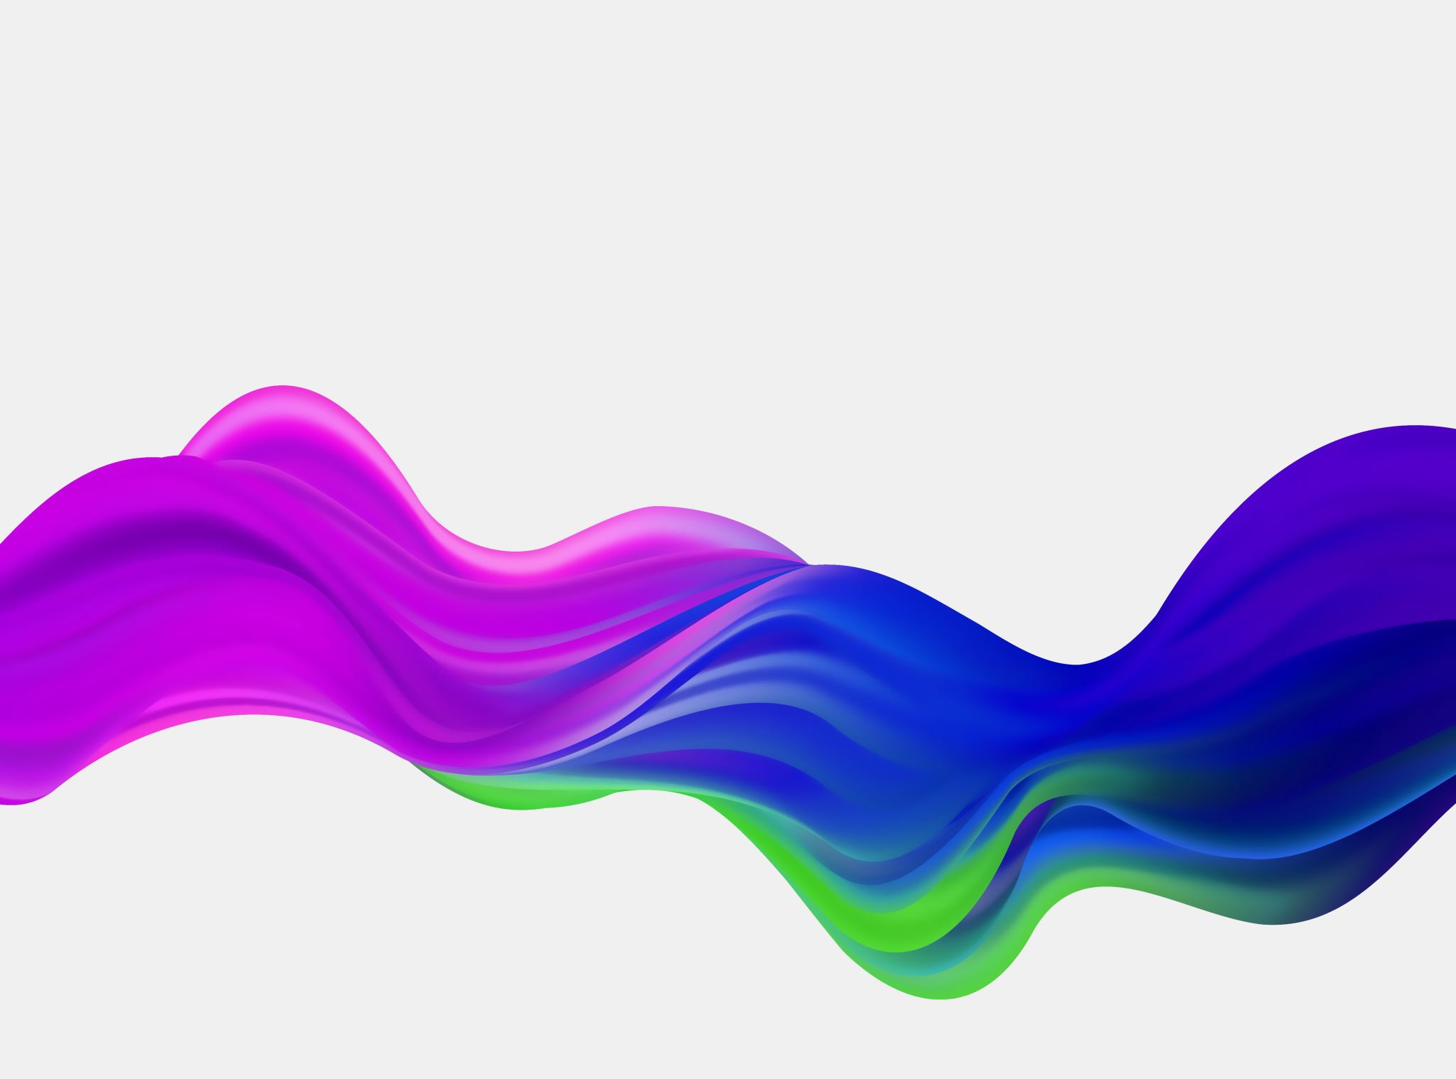
Some of the many applications of photon counting detectors

Slide 14
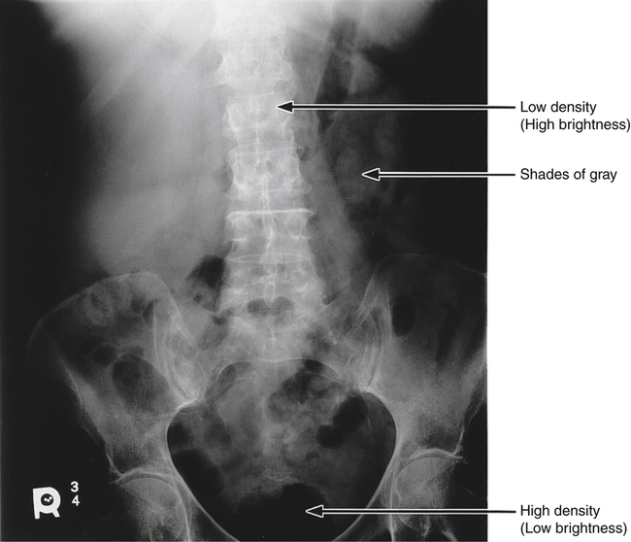
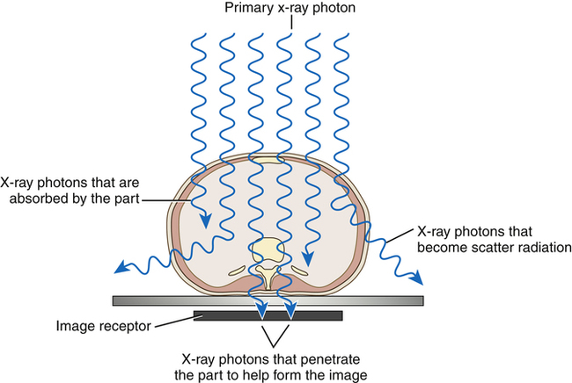
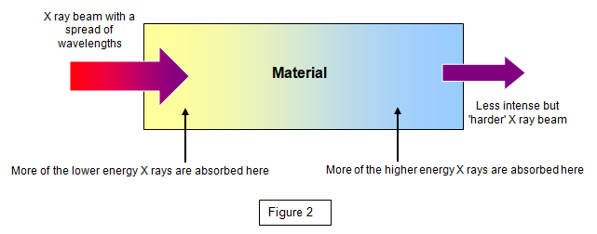
“Conventional” X-ray CT scan
https://www.schoolphysics.co.uk/age16-19/Atomic%20physics/X%20rays/text/X_ray_absorption/index.html
https://radiologykey.com/image-production/

Slide 15
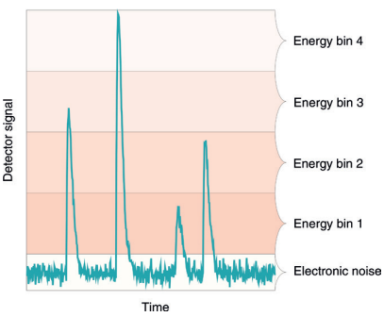
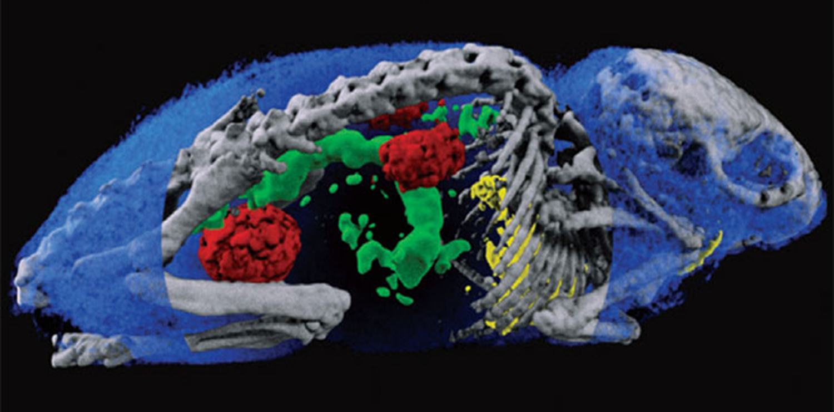
1. Spectroscopic X-ray imaging
able to discriminate the energy of each incident x-ray photon.

Slide 16
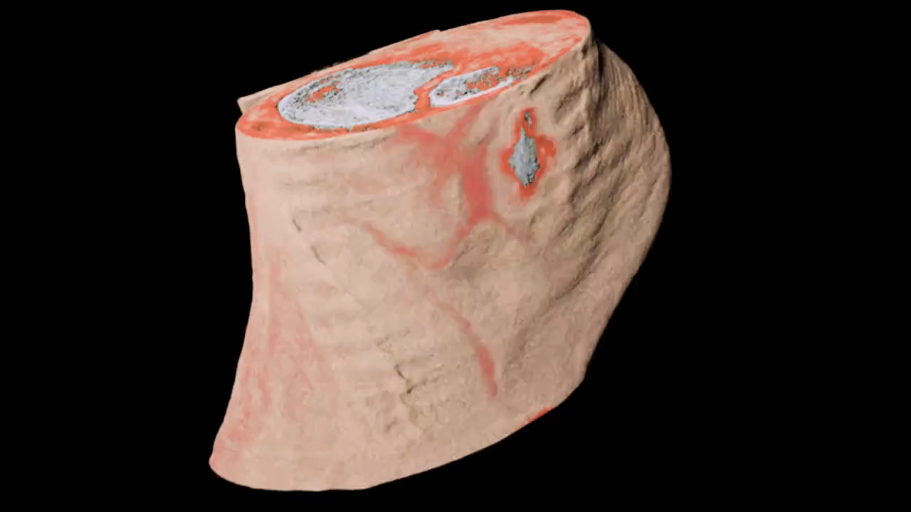
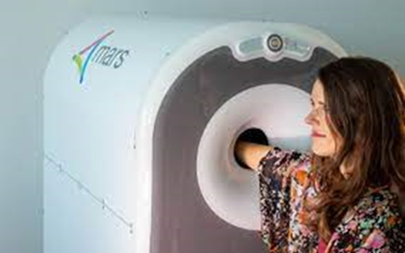
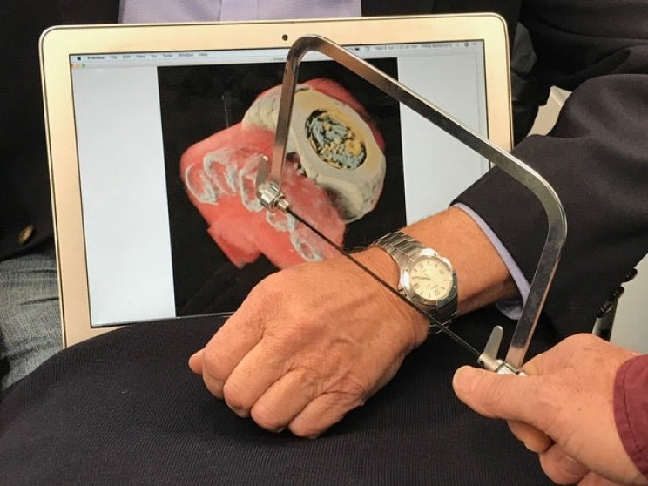
1. Spectroscopic (Color) X-ray imaging
Notes:
MARS Bioimaging’s 3D colour X-ray wrist scanner is awaiting approval to start clinical trials at Lausanne University Hospital (CHUV, Switzerland) and is the subject of ongoing clinical trials within the Pacific Radiology Group, New Zealand's largest radiology service provider. CERN and the New Zealand company MARS Bioimaging teamed up in 2008 to develop this 3D colour X-ray scanner based on the Medipix3 technology.
The X-ray beams used in medical equipment contain a wide spectrum of X-ray energies, which can be thought of as different X-ray colours. In conventional detectors, the image taken is based on the total X-ray energy absorbed by each pixel, forming a kind of black and white image. When spectroscopic detectors are used, the images also contain the “colours” of the incoming X-rays, providing better, clearer images at optimised doses with significant benefits when diagnosing disease. In some circumstances, MRI (magnetic resonance imaging) may even become superfluous. In other cases, where metal contrast agents attached to bio-markers are injected into the body, expensive PET–CT (positron emission tomography – computed tomography) scans, may be avoided.

Slide 17
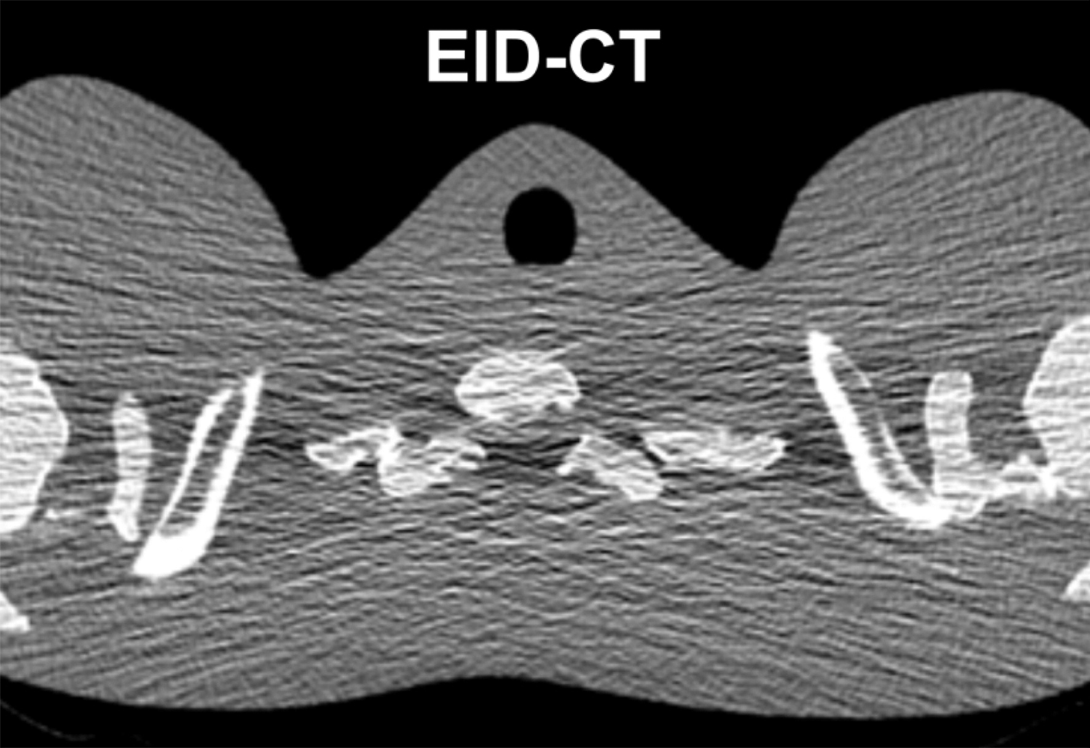
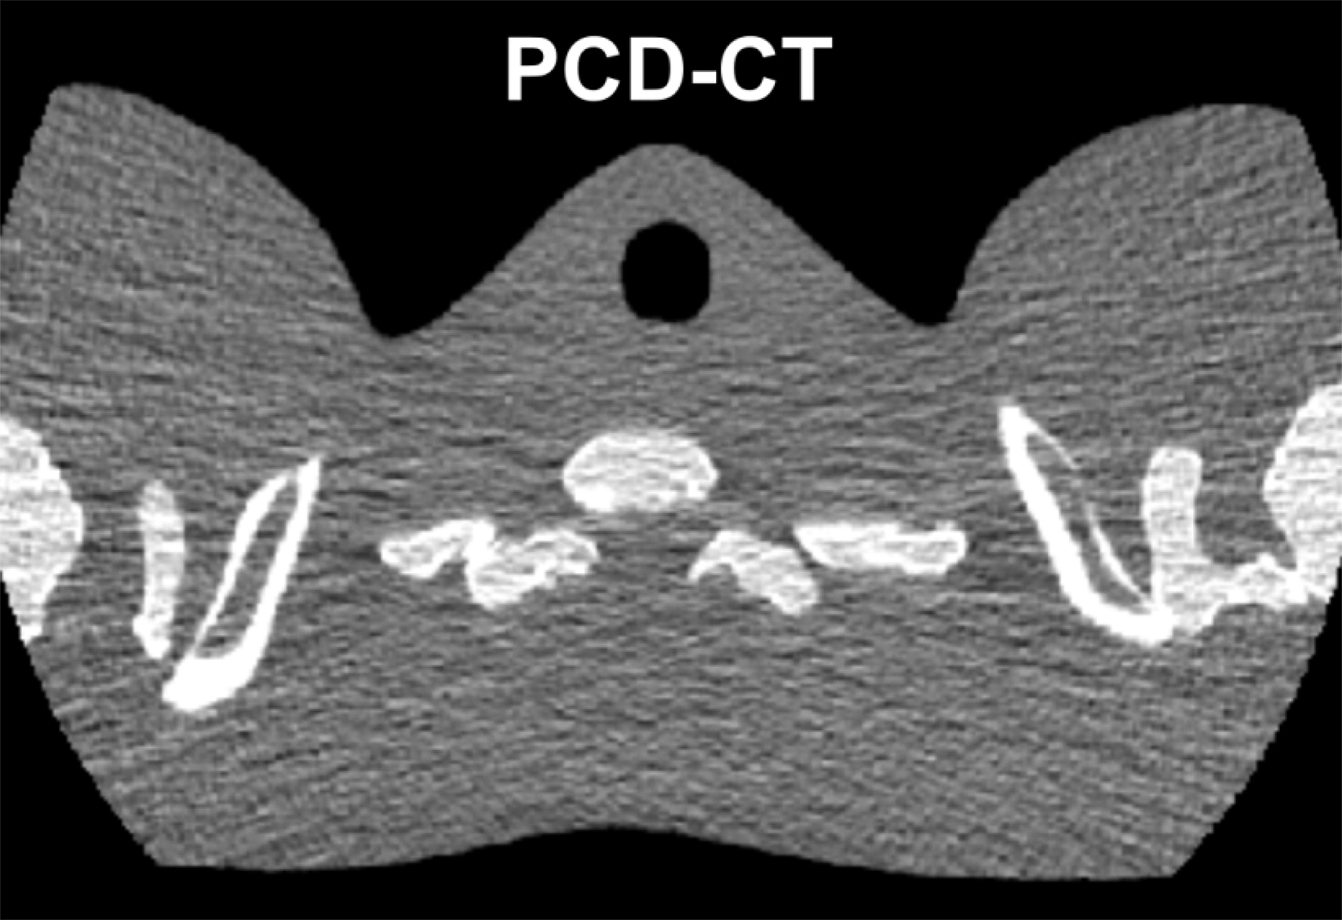
Medical applications: Computed tomography
“Conventional” Energy Integrating Detectors (EID)
Photon Counting Detectors (PCD)
Give less noisy image!
The shoulder section of a thorax phantom reconstructed from data acquired with EID CT (a) and with PCD CT (b) using the same x-ray tube potential and radiation dose
Notes:
common x-ray tube produces a broad spectrum of x-rays, and the conventional x-ray CT detector is a photon-integrating sensor whose output is proportional to the energy fluence over the entire x-ray spectrum. Given that x-ray attenuation is dependent both on the object material and photon energy, a conventional x-ray CT detector loses spectrally varying attenuation information due to the energy integration. In contrast, an energy-discriminative photon-counting detector has the capability to resolve the energy levels of incident photons, which helps identify additional information.

Slide 18
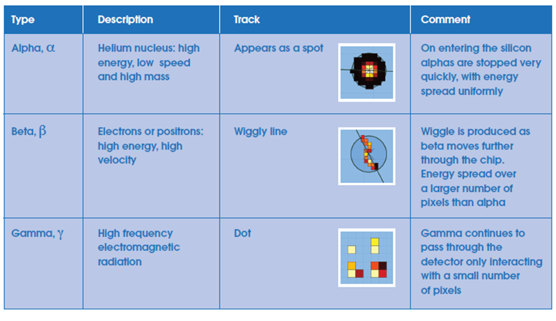
2. Application: school projects Particle identification
The pattern of the
energy deposited across numerous pixels allows for identification of
alpha, beta, gamma, muon, etc.

Slide 19
Data analysis with Pixet Basic software
Let's compare two datasets using the PIXET BASIC SOFTWARE!
https://satram.utef.cvut.cz/
Notes:
https://hawkeyesi.com/experiments/introduction-to-pixet-basic-software/

Slide 20
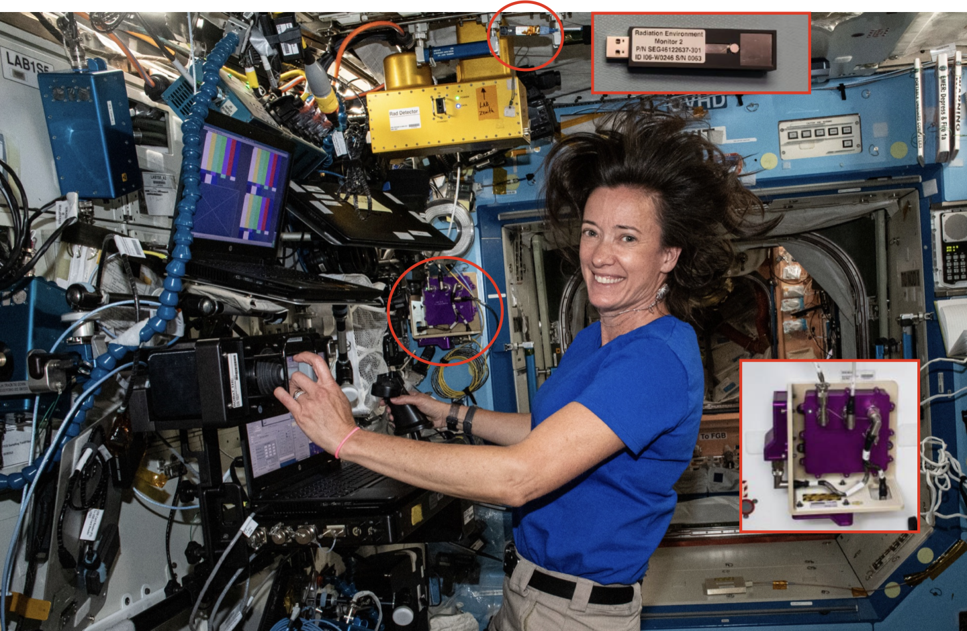
3. The detector in SPACE!
Total Radiation Dose Monitoring
Adaptive Protective Measures
Space Weather Forecasting
Data for the detector on the One Web – JoeySat satellite – launched last year/May 2023. orbit - 600 km LEO. With ADV’s MiniPIX Space with TPX3 500 um Si sensor

Slide 21
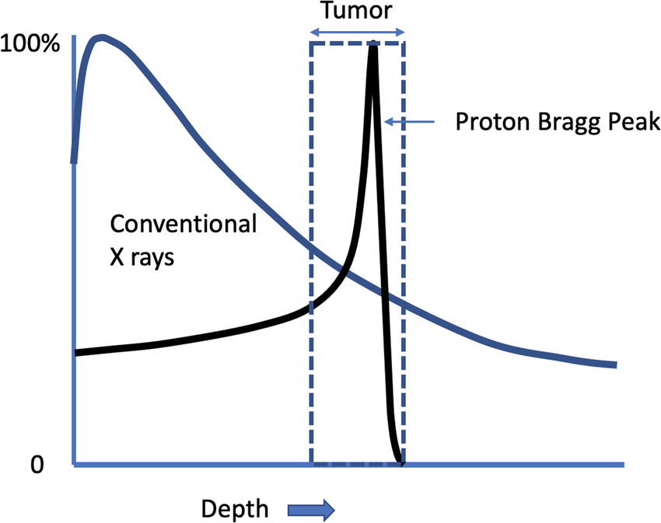
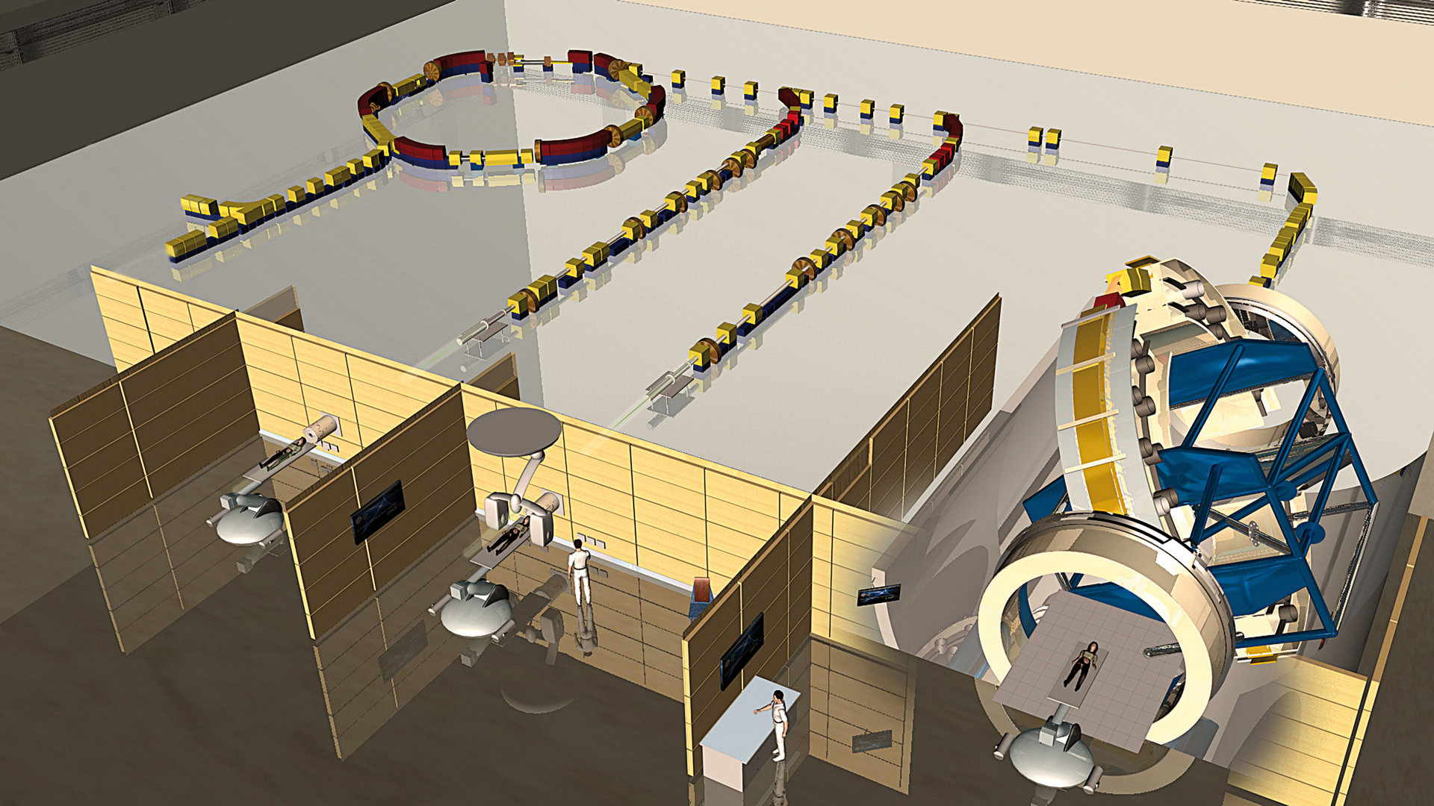
4. Treatment planning for hadron therapy
Let’s check two more datasets!

Slide 22
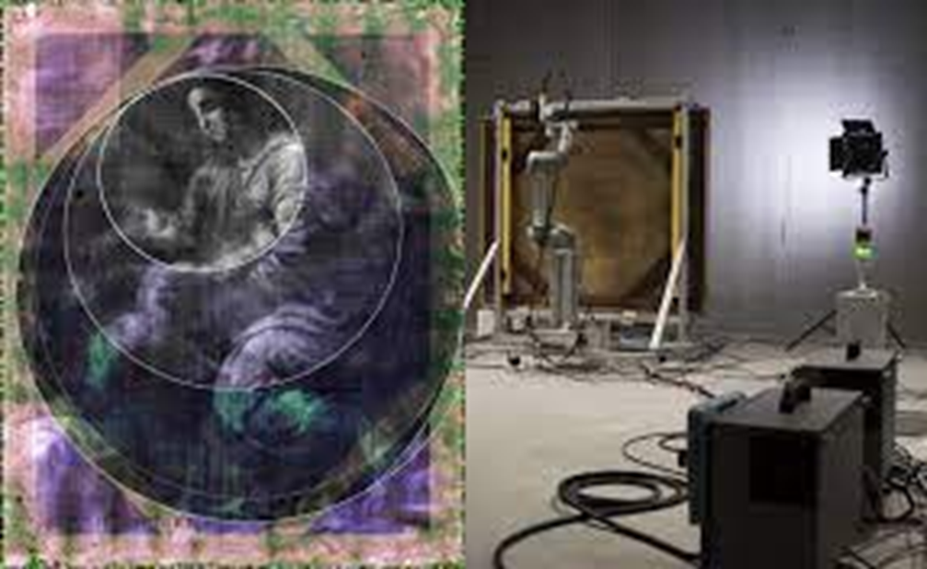

5. Material reconstruction for art
CERN technology helps rediscover lost painting by Raphael: The Madonna and Child
https://medipix.web.cern.ch/news/news/timepix/cern-technology-helps-rediscover-lost-painting-raphael

Slide 23
SUMMARY
Ionization is necessary to have signal in our detectors!
We are dealing with Photon Processing Detectors (we have information for the energy and the time of individual photons interacting with our sensor)
The spatial and energy resolution improve significantly in photon counting pixelated semiconductor detectors!
Particle identification is possible!
There are many applications in a variety of fields!

Slide 24
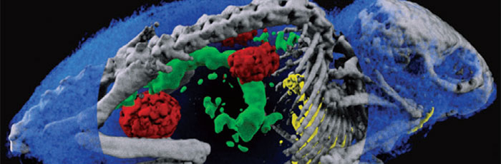
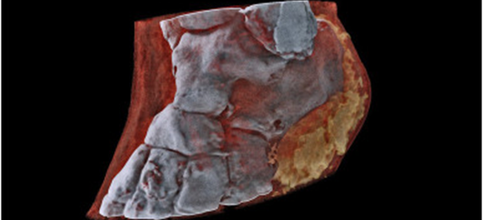
So lets connect the Minipix-Edu to the laptops!

Slide 25

EXTRA SLIDES

Slide 26
USEFUL LINKS
• https://medipix.web.cern.ch/home
• ADMIRA PROJECT: https://serviparticules.ub.edu/en/projects/admira-project
• Really interesting article about educational use of Timepix detectors: https://cds.cern.ch/record/2801427/files/document.pdf
• Knowledge transfer success story: https://knowledgetransfer.web.cern.ch/success-stories/medipix-chips-and-collaborations-medical-imaging-space-dosimetry
• Minipix edu from ADVACAM: https://advacam.com/camera/minipix-edu/
• SESTRA KIT and book with experiments: http://www.utef.cvut.cz/cms_files/original/cms_data/00099/SESTRA_flyer_-_2022-06-02_-_EPS_forum_Paris.docx_compressed.pdf

Slide 27
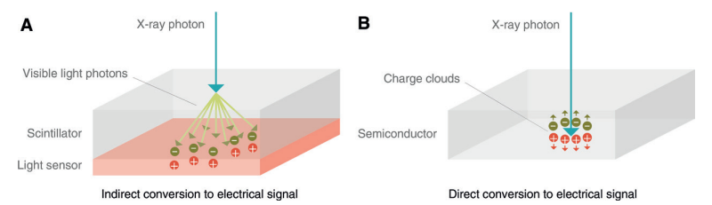
Photon counting detectors
1. Direct conversion
Conventional energy-integrating detector
Photon-counting detector
https://doi.org/10.1148/radiol.2018172656
Notes:
The spectroscopic information enables various advantages:-The image contrast and signal-to-noise-ratio can be enhanced
-A reduction of radiation dose is possible while preserving the same image quality
-A more accurate dose calculation, derived from the actual energy spectrum, is possible
-Identification and quantification of multiple contrast agents with just one examination is feasible
-A reduction of beam hardening artifacts, including lowering of artifacts caused by metal parts, is obtainable
-A detailed material identification can be achieved

Slide 28
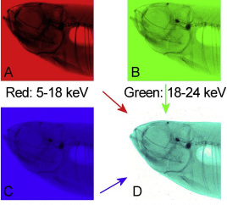
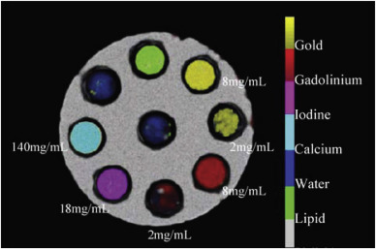
1. Coloured X-ray imaging using the head of a small fish
https://www.sciencedirect.com/science/article/pii/S1350448719300599
Notes:
The swim bladder is white as the air around the fish because the photons of all energy ranges are almost not absorbed here. The low energy photons are not able to penetrate the tissue and the remaining photons of the medium and high energy range appear cyan colored. The bones are blue-black colored because only the high energy photons are able to penetrate them.

Slide 29
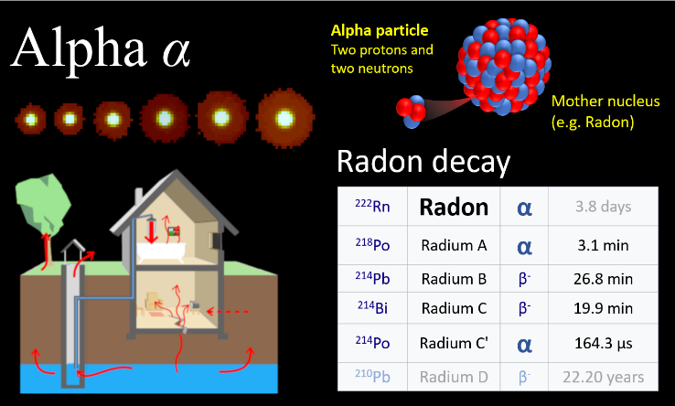
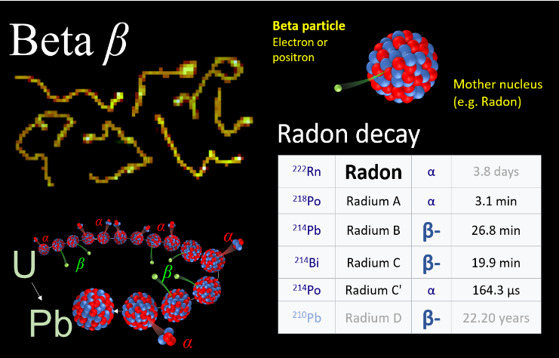
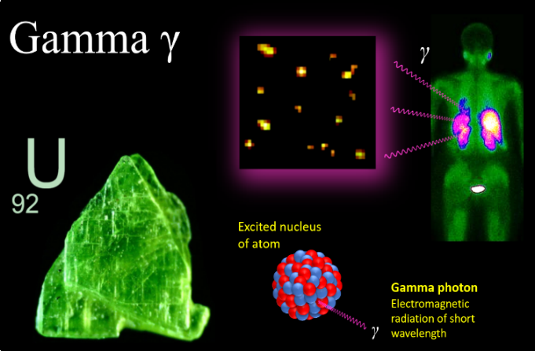
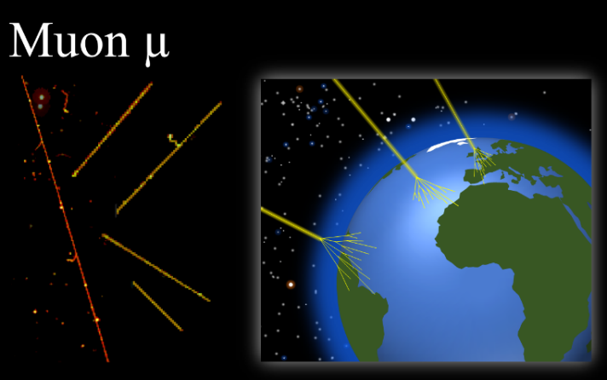
Different types of particles!
Notes:
https://www.linkedin.com/pulse/fascinating-patterns-drawn-radiation-particle-physics-jan-jakubek/

Slide 30
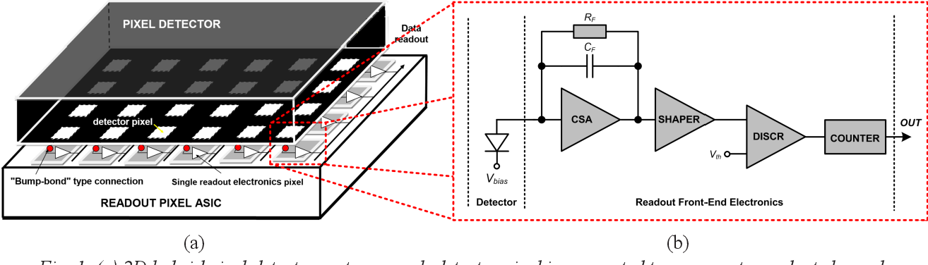
Electronic circuit
https://www.semanticscholar.org/paper/Ultrafast-signal-processing-readout-front-end-in-40-Kleczek-Grybos/02c65115cf5c79d68de222a020b06aeede47736a

Slide 31
Nice video
https://advacam.com/camera/minipix-sprinter/?gad_source=2&gclid=CjwKCAjwzN-vBhAkEiwAYiO7oLRNOM4hJPwT0M0nZts0g35LEOn74Dd9U9Hp7DSS1WYXUk_GezV8sBoC_vgQAvD_BwE

