Slide 1
UC QuarkNet 2024
Michael K. Wilkinson
24 June 2024

Slide 2
Who am I?
Michael K. Wilkinson, PhD
  B.S. in Physics and B.A. from the University of Oklahoma
  Ph.D. from Syracuse University
  Currently postdoctoral fellow at the University of Cincinnati

Slide 3
What should you call me?
Dr. Wilkinson
Michael
Same for everyone else you will be working with—first name only

Slide 4
Who are you?
Name
The school you attend/will be attending in the fall
One piece of media you enjoyed recently
Hand in your forms if you haven’t already

Slide 5
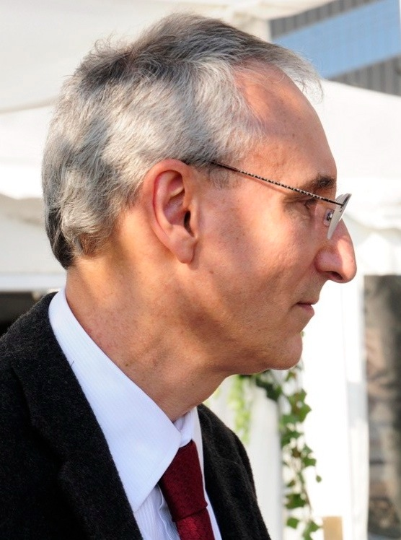
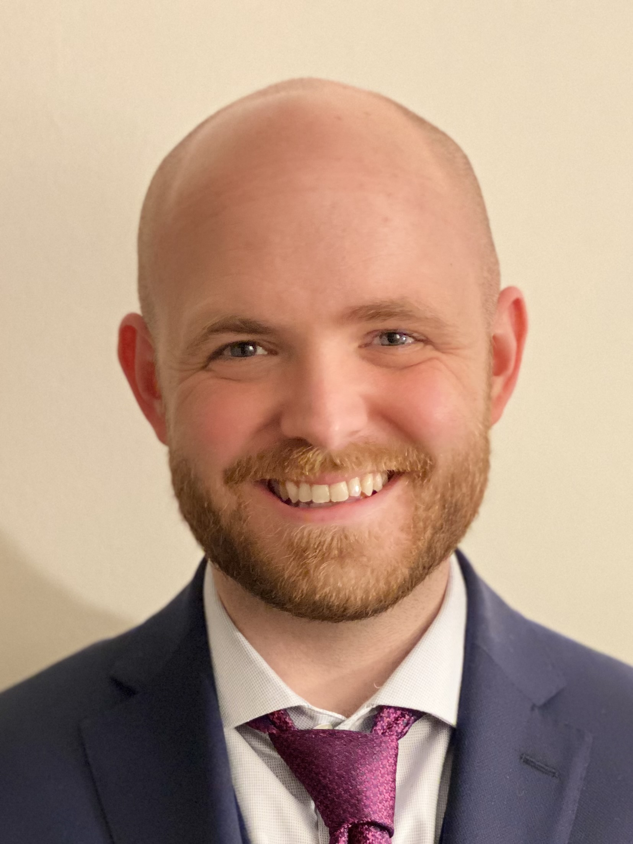
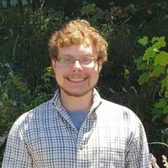
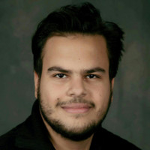
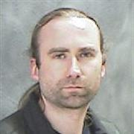
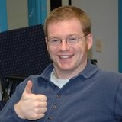
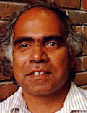
Who will you be working with?
Gabe Nowak
Mohamed Elashri
Phil Ilten
Mike Sokoloff
Michael K. Wilkinson
Rohana Wijewardhana
These are some of the people who helped to organize UC QuarkNet 2024 and its introductory materials
Conor Henderson
[not pictured]
Jacob Kautz

Slide 6
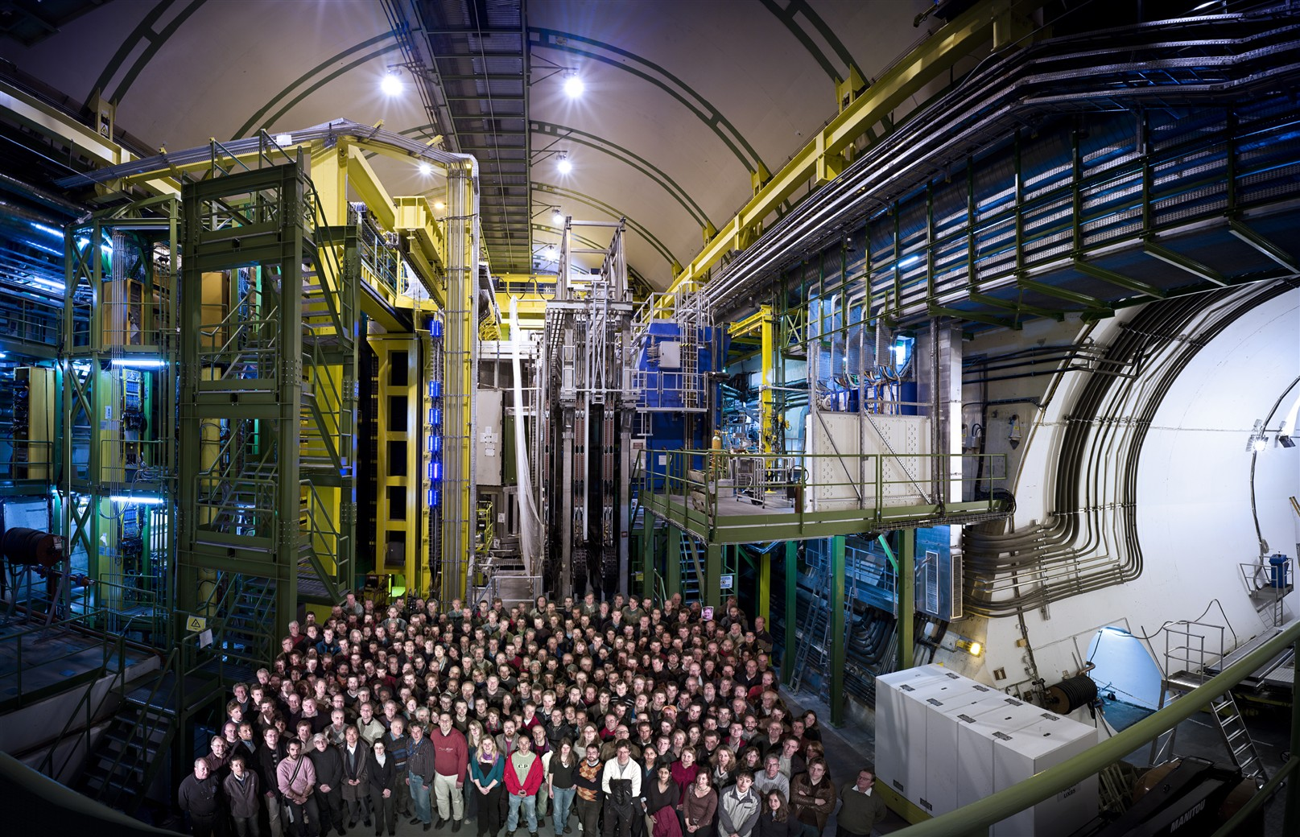
What will you be working on?
You will be analyzing particle physics data collected using the LHCb detector (pictured), which is located on the Large Hadron Collider at CERN, near the French/Swiss border.
You will join the thousands of other scientists (some pictured) who have worked together to build and operate the detector and use its output to make meaningful measurements.
https://cds.cern.ch/record/1221090

Slide 7
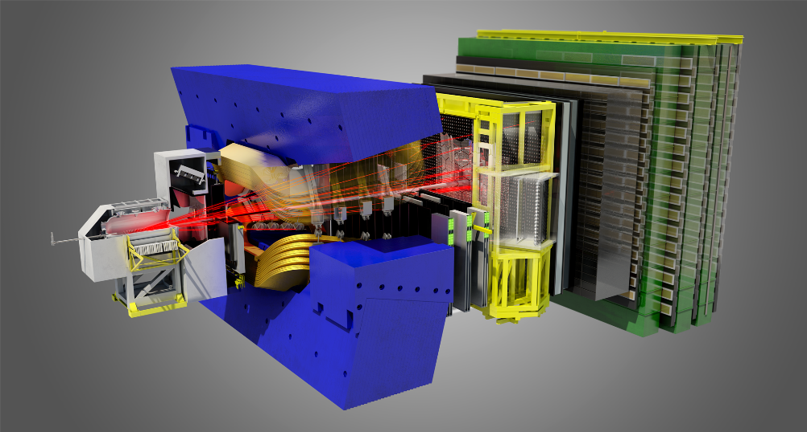
What will you be doing?
LHCb is currently collecting new data.
You will be analyzing early some of this early data using the programming language Python.
Mike will give more details about the specific measurements.
This will culminate in presentations:
  Group presentation to LHCb researchers at UC
  Individual presentations demonstrating what you found
https://lhcb-public.web.cern.ch/en/LHCb-outreach/multimedia/LHCbDetectorpnglight1.png

Slide 8
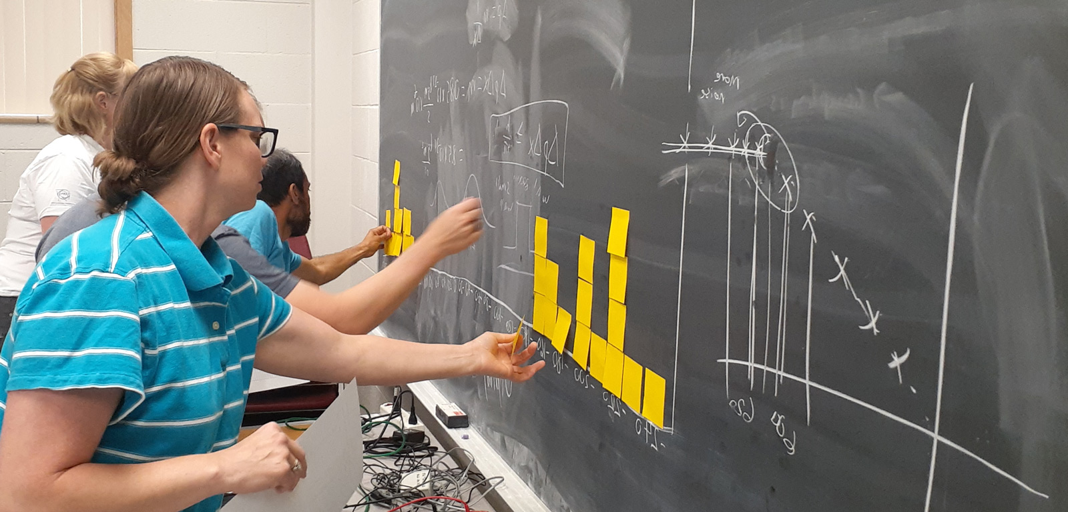
What is QuarkNet?
“The QuarkNet Collaboration is a long‐term, national program that partners high school science teachers with particle physicists working in experiments at the scientific frontier.”
Also has programs to connect students with universities directly.
Links to great resources to learn more about particle physics.
https://quarknet.org

Slide 9
Where and when?
Geology/Physics Building at UC, room 300
Monday-Friday, 9-4, excepting university holidays, one hour lunch
Some additional work outside this location and these hours

Slide 10
Schedule
 | M | T | W | H | F
Week 1 | Introductory lessons
Week 2 | Research
Week 3
Week 4
Week 5
Week 6
Notes:
There will be lessons on selected topics during weeks 2-6 as well.

Slide 11
Week 1
 | M | T | W | H | F
AM | Physics
lunch
PM | Coding
Notes:
There will

Slide 12
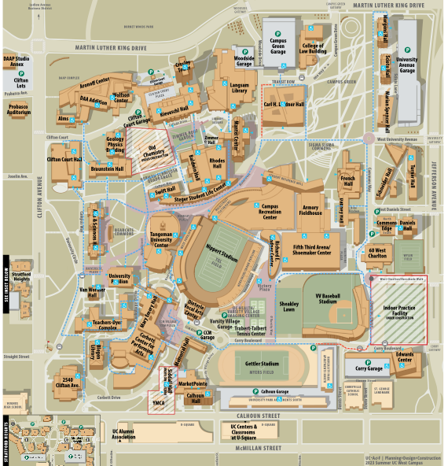
Lunch information
Monday – Thursday:
  On-the-Green
  In Marian-Spencer Hall
Friday:
  Center Court
  In the Rec Center
At the register say you are a part of the QuarkNet Summer Internship—they should have a spreadsheet with your name—you should not have to pay
On-the-Green
Geology / Physics
Center Court

Slide 13
Other practical information
To find the bathrooms, turn left out of room 300, walk to the door leading outside, then turn right (without going outside). The bathrooms are behind the stairwell.
You do not need to ask permission to go to the bathroom
Your stipend will be paid upon successful completion of the internship
The main physics office is in room 400 (4th floor, just above)
Bring a notebook and pen/pencil every day
Ask questions
Don’t panic

Slide 14
Ask questions

