Slide 1



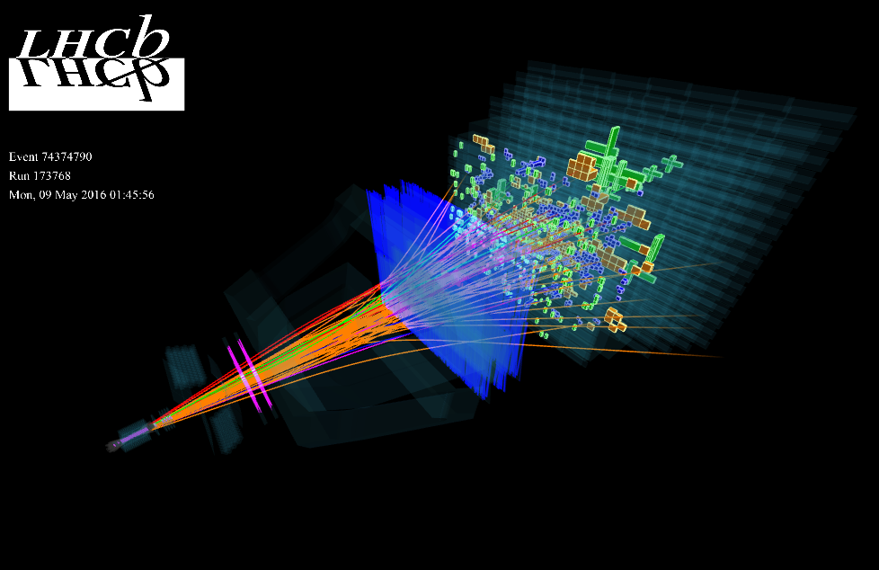
QuarkNet Internship Lecture Series:
Detector Physics

Slide 2
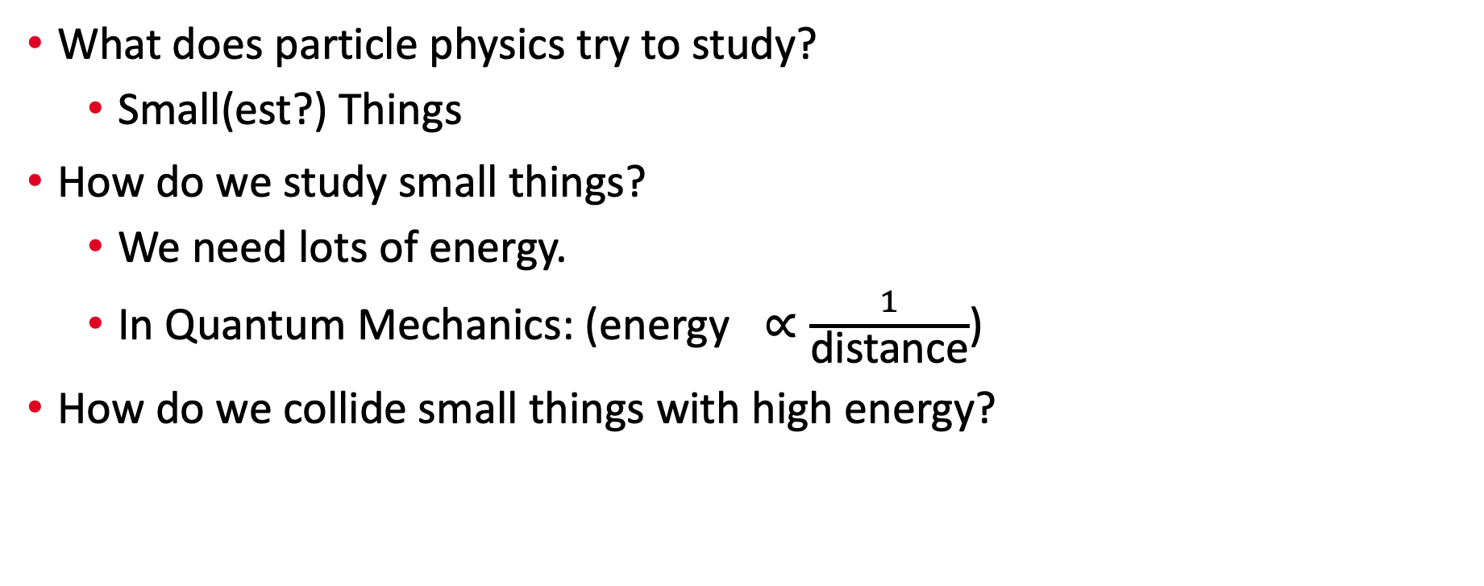
Motivation
What does particle physics try to study?
  Small(est?) Things
How do we study small things?
  We need lots of energy.
  In Quantum Mechanics: ($\text{energy} ∝\frac{1}{\text{distance}}$)
How do we collide small things with high energy?

Slide 3
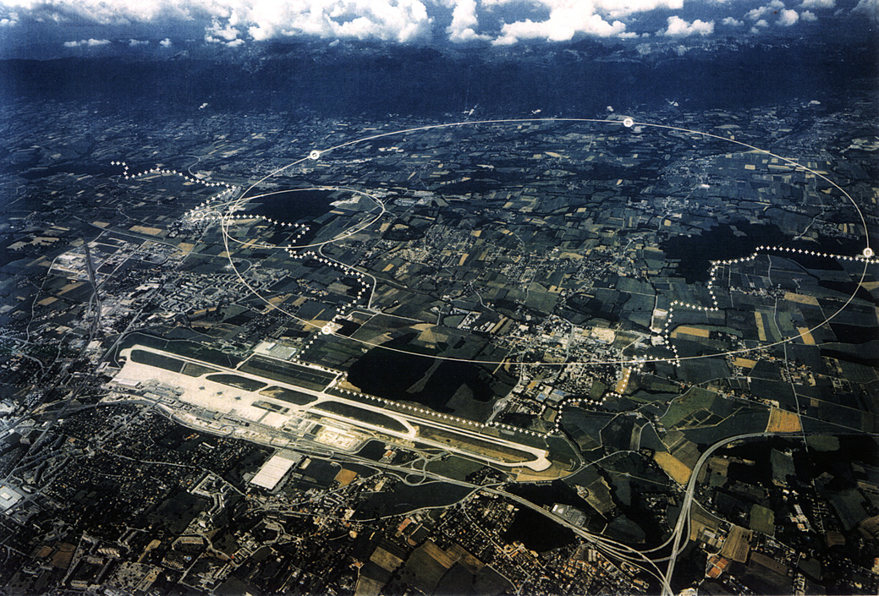
Large Hadron Collider (LHC)
Enter the Large Hadron Collider (LHC).
A large particle collider on the border between Switzerland and France.
It is a machine designed to collide small things at high energy.
Notes:
Rings super-imposed—actual LHC 100 meters underground
Circumference ~17 mi.
“one of places the protons collide is the LHCb detector, near the Geneva Airport”

Slide 4
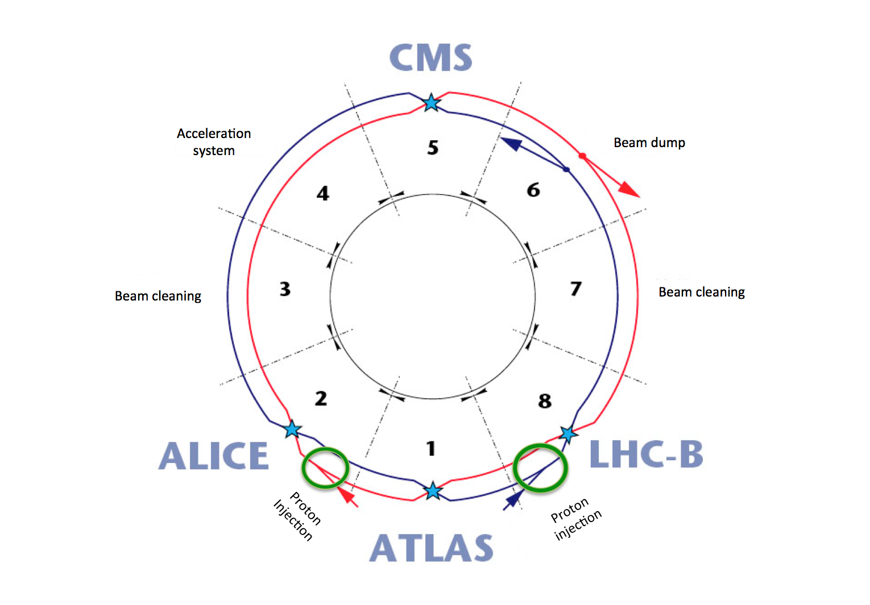
Large Hadron Collider (LHC)
There are four collision points on the LHC each with their own experiments.
Two general purpose experiments: CMS and ATLAS
Two specialized experiments: ALICE and LHCb
Notes:
The LHC circulates two beams of protons, one clockwise and one anti-clockwise, held in separate rings where they are each accelerated to 6.5 TeV. They are then forced to collide at four different interaction points around the ring, the locations of the ALICE, ATLAS, CMS, and LHCb detectors, with a total center-of-mass collision energy of 13 TeV. The protons are separated into discrete bunches to help control the collisions; a bunch in one beam is brought into an interaction point at the same time as a bunch in the other beam, allowing the protons in the bunches to collide. Bunch crossings occur once every 25 ns. Bunch crossings where protons collide are referred to as “events”.

Slide 5
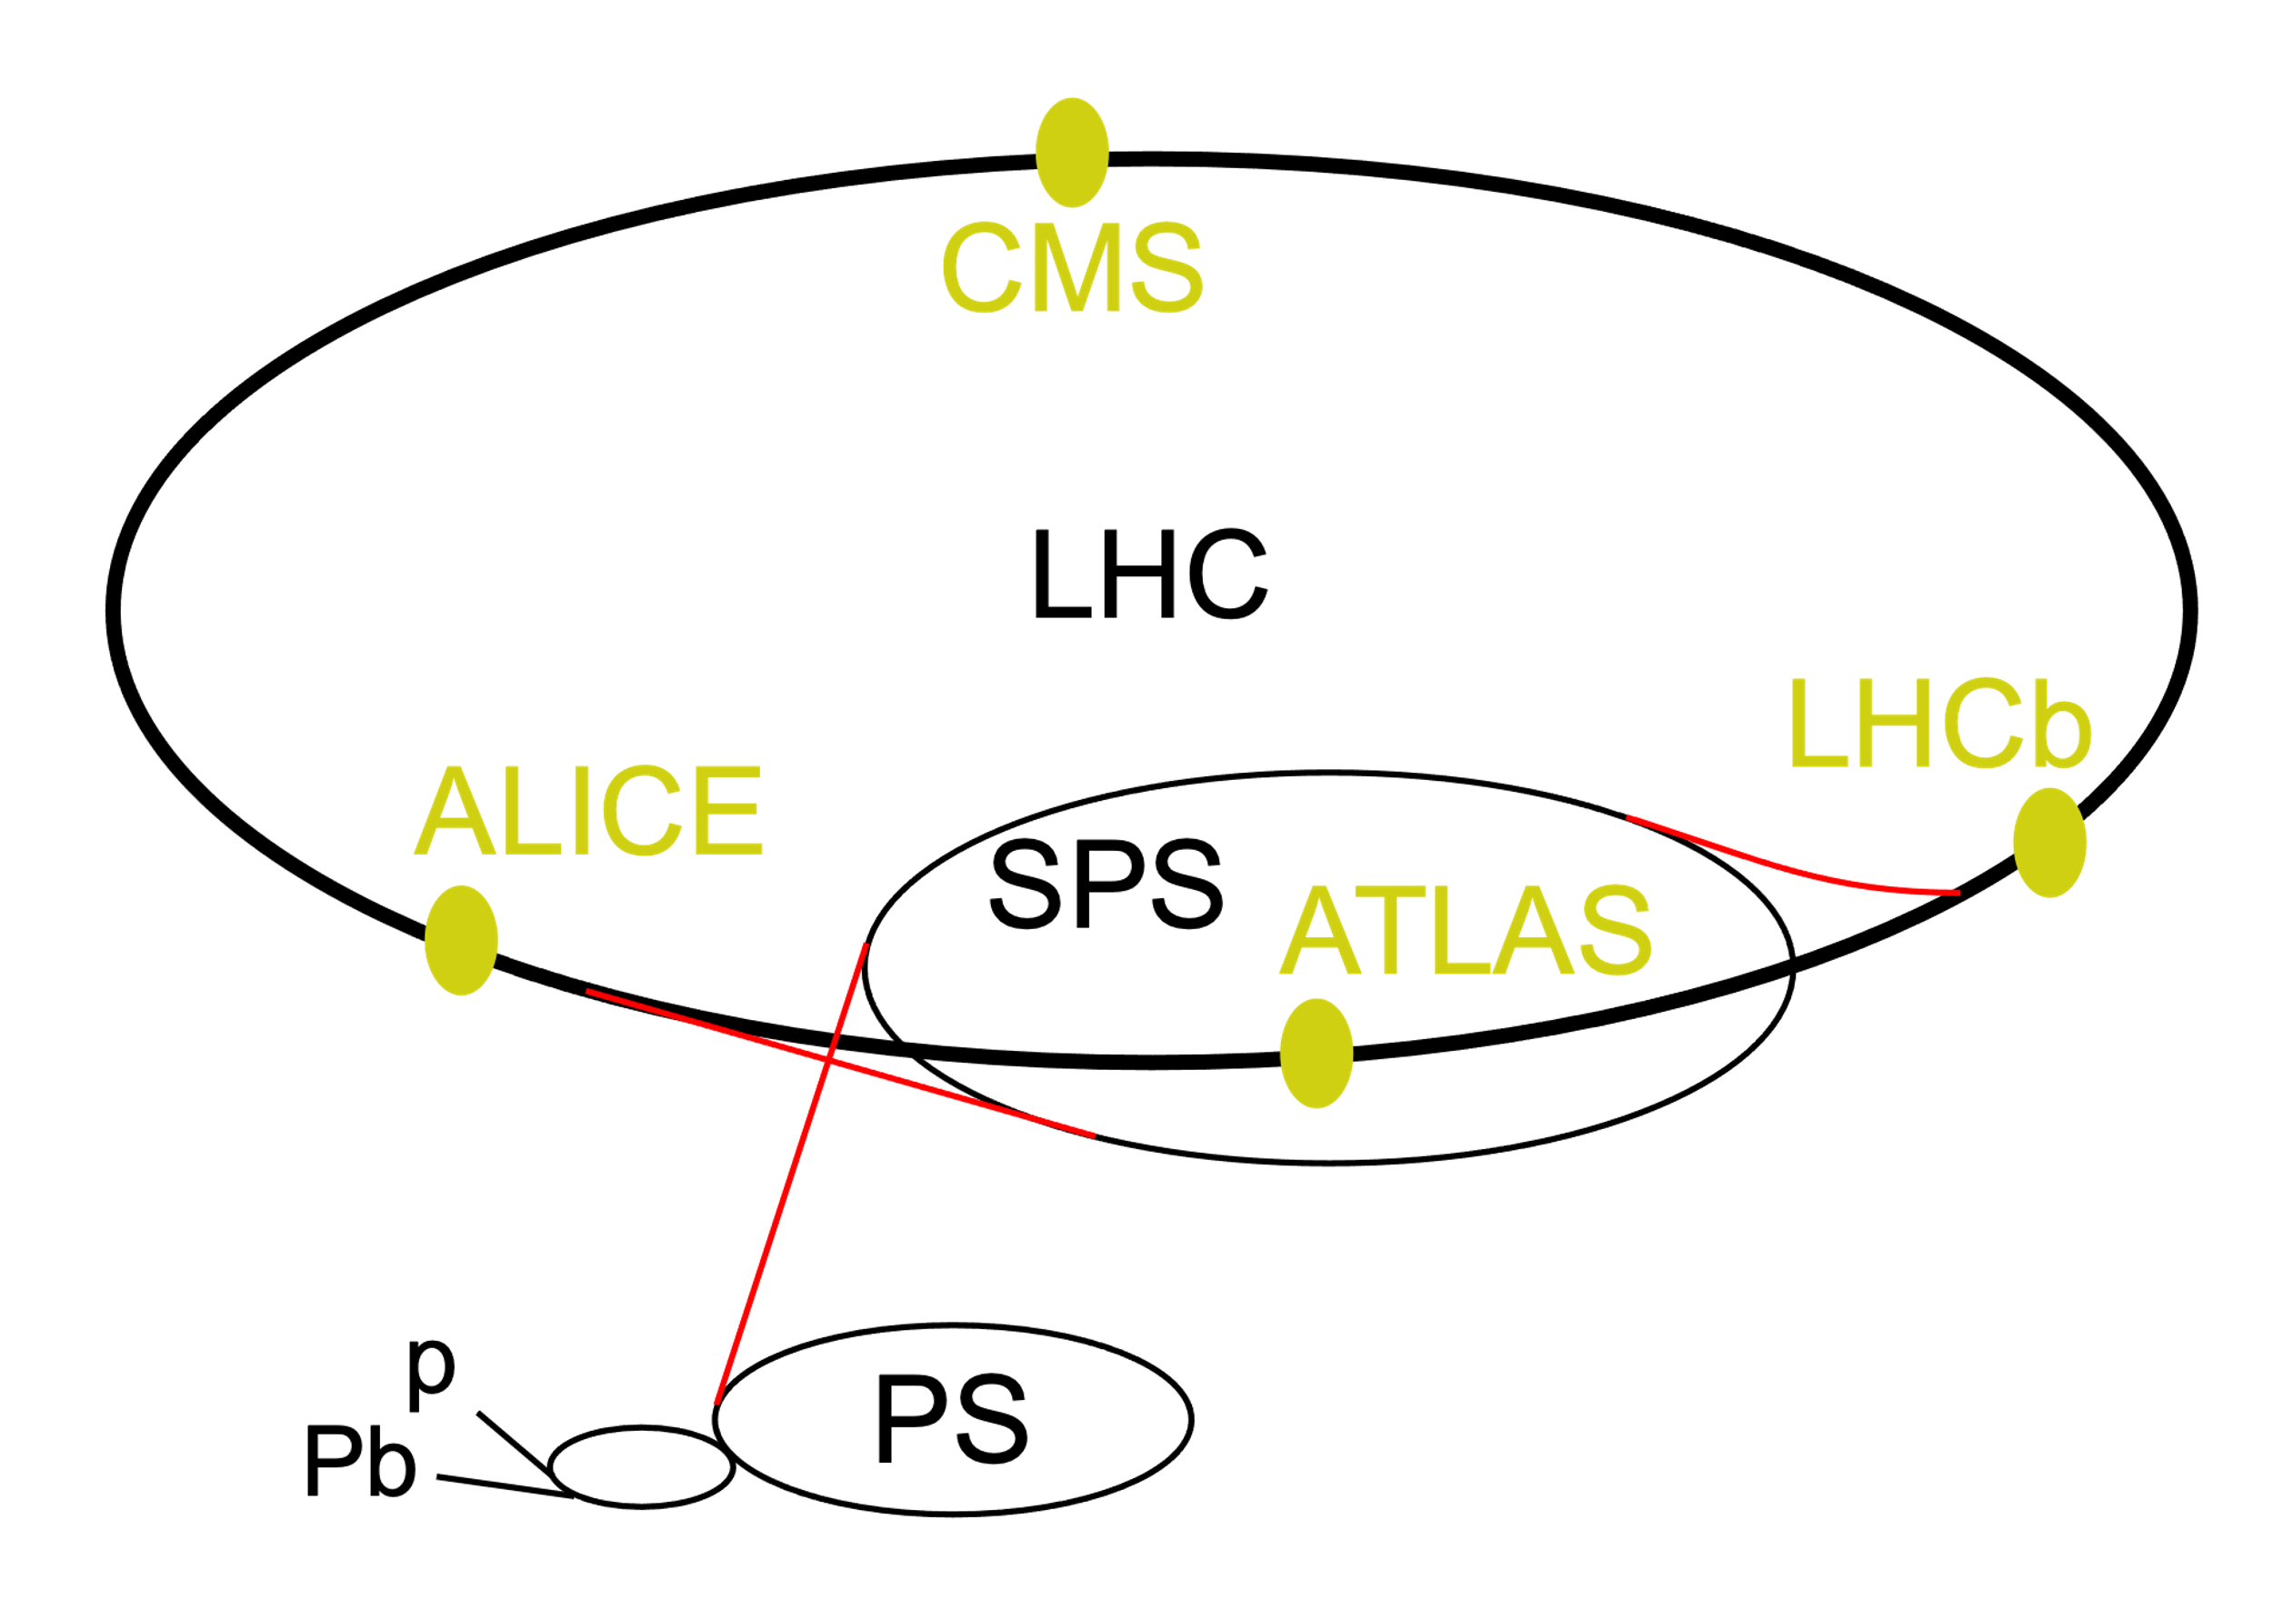
Large Hadron Collider (LHC)
Protons go through many steps before reaching the LHC though.
Each of these successive rings increase the energy of these protons by accelerating them and steering them.
Acceleration: Radio Frequency Cavities
Steering: Magnets
Notes:
The acceleration process begins with Linear Accelerator 4 (LINAC4), which accelerates negative hydrogen ions to 160 MeV. These ions are then fed into the Proton Synchrotron Booster (PSB), during which the electrons are stripped from the ions, leaving only protons. The PSB brings the protons up to 2 GeV before injecting them into the Proton Synchrotron (PS), which accelerates them to 26 GeV before passing them to the Super Proton Synchrotron (SPS), which accelerates them to 450 GeV. Now the protons can be injected into the LHC itself.

Slide 6
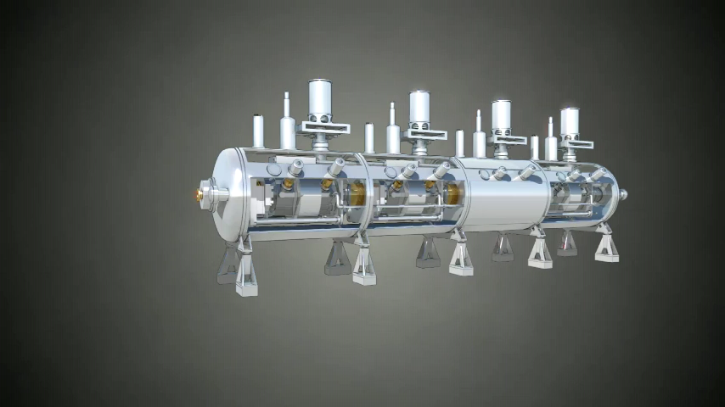
Large Hadron Collider (LHC)

Slide 7
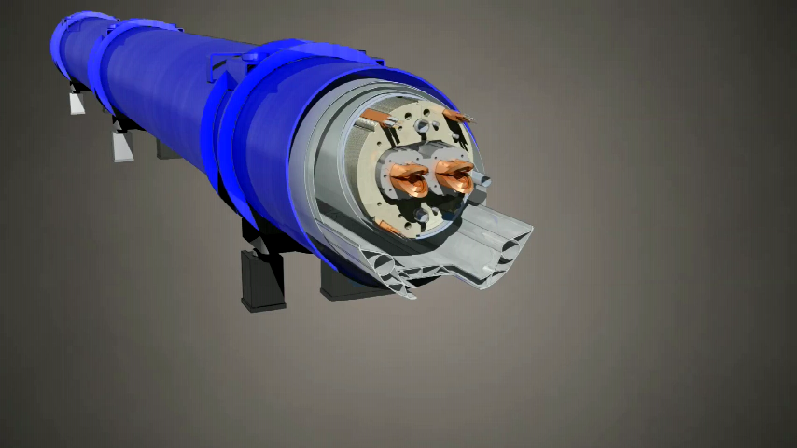
Large Hadron Collider (LHC)

Slide 8
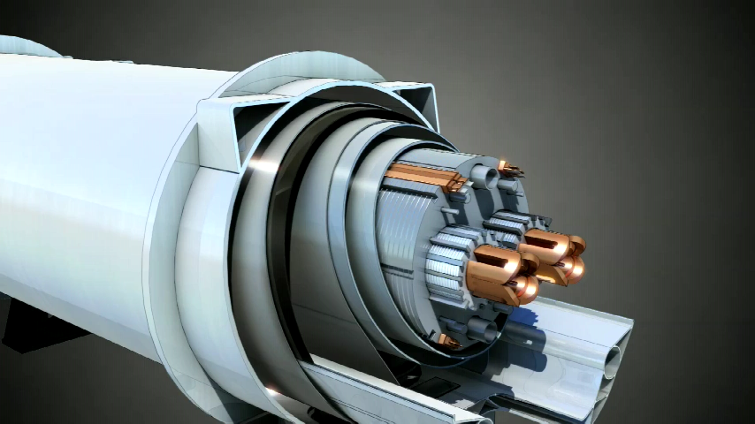
Large Hadron Collider (LHC)

Slide 9

Large Hadron Collider (LHC)

Slide 10
Material Interactions
Great, we are now colliding things and creating particles.
…. And that’s it right?
p
p

Slide 11
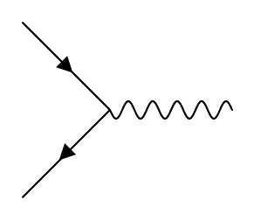
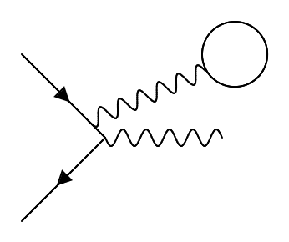
Material Interactions
We need to build a detector.
But first we need to learn about how particles travel through matter.
The theory that you learned yesterday is applied to particles that travel through vacuum.
Unfortunately for us, particles don’t travel through a complete vacuum.
matter

Slide 12
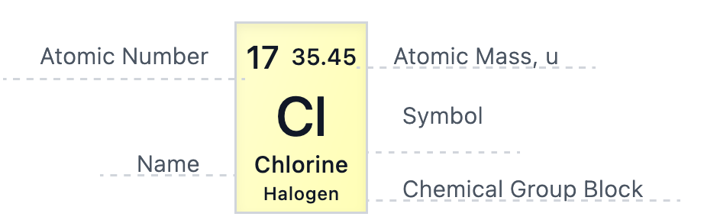
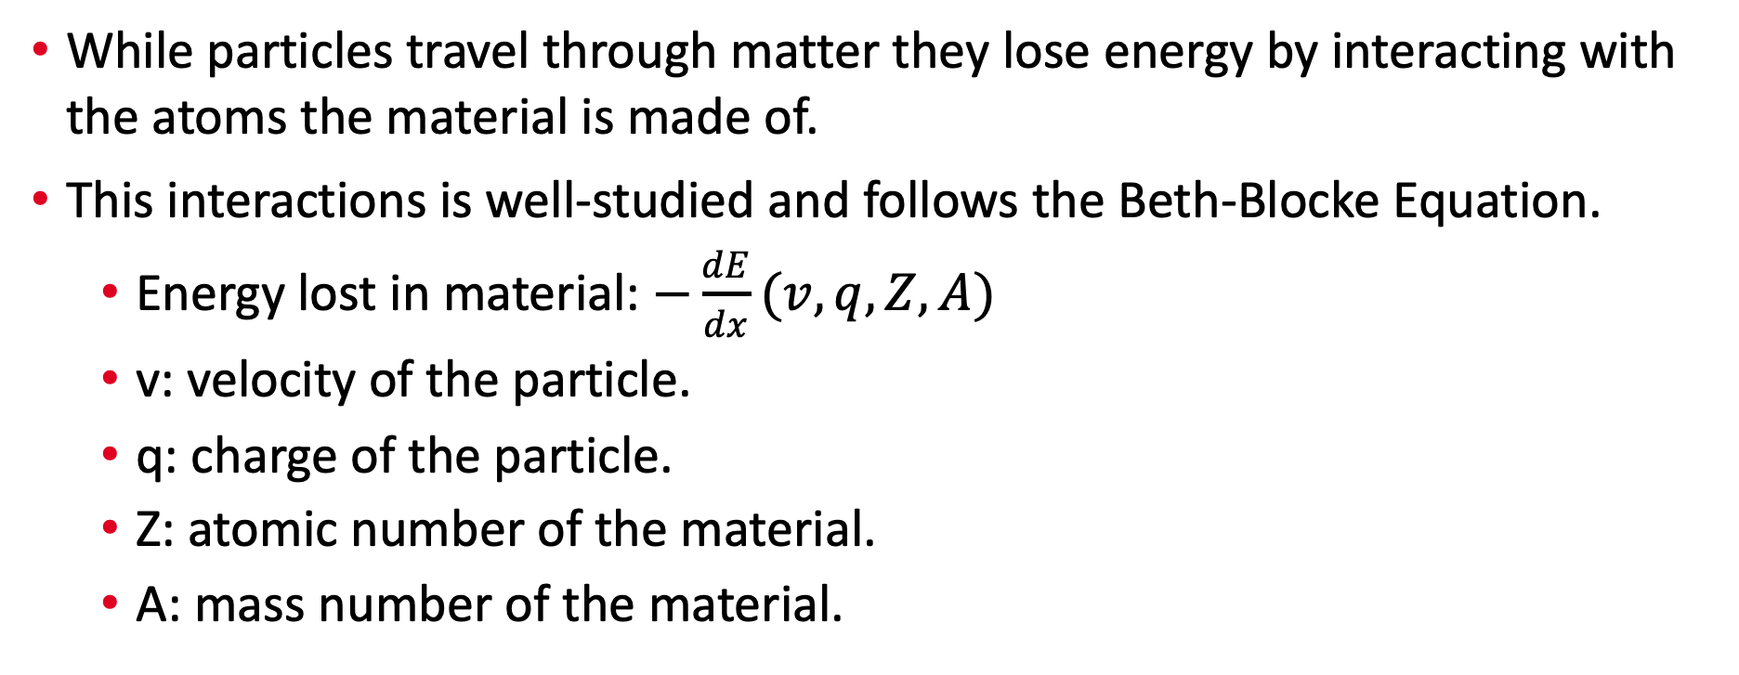
Material Interactions
While particles travel through matter they lose energy by interacting with the atoms the material is made of.
This interactions is well-studied and follows the Beth-Blocke Equation.
  Energy lost in material: $−\frac{dE}{dx}(v,q, Z, A)$
  v: velocity of the particle.
  q: charge of the particle.
  Z: atomic number of the material.
  A: mass number of the material.
[1]

Slide 13
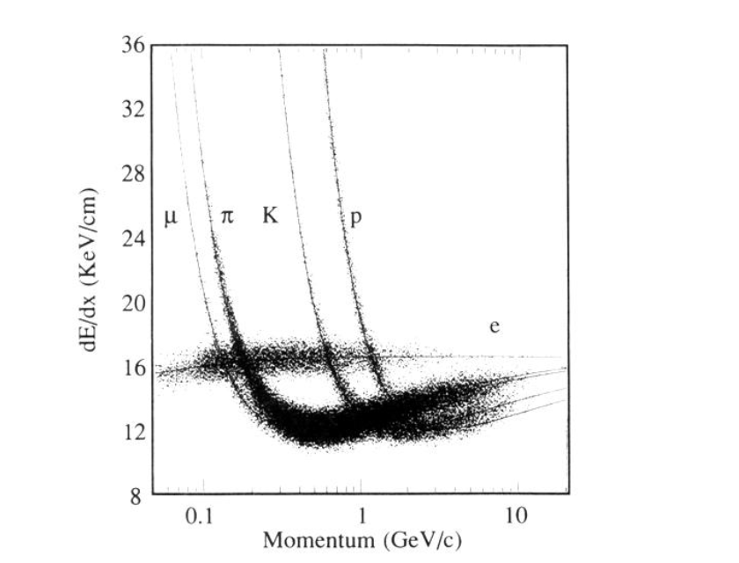
Material Interactions
This graph shows the average energy loss of a particle traveling through a detector for several different particles.
Why do the muon, pion, kaon, and proton have similar shapes?
Why does the electron look the way it does?
Now we know how particles interact with matter. Enter: the LHCb Detector.
Aihara et al. 1988

Slide 14
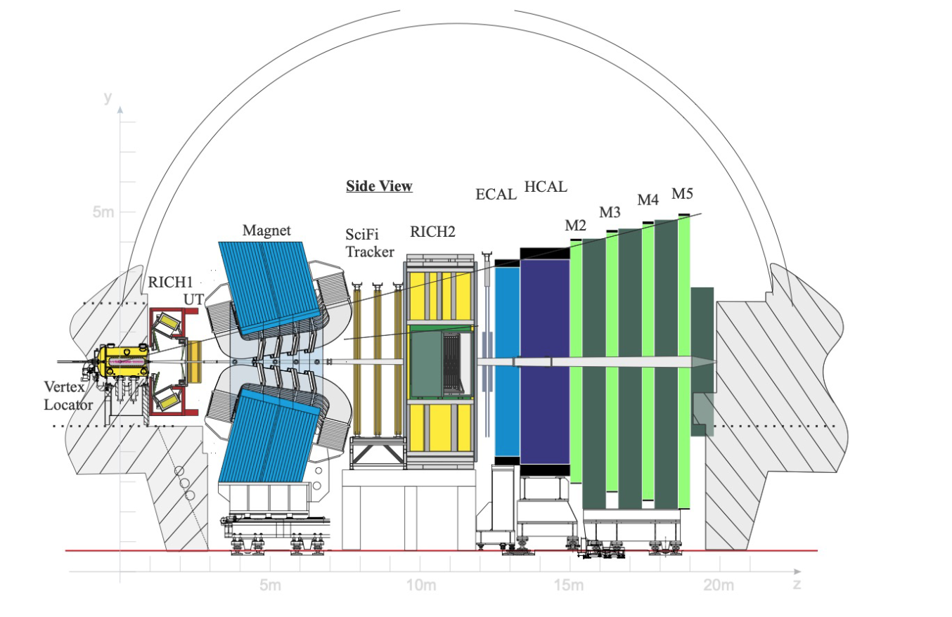
LHCb Detector
arXiv:2305.10515

Slide 15
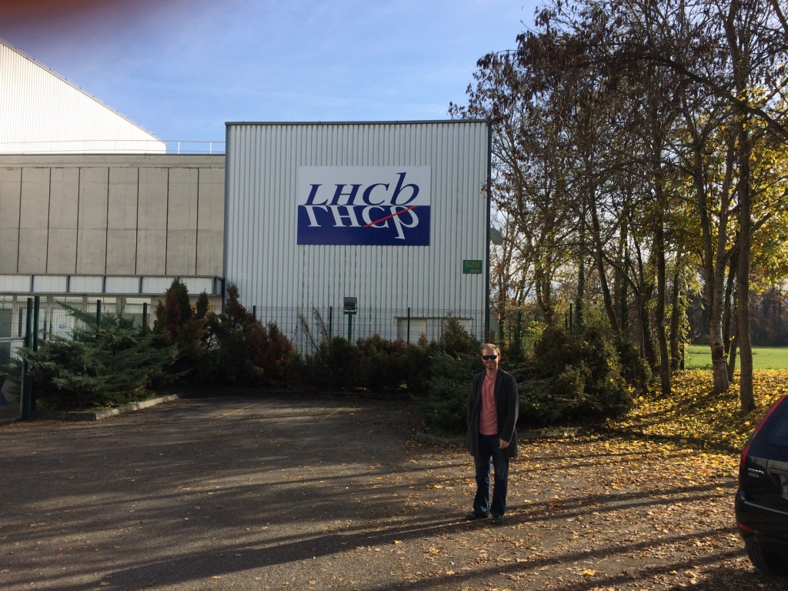
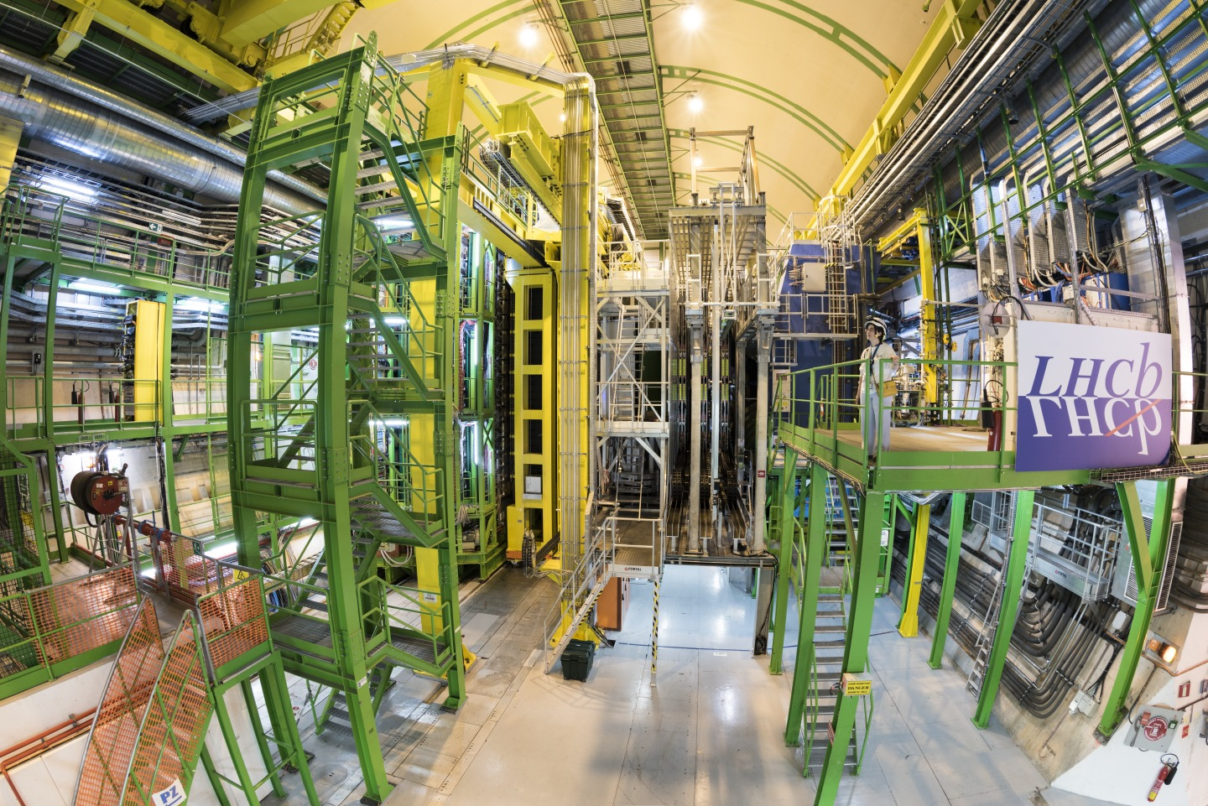

LHCb Detector

Slide 16
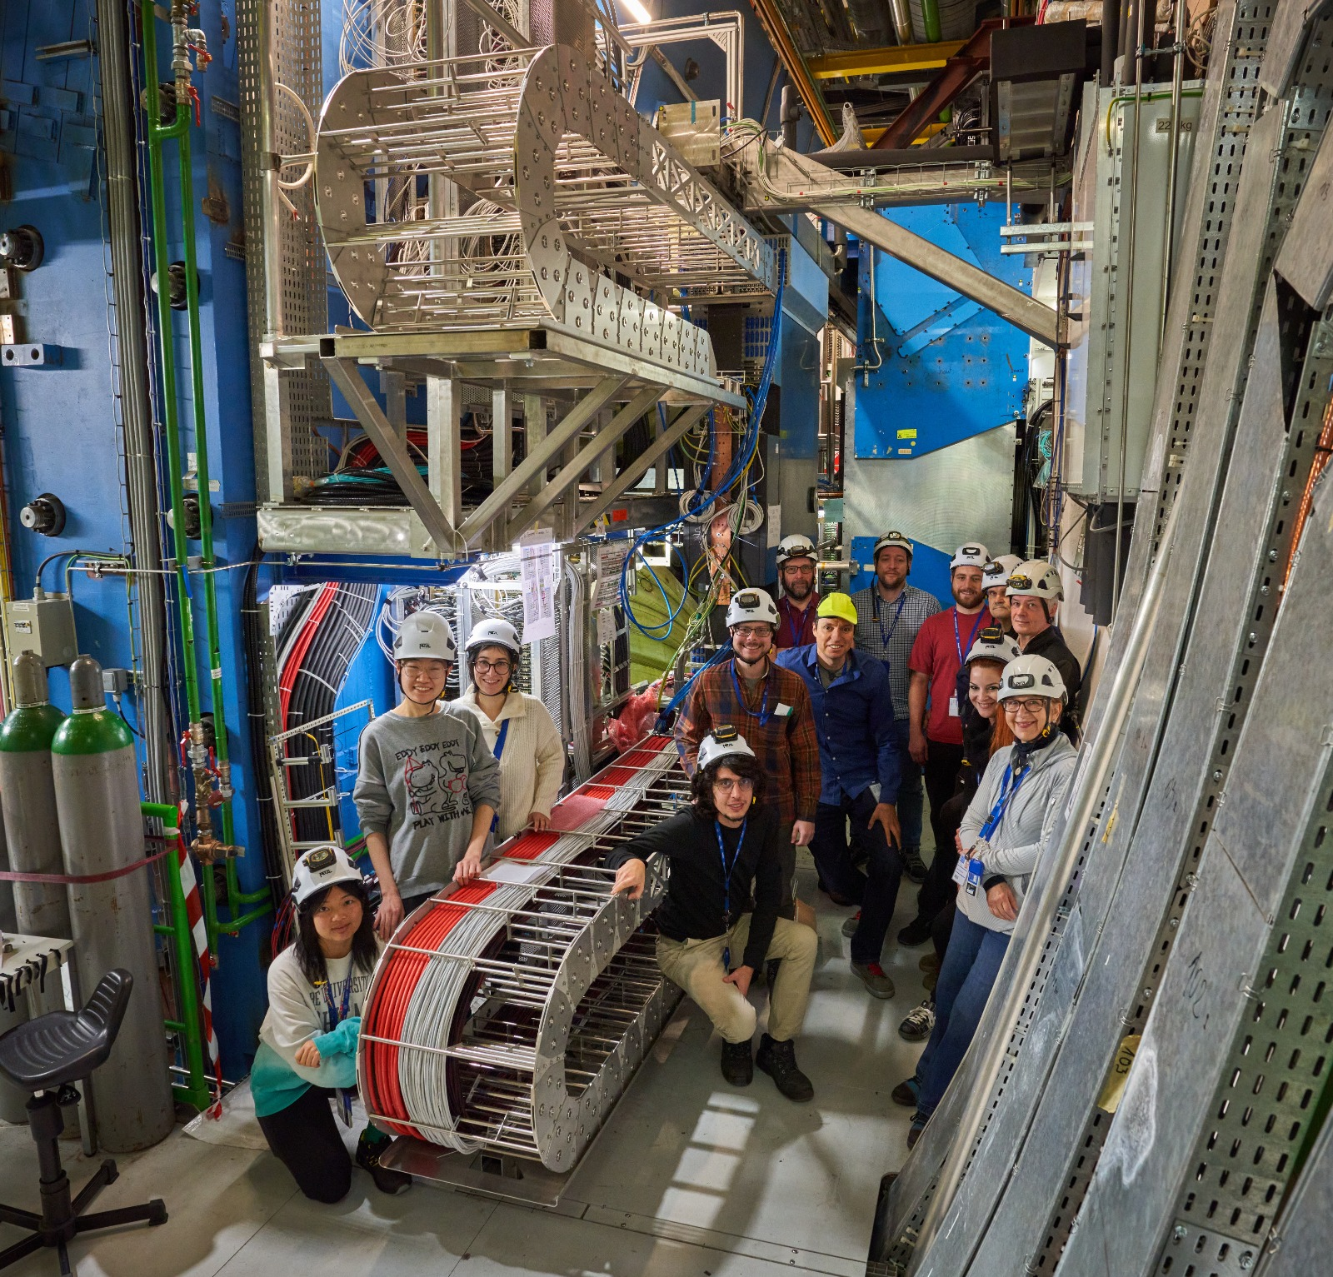
LHCb Detector

Slide 17
LHCb Detector
Let’s say a particle travels through our detector.
What properties would you like to measure?
  Position?
  Momentum?
  Energy?
  Mass?
  Charge?
arXiv:2305.10515

Slide 18
LHCb Detector
We design sub-detectors to detect exactly these properties.
Tracking: Position -> Momentum
  Vertex Locator (VELO)
  Upstream Tracker(UT)
  Scintillating Fiber Tracker (SciFi).
Calorimetry: Energy
  Electron Calorimeter (Ecal)
  Hadron Calorimeter (Hcal)
Particle Identification: Charge, Mass, etc…
  Ring Imaging Cherenkov Detectors (RICH 1 and 2)
  Muon ID: Muon Chambers

Slide 19
LHCb Detector
Tracking system
Calorimetry
Particle ID system
Muon ID
arXiv:2305.10515

Slide 20
Tracking
Tracking: Making several precise position measurements in order to reconstruct a particle’s trajectory through a detector.
Tracking is used in tandem with a magnetic field to measure a particle’s momentum (q/p). *
LHCb has three tracking detectors with two technologies:
  Vertex Locator (VeLo): Silicon Tracker
  Upstream Tracker (UT): Silicon Tracker
  Scintillating Fiber Tracker (SciFi): Scintillator Tracker

Slide 21
Tracking
Tracking: Making several precise position measurements in order to reconstruct a particle’s trajectory through a detector.
VELO
UT
SciFI

Slide 22
Tracking
Sensor
Sensor
Sensor
High energy particles interact with individual sensors within a detector.
By combining information from multiple sensors at once we can start to see trajectories form.
A computer algorithm combines individual sensor hits into particle tracks.
Sensor
Sensor
Sensor
Sensor
Sensor
Sensor

Slide 23
Tracking
We categorize tracks into several different types that will be useful in your studies:
  VELO Track: Only includes information from the VELO.
  Upstream Track: Only contains information from the upstream detectors (VeLo and UT).
  Downstream Track: Only contains information from the downstream detectors (UT and SciFI).
  T Track: Only includes information from the SciFI.
  Long Track: Contains information from all tracking detector.

Slide 24
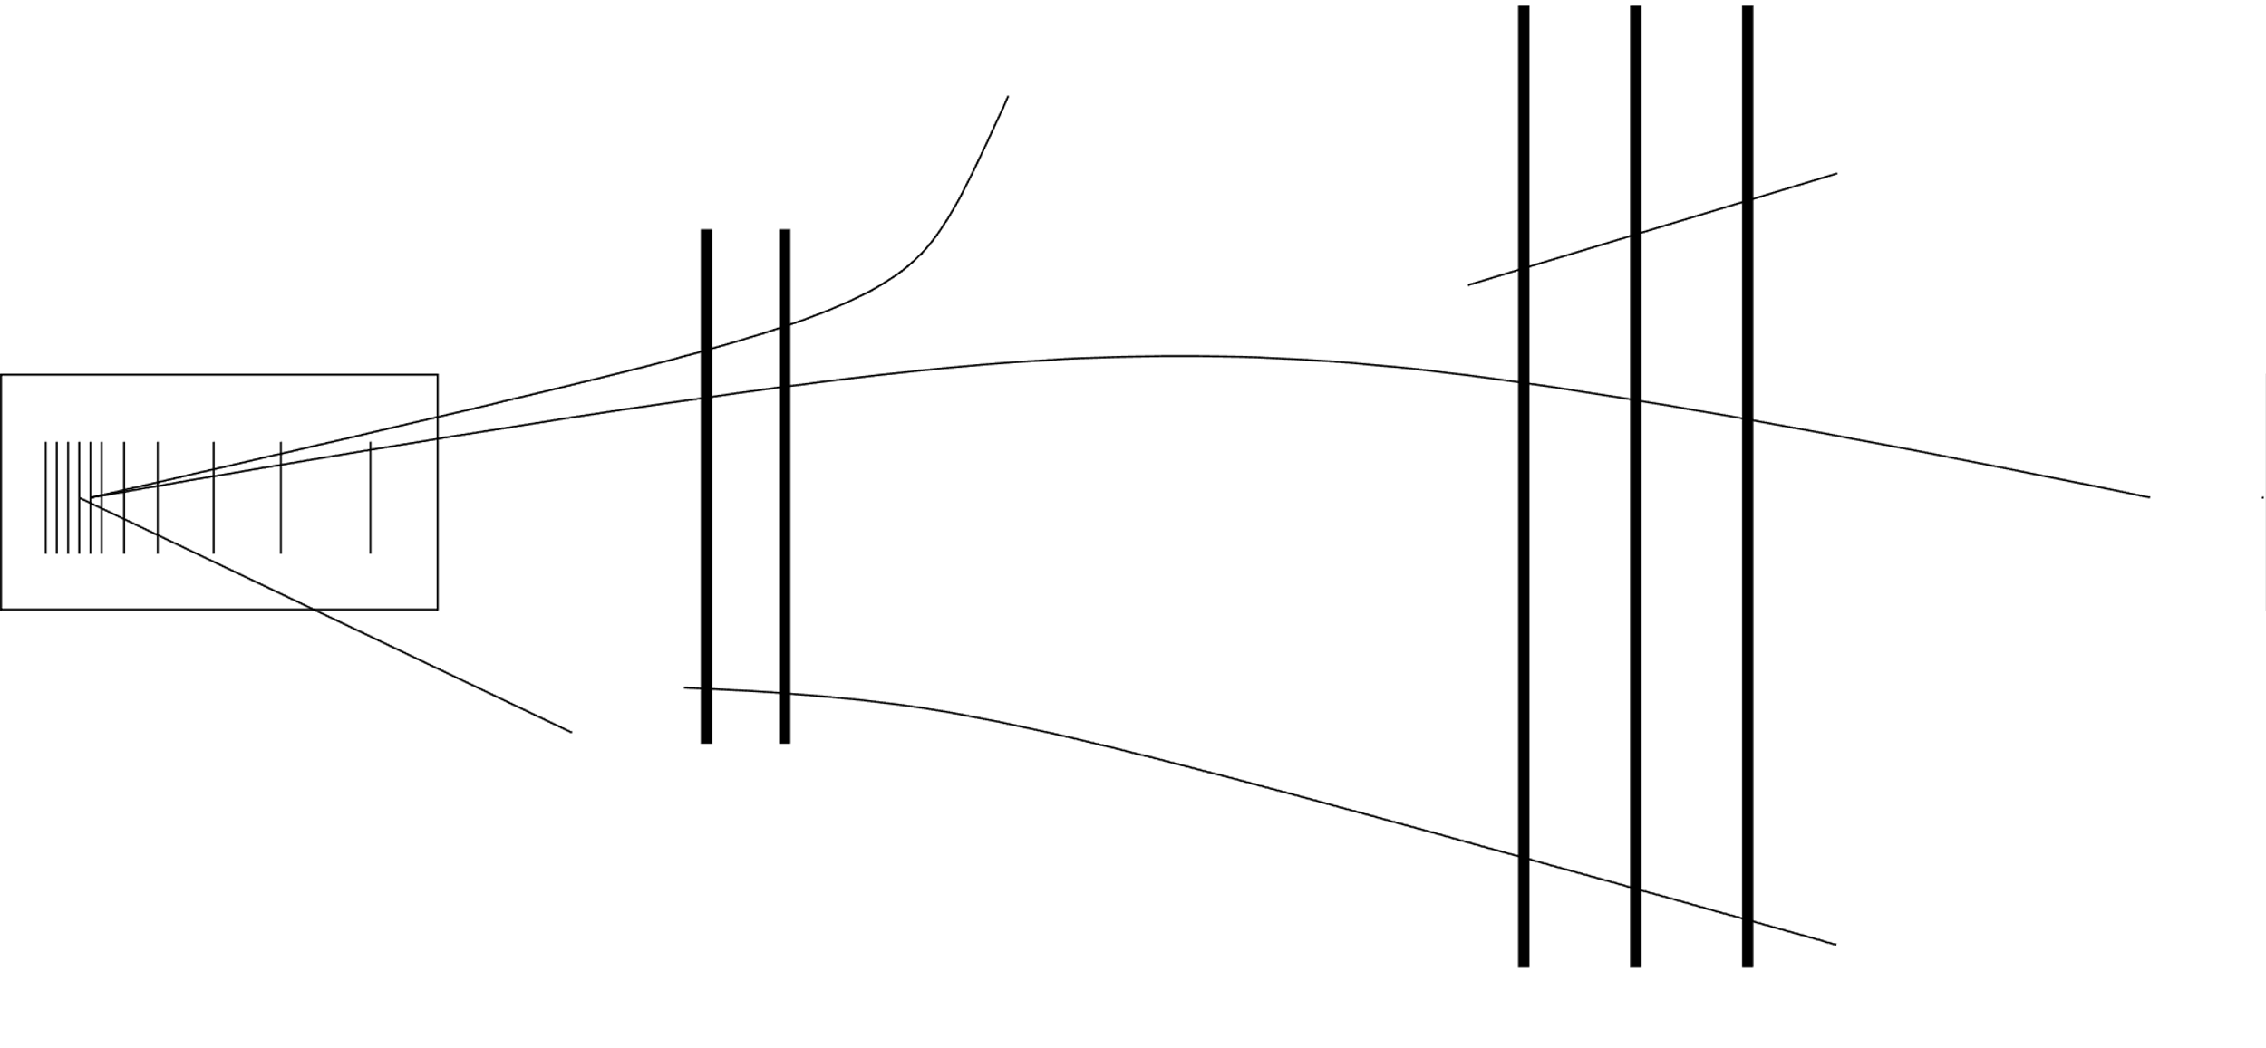







Tracking
How does all of this look in practice? $Λ→p π^{−}$
Long tracks
$$p$$
$$Λ$$
$$Λ$$
$$π^{−}$$
$$p$$
Decay Vertex
Downstream tracks
$$π^{−}$$

Slide 25
Tracking
Tracking: Making several precise position measurements in order to reconstruct a particle’s trajectory through a detector.
LHCb has three tracking detectors with two technologies:
  Vertex Locator (VeLo): Silicon Tracker
  Upstream Tracker (UT): Silicon Tracker
  Scintillating Fiber Tracker (SciFi): Scintillator Tracker
Tracks are created by combining information from many different sensors in these detectors.
Tracks can be sorted into different types which may be useful for your analysis!

Slide 26
Calorimetry
Calorimetry: Measuring the energy of high energy particles by forcing it to “stop” in a material.
There are two calorimeters in LHCb, placed one after the other.
  Electronic Calorimeter (Ecal): Collect electrons, photons, and anything that interacts primarily the electron-magnetic interaction.
  Hadronic Calorimeter (Hcal): Collect hadrons and anything else that survives the electron calorimeter.
They are both “sampling” calorimeters where a detection material is put in-between sheets of metal.
Notes:
Talk about Heidi’s analogy to shopping carts here.

Slide 27
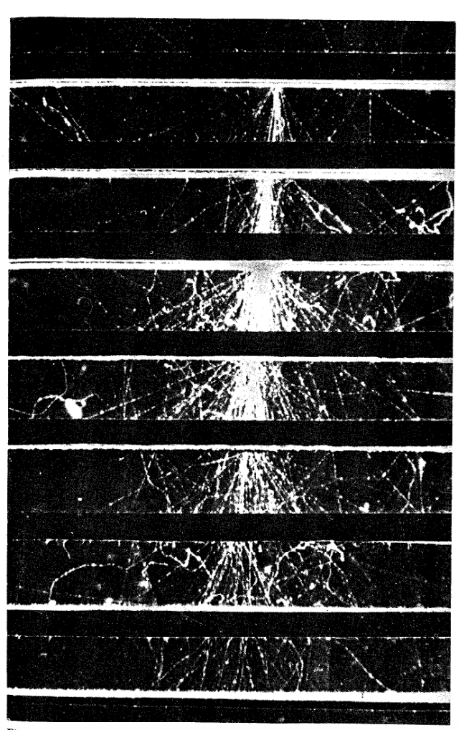
Calorimetry
To the right is an image of a photon traveling through an electronic calorimeter.
The black/white lines are pieces of lead and the images are taken in a gas.
As the photon travels through the materials it interacts and “showers”.
[4]
Notes:
Talk about Heidi’s analogy to shopping carts here.

Slide 28
Calorimetry
Summary:
  Calorimeters measure the energy of a particle.
  Particles generally “stop” in caloritmeters.
  LHCb has two calorimeters.
    Ecal
    Hcal
  Particles traveling through a calorimeter shower as shown to the right.
[4]
Notes:
Talk about Heidi’s analogy to shopping carts here.

Slide 29
PID Detectors
PID Detectors: Detectors that attempt to find out what particle is traveling through it.
This is a large group of detectors that are very different from each other, not as standardized as calorimetry or tracking.
Today we will talk about:
  Ring Imaging Cherenkov Detectors (RICH)
  Muon Stations
In LHCb we have:
  2 RICH detectors
  4 Muon Stations
Notes:
Talk about Heidi’s analogy to shopping carts here.

Slide 30
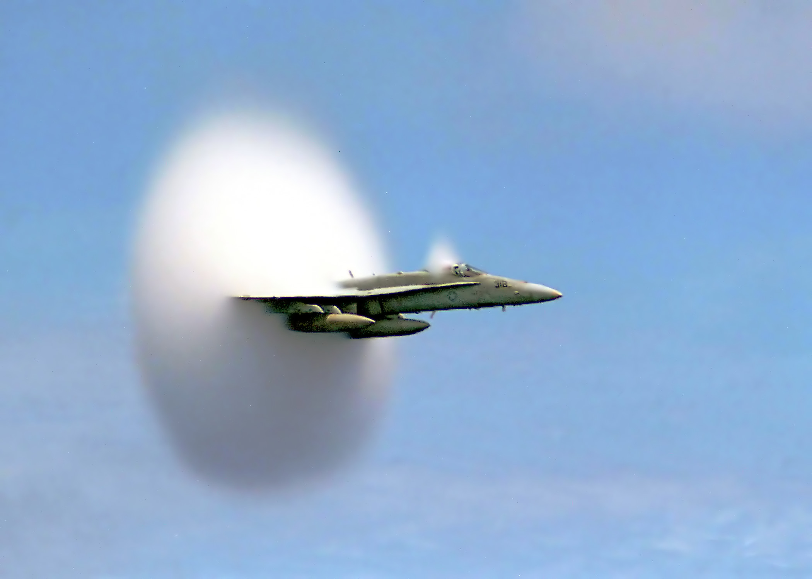
PID Detectors
Ring Imaging Cherenkov (RICH) Detectors: Detectors that make use of the Cherenkov radiation that is created when particles travel through matter*.
This is a similar phenomena to airplanes breaking the sound barrier.
[6]
Notes:
Talk about Heidi’s analogy to shopping carts here.

Slide 31

PID Detectors
Ring Imaging Cherenkov (RICH) Detectors: Detectors that make use of the Cherenkov radiation.
[5]
Notes:
Talk about Heidi’s analogy to shopping carts here.

Slide 32
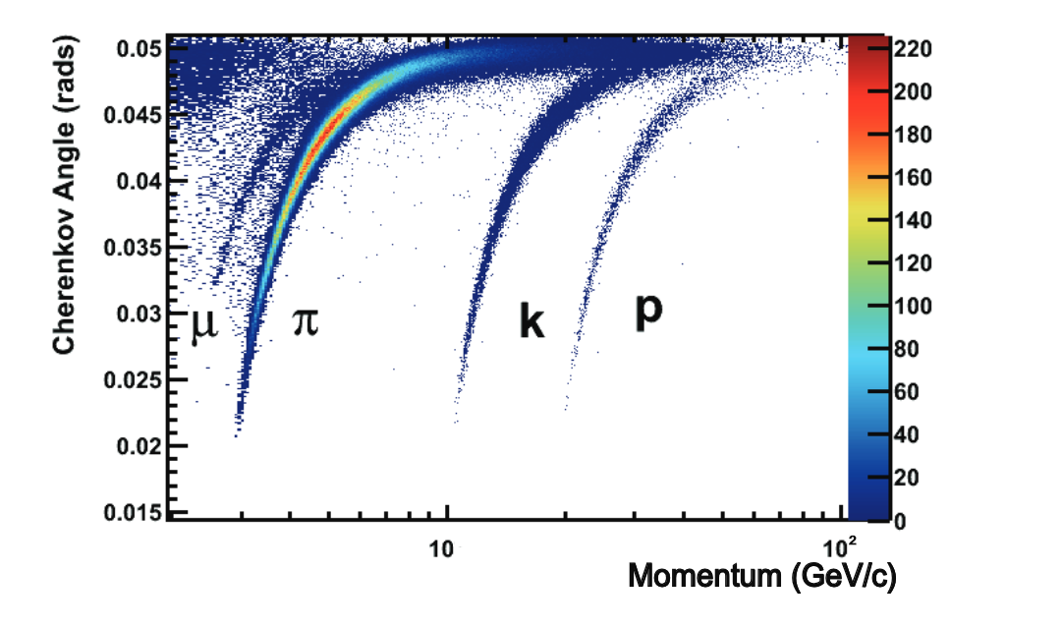
PID Detectors
The angle between the wavefront and the particle is characterized by the speed of the particle and the material.
By measuring this angle, we can identify the particle traveling through our detector
The graph to the left shows the Cherenkov angle measured at different momentum of particles.
Summary: RICH detectors make use of the Cherenkov effect to classify particles.
arXiv:2305.10515
Notes:
Talk about Heidi’s analogy to shopping carts here.

Slide 33
PID Detectors
The last detector we will discuss are the muon stations.
They are made of Multiwire Proportional Chambers.
  Small chambers filled with gas with several electric wires inside.
  The outside of the chamber is kept at a negative potential and the wires are held at a positive potential.
  A high energy particle ionizes the gas and causes the electrons to flow to the wire.
LHCb has four of these stations placed at the very end of our detector.
Very few particles can travel through the entirety of the LHCb detector without being stopped, but muons can!
So we collect as much information as we can from them at the end of our detector.
Notes:
Talk about Heidi’s analogy to shopping carts here.

Slide 34
Triggering
We need to mention one more things (that isn’t a detector) before we look at this process as a whole.
The LHC collides a Lot of protons. A collision happens every 6.25ns (10^-9s).
With all of the detectors we learned about, that is a lot of information to store.
LHCb quickly makes a process whether to store data from that specific proton-proton collision and what data to store through a process called Triggering.
Notes:
Talk about Heidi’s analogy to shopping carts here.

Slide 35
Triggering
LHCb has two triggers:
  HLT1 (High Level Trigger 1): Combines raw information from sub-detectors to make a decision on if an events should be stored.
  HLT2 (High Level Trigger 2): Begins the process of reconstructing an particles after a proton-proton collision.
Typical decision criteria:
  A track originating a distance from the collision site (displaced track trigger).
  Two tracks originating a distance from the collision site (displaced track trigger).
  Two well-separated muons (high mass dimuon trigger).
After this point the data goes through a Lot more processing, but these are the most important first steps.
Notes:
Talk about Heidi’s analogy to shopping carts here.

Slide 36
Putting it all together
Let’s go through the steps of how all of these methods work together:
  The LHC collides two protons at the LHCb interaction point.
  The sub-detectors of LHCb store raw information from the collision.
  The LHCb HLT1 begins combining information from tracking detectors to determine a particle’s momentum and any related vertices.
  The LHCb HLT2 fully reconstructs using information from the Calorimetry and RICH Detectors the particles from the collision and decides if the event is still interesting.
  Information from the event is stored for offline analysis (us).
Notes:
Talk about Heidi’s analogy to shopping carts here.

Slide 37
References
National Center for Biotechnology Information (2024). Periodic Table of Elements. Retrieved June 13, 2024 from https://pubchem.ncbi.nlm.nih.gov/periodic-table/.
Michael Wilkinson’s 2023 Detector Physics Talk at the University of Cincinnati Quarknet Summer Internship.
https://twiki.cern.ch/twiki/bin/view/LHCb/LHCbTrackingStrategies#Track_types
High Energy Particles. Rossi Bruno, 1952.
By H. Seldon - vlastni dilo, own work, Public Domain, https://commons.wikimedia.org/w/index.php?curid=2557072
By Ensign John Gay, U.S. Navy - This image was released by the United States Navy with the ID 990707-N-6483G-001 (next).This tag does not indicate the copyright status of the attached work. A normal copyright tag is still required. http://www.news.navy.mil/management/photodb/photos/990707-N-6483G-001.jpg, Public Domain, https://commons.wikimedia.org/w/index.php?curid=3890362

Slide 38
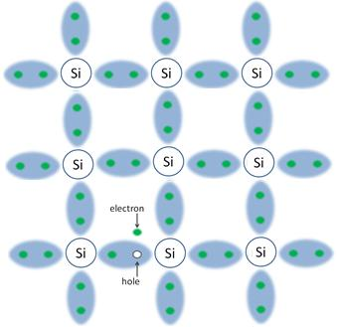
Tracking
Positive plate
Readout system
Negative plate

Slide 39
Tracking
If we zoom in to one of these silicon detectors the process is as follows:
  A high energy particle travels through the silicon detector.
  The particle deposits energy in the material and excites electrons in the silicon.
  These excited electrons are collected via an applied voltage.
  The movement of these electrons creates a current which is documented by the readout system.
The process is very similar for scintillating fiber detectors except photons are excited in the material and are collected via a system of optical tubes.

Slide 40
BackUp - Tracking
Sensor
Sensor
Sensor
By combining information from multiple sensors at once we can start to see trajectories form.
A computer algorithm combines individual sensor hits into particle tracks.
Sensor
Sensor
Sensor
Sensor
Sensor
Sensor

Slide 41
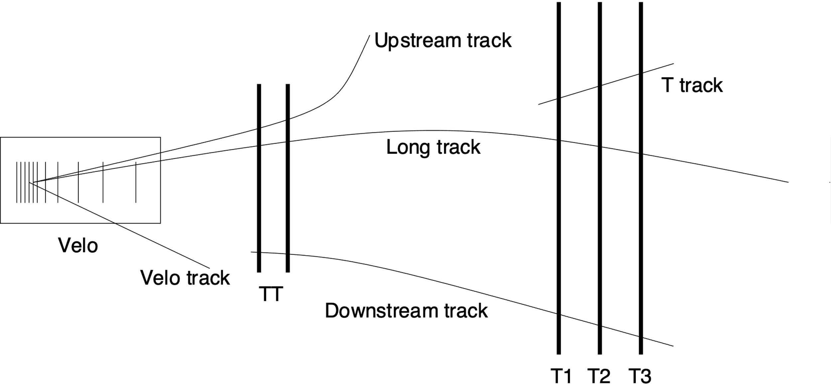
BackUp - Tracking
We categorize tracks into several different types that will be useful in your studies:

