Slide 1
Cooling and ventilation studies
F. Dragoni, N.Zaric/ EN-CV ,
HI-ECN3 WP4 – TARGET COMPLEX #2 – 28.06.2024.

Slide 2
Agenda
BA82 Building:
  Current cooling stations
  Current ventilation system
Status of User’s requirements on cooling:
  Informations we have / Missing informations
Target – Helium Station Gas:
  Gas Circulation Skid
28/06/2024
F. Dragoni, N.Zaric | Cooling and ventilation studies| Indico 1426691

Slide 3
BA82 building: Current cooling station
North area cooling capacity:
  Primary water:
    Nominal cooling capacity: 33MW
    Max cooling capacity: 45MW
    Bld 893, 4 cells
    Nominal flow rate: 2100m3/h
  Demineralized water:
    3 cooling plants for underground halls and tunnels located in BA80, BA81 and BA82
      BA80: TTC2, TDC2, TT20 – 10MW, 675m3/h
      BA81: TT83, TT84, EHN1 – 15MW, 900m3/h
      BA82: EHN2, ECN3, GHN 300, NA62, TCC8 – 7MW, 450m3/h
        Rectifier cooling circuit (Hall 891) – 0.2MW, 17m3/h
  Chilled water:
    Used for air-conditioning of the buildings, tunnel, computer rooms and halls
    Production station in BA81 consists of 3 water cooled chillers, cooling capacity 3 x 2.2MW (N+1 redundancy)
28/06/2024
F. Dragoni, N.Zaric | Cooling and ventilation studies| Indico 1426691

Slide 4
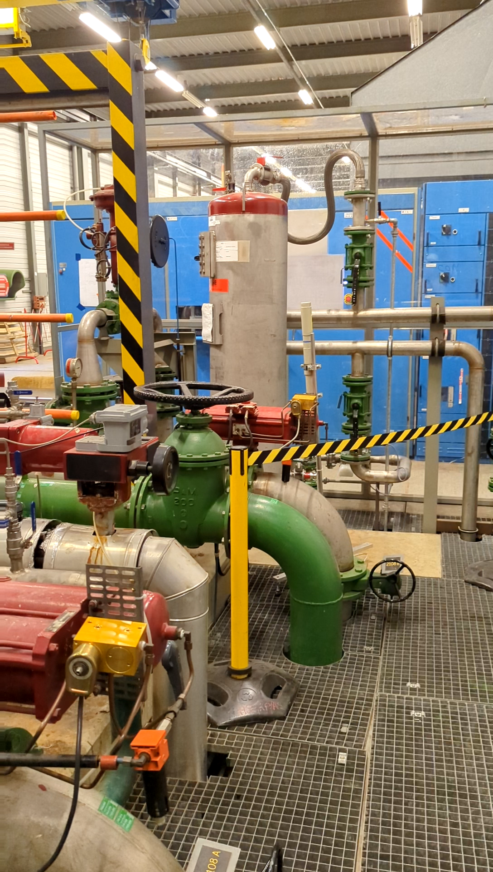
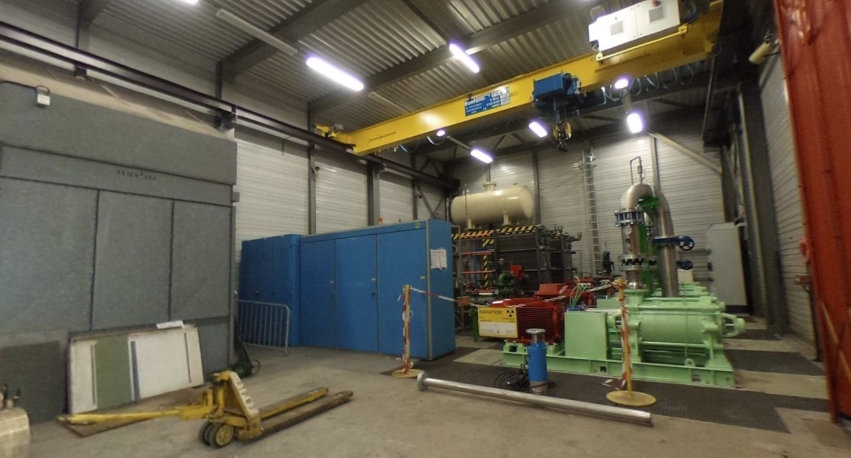
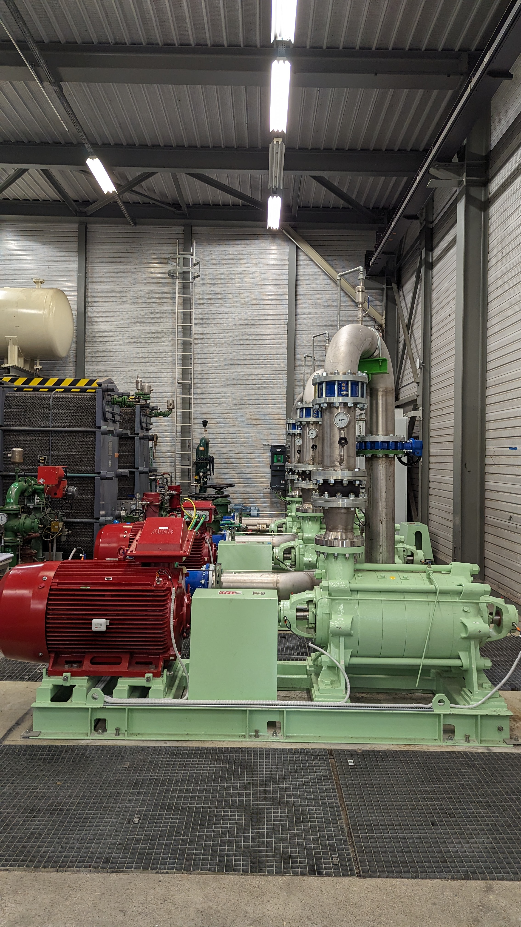
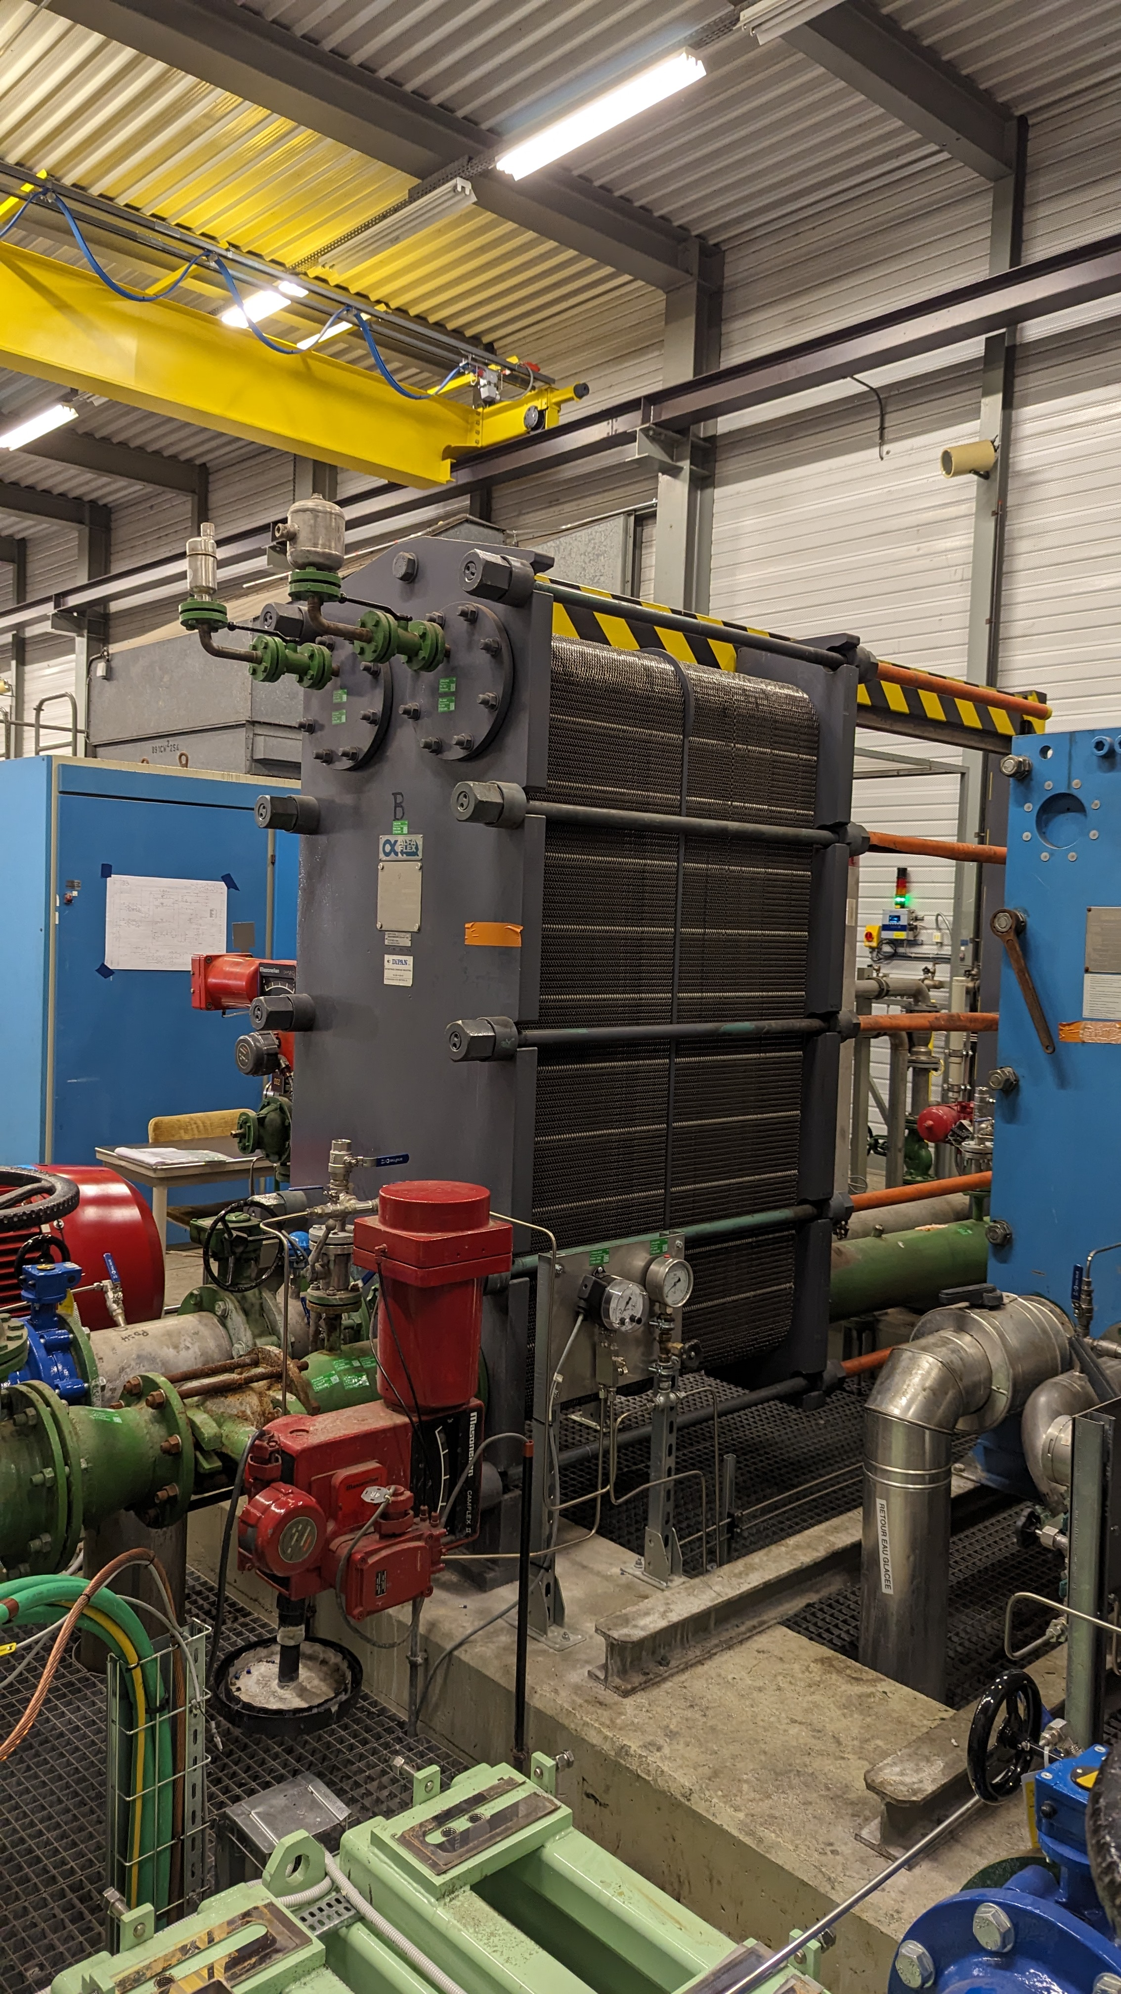
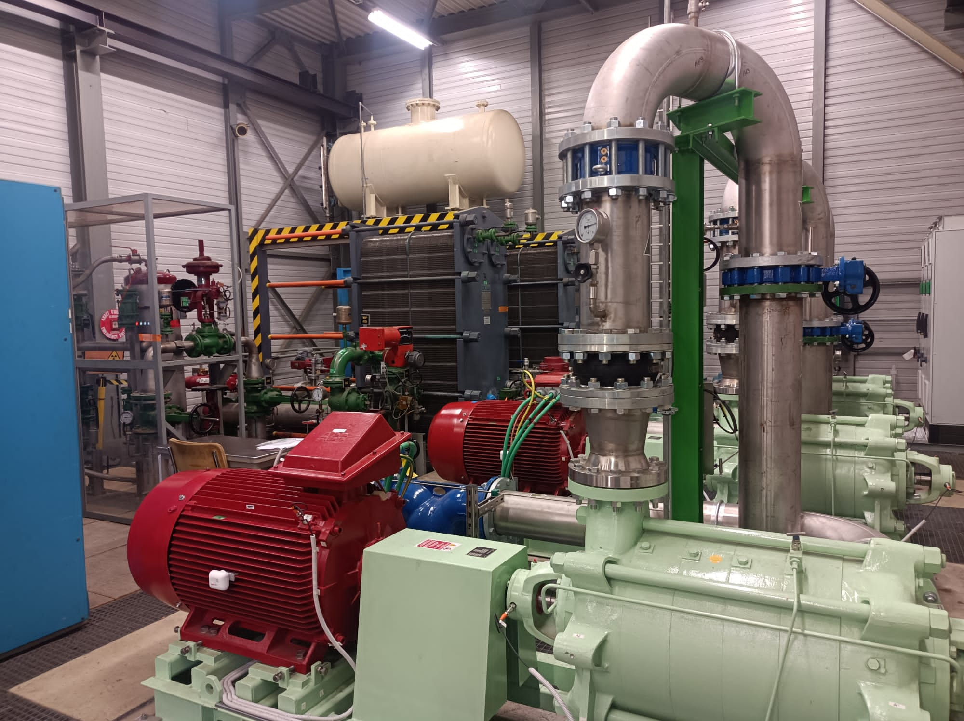
BA82 building: Current cooling station
28/06/2024
F. Dragoni, N.Zaric | Cooling and ventilation studies| Indico 1426691

Slide 5
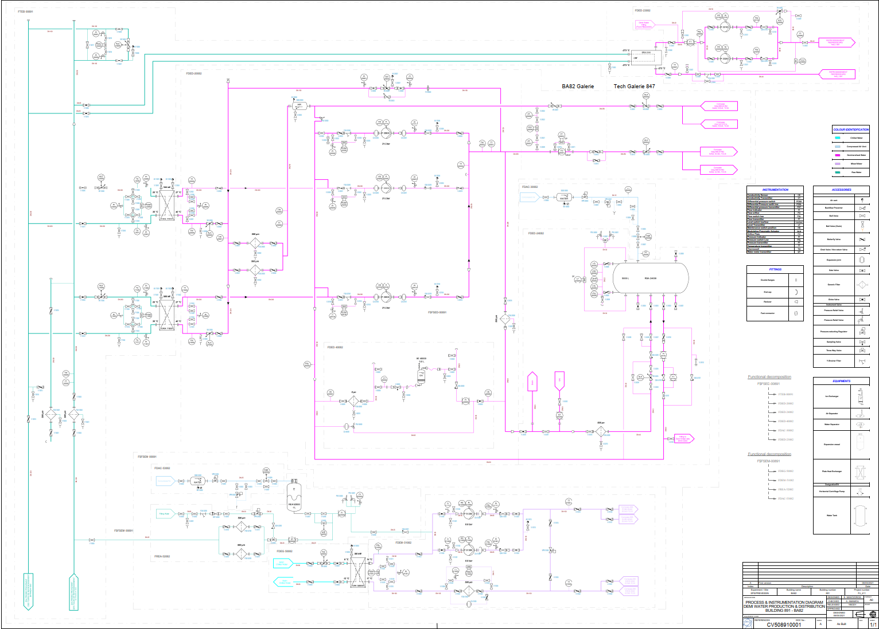
BA82 building: Current cooling station
Demineralized water for power converters
Demineralized water – supply for Amber, EHN2, NA62, ECN3, TCC8
Chilled water from BA81
Raw water from CT2
MIXED water – supply for EHN2
28/06/2024
F. Dragoni, N.Zaric | Cooling and ventilation studies| Indico 1426691

Slide 6
BA82 building: Current cooling station
BA82 Users:
  Demineralized water:
    Magnets
    Water cooled cables
    Power converters
    Vacuum pumps
  Chilled water:
    2 old AHUs
    1 new AHU
    Clean room AHU
  Mixed water production
28/06/2024
F. Dragoni, N.Zaric | Cooling and ventilation studies| Indico 1426691

Slide 7
BA82 building: Current cooling station
Demineralized water – Now
28/06/2024
F. Dragoni, N.Zaric | Cooling and ventilation studies| Indico 1426691

Slide 8
BA82 building: Current cooling station
Demineralized water – Future
28/06/2024
F. Dragoni, N.Zaric | Cooling and ventilation studies| Indico 1426691

Slide 9
BA82 building: Current cooling station
Magnets
28/06/2024
F. Dragoni, N.Zaric | Cooling and ventilation studies| Indico 1426691

Slide 10
BA82 building: Current cooling station
Demineralized water – Nominal values
Demineralized water - Future
 | T_{in} | T_{out} | P_{max} | Pressure drop | Total dissipated Power | Total flow | Type of water
 | (°C) | (°C) | (bar) | (bar) | (kW) | (m³/h)
Magnets | 26 | 35-42-46-56 | 30 | 15 | 696.4 | 77.8 | Demineralized
Power converters | 26 | 36 | 16 | 3 | 45 | 2 | Demineralized
Vacuum pumps |  |  |  |  | 4.19 | 0.363 | Demineralized
Water cooled cables |  |  |  |  | 200 | 17.3 | Demineralized
EHN2/Amber facility |  |  |  |  | 4000 | 105 | Demineralized
 |  |  |  | Σ | 4945.59 | 202.46
 |  | T_{in} | T_{out} | P_{max} | Pressure drop | Total dissipated Power | Total flow | Type of water
 |  | (°C) | (°C) | (bar) | (bar) | (kW) | (m³/h)
1st cooling substation | Power converters | 26 | 36 | 16 | 3 | 165 | 22.56 | Demineralized
2nd cooling substation | Vacuum pumps |  |  |  |  | 4.19 | 0.363 | Demineralized
 | SHIP |  |  |  |  | 1166 | 99.17 | Demineralized
 | Water cooled cables |  |  |  |  | 200 | 17.3 | Demineralized
 | EHN2/Amber facility |  |  |  |  | 4000 | 105 | Demineralized
3rd. 4th, 5th cooling substation | Target complex | 27 | 30-33.7-35.6 |  |  | 380 | 65.76 | Demineralized
 |  |  |  |  | Σ | 5915.19 | 310.15
Current measurement:
Cooling capacity: 6.2MW
Flow rate: 290 m3/h
Pending final verification BA82 stations for EHN2, TCC8 and ECN3 have sufficient power and flow rate
Chilled water – to be clarified
Mixed water needs – no need so far
28/06/2024
F. Dragoni, N.Zaric | Cooling and ventilation studies| Indico 1426691

Slide 11
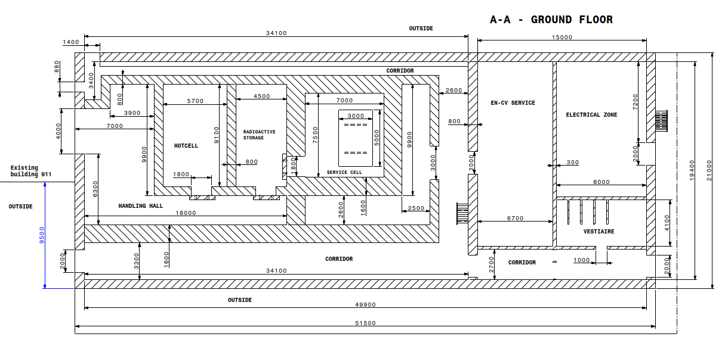
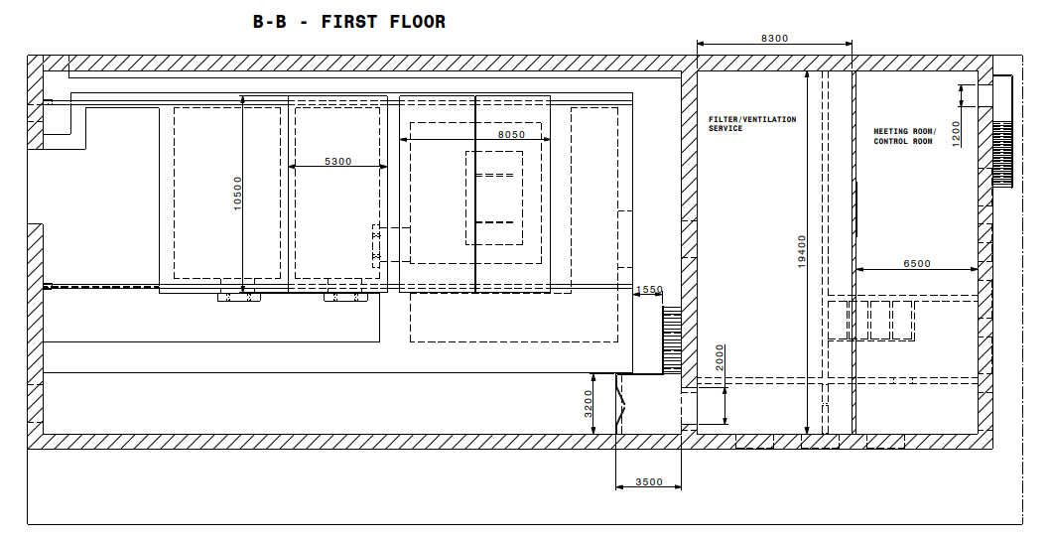
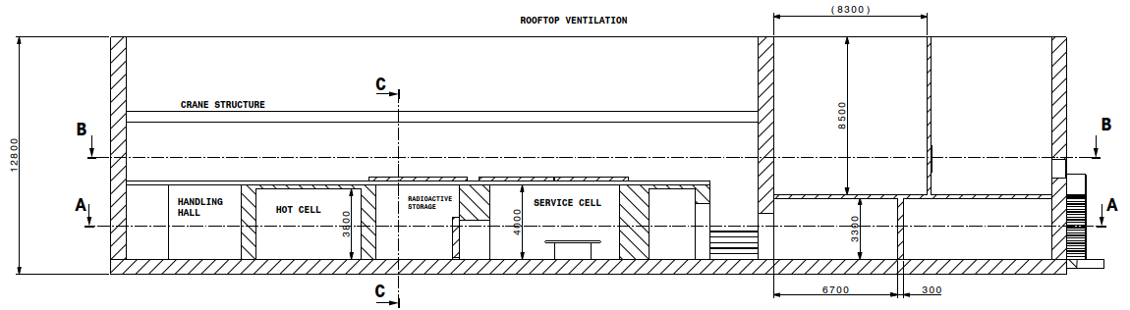
Ventilation system – New service building
In progress – will be shown in presentation of New service building (presentation later afternoon)
28/06/2024
F. Dragoni, N.Zaric | Cooling and ventilation studies| Indico 1426691

Slide 12
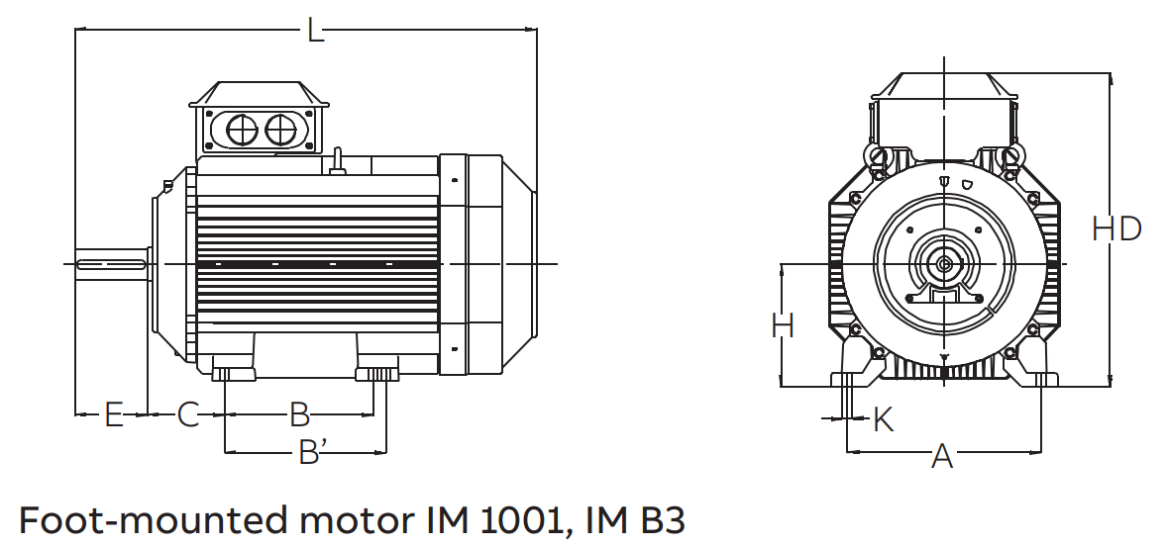
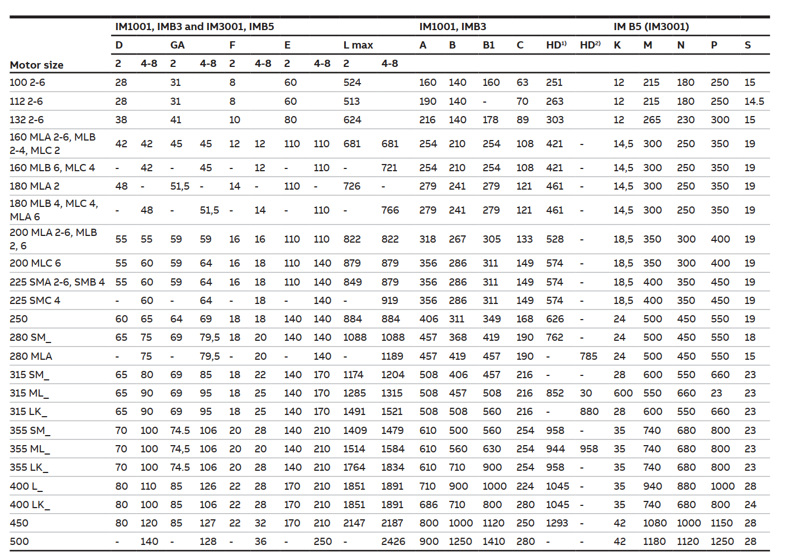
Target - Helium Station Gas
Market survey activity – Technical selection
Compressor :
  Aerzen
  Roots UK
  Linde
Heat Exchanger
  Funke (n_TOF HX)
  VDL
  ETS
Filter
  Porvair Filtration (Nuclear)
  Guerin Filter
Water station 45 m3/h @ 18 bar (g) – 37 kW motor – 250 motor size
Helium compressor 8050 Nm/3h @1.5 to 5 bar(g) – 630 kW motor – 400 motor size
28/06/2024
F. Dragoni, N.Zaric | Cooling and ventilation studies| Indico 1426691

Slide 13
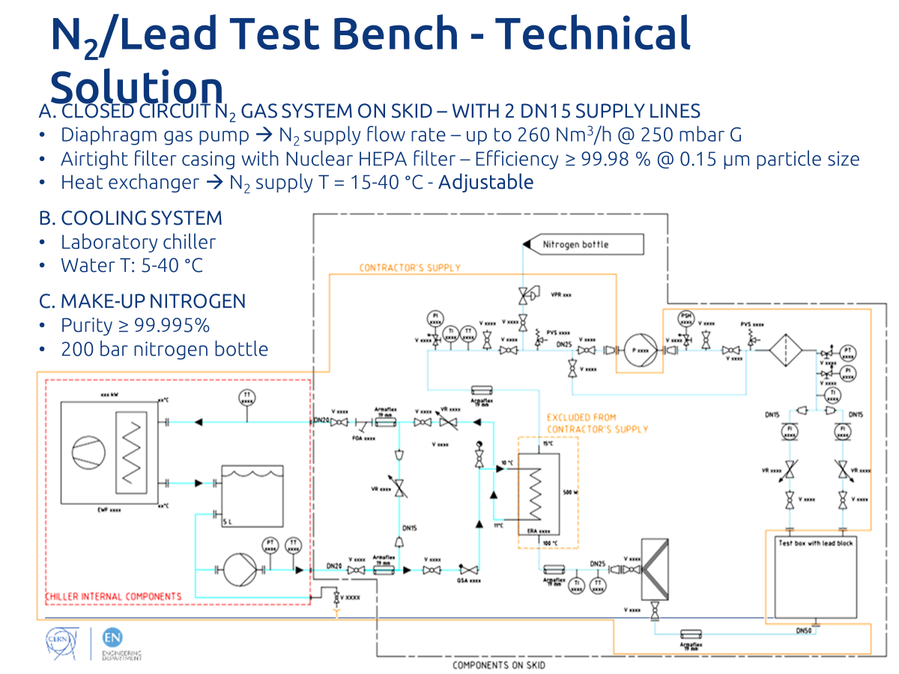
Gas Circulation Skid
Compact design for Nitrogen erosion skid on lead blocks carried out in 2018
Requested update pump curve for helium
Possibility of having safety diaphragm and increased gas tightness
Cold source was stand-alone chiller need to be converted to different chilled
28/06/2024
F. Dragoni, N.Zaric | Cooling and ventilation studies| Indico 1426691

